Slide 1


Raleigh Durham
2018 / 2019
HOTEL INDUSTRY UPDATE
John Hach
Senior Industry Analyst
November 7th 2018

Slide 2

Agenda for today’s presentation:
Disruptors and Innovators; three
key issues
Raleigh Durham fourth quarter 2018 performance
United States versus Raleigh Durham comparison of key metrics
Maximizing ADR in 2019 & beyond
Raleigh Durham 2019 outlook and forecast
2
Notes:
BT to KM

Slide 3
Navigating The Road Ahead: Three Key Issues
Marriott / Starwood Integration
6,700 hotels, one million one hundred thousand rooms, across 29 individual Brands
The Rapid Increase of Artificial Intelligence
Google, Apple and Amazon become even bigger players in online travel
Affordability
The Ability to Differentiate
Escalating room rates, new inventory, alternative accommodations and changes in consumer buying behavior

Slide 4
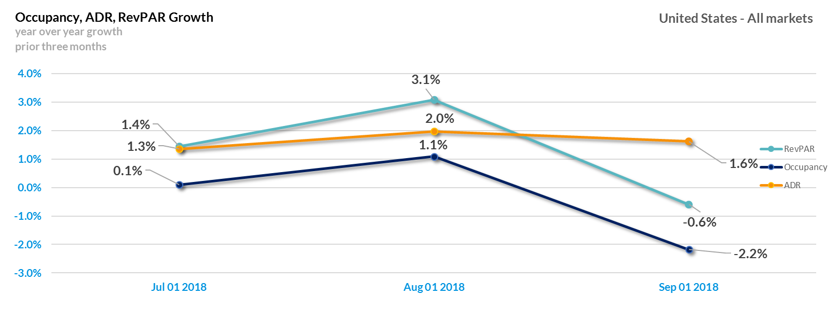
At-A-Glance | Trailing Three Months
Source: TravelClick Demand360®. ADR for Europe in EUR. All other countries in USD.
Notes:
KM to JH

Slide 5
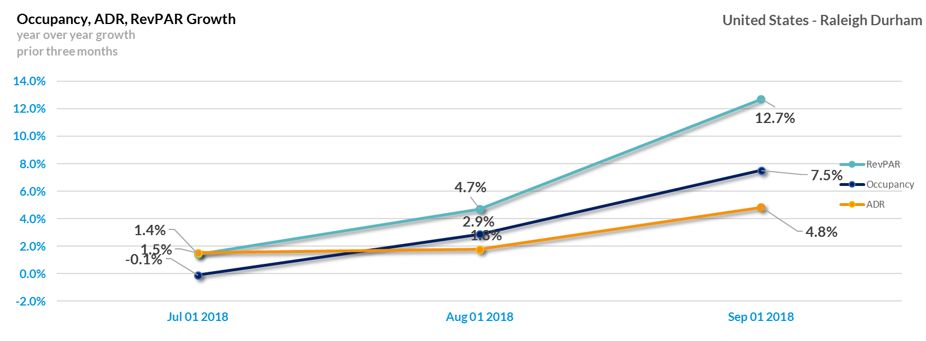
At-A-Glance | Trailing Three Months
Source: TravelClick Demand360®. ADR for Europe in EUR. All other countries in USD.
Notes:
KM to JH

Slide 6
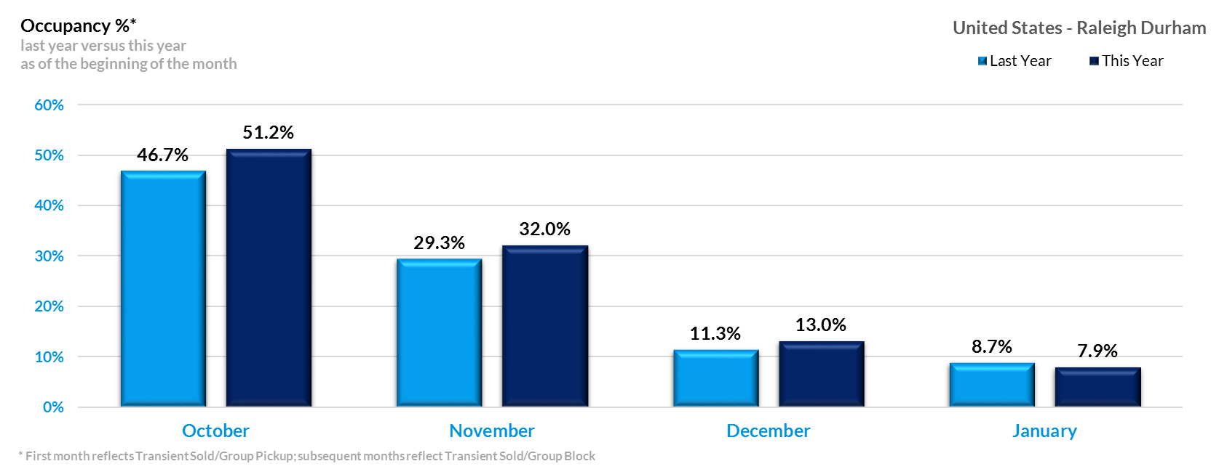
Raleigh Durham Total Occupancy Through January 2019

Slide 7
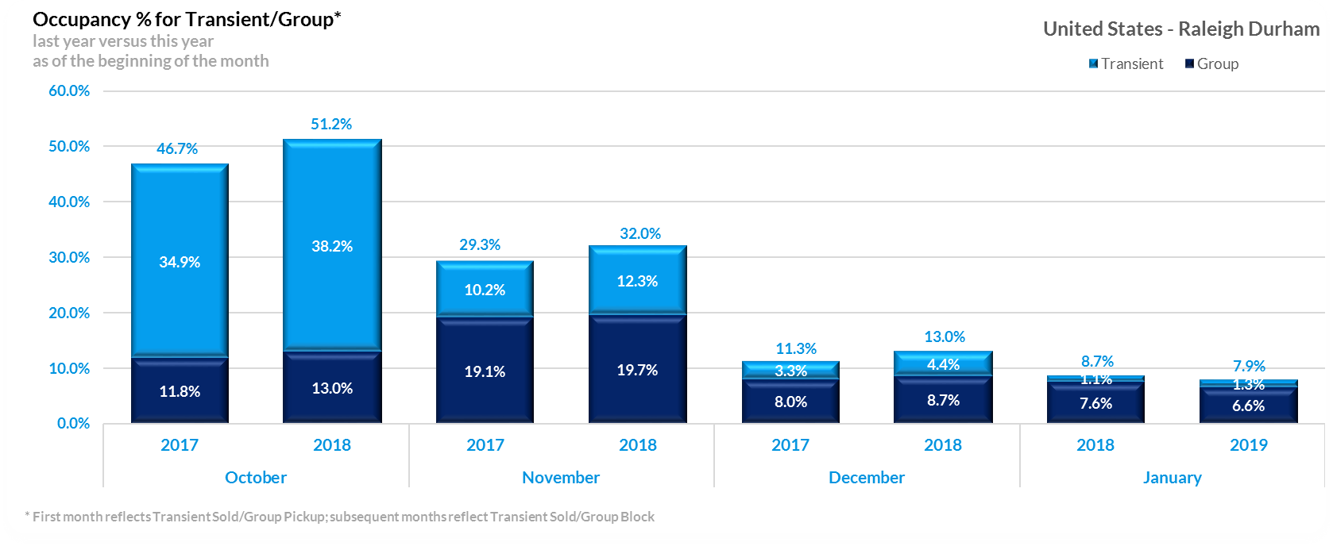
Raleigh Durham Transient / Group Occupancy Through January 2019

Slide 8
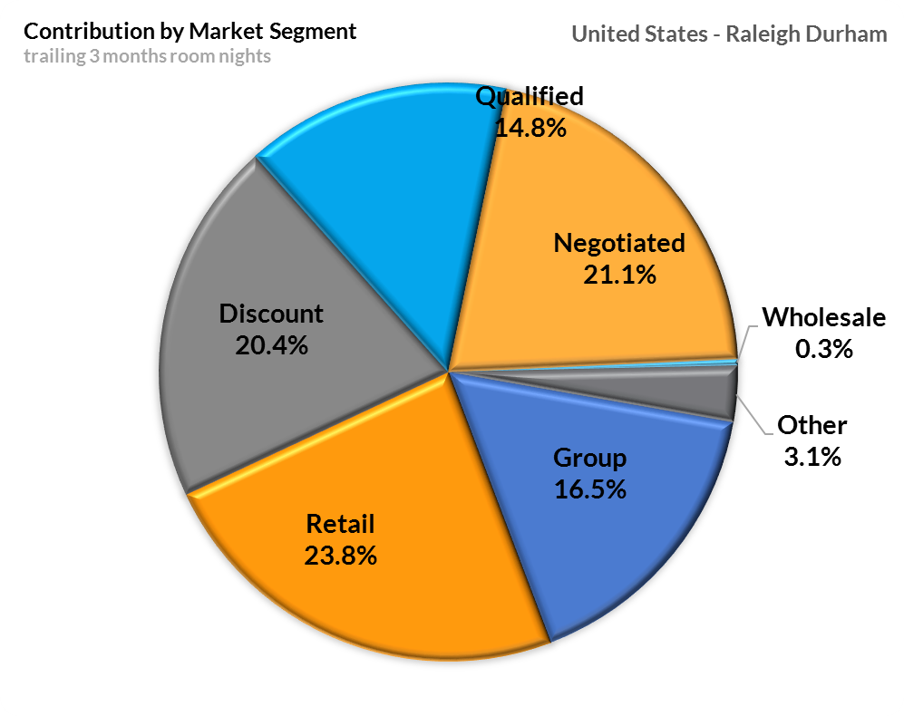
Raleigh Durham Contribution By Market Segment

Slide 9
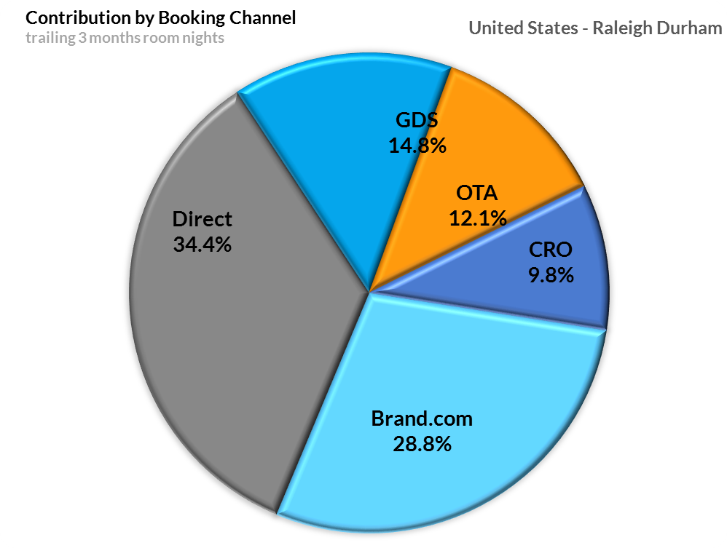
Raleigh Durham Contribution By Booking Channel

Slide 10
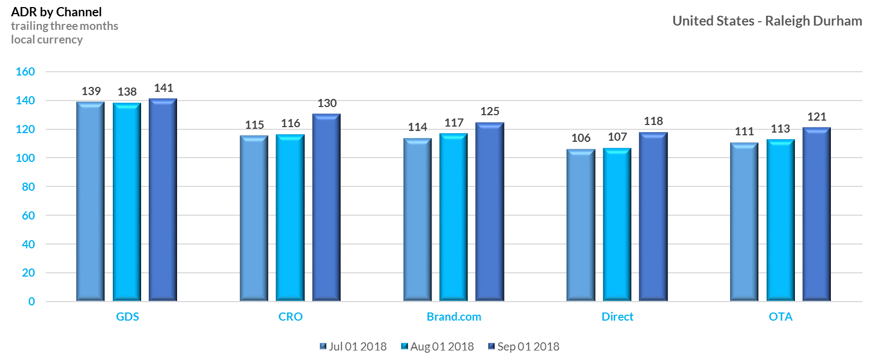
Raleigh Durham ADR By Channel

Slide 11
Prior Three Months / Current and Future Two Month Outlook

Slide 12
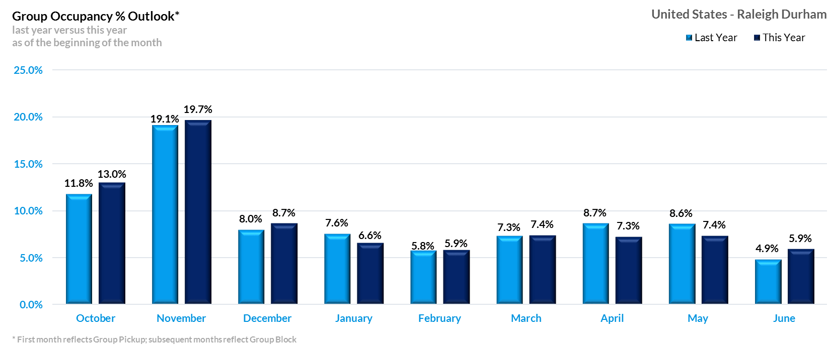
Raleigh Durham Group Outlook Through June 2019

Slide 13
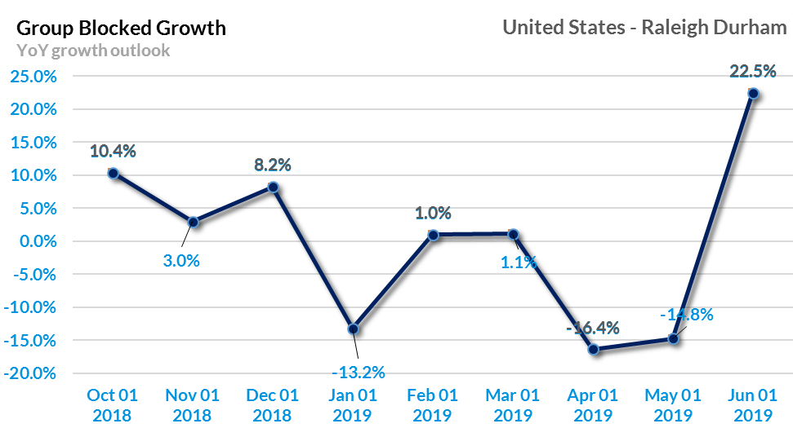
Raleigh Durham Group Outlook Through June 2019

Slide 14
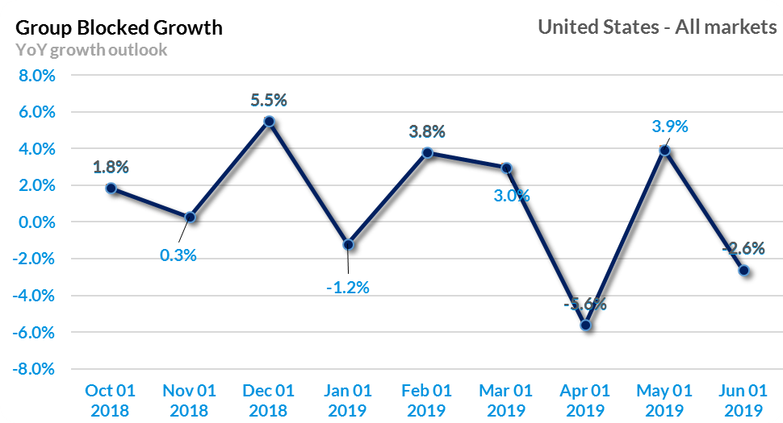
United States Group Outlook Through June 2019

Slide 15

MAXIMIZING ADR
IN 2019 & BEYOND

Slide 16
GDS | Historical Year over Year Performance
HOTEL BOOKINGS (IN MILLIONS)
Source: TravelClick Agency360®. 2018 GDS hotel bookings annualized based on August 2018 YTD actual results .
Notes:
BT to JH

Slide 17
Importance of GDS Offering Rate Parity
Travel agents across the globe are virtually unanimous in their belief that GDS systems should offer rate parity.
89%
91%
88%
88%
Q. How important is it to you to know that the GDS can offer rate parity (Very important, somewhat important, not very important, not at all important)?
Source: Copyright © 2017 Phoenix Marketing International. All rights reserved.

Slide 18


Percent of Time Offering Alternate Lower Price When Booking Corporate Negotiated Rate
Agents in the EMEA will offer a lower rate than the corporate negotiated rate significantly more often than agents in the Americas and Asia/pacific.
Q. When looking to book a corporate negotiated rate hotel, what % of times do you offer clients a lower
priced room when you find an alternative hotel priced lower than a negotiated corporate rate hotel?
(Mean % shown)
Source: Copyright © 2017 Phoenix Marketing International. All rights reserved.

Slide 19
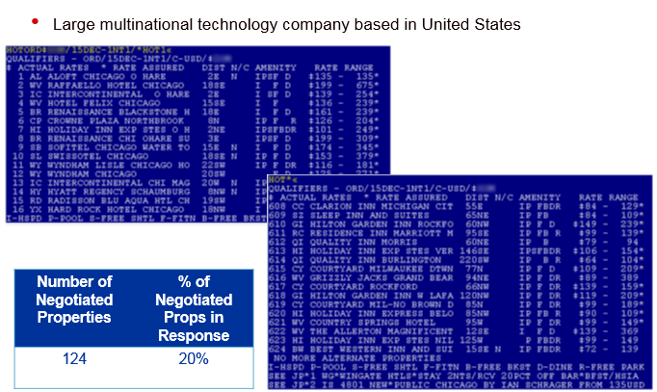
How Are Corporate Negotiated Rates Displayed: Chicago O’Hare (ORD)
Large multinational technology company based in the United States
Source: Sabre Travel Network.

Slide 20
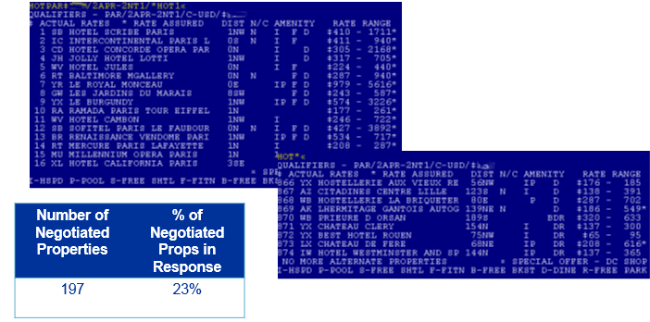
How Are Corporate Negotiated Rates Displayed: Paris, FR (PAR)
Large multinational manufacturing company based in Europe
Source: Sabre Travel Network.

Slide 21

RECAP / BEST PRACTICES

Slide 22

Recap / Best Practices
Revisit your competitive set, especially in markets with new hotels or renovated properties.
Carefully review implementation of sharp and sudden increases in ADR, particularly if your hotel is the market leader on price.
Focus on local differentiation, aggressively promote inclusions that are often a tie breaker in conversion of higher ADR transient stays.
2019 group reservation pace is showing signs of deceleration. In planning for the upcoming year look for ways to become more aggressive in competing for transient business early in the travel planning and reservation process.
Notes:
JH

Slide 23
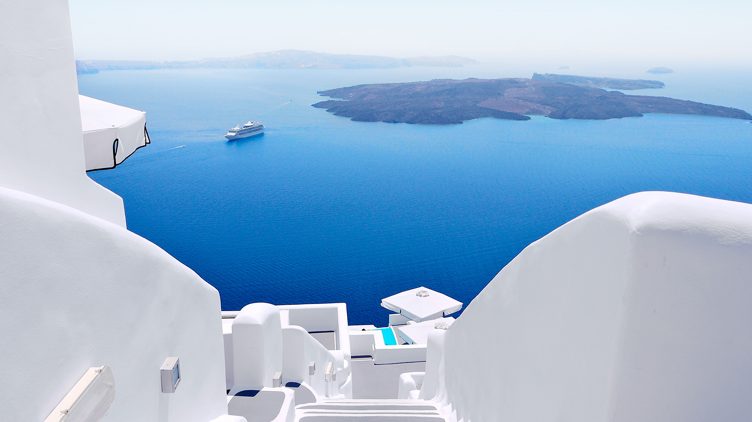
THANK YOU
jhach@travelclick.com
Notes:
BT takes it home!

