Slide 1
The Committee’s Guide to Collaborate
Tips, tricks, and helpful hints

Slide 2
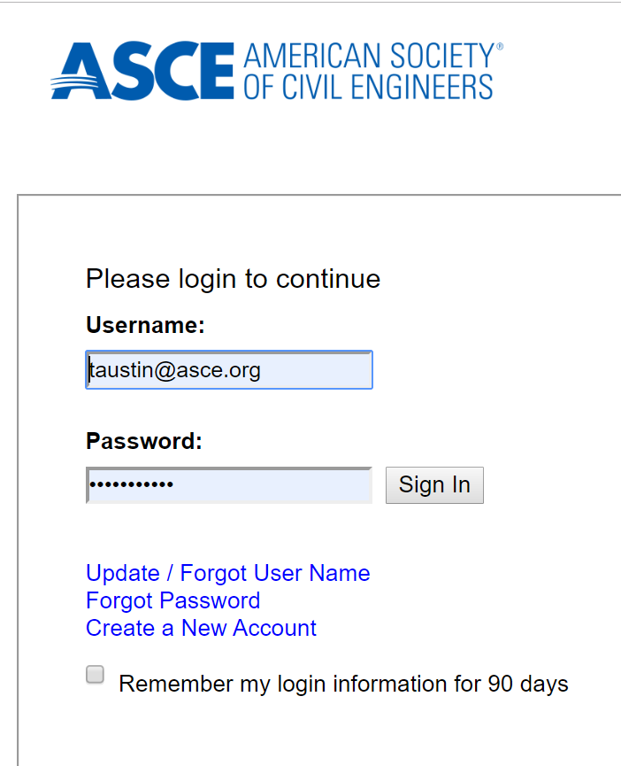
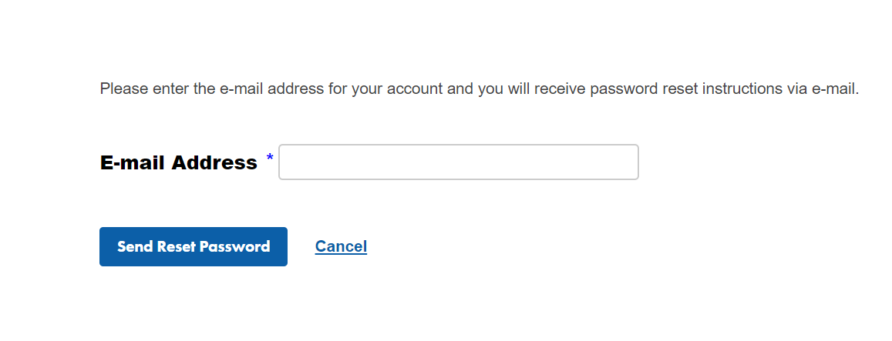
Sign In
Your Collaborate Login and Password is the same as your ASCE.org login.
If you need to find your password, click on “look it up here” to enter your email address, and it will be sent to you.
Don’t forget to click the “Remember my login” box.

Slide 3
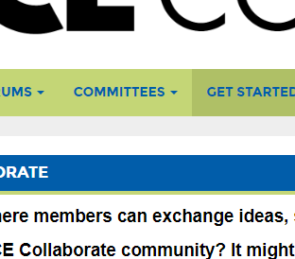
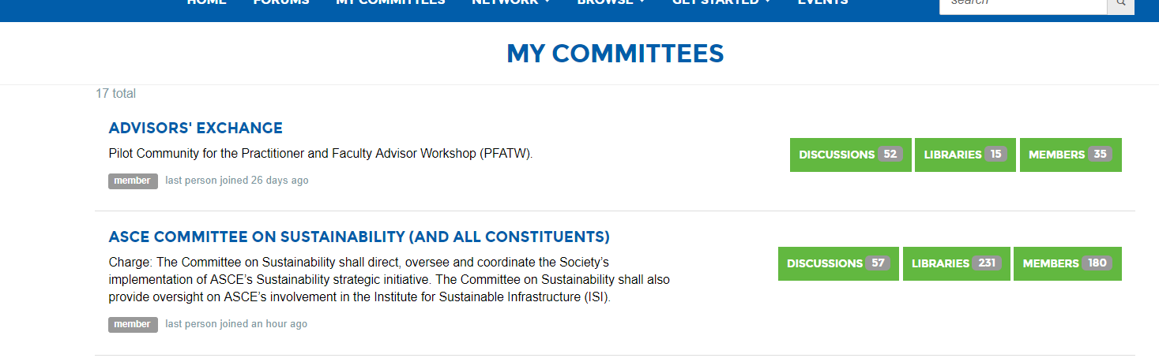
Find your committee’s home page
Each committee has its own ASCE Collaborate homepage with a space to start conversations, store documents, and view events.
These spaces are often referred to as “Communities” in ASCE Collaborate.
You can view your committees by clicking Committees > My Committees.
Click on the committee name to view the page, or you can directly view the library, discussions, or other members by clicking the green buttons in the same bar.

Slide 4
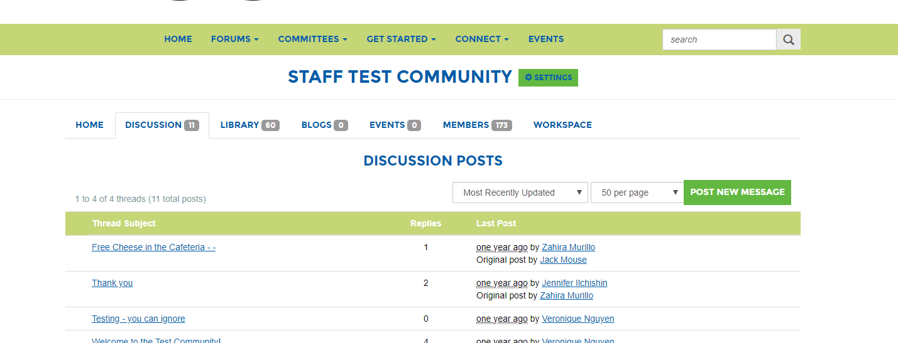
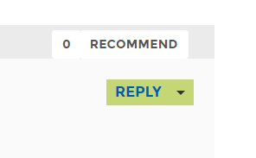
Discuss committee issues “offline”
The discussion space allows you to start conversations about topics you may not have been able to discuss in a meeting. It allows you to discuss these topics at your own convenience in one centralized place. No one has to search through a messy email chain.
Click on the discussion tab to view the thread list.
Click the green “Post New Message” to start a new discussion.
Reply to a discussion by clicking the subject thread and click “Reply to Discussion” on the right.

Slide 5
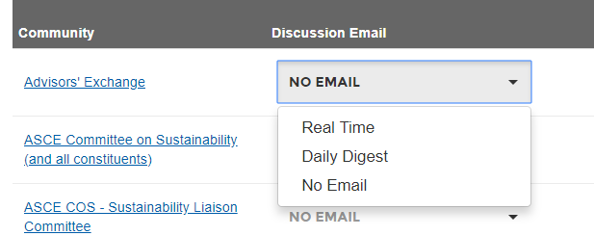
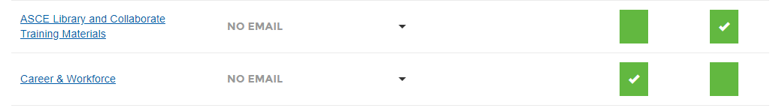
Set your email preferences
Posting in a discussion will generate emails through ASCE Collaborate to other committee members. You can control how often you get notifications from the committee by clicking Get Started > Email Preferences.
We recommend committee members select “consolidated digests.” Notifications will be sent when there are any updates in the community/committee group (announcements, new calendar events or new documents are posted). You can receive these notifications on a daily or weekly basis.
If you do not want to receive emails select the drop down Discussion Email > No Email.

Slide 6
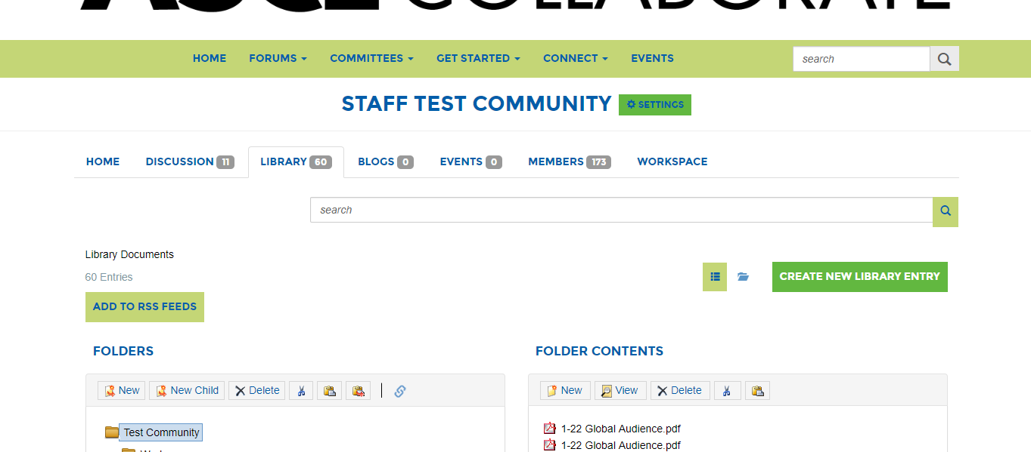
View Documents
Every committee has a “Library” to archive and share documents.
You can share the links from the files with your committee members, so they can download the documents.
To view your committee’s folders click on the “Library” tab at the top of the “Home” page.

Slide 7
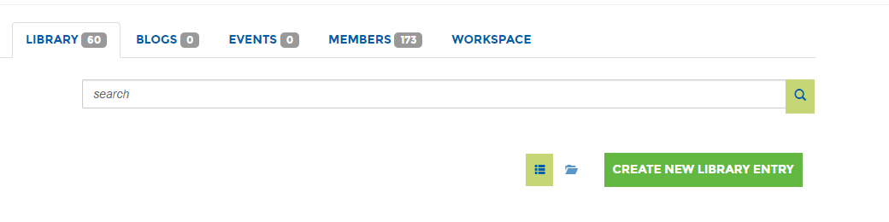
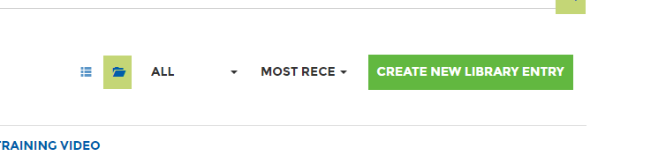
Finding Documents
When you open the Library you will see the folder structure to keep your committee organized. Talk to your committee about how you collectively want to store documents, so they are easy to find.
There is a “Search” feature to easily access documents
Talk with your committee about how the folder structure for your committee should be organized.
To switch between the list view and the folder view click the green square icon.
You can filter the list results by selecting the arrow next to most recent.

Slide 8
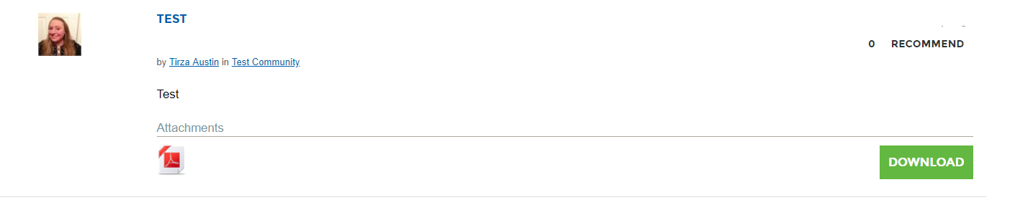
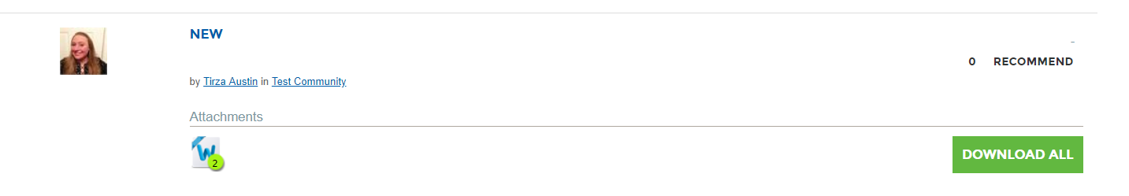
Download a Document
Click the green “Download Now” button to download the document.
If there are multiple files in an entry (within the folder) you will see a green “Download All” button. You can only select “Download Now” if the files are stored in the same entry.
Click on the name of the entry if you would like to select a specific document to download.

Slide 9
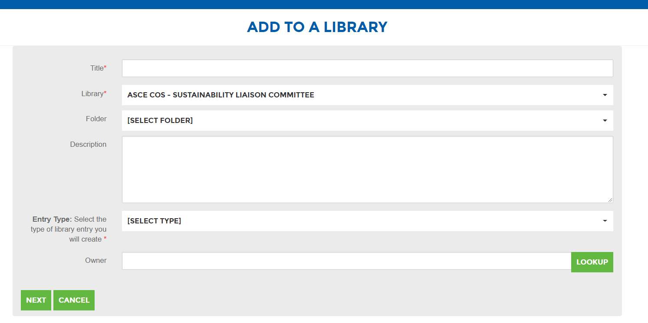
Upload a Library Document
As you work with a committee, you will need to share documents such as award applications, agendas, minutes, policies and supporting documents.
You can store them in one central place by uploading a document. This makes all records easier to find.
Click the green “Create New Library Entry” button.
Add the title of the document.
The committee library will already be selected.
Pick an existing folder within the library.
Select entry type. Most files will be a “Standard File Upload.”
Add your email address as the owner if you wish. You will be automatically added as the owner.
Click the green “Next” button.

Slide 10
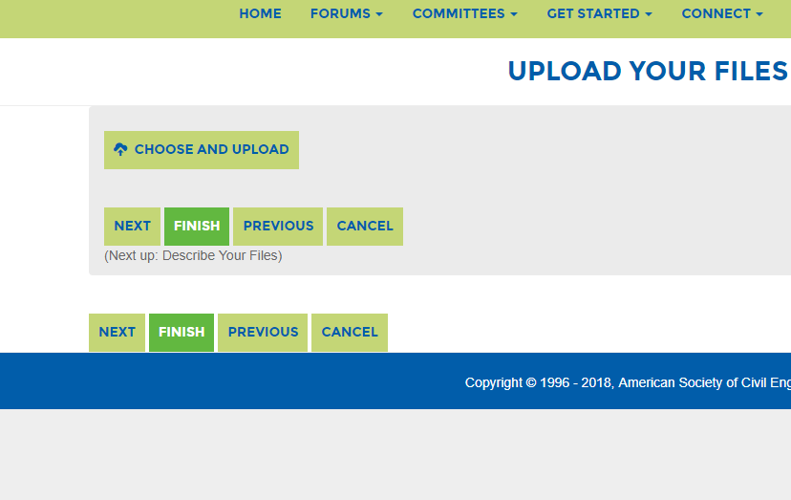
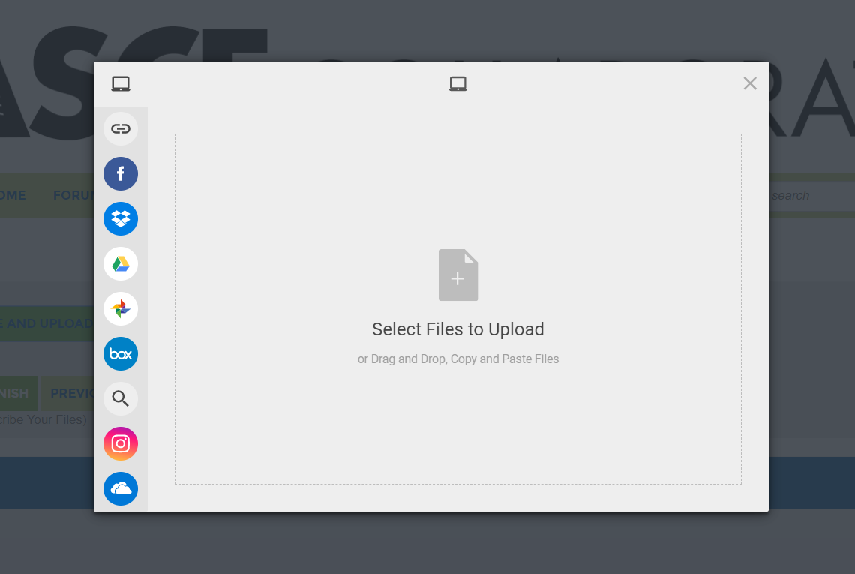
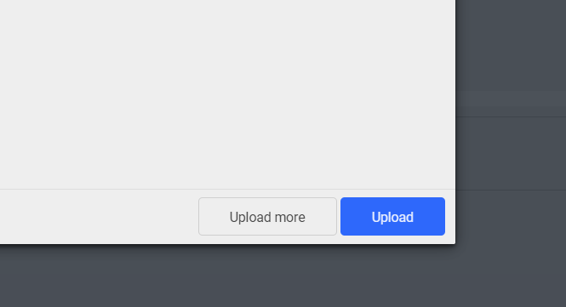
Upload multiple files
You are able to upload multiple files into the same entry. This is recommended if you are loading documents for the same meeting or project so others can download the files at the same time.
Click the green “Choose and Upload” button.
Click the blue “Choose Files” button.
Choose and drag the files you would like to upload in the gray box.
Click the blue “Upload” button to upload your documents once they have been added to the screen.

Slide 11
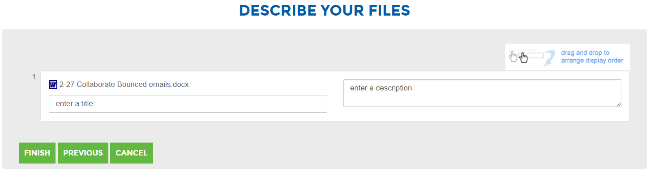
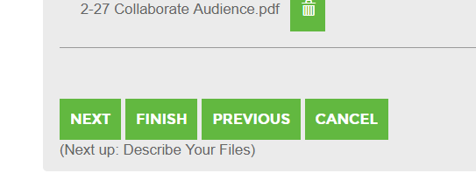
Rename the file
Sometimes you will want to rename the file so the committee will understand which document they want to download.
Select “Next” button if you would like to change the title of the document in the library.
Click the green “Finish” button. You will see another page. You need to click “Finish” again for your document(s) to be uploaded.
A notification will be sent to any committee members who have selected a consolidated daily or consolidated weekly digest.

Slide 12
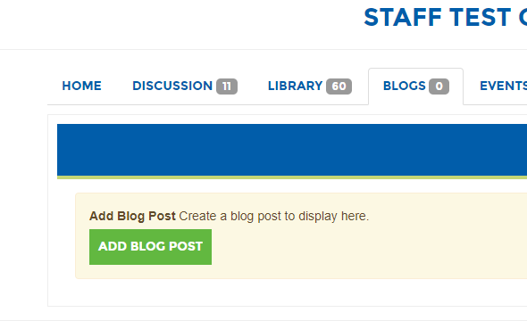
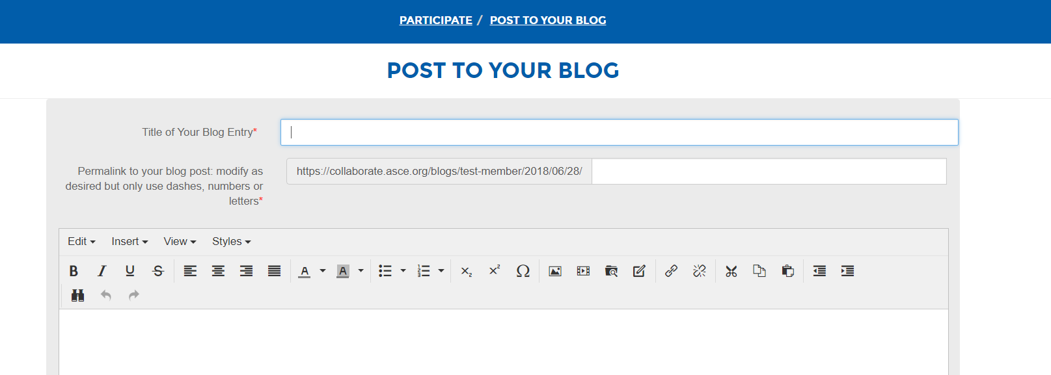
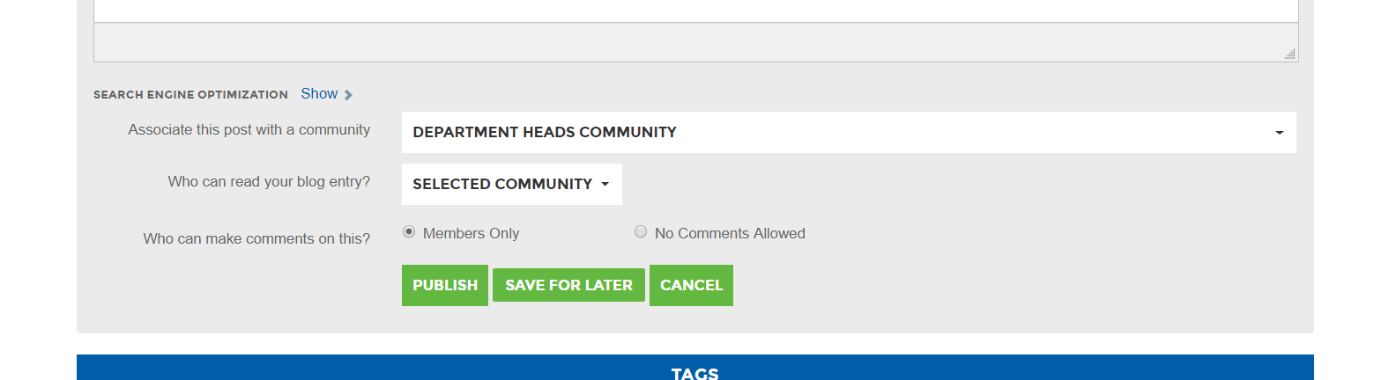
Sharing case studies
Blogs are a great way for committee members to share case studies or best practices without starting a conversation.
Click Blog tab > Add Blog Post
Create your blog. Insert title and post your message in the text box. Select your committee/community and which committee/community can view your blog.
Click “Publish” to Post.
You may select tags if you wish.

Slide 13
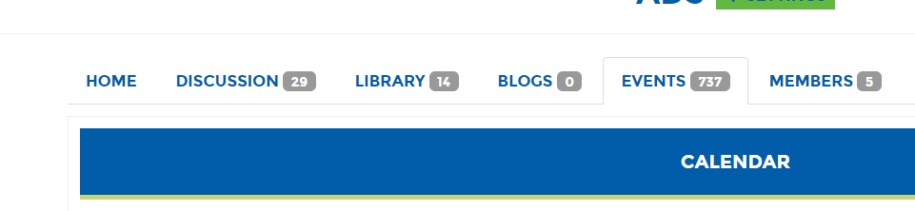
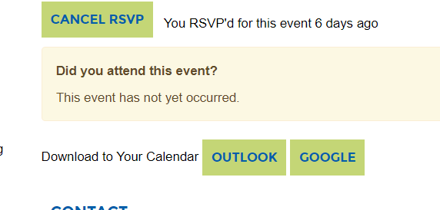
Download an event to Outlook
The event tab is a centralized place for your committee to record important dates for your committee tasks or dates of interest. There is another here on events.
Talk to your committee to see if storing events in Collaborate will help you stay organized.
Click the event tab to view your committees events.
Double click on an event to add it to your Outlook calendar.
Click the green “Download To Your Calendar” button.

Slide 14
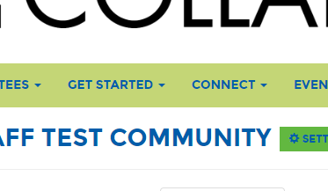
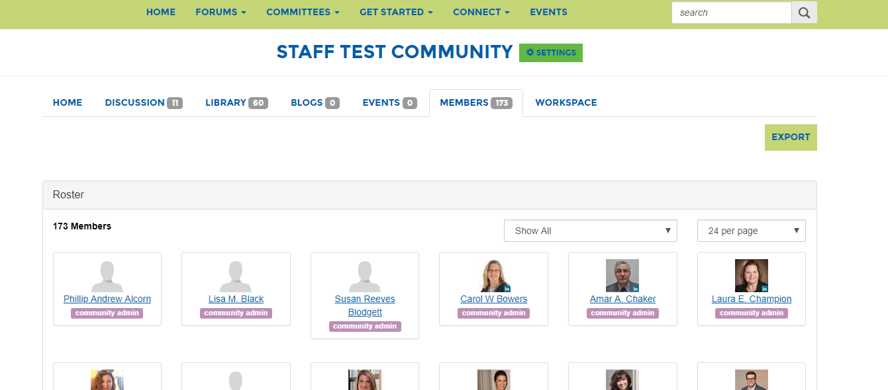
Contact other committee members
Data privacy is important at ASCE. We do not share committee members contact information with the committee. However, you are able to contact other committee members through ASCE Collaborate. Members can control what information they share with others by clicking Get Started > Privacy Settings
Click the members tab to view committee members.
Click the green “Send Message” button to send a message to that member through Collaborate.
You can also scroll to the bottom of the committee home page to see a full list of committee members.

Slide 15
Thank you!
If you have any questions, please contact Tirza Austin at taustin@asce.org.

