Slide 1
Managing Events

Slide 2
Why use ASCE Collaborate events?
Events allow members to download the meeting invite.
Events allow paid or non-paid registration.
Events allow automated messaging.
Scheduling events is available for admins in their committee or local groups.
Being a Chair or President in the ASCE membership database will grant you these permissions.

Slide 3
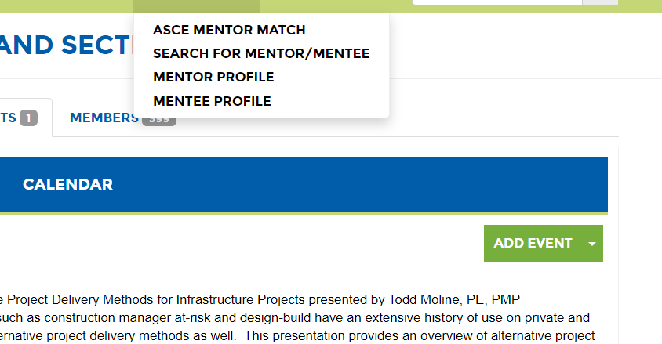
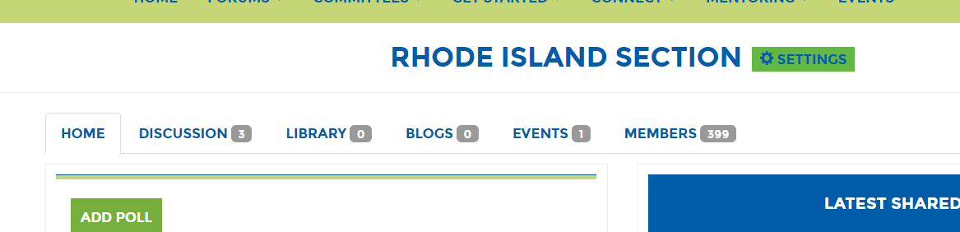
Create an event
Click on the “Event” tab > “Add Event”

Slide 4
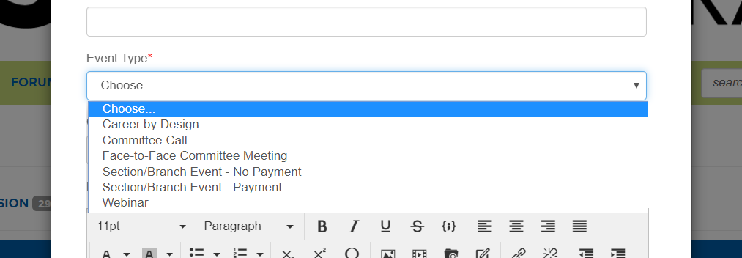
Event Types
Select the event type first or you will loose any information you already submitted.
The event type that you select controls what functionality is available as you are creating the event. Please see the options available for each event type in the following slides.

Slide 5
Committee Call
Title
Description
External URL
Start time and end time
Timezone
Make a repeating event
Add dial in instructions
Add contact information
Automatically send an invite
Automate reminders

Slide 6
Face-to-Face Committee Meeting
Title
Description
External link
Date and time
Timezone
Location
Contact information
Send meeting invite
Automate reminders

Slide 7
Section/Branch Event - Payment
Title
Description
External Link
Photo
Date and time
Timezone
Custom fields for registration
Location
Contact information
Pricing
Currency
Send meeting invite
Automate reminders

Slide 8
Section/Branch Event – No Payment
Title
Description
External URL
Date and time
Timezone
Limit Registration
Physical address
Contact information
Send event invite
Automate reminders

Slide 9
Webinar
Title
Description
Photo
External link
Date and time
Timezone
Dial-in instructions
Contact information
External registration required
Send event invitation
Personally share event

Slide 10
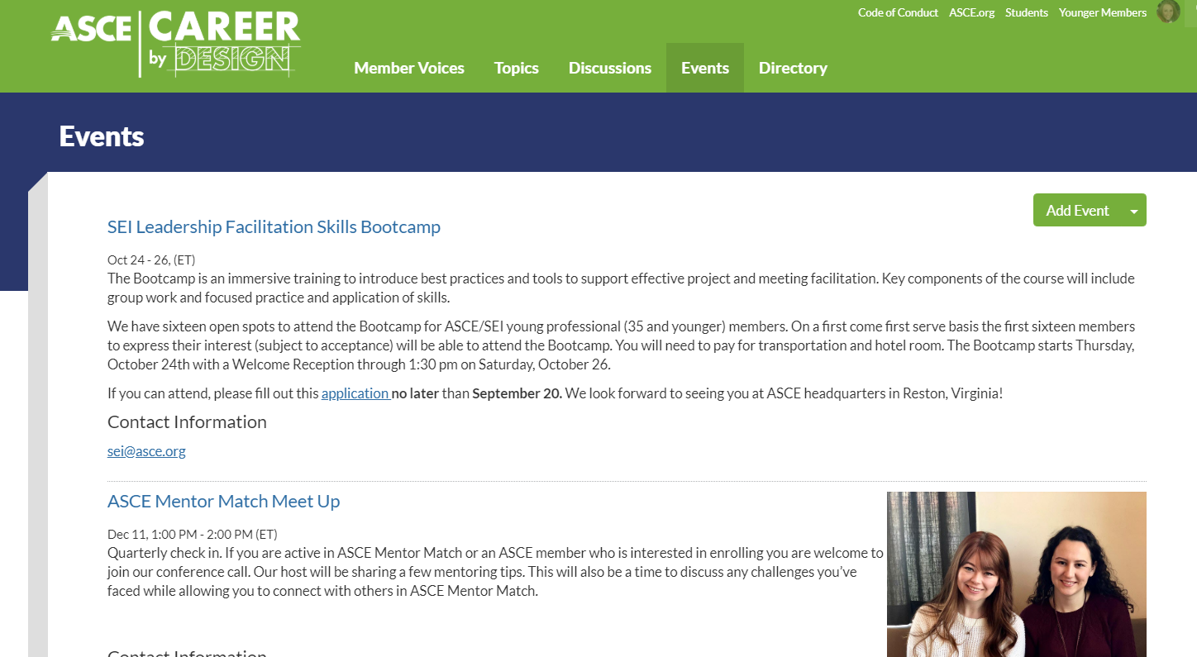
Career by Design
Anyone in the Career by Design Community can add “Career by Design” events. These events appear on the Career by Design Event page.
They should be of interest to students and younger members.

Slide 11
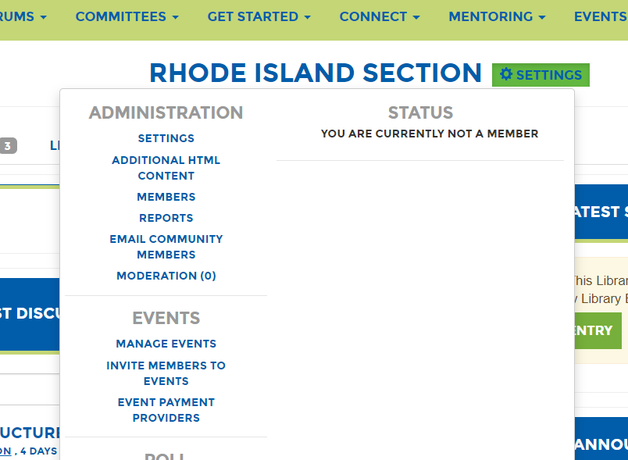
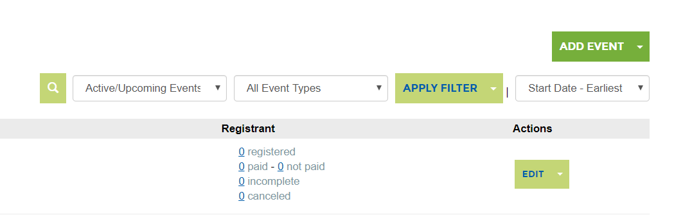
Manage Events
You can view registration by clicking “Settings” > Manage Events.

Slide 12
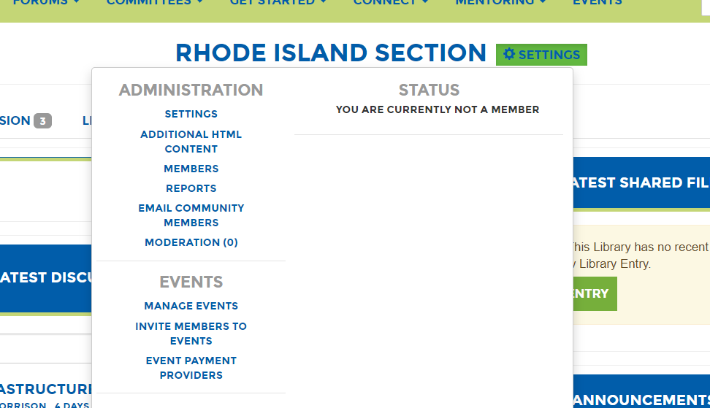
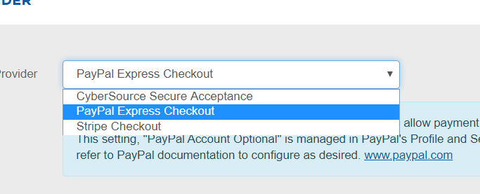
Event Payment
Click “Settings” > “Event Payment Providers” to select your payment providers for registration.
Options are:
CyberSource Secure Acceptance
PayPal Express Checkout
Stripe Checkout

Slide 13
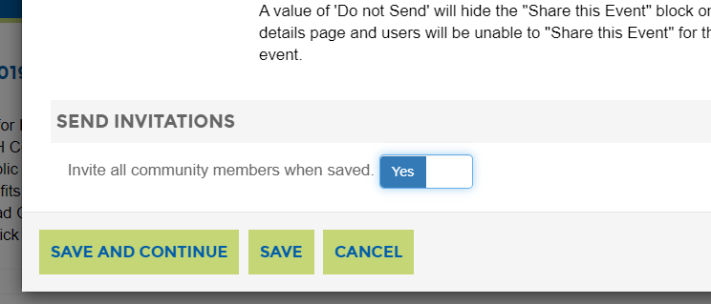
Email Invitations
Send the invite to community members when you save the event by toggling the “Send Invitations” button to “Yes”

Slide 14
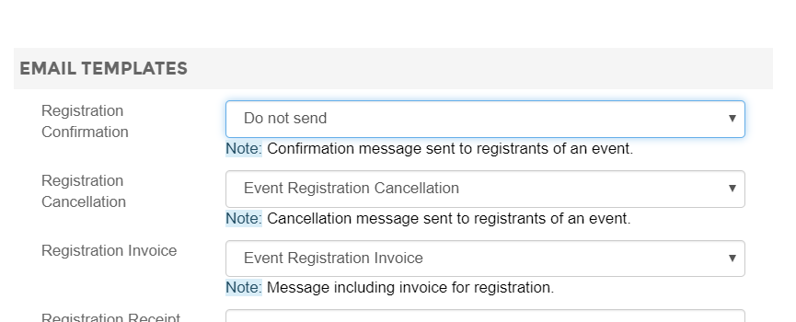
Automated Reminders
Registration action will trigger email templates to be sent by the system. Please review and set to “Do not send” if any of the automated templates would not apply to your use case.

Slide 15
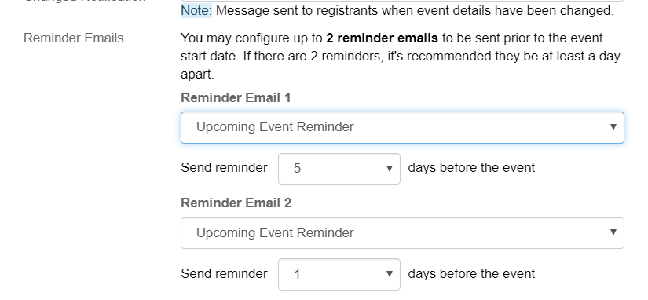
Configure Reminders
Select when you would like event reminders to be sent by selecting how many days before.

Slide 16
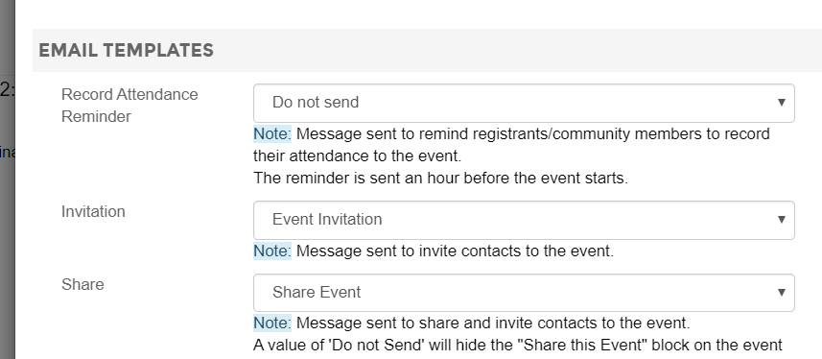
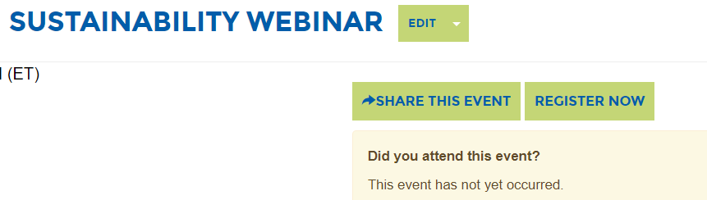
Share Events
Select “Share Event” to make the “Share This Event” button available to send individual invites to group members.

Slide 17
Additional functionality may be available if you have specific needs. Please contact Tirza Austin at taustin@asce.org with any questions.

