Slide 1
Welcome!
Here’s how to join the conversation at ASCE.

Slide 2
We are happy you joined the ASCE online community. We want to make sure you are integrated with the community so you can connect with other civil engineers and find the resources you need to be successful. This slideshow will explain the following action steps to properly assimilate with your new community:
ASCE Collaborate is an exclusive online forum where ASCE members can exchange ideas, share documents, and network.
Create your Profile
Control your Privacy Settings
Set your Email Subscriptions
Know the Community Guidelines
Network

Slide 3

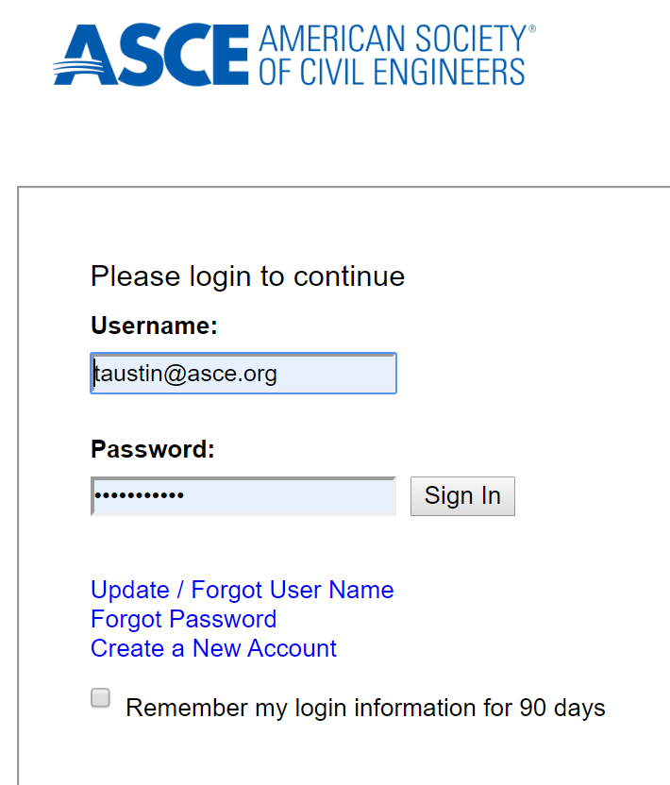
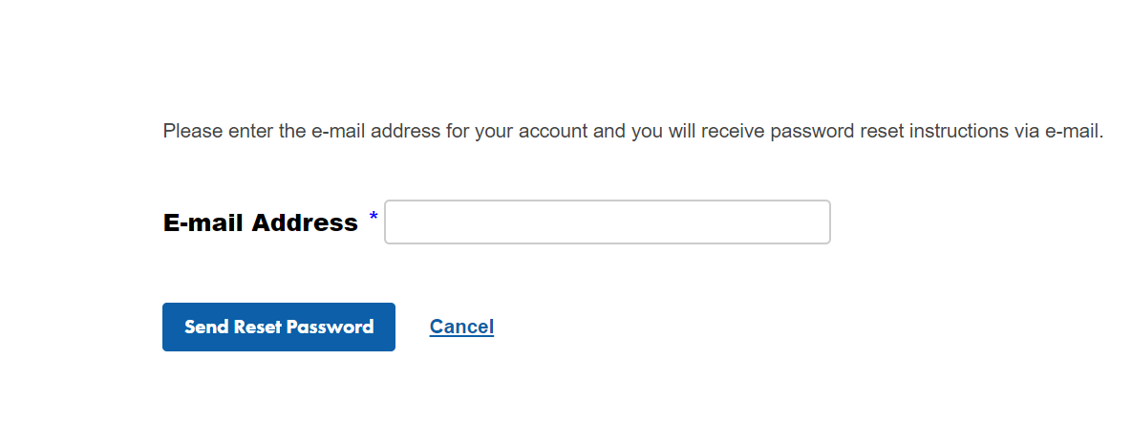
Sign In
Sign In using the green “Sign In” button on the upper-right hand side of the homepage.
Your ASCE Collaborate login and password is the same as your ASCE.org login.
If you need to find your password, click on “Forgot password.” Enter your email address, and it will be sent to you.
Don’t forget to click the “Remember my login” box.

Slide 4
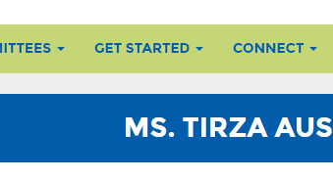
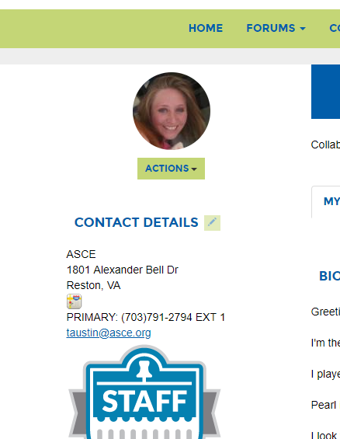
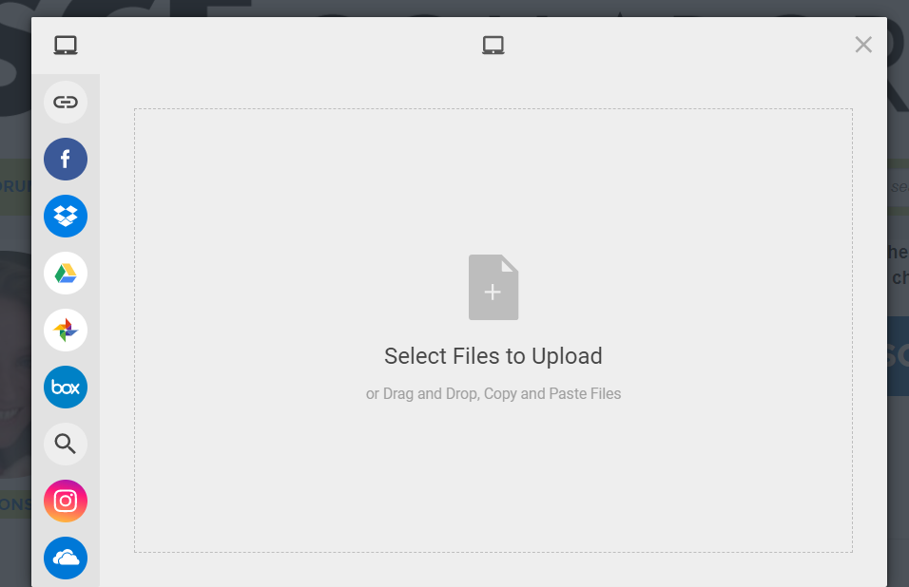
Introduce Yourself!
You are more likely to get a response to your question if you fill out your profile.
View your profile by clicking on Get Started > My Profile.
Your credentials, education, title, and contact information are already imported from our member database. To update contact information or credentials, contact Member@asce.org.
To upload a photo, click on the green “Actions” button. Select Change Picture > Select files to upload > Double click on the photo file > Save.

Slide 5
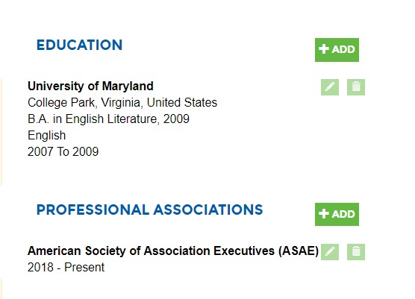
Update your profile
You may add the following profile information by clicking the green “Add” button.
Bio
Job History
Professional Associations
Honors and Awards
You may edit your information by clicking the green “Pencil” button.
You may delete content by clicking the green “Trashcan” button.

Slide 6
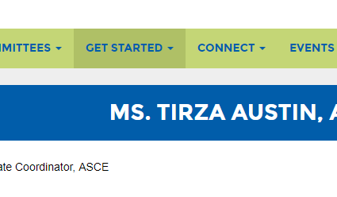
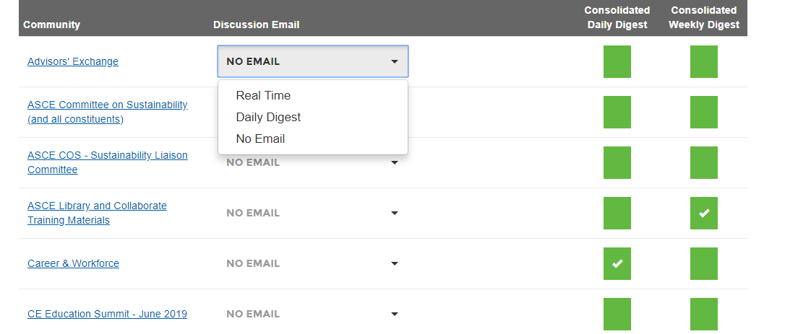
Set your email preferences.
Depending on your involvement in ASCE, you will receive notifications from certain groups referred to as “Communities” in ASCE Collaborate. Please review your groups, and decide what emails you would like to receive.
Click on Get Started > Email Preferences.

Slide 7
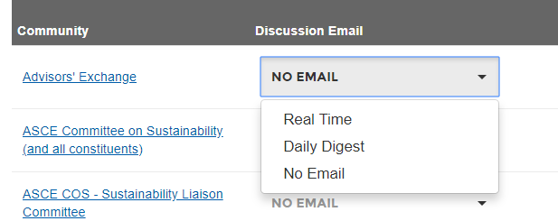
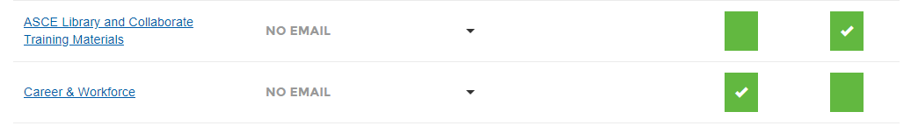
How often do I want notifications?
You will see two types of subscriptions. “Discussion Emails” send updates for ASCE Collaborate conversations only. You will see the following options:
Real Time – Immediate notifications from discussion threads.
Daily Digest – A list of all discussion posts for the entire day.
No email – You will not receive emails from this community.
Consolidated digests send notifications as one consolidated or daily email (announcements, new calendar events, or new documents are posted). This is recommended if you work in a committee. You can receive these notifications on a daily or weekly basis.

Slide 8
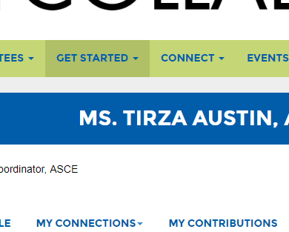
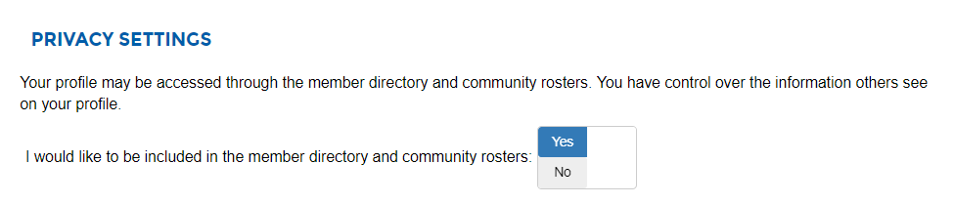
Control your Privacy Settings
All ASCE members are added to the ASCE Collaborate Member Directory. You may control what information you share in the directory by adjusting your privacy settings Get Started > Privacy Settings.
You may opt-out from the directory entirely by selecting “No” at the top of the page.

Slide 9
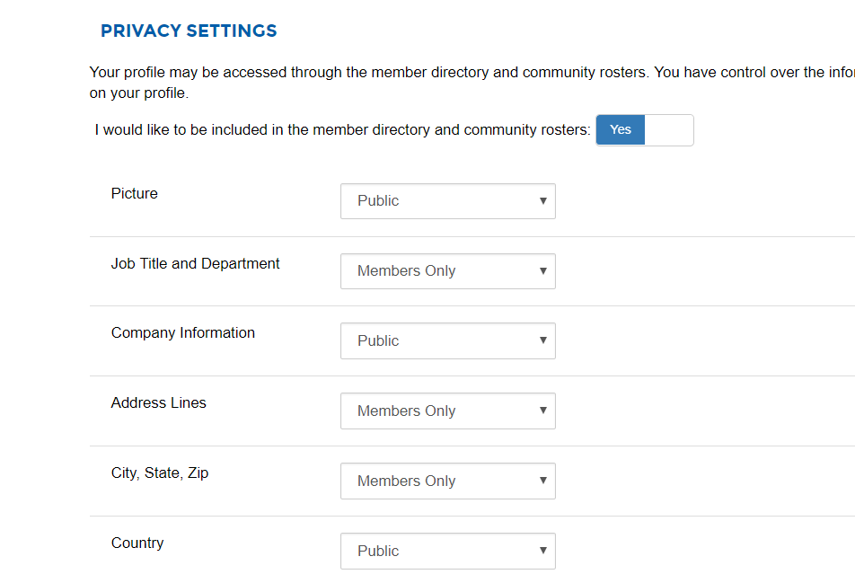
Who can view your profile?
You may set your information to be viewed by the following groups. Please select from the following options on the drop-down menu.
My contacts – An individual you have accepted as a personal contact.
Members Only – An ASCE Member.
Public – An individual who does not have an ASCE login.
Only me – No one is able to view the information.

Slide 10

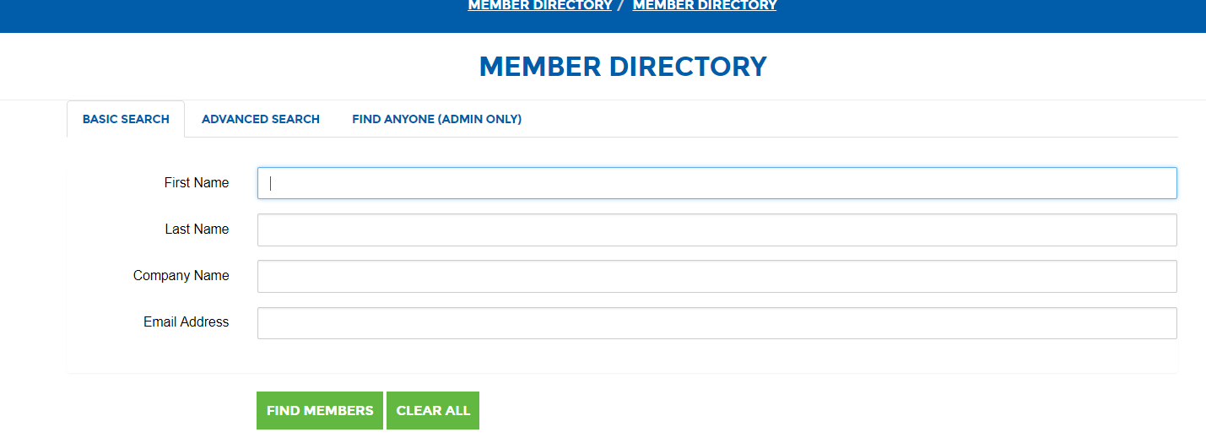
Network with the ASCE Directory
ASCE Collaborate allows you to connect with ASCE members through the ASCE Directory. Click Connect > Directory. You can control what information you display in the directory by adjusting your Privacy Settings.
You can search by the following options:
First name
Last name
Company name
Email address
You may use advanced search for the following options by clicking on the advanced search tab.
City
State
Country

Slide 11
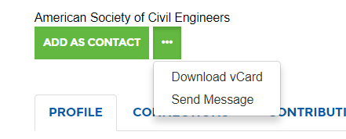

Connect with other engineers
Adding contacts allows you to share more intimate details of your profile. Your contacts are also stored in one central place in your profile making it easier to keep track of the connections you’ve developed.
Click on the member you would like to view.
Click on “Add As Contact” within their profile to send a contact request.
Click the green drop-down box to send them a message or download their vCard.
To view your contacts, click on Connect > My Contacts.

Slide 12

Ground Rules
Every group has its own expectations and rules. Please take the time to review some of ours.
https://collaborate.asce.org/codeofconduct
The Code of Conduct also gives some guidance on the best way to post and answer questions.
You can locate the Code of Conduct in the upper left-hand side of the Collaborate site.
If you have any questions or comments about the Code of Conduct or the ASCE Privacy Policy, please email us.
taustin@asce.org

Slide 13
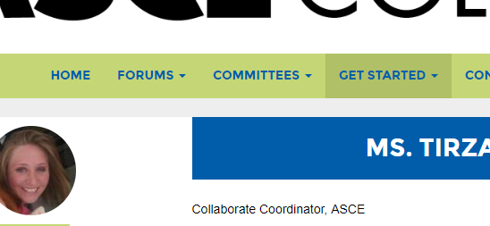
Get Active!
Now that you got all the work out of the way, it’s time for the fun part!
ASCE Collaborate has five forums.
One General Forum: Professional & Career Topics
One forum for students and younger members: Career by Design
Three Technical Forums:
Environmental, Coasts, Oceans, & Water Infrastructure
Horizontal/Subsurface Infrastructure and Transportation
Integrated Buildings & Structures
Take the time to browse the forums and see what topics interest you.

Slide 14

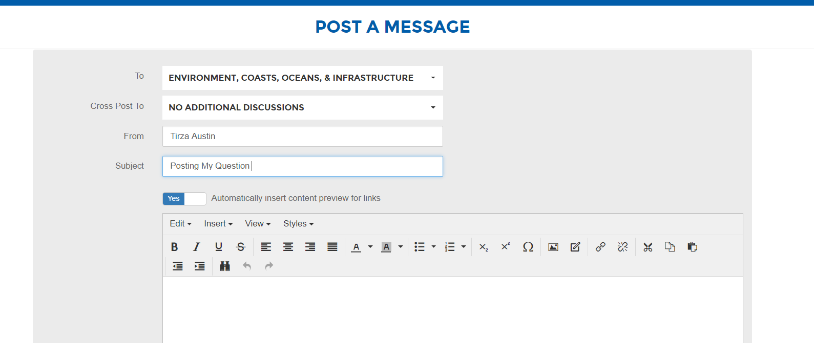
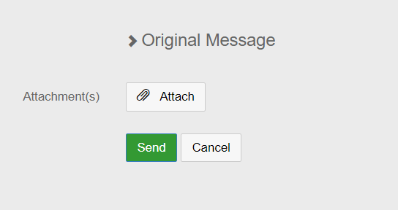
Ask a Question!
Do you have a question? Or need help with a particular project? You can ask other ASCE members in the forums.
Click on “Forums.” Click on the group you would like to post your question. You can look at the forum description if you are not sure where to post your question.
Click on the green “Add” button to post in the group. Create a subject and message.
You can attach a file, picture, or external link.
Hit the green “Send” button at the bottom of the page.

Slide 15
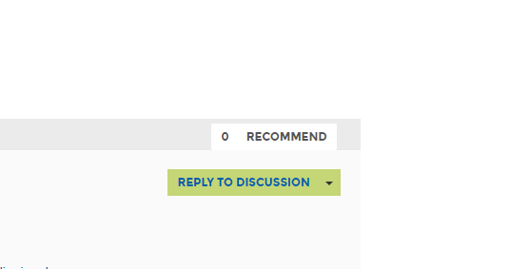
Answer a Question!
You asked your question. But there are other ASCE members that have questions just like yours. They are looking for answers too!
Take the time to browse the discussions where you can add value.
This is an opportunity for you to share your expertise in addition to helping you create relationships with other experts in your field.
By taking the time to invest in ASCE Collaborate, you become a global leader building a better quality of life.

Slide 16
Thank you!
Contact Tirza Austin at taustin@asce.org with any questions.

