Slide 1
Event Types

Slide 2
Event Types
Events control the functionality of your event. You will need to select the event with the correct functionality to set up your event.
There are five types of event functionality that are being used to create event types. You will sometimes see them included in the event type names.
External
Full
No Reg
RSVP
Simple
We have set up and named Section/Branch Event types, so they are intuitive for you. The following slides include functionality for each one. If you require additional functionality please contact taustin@asce.org to see if we can configure an event type for you.

Slide 3
Event Type Description
No registration - Select this for events you simply want to add to your Event Calendar to keep your members aware of your organization's upcoming events.
Link to External Registration System - Select this if registration for these events will be handled via an external registration system. Event creators will be able to specify the link during event creation.
RSVP Only - no payment - This option is for events where formal registration (or payment) isn't required but users still must acknowledge their attendance by RSVP. This allows an attendee roster to be tracked. Webinars, fun-runs, and various work functions are the types of events this process is often used for. Note that only users with accounts on your site can RSVP.
Simple - Use this for smaller events where registration is desired but sessions and registration add-ons aren't needed. Generally, member/non-member pricing is used for this type of registration, but more complex pricing can be set up, if needed.
Full - Use this for large, multi-day events, like annual conferences, etc., where you plan to host an agenda full of sessions and other registrations add-ons (e.g., keynotes, lunches, and after-hours events).

Slide 4
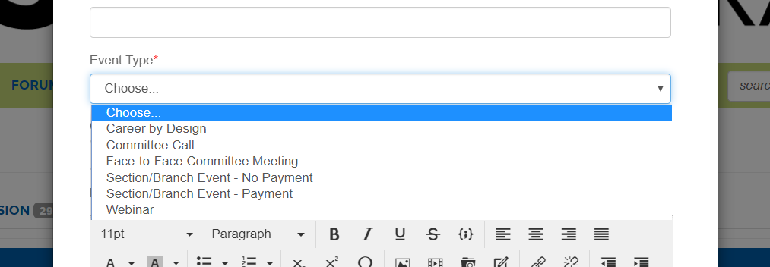
Event Types
Please note*****
Select the event type first or you will lose any information you already submitted.

Slide 5
Section/Branch Event - Payment
Full Registration
Title
Description
External Link
Photo
Date and time
Timezone
Custom fields for registration
More choices for additional forms of payment
Location
Contact information
Pricing
Currency
Send meeting invite
Automate reminders

Slide 6
Section/Branch Event – No Payment
RSVP Only – No Payment
Title
Description
External URL
Date and time
Timezone
Limit Registration
Physical address
Contact information
Send event invite
Automate reminders

Slide 7
Section/Branch Event – Invoice Only
Full Registration
Invoice customers
Title
Description
External Link
Photo
Date and time
Timezone
Custom fields for registration
More choices for additional forms of payment
Location
Contact information
Pricing
Currency
Send meeting invite
Automate reminders

Slide 8
Section/Branch Event – Online Payment Only
Full Registration
Online Payment Only
Title
Description
External Link
Photo
Date and time
Timezone
Custom fields for registration
More choices for additional forms of payment
Location
Contact information
Pricing
Currency
Send meeting invite
Automate reminders

Slide 9
Online Events – Simple Registration
Simple Registration
Title
Description
Link to external website
Image
Multiple dates
Online only
Contact
Early, regular, late pricing
Registration classes
Guest Login
Does not allow more choices or custom input fields
Automated messages

Slide 10
In-Person – Simple Registration
Simple Registration
Title
Description
Link to external website
Image
Multiple dates
In-Person/hybrid location available
Contact
Early, regular, late pricing
Registration classes
Guest Login
Does not allow more choices or custom input fields
Automated messages

Slide 11
No Registration – Event Page
No Registration
Title
Description
External link
Image
Single date
Timezone
Online location only
Contact
Link to external registration system
No automated messages

Slide 12
Webinar
Link to External Registration System
Title
Description
Photo
External link
Date and time
Timezone
Dial-in instructions
Contact information
External registration required
Send event invitation
Personally share event

Slide 13
Committee Call
RSVP Only – No Payment
Title
Description
External URL
Start time and end time
Timezone
Make a repeating event
Add dial in instructions
Add contact information
Automatically send an invite
Automate reminders

Slide 14
Face-to-Face Committee Meeting
RSVP Only – No Payment
Title
Description
External link
Date and time
Timezone
Location
Contact information
Send meeting invite
Automate reminders

Slide 15
You can find more information here.
Contact Tirza Austin at taustin@asce.org with any questions.

