Slide 1



The development of a Team Science Lifecycle (TSLC) Evaluation Model: A Proposed Framework for Assessment, Development, and Evaluation Outcome Measures for Scientific Teams
Presented to the American Evaluation Association TRE-TIG September 17, 2025
Kevin C. Wooten, Ph.D., University of Houston Clear Lake, College of Business
Institute for Translational Sciences, University of Texas Medical Branch

Slide 2
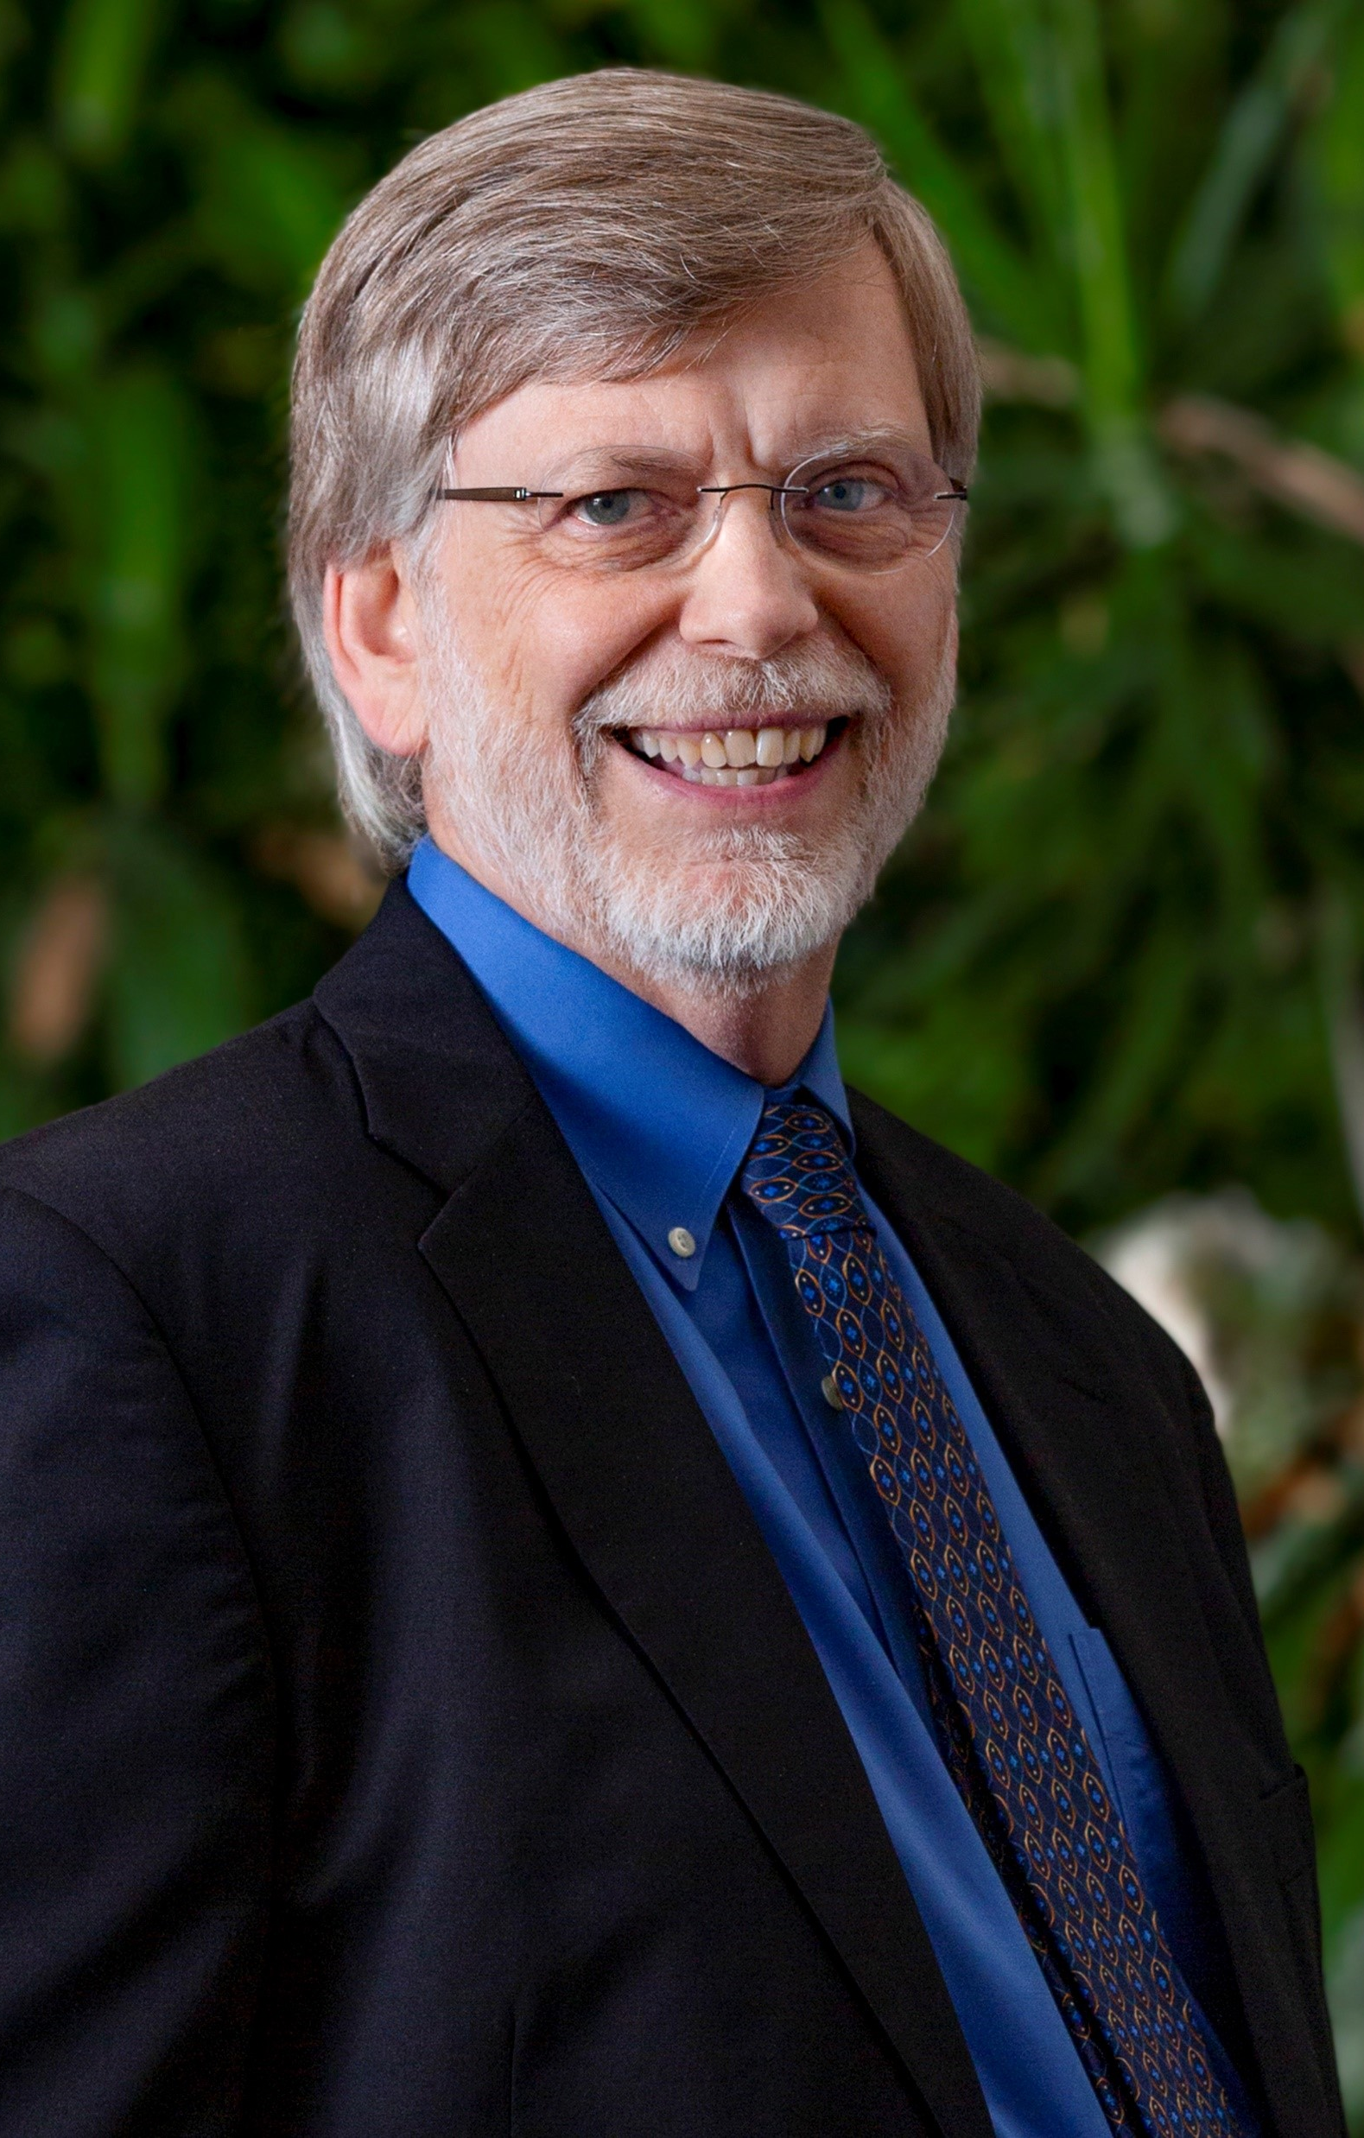
Bio sketch – Kevin C. Wooten, Ph.D.
Kevin is currently serving as Professor of Management and Human Resource Management at the University of Houston Clear Lake. Previously, he served as the Chief Strategy Officer and was responsible for organizing, maintaining, communicating, implementing, and evaluating the overall university strategy developed by senior leadership in partnership with all major internal constituents. He previously served for over a decade as Chair of the Management Department at the University of Houston Clear Lake, and currently serves as an adjunct faculty member in the Department of Psychology at Rice University, and the School of Public Health at the University of Texas – Medical Branch at Galveston. Prior to joining the University of Houston System, Kevin served as adjunct faculty at the A.B. Freeman School of Business at Tulane University, teaching Organizational Behavior in the Executive MBA Program.
Kevin holds a Ph.D. in Industrial Organizational Psychology from Tulane University. He has over nine years of industrial experience, much of which involved managing the corporate training and development function for a Fortune 500 corporation. Kevin also has over three years of experience as a Vice President and Staff Psychologist for a national consulting firm.
Over the past sixteen years, Kevin has served as the Consulting Director of Evaluation/Quality Improvement and the Lead Team Science Consultant for three consecutive NIH/NCATS CTSA Awards at the University of Texas Medical Branch at Galveston. He has been a national thought leader in the application of Balanced Scorecard methodologies for research centers, team science training and evaluation, as well as pioneering the usage of leadership assessment center methods for scientific leaders. He is the Director and overall architect for the TeamMAPPS program which provides behavioral skills training for team science collaboration.
Kevin maintains an active research and consulting agenda. He presents his research frequently at international, national, and regional academic conferences. His research interest includes organizational development, strategic planning, organizational justice, applied evaluation methodologies, change resistance and readiness, and team science. Kevin currently serves on the editorial board for the Journal of Applied Behavioral Science. He has served as a Guest Editor for the Journal of Change Management, Journal of Clinical and Translational Science, and Frontiers of Psychology. Additionally, he has co-authored an award-winning book on the ethics of organizational change. Kevin served on the Inaugural Board of Directors for the International Network for the Science of Team Science and led them to a 501(c) status. Over the span of his career, Kevin has consulted leading institutions and Fortune 100 organizations involving organizational development, organizational design, human resource practices, and strategic planning.
Among Kevin’s hobbies and interests are fly fishing the small creeks and rivers in Missouri and Virginia, traveling abroad, and reading history. His wife Heather is a medical historian and noted polio scholar, and they both enjoy spending time with two grown children in New York and London.

Slide 3
Agenda
Objectives of the Session and Audience Challenge
General Models of Team Development and Evaluation
Models of Team Development Evaluation of Scientific and Translational Teams
Proposed Team Life Cycle Model
  Assumption Development
  The Overall Model
  Team Readiness
  Team Processes
  Team Collaboration
  Team Affect
  Team Evolution and Adaptation
  Team Outcomes
Proposed Assessment Measures by Stage of Scientific Team Development
Plans to Develop the TSLC Model

Slide 4
Objectives of the Session
To explore the needs of scientific team evaluation
To briefly review applicable models of general team development and team evaluation, and effort thus far for translational science
To propose a life-cycle evaluation model appropriate for translational teams

Slide 5
What is Needed? My Opinion/Observation
Provide an evaluation process applicable to translational research teams at different stages of development and different stages of translation
Develop a flexible model that might provide evidence based and evidence informed measures applicable to translational teams
Generate a flexible model that could be used for multidisciplinary and multi-institutional teams
Create a model of team evaluation that provides a choice of outcome measures appropriate for nature of project or study, as well as stage of translation

Slide 6
Audience Challenge
Is an evaluation framework that is flexible to the assessment context superior to a fixed system that evaluates all teams the same?
Is it feasible to allow evaluators choice in assessment criteria as well as appropriate outcome measures?

Slide 7
General Models of Team Development and Effectiveness
Tuckman’s Five Stages of Team Development (1965)
  Forming
  Storming
  Norming
  Performing
  Adjourning
Bechard’s General Model of Team Evaluation and Team Effectiveness (GRPI) Model (1972)
  Goals
  Roles
  Processes
  Interpersonal Relationships

Slide 8
General Models of Team Development and Effectiveness
Lombardo & Eichinger’s T7 Model (1995)
  Talent
  Trust
  Teaming
  Thrust
  Tasks
  Team Leader Fit
  Team Support

Slide 9
General Models of Team Development and Effectiveness
LaFasto & Larson’s Team Dynamics (2001)
  Right Team Members
  Productive Relationships
  Problem Solving
  Effective Leadership
  Team Support and Resources
Ilgen’s Input – Process – Output Model (2005)
  Inputs: Individual level factors (e.g., personality, norms, etc.)
  Processes: Mediating mechanisms (e.g., coordination, communication, etc.)
  Outcomes (e.g., performance, satisfaction, etc.)

Slide 10
General Models of Team Development and Effectiveness
Turner et al. Multisystem (MTS) Effectiveness Model (2020)
  Task Work
  Teamwork
  Customer Value
  Performance
Tannenbaum & Salas’ Seven Drivers of Team Effectiveness (2021)
  Capability
  Cooperation
  Coordination
  Communication
  Cognition
  Coaching
  Conditions
Similar models provided by Huckman (2002), Katzenback & Smith (1993)

Slide 11
Models of Team Development and Evaluation for Translational Science
Hall et al. Four Phase Model of Transdisciplinary Team Based Research (2012)
  Development
  Conceptualization
  Implementation
  Translation
Wooten et al. Behavior Observation Multidisciplinary Team Evaluation Model (2012)
  Team Development (vision/charter/goals, transformational leadership, meeting management, coordination, communication and coordination)
  Research Scientific Factors (research plan, research generation, research communication/program growth, progress across translational domains)

Slide 12
Models of Team Development and Evaluation for Translational Science
Luke et al. Translational Benefits Model (2018)
  Bibliometrics
  Policy Development
  Economics
  Public Health Advancements

Slide 13
What Have We Learned from General Models and Translational Science Models?

Slide 14
Key Question
Are scientific teams the same as business task teams?

Slide 15
Chat GPT Comparison Between
Scientific Process and the Business Model
Scientific Process
Goal: To understand how the world works through evidence, testing, and observation
Key Steps
Ask a Question – start with a curiosity or problem
Do Background Research – understand what’s already known
Form a Hypothesis – make an educated guess
Conduct Experiments – test the hypothesis
Analyze Data – look at the results
Draw Conclusions – decide if your hypothesis was correct
Communicate Results – share with the scientific community
Focus: Truth, evidence, and repeatable results
Driven by: Curiosity, peer review, and objective inquiry

Slide 16
Chat GPT Comparison Between
Scientific Process and the Business Model
Business Model
Goal: To create and deliver value in a way that generates profit
Key Steps
Customer Segments – Who are your customers?
Value Propositions – What problem are you solving?
Channels – How do you reach customers?
Customer Relationships – How do you interact with them?
Revenue Streams – How do you make money?
Key Resources – What assets do you need?
Key Activities – What do you do to deliver value?
Key Partners – Who helps you?
Cost Structure – What does it cost to operate?
Focus: Profitability, market fit, scalability
Driven by: Customer needs, competition, and financial sustainability

Slide 17
Assumptions on the Development of the TSLC
A comprehensive assessment and evaluation framework is much needed for scientific teams
Most work teams have the same characteristics, but considerations need to be made relative to the scientific process and needed multi-disciplinarity to solve highly complex problems
The framework must be evidence-informed and ultimately evidence-based
The framework to be considered must assume that all teams are in different stages of development or translation and should be assessed on measures relevant to their stage of development
Assessment of scientific teams should embody formative evaluation, providing ongoing feedback to strengthen team processes and collaboration
Substantive evaluation involving outcomes and impact metrics should be tracked longitudinally, and be linked to assessment results over time and measures
Team members and leaders should have input into the choice of assessment measures and evaluative criteria
Assessment and evaluation should be systematically tied to team development – not separated

Slide 18
TSLC Model for Team Science Assessment, Development, and Evaluation Measures (Wooten, 2024) readiness – PROCESSEs – Collaboration – Affect – Adaptation – Team OUTCOMES
Team Readiness
(TR)
Team Evolution Adaptation (TE)
Team Process (TP)
Team Affect (TA)
Team Collaboration (TC)
Team Outcomes
(TO)

Slide 19
General Model of Expected Scientific Team Development
Nascent State
Stage 1
Formation
Stage 2
Formation
Stage 1
Performance
Stage 2
Performance
Maturity
Exploring possibilities Exploring potential team members and expertise Consideration of principal areas and funding sourcing
Establishing boundaries Creating team vision and overall research strategy Formulating goals, roles, and rules of operation and governance
Creating team identity Engaging team protocols and behaviors Leading, influencing, exchanging, resolving issues
Utilizing and integrating resources and knowledge Enacting collective responsibility for success Empowering self diagnosis and change, adopting new roles and behaviors
Solidifying identity Enhancing the experience of team membership Creating awareness of personal and collective experience
Implementing sustainable success strategies Generating alternative pathways for achievement Reframing purpose and processes
RESTUCTURING
ASSESSING, DIAGNOSING, AND CHANGING

Slide 20
TSLC Model: Team READINESS (TR)
Team Readiness (TR)
Team Orientation
Team Efficacy Expectations
Collaboration Readiness

Slide 21
TSLC Model: Team Processes (TP)
Team Processes (TP)
TP1
Task Orientation Goal Clarity Role Clarity Coordination & Control Performance Review | Expectations Norms Mental Model
TP2
Interactions Transformational Leadership Communication Conflict Resolution | Development Reflection and Action Planning Developmental Focus Member Support

Slide 22
TSLC Model: Team COLLABORATION (TC)
Team Collaboration (TC)
TC1
Disciplinary and Community Expertise Effective Meeting Management Resource Sharing Information Exchange
TC2
Member Equity Joint Problem Solving Psychological Safety Shared Leadership

Slide 23
TSLC Model: Team AFFECT
Team Affect (TA)
Team Satisfaction
Team Commitment
Team Trust

Slide 24
TSLC Model: Team Evolution and ADAPTATION (TE)
Team Evolution and Adaptation (TE)
Team Resilience
Team Plasticity

Slide 25
TSLC Proposed SUBTANTIVE Team Evaluation
OUTCOMES AND TRACKING METRICS
Team Outcomes
Publications & Paper Presentations
Scientific Impact
Technological Progress
IP Products
Translational Progress
Return on Investment
Community Trust
Community Engagement
Community Impact
Dissemination and Implementation
Study Reproducibility
Transdisciplinary Impact
Team Development and Change

Slide 26
Proposed Assessment measures by Stage of Scientific Team Development
Nascent Stage
Team Readiness Measures
Stage 1 Formation
Team Process 1 Measures
Stage 2 Formation
Team Process 2 Measures
Stage 1 Performance
Stage 2 Performance
Maturation
Team Collaboration 1 Measures
Team Affect Measures
Team Collaboration 2 Measures
Team Affect Measures
Team Evolution & Adaptation Measures
Team Affect Measures

Slide 27
Proposed Assessment measures by Stage of Scientific Team Development (cont.)
Nascent Stage
Team Readiness Measures
Stage 1 Formation
Team Process 1 Measures
Stage 2 Formation
Team Process 2 Measures
Stage 1 Performance
Stage 2 Performance
Maturation
Team Collaboration 1 Measures
Team Affect Measures
Team Collaboration 2 Measures
Team Affect Measures
Team Evolution & Adaptation Measures
Team Affect Measures
Team Orientation
Team Efficacy Expectations
Collaboration Readiness
Task Orientation
Goal Clarity
Role Clarity
Coordination & Control
Performance Review Expectations
Norms
Mental Model
Interactions
Transformative Leadership
Communications
Conflict Resolution
Development
Reflection and Action Planning
Development Focus
Member Support
Disciplinary and Community Expertise
Effective Meeting Management
Resource Sharing
Information Exchange
Team Satisfaction
Team Commitment
Team Trust
Member Equity
Joint Problem Solving
Psychological Safety
Shared Leadership
Team Satisfaction
Team Commitment
Team Trust
Team Resilience
Team Plasticity

Slide 28
Proposed Assessment measures by Stage of Scientific Team Development (cont.)
Nascent Stage
  Team Readiness Measures
Team Orientation
Team Efficacy Expectations
Collaboration Readiness

Slide 29
Proposed Assessment measures by Stage of Scientific Team Development (cont.)
Stage 1 Formation
  Team Process 1 Measures
Goal Clarity
Role Clarity
Coordination & Control
Performance Review Expectations
Norms
Mental Model

Slide 30
Proposed Assessment measures by Stage of Scientific Team Development (cont.)
Stage 2 Formation
  Team Process 2 Measures
Transformative Leadership
Communications
Conflict Resolution
Reflection and Action Planning
Development Focus
Member Support

Slide 31
Proposed Assessment measures by Stage of Scientific Team Development (cont.)
Stage 1 Performance
  Team Collaboration 1 Measures
  Team Affect Measures
Disciplinary and Community Expertise
Effective Meeting Management
Resource Sharing
Information Exchange
Team Satisfaction
Team Commitment
Team Trust

Slide 32
Proposed Assessment measures by Stage of Scientific Team Development (cont.)
Stage 2 Performance
  Team Collaboration 2 Measures
  Team Affect Measures
Member Equity
Joint Problem Solving
Psychological Safety
Shared Leadership
Team Satisfaction
Team Commitment
Team Trust

Slide 33
Proposed Assessment measures by Stage of Scientific Team Development (cont.)
Maturation
  Team Evolution & Adaptation Measures
  Team Affect Measures
Team Resilience
Team Plasticity
Team Satisfaction
Team Commitment
Team Trust

Slide 34
What’s Next?
Stages of Development
Finalization of items/measures (adaptation from literature)
Context validation from team science community and practicing team scientists
Field test survey measures
SEM model testing
Refinement of measures
Dissemination

Slide 35
Want to Play?

Slide 36
Audience Challenge
Is an evaluation framework that is flexible to the assessment context superior to a fixed system that evaluates all teams the same?
Is it feasible to allow evaluators choices in assessment criteria as well as appropriate outcome measures?

Slide 37
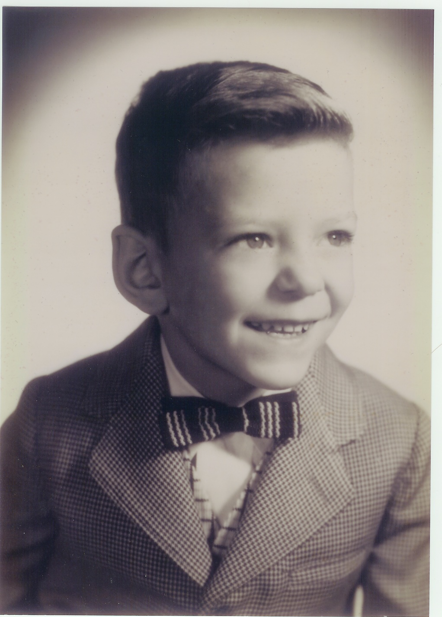
Thanks!

