Slide 1
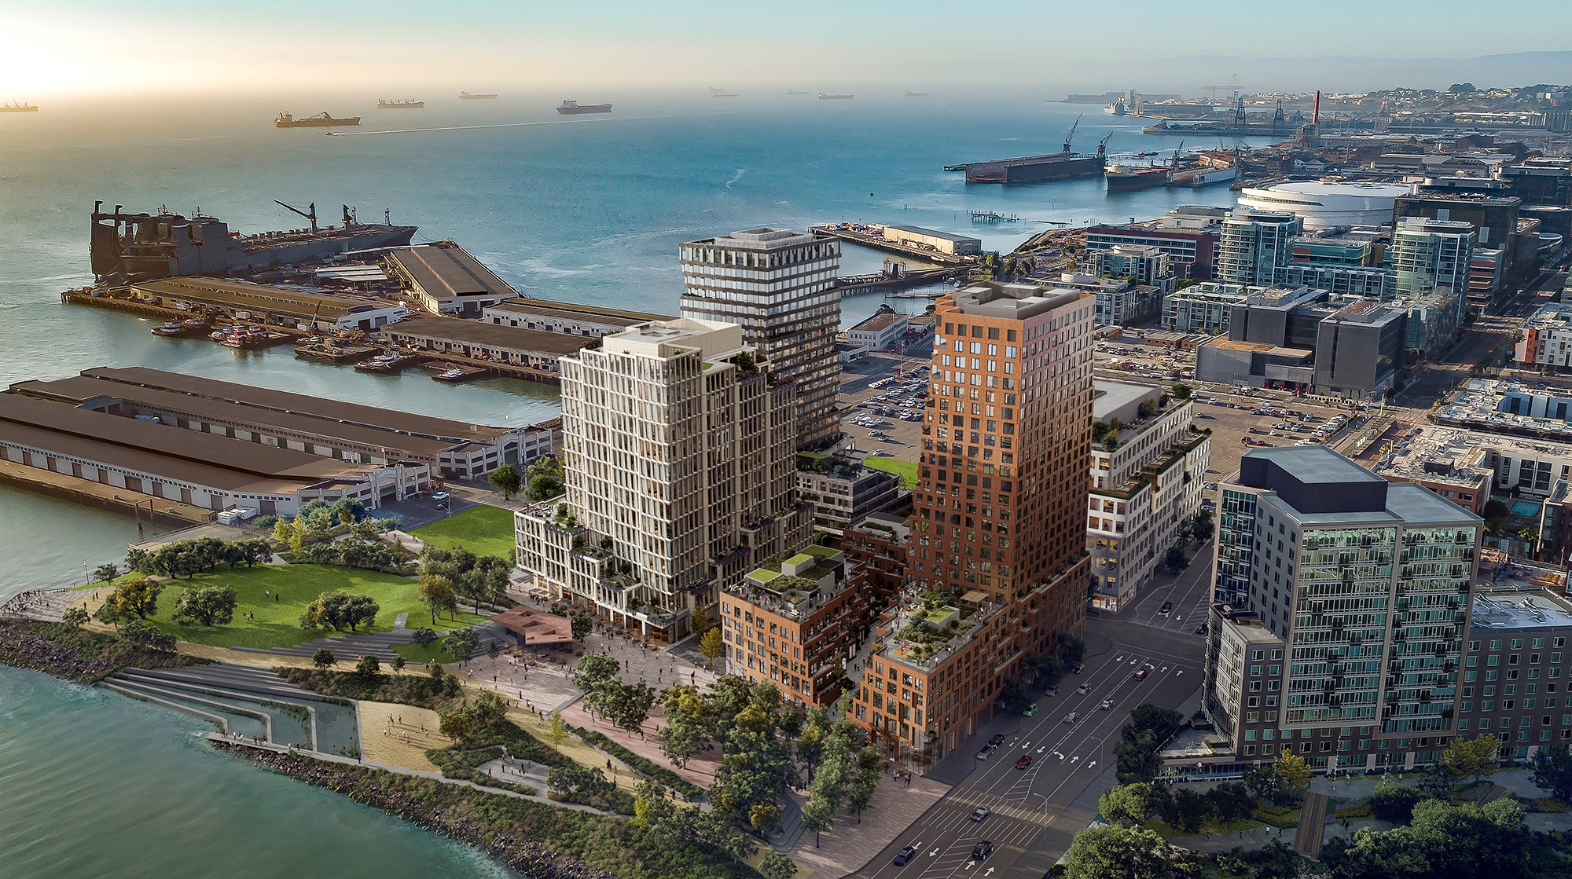
Capturing Energy System Opportunities in Your Community
Michael Ahern

Slide 2
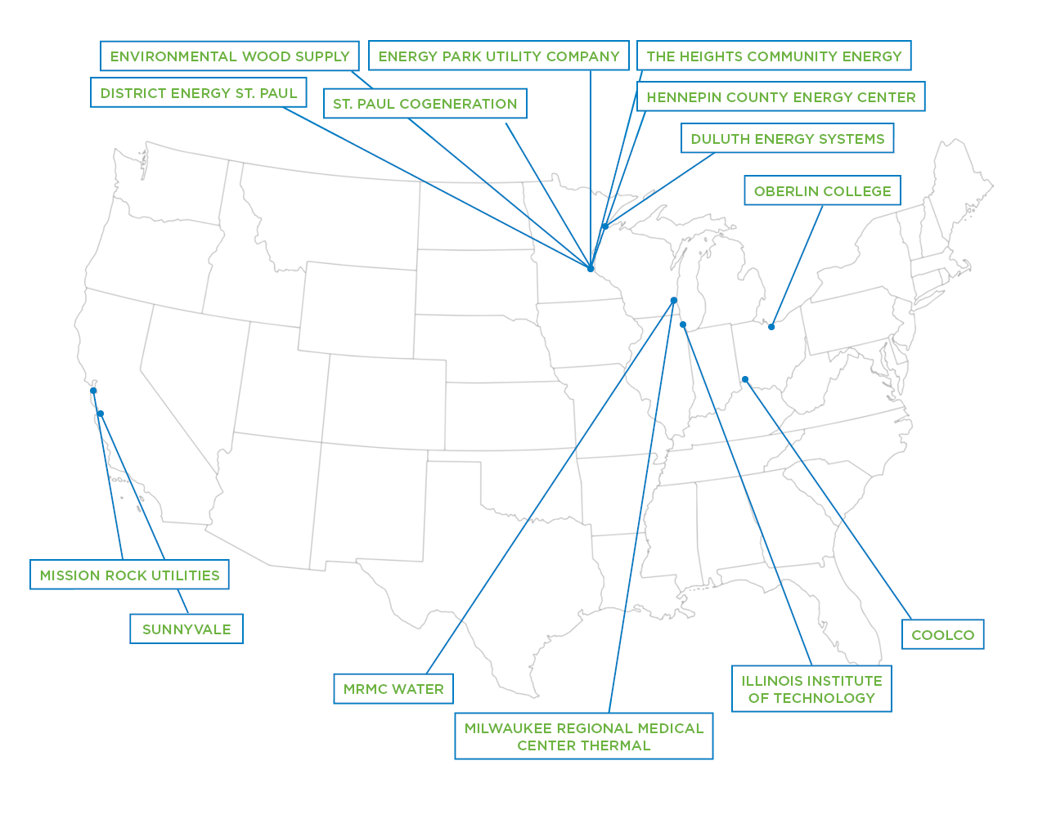
Leveraging decades of operations, planning, and engineering experience to develop and advance smart and sustainable community and campus energy systems.

Slide 3
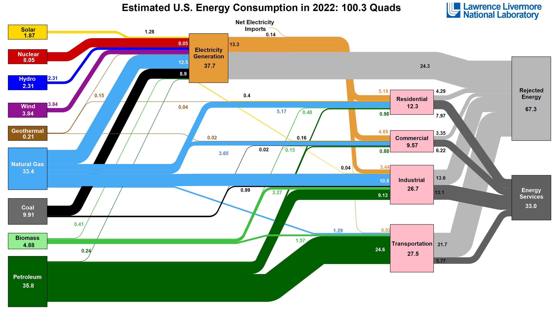

Slide 4
Challenges and Barriers to Success
Varying awareness of options
Multiple property owners with varying schedules
Short-term ownership vs long-term investments
Up-front cost of alternatives
Unaligned incentives for stakeholders
Simplicity of “Business as Usual”

Slide 5
Potential Opportunities
New multi-building developments and redevelopments
Industrial parks
Energy intensive industry
Data centers growing and increased energy intensity
Food/ag/pharmaceutical processing
Campuses and communities where district heating and/or cooling exists
Wastewater treatment plants
Catalyst infrastructure renewal projects (streets, water, wastewater)
New hydrogen and ammonia generation hubs

Slide 6
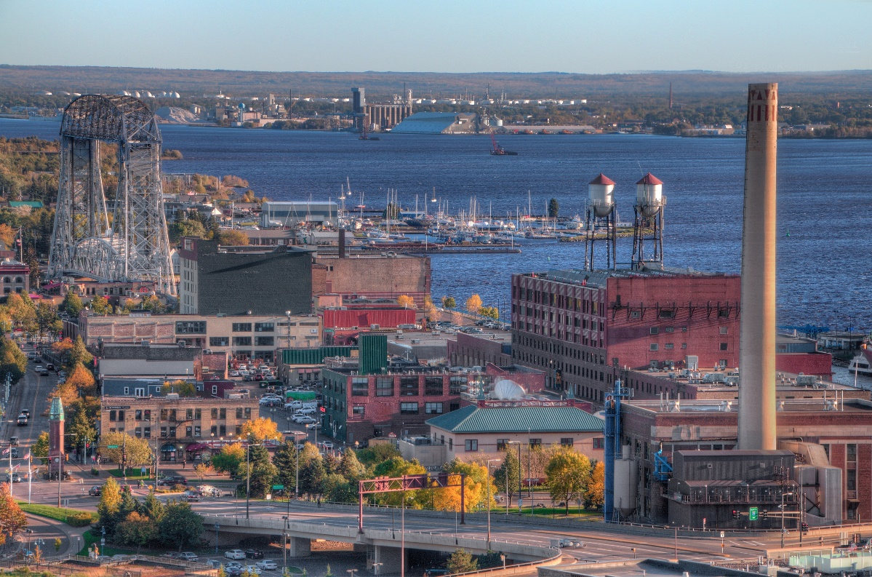
Successful Municipal Systems
Duluth Energy Systems (MN)
40% of load recently transitioned to hot water
Reduced customer costs, coal use, and emissions
District Heat Montpelier (VT)
Biomass-fired hot water system
Eliminated a significant amount of fuel oil combustion in the City
District Energy Corporation (Lincoln, NE)
Growth, reduce cost for customers, increase resiliency
Notes:
Duluth
Operational since 1932
160 customers; 6 M square feet
Steam to hot water conversion
State bonding to support transition of major portion of the system from steam to hot water
Similar structures in Montpelier, VT, Lincoln, NE, and Lansing, MI
Refinanced tax-exempt debt in 2012 with taxable bonds to enter into long-term customer agreements
Signing customers to long-term energy service agreements
Cost-based rates
Municipal utility taxable debt
40% of the system load (not customer count) transitioned to hot water with estimate for 50% by 2024
(average) 26% energy savings for hot water customers
98% reduction in coal use, now only used for the coldest days
50% emission reduction
Montpelier
380,000 square feet
17 buildings
City, county, federal, and private buildings
Modernized system including advanced leak detection
DEC Lincoln
Nonprofit, interlocal agency formed by the city of Lincoln and Lancaster County
Goal to provide innovative, efficient, and low-cost utility services to facilities in the city of Lincoln, Nebraska
15 buildings; 2.8 million square feet

Slide 7
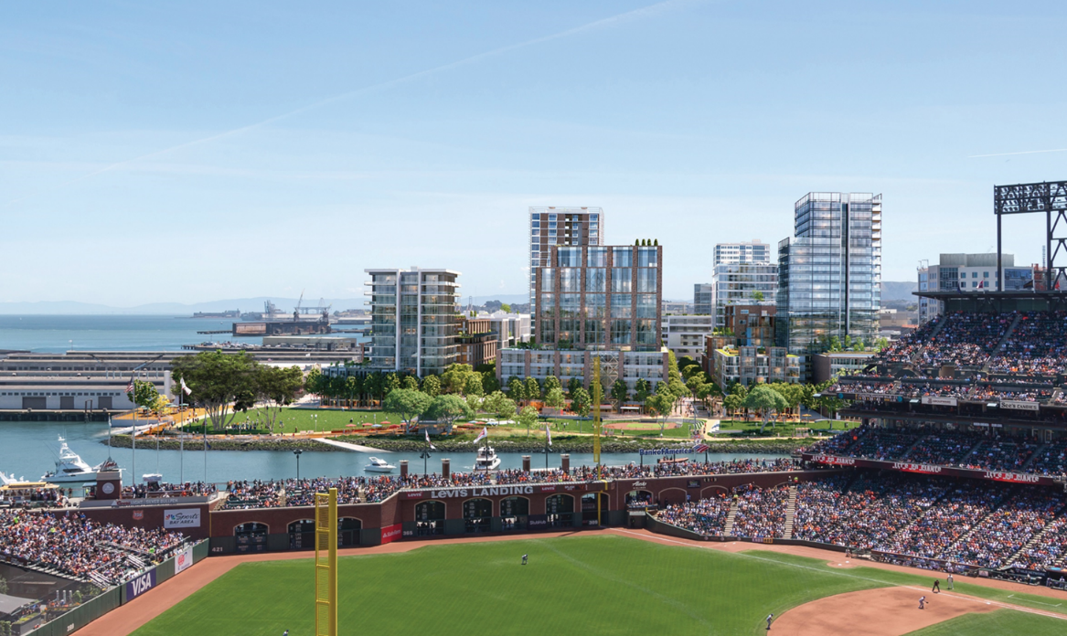
Successful Privately-Owned Systems
District Energy St. Paul (MN)
Biomass-fired combined heat & power, thermal storage, solar thermal
Lower energy costs today than in 1980, when adjusting for inflation
Mission Rock Utilities (CA)
Community support and ballot vote
Bay water energy exchange
Energy Park Utility Company (MN)
Partnership with the Saint Paul Port Authority
Notes:
District Energy St. Paul
501(C)3 nonprofit
When adjusted for inflation, customers are paying less today than when we started. Rate increases have remained below the rate of inflation for 40 years
Board includes customers and City appointees who help to set rates and shape strategic direction.
One of the first steam to hot water transitions
Largest hot water system in North America
Highly integrated system: biomass cogen, 7M gallons thermal storage, solar thermal,
Up to 50% of the heating on an annual basis) and carbon-neutral cooling for all customers through REC purchase for MN and WI energy projects (no additional fees or need to opt in)
Customer engagement: customer portal, events, building operator training, plant tours, engineering support, annual satisfaction survey, and newsletter
Monitoring of customer energy use to improve system delta T, support customer, and on occasion detect building operations issues
Mission Rock Utilities
Mission Rock Partnership: SF Port, SF Giants, Tishman-Speyer Properties
Non-stock corporation
100% debt-financed, taxable and tax-exempt bonding
28-acre site
3+ Million SF of mixed-use development including 40% affordable housing
Supporting site sustainability goals
District energy system leveraging bay water energy exchange
Black water recycling system to serve all non-potable water needs
Energy Park Utility Company
(Super Fund) Brownfield redevelopment in the urban core by the Saint Paul Port Authority in 1983.
Conceptualized as a district neighborhood so that people could live, work, and play without the need for cars
Provides heating and cooling services to the mixed-use business center offering office space, schools, light industrial manufacturing facilities, health clinics, a hotel, and more than 780 affordable and market-rate housing options within Energy Park.
2014 – System upgraded from two-pipe heating and cooling distribution to four-pipe, as well as expansion of the cooling system.
2018 – Recapitalization of heating equipment and expansion to serve additional customers.

Slide 8
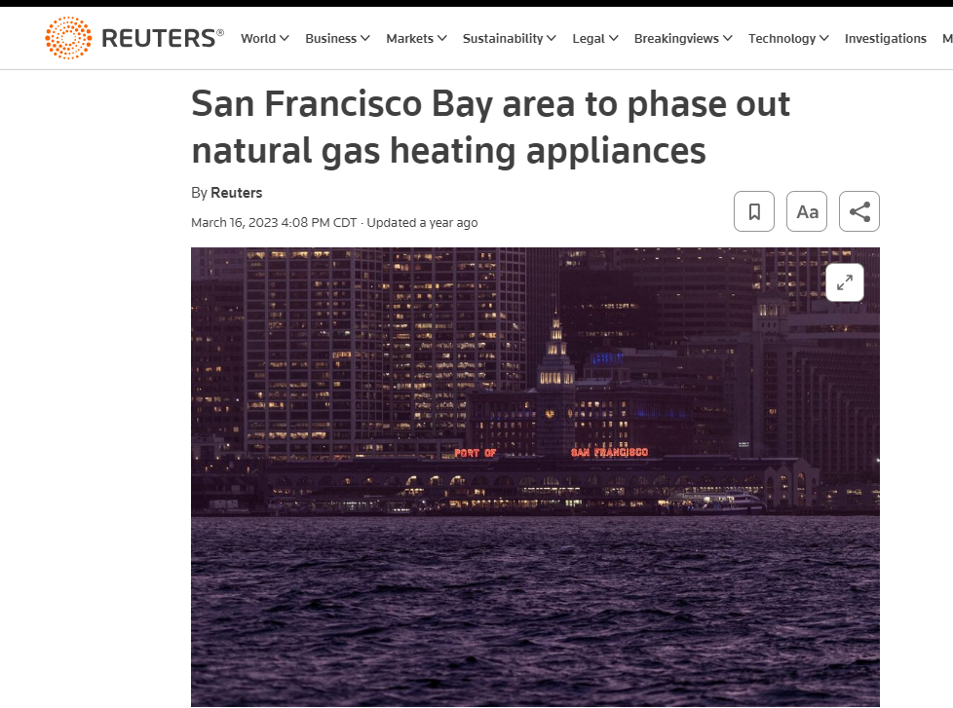
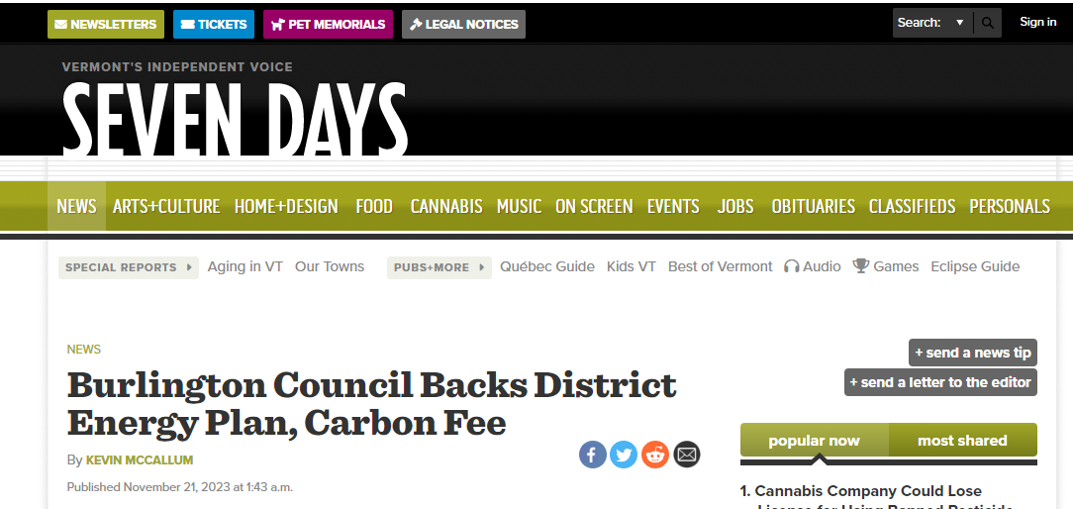
Policy Driving Success

Slide 9
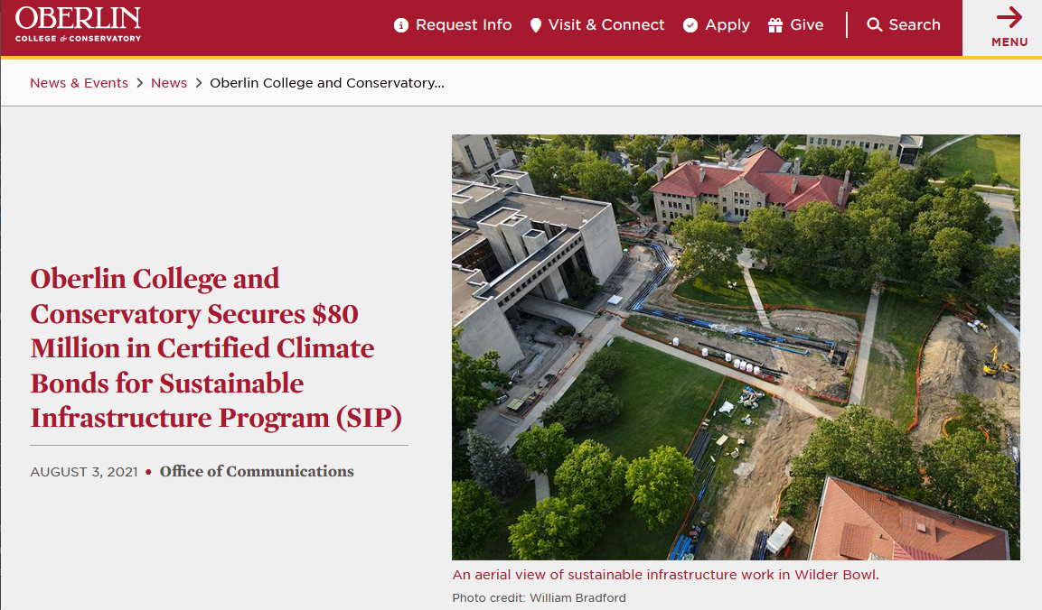
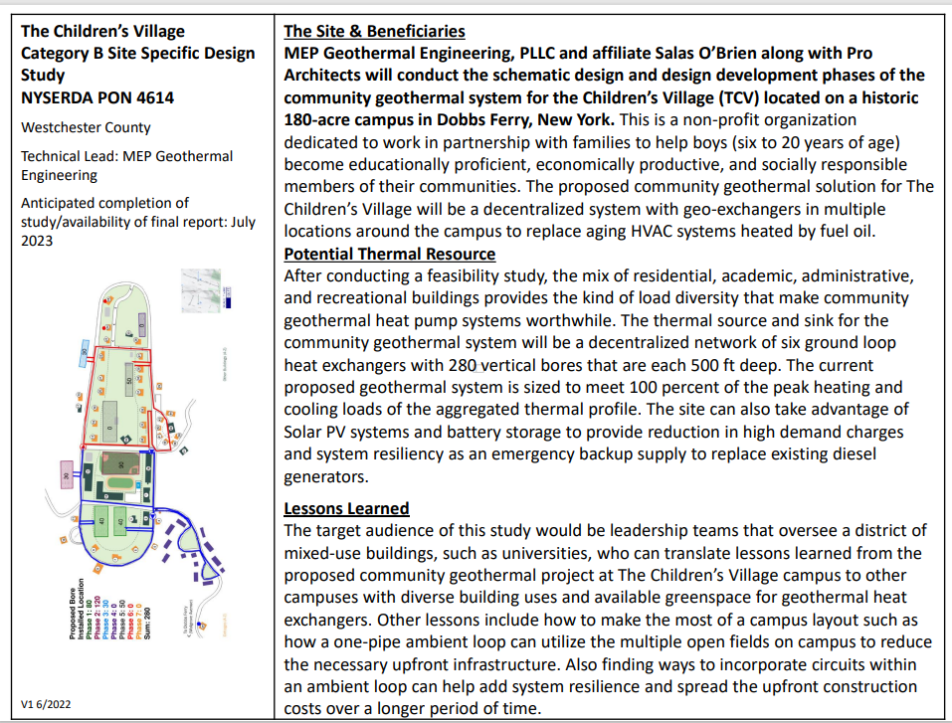
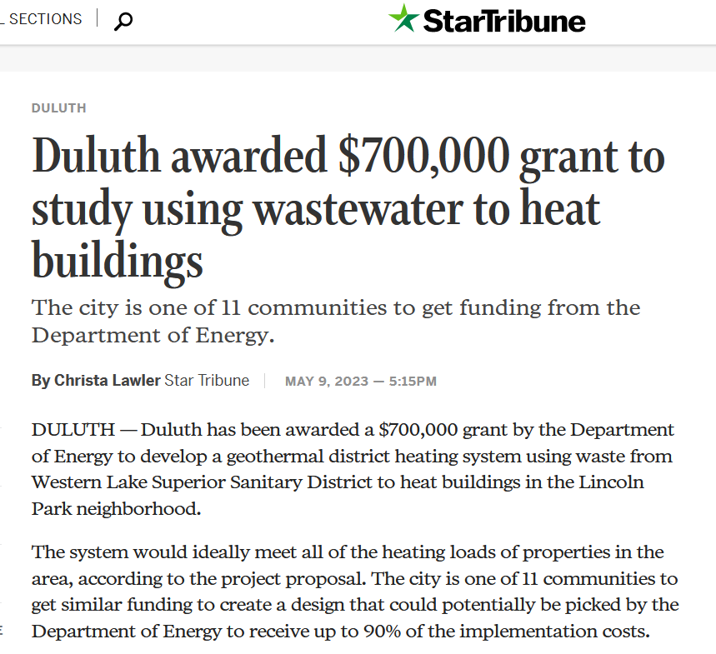
Grants & Tax Incentives

Slide 10
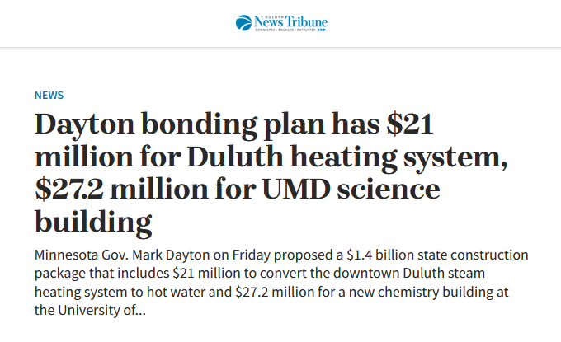
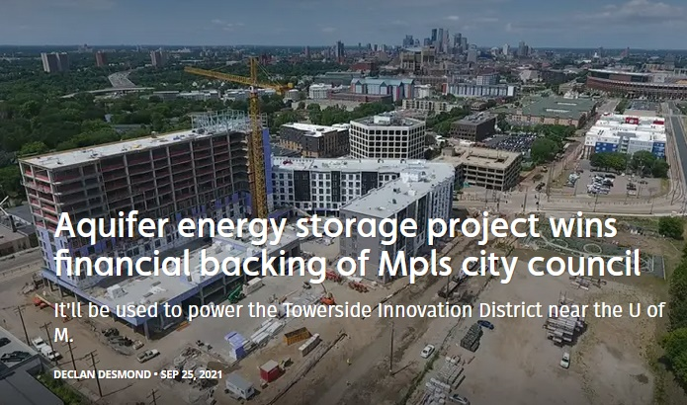
Bonding and Credit Enhancement
Notes:
Duluth received $15M from bonding in 2017

Slide 11
Consider All Organizational & Financing Approaches
Private Nonprofit
Non-Stock Corporation
501(c)(3) support organization
Public-Private Partnership (P3)
For-Profit
Municipally-owned
Campus-owned
100% debt financing vs debt/equity mix
Long-term utility service agreements
Cost-based rates vs fixed/indexed rates
Agreement structures (take or pay, two-part rates, etc.)
Renewable thermal and electric credits
Climate-certified green bonds
Grant opportunities

Slide 12

“Every system is perfectly designed to get the result that is does.”
Dr. W. Edwards Deming

