Slide 2



Why Municipally Owned District Energy Utility Works
Alen Postolka, P Eng
Director, District Energy/Chief Operating Officer

Slide 3

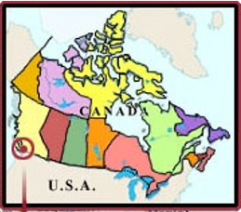

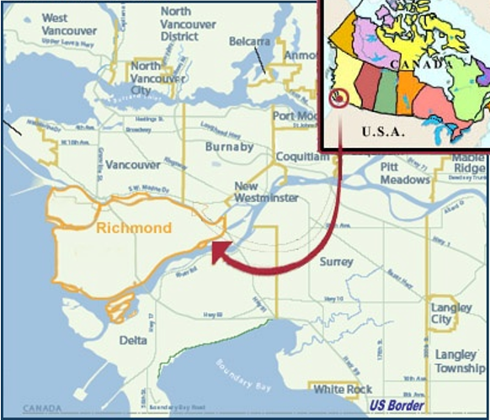
Richmond, BC Canada
OPERATING DISTRICT ENERGY IN RICHMOND SINCE 2012

Slide 4
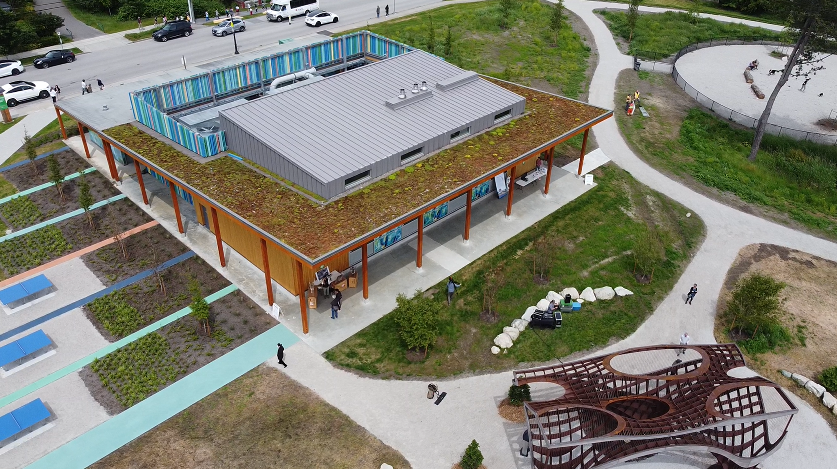
Governance Model

Slide 5

Delivery Models

Slide 6
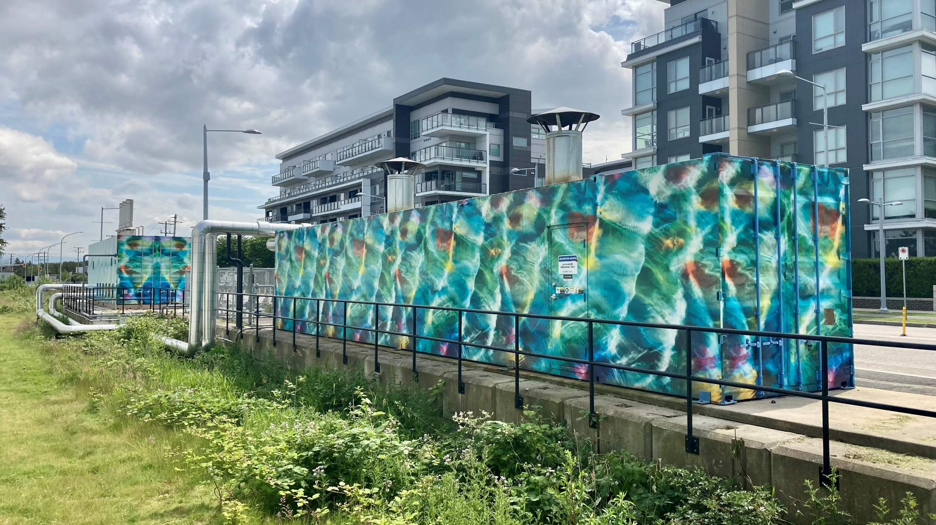
Customer Rates

Slide 7

Business Case

Slide 8
Municipal Tools

Slide 9
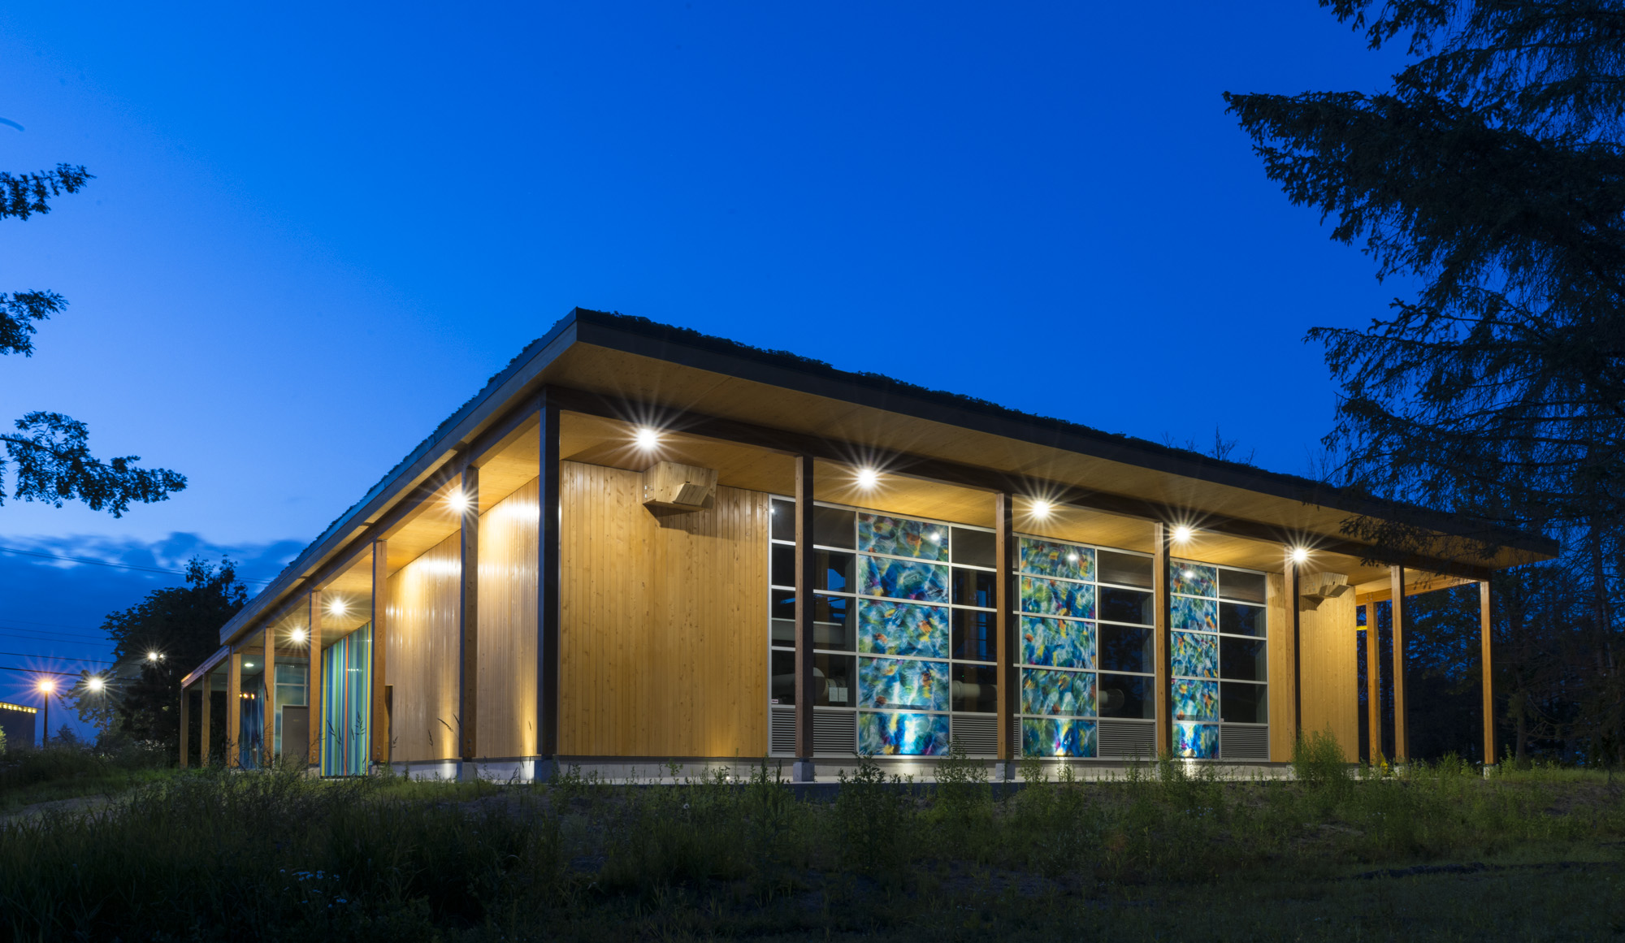
Thank You
Alen Postolka, P Eng
Director, District Energy/Chief Operating Officer

