Slide 1
A Vision for
District Energy in Canada
250+
district energy
systems in Canada
2.5%
of heating demand
currently served
25%
How federal investment in shared thermal networks can decarbonize buildings, relieve the electricity grid, and advance Canada's climate goals.
potential in dense
areas (international)

Slide 2
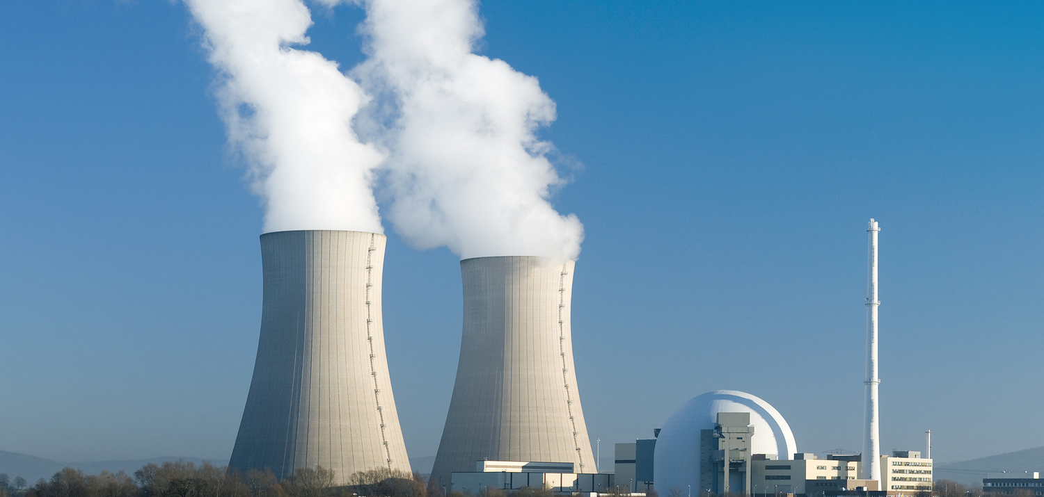
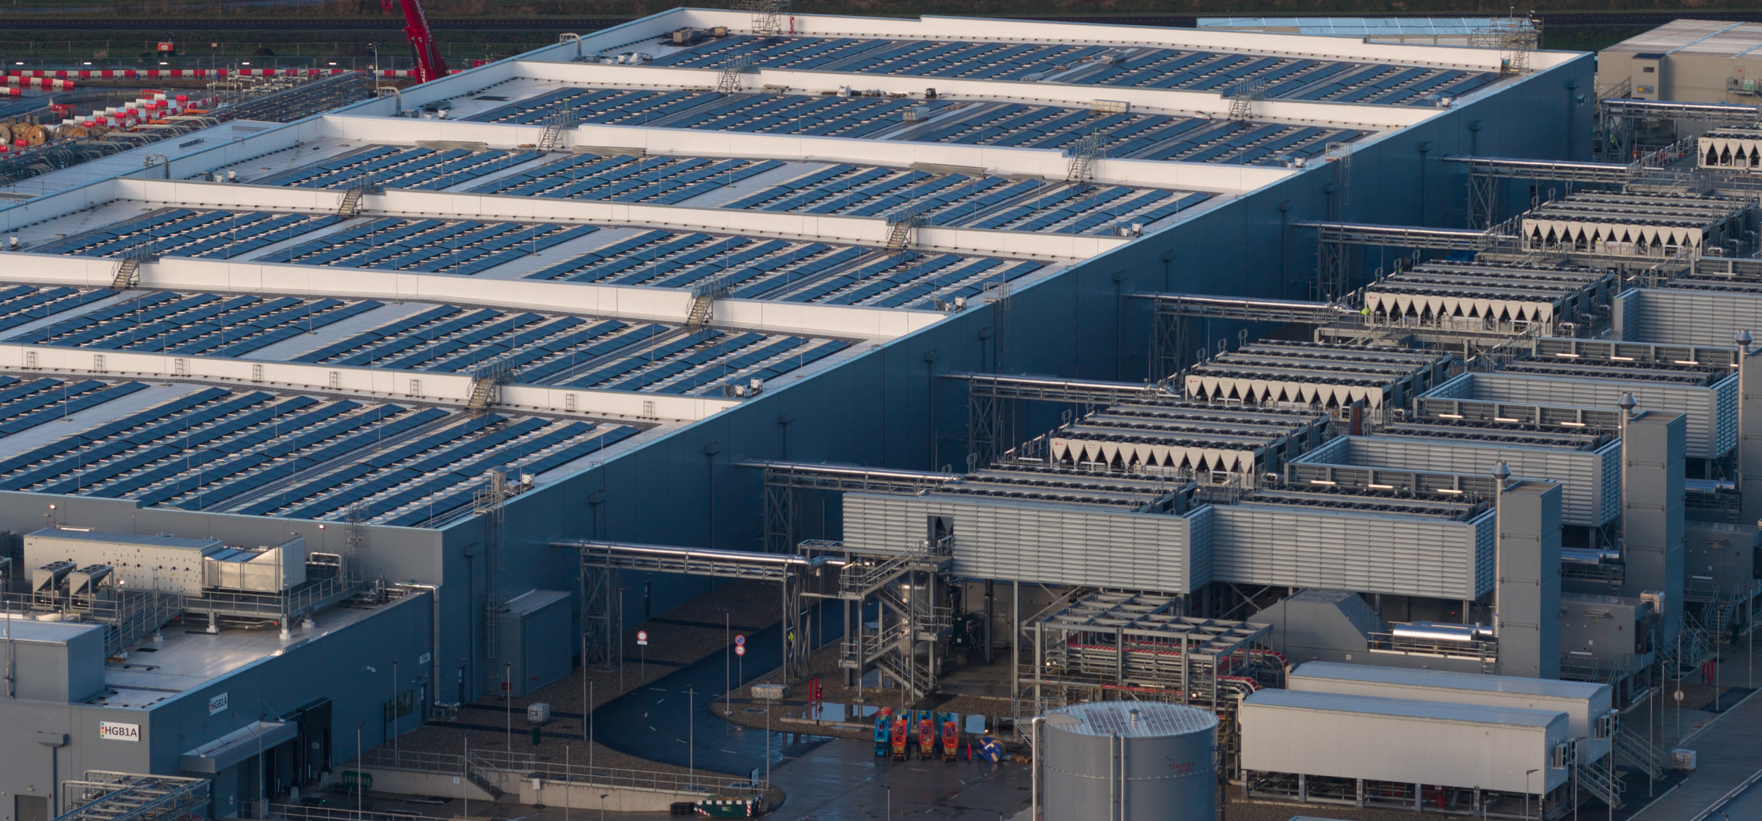
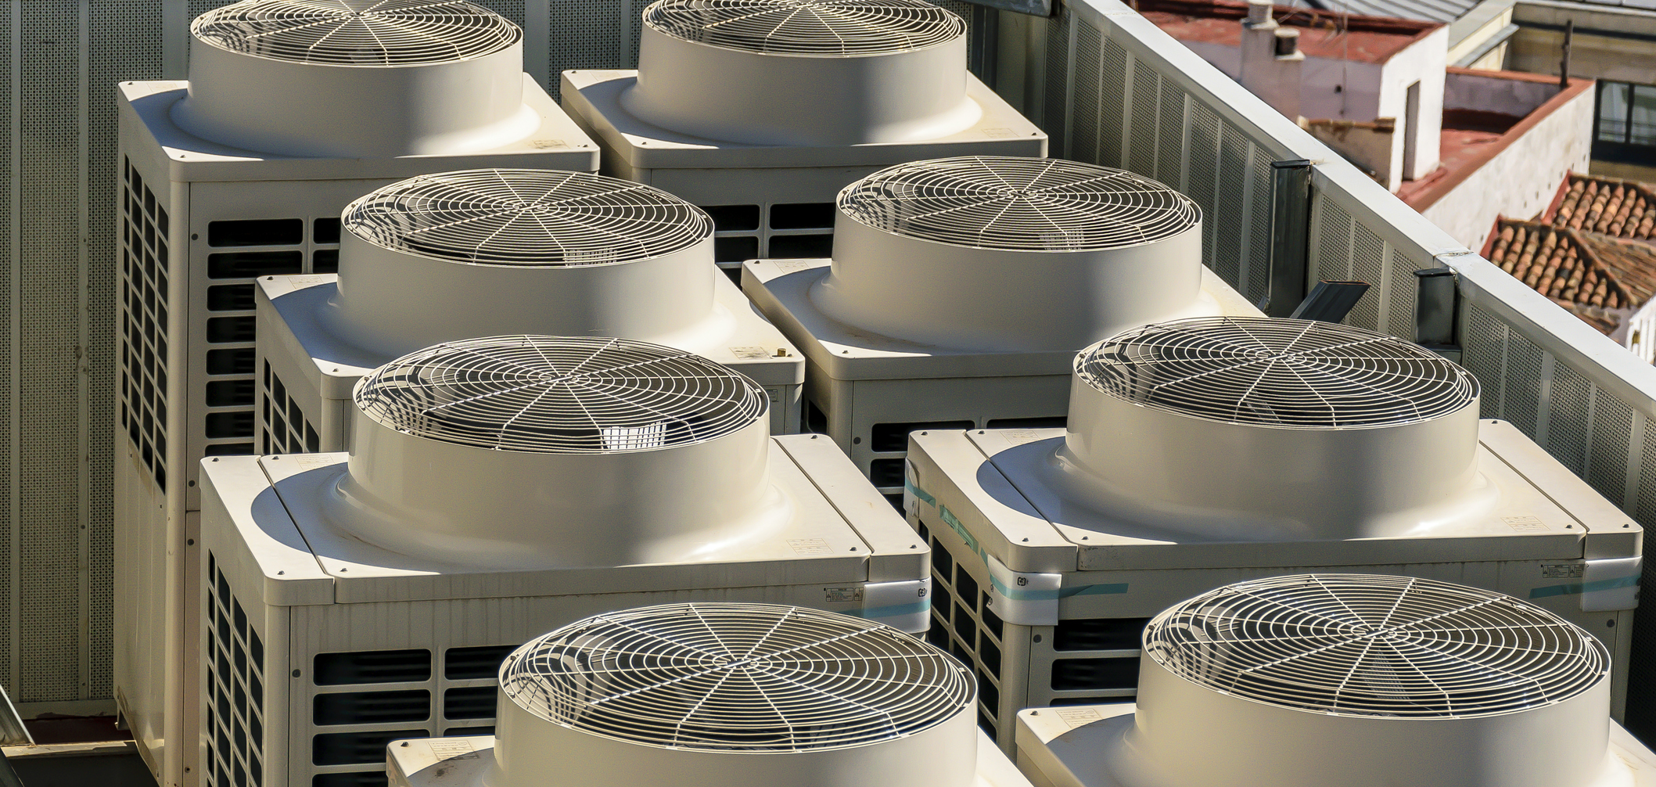
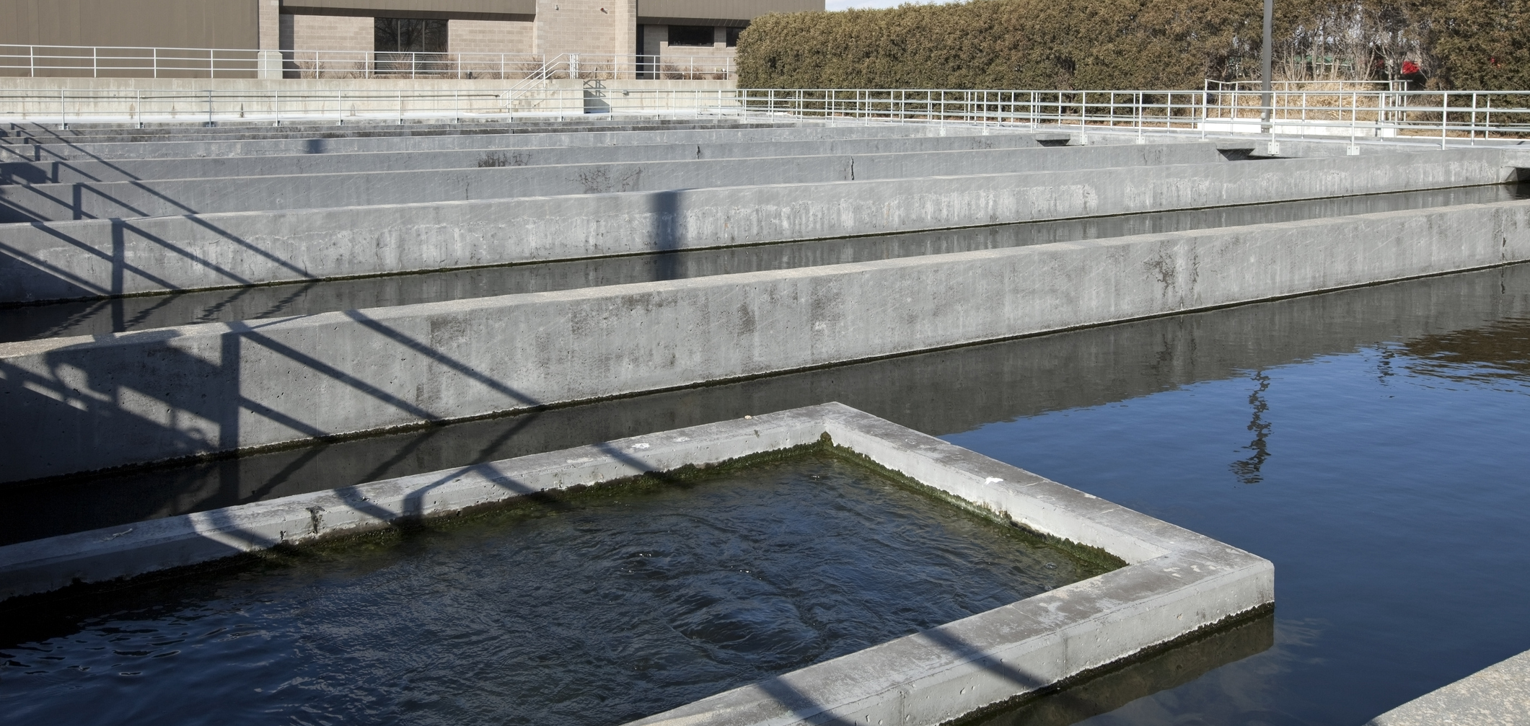
Business as Usual is No Longer Sufficient
All of this energy is being wasted—district energy creates the infrastructure to capture and use it.
Power Plants
Data Centres
Building Systems
Waste & Wastewater
Up to 70% of energy input is rejected as waste heat through cooling towers and exhaust stacks.
Massive heat generators operating 24/7—nearly all of it released unused into the local environment.
Individual buildings, especially in cities, reject heat and rely on over-sized equipment to meet peak heating/cooling demands.
Sewer and wastewater systems convey large volumes of thermal energy throughout municipalities that is often treated as a liability.

Slide 3
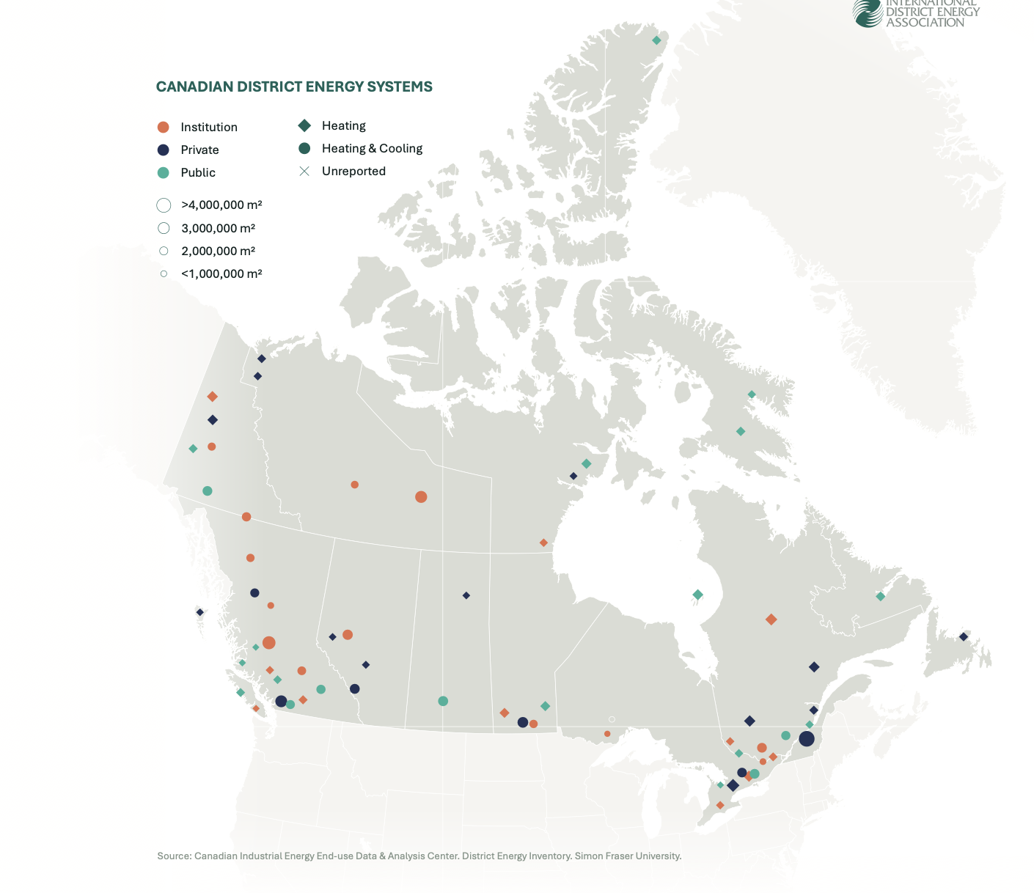
Canada Is Already Leading
We don't need to start from scratch—we need to scale what's working.
Toronto
Enwave is offering deep lake water cooling—one of the largest in the world, serving downtown office towers and cutting electricity demand for cooling by up to 90%.
Vancouver
Prince Edward Island
Island-scale waste-to-energy: converting municipal solid waste into fuel, eliminating offshore shipment and generating local energy.
Metro Vancouver waste-to-energy recovery—turning what would be landfill into heat supply for thousands of buildings.
ESAP
Markham
Canada's own flagship—the federal government modernizing district energy in the National Capital Region, achieving up to 92% GHG reductions through a public-private partnership.
Markham District Energy data center heat recovery + wastewater energy transfer.
IBM’s North American research campus anchored here after the 1998 ice storm proved resilience. Now serves over 15.4 million sq. ft. with reliability exceeding 99.9992%.

Slide 4
Canada is Already Doing Great Things
Strong building blocks are in place—strategic alignment would multiply their impact.
Canada Infrastructure Bank (CIB)
Clean Technology ITC
Anchor financier for large-scale thermal networks—proven track record
15–30% refundable tax credits for heat pumps, storage, geothermal, sewer heat
FCM Green Municipal Fund
CERRC
Early-stage feasibility grants and low-cost loans for community energy projects. The GMF is available to municipalities as well as private-sector and other parties working in formal partnership with a municipality
District heat and biomass support for Indigenous and northern communities. $450M+ committed since 2018; May 2026 NRCan announcement funded a biomass district heating study serving Haida Gwaii.
Low Carbon Economy Fund
25–40% capital support for high-impact low-carbon projects
SREPs
Electrification-ready thermal infrastructure in rural and remote areas

Slide 5
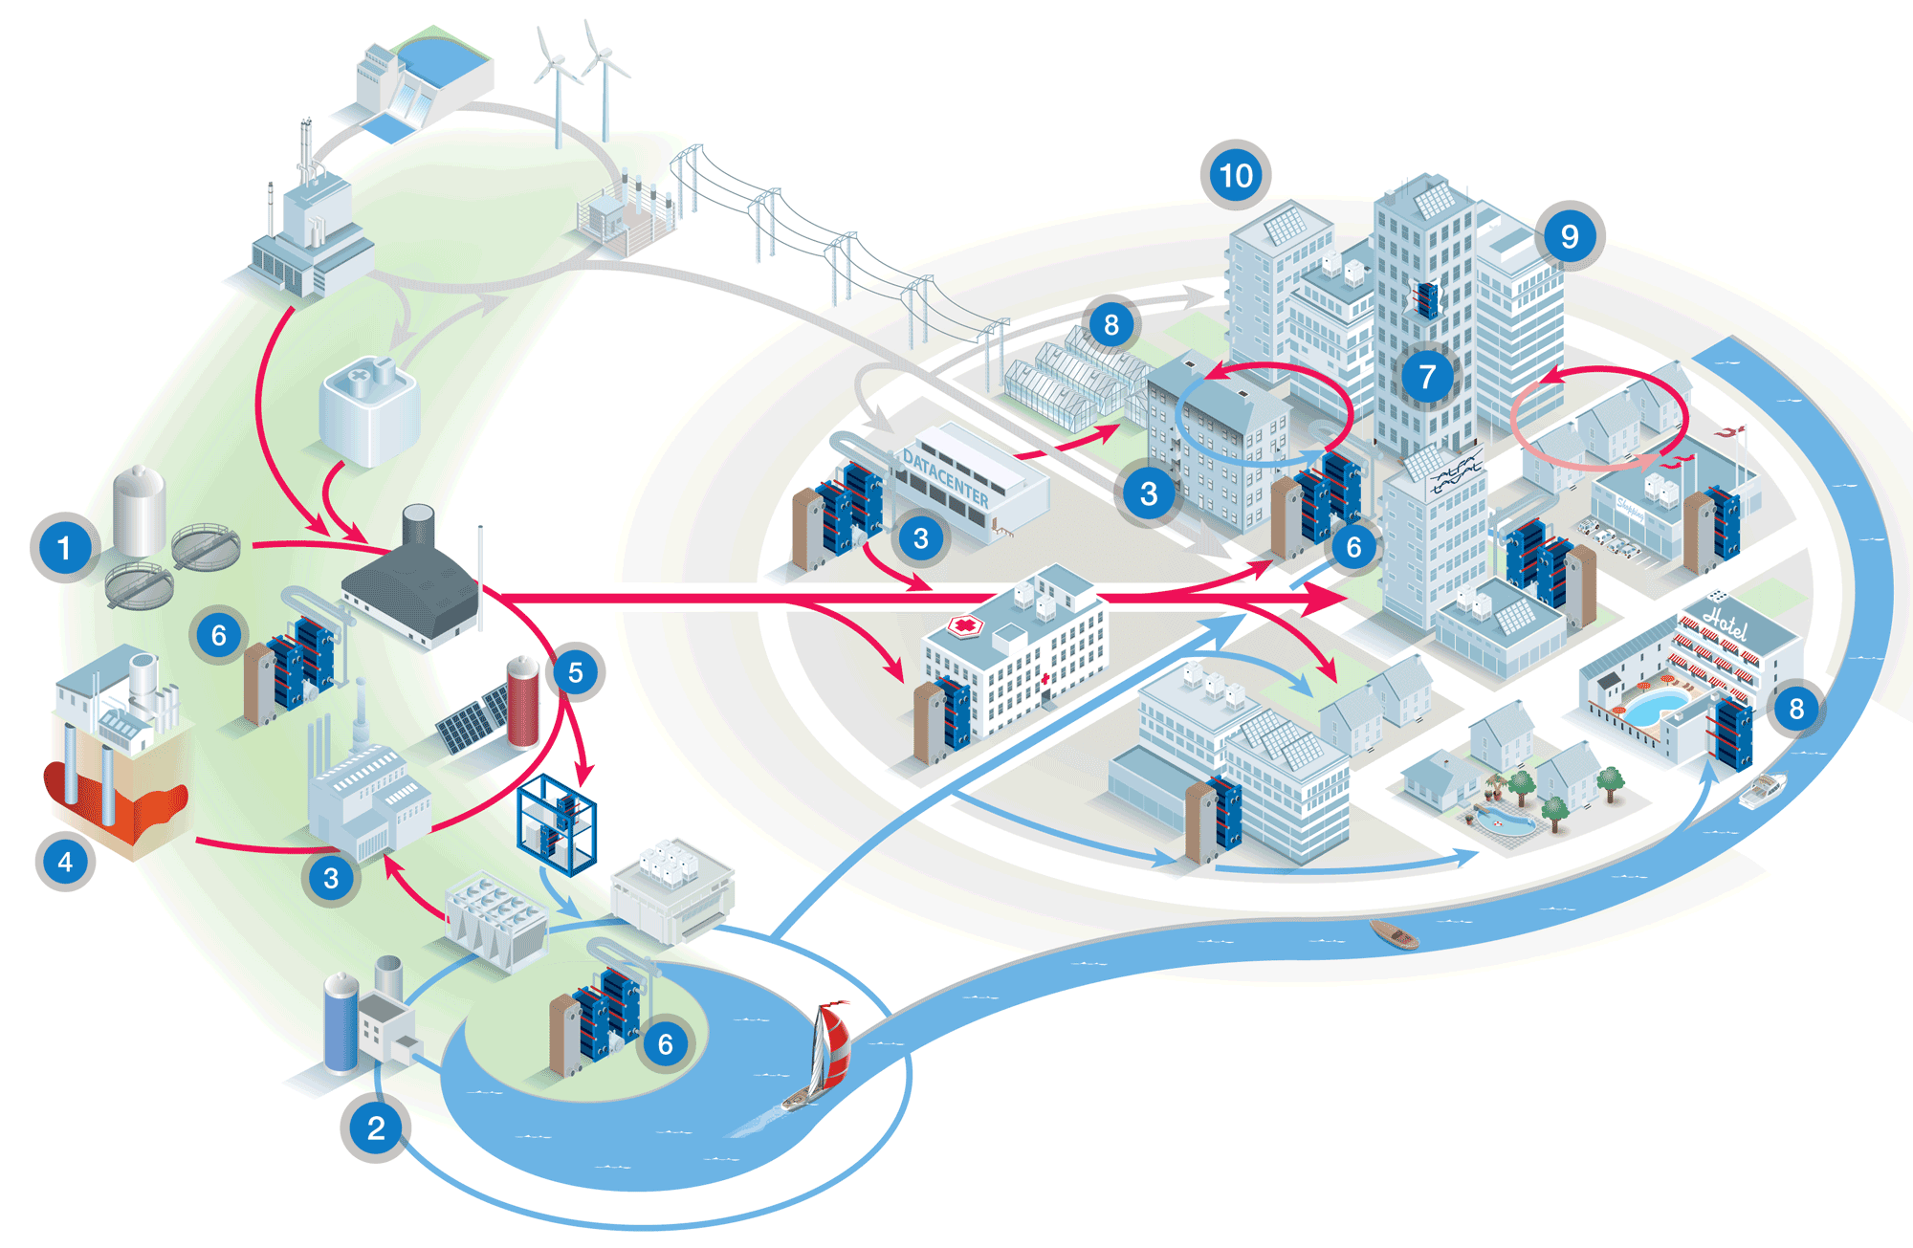
Many Inputs. One Network.
Sector coupling is the principle behind district energy: linking and integrating thermal, electrical, and surplus thermal energy resources at a community scale to help balance the electricity grid, enhance resilience, cut emissions, and strengthen energy security.
A district energy thermal network is vital infrastructure for a local economy to adapt, accelerate
and retain flexibility throughout the energy transition.
Source: Alfa Laval

Slide 6



Building Heat at a System Crossroads
Three pressures are converging, and they demand a coordinated response:
Grid Risk
Cost Gap
Timing Pressure
Building-by-building electrification creates sharp winter peaks requiring oversized generation and transmission assets. Canada’s “Powering Canada Strong” strategy targets doubling the electricity grid by 2050 at an estimated cost of more than $1 trillion. District energy can reduce required grid infrastructure investment by over
$100 billion.
The removal of the consumer carbon price on heating fuels weakens near-term economics of low-carbon heat. Individual retrofits are slow, expensive, and grid-intensive—the economics without direct support are challenging.
Provinces and municipalities face
2030 and 2050 targets. District energy addresses all three by concentrating heat production, integrating waste heat, and managing when thermal demand hits the grid.

Slide 7



Why District Energy—Why Now
GHG Reductions at Scale
Grid Cost Containment
Nation-Building Infrastructure
Replace millions of individual combustion units with central assets that can decarbonize rapidly. Canada’s waste heat potential is hundreds of TWh annually—a major untapped domestic resource. Targeted federal action can achieve over 25 megatonnes of annual GHG reductions by 2050.
District energy enables industrial-scale heat pumps and thermal storage—shifting demand off-peak and deferring major grid upgrades. Managing thermal peaks centrally is far cheaper than managing millions of individual devices.
District networks are long-lived utility assets supporting housing delivery, urban densification, Indigenous energy ownership, and investment-intensive sectors: data centres, healthcare, and research campuses.
Hundreds of TWh
annual waste heat potential in Canada
billions
in grid infrastructure investment saved
75+ years
proven track record of fuel switching

Slide 8
International Leaders Are Moving Faster
Peer countries scale district energy through mandates, capital, and public finance. Canada can too.
🇩🇰 Denmark
~65%
🇬🇧 United Kingdom
£338M+
Heat planning mandates underpin ~65% household coverage. A national dot-map from the 1980s to today shows exponential growth from a handful of systems to near-total coverage.
Heat Network Transformation Programme committed since 2022—growing coverage from ~2% today to 20% by 2050. Public investment de-risks private delivery at scale.
🇩🇪 Germany
Multi-year
🇫🇮 Finland
Default infra
Federal subsidies paired with mandatory municipal thermal energy planning as well as investment support. Planning requirements create bankable project pipelines for private capital to follow.
District energy is default urban infrastructure. Exemplary sector-coupling and competitive market drivers. Decades of heat planning and light-touch regulation make it the path of least resistance for building owners.
🇮🇪 Ireland
Emerging fast
🇪🇺 European Union
45,000+
Public bank project development support and emerging heat regulation de-risk municipal delivery and attract long-term capital.
Cities with more than 45,000 residents are required to prepare heating and cooling plans. Current district energy penetration is 15%. An Aalborg University study finds 55% of EU heat demand is most cost-effectively served by district energy, reducing the cost of the energy transition by 20%.

Slide 9



Three Federal Policy Asks
A lot of the building blocks are in place. Future generations demand we do more.
Increase Capital
Funding
Broaden Financial
Terms
Develop
National Strategy
Calibrated to peer jurisdictions; commit through existing programs including grants and ITCs
Existing systems: add heat pumps & thermal storage
New systems: community-scale networks tied to housing & Indigenous infrastructure
Directly addresses the investment gap left by carbon price repeal
Current CIB thresholds make accessibility challenging for many municipal systems—bar too high
Create a district energy-specific CIB window or Infrastructure Canada facility
Eligible: municipalities, universities, hospitals, Indigenous governments
Unlock projects already in development across the country
Fund thermal planning in major cities to identify viable zones
Integrate into building codes, greening government, and net-zero frameworks
Recognize district energy as a non-wires, peak management resource
Align with housing, clean electricity, AI, and Indigenous partnership

Slide 10
The Model: Public-Private Partnership
Federal Government
Provides
Energy Planning
& Feasibility
Private Capital
Follows
More Dots
on the Map
Planning support
Seed capital
Policy framework
Identify viable zones
Standardized business cases Credit enhancement
IDEA member companies are eager to invest
where conditions are right
Expanded district energy
across Canada's cities,
campuses & communities
Provide the planning support and seed capital—and private capital will follow. IDEA member companies have demonstrated readiness to invest and grow businesses where the conditions are right.

Slide 11
Future generations
demand we do more.
Three federal commitments—streamlined grants, a $2B low-cost financing facility, and a national district energy strategy—would grow district energy from 2.5% to 25%+ of national heating demand, unlock billions in private investment, reduce peak grid pressure, support Indigenous energy sovereignty, and achieve over 25 megatonnes of annual GHG reductions by 2050.
District energy is the missing thermal layer in Canada's clean energy system.

