Slide 1

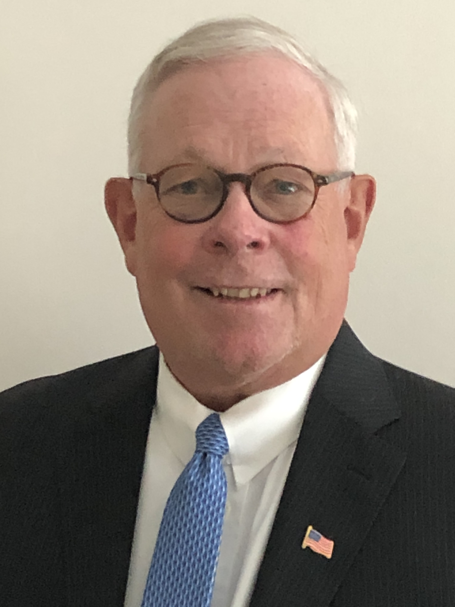
Business Law
Professor Harvey F. Seegers, J.D. (Catholic University), M.B.A. (Harvard University)
Attorney and Counselor,
Supreme Court of the United States

Slide 2

Webinar Agenda
* The Moral and Political Foundations of U.S. Law
* Contract Law
* Legal Forms of Business Organization
* Employment Law
* Intellectual Property Law

Slide 3
Business Law: Learning Objectives
Objective #1: Students will learn the moral and political foundations of U.S. law, especially as they pertain to business.
Objective #2: Students will learn the essential elements of a legally binding contract and analyze how contract law applies to business transactions.
Objective #3: Students will learn different types of business organizations, such as sole proprietorships, partnerships, corporations, and limited liability companies (LLCs), and understand the difference between for-profit, non-profit, and not-for-profit enterprises.
Objective #4: Students will learn key aspects of employment law relevant to businesses, including the employment-at-will doctrine, Title VII of the 1964 Civil Rights Act, the Federal Labor Standards Act (FLSA), and the Occupational Health and Safety Organization (OSHA).
Objective #5: Students will learn the various forms of intellectual property rights, their legal foundations, and their significance in protecting creative and innovative endeavors.

Slide 4

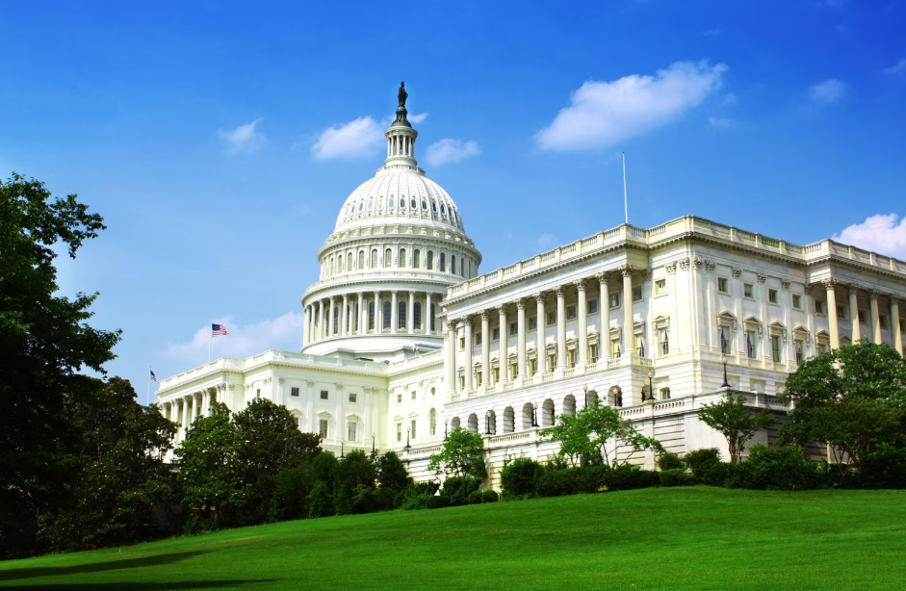
The Moral and Political Foundations of U.S. Law in the United States

Slide 5

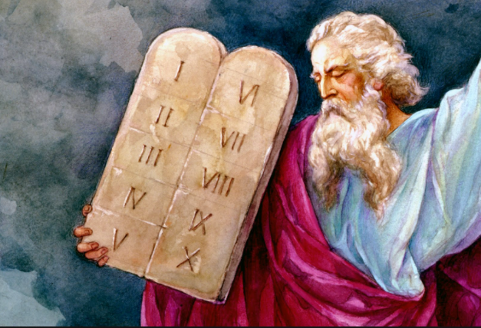
The Laws of the Western World began around 1446 B.C.
when Moses was given The Ten Commandments

Slide 6
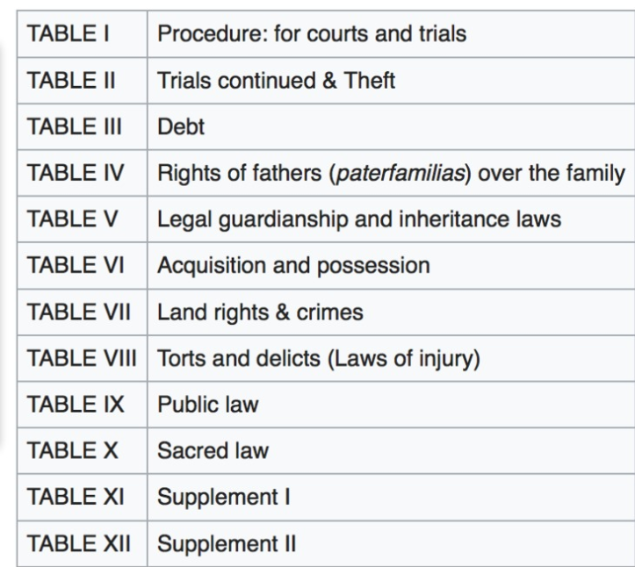

The “Twelve Tables” were written in 451 B.C.
and became the first codification of Roman Law

Slide 7
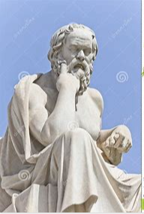
Socrates (469 – 399 BC) was the first Greek moral philosopher
of the Western ethical tradition of thought

Slide 8
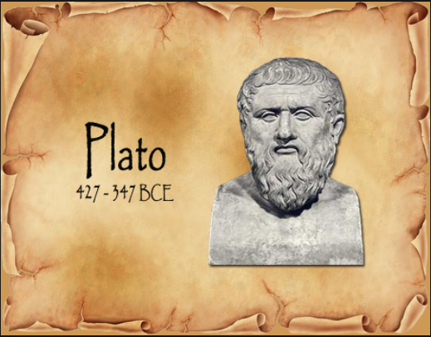
Plato was a student of Socrates and established the “Academy,”
the first Western institution of higher learning,
and is generally regarded as one of the founders of Western religion and spirituality

Slide 9
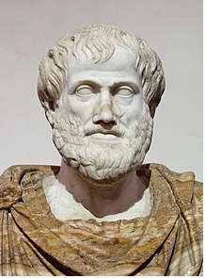
Aristotle (384 – 322) was a student under Plato in the Academy and later wrote extensively
about what is now called “virtue ethics” – or habits of the mind aimed toward doing good

Slide 10
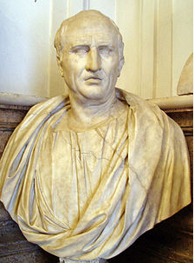
Cicero (106 – 43 BC) was a Roman lawyer/philosopher
who was heavily influenced by the teachings of Aristotle

Slide 11
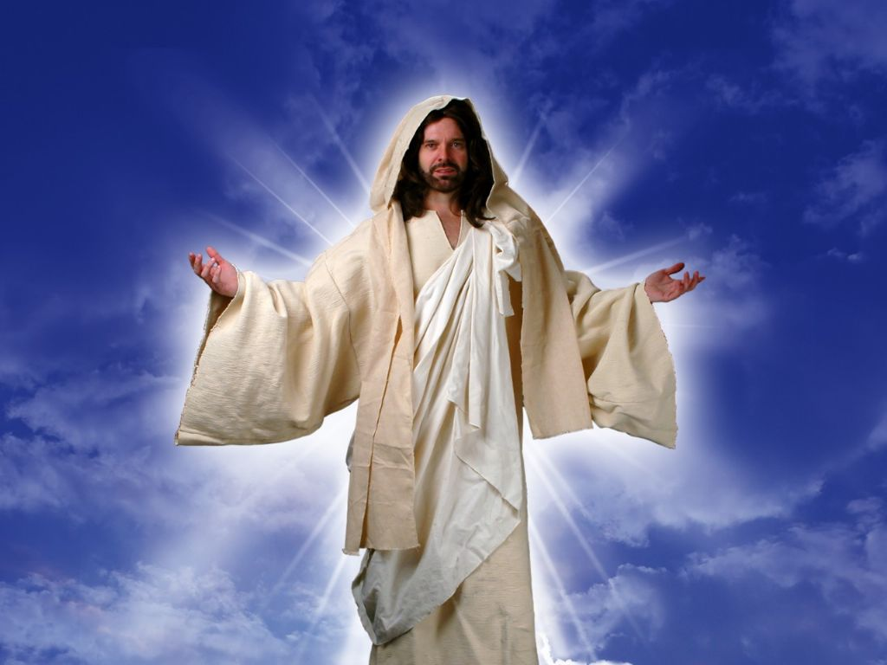
Jesus Christ affirmed the separation between His Church and the State
“Render unto Caesar the things that are Caesar’s
and unto God the things that are God’s.”

Slide 12
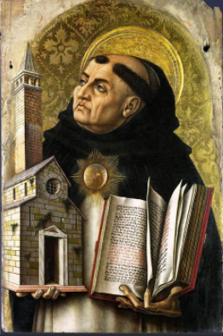
St. Thomas Aquinas (1225 – 1274) was a Catholic Priest who was heavily influenced
by Aristotelian philosophy and was the first Roman to espouse the theory of natural law:
the inalienable rights of human beings

Slide 13
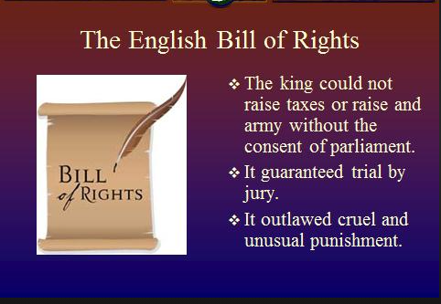
In 1689 the English Bill of Rights was established,
as English law drew upon much of Roman Law tradition

Slide 14
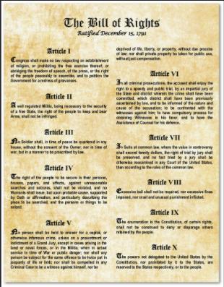
The U.S. Bill of Rights were heavily influenced by the English adoption of Roman law

Slide 15
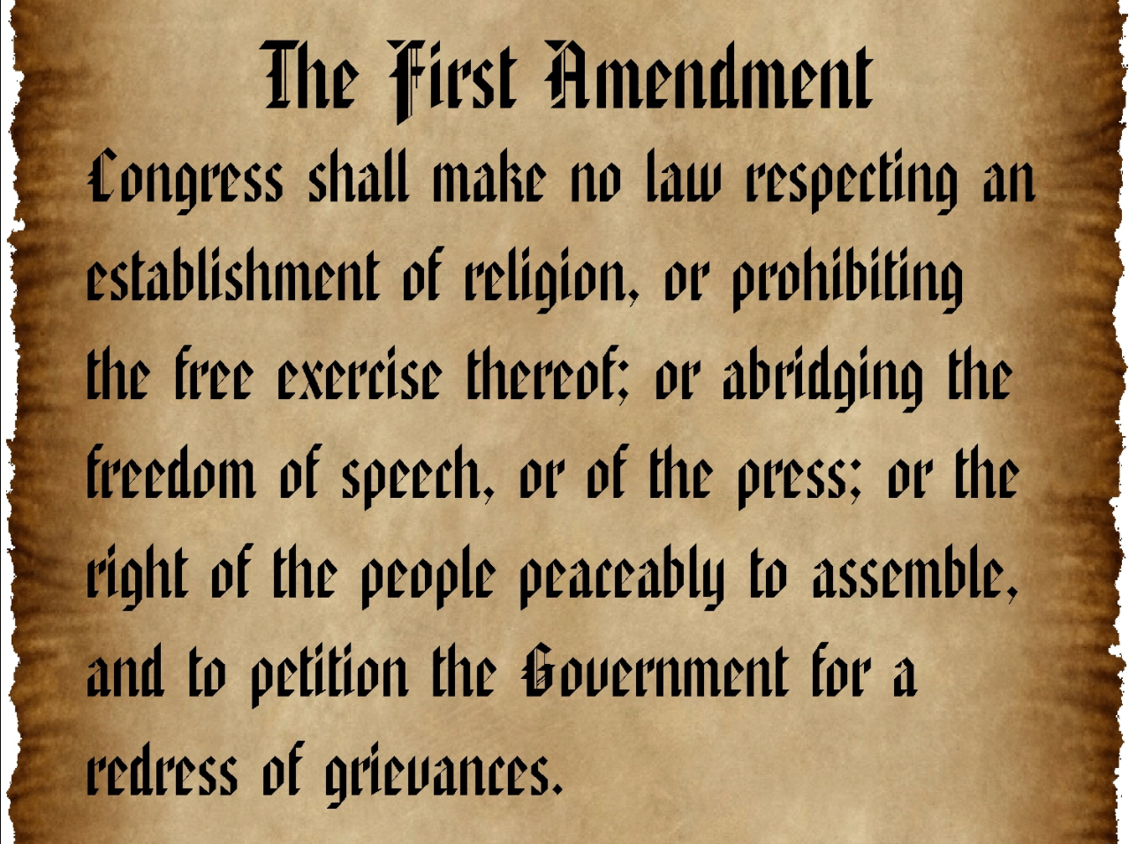
The U.S. Constitution preserves the separation between Church and State

Slide 16
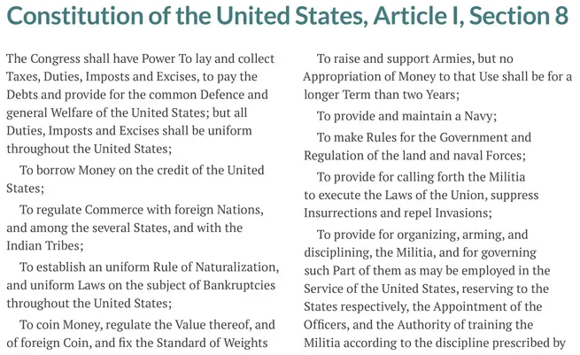
The Commerce Clause of the U.S. Constitution

Slide 17
Poll Question #1

Slide 18


Slide 19
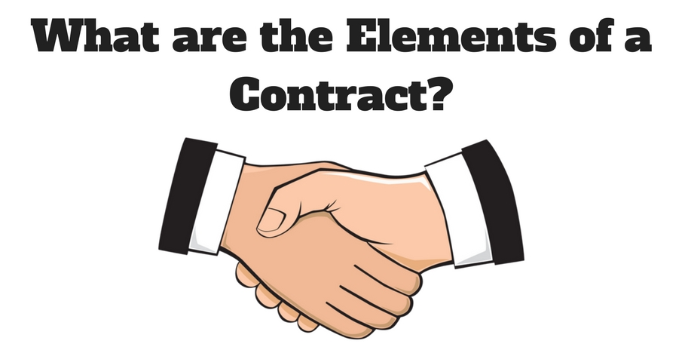
A contract is an agreement between parties that creates mutual legal obligations.

Slide 20


Slide 22
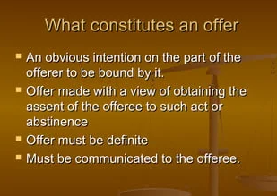

Offer

Slide 24
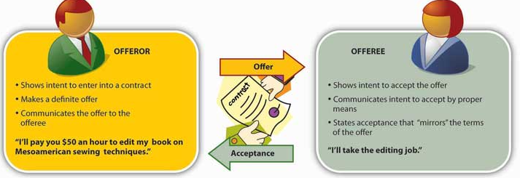
Acceptance
Acceptance is when the “offeree” agrees to the terms and conditions
of the contract as proposed by the “offeror.”

Slide 25
Types of Contracts
Express Contract
(written or verbal agreement)
Implied Contract
(unwritten and non-verbal agreement)
All terms and conditions are clearly stated
and agreed upon by the parties
Created by the actions, behaviors,
or circumstances of the parties
“Mirror Image Rule”
Implied-in-fact
Implied-in-law
Arises from the conduct
of the parties
Imposed by law to prevent
unjust enrichment

Slide 26

Implied-in-fact Contract Example:
Food Services

Slide 27


Implied-in-law Contract Example:
Emergency Services

Slide 28




Counteroffer
A counteroffer is a response to an original offer that modifies its terms, which may include changes to the price or other conditions. It indicates that the original offer has been rejected and proposes new terms for negotiation.
Offeror
Offeree
“I will buy your house today for a million dollars.”
offer
“I will sell my house to you tomorrow for two million dollars.”
counteroffer

Slide 30

Awareness
Awareness is often called a “meeting of the minds” – meaning all parties
are fully aware and understand the terms and conditions of the offer and acceptance.
Offeror
Offeree

Slide 32
Consideration
Consideration is the value each party agrees to exchange to the other party.
It can be money, goods, services, promises, or any form of legal tender agreed by the parties.
Offeror
Offeree
“I will buy your house today for a million dollars.”
“I will sell my house to you today for a million dollars.”

Slide 34
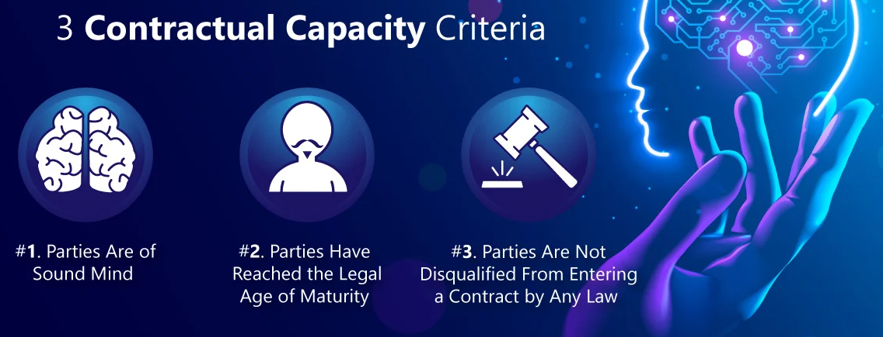
Capacity
Capacity is the mental and legal ability to enter a binding contract.
“sane and sober”
“18 or older”
“solvent and sustaining”

Slide 36

Legality
The legality of a contract depends upon the lawfulness of its contractual obligations.
An agreement containing unlawful obligations is not a contract.

Slide 37
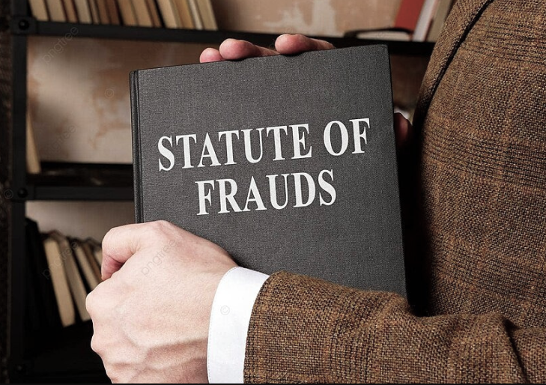

Slide 38
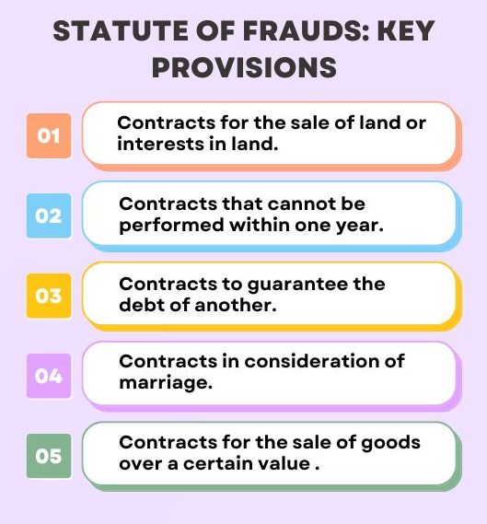
Contract Must Be in Writing to be Enforceable
Real Estate Contracts and Land Leases > one year
For example: Supply Contracts for goods and/or services > 1 year
Executor’s promise to pay debts of the estate from personal funds
Prenuptial Agreements
Sales Contracts > $500

Slide 39
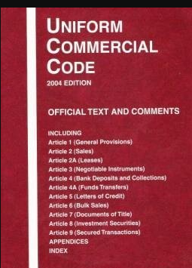
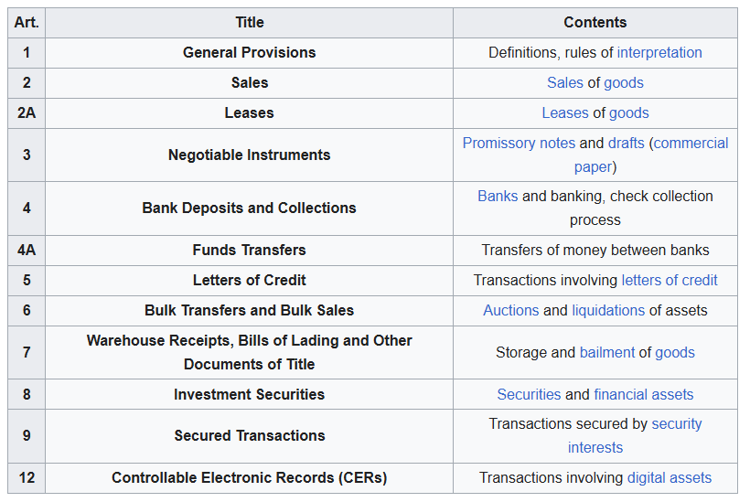
Uniform Commercial Code Regulating Interstate Commerce

Slide 40
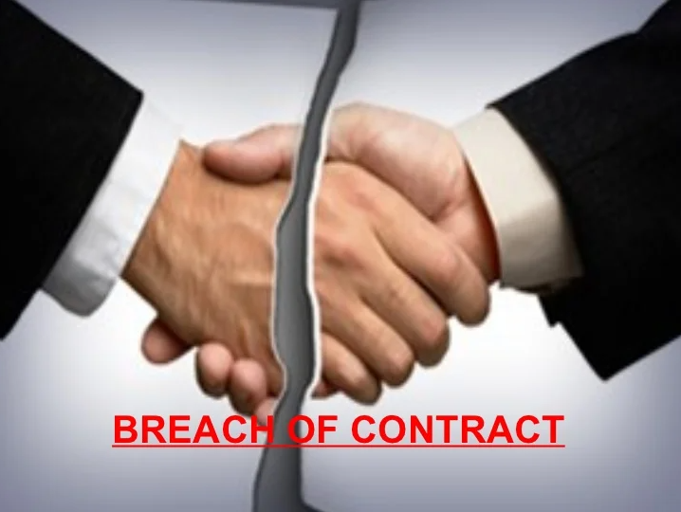
Breach of Contract
Bing Videos (Breach)

Slide 41
Poll Question #2

Slide 42
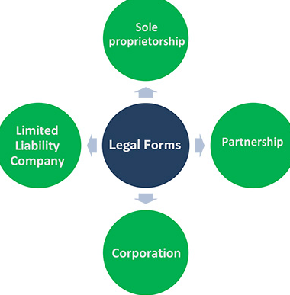
Legal Forms of Business Organization
General
Limited
Limited Liability
S- Corporation
C- Corporation

Slide 43
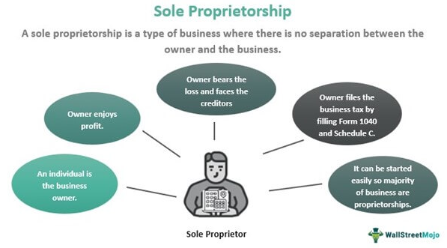

Slide 44
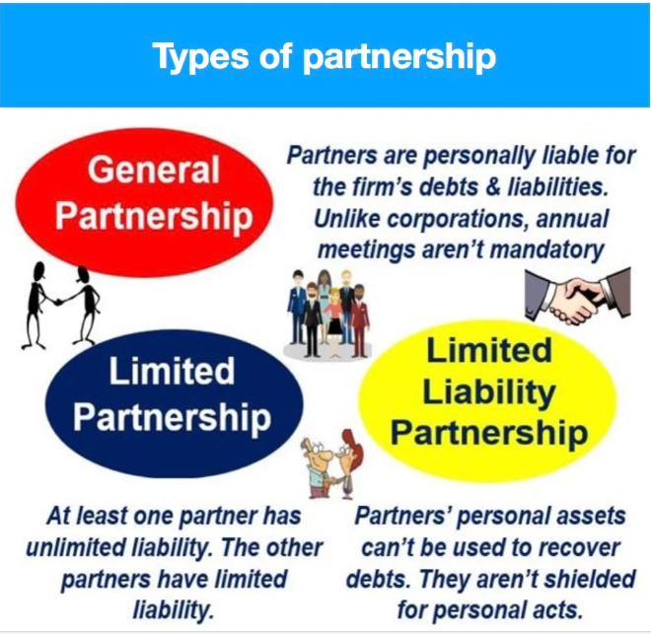

Slide 45
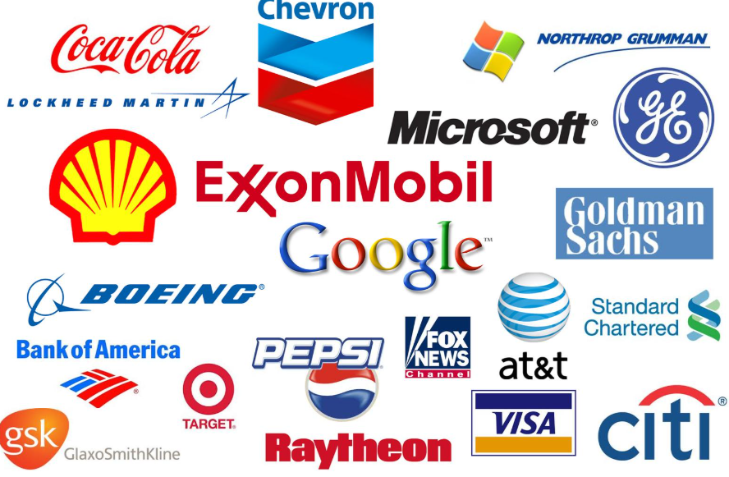
Corporations
Bing Videos

Slide 46
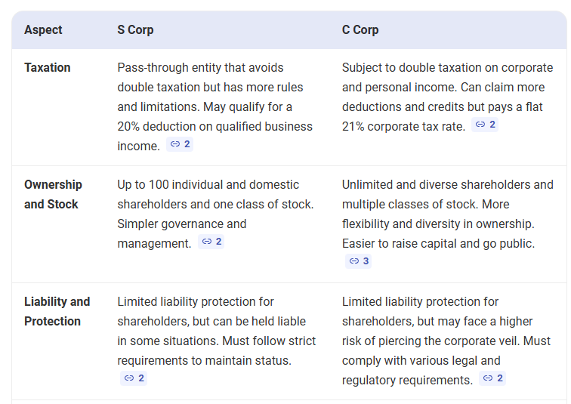
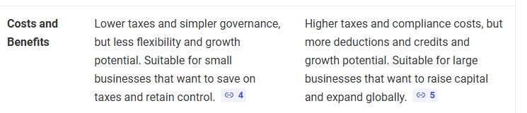

Slide 47
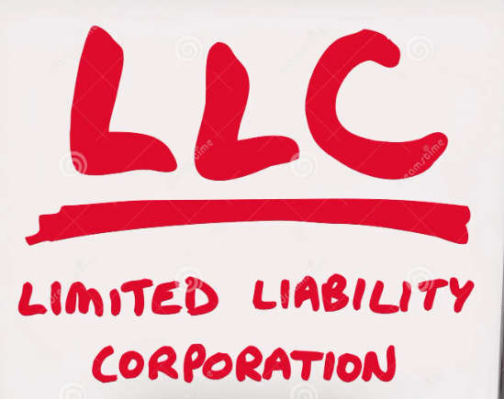
Bing Videos

Slide 48
Profit vs, Non-profit vs. Not-for-profit
Most churches are non-profit C - corporations
Business Structures
Profit
Non-Profit
Not-For-Profit
Purpose:
Investor wealth
Societal benefit
Social Association
Example:
Apple
Red Cross
Homeowner Associations
Tax Exempt:
No
Yes
Sometimes

Slide 49
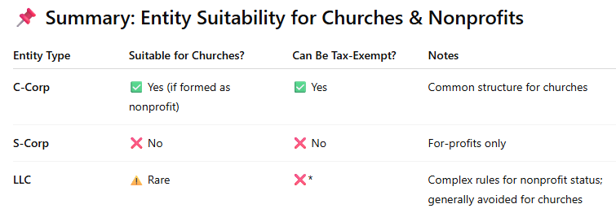
Most Churches Are Non-Profit C-Corporations
With Tax Exemptions Under Section 501(3)(c) of the IRS Code

Slide 50
Poll #3

Slide 51


Slide 52
“Employment-at-Will”
Employer or Employee may terminate employment
at any time, for any reason, without warning
Employer may not terminate employment for reasons pertaining to
an employee’s race, gender, age (>39), national origin, or disability
Employer may not terminate employment as retaliation for reporting
unsafe workplace practices or illegal activities
An employment contract or collective bargaining agreement can
limit or override the “employment-at-will” presumption

Slide 53
Title VII of the Civil Rights Act of 1964
Title VII of the Civil Rights Act of 1964 (Title VII) makes it unlawful for an employer to discriminate against someone because of: race, color, creed, gender, or national origin
Title VII also makes it unlawful for an employer to take a negative action, or retaliate
against a person because they:
Complained about discrimination, whether formally or informally;
Filed a charge of discrimination with an agency like the U.S. Equal Employment
Opportunity Commission, or
Participated as a witness in an employment discrimination investigation or lawsuit.

Slide 54
Title VII of the Civil Rights Act of 1964
Under Title VII, it is unlawful to discriminate in any aspect of employment, including:
Hiring and firing;
Compensation, assignment, or classification of workers;
Transfer, promotion, layoff, or recall;
Job advertisements and recruitment;
Testing;
Use of employer facilities;
Training and apprenticeship programs;
Retirement plans, leave, and benefits; or
Other terms and conditions of employment.

Slide 55
Poll #4
Title VII of the Civil Rights Act of 1964
Under Title VII, employers also cannot:
Harass an employee because of race, color, religion, sex, or national origin;
Refuse or fail to make reasonable adjustments to workplace policies or practices that allow individual workers to observe their sincerely held religious beliefs;
Make employment decisions based on stereotypes or assumptions about a person’s abilities, traits, or performance because of their race, color, religion, sex, or national origin;
Deny job opportunities because a person is married to, or associated with, a person of a particular race, color, religion, sex, or national origin.

Slide 56

NON-EXEMPT
EXEMPT
Non-EAP Responsibilities
Hourly Pay
Record Hours Worked
Minimum Wage Requirement
Overtime (1.5x) Pay > 40 hrs/wk
Executive, Administrative, Professional (EAP)
Salaried > $684/week
No Recording Hours Worked
No Minimum Wage
No Overtime Pay
65% of USA Workforce
35% of USA Workforce

Slide 57
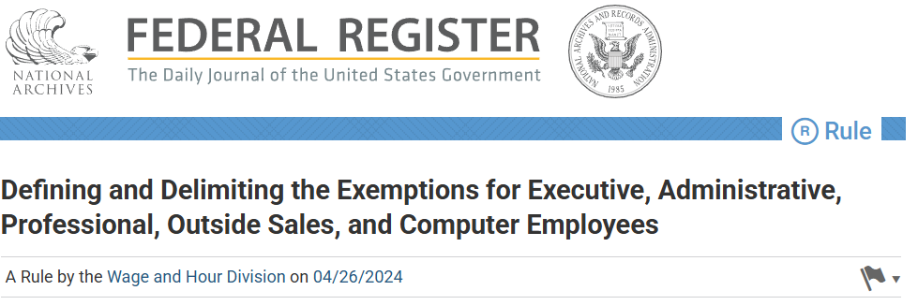
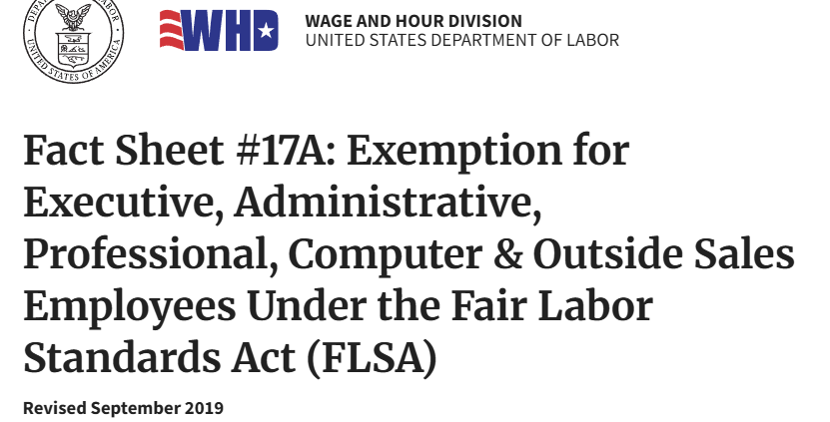
Business Groups Are Challenging Labor Department’s
New Rules on FLSA Exemptions . . . Stay Tuned

Slide 58



Slide 59
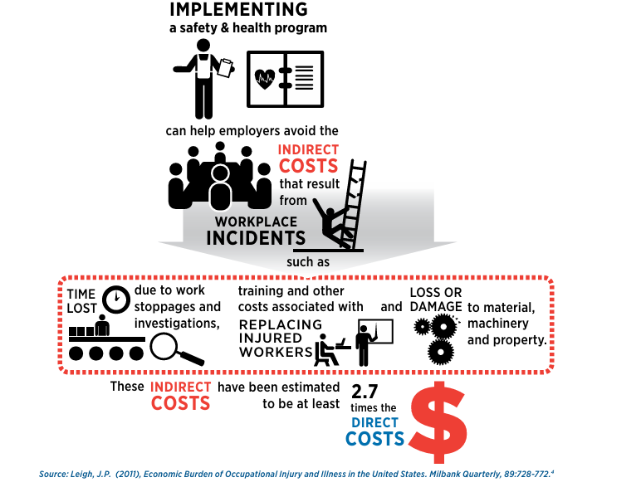

Slide 60
Poll #4

Slide 61


Slide 62

Intellectual Properties Are:
Copyright
Patent
Trademark
Trade Secrets

Slide 63

Copyright video
Bing Videos

Slide 64

Patent Video
Bing Videos

Slide 65



* A trademark can be any word, phrase, symbol, design, or a combination of these things
that identifies your goods or services. It’s how customers recognize you in the
marketplace and distinguish you from your competitors.
* The word “trademark” can refer to both trademarks and service marks. A trademark is used for goods, while a service mark is used for services.
* A trademark:
Identifies the source of your goods or services.
Provides legal protection for your brand.
Helps you guard against counterfeiting and fraud.

Slide 66

trademarks
Trade secrets video
Trade secrets / regulatory data protection | USPTO

Slide 67
Business Law
Thanks for your attention !

