Slide 1
Clergy Compensation, Taxes, and Retirement: The Why and How
July 16, 2025
Sponsored by Villanova University
and DFMC
Presented by:
Scott A. Hoselton, CPA, CDFM, CGMA
Jennifer Cantrell, CPA
Notes:
JEN

Slide 2

Objectives
Attendees will gain an understanding of clergy:
Clergy compensation tax code rules
Taxable and nontaxable benefits and income
Tax liabilities
Retirement plans and savings
Notes:
JEN

Slide 3
Disclaimer
This presentation is designed to provide accurate information with regard to the subject matter covered. It is presented with the understanding that the presenters are not engaged in rendering legal, accounting, or other professional services. If legal advice or expert assistance is required, the services of a competent professional person should be obtained.
Every reasonable effort has been made to make the information in this presentation as current possible. Federal tax laws, however, are subject to change, and tax forms may change. Further, court decisions and IRS rulings can significantly affect the application of Federal tax laws to individual circumstances. Such changes may affect the accuracy of this information.
Notes:
SCOTT

Slide 4
Presentation Outline
Introduction and personal background
Common Questions
Ten tax differences between priests/laity
Required taxes paid by clergy
Special Status & Allowances
Meals, housing, SECA, retirement
Notes:
SCOTT

Slide 5
Presentation Outline
Clergy Compensation
Business (ministerial) expenses – Non-taxable and Taxable Allowances
Stipends and stole fees
Determining value of “room and board”-housing allowance
Notes:
SCOTT

Slide 6
Presentation Outline
Sample tax calculations for diocesan priests
Taxable and nontaxable “gifts”
Tax on pension benefits
Taxes on Social Security benefits
Tax aspects of retirement plans & savings
Notes:
SCOTT
Before we go further . . . Do not try to make any sense out of tax rules – Congress passes laws and the IRS implements – Designed to create revenue for government
Miles traveled – if there is income .70 cents vs. .14 cents as charity;
Medical mileage 21 cents – Yes deductible, but not really (except in some states – NM allows medical deduction even if not on federal return)
Sick 21 cents; Nice 14 cents; Business/ministry .70 cents

Slide 7
Personal Background
Scott A. Hoselton, CPA, CDFM, CGMA
• Phone: 701-356-7920; 701-371-9681
• Email: scott.hoselton@fargodiocese.org
ShepherdsAdvisor@gmail.com
• CFO for Diocese of Fargo – 37 years
• Author of:
Income Taxes for Priests Only
Tax Manual For Deacons
Notes:
SCOTT

Slide 8
Personal Background
Jennifer Cantrell, CPA
Jennifer Cantrell, CPA PC
Phone 505-503-8637; Fax 505-343-1463
Email: Jen@jcantrellcpa.com
• CPA in private practice in Albuquerque, NM, limited to clergy taxation, retirement, parish education, policies & procedures across US Dioceses.
• Manage the clergy retirement funds in 4 (arch)dioceses
• Currently under contract with Archdiocese of
Santa Fe as Director of Parish & School Finance
Administration
Was member and Chair of ASF Finance Council for 27 years
Notes:
JEN

Slide 9
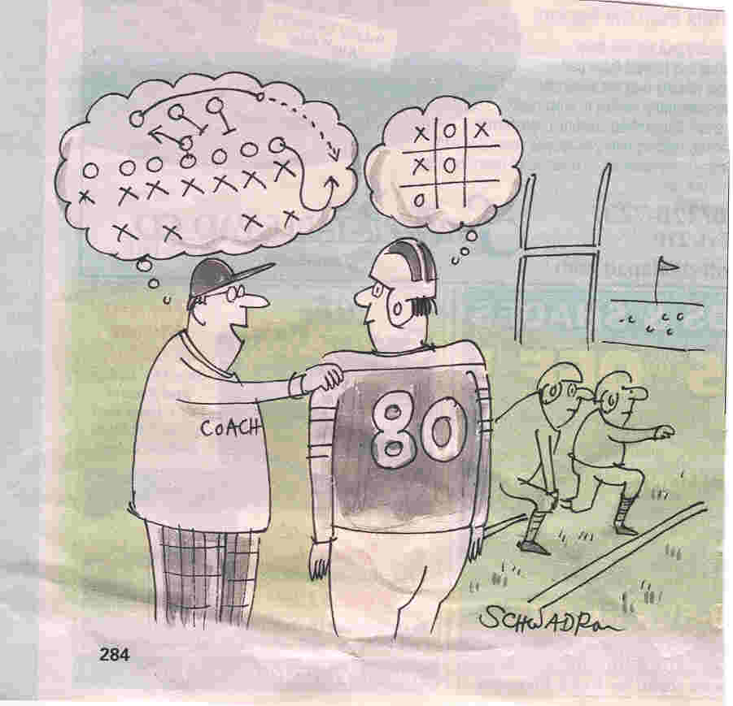
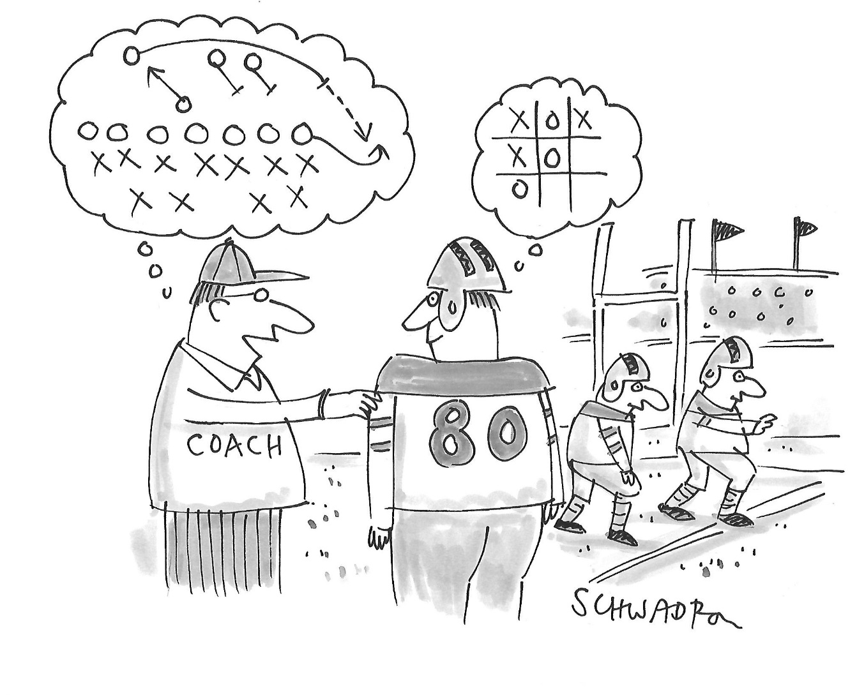
Notes:
SCOTT
We all understand things differently – Please ask questions.

Slide 10
Common Questions
How to determine and report fair market value of rectory housing
What is taxable/reportable income for clergy
At what point do gifts from parishioners become taxable?
What expenses are deductible and how?
How do retired priests claim income and expenses?
IRA vs. 401(k)/403(b)?
Diocesan retirement plans for clergy
Traditional retirement savings vs. Roth?
Notes:
SCOTT
Cliff hanger for valuing rectory – Will discuss in later slide. #1 question relating to priests taxes.
Gifts are from Friends – Because they love you. Not because you blessed their house or baptized their grandchildren
Repeat (?): Do not try to make any sense out of tax rules – Congress passes laws and the IRS implements – Designed to create revenue for government

Slide 11

10 Tax Differences
Clergy are self-employed for Social Sec. tax (pp 14-15)
Clergy may receive tax free housing (p 16)
Clergy are exempt from payroll withholding (p 17)
Clergy may, at their option, request withholding (p 17)
Clergy may opt out of Soc Sec within 2 years/ ordination
(pp 18-19) – Many bishops now require participation
Legality in question for Catholics
6. Clergy receive various allowances, some taxable (p 19)
The IRS classifies priests as “Dual Status” (p 20-26)
Some clergy business expenses are not deductible (p 27)
Clergy living expenses often increase after retirement (p 27)
Clergy 403(b) retirement plan contributions are exempt from Social Security Self-employment tax (p 28)
Notes:
SCOTT
1. IRS Publication 517: The services performed in the exercise of ministry are covered by social security and Medicare under the Self Employment Contributions Act (SECA). Your earnings for these ministerial services are subject to self-employment (SE) tax. Ministerial defined: • Performing sacerdotal functions; • Conducting religious worship; and • Controlling, conducting, and maintaining religious organizations (including the religious boards, societies, and other integral agencies of such organizations) that are under the authority of a religious body that is a church or denomination. You are considered to control, conduct, and maintain a religious organization if you direct, manage, or promote the organization's activities. This includes deacons working in church positions.
2. Tax free housing = Ordained ministers and soldiers are the only two classes of taxpayers
5. Opt out = Form 4361 1983 Statement on Social Security by USCCB Administrative Board … in the interest of the common good we urge all of the clergy and religious to participate in Social Security.
It is a program that is vital to the protection of human dignity for millions of Americans. It makes our society more humane and is a program that merits the full support of all Americans.
. . . . Participation includes SS as one leg of the three-legged retirement stool
Allowances = Internal Equity vs. External Equity
7. Dual status – SE for SS; EE for Federal (and state) tax purposes. Not a bad thing . . . Benefits are not considered income

Slide 12
Clergy Taxes 101
Types of Required Taxes
Three types of tax clergy are required to pay
Income tax – federal and state
Rates vary but most priests are in the 12% or 22% federal bracket (changes at $48,475 in 2025)*
State tax rates vary; some high and some are zero
Social security (also known as self-employment tax or SECA) 15.3%
Notes:
JEN
* Subject to change per One Big Beautiful Bill Act

Slide 13
Clergy Taxes 101
Special status & allowances
IRS regulations –Dual status - common law employee for federal income tax purposes, self-employed for social security tax purposes (SECA)
Not allowed to withhold social security taxes from clergy compensation
Ways to pay –
Quarterly estimated tax payments
Withholding from salary
Notes:
JEN

Slide 14
Clergy Taxes 101
Special Allowance – Meals
Section 119 of the Internal Revenue Code stipulates that under certain conditions the value of meals furnished on the parish/institution premises are free from federal income tax but must be claimed by the priest for self-employment (Social Security and Medicare) tax purposes.
The meals must be consumed on the premises of the parish.
The meals are for the convenience of the parish.
The meals are required as part of the priest’s working conditions.
Notes:
JEN
Does not include meals out of the rectory or while on vacation.

Slide 15
Clergy Taxes 101
Special Allowance - Housing
IRS Code Section 107 - clergy housing allowance subject to
social security/self-employment tax but not income tax.
Failure to include this can trigger penalties and audit.
HOW TO DETERMINE THE HOUSING ALLOWANCE:
The housing allowance is the Fair Market Rental Value of the rectory
furnished, based on local real estate market, plus utilities.
Two methods of determining the FMRV approved by courts:
Comparable fair rental value (including furnishings) determined
by a realtor or expert who compares with other similar properties
(plus utilities)
2. Comparable sales method-sales price value times a rate of return
based on area (i.e.8-15%) i.e. $180,000 X 8%=$14,400 (plus
utilities)
Notes:
JEN
IRS Guide = Ministers Audit Techniques Guide = A minister is frequently provided a parsonage or is paid a housing allowance, which is exempt from income tax. The ‘allowable’ allowance is subject to SE tax under SECA.
IRC § 107(1) Parsonage/Rectory provided
IRC § 107(2) Money provided
If providing money instead of a rectory/parsonage then the amount must be designated in advance.
107(2) Ruled Unconstitutional by WI Western District Judge Crabb
March 15, 2019 -- 7th Circuit Court of Appeals reversed that ruling. 3 Judge Panel said the principal effect of the tax exemption is “neither or endorse nor to inhibit religion, and it does not cause excessive government entanglement.”
Case brought forward by the Freedom From Religion Foundation. We will see this challenge again, but not until there is a favorable court.

Slide 16
Clergy Taxes 101
HOW TO DETERMINE THE
HOUSING ALLOWANCE
Zillow/MIT Living Wage/HUD or other websites rates have been used but have not been tested in court, and do not include furnishings and utilities – if well documented, would probably pass
Safest method in audit would be fair rental value, determined by a realtor or other qualified expert
Should be reasonable and comparable to similar homes in the community, based on facts and circumstances
Get all quotes in writing and maintain documentation
Notes:
JEN
MIT for Salt Lake City: Housing $14,688 + Food $4,218 = $18,906 or $1,576 per month
FMV – have realtor provide square footage rental figure and apply it to space in rectory used for personal daily use
IRS (housing and standards) for SLC = $2,061for 1; $2,421 for 2. $2,421 x 12 = $29,052 /2 = $14,526 or

Slide 17
Clergy Taxes 101
Special Allowance – Housing
Diocese can assist, but if parish is the employer, value cannot be set by diocese. Must be set by the parish location, using facts and circumstances for the area.
Must be designated and documented annually. Can use “safety net” by saying all future years, but should be re-evaluated annually. Must be done before year end for subsequent year.
Good method of documentation is to insert into minutes of
last meeting of the parish finance council
Deacons can provide estimate of their actual housing costs.
If applicable, salary can be reduced by designated amount.
Notes:
JEN

Slide 18
Clergy Taxes 101
Special Allowance –Housing & SECA Fair Market Value of Housing provided must be included in self employment tax calculation. Using an accurate number will significantly increase the Social Security benefit at retirement.
Clergy must not reduce the amount declared by not following the rules! A reduced benefit means a reduced retirement!
Clergy are allowed to deduct any unreimbursed ministerial expenses against self employment income, but not federal income.
EXCEPTION - Expenses eligible for Schedule C - Profit or Loss from Business must be computed as a percentage of
non-taxable/taxable income for any eligible deduction.
Notes:
JEN
Deason deduction 1964

Slide 19
Clergy Taxes 101
Special Allowance - SECA and Retirement
Benefit of tax free income for federal income tax purposes for housing provided is only available to ordained clergy, not laity. The benefit continues into retirement and clergy can deduct actual housing costs
in retirement from the diocesan clergy retirement benefit.
Diocesan clergy retirement benefit not subject to SECA
Trustees/Administrators of diocesan clergy plan can designate a
a portion of the retirement benefit as housing and clergy can
exclude it from income tax
RULES
What can be excluded by clergy on their return?
Least of:
Amount designated
Actual expenses (not applicable for rectory living)
Fair market value of room and board
This has been tested in and continues to hold up legally
Notes:
JEN
IRS Guide: A minister is frequently provided a parsonage or is paid a housing allowance, which is exempt from income tax. The ‘allowable’ allowance is subject to SE tax under SECA.
In retirement the arch/diocese or governing board designate a portion (or up to 100%) of the benefit as housing allowance.

Slide 20
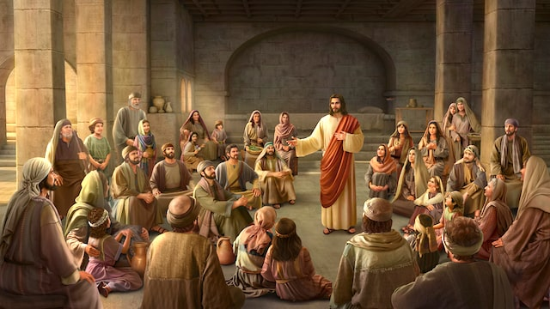

Clergy Taxes 101 And Jesus said to them, “Whose likeness and inscription is this?” They said, “Caesar’s.” Then he said to them, “Render therefore to Caesar the things that are Caesar’s, and to God the things that are God’s. Matthew 22:20-21
Notes:
JEN

Slide 21

Clergy Compensation
Notes:
SCOTT

Slide 22
Clergy Compensation
If there are 194 Archdioceses/Diocese in the USA there are
likely 194 different compensation models.
What may be included in taxable income?
Remuneration/Salary
Taxable allowances – What does that even mean?
Mass Stipends
Stole Fees
Food/Meals – Yes, No, Maybe
Other imbedded expenses – mileage/vehicle use
Notes:
JEN
Minister Audit Technique Guide says this about stipends and stole fees:
The minister may receive fees paid directly from the parishioners for performing weddings, funerals, baptisms, Masses and other contributions received for services. All are includible in gross income.

Slide 23
Taxable and Nontaxable Gifts
Is it Taxable?
Gifts of “love and affection” not associated with a parochial function – Christmas, birthdays, anniversaries, etc. are not taxable.
What was the reason for the gift?
Detached generosity?
Were there services rendered?
Collections for priest through parish checking account – taxable
Amounts from parishioner to priest – tax-free if no parochial service
Burden of proof is on the priest
What the Minister Audit Technique Guide says about “gifts”
Notes:
JEN
IRS audit guide: . . . May receive fees paid directly from the parishioners for performing weddings, funerals, baptisms, Masses and other contributions received for services. All are includible in gross income.
True gifts vs. paying for services/ministry = Birthday, anniversary, going away, get well soon . . A gift is NOT tax deductible to the giver/donor.

Slide 24
Clergy Compensation
Taxable and Non-taxable Allowances
NON-TAXABLE ALLOWANCE:
Any reimbursement for a business expense under IRC Sec 62 if documented from actual receipt
Must include substantiation documenting the nature and amount
of the expense
Must have a business purpose and be in connection with the performance of services as an employee
Not taxable allowance because a priest or deacon must submit documentation for expenses incurred and does not receive the funds if he incurs no expense.
TAXABLE ALLOWANCE
A flat “allowance” vs. an entitlement
No documentation or substantiation required
Notes:
JEN
IRC Sec. 62 defines Adjusted Gross Income, and what is or is not included in it.

Slide 25
Clergy Compensation
Non-taxable Income:
Reimbursements for expenses with a business (ministerial) purpose when a receipt is provided for reimbursement, mileage reimbursement with mileage logs
Value of housing provided is income tax free; must be reported for self-employment tax (Schedule SE Line 2 – see instructions)
Notes:
JEN
As discussed in the previous slides……………….

Slide 26
Clergy Compensation
What may not be included in taxable income:
Benefits – What are benefits?
Paid Vacation – 4 weeks per year
Retirement benefit paid to a Plan.
Insurances – Health, Dental, Vision, LTC
Business/Ministry Expense Reimbursements
Personal Gifts
Cell phone for ministry use
Sabbaticals approved by arch/bishop
Notes:
JEN

Slide 27
Clergy Compensation
What may be considered Personal Clergy Expenses:
Personal Cell phone (no staff access)
Personal food
Vestments and personal furniture
Housing and meals with friends or family
Clothes, clerics, personal hygiene products, vitamins, etc.
Vehicle Expenses
Insurance copays, deductibles, co-insurance
Personal use of postage, supplies, etc.
Vacation expenses
Hobbies/golf/health club memberships
Any reimbursement of these expenses could be taxable
Notes:
JEN

Slide 28
Clergy Compensation
 |  |  | PARISH/DIOCESAN REPORTING |  |  |  |  | PRIEST REPORTING
 |  |  | W-2 Income | 1099-NEC | Not reported |  | Page 1 -1040 | Sch C-1040 | SE Tax | Not reported
Salary |  |  | X | N/A |  |  | X | N/A | X
Allowance w/o substantiation
(i.e., auto, food allowances) |  |  | X | N/A |  |  | X | N/A | X | *
Allowance as reimbursement
for expenses: |  |  | N/A |  | X |  |  |  | N/A | X
(a) Actual expenses with
receipts submitted to parish |  |  | N/A | N/A | X |  |  |  |  | X
(b) Using IRS per diem/mileage
rates & proper accounting to
parish |  |  | N/A | N/A | X |  |  |  |  | X*
Reimbursement for SECA tax
paid by parish |  |  | X | N/A |  |  | X | N/A | X
Mass stipends & stole fees
collected by parish & paid to
priest |  |  | X | X |  |  | X |  | X
Mass stipends & stole fees |  |  | N/A | N/A
paid directly to priest by
parishioners |  |  |  |  |  |  | X | X | X
Stipends/Other parishes, etc. |  |  | N/A | X |  |  | X | X | X
Gifts of "love & affection"
& not for services (parish
cannot give-considered bonus) |  |  | N/A | N/A
Professional fees to visiting
clergy |  |  | N/A | X |  |  | X | X | X
Room & Board (Fair Market
Rental Value of furnished
rectory, plus utlities paid |  |  | N/A | N/A | X |  |  |  | X
Social Security benefits |  |  | N/A | N/A | N/A |  | X
Investment earnings |  |  | N/A | N/A | N/A |  | X
Pension/retirement benefits |  |  | N/A | N/A | N/A |  | X
(1099-R reporting if diocesan plan)
Notes:
JEN
Hard to read, can provide hand out

Slide 29
Tax Forms
Form 1040 – pages 1 and 2
Schedule 1 – Deductible part of self-employment tax
Business Income/Loss from Sch. C
Educator Expenses if teacher
Deductible ½ Self-employment Tax from Schedule SE
IRA Deduction
Student Loan Interest if applicable
Schedule 2 – Self-employment tax for Sch. SE
Schedule 3 - Saver’s Credit [Form 8880]
Notes:
SCOTT

Slide 30
Tax Forms
Schedule A – Itemized Deductions, SALT,
Charity, Medical, Mortgage Interest
Schedule C – Business Income/loss
(non W-2 income/1099)
Schedule SE – Self Employment Tax*
Attachment to SE – for Value of Housing/Food and Unreimbursed Expenses
Form 8880 - for Saver’s Credit
Form 8995 - Qualified Business Income Deduction
(For Schedule C filers only)
Notes:
SCOTT
Line 2 of Sch SE: Ministers and members of religious orders see instructions for type of income to report on this line.

Slide 31
Notes:
SCOTT
So . . . What next? Where do we go from here?

Slide 32
Clergy Tax Example
Salary $36,000
SECA Allowance Reimbursed 3,420
Mass stipends, Stole fees, etc. 5,700
Total compensation $45,120
Electing 12% 403(b)/401(k) contribution
12% = $5,400 Total reported as $39,720
Notes:
SCOTT
Example similar to first tax return example in 2024 Edition of Income Taxes for Priests Only – so you can go back and review that if you need more understanding.

Slide 33
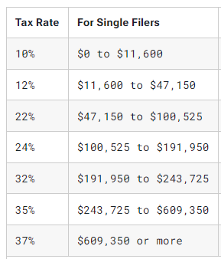
Tax Brackets Explained - 2024
Notes:
JEN
How tax brackets work
*The United States has a progressive tax system, meaning people with higher taxable incomes pay higher federal income tax rates.
Being "in" a tax bracket doesn't mean you pay that federal income tax rate on everything you make. The progressive tax system means that people with higher taxable incomes are subject to higher federal income tax rates, and people with lower taxable incomes are subject to lower federal income tax rates.
*The government decides how much tax you owe by dividing your taxable income into chunks — also known as tax brackets — and each chunk gets taxed at the corresponding tax rate. The beauty of this is that no matter which bracket you’re in, you won’t pay that tax rate on your entire income. (This is the idea behind the concept of an effective tax rate.)

Slide 34
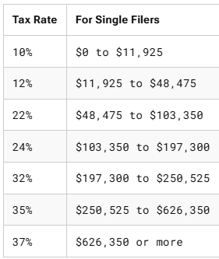
Tax Brackets Explained - 2025
Notes:
JEN
How tax brackets work
*The United States has a progressive tax system, meaning people with higher taxable incomes pay higher federal income tax rates.
Being "in" a tax bracket doesn't mean you pay that federal income tax rate on everything you make. The progressive tax system means that people with higher taxable incomes are subject to higher federal income tax rates, and people with lower taxable incomes are subject to lower federal income tax rates.
*The government decides how much tax you owe by dividing your taxable income into chunks — also known as tax brackets — and each chunk gets taxed at the corresponding tax rate. The beauty of this is that no matter which bracket you’re in, you won’t pay that tax rate on your entire income. (This is the idea behind the concept of an effective tax rate.)

Slide 35
Clergy Tax Example – SE Tax
No 403(b)/IRA 403(b) IRA
Salary plus other $45,120 $39,720 $45,120
Plus value of housing/food $13,500 $13,500 $13,500
Social Security earnings $58,620 $53,220 $58,620
Self-employment tax
X 15.3% X .9235 = $ 8,283 $ 7,520 $ 8,283
Notes:
JEN

Slide 36
Clergy Tax Example – Federal Tax
Total Earnings $ 45,120 $ 39,720 $45,120
Deductions No 403(b) 403(b) IRA
One-half Soc. Sec. tax - 4,142 - 3,760 - 4,142
IRA Deduction - 5,400
Standard deduction (< 65) - 14,600 - 14,600 -14,600
Sec. 199A Deduction - 1,140 - 1,140 - 1,140
Taxable income $25,238 $20,220 $ 19,838
Tax:
$11,600 x 10% = $1,160 $ 1,160 $1,160
12% $13,638/$8,620/$8,238 $1,637 $ 1,034 $ 989
Tax at 10% - 12% $2,797 $ 2,194 $2,149 Saver’s Credit $ 0 $ 200 $ 200
Net Income Tax liability $2,797 $ 1,994 $1,949
Notes:
SCOTT
199A = Form 8995 Qualified Business Income Deduction – 20% of net income on Schedule C is deductible as long as total income is less than $191,950 for single person in 2024
AGI less than $38,251 qualifies for 10% of first $2,000 = $200

Slide 37
Clergy Tax Example – Federal Tax Liability
No 403(b)/IRA 403(b) IRA
Total Earnings $ 45,120 $ 39,720 $45,120
Federal income tax $ 2,797 $1,994 $1.949
Soc. Sec. Self-employment tax $, 8.283 $7.520 $8,283
Total Federal tax liability $11,080 $9,514 $10,232
Amount to withhold 12 periods $ 923 $ 793 $ 853
Amount to withhold 26 periods $ 426 $ 366 $ 394
Federal tax as % of cash income = ~24%
Net of IRA/403(b) elections
Notes:
403(b) tax is $1,566 less
IRA Tax is $848 less but $718 more than the 403(b) saver

Slide 38
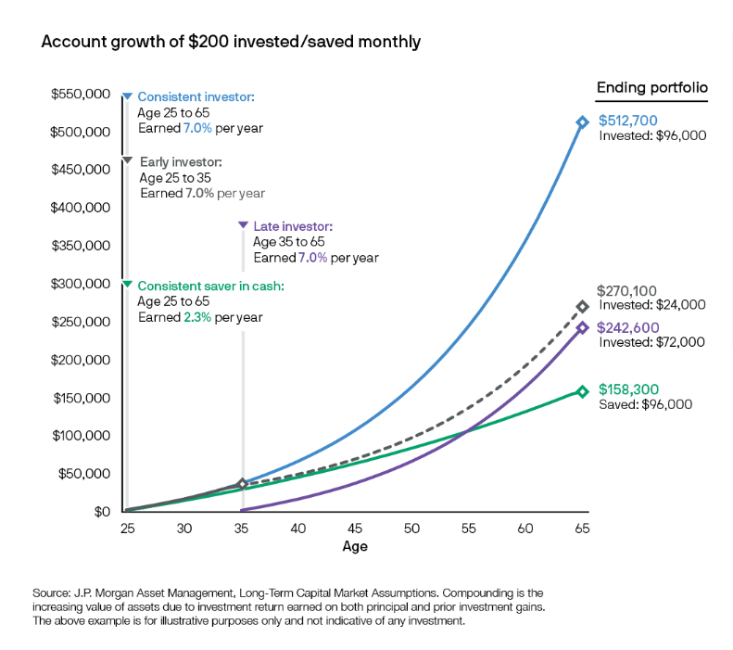
Benefit of saving and investing early
Notes:
JEN

Slide 39
Traditional vs. Roth
Traditional accounts are pre-tax contributions. Taxes are paid in year of distribution at tax rate in force at that future time.
• IRA contributions are deducted on Form 1040 Schedule 1 Line 20. Total earnings are reported on Form W-2.
• 403(b)/401(k) contributions are NOT reported as income on Form W-2. Reduces earnings for Income Taxes and Self-employment Taxes.
Roth contributions are post-tax. Reported as earnings on Form W-2. Future distributions, including earnings, are tax-free when taken.
Notes:
JEN

Slide 40
Retirement Savings Options
2025 Limits
IRA or Individual Retirement Account
Under Age 50 $7,000
Age 50+ $8,000 (additional $1,000)
401(k) and 403(b)
Under Age 50 $23,500
Age 50+ $31,000 (additional $7,500)
Age 60-63 $34,750 (additional $11,250)
Notes:
JEN

Slide 41

Saving for Retirement – the later years
For which of you, desiring to build a tower, does not first sit down and count the cost, whether he has enough to complete it.’
Luke 14:28-33
Notes:
JEN

Slide 42
Senior Priest – Salary/Soc. Security
Active Priest age 67 with Social Security Benefits
Salary+ $45,120
Social Security $24,972*
$70,092
*Taxable $21,226 (85%) vs $3,817 (15%)
Notes:
SCOTT
Total = $70,092; taxable is $66,346
If do nothing 85% or $21,226 of SS is taxed
If he defers SS into 403(b) only 15% or $3,817 is taxed

Slide 43
When to Begin Social Security Benefits?
At normal retirement age (66 if born between 1943 and 1954, then increases 2 months per year until age 67 in 1960)
Three brackets of benefits based on best 35 years of lifetime indexed earnings:
$0 to $1,174 per month x 90% $1,057
$1,174 to $7,078 per month x 32% $1,024
Over $7,078 per month x 15% $ 0
Most priests will be in the 32% benefit bracket $2,081
www.SSA.gov
Notes:
SCOTT
Assume $52,500 35 year average = $4,375/ month Remember Pay & Housing for SECA = $58,620/$53,220
$1,174 x 90% = $1,057
$3,201 x 32% = $1,024
for total of $2,081 per month or $24,972 per year
$24,972 + PPP of $26,400 = $51,372 B4 Investments, 403(b)/IRA, etc.
At age 62 = $24,972 x 72.5% = $18,105
At age 70 = $24,972 x 124% = $30,965
www.SSA.gov

Slide 44
Social Security - Full Retirement Age
Year of Birth Full Retirement Age
1943-1954 66
1955 66 and 2 months
1956 66 and 4 months
1957 66 and 6 months
1958 66 and 8 months
1959 66 and 10 months
67
NOTE: People born on January 1 of any year, refer to the previous year
Notes:
SCOTT

Slide 45
Senior Priest – Salary/Soc. Security
Active Priest age 67
Recommend using 403(b) to reduce earnings and taxes
403(b) -$24,972
Subject to Income tax $ 23,966* (total was $66,346)
One-half Soc. Sec. tax - 2,377
Standard deduction (over 65) - 16,550
Sec. 199A Deduction - 1,140
Taxable income $ 3,899
Tax:
$3,899 x 10% = $ 390
Savers Credit -$ 390
Income Tax + SE Tax $ 0 + SE $4,754 = $4,754
7.3% of total cash before 403(b) deduction; savings of $3,529 SE tax;
and $5,116 Federal income tax
Notes:
SCOTT
Total income was $70,092; taxable would have been $66,346
Total Federal Tax savings of $8,645 x 8 years to age 75 = $69,160 in tax savings and $199,776 in additional savings plus earnings

Slide 46
Senior Priest – Salary/Soc. Security
Active Priest age 70 with Social Security Benefits starting at age 70
Salary+ $45,120
Social Security $30,965*
$76,085
*Taxable $26,320 (85%) vs $2,319 (7%)
Notes:
SCOTT
Total = $76,085 – Taxable is $71,440
If do nothing 85% or $26,320 of SS is taxed
If he defers SS into 403(b) only 7% or $2,319 is taxed

Slide 47
Senior Priest – Salary/Soc. Security
Active Priest age 70
Recommend using 403(b) to reduce earnings and taxes
403(b) -$30,965
Subject to Income tax $ 16,474* (total was $71,440)
One-half Soc. Sec. tax - 1,954
Standard deduction (over 65) - 16,550
Sec. 199A Deduction - 1,140
Taxable income $ 0
Tax: $00 x 10% = $ 0
Income Tax + SE Tax $ 0 + SE $3,908 = $3,908
5.1% of total cash before 403(b) deduction; savings of $4,375 SE tax;
and $5,978 Federal income tax
Notes:
SCOTT
Total income was $76,085; taxable would have been $71,440
Total Federal Tax savings of $10,353 x 5 years to age 75 = $51,765 in tax savings and $154,825 in additional savings plus earnings

Slide 48
Clergy Retirement Issues
How much does the average person, age 65-74, spend a day? The average person in that age group spends about $155 per day, or $56,575 annually, This figure includes spending on housing, food, transportation, entertainment, clothing, pets, healthcare, contributions and other goods and services.
Source: US Bureau of Labor Statistics 2022
-Currently averaging 3.10% inflation over the next five years
Average credit card debt in the US is $6,218 per cardholder. Source: yahoo.finance May 17, 2024
Average interest rate on credit cards is 24.71%.
Source: Lending Tree May 13, 2024
Data shows one-person households spend less but have it the hardest financially.
Source: The Ascent- November 21, 2022
Notes:
JEN

Slide 49
Clergy Retirement Issues
Biggest Expenses for Retirees
#1 - Housing – averages $1,900 month – does not
include maintenance, utilities, insurance, etc.
#2 – Food – average food costs for a single retiree are
about $7,300 annually
#3 – Healthcare – Depends on policies
#4 – Transportation – about 14% of expenses in
retirement
#5 – Utilities and services – about $4,300 annually
Source: Insider Monkey March 25, 2024
Notes:
JEN
#1 + #5 = $27,100 This is important when declaring how much of pension should/could be housing related.

Slide 50
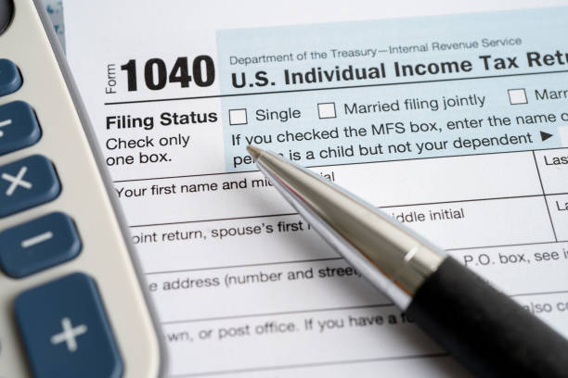


Clergy Retirement Issues
Biggest Expenses for Retirees
Other expenses in retirement
Income taxes
Charitable
Home insurance, maintenance, etc.
Travel and Entertainment
Source: Insider Monkey March 25, 2024
Notes:
JEN

Slide 51
Clergy Retirement Issues
Other Need to Knows
Unlike lay persons, typical clergy living costs increase at retirement - priests have been provided housing, groceries, health insurance and transportation costs. They will have to provide for themselves in retirement.
According to data compiled by the Social Security Administration:
A man reaching age 65 today can expect to live,
on average, until age 82.
And those are just averages. About one out of every four
65-year-olds today will live past age 90, and one out
of 10 will live past age 95
Sourced 2021/2024 Trustees Report: http://ssa.gov/oact/STATS
Notes:
JEN

Slide 52
Retired Priest – Taxes are Different
Work in Retirement $ 6,000
Taxable Pension $ 4,800
Subtotal before Social Security $10,800
½ of Social Security $15,483
Potential Taxable Income $26,283
2% or $619 of Social Security benefits are taxable; $1,200 Pass Through Deduction on the $6,000 earnings; Only Self-employment tax of $848 on the $6,000. No Self-employment tax on retirement funds.
Tax on $65,765 [$6K Earnings + $28,800 Pension + $30,965 SSA
= $848 or 1.3% of total income [Before RMD’s on 403(b)/IRAs]
Notes:
SCOTT
Tax on $65,765 [$6K Earnings + $28,800 Pension + $30,965 SSA
= $848 or 1.3% of total income [Before RMD’s on 403(b)/IRAs]

Slide 53
Example of Tax on Pension Benefits
Retirement Benefit = $2,400 per month = $28,800 annually
Taxable portion = $28,800 less amount allocated to housing; up to 100% of benefit
Housing costs are $2,000 per month with utilities or $24,000 per year
$28,800 – 24,000 = $4,800 taxable income for pension income alone.
Notes:
SCOTT
$15,750 + $6,000 standard deduction for age 65

Slide 54
Retired Priest – Taxes are Different
Income subject to tax: $ 11,441
Deductions
One-half Soc. Sec. tax - 424
Standard deduction (Over 65) - 16,550
Sec. 199A Deduction - 1,200
Taxable income $ 0
Tax:
Income Tax $ 0
Self-employment tax $ 848
Total Tax $ 848
Notes:
SCOTT
1.3% of $65,765
Tax on $65,765 [$6K Earnings + $28,800 Pension + $30,965 SSA
= $848 or 1.3% of total income [Before RMD’s on 403(b)/IRAs]
Taxes, Charity and Home were highest expenses.

Slide 55
Clergy Taxes – Traditional vs. Roth
Traditional are pre-tax contributions. Taxes are paid in year of distribution at tax rate in force at that future time.
• IRA contributions are deducted on Form 1040 Schedule 1 Line 20. Total earnings are reported on Form W-2.
• 403(b)/401(k) contributions are NOT reported as income on Form W-2. Reduces earnings for Income Taxes and Self-employment Taxes.
Roth contributions are post-tax. Reported as earnings on Form W-2. Future distributions, including earnings, are tax-free when taken.
So which is better? Traditional or Roth?
Clergy need to choose between saving 26-30% today vs. paying 0-12% in the future.
Notes:
SCOTT
In example, while working he can withdraw $6,700 and still pay zero FIT.
Fully retired he will have no Self-employment tax and withdraw $9,500 before FIT.
How much will he need if expenses are less than $60,000 which is his Pension and SS, and income taxes are not a large expense?

Slide 56
Issues for Financial Preparation for Retirement
Social Security
Defined Benefit Plan or Priests Pension
Defined Contribution Plan or 403(b) Plan
Management of Medicare/Other Insurance
Required Minimum Distributions (RMDs)
Will and Power of Attorney should be on file
at Diocese
Digital Estate Planning?
Who will help clergy manage their online
persona?
Notes:
JEN

Slide 57
Common Tax Return Mistakes
Retired priests:
Paying tax on housing portion of pension
Not paying tax on unused housing portion of pension
Not reporting all income
Active priests:
Not including the value of room and board for Social
Security tax purposes
Reporting unreimbursed business expenses on Schedule C
Not reporting Mass stipends or stole fees as taxable income
Using estimates for tax deductions
Deducting reimbursed business expenses
Notes:
SCOTT

Slide 58
Tax Audits
Items that increase the likelihood of an audit:
Schedule C
Schedule A
Large (over $1,000) in taxes owed
“Audit proof” clergy tax return:
Follow examples
The only questionable item is the value of housing (If any reasonable amount is used AND DOCUMENTED, there
should be no problem).
Auditors usually request 14 months of bank statements so
be prepared to prove source of deposits (including “gifts”)
Clergy should not represent themselves in an audit.
Notes:
JEN

Slide 59
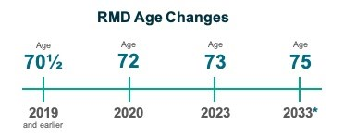
Required Minimum Distributions (RMD’s)
If retired you must begin withdrawals by April 1st
following the year in which you reach age 73
If actively employed you are not required to begin withdrawing from a 403(b) account until you retire
• RMD as Qualified Charitable Distribution (QCD) from IRA
Notes:
JEN
Tax planning is important. Roll 403(b) into an IRA and use QCD’s for RMD’s – no taxable income.

Slide 60
Diocesan Clergy Retirement/Pension Plans
Types of clergy retirement plans:
403(b) – most diocesan plan documents cover lay
employees only – make sure your document defines
who can participate
Church plans – provide more flexibility
- Sometimes fully funded by arch/diocese with little or
no funding from clergy
-Not subject to ERISA, although ERISA coverage can be
elected
-Less required reporting, regulations
-Administered by Church Benefits board whose principal
purpose is administration and/or funding of pension
plans
Notes:
JEN
Tax planning is important. Roll 403(b) into an IRA and use QCD’s for RMD’s – no taxable income.

Slide 61
Diocesan Clergy Retirement/Pension Plans
Church clergy retirement plans:
Usually a defined benefit (pension) plan
Qualified plan, non-ERISA Church plan has been
approved by IRS with determination letter
Has been proven to be protected in bankruptcy
Non-qualified plan – no approval by IRS
More flexibility for benefits, other costs
Notes:
JEN

Slide 62
Deacon Tax Example
 |  |  |  |  |  |  | Deacon
 | Lay EE |  |  | Deacon |  |  | w/ 403(b)
Salary | $60,000 |  |  | $60,000 |  |  | $60,000
403(b) Election | $0 |  |  | $0 |  |  | -$6,000
Housing Allowance | $0 |  |  | -$30,000 |  |  | -$30,000
Payroll Taxes |  |  |  | $4,590 |  |  | $4,590
Total | $60,000 |  |  | $34,590 |  |  | $28,590
Payroll Taxes | -$4,590 |  |  | $0 |  |  | $0
Spouse Income | $60,000 |  |  | $60,000 |  |  | $60,000
Standard Deduction | -$29,200 |  |  | -$29,200 |  |  | -$29,200
50% of SE Tax |  |  |  | -$4,563 |  |  | -$4,139
Taxable Income | $90,800 |  |  | $60,827 |  |  | $55,251
Notes:
SCOTT

Slide 63
Deacon Tax Example
 |  |  |  |  |  |  | Deacon
 | Lay EE |  |  | Deacon |  |  | w/ 403(b)
Federal Income Tax
23,200 x 10% | $2,320 |  | 23,200 x 10% | $2,320 |  | 23,200 x 10% | $2,200
67,600 x 12% | $8,112 |  | 37,627 x 12% | $4,515 |  | 32,051 x 12% | $3,846
0 x 22% | $0 |  | 0 x 22% | $0 |  | 0 x 22% | $0
Total | -$10,432 |  | Total | -$6,835 |  | Total | -$6,046
SE Tax | $0 |  | SE Tax | -$9,126 |  | SE Tax | -$8,279
Net Income | $100,388 |  | Subtotal | $78,628 |  | Subtotal | $74,265
Housing Allowance |  |  | Housing Allowance | $30,000 |  | Housing Allowance | $30,000
Saver's Credit
 | $100,388 |  |  | $108,628 |  |  | $104,265
Total Federal Taxes | -$19,612 |  |  | -$20,552 |  |  | -$18,915
+/- Net Income | $0 |  |  | $8,240 |  |  | $3,877
+/- Taxes | $0 |  |  | $940 |  |  | -$1,637
+/- Retirement Savings | $0 |  |  | $0 |  |  | $6,000
Net gain | $0 |  |  | $7,301 |  |  | $11,514
Notes:
SCOTT

Slide 64
One Big Beautiful Bill Act – Now and the future
Current Tax Brackets made permanent
10%, 12%, 22%, 24%, 32%, 35%, 37%
Current 20% QBI Deduction made permanent
New minimum for taxpayers with at least $1,000 QBI
Standard Deduction increased for 2025
From $15,000 to $15,750
Bonus Deduction for age 65 and older
$6,000 for 2025 through 2028
State and local tax (SALT) deduction
$40,000 for 2025; increases 1% through 2029; reverts to $10,000 in 2030
Tips? Deduct up to $25,000 per year
from 2025 through 2028*; Phase out when MAGI exceeds $150,000
Treasury has 90 days to define what professions this applies to.
Notes:
SCOTT
$400 minimum so if net Sch C income is less than $2,000 the deduction is more than 20%

Slide 65
One Big Beautiful Bill Act – Now and the future
Miscellaneous itemized deductions – Permanently terminated
Moving expense deduction – Permanently terminated
Auto loan interest – Deduct up to $10,000 annual interest on
New loans from 2025 through 2028; US assembled, restrictions apply
Charitable deduction for non-itemizers
$1,000 for single; permanent and starts after 2025
Sec. 127 Employer payments of student loans
Made permanent and adjusted for inflation; current = $5,250
1099 Reporting
Restrictions apply; raised from $600 to $2,000
Notes:
SCOTT
* Treasury has 90 days to define what professions this applies to.

Slide 66
QUESTIONS?

