Slide 1
Accounting Update
The Catholic University of America
Mary Njai
4/30/2025

Slide 2
Objectives
Understand the different types of financial statements, and the information provided by each statement.
Be knowledgeable about how to prepare different types of financial statements.
Understand basic review mechanisms for financial statements.
Recognize how to read and interpret financial statements.

Slide 3
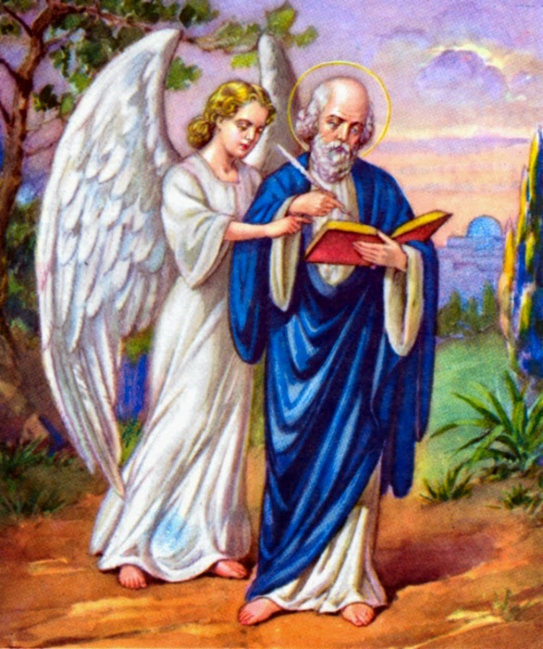
The Accountant’s Prayer
“Lord, help me be more
relaxed about insignificant
details, starting
tomorrow at 10:53:16 am,
Eastern Daylight Time.”

Slide 4

Father of accounting
Franciscan Friar
Lived 1447 - 1517
Consider also living at the same time were:
Saint Ignatius Loyola (1491 - 1556)
Saint Thomas More (1478 - 1535)
Michelangelo Buonarroti (1475 - 1564)
Pope Alexander VI (reigned from 1492 - 1503)

Slide 5
Fra Luca Pacioli
The FATHER OF ACCOUNTING
Member of the clergy
(OFM-Conventual)
Italian Mathematician
Taught Leonardo da Vinci
Knew Michelangelo
Double-entry bookkeeping

Slide 6

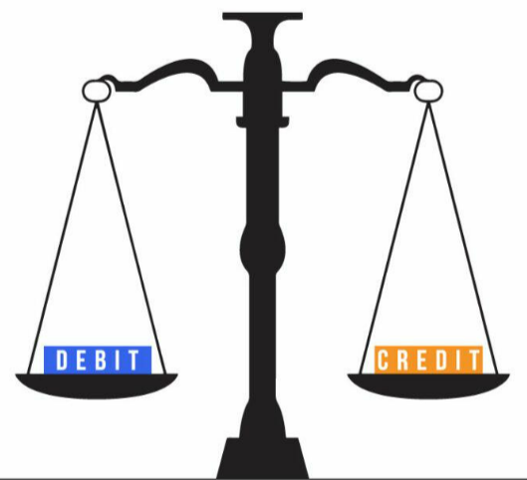
Double-entry bookkeeping
Summa de arithmetica, geometria, proportioni et proportionalita
Summary of arithmetic, geometry, proportions and proportionality
Included a description double-entry bookkeeping
It is still used 500 years later by all types of organizations.

Slide 7
Good Financial Steward over Assets
Stewardship: The supervising or managing of something; especially the careful and responsible management of something entrusted to one's care
Governance: Establishment of policies, and continuous monitoring of their proper implementation, by the members of the governing body of an organization…mechanisms required to balance the powers of the members (with the associated accountability), and their primary duty of enhancing the prosperity and viability of the organization
Good stewardship works with proper governance.

Slide 8
Accounting
The American Institute of Certified Public Accountants (AICPA) defines accounting as:
“the art of recording, classifying, and summarizing in a significant manner and in terms of money, transactions and events which are, in part at least of financial character, and interpreting the results thereof.”

Slide 9



Accounting
Identify
Measure, Record, Summarize
Communicate

Slide 10
Financial Reporting
Transparency
characterized by visibility or accessibility of information especially concerning business practices
Accountability
capable of being explained

Slide 11
Basis
Guiding documents include:
The Bible: include The Parable of the Talents
Code of Canon Law: include Canons 519, 532, 635, 1254, 1284, 1376
Diocesan Financial Management (A Guide to best practices) – USCCB
Socially Responsible Investment Guidelines for the United States Conference of Catholic Bishops

Slide 12
Guidelines
DIOCESAN FINANCIAL MANAGEMENT (A GUIDE TO BEST PRACTICES)
Summary of Good Financial Management Recommendations
M. Issue budgeting and financial reporting guidelines for all (arch)diocesan parishes, schools and agencies, stipulating that:
1. budgets are to be prepared annually;
2. the pastor and finance council are to review actual revenues and expenses against budgeted amounts on a regular basis;
3. periodic financial reports are to be issued to the parish council and an annual financial report is to be issued to the entire parish community; and
4. the financial reports and supporting schedules required by the (arch)diocese are to be submitted timely.

Slide 13
Financial Statements
Financial Statements:
Statement of Financial Position - Balance Sheet
Statement of Activities - Income Statement
Statement of Cash Flows
Statement of Functional Expenses (not for profits)

Slide 14
Statement of Financial Position
Statement of Financial Position – Balance Sheet
Financial Position at a particular date
Assets - Resources
Liabilities - Obligations
Net Assets [without and with donor restrictions]

Slide 15
Statement of Financial Position
Assets | Liabilities | Net Assets
Cash | Accounts payable | Without donor restrictions
Accounts Receivable | Deferred revenue | - Undesignated
Prepayments | Loans payable | - Designated
Investments |  | With donor restrictions
Property and Equipment |  | - Temporary: time or purpose
 |  | - Permanent: resource permanently maintained

Slide 16
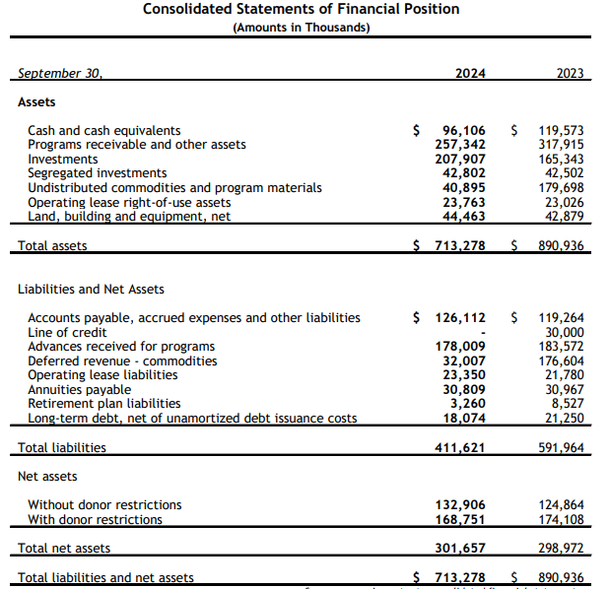
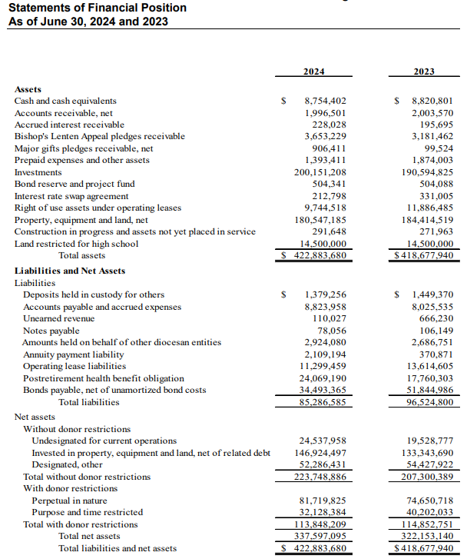
Statement of Financial Position

Slide 17
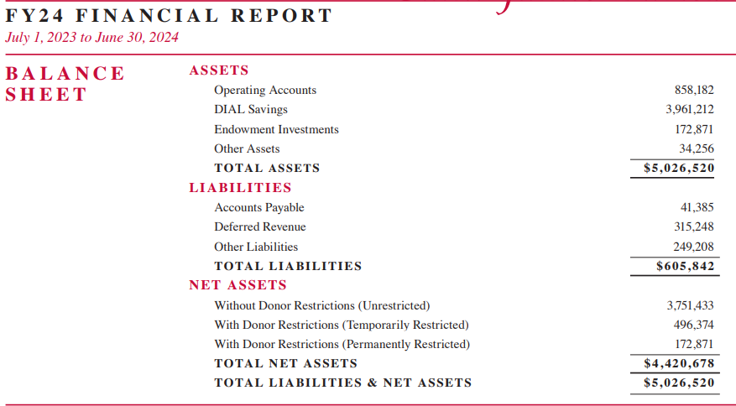
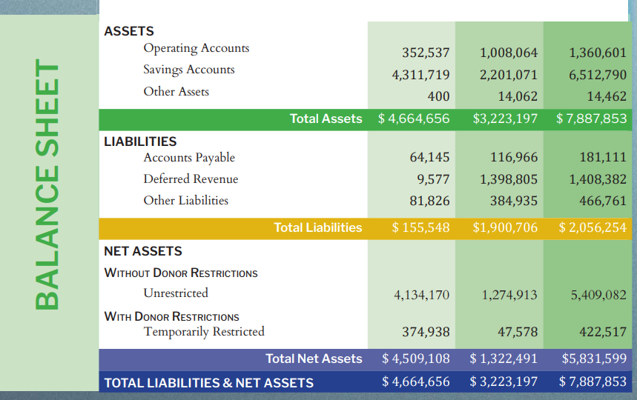
Statement of Financial Position

Slide 18
Statement of Activities
Statement of Activities – Income Statement
Results of operations over a period of time
Revenue – amounts generated
Expenses – incurred to carry out activities
Change in Net Assets – Revenue less Expenses

Slide 19
Statement of Activities
Statement of Activities - Expenses classification
Program Services
Support Services
Management and General
Fundraising

Slide 20
Statement of Activities
Revenues | Expenses
Offertory | Program services
Tuition Income | Supporting services
Ministry Revenues | Salaries
Donations | Utilities
Investment income | Interest expense

Slide 21
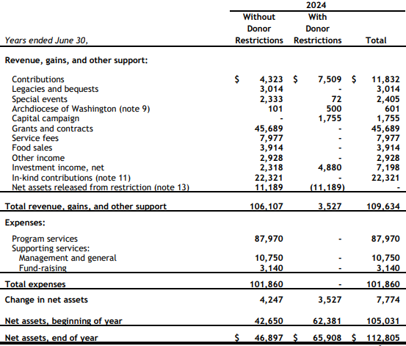
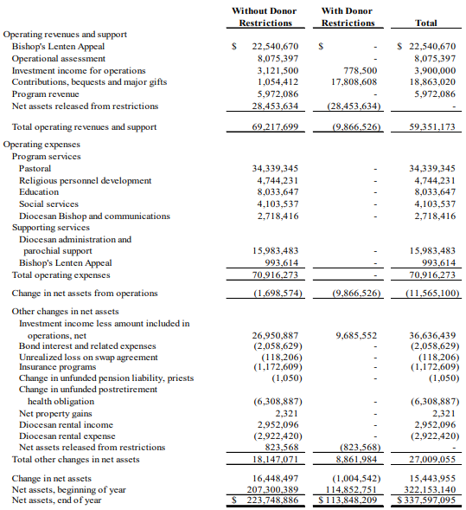
Statement of Activities

Slide 22
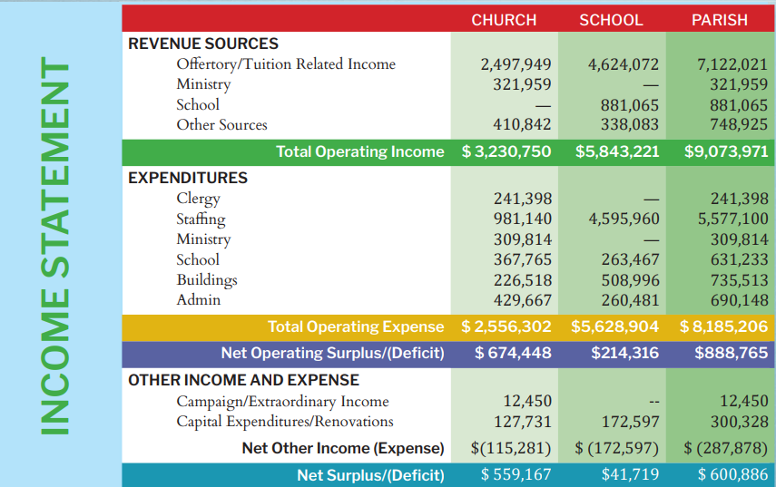
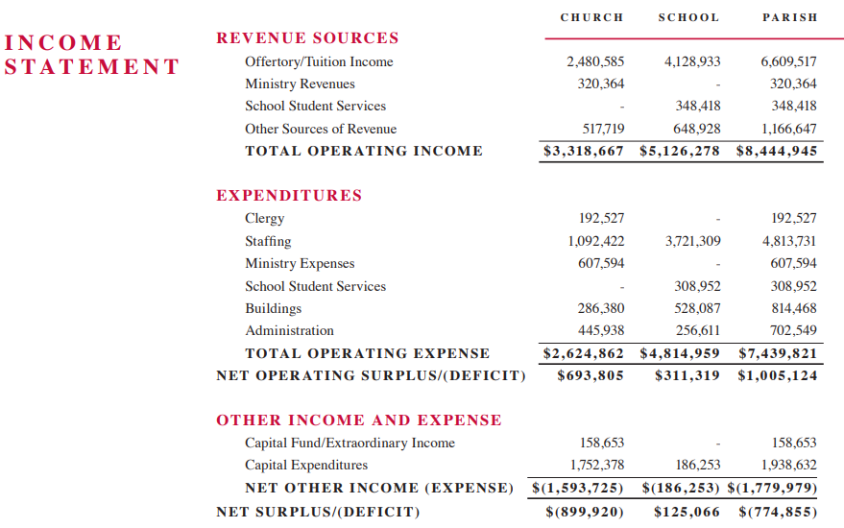
Statement of Activities

Slide 23
Statement of Cash Flows
What has caused the change in cash over a period of time
Cash Inflows and Cash Outflows
Cash flows from operating activities
Cash flows from investing activities
Cash flows from financing activities

Slide 24
Statement of Cash Flows
Operating activities | Investing activities | Financing Activities
Tuition | Land, building and equipment | Long term loans
Collections | Investments | Bonds
Salaries |  | Lines of credit
Office supplies

Slide 25
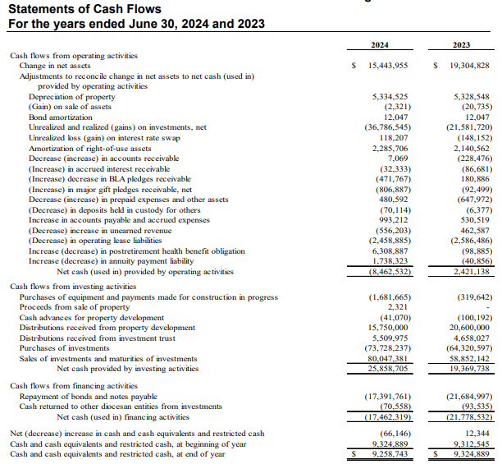
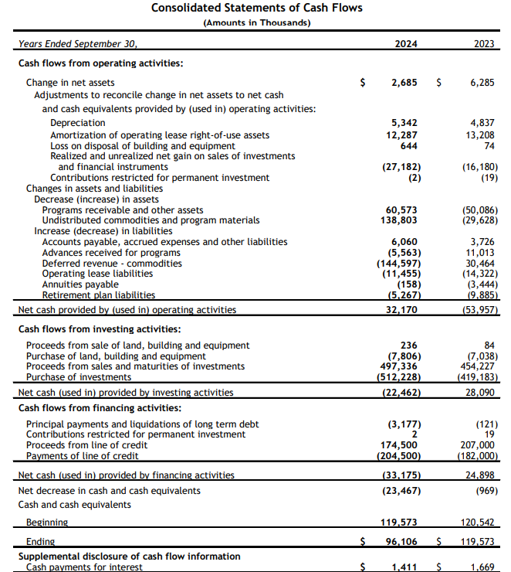
Statement of Cash Flows

Slide 26
Statement of Functional Expenses
Presentation of the expenses by functional classification
Expenses grouped to show the expenses for the main Program services and Support services
The information can be reported on the face of the statement of activities, in a separate statement of functional expenses, or in the notes to the financial statements.

Slide 27
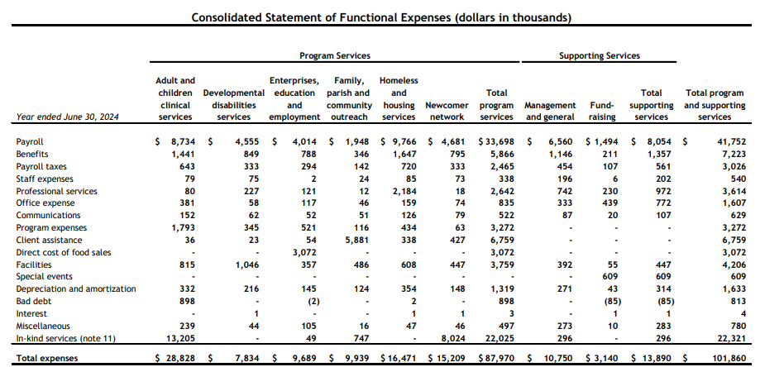
Statement of Functional Expenses

Slide 28

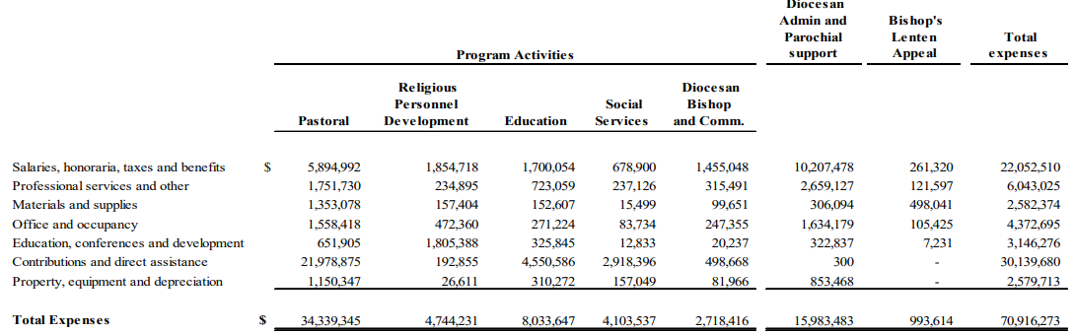
Statement of Functional Expenses

Slide 29
Contributions
Contributions in cash without restrictions on use or availability are recognized when received
Pledges are recognized as support when the pledge is made and there is sufficient documentation
Contribution of services recognized if requires a specialized skill, the person providing it has the specialized skill, and it would be purchased if not donated
The contributions in service reported at fair value
Conditional promises are recognized when the conditions have been substantially met

Slide 30
The Accounting Cycle
Analyze
Record
Adjust
Report
Close

Slide 31

Analyze
Balance Sheet Equation:
Assets = Liabilities + Net Assets
Debit
Credit

Slide 32
Analyze
What transaction has occurred and does it affect any of an Asset, Liability, Net Asset
The balance sheet equation must always balance

Slide 33
Analyze
Collection of tuition revenue for the month
Assets | = | Liabilities | + | Net Assets
Cash |  |  |  | Revenue
+1,000 |  |  |  | +1,000
Collection of donations
Assets | = | Liabilities | + | Net Assets
Cash |  |  |  | Revenue
+1,000 |  |  |  | +1,000

Slide 34
Analyze
Provided services on credit
Assets | = | Liabilities | + | Net Assets
Accounts receivable |  | Deferred Revenue |  | Revenue
+1,000 |  |  |  | +1,000
Collect cash on the Accounts Receivable
Assets | = | Liabilities | + | Net Assets
Cash
+1,000
Accounts receivable
-1,000

Slide 35
Analyze
Collection of tuition revenue in advance
Assets | = | Liabilities | + | Net Assets
Cash |  | Deferred Revenue |  | Revenue
+1,000 |  | +1,000
Provision of classes
Assets | = | Liabilities | + | Net Assets
Cash |  | Deferred Revenue |  | Revenue
 |  | -1,000 |  | +1,000

Slide 36
Analyze
Payment of salaries and wages
Assets | = | Liabilities | + | Net Assets
Cash |  |  |  | Salaries expense
-1,000 |  |  |  | -1,000
Payment of rent for the month
Assets | = | Liabilities | + | Net Assets
Cash |  |  |  | Rent expense
-1,000 |  |  |  | -1,000

Slide 37
Analyze
Payment of rent in advance of using office space
Assets | = | Liabilities | + | Net Assets
Cash
-1,000
Prepaid rent
+1,000
Recognize rent when office space used
Assets | = | Liabilities | + | Net Assets
Prepaid rent |  |  |  | Rent expense
-1,000 |  |  |  | -1,000

Slide 38
Analyze
Use of office space for the month and rent to be paid later
Assets | = | Liabilities | + | Net Assets
 |  | Rent payable |  | Rent expense
 |  | +1,000 |  | -1,000
Payment of rent used before payment made
Assets | = | Liabilities | + | Net Assets
Cash |  | Rent payable
-1,000 |  | -1,000

Slide 39
Record
Journalize - Diary of a business
Post – From journal to ledger in a T-account
Trial balance – Each account and its balance

Slide 40
Record - Journal
Date
Reference number
Account titles (Debit and Credit)
Amounts (Debit and Credit)
Explanation of the transaction

Slide 41
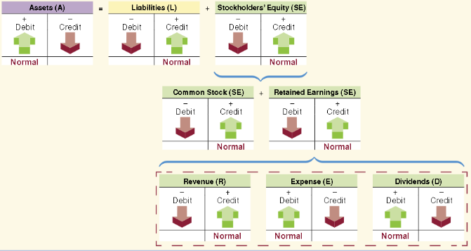
Record - Journal
System of decreases and increases in accounts

Slide 42
Record - Journal
 | Date | Account Titles and Explanation | Debit | Credit
1 | 30 April | Cash (+A) | 1,000
 |  | Tuition Revenue (+NA) |  | 1,000
 |  | To record collection of tuition revenue for the month

Slide 43
Record – Ledger
Cash
1. 1,000
Tuition Revenue
 |  | 1. 1,000

Slide 44
Record – Trial Balance
A trial balance is a listing of all accounts from the general ledger with their respective debit or credit balance

Slide 45
Record – Trial Balance
 | Debit | Credit
Cash | 20,000
Accounts receivable | 7,000
Office supplies | 9,000
Prepaid rent | 3,000
Office equipment | 15,000
Accounts payable |  | 2,000
Unearned revenue |  | 6,000
Loan payable |  | 5,000
Net Assets - not donor restricted |  | 20,000
Net Assets - donor restricted |  | 10,000
Contributions |  | 19,000
Wages expense | 3,000
Rent expense | 3,000
Totals | 57,000 | 57,000

Slide 46
Adjust
Prepare adjusting entries
Prepare adjusted trial balance

Slide 47
Adjust
Prepaid Expenses - Allocating previously recorded assets to expense, to reflect the proper expenses incurred during the period
Unearned Revenue - Allocating previously recorded unearned revenue to earned revenue, to reflect revenues earned during the period
Accrued Expenses - Recording operating expenses that have not yet been paid or recorded, to reflect expenses incurred during the period
Accrued Revenues - Recording revenue that has been earned, but not yet been received or recorded, to reflect revenue earned during the period

Slide 48
Report
Prepare the financial statements
Statement of Financial Position - Balance Sheet
Statement of Activities - Income Statement
Statement of Cash Flows
Statement of Functional Expenses

Slide 49
Close the accounts
Closing is the process of transferring the balances in temporary accounts to the Net Assets

Slide 50
Who can assist with being a good financial steward?
Committed and competent business manager/accountant
Parish Finance Council with business expertise
Archdiocesan financial and operations staff

Slide 51
Strong and effective Internal Controls
A strong system of internal controls should be established and implemented
A strong system of internal control helps to reduce the risk of fraud, misuse, waste, or embezzlement of resources
There should be written policies that are clearly communicated on a regular basis to personnel and training provided frequently
The internal controls should be evaluated periodically
An effective system of internal control starts with setting the proper tone at the top

Slide 52
Review and Interpretation of Financial Statements
The dollar value in the financial statement in itself is not sufficient without more information.
Techniques that can aid in analysis include:
  Horizontal (trend) analysis
  Vertical (common-size) analysis
  Ratio analysis

Slide 53
Horizontal (trend) Analysis
Horizontal analysis (or trend analysis) shows the changes between years in the financial data in both dollar and percentage form
Compare two or more years
Often compare both dollar changes and percentage changes between years
The year comparing against is the base year

Slide 54
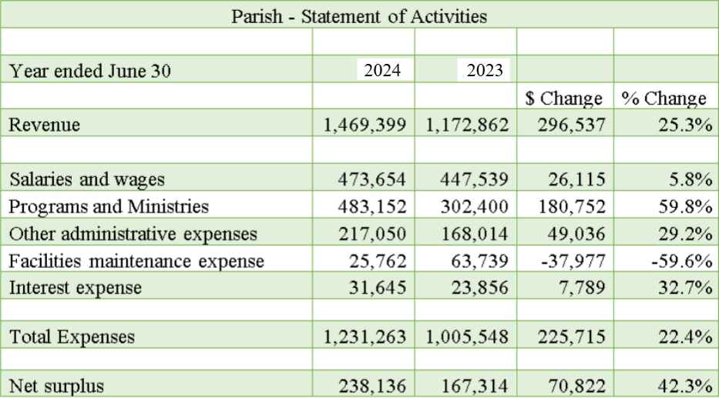
Horizontal Analysis

Slide 55
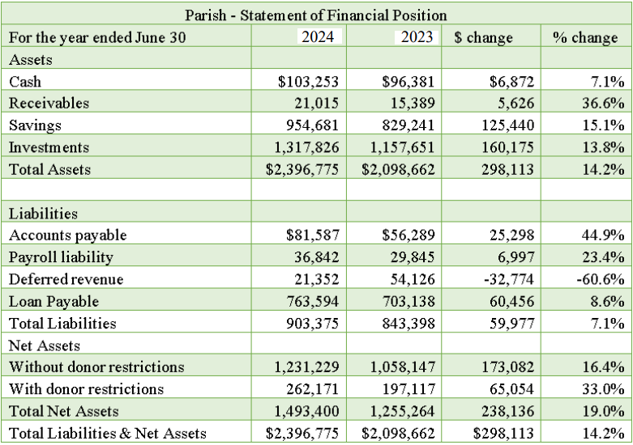
Horizontal Analysis

Slide 56
Vertical (common size) Analysis
Vertical analysis focuses on the relationships among financial statement items at a given point in time. A common-size financial statement is a vertical analysis in which each financial statement item is expressed as a percentage
In statement of financial position, all items usually are expressed as a percentage of total assets
In statement of activities, all items usually are expressed as a percentage of revenue

Slide 57
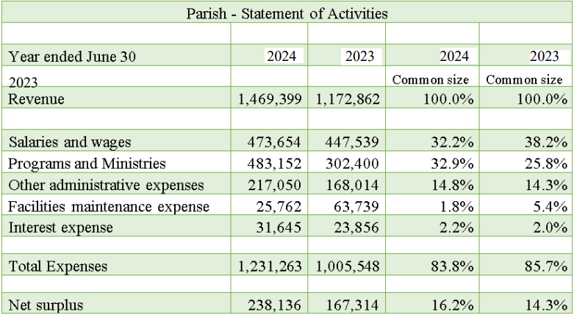
Vertical Analysis

Slide 58
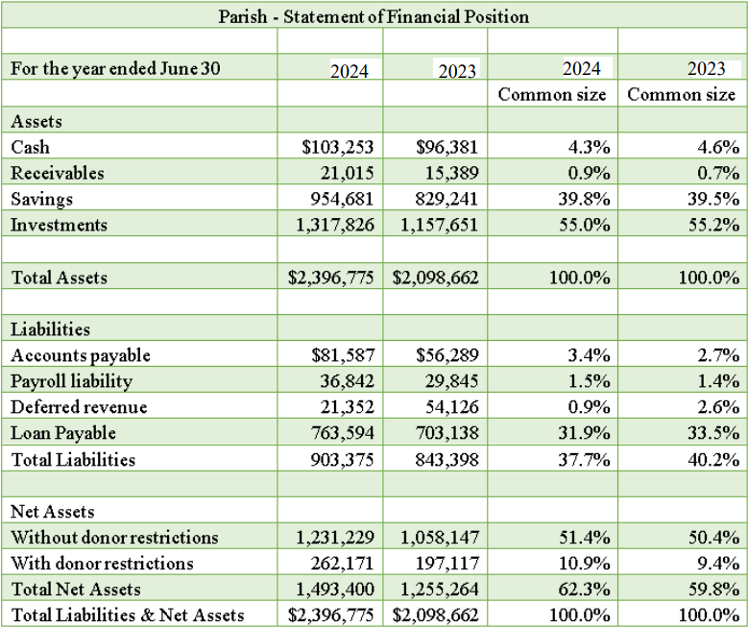
Vertical Analysis

Slide 59
Ratio Analysis
The dollar value in the financial statement in itself is not sufficient without more information. One technique to aid in the analysis of financial reports is Ratio analysis
Financial Statement Ratios are computed by dividing various financial statement numbers
The ratios should be examined to see any trends of the ratios for the organization over time and identify the reasons for the changes in the financial statement numbers causing the change in the ratio
Ratios can also be compared with those of similar organizations (benchmarking)
Ratios standardize the numbers in the Statement of Financial Position (Balance Sheet) and the Statement of Activities (Income Statement). This makes comparison of different size organizations ratios

Slide 60
Ratio Analysis
There are many types of ratios that can be calculated. Common groups are:
Liquidity ratios: show the ability to satisfy current obligations when they are due
Financial Leverage ratios: show the extent to which borrowed amounts or debt have been used to purchase assets; show the long-term debt repayment capability
Activity ratios: show how efficiently the organization is in utilizing its assets
Profitability analysis: show how effectively the organization has performed

Slide 61
Ratio Analysis
Examples:
Liquidity ratios:
Current ratio = Current assets/Current liabilities
Financial Leverage ratios:
Total Debt to Total Assets ratio = Total Debt/Total Assets
Activity ratios include:
Total Assets Turnover = Net Revenue/Total Assets
Profitability ratios:
Net Profit Margin = Net Income/Net Revenue
Other ratios:
Fundraising expense ratio = Fundraising Expenses/Total Expenses

Slide 62
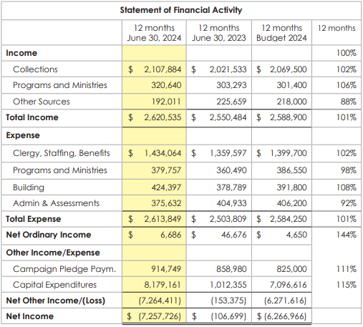
Review of Budget vs Actual

Slide 63
Review of Specific Accounts examples
Cash – Bank reconciliations
Accounts receivable – Names of debtors, amounts and how long outstanding
Prepaid expenses – Prepayments, duration
Property, plant and equipment – Assets schedule
Accounts payable – Payables and due dates
Unearned revenue – When payment received, when good/service to be provided
Accrued expenses – Expenses incurred and when amounts due
Donations – Schedule and documentation for pledges

Slide 64
Other Measures
Registered parishioners
Masses celebrated
Number of baptisms
First communicants
Confirmandi
Marriages
Parishioners preparing for priesthood
Funerals
Students enrolled in parish school

Slide 65
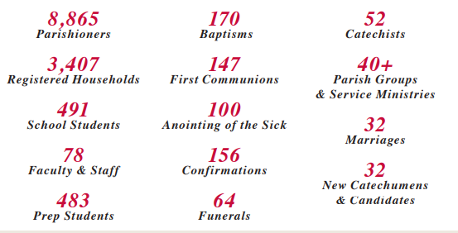
Other Measures

Slide 66
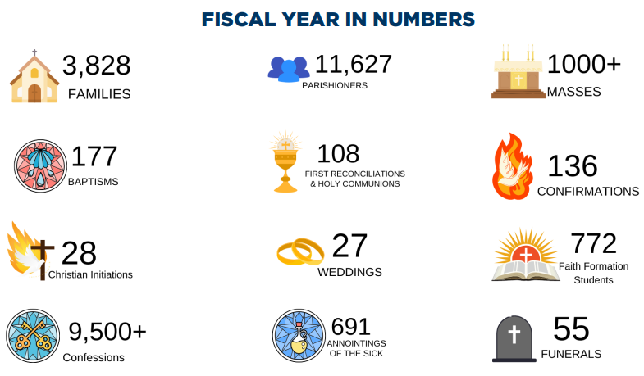
Other Measures

Slide 67
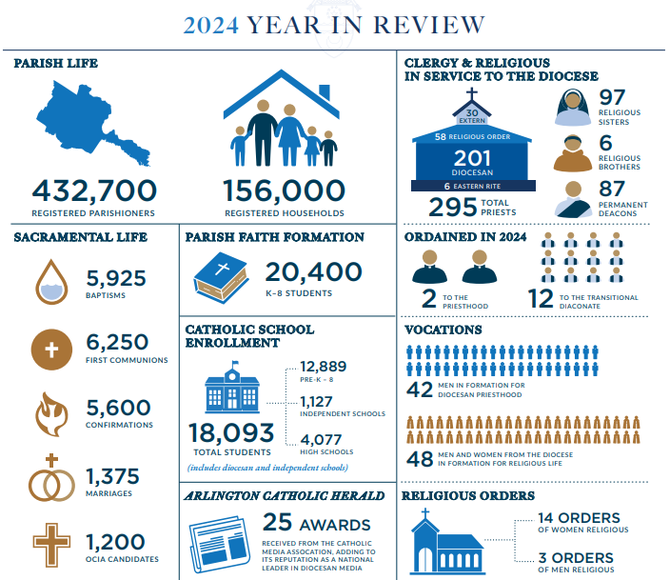
Other Measures

Slide 68
Thank you!

