Slide 1

Southeast Region
Programs
Preparation
Chapter Programs Chair Duties And Responsibilities
April 12, 2019
Notes:
Chapter Programming tips and tricks

Slide 2
Agenda
Why Chapter Programs?
Great Lakes Region Chapter Meeting Examples
Planning Programs for the Chapter
Monthly Program Ideas
Goals – details, details, details
Logistics – making it happen
Marketing – getting the word out
At the Meeting
Speaker’s Bureau

Slide 3
Why Chapter Programs?
Building Blocks to stronger chapters include Good Programs

Slide 4

Chapter Programs
Strong Programs are the Heart of a Strong Chapter
They promote meeting attendance, networking and industry focus.
Notes:
It’s no secret that a chapter’s monthly meetings are the heartbeat of the reason people join. If there is value in these programs, there will be good attendance and chapter interest. Many say networking is dead with Iphones and Information on the Internet. But over and over we hear that nothing beats a face to face conversation.

Slide 5
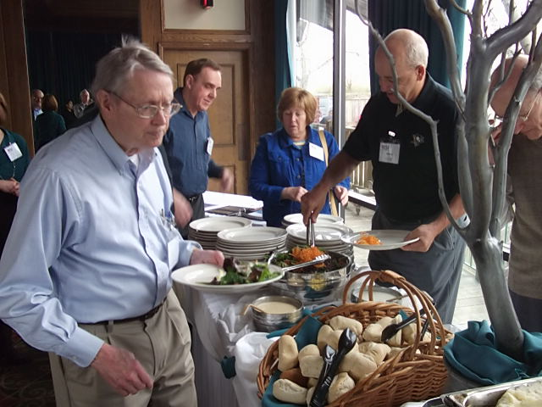
Make Programs work for your Chapter
Every Chapter is Different
There is no right or wrong way.
Be Creative.
Be Consistent.
Notes:
The things that work for chapters in the Great Lakes Region are a varied as the different locations they meet. Every successful chapter gets there on a different road, with different delivery vehicles. The one thing that sticks out is the ones that are consistent, are winning the battle to get people in the room.

Slide 6
Planning Programs for the Chapter

Slide 7

Basic Goals
Chapter Board/Committee Goals
How many meetings/yr
What type format
# of people attending
Target Audience
Notes:
Steven Covey’s theory of being able to Begin with the END in mind works well for setting up your program goals. As you have seen in our examples, depending on your audience, there are several ways to set up monthly meetings.
It’s good to have an annual planning meeting and answer the questions on this slide: What are your goals for the year, what kind of topics do you want to cover, is your format working to keep bringing people in, are the right number and type of people attending, have you defined your target audience, and are you speaking to them?

Slide 8
Monthly Program
Ideas
Notes:
As we said before, there is no right or wrong way to put together a meeting if it works. Be creative, look at what your local community needs and feed them the right information at the right time.

Slide 9
Meeting Ideas
Themes for Meetings
Construction Documents
Historic events series (St Louis 93 flood,etc)
Panels
Forums
Webinars
Bid Day Scenarios
Mock Trial
Grill the Specifier, Manufacturers Rep, Owner
Construction Jeopardy
Job site Tours
Historic Buildings (remodels)
LEED Buildings
Procrastinators Day
Game Show
Notes:
Go over listed ideas/add more as they come to mind

Slide 10

Meeting Ideas
Tech Talk- assembly-focused presentation held just prior to the monthly chapter meeting
Division Night (tabletops for a certain division at meeting)
Coordinate with Chapter’s Education Committee
Notes:
Meeting ideas continued

Slide 11








Joint Association Meetings
Like Minded Groups
-Share Industry Info
Widen Industry
-Thought Leadership
-Contacts
Notes:
Don’t forget that one way to add to your numbers for a meeting is to bring in other groups in the Built Environment. This is certainly a great idea for topics that can be applied to other trade organizations.

Slide 12
Goals-
details, details, details
Notes:
These next few slides delve into more detail on how a specific chapter- Columbus- thinks and organizes their programs. You may already use these. If not, this example may provide some ideas for moving the needle on in your chapter.

Slide 13
Chapter Meetings- # per Year
Decide how many meetings you want each year, which months you will have meetings, and if Keystone events like Trade Shows, Golf Outings, Awards banquets will be included or stand alone events in addition to monthly meetings.
Once you have a basic idea of what you want to accomplish, Think about your target market.
Are you looking to support architectural AIA credits; educational programs that they can’t get in their offices to draw a crowd. Engineers, product reps and owners need to be considered if they are a big part of your chapter or target market for growing your chapter.

Slide 14
Chapter Questions/Options
  1 Monthly Meeting a month
  Two month Break in Summer
  Lunch n Learn-
  -allowed and encouraged
  -not desired
  Panel discussions
  Speaker Presentations
  Community Leader Presentations

Slide 15
Chapter Goals
What are your Annual Chapters Goals for Programs?
  1 Monthly Meeting a month
    Panel discussions
    Speaker Presentations
    Lunch n Learn Type or not
  Keystone events
    Golf Outings/Trade Shows/Awards Banquets/Fun Events
  Tours
    Current jobs/Unique Standing Facilities/LEED Projects
    1-2 per year
  Joint Meetings
    AIA/USGBC/BX/BIA/IIDA/IFMA/ASCA
Notes:
From GLR Policy Document.

Slide 16
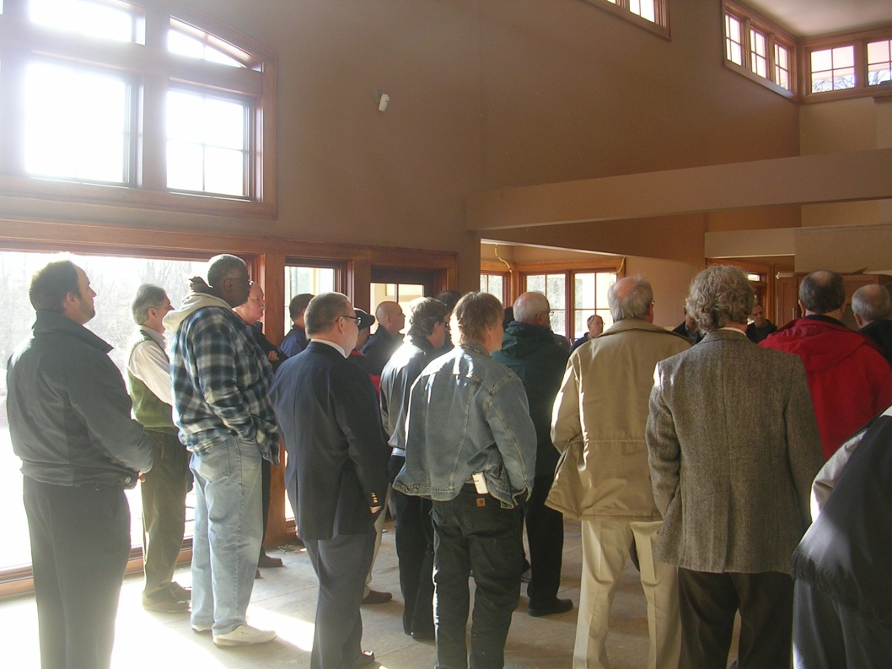
Tours

Slide 17
Chapter Goals
What are your Chapters Goals for Programs?
  Target Audience
    Architect/Engineer/Product Rep/Owner/Contractor
  Brainstorming session for ideas
    Strategic Planning Retreat
  Survey
Notes:
A chapter survey every 3-4 years is a good idea to get feedback from those who come to meetings, and those who might not. You need both sides of the story to serve everyone.

Slide 18

Logistics-
making it happen
Notes:
OK- so you have thought it out. Now the next few slides will address the logistics of making it happen.

Slide 19
What makes a program run smooth?
Although every location has an individual that sits as the program chair it takes a team.
  Searching and setting up speakers
  Team members. Each do something….
  Invites(Eventbrite, Constant Contact), Speaker’s Bio, and CSI Members and Guests.
  PAL (Purpose/Agenda/Length)
  Speaker Introduction
  Plan ‘B’
  Speaker Database (Speaker’s Bureau)

Slide 20
Searching & Setting up Speakers
Every CSI Member should be tasked with bringing up topics and ideas of presentations to be reviewed.
CSI is built on a wide range of professionals covering all aspects of the construction process. The program speakers should reflect the make-up of CSI.
Speakers should be current and relevant.
Speaker data base (Speaker Bureau).

Slide 21

Marketing-
Getting the word out!

Slide 22
Promotions/Eventbrite/Constant Contact
Electronic invitation sent to current members and guests that have attended previous events.
Published Speaker Bio.
Board Members invite additional guests. CSI Cbus Program Chair Ed Gebauer sends additional 150 invites to Architects, previous guests, and past and future speakers. CSI Indy Program Chair Jack Morgan invites in similar fashion.
Advertised in the COMMENT by Thad Goodman and Ryan Carpico. Advertised in the WINNER’S CIRCLE by Mike Halstead and Ryan Mazillo.

Slide 23

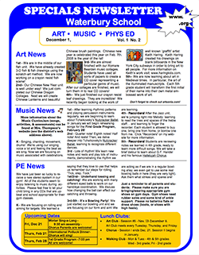
Program Promotion

Slide 24
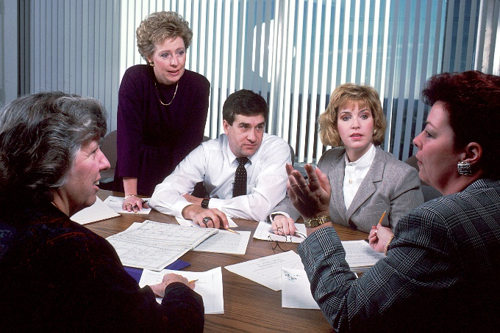
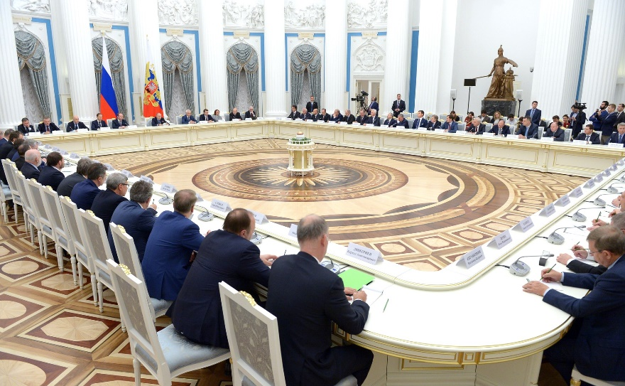
At the Meeting

Slide 25


At the Meeting
  Looped PowerPoint
  Coming Events!
  Having a visual record of upcoming meetings and events is a best practice.
  Broadcast on movie screen or on a monitor that is prominent.
Notes:
Architects, Engineers, Contractors, Product Reps. We are all visual learners. Having a looped PowerPoint running during networking time to promote upcoming meeting and events can really help drive home the next keystone event, upcoming meeting, overview of a successful golf outing, trade show or orientation program.

Slide 26
Program Team
CSI is a group of volunteers.
  6-8 members make up the Program Committee.
  Eventbrite – Columbus; Constant Contact – Indianapolis.
  Name tags and giveaway.
  Hospitality.
  Speaker Certificate.
  AIA Sign-In Sheet.
  Program Certificate.

Slide 27
P.A.L.
Purpose
Agenda
Length

Slide 28
Speaker Introductions
Very important that someone introduce the speaker. Can be the Chapter Program Chair, Chapter President, or an acquaintance of speaker.
Preparing the speaker biography ahead of time not only helps advertise the event but also gives the person introducing a chance to set the stage for the speaker during the introduction.
If there is change of speaker, attempt to secure the new speaker’s biography as soon as possible.

Slide 29
Plan ‘B’
What happens if the speaker has to cancel last minute?
Be prepared to have a couple accredited presentations on standby.
  All Chapters have Product Representatives that can present to the Chapters. Have someone that is on deck so we do not waste member’s time. If possible, have 2 or 3 volunteers set up in case of an emergency.
End result is to have a noteworthy presentation that is informational, interesting, and compelling.

Slide 30
Southeast Region - Speaker Bureau

Slide 31
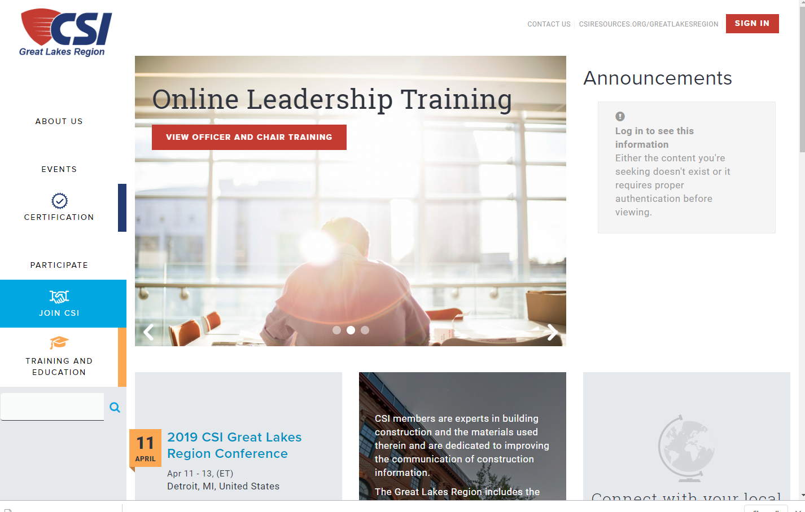

Speaker’s Bureau

Slide 32
Thank You!
2019 GLR Conference
Detroit, MI
April 12, 2019
Programs

