Slide 1

Southeastern Region
Chapter Director
Preparation
Chapter Director
Office Duties and Responsibilities
Notes:
This document is a training guide. It is intended to allow you to see how others have handled the office and what has been encountered, considered important. This is a FY 20 document put together by the current Great Lakes Region President-Elect, who has been a chapter (Columbus) and Region Director. It has been put together in an effort to reduce the learning curve problem that plagues CSI in general. We are a volunteer organization, are constantly re-inventing the wheel as we move in and out of offices. We spend a lot of time learning and re-learning things that happened to the person in front of us. This takes valuable time and energy from performing and/or growing the position, hampering progress. This is meant to provide a solid roadmap for the next in line. This is an attempt to provide an outline for the people who chair the Chapters of the Region, the next generation of Officers at any level. It is not perfect, and it will become dated over time. It is a living document, and will change as CSI changes. All that is ask is that as you change it with better ideas, and updates; you will document them and return it here. My goal was to leave things better than I found them. This tool is a start to make that happen. I trust you will build on those who have created CSI in front of you and do the same.
Thad Goodman, FY20 Great Lakes Region President-Elect.

Slide 2

July 1- Take Office!
Your job starts on July, 1.
CSI’s fiscal year runs July 1 to June 30th.
Notes:
As you take the Directors office you will begin to receive board communications. Contact with the Chapter President and other board members will help you get acclimated.
Start by doing some research. What are the Chapter By-Laws? Do your chapter have an operating guide? Do they have a duties spreadsheet or position outline?
Ask the questions about what’s expected. Take notes of timelines and occurrences.

Slide 3



What is a Director?
di·rec·tor
(diˈrektər)
Noun
a member of the board of people that manages or oversees the affairs of a business or an association.
Notes:
Director is the most asked about position on the board- who qualifies and what do they do?
How do you get to be one is a common question.
What can I do to make a difference is even more common.

Slide 4



Director Selections
How are directors chosen?
Notes:
How are directors chosen? Often it’s someone in the chapter who is interested in getting more involved. Many Board leaders see the director position as a good place to get your feet wet in leadership. You can slide into a position with other directors to support the overall effort, which allows for growth. Seeing up close what other board members do can allow someone to find their passion and still be a part of the leadership team.
More often than not- someone has been watching you at meetings, seen you speak up on an important chapter issue, your work on a committee or a task team, and thinks you would be good at serving in a larger capacity.

Slide 5

Director Hierarchy
How many Directors does your Chapter have?
What is the rotation and timeline?
  Typically Staggered
What is expected
of a Chapter Director?
Notes:
Each Chapter has their own rules according to their By-Laws. Read and know them. Know the other Directors terms and where you fit into the hierarchy. It’s important to know what each is working on- especially the ones who will be rolling off the board next.
Also- what were the primary projects the previous directors were working on? Is that something one of the new directors need to get involved in?

Slide 6

Responsibilities
A Director Looks like this
Governing member of the Chapter
Uphold the By-Laws
Execute the Mission of the Chapter
All Shapes and sizes
Notes:
The Directors primary duties as a board member of the chapter are to know and uphold the chapter rules. These are most often outlined as By-Laws, but can include an operating guide, a mission statement, a membership drive, an strategic plan review, etc.

Slide 7

Responsibilities
Trade Show, Budget, Golf Outing,
Attend the monthly Board meetings
Liaise to a chapter committee of interest or concern
  Report progress to the board
Audit, Programs, Membership…
Notes:
Being present is important for any member of the board. Commit to being at the monthly Board meetings. There is business to be voted on at every meeting, even if it’s just the minutes of the last meeting. Next, find something that is happening in the chapter and take an interest in it. Most often the Chapter President will have something he or she needs help with- that is a great place to start. It does not have to be a heavy lift, but an inquiry into a committee to ask how things are going.
Then report your findings at the next board meeting. Things will start to happen!

Slide 8

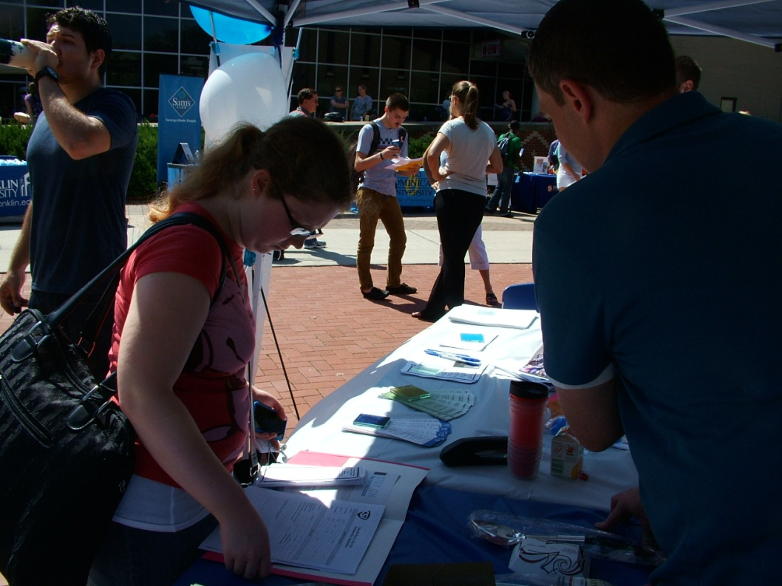
Director-
By-Laws
Operating Guide
Strategic Plans
Surveys
Officer Data Bases
Chapter Communication Platform
Notes:
As a director you provide another set of eyes for all the things that govern the chapter. The logistics of what we do. Look over these documents and be familiar with them. If they haven’t been updated in awhile, help drive some action with a soft suggestion or a willingness to set and complete an action item.

Slide 9
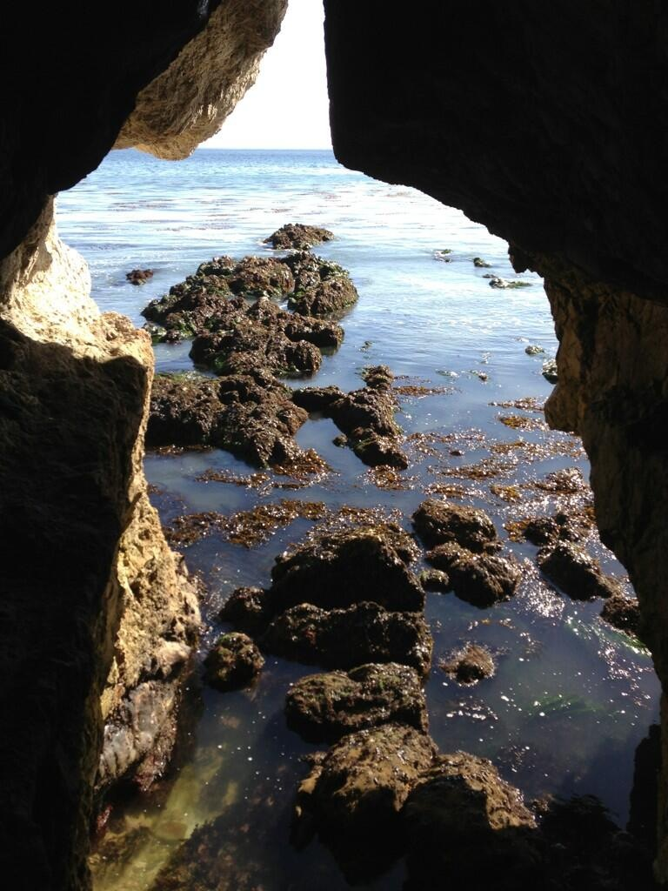
Foundation Stones
Traditional Events
Chapter Meetings
Golf Outing
Trade Show
Specifier
Be present often
Notes:
You are a part of the leadership team. As often as possible attend those events that help build the foundation for the chapter. Events that draw a large number of members and non members. You have a story to tell about your experience, share it. Be an ambassador for your chapter in the construction community.

Slide 10
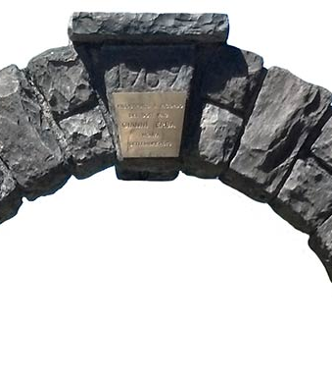
Keystone Events
“Day at the Races”
“Procrastination Day”
Member Orientation
Scholarships
Elections
Notes:
Double check the major events planning for the chapter. The things your chapter does that are different and everyone looks to each year.
Make sure the people in place are continuing on and all is underway for a great event.

Slide 11
Reading List Reminder:
By-Laws
Chapter Administration/OperatingGuide
Budget overview & review
Chapter Strategic Plan
Historical Minutes from the last year
Happy Reading!

Slide 12
THANK YOU
Glenn , CCPR, LEED Green Associate
Glenn.J.Remler@sherwin.com
(954) 547-1217

