Slide 1
Trade Shows
Tips and Pointers for your Chapter.
Notes:
Tips and pointers to organize your Chapter’s Trade Show.

Slide 2
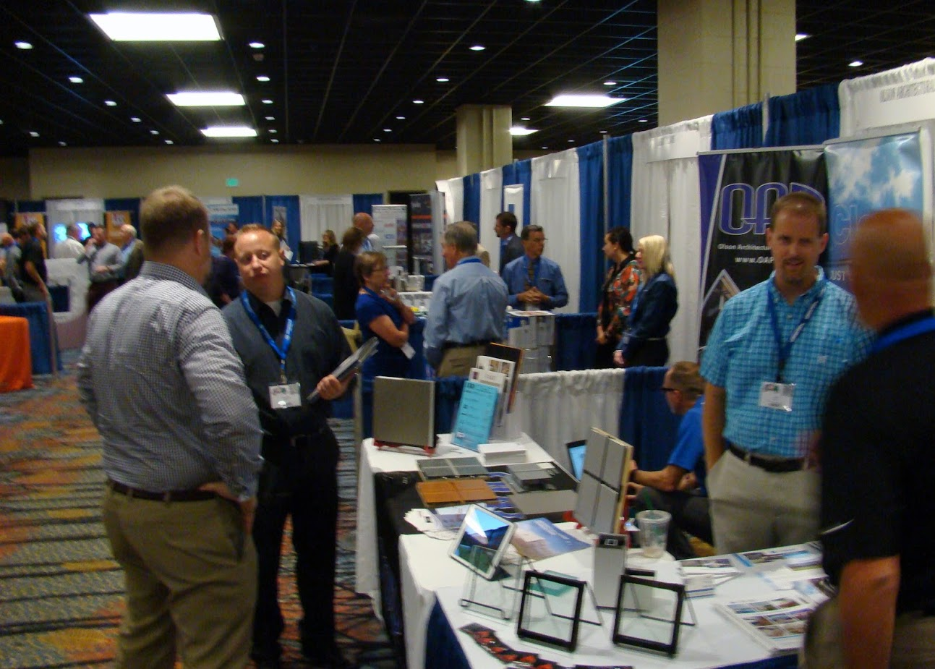
Trade Shows
-
Notes:
Typical Trade Show Event.

Slide 3



Decide what your goals are for the event.
Make Money
Education
Promote CSI
All of the above?
Notes:
Decide on your Chapter’s goals of a successful Trade Show. The largest event of the year and helps fund other Chapter events. Offering continuing education is often a big draw. Promoting CSI through your Chapter offers the advantages of membership. Often all three items happen with a successful Trade Show.

Slide 4
Be Consistent
Consistent Date Each Year
  Third Thursday in September
Consistent Place Each Year
Continuity in the Committee Leadership
Notes:
Consistency is important. Having the show on the same day and place each year makes attending easier. Seasoned leadership from previous shows help make the event come together with no problems.

Slide 5



Promote Awards!
Chapter
Region
Booth
Student
Notes:
Since this your Chapter’s largest event, look at ways to promote awards at the Chapter and Region levels. Booth Awards reward the participants with booth incentives to come back next year. Student awards encourage interaction when they visit each booth. Spreading knowledge of each exhibitor and their product and how it relates to Master Format is one example. At Chapter Booth show awards won by the Chapter.

Slide 6


Advertise….
Let People Know it’s happening!
Notes:
Getting the word about the date of the show early will allow the attendees to plan their activities to include coming to the show. Allows exhibitors to plan reserving booth space and allocating manpower to man the booths.

Slide 7
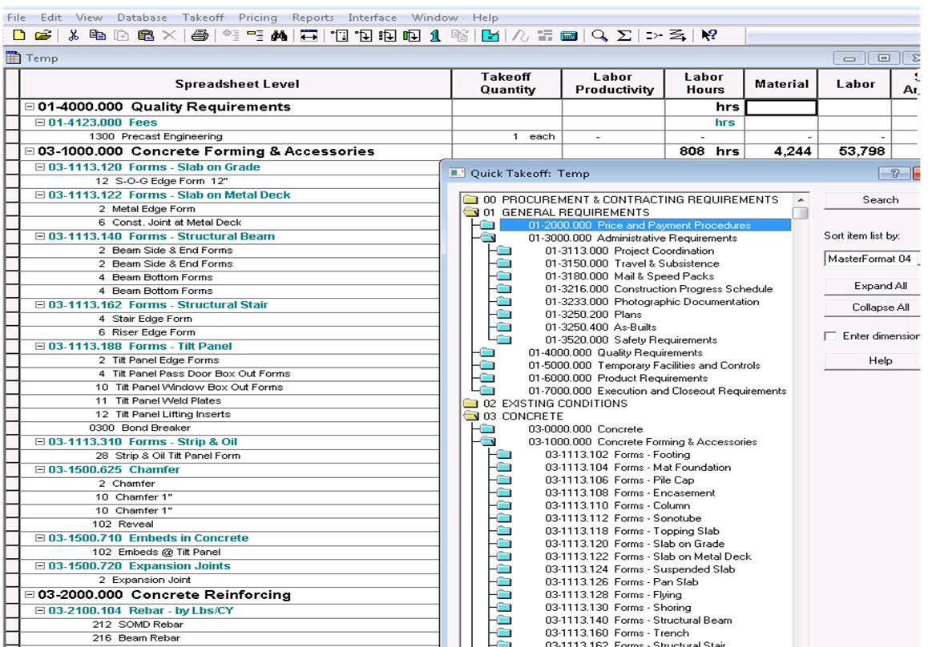
Promote CSI Standards & Formats
MasterFormat
UniFormat
SectionFormat/
PageFormat
PPDFormat
OmniClass
Notes:
Having a Chapter Booth will allow promoting of CSI Standards & Formats. Physical copies are good for people to browse. Include upcoming Chapter Events. Include Membership Forms.

Slide 8
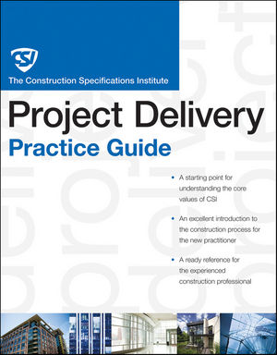
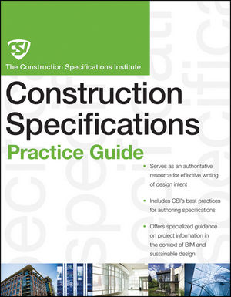
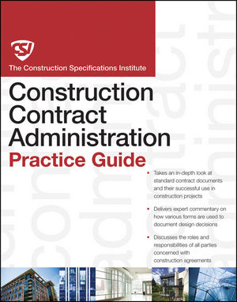
Industry Certifications
Promote CSI
Certification Programs
CDT
CCCA
CCS
CCPR
EIEIO
Notes:
In Chapter Booth promote Certification Programs, especially CDT.

Slide 9
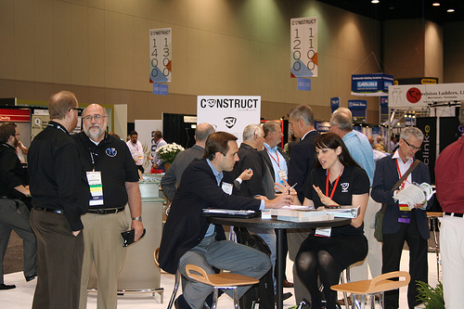
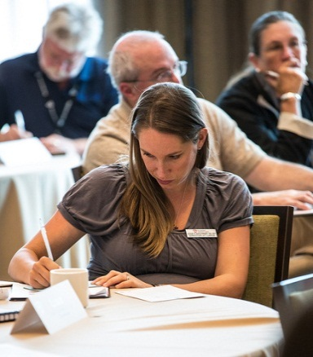
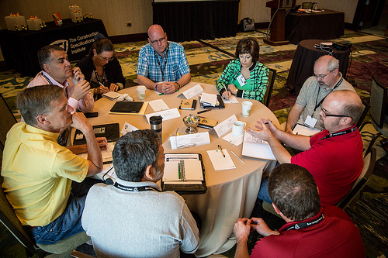
Learning Opportunities
CSI Education Events
CONSTRUCT Show
Monthly Chapter Meetings
CSI Practice Groups
Webinars
  Monthly
  Leadership Connect
  Many topics
Notes:
Promoting CSI includes educational offerings at the Chapter, Region, and Institute levels.

Slide 10
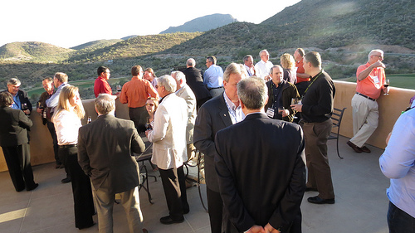
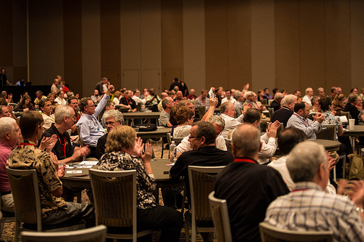
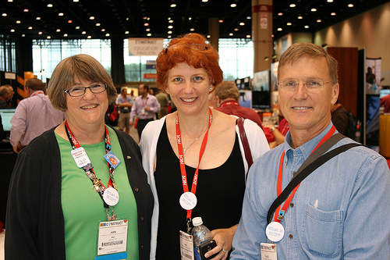
Good Friends
Provide networking opportunities
Notes:
Networking with friends and colleagues is a hallmark of being a CSI member.

Slide 11

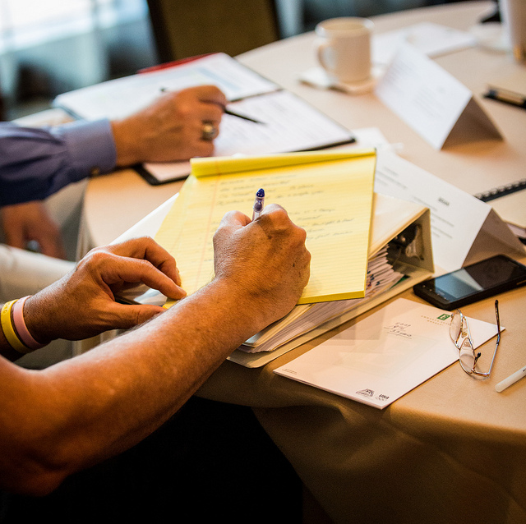
CSI Education
Have Continuing Education Credit Classes
Unique Education Programming
Learn Construction Documentation & Communication Skills
Notes:
CSI offering Continuing Education, building tours, and knowledge of Construction Documentation.

Slide 12
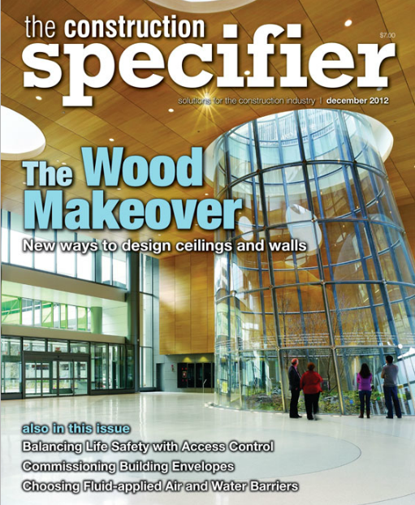
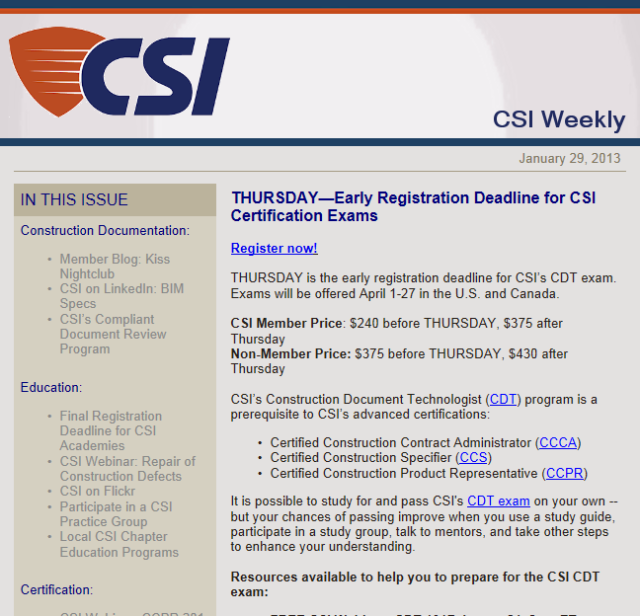
CSI Memberships
Promote CSI publications tools including The Construction Specifier and CSI Weekly.
Notes:
CSI’s Publications The Construction Specifier and CSI Weekly offer detailed technical knowledge of the construction process.

Slide 13

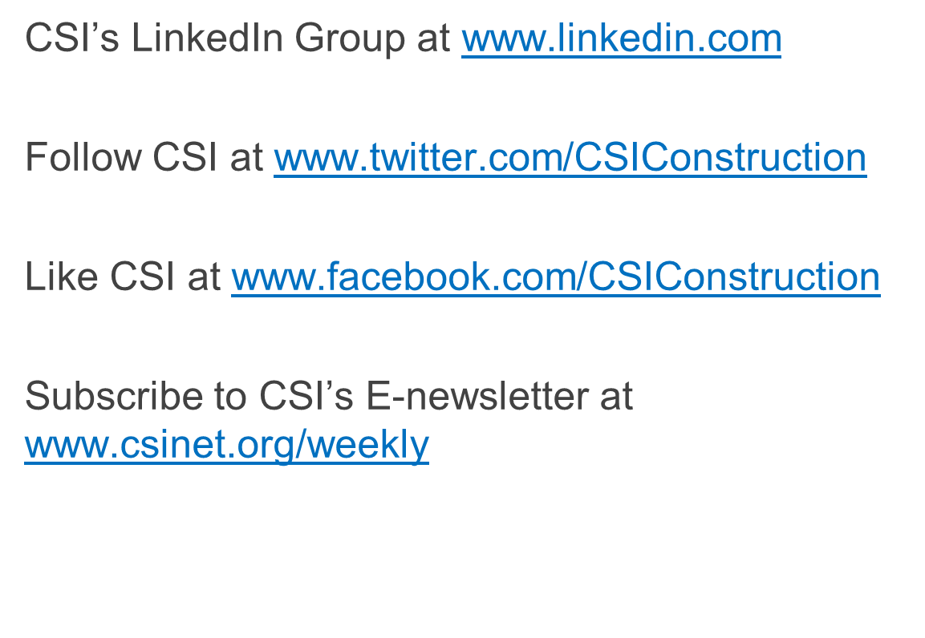



Connect with CSI
Notes:
There are many ways to connect at CSI.

Slide 14

Friendships grow
Notes:
The mixture of different professions that comprise the memberships in CSI helps foster friendships that are unique in the construction industry.

Slide 15
Chapter Tips and Pointers
Southeast Region
Notes:
Pointers to organizing, promoting, and conducting a successful Trade Show.

Slide 16
Have a Theme for the Day/Event
Full Construction Products
Building Envelope
Interior Finishes
Student Activities
Interaction between Construction
Parties
ie: Chicago Chapter’s CSI to Eye
Notes:
Shows can offer vendors promoting products for the building envelope, interiors, or both. Promote student activities to allow them to familiarize with various building products and their relationship to a building project. One on one exchanges with contractors and architects exchanging their wishes and concerns of their relationships have become popular in some chapters such as Chicago Chapter CSI to Eye.

Slide 17
Costs to watch out for
Conference style venues – most expensive
Representatives can bring projectors
Notes:
When offering educational offerings, Conference style venues are the most expensive. (Speaker talking to a large group).
Product Representatives can save costs by providing their projectors for their presentation.

Slide 18

Committees
Help spread the workload
Venue
Registration
Online Registration and Website
Event Sponsorship
Education/Seminar Marketing
Booth Sales
Finance
Communications
Show Stewards
Dock Coordinator
Student Activities
Notes:
Successful Trade Shows have many committees to organize several components of the overall show. Having the same committee chairs assists the effort, but great opportunity for new volunteers to help as well.

Slide 19
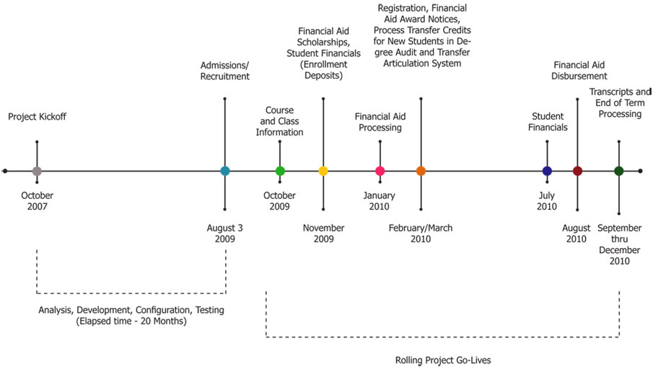
Planning Milestones
After current show, start planning
for next one.
12 Months -
- Lessons Learned Meeting
- Search or confirm venue
- Set date
10 Months -
- Create a Budget
- Select Organization Committee
- Secure Beverages and Food
- Secure Audio Visual
- Secure Pipe and Drape
- Secure Seminar Room
Notes:
Successful Trade Shows take much planning. Start right after a Trade Show concludes planning for the next one.
These milestones are taken from the Indianapolis Chapter of items to be completed at what times before the next show.

Slide 20
Planning Milestones
10 Months (Continued)
- Start Designing Showroom Floor
- Establish Booth Sales Team
- Establish Booth Pricing
- Prepare Vendor Registration
Packet
- Prepare Vendor Confirmation
Packet
- Set-up Online Registration
- Set-up Website for Registration
and Promotion
- Track sales and update layout
frequently.
Notes:
Planning Milestones (Continued)

Slide 21
Planning Milestones
6 Months
- Hire a Marketing Professional
- Start Monthly Committee Meetings and
Form Sub-Committees
- Save the Date Flyers Sent Out
- Start Marketing Program
4 Months
- Continue Monthly Committee
Meetings
- Secure volunteers
2 Weeks
- Confirm arrangements of venue,
registration, manning entry doors, and
student activities
Show Day
- All the work pays off!!
Notes:
Planning Milestones all the way to Show Day.

Slide 22

Ready to Join?
Visit www,csiresources.org for Current Dues
Have membership forms available
Membership Levels:
Professional
Emerging Professional
Student
Notes:
Showing the advantages of joining CSI, have membership forms available. Three levels of membership: Professional, Emerging Professional, and Student.

Slide 23

Questions?
Notes:
Questions?

Slide 24
Thank You!
CSI Southeast Region
Notes:
Thank You!

