Slide 1

Southeast Region
President & President-Elect
Preparation
Region President Office Duties and Responsibilities
Notes:
This document is a training guide. It is intended to allow you to see how others have handled the office and what has been encountered, considered important. This is a FY 2014 document put together by the current Great Lakes Region Institute Director, who has been a chapter (Columbus) and Region President. It has been put together in an effort to reduce the learning curve problem that plagues CSI in general. We are a volunteer organization, are constantly re-inventing the wheel as we move in and out of offices. We spend a lot of time learning and re-learning things that happened to the person in front of us. This takes valuable time and energy from performing and/or growing the position, hampering progress. This is meant to provide a solid roadmap for the next in line. This is an attempt to provide an outline for the people who chair the Chapters of the Region, the next generation of Presidents at that level. It is not perfect, and it will become dated over time. It is a living document, and will change as CSI changes. All that is ask is that as you change it with better ideas, and updates; you will document them and return it here. My goal was to leave things better than I found them. This tool is a start to make that happen. I trust you will build on those who have created CSI in front of you and do the same.
Thad Goodman, FY 2014 Great Lakes Region Director.

Slide 2

July 1, XXXX-1
Your job actually starts with your election to President-Elect
Spend the year getting to know expectations
Notes:
As you take the President- Elect’s office, think of it as the countdown to the President’s office. Constant contact with the person as the top is paramount. Ask to be copied on any communication that comes in or goes out to the top position. Start by not offering any opinions, but asking the questions about how it’s going to be handled by the current president. Take notes of timelines and occurrences. It will be your roadmap to service the next year with you step into the seat.

Slide 3

Mirrors
Regular conversations with the Current President
sharing of e communications
Discussion on CSI Issues
Notes:
Use your position to get to know about all the things that are going on currently, be front of mind with the workings of the Chapter,
Mirror the thoughts and ideas of the current president- it’s your chance to get to know the issues standing outside the line of fire.
This provides you with a chance to ask all concerned questions, and form opinions to attack the position the next year.

Slide 4
Outstanding Chapter Time Line
Notes:
The Columbus Chapter applies for the Outstanding Chapter award each year. We have a document set up on Google Docs to highlight each function to get every category covered. Is this a goal? Then make sure everyone is on board!

Slide 5
President-Elect
Take an interest in sharing the events for your chapter.
The MORE you get involved, the easier it will be for you at the top.
Notes:
Contact your current planning chair, the Current President, the membership chair. Begin thinking about what you want to accomplish.
You can’t have too much communication.

Slide 6
Chapter President
You Made It!
Congratulations!
(I’m Sorry….)
Notes:
Stepping into your big year doesn’t have to be a chore, if you have planned right and get off of the right foot.
So how do you do that??

Slide 7

Paperwork
Agenda
Budget
Call list
Meeting minutes
Treasurers report
Directors report
Whatever report!
Collect the right forms
  Agenda templates
  Meeting notice templates, emails
  Board invitation lists,
Notes:
There are some basic things you have to gather to be able to conduct the business of the chapter. Each chapter does things differently. You get these from the current Chapter President on his way out.

Slide 8


Paperwork $$$
Signature Cards
  You are a signatory for the chapter now.
  Treasurer can help with bank identification, location, joint visit
    (they need to know it’s you!)
    -Budget presented July Board meeting, August Approval
Notes:
Make arrangements to get the current president’s signature off the chapter account and yours on it. You will need to go with someone who is currently on the banks account as a signatory.
Also work with the treasurer to get the annual budget ready for presentation at the July Board meeting to start the year out right.

Slide 9

Planning Meeting
Looking at your Year ahead
Get the new officers together for a planning meeting in June/July.
Best move you will make!
Program included (csinet.org)
Notes:
A summer planning meeting for 2-4 hours on a Saturday is a great idea.
I have included this CSI PPT in your flash drive with this presentation at the region conference. It can also be found on the CSI website. Kathy Proctor did a great job of putting it together.

Slide 10

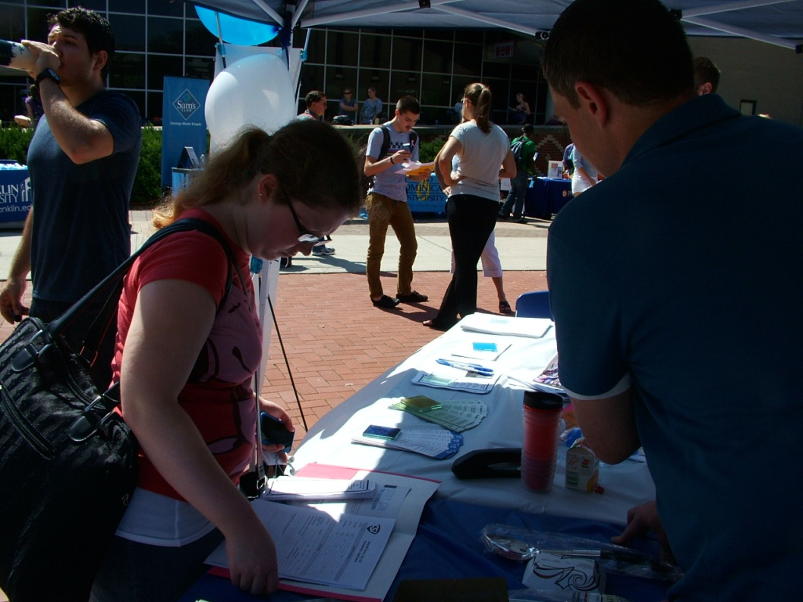
Maintain/Update
By-Laws
Operating Guide
Strategic Plans
Surveys
Officer Data Bases
Chapter Communication Platform
Notes:
The paperwork of the office. The logistics of what we do. President and President-Elect should talk at the beginning of the year, identifying who is doing what part of these actions. Also who is going to track the progress of these things getting done.

Slide 11
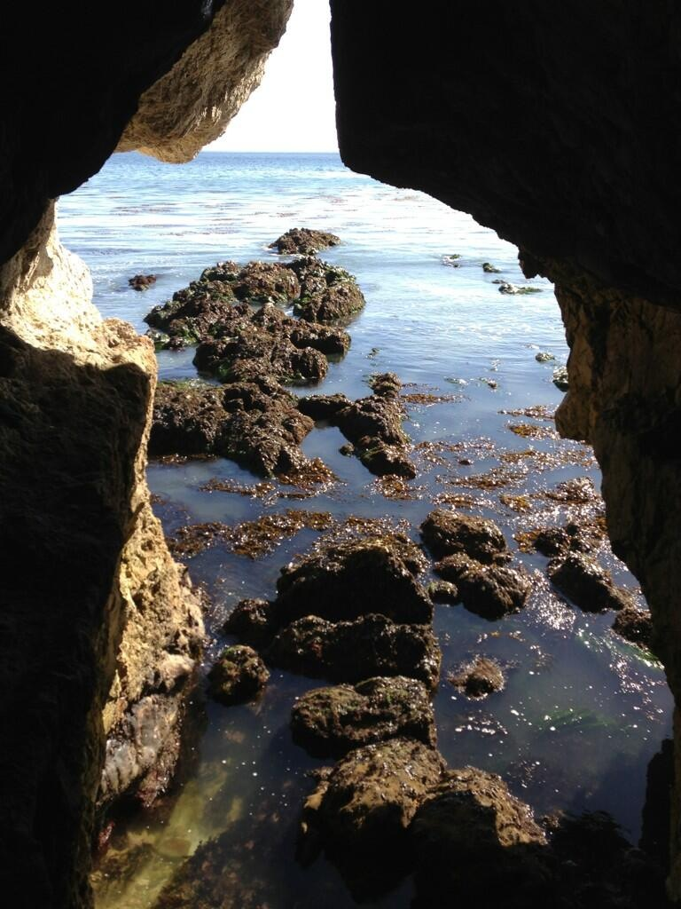
Foundation Stones
Traditional Events
Chapter Meetings
Golf Outing
Trade Show
Specifier
All Covered?

Slide 12

Keystone Events
“Day at the Races”
“Procrastination Day”
Member Orientation
Scholarships
Elections
Notes:
Double check the major events planning for the chapter. The things your chapter does that are different and everyone looks to each year.
Make sure the people in place are continuing on and all is underway for a great event.

Slide 13
Hello Leader
Elections happen no later than the April Meeting!
February nominations
March visibility month
April Meeting vote, because……
Updating Forms for the CSI Website is an important part of the job.

Slide 14
Hello Leader
Officer and Chair Updates Due!
This is just a quick reminder that the Chapter and Region Officer and Chair Update Forms are due by the end of the day (typically the second week of MAY).
Updating Forms for the CSI Website is an important part of the job.
Notes:
This is an action driven by Institute. As Chapter President, you will receive the forms proactively. It’s important to be aware that they are coming and have your elections done, and the committee’s filled. This is a good exercise for the President- Elect, as this will be the team He/She works with for the following year.

Slide 15
Hello Leader
Awards Deadline- First Friday in May!
Awards are important for the chapter
Notes:
Awards are currently due the first Friday in May. It takes your awards chair months to get everything together. Help them plan by nudging the at the beginning of the year (January) to start identifying the people or awards desired and start the process of looking through the forms that need to be filled out, records that need to be found, letters written, etc.

Slide 16

Rewards
We have a GREAT Region with fantastic chapters.
With a little forethought and communication…
You will have a Great Year!!!!!
Notes:
This is a wonderful position to hold for CSI. Like most of anything else- it’s what you make of it. Allocate as your time allows, and use this guide to be prepared. Get involved and Get Rewarded!

Slide 17
Additional Tools:
Best Practices for Effective Chapter Meetings
Chapter Administration Guide
Chapter President Guide
LIFE Articles
Looking at your Year Ahead
Presidents Training
Social Media
Volunteer Leadership Management
Why CSI
Most Available on csinet.org
Others by request-
Glenn.J.Remler@sherwin.com
Happy Reading!

Slide 18
THANK YOU
Thad Goodman
Region Director FY 15
thadg@nationalgypsum.com
614-296-5375

