Slide 1

Southeast Region
Education Chair
Duties and Responsibilities
2021

Slide 2

Congratulations!
You’ve accepted the position of Education Chair for your CSI chapter! Professional development is an integral part of the chapter experience, and you are in the enviable position to help shape that experience.
Southeast Region

Slide 3

Goals
Establish programs in construction communications, improve those now in existence, and assist in maintaining those programs.
Promote the use of standard documents, particularly those recommended in the CSI Project Resource Manual, in construction communications courses.
Assist in the development of seminars and courses for current state-of-the art practices.
Encourage university and technical institute administrators offer courses in construction communications as part of their credit extension programs.
Establish continuing education courses for both state-of-the-art and tutorial programs

Slide 4
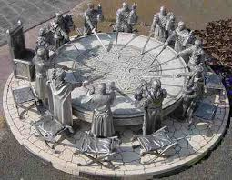
Organizing Committee
Don’t be Afraid to Ask for Help
Form a committee of interested members to decide on certification activities and events for the year and delegate tasks.

Slide 5
Guidelines
Meet with committee on a regular basis to establish goals and plan committee activities such as the following:
  Chapter sponsored seminars, workshops and short courses.
    Member education.
    Liaison with local educations institutions.
    Liaison with local chapters of related construction industry organizations.

Slide 6

Guidelines
  Committee Meetings:
    Encourage participation in the committee from industry and professional members.
    Set time and achievement goals/deadlines.
    Keep meeting minutes.
    Delegate responsibilities required for sponsoring seminar.
    Keep summary of any seminar, workshop or short course.
    Compile evaluation forms compilation for review of seminars and requests for future seminar topics.

Slide 7
Guidelines
Coordinate with Chapter Programs Committee for coordinating a seminar topic with monthly program.
Coordinate with Trade Show Committee for sponsoring a seminar prior to trade show with the intent to encourage attendance at the trade show.
Provide a liaison with other disciplines in the construction industry.
Coordinate with Certification Chair for training seminars for certification exams.
Report to Chapter Board monthly.
Report to Region Education Chair. Send reports on seminars as they occur with a quarterly report on total committee activities.

Slide 8
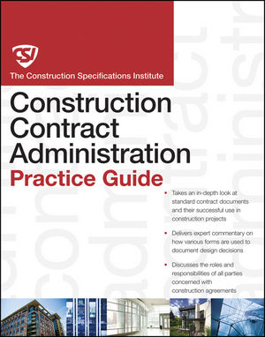
Education Topics
Educated members are CSI’s best ambassadors.
Short education presentations before monthly chapter meetings.
  Describe the Project Delivery Guides.
  Explain the 3-Part Section format.
  Explain and promote a CSI or joint industry publication.
Present Master Format 2004. Encourage member of Education Committee to become a Certified Instructor.

Slide 9

Education Topics
Speakers:
  Explore expertise within own chapter members.
  Previous CSI conferences or convention.
  Local chapters of related construction associations.
  Colleges, Universities or trade schools.
  Principals of local A/E firms.
  Lawyers involved in construction law.
  Code consultants.
Explore “spin-off” topics from another seminar or workshop.

Slide 10
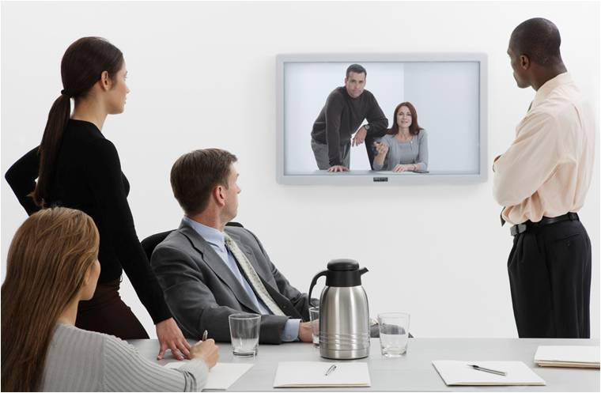
Education Topics
Encourage members to write educational articles for chapter newsletter.
Take advantage of Audio Exchange programs. Coordinate with local architecture firm with facility to view programs to larger audience.

Slide 11
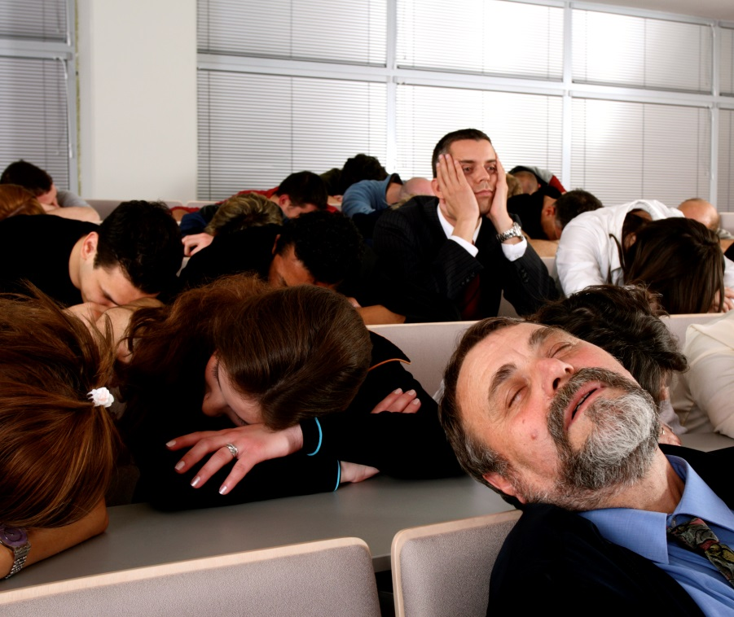
Education Topics
Change the delivery and approach to seminars and presentations.
  Workshop.
  Panel of experts.
  Seminar.
  Audio presentation.
  Round table discussions.
  Short course.

Slide 12

Education Topics
8. Develop liaison with other disciplines in the local construction industry. This provides the opportunity for their membership to present topics of interest to your chapter.
Technical information should be timely, controversial and in the forefront of the building industry.

Slide 13

Education Topics
Division Topics
Coordinating Program and Education Seminar Topics
Code Topics
Popular Convention Topics
Controversial Topics

Slide 14
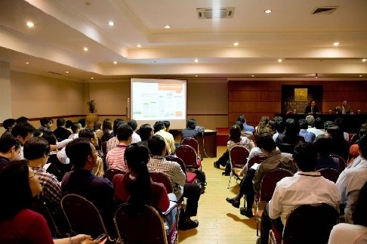
Continuing Education Units
Continuing education units (CEU) and Learning Units (LU) are a significant benefit to the attendees of any educational program. Requirements for maintaining certification and professional registrations make submitting for approval and recording attendees crucial to the success of an education program.

Slide 15
Continuing Education Units
Submit a CEU application to CSI Institute and to AIA for approval a minimum of four to eight weeks before your presentation is scheduled.
Some CSI sponsored programs will entitle participants to receive Intern-Architect Development Program IDP value units. Contact Director of Internship Programs at NCARB for information.
CEU certificates are awarded to all participants of approved programs. Provide sign up form for CSI CEU’s and AIA LU’s at each presentation. The ability to keep records of attendance for your membership over an extended period of time is an added value.
Promote the number of CEU’s or LU’s in advertisement and registration forms for the education program. Send notification to other neighboring Chapters that may have membership interested in obtaining continuing education credits.
Submit record of education programs or seminars to your CSI Region Education Chair.

Slide 16

Communication
Monthly Meetings
  Certification Flyer
Publicize
  Monthly Newsletter
  Social Media
  Seminar Dates
New Certificants
  Press Release
  Recognition at Chapter Meetings

Slide 17

Region Conference
Communicate with Region Certification Chair
Obtain Future Seminar Dates around Region
Obtain Future Seminar Topics around Region
Obtain Education Literature

Slide 18

Successor
Thank your Committee Members
Identify and Develop your Successor

