Slide 1
CHAPTER SECRETARY
CSI SOUTHEAST REGION
LEGACY TRAINING
Best Practices And
How To Be An Effective
Chapter Secretary
Notes:
Welcome and introduce self – name, chapter, chapter and regional roles

Slide 2
LEARNING OBJECTIVES
Introduction
Responsibilities
Calendar
Board Meetings
Documentation
Resources
Notes:
These are our learning objectives for this session

Slide 3

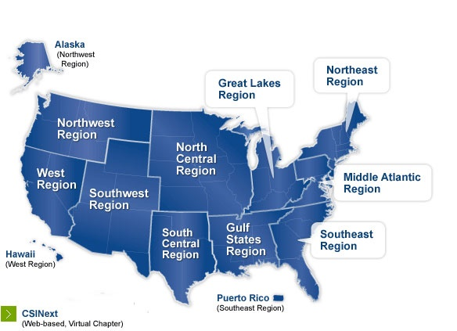
INTRODUCTION
Congratulations!
So you’ve accepted the position of Chapter Secretary for your CSI chapter!
Each year, over 130 of you take office and “carry the torch” as Secretary for CSI Chapters across the country.
Serving as a Chapter Secretary is a great honor, and an opportunity to not only have an impact on CSI but enhance your own leadership skills.
This guide will provide you with the tools you need to succeed in this important job.
Notes:
Personally – the Secretary role has been gateway into participating in professional organization leadership – AIA, Toastmasters, CSI, church boards

Slide 4

RESPONSIBILITES
General Duties of the Chapter Secretary
See that notices are sent in advance of all meetings of the board and of the chapter and keep accurate minutes thereof;
Maintain a file of all chapter correspondence;
Keep a roster of members and committees;
Co-sign all agreements and formal instruments, except those pertaining to the office of the Treasurer;
Submit a report of office at the annual meetings of the chapter and region;
Perform other duties as assigned by the board;
Shall serve for a term of two years (FY = July 1st-June 30th) per chapter bylaws
Notes:
Your general responsibilities should be defined in you Chapter’s bylaws

Slide 5

RESPONSIBILITES
Keeper of Chapter Records
Best Practices:
GO ELECTRONIC!
Maintain files on your computer or the cloud
Backup regularly to a portable hard drive or flash drive
Pass on past and current records to successor
Scan and file loose documents
Files:
  Meeting Minutes
  Committee Reports
  Treasurer Reports
  Newsletters and Communications
  Membership Rosters
Notes:
Primary task – Keeper of Chapter Records
Best Practice is Go Electronic – ditch the paper
Set up a cloud based location for your chapter records for easier transfer to future secretaries

Slide 6

RESPONSIBILITES
Related Duties of the Chapter Secretary
The Secretary shall work closely with:
Chapter President
  Preparing for board meetings
Chapter Treasurer
  Recording financial reports
Awards Committee
  Maintaining chapter records
Communications/Publications Committee
  Publishing meeting minutes
Membership Committee
  Membership records
Notes:
Your tasks and record keeping ties in with other board and committees

Slide 7

CALENDAR
First Quarter
July - Starting Up
Chapter board meeting
On-board new chapter leadership
Institute Outstanding Chapter Commendation (OCC) submission due
August
Chapter board meeting
Chapter leadership planning retreat
September
Chapter board meeting
CONSTRUCT/ Regional Caucus
Notes:
Besides monthly board meetings, there are other activities you will be responsible for during your fiscal year calendar

Slide 8
CALENDAR
Second Quarter
October
Chapter board meeting
November
Chapter board meeting
December
Chapter board meeting

Slide 9
CALENDAR
Third Quarter
January
Chapter board meeting
Call for chapter board nominations
February
Chapter board meeting
Chapter board approval of nominations
March
Chapter board meeting
Publish chapter board nominations
Regional Awards submissions due

Slide 10
CALENDAR
Fourth Quarter
April - Your Busy Month!
Chapter board meeting
Chapter board elections
Invite new chapter board members to Regional Conference
Prepare Chapter Annual Report for Regional Conference
Regional Leadership Conference
Update Institute with newly elected Chapter Board and Committee Chairs
May
Chapter board meeting
Institute Award submissions due (except OCC)
June - Year End
Chapter board meeting, include new board members
Transfer records and train new Secretary

Slide 11


BOARD MEETINGS
Meeting Types
Scheduling:
Meet prior to Chapter Meeting
Meet day other than Chapter Meeting
Set up regularly scheduled meeting dates
Face-To-Face Meetings
Link in others electronically if unavailable
E-Meetings
Visual electronic programs
  GoTo-Meeting
  Skype
  Webex
Conference Calls
Non visual
Notes:
Work out your board meeting type and schedule with your Chapter President

Slide 12

BOARD MEETINGS
Preparation
Two Weeks Prior
Send meeting reminder
Request agenda items
Request reports
One Week Prior
Send out requests again :-)
Send out Board Meeting Packages
  Past meeting minutes
  Meeting agenda
  Monthly financial reports
  Monthly committee reports
Day of Meeting
Print off additional board meeting packages
Be prepared to take meeting minutes
Arrange for a backup Secretary, if unable to attend

Slide 13
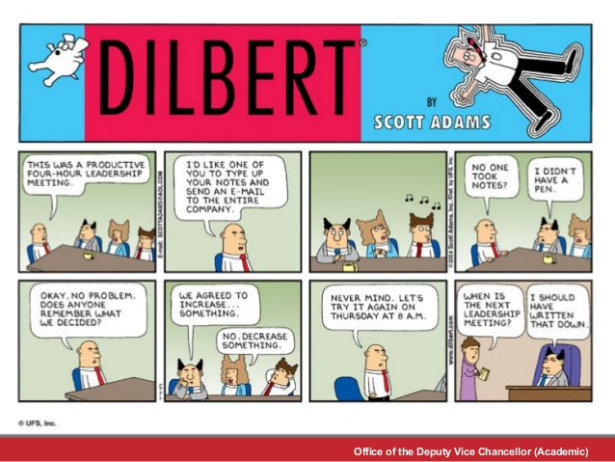
BOARD MEETINGS
Meeting Minutes

Slide 14

BOARD MEETINGS
Meeting Minutes / Agenda
Record of the Meeting (see sample)
Attendance - Present / Absent
Review and acceptance of previous minutes
Review and acceptance of financial report
Highlights of committee activities
  Majority of information provided in Committee Reports
Old and New Business
Decisions made / voting
Next Meeting
Notes:
You’ve probably done this for your own work related meetings
See agenda sample in handout

Slide 15
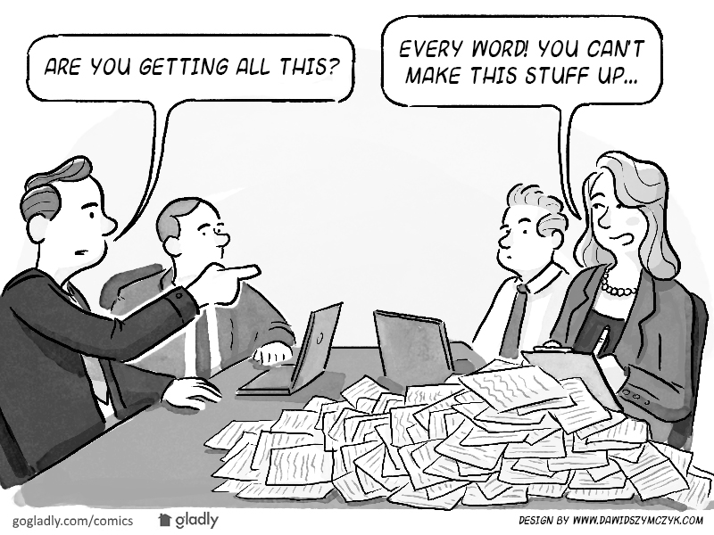
BOARD MEETINGS
Taking Meeting Minutes
Best Practices
Be sure you are organized
  Prepare your minutes template, utilize your agenda
  Have documents up on your computer prior to meeting
CSI Specification 4 "C's"
  Clear / Concise / Correct / Complete
Key is to record the business and decisions made in the meeting, not necessarily the discussion
Document tasks, responsibilities, deadlines
Record decisions and voting
Notes:
K.I.S.S.

Slide 16

DOCUMENTATION
Committee Reports
Written Monthly Report (see sample)
Submit to Secretary in include in monthly board package
  Reduces discussion during board meetings
Include Committee:
  Name
  Chair
  Members
  Goals and Objectives
  Last meeting
  Activities and Accomplishments
Notes:
This is a great tool for stream-lining your Chapter Board meetings
See sample in handout

Slide 17
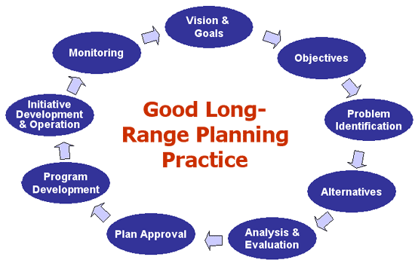
DOCUMENTATION
Chapter Long Range Planning Report (LRP)
Begin year with a LR Planning session
Best practice for a successful chapter
Target a 3-year plan
Review previous LRP
Develop primary chapter vision
Develop goals and objectives for committees to support chapter
"SMART" goals
  Specific
  Measurable
  Attainable
  Relevant
  Time-Oriented
Notes:
Review Healthy Chapter Checklist and OCC criteria to see where you are and could be
GLR LRP available on website

Slide 18

DOCUMENTATION
Chapter Annual Report
Prepare for Chapter Annual Meeting and Regional Conference
Utilize report to prepare Outstanding Chapter Commendation (OCC) submission
Follow "Healthy Chapter Checklist"
See sample report
  Board and Committee Chairs
  Membership status
  Communications
  Programs
  Special Events
  Special Mentions/Awards/Honors
Notes:
Could even be a living document – maintain and update throughout the year
See sample in handout

Slide 19

RESOURCES
Support and "Go To's"
Chapter
Use past Secretary and board as resources
Use existing chapter forms
Be familiar with your chapter bylaws
Regional
Use Regional Board and Committee Chairs as resources
Legacy Leadership Training
Regional Bylaws
Institute
Institute website
  Leader Community and Tools
  Membership Roster
  Email Tool
  Staff
  Special Events
  Special Mentions/Awards/Honors
Notes:
Lots of resources at all levels

Slide 20
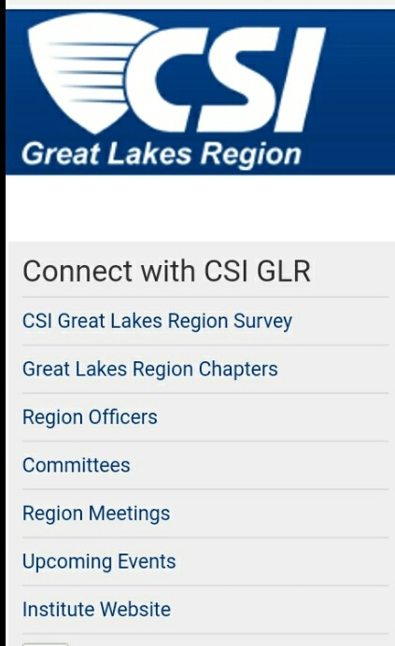
RESOURCES
Great Lakes Region (GLR)
Website
http://greatlakes.csinet.org
Website Resources/Tools
GLR Bylaws
GLR Strategic Plan FY16-20
Officer and Committee Training
Regional Contacts
President: Ed Brown
Secretary: Gregg Jones
GL Regional Director: Jack Morgan
Notes:
Your Chapter President is also a Director on the Regional BOD

Slide 21
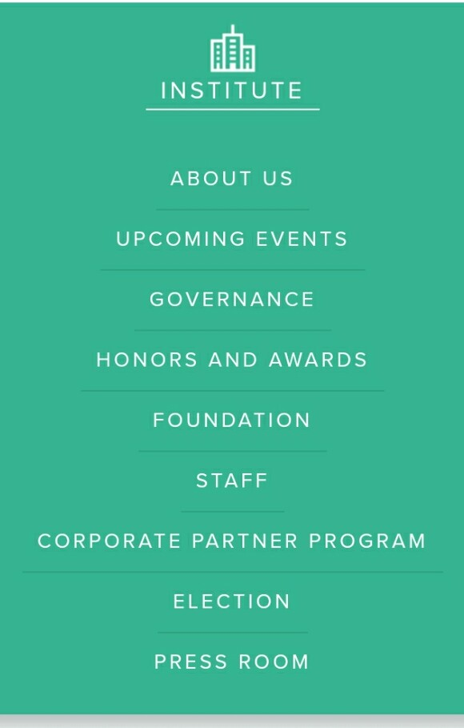
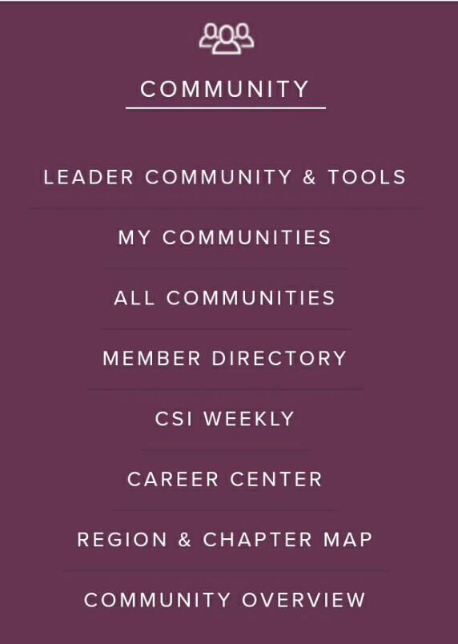
RESOURCES
Construction Specifications Institute (Institute)
Website
http://csiresources.org
Website Resources / Tools
Institute
  Staff
Leader Community & Tools
  Roster Tool
  E-mail Tool
Staff
CEO: Mark Dorsey
Chapters/Communities: Cathy Stegmaier
Manager Technical Community and Strategy: Matt Fochs
GLR Regional Director: Jack Morgan
Notes:
If time, sidebar with demonstration of accessing Roster and Email tools

Slide 22
SUMMARY
Refer to your Chapter Bylaws for responsibilities
Work with your Chapter Board and Committee Chairs
Know your calendar – Chapter/Region/Institute
Conduct and document effective Board Meetings
Be prepared to assist with additional documentation
Get to know your available resources at Chapter, Regional, and Institute levels
Notes:
In closing …..

Slide 23
Final Questions / Comments
Best Practices And
How To Be An Effective
Chapter Secretary
Notes:
Contact information

