Slide 1

Southeast Region
Awards Chair
Preparation
Awards Chair Duties
And Responsibilities
February 20, 2017
Notes:
Region Award’s Chair Preparation

Slide 2
Responsibilities from the SE Policy
First place to find basic responsibilities for position:
Appointment
Responsibility
Duties
Notes:
No mention in Bi-Laws, only in the GLR Policy Document.

Slide 3
Appointment
Awards Chair is an appointed
position for a two year term
(Policy, Article V)
  Begin term on July 1
Appointed by the
SE President-Elect
Notes:
From GLR Policy Document.

Slide 4

Awards Committee
Region President
Region President-Elect
Region Immediate Past President
Awards Committee Chair
Awards Committee Immediate Past Chair
(No fewer than three members of the Region)
Notes:
From Region Honors & Awards Guide.

Slide 5

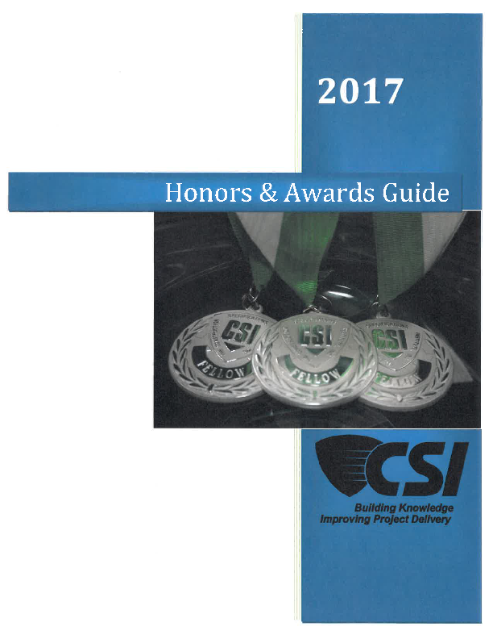
Three Levels of Awards
Institute
Honors & Awards Guide
Region
Honors & Awards Guide
Chapter
Chapter Awards Guide
Notes:
Picture of the Institute’s 2017 H&A Guide. Chapters may or may not have a printed guide.

Slide 6

Purpose
  To recognize talent and achievements.
  To highlight and share innovative ideas and practices for replication.
  Significant way to show appreciation in an all volunteer organization.
  Public Recognition
  To stimulate membership
  Doesn’t someone from your
  Chapter deserve recognition?
Notes:
Probably more, but five are listed.

Slide 7
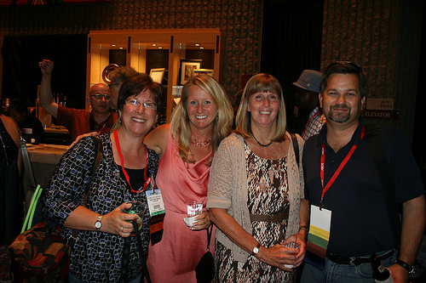
Institute Awards
Institute Honors
  Distinguished Membership
  Honorary Membership
  Fellowship
Institute Awards
  15 different awards
Institute Recognition
  Board Chair Medal
  Former Board Chair’s Medal
  Lifetime Member Plaque
  Board Chair’s Plaque
  Special Award
  Certificate of Merit and Appreciation
  Chapter’s 50th Anniversary Plaque
Notes:
Institute Awards listed in 2016 H&A Guide.

Slide 8
Institute Awards
  Environmental Stewardship
  Education
  Certification
  Technology
  Specifications
  Service
  Quality and Process Improvement
  Communications
  OCC Awards
Wide range of Institute awards are available in a multitude of areas including:
Notes:
Institute Awards listed in the 2016 H&A Guide

Slide 9
Region Awards
Service Recognitions
Service Awards
Professional
Accomplishment
Awards
Publication Awards
Region Recognitions
Wide range of Region awards are available including:
Notes:
As listed in the Region H&A Guide.

Slide 10
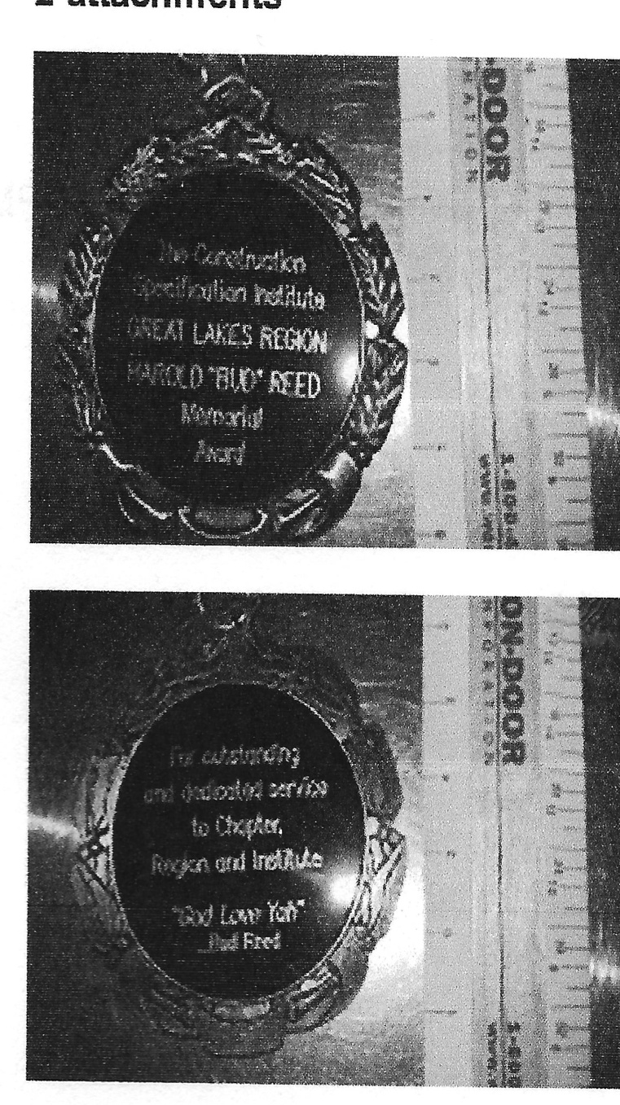
Region Awards
Great Lakes Region
Special Recognition
Award:
Bud Reed Memorial Award
Notes:
Size and script of the Bud Reed Memorial Award medal

Slide 11
Chapter Awards
Service Recognition
Professional Accomplishment Awards
Publication Awards
Each Chapter has it’s Highest Recognition Award
A wide variety of Chapter Awards are available that differ by Chapter.
Notes:
Chapters have many available awards that differ by Chapter.

Slide 12

Duties and Responsibilities
Region Awards Chair To
Institute:
Publicize the
Institute Awards
Programs.
Act as liaison with the
Institute Awards
Committee
Submit reports to the
Chair of the Institute
Awards Committee
Suggest changes to
Institute Awards Program
Notes:
Responsibilities to the Institute Award Committee

Slide 13

Duties & Responsibilities
Region Awards Chair To
Region:
Organizes, implements, administers, and publicizes the Region Awards Program
Receive and coordinate nomination paperwork for Region nominations
Review nominations with Awards Committee and make selections
Notes:
Duties and Responsibilities – Awards Based – Region H&A Guide

Slide 14

Duties and Responsibilities
To Region: (Continued)
Each Region Award:
- Develop and details criteria,
nomination, and judging
procedures
- Seeks submission of
Awards Candidates
Awards Guide:
- Review
- Revise
- Publish changes
Provide suggested awards
budget amounts to the
Region Treasurer
Notes:
Duties and Responsibilities – Administrative – Region H&A Guide

Slide 15

Duties & Responsibilities
To Region: (Continued)
Assist the Region President, President-Elect, and Immediate Past President in the presentation of awards at the annual Region Awards Banquet.
Suggest changes to the Region Awards Programs
Notes:
Duties and Responsibilities – Awards Based – Region H&A Guide

Slide 16

Duties and Responsibilities
Region Awards Chair to the
Chapter:
Serve as resource person to Chapter Awards Chairs or Chapter Presidents if no Awards Chair is identified
Notify Chapter Awards Chairs about successful selections and nominations not selected
Notes:
Region H & A Guide

Slide 17

H&A Guide
Institute:
Submission Information
Nomination Matrix
Overview of the H&A Program
Institute Honors
Institute Awards
Institute Recognition
Honors & Awards Forms
Notes:
Institute 2017 H&A Guide

Slide 18

H&A Guide
Region:
Submission Information
Overview of the H&A Program
Region Honors
Region Awards
Region Recognition
Region Honors & Awards Forms
Past Awards Winners
Notes:
Region H&A Guide

Slide 19

H&A Guide
Chapter:
Submission Information
Overview of the H&A Program
Chapter Honors
Chapter Awards
Chapter Recognition
Chapter Honors & Awards Forms
Past award winners
Varies by Chapter
Notes:
Chapter may or may not have a guide.

Slide 20




OCC
Designed to Reward Chapters for their good work on behalf of their members
All Chapters should nominate themselves
Use it as a gage for supporting members and CSI’s mission
All nominations submitted to Institute
Region Awards Chair promotes the OCC to the Chapters
Outstanding Chapter Commendation
Notes:
OCC – Chapter Awards Chair Responsible to Cooridinate

Slide 21
OCC
Pre-Requisite Core Criteria must be met
Pre-Requisite Core Criteria cover key responsibilities that chapters need to perform in order to prosper and flourish.
Supplemental Criteria earns points
Supplemental Criteria covers additional criteria related to chapter administration, membership, finances, certification, educational programs, communications, and much more.
Outstanding Chapter Commendation
2 Parts:
- Pre-Requisite Core
Criteria
- Supplemental Criteria
Notes:
OCC – 2 Steps in Process

Slide 22
OCC
3 Classifications for
Chapters:
Based on the number
of Chapter members
- Level I – 126 or more
members
- Level II – 61-125
members
- Level III – 60 or
fewer members
Three Classifications
Notes:
OCC – Classified by Chapter’s Membership and Three Various Levels

Slide 23
OCC
As chapters earn the OCC, they reach the following milestones:
1-4 Years – Base OCC
5 Years – Bronze Level
10 Years – Silver Level
20 Years – Gold Level
Various Levels
Notes:
Four levels

Slide 24
OCC
Chapter Administration
  Leadership at FY Start
  Leader Names to CSI
  Reviewed Bylaws
  Held Board Meetings
Fiscal Responsibility
  Use a Budget
  Good Standing with IRS
Education & Programs
  Regular Meetings
  Min 4 Educational Programs
Communications
  Min 6 Times per Year
Pre-Requisite Core Criteria
Notes:
Pre-Requisite Core Criteria

Slide 25
OCC
Back-up Provided
  Chapter Bylaws
  Officers Submitted to CSI
  Chapter Budget
  Description of 4 Educational Programs
  3 Examples of Communications
Back-up Must be Provided in the PDF File - Form 306
Criteria
Notes:
OCC - Criteria

Slide 26
OCC
Administration
Membership
Finances
Certification Programs
Education/Technical Programs
Communications
Events
Academic Relationships
Region & Institute Participation
Brag Box
Supplemental Core Criteria
This is Where Chapters Explain:
  Who We Are
  Why We Are Special
  What Makes Us Outstanding
Notes:
OCC – Supplemental Core Criteria

Slide 27

Prepare Awards
Once recipients have been
determined:
Coordinate with Region President on appearance of Awards
Create awards according to templates
Order awards as needed
Allow time for order to be completed
Once received, organize for distribution at Awards Banquet
Notes:
Check spelling of names of all successful award winners. If nomination has specific language to be incorporated on the award, verify all wording and spelling. Allow for another person to review your efforts.

Slide 28
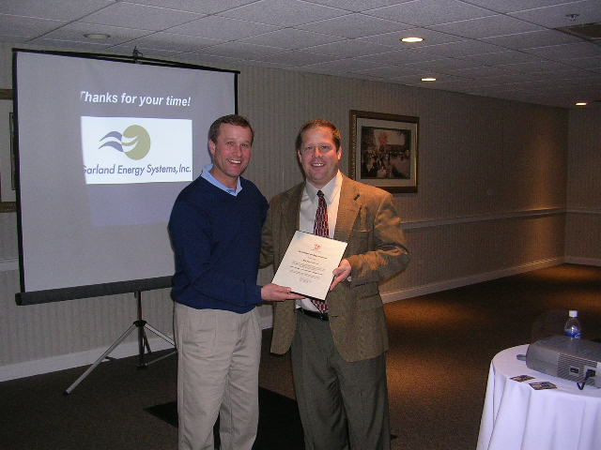
Rewards
Rewards of an Awards
Chair:
Promote significant achievement
Honor to introduce members to the Region
Honor to reward their efforts
Honor to promote CSI
Notes:
We have many deserving members that need to be recognized to honor them and CSI.

Slide 29
Other Nomination Information
Region Award Chair Address:
Address letters of endorsement to Awards Chairman.
Organize forms, exhibits and other materials and/or bind them
for a professional and easy-to-read nomination package.
Read the full requirements of each award in the Region or Institute CSI
Honors & Awards Guide.
Have someone else review and proof the nomination package
prior to submission.
Submit the appropriate number of nomination packages in the
appropriate format.
Remember to get your nomination in before the deadline!
Notes:
Information for submission of Region Awards.

Slide 30

DEADLINES:
Nominations for all Region
Awards
Date Here
5:00 PM Eastern
Nominations for all Institute
Awards:
Date Here
2:00 PM Eastern
OCC Nominations to Institute:
Date Here
2:00 PM Eastern
Start preparing your
Nomination packages NOW!
Notes:
Deadlines for Institute, Region, and OCC Awards

Slide 31

NOMINATE
What If You Have Questions?
Email awards@csiresources.org
Call 800-689-2900 x 4783
Visit www.csiresources.org/honorsandawards to download the Honors & Awards Guide
Region Awards Chair:
Name here
RECOGNIZE EXCELLENCE
Nominate Someone Today!
Notes:
Institute and Region Contact Information.

