Slide 1
OPERATIONAL EXCELLENCE
PROGRESSIVE + STRATEGIC WORKPLACE
Sheri Ginett, IIDA, NCIDQ, Interior Architects
Carol Fadden, Duke Energy
September 9, 2015

Slide 2


HELLO.
SHERI GINETT, IIDA, NCIDQ
Managing Director Interior Architects
CAROL FADDEN
Director of Real Estate Strategy Duke Energy
Over 23 years of experience in the interior architecture industry
Licensed Interior Designer
Managing Director of the IA Raleigh and Charlotte office
Over 13 years of experience in the utility industry
Licensed real estate broker in the state of North Carolina
Certified Property Manager
Leads the Customer Relationship Management team

Slide 3













THE
BIG IDEA…
EMPOWERED
Productivity

Slide 4
VISION OF EMPOWERED PRODUCTIVITY
Empowered Productivity - (“EP) The vision for Empowered Productivity is to engage and develop our changing workforce to do their best work anywhere by offering flexible and innovative work practices and space designs to deliver on customer promises.

Slide 5

PURPOSE
WHY: Statement of Intent
The nature of work is evolving at a faster pace than ever before. Changing technology, need for more flexibility, cost pressures, greater collaboration and, the desire for sustainability all impact how work is accomplished. Organizations today are focused on driving innovation and productivity – and they recognize their workforce is the source of the ability to stay competitive. Yet how organizations support their work force hasn’t always kept up with pace of change.
This study is the first phase to determine how we work today and consider how we will work differently in the years ahead.
The purpose of this initial project initiated by Real Estate is to gather and analyze data associated with employee utilization of company occupied office space. Specifically, Duke Energy is targeting their four downtown Charlotte locations housing nearly 6,000 workers (employees and contingent workers) as a test area to study employee behavior in the use of office and common work area space. We will utilize Duke Energy worker mobility data, industry benchmarking information, best practices from leading companies in human capital mobility and a depth of knowledge associated with Occupancy Planning to draw conclusions and recommendations on the optimal Workplace Occupancy and Design Strategy for Duke Energy.

Slide 6
BACKGROUND
Duke Energy has experienced significant worker growth over the last several years through a series of mergers and acquisitions. As a result of this growth and in an attempt to leverage the synergies associated with consolidation, many employees have been relocated to the Charlotte area. Currently, there are nearly 6,000 workers assigned to the metro-Charlotte area in four corporate facilities as a reporting location. This growth combined with temporary assignments with contingent workers for project activities and employees working in these facilities on short term assignments from across the service territory has placed a strain on existing company facilities that cannot be sustained. In addition, Duke Energy desires to increase worker engagement in the workplace as a means toward improving worker morale and productivity, as well as design future workplaces to the way workers perform their tasks with new technology and office tools.
The need to develop a comprehensive workplace strategy has been identified to create a standard for shared office space, common work areas and an overall “Intentional Mobility Strategy.” The first step in this process is the analysis of employee and contingent worker work patterns, the results of which are included in this report.
Duke Energy recognizes that completing a comprehensive Workforce Data Analysis is critical to both short and long-term strategy development and necessary for a comprehensive capital and major O&M project planning associated with the facilities portfolio.

Slide 7
PLAN & TIMELINE
Workplace Assessment
Transformation Strategy
WEEKS 1-4:
March 16- April 10
WEEKS 4-16
April 13 – July 3
WEEKS 17-18
July 6 – July 17
WEEKS 18-21
July 20 – August 3
01
02
03
04
05
Project
Mobilization
Data
Gathering
Data
Analysis
Opportunities &
Recommendations
Strategy &
Initial Scenarios
Work Session 1
Work Session 2
Work Session 3
Work Session 4
Work Session 5
Coordination Meetings
Building Tours
Space Utilization Studies
Space Assessment
Employee Workstyle Survey
Key Stakeholder Engagements
Focus Groups
Key Findings Summary
Opportunities
Recommendations
Workplace Strategy
High-Level Scenarios
Notes:
TK

Slide 8
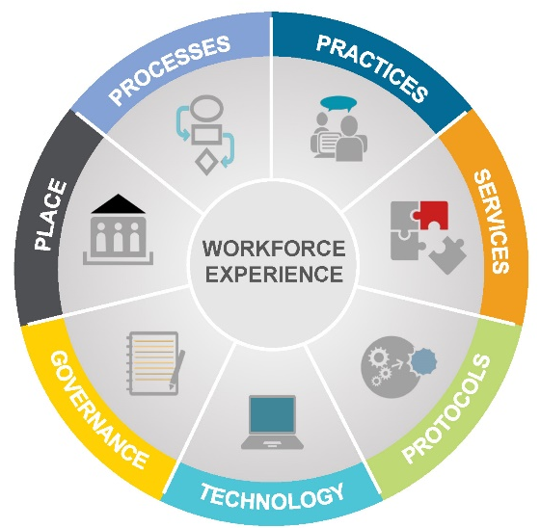
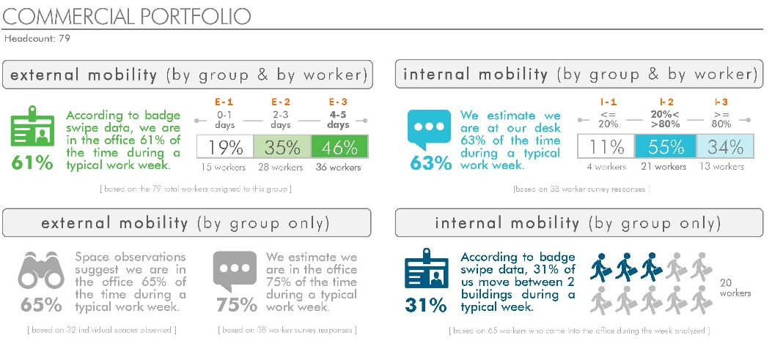
WORKPLACE ASSESSMENT
Plan Part I:
PURPOSE
Understanding how people work and how the organization operates at peak performance is key to developing effective workplaces. We conduct relevant research, analyze it and interpret it.
Articulating the preliminary vision and opportunity for change, along with the next steps framework. This work establishes the initial case for “why change?”
BENEFITS
How are you using the work environment today, how do you compare to other organizations, what is projected for the future of work, and what are the initial opportunities for Duke Energy?
RESULTS
Detailed findings from all data gathering efforts
Education regarding best practices and next practices
Identification of initial opportunities for change
Determine change readiness
Considerations for initial change approach

Slide 9
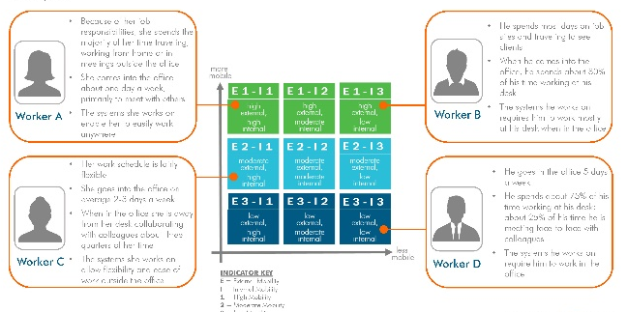
TRANSFORMATION STRATEGY
Plan Part II:
PURPOSE
Create the vision, objectives and action plan to establish a new workplace
Based on the interpretation of data we identify opportunities for improvements or change, develop a set of recommendations, and then develop a set of solutions to address the needs in an integrated way.
An effective work environment today addresses technology, services, HR policies, protocols and work practices to support all aspects of employee needs. All these components are identified and integrated to develop a strategy.
BENEFITS
Create the vision, objectives and comprehensive action plan to establish a new workplace
BENEFITS
Vision and goals for the future state (why change)
Set of recommendations covering all relevant aspects of the workplace – the overall physical work environment, flexible work practices, work processes, services, protocols, and technology. (what to change)
Scenario options to addressing and integrating recommendations with corresponding business case, including order of magnitude occupancy costs and potential cost savings
Preferred scenario option developed (how to change – initial strategy)
Action plan to implement strategy (how to achieve results)
Overall space footprint to size need (real estate direction)
Leadership commitment for the appropriate workplace strategy to support business needs

Slide 10
EMPOWERED PRODUCTIVITY = Being Productive Working Anywhere
Attract and retain the best talent
Increase workforce productivity
Reduce carbon footprint through sustainable architecture
Add flexibility to static real estate portfolio
Reduce costs through densifying occupancy
+

