Slide 1
Client Satisfaction/ Customer Experience
Occupant/Tenant Satisfaction
Patient Experience
Employee Retention

Slide 2
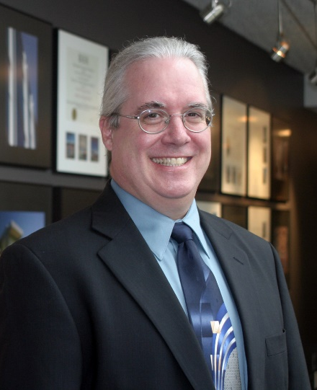
Dana W. Watts, AIA Principal Symmes Maini & McKee Associates
Dana is Principal-in-Charge of SMMA’s Chapel Hill, North Carolina, office. A practicing architect with more than 31 years of experience, he has spent 25 of those years at SMMA, mostly focused on the design and planning of mission critical and advanced technology facilities for corporate and institutional clients.
His diverse experience has informed his “all-encompassing” project vision and approach, integrating new products and technology into cutting-edge design, all while working within the fast-paced time-to-market schedules these project types require.

Slide 3
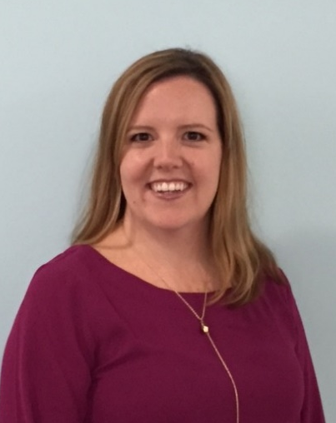
Amanda Bingham Account Executive Office Environments
Amanda is an Account Executive with Office Environments, one of the largest Steelcase dealers in the Southeast. Amanda is responsible for oversight and management of client accounts as well as client development.
Amanda has over 15 years of combined design, sales and account management experience. Prior to joining Office Environments, Amanda worked as the Facility Planning Manager at Family Dollar Stores, where she managed workspace planning for 215,000 square feet, building renovations and contract negotiations.
Amanda graduated from East Carolina University with a Bachelor of Science Degree in Interior Design and is also NCIDQ Certified. She is an active member in CoreNet.

Slide 4
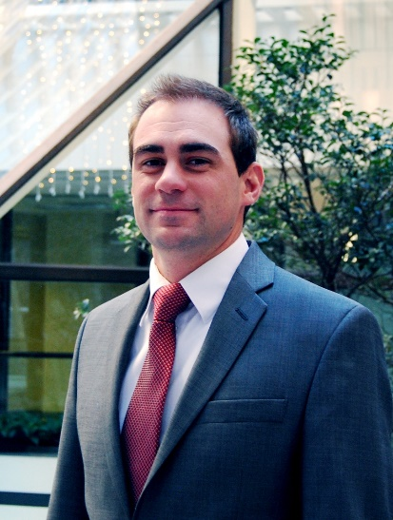
Tim Griffin Senior Project Manager Kingsley Associates
Tim joined Kingsley Associates in 2012. As a senior project manager, Tim manages the analysis and report creation for several of Kingsley Associates' key commercial and residential clients.
In addition, Tim is actively involved in several industry research initiatives, including IREI’s annual Global Investor Survey and BOMA's Experience Exchange Report.
Prior to joining Kingsley, Tim worked in Germany at Ernst & Young and Chrysler International, and had a successful career as a real estate appraiser.
Tim graduated from the Richard T. Farmer School of Business at Miami University with a BSBA in Finance.

Slide 5
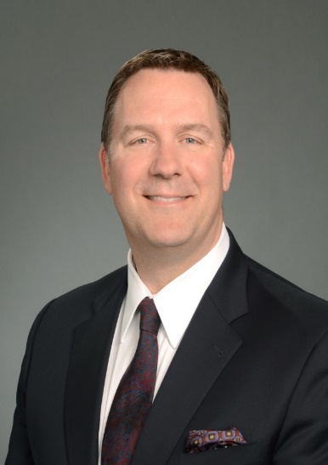
Marc Stricker Vice President Lincoln Harris
Marc Stricker currently services as a Vice President in the Lincoln Harris’ Corporate Services Group (CSG). Mr. Stricker is responsible for oversight and management of the Carolinas HealthCare System account. In his role, Marc is responsible for client development, contract governance, compliance and operational oversight.
With over 17 years’ experience in commercial real estate, Mr. Stricker has managed a variety of real estate products including Class “A” high-rise, corporate facilities, retail, medical office and LEED certified properties. Marc has performed over $100MM in real estate development and brokerage transactions throughout his career.
Mr. Stricker holds a Bachelor’s of Science in Business Administration from Western Carolina University and is an active member of BOMA and Corenet. In addition to holding his RPA designation; Six Sigma Green Belt and Brokers License; Mr. Stricker is also an MCR candidate and past president of BOMA Greater Charlotte.

Slide 6
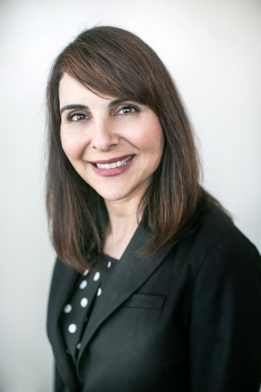
Mona Baset Assistant Vice President, Advertising, Digital & Brand Management Corporate Communications, Marketing & Outreach Carolinas HealthCare System
As Assistant Vice President of Advertising, Digital & Brand Management for Carolinas HealthCare System, based in Charlotte, NC, Baset leads advertising and media activities, management of the Carolinas HealthCare System brand, management of all consumer digital channels, creative design and content production, and process and operations management. Her team’s work is tightly aligned to the organization’s strategic vision and goals.
Baset came to Carolinas HealthCare System in 2013 after nine-plus years at Bank of America, where she led various marketing and communications teams, including her last role as Senior Vice President, leading the Digital Sales and Marketing team for home loans products.
Before joining Bank of America, Baset had her own marketing and communications firm in Southern California, with clients in real estate, education, health care and financial services. Prior to this, she was the Director of Corporate Communications for CORE, INC., a publicly held disability and employee absence management services provider.
Baset holds a bachelor’s degree in English from the University of California at Irvine, a master’s degree in Communications from California State University at Fullerton, and a master’s degree in Business Administration from Wake Forest University. She is also Green Belt certified.

Slide 7
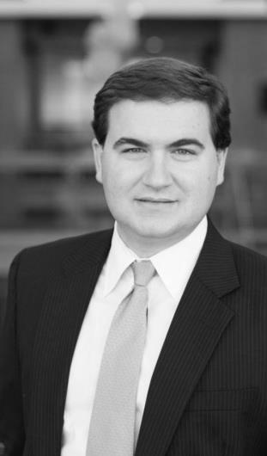
Park Denning joined Red Ventures in 2010 and works as a Director of Operations, currently leading one of the company’s telecommunications partnerships.
Mr. Denning has previously been involved in workspace planning and capacity management through his work with Red Ventures’ Human Capital team. In this role he led the planning and launch of a remote facility for Red Ventures and was closely involved with the formation of its 300,000 square foot Charlotte-area campus.
Mr. Denning graduated from the University of North Carolina at Chapel Hill with a degree in Business Administration from the Kenan-Flagler Business School. A North Carolina native, he currently resides in Charlotte, NC.
J. Park Denning
Director
Red Ventures

Slide 8


The Impact of Customer Surveys on Corporate Real Estate
Presenters
Tim Griffin - Kingsley Associates
Marc Stricker - Lincoln Harris

Slide 9
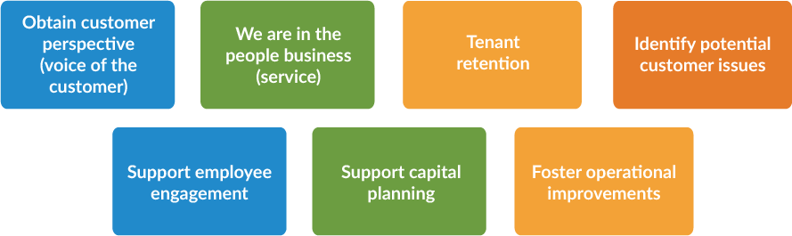
The Impact of Customer Surveys on Corporate Real Estate
Why do we conduct customer surveys?

Slide 10
Satisfied Tenants Make
Economic Sense
% Likely to Renew
Satisfied tenants are
3.5 times
more likely to renew than
dissatisfied tenants
Tenant Overall Satisfaction
Source: Data from the Kingsley IndexSM

Slide 11
The Impact of Customer Surveys on Corporate Real Estate
What is the financial impact of losing a 10,000 sq. ft. office tenant?
 | Assumptions | Revenue Lost
Rental income | 10,000 s.f. tenant in Class A office building Annual rent is $28 per s.f. One year to replace tenant | ($280,000)
Tenant improvements | TI’s of $7 per s.f. | ($70,000)
Commission | Commission of 6% paid | ($117,600)
Total potential annual loss |  | ($467,600)
Estimated Cost of Losing a Tenant

Slide 12
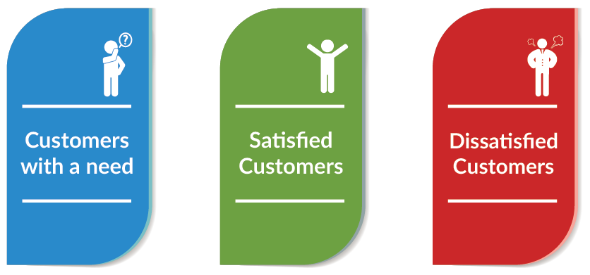
The Impact of Customer Surveys on Corporate Real Estate
Who typically responds to surveys?

Slide 13
The Importance of Benchmarks
In this example, Overall Satisfaction and Management Satisfaction have the same score
Benchmarks provide context for your results
Other comparisons include:
Prior score
Peer score
Portfolio score
Source: Data from the Kingsley IndexSM

Slide 14
Using Ethnography to Improve Consumer Experiences
Mona A. Baset
AVP, Advertising, Digital & Brand Management
Carolinas HealthCare System

Slide 15
Second largest public, not-for-profit healthcare system in the nation.
More than 40 hospitals and more than 900 care locations in the Carolinas, with the largest primary care network in the region.
60,000+ team members, including 3,000+ System-employed physicians and 14,000+ nurses.
Carolinas Medical Center in Charlotte offers the only Level I trauma center in the region, and is one of only five academic medical center teaching hospitals in North Carolina.
In 2014, Carolinas HealthCare System had 11.5 million patient encounters and produced $1.63 billion in community benefit.

Slide 16
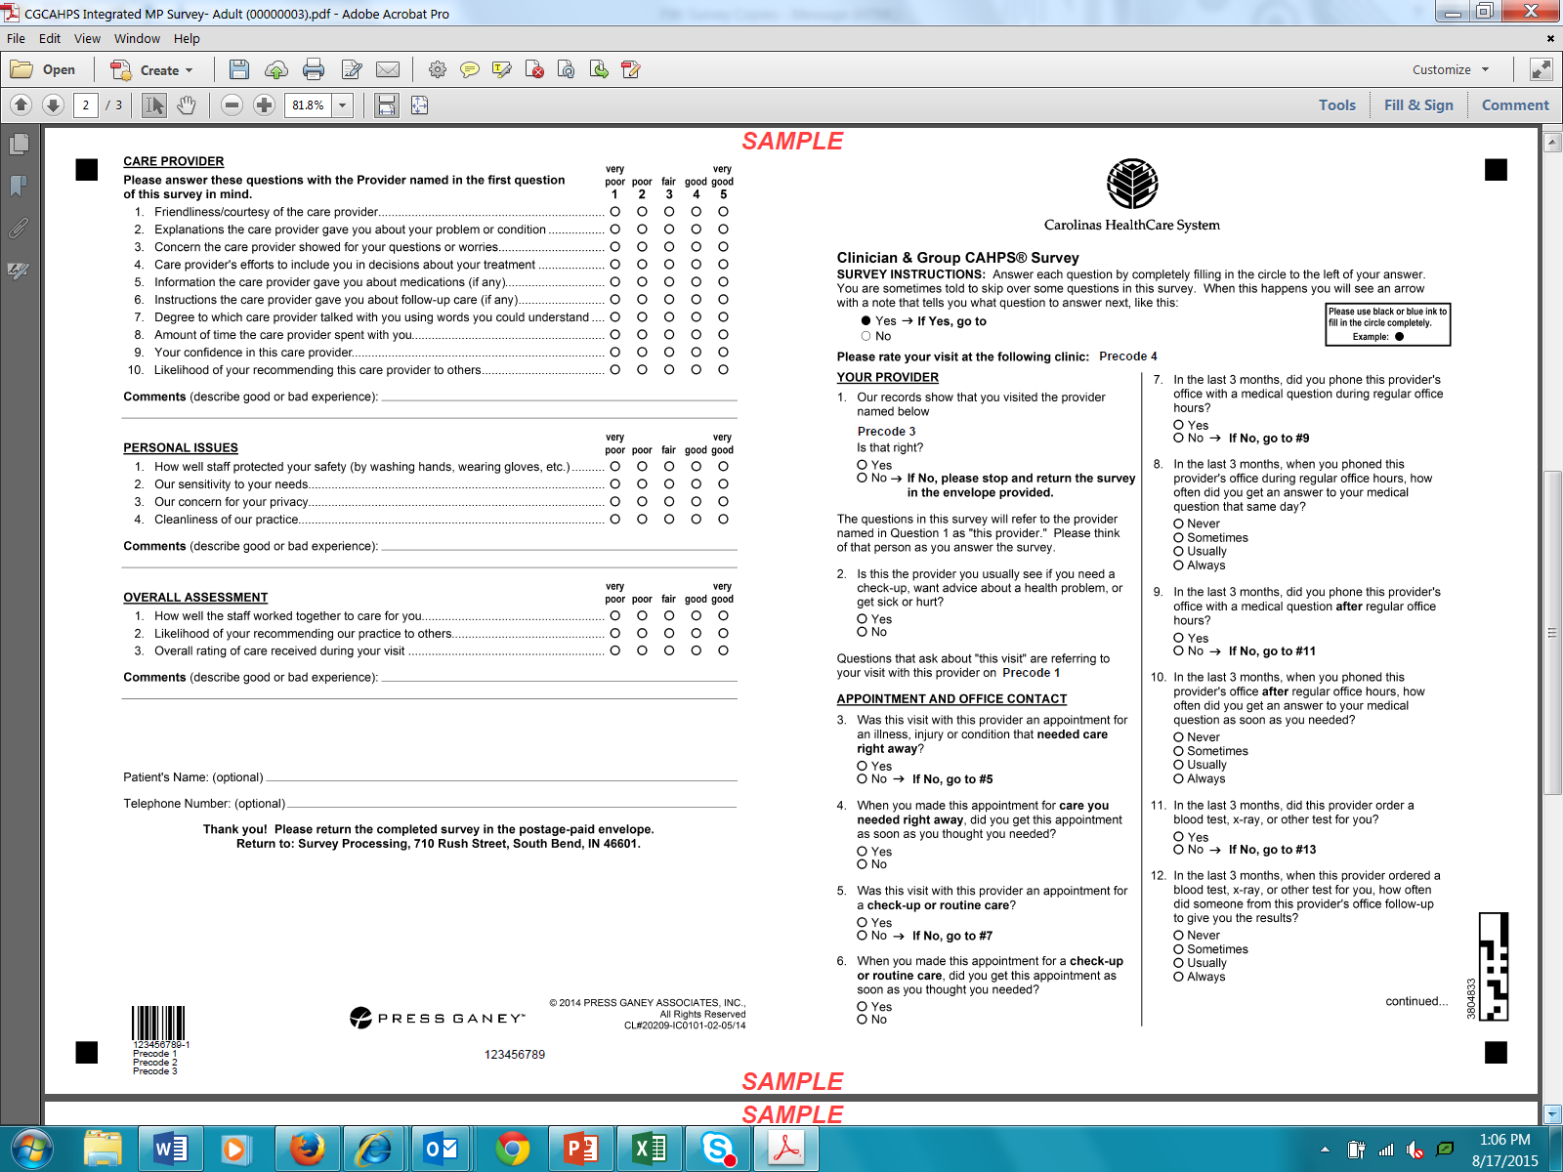

Slide 17


Slide 18
If you only survey consumers …
You may never get things like …
I want a faster horse
Ford Model T
I want longer banking hours
ATM
I want to see a doctor any time
Virtual Visit
I want a fuel-efficient car
Tesla

Slide 19
eth·nog·ra·phy
/eTHˈnäɡrəfē/
The study of human behavior in its most natural and typical context
Look around: observe what people do, how they think, what they need, what they want

Slide 20

How can we improve the patient experience, from appointment to billing and everything in between?

Slide 21



Three Segments in the Primary Care Setting
Parents
Unhealthy Empty Nesters
Healthy Seniors
36 ethnographies completed, recruited via letter from Patient Experience Executive

Slide 22


Easy online screening
Meet at patient’s home

Slide 23
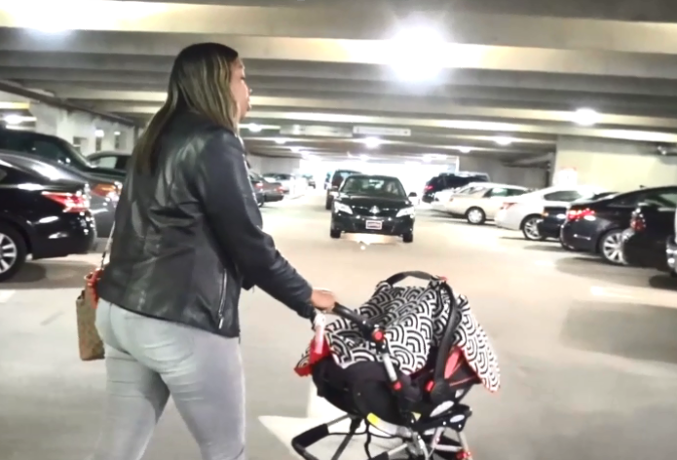
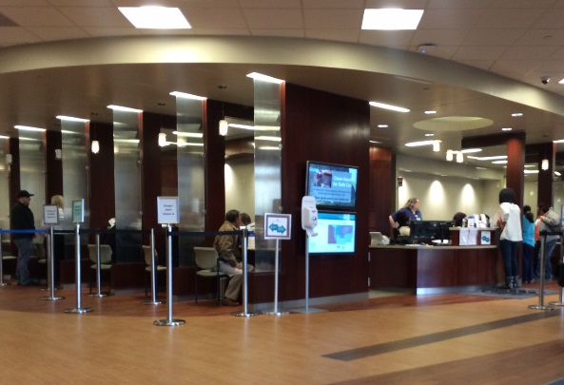
Interview starts upon departure
Observations throughout experience

Slide 24
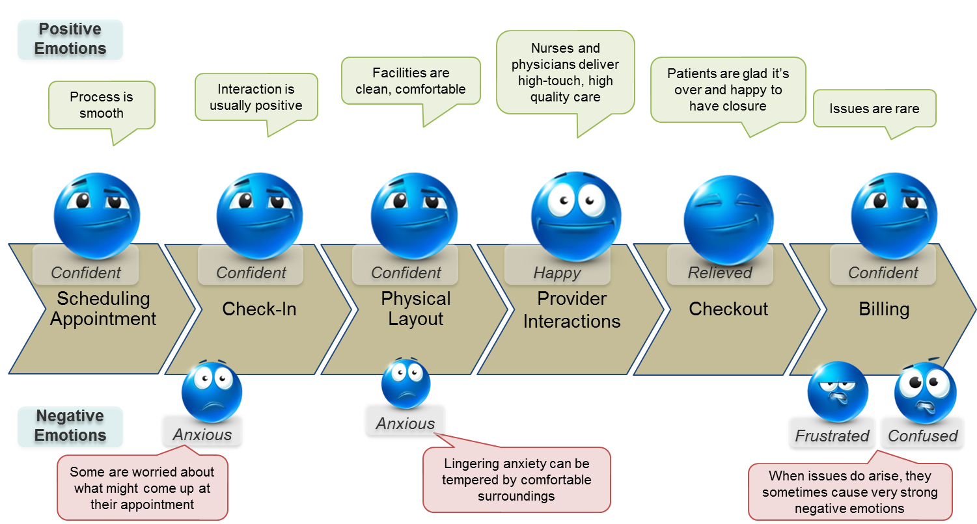

Slide 25
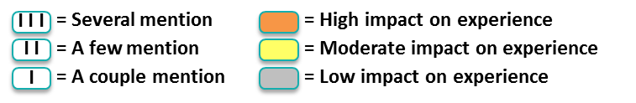

Slide 26
Overall Physical Layout Assessment
Very positive experiences, with low-impact, low-volume areas of dissatisfaction

Slide 27
ENCOURAGE SOCIAL INTERACTION: Waiting rooms are sometimes valued as places to socialize among moms and older adults
LEAD THE WAY: Designated walkways in parking structures are especially important for moms
KNOW YOUR AUDIENCE: The waiting room experience can be awkward for teenagers/older children in pediatric practices
GREEN IS GOOD, BUT NOT GREAT: For most, sustainable features are nice-to-haves, but patients wonder if this is the best use of funds
GIVE PATIENTS CONTROL (BUT NOT TOO MUCH): Self check-in via kiosk could make things faster; self-rooming is disorienting the first time
HELP PATIENTS GET AROUND: Offer a transportation service and/or valet parking to help sick or elderly patients get to the office more easily
FORMALIZE THE SHORTCUT: Create formal paths in areas where patients are constructing their own through grass and dirt

Slide 28
Improve your understanding by using your eyes

Slide 29

Questions?

