Slide 1

The New Economy, Change & the Workplace
Bob Fox, AIA, IIDA, LEED-AP
@bfoxj42

Slide 2
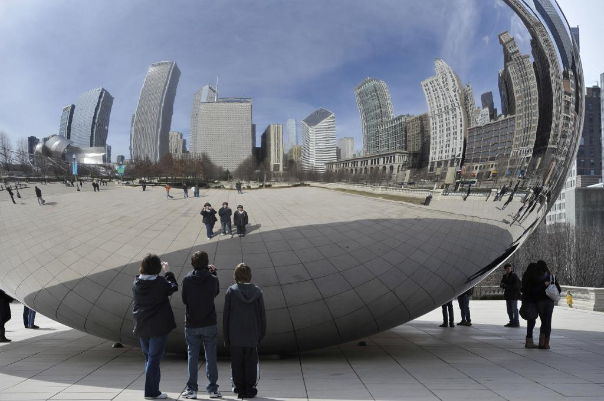
History
The workplace is a…
…Reflection of what is happening in the economy
Agrarian Age
Industrial Age
Efficiency Movement
Service Economy
Information Age
The Knowledge Economy

Slide 3







Disruptive Change
60 year tenure down to 15 years
50% off the list in past 10 years
90% off the list since 1955
72% of CEO’s in position < 5 years
CEO Median tenure is 3 years
70% of employees are disengaged
Unpredictable
Conflicts with core business
Discounted risk
From outside industry

Slide 4
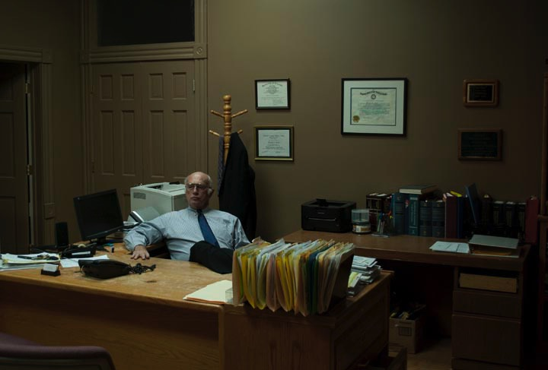
Workplace Issues
Rapid Change
Complacency
Entitlement
Bound by tradition
Inability to adapt
Lack of engagement
Insufficient interaction
Loss of talent

Slide 5
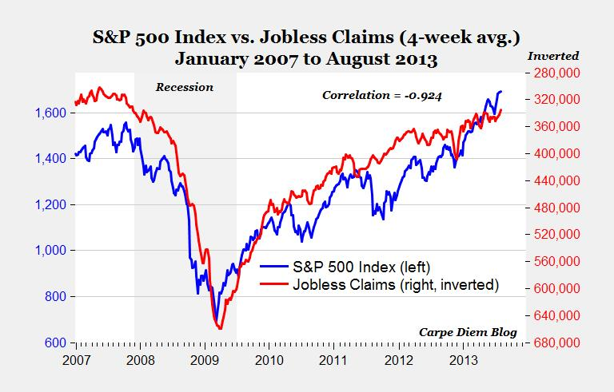
Change in the Economy
2008 - The Great Recession
things change…
Insert chart ….

Slide 6
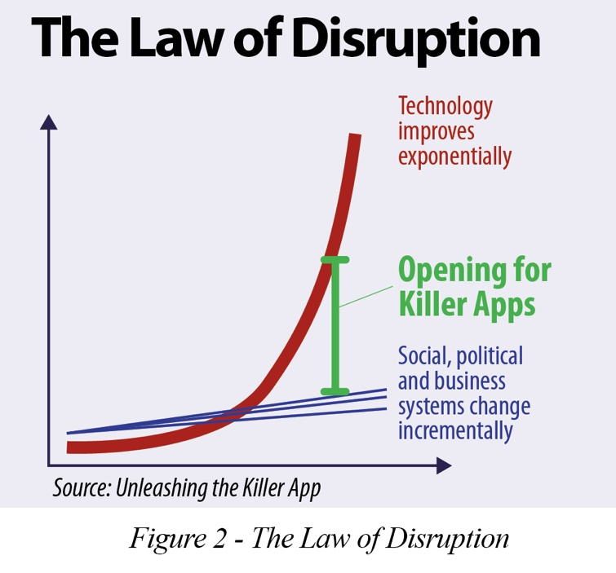
Post Recession
The Collaborative Economy
Exponential Change
Moore’s Law
Leveraged social networks
Integrated technology
Agile – rapid change
Captures latent value

Slide 7
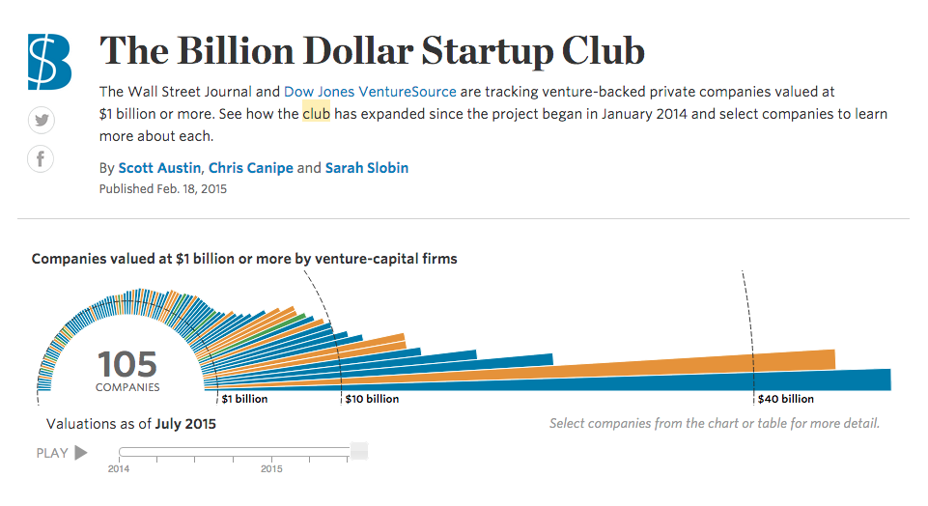
Exponential Valuations

Slide 8
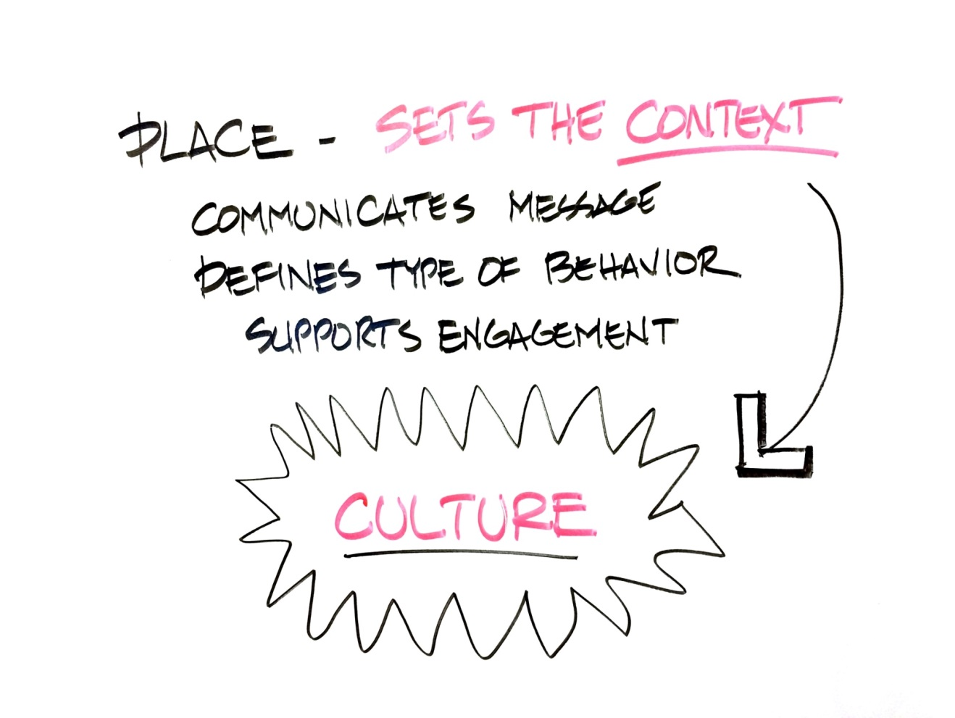
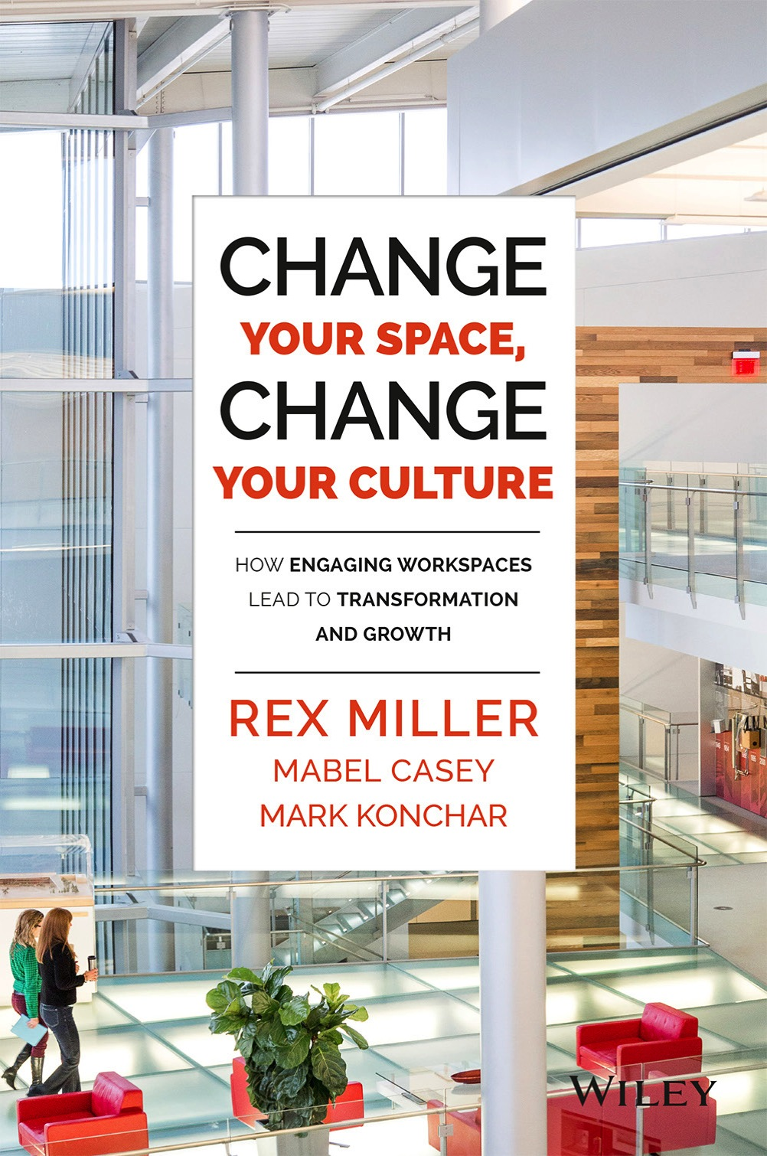
Case4Space
Drivers that affect performance:
Choice
Interaction
Engagement

Slide 9
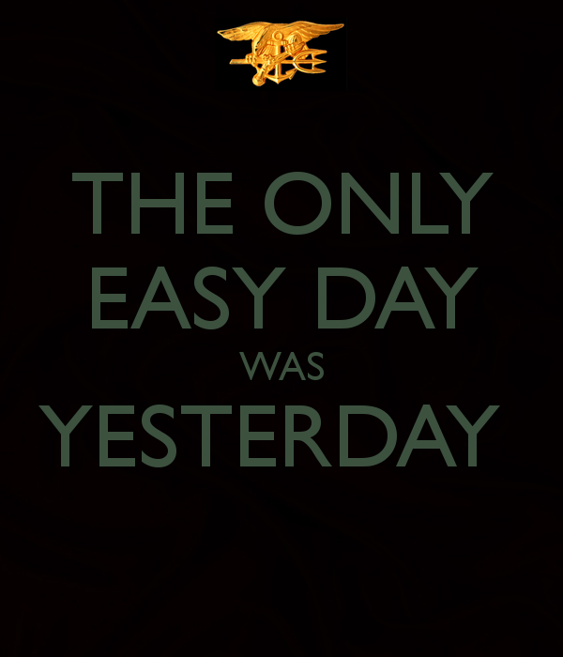
Talent
The WAR for TALENT is on
The performance of your business is dependent upon the quality of your people

Slide 10
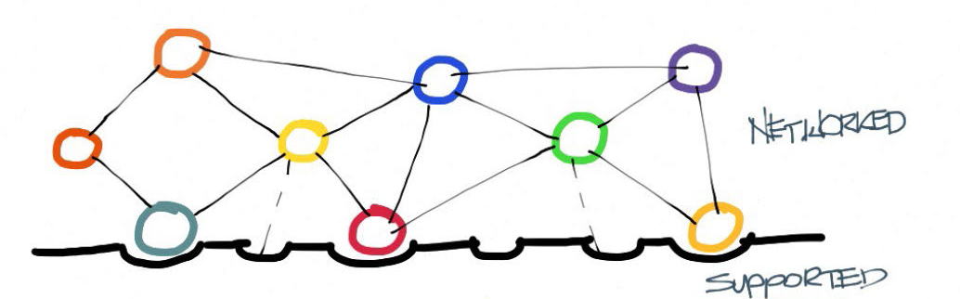
Work is Autonomous
To work autonomously you need the…
BEST TALENT
BEST TRAINING
BEST TOOLS
HIGHLY NETWORKED
SUPPORTED PLATFORM
RIGHT CULTURE
Flexible / Agile / Self-managed
“The new CEO is almost like some sort of rebel general, inspiring small guerilla-style teams to dream up new products or experiences. They rally the troops rather than outright command them.”
Mark Wilson, Fast Company

Slide 11
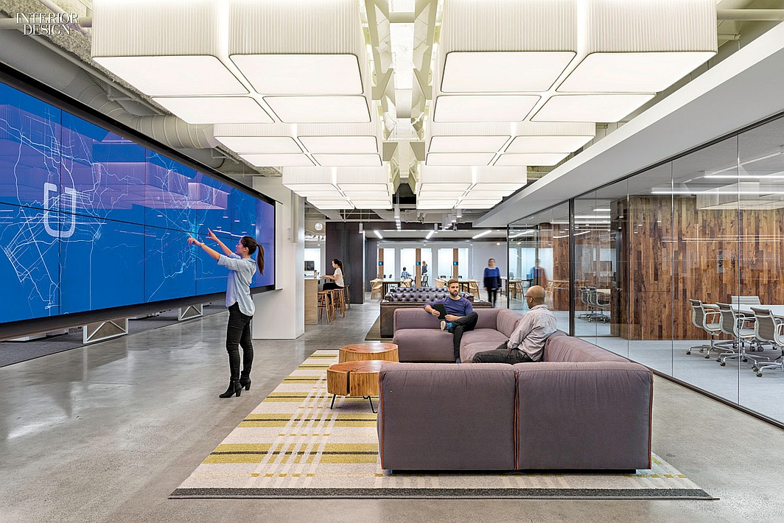
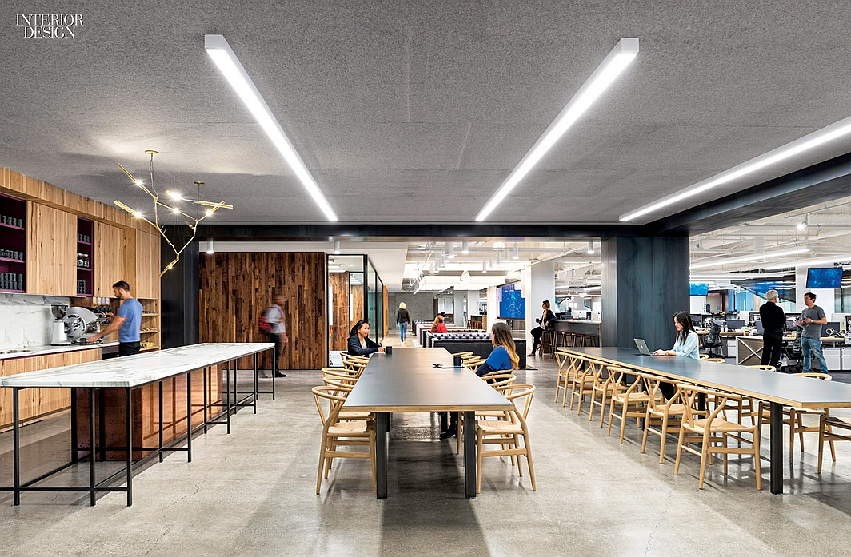
Work is Social & Engaging
Technology / Highly Leveraged / Collaborative
Leveraged social network
Technology centric
Dependent on community
Small agile teams
Autonomous work
Rapid growth
Knowledge & Information
Collaboration
Sharing
Interaction

Slide 12
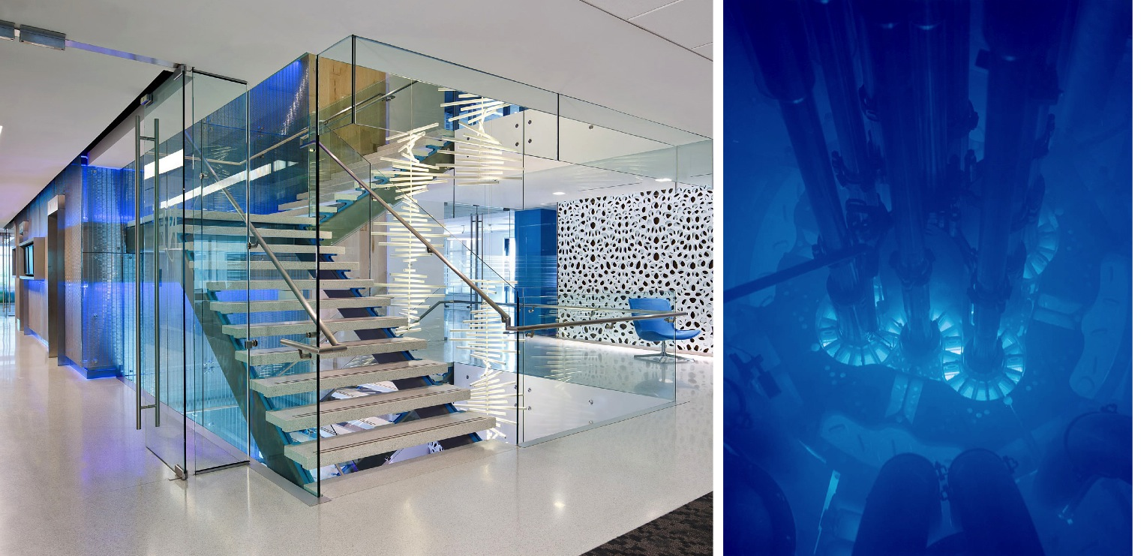
Remarkable Experiences
Context Unique Memorable
How do you want to make someone feel?

Slide 13
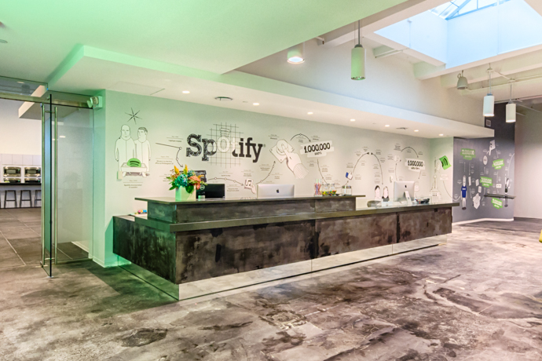
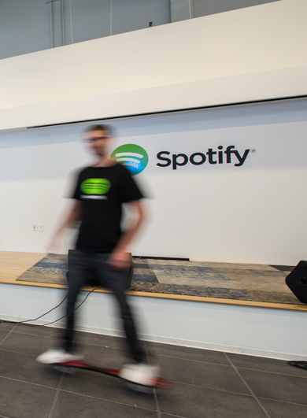
Communication & Brand
Space as a tool!
What is the story you want told?

Slide 14

The New Workplace
Value
Talent
Culture
Inspiration
Vision
Alignment
Communication
Brand
Technology
HR
Attracting Staff
Engagement
Leadership
Cost
Full spectrum

Slide 15
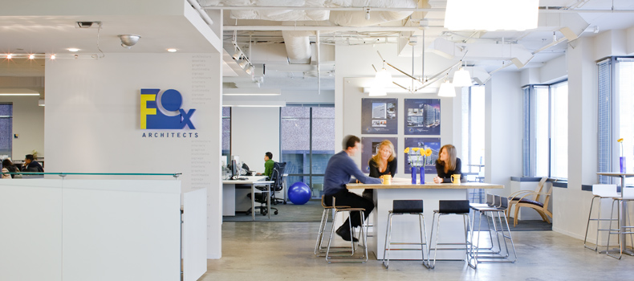
Bottom Line
Workspace is a high performance business tool to connect people and rapidly capture & develop new ideas that will sustain companies long into the future.

Slide 16

The beginning...

