Slide 1

PPP Program Update October 27, 2020
Tim Geppert & Leticia Mond

Slide 2
Outline
Introductions
Form to be Used
High Level Form Review
Timeline
Documentation Requirements
Bank/Lender Portals, Tools
Other Forgiveness Topics
Tax Affect
GAAP Affect
Claims & Change Orders
Sale of a Business
Q&A – Chat on “Go To Webinar”

Slide 3
Which Form Should be Used?

Slide 4
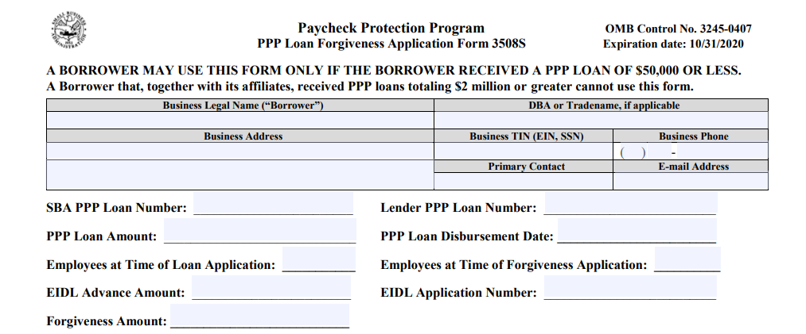

Form 3508S – Pg 1

Slide 5
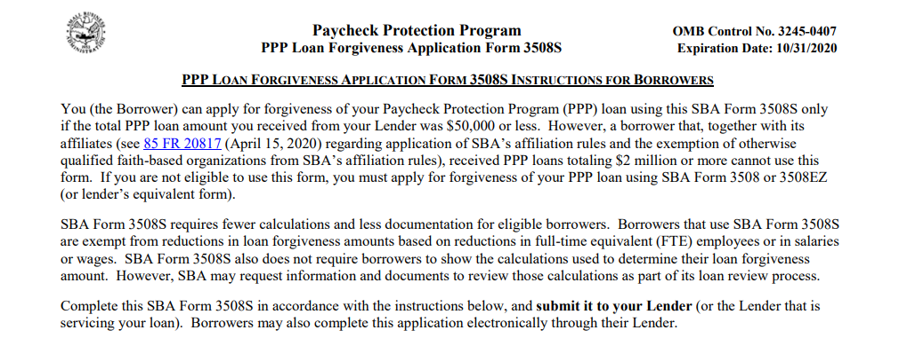
Form 3508S - Instructions

Slide 6
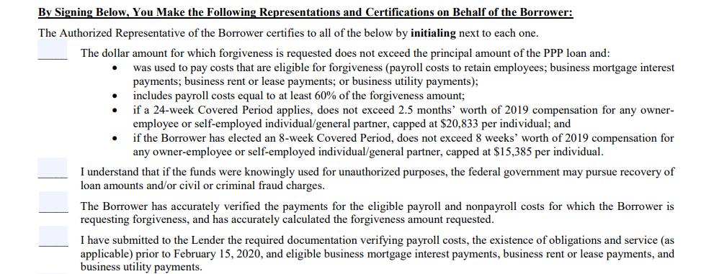




















Form 3508S - Certifications

Slide 7
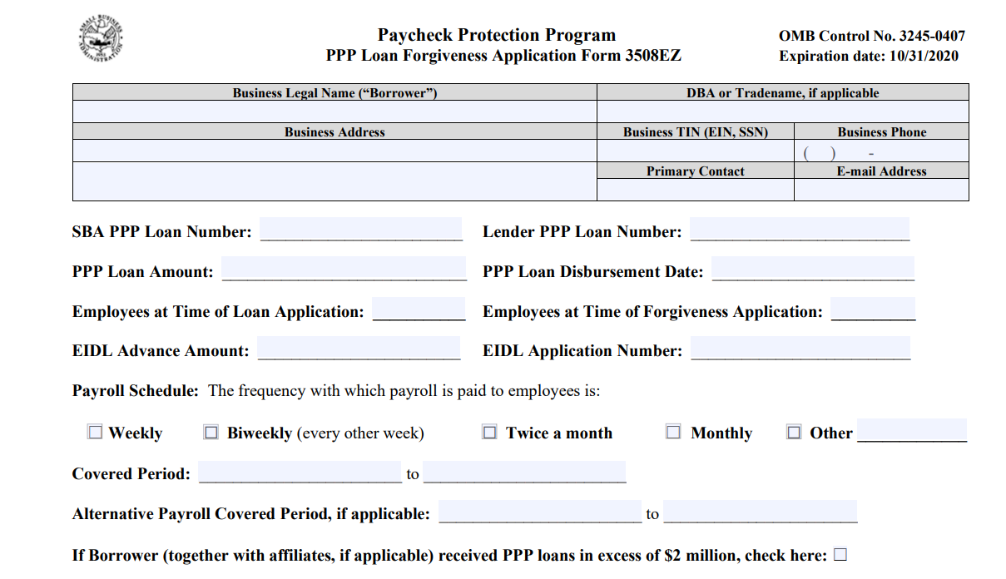
Form 3508EZ – Pg 1

Slide 8

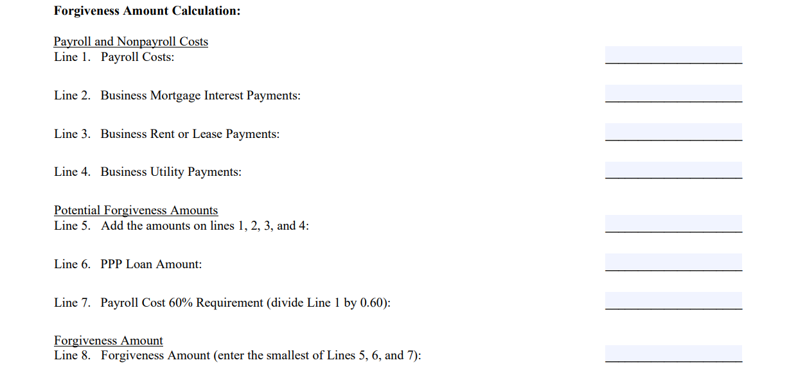
Form 3508EZ – Pg 1 cont.
Lender Review Required

Slide 9
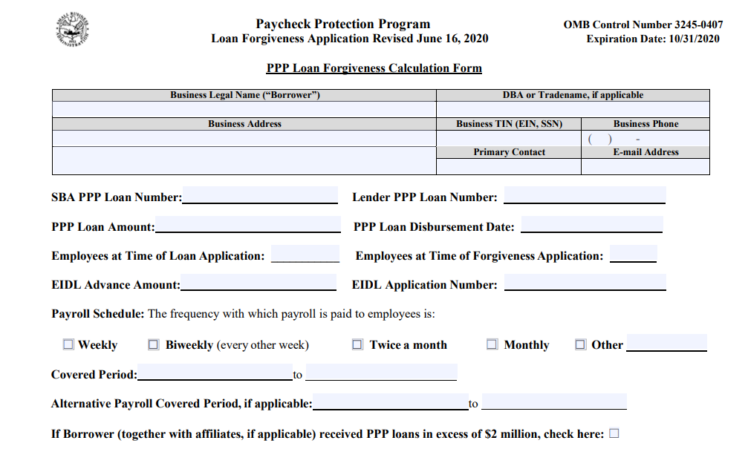
Form 3508 – Pg 1

Slide 10
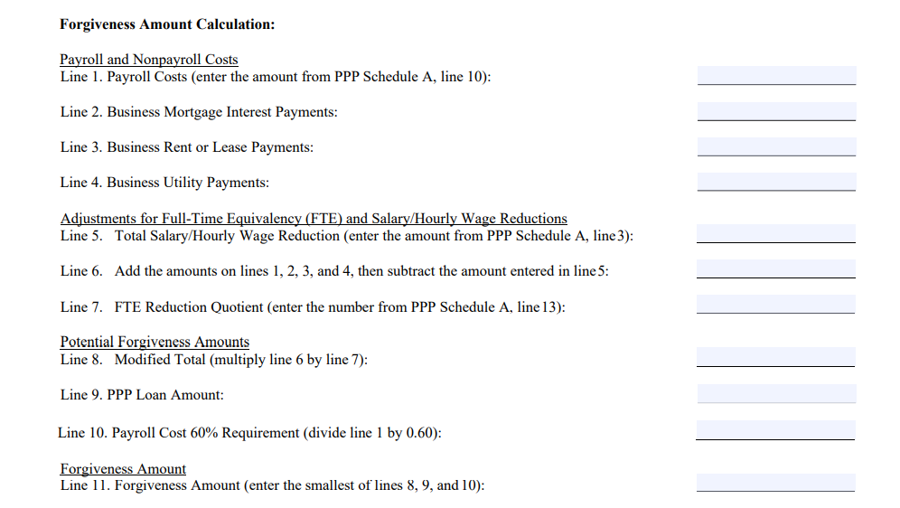
Form 3508 - Pg 1 cont.
Lender Review Required

Slide 11
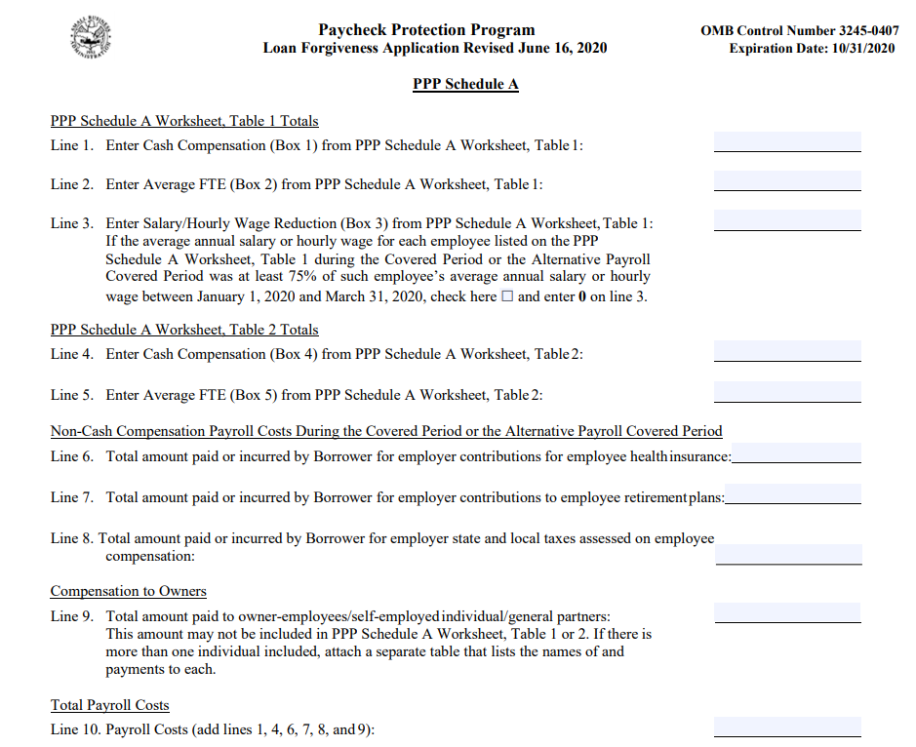
Form 3508 – Schedule A
Lender Review Required

Slide 12
Timeline

Slide 13
Documentation Requirement

Slide 14
Documentation Requirement

Slide 15
Documentation Requirement

Slide 16





Bank/Lender Portals, Available Tools
https://www.pppforgivenesstool.com/
3508S
3508EZ
3508

Slide 17

Forgiveness Application
Interest Deferral
Use of Funds for Intended Purpose
Internal Notes Documenting Need for PPP Funds (CFMA Webinar, 7//28/20)
“PPP” Bank Account & Transfer of Funds
Retain Records for 6 years, Audit period 6 years
Rental Payments to Related Parties
Use all Payroll for 24 Weeks to “Out Spend” FTE Reductions
EIDL Advance Subtracted

Slide 18
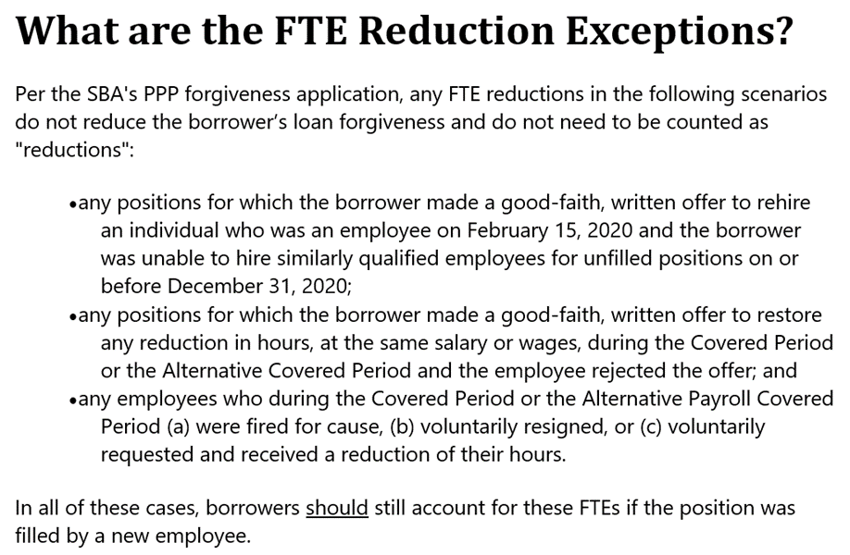

Slide 19
Owner-Employee
Owner payments are capped:
Owner-employees
Self employed
General partners
During the 24-week period, the cap is: $20,833 or 2.5 months (2.5/12) of 2019 compensation/net profit/SE earnings (lesser of)
During the 8-week period, the cap is: $15,384 or 8 weeks (8/52) of 2019 compensation/net profit/SE earnings (lesser of)
Excludes owner-employees that own less than five percent

Slide 20
Owner-Employee (cont.)
Owner noncash compensation is also capped:
C corporation owner-employee: Include state and local taxes, employer contributions for health insurance, and retirement contributions (capped at 2.5/12 of 2019 amount)
S corporation owner employee: Include state and local taxes, and employer retirement contributions (capped at 2.5/12 of 2019 amount)
Self-employed or Schedule C filers – N/A

Slide 21
Good Faith Certification Documentation
Borrower Must Demonstrate and Document:
Borrower acted in good faith
Regarding the necessity of the loan request
Based on economic need for a PPP loan
Under the standard established by the CARES Act and the PPP regulations
At the time of the loan application
Components of Borrowers Documentation
Existence of Economic Uncertainty caused by COVID-19
Affect on Current Business Activity caused by COVID-19
Access to other sources of liquidity sufficient to support your ongoing operations in a manner that is not significantly detrimental to the business
Intended use of funds consistent with the goals of PPP to retain workers and maintain payroll or make mortgage payments, lease payments and utility payments

Slide 22
Conditions & Impact Analysis
Private Company Lack of Access to Capital Markets
Existing Lines of Credit
Effect on customers, market segments, geographic markets, suppliers, employees
Customer losses, delays, closings, shutdowns or cancellations
Requests for price reductions or extended payment terms
Supply chain disruptions, delays and closures
People issues, including distancing measures, people not coming to work, etc.
Layoffs, reductions or other personnel actions
Project shutdowns/demobilization costs
Receivables and collection risks and deterioration
Working capital deterioration
Cash balances and cash flow trends
Potential debt covenant breaches/bank pressure/default risks/loss of lines of credit
Potential risks to bonding relationship and capacity, ability to bid work

Slide 23
Tax Issues
Cash Received & Forgiven Not Taxable
Related Expenses Not Deductible
Tax Impact Reported When?
2020 When Expenses Incurred?
2021 When SBA Forgives the Loan (All Events Test)?
No Tax Impact as Congress Intended?
Amend 2020 Return When You Get Forgiveness?
Include in ES Payments 9/15/20, 1/15/21?
Consider possible rate change after election?

Slide 24
GAAP Issues
AICPA Position
EY Position
Presentation Examples:
Balance Sheet
Income Statements
Footnotes

Slide 25
GAAP
Journal of Accountancy.com
Once there is reasonable assurance that the conditions will be met, the earnings impact of the government grants would be recorded on a systematic basis over the periods in which the entity recognizes as expenses the related costs for which the grants are intended to compensate.
The TQA also states that in situations in which the PPP’s eligibility and loan forgiveness criteria are expected to be met:
A business entity can also analogize to the guidance in ASC Subtopic 958-605 or ASC Subtopic 450-30.

Slide 26
GAAP
EY AccountingLink
Application of IAS 20
Under IAS 20, PPP proceeds received would be accounted for as an income grant. A deferred income liability would be recognized upon receipt of the forgivable loan, if it determined that there is “reasonable assurance”¹ that it will meet the conditions for forgiveness of the full loan amount. The deferred income liability would be recognized in income on a systematic and rational basis over the periods in which the entity recognizes as expenses the costs the grant is intended to defray.
IAS 20 provides that grants related to income can be presented as (1) a credit in the income statement, either separately or under a general heading, such as “other income,” or (2) a reduction to the related expense.

Slide 27
GAAP
Analogy to IAS 20
Loan recognized as Deferred Income Liability
Requires Reasonable Assurance of meeting forgiveness criteria (equivalent to “Probable” under GAAP)
If reasonable assurance criteria met – recognize as income as expenses are incurred
Can be “Other income” or a reduction to the related expenses
If repayable later, account prospectively as change in estimate
Reasonable Assurance Concept
Certification and Related Quality and Sufficiency of Documentation

Slide 28
Miscellaneous
Claims & Change Orders to GC or Owner for COVID Related Expenses
Sale of a Business, SBA Permission, Escrow
Families First COVID Response Act & 941
Next Stimulus Bill, 2nd PPP Bill
Questions & Answers:

Slide 29
Bio’s
Tim Geppert, CPA, CFO Advisor – Vaco – Tim.Geppert@Vaco.com 210-867-9038
Since joining Vaco (formerly Aventine Hill) in 2012, Tim has focused his practice on small to midsize construction companies. This includes General Contractors, concrete, masonry, interior, electrical, mechanical, telecom, utility, flooring and other specialty contractors. Services include Fractional CFO or Controller, family mediation, buy/sell transactions, productivity/profitability improvement and quarterly financial statement review.
In over 30 years as CFO and Chief Administrative Officer, Tim managed the IT, HR, legal, insurance, project controls, field office, travel, state licensing, tax and administration departments. Tim was directly responsible for and involved in international projects in Surinam, Colombia, Jamaica, St. Croix, Australia, UK, France, Mexico, Brazil and other locations.

Slide 30
Bio’s (cont.)
Leticia C. Mond, CPA, LeticiaMond@gmail.com 210-250-0217
Leticia worked at Zachry Corporation for over 20 years, most recently as Vice-President and Treasurer. Her experience includes cash management / cash projections, lead investment committee / manage investments for all operations. Preparation of federal tax returns, state tax returns, pre-qualification, property / sales tax returns and processes.

