Slide 1



The Correlation Conundrum
How To Invest When Diversification No Longer Works
Swan Global Investments
Define Risk, Seek Improved Outcomes – Investing Redefined®
For Financial Professional Use Only

Slide 2

Outline
Distinct Investment Process – Step 2: Always Hedged
Diversification’s failure due to rising correlations
The “smoking gun” behind rising correlations
Alternatives’ role in portfolio construction
For Financial Professional Use Only.
Notes:
Marc

Slide 3
2022 Year in Review: “Everything Bear Market”
Distinct Investment Process – Step 2: Always Hedged
For Financial Professional Use Only. Source: Morningstar Direct.
Notes:
Marc

Slide 4
2022 Year in Review: “Everything Bear Market”
Distinct Investment Process – Step 2: Always Hedged
When everything is down, the only thing up is correlations
2022
Jan 2022 - Dec 2022 | 1 | 2 | 3 | 4 | 5 | 6 | 7 | 8 | 9 | 10
1) S&P 500 | 1.00 | 0.94 | 0.97 | 0.98 | 0.88 | 0.56 | 0.67 | 0.89 | 0.91 | 0.29
2) Russell 2000 | 0.94 | 1.00 | 0.92 | 0.94 | 0.78 | 0.41 | 0.58 | 0.87 | 0.82 | 0.23
3) Russell 3000 Value | 0.97 | 0.92 | 1.00 | 0.90 | 0.90 | 0.58 | 0.63 | 0.89 | 0.86 | 0.42
4) Russell 3000 Growth | 0.98 | 0.94 | 0.90 | 1.00 | 0.82 | 0.49 | 0.66 | 0.87 | 0.90 | 0.15
5) MSCI EAFE Index | 0.88 | 0.78 | 0.90 | 0.82 | 1.00 | 0.80 | 0.82 | 0.87 | 0.83 | 0.24
6) MSCI Emg Mkt | 0.56 | 0.41 | 0.58 | 0.49 | 0.80 | 1.00 | 0.79 | 0.54 | 0.58 | 0.09
7) Bloomberg U.S. Agg | 0.67 | 0.58 | 0.63 | 0.66 | 0.82 | 0.79 | 1.00 | 0.73 | 0.61 | -0.06
8) Bloomberg U.S. Corp HY | 0.89 | 0.87 | 0.89 | 0.87 | 0.87 | 0.54 | 0.73 | 1.00 | 0.78 | 0.24
9) FTSE Nareit All REITs | 0.91 | 0.82 | 0.86 | 0.90 | 0.83 | 0.58 | 0.61 | 0.78 | 1.00 | 0.31
10) S&P GSCI | 0.29 | 0.23 | 0.42 | 0.15 | 0.24 | 0.09 | -0.06 | 0.24 | 0.31 | 1.00
For Financial Professional Use Only. Source: Zephyr StyleADVISOR
Notes:
Marc

Slide 5
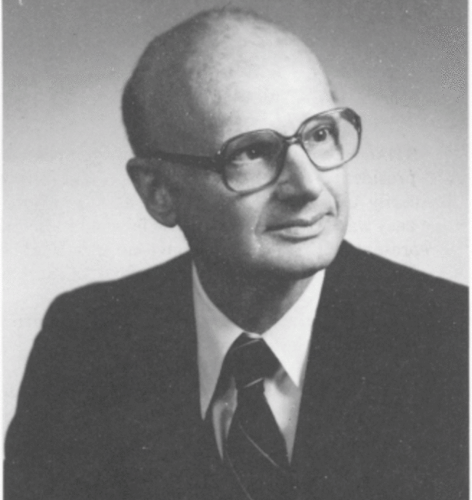
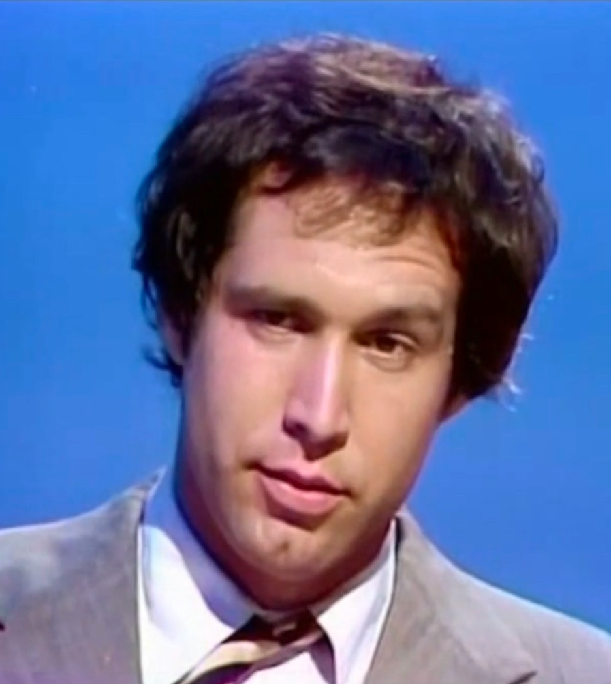

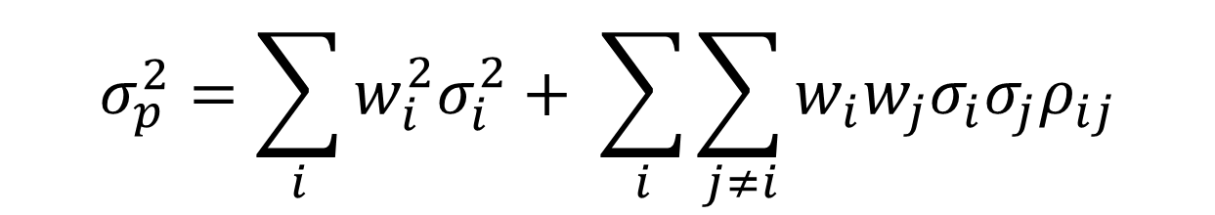
Modern Portfolio Theory
Distinct Investment Process – Step 2: Always Hedged
$$σ_{p}^{2}=\sum_{i}{w_{i}^{2}σ_{i}^{2}+ \sum_{i}{\sum_{j≠i}{w_{i}w_{j}σ_{i}σ_{j}ρ_{ij}}}}$$
Harry Markowitz
"Portfolio Selection" The Journal of Finance, 1952
“It was my understanding there would be no math.”
Chevy Chase
Saturday Night Live, 1976
For Financial Professional Use Only.
Notes:
Marc

Slide 6
The Math Behind Diversification & Modern Portfolio Theory
Distinct Investment Process – Step 2: Always Hedged
Portfolio Risk
Weighted Risk of B
$$σ_{p}^{2}=w_{A}^{2}σ_{A}^{2}+w_{B}^{2}σ_{B}^{2}+2w_{A}w_{B}σ_{A}σ_{B}ρ_{AB}$$
Weighted Risk of A
Diversification Risk
If correlation is 0, that zeros out the entire final term
If correlation is negative, we can subtract the final term from portfolio risk
However, if the correlation is close to 1, then the portfolio risk is not reduced
For Financial Professional Use Only.
Notes:
Marc

Slide 7
Theoretical Benefits of Diversification
Distinct Investment Process – Step 2: Always Hedged
For Financial Professional Use Only. Source: Swan Global Investments
Notes:
Marc

Slide 8
Comparing Market Environments
Distinct Investment Process – Step 2: Always Hedged
For Financial Professional Use Only. Source: Morningstar Direct.
Notes:
Marc

Slide 9
A Correlation Conundrum
Distinct Investment Process – Step 2: Always Hedged
Three years of lockstep returns
Since Covid
Jan 2020 - Dec 2022 | 1 | 2 | 3 | 4 | 5 | 6 | 7 | 8 | 9 | 10
1) S&P 500 | 1.00 | 0.90 | 0.94 | 0.96 | 0.90 | 0.70 | 0.49 | 0.84 | 0.91 | 0.44
2) Russell 2000 | 0.90 | 1.00 | 0.92 | 0.85 | 0.86 | 0.74 | 0.37 | 0.86 | 0.82 | 0.55
3) Russell 3000 Value | 0.94 | 0.92 | 1.00 | 0.82 | 0.93 | 0.73 | 0.35 | 0.84 | 0.89 | 0.59
4) Russell 3000 Growth | 0.96 | 0.85 | 0.82 | 1.00 | 0.81 | 0.65 | 0.57 | 0.80 | 0.85 | 0.32
5) MSCI EAFE Index | 0.90 | 0.86 | 0.93 | 0.81 | 1.00 | 0.80 | 0.49 | 0.82 | 0.85 | 0.55
6) MSCI Emg Mkt | 0.70 | 0.74 | 0.73 | 0.65 | 0.80 | 1.00 | 0.52 | 0.73 | 0.69 | 0.44
7) Bloomberg U.S. Agg | 0.49 | 0.37 | 0.35 | 0.57 | 0.49 | 0.52 | 1.00 | 0.54 | 0.46 | -0.10
8) Bloomberg U.S. Corp HY | 0.84 | 0.86 | 0.84 | 0.80 | 0.82 | 0.73 | 0.54 | 1.00 | 0.82 | 0.55
9) FTSE Nareit All REITs | 0.91 | 0.82 | 0.89 | 0.85 | 0.85 | 0.69 | 0.46 | 0.82 | 1.00 | 0.52
10) S&P GSCI | 0.44 | 0.55 | 0.59 | 0.32 | 0.55 | 0.44 | -0.10 | 0.55 | 0.52 | 1.00
For Financial Professional Use Only. Source: Zephyr StyleADVISOR
Notes:
Marc

Slide 10
A Correlation Conundrum
Distinct Investment Process – Step 2: Always Hedged
No one cared because markets were setting record highs
Since GFC
Aug 2007 - Dec 2022 | 1 | 2 | 3 | 4 | 5 | 6 | 7 | 8 | 9 | 10
1) S&P 500 | 1.00 | 0.91 | 0.97 | 0.97 | 0.88 | 0.75 | 0.18 | 0.74 | 0.78 | 0.51
2) Russell 2000 | 0.91 | 1.00 | 0.93 | 0.89 | 0.80 | 0.70 | 0.08 | 0.73 | 0.76 | 0.51
3) Russell 3000 Value | 0.97 | 0.93 | 1.00 | 0.89 | 0.87 | 0.74 | 0.11 | 0.74 | 0.79 | 0.55
4) Russell 3000 Growth | 0.97 | 0.89 | 0.89 | 1.00 | 0.85 | 0.74 | 0.23 | 0.74 | 0.73 | 0.48
5) MSCI EAFE Index | 0.88 | 0.80 | 0.87 | 0.85 | 1.00 | 0.87 | 0.22 | 0.78 | 0.72 | 0.58
6) MSCI Emg Mkt | 0.75 | 0.70 | 0.74 | 0.74 | 0.87 | 1.00 | 0.24 | 0.76 | 0.63 | 0.56
7) Bloomberg U.S. Agg | 0.18 | 0.08 | 0.11 | 0.23 | 0.22 | 0.24 | 1.00 | 0.32 | 0.33 | -0.13
8) Bloomberg U.S. Corp HY | 0.74 | 0.73 | 0.74 | 0.74 | 0.78 | 0.76 | 0.32 | 1.00 | 0.74 | 0.52
9) FTSE Nareit All REITs | 0.78 | 0.76 | 0.79 | 0.73 | 0.72 | 0.63 | 0.33 | 0.74 | 1.00 | 0.34
10) S&P GSCI | 0.51 | 0.51 | 0.55 | 0.48 | 0.58 | 0.56 | -0.13 | 0.52 | 0.34 | 1.00
For Financial Professional Use Only. Source: Zephyr StyleADVISOR
Notes:
Marc

Slide 11
A Correlation Conundrum
Distinct Investment Process – Step 2: Always Hedged
Correlations were low and beneficial prior to the GFC
Pre-GFC
Jan 1988 - Jul 2007 | 1 | 2 | 3 | 4 | 5 | 6 | 7 | 8 | 9 | 10
1) S&P 500 | 1.00 | 0.73 | 0.91 | 0.94 | 0.62 | 0.58 | 0.18 | 0.50 | 0.37 | -0.09
2) Russell 2000 | 0.73 | 1.00 | 0.71 | 0.79 | 0.53 | 0.62 | 0.03 | 0.57 | 0.53 | 0.00
3) Russell 3000 Value | 0.91 | 0.71 | 1.00 | 0.76 | 0.57 | 0.56 | 0.18 | 0.51 | 0.51 | -0.09
4) Russell 3000 Growth | 0.94 | 0.79 | 0.76 | 1.00 | 0.58 | 0.58 | 0.13 | 0.47 | 0.29 | -0.07
5) MSCI EAFE Index | 0.62 | 0.53 | 0.57 | 0.58 | 1.00 | 0.58 | 0.06 | 0.35 | 0.25 | 0.01
6) MSCI Emg Mkt | 0.58 | 0.62 | 0.56 | 0.58 | 0.58 | 1.00 | -0.05 | 0.43 | 0.30 | 0.04
7) Bloomberg U.S. Agg | 0.18 | 0.03 | 0.18 | 0.13 | 0.06 | -0.05 | 1.00 | 0.24 | 0.18 | -0.02
8) Bloomberg U.S. Corp HY | 0.50 | 0.57 | 0.51 | 0.47 | 0.35 | 0.43 | 0.24 | 1.00 | 0.44 | -0.11
9) FTSE Nareit All REITs | 0.37 | 0.53 | 0.51 | 0.29 | 0.25 | 0.30 | 0.18 | 0.44 | 1.00 | -0.10
10) S&P GSCI | -0.09 | 0.00 | -0.09 | -0.07 | 0.01 | 0.04 | -0.02 | -0.11 | -0.10 | 1.00
For Financial Professional Use Only. Source: Zephyr StyleADVISOR
Notes:
Marc

Slide 12
The “Smoking Gun”: Market Intervention
Distinct Investment Process – Step 2: Always Hedged
GFC
Covid
For Financial Professional Use Only. Source: multpl.com 10 Year Treasury Rate by Month - Multpl
Notes:
Marc
SECOND POLL:
What is your response to the "correlation conundrum?":
Accept that correlations will be high and stay the course?
Hope that correlations revert to lower levels?
Abandon diversification?
Seek a solution with lower correlation

Slide 13
The “Smoking Gun”: Market Intervention
Distinct Investment Process – Step 2: Always Hedged
For Financial Professional Use Only. Source: Board of Governors of the Federal Reserve System (US), Assets: Total Assets: Total Assets (Less Eliminations from Consolidation): Wednesday Level [WALCL], retrieved from FRED, Federal Reserve Bank of St. Louis; https://fred.stlouisfed.org/series/WALCL, February 8, 2023.
Notes:
Marc
SECOND POLL:
What is your response to the "correlation conundrum?":
Accept that correlations will be high and stay the course?
Hope that correlations revert to lower levels?
Abandon diversification?
Seek a solution with lower correlation

Slide 14
Decision Time
Distinct Investment Process – Step 2: Always Hedged
  So now what?
  Accept correlations and volatility will be high?
  Hope that correlations eventually revert?
  Abandon diversification?
  Seek a solution offering true diversification benefits
For Financial Professional Use Only
Notes:
Rob

Slide 15
Post-GFC Growth Has Been Steady
Distinct Investment Process – Step 2: Always Hedged
For Financial Professional Use Only. Source: Morningstar Direct.
Notes:
Marc

Slide 16
Narrowing the Scope
Distinct Investment Process – Step 2: Always Hedged
Public | Private
“Liquid Alternatives” Mutual funds ETFs | Private equity Private debt Direct real estate Venture capital Infrastructure Timber/Farmland
For Financial Professional Use Only.
Notes:
Marc

Slide 17
Too Many to Choose From
Distinct Investment Process – Step 2: Always Hedged
MStar Alternatives | “Quasi” Alternatives
Digital assets Equity market neutral Event driven Macro trading Multistrategy Options trading Relative value arb Systematic trend | Commodities (2) Currency Derivative income Energy LP Infrastructure Long/Short equity Multisector bond Natural resources Nontraditional bond Precious metals Tactical allocation Trading (7)
For Financial Professional Use Only.
Notes:
Marc – Morningstar currently has 120 categories

Slide 18
Key Takeaways
Distinct Investment Process – Step 2: Always Hedged
  General Rules of Thumb
  Dispersion within categories can be high
  Understand the drivers of return and risk
  Traditional performance metrics might not work
  Due diligence pays off
For Financial Professional Use Only
Notes:
Marc

Slide 19
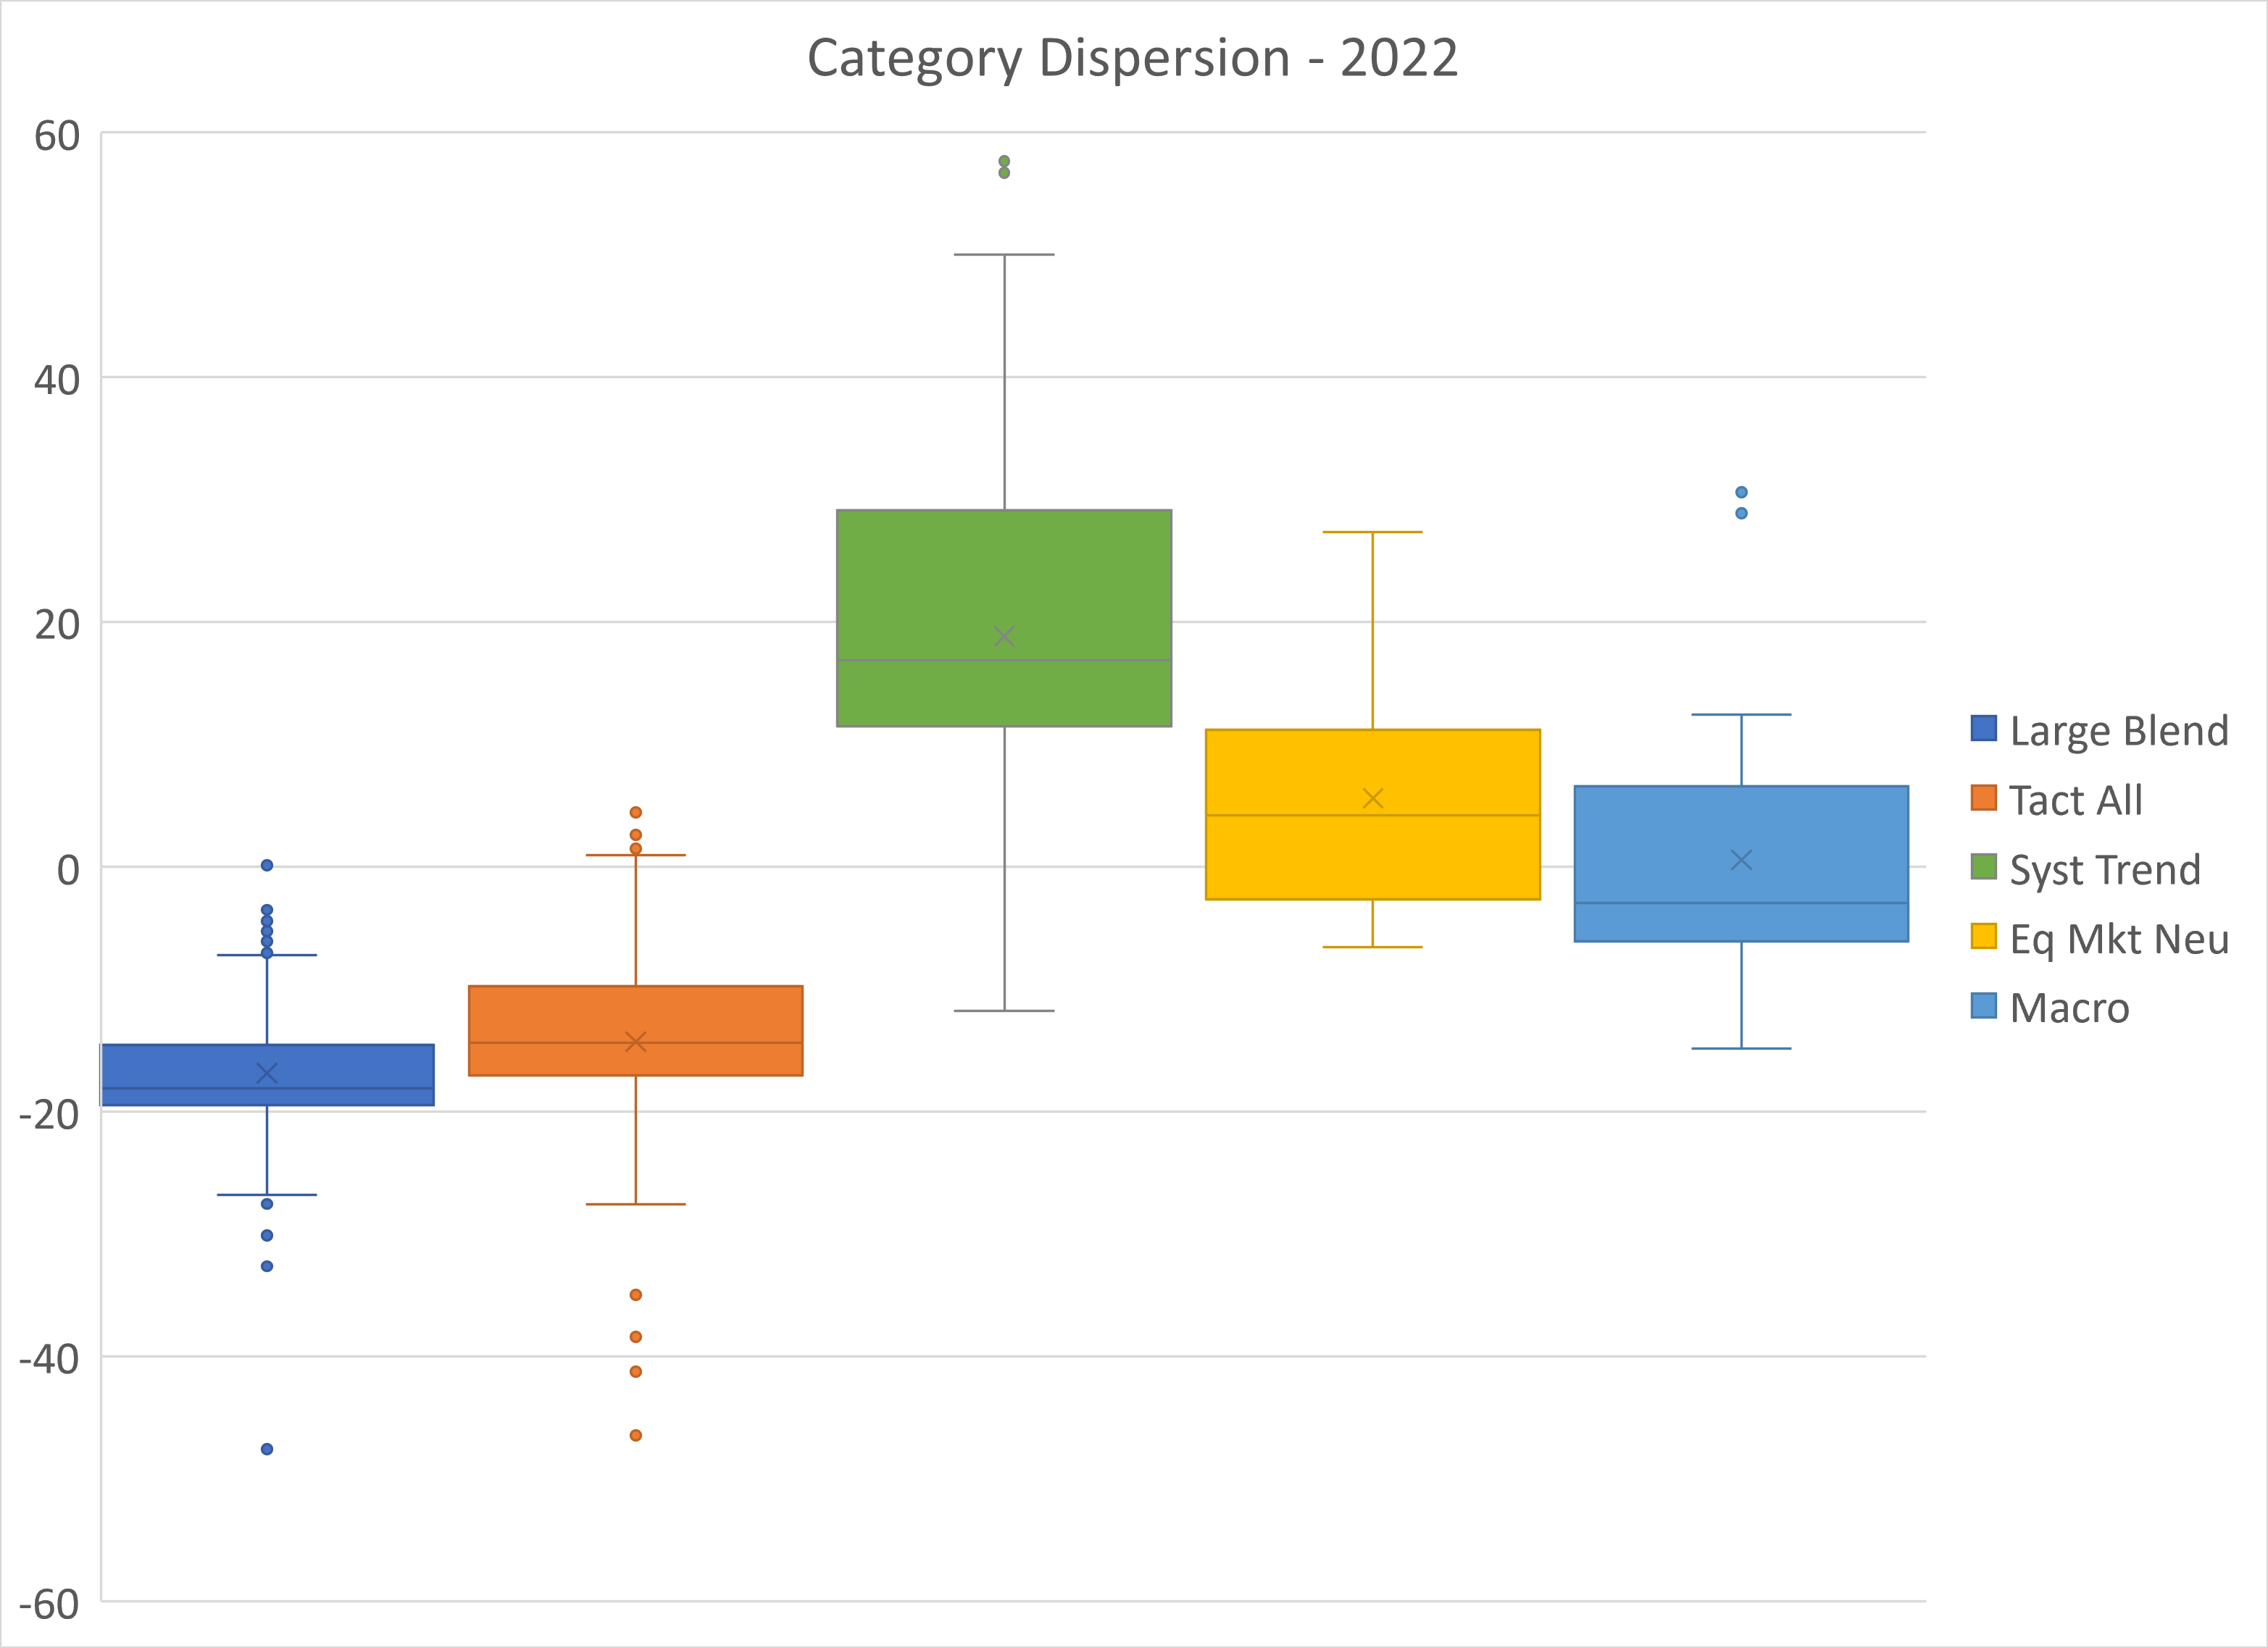
Distinct Investment Process – Step 2: Always Hedged
Large Dispersions Within Categories
  Of the 1,399 large blend funds, 700 had returns between -19.5% and -14.6%
For Financial Professional Use Only. Source: Morningstar Direct
Notes:
Marc

Slide 20
Measuring Sticks
Distinct Investment Process – Step 2: Always Hedged
Useful | Not useful
Metrics that measure risk in terms of volatility, drawdowns or benchmark-sensitivity | Metrics that measure incremental value-add vs. a traditional benchmark
Beta (low) Correlation (low) Up/Down capture St Dev or Semi-St Dev Sharpe or Sortino ratio Max drawdown Pain index/Pain ratio Omega | Tracking error Information ratio Alpha
For Financial Professional Use Only.
Notes:
Marc

Slide 21
Past Performance Does Not Guarantee Future Results
Distinct Investment Process – Step 2: Always Hedged
  Tip: Be wary of using results from an entirely different market environment
For Financial Professional Use Only. Source: Zephyr StyleADVISOR
Notes:
Marc

Slide 22
Key Takeaways
Distinct Investment Process – Step 2: Always Hedged
  Portfolio Construction Tips
  Try to mix strategies with different drivers of returns
  Proper setting of expectations is essential
  If everything is up at the same time, you’re not diversified
For Financial Professional Use Only

Slide 23
Category Focus: Tactical Asset Allocation
Distinct Investment Process – Step 2: Always Hedged
Tactical Asset Allocation/Market Timing
Broad description | Seeks to outperform by actively rotating into or out of asset classes, countries, or sectors. Typically willing to make big bets/moves.
Drivers of Return | Success depends upon staying one- or two-steps ahead of everyone else PMs tend to have their own triggers for re-allocation (e.g. relative values, absolute values, ratios, etc.)
Risks | “Live by the sword, die by the sword” Risk of being “too early” If wrong, can trail the market or a strategic allocation by a wide margin
Role in Portfolio | Can be a useful diversifier Must be willing to accept possibility of underperformance Allocation limits would be prudent
For Financial Professional Use Only.
Notes:
Marc –

Slide 24
Category Focus: Long/Short Equity
Distinct Investment Process – Step 2: Always Hedged
Long/Short Equity
Broad description | Seeks to profit from not only picking potential winners but also shorting potential losers
Drivers of Return | Tends to be bottom-up Stock-specific risk May or may not have index-based risk controls
Risks | Success depends upon getting both longs and shorts correct PMs tend to have a bias that will impact both longs and shorts Can diverge widely from the market Short-squeezing is a risk
Role in Portfolio | Useful for those who don’t believe in efficient markets Can be a good way to reduce beta
For Financial Professional Use Only.
Notes:
Marc

Slide 25
Category Focus: Systematic Trend-Following
Distinct Investment Process – Step 2: Always Hedged
Systematic Trend-Following/Managed Futures
Broad description | Tend to utilize derivatives (futures, options, swaps, forwards, etc.) to construct trend-following, momentum-based strategies
Drivers of Return | Underlying exposures tend to be macro-level, top-down exposures to countries, currencies, interest rates, commodities, etc. Use of derivatives gives them “turbo-charged” exposure
Risks | Returns tend to be “feast or famine” Dispersion within category tends to be wide Consistency is hard to come by – don’t chase performance
Role in Portfolio | More of an alpha-driver, warranting a smaller allocation Not prudent to be a core holding
For Financial Professional Use Only.
Notes:
Marc – Morningstar currently has 120 categories

Slide 26
Category Focus: Options
Distinct Investment Process – Step 2: Always Hedged
Options Trading & Derivative Income
Broad description | Utilizes the asymmetric returns offered by options to 1) hedge market exposure, 2) create an income stream, and/or 3) provide non-directional returns.
Drivers of Return | Long options Profitable if options to in-the-money Puts gain if asset goes down Calls gain if asset goes up | Short/written options Hopes to collect premium Profitable if options do not go in-the-money
Risks | Long options If options do not go in-the-money, options will expire worthless and be a drag | Short/written options If options go in-the-money losses are theoretically unlimited
Role in Portfolio | Hedged Equity Can provide downside risk mitigation | Derivative Income Can provide a yield not dependent upon interest rates
For Financial Professional Use Only.
Notes:
Marc –

Slide 27
Category Focus: Multistrategy
Distinct Investment Process – Step 2: Always Hedged
Multistrategy
Broad description | A “fund-of-funds” where many different alternative strategies are rolled into a single ticker. Sub-strategies can potentially all be run in-house or be a “best of breed” approach.
Drivers of Return | Varies widely. A properly constructed Multistrategy approach will have several or many uncorrelated substrategies, which should have many different drivers of returns.
Risks | Lack of clarity into performance of individual parts. Additional layer of fees. Risk of substrategies “cancelling out” each other. Some may tactically shift allocations within portfolio.
Role in Portfolio | Can be an “easy button” approach if willing to offload due diligence and monitoring of constituents. Might be more appropriate for smaller portfolios.
For Financial Professional Use Only.
Notes:
Marc

Slide 28
Potential Use Cases
May Serve Various Objectives
Help Increase Return Potential
Remain Invested
Mitigate Market Risk & Reduce Volatility
Diversify Traditional Allocation
Shift Cash Off the Sidelines
Re-Allocate Equity Positions
Fixed Income
Cash
Fixed Income
Equity
Equity
Equity
Fixed Income
Reposition proportionate share of balanced portfolio into Hedged Equity to potentially:
Increase overall portfolio return
Maintain a similar risk target
Reposition portion of cash into Hedged Equity to potentially:
Increase market exposure
Maintain a level of risk mitigation
Reposition portion of large equity allocation to Hedged Equity to potentially:
Mitigate downside risk/volatility
Maintain a level of equity upside participation
For Financial Professional Use Only NOTE – these charts provide hypothetical portfolios and are for illustration purposes, not a guarantee of future performance, nor a recommendation for specific investors. The charts and graphs contained herein should not serve as the sole determining factor for making investment decisions.
Notes:
Rob
THIRD POLL:
Are you currently using hedged equity?
Yes, primarily as an alternative to equity and fixed income
Yes, primarily as a bond alternative
Yes, primarily as a way to reduce equity risk
No, I am not currently using hedged equity

Slide 29
Key Takeaways
Distinct Investment Process – Step 2: Always Hedged
  Summary
Alternatives are back en vogue following 2022
“Alternatives” encompasses vastly different strategies
Appropriate due diligence is essential when analyzing alts
For Financial Professional Use Only

Slide 30
Disclosures
Distinct Investment Process – Step 2: Always Hedged
  Swan Global Investments is an SEC registered Investment Advisor that specializes in managing money using the proprietary Defined Risk Strategy (DRS). Please note that registration of the Advisor does not imply a certain level of skill or training. All investments involve the risk of potential investment losses as well as the potential for investment gains. Prior performance is no guarantee of future results and there can be no assurance that future performance will be comparable to past performance. This communication is informational only and is not a solicitation or investment advice. Further information may be obtained by contacting the company directly at 970-382-8901 or www.swanglobalinvestments.com. 226-SGI-111723
For Financial Professional Use Only

