Slide 1
Society Training: Salesforce Refresher Case Study
Global Society Operations
January 2026

Slide 2
A Few Reminders and Disclaimers
Salesforce refresher case study
Salesforce Data is Fluid
Visibility of contact records in Salesforce is determined by:
Membership
Candidacy
Location
Member and Candidate data is close to real time. Membership data is overwritten with the most recent transaction (join, renew, lapse, cancel). Candidate data updated as candidates register for exam, sit for exam, pass or fail, register for next exam level or reregister for same level.
These updates to a contact record determine if an individual is included or excluded from Salesforce reports.
Candidate Example: February 2026 exam, soon after the exam date the report 2026-02 (Feb) - Currently Registered is obsolete as my registration status is updated and no longer meets filter requirements for Registration Status = Registered.
Member Example: If a member failed to renew for MY26 that member will appear in the Lapsed-Member Year 2025 report as their most recent transaction was a lapse. If the member renews at some point their transaction type is updated to Renew and they will be removed from lapse report and included in 2026 Renewed Members report and the Active Society Members report.
Reports are customizable. Edit filters and fields to fit your needs.
2
© 2026 CFA Institute. All Rights Reserved.

Slide 3
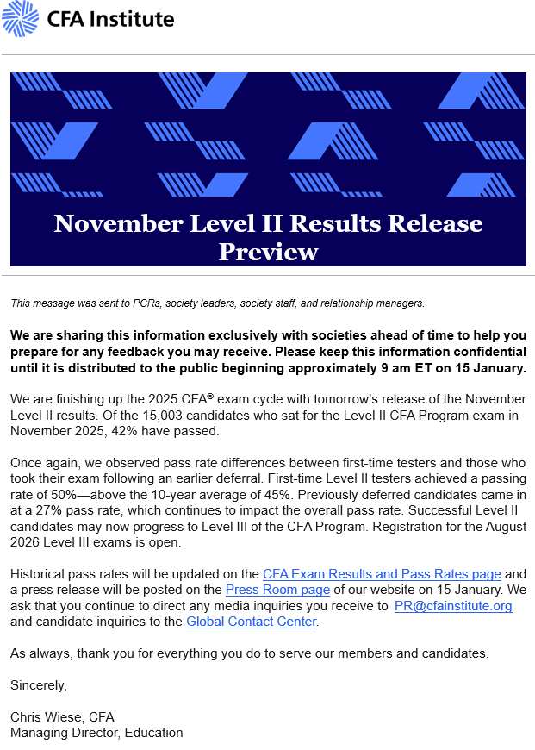
Case 1: Candidate Support and Outreach
Salesforce refresher case study
Enterprise site: CFA Exam Schedule: Registration deadlines, exam dates
Results to be announced around 6 weeks after exam date.
Connexions: Candidate Communications timeline from CFA Institute
Raise awareness of candidate support resources available, the new skills developed at each level and improve candidates’ progress through the CFA Program.
Customized communications created for all levels, passers and non-passers.
Salesforce: Candidate Reports Folder
Active Candidates Report: Reach out to candidates prior to exam to inform how society supporting candidates (study group, mock exams, mentorship, networking, etc.)
Candidate Report (Prep Provider): Sharing prep provider resources and promotions.
3
© 2026 CFA Institute. All Rights Reserved.

Slide 4
Case 1: Candidate Support and Outreach
Salesforce refresher case study
Salesforce: Candidate Reports Folder
Pass list: Congratulatory message, support resources, associated events (post exam celebration/networking, member recruitment)
Charterpending: CP conversion, membership application step, society factsheet, local member benefit highlight such as events, PL content, networking opportunity.
Potential Level II and III candidates: Share society Support resources for the prospects
Other Certificates: Expand your community and member growth.
Private Equity Certificate Awarded / Currently Registered
Climate Risk Certificate Awarded / Currently Registered
Private Markets Cert Awarded / Current Registered
Invest Foundations Cert Awarded / Currently Registered
(Sustainable Investing Certificate) ESG Historically Passed / Currently Registered
*Information column with checkbox to indicate if they are also charterholder/society member.
Salesforce: Marketing Cloud Reports folder: Corresponding member/candidate list for societies using MC.
4
© 2026 CFA Institute. All Rights Reserved.

Slide 5
Case 2: New Charterholder Recognition
Salesforce refresher case study
Connexions: Charter Award Ceremony Resources
Welcome assets, congrats video from Marg Franklin, charter shipment request.
Salesforce: Membership Reports folder
Build a cadence of communications with new members especially for the first year!
Introduce society, website and social channels’ member value highlights including local events, connections, networking, PL content.
New charterholders – All in Soc. (everyone)
New charterholders with Society Membership
*Edit charter award date filter to capture charterholders within selected timeframe.
5
© 2026 CFA Institute. All Rights Reserved.

Slide 6
Case 3: Member Engagement & Renewal Campaign
Salesforce refresher case study
Connexions: Membership Renewal resources Check the recommended calendar schedule and develop renewal message (e.g. within 1-2 weeks of renewal). Don’t forget about lapsed or cancelled members. Outreach leads to retention.
Salesforce: Membership Reports folder
Member Activity – New Joins Mem Year 2026
Member Activity – 30 Days Transactional
2026 Renewed Members
Lapsed – Member Year 2025
Lapsed – All Historical Members
Cancelled Members – Member Year 2025
Cancelled Members – All Historical
6
© 2026 CFA Institute. All Rights Reserved.

Slide 7
What’s more? The Salesforce Library!
Salesforce refresher case study
Consolidated Society Data Report
Monthly overview of your society's member and candidate counts, demographics, historical trends, NPS scores, candidate registration rates
Great resource for your society’s planning!
Member Retention Report
Monthly/bi-monthly during renewal season for renewal rate in your society, at regional and global level including new members, renewed members, recovered and reactivated members.
Orders & Payments Reports
Around 15th every month. Orders: Membership transactions
Payments: Funding, revenues (Career Center / Sustainable Investing Certificate)
7

Slide 8
Questions?
Contact Society Support Center at societysupport@cfainstitute.org
© 2026 CFA Institute. All Rights Reserved.

