Slide 1
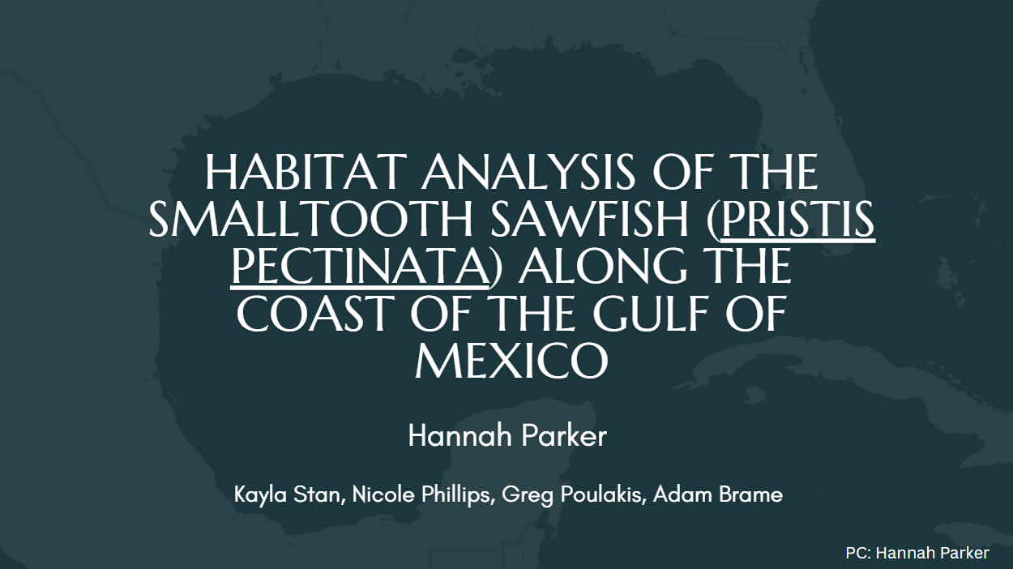

Slide 2
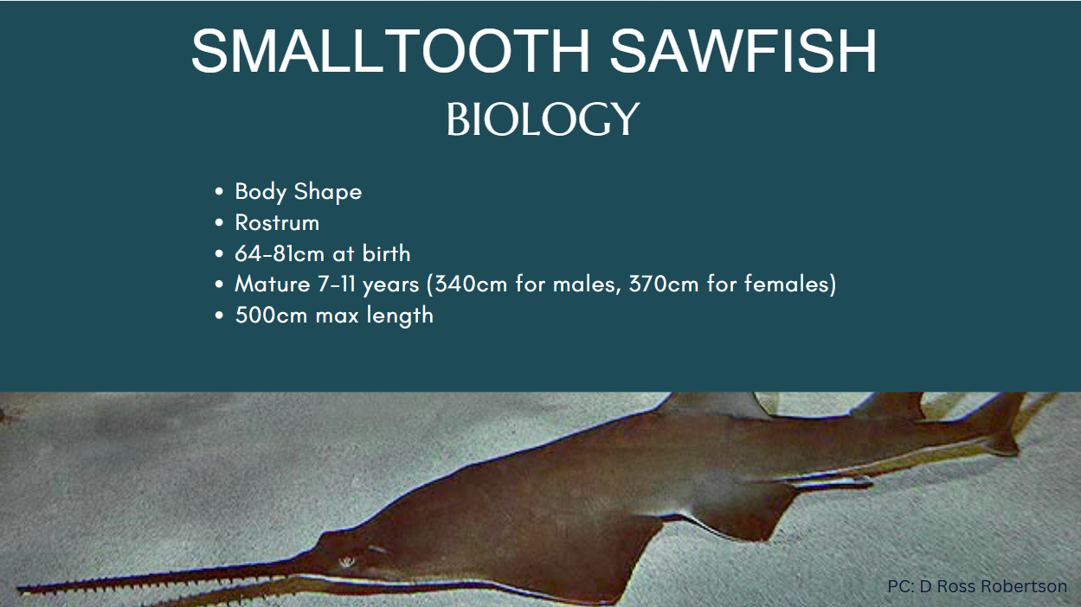

Slide 3
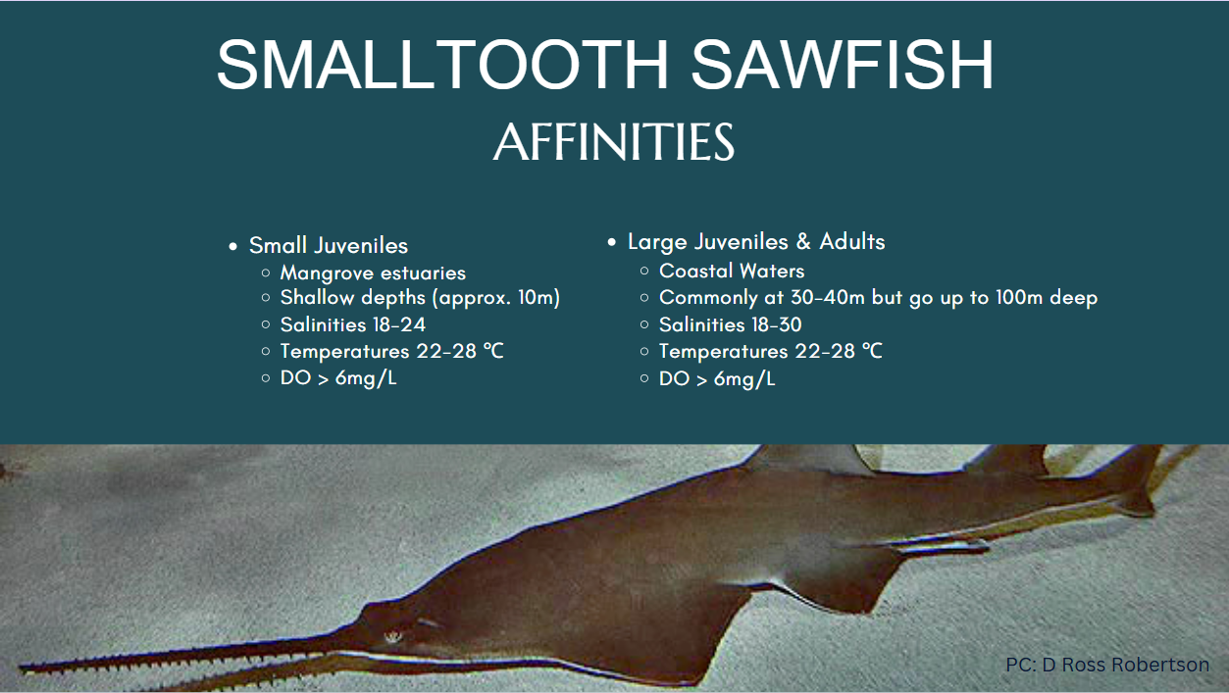

Slide 4
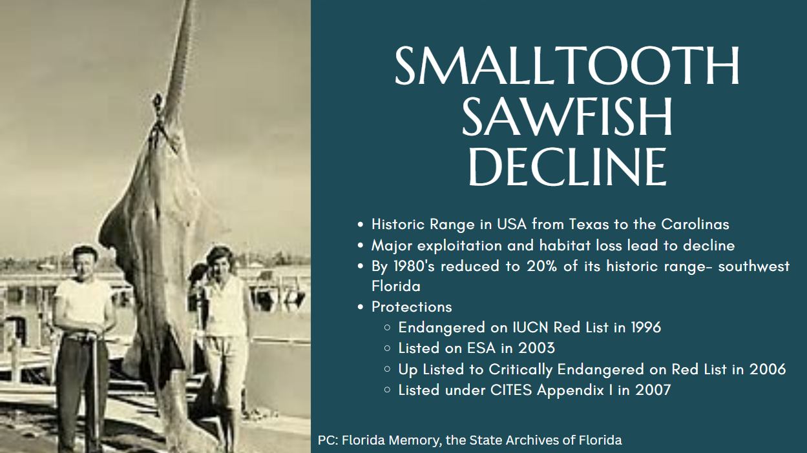

Slide 5
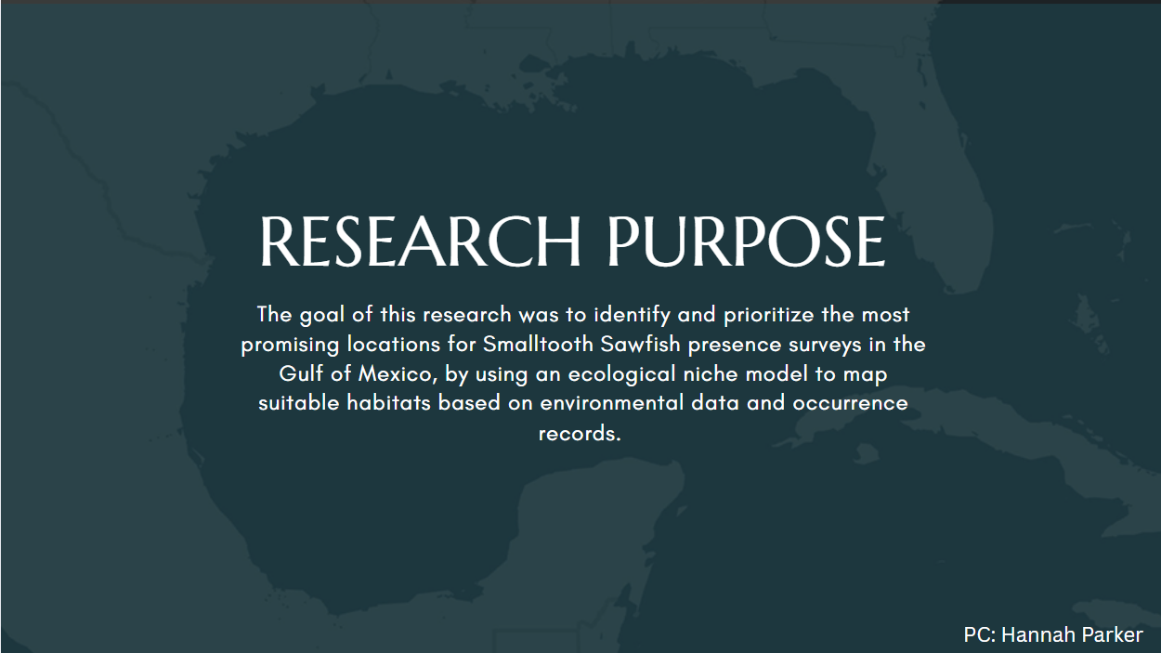

Slide 6
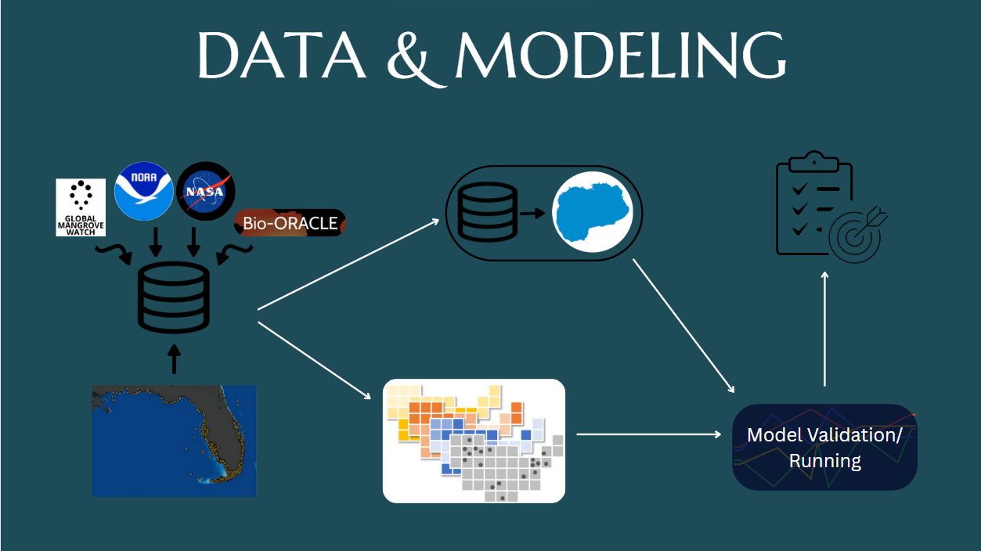
Notes:
Data Collection
Occurrence Data: NOAA Fisheries 2024 Smalltooth Sawfish Database
Environmental Data: Bio-ORACLE, Global Mangrove Watch, NASA SRTM30, NOAA Gulf Data Atlas
Data Layers: Distance from Mangroves, Bathymetry, Sediment Types, Ocean Temperature, Salinity, Sea Water Direction, Sea Water Current, Dissolved Oxygen, Primary Productivity, Terrain Ruggedness
Modeling:
1. Make a study area mask, Calculate the distance from mangroves
2. Maxent Model: Presence-Background Model, Measured Habitat data and Occurrence Points, Mathematical functions: linear, quadratic, interaction, threshold, and hinge
3. Model Training: Validation
Model Types Run (50): Individual Variable Testing, All Variables, Thinning Testing
4. Model Accuracy: Correctly Classified Presence Points
5. Model Ensemble: Max, Min, Mean, Median

Slide 7
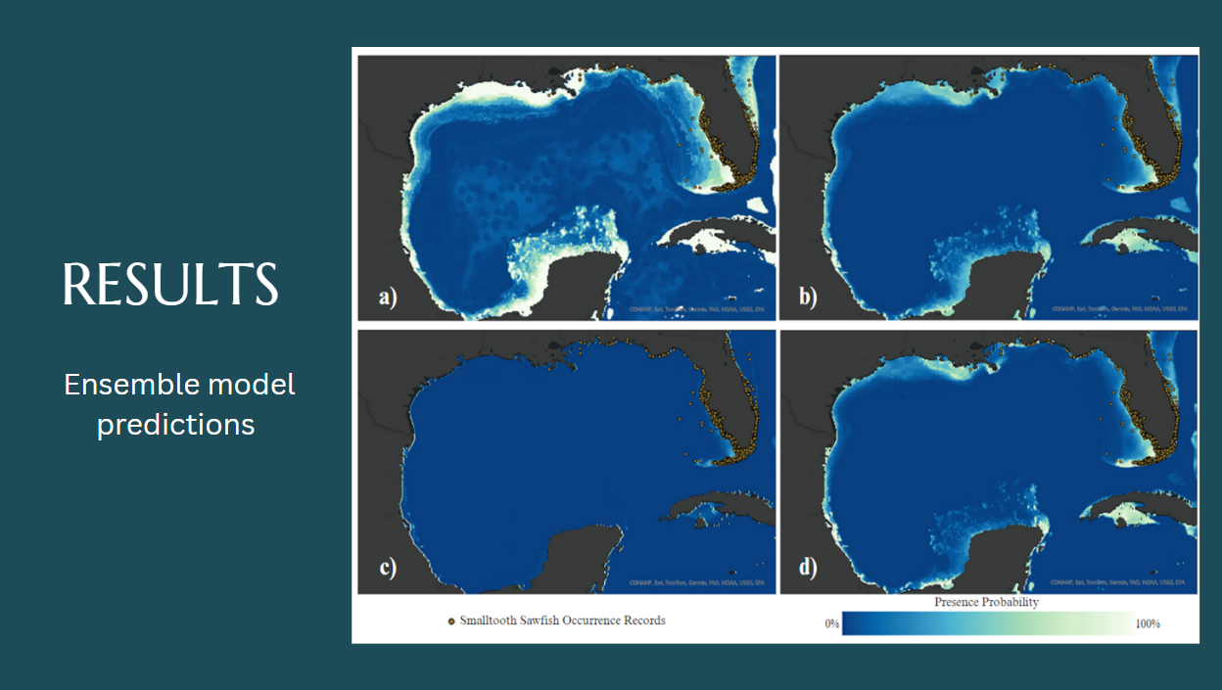

Slide 8
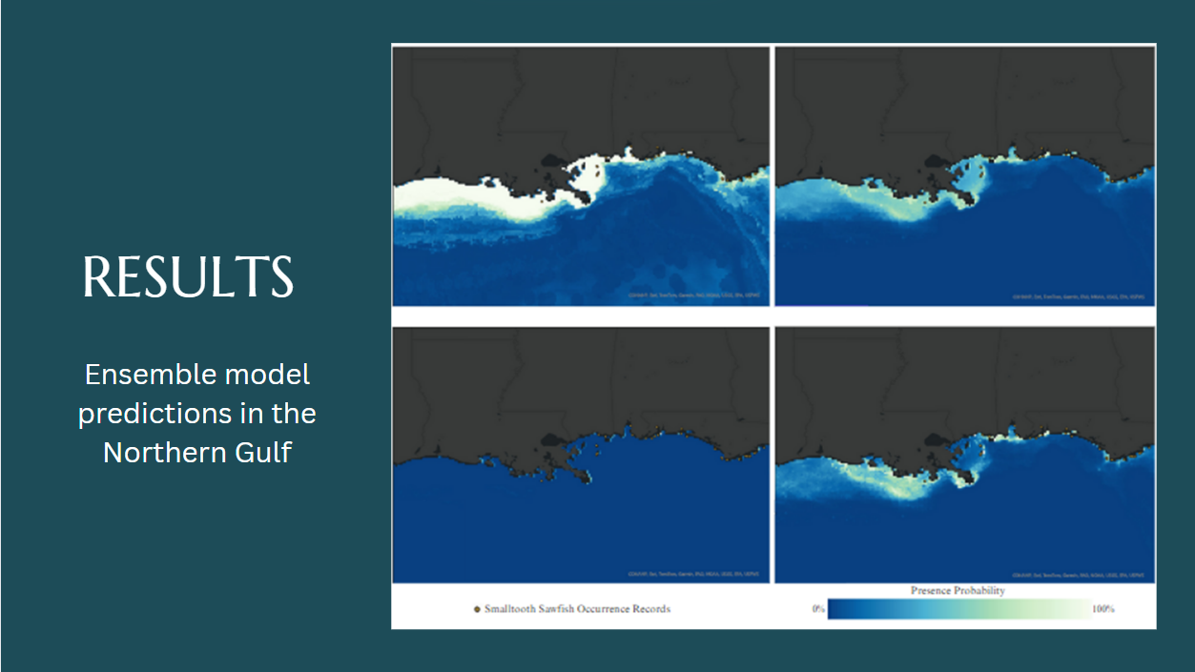

Slide 9
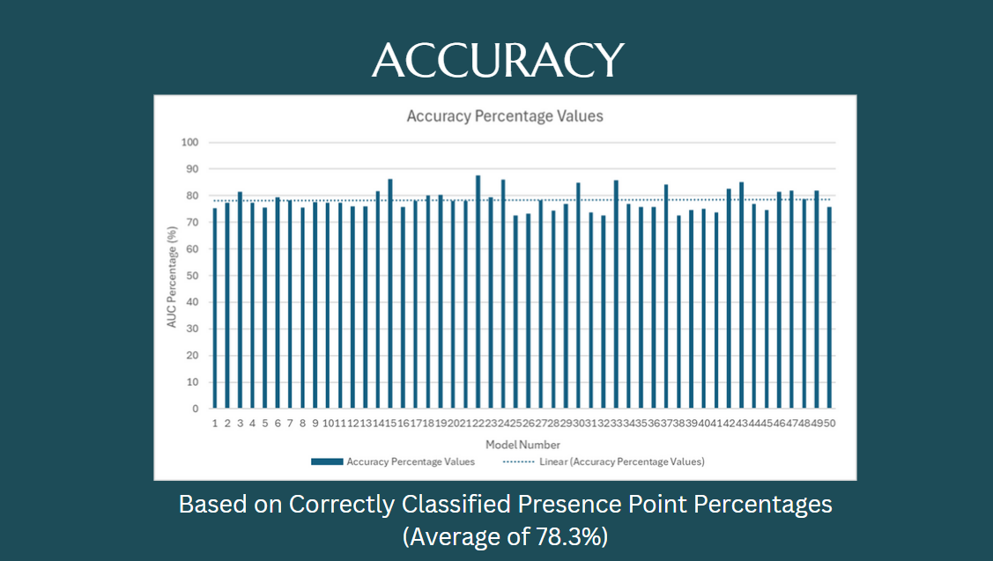

Slide 10
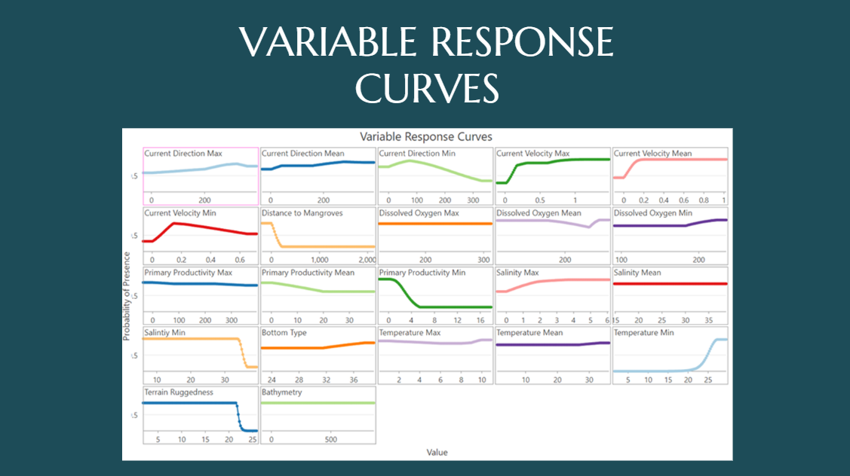

Slide 11
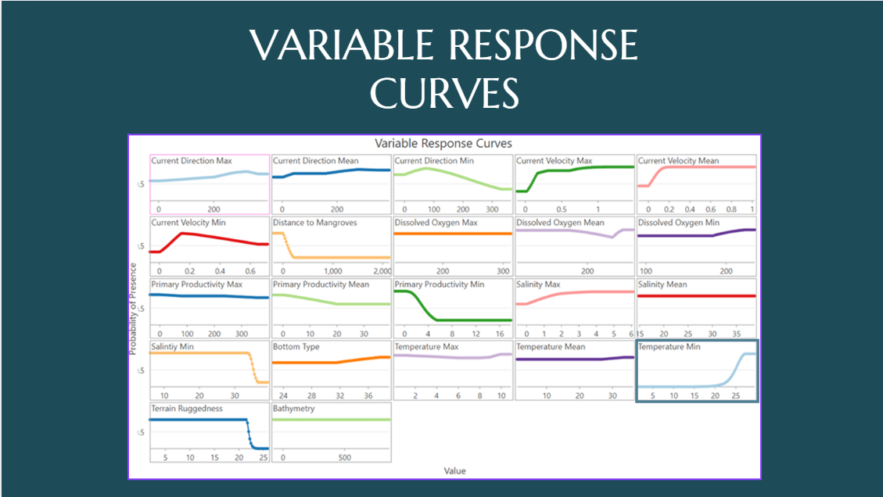

Slide 12
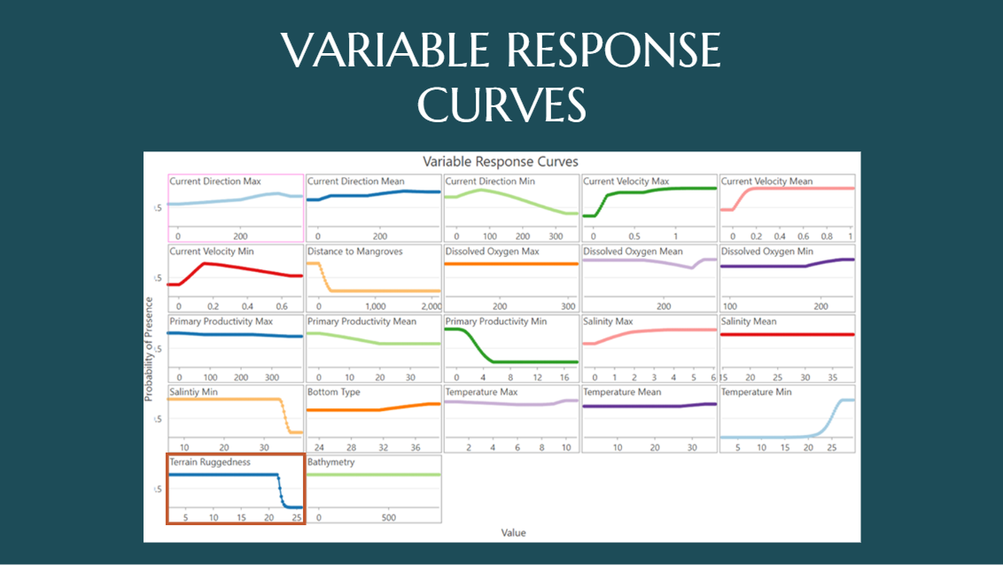

Slide 13
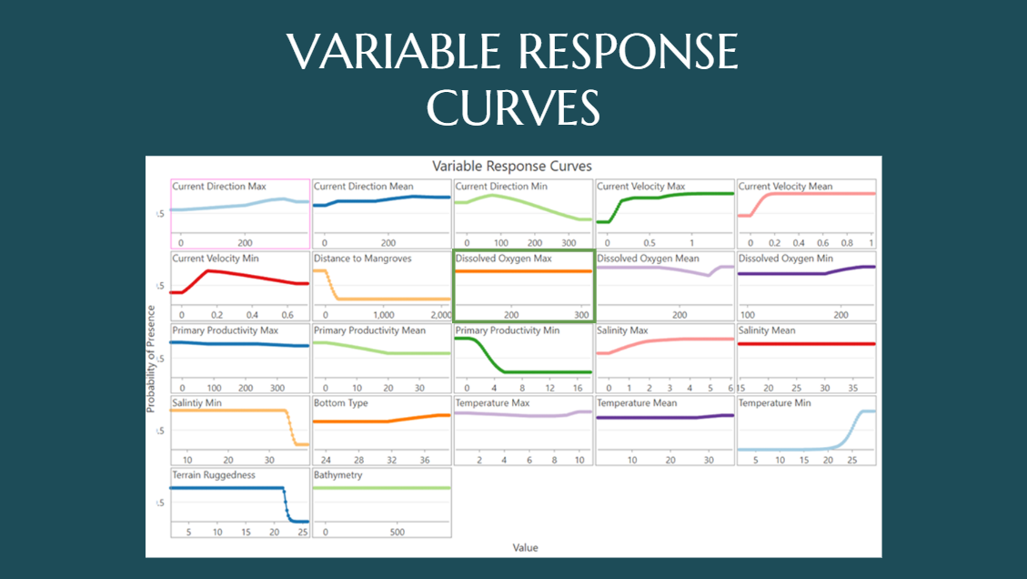

Slide 14
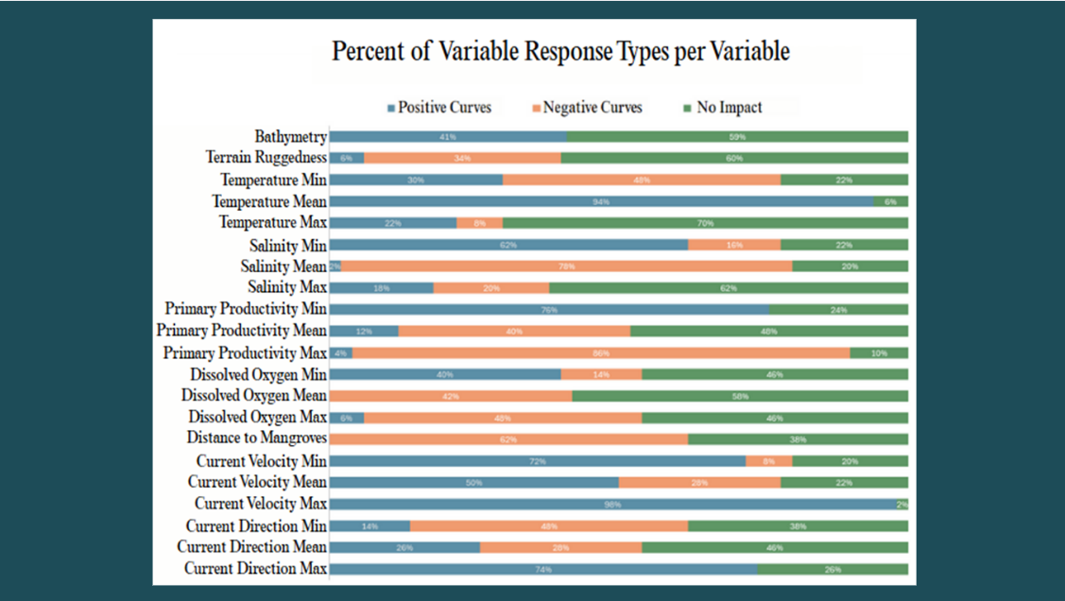

Slide 15
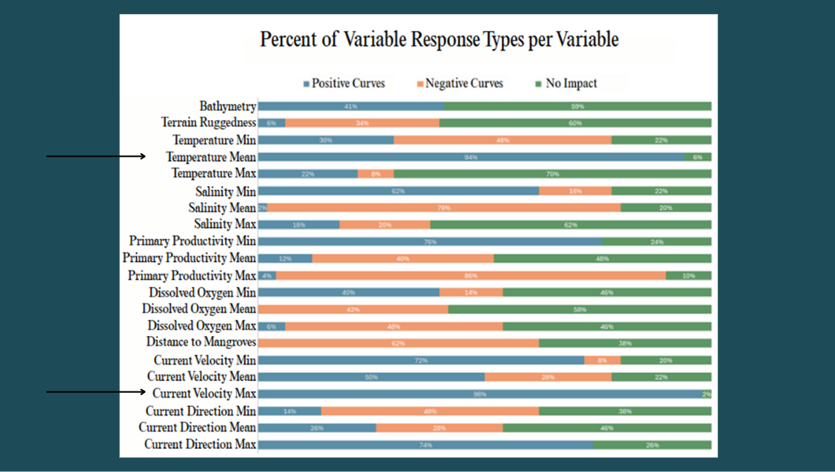

Slide 16
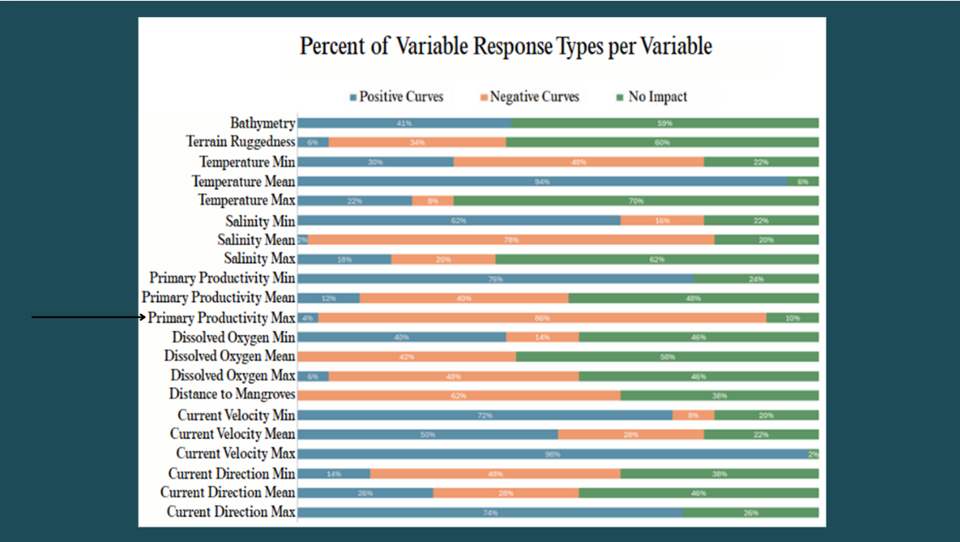

Slide 17
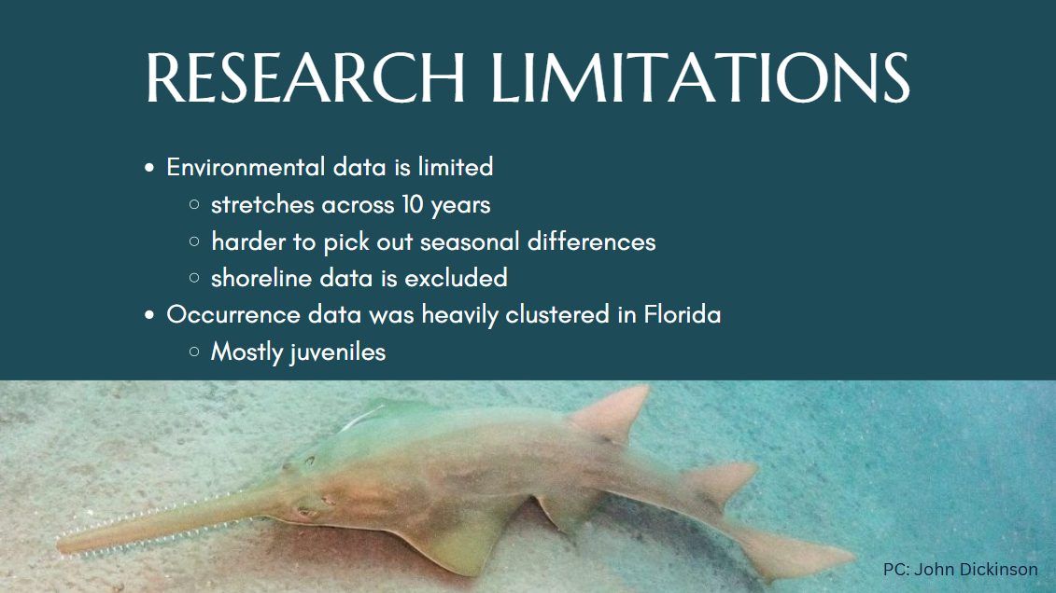

Slide 18
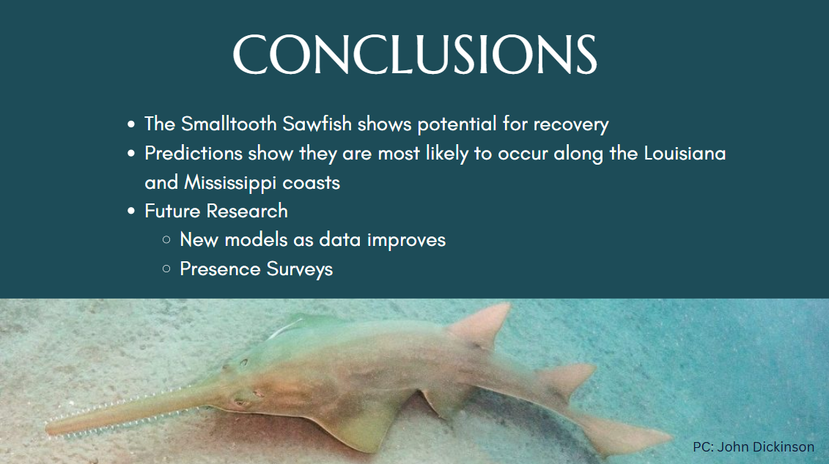

Slide 19


Slide 20
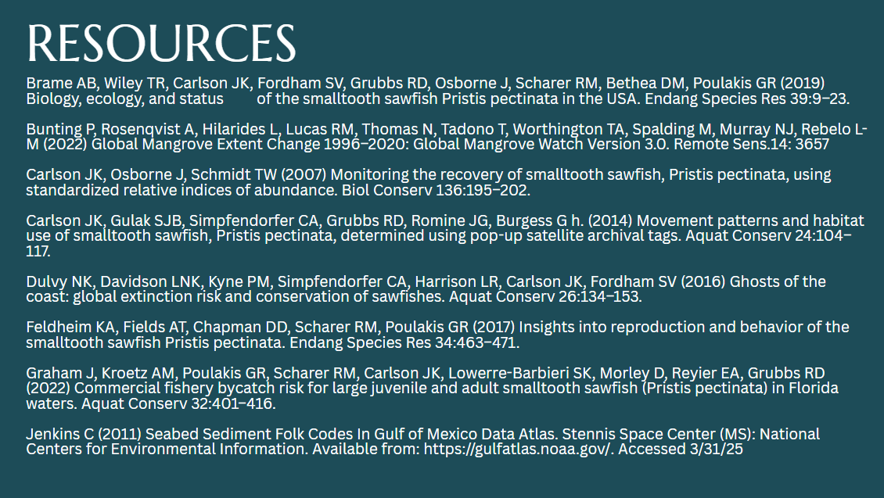

Slide 21
