Slide 1
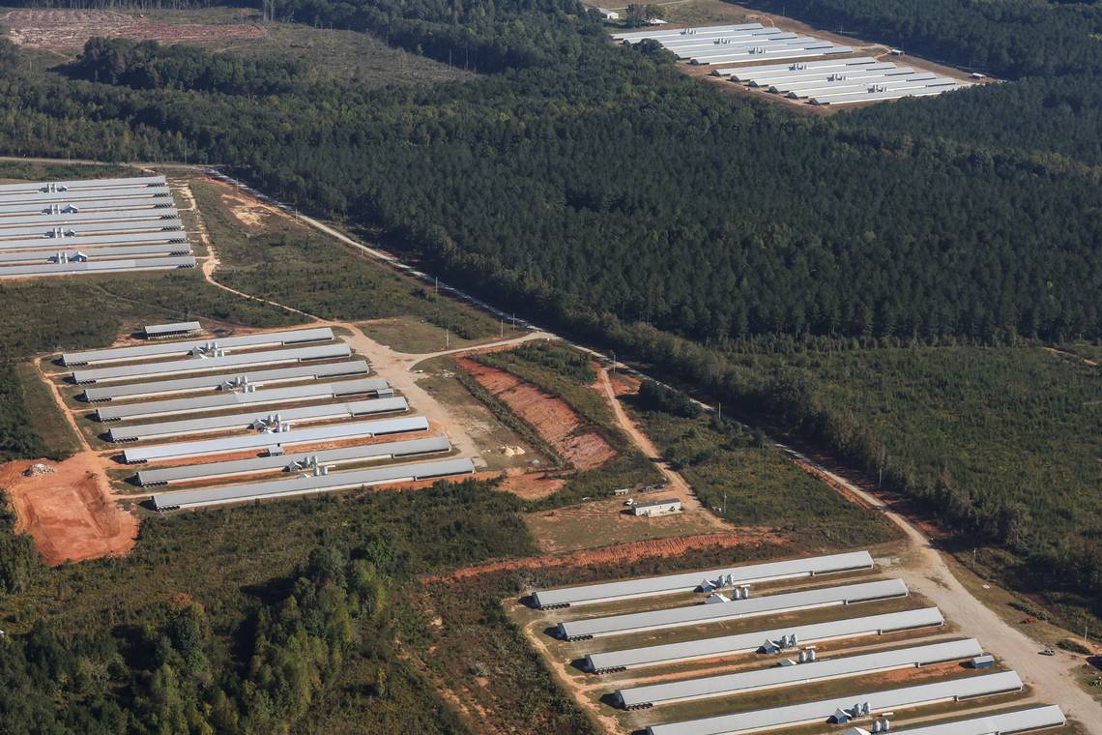
Monitoring Through Deep Learning: Poultry AFO Detection
Savannah B. Jobkar
Advisor: Dr. Emine Fidan
Co-Authors: Drs Hao gan,
Shawn Hawkins,
Phillipe ambrozio
Notes:
Locating and Map AFOS across Tennessee
Estimate their water use

Slide 2
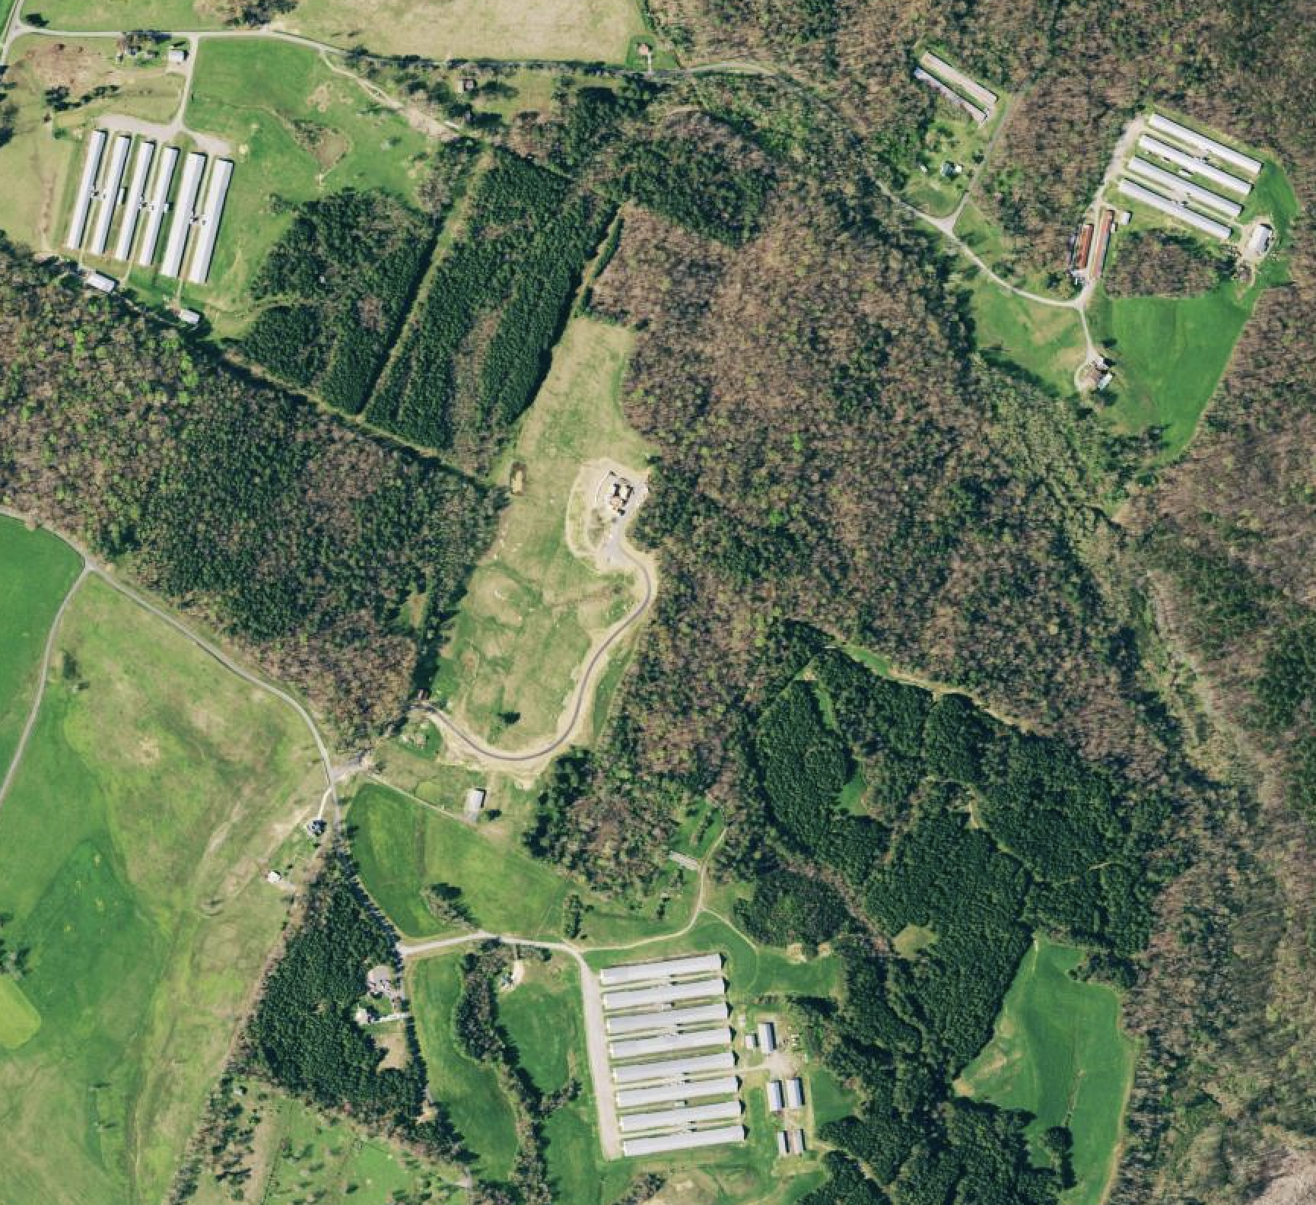
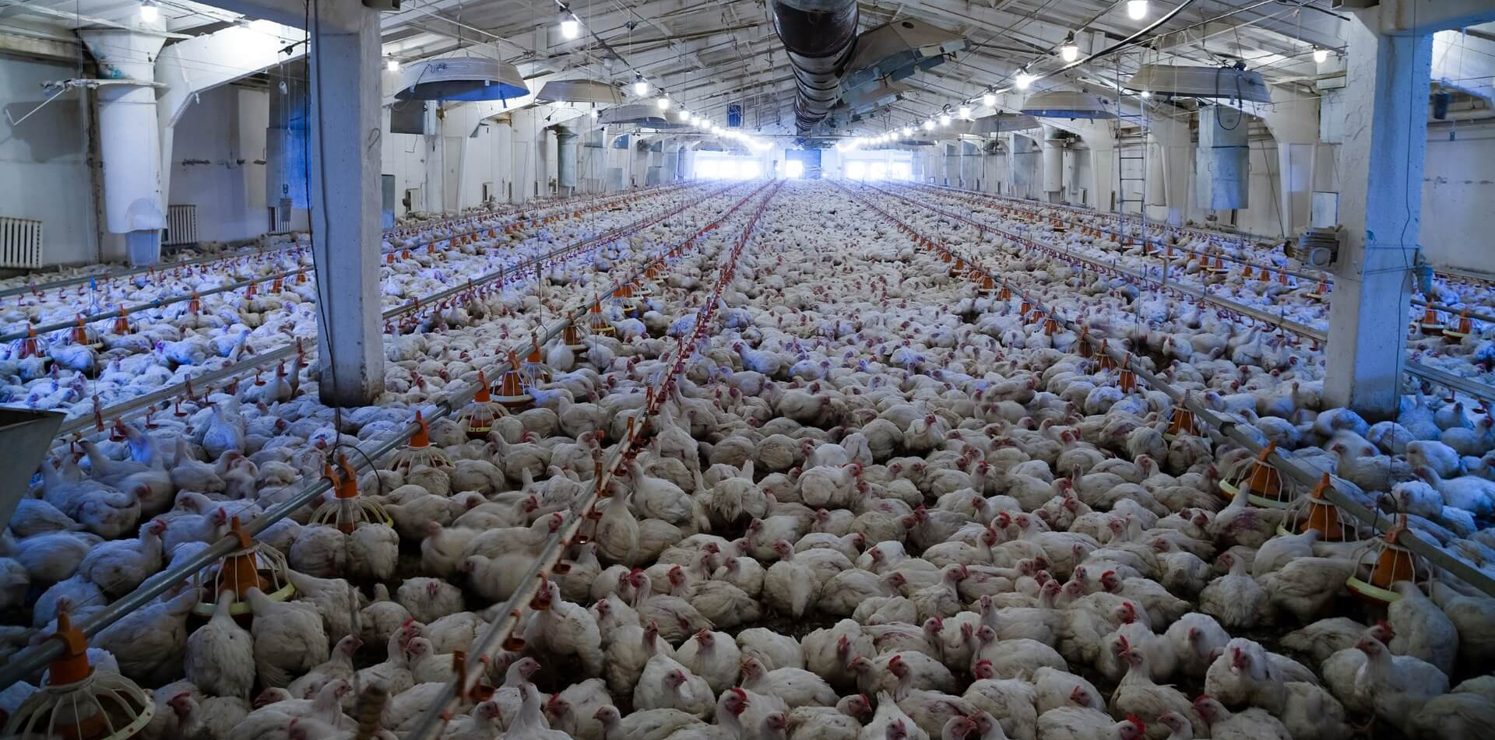
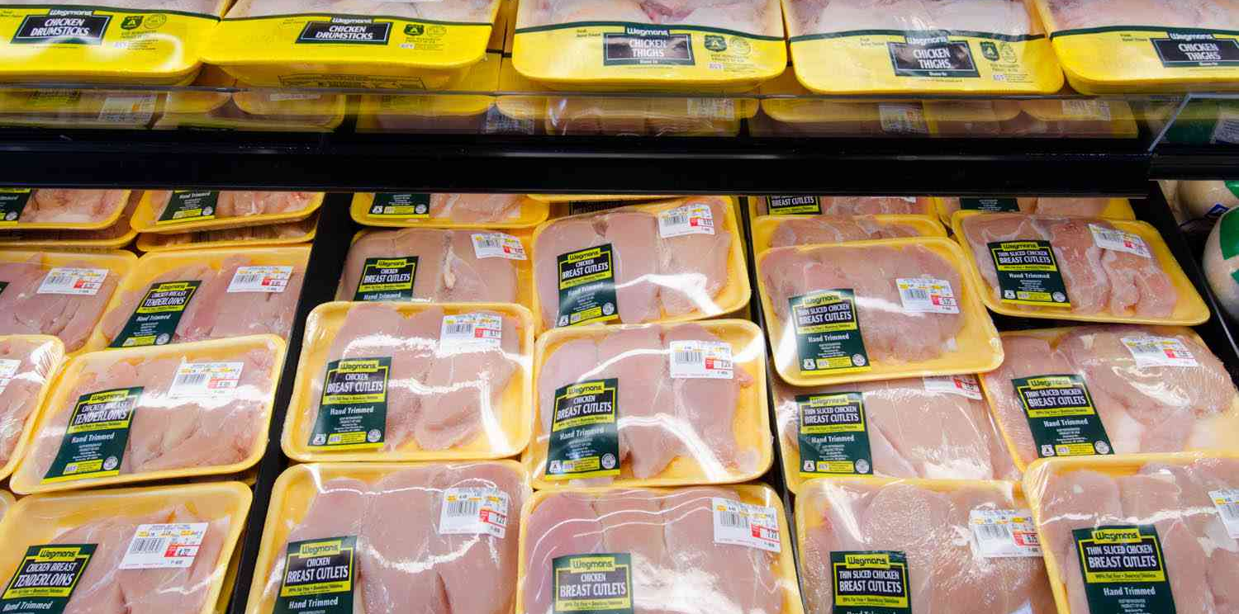

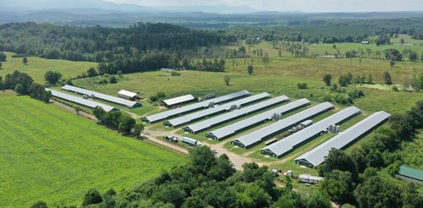
What are AFO’s & What are their Benefits?
Notes:
!. Large scale animal production facitlies that feed and house animals in a confined space
2. Range in size 40x400 to 60x600, come I groups of 2-20, some are singles on smaller farms.
3. CAFOs are the primary producer of meats in the US, Since AFOs are mass production facitlies, there is lower production cists associated with them, hich leads to lower consumer costs.
4. AFOs provide a consistent supply and quality of animal products, as all steps of production are carefully monitored.
5. play a large role in the communities they are located, as they aid economic development in rural communities by providing jobs for a diverse workforce.

Slide 3
Nationwide AFO Statistics
60%
70%
93%
Unpermitted
Ag Water Use
Waste Production
The US EPA states 60% of concentrated AFOs do not hold a permit, with the US GAO noting that there is not enough information to effectively regulate them.
Agricultural Water Use accounts for 70% of worldwide freshwater withdrawals. Tennessee is already facing potential water shortages due to historical trends.
93% of annual organic waste comes from Livestock operations. The EPA estimates that livestock generates over 1.4 billion tons of manure annually, 13 to 20 times more waste than the entire U.S population.
Notes:
1. Without permits, we have no way to make sure farms are in regulation compliance with environmental, and industry set standards.
2. Worldwide, agriculture uses 70% of freshwater withdraws. In Tennessee, water issues and increasing water demands (due to population growth, aging water infrastructure, and litigations over aquifer water rights like in west tennessee) highlight the need to gain a comprehensive understanding of agricultural water use. Water use estimations from broiler houses are necessary for sustainable water resource management.
3. The EPA estimates livestock generates 1.4 tons of manure a year, or 93% of all organic waste annually. Compared to humans, which produces the other 7 %.
A single large dairy farm (2,500 cows) produces as much waste as 400,000 to 500,000 people—a population size similar to Atlanta, Miami, or New Orleans.
AFO waste is largely untreated and spread on fields, increasing ricks of water contamination.

Slide 4
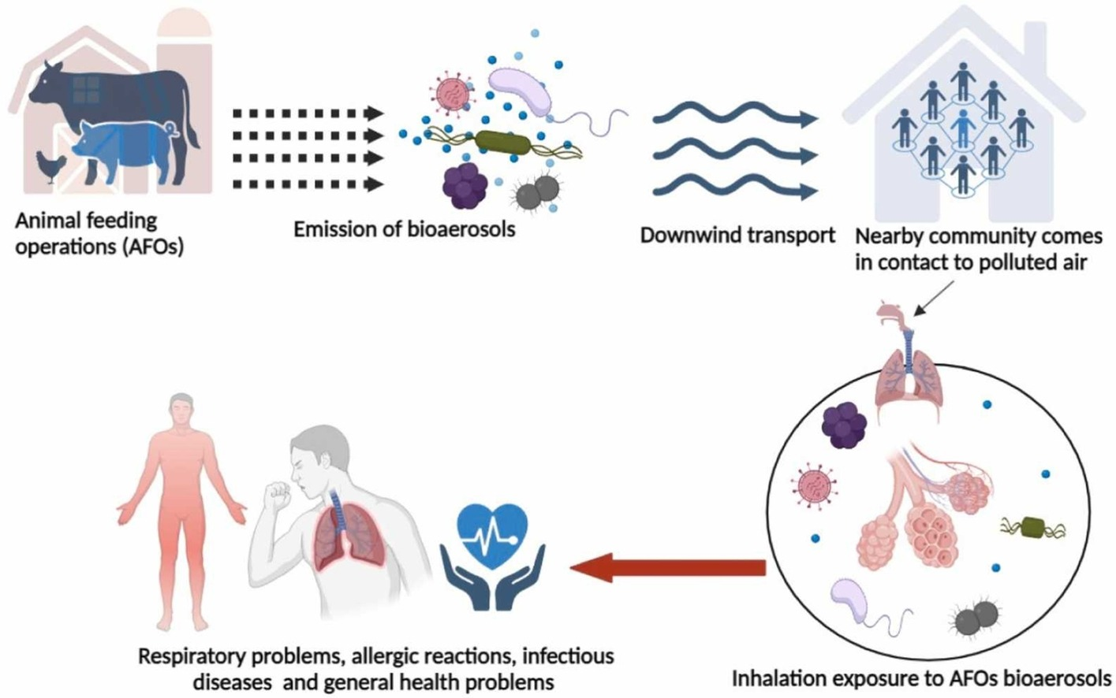
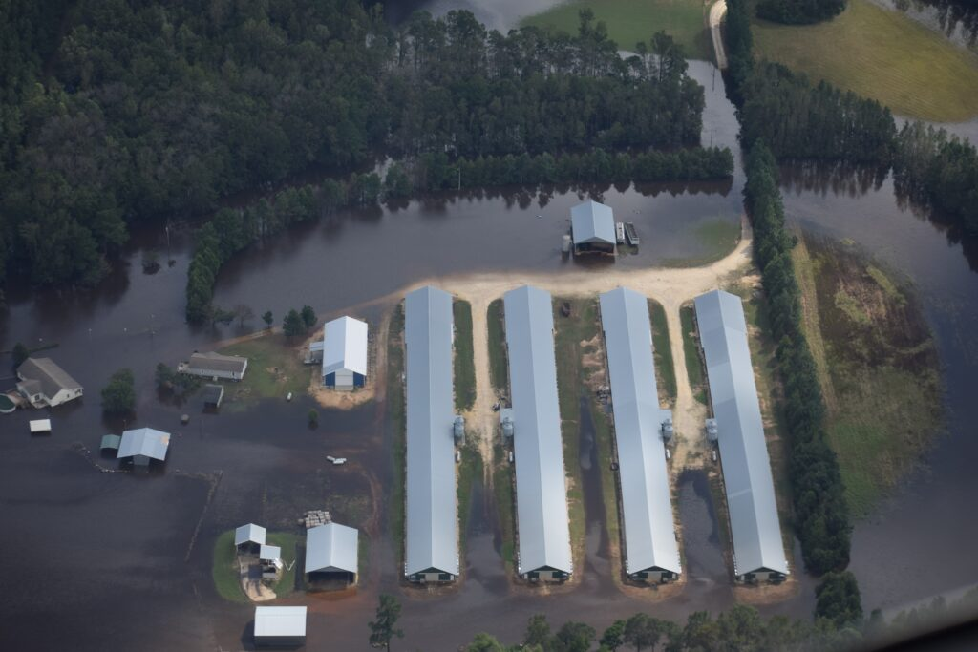
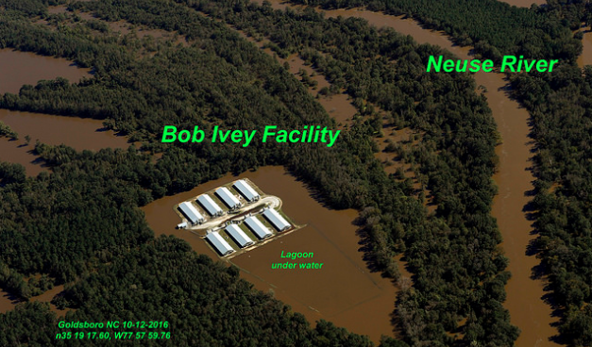
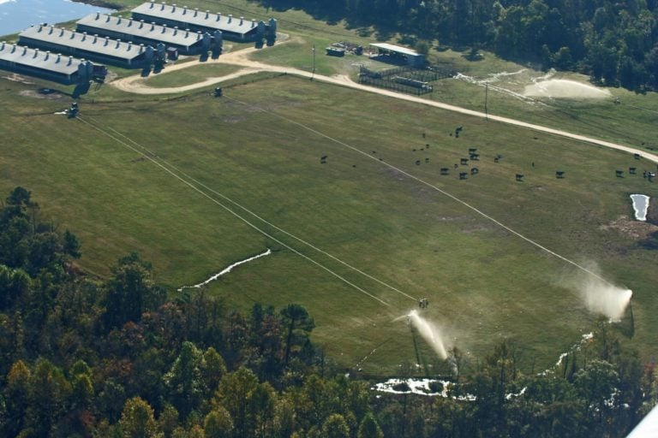
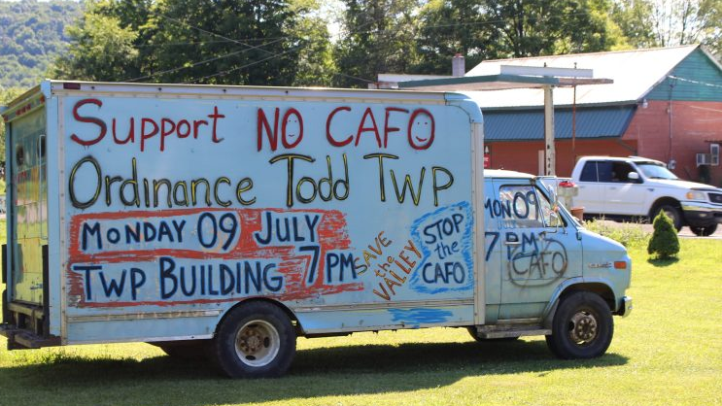
AFO Downsides
Notes:
1. Contamination of natural water ways and groundwater. Extreme weather events like heavy rainfall and floods can lead to the overflow of manure lagoons and the spread of pollutants into nearby water bodies. excess nutrients can cause toxic algal blooms, decrease oxygen content, lead to fish kills, and bacteria in waterways.
Animal Feeding Operations (AFOs) can pollute the air by releasing ammonia, hydrogen sulfide, particulate matter, volatile organic compounds.Environmental interest groups tend to protest the construction of these faculties in many rural towns due to ethical reasons and perceived health risks.
A study done at South Dekota Sate has found that Bioaerosols (containing infectious pathogens, allergens, and hazardous biocomponents) have been found seven kilometers downwind of AFO sites.
https://www.sciencedirect.com/science/article/abs/pii/S030438942402404X

Slide 5

Research Questions and goals
1. Can we create a more accurate database for AFOs in Tennessee’s most agriculturally dominated counties?
GOAL: Locate and quantify AFO’s at parcel scale by developing an automated machine vision approach
2. Can we estimate spatiotemporal poultry livestock water use?
GOAL: Use outcomes from Goal 1 and poultry water use equations to quantify water withdraws on a barn-to-barn basis.
Notes:
Tennessee does not currently require Afo permits for medium sized operations, only large (greater than 125,000 chickens per barn) So were interested in building a farmwork to map their locations.
Information on water usage is aggregated at a county and watershed scale in the US, thus making it difficult to account for the location, timing, and quantity of water withdrawals
Working toward bridging the gap in our understanding of the complete scope of AFO impacts.

Slide 6
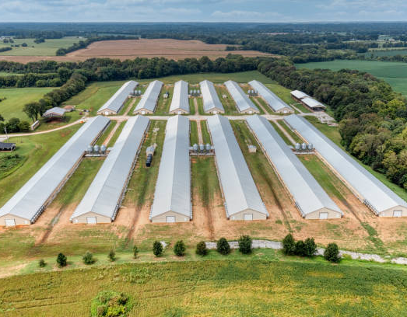
Goal 1: Semantic Image Segmentation to detect afo’s
Notes:
Usiing machine vision to geolocate poultey barns in Bradley and Bedord coutnies. Chosen bc they are agriculturally dominant.

Slide 7
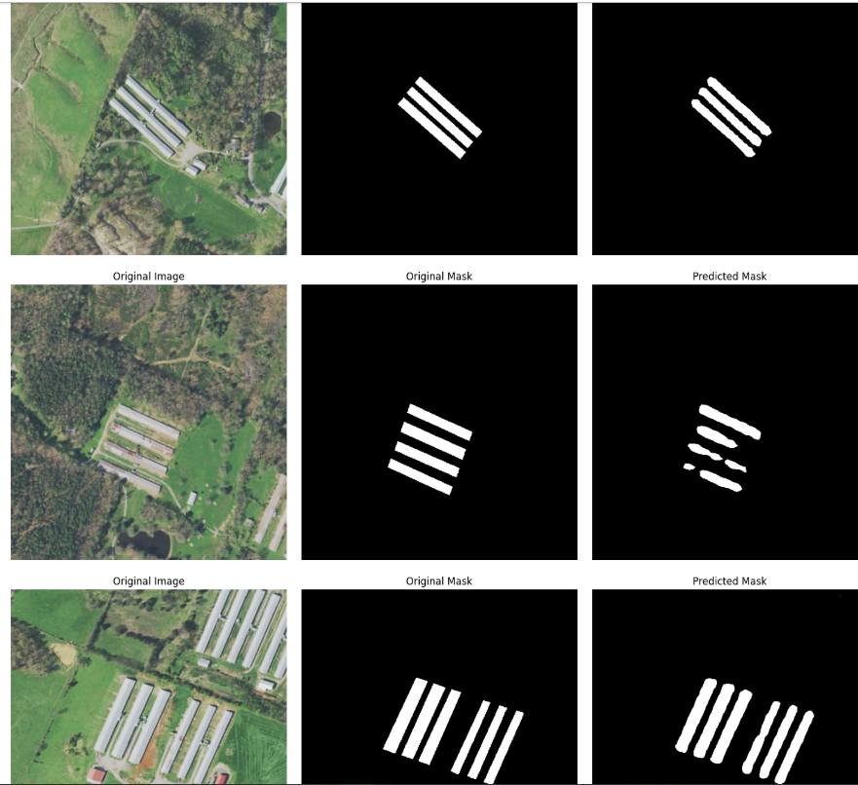
Model Architecture & Data
Pertained Semantic Segmentation Model : DeepLabV3 CNN with Resnet 50 backbone
2021 High Resolution (60cm) ortho imagery from USDA National Agriculture Imagery Program (NAIP)
Training Data
Manual Delineation of 171 barns in Bradley & Weakley County
Barns Converted to Binary masks for model Training
Image (512 x 512) and Mask tiles fed into DeepLabV3 Architecture
Notes:
DeepLabV3 is a semantic segmentation model, meaning it classifies every pixel in the image. As seen in this image, the model is separating barns from everything else.
Model architecture used atrous convolutions to capture multi-scale context without down sampling too much. This means it sees the big picture (fields, roads, other buildings) while preserving fine detail (roof edges, shadows).
Backbones allow for faster training.

Slide 8
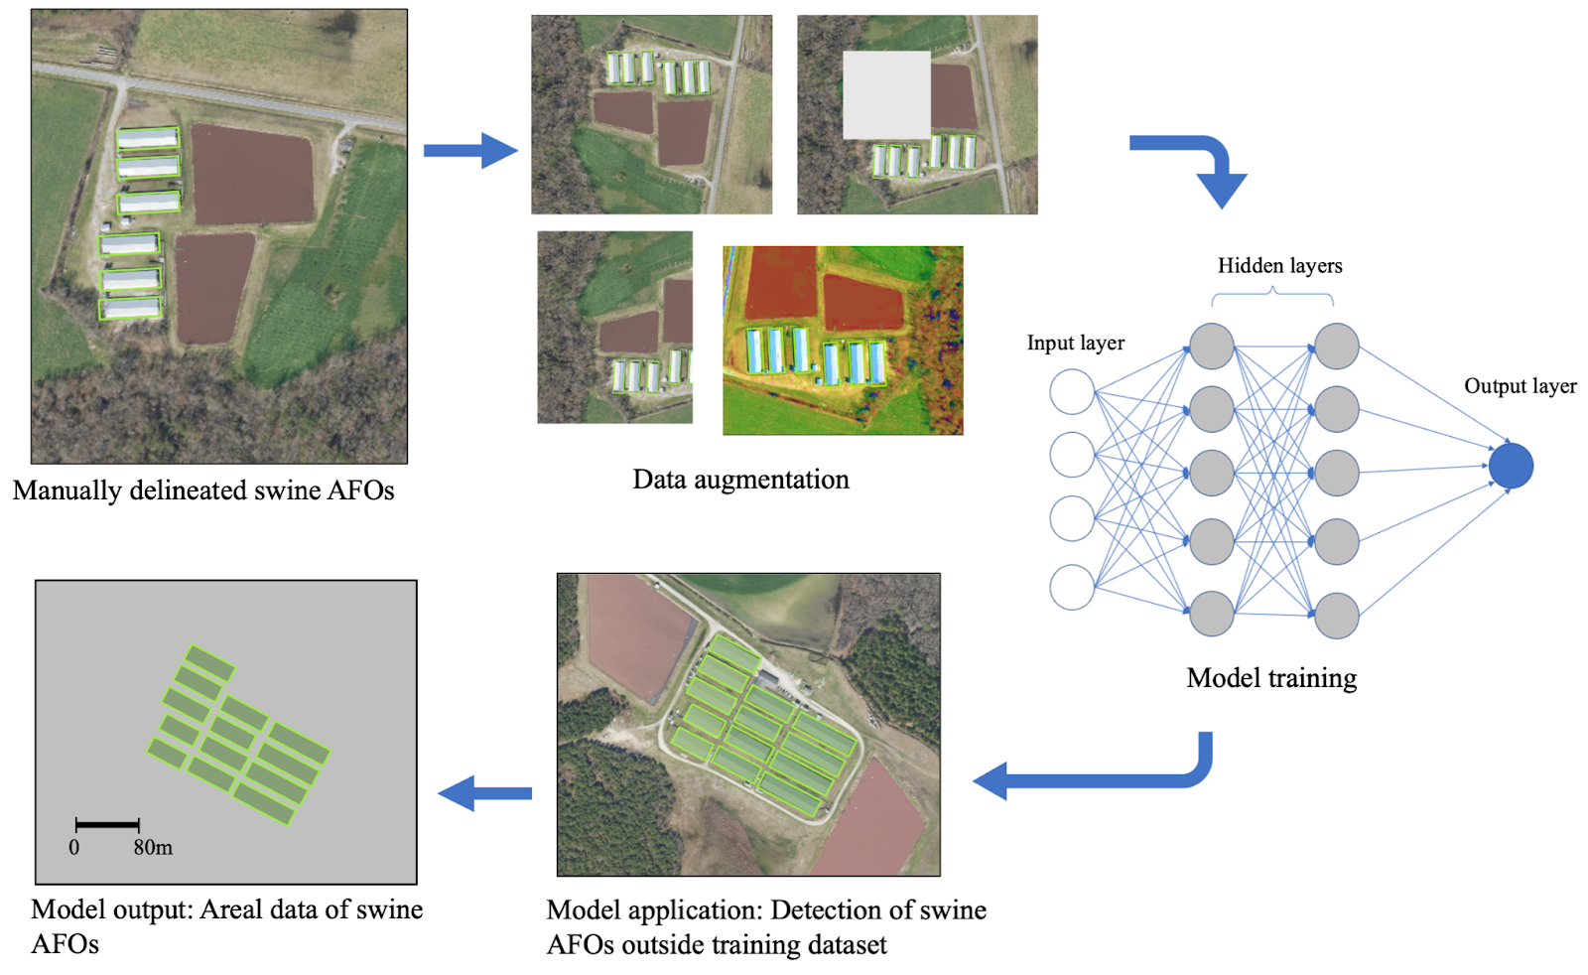
Model Workflow
2. Data augmentation to improve model performance
1. Training data generation
3. Model building
5. Extraction of AFO spatial extent
4. Model Evaluation and Filtering
Notes:
Hand delineate
Crop images to 512x512 for model training, apply random flips and rotations, sizing, change contrast of some images. We do this to make the model more robust
3. feed into deep labV3 let it train until reaches satisfactory accuracy on hold out validation set
Run model over unseen set of imagery (evaluate Bradley and Bedford counties)
Final geospatial outputs of AFO locations with bounding boxes around each detection.

Slide 9
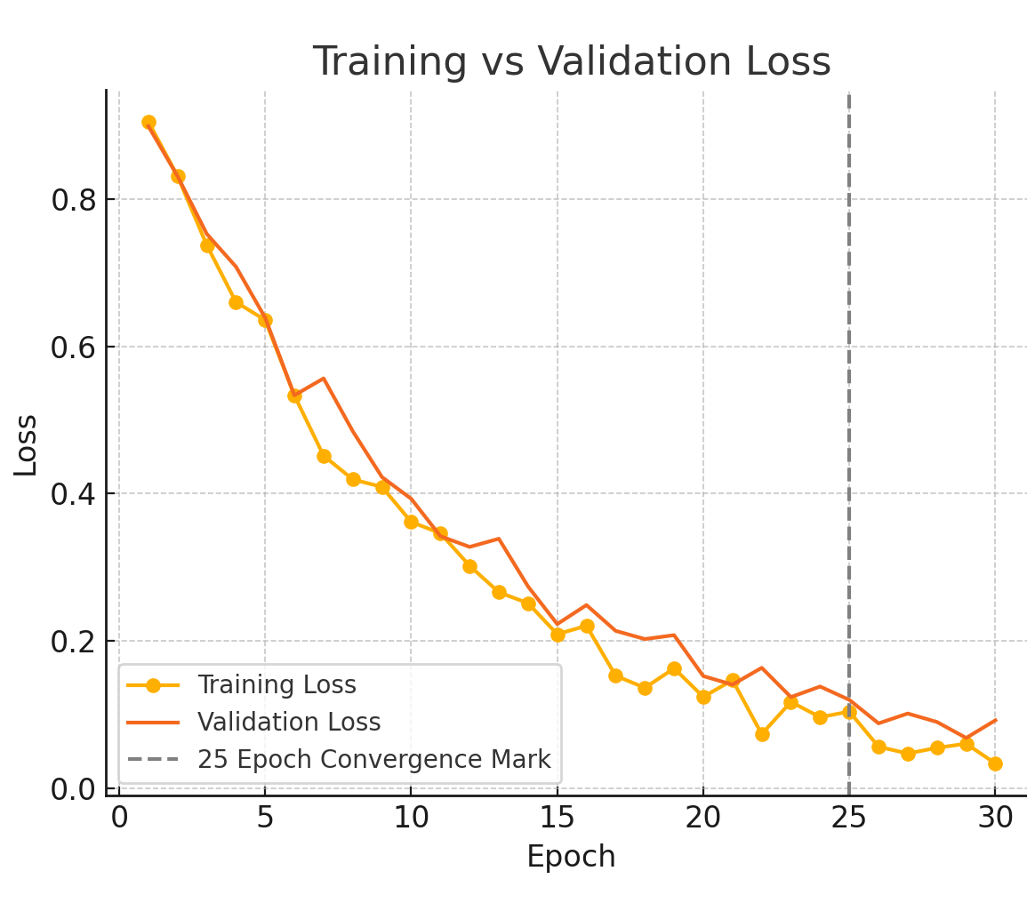
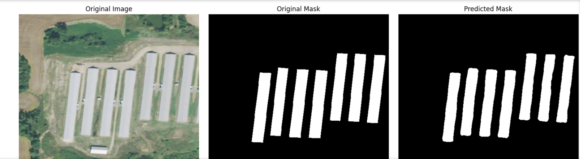
Model results
80/20 Test train Split
Training and Validation Loss Convergence at Epoch 25 (>5%)
92% Model Accuracy on Hold out Validation set
Visualization Threshold .7
Notes:
Model wa trained on a 80/20 train/validate split.
Model training stopped when the training and validation loss curves converged around 5 %
The model preformed to 92% accuracy on my hold out validation set with a visualization threshold of 70%
I got to this threshold through multiple rounds of testing. Anything lower was picking up too many specks and anything higher was cutting off bard edges.

Slide 10
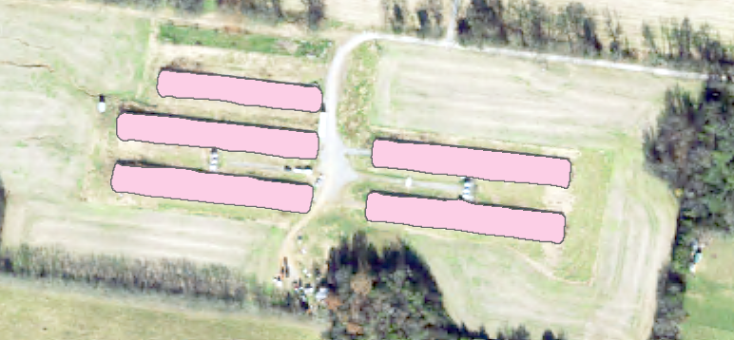
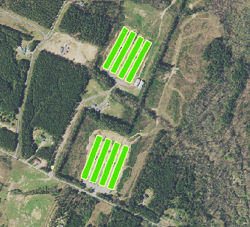
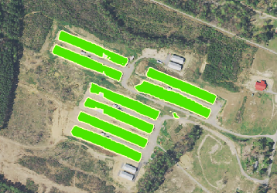
Model Evaluation – raw Outputs
Bradley County
12,676 Raw Detections
Bedford County
13,548 Raw Detections
Notes:
Model evaluation over Bradley county at first yieled 12,676 detections
Model Evaluation Over Bedford County yielded 12,548 detections
Raw dtections contained rounded corners, bumpy edges, and some small cutouts. Since we are classifying wither pixel or background class at a threshold limit, the model struggles more on the edges where there is sharp transitions

Slide 11

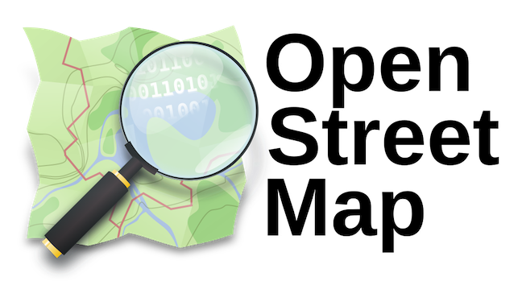

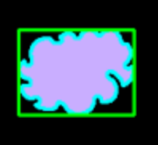
Filtering Steps
Raw detections are sent through a series of filtering steps. Our model is trained to identify barn like features, and there are many other objects that may appear as barns
Step 1: Land Use Filtering (Zoning Data from TN Comptroler)
Step 2: Road Filtering (Open Street Maps)
Step 3: Railroad Filtering (USDOT)
Step 4: Minimum Bounding Rectangle Application
Step 5: Barn Size Filtering (Area of typical commercial broilers)
FINAL OUTPUT
Notes:
Want to get AOI, high means getting rid of detections In zones that barns wouldn't be. Such as municipal, industrial, residential, and protected lands. We are instructed in agricultural lands and residential lands above 5 acres. TN comptroller as labd oning data for each county.
Roads can look like barns, long reflective bright surfaces. Using OSM we are able to filter out most false detections
Very few detections fell on railroads, even though rail roads appear a little darker than roads, model could have picked them up due to the contrast change in the pre processing
4. We apply a MBR function to the detections since they are rounded edges, were interested in finding the area under the roof so we need accurate edges
Finally, we filter barn side to typical size of commercial broilers. Anything above or below this area threshold is not in use or impractical for production (30x300 to 60x600, so we filter 9,000 to 49,000 ft sq)
6 We get final outputs that require a little bit of manual cleaning.

Slide 12
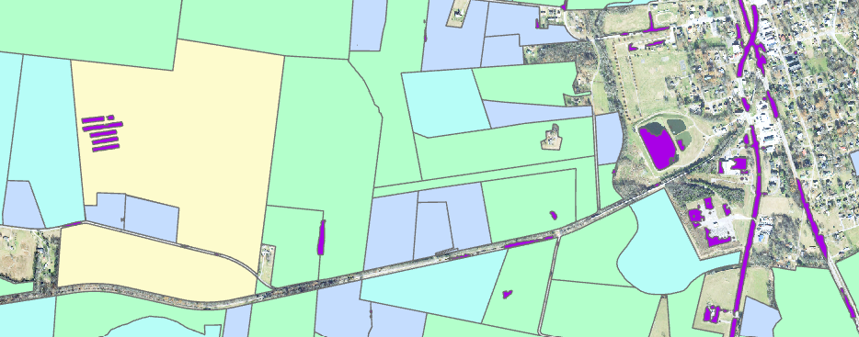
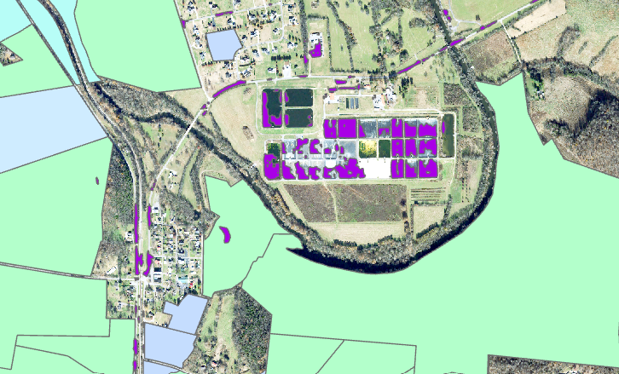
Filtering – Land use & Zoning
TN Comptroller Zoning Land Use Data
Filter out Municipal and Industrial Areas
USDA Cropland Data layer is by pixel – so it wont work.
Bradley County
5,651 detections AFTER AOI Filtering
Bedford County
9,388 detections AFTER AOI Filtering
Notes:
We know that there aren’t that many detections. Reason for this: lots of things look lie poultry barns. On of those things are buildings, parking lots, roads, or other rectangular shaped reflective surfaces. That’s a lot to work with.
Started by filtering out areas that don’t contain barns – such as residential, municipal, industrial, or protected lands.
Using data from the TN comptroller zoning data, we are able to filter out areas we aren’t interested in. See image of detections in a city, on roads.
Attemped to explore USDA cropland data layer but iys pixel by pixel and sometimes a small overlap of a unwanted land use layer eith a detection caused the whole barn to erase.
After this step, 5,651 detections in Bradley county and 9,388 detections in Bedford county remained
4588 roads
207 rail
7025 outside AOI
so

Slide 13
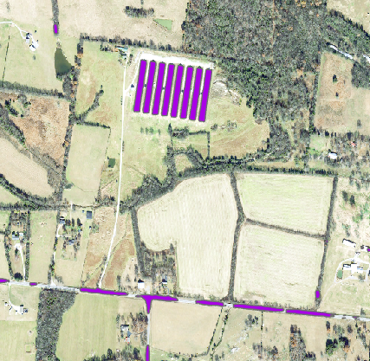
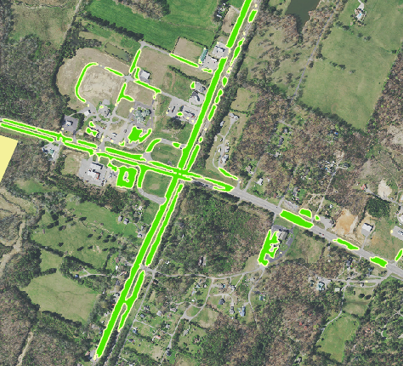
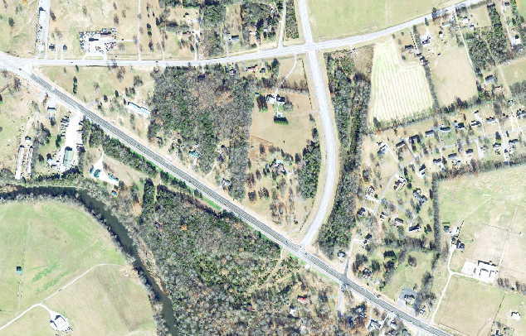
Filtering – Road and Rail Filtering
Bradley County
4,800 After Road Filtering
4,593 AFTER Rail Filtering
Bedford County
5,537 Detections AFTER Road Filtering
5,467 Detections AFTER Rail filtering
Notes:
Second step involves filtering out roads, since roads can look like barns.
Top image shows us detections (purple) that are barns, compared to detections that are along a road (fix this image)
Example of a highway intersection being deteted. OSM Data lets us filetr these out

Slide 14
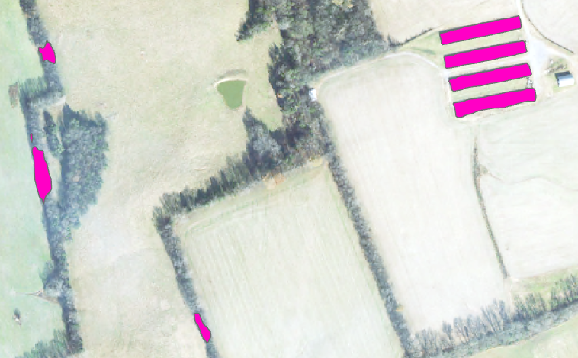
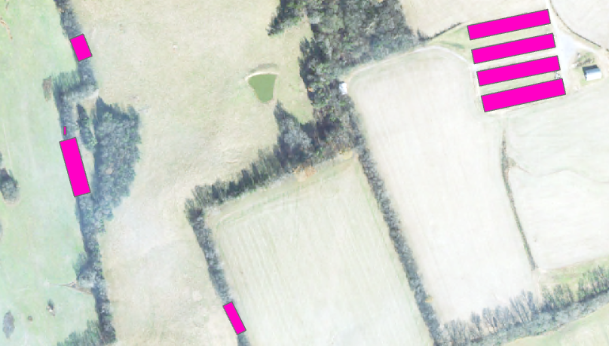
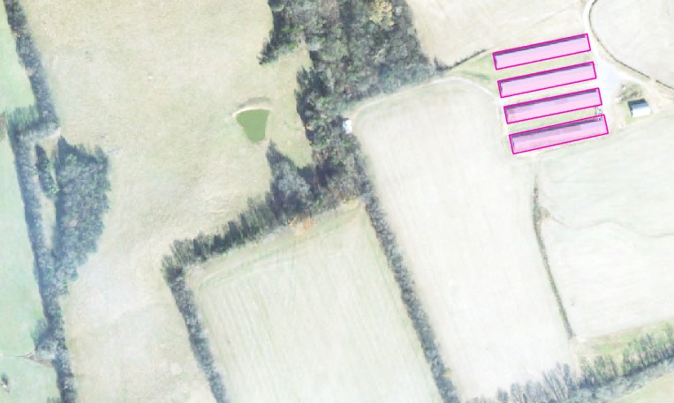
Minimum Bounding Rectangle (MBR) & Size Filtering
MBR Applied to morph detections into ground truth barn shapes
Area Filtering 9,000 sqft > Barn Area > 49,000 sqft
After Area Filtering:
Bradley: 744
Bedford: 570

Slide 15
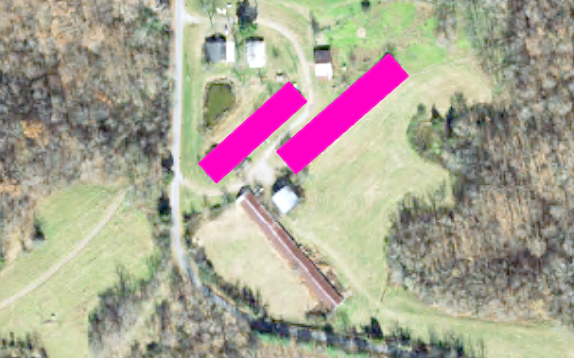
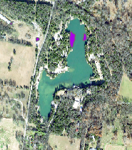
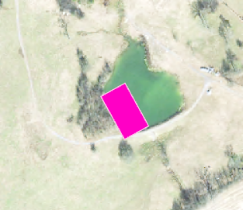
Clean final outputs
Final Filtering Steps by hand included:
1. Deletion of detections on small ponds or lakes.
2. Checking for Barns no longer in use
After Spot Filtering:
Bradley: 524
Bedford: 374

Slide 16
Summary Table
Step | Bradley County Detections | Bedford County Detections
1. Model Raw Outputs | 12,676 | 13,548
2. Filter Out Land Use | 5,651 | 9,388
3. Filter Out Roads | 4,800 | 5,537
4. Filter Out Rail | 4,593 | 5,467
5. Size Filtering | 744 | 570
6. Final Cleaned Outputs | 524 | 374
Notes:
Having such a small prediction thresholdpicked up a lot of small detections, maybe reflevsuve surfaces r dirt paths. The issue woth raising the preduction threshold is soemtomes. The model wont pick up edges of the bar or leave out small holes within a barn image. Lowering the threshold to get full barn detection outputs ended up being the best idea after ecperimenting.

Slide 17
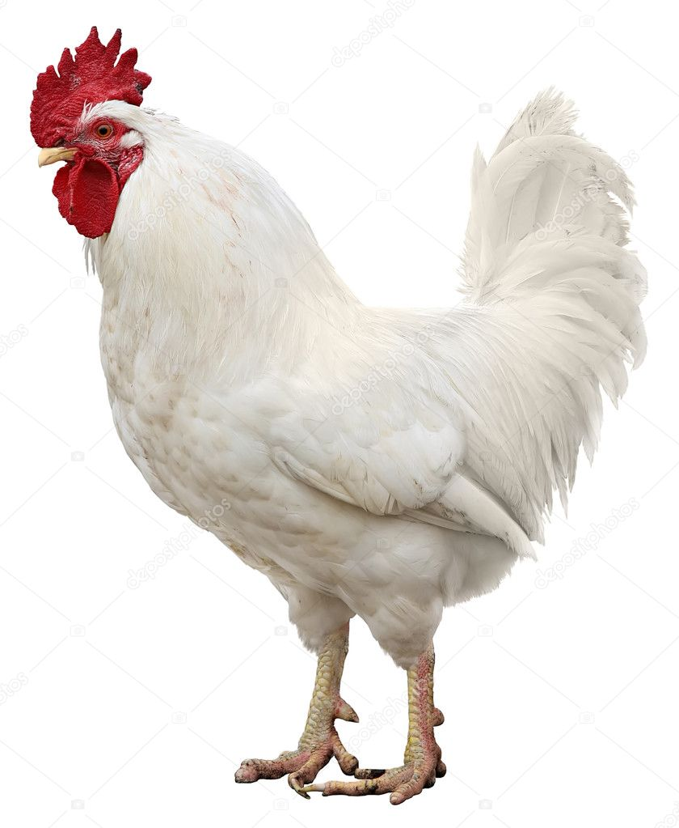
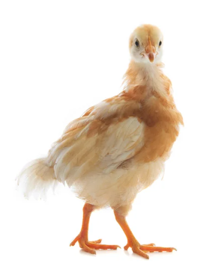
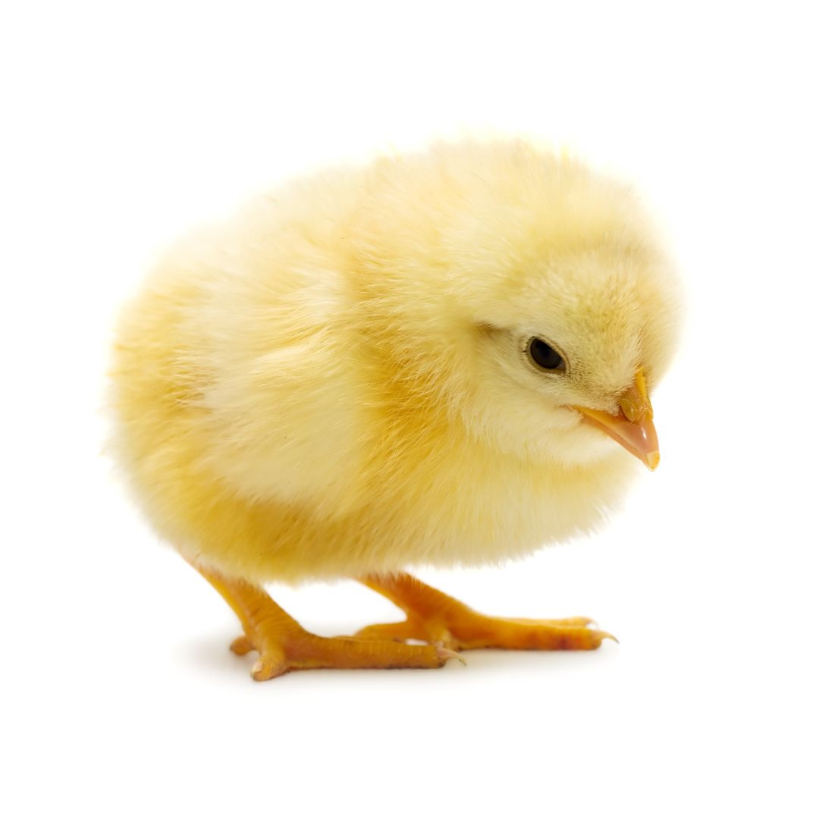

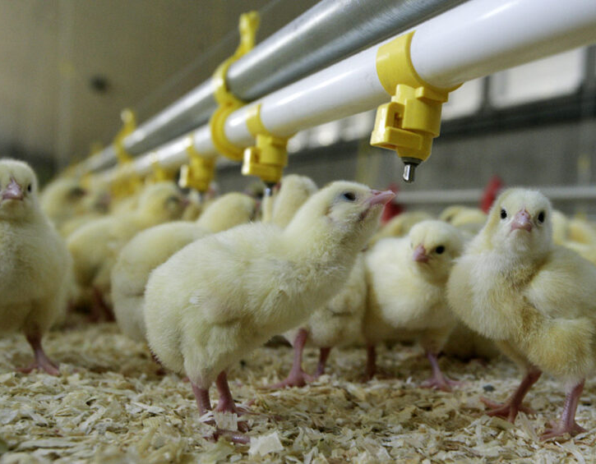
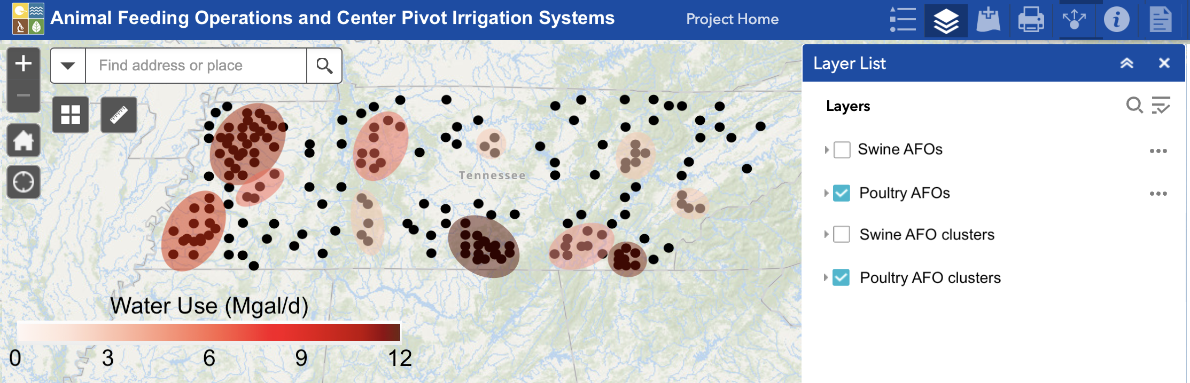
Future Work
Goal 2: Estimate poultry water use based on USDA standards
Use DBCAN to preform a hotspot analysis
Create a database on ArcGIS Hub for stakeholders to visualize AFO locations
Notes:
Run the model over more counties : required a lot of time and pre processing
Create a arcgis hub databsse of the high water demand clusters, highlgjt water demand concerns.

Slide 18
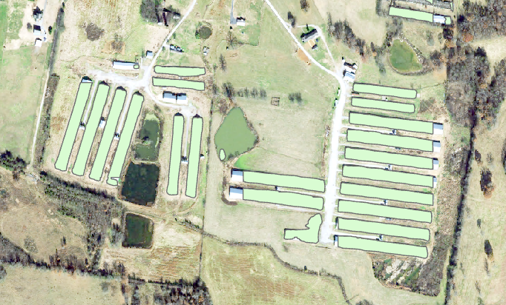
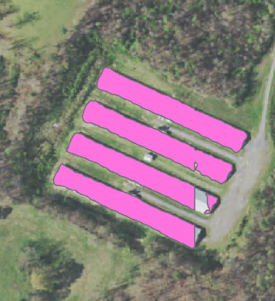
Project Limitations
Computational Limitations: Crashes occurred when using larger overlap or tile sizes;
Unmapped Roads: Some “back roads” were missing in datasets, causing incorrect detections that required manual filtering.
Lack of Classification for Small Ponds: No available database to identify or classify small agricultural or livestock ponds.
Limited Evaporative Cooling Data: Only one farm provides data, which limits water use estimation accuracy.
Notes:
Computational Power Constraints
Mention the trade-off between tile size and system capability.
Emphasize the need for more robust computing resources to increase tile size for better barn detection.
Road Network Data
Propose integrating a more detailed and extensive road network dataset.
Highlight how missing roads impact detection and post-processing time.
Data Gaps in Remote Areas
Explain the issue with unmapped “back roads.”
Share how this leads to false positives and the time cost of manual cleanup.
Classification Gaps for Water Bodies
Stress the absence of databases for small ag/livestock ponds.
Suggest exploring ways to create or supplement such a dataset.
Limited Scope of Cooling Data
Point out how using only one farm’s data reduces generalizability.
Recommend expanding partnerships to collect more evaporative cooling data across regions for better modeling accuracy.

Slide 19
Project Implications
Create a Framework to detect AFOs using computer vison
Quantify AFO water use to gain a comprehensive understanding of agricultural water withdraws.
Provide stakeholders with accurate information to better manage AFO operations and environmental compliance.
Notes:
1.There is not a generalizable automated framework to detect the operations at parcel scale, and out deeplab V3 model shows potential to become a reliable automated approach
2. Quantify AFO water use on a barn to barn basis, heling us understand the footprint of agricultural water use in Tennessee.
3. Overall, this information collectively will help stakeholders and governing entities make educated decisions on agricultural water resource management.

Slide 20




Thank you!
Accomplished with funding from
and

