Slide 1

Simulating Future Land Cover Trends in Tennessee: A Machine Learning Approach across Four Counties.
Rezaul Bari Ishan​
​ASPRS Mid-South Annual Conference, April 2025

Slide 2
Overview
Urbanization projected to reach 65% by 2050. (UN 2007).
Growth concentrated in small and medium-sized cities (Sukhdev et al., 2021).
Urbanization benefits society but negatively impacts the environment. (Sun et al., 2011; Qin, 2020).
LULC changes in the US reflect these trends particularly in the Midwest and southeastern regions. (Berhane et al., 2020).

Slide 3
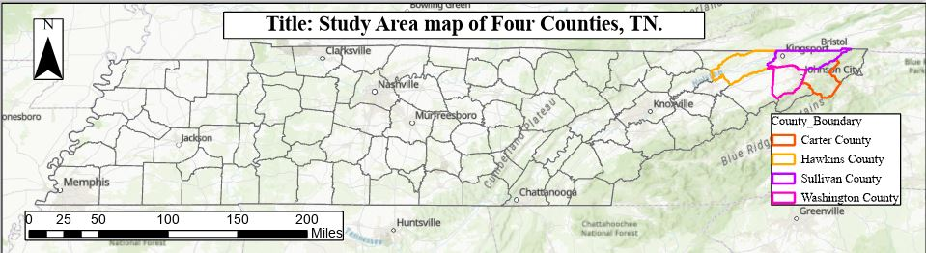
Goal of the Study
To predict future LULC changes for 2041 in four northeast TN counties (Washington, Sullivan, Carter, and Hawkins), TN.

Slide 4
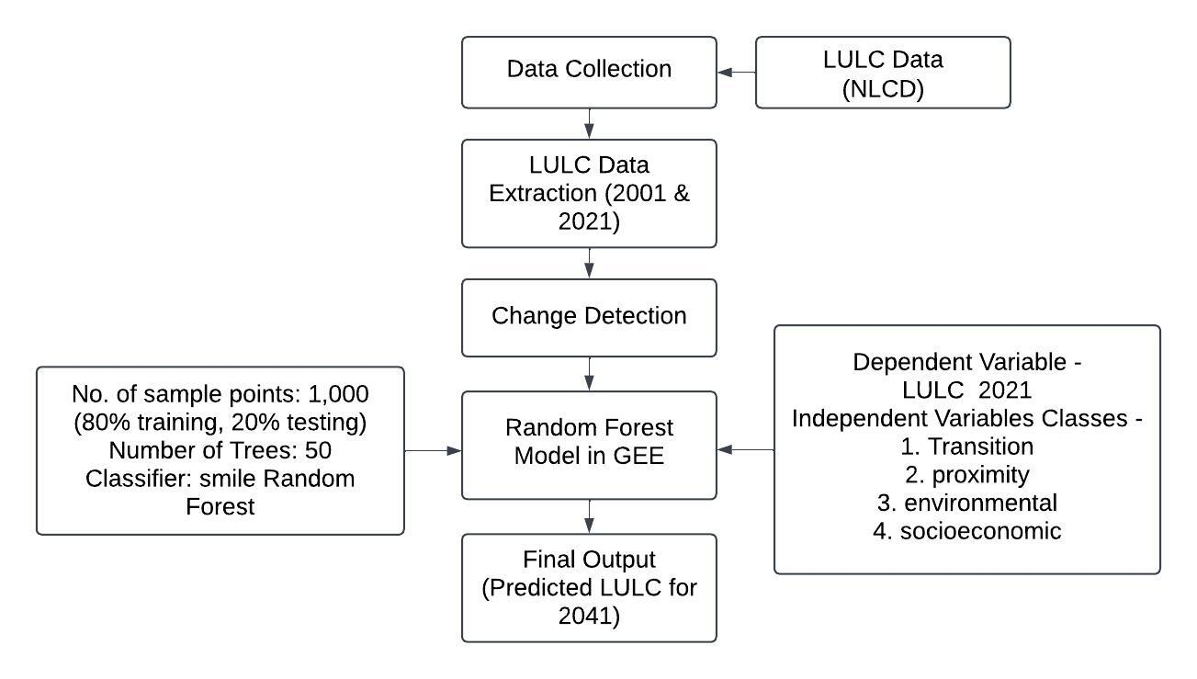
Methodology

Slide 5
Variables
Variable Name | Description | Category
End | Final LULC class in 2021 (target variable) | Dependent Variable
Start | Initial LULC class in 2001 | Transition
Transition | Encoded LULC change pattern (e.g., forest to urban) | Transition
Year | Change year indicator (2021 if changed, else 0) | Transition
Distance from road | Distance to nearest road (normalized) | Proximity
Landfill | Proximity to landfill sites | Proximity
Distance from Urban | Distance to nearest existing urban area | Proximity
Elevation | Elevation (meters) from SRTM | Environmental
Distance from Wetland | Distance to nearest wetland | Environmental
Slope | Slope derived from DEM | Environmental
Heatmap | Heatwave intensity or frequency | Environmental
Schools | Number of schools | Socio-economic
Business Count | Enterprise count (economic activity) | Socio-economic
GDP | GDP (economic strength proxy) | Socio-economic
Population Density | Population density per pixel | Socio-economic

Slide 6
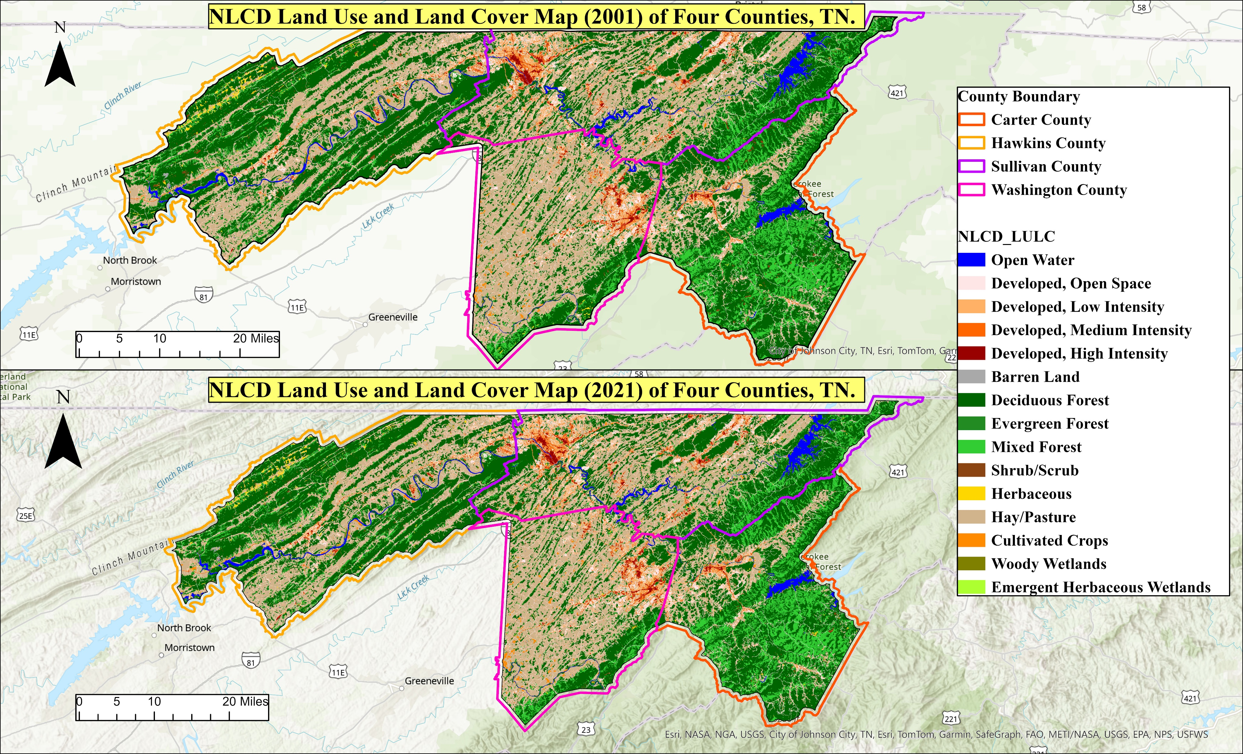
Results

Slide 7
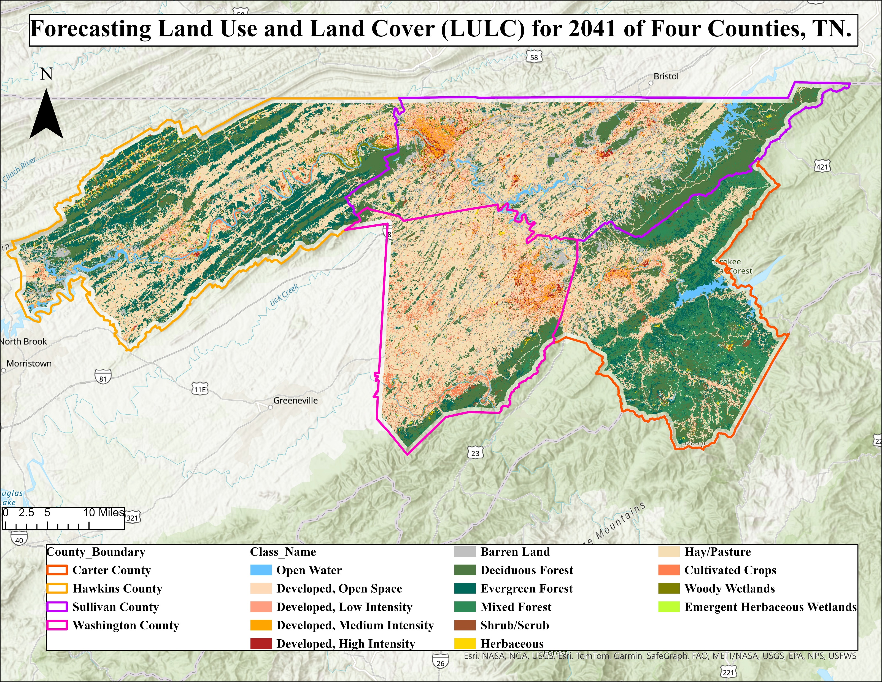
Results
Figure: Forecasting LULC for 2041

Slide 8
Model Performance: Random Forest (RF) Model
Dataset stratified and split: 80% training and 20% testing.
High prediction accuracy (88.89%).
Kappa coefficient = 0.88
Dependable predictions for land management.
Confusion matrix highlights the model's ability to distinguish complex spatial data.

Slide 9
Confusion Matrix
 | No Change | Open Water | Developed Open Space | Developed Low Intensity | Developed Medium Intensity | Developed High Intensity | Barren Land | Deciduous Forest | Evergreen Forest | Mixed Forest | Shrub | Herbaceous | Hay | Cultivated Crops | Woody Wetlands | Emergent Herbaceous Wetlands
No Change | 0 | 0 | 0 | 0 | 0 | 0 | 0 | 0 | 0 | 0 | 0 | 0 | 0 | 0 | 0 | 0
Open Water | 0 | 1423 | 8 | 1 | 0 | 1 | 8 | 1 | 1 | 0 | 1 | 5 | 1 | 0 | 0 | 0
Developed Open Space | 0 | 8 | 1571 | 103 | 18 | 11 | 3 | 53 | 15 | 5 | 5 | 1 | 21 | 0 | 0 | 0
Developed Low Intensity | 0 | 11 | 65 | 1461 | 1 | 4 | 5 | 13 | 3 | 0 | 1 | 6 | 12 | 0 | 0 | 0
Developed Medium Intensity | 0 | 10 | 25 | 83 | 1262 | 32 | 5 | 12 | 0 | 2 | 1 | 3 | 0 | 0 | 0 | 0
Developed High Intensity | 0 | 13 | 6 | 23 | 52 | 1114 | 9 | 13 | 2 | 0 | 0 | 2 | 1 | 0 | 0 | 0
Barren Land | 0 | 9 | 14 | 12 | 18 | 27 | 14 | 1984 | 19 | 33 | 6 | 13 | 0 | 0 | 4 | 0
Deciduous Forest | 0 | 9 | 10 | 6 | 3 | 41 | 1087 | 31 | 31 | 1 | 2 | 16 | 0 | 0 | 0 | 1
Evergreen Forest | 0 | 17 | 23 | 8 | 7 | 10 | 3 | 28 | 211 | 1544 | 11 | 17 | 28 | 0 | 3 | 0
Mixed Forest | 0 | 15 | 8 | 7 | 10 | 3 | 1 | 6 | 11 | 1628 | 12 | 5 | 1 | 0 | 0 | 0
Shrub | 0 | 35 | 20 | 13 | 5 | 21 | 4 | 29 | 7 | 27 | 18 | 1297 | 36 | 0 | 8 | 0
Herbaceous | 0 | 11 | 7 | 13 | 9 | 14 | 2 | 25 | 1 | 22 | 5 | 28 | 2173 | 0 | 6 | 1
Hay | 0 | 9 | 1 | 1 | 0 | 2 | 0 | 0 | 1 | 1 | 25 | 2 | 568 | 1 | 0 | 0
Cultivated Crops | 0 | 17 | 0 | 1 | 2 | 0 | 1 | 3 | 1 | 0 | 2 | 10 | 2 | 10 | 159 | 0
Woody Wetlands | 0 | 0 | 0 | 0 | 0 | 0 | 0 | 0 | 0 | 0 | 0 | 0 | 0 | 0 | 0 | 0
Emergent Herbaceous Wetlands | 0 | 0 | 0 | 0 | 0 | 0 | 0 | 0 | 0 | 0 | 0 | 0 | 0 | 0 | 0 | 0
Figure: Confusion Matrix

Slide 10
Key Drivers of LULC Change
Features | Importance Score | % of Contribution
Transition | 26320.07 | 19%
Slope | 14026.95 | 10%
Elevation | 13880.01 | 10%
Schools | 13593.39 | 10%
Landfill | 13152.46 | 9%
Distance from Wetland | 13073.19 | 9%
Population Density | 11850.50 | 9%
Distance from Road | 11373.75 | 8%
Distance from Urban Area | 8266.32 | 6%
Start | 6791.12 | 5%
Year | 1624.23 | 1%
Business Center | 1563.24 | 1%
Heatmap | 1560.89 | 1%
GDP | 1522.06 | 1%

Slide 11
Results

Slide 12
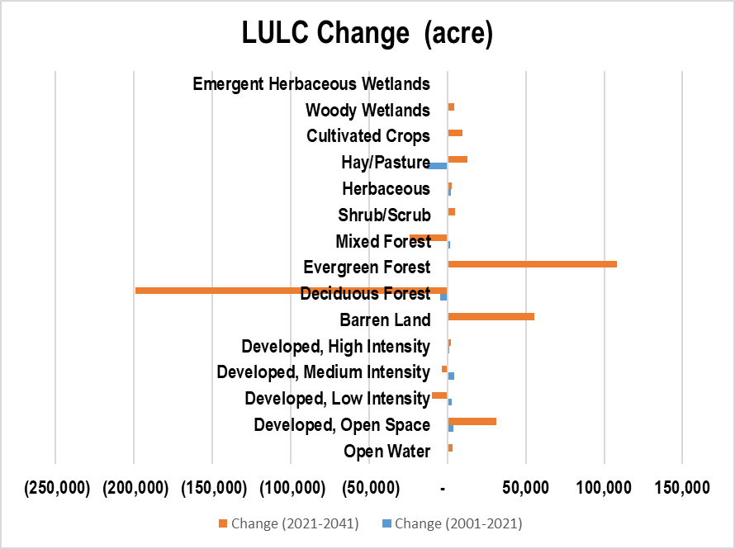
Results

Slide 13
Results

Slide 14
Major Findings of LULC Forecast (2021-2041)
High-intensity urban areas will expand (9,361 acres), lower and medium density development will decline.
Densification in city centres, commercial zones, and industrial hubs.
Developed, Open Space areas will be increased by 28%, suburban growth and possible new residential zones.
Major natural forest covers declined.
Predicted changes suggest urban sprawl, urban heat island impacts, and climate vulnerability concerns.​

Slide 15
Why Accurate LULC Forecasting Matters
Land use is changing rapidly. Accurate forecasts help in better decision-making.
Machine learning models provide data-driven insights to guide urban planning, conservation, and transportation strategies.
Accurate LULC forecasts enable decision-making for policymakers, urban planners, and environmental managers.

Slide 16
Future Study
Currently focusing on Urban Growth Boundary of Tri-Cities, TN.
Identify hotspots of LULC change in the study area.
Examining how urban expansion & deforestation affect runoff & flood risk.
Focus on analyzing Urban Heat Island (UHI) patterns in relation to land use change and surface temperature dynamics.

Slide 17
Thank you

Slide 18
Extra Slide (Results)
NLCD_Land | Area_2001 (acre) | Area_2021 (acre) | Area_2041 (acre) | Change (2001-2021) | Change (2021-2041) | % Change (2001-2021) | % Change (2021-2041)
Open Water | 18,359 | 18,121 | 21,704 | -238.41 | 3582.78 | -1% | 17%
Developed, Open Space | 77,210 | 80,848 | 112,162 | 3637.71 | 31313.81 | 4% | 28%
Developed, Low Intensity | 45,193 | 48,186 | 38,459 | 2992.54 | -9726.87 | 6% | -25%
Developed, Medium Intensity | 15,855 | 20,159 | 16,674 | 4304.00 | -3484.48 | 21% | -21%
Developed, High Intensity | 6,052 | 7,286 | 9,361 | 1233.62 | 2075.16 | 17% | 22%
Barren Land | 1,498 | 1,854 | 57,265 | 356.72 | 55410.70 | 19% | 97%
Deciduous Forest | 388,927 | 384,541 | 185,562 | -4386.51 | -198978.36 | -1% | -107%
Evergreen Forest | 8,362 | 8,585 | 116,762 | 223.06 | 108176.47 | 3% | 93%
Mixed Forest | 93,216 | 94,742 | 70,956 | 1526.29 | -23786.43 | 2% | -34%
Shrub/Scrub | 4,113 | 4,519 | 9,332 | 406.09 | 4812.62 | 9% | 52%
Herbaceous | 5,291 | 7,598 | 10,379 | 2306.68 | 2781.04 | 30% | 27%
Hay/Pasture | 278,977 | 265,778 | 278,462 | -13199.11 | 12684.05 | -5% | 5%
Cultivated Crops | 2,403 | 3,126 | 12,937 | 723.89 | 9810.93 | 23% | 76%
Woody Wetlands | 1,229 | 1,303 | 5,659 | 74.06 | 4356.49 | 6% | 77%
Emergent Herbaceous Wetlands | 201 | 240 | 947 | 39.36 | 706.32 | 16% | 75%

