Slide 1

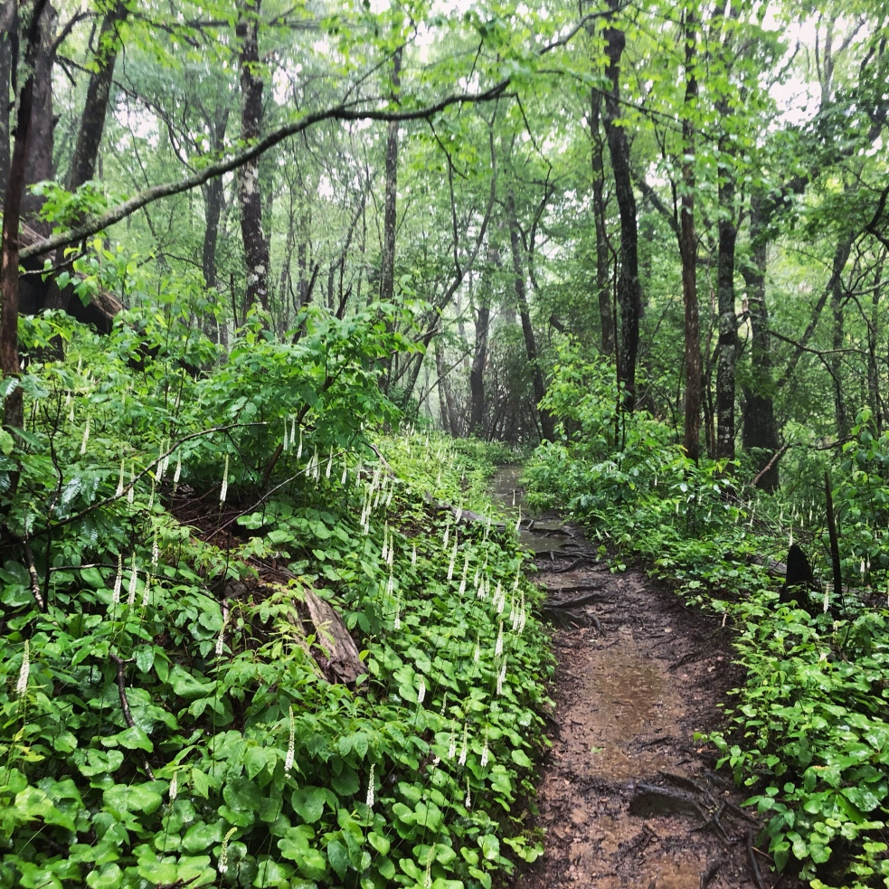
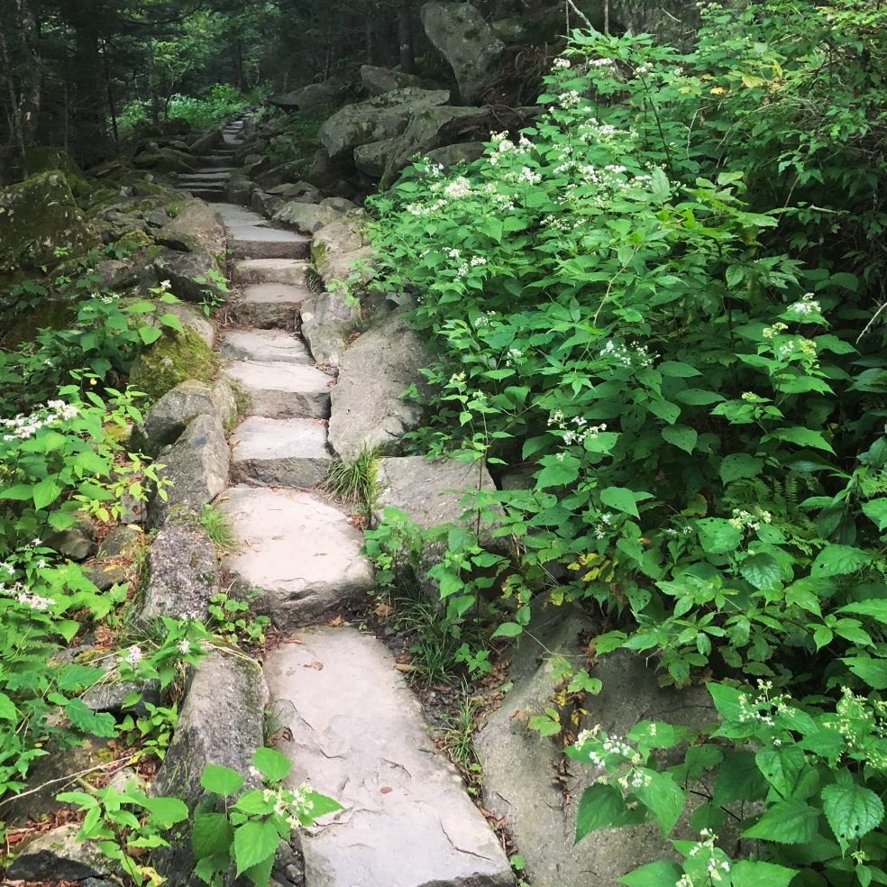
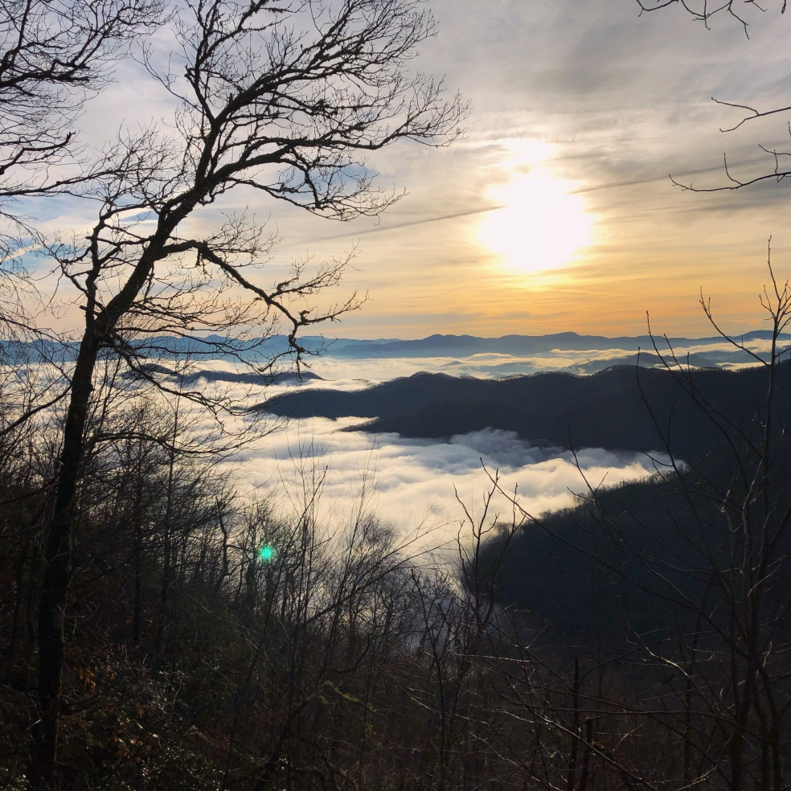
Mapping & Monitoring Ecological Health through Satellite Technology:
Hiking Trails as Conservation Corridors
Amber R. Ignatius¹*; Ashley N. Annis¹; Casey A. Helton¹; Alec W. Reeb¹; Dylan F. Ricke²
1 University of North Georgia, Institute for Environmental & Spatial Analysis; 2 Jacobs Engineering
Appalachian Trail Galax urceolata in flower
Standing Indian, Tennessee. R. Ignatius
AT Sunrise. Wayah Bald. Ryan Ignatius
Notes:
Conservation lands associated with protected hiking trails play an important role in ecological preservation by providing essential wildlife habitat. These lands support species migration and contribute to environmental connectivity. Remote sensing technologies are utilized to monitor the health of these ecosystems, offering valuable data on land cover change, vegetation patterns, and environmental trends. This analysis incorporates a range of satellite sensors, including Landsat, MODIS, NAIP, and various satellite-derived products focused on wildfire and vegetation productivity. Findings reveal a diverse set of challenges to trail systems such as land cover change driven by wildfire and drought along western trails. Deforestation near trail corridors in the northeastern U.S. is primarily caused by logging activities. In addition, the damage inflicted by Hurricane Helene along the southern section of the Appalachian Trail highlights the vulnerability of these regions and underscores the need for effective management strategies to mitigate such impacts. This study emphasizes the need for careful monitoring of these essential conservation areas to preserve and restore these vital corridors and further conservation efforts.

Slide 2
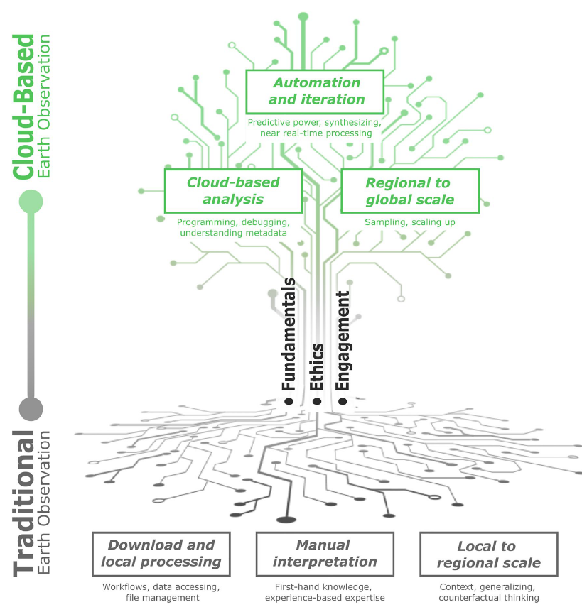
Cloud-First Geospatial
Higher Education
Undergraduate research
  GISC4490-Applied Image Processing
  Independent study
  Google Earth Engine immersion
Professional development
  travel grant writing, SEDAAG conference
  manuscript peer-review publishing
Crowley, M.A., Stuhlmacher, M., Trochim, E.D., Van Den Hoek, J., Pasquarella, V.J., ... Ignatius, A.R. et al. (2023). Pillars of cloud-based Earth observation science education. AGU Advances, 4, e2023AV000894. DOI: 10.1029/2023AV000894

Slide 3
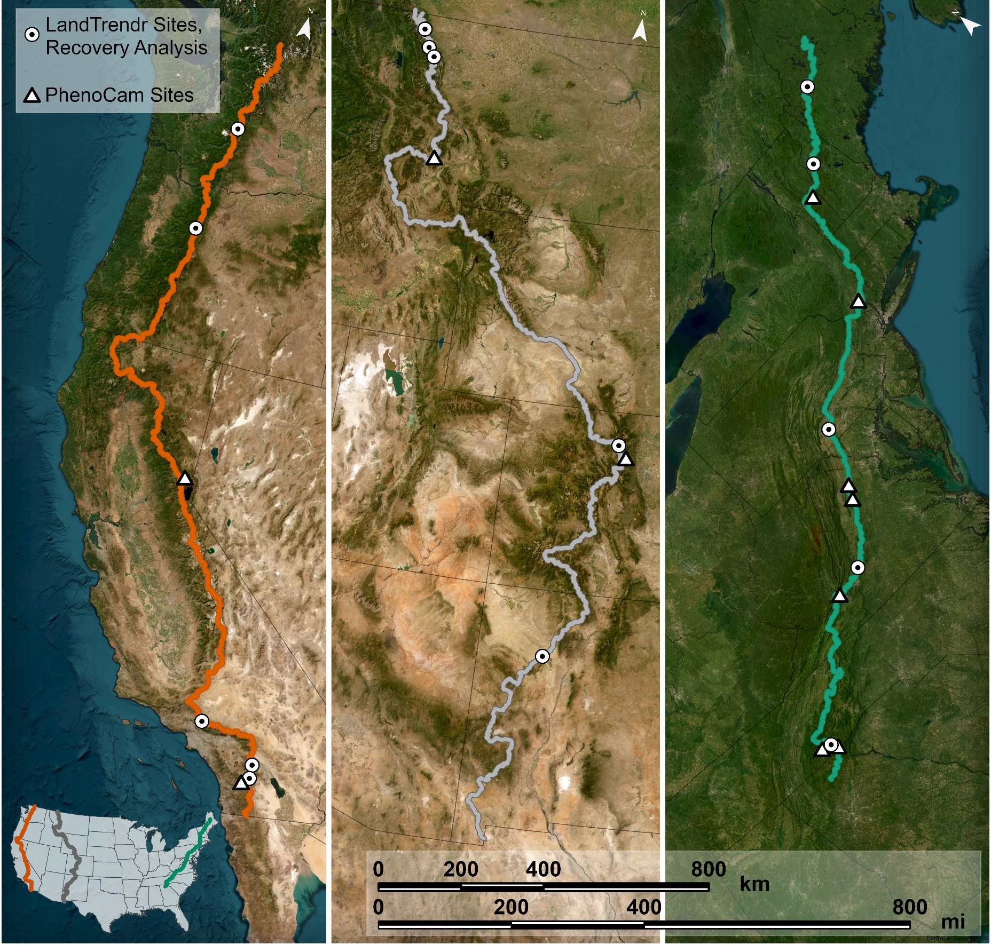
Triple Crown
PCT
CDT
AT
+12,000km trail system
  Pacific Crest Trail (PCT)
  Continental Divide Trail (CDT)
  Appalachian Trail (AT)
Conservation Corridors
habitat connectivity
mosaic of protected lands
mountainous regions as biodiversity refuge (Wilson & Belote 2022)
Notes:
Wilson, M.B.; Belote, R.T. The Value of Trail Corridors for Bold Conservation Planning. Land 2022, 11, 348. https://doi.org/10.3390/land11030348.
7,900 miles (12,712 km), 22 states

Slide 4
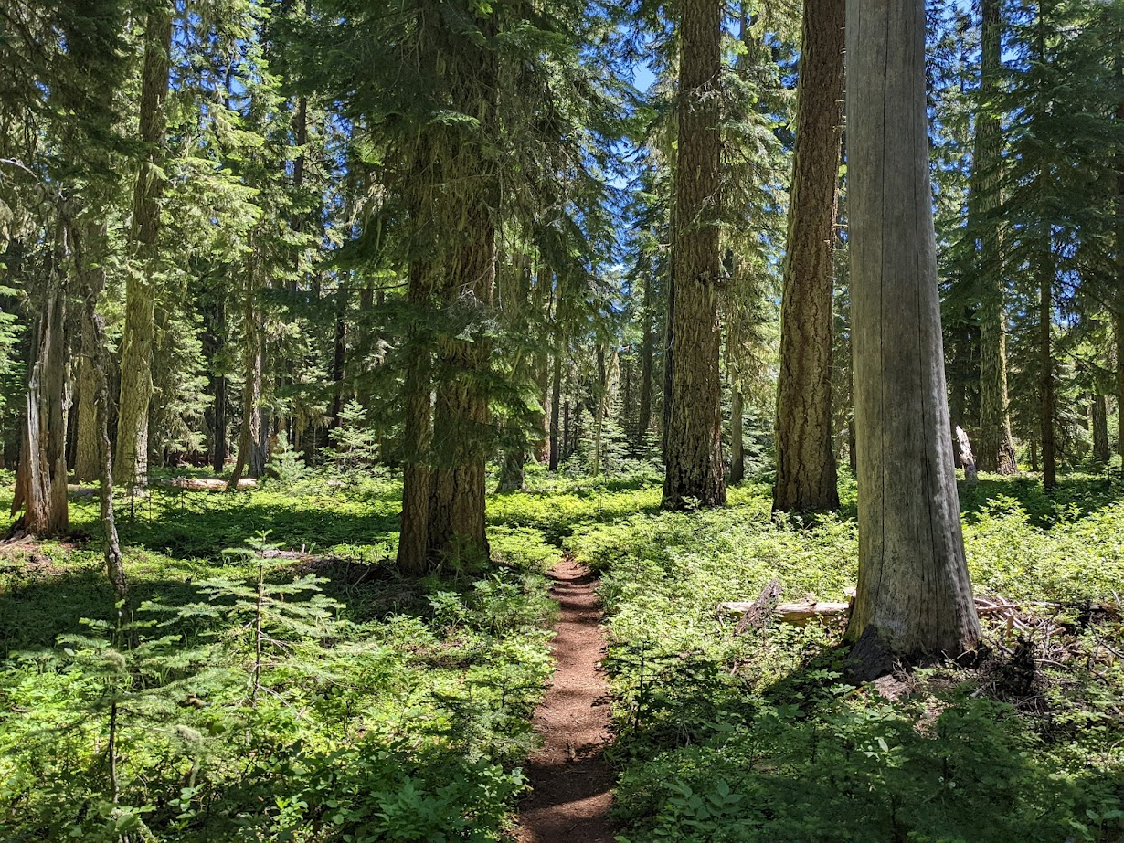
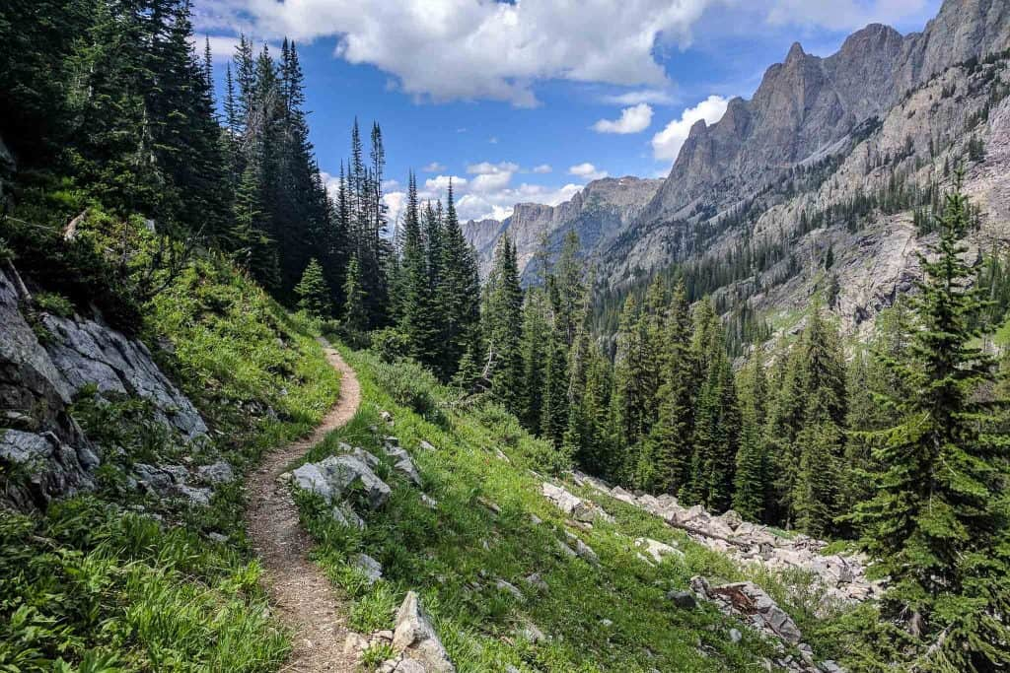
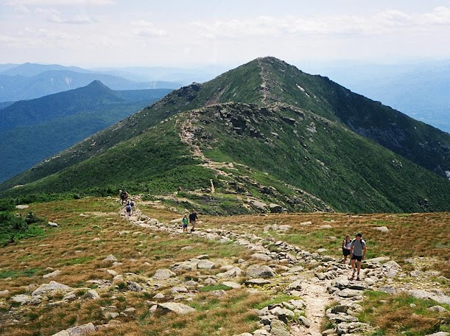
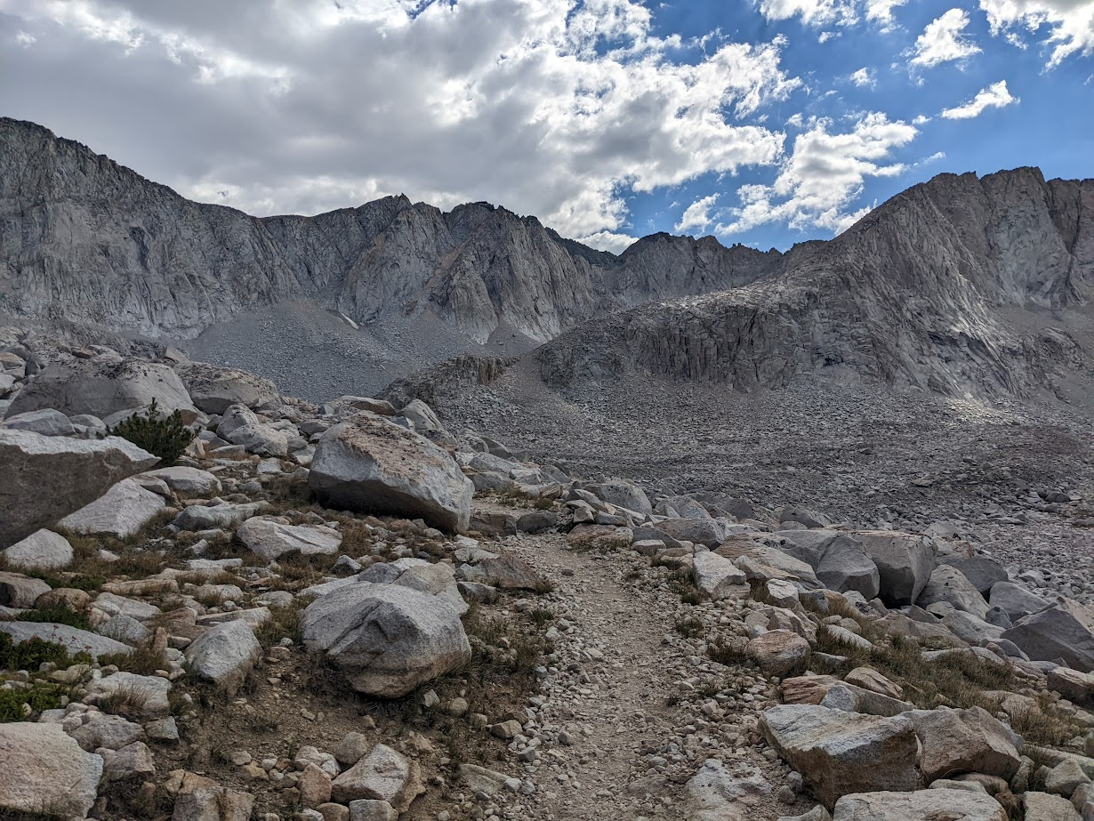
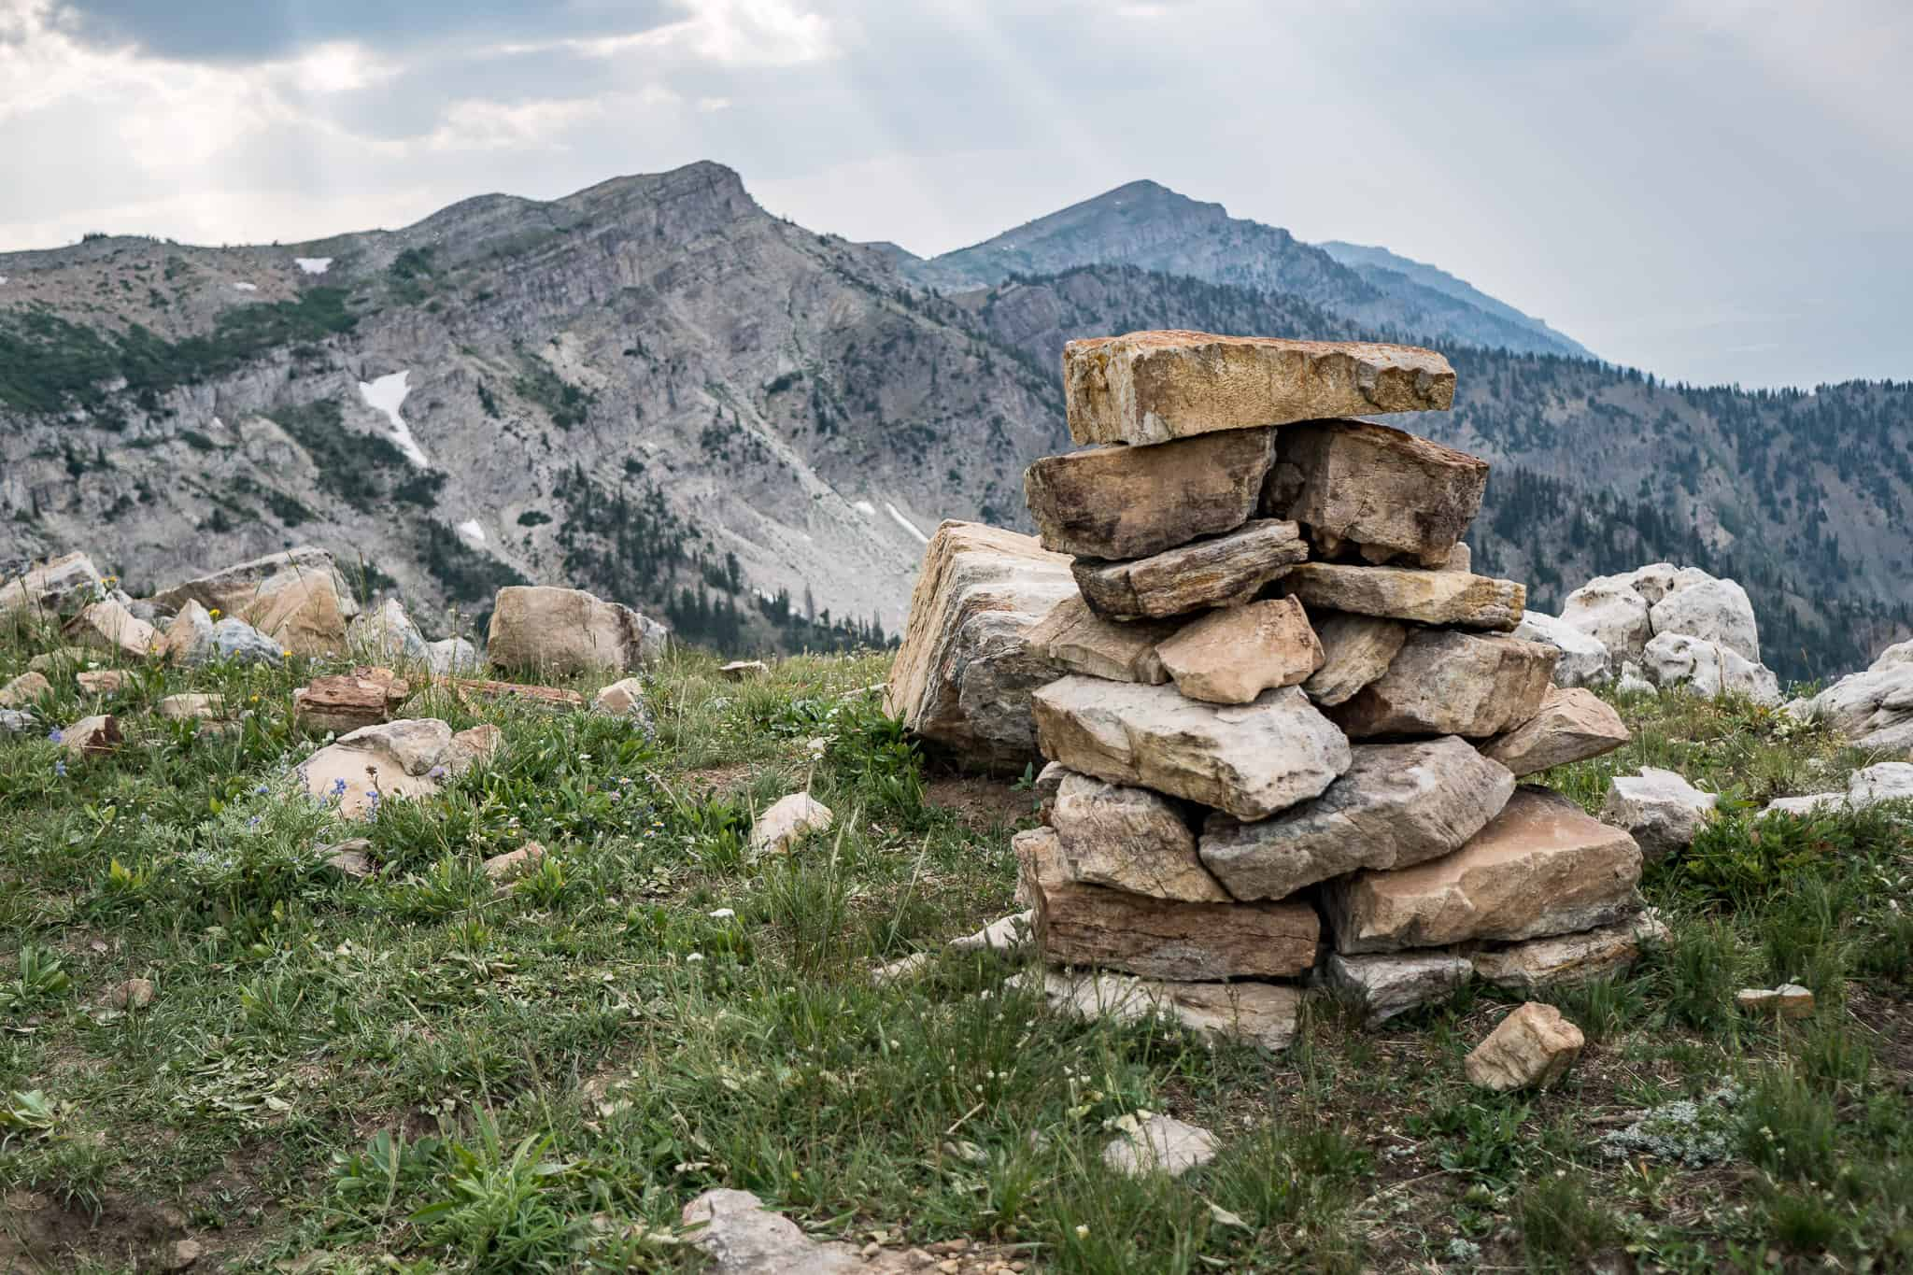
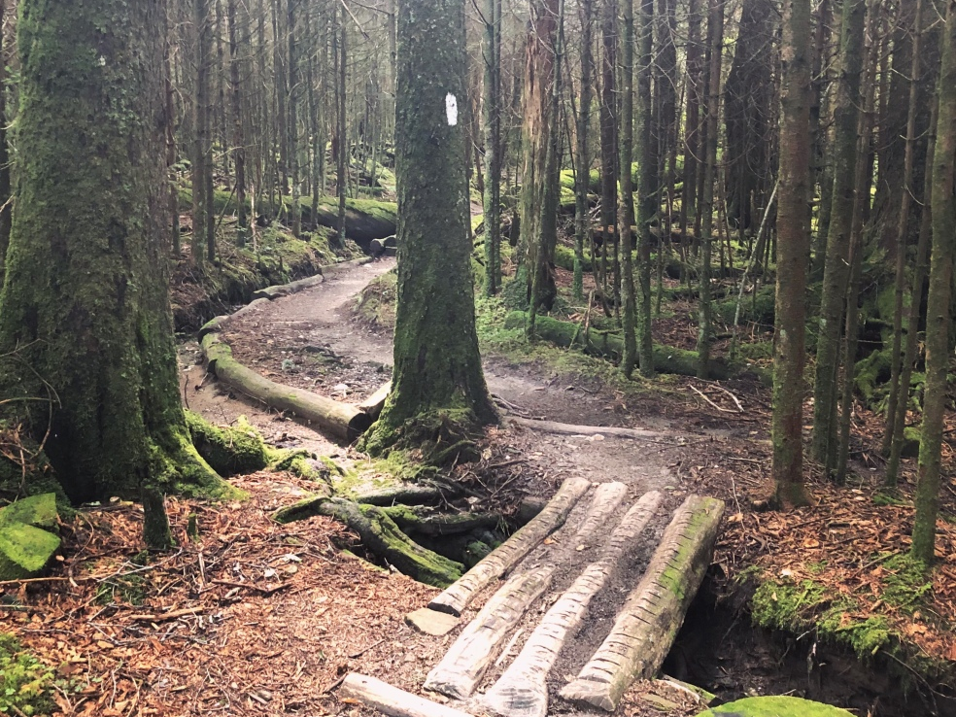
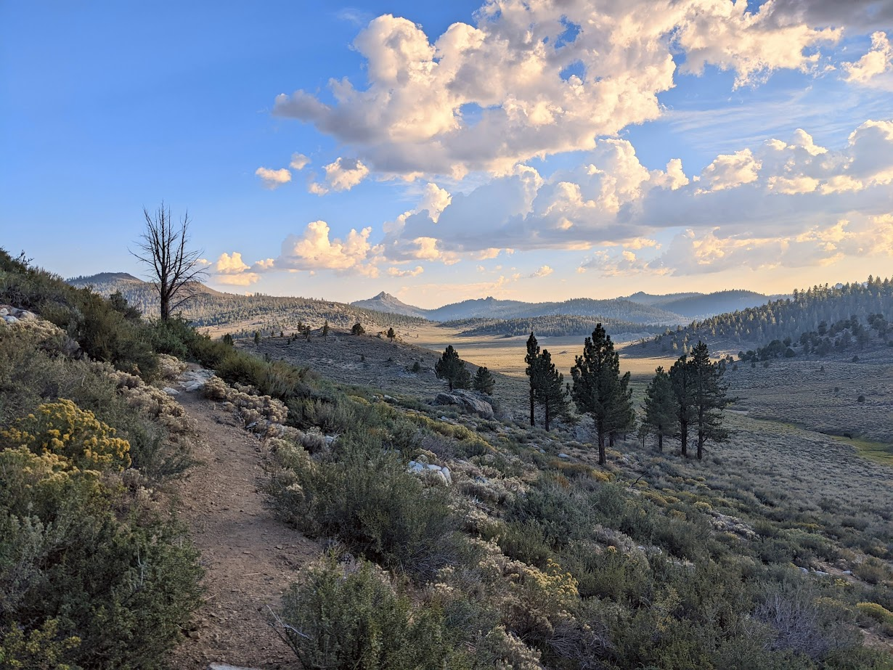
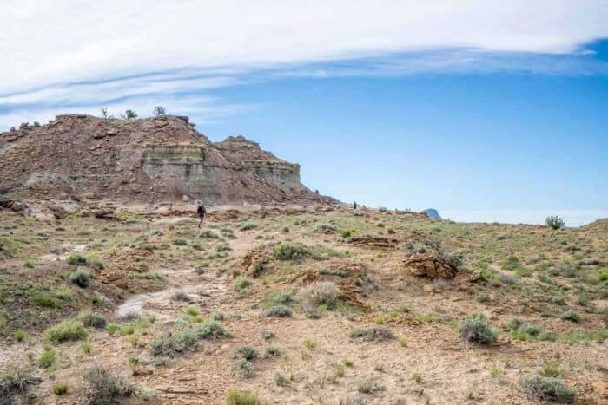
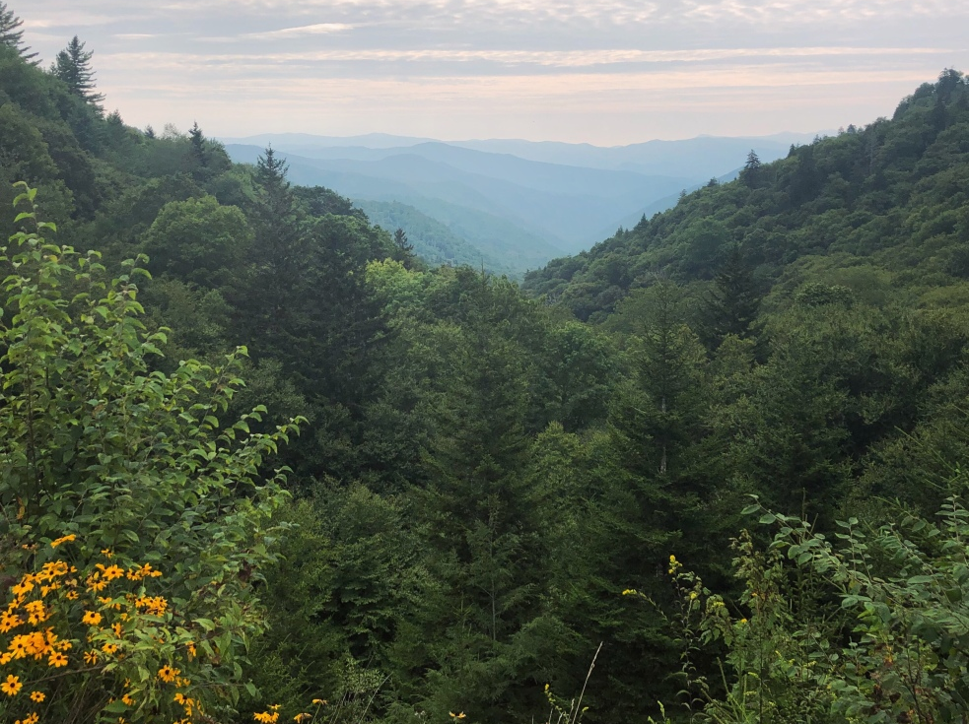
PCT
CDT
AT
Washington, D. Ricke
Wyoming, T. Fox
New Hampshire, A. Ignatius
California Palisades, D. Ricke
Idaho-Montana Border, T. Fox
Smoky Mountains, R. Ignatius
California Sierras, D. Ricke
New Mexico, T. Fox
Smoky Mountains, R. Ignatius

Slide 5
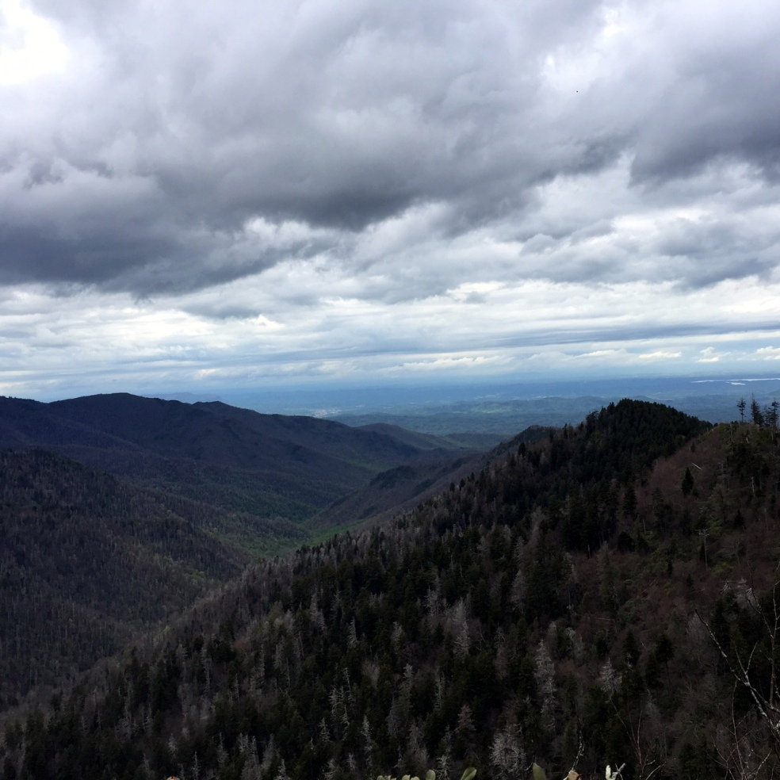
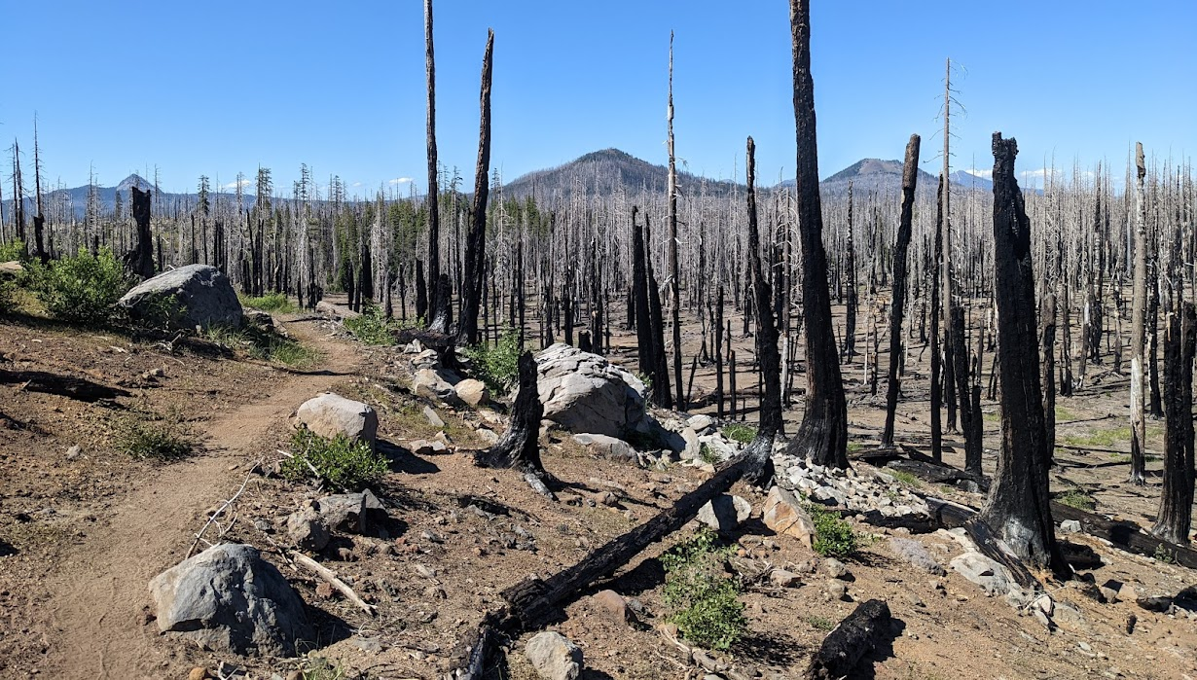
Environmental Threats
wildfire
deforestation
invasive species
  hemlock woolly adelgid
  western pine beetle (ponderosa pine)
climate change
  drought, heat, extreme weather
AT “White Ghost” Hemlocks killed by Woolly Adelgid
Great Smoky Mountains National Park, 2017, R. Ignatius
PCT Wildfire Damage Southern Oregon 2022, D. Ricke

Slide 6
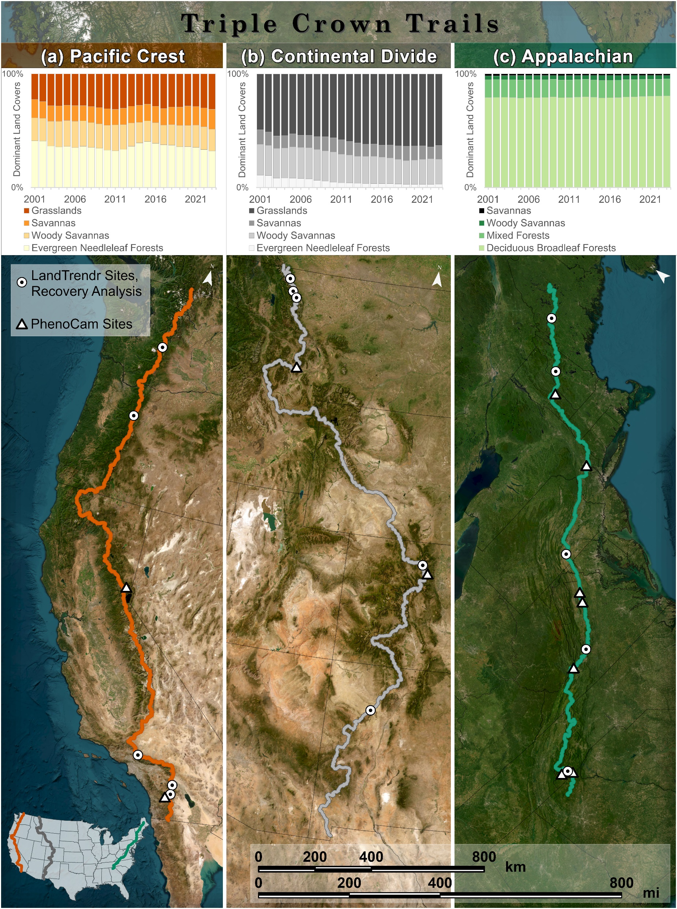
Land Cover Change
sfgd
MODIS Land Cover - MCD12Q1 v6.1

Slide 7
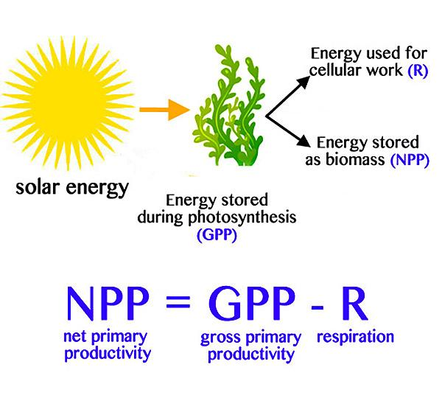
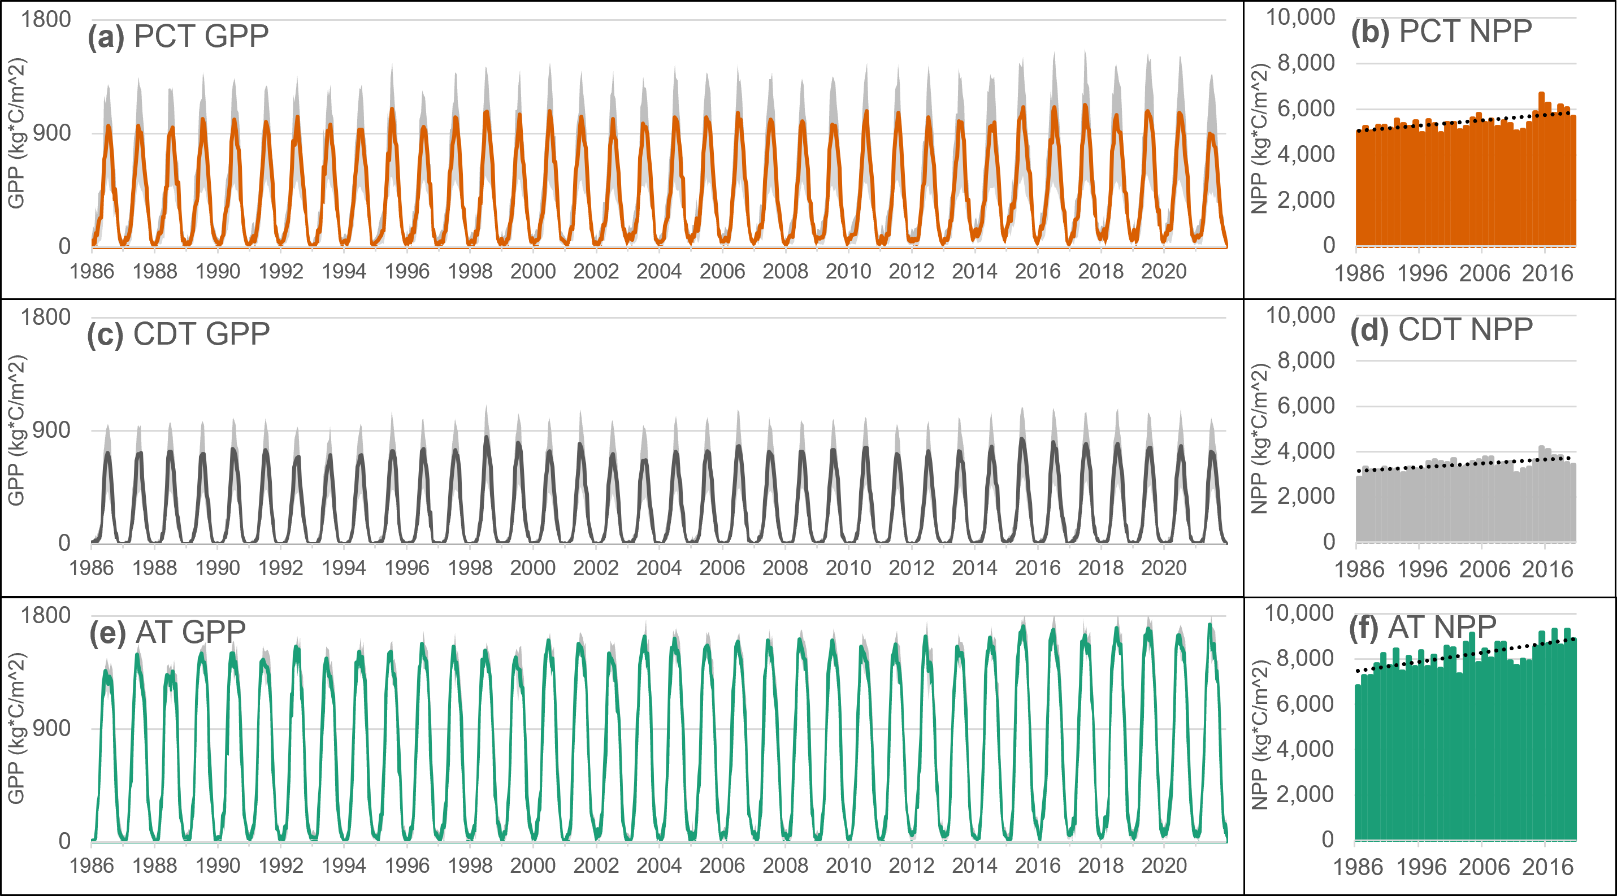
Primary Production
projected increase with elevated temperatures/CO₂ (Lu et al. 2024)
  high latitudes/altitudes
Landsat Gross/Net Primary Production
Numerical Terra-dynamic Simulation Group (NTSG), University of Montana
Notes:
Figure Landsat-derived 16-day GPP and annual NPP time series for the (a,b) PCT, (c,d) CDT, and (e,f) AT. Gray areas indicate first and third quartile values, while the colored line indicates the median GPP.
Lu, Qikai & Liu, Hui & Wei, Lifei & Zhong, Yanfei & Zhou, Zheng. (2023). Global prediction of gross primary productivity under future climate change. Science of The Total Environment. 912. 169239. 10.1016/j.scitotenv.2023.169239

Slide 8
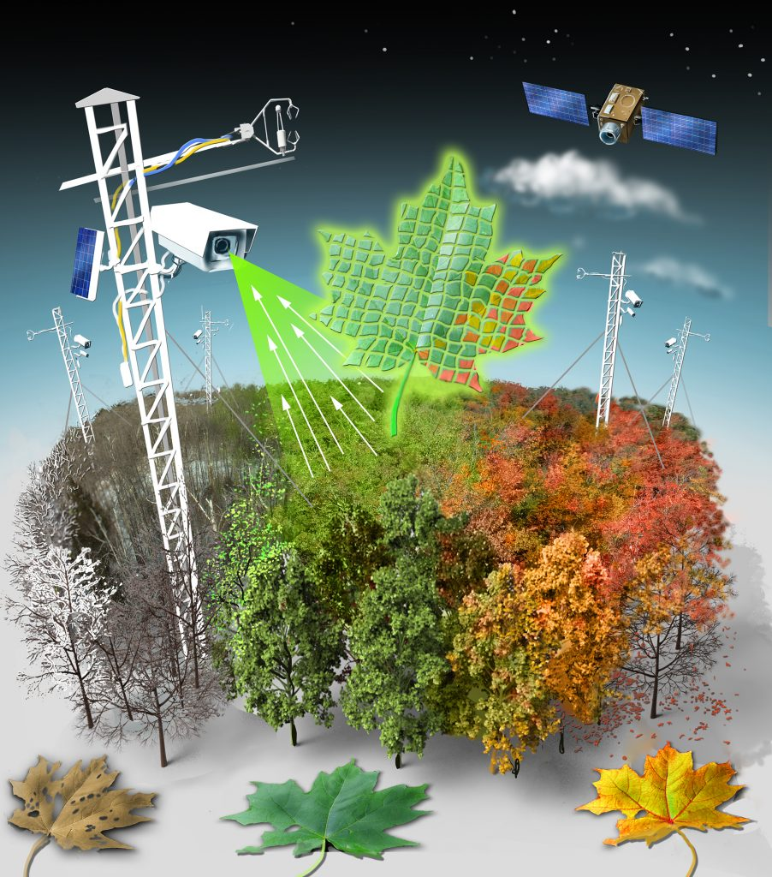
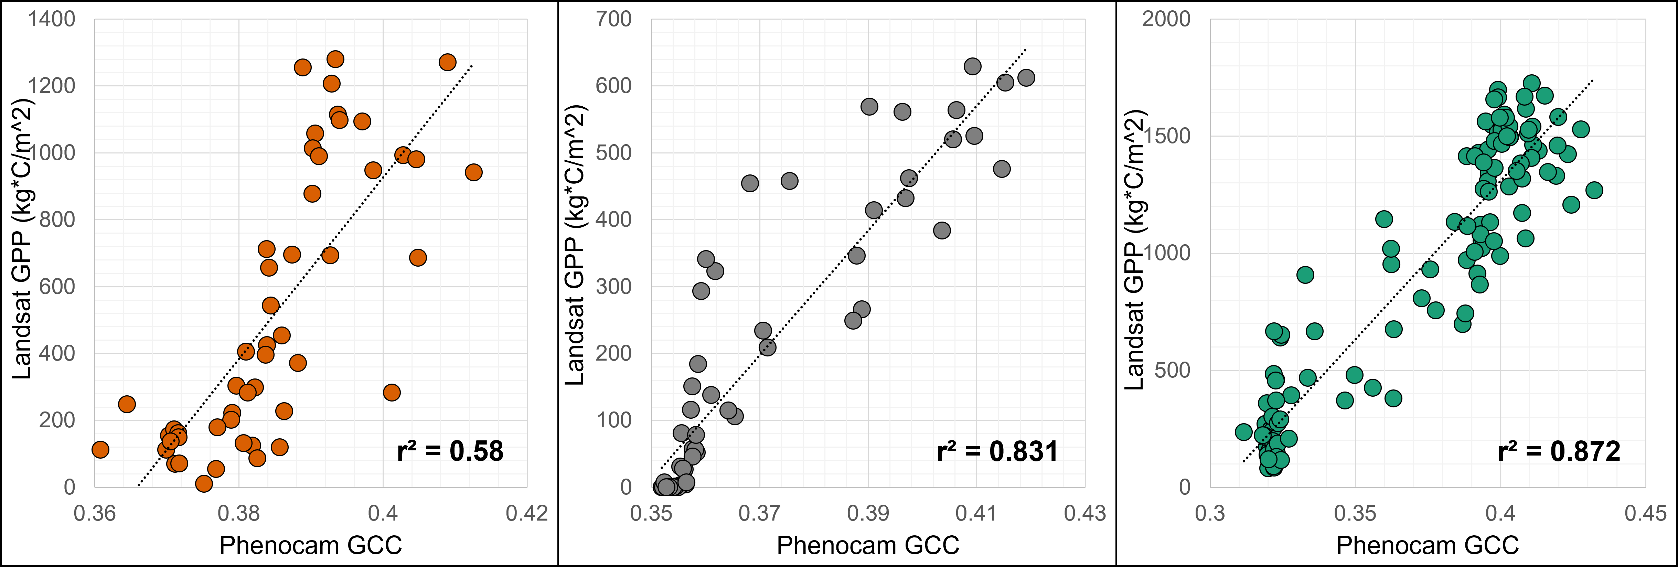
PhenoCam Validation
Richardson 2018
11 PhenoCam sites
in situ Green Chromatic Coordinate (GCC)
GCC = Green/(Red + Blue + Green)
Oak Ridge National Laboratory (ORNL) Distributed Active Archive Center Phenom Dataset v2.0
Notes:
Scatterplots comparing the PhenoCam GCC estimates and the Landsat-derived GPP for (a) PCT Sagehen PhenoCam site (39.431°, −120.239°), (b) CDT Butte PhenoCam site (45.95°, −112.479°), and (c) AT NEON D02.SERC.DP1.00033 PhenoCam site (38.89°, −76.560°).

Slide 9
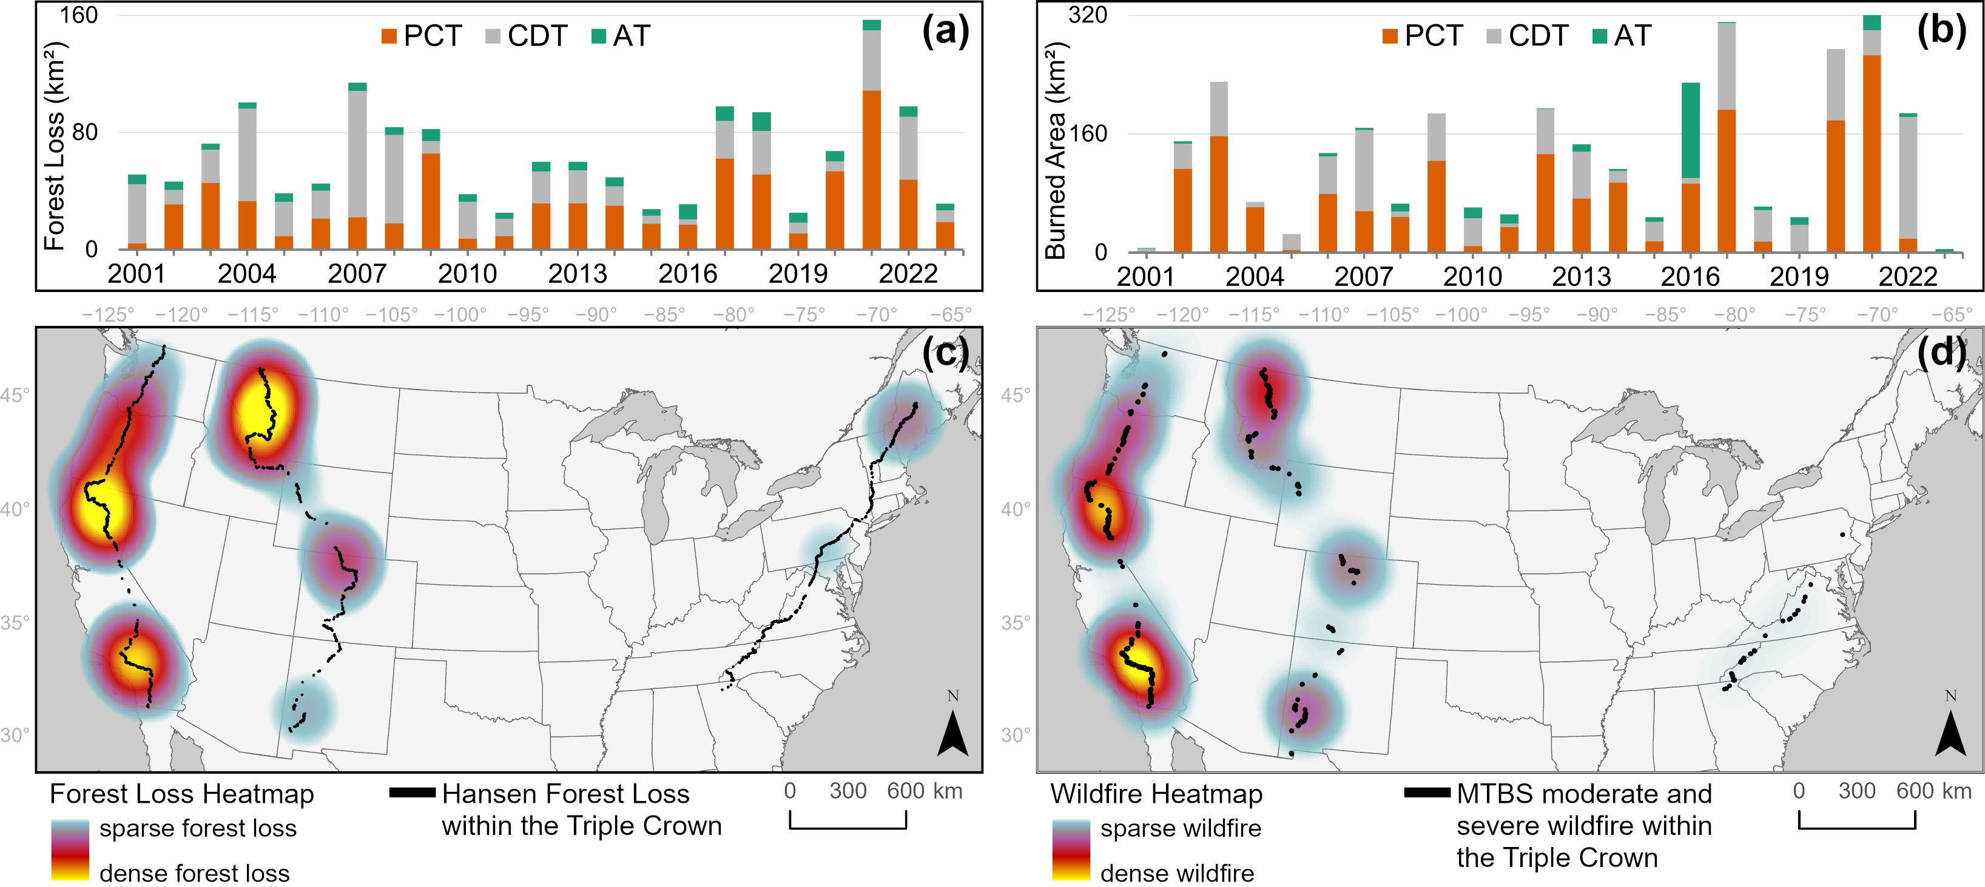
Forest Loss
Wildfire
Hansen Global Forest Loss v1.11
Monitoring Trends in Burn Severity (MTBS)
Notes:
Hansen Global Forest Change v1.11, 30 m,
Monitoring Trends in Burn Severity (MTBS), 30 m, USGS

Slide 10
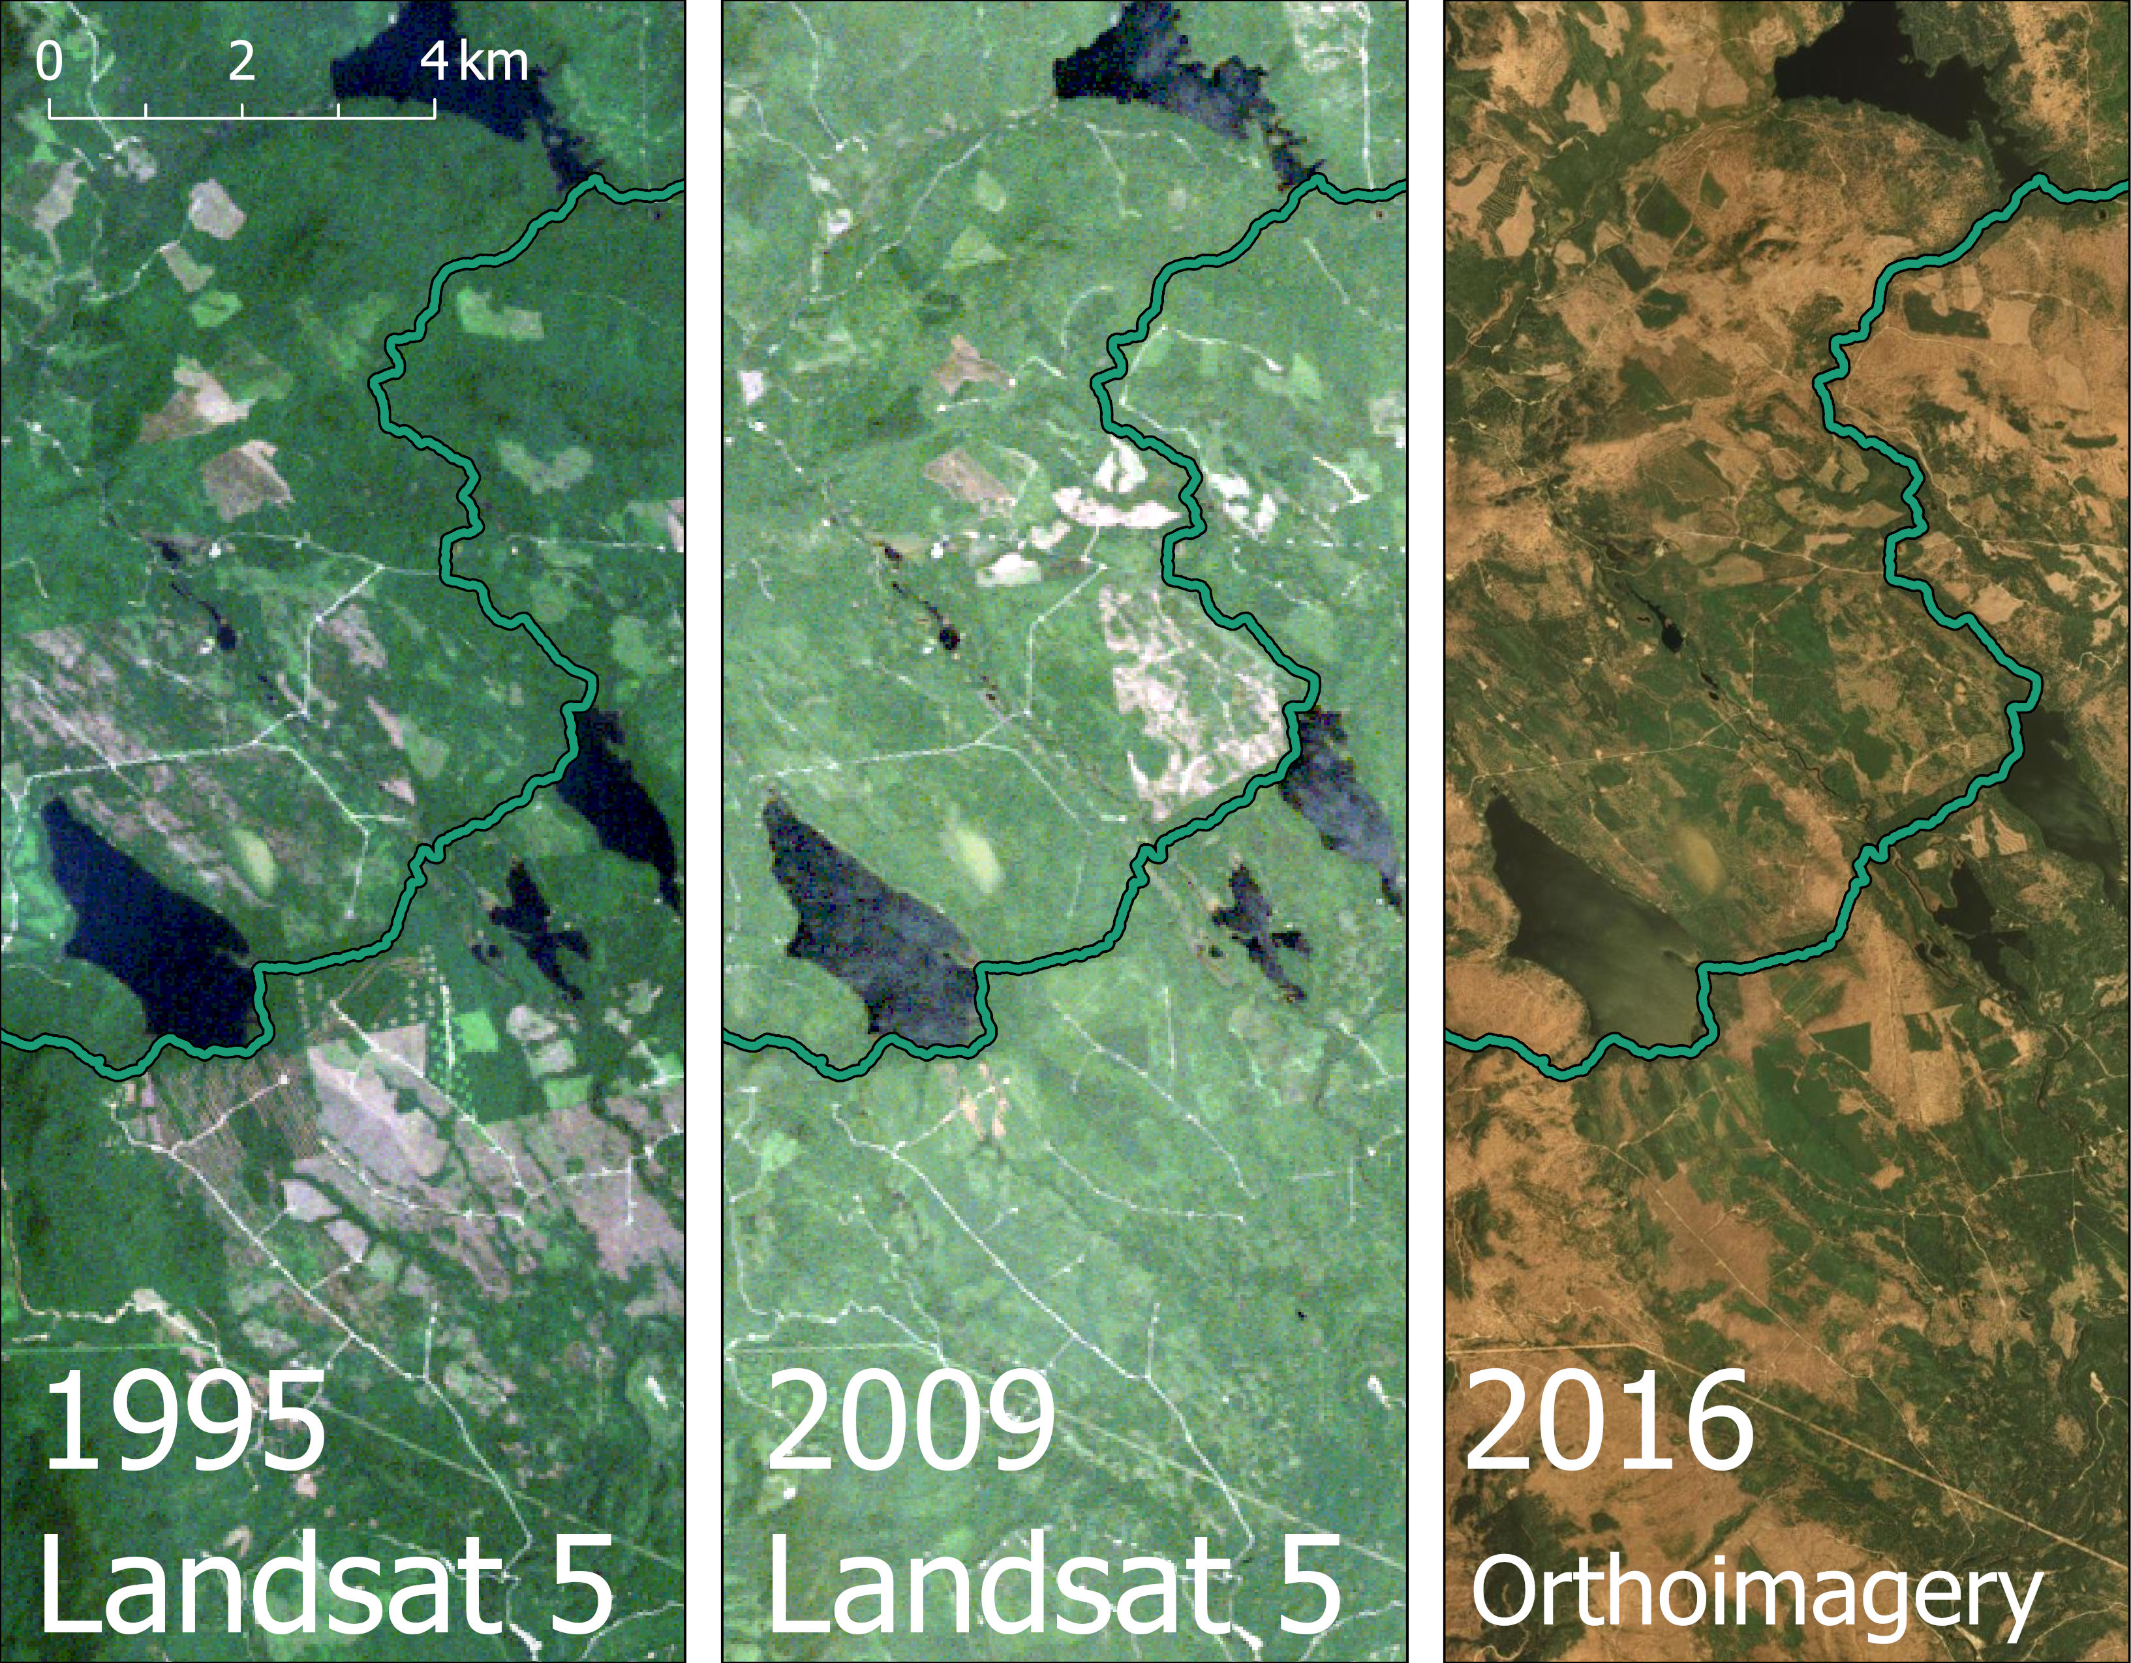
AT, Maine Deforestation

Slide 11
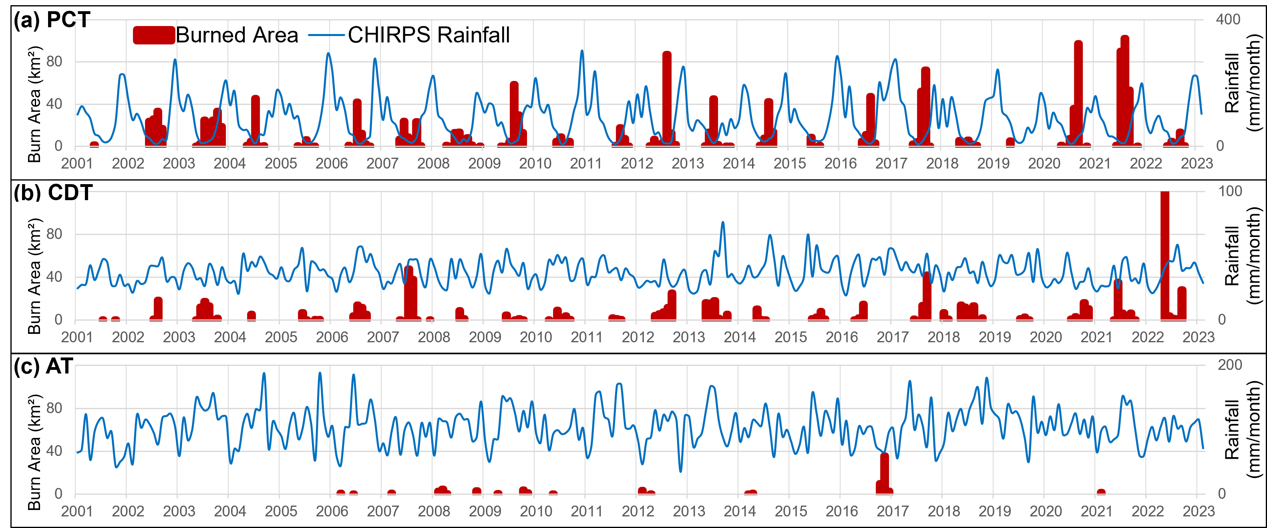
Wildfire & Rainfall
MODIS MCD64A1 v6.1 Burned Area & Climate Hazards Center InfraRed Precipitation with Station (CHIRPS)
Notes:
Dual-axis time series showing the relationship between the monthly MODIS burned area and CHIRPS average monthly rainfall for (a) the PCT, (b) the CDT, and (c) the AT. Note the different y-axis values for rainfall on each trail. Wildfires along the PCT are frequent and highly seasonal, occurring during dry summer months.

Slide 12
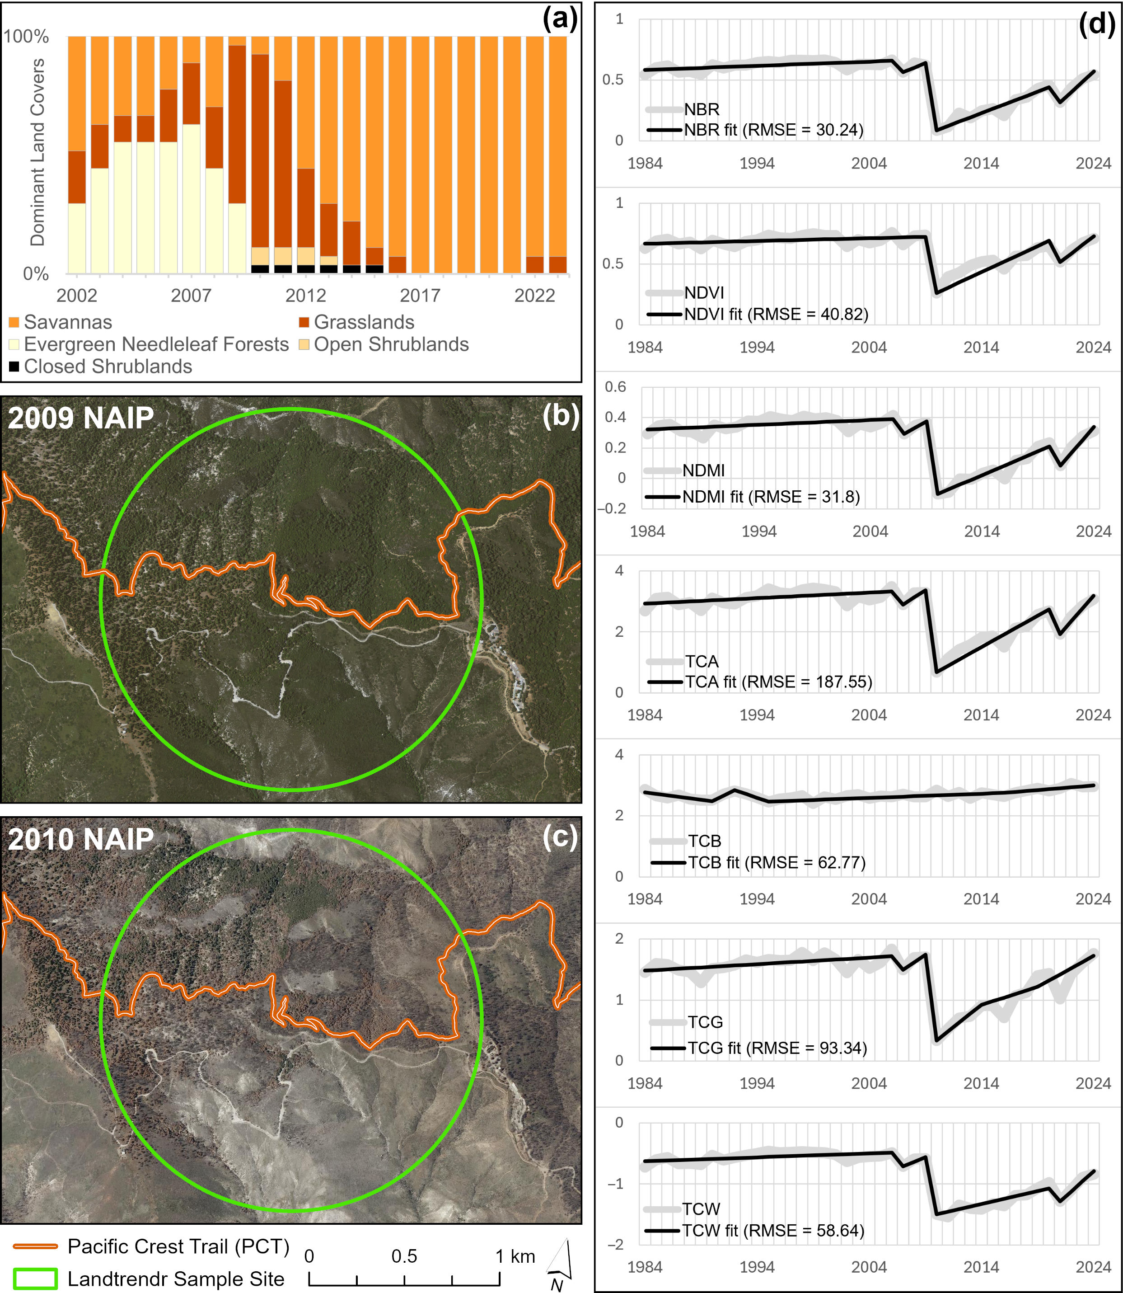
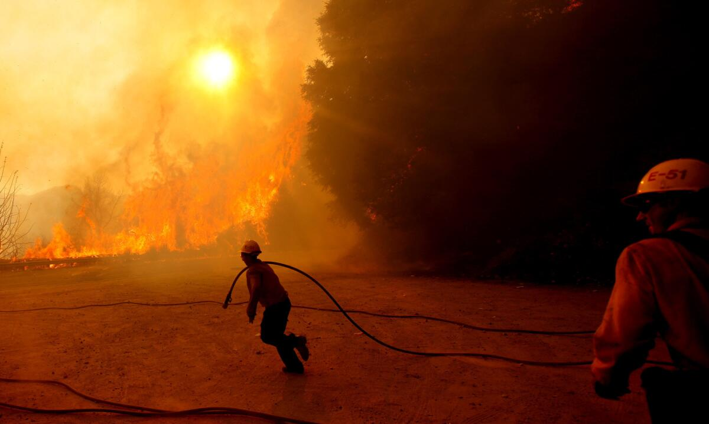
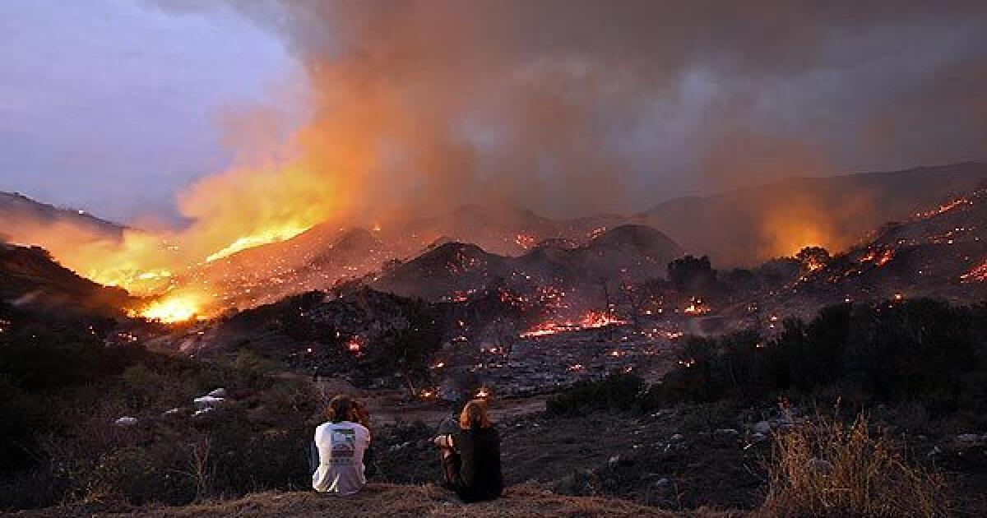
Wildfire Impact
PCT site following the 2009 Station Fire
“As firefighters mobilize, the Station fire moves up a hill after leaping Angeles Crest Highway. The conflagration that started just above La Cañada on the afternoon of Aug. 26, 2009 devastated one of America’s most-visited national forests.”
Los Angeles Times, Al Seib
Los Angeles Times, Luis Sinco
Notes:
Vegetation recovery analysis at PCT trail site C (34.379, −118.164) following the 2009 Station Fire. The MODIS MCD12Q1 land cover analysis for the study site (a) shows a transition from abundant evergreen needleleaf forest (2002–2008) to grassland (2009–2011) and savanna (2012–2023).

Slide 13
Wildfire Impact
MODIS MCD12Q1 shows transition from abundant evergreen needleleaf forest (2002–2008) to grassland (2009–2011) and savanna (2012–2023).
Notes:
Vegetation recovery analysis at PCT trail site C (34.379, −118.164) following the 2009 Station Fire. The MODIS MCD12Q1 land cover analysis for the study site (a) shows a transition from abundant evergreen needleleaf forest (2002–2008) to grassland (2009–2011) and savanna (2012–2023).

Slide 14
Wildfire Impact
LandTrendr disturbance & recovery analysis (Kennedy et al. 2018)
  Landsat data 1984-2024
  7 spectral indices
  temporal segmentation algorithm
Notes:
Vegetation recovery analysis at PCT trail site C (34.379, −118.164) following the 2009 Station Fire. The MODIS MCD12Q1 land cover analysis for the study site (a) shows a transition from abundant evergreen needleleaf forest (2002–2008) to grassland (2009–2011) and savanna (2012–2023).

Slide 15
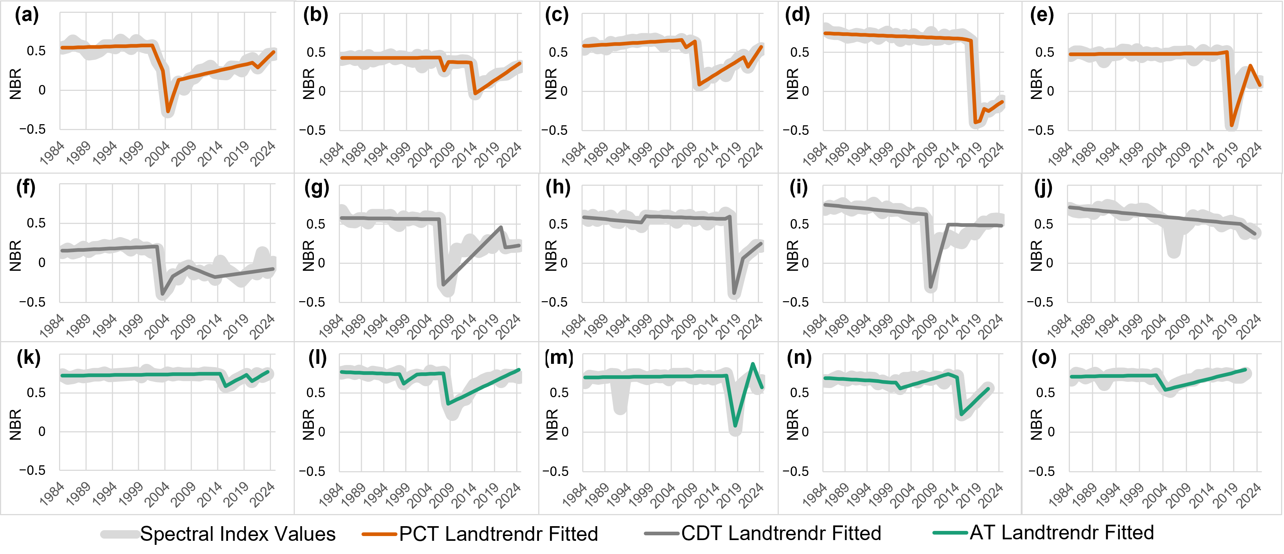
LandTrendr Recovery
NBR = (NIR − SWIR2)/(NIR + SWIR2)
15 sites. For sites that recovered, avg 10.8 years
Notes:
Forest loss impact and recovery for selected disturbance sites on the PCT (a–e), CDT (f–j), and AT (k–o) based on the Landsat-derived NBR spectral index values and LandTrendr temporal segmentation, where higher NBR values indicate more vegetation. The average NBR values decreased from 0.6 pre-event to 0.31 five years later.

Slide 16
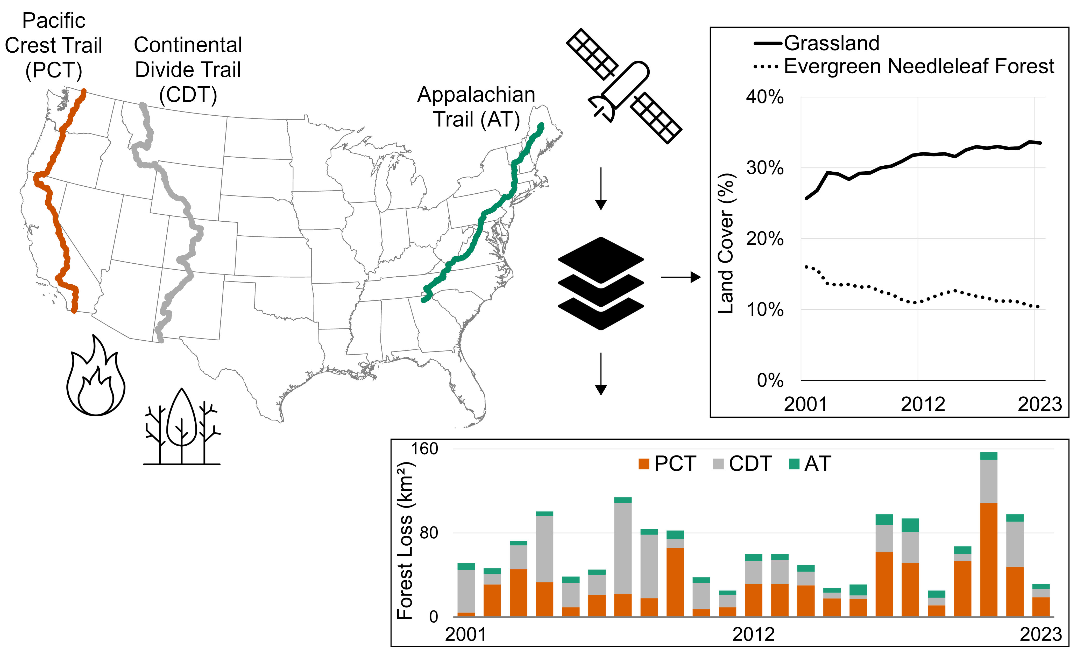
Summary
Notes:
Future Research
Dashboard to monitor trail corridors
conservation/management guidance

Slide 17
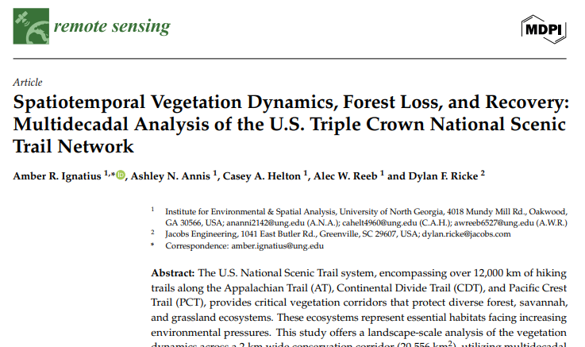
References
Ignatius, A., Annis, A., Helton, C., Reeb, A., Ricke, D. 2025. Spatiotemporal Vegetation Dynamics, Forest Loss, and Recovery: Multidecadal Analysis of the U.S. Triple Crown National Scenic Trail Network. Remote Sensing. 17. 1142. 10.3390/rs170711420
Crowley, M.A., Stuhlmacher, M., Trochim, E.D., Van Den Hoek, J., Pasquarella, V.J., ... Ignatius, A.R. et al. 2023. Pillars of cloud-based Earth observation science education. AGU Advances, 4, e2023AV000894. DOI: 10.1029/2023AV000894
Kennedy, R.E.; Yang, Z.; Gorelick, N.; Braaten, J.; Cavalcante, L.; Cohen, W.B.; Healey, S. Implementation of the LandTrendr Algorithm on Google Earth Engine. Remote Sens. 2018, 10, 691. 10.3390/rs10050691
Lu, Q., Liu, H., Wei, L., Zhong, Y., Zhou, Z. 2023. Global prediction of gross primary productivity under future climate change. Science of The Total Environment. 912. 169239. 10.1016/j.scitotenv.2023.169239
Richardson, A. 2018. Tracking seasonal rhythms of plants in diverse ecosystems with digital camera imagery. New Phytologist. 222. 10.1111/nph.15591
Wilson, M.B.; Belote, R.T. The Value of Trail Corridors for Bold Conservation Planning. 2022. Land. 11, 348. 10.3390/land11030348
Notes:
Future Research
Dashboard to monitor trail corridors
conservation/management guidance

Slide 18
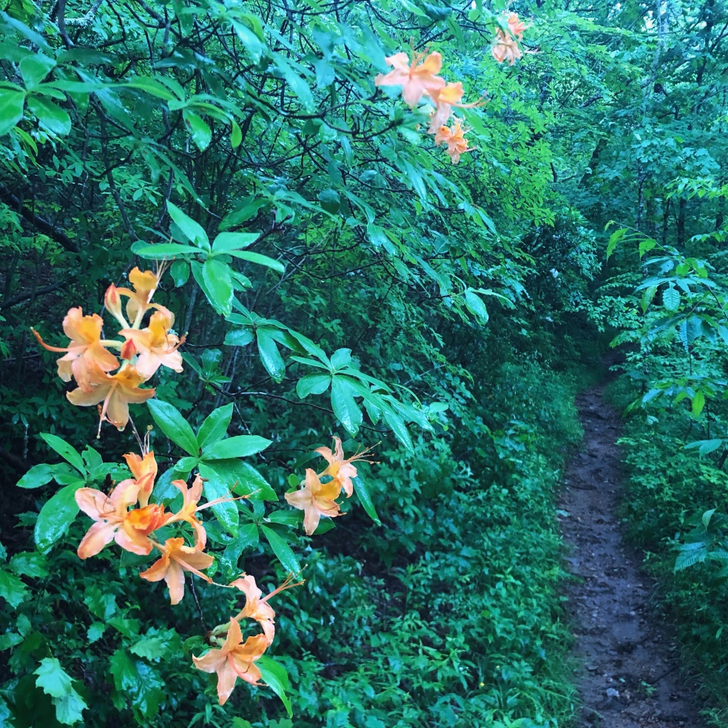
Questions?
AT sunrise. R. Ignatius

