Slide 1

Understanding the Historical Dynamics of Turbidity in the Tennessee River Using Remote Sensing
AKM Azad Hossain, Ph.D.
Associate Professor
Department of Biology, Geology and Environmental Science
Connor Firat, M.S.
Recent Graduate. M.S. Env. Sc.
Department of Biology, Geology and Environmental Science
ASPRS Mid-South Regional Conference 2025
ORNL, April 24-25

Slide 2
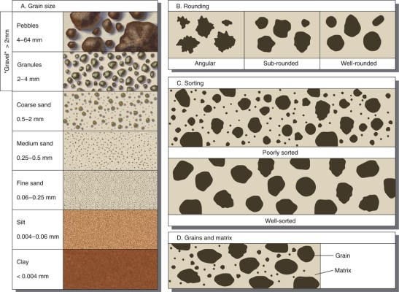
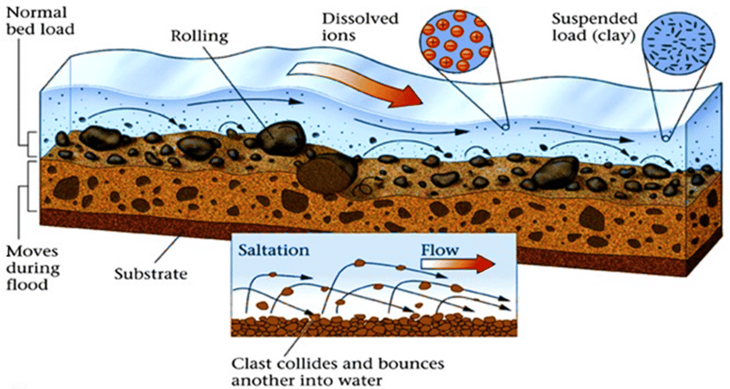
Sediments?
Any particles can be considered as sediments. They are classified based on their diameters.
https://www.nps.gov/teachers/classrooms/sediment-sorting.htm
http://www.geophile.net/Lessons/ND_floods/images/load.fw.png
Streams consist of different types of sediments such as clay, sand, gravel etc. Medium to fine grained sediments like sand and clay are usually found as suspended loads.
Turbidity is the most common water quality parameters that is used to understand the amount of suspended solids present in the water.
Sediments are the major source (arguably) of pollutions in the in-land water bodies – As they carry most of the pollutants that impair the quality of water!

Slide 3
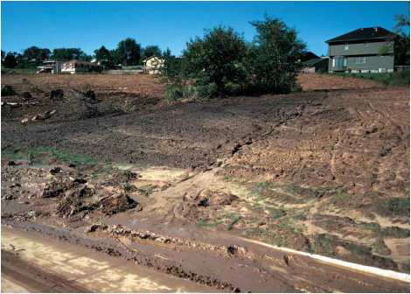
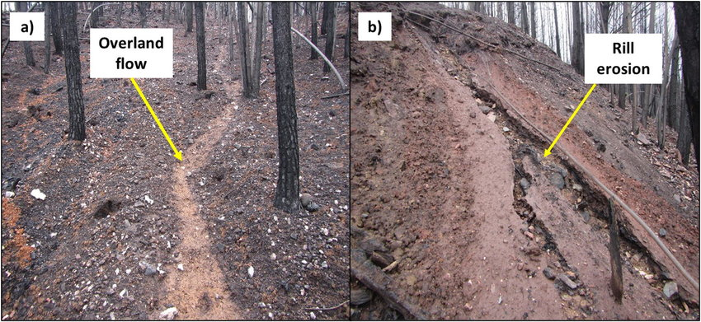
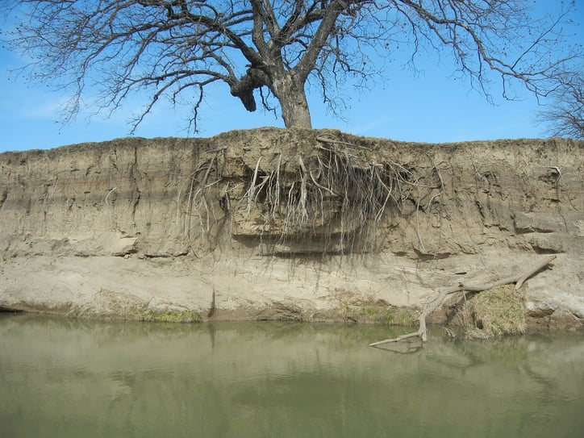
How Sediment Gets into Natural Waters?
Sediment enters streams via [Belasri and Lakhouili,2016]:
  Overland flow-induced hillslope erosion
  Stream bank erosion
Human-induced landscape changes [Nietch et al., 2005]
  Urban Development and Impervious Surfaces
    Expose soils
    Increase stream discharge, causing higher stream bank erosion and elevated sedimentation rates
    Contribute to sediment accumulation through wash-off, with toxins binding to the sediment
  Agricultural tilling
    Expose soil
    Higher intensity rain events
      Increase sediment detachment from these engineered lands
      Carry more sediments to the stream
https://www.washtenawcd.org/erosion-control.html
https://www.researchgate.net/publication/350791925_Sediment_source_apportionment_following_wildfire_in_an_upland_commercial_forest_catchment
https://pxhere.com/en/photo/982100

Slide 4
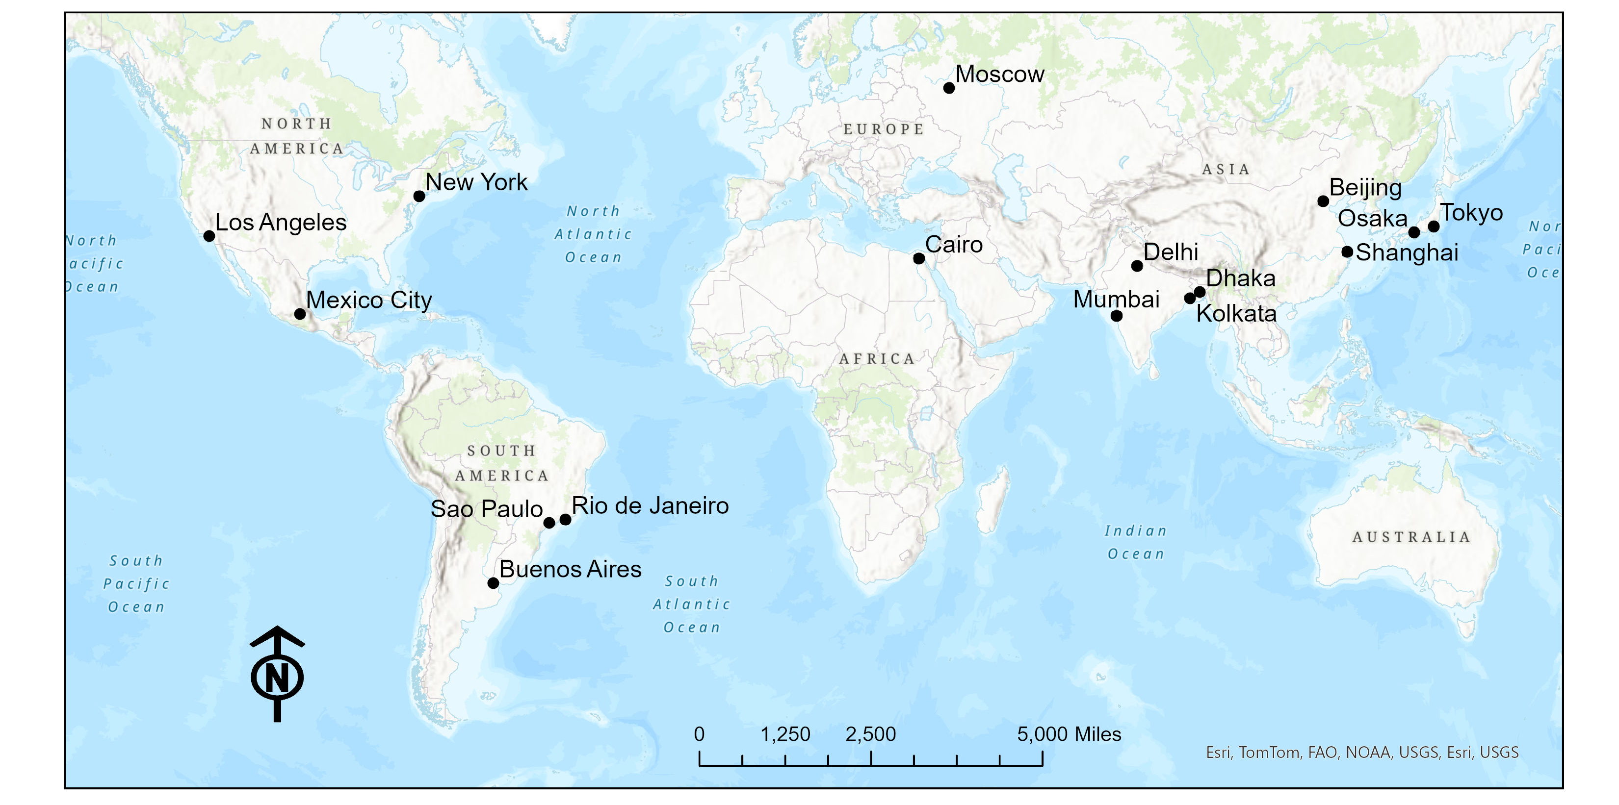
Prominent Megacities in 2000
Only Megacities in 1950
London
Total – 17!
A megacity hosts more than 10 million people! [New Scientist Magazine, 2006; Hossain and Easson, 2021; United Nations, 2014].

Slide 5
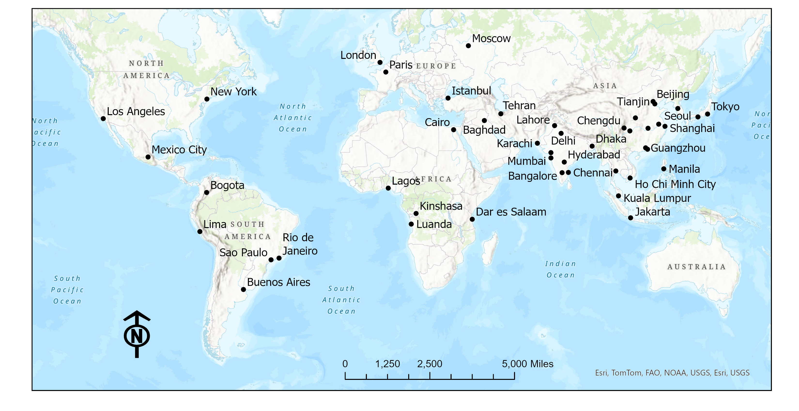
Projected Megacities in 2035
Only Megacities in 1950
More than – 43!
A megacity hosts more than 10 million people! (New Scientist Magazine, 2006; Hossain and Easson, 2021; United Nations, 2014).

Slide 6
Urbanization and Sediment Influx to In-land Water
Today, over 4 billion people around the world – more than half the global population – live in cities. This trend is expected to continue (World Bank, 2025).
In fact, the world's population living in cities, projected to reach nearly 70% by 2050.
This shift presents both opportunities and challenges for sustainable development, requiring effective management of urban growth.
So, we need to understand and monitor the fate and transport of the sediments potentially generated from urbanization.
This study focuses on the inland water bodies.
https://www.washtenawcd.org/erosion-control.html
https://www.researchgate.net/publication/350791925_Sediment_source_apportionment_following_wildfire_in_an_upland_commercial_forest_catchment
https://pxhere.com/en/photo/982100

Slide 7
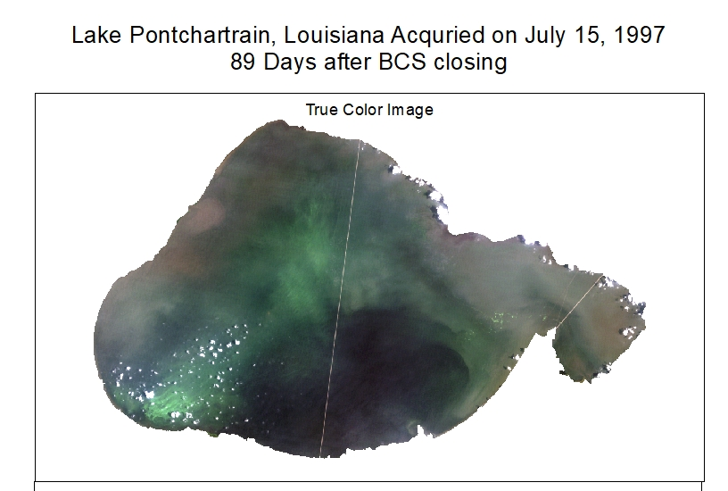
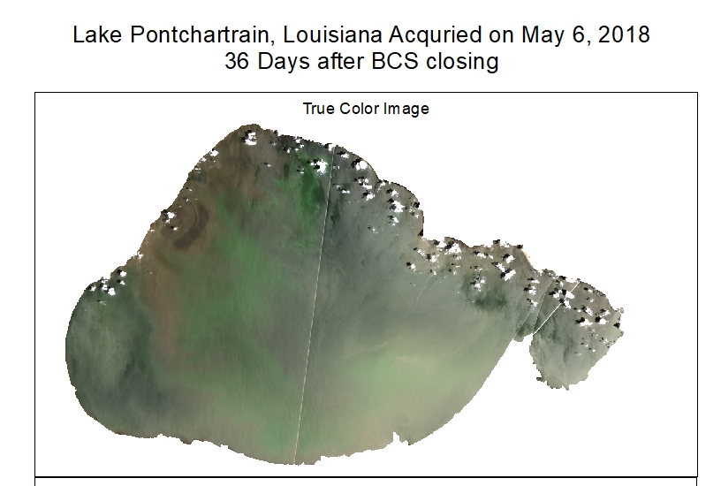
Closing the Early Warning Gap!
Proper understanding of the historical dynamics of the sediment concentration in the inland water bodies, particularly in major rivers/water bodies would provide valuable information related to changes in water quality and issues like algal bloom.
For Example, Sediments carry nutrients that promote algal bloom!
[Larson and Hossain, 2023]

Slide 8
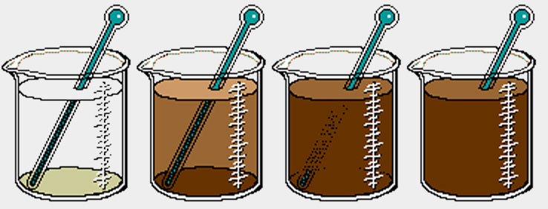
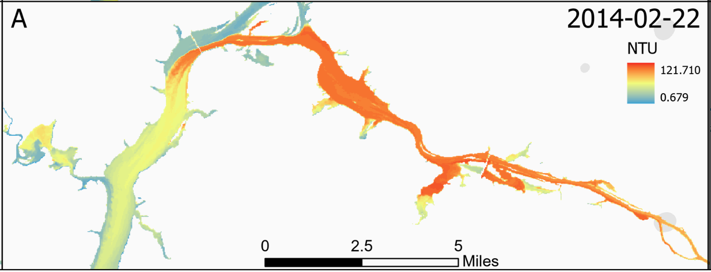
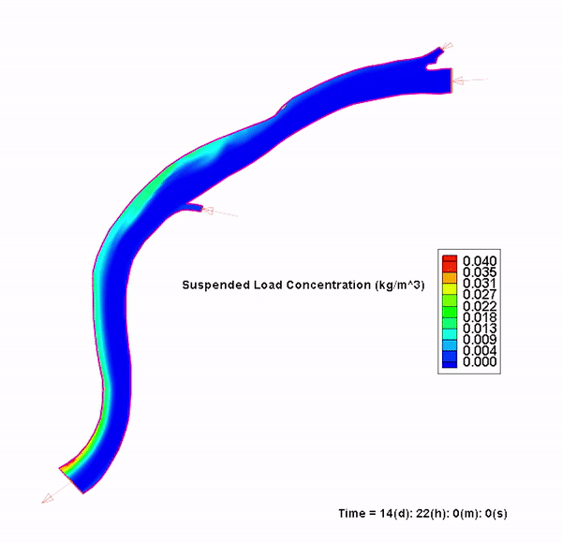
Approaches to Study Aquatic Sedimentation
Turbidity/In-situ devices/collection
Clarity of water based on light scattering in a waterbody
Units of JTU, FNU (or NTU), and FAU [Trevathan et al., 2020]
Turbidity and discharge sensors can be put into in streams, often reading in hour or 15-minute intervals.
Remote sensing
Sensors like IKONOS [Giardino et al., 2014], Landsat [Tsapanou et al., 2020], Sentinel-2 [Liu et al., 2017], RapidEye [Pereira et al., 2019], and MODIS [Wu et al., 2014] help assess turbidity in various environments
Satellite imagery can be correlated with in situ measurements using regression techniques to obtain useful units like mg/L of sediment in water [Hossain et al., 2021]
Numerical modeling/Hydrodynamic Modeling
Uses complex equations, to predict streamflow and turbidity out of a given watershed basin and inside a streams [Donigian and Imhoff, 2006]
https://www.kemtrak.com/product/tc007/

Slide 9
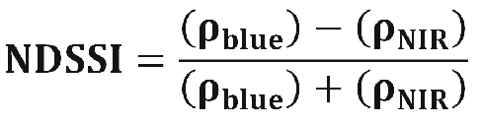
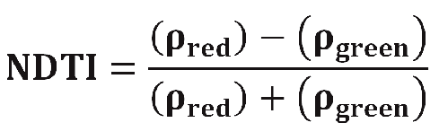
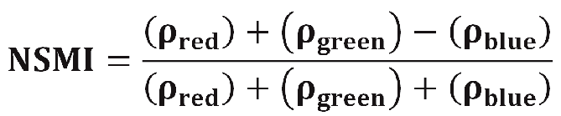
Remote Sensing of Aquatic Sediment
Qualitative Approach – Different Indices
Normalized Difference Suspended Sediment Index (NDSSI)
[Hossain et al., 2010]
Uses the blue and Near Infrared bands
Normalized Difference Turbidity Index (NDTI) [Lacaux et al., 2007]
Uses the green and red bands
Normalized Suspended Material Index (NSMI) [Montalvo, L. G., 2010]
Uses the red, green, and blue bands

Slide 10
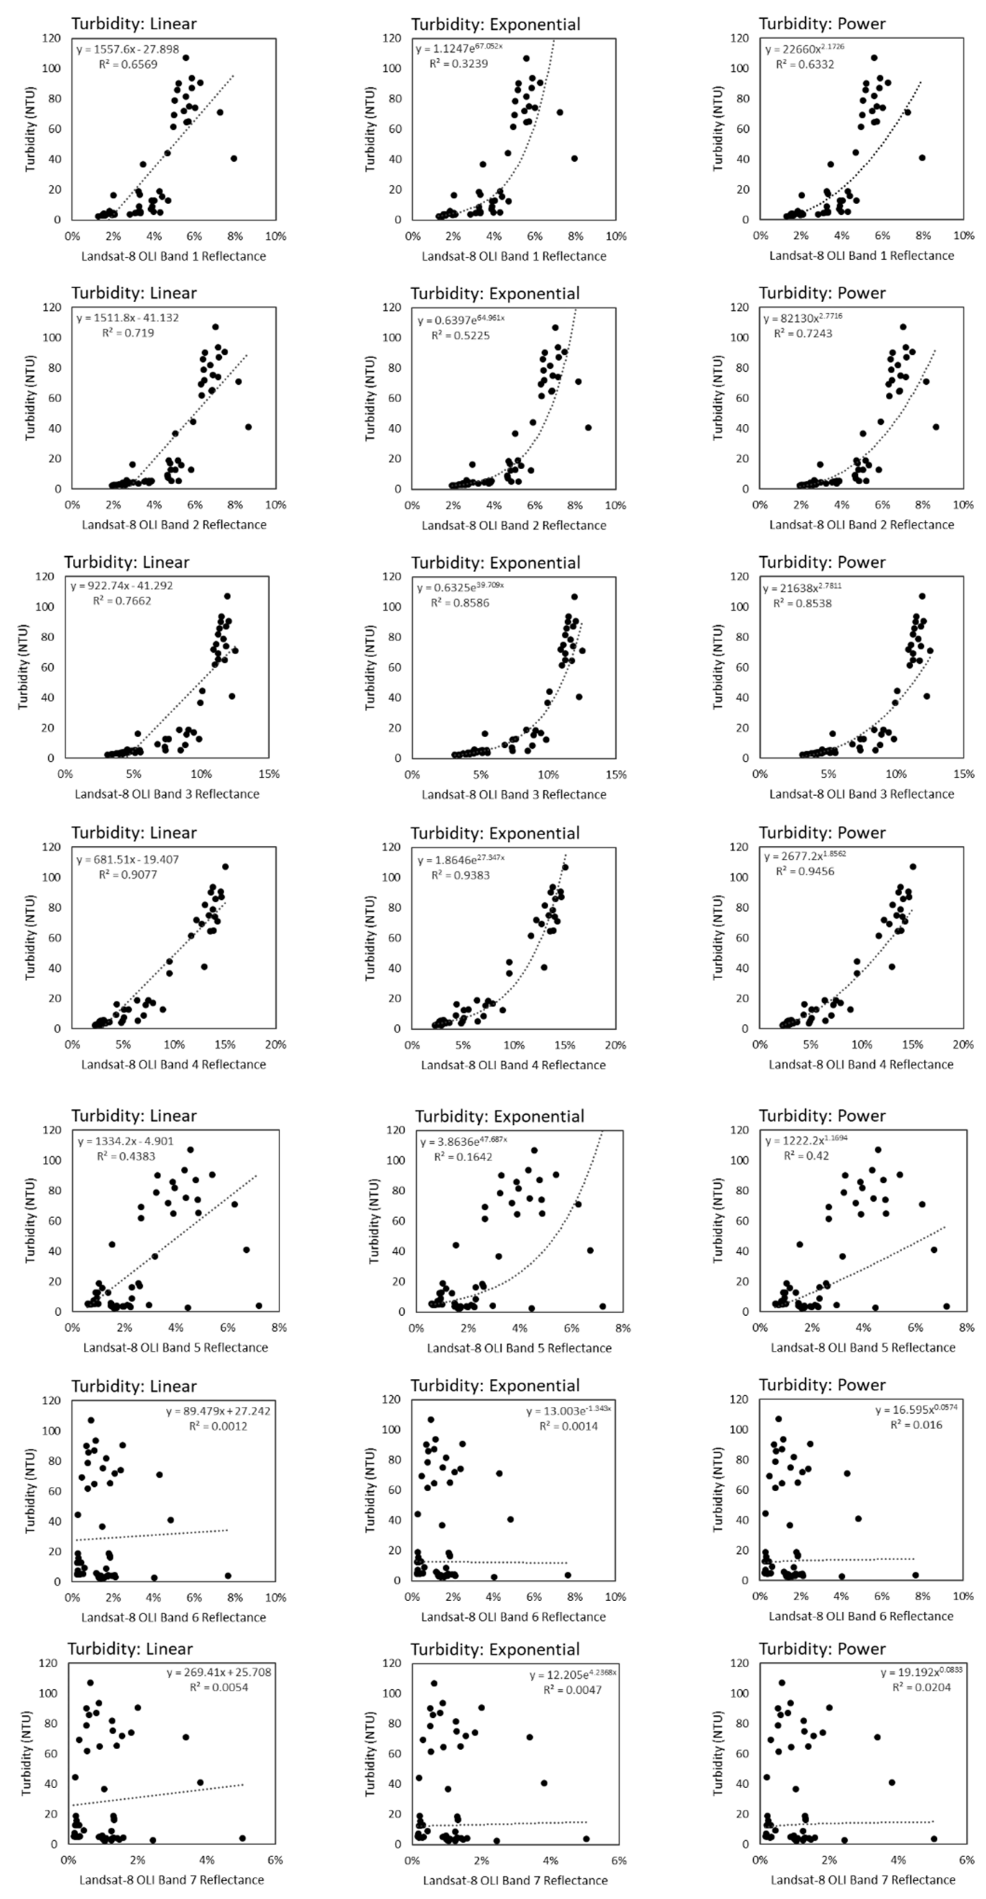
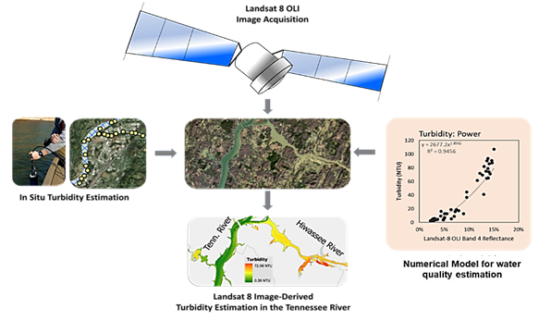
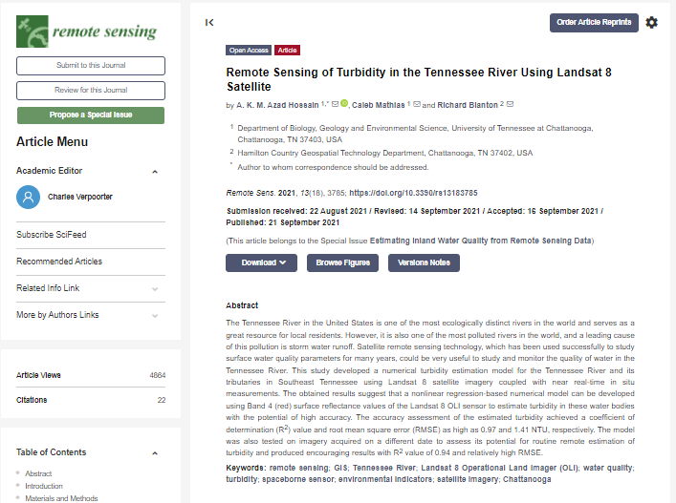
Remote Sensing of Aquatic Sediment
Quantitative Approach: Turbidity Estimation [Hossain et al., 2021]
R² = 0.95

Slide 11


Google Earth Engine Python API
Processes large satellite image datasets rapidly
Users make API requests in JavaScript and Python
GEE's unique ability includes extracting clouds from images and preserving only land and water pixels, crucial for water quality studies.
Google Earth Engine (GEE)
Cloud computing platform
Used in vegetation monitoring, land use changes, and water quality monitoring using sensors like Landsat, Sentinel, and MODIS [Johansen et al., 2015, Kumari et al., 2021]
Free access for academic research.
https://www.appgeo.com/wp-content/uploads/GoogleEarthEngine.png
https://splunkable.com/wp-content/uploads/2023/03/Python-Symbol.png

Slide 12
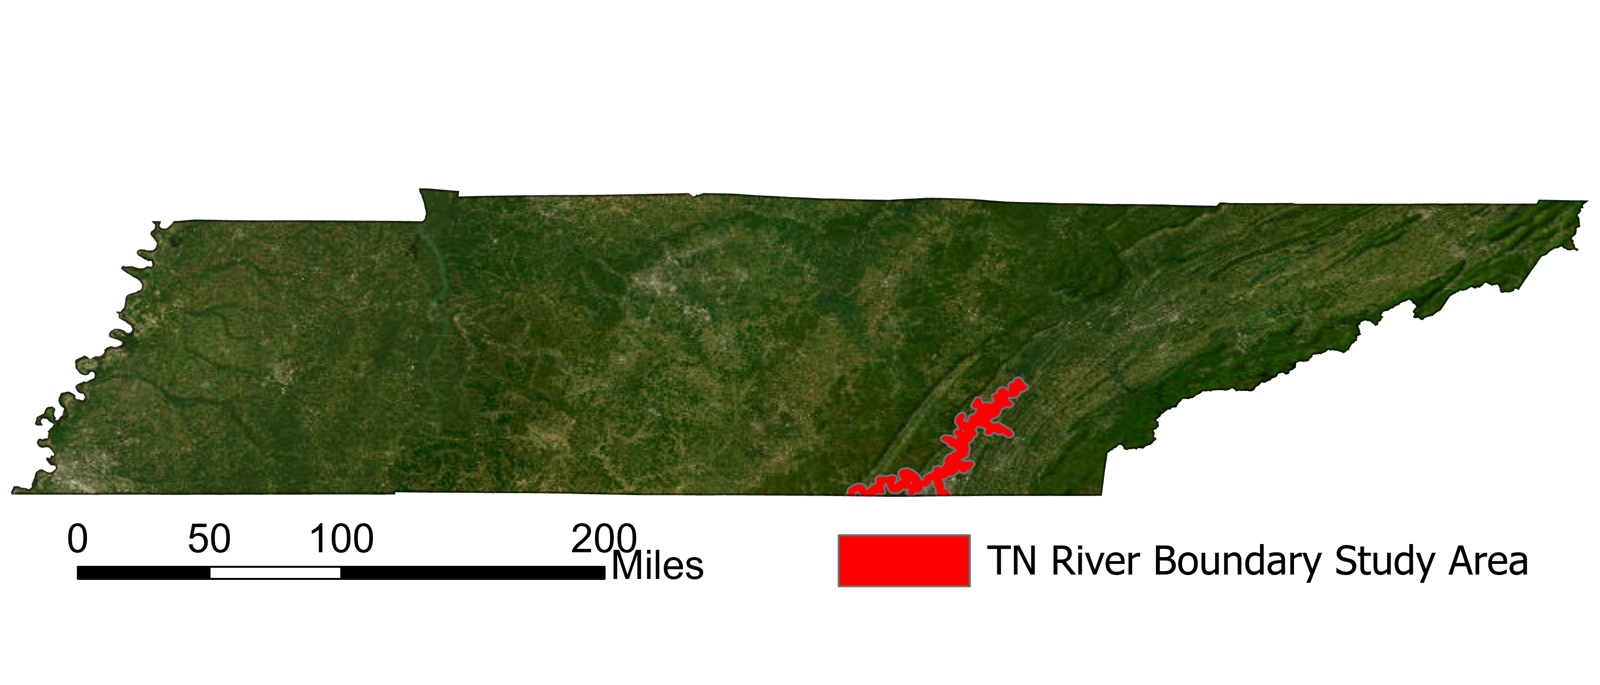
Study Site

Slide 13
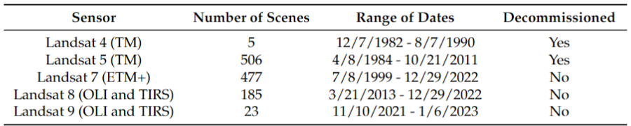
Landsat 4-9 Images
The time frame
  From 12/7/1982 to 1/6/2023 = around 40 years
Landsat 4, 5, 7, 8, and 9 sensors
  Landsat 6 not used due to the mission failing from the satellite not achieving orbital velocity
  Data for Landsat missions 1-3 are not used in this analysis due to the spectral resolution being much larger at 60 meters
Total Scenes: 1196

Slide 14

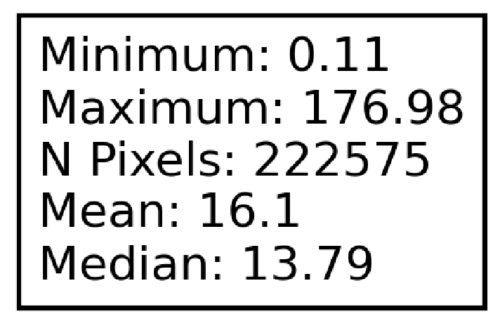
Result
1,196 scenes processed
Generated mosaic images, removed clouds, run turbidity estimation model
If turbidity reaches a value higher than 50 NTU, pixels will be shown in dark red.
Landsat collected after May 31, 2003 has data gaps due to the Scan Line Corrector Failing.
Example of statistics of the whole image
Notes:
Overall, rivers and streams show a decrease in annual suspended sediment loads, but some areas experience increases (Murphy, 2020).
Climatic changes can lead to high peak suspended sediment concentrations, affecting annual levels.

Slide 15
Time Series Analysis of Each Study Area
A time-series graph was constructed by
  Taking the zonal statistics averages on each of the four main study sites:
    The Hiwassee River
    Harrison Bay
    South Chickamauga Creek
    Nickajack Lake
The data was put into a line plot
  Multiple y-axis pertaining to
    Turbidity (NTU) of the four study sites
    Discharge at the Lookout Creek gage.
  While the x-axis just has the time.
Condensed down to 8 separate 5-year intervals:
  1982-1987, 1988-1992, 1993-1997, 1998-2002, 2003-2007, 2008-2012, 2013-2017, and 2018-2023

Slide 16
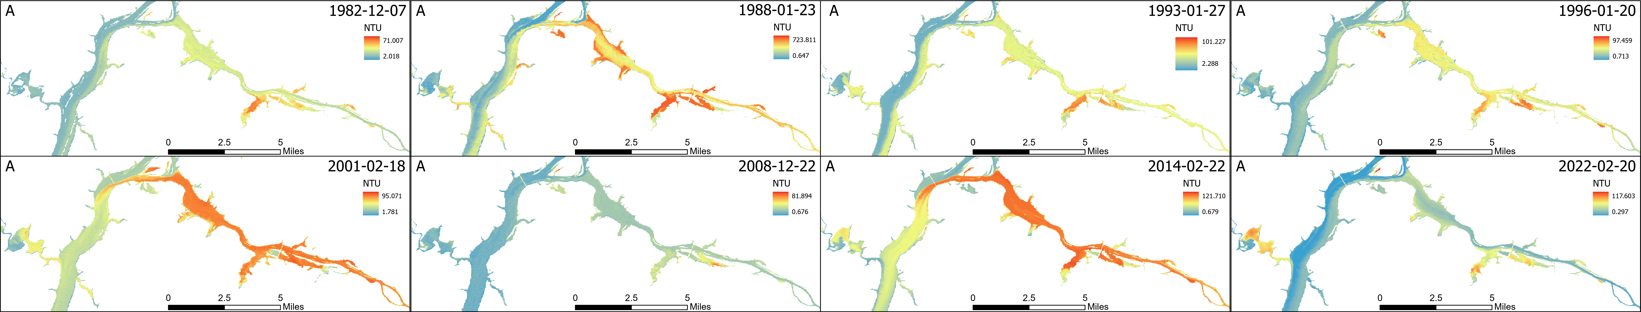
Hiwassee River
High variations in turbidity feeding into the Tennessee River
  Seems to be one of the biggest contributors of sediment for our area
The site shows what happens to high concentrations of suspended sediment when they meet a higher velocity current.

Slide 17
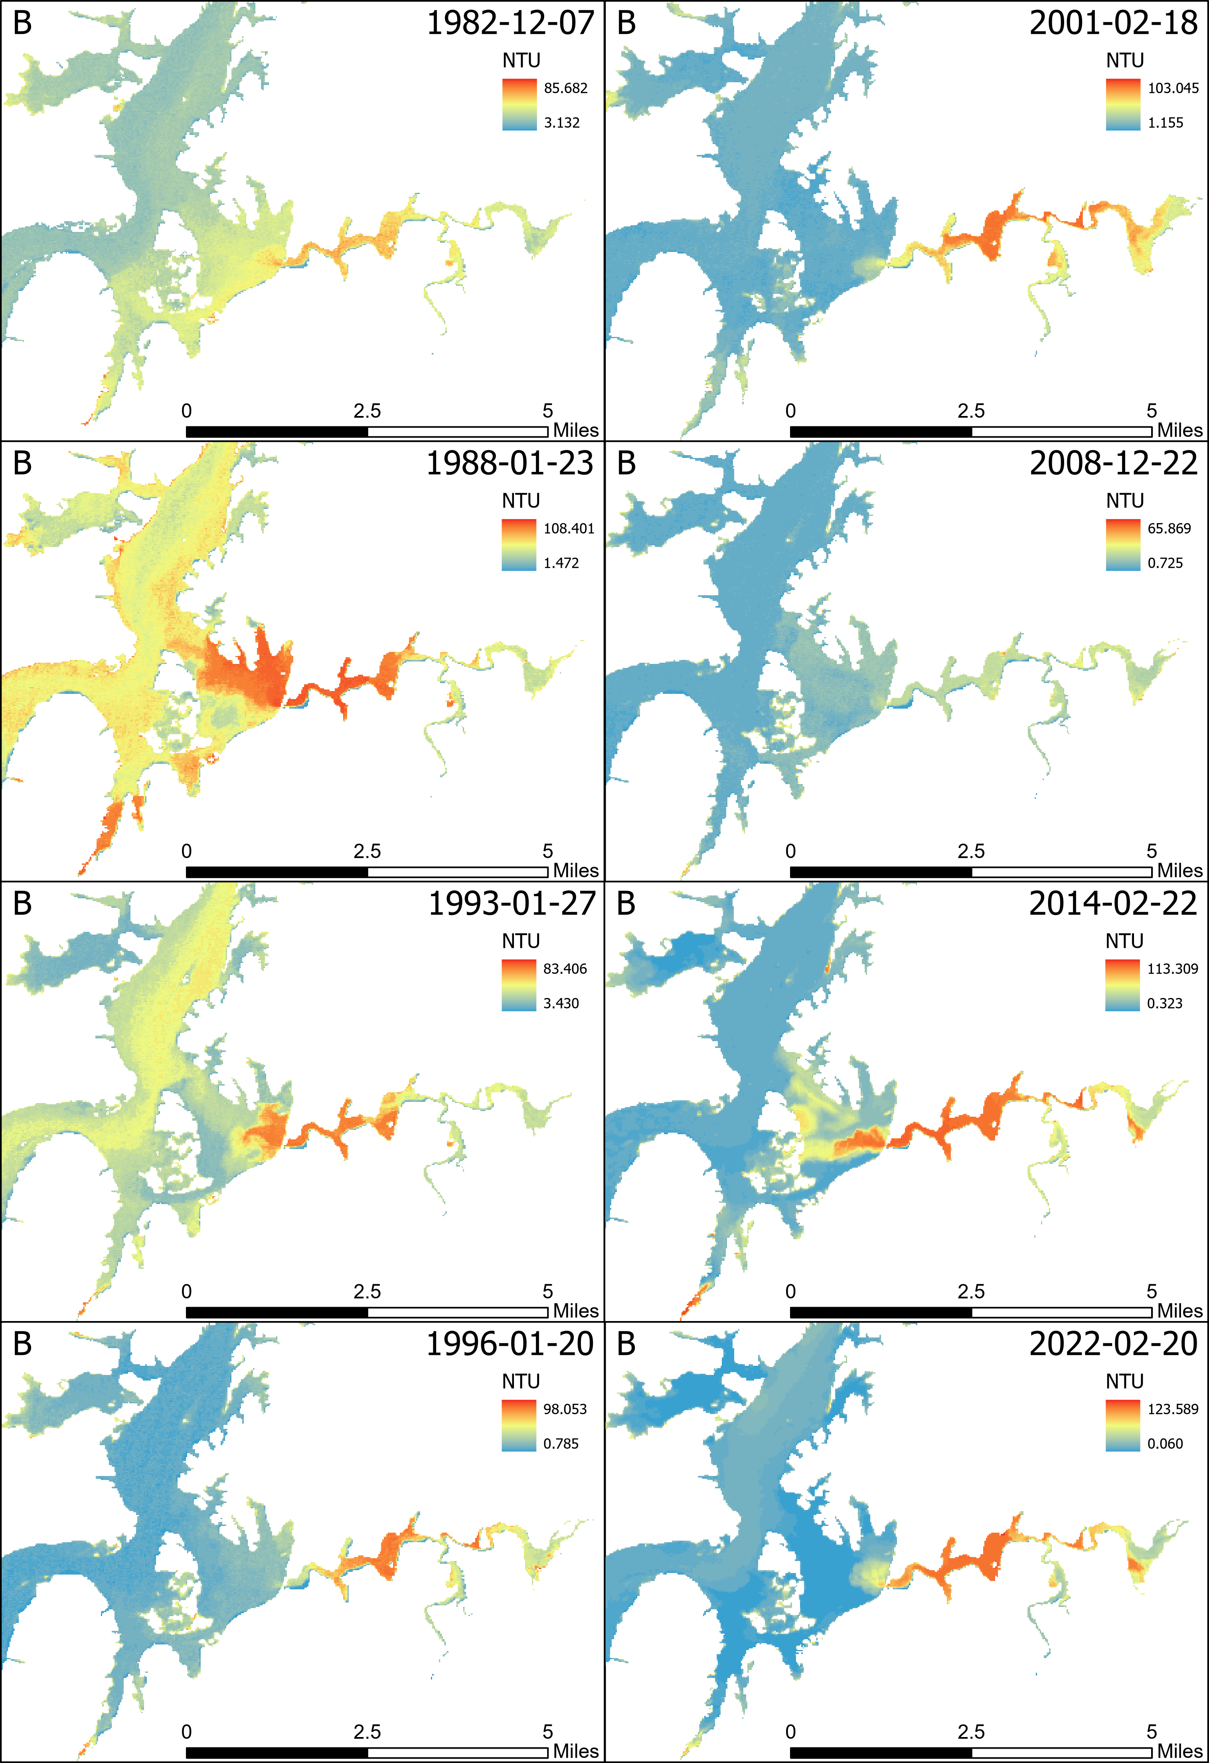
Harrison Bay
Seen to be a large contributor of sediment to the Tennessee River as well
The site shows what happens to the sediment when it meets the low flow velocities in the lake

Slide 18
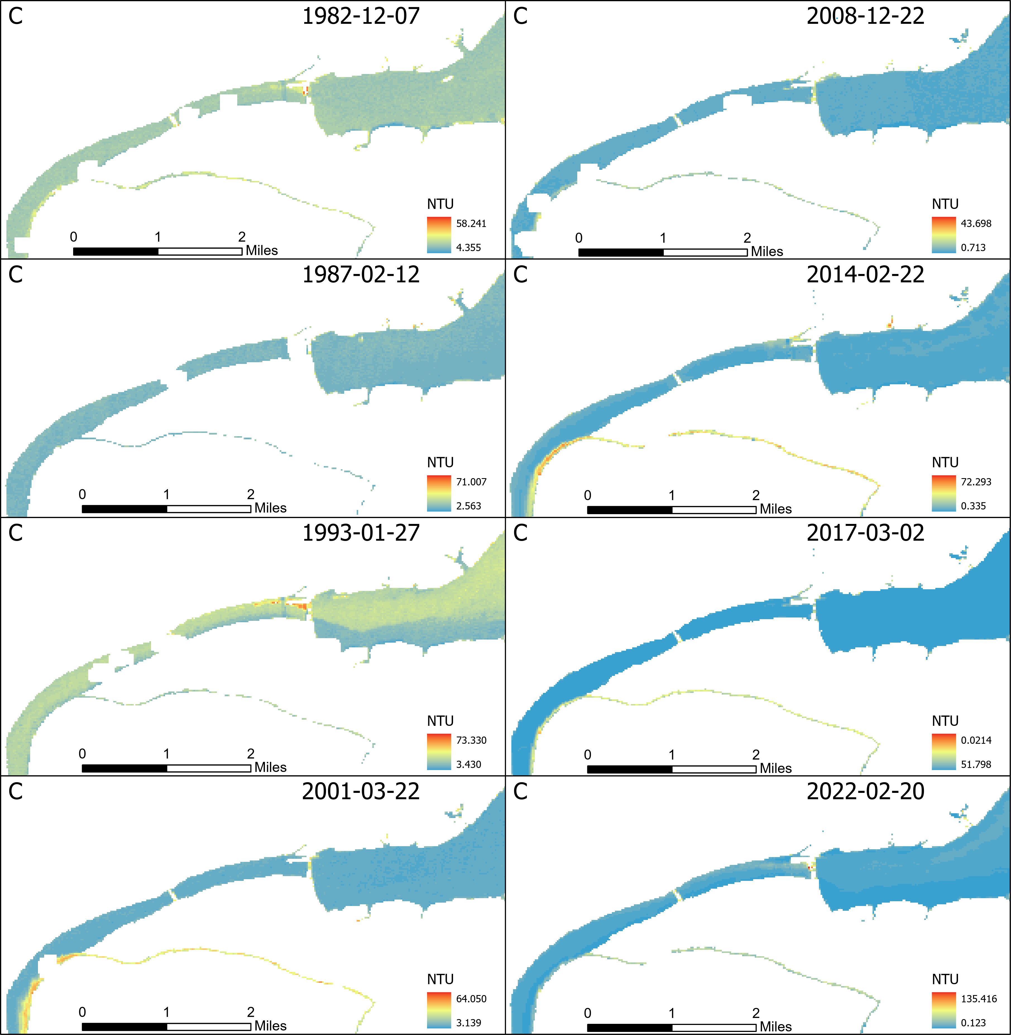
South Chickamauga Creek
Shows the effect of what a smaller tributary has on the Tennessee River.
  The site seems to have a substantial amount of sediment feeding into the Tennessee River for a very small tributary.

Slide 19
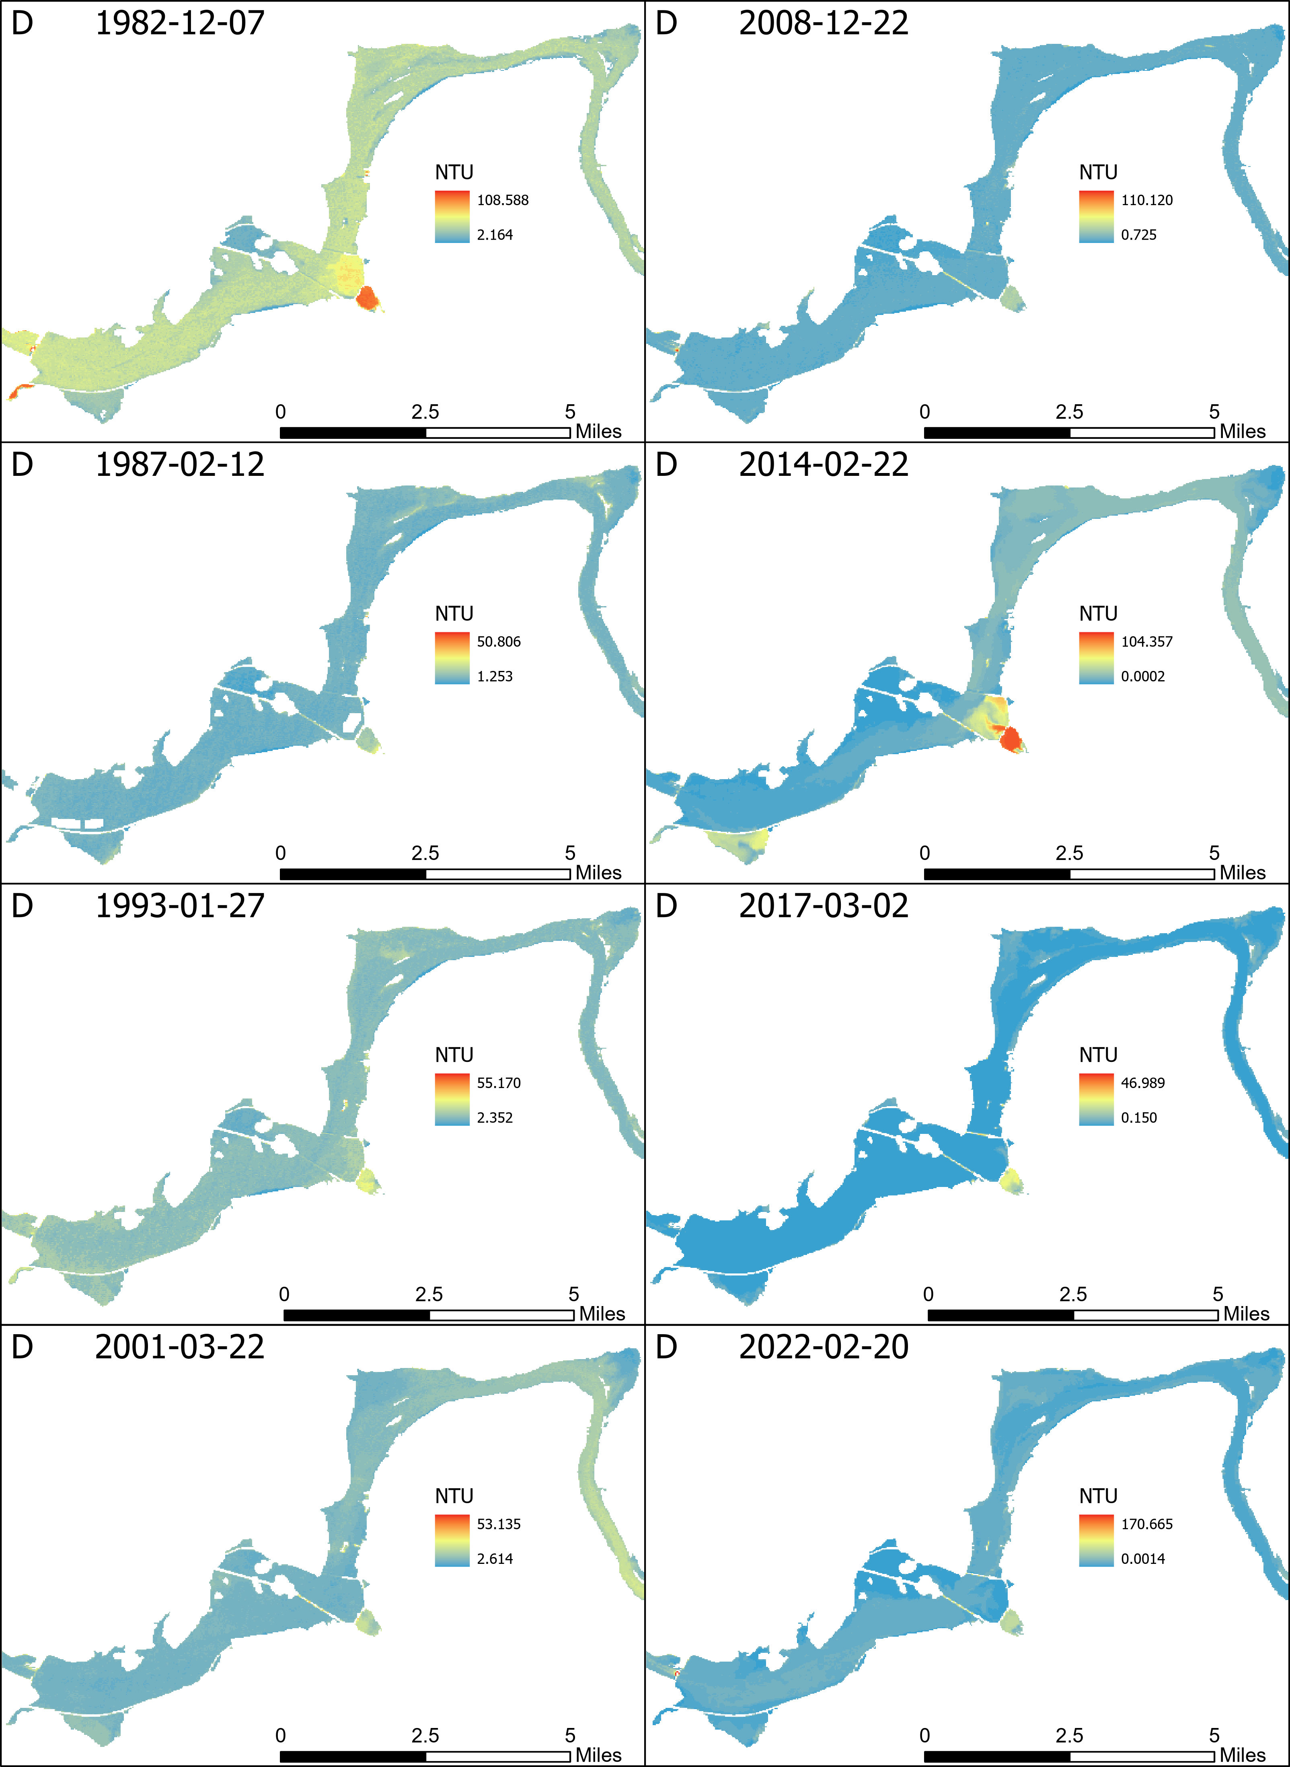
Nickajack Lake
Shows the effect off how point bars and cut banks have on the suspended sediment concentrations.
Suspended sediment seem to be lower at the point bars and higher in the cut bank sections.

Slide 20
Five-year Interval Box-plot Distributions
Take the actual maximum, minimum, and mean statistics from all 1196 images and see whether there has been an over all change in turbidity.
These box-plots will group the data into 8 different five-year intervals which are
  1983-1987
  1988-1992
  1993-1997
  1998-2002
  2003-2007
  2008-2012
  2013-2017
  2018-2022
Each five-year interval will contain a box for each study area’s statistics.
  All outliers are disregarded for these box-plots.
Notes:
Overall, rivers and streams show a decrease in annual suspended sediment loads, but some areas experience increases (Murphy, 2020).
Climatic changes can lead to high peak suspended sediment concentrations, affecting annual levels.

Slide 21
Notes:
Overall, rivers and streams show a decrease in annual suspended sediment loads, but some areas experience increases (Murphy, 2020).
Climatic changes can lead to high peak suspended sediment concentrations, affecting annual levels.

Slide 22
Interpretation of Turbidity in Study Areas
Each of the 1196 processed images contain a snapshot of the unique river turbidity occurring for the full domain of the Tennessee River.
Each 30m pixel has a turbidity value associated to it, where the
  Concentration locations can be mapped and used to understand which areas have higher variation of turbidity.
Four study areas have a unique hydrologic settings
  Different flow regimes interact with each other from various sources such as the streams that gather water from local watershed networks and the man-made dams releasing water at different intervals.

Slide 23
Conclusions from Current Research
This research indicates using Google Earth Engine, Landsat satellite can be used to estimate historical turbidity in the Tennessee River.
This research provides Landsat derived turbidity estimating in part of the Tennessee River almost every month from 1984-2023.
Timeseries can give great insight into general turbidity trends and sometimes catches high turbidity events. Although the window for peak turbidity is hard to catch due to the rapid decline.
The high number of images produced helps determine the exact locations of where turbidity is highest and what to expect after a large storm event.
Historical turbidity statistics suggested an overall downward trend for the mean and max box plots as well as peak turbidity on all four study sites.

Slide 24


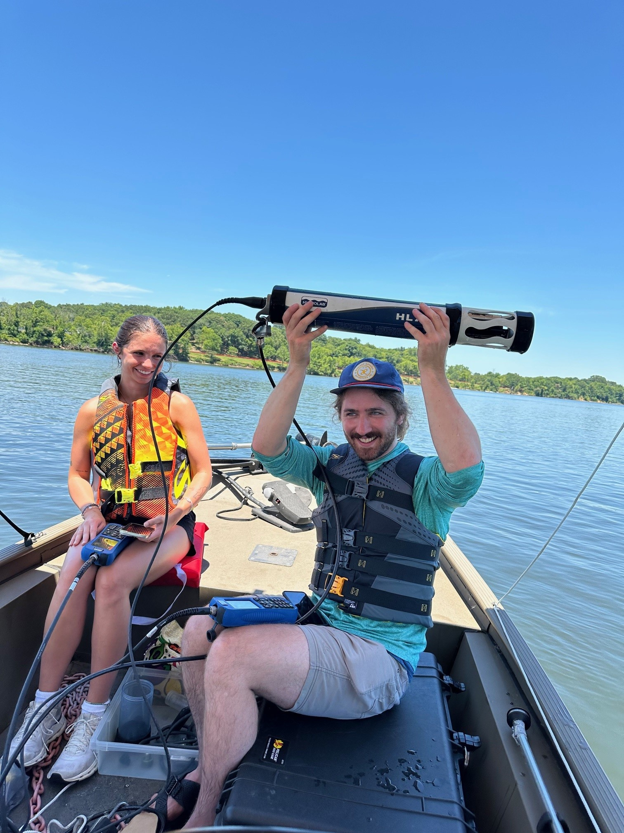

Limitations/Future Study
Recently funded NASA ROSES grant at UTC addressing this issue by developing new models incorporating more in situ measurements and machine learning approach.
Sample Collection
Hydrolab HL4
Hydrolab HL7
Research Boat
Hossain et al (2021) Model has uncertainty in low turbidity regime !

Slide 25
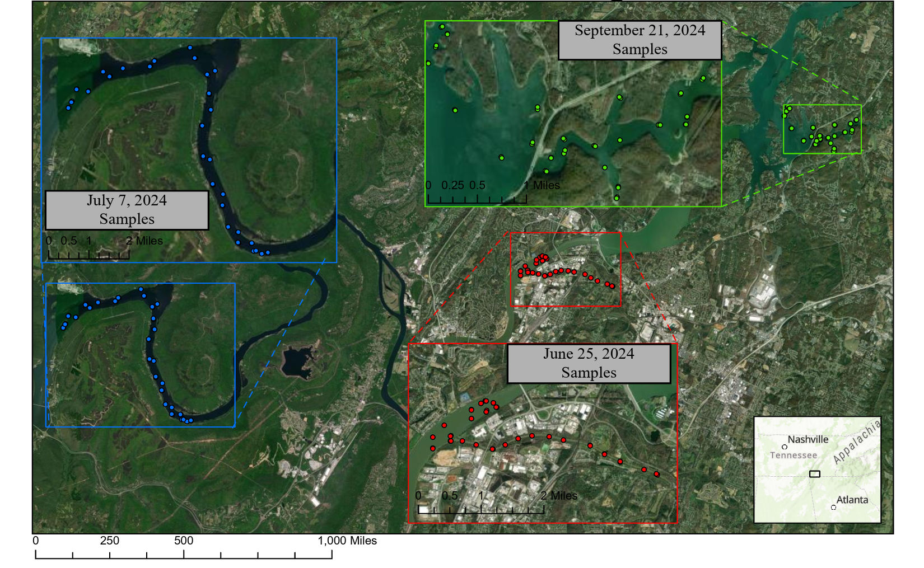
New Turbidity Measurements
11

Slide 26
Acknowledgements
This research is partly based upon work supported by NASA ROSES RIA grant under the award No.80NSSC24K0784.
The Geological and Environmental Research Lab (GERSLab) at the University of Tennessee at Chattanooga provided necessary equipment and research boat for water quality data collection including.
Geospatial software resources provided by the University of Tennessee at Chattanooga.
NASA/USGS for providing Landsat satellite imageries.
Google Earth Engine for providing cloud computing resources.

Slide 27
Disclosure
Any opinions, findings, and conclusions or recommendations expressed in this material are those of the author(s) and do not necessarily reflect the views of the National Aeronautics and Space Administration.

Slide 28
References
Belasri, A., and Lakhouili, A., 2016, Estimation of Soil Erosion Risk Using the Universal Soil Loss Equation (USLE) and Geo-Information Technology in Oued El Makhazine Watershed, Morocco: Journal of Geographic Information System, v. Vol.08No.01, p. 10.
Nietch, C. T., Borst, M., and Schubauer-Berigan, J. P., 2005, Risk management of sediment stress: a framework for sediment risk management research: Environmental Management, v. 36, no. 2, p. 175-194.
New Scientist Magazine (2006) How big can cities get? 17 June 2006, p 41
Hossain A, Easson G (2021) Potential impacts of the growth of a mega City in Southeast Asia, a case study on the City of Dhaka, Bangladesh. In: Chen W-Y, Seiner JM, Suzuki T, MBA ML (eds) Handbook of climate change mitigation and adaptation. Springer International Publishing, pp 1– 24. Online ISBN 978-1-4614-6431-0
United Nation (2014) World urbanization prospects, the 2014 revision. Department of Economic and Social Affairs, United Nations, New York.
World Bank, 2025, Urban Development Overview. https://www.worldbank.org/en/topic/urbandevelopment/overview

Slide 29
References
Larson, B. and Hossain, A., 2023, Qualitative Analysis of Algal Blooms in Lake Pontchartrain Using Remote Sensing, ASPRS Mid-South Conference 2023, April 21, 2023, Oak Ridge National Laboratory, Knoxville, TN.
Trevathan, J., Read, W., and Schmidtke, S., 2020, Towards the Development of an Affordable and Practical Light Attenuation Turbidity Sensor for Remote Near Real-Time Aquatic Monitoring: Sensors, v. 20, no. 7, p. 1993.
Giardino, C., Bresciani, M., Cazzaniga, I., Schenk, K., Rieger, P., Braga, F., Matta, E., and Brando, V. E., 2014, Evaluation of Multi-Resolution Satellite Sensors for Assessing Water Quality and Bottom Depth of Lake Garda: Sensors, v. 14, no. 12, p. 24116-24131.
Tsapanou, A., Oikonomou, E., Drakopoulos, P., Poulos, S., and Sylaios, G., 2020, Coupling remote sensing data with in-situ optical measurements to estimate suspended particulate matter under the Evros river influence (North-East Aegean sea, Greece): International Journal of Remote Sensing, v. 41, no. 6, p. 2062-2080.
Liu, H., Li, Q., Shi, T., Hu, S., Wu, G., and Zhou, Q., 2017, Application of Sentinel 2 MSI Images to Retrieve Suspended Particulate Matter Concentrations in Poyang Lake: Remote Sensing, v. 9, no. 7, p. 761.

Slide 30
Thanks!
Questions?

