Slide 1
Illuminating the Night: A Multimodal Fusion Approach to Super-Resolving Nighttime Light Images
APRIL 24-25, 2025
Haley Duba-Sullivan, Tony G. Allen, and Emma J. Reid
Cyber Resilience and Intelligence Division, NSSD

Slide 2
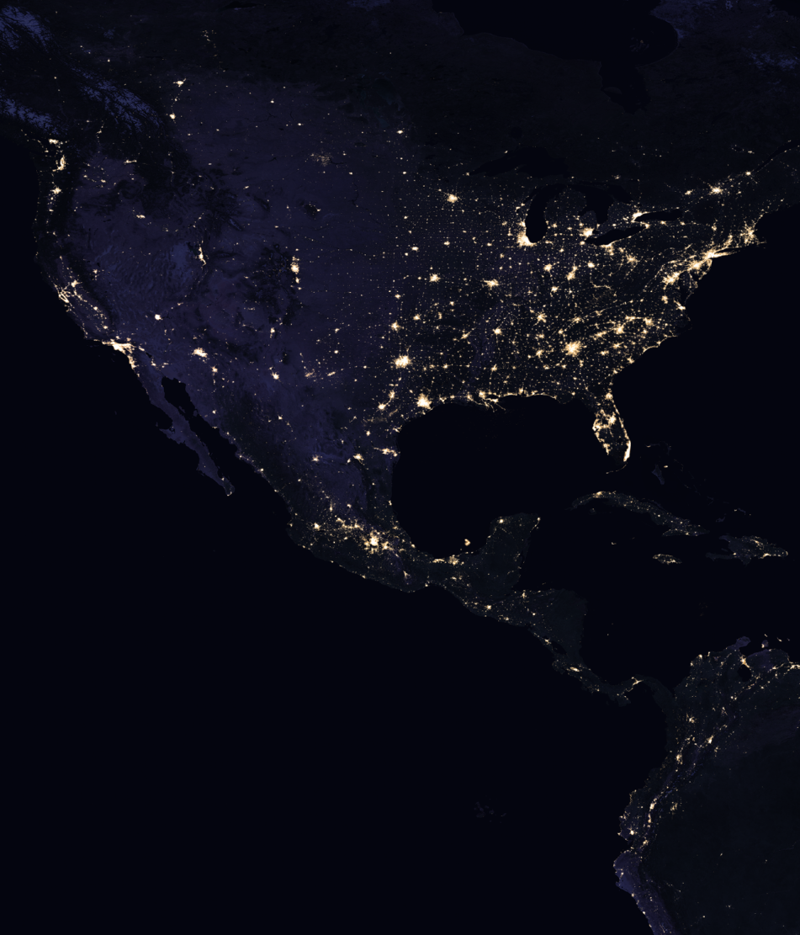
Nighttime Light (NTL) Images
Satellite images that capture artificial light emissions on Earth at night
  Include city lights, roads, industrial areas, fishing fleets, and even some natural events
  Many applications, e.g., urbanization monitoring, disaster risk assessment and response monitoring, and power outage detection
Focus on NASA’s Black Marble Day/Night Band (DNB) sensors on the Visible Infrared Imaging Radiometer Suite (VIIRS)
  High temporal resolution: 1-day revisit rate
  Low spatial resolution: 500m GSD
Localized analysis limited by spatial resolution
  Trade-off between spatial resolution and revisit rate
  How can we mitigate this?
Image Credit: NASA's Goddard Space Flight Center
Source: https://svs.gsfc.nasa.gov/30876/#media_group_330578

Slide 3
NTL Super-Resolution
Recover a high-resolution (HR) NTL image from its low-resolution (LR) NTL counterpart
Enables finer-grained analysis and more accurate assessment

Slide 4
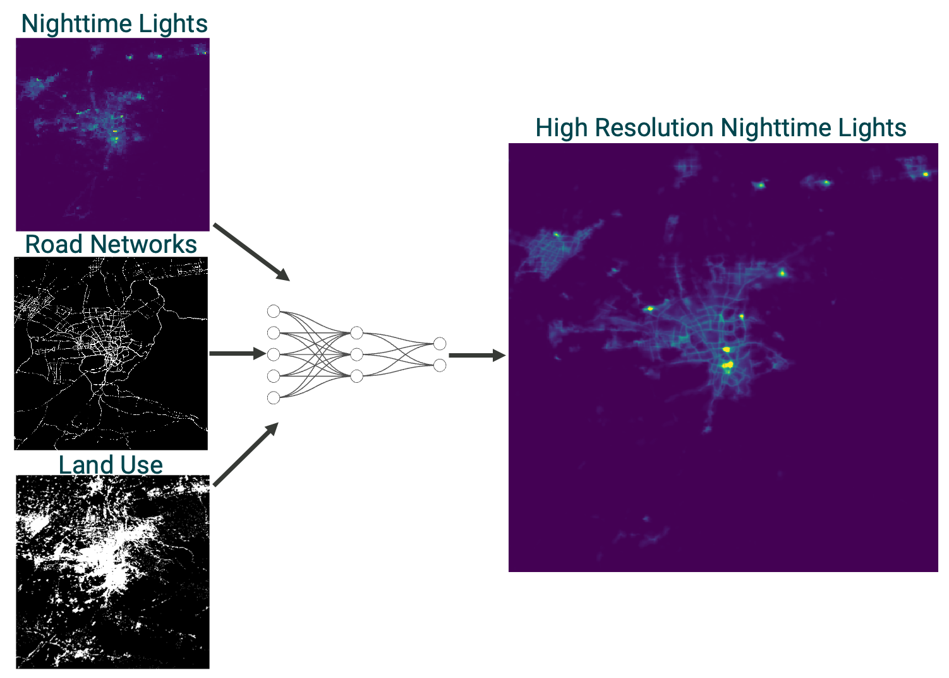
Multimodal Super-Resolution (MMSR)
Train a network that learns to integrate information from multiple, correlated imaging modalities when super-resolving the LR NTL image

Slide 5
Multimodal Data
LR NTL images: NASA’s Black Marble images
  In-operation: Operational from 2012 until present
  High temporal resolution: Daily revisit rate
  Low spatial resolution: 500m GSD
HR NTL images: Luojia 1–01 dataset
  Not in-operation: Operational from 2018-2019
  Low temporal resolution: 15-day revisit rate
  High spatial resolution: 130m GSD
Auxiliary modalities: binary images at 130m GSD
  Land-use from DynamicWorld: classifies land cover into 10 categories, of which we use the ‘built’ class to correlate with lights
  Road networks from Open Street Map (OSM): includes network of nodes indicating roads, buildings, etc., of which we use road nodes to correlate with lights

Slide 6
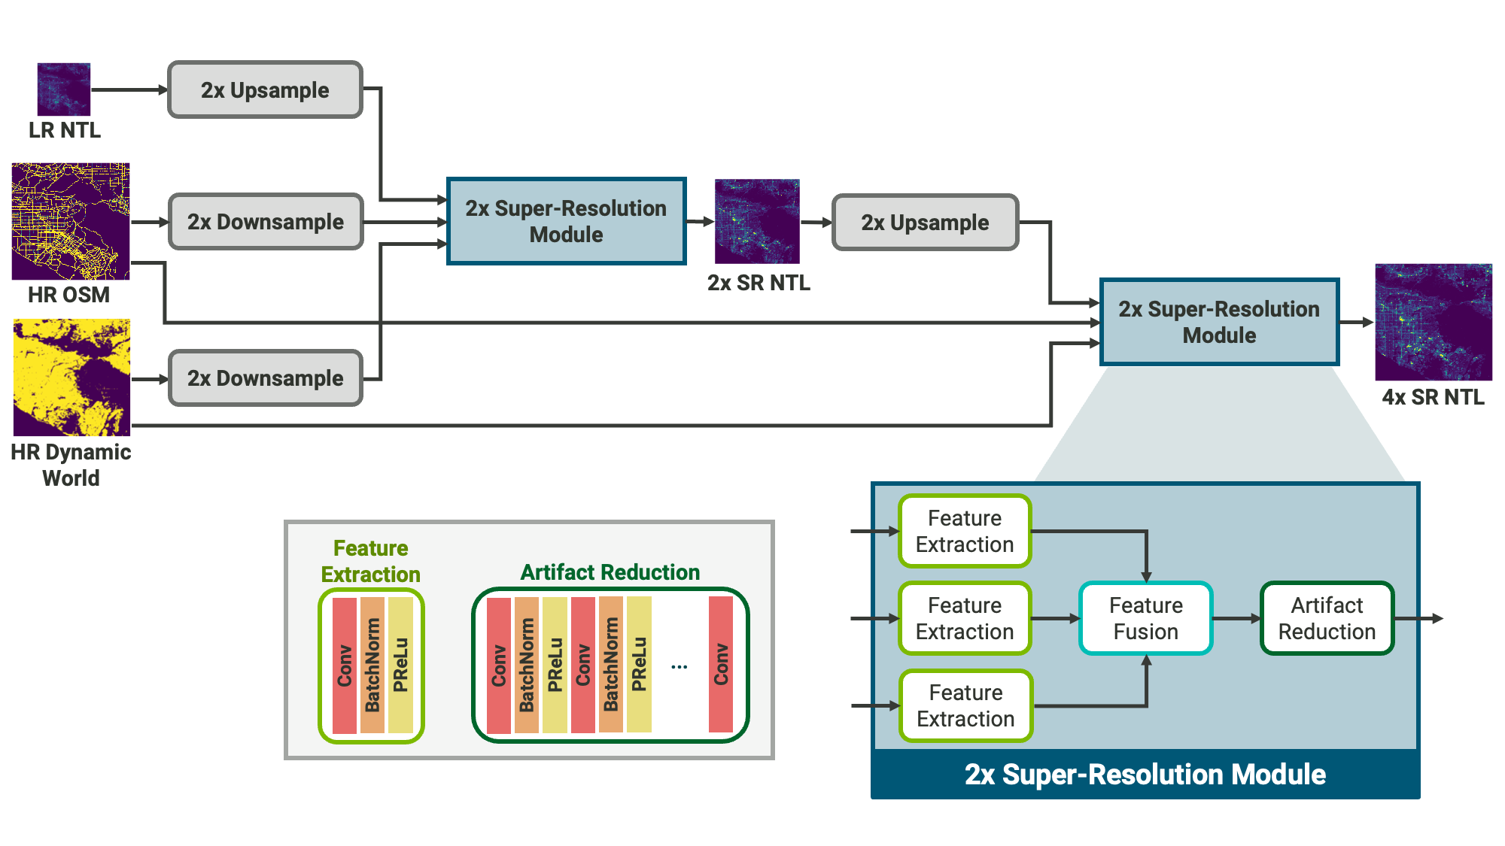
Pipeline of Proposed MMSR Method

Slide 7
Visual Comparison of Super-Resolution Results
HR Dynamic World
HR Open Street Map
SRCNN
EDSR
LR Black Marble
HR Luojia 1-01
SRResNet+
MMSR

Slide 8
Puerto Rico Case Study: 2025 New Year’s Power Outage
Outage on December 31, 2024 caused by line failure in transmission system
Affected 1.2 million customers with majority of island experiencing a blackout
LR Black Marble before outage (average over December)
LR Black Marble during outage (January 1)
HR MMSR before outage (average over December)
HR MMSR during outage (January 1)

Slide 9

Puerto Rico Case Study: Outage Index
Measure of the percentage of light lost (relative to month of December)
$$\text{Outage}=\frac{NTL_{\text{December}}−NTL_{\text{Jan}\text{. 1}}}{NTL_{\text{December}}} × 100\%$$
LR Black Marble Outage Index
HR MMSR Outage Index

Slide 10
Puerto Rico Case Study: Locations with High Variance
High standard deviation of light may indicate an unreliable power supply
Temporal instability in Puerto Rico over December and January
  Red dots indicate points where the standard deviation exceeds twice the mean value
  MMSR offers more localized assessment of unstable locations
LR Black Marble High Variance Points
HR MMSR High Variance Points

Slide 11
Key Takeaways
Our MMSR method leverages land-use and street map data to generate high-quality, artifact-free super-resolved images that preserve both input structure and HR detail.
Our MMSR method does not hallucinate features that are not present in the NTL images.
Preliminary case study results imply that our MMSR method can help to localize power outage detections.

Slide 12
Future Directions
More thorough investigation of impact on power outage detection
  Preliminary results suggest MMSR can aid in detecting and localizing outages
  Include existing outage prediction models in pipeline
Further refinement of MMSR method
  Incorporate more auxiliary data (e.g., NDVI, VIIRS bands)
  Explore advanced architectures (e.g., transformers, residual networks)
  Integrate learned image registration/deformation for better alignment
Integrate temporal data into super-resolution
  Combine MMSR with temporal data for improved super-resolution
  Use alternative satellites (e.g., SDGSAT-1, EROS-B) due to Luojia 1-01's limitations

Slide 13
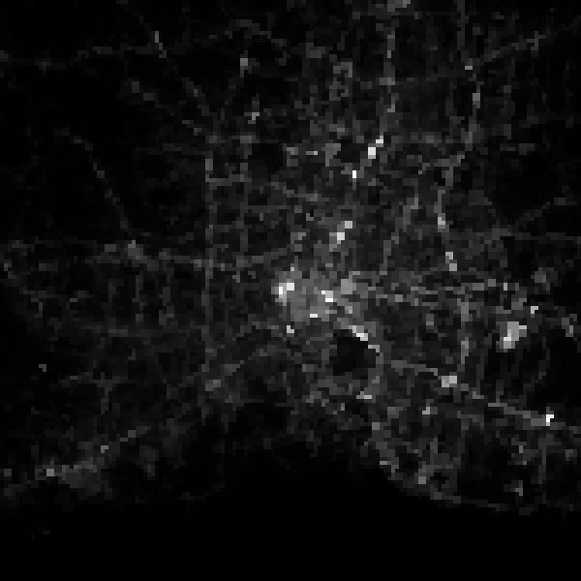
Thank you!
If you want to learn more…
  A detailed report will be available through OSTI
  Our dataset will be available on ORNL’s Constellation
  Code is available upon request (hosted on Gitlab)
Feel free to email me and/or any of the team members
  Haley Sullivan, sullivanhe@ornl.gov
  Tony Allen, allentg@ornl.gov
  Emma Reid, reidej@ornl.gov

Slide 14
Histogram Distribution Comparison of MMSR Result
Comparison between HR and LR NTL images
Comparison between HR and SR NTL images

