Slide 1
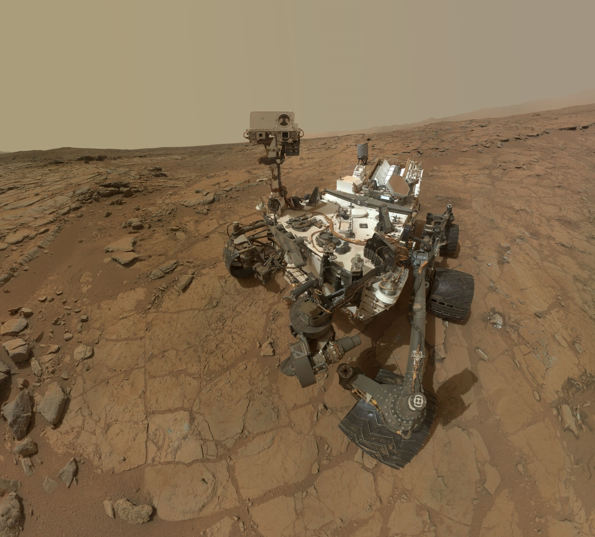

Helping to Land a Mars Rover
-Trent Hare
Image: NASA/JPL-Caltech/Malin Space Science Systems

Slide 2
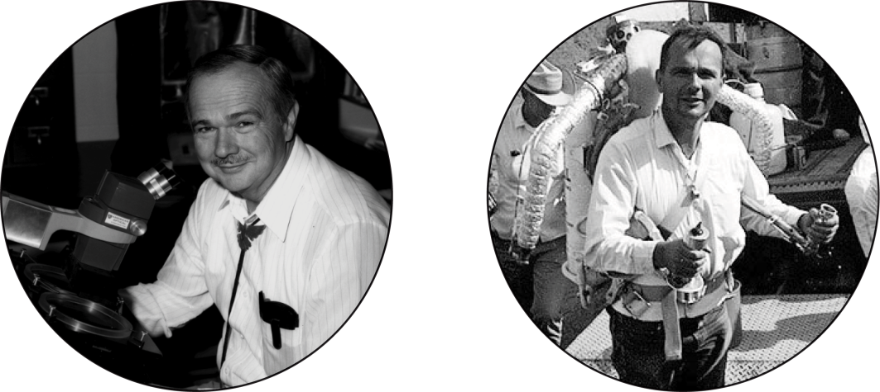
Astrogeology - USGS
Founded in 1963 by Dr. Eugene M. Shoemaker
    2023 - 60-year anniversary
Mission -- to support U.S. Space Program
  Lunar Geologic Mapping
  Lunar Landing Site Characterization (now Mars)
  Training Astronauts in Field Geology and Techniques

Slide 3
Astrogeology - Standards
Help to facilitate:
Planetary Geodesy - define size of planetary bodies (IAU)
Planetary Nomenclature – names of planetary features (IAU)
Geologic Mapping – Publication, GIS, templates (USGS, FGDC)
PDS – data publication, documentation, archives (NASA)
Planetary Cartography / Mapping (MAPSIT / NASA)
Mapping / Web Standards (OGC – Open Geospatial Consortium)
GIS Format Standards (GeoTiff/COG, GeoPackage, WKT2 projections, STAC – most sponsored by OGC)
Help with Camera Sensor Model (CSM) Working Group

Slide 4
Lessons Learned (over 35 years)
Help make the DATA the focus
“Analysis-ready” (ARD) products are critical
  -- to produce…
  -- and release…
Support Open Standards and Open Source widely beneficial
  -- adapting standards/technology is almost always better than inventing
Always credit data providers
  -- but two-way street, data providers need good metadata!

Slide 5
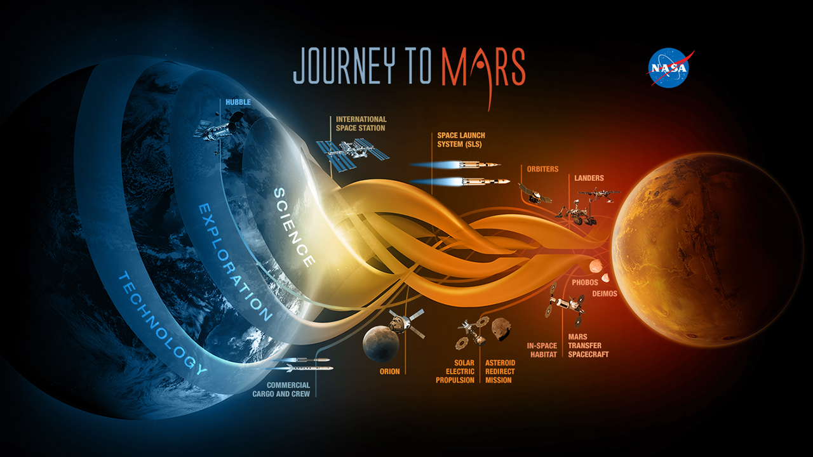
Image: NASA

Slide 6
Previous landing site support for
Mars Pathfinder (late 90’s)

Slide 7
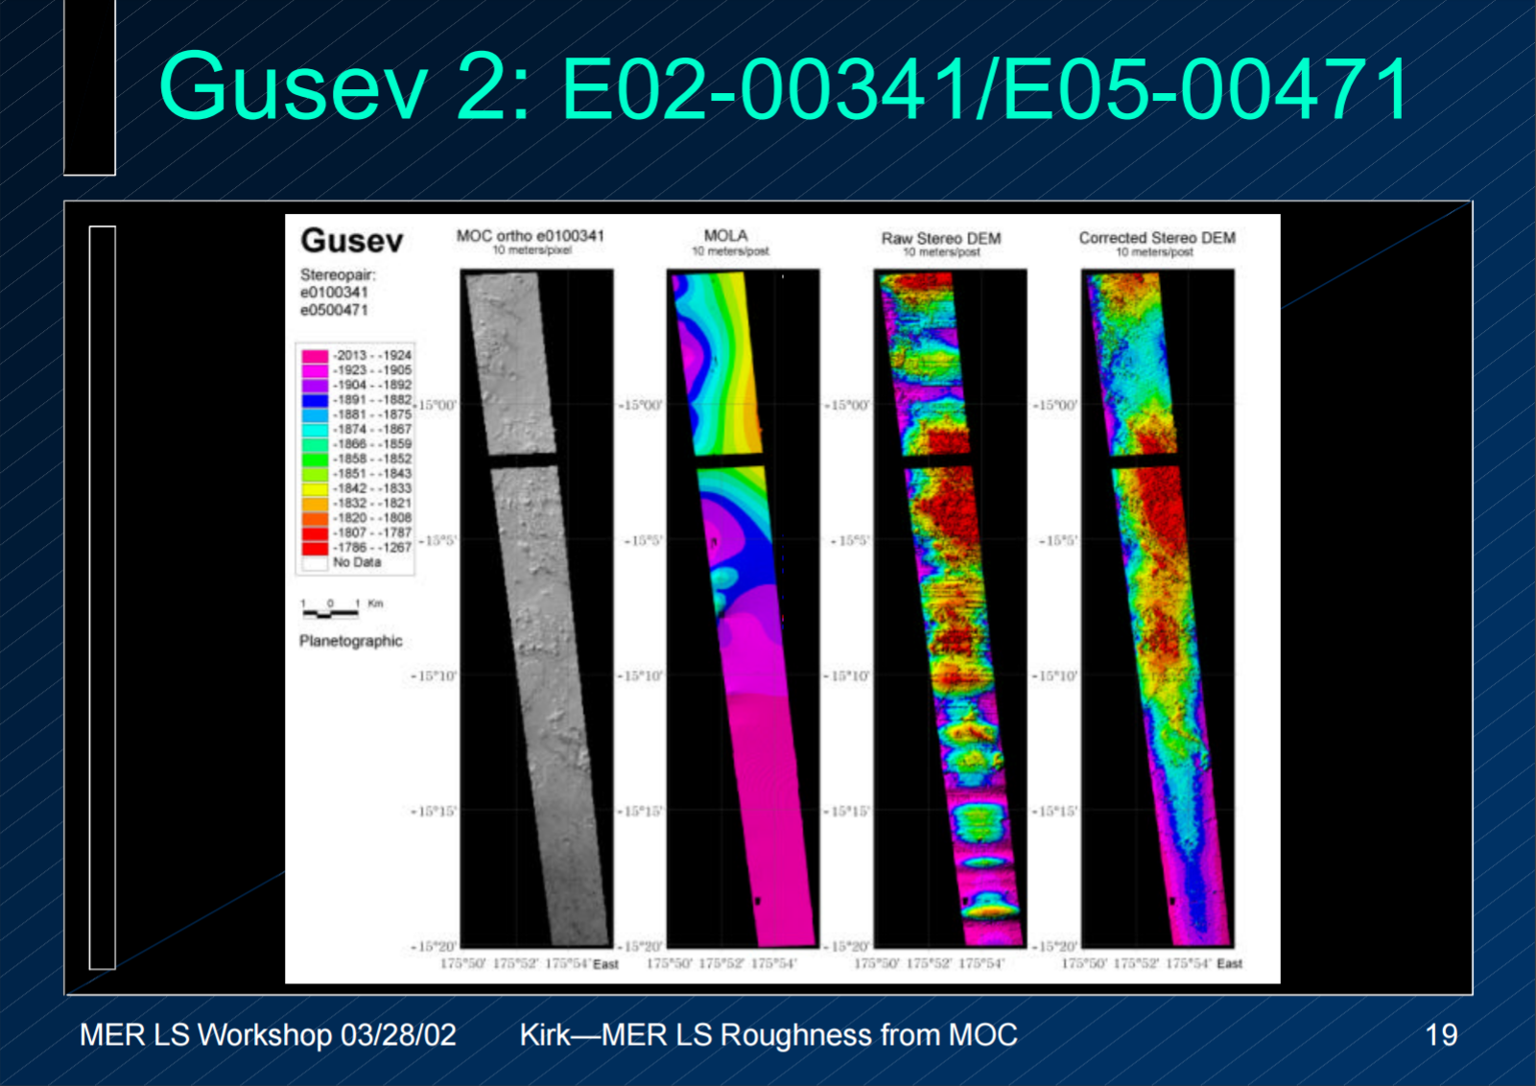

Slide 8
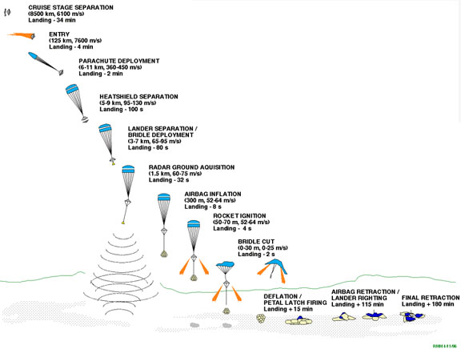
“Simple”
Entry and
Descent

Slide 9
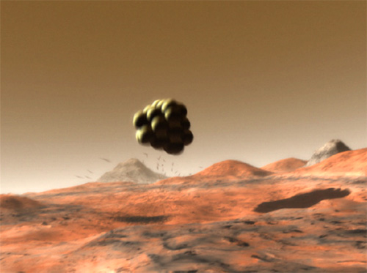
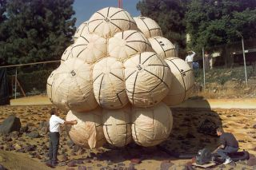
Bouncing Airbag Entry!

Slide 10
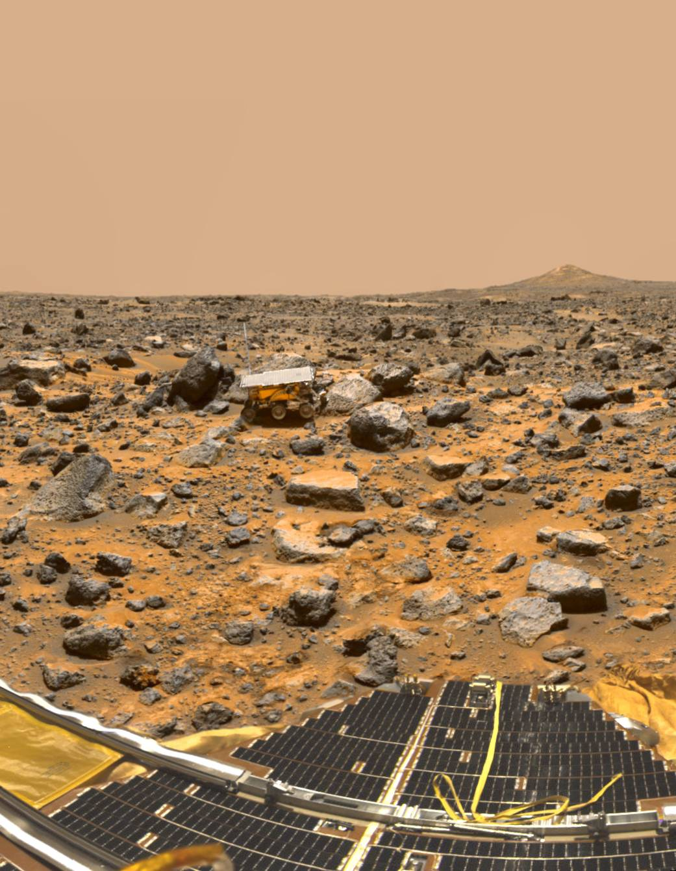
Landing site support for
Mars Pathfinder
Sojourner rover is 10.6 kg Mars rover
Mars' Ares Vallis
on July 4, 1997.
Image: NASA

Slide 11
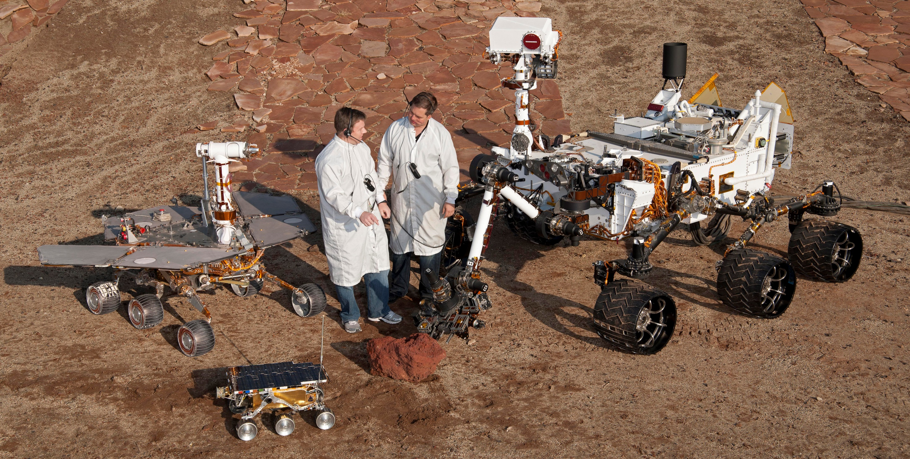

Slide 12
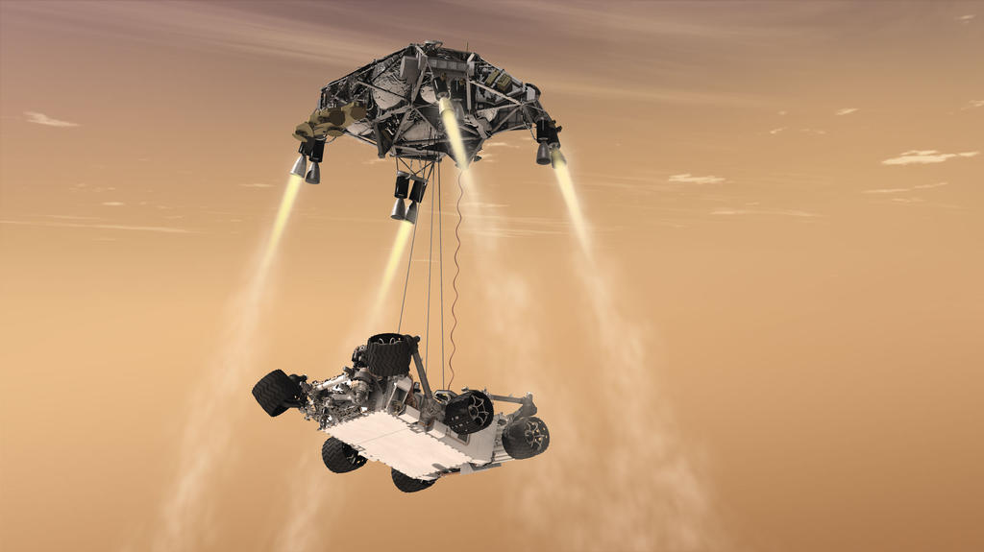
Landing Evolved: 2020 Perseverance Rover (1025 kg)
The Mars 2020 Rover used an entry descent and “Skycrane” landing technique pioneered by the Curiosity Rover.
However, the mission is incorporating major new technologies that improve entry, descent, and landing: Range Trigger, Terrain-Relative Navigation (TRN) with EDL cameras and microphone.
Image: NASA
Notes:
Items on Mars 38% less so Perseverence ~400kg on Mars

Slide 13
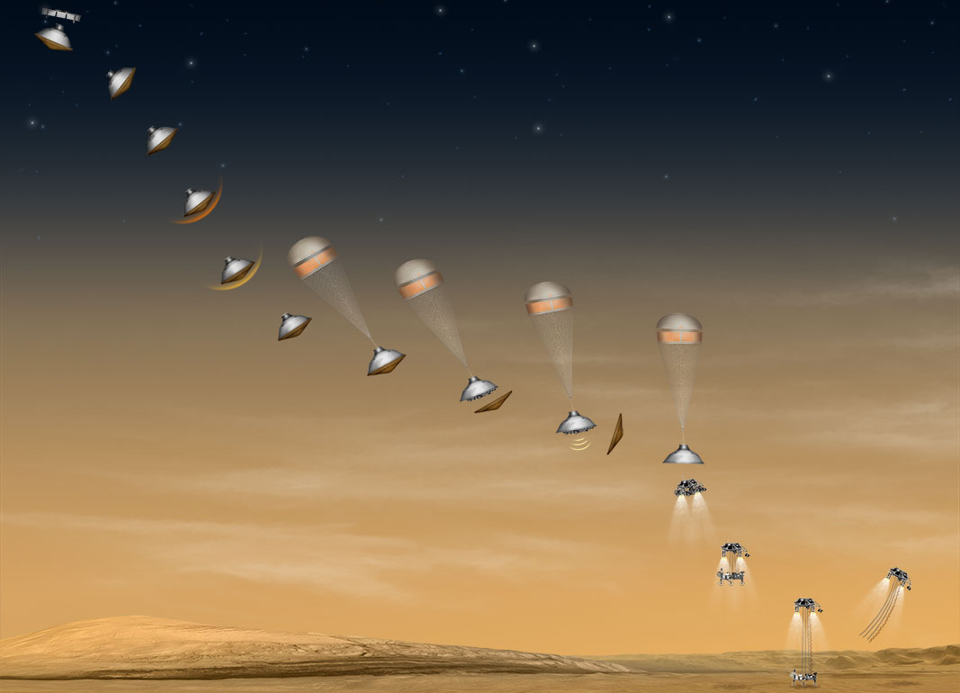
2020 Rover Landing:
Entry, Descent, and Landing (EDL) Cameras and Microphone
Mars 2020 has a suite of cameras that can help engineers understand what is happening during one of the riskiest parts of the mission: entry, descent, and landing.
The Mars 2020 EDL system also includes a microphone to capture sounds during EDL, such as the firing of descent engines.
Notes:
The Mars 2020 rover is based heavily on Curiosity's successful mission design, but Mars 2020 adds multiple descent cameras to the spacecraft design.
The camera suite includes: parachute "up look" cameras, a descent-stage "down look" camera, a rover "up look" camera, and a rover "down look" camera.
In addition to providing engineering data, the cameras and microphone can be considered "public engagement payloads." They are likely to give people on Earth a good and dramatic sense of the ride down to the surface! Memorable videos depicting EDL's "Seven Minutes of Terror for the 2012 landing of NASA's Curiosity Mars rover went viral online, but used computer-generated animations. No one has ever seen a parachute opening in the Martian atmosphere, the rover being lowered down to the surface of Mars on a tether from its descent stage, the bridle between the two being cut, and the descent stage flying away after rover touchdown!

Slide 14
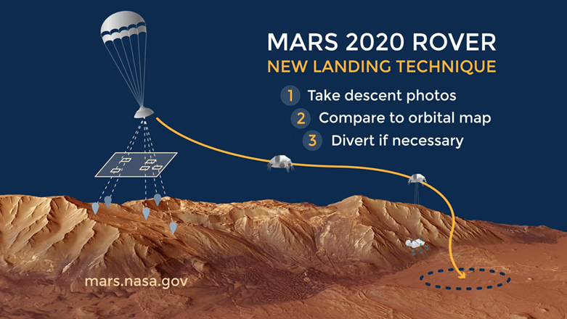
2020 Rover Landing:
Terrain–Relative Navigation (TRN)
Some of the most interesting places to explore lie in tricky terrain. Using terrain relative navigation, allowing it to land in more landing sites with far less risk.
Until now, many of these potential landing sites have been off-limits. The risks of landing in challenging terrain were much too great. Using Terrain-Relative Navigation, the Mars 2020 rover will estimate its location while descending through the Martian atmosphere on its parachute.
Image: NASA
Notes:
In prior missions, 99% of the potential landing area (the landing ellipse) had to be free of hazardous slopes and rocks to help ensure a safe landing. The spacecraft carrying the rover estimated its location relative to the ground before entering the Martian atmosphere, as well as during entry, based on an initial guess from radiometric data provided through the Deep Space Network.. That technique had an estimation error prior to EDL of about 0.6 - 1.2 miles (about 1-2 kilometers), which grows to about (2 - 3 kilometers) during entry.
Using Terrain-Relative Navigation, the Mars 2020 rover will estimates its location while descending through the Martian atmosphere on its parachute. That allows the rover to determine its position relative to the ground with an accuracy of about 200 feet (60 meters) or less.
How it works:
Orbiters create a map of the landing site, including known hazards.
The rover stores this map in its computer "brain."
Descending on its parachute, the rover takes pictures of the fast approaching surface.
To figure out where it's headed, the rover quickly compares the landmarks it "sees" in the images to its onboard map.
If it's heading toward dangerous ground up to about 985 feet (300 meters) in diameter (about the size of two professional baseball fields side by side), the rover can change direction and divert itself toward safer ground.

Slide 15
Mars 2020 Mission Objectives
Conduct Rigorous In Situ Science
  Geologic Context and History Carry out an integrated set of context, contact, and spatially-coordinated measurements to characterize the geology of the landing site
  In Situ Astrobiology Using the geologic context as a foundation, find and characterize ancient habitable environments, identify rocks with the highest chance of preserving signs of ancient Martian life if it were present, and within those environments, seek the signs of life
Enable the Future
  Sample Return Assemble rigorously documented and returnable cached samples for possible return to Earth
  Human Exploration Facilitate future human exploration by making significant progress towards filling major strategic knowledge gaps and…
  Technology …demonstrate technology required for future Mars exploration
These are a thoroughly integrated set of objectives to support Agency’s Journey to Mars
15

Slide 16
Terrain Hazards Considered
Rocks - Large dangerous rocks identified through HiRISE imagery and smaller dangerous rocks estimated by analytical models
High slopes - Identified through Digital Elevation Models of the environment
Inescapable areas
  Fresh craters with non-traversable boundaries
  Sand ripples that look very challenging for traversal; identified through HiRISE imagery
Thruster plume interaction
  Bounding analysis for interaction risk with the thruster plume when landing on a given slope
Relief over a 2.5km baseline
  Topographical relief may require more fuel for a safe landing
  A fuel budget constrains the amount of relief we can mitigate

Slide 17
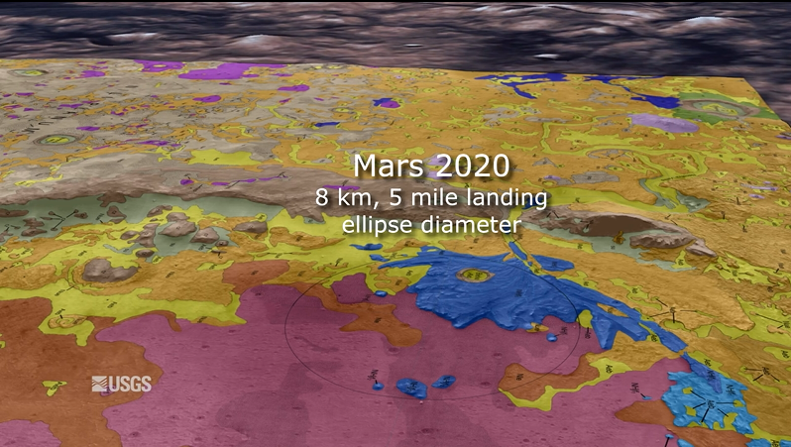
Site Selected: Jezero Crater
Geologic Map: Sun et. al

Slide 18
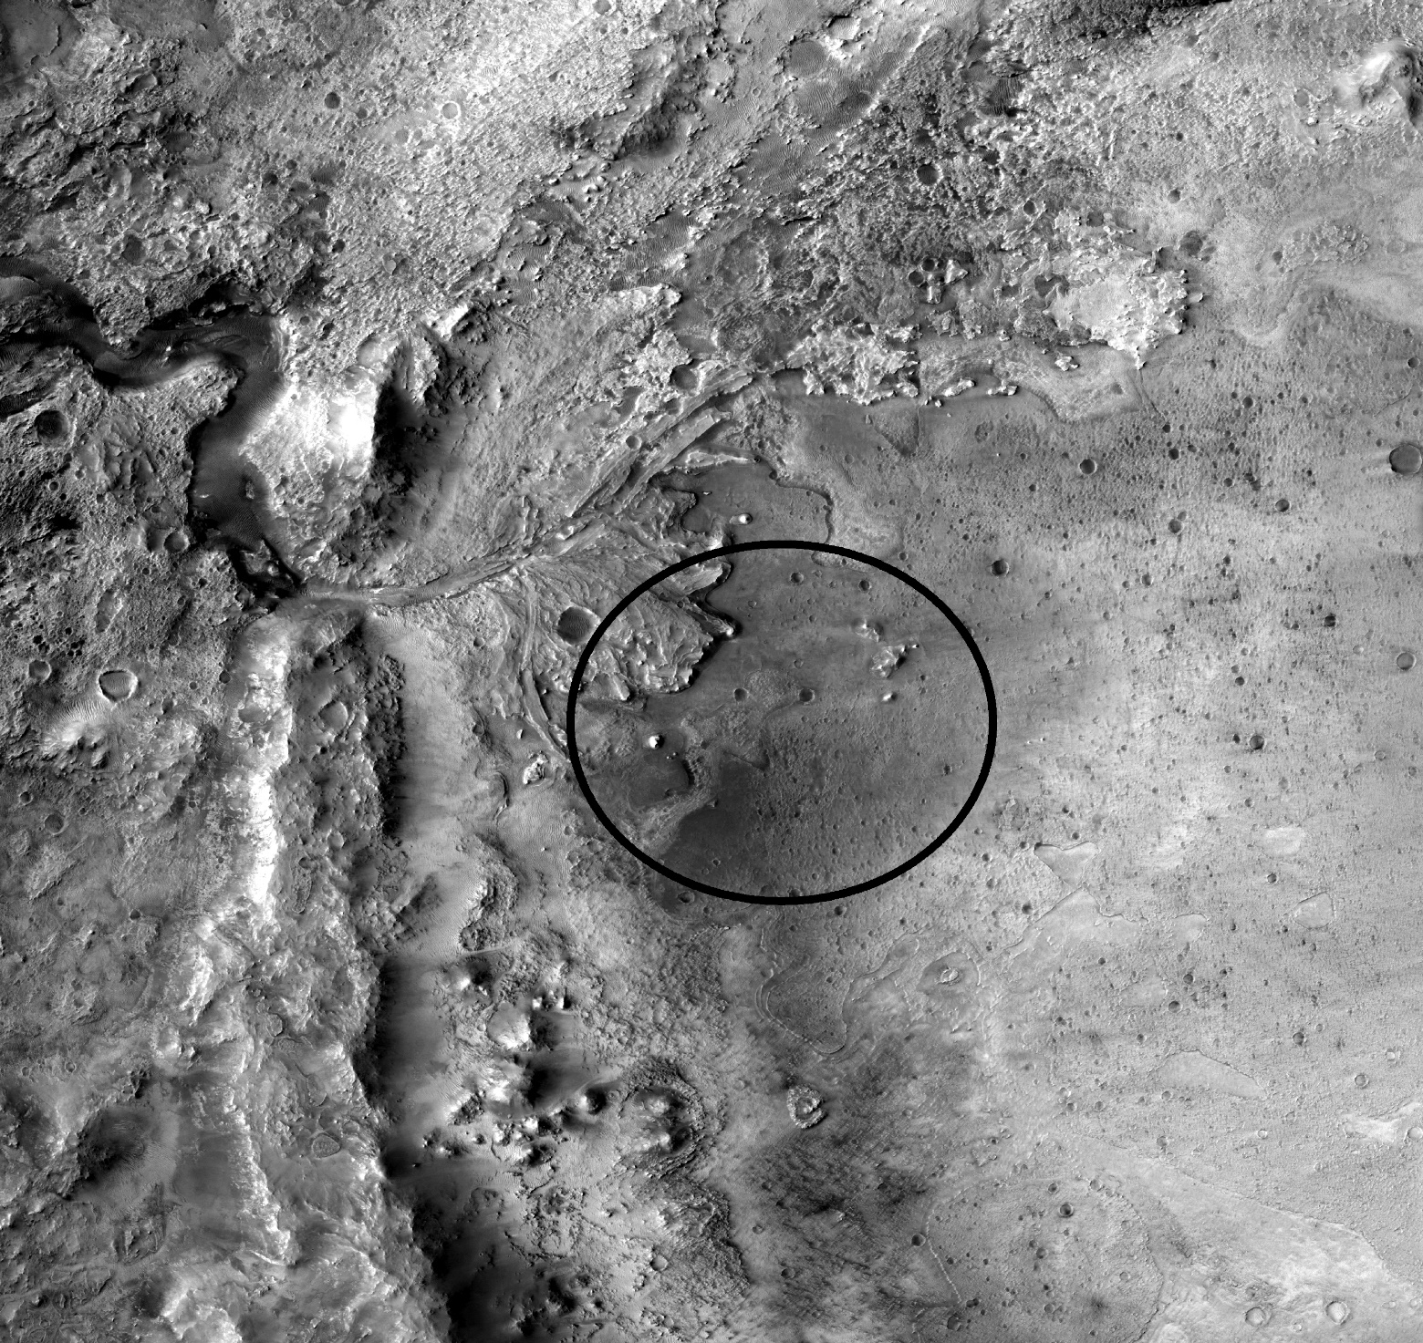
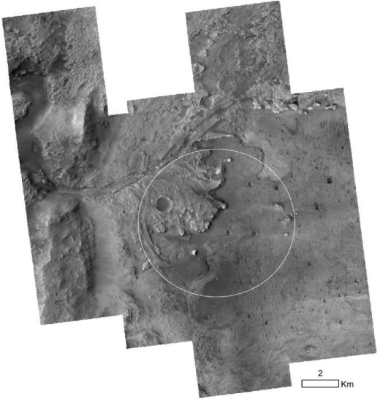
What does this require in terms of data?
** lots of it -- from both NASA and ESA **
Medium-res, 6m/p highly accurate, no internal distortion, context orthorectified mosaic
High-res, 25 cm/p orthorectified mosaic for hazards mask
10 km

Slide 19
Context (CTX) Flight Mosaic for TRN (6m/p)
3
Orthoimage mosaic will be onboard the Mars2020 spacecraft
Considered “truth” when locating the surface landing site during EDL.
Requirements (subset)
  Absolute vertical elevation error less than 20 m (3 sigma) with respect to HRSC L5 DM
  CTX to CTX elevation values will be co-registered to within 6 m (99%-tile)
  Horizontally co-registered to within 60 m (99%-tile) relative to HRSC
  CTX to CTX orthoimages will be horizontally co-registered to within 6 m (99%-tile)
10 km
https://doi.org/10.5066/P906QQT8

Slide 20
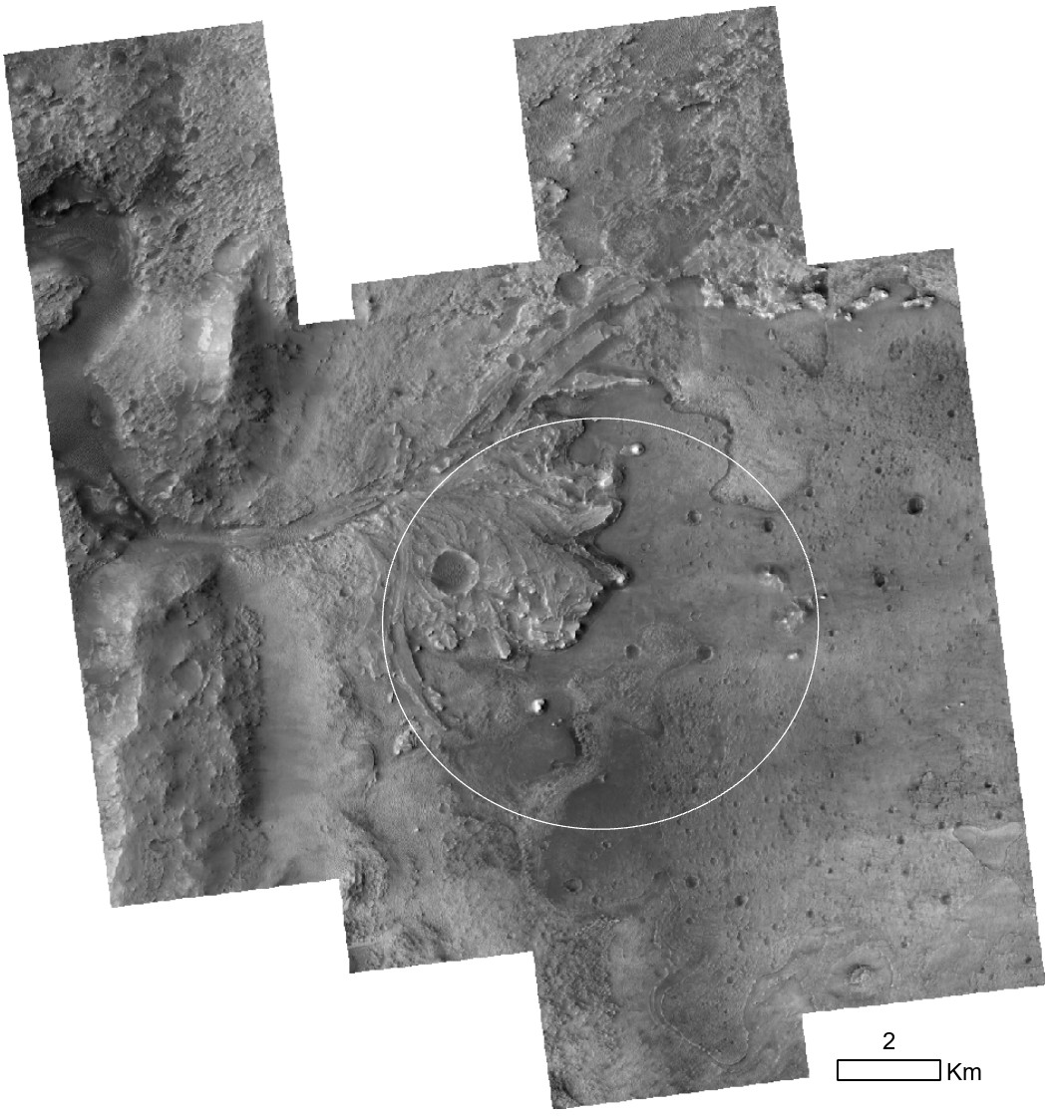
HiRISE Orthomosaic (25cm/p)
15
HiRISE orthomosaic will be the basemap that landing hazards will be mapped upon.
  Pixels will be aligned between the CTX flight mosaic and HiRISE orthomosaic.
Horizontal registration requirements
  HiRISE orthoimage mosaic shall be co-registered to the LVS CTX orthoimage mosaic to a 99%-tile value <6 m.
  HiRISE orthoimage mosaic shall be composed of HiRISE images that are co-registered to their neighboring HiRISE images to a 99%-tile value <3m.
10 km
https://doi.org/10.5066/P9QJDP48
Notes:
In SOCET Set (Standard HiRISE process)
Run a relative bundle adjustment to do a height adjustment to the CTX flight product and initial attempt to remove tilt
Densify, bundle adjust again
Generate 1-meter post-spacing DTM and pass to Ames Stereo Pipeline (ASP)
In ASP (New Process)
Surface-fit procedure
Perform a sequential alignment between each HiRISE DTM and generate a temporary mosaic
Align the temporary mosaic to CTX flight product
Generate updated Ground Point Files (GPFs) for SOCET Set
In SOCET Set (New Process)
Apply the updated GPF to each DTM
Create a single project to build a mosaic in SOCET Set
Apply tie points to each image to get a better relative alignment between images. Run another bundle adjustment
Generate a 1-meter post spacing DTM
Edit the individual DTMs
In ASP (in parallel with editing)
Final check for tilt and vertical and horizontal alignment
Between individual HiRISE images
Between HiRISE and CTX flight product
Determine a final transform to help ensure a best alignment with CTX
Notes:
Sequential alignment between each HiRISE DTM = a rigid 3D alignment (translation + rotation)
We applied a *non-rigid* affine transformation in 2 dimensions (horizontal). This affine transformation includes components for translation, rotation and linear scaling.
We do not plan to add a vertical translation (if we do, it will likely be < 1 meter).

Slide 21
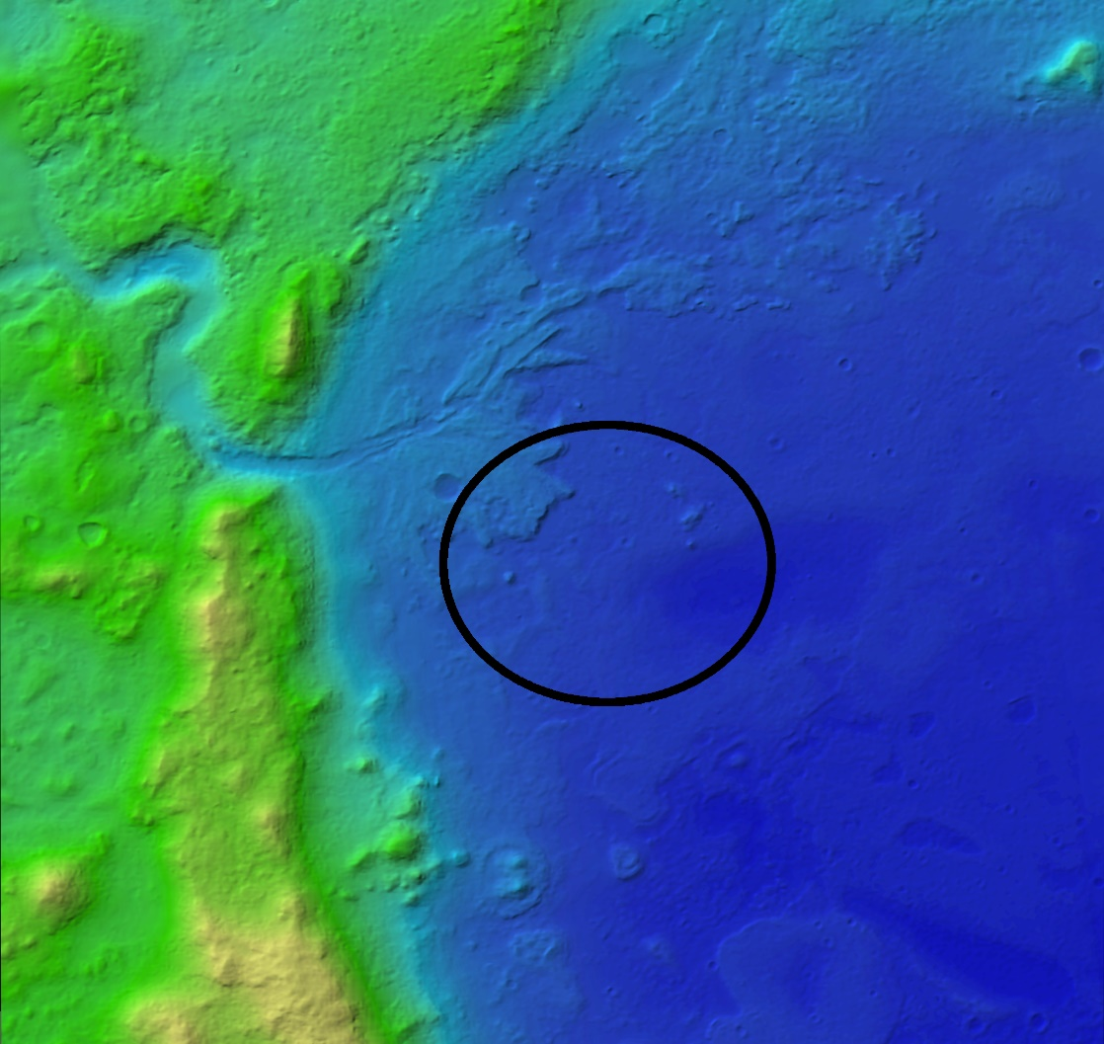
Workflow / Mostly Open-source Software
Context (CTX) and HiRISE Mosaic processing needs
GDAL / OGR / PROJ
USGS ISIS3; JPL NAIF
Integrated Software for Imagers and Spectrometers. Initial image calibration and SPICE (location).
BAE’s SOCET SET
Stereo image triangulation, Z registration, DEM generation
(iterative w/ ASP), Ortho generation.
NASA ASP
NASA Ames Stereo Pipeline. 3D aligns two point clouds, Iterative Closest Point (ICP), to MOLA “lidar”.
(DEM and Ortho blended mosaics)
QGIS/SAGA
Evaluated horizontal registration between orthoimages using IMCORR (normalized cross-correlation). algorithm by NSIDC.
Standards: GeoTIFF, OGC WMS/WMTS, IAU
Color Hillshade
Notes:
In SOCET Set
Used de-jittered CTX images provided by JPL; no bundle adjustment was performed
Generated 1-meter post-spacing DTM and passed to Ames Stereo Pipeline (ASP)
In ASP
Generated an intermediate CTX mosaic for analysis
Previously determined that the vertical alignment between CTX is sub-meter.
Computed the vertical difference between the intermediate mosaic and HRSC using the geodiff program in ASP
Chose the median of the difference raster as the vertical offset to apply to each CTX DTM.
The CTX DTMs vertically aligned to HRSC are then mosaicked using dem_mosaic
The orthoimages were derived from the nadir-most member of each stereopair were mosaicked using dem_mosaic.

Slide 22
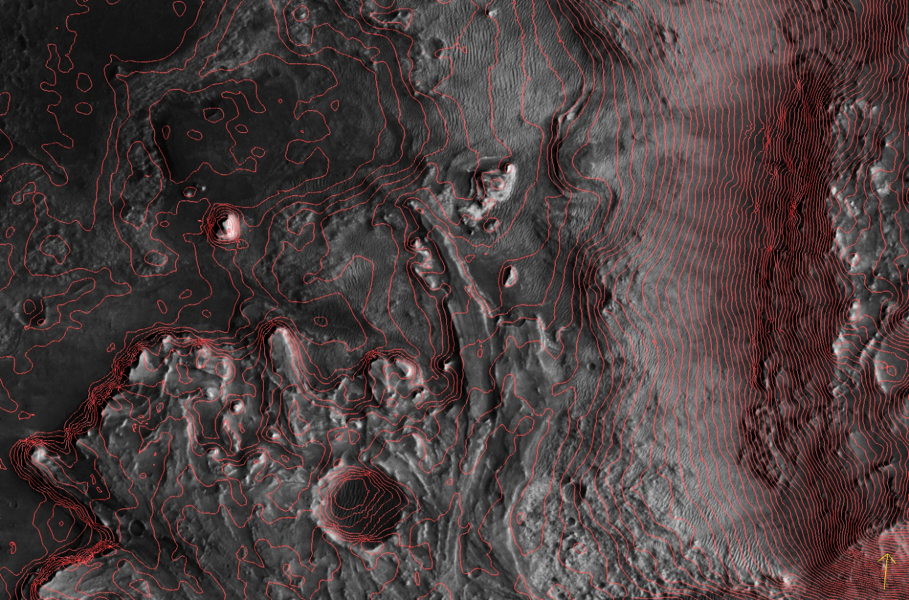
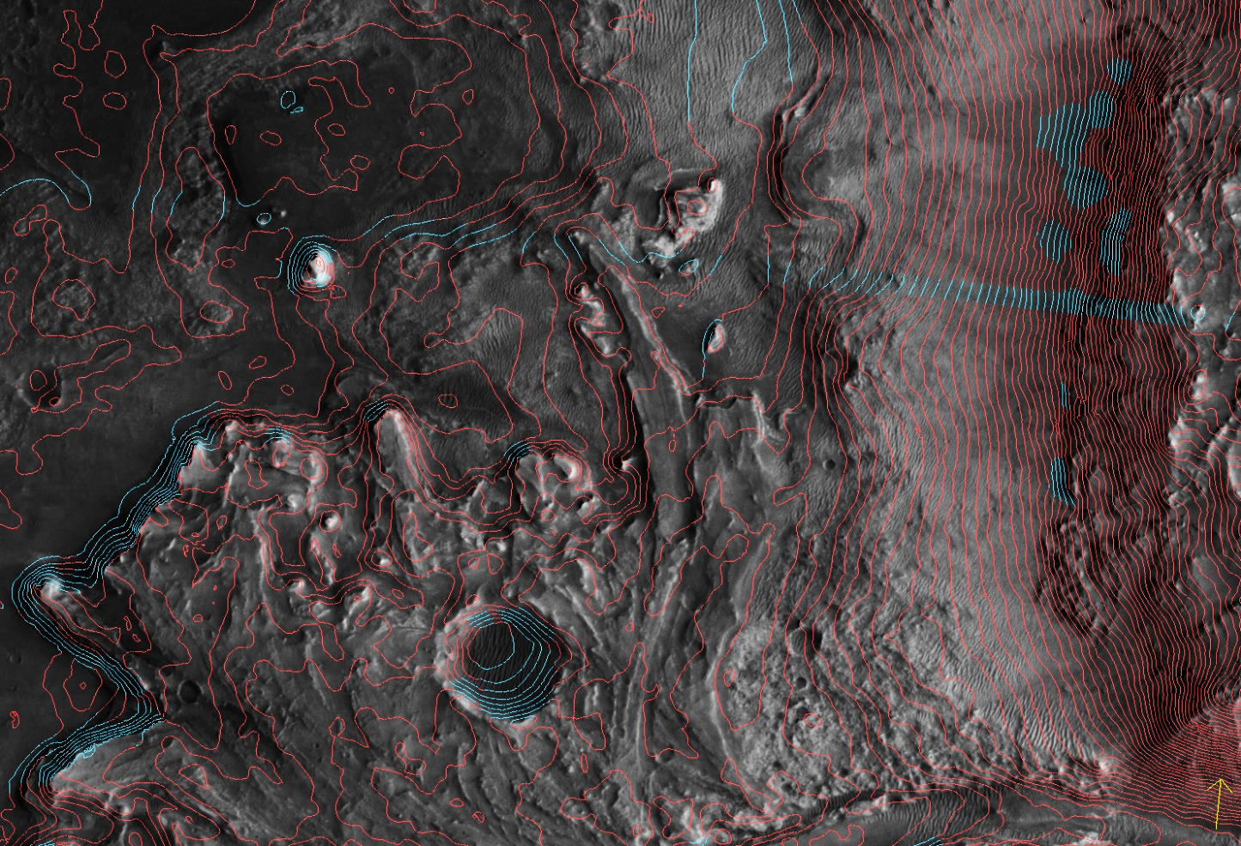
Editing Philosophy and Results
22
Edited the DTM to correct erroneous posts that occur in photogrammetrically-derived DTMs where the stereo photogrammetry software has incorrectly matched features between a pair of images.
Our guiding approach during editing was to correct features in the DTMs while still editing as few posts as possible.

Slide 23
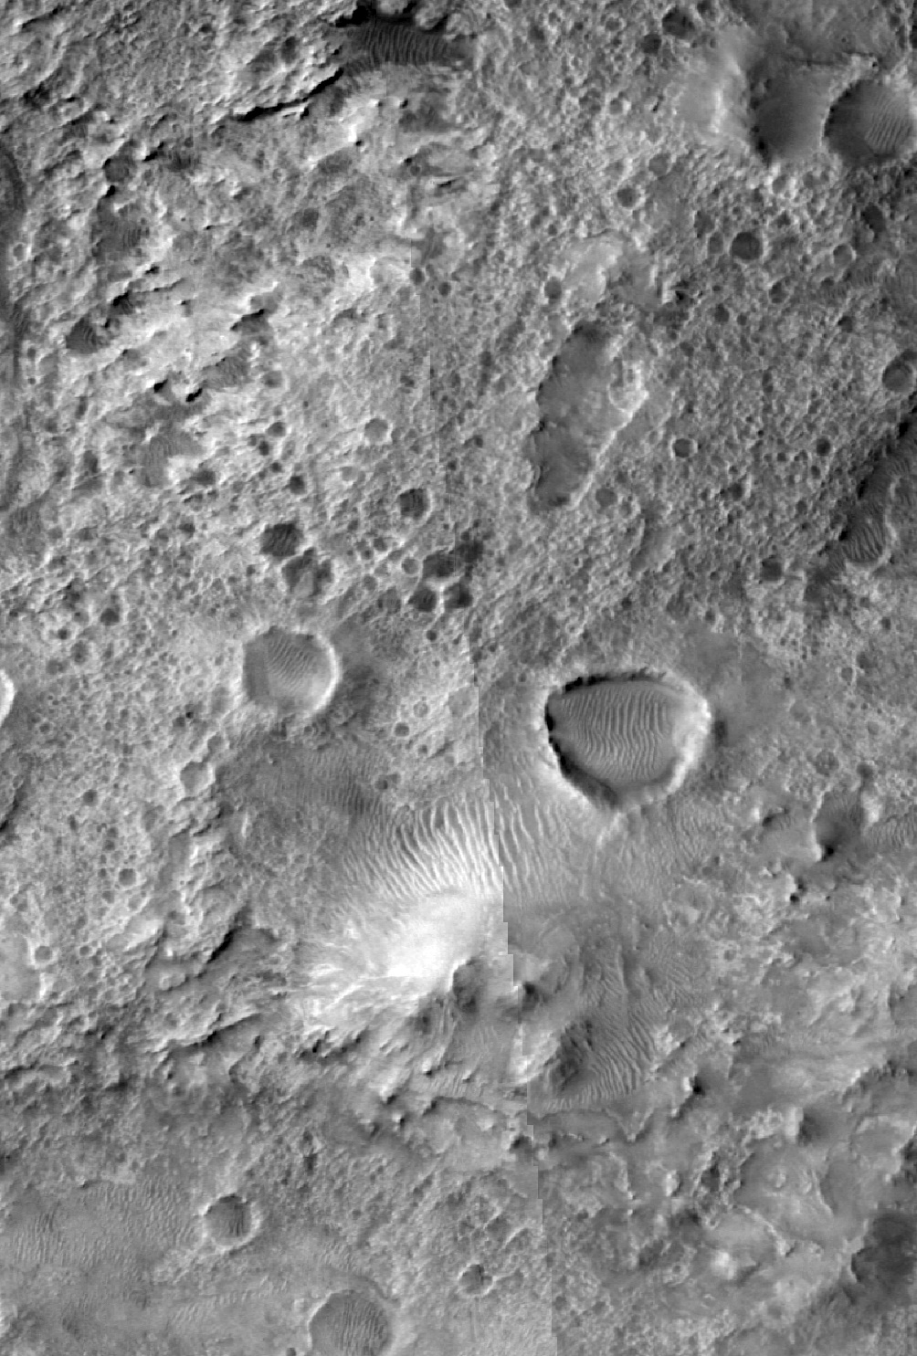
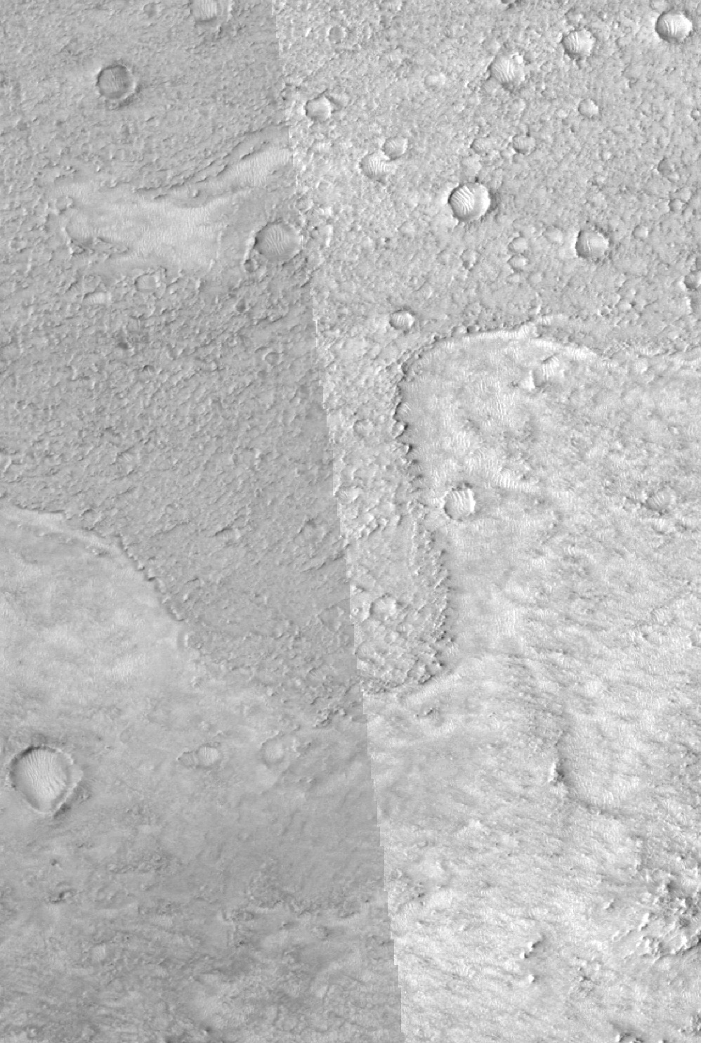
Seam Removal
Tone matching was a manual process to align the tone of the different orthophotos.
  A single value was added to shift J03 and J21 orthos to match F05
Blending was achieved using the dem_mosaic tool in ASP.
  120 pixel linear seam blend was applied to the 6 m orthomosaic.
Images were ordered to to push image seams as far from the center of the mosaic as possible.
820 m
750 m
J21 and J03
J03 and F05

Slide 24
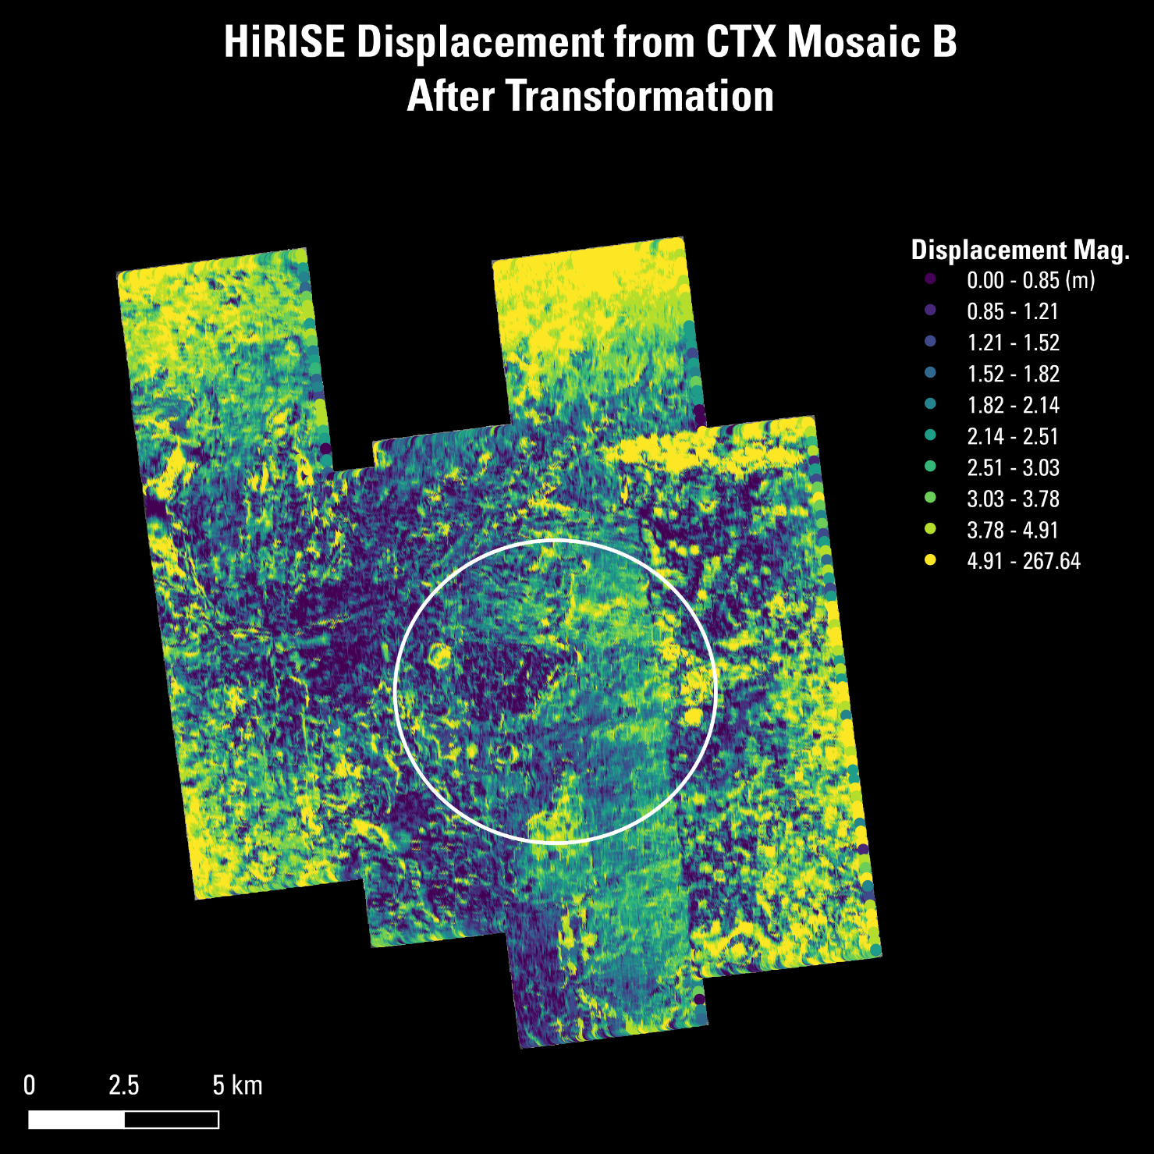
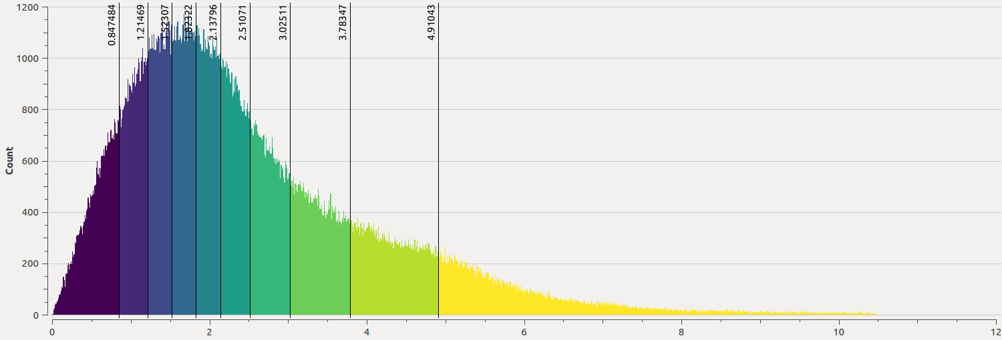
Horizontal Registration Results = HiRISE vs. CTX
24
The median magnitude of displacement of features in the transformed HiRISE orthomosaic from CTX is 2.1 meters.
  95.4% of features are displaced <6 meters.
The affine transformation appears to have eliminated the scale distortion that was present in the initial HiRISE orthomosaic.

Slide 25
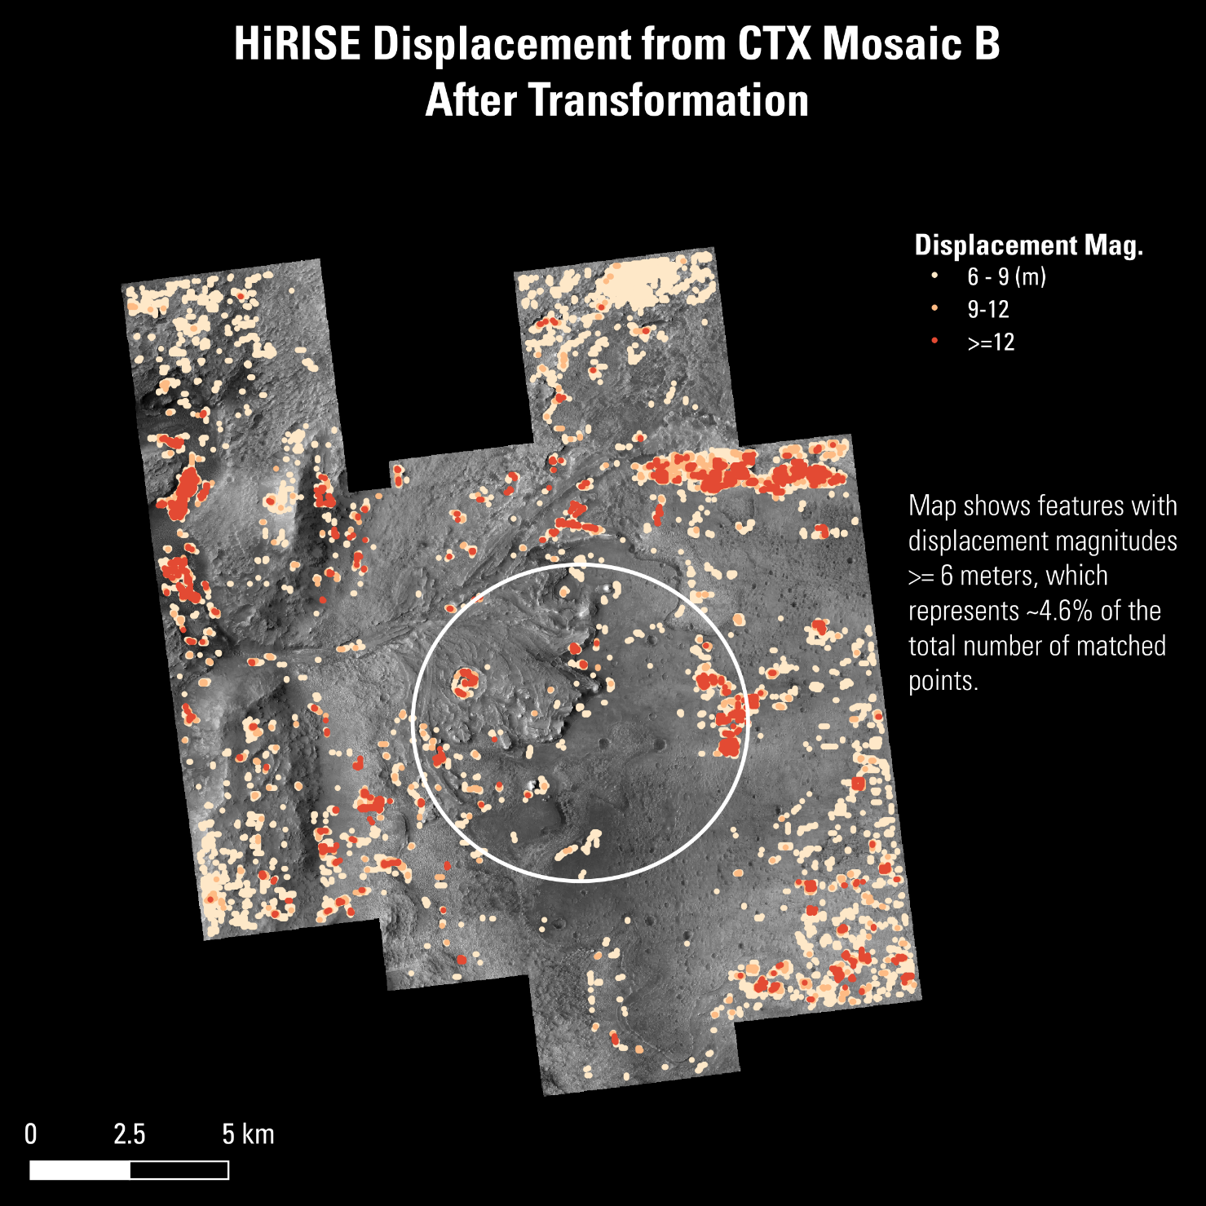
Horizontal Registration Results = HiRISE vs. CTX
25
Image shows the location of matched features with displacement magnitudes >=6 meters.
  Most of them (and nearly all of the points with displacements >9 meters) can be attributed to bad matches in IMCORR
Observations suggest that IMCORR’s estimate that 95.4% of matched features have displacements <6 meters is conservative.
  The actual percentile is closer to the formal requirement of 99%.
Notes:
The solar azimuth in the easternmost HiRISE orthoimage differs by >20 degrees from the solar azimuth in the CTX orthomosaic. This difference can create exaggerated displacement magnitudes in the IMCORR results, particularly in areas with high relief because they tend to cast the longest shadows.
Visual inspection of the HiRISE and CTX images in this area shows that features are actually registered to better than 6 meters.
IMCORR is known to return erroneous matches in areas of repeating terrain, such as rippled bedforms.
Erroneous matches in areas containing rippled bedforms may explain the large displacement magnitudes located inside the channel and along the northern edge of the westernmost HiRISE orthomosaic.
The cluster of matched points in the north-central region of the mosaic with displacements between 6 and 9 meters appear to represent real displacements between the HiRISE and CTX images, but these points represent <0.6% of the total number of matched features.

Slide 26
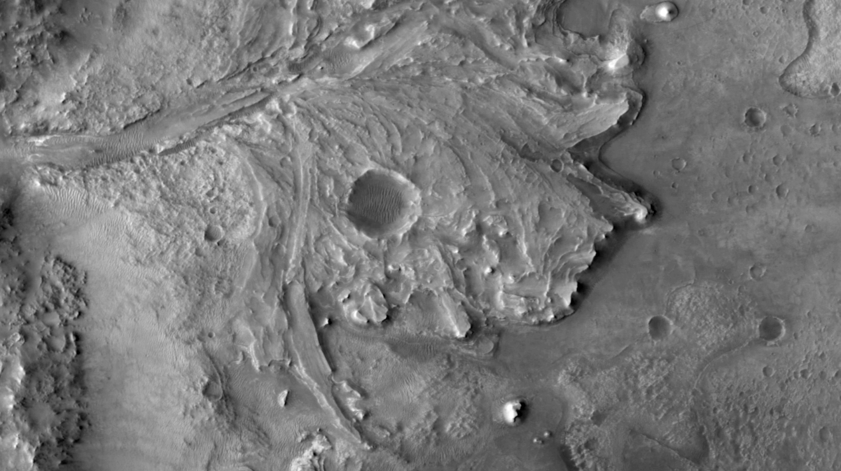
Horizontal Registration Results
HiRISE (25cm) vs. CTX (6m)
25

Slide 27
In Conclusion - we landed Safely
25
https://mars.nasa.gov/mars2020/multimedia/videos/?v=461
video: NASA

Slide 28
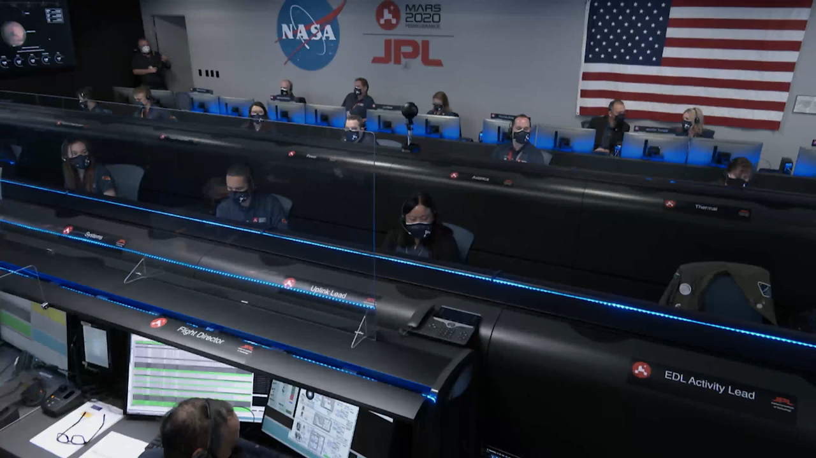
25

Slide 29
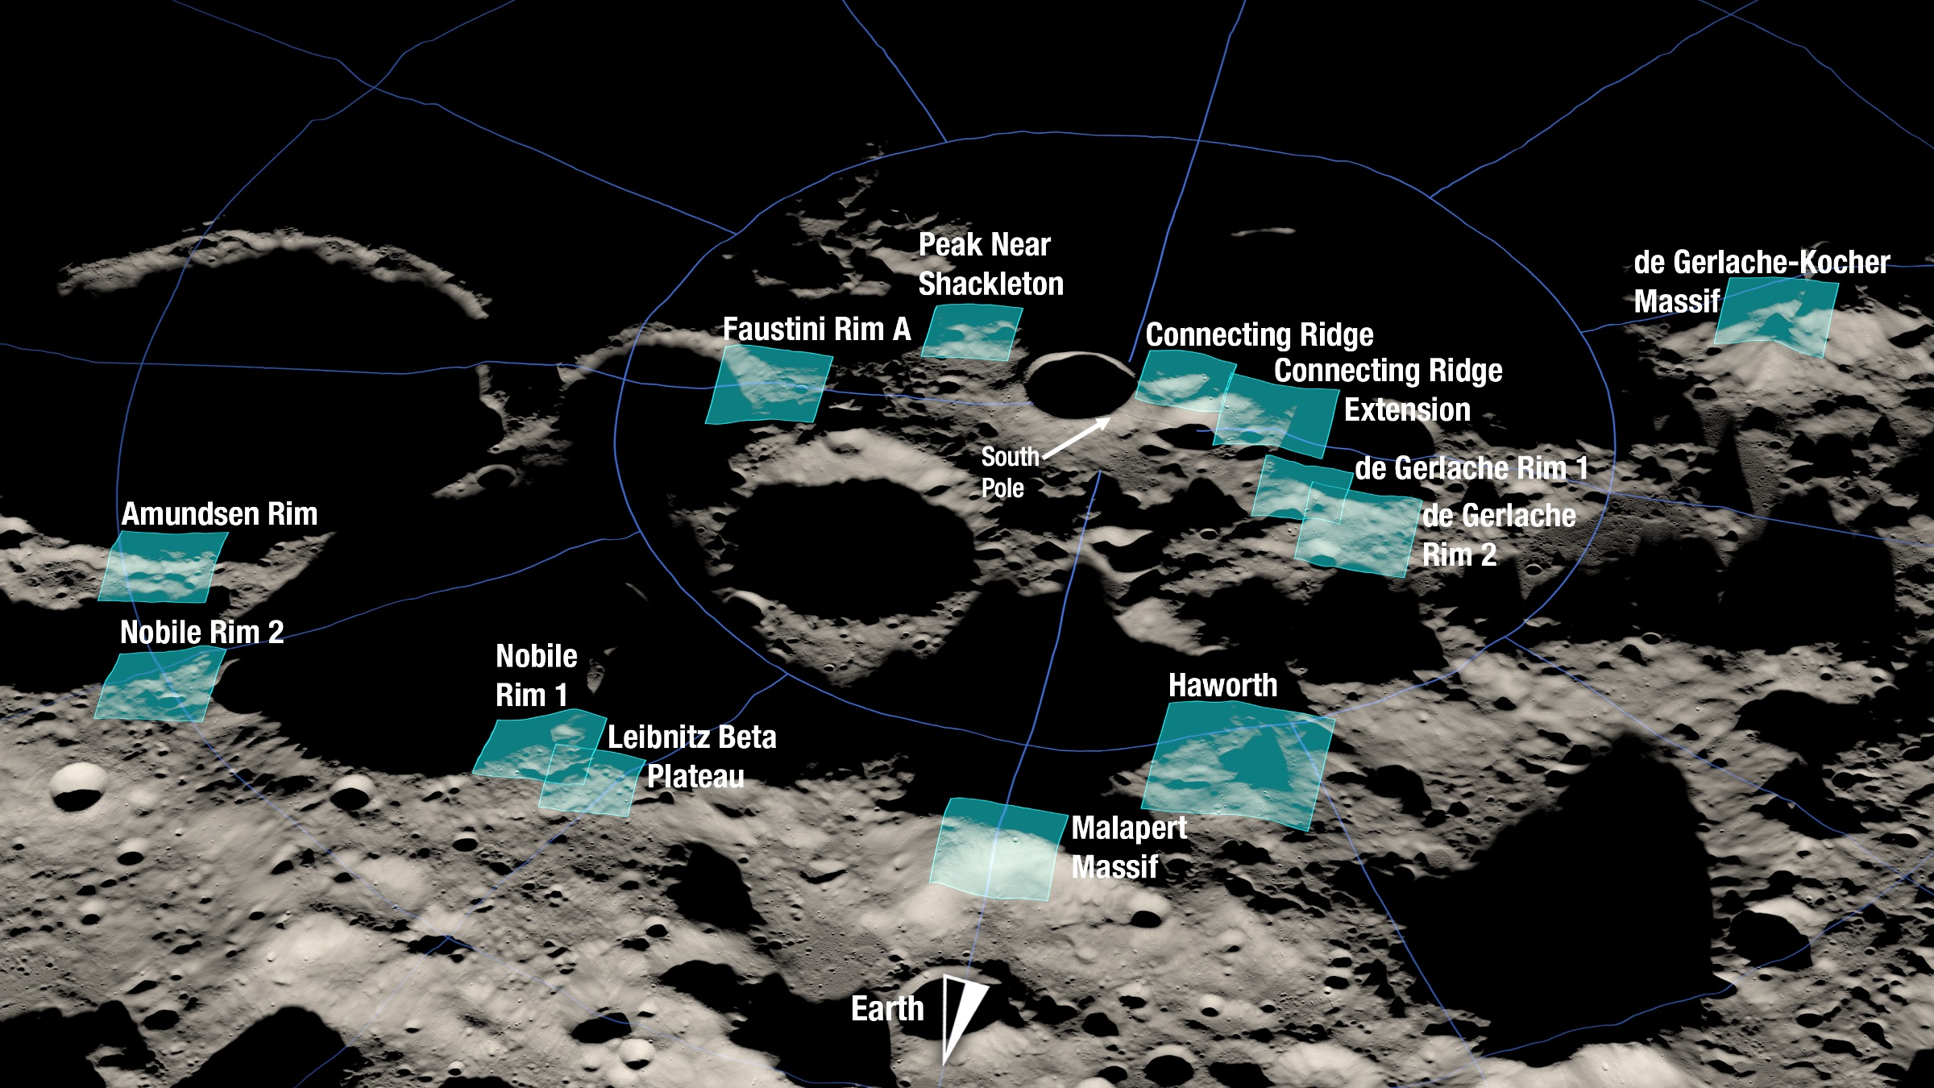
Next TRN – The Moon
25
Image: NASA

Slide 30
Ongoing CSM Work at USGS (Astrogeology)
backup slides
from Jan 2022, Community Sensor Model Working Group

Slide 31
USGS Planetary Mapping:
Modern Period, 1996–Present
ISIS (Integrated Software for Imagers and Spectrometers v3-7)
  Data support, calibration, rigorous camera models and control
Responsible for control networks (previously RAND)
Photogrammetry (topographic generation)
  Mapping Venus, Moon, Mars, asteroids, comets…
  2D Photoclinometry integrated w/ stereo
Data archive/distribution
GIS tools and geologic mapping support

Slide 32
Challenges of Planetary Mapping
Problems of definition
  What is the body size or prime meridian?
  What is “sea level”?
Problems of data quality
  Irregular/incomplete data coverage, especially in stereo
  Poor spatial resolution
  No existing control networks; little/no ground control/GPS
Problems with sensors
  Evolving sensors for every mission
  Digital (except for early lunar missions)
  Diverse types
    narrow angle framing cameras, pushbrooms, pixel scanners, lidars, radars, …

Slide 33
Selected Planetary Imagers
Target | Mission | Instrument | Res | Image Size | Sensor Model | Remarks
Moon | Lunar Orbiter | High Res | 1-60 m | 31000x8000 | Frame | Film scanned on s/c
 |  | Med Res | 8-500 m | 9000x8000 | “ | “
 | Apollo | Mapping | 20 m | 9000x9000 | “ | Film returned
 |  | Panoramic | ≥ 1 m | 9000x90000 | Panoramic | “
 | Clementine | UVVIS | 100-300 m | 384x288 | Frame | Polar maps made
Venus | Magellan | SAR | 75 m | 250x250000 | Custom | 18% of planet in stereo
Mars | Viking Orbiter | VIS | 8-1000 m | 1156x1204 | Frame | Vidicon, pre-correct dist’n
 | MGS | MOC NA | ≥ 1.5 m | 2048x many k | Pushbroom | Limited stereo
 |  | MOC WA | ≥ 250 m | 3456x many k | “ | Fisheye, pre-correct dist’n
 | Odyssey | THEMIS VIS | ≥ 18 m | 1024x200 | Frame | Nadir only, so far
 |  | THEMIS IR | 100 m | 320x many k | Pushbroom | “
 | Mars Express | HRSC | ≥ 10 m | 5184x many k | “ | 9-line stereo + color
 |  | SRC | ≥ 2.5 m | 1024x1024 | Frame | Stereo with MOC NA
 | MRO | HiRISE | ≥ 0.3 m | 20000x60000 | Pushbroom | Extensive stereo planned
Landers | Viking Lander | Panoramic | ≥ 2 mm | ≤9000x2500 | Custom Req’d | 2 cams for stereo, fixed
 | MPF | IMP | ≥ 1 mm | 256x248 | Frame | 2 cams for stereo, rotating
 | MER | Pancam | ≥ 0.3 mm | 1024x1024 | “ | “
 |  | MI | 0.03 mm | 1024x1024 | “ | Microscope w/stereo
Asteroid | NEAR | MSI | 2-10 m | 244x537 | “ | Complex image coverage
Comets | DS 1 | MICAS | ≥ 50 m | 60x150 | “ | 2 stereopairs
 | Stardust | ONC | ≥ 14 m | 150x150 | “ | ~10 stereopairs
Titan | Cassini | RADAR | 300-1400 m | 400x25000 | Custom | Limited stereo planned
 | Huygens | DISR | ≥ 10 m | ≤130x256 | Frame | 3 cameras on spinning probe, some stereo

Slide 34
Working with Standards
Planetary Community Standards
  SPICE (NAIF) – Spacecraft pointing – “life without GPS”
  International Astronomical Union (IAU) – defines geodetic parameters (size, reference meridian, rotation rate…)
  IAU Nomenclature (feature names and sizes)
  Planetary Data System (PDS) – data archival
Earth-based communities
  Web services/formats – Open Geospatial Consortium (OGC)
  Metadata/Geologic symbology – Federal Geographic Data Consortium (FDGC)
  CSM WG

Slide 35
Why CSM?
Our work for NASA:
support infrastructural standards
What standard?
The Community Sensor Model (CSM) Working Group was established by the U.S. defense and intelligence community with the goal of standardizing camera models for various remote sensor types. The CSM standard, now at version 3.0.3, provides a well-defined application program interface (API) for multiple types of sensors and has been widely adopted by Earth remote sensing software systems.

Slide 36
CSM GOALS
1. Share camera model implementations across photogrammetric systems
ISIS
AMES Stereo-pipeline (ASP)
VICAR (JPL, ESA)
Commercial
  SOCET GXP
  Harris (ENVI)*
  Hexagon ERDAS Imagine*
  ArcGIS Pro*
* not yet tested
Notes:
Integrated Software for Imagers and Spectrometers version 3 (ISIS3)
(VICAR)

Slide 37
CSM GOALS
2. Serve as example for future mission instruments
  CSM doesn’t really make writing the “camera model” implementation easier but the standard provides a thoughtful design for how it can be used.
  Help to make camera model software understandable (not magic).
Notes:
Integrated Software for Imagers and Spectrometers version 3 (ISIS3)
(VICAR)

Slide 38
Integrating with CSM
Custom ellipses added at v.3.0.3
  Thanks to support from CSM WG
Benefits for Astro:
    Modernize our processing system with the API
    Standardize API across planetary instruments and photogrammetry/engineering community
    Better planetary support in not only SOCET GXP but other commercial photogrammetric applications

Slide 39
CSM work at Astrogeology
overview
  Developers now well-versed in the API
  Supporting external library for ISD (image support data). Abstraction Layer for Ephemerides (ALE): https://github.com/DOI-USGS/ale
  Wrapped CSM C++ API w/ SWIG (Python, etc.)
  Working toward a test environment
  Simple “conda” install environment (linux, Mac, Windows)
  Supporting NASA Ames and BAE with models and testing
  ALL open source: https://github.com/DOI-USGS/usgscsm

Slide 40
CSM work at Astrogeology
  Generic framing camera using CSM API
    Supporting for a few distortion methods (linear 3 – 10 parameters, circular, etc.) as defined by ISD

Slide 41
CSM work at Astrogeology
  Generic Pushbroom CSM
    Testing variable line-rate support (elliptical orbit, HRSC)
    Original based on BAE implementation with lots of updates. Has permissive BSD license (thanks to BAE)
    https://github.com/DOI-USGS/usgscsm

Slide 42
CSM work at Astrogeology
  Not so generic SAR CSM
    Planetary SARs widely vary
    Currently testing Lunar Mini-RF SAR instrument
      https://www.nasa.gov/mission_pages/Mini-RF
    Goal to support future Venus mission

Slide 43
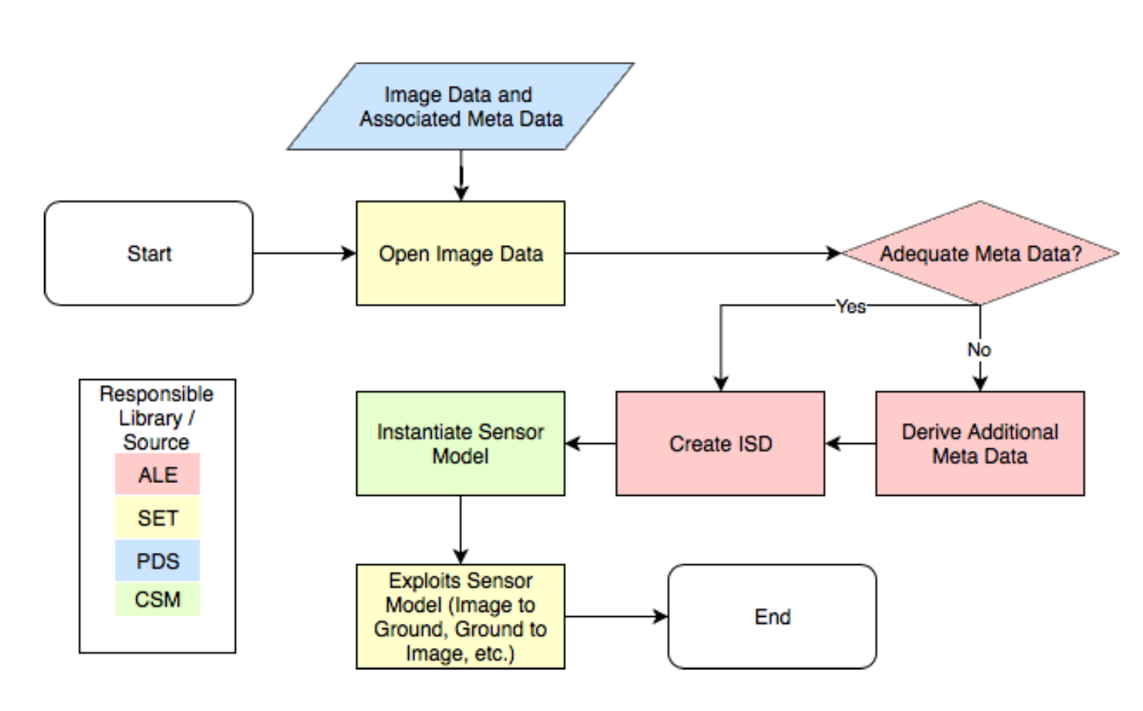

Slide 44
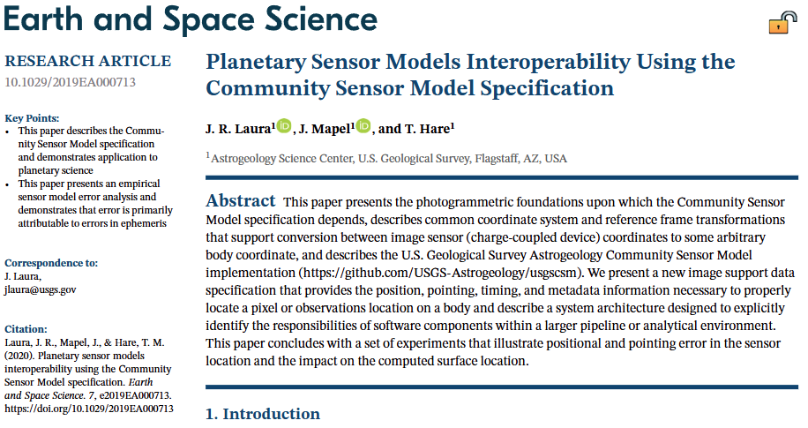

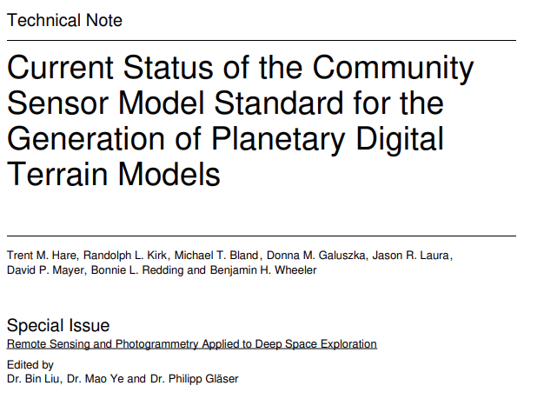
https://doi.org/10.1029/2019EA000713
https://doi.org/10.3390/rs16040648

