Slide 1
Okefenokee Wildfire Risk, Resilience and Recovery: 2017 West Mims Fire
By: Abigail Hightower
Acknowledgements to
Dr. Amber Ignatius
Dr. Jamie Mitchem
Michael Wild
University of North Georgia
Institute for Environmental & Spatial Analysis

Slide 2
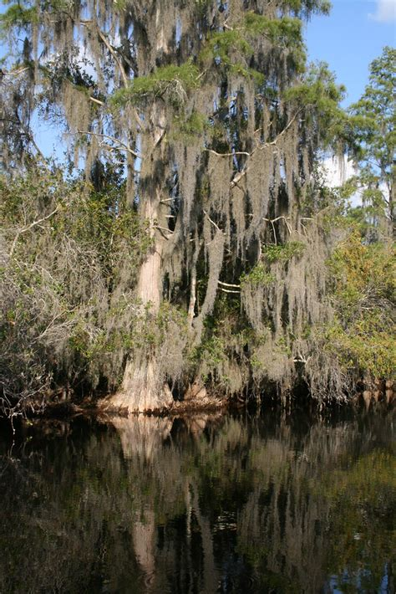
Importance
Ecology
Wetland of International Importance
Wildfire dependent ecosystem for nutrient cycling and water retention
Working landscape
carbon sequestration
filter/contain water resources
Threats
Climate change, climate extremes
Human development: Twin Pines mining
Mismanagement
reduced old-growth cypress (disturbed fire/moisture regimes)

Slide 3
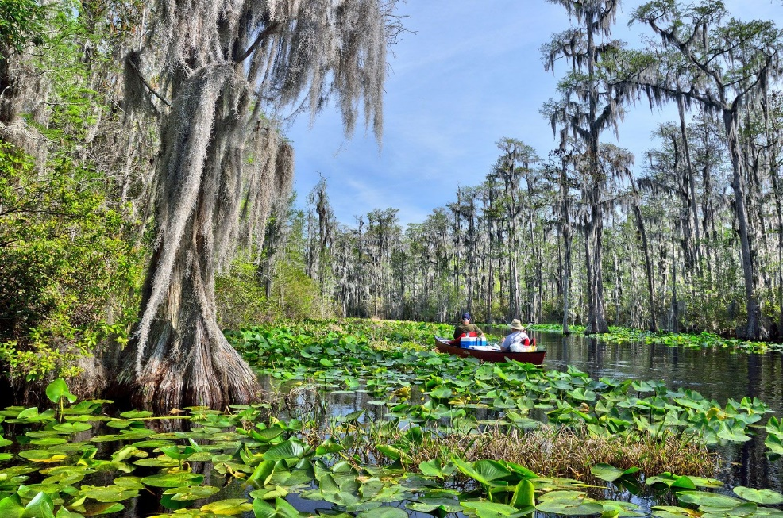
Ecological Background
Unique species, mixed landscapes
over 850 plant species and 400 vertebrate animals
large tree canopies, grasslands, lakes & aquatic surface plants
Water and moisture retention dependent on peat build up
- peat can dry and become hydrophobic = burned holes in the landscape change hydrologic patterns
Substantial precipitation is essential for vegetation growth and peat saturation
Wildfires promote biodiversity through disturbance/nutrient ash
- biochar increases water retention
- prescribed fire can promote climate resilience
- peat wildfires alter landscapes compared to surface fires that don't harm larger cypress trees and prevent hardwood encroachment
Timothy J Creative Commons Attribution 2.0

Slide 4
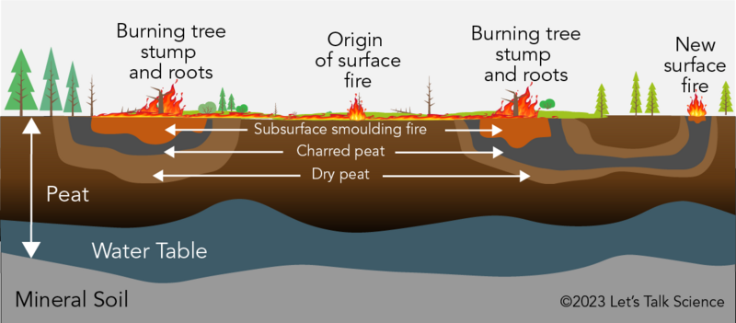
Ecological Background
53 years for 1" of Peat in Okefenokee
Unique species, mixed landscapes
- large tree canopies, grasslands, lakes & aquatic surface plants
Water and moisture retention dependent on peat build up
- peat can dry and become hydrophobic = burned holes in the landscape change hydrologic patterns
Substantial precipitation is essential for vegetation growth and peat saturation
Wildfires promote biodiversity through disturbance/nutrient ash
- biochar increases water retention
- prescribed fire can promote climate resilience
- peat wildfires alter landscapes compared to surface fires that don't harm larger cypress trees and prevent hardwood encroachment

Slide 5
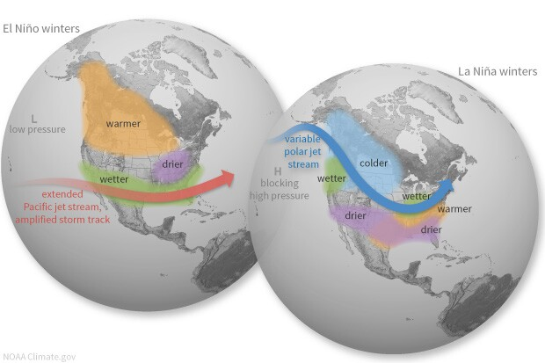
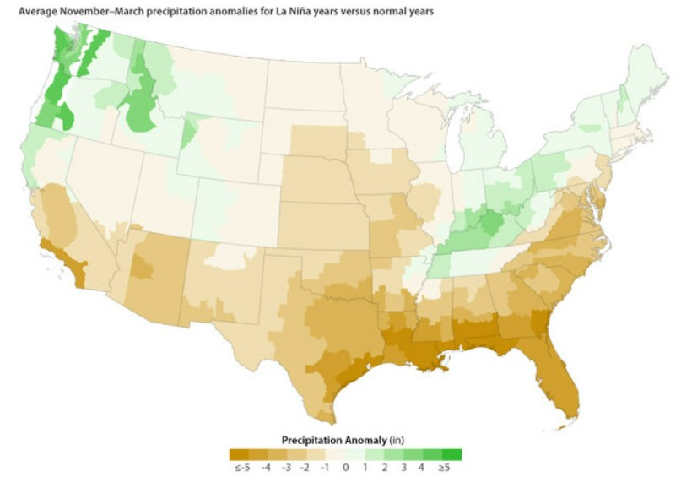
ENSO Patterns & Wildfires
La Niña = drier/warmer Okefenokee winters
inhibits vegetation growth, decreases wildfire recovery
without protection of a canopy...
- water table accumulation inhibited
- soil moisture decreases
Dramatic transitions between El Niño and La Niña can create large fuel loads in Southeastern forests
ENSO variability can create opportunities for massive wildfires when conditions are met
ENSO may be vulnerable to climate change, increase in variability and intensity

Slide 6
ENSO Patterns & Wildfires ESST & SST Anomalies
El Niño
La Niña
Year | DJF | JFM | FMA | MAM | AMJ | MJJ | JJA | JAS | ASO | SON | OND | NDJ
2000 | -1.7 | -1.4 | -1.1 | -0.8 | -0.7 | -0.6 | -0.6 | -0.5 | -0.5 | -0.6 | -0.7 | -0.7
2001 | -0.7 | -0.5 | -0.4 | -0.3 | -0.3 | -0.1 | -0.1 | -0.1 | -0.2 | -0.3 | -0.3 | -0.3
2002 | -0.1 | 0.0 | 0.1 | 0.2 | 0.4 | 0.7 | 0.8 | 0.9 | 1.0 | 1.2 | 1.3 | 1.1
2003 | 0.9 | 0.6 | 0.4 | 0.0 | -0.3 | -0.2 | 0.1 | 0.2 | 0.3 | 0.3 | 0.4 | 0.4
2004 | 0.4 | 0.3 | 0.2 | 0.2 | 0.2 | 0.3 | 0.5 | 0.6 | 0.7 | 0.7 | 0.7 | 0.7
2005 | 0.6 | 0.6 | 0.4 | 0.4 | 0.3 | 0.1 | -0.1 | -0.1 | -0.1 | -0.3 | -0.6 | -0.8
2006 | -0.9 | -0.8 | -0.6 | -0.4 | -0.1 | 0.0 | 0.1 | 0.3 | 0.5 | 0.8 | 0.9 | 0.9
2007 | 0.7 | 0.2 | -0.1 | -0.3 | -0.4 | -0.5 | -0.6 | -0.8 | -1.1 | -1.3 | -1.5 | -1.6
2008 | -1.6 | -1.5 | -1.3 | -1.0 | -0.8 | -0.6 | -0.4 | -0.2 | -0.2 | -0.4 | -0.6 | -0.7
2009 | -0.8 | -0.8 | -0.6 | -0.3 | 0.0 | 0.3 | 0.5 | 0.6 | 0.7 | 1.0 | 1.4 | 1.6
2010 | 1.5 | 1.2 | 0.8 | 0.4 | -0.2 | -0.7 | -1.0 | -1.3 | -1.6 | -1.6 | -1.6 | -1.6
2011 | -1.4 | -1.2 | -0.9 | -0.7 | -0.6 | -0.4 | -0.5 | -0.6 | -0.8 | -1.0 | -1.1 | -1.0
2012 | -0.9 | -0.7 | -0.6 | -0.5 | -0.3 | 0.0 | 0.2 | 0.4 | 0.4 | 0.3 | 0.1 | -0.2
2013 | -0.4 | -0.4 | -0.3 | -0.3 | -0.4 | -0.4 | -0.4 | -0.3 | -0.3 | -0.2 | -0.2 | -0.3
2014 | -0.4 | -0.5 | -0.3 | 0.0 | 0.2 | 0.2 | 0.0 | 0.1 | 0.2 | 0.5 | 0.6 | 0.7
2015 | 0.5 | 0.5 | 0.5 | 0.7 | 0.9 | 1.2 | 1.5 | 1.9 | 2.2 | 2.4 | 2.6 | 2.6
2016 | 2.5 | 2.1 | 1.6 | 0.9 | 0.4 | -0.1 | -0.4 | -0.5 | -0.6 | -0.7 | -0.7 | -0.6
2017 | -0.3 | -0.2 | 0.1 | 0.2 | 0.3 | 0.3 | 0.1 | -0.1 | -0.4 | -0.7 | -0.8 | -1.0
2018 | -0.9 | -0.9 | -0.7 | -0.5 | -0.2 | 0.0 | 0.1 | 0.2 | 0.5 | 0.8 | 0.9 | 0.8
2019 | 0.7 | 0.7 | 0.7 | 0.7 | 0.5 | 0.5 | 0.3 | 0.1 | 0.2 | 0.3 | 0.5 | 0.5
2020 | 0.5 | 0.5 | 0.4 | 0.2 | -0.1 | -0.3 | -0.4 | -0.6 | -0.9 | -1.2 | -1.3 | -1.2

Slide 7
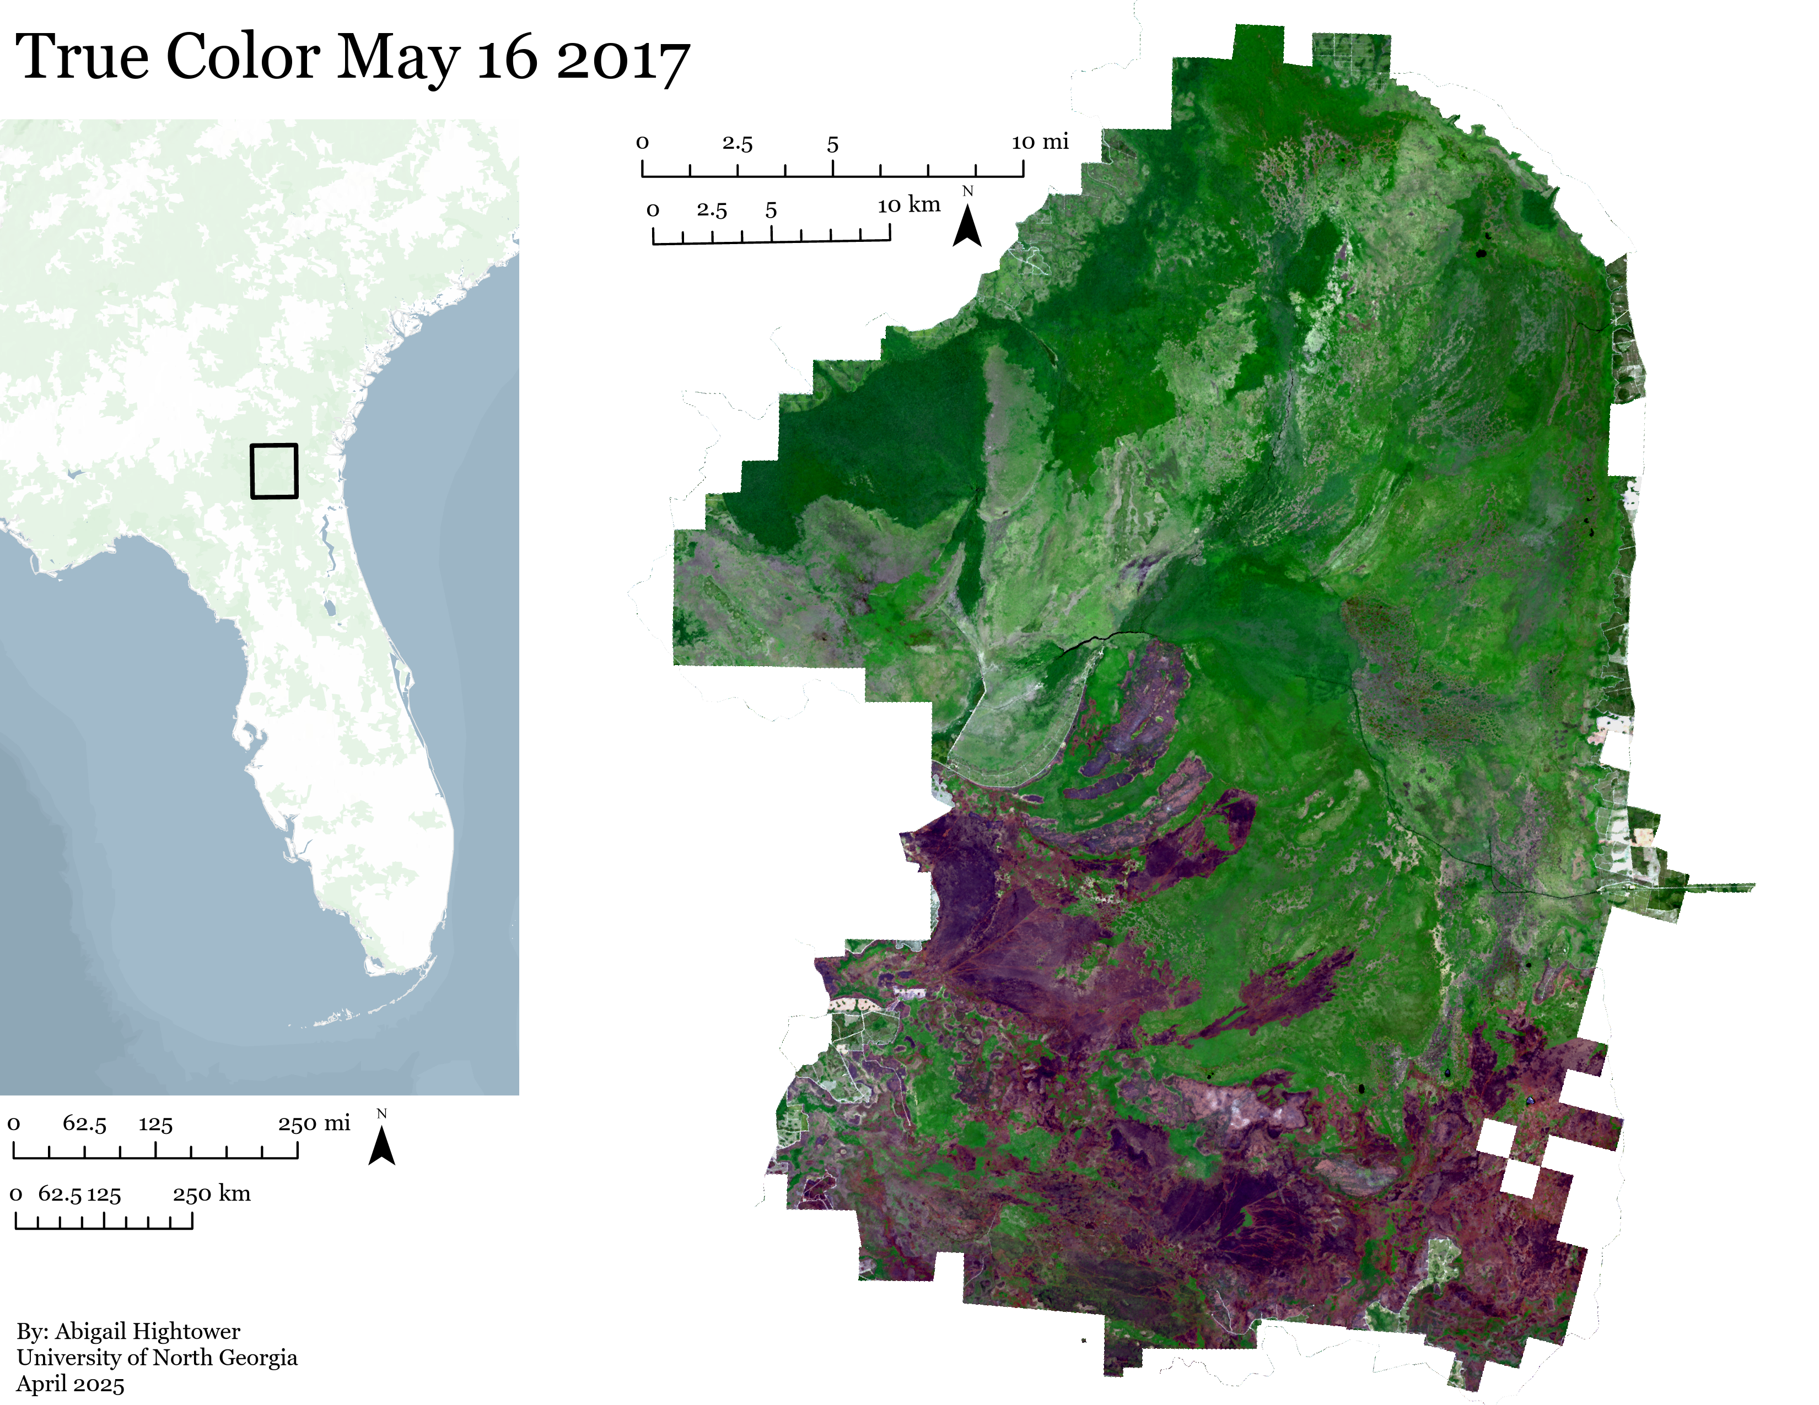
Study Area

Slide 8
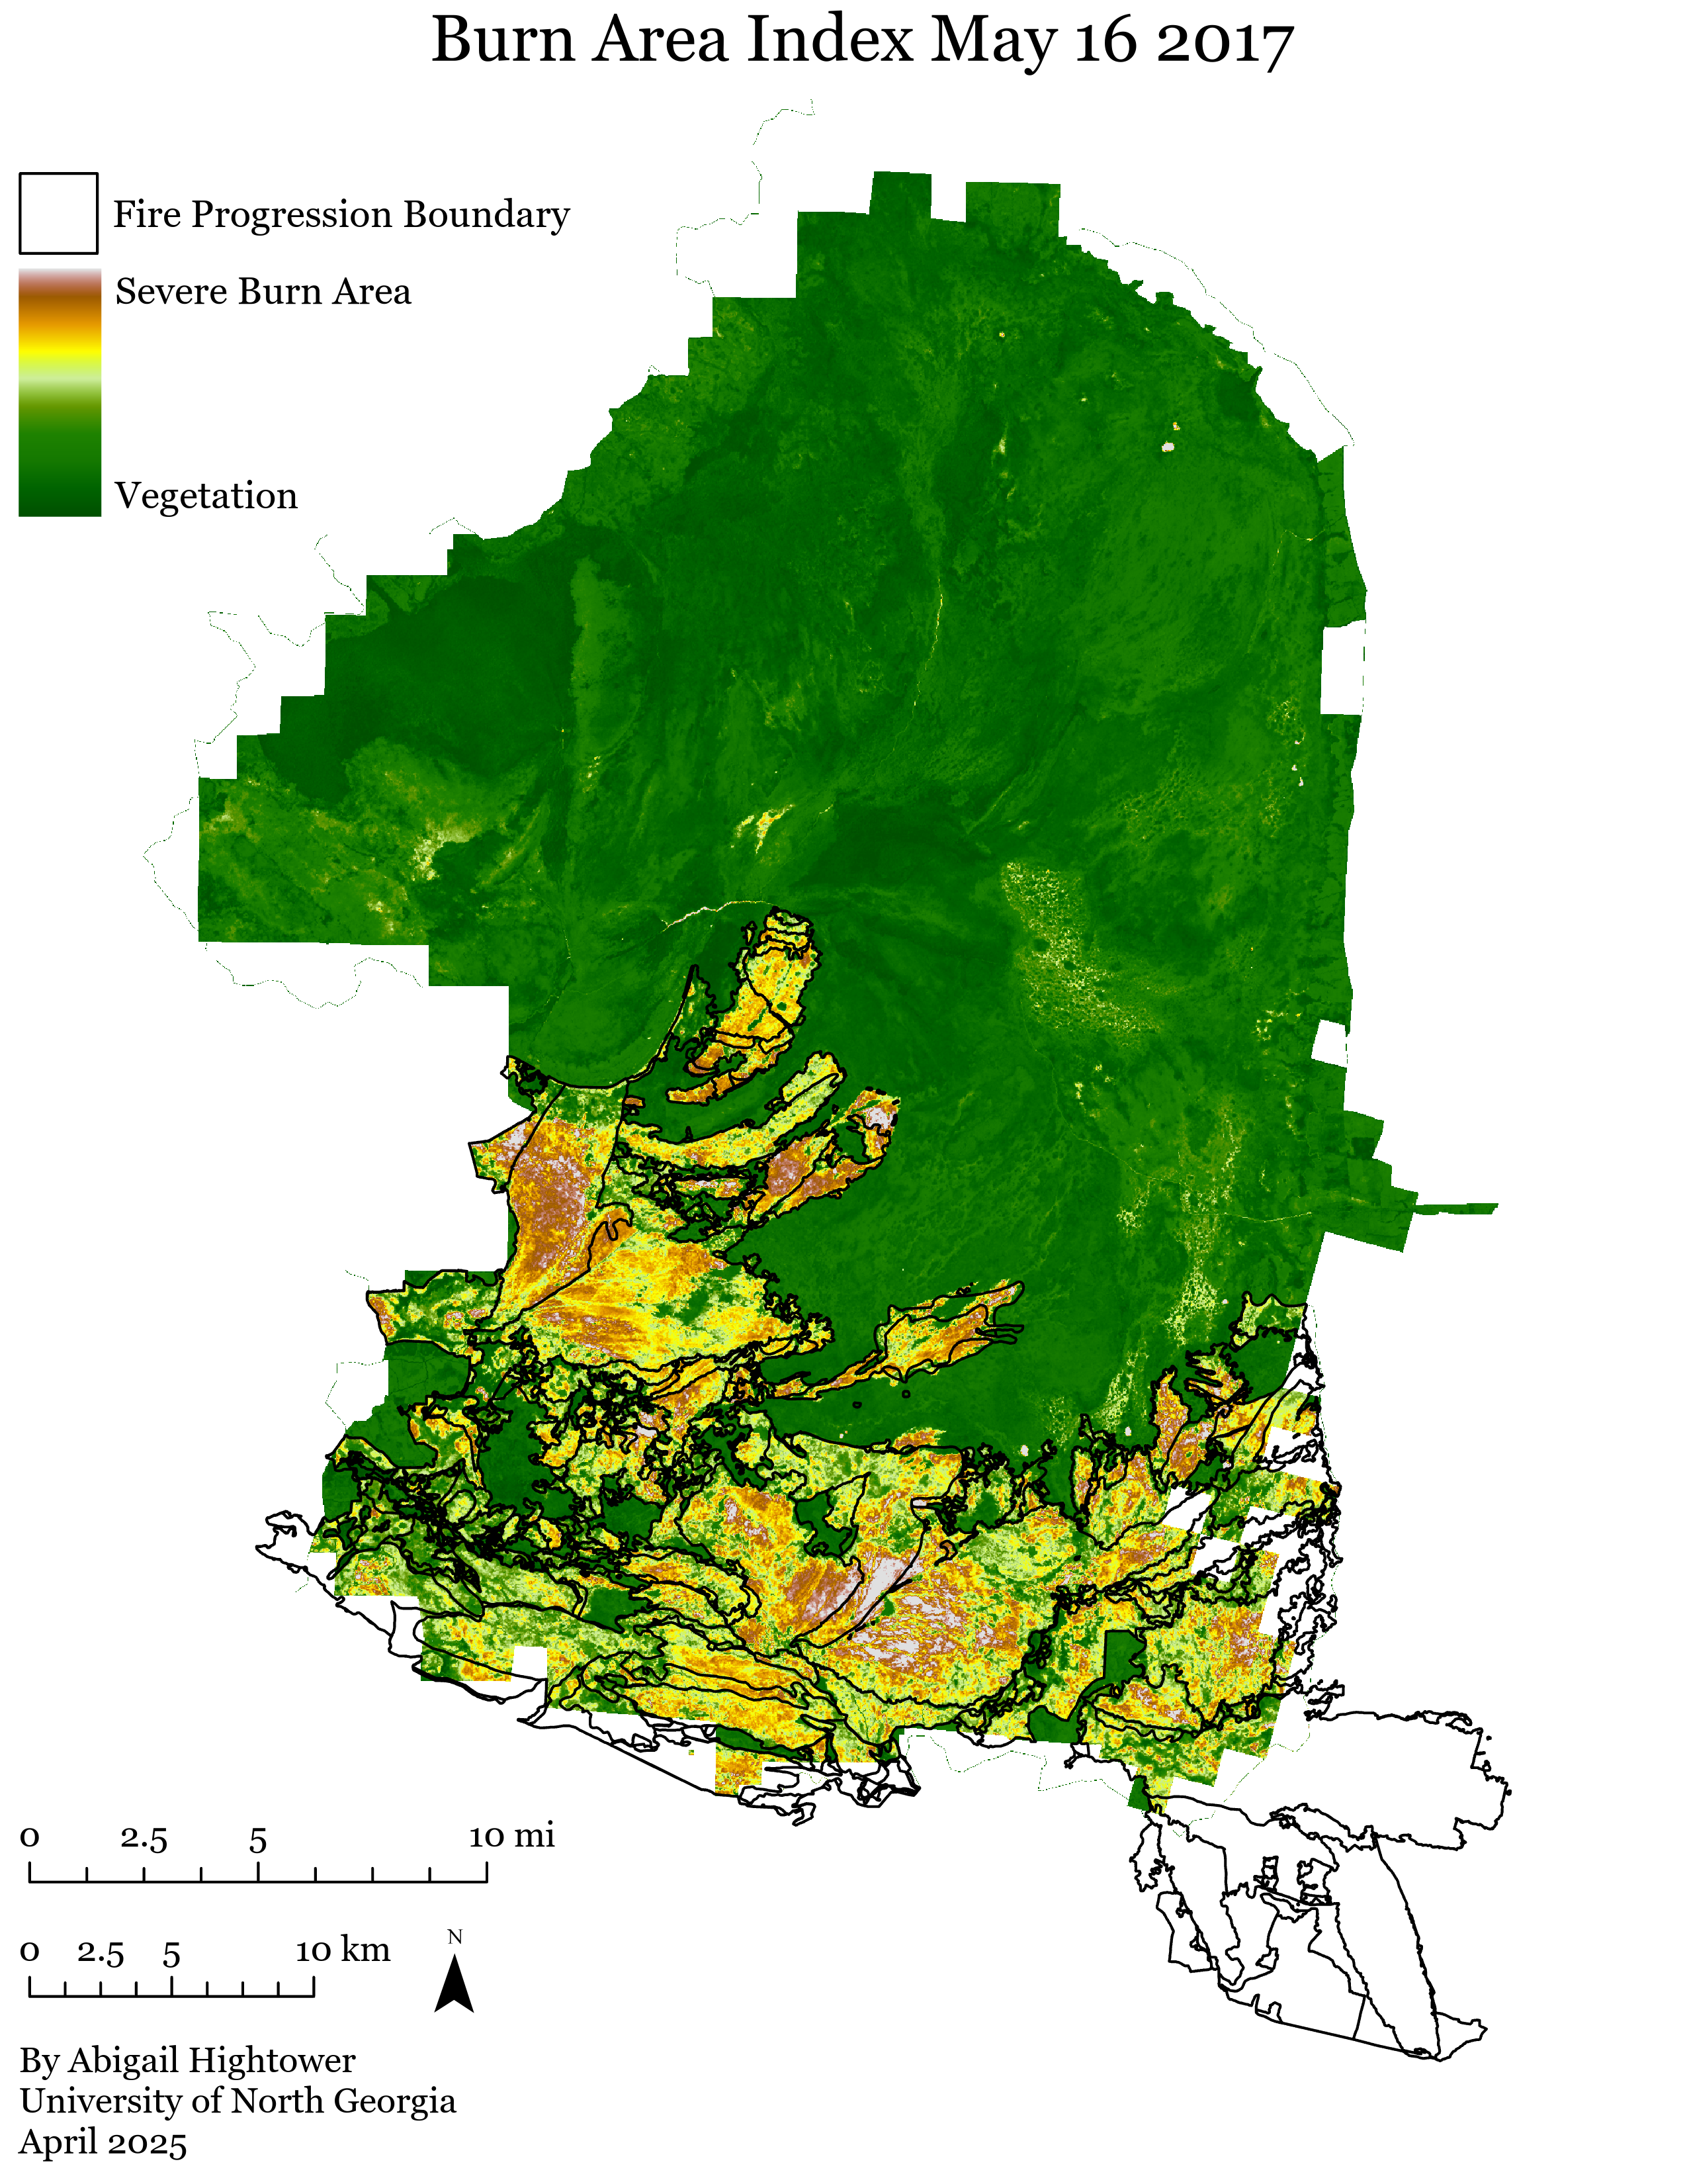
Burned Area Index Fire Boundary & Severity
BAI = 1/((0.1 -RED)^2 + (0.06 - NIR)^2)

Slide 9
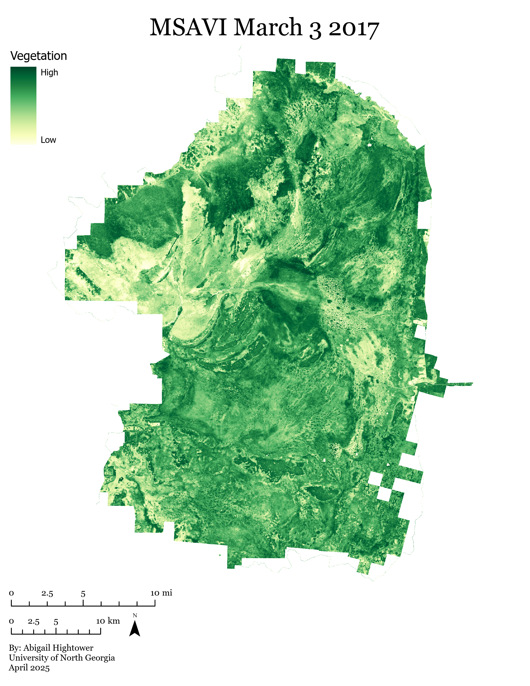
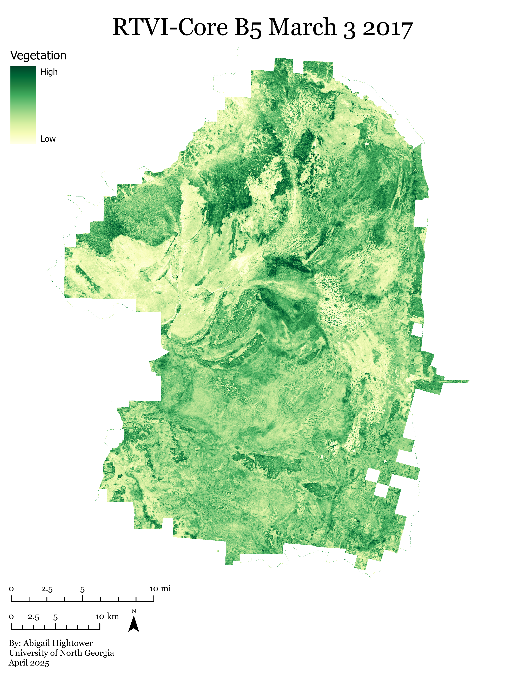
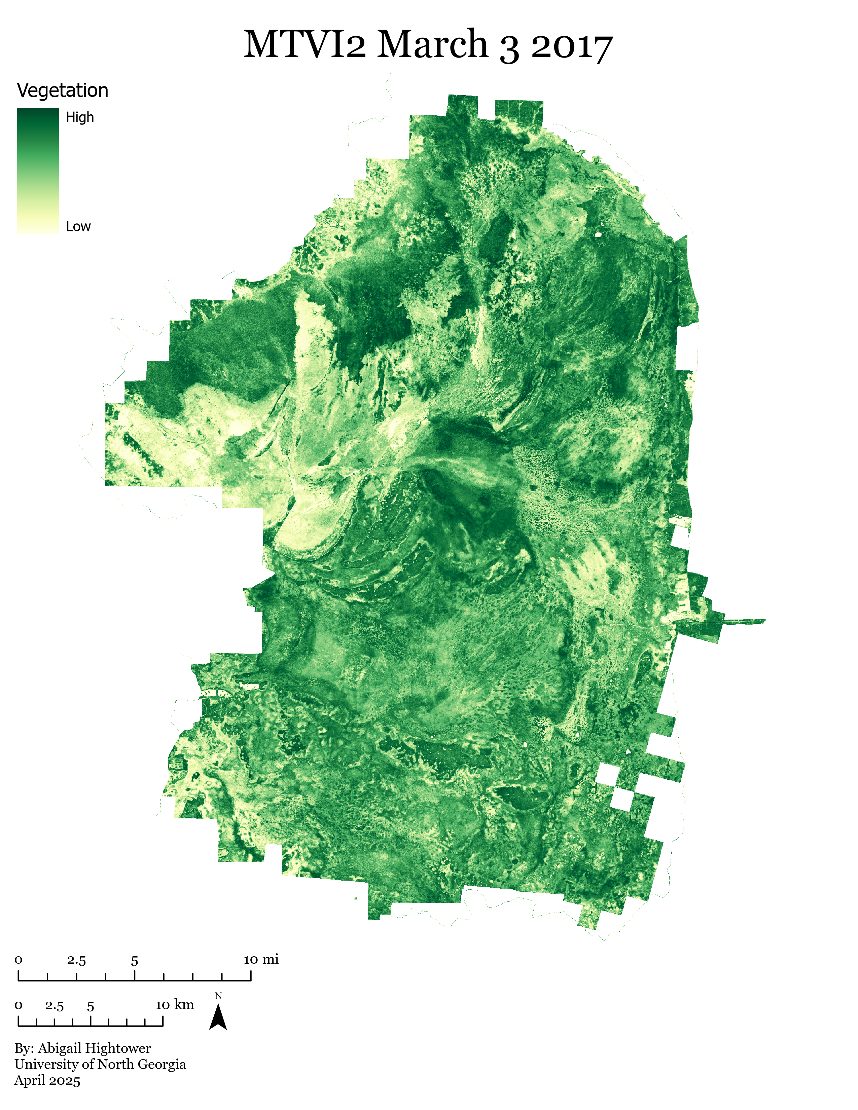
2017 Pre-Fire Vegetation Indices
Overall Vegetation Levels
Leaf Area Index & Biomass
Canopy Structure
Notes:
Modified Soil Adjusted Vegetation Index (MSAVI) minimizes the effect of bare soil
Red-Edge Triangulated Vegetation Index (RTVICore) estimates leaf area index and biomass
Modified Triangular Vegetation Index (MTVI2) detects leaf chlorophyll content at the canopy scale while being relatively insensitive to leaf area index

Slide 10
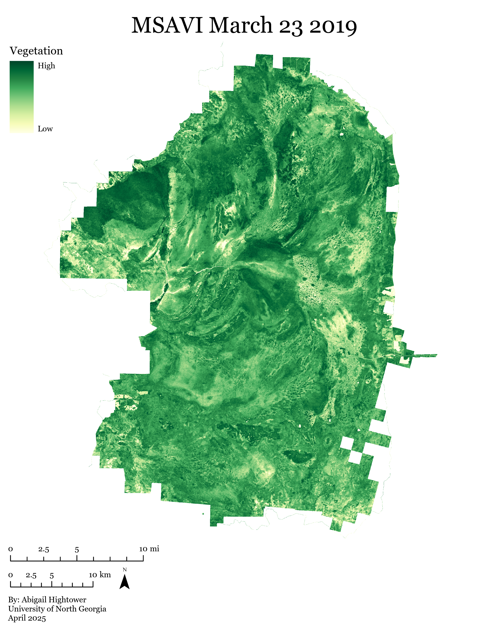
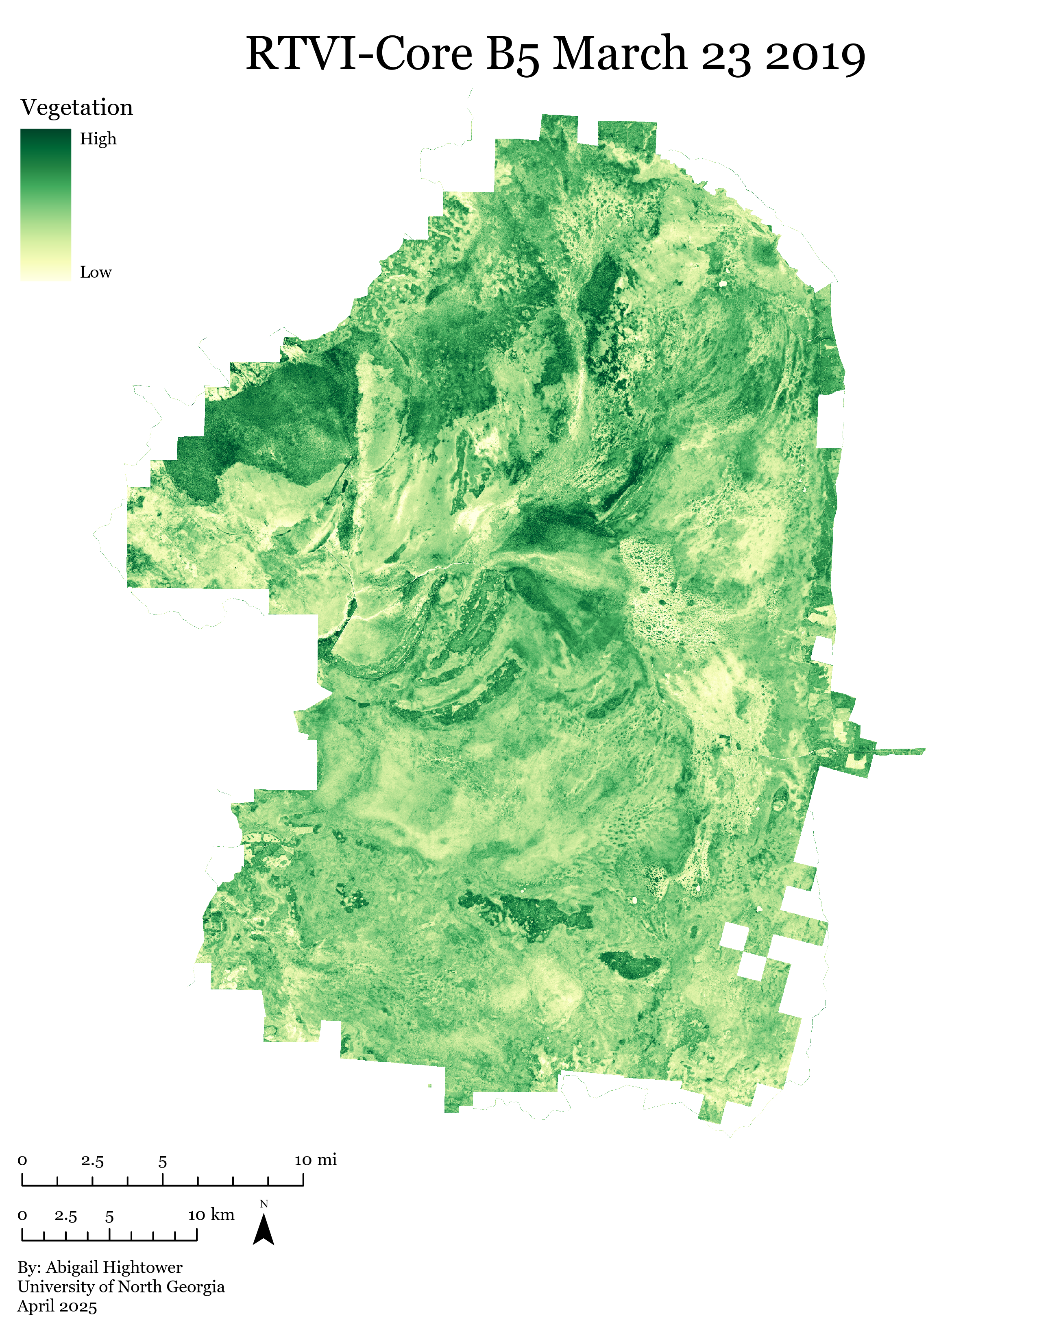
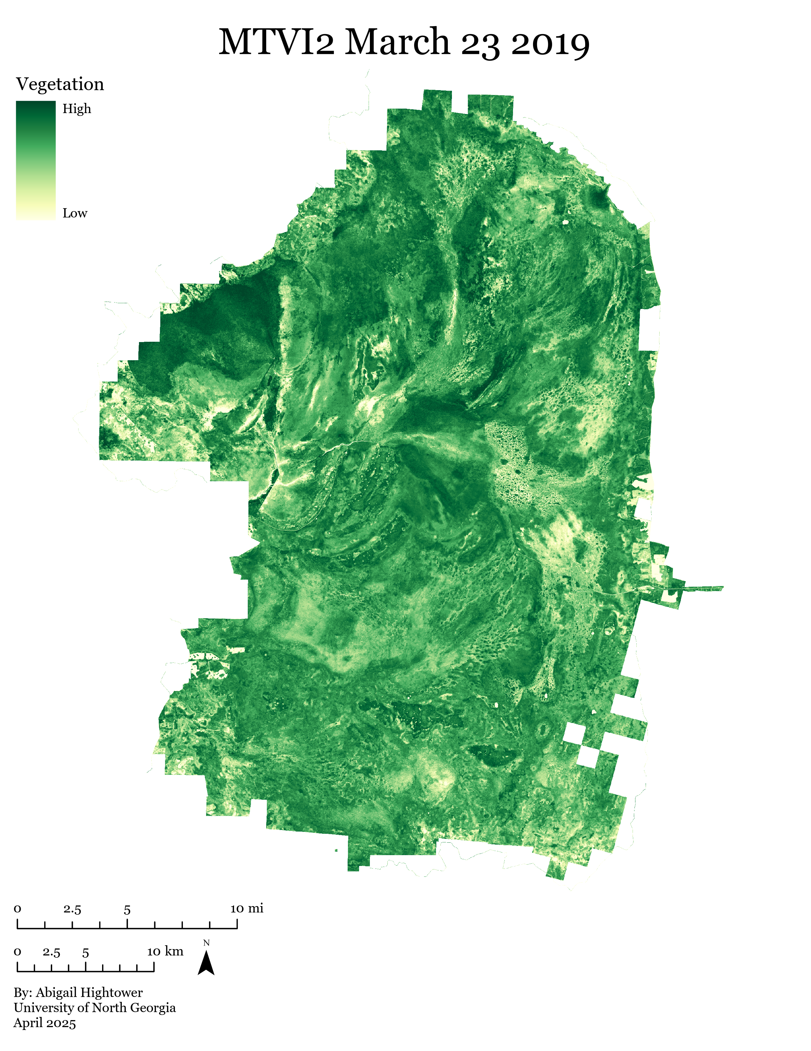
2019 Post-Recovery Vegetation Indices
Overall Vegetation
Leaf Area Index & Biomass
Canopy Structure

Slide 11
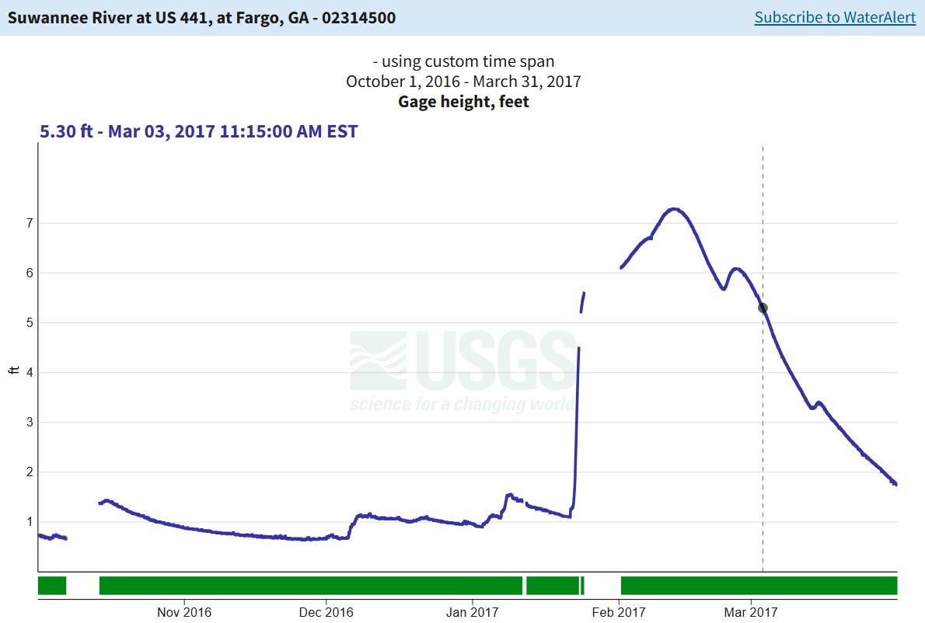
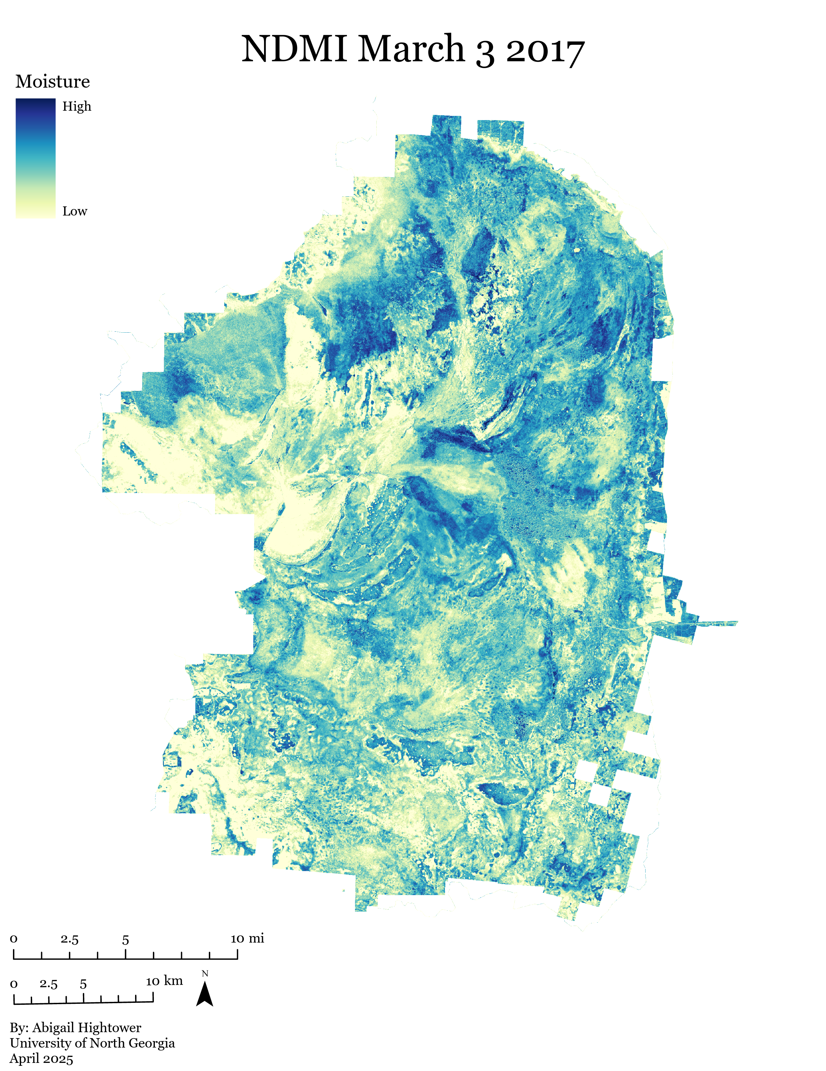
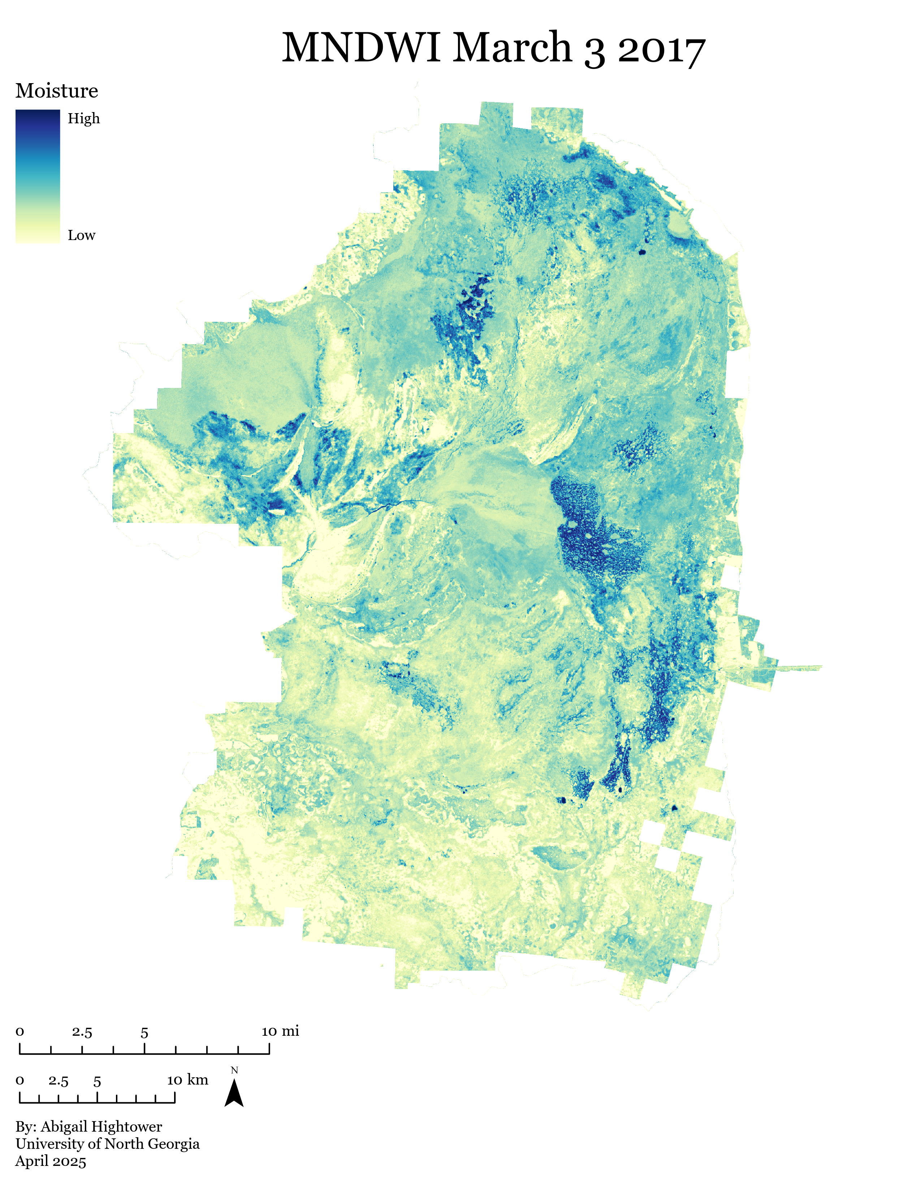
2017 Pre-Fire Moisture
Vegetation Moisture
Open Bodies of Water
Notes:
Normalized Difference Moisture Index (NDMI) focuses on vegetation water content
Modified Normalized Difference Water Index (MNDWI) enhances open water bodies while reducing the influence of built-up areas and shadows

Slide 12
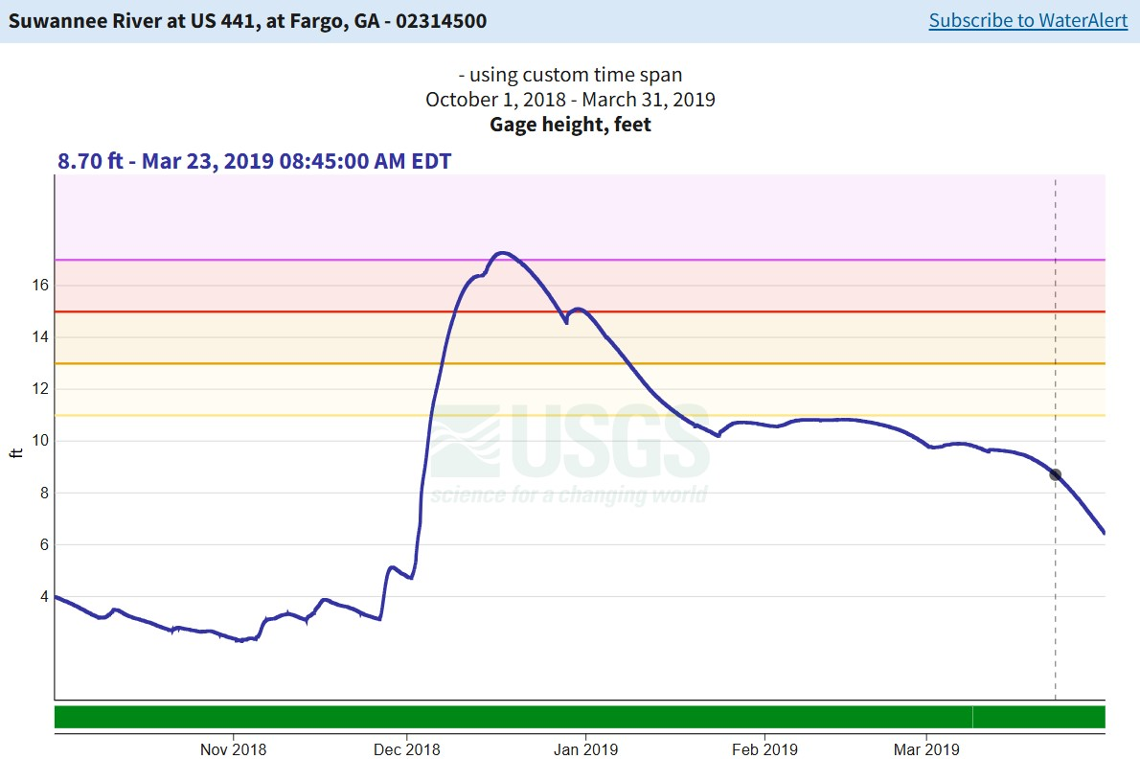
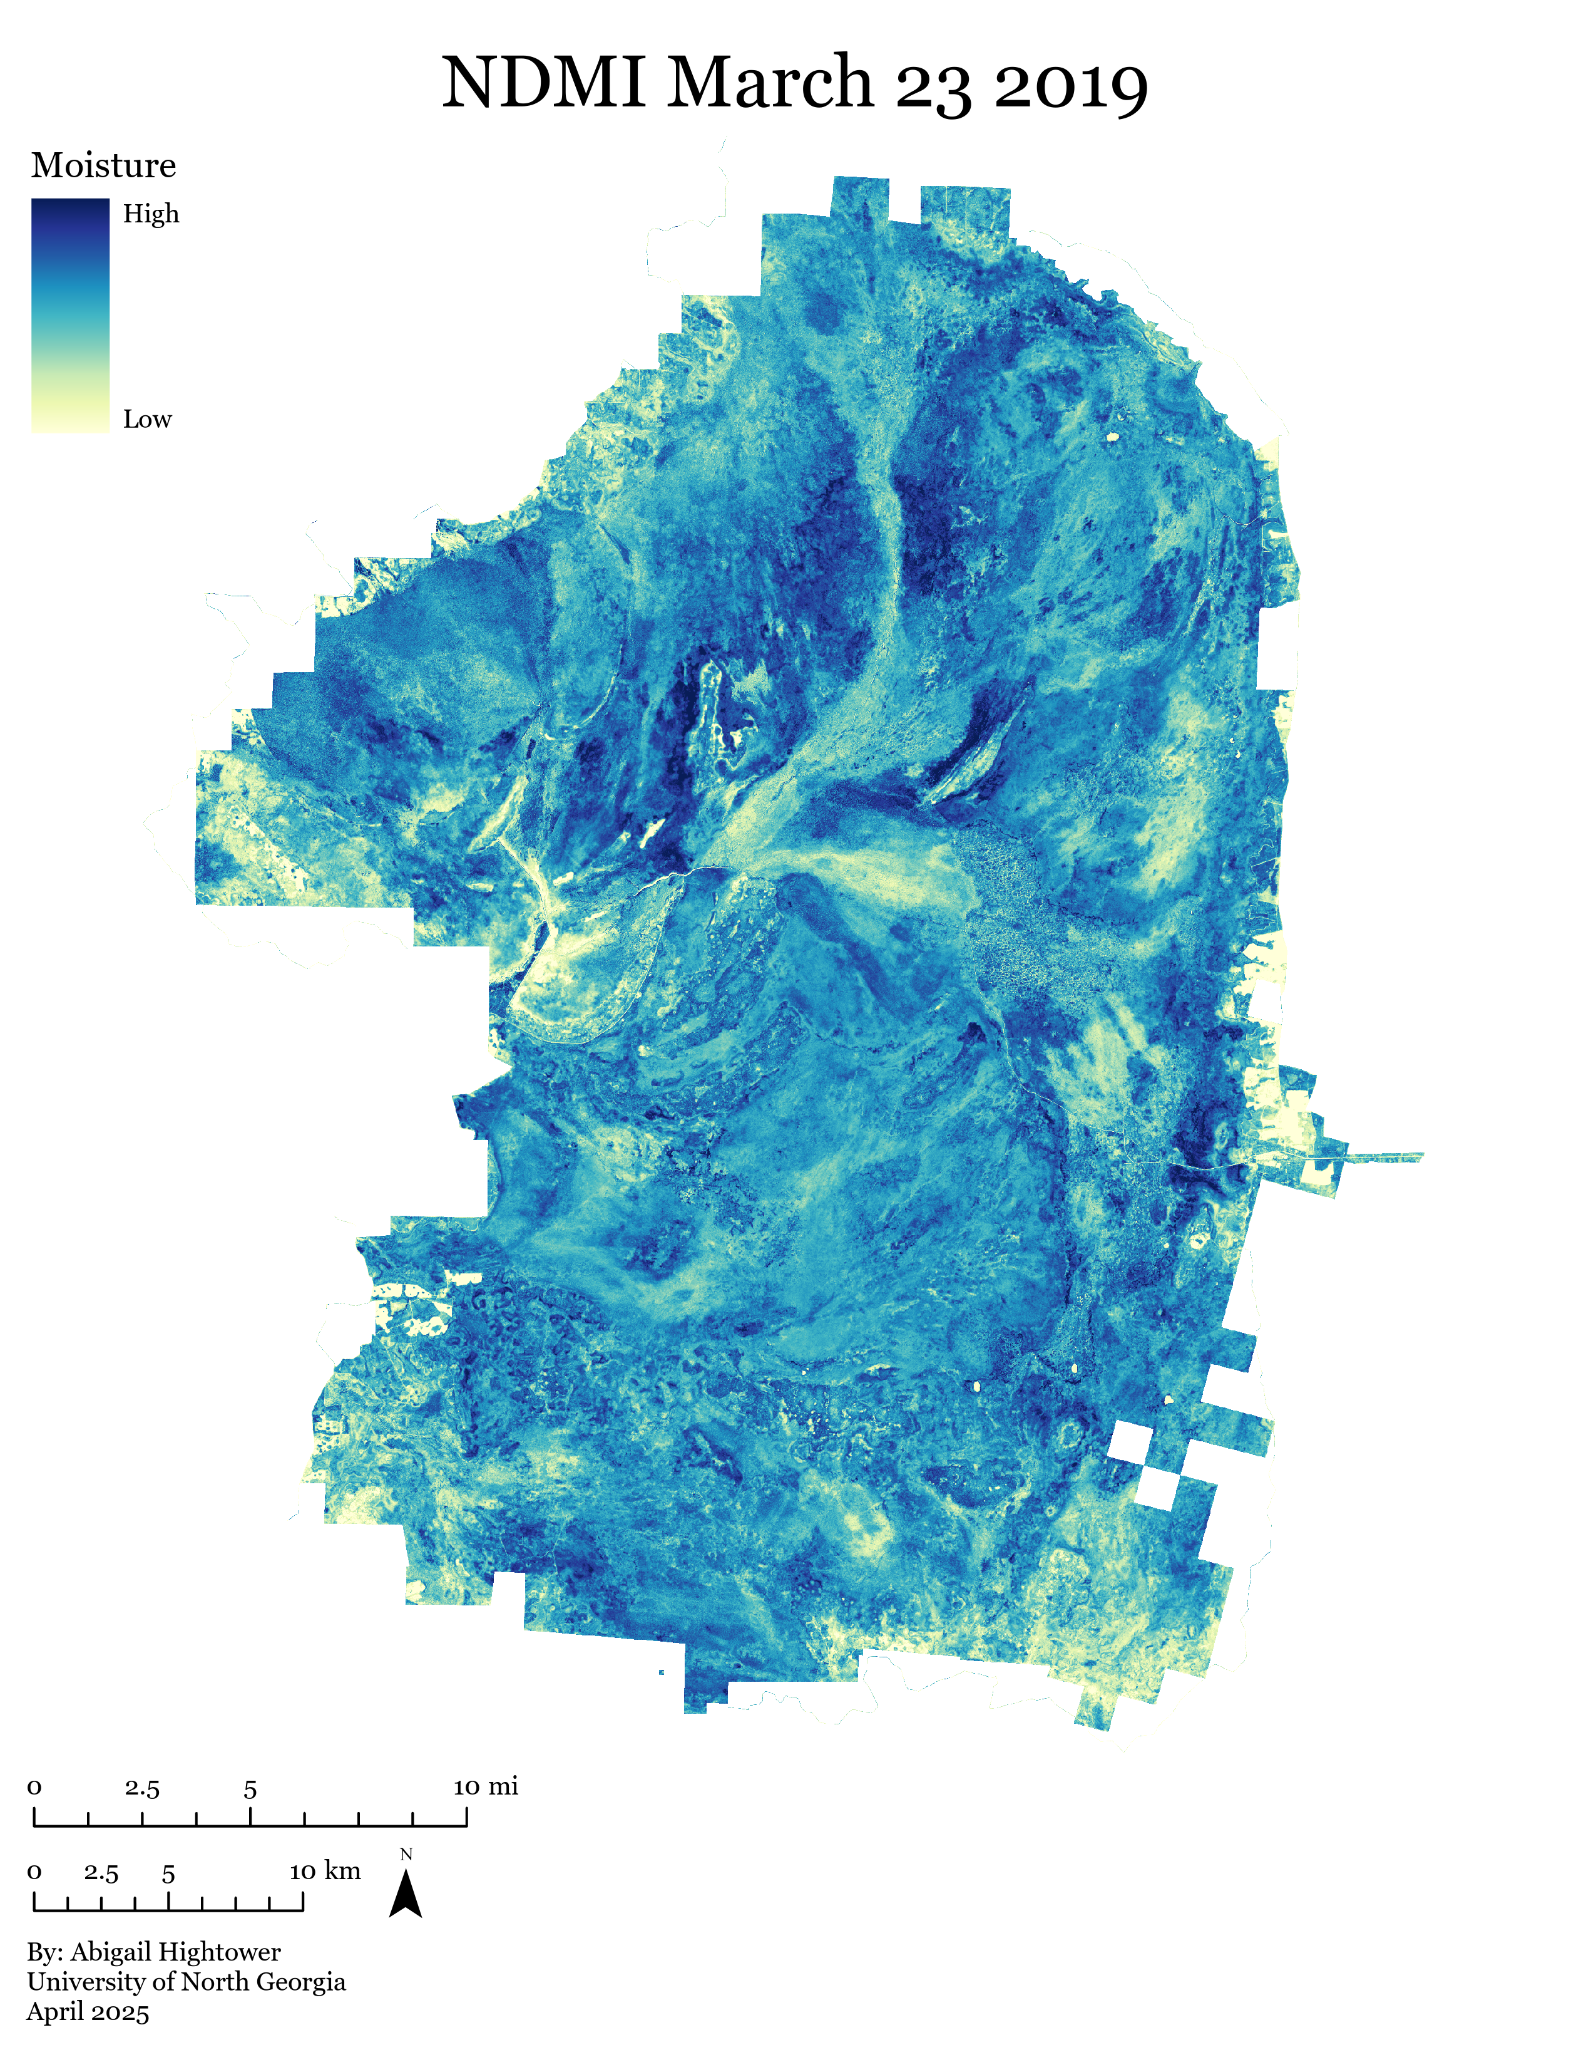
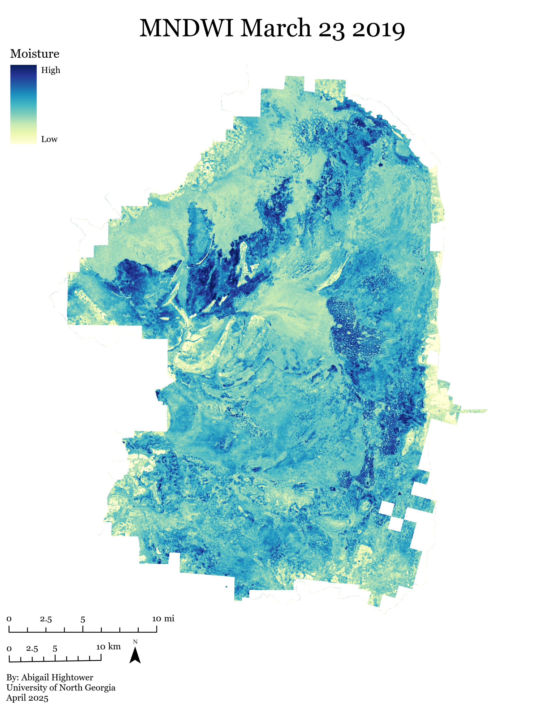
2019 Post-Recovery Moisture
Vegetation Moisture
Open Bodies of Water

Slide 13
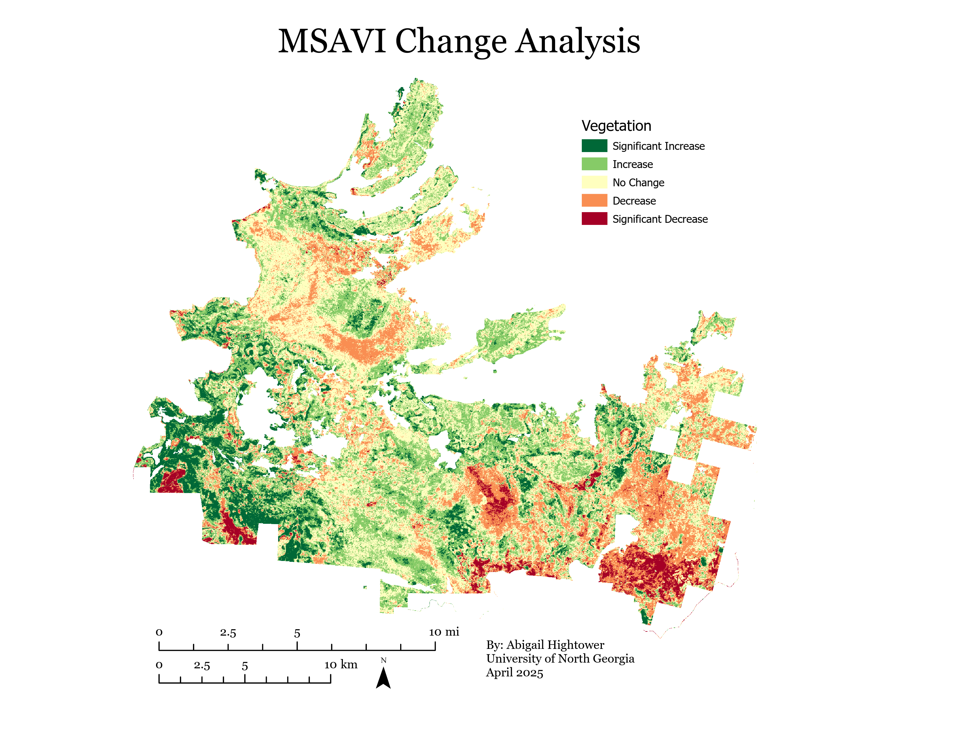
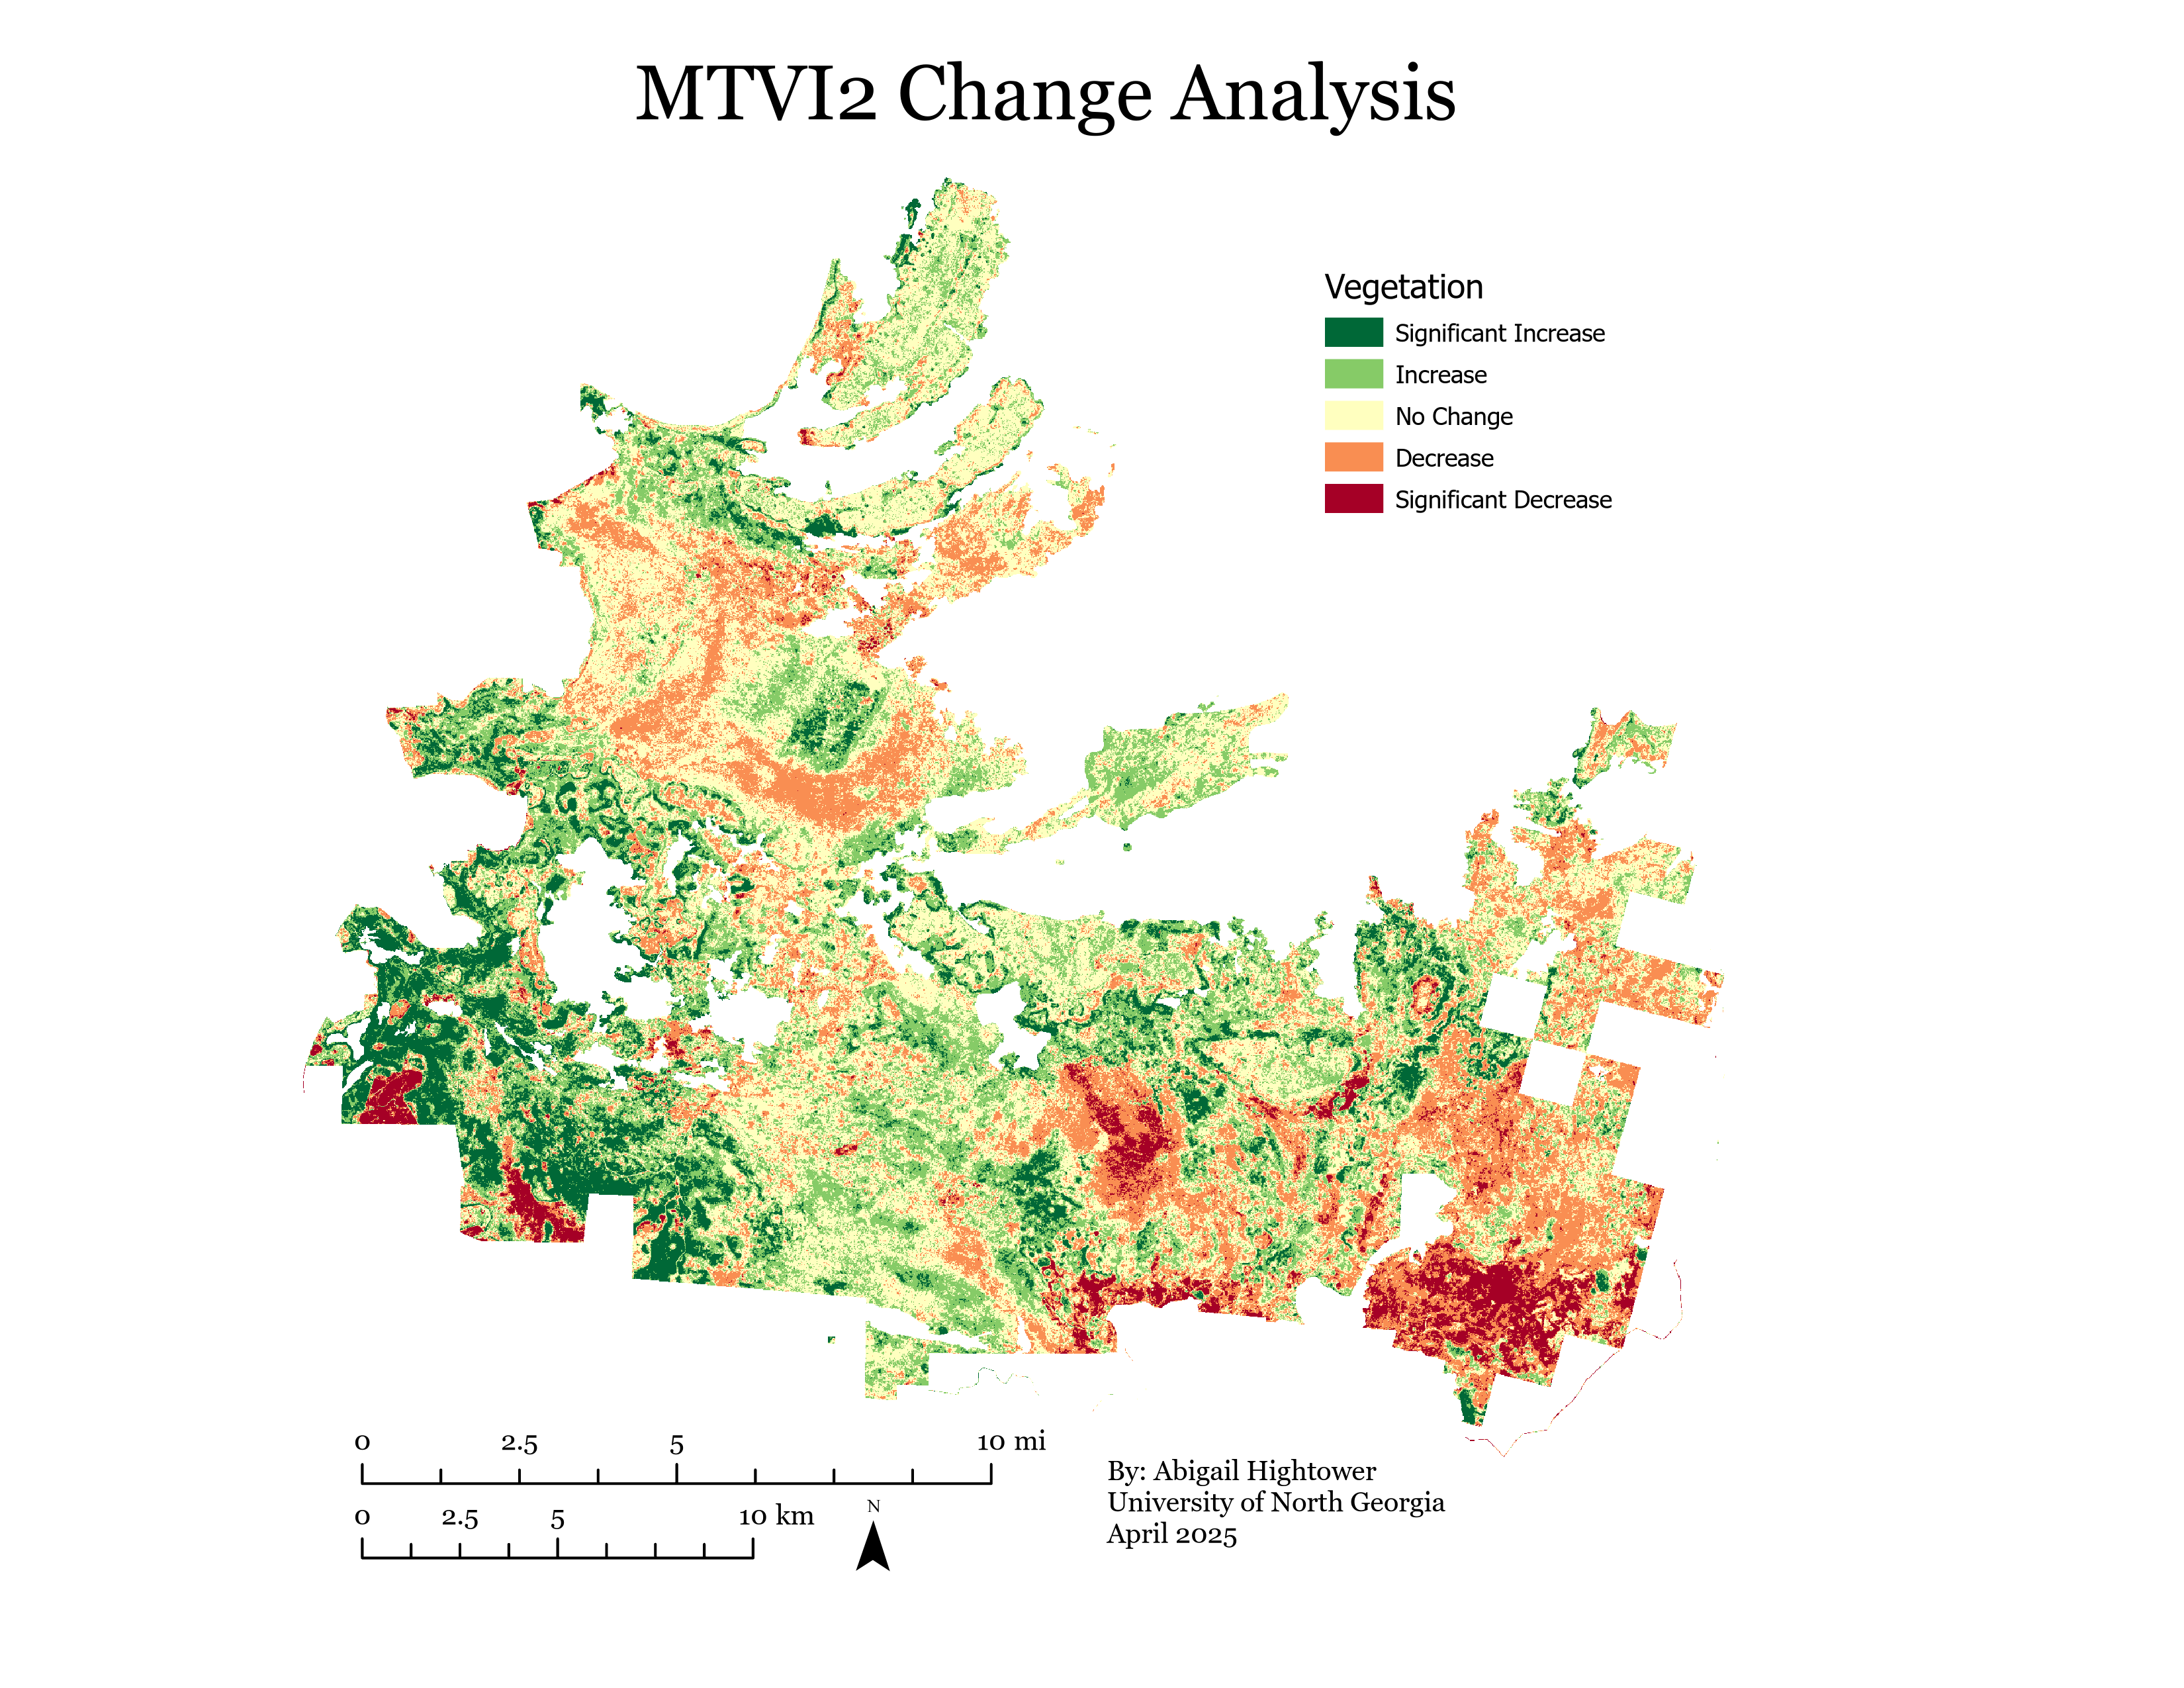
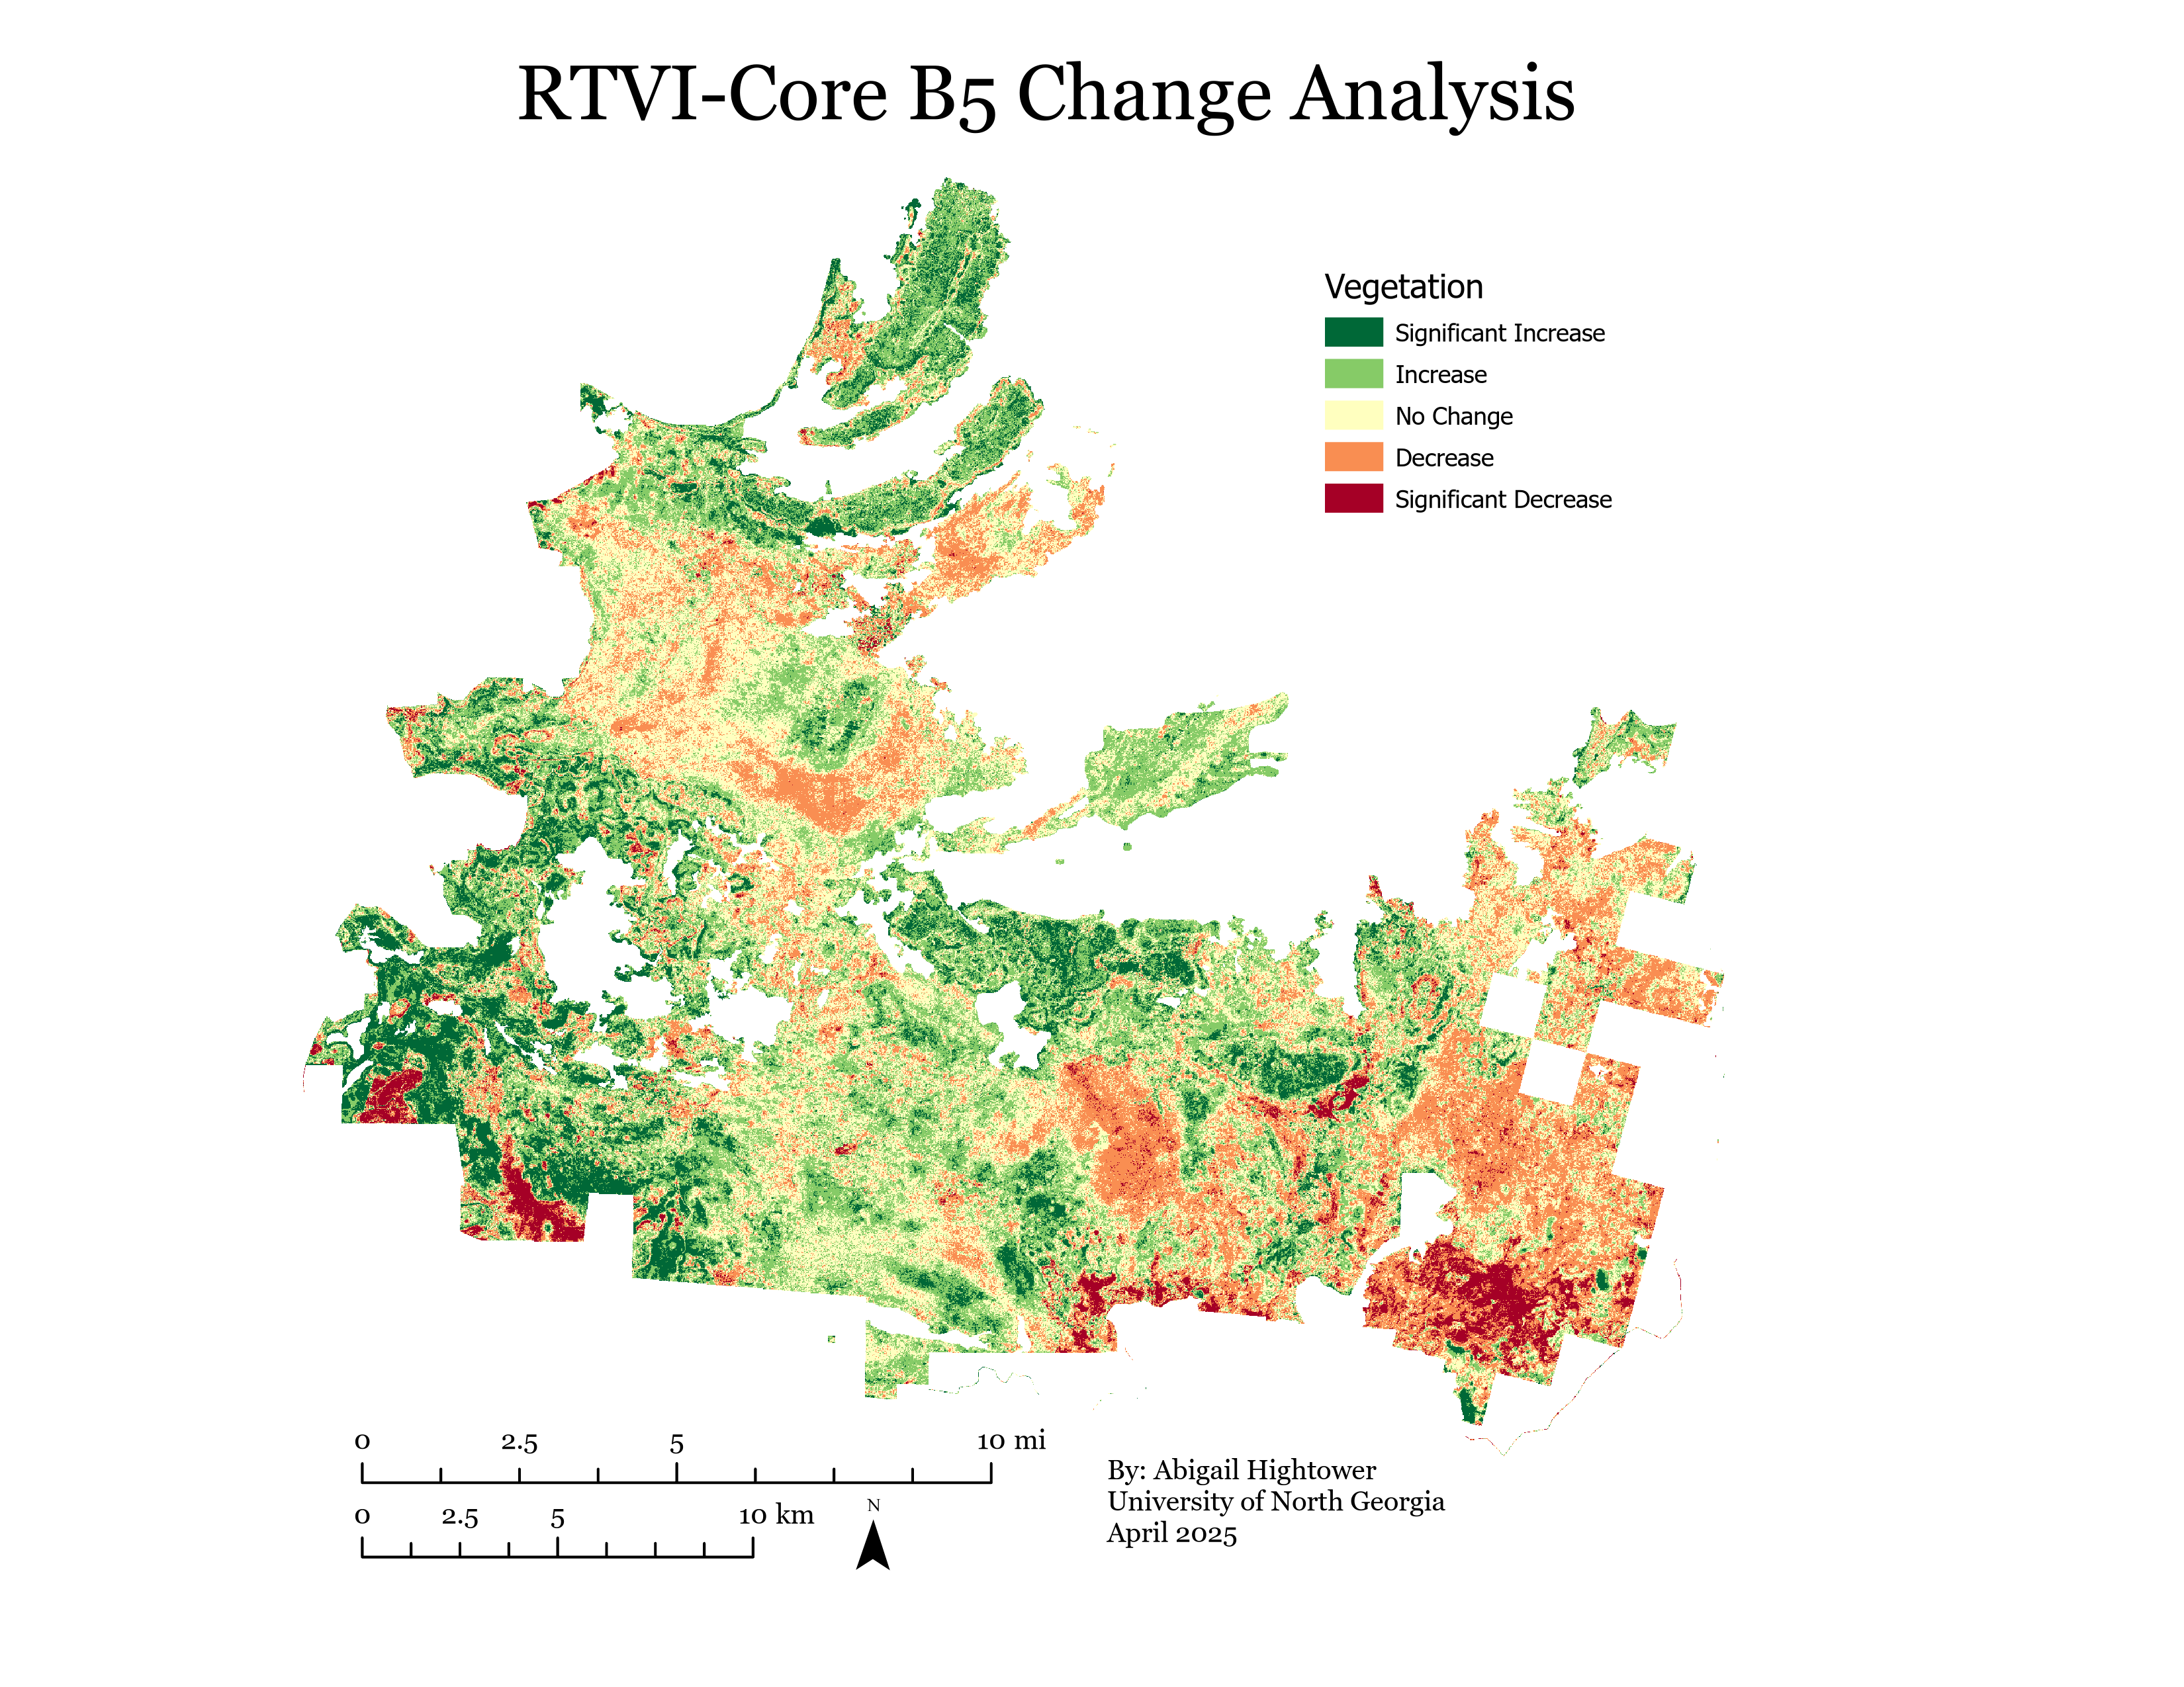
Analyzing Vegetation Changes 2017-2019

Slide 14
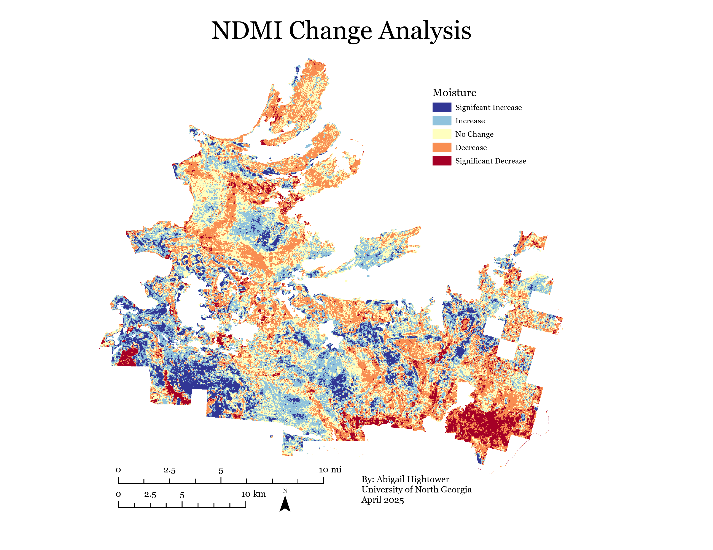
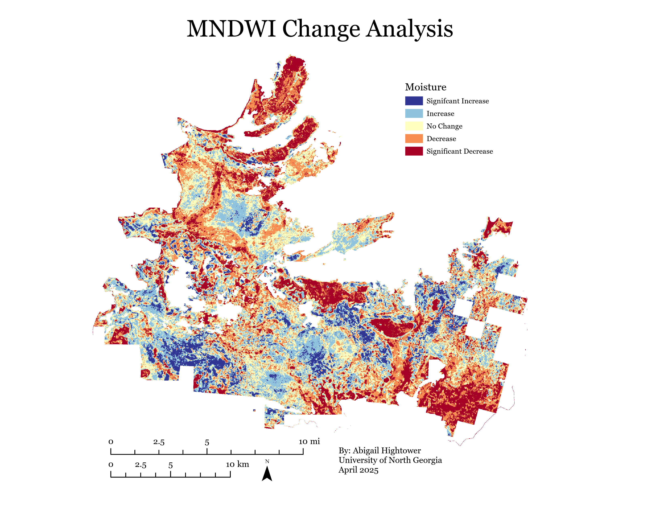
Analyzing Moisture Changes

Slide 15
Discussions and Conclusions

Slide 16
Future Natural Resource Management
Incorporate global climate cycles with regional annual cycles​ when estimating fire risk
Time prescribed fire to increase biodiversity and mitigate uncontrolled wildfires
- burn during high moisture (El Nino) periods
Adaptability for decision making in natural resource management; fire suppression or not?
Promoting species that help with landscape resilience such as old-growth trees to retain moisture using within a grassland area
Draw Down Georgia initiatives as a carbon sink
Importance of quick data processing and remote sensing techniques

Slide 17
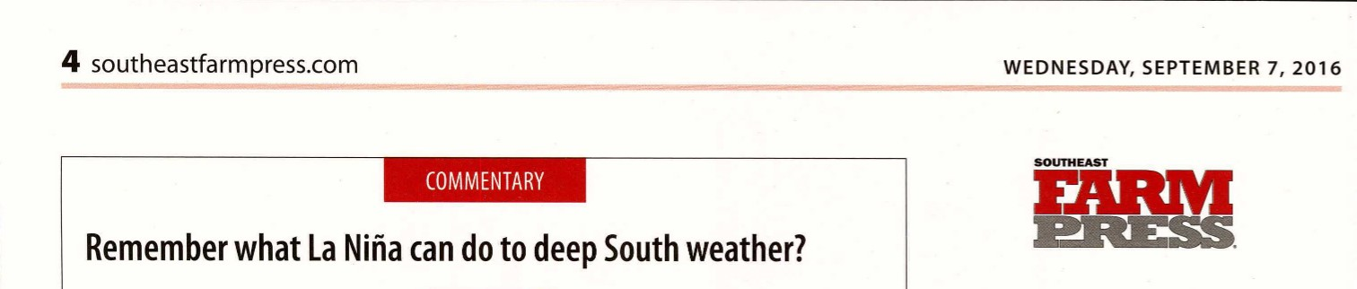
Future Research
Changing ENSO cycles, their variability and their effect on the Southeastern U.S.
Monitoring vegetation changes over long time periods with multiple wildfires
Determining wildfire severity and frequency throughout the wetland, differentiating between peat and surface fires and their comparable effects
Including in-situ data for nutrient availability analysis and peat deposits
Remote sensing applications: Google Earth Engine for moisture and vegetation changes, LiDAR for peat topography changes, NAIP/ high resolution imagery for identifying plant species and communities

Slide 18

Thank you !
Have a good day :)

