Slide 1
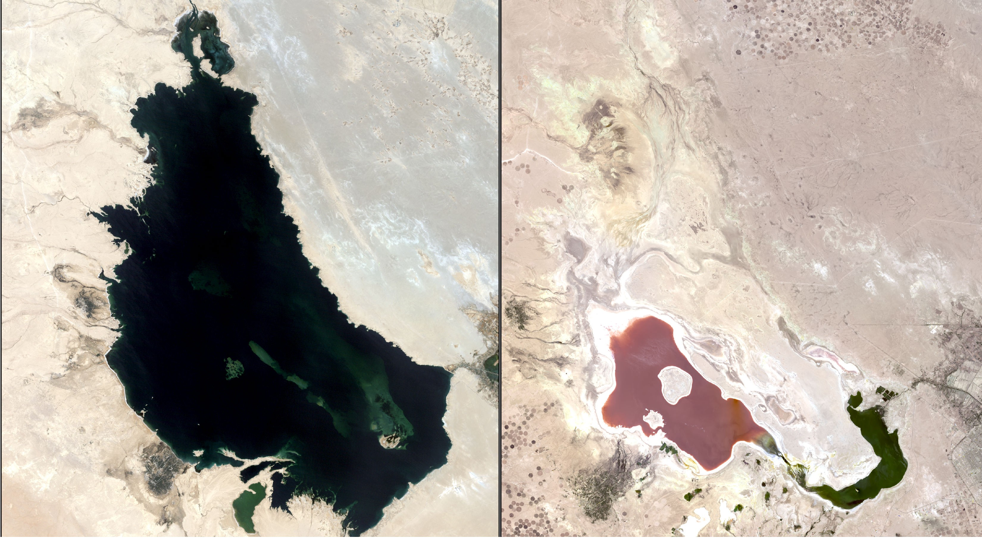

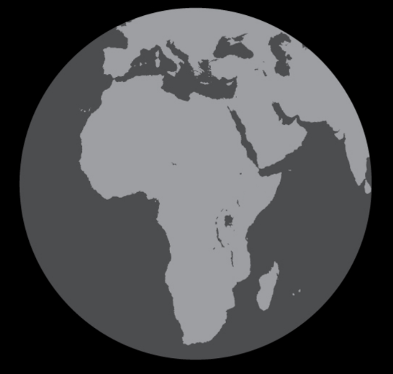
Spatiotemporal Analysis of the Shrinking of Lake Milh in Karbala, Iraq
Albany Zavarce · Dr. Ignatius, IESA

Slide 2
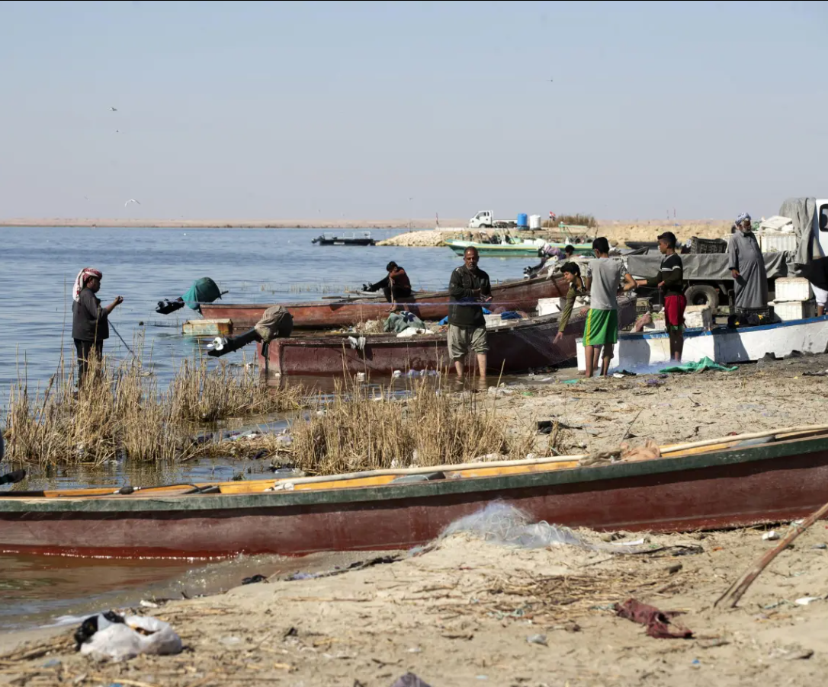
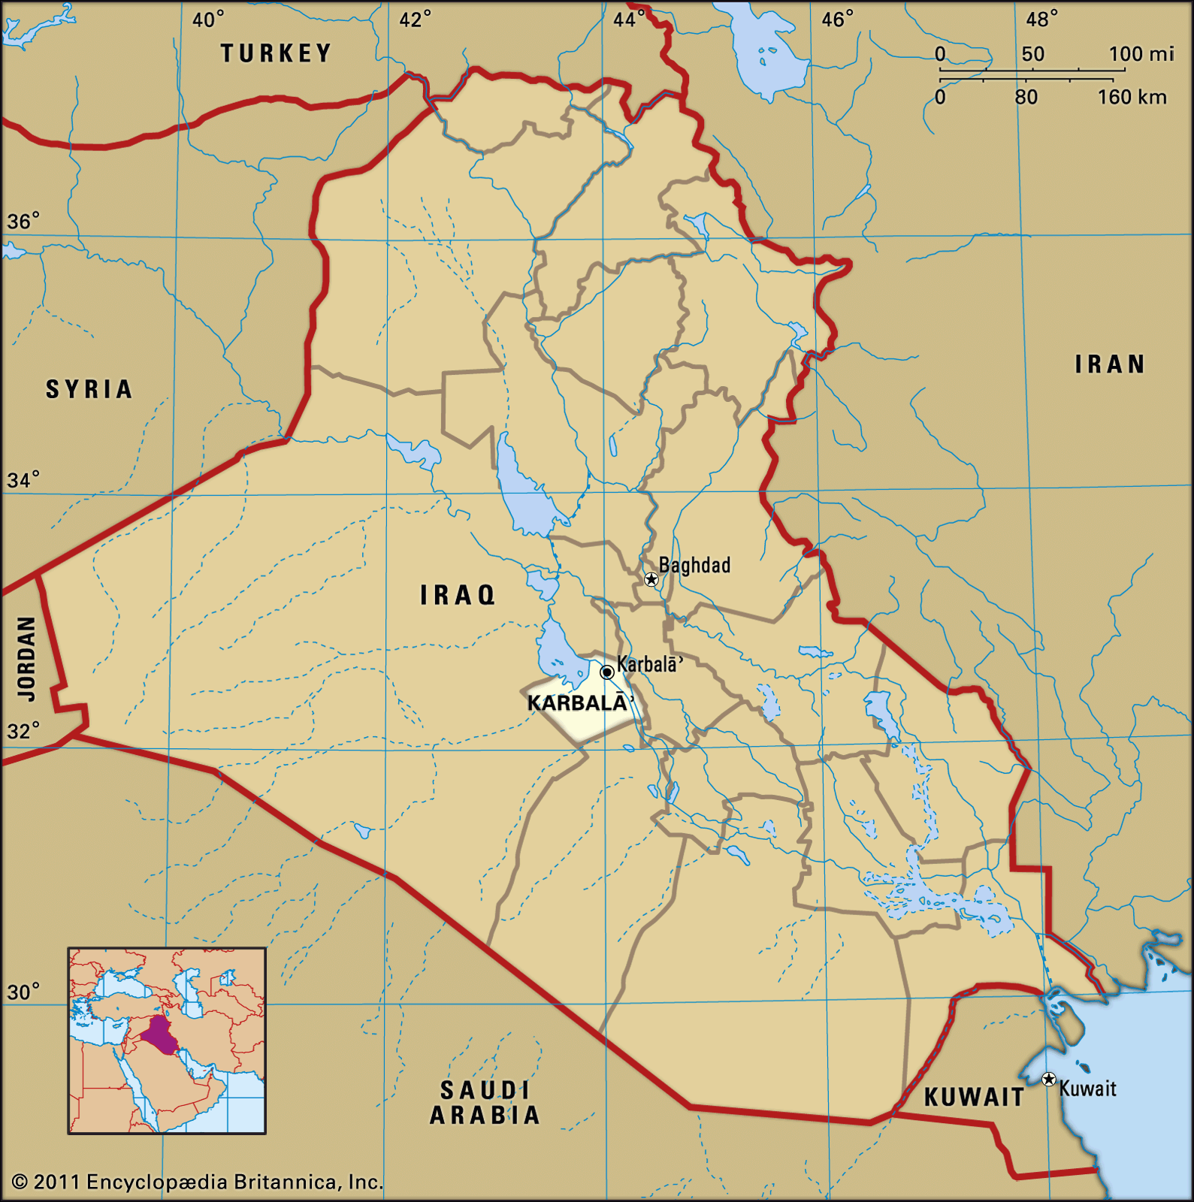
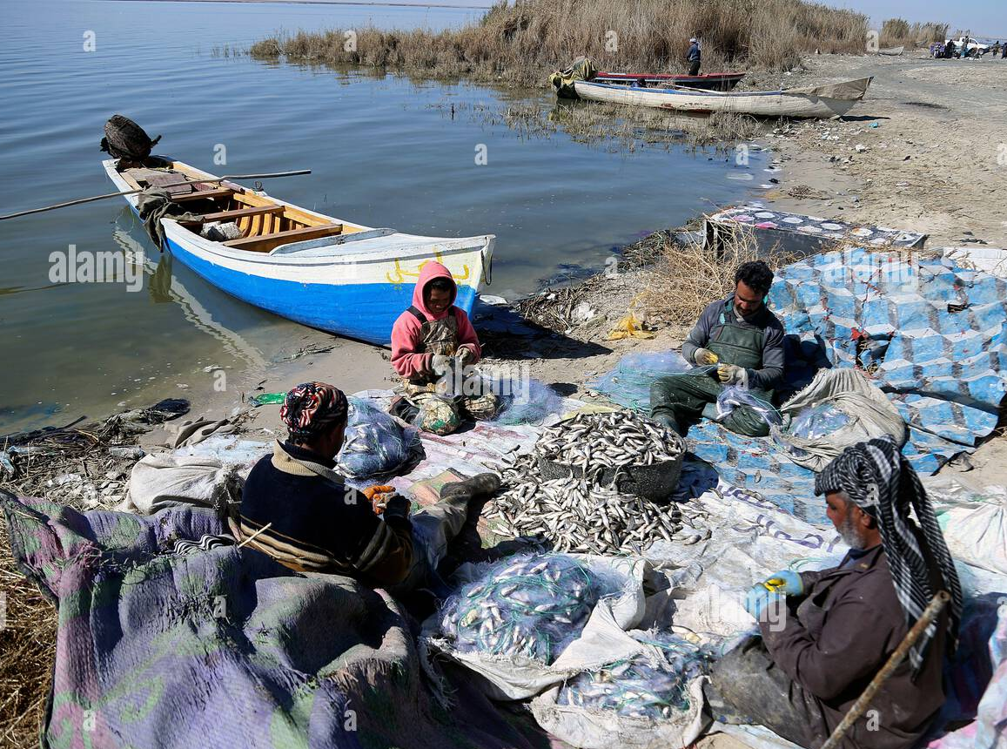
Abstract
The quantity, quality, and timing of water resources is vital to sustain life, biodiversity, and agriculture. Remote sensing techniques monitor hydrologic change in Karbala, Iraq focusing on drought impact, temperature rise, and vegetation health. Finds in this study highlight the urgent need for better resource management, as seen in the case of Lake Sawa, which dried up in 2023 due to poor oversight and climate change. This study could potentially guide management of finite freshwater resources such as reservoirs.

Slide 3
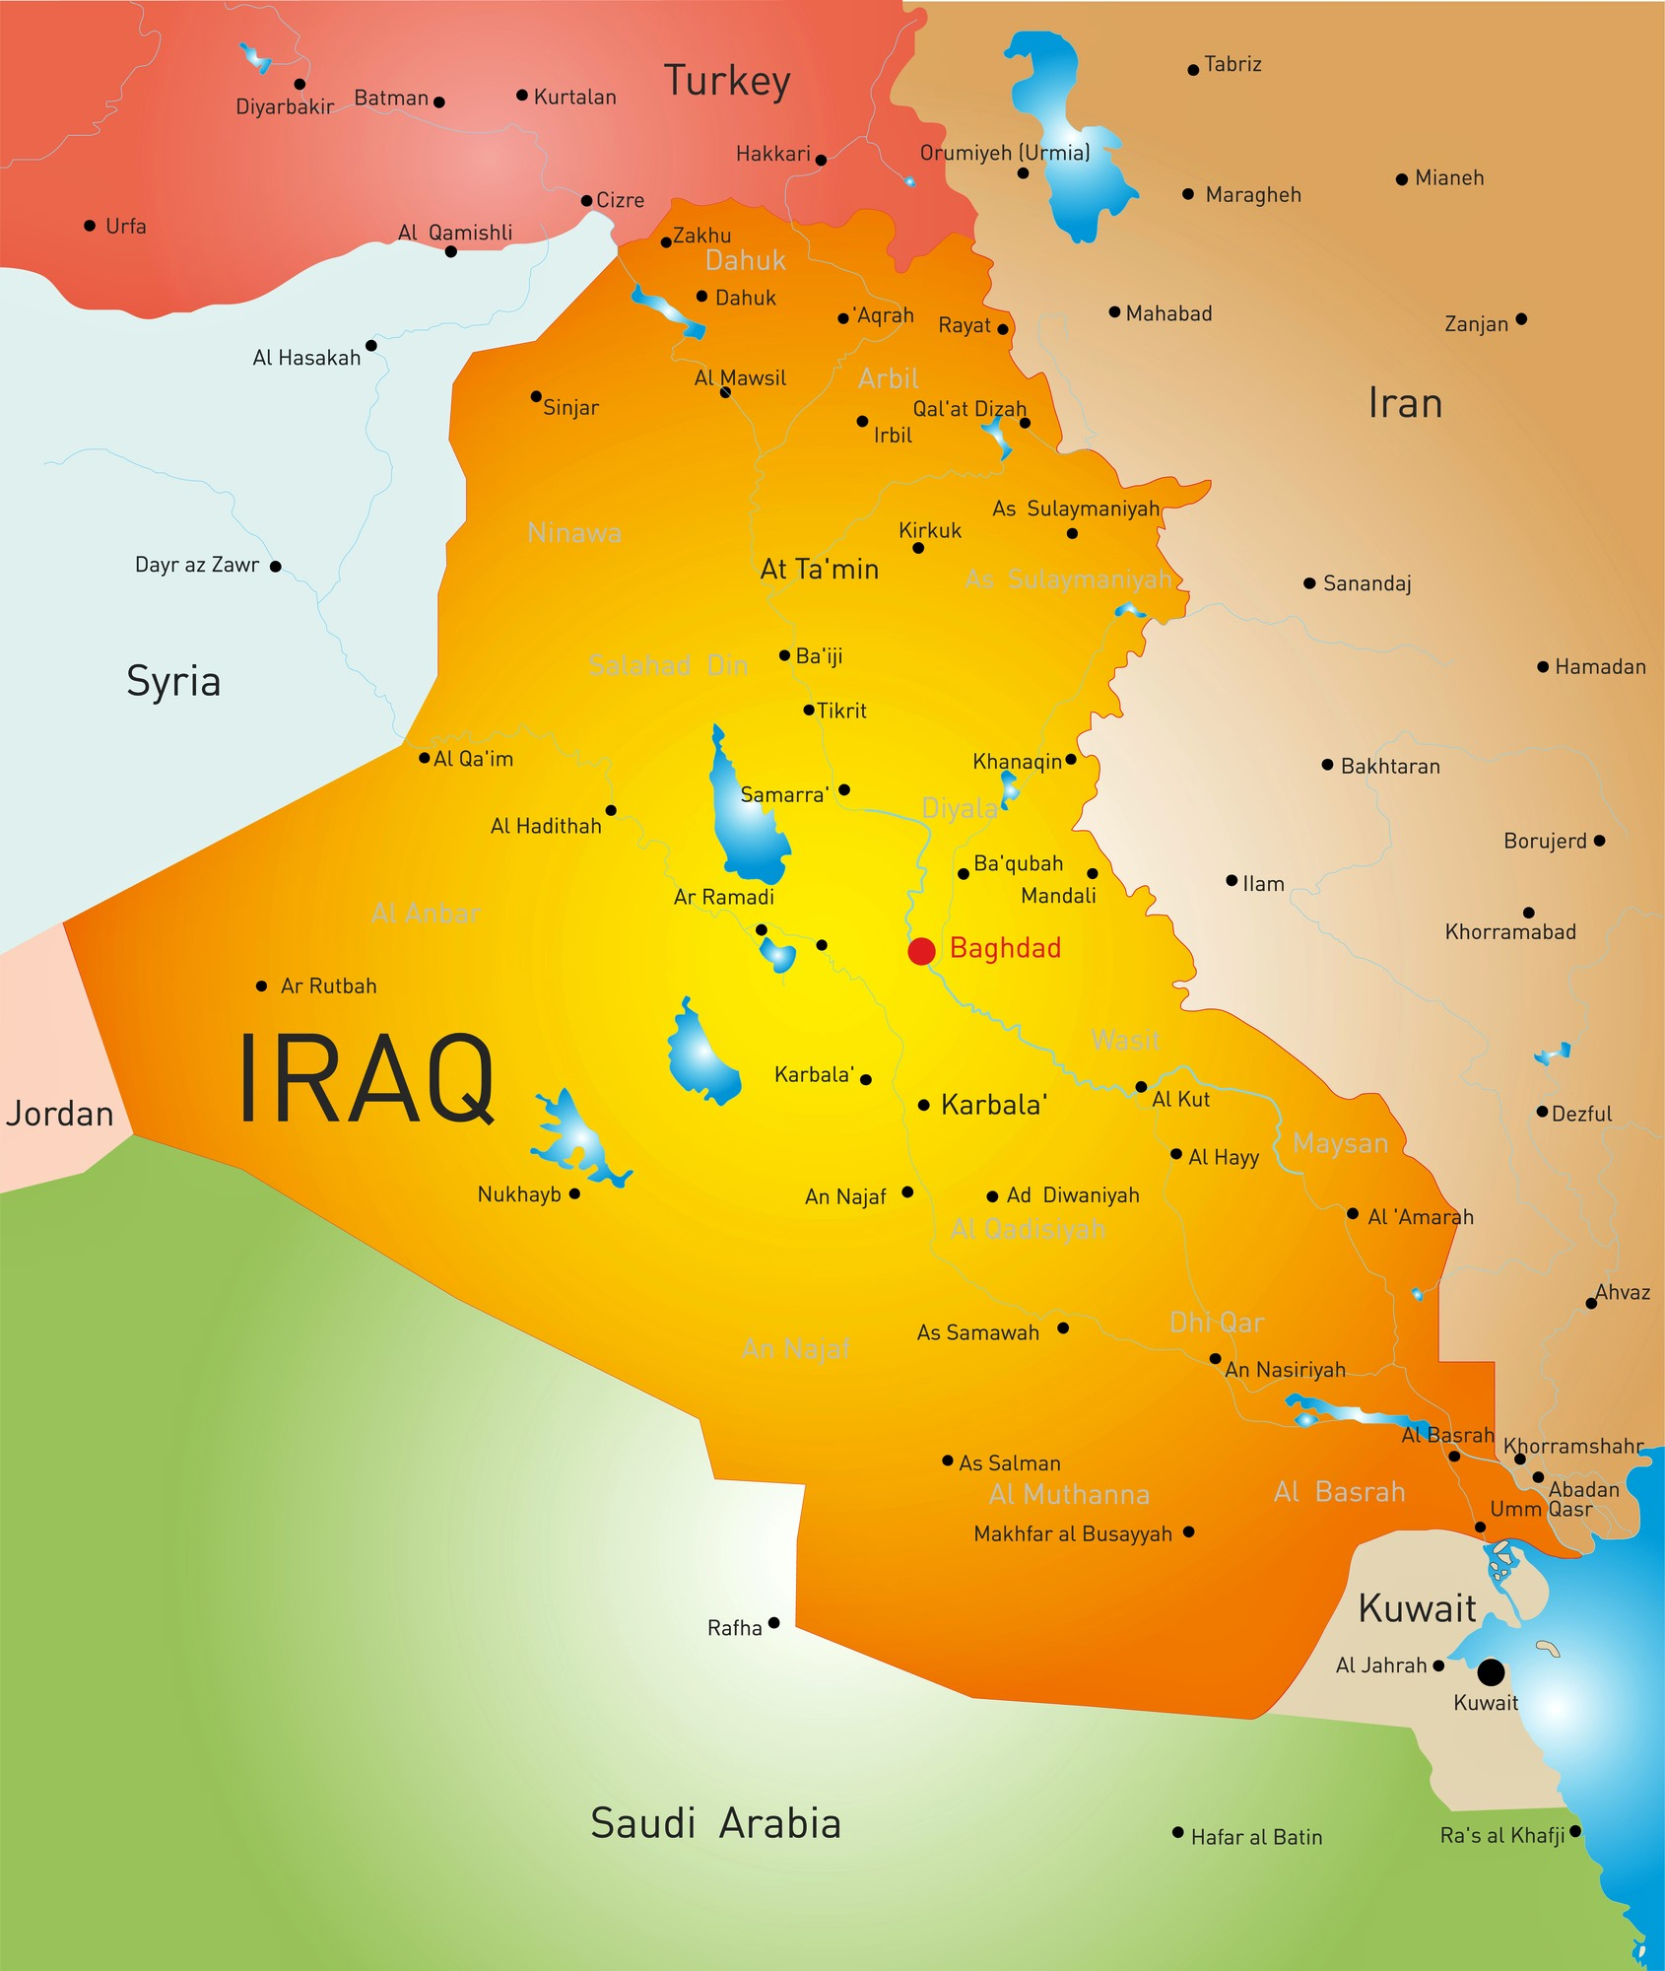
Introduction
Lake Milh, also known as Lake Razzaza, is the second largest lake in Iraq with Lake Tharthar being the largest in the region. Lake Milh suffered significant water loss due to upstream wars and agricultural use. Climate change plays a significant role in worsening the situation by reducing rainfall and increasing evaporation and salinity levels, which threaten local fish populations. The lake’s water level dropped from 112 feet to 66 feet above sea level, impacting agriculture and people in cities like Karbala and Baghdad.

Slide 4
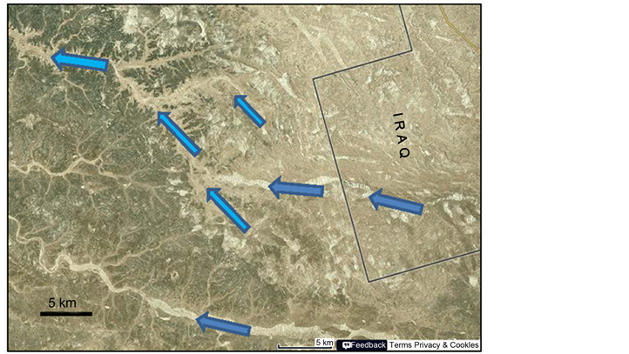
Land Cover Unsupervised classification
Unsupervised land cover classification was conducted using Landsat 5/8 imagery. ISO classification quickly highlights similar land types like water, agriculture, and urban areas, without needing training data. Only nine classes were needed to represent the region’s land cover trends. However, the classification may include errors due to mixed pixels, where a single pixel contains more than one land type, such as water and agriculture (Chen, 2025).

Slide 5
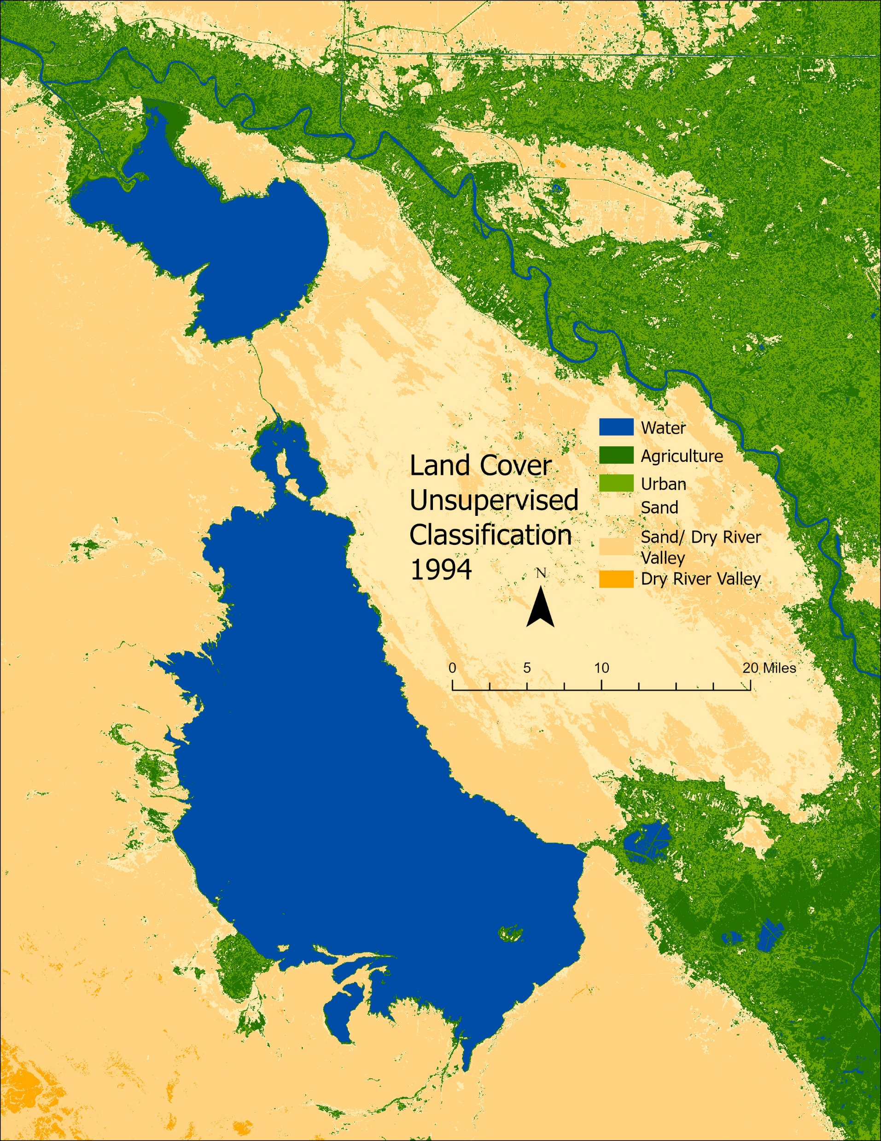
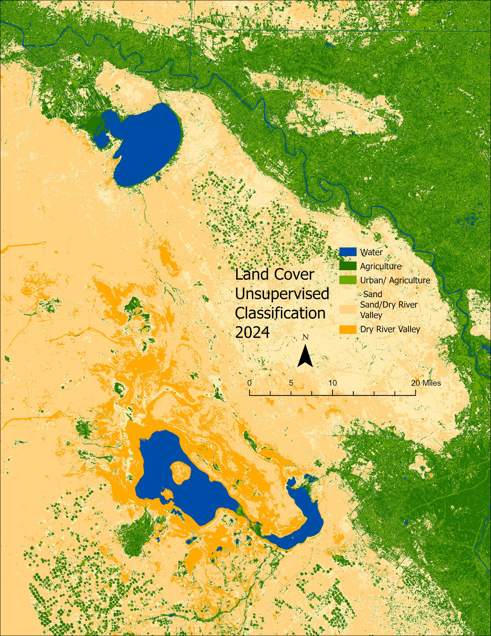

Slide 6
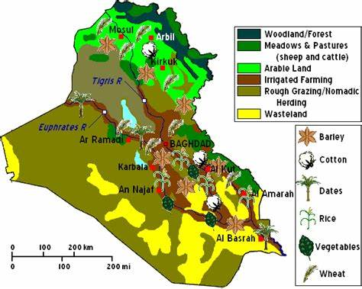
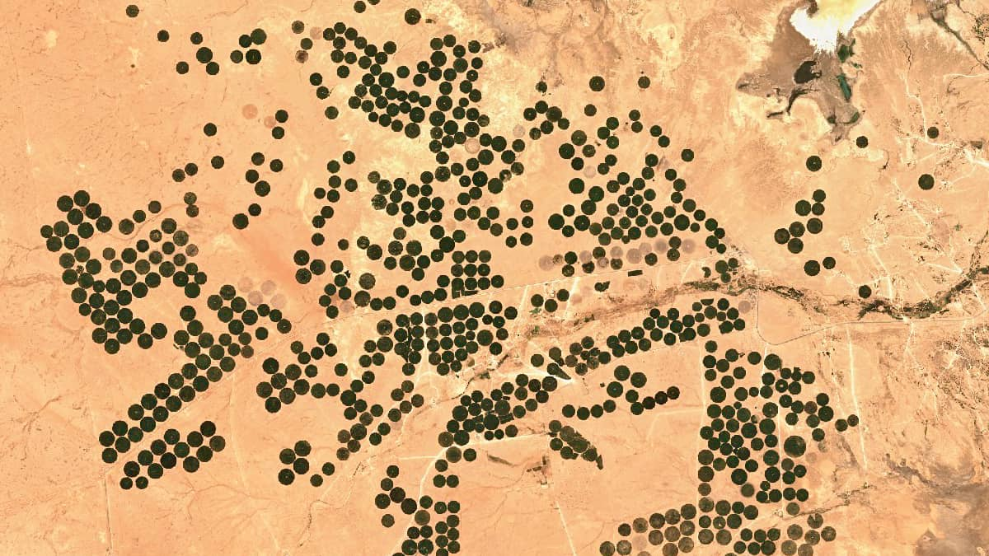
Temperature
Temperature analysis using Landsat 5/8 thermal data visualizes how human activities and climate change impacts the distribution of hot and cool surface temperatures across the landscape (Imtiaz, 2025).
Barley needs around 4 inches to 5 inches while wheat needs 12 to 15 inches of water to get a crop from germination to reproductive state where it produces grain.

Slide 7
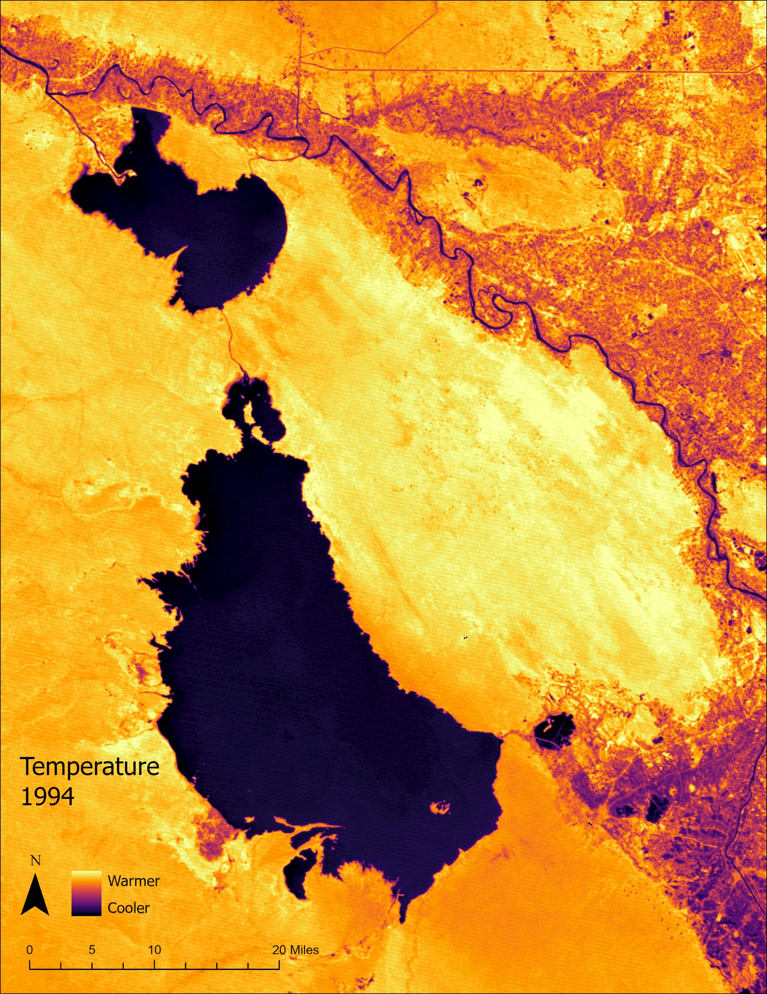
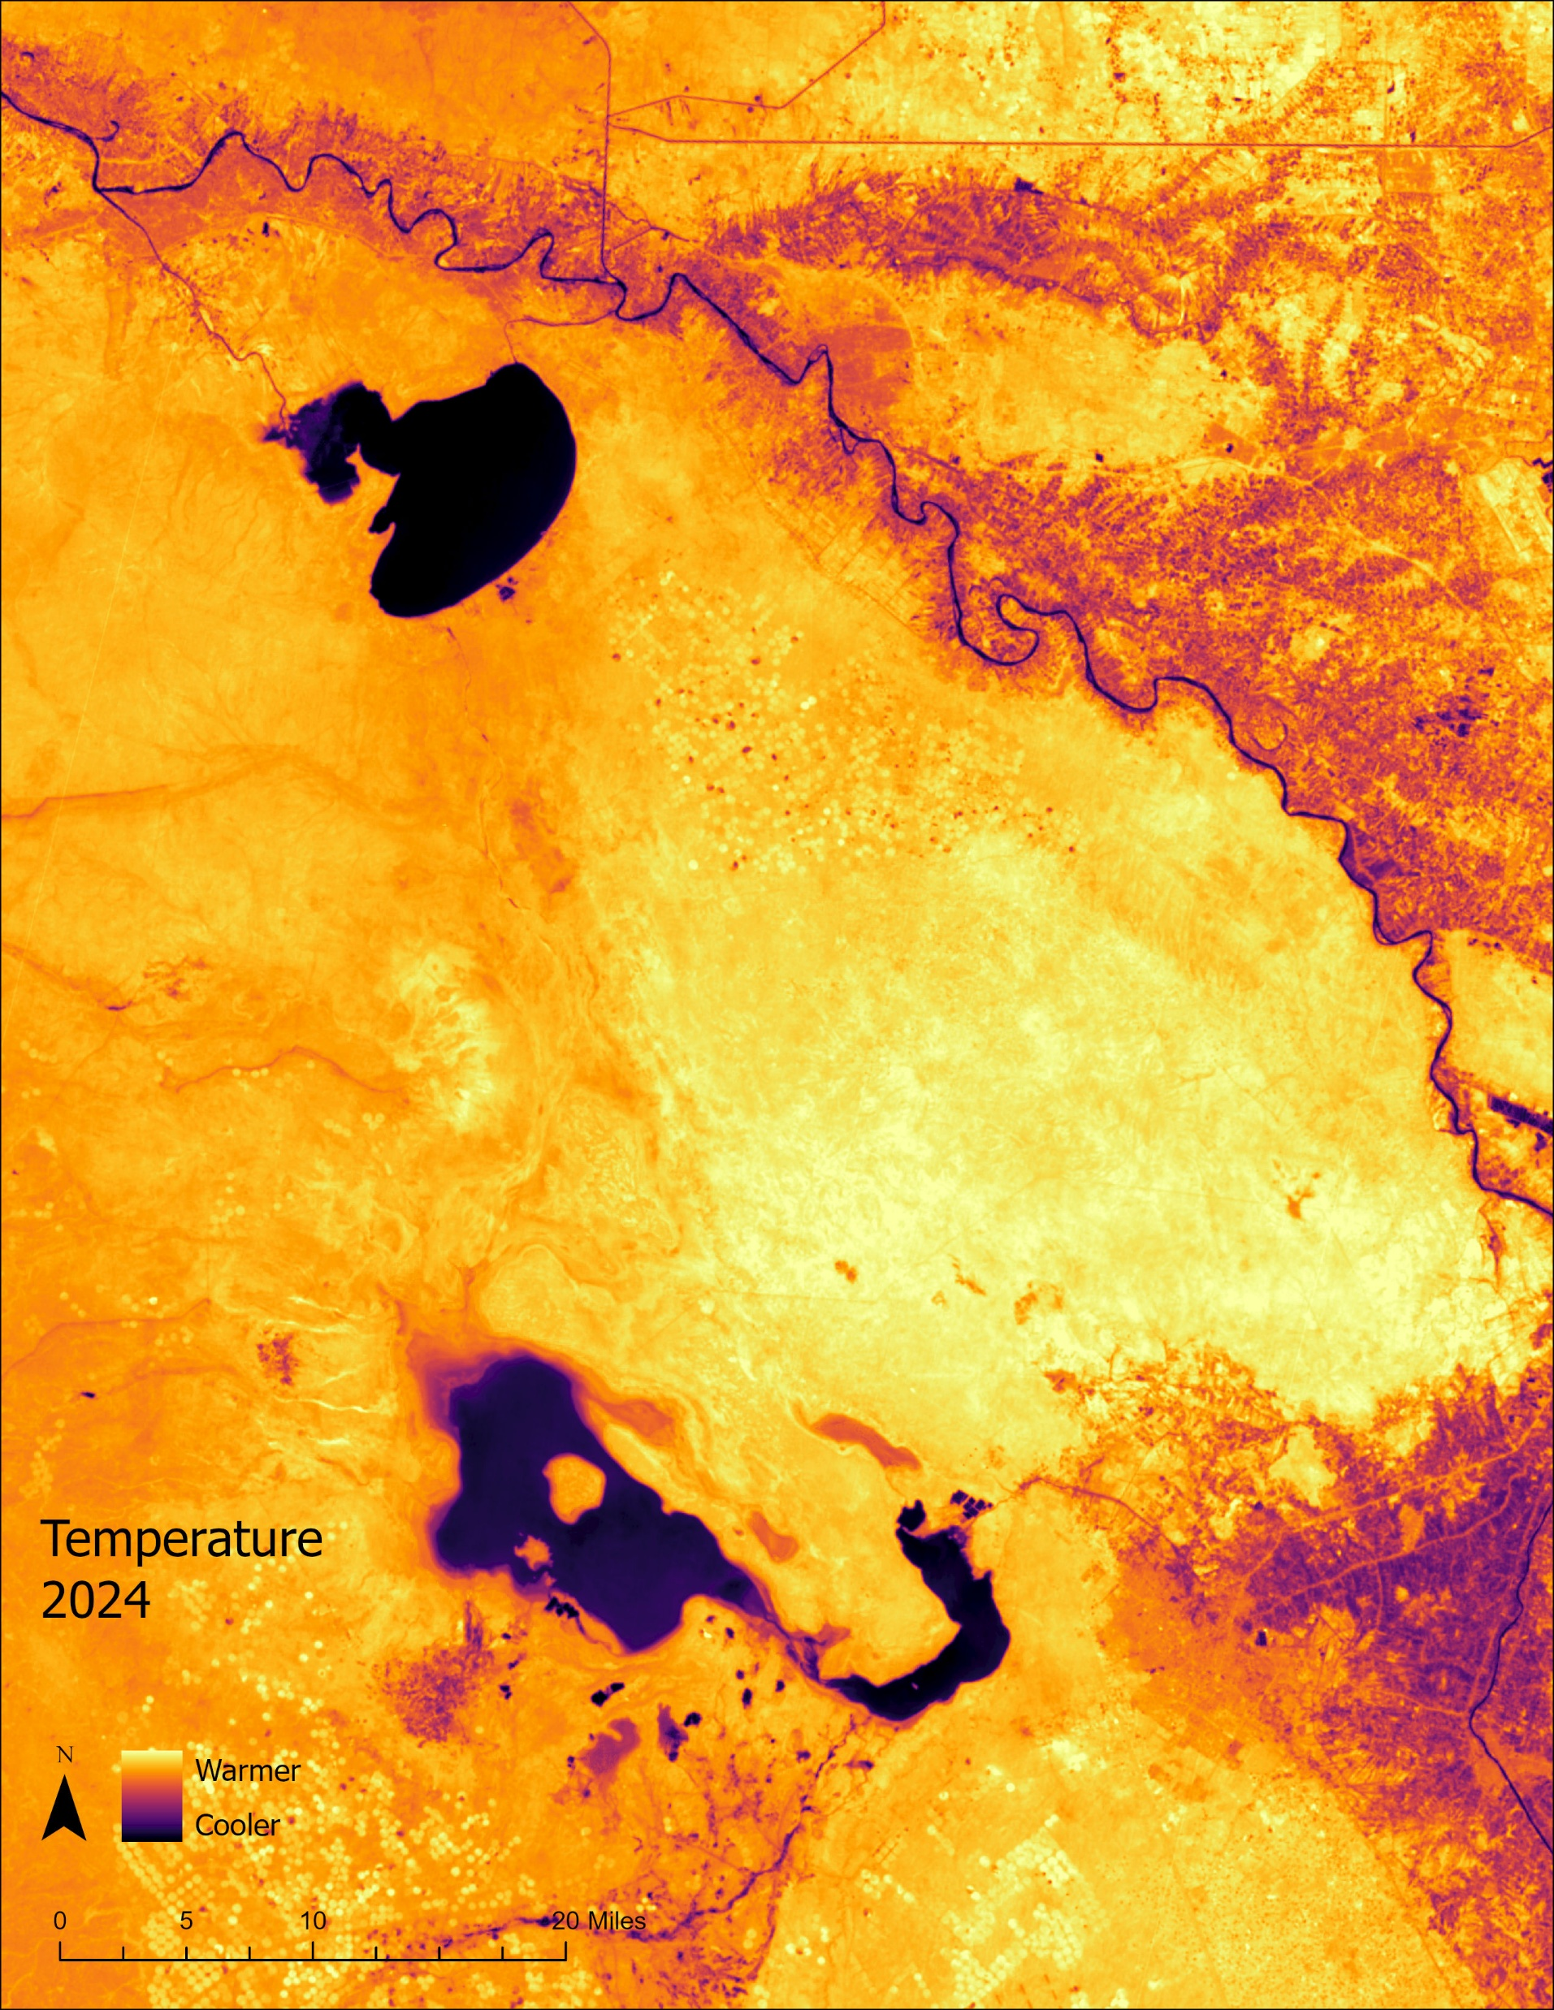

Slide 8
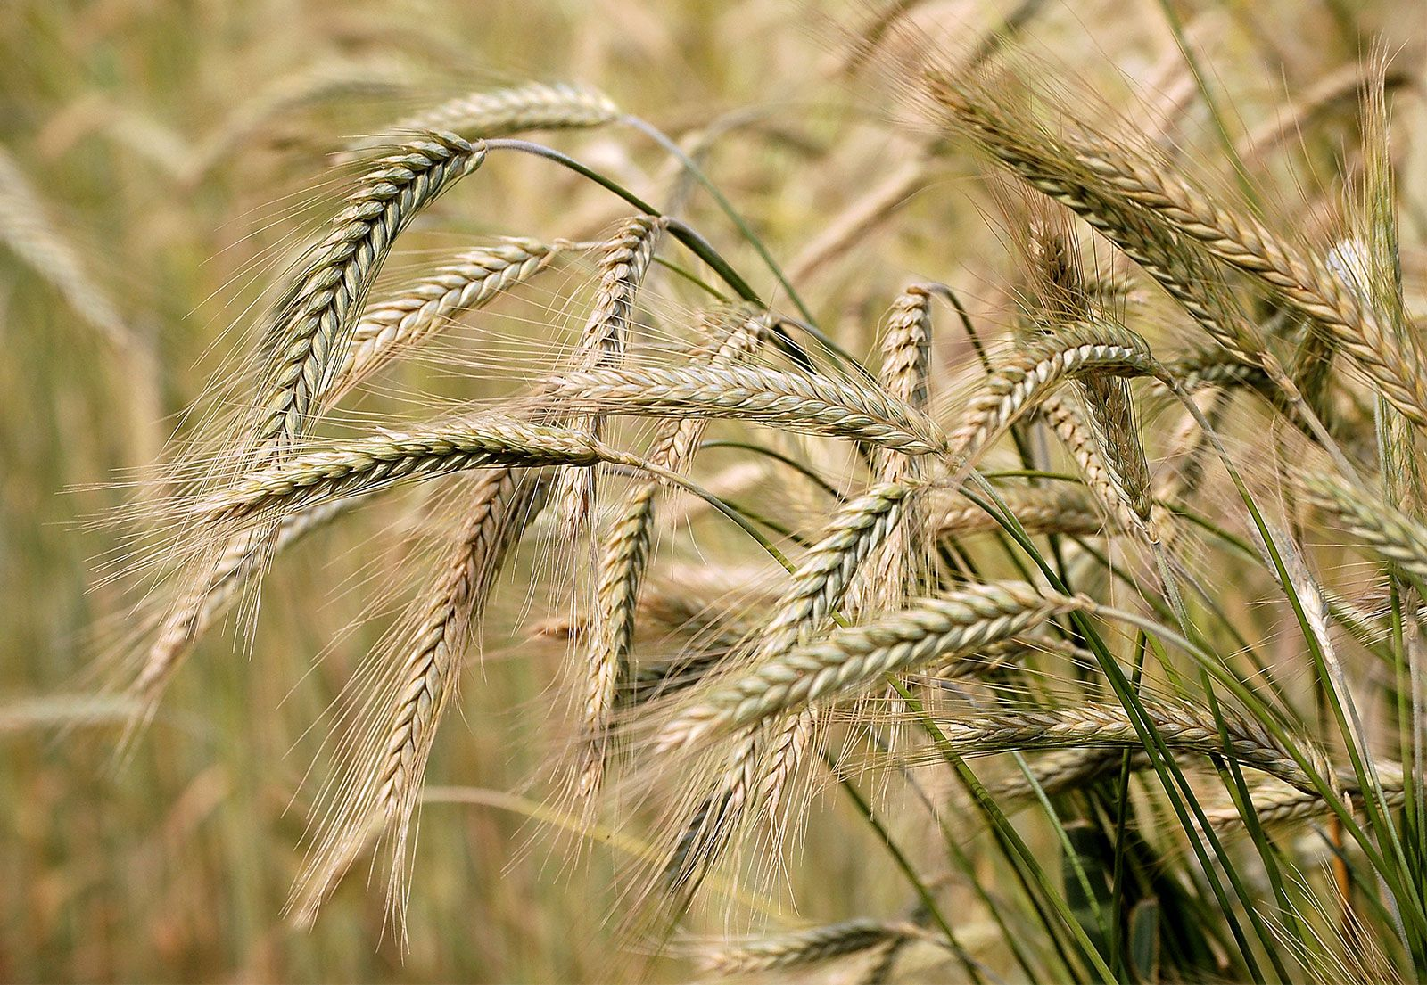
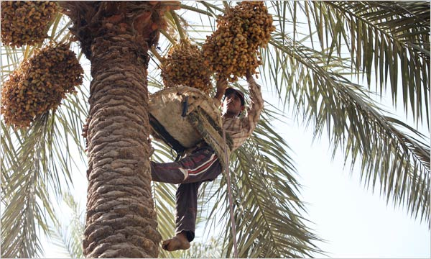
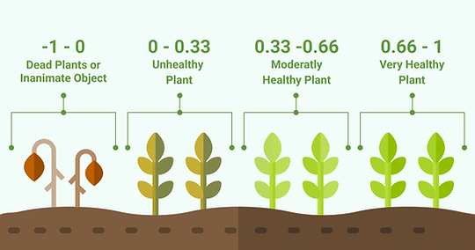
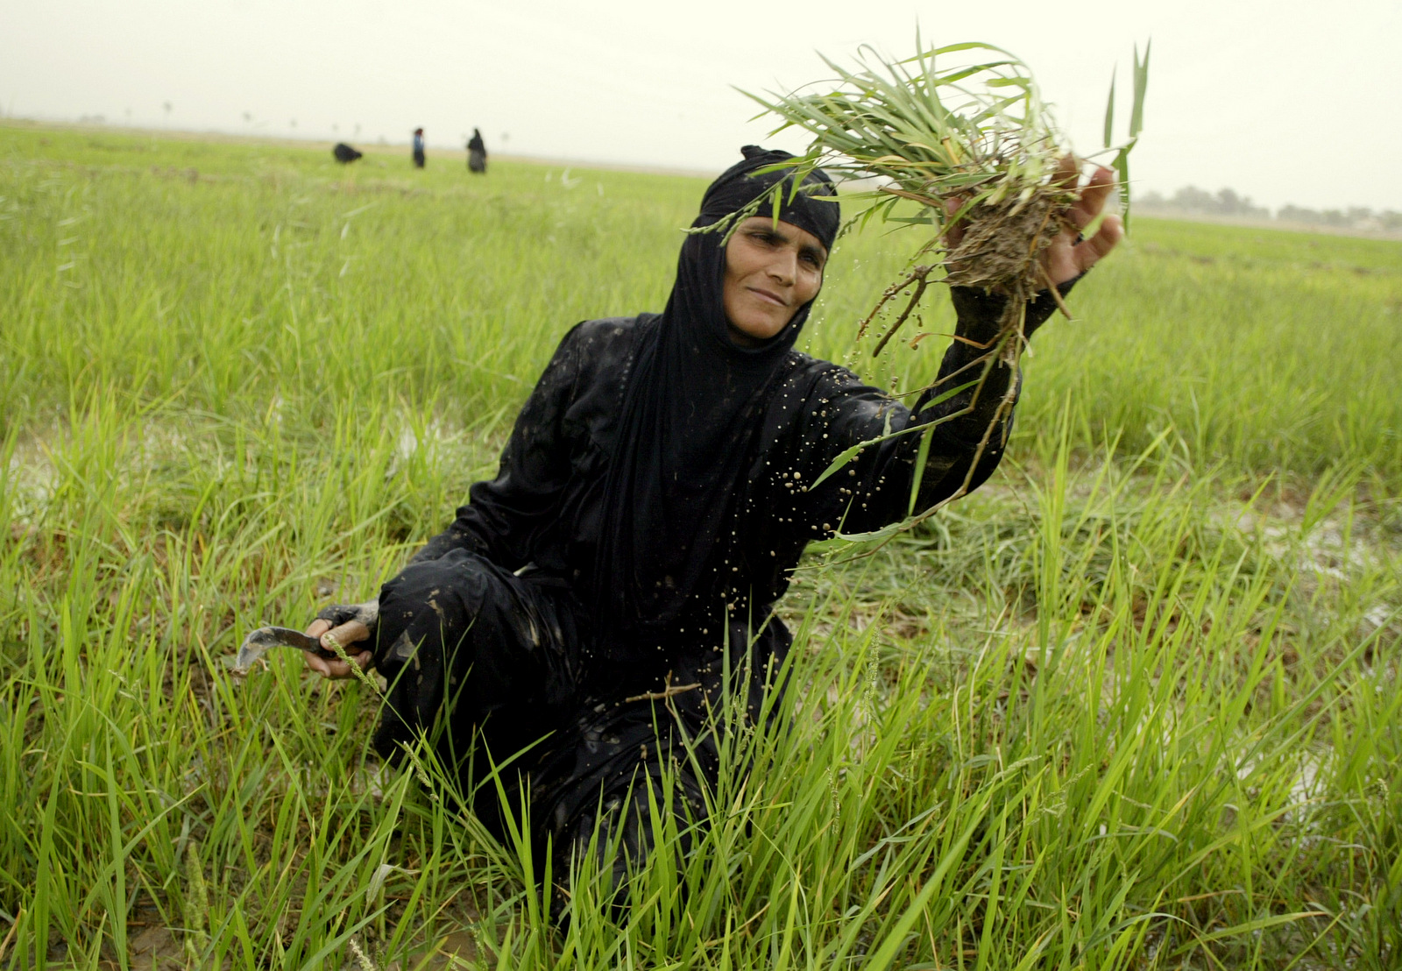
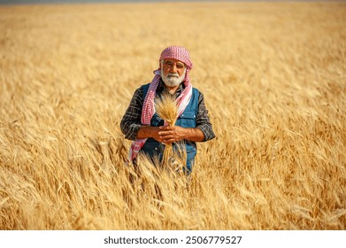
Vegetation
Normalized Difference Vegetation Index (NDVI) was calculated using Landsat 5/8 to monitor environmental vegetation health. Changes in vegetation indicate areas where vegetation has declined (Bellvert, 2025).
Barley
Dates
Rice
Wheat

Slide 9
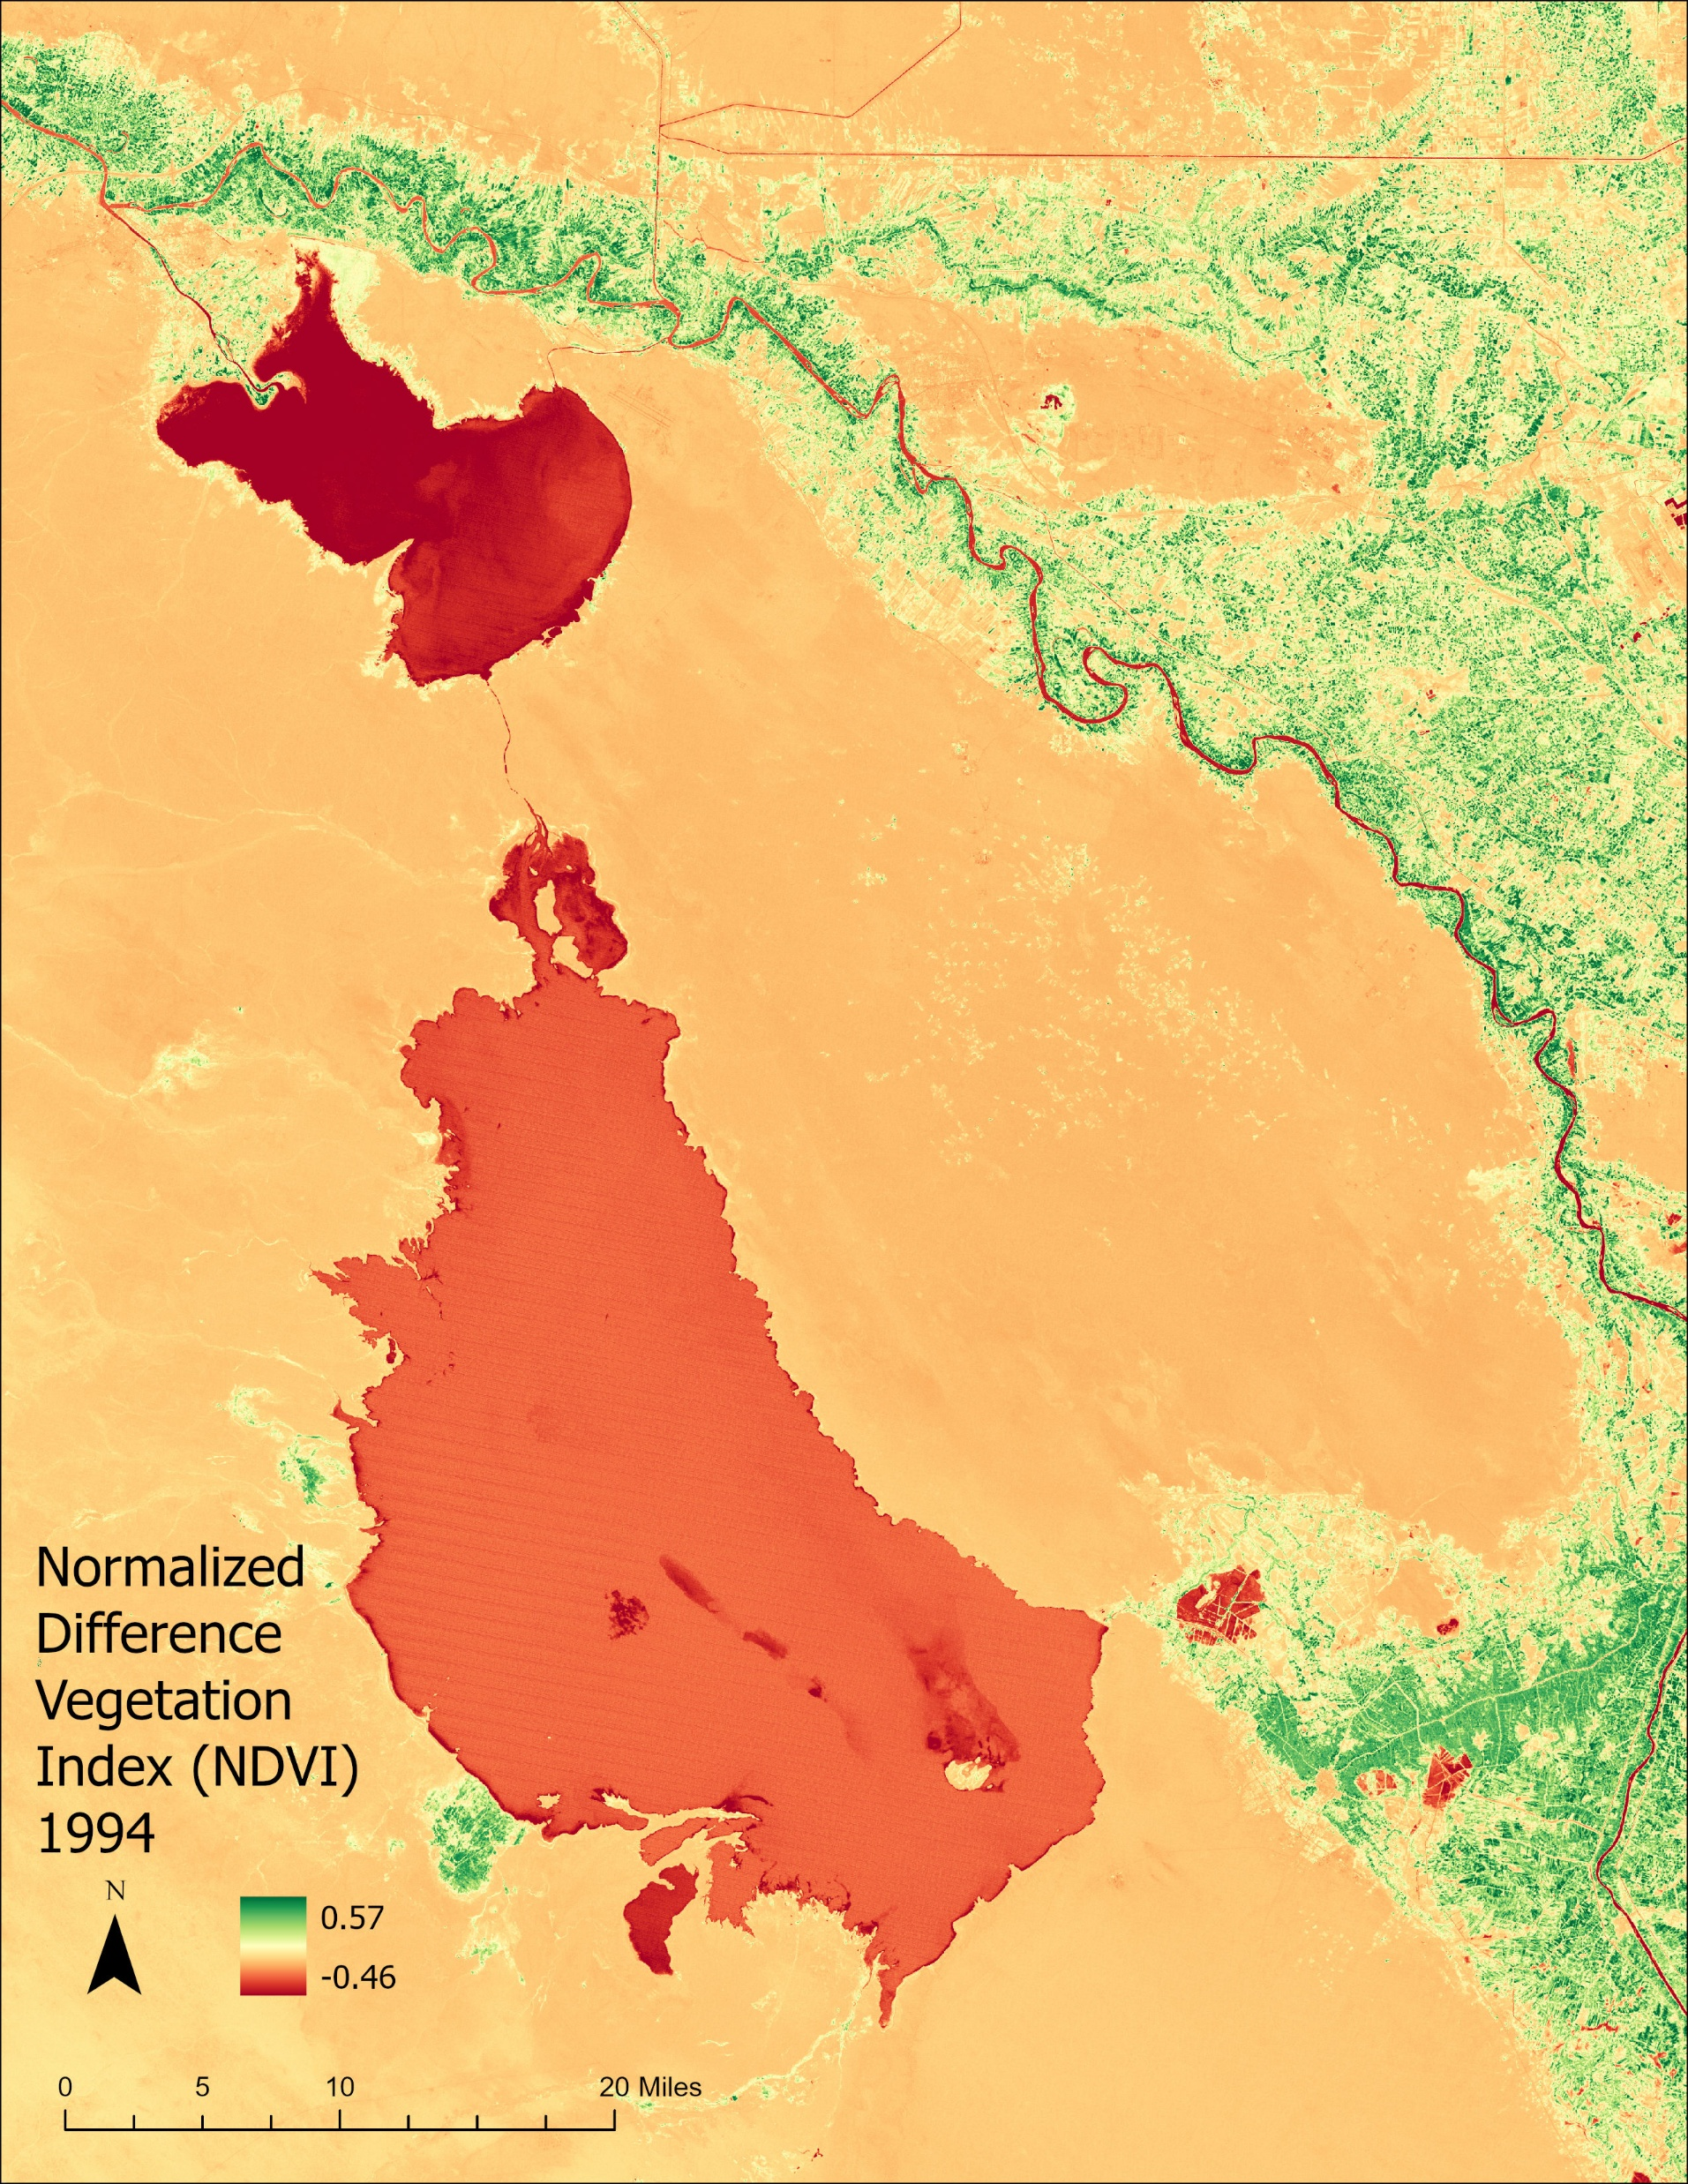
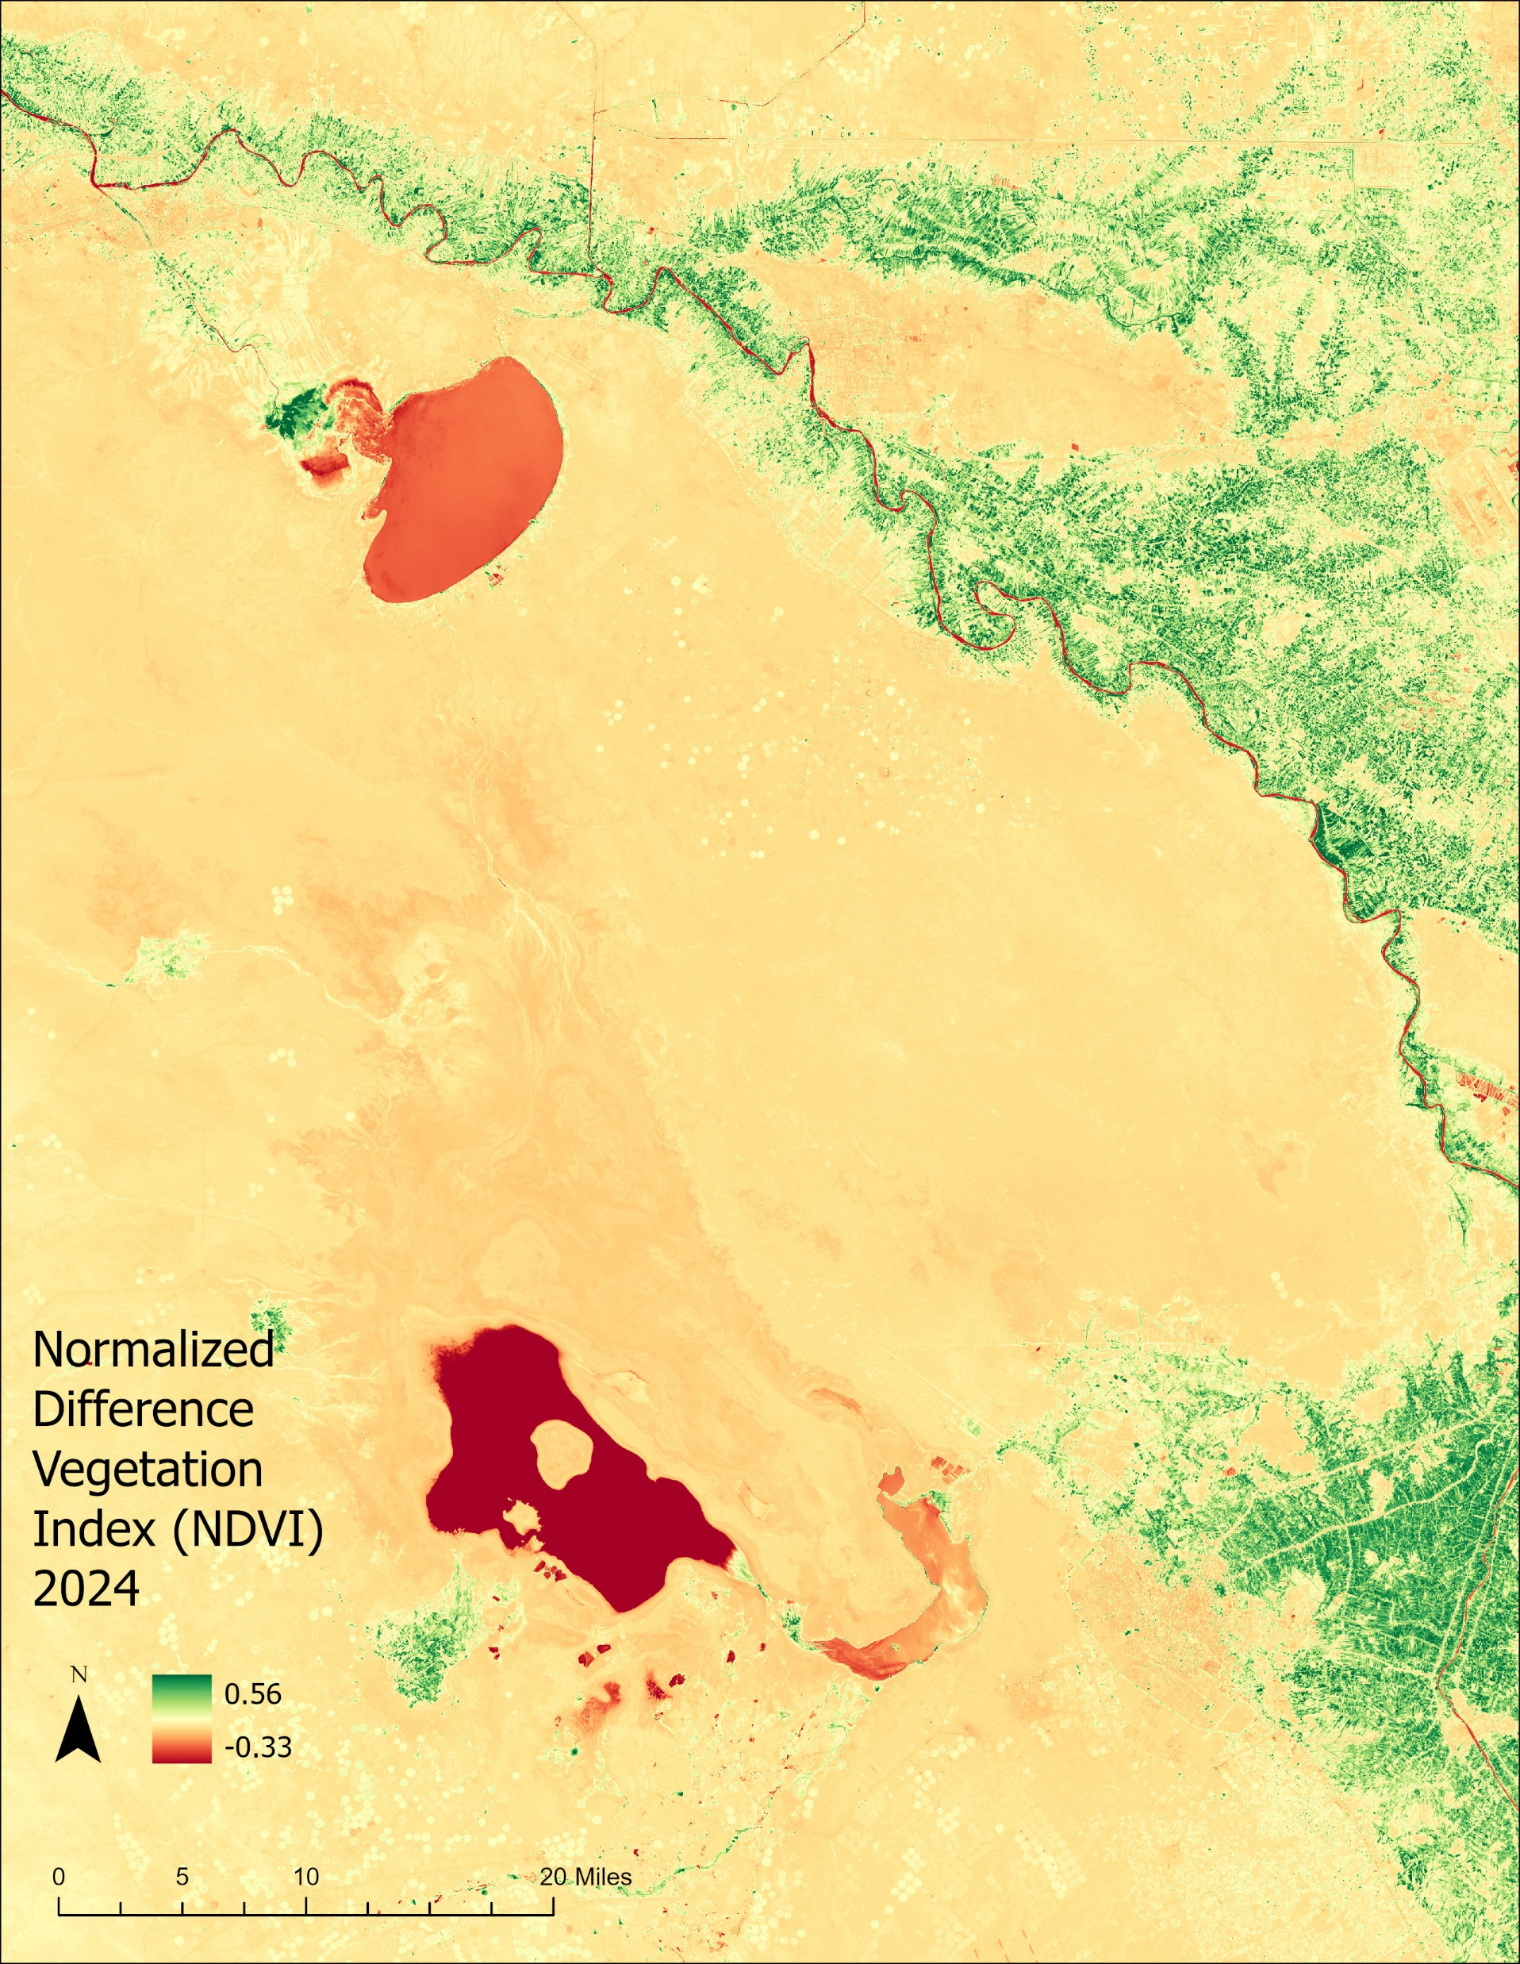

Slide 10
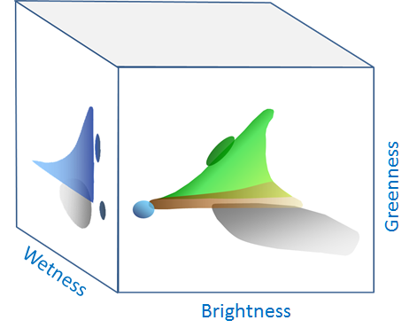
Tasseled Cap Transformation
Tasseled Cap Transformation was applied to Sentinel-2 data from January 16, 2024, converting the multispectral information into three key components: brightness, greenness, and wetness.

Slide 11
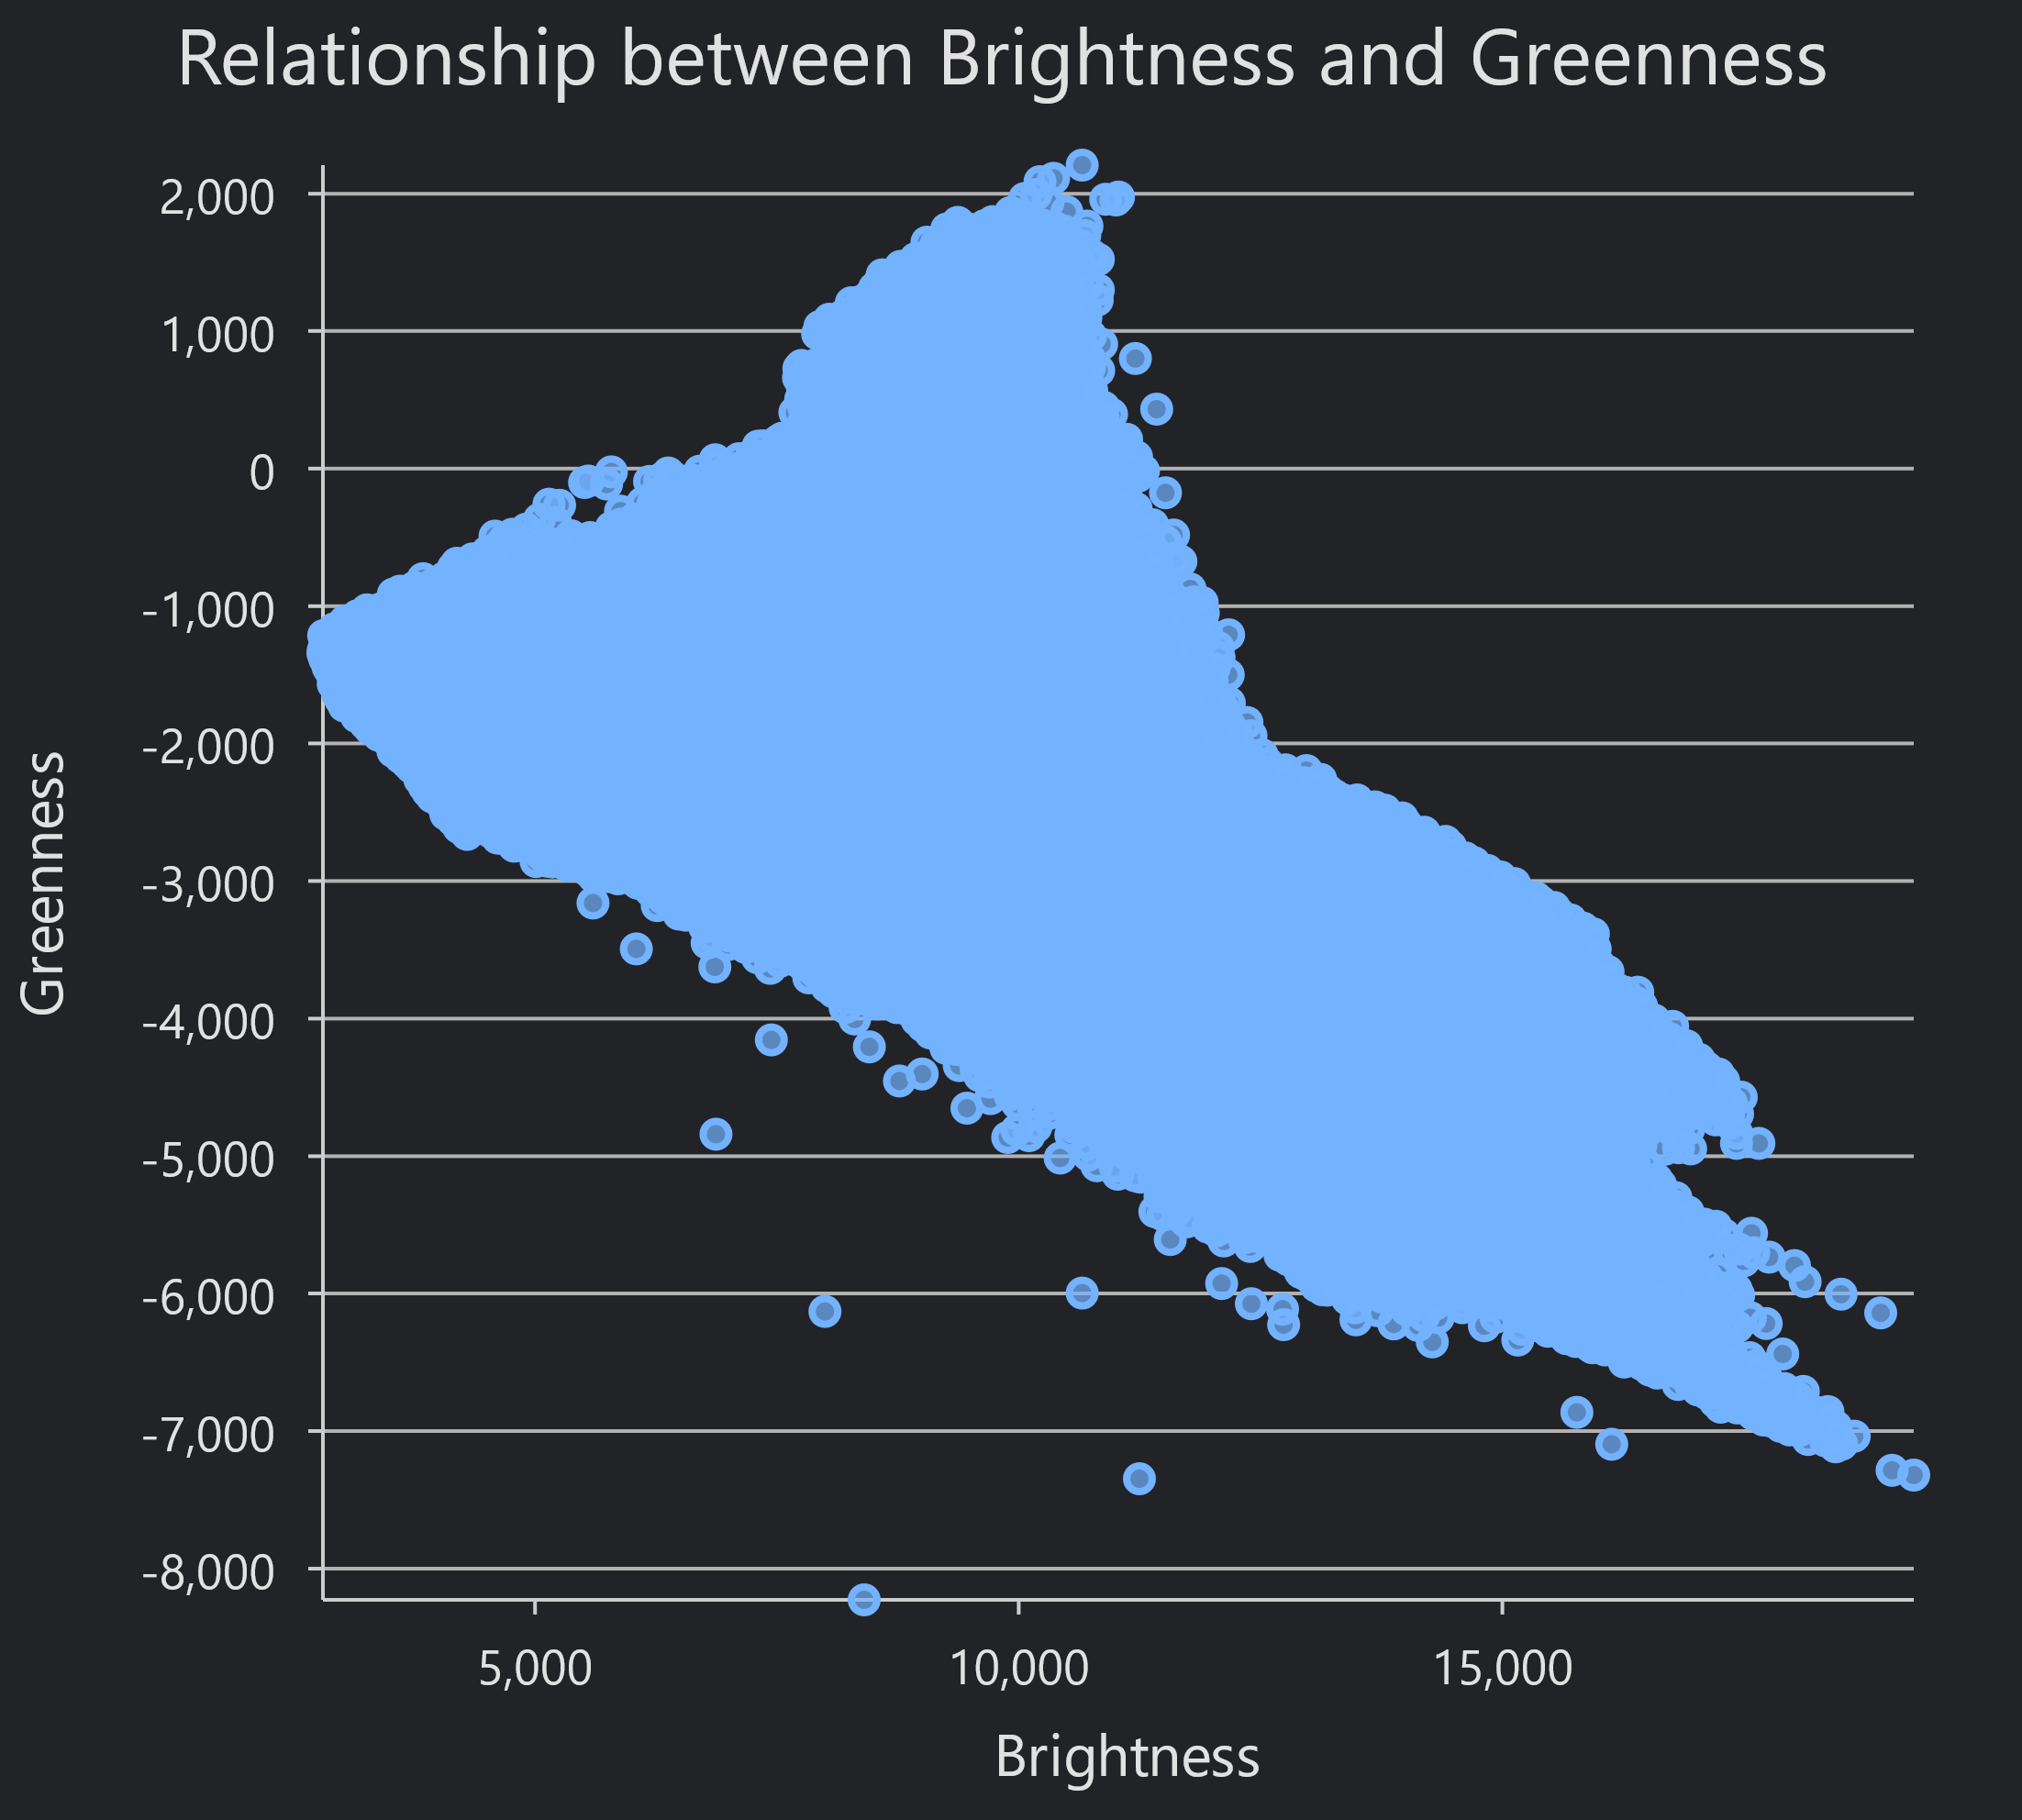
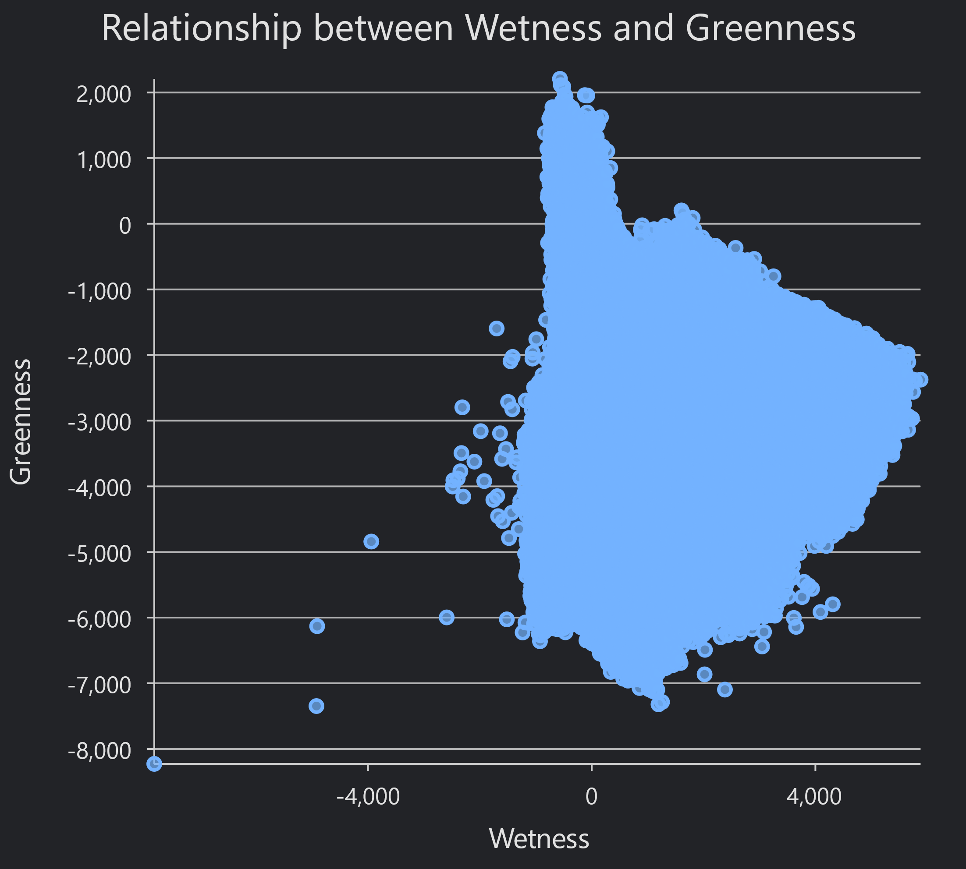
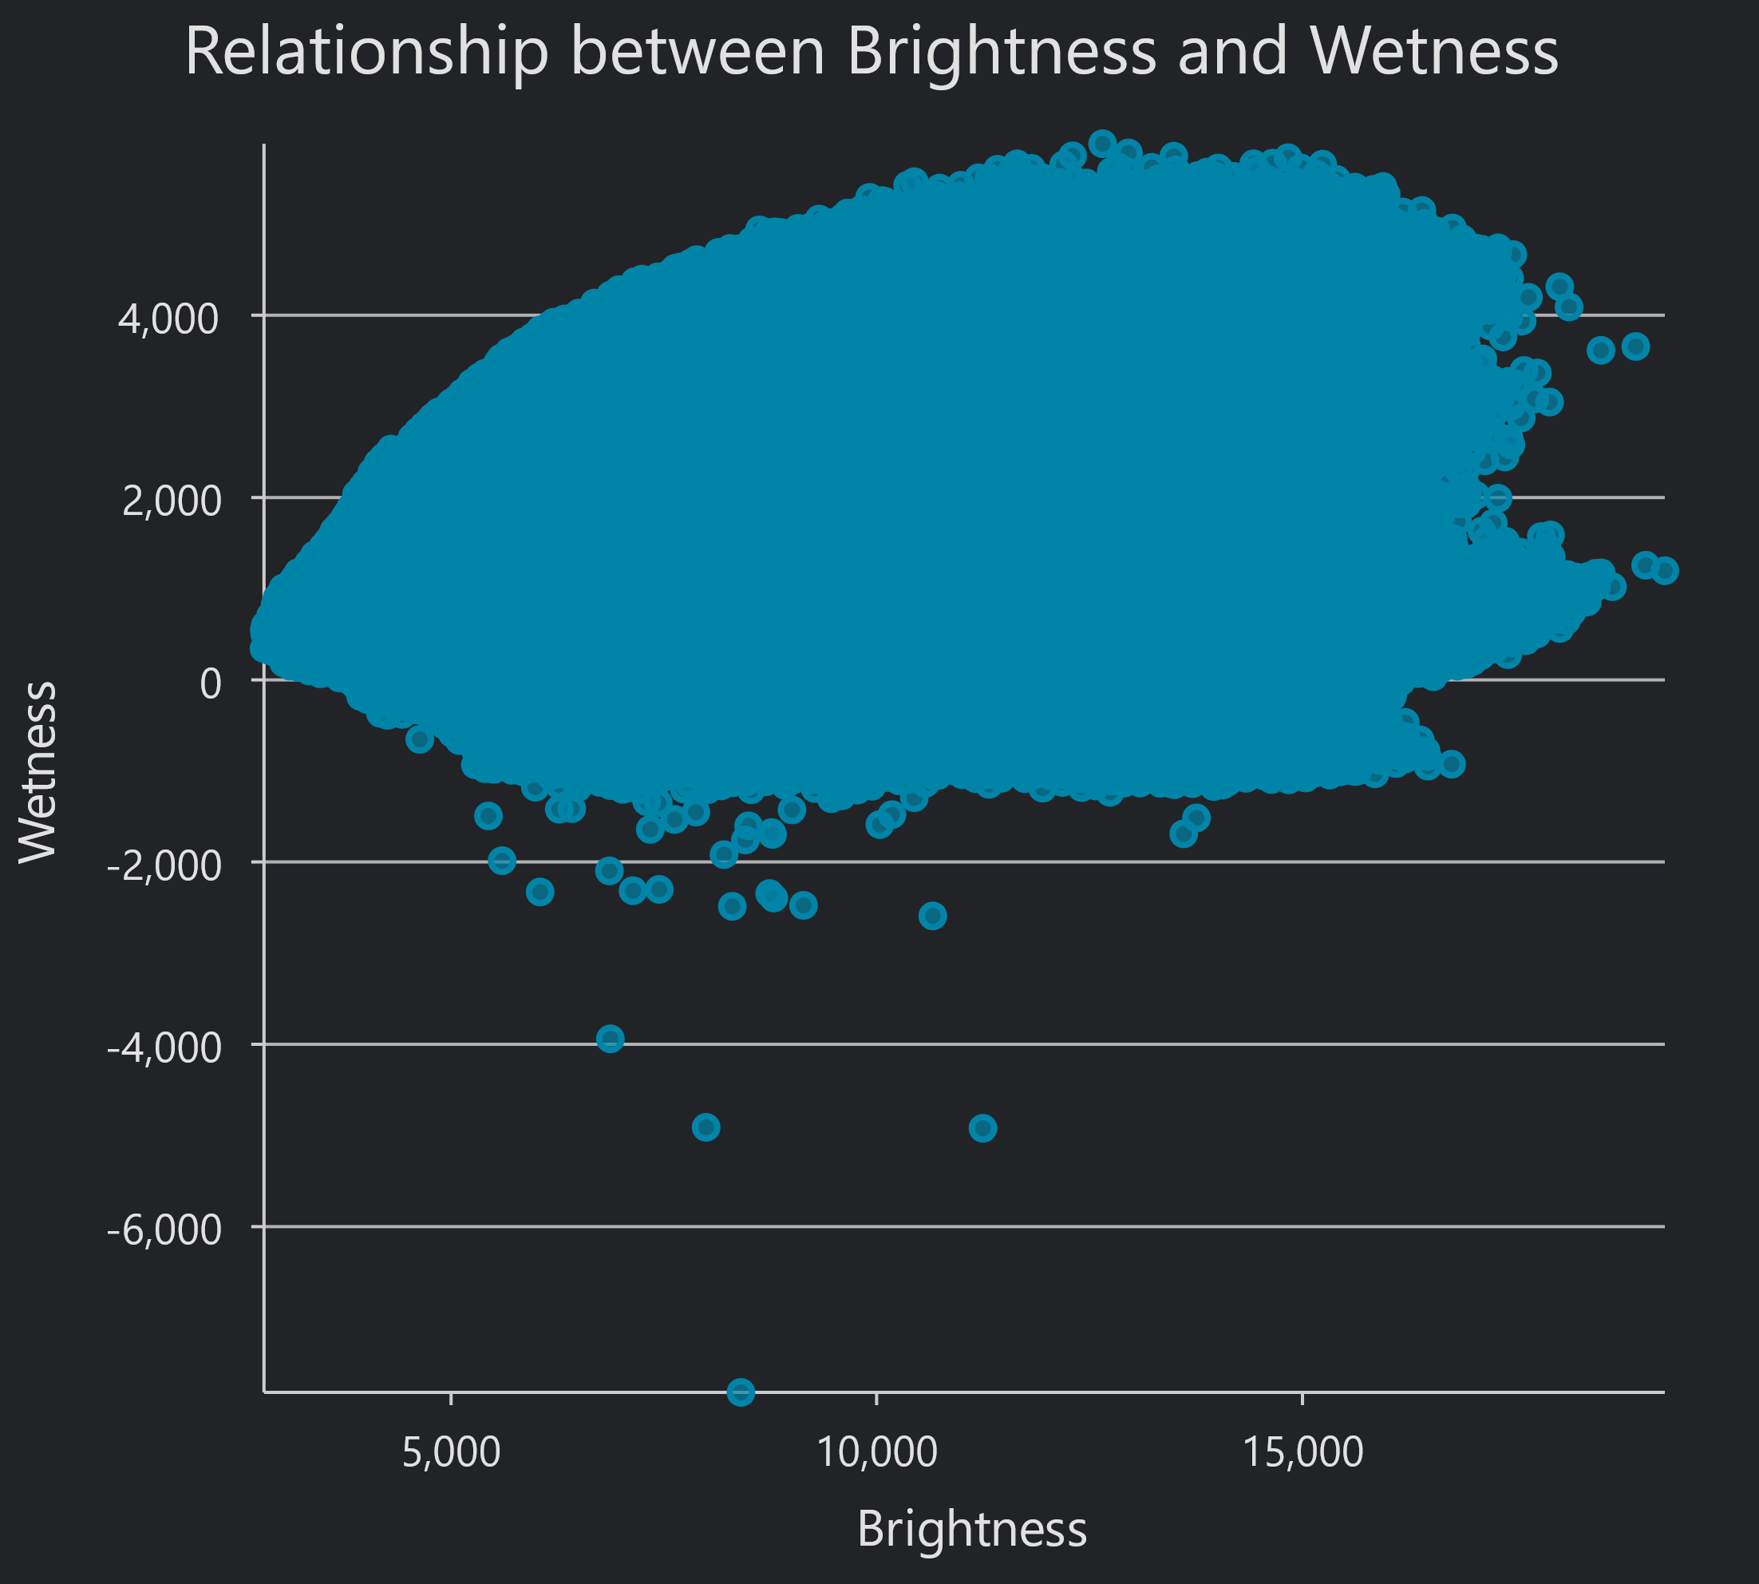
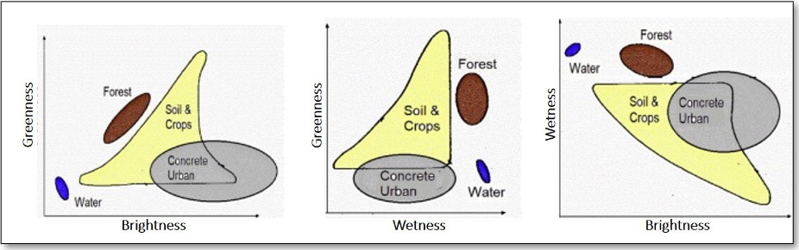

Slide 12
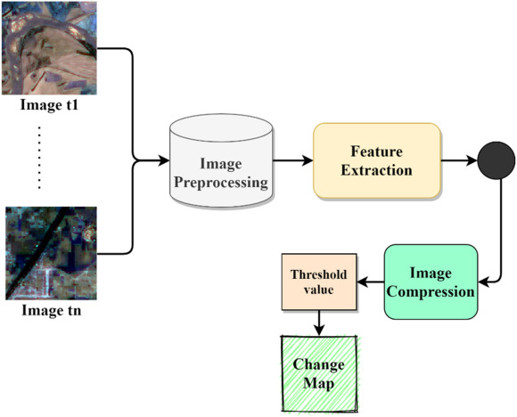
Change Detection
Change detection image differencing was performed using Landsat 5/8 imagery, focusing on band 4 which is the Near- infrared. This type of map plays a key role in environmental monitoring, urban planning, and assessing impacts of both natural and human-made disasters.

Slide 13
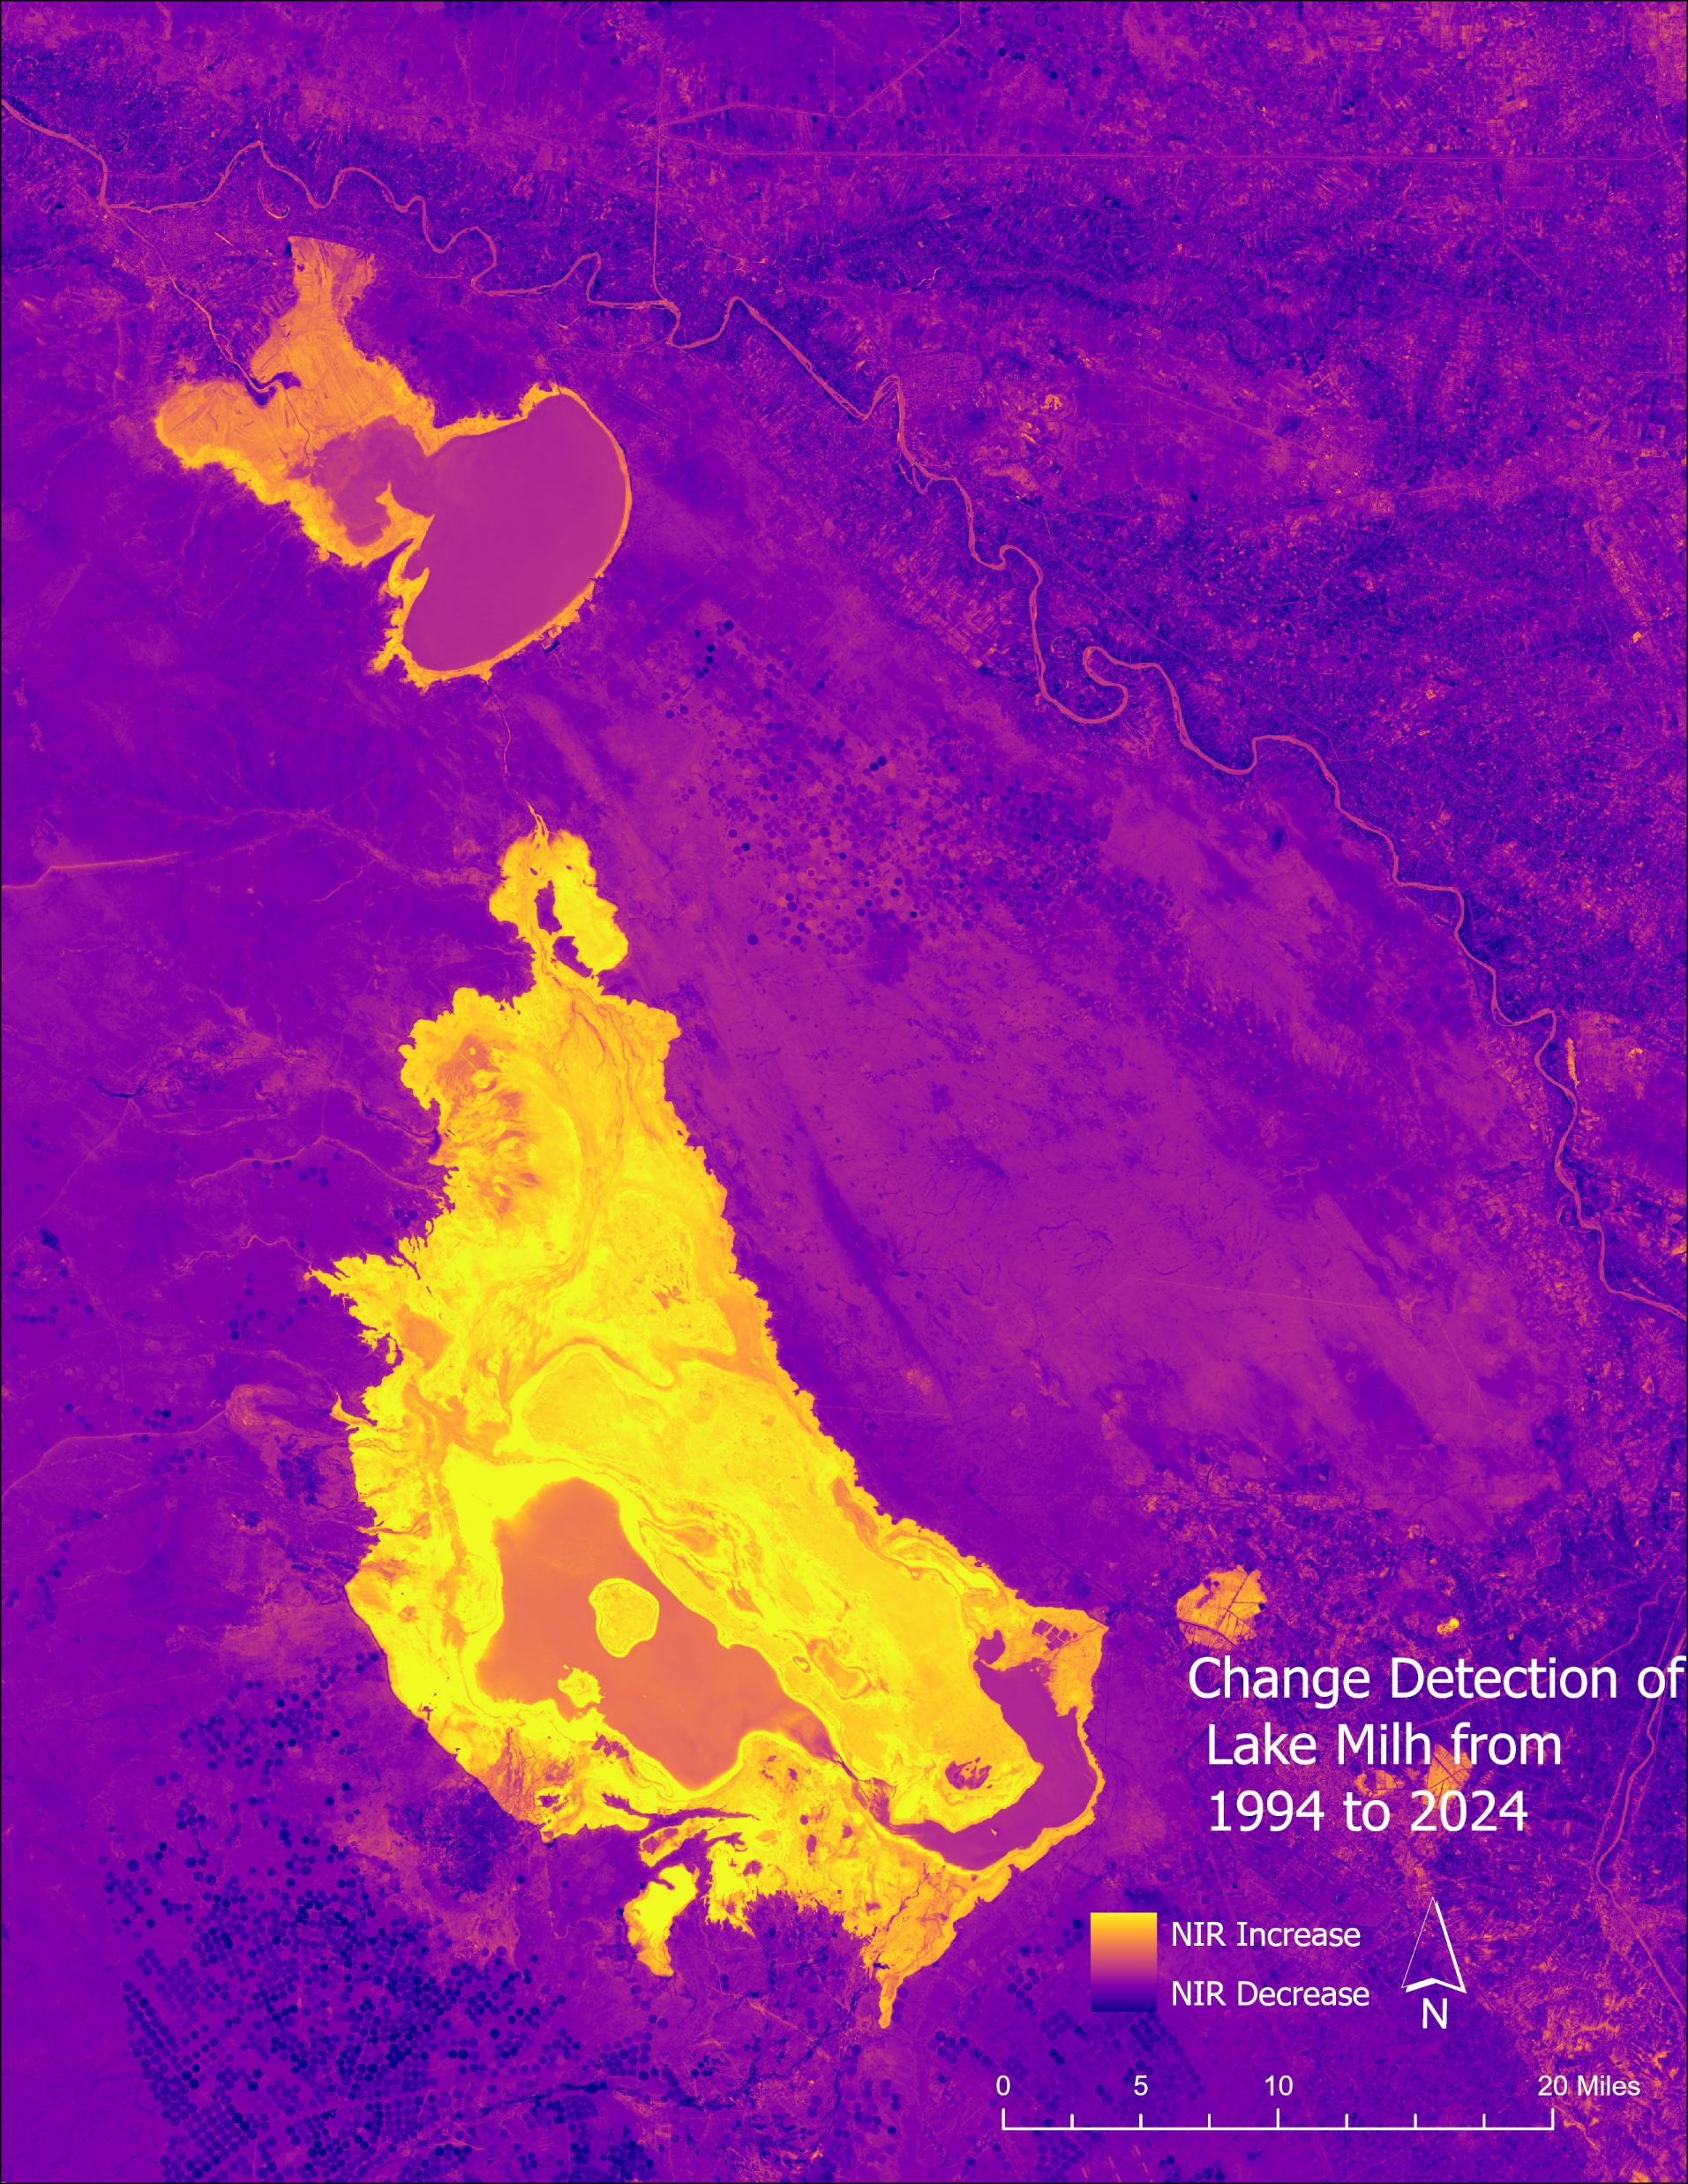

Slide 14

Conclusion
This explanatory remote sensing project examines the impacts of droughts in dry areas, where upstream disputes, dam constructions, and decreased rainfall have resulted in dramatic reductions in water levels. These water shortages have regional tensions and conflicts. The project measured the magnitude of water loss over 30 years, and the result was a dramatic change.

Slide 15


Acknowledgments
I would like to thank Dr. Ignatius for her support and encouragement throughout this study. I also appreciate the IESA program at the University of North Georgia for providing the educational resources that made this work possible. Finally, I’m grateful to the ASPRS Mid-South Conference Lead for the opportunity to present this research.

Slide 16
References
Bellvert, Joaquim, et al. "Evaluating the Impact of Drought and Water Restrictions on Agricultural Production in Irrigated Areas through Crop Water Productivity Functions and a Remote Sensing-Based Evapotranspiration Model." Agricultural Water Management, vol. 309, 2025, p. 109319. Elsevier, 10.1016/j.agwat.2025.109319.
Chen, Hao, et al. "A Novel Agricultural Drought Index Based on Multi-Source Remote Sensing Data and Interpretable Machine Learning." Agricultural Water Management, vol. 308, 2025, p. 109303. Elsevier, 10.1016/j.agwat.2025.109303.
Imtiaz, Fatima, et al. "Remote Sensing-Based Spatiotemporal Dynamics of Agricultural Drought on Prince Edward Island Using Google Earth Engine." Ecological Informatics, vol. 86, 2025, p. 103073. Elsevier. 10.1016/j.ecoinf.2025.103073.
Mostafiz, C. & Chang, N. “Tasseled cap transformation for assessing hurricane landfall impact on a coastal watershed”. International Journal of Applied Earth Observation and Geoinformation. 73. 736. 2025. 10.1016/j.jag.2018.08.015

Slide 17

Any questions?

