Slide 1





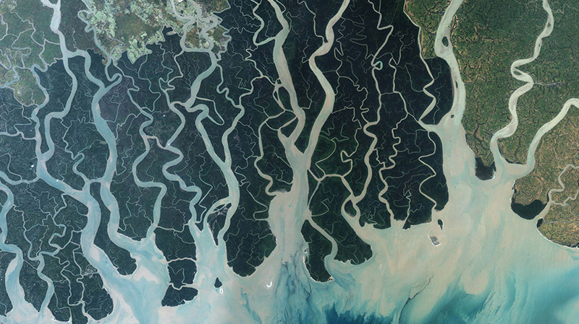
Classification Feature Optimization for Global Wetlands Mapping
Xin Yan
4/21/2025

Slide 2
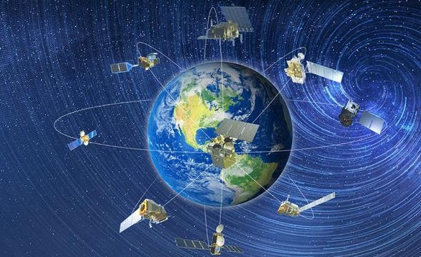
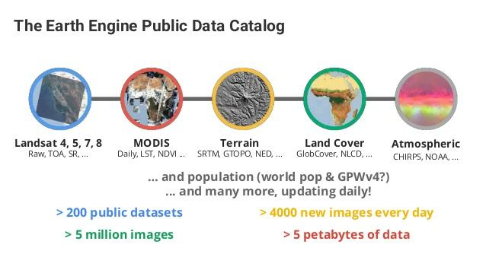
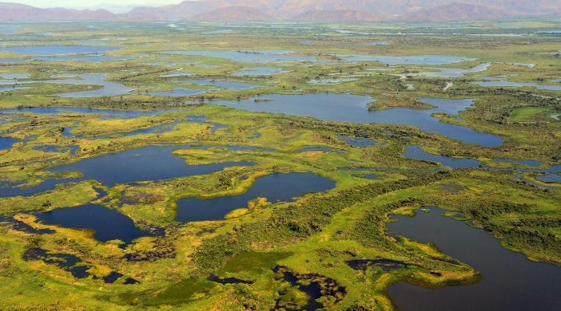
Introduction
Large-scale wetland remote sensing research will be one of the main development directions of wetland research in the future. The emergence of cloud platforms such as Google Earth Engine provides new opportunities and perspectives for large-scale wetland research.
Because different studies use different training or validation sample datasets, sensors, wetland classification methods, classification features, etc., the results are often inconsistent or incompatible.
Notes:
With the rapid development of remote sensing data and computing power, wetland remote sensing classification is also moving towards a global scale.
But there are still many problems, such as different studies use different samples, sensors, classification methods and classification features, which makes their results incomparable.

Slide 3
Research Background
Wetland-related datasets
Coverage | Dataset Type | Dataset Name | Date | Spatial Resolution | Temporal Resolution | Wetland-related Types
Global | Land Cover | FROM-GLC30 | 2015 | 30m | Static | Swamps, mudflats, deciduous swamps, water bodies
 |  | GlobeLand30 | 2010 | 30m | Static | Wetlands, water bodies
 |  | ESA GlobCover | 2009 | 300m | Static | Water bodies, broad-leaved forest freshwater inundation, broad-leaved semi-deciduous saltwater inundation, open vegetation inundation
 |  | GLC_FCS30 | 2020 | 30m | Static | Wetlands, water bodies
 |  | CGLS-LC | 2015-2019 | 100m | Dynamic | Permanent water bodies, seasonal water bodies, mosses
 | Water Body | GSWED | 2000-2018 | 250m | Dynamic | Water bodies
 | 水体 | JRC | 2018 | 30m | Dynamic | Water bodies
 | 水库 | GRanD | 2019 | Vector | Static | Water bodies
 | Potential Wetland | GPW | 2017 | 1km | Static | Wetlands, water bodies
 | Lake and Wetland | GLWD | 2004 | 1km | Static | Lakes, reservoirs, rivers, flooded swamps, forest swamps, coastal swamps, saline-alkali lands, marshes, temporary wetlands/lakes
 | Mangrove | GMW | 1996-2016 | Vector | Dynamic | Mangrove
 | Intertidal Zone | Murray Global Intertital Change | 1984-2016 | 30m | Dynamic | Flooded Frequency
Notes:
As shown in this table of several global wetland datasets, wetlands can be considered as a whole or broken down into swamps, mudflats, etc.

Slide 4
Research Background
Large-scale wetland samples
Multi-source data
Difficult to obtain
Highly subjective
Not portable
Sentinel
Landsat
MODIS
Classification method
Classification features
Unsupervised classification
Supervised classification
Index threshold
Artificial intelligence
Spectral bands
Band ratios
Topography
Temperature
Notes:
These differences greatly limit the applicability of our research results.
Users and researchers of the dataset are also very confused. How should I obtain my samples, what remote sensing data should I use, and what features and classification methods should I choose?

Slide 5
Research Objective
Objective
Global Wetland Sample
Develop an effective method to automatically generate accurate global wetland samples for different sensors.
A
Wetlands Classification Features
Analyze and screen wetland classification features for widely used satellite sensors (Landsat, MODIS, Sentinel-1/2) on a global scale.
B
C
Feature Mapping Between Different Sensors
Realize multi-satellite collaborative work on global wetland classification and mapping.
Notes:
These questions inspired me to propose three goals. First, develop a process to automatically produce global wetland sample points. Second, test the advantages and disadvantages of several mainstream remote sensing data in distinguishing the three major categories of wetlands, non-wetlands and water bodies. Finally, explore whether these data sets can be combined to jointly promote the development of wetland classification research.

Slide 6
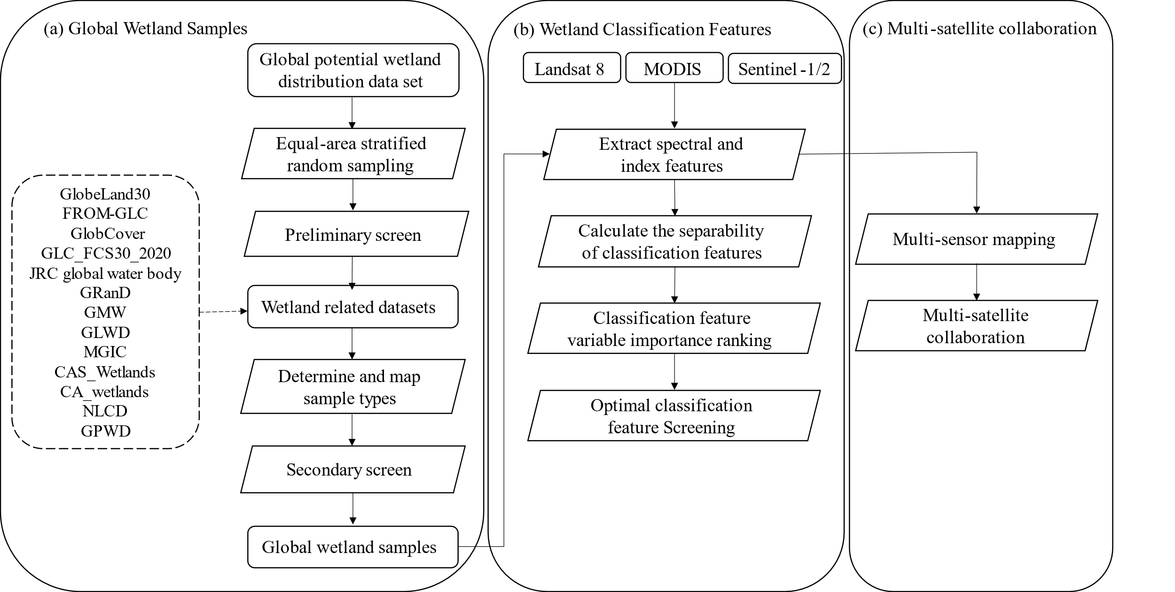
Research Workflow

Slide 7
Global Wetland Samples
The total number of samples is planned to be 500,000 worldwide.
The number of samples in each grid is divided according to the proportion of potential wetlands in each grid.
Samples are randomly generated.
Total: 413553
Non-wetland: 268308
Water Body: 38783
Wetland: 106462
Global potential wetland distribution and equal-area stratified sampling grid
Hu, S., Niu, Z., Chen, Y., Li, L., & Zhang, H. (2017). Global wetlands: Potential distribution, wetland loss, and status. Science of The Total Environment, 586, 319–327. https://doi.org/10.1016/j.scitotenv.2017.02.001
Notes:
I prepared 500,000 samples and a global grid, allocated the sample size for each grid based on the proportion of potential wetlands, water bodies, and non-wetlands in each grid, and performed preliminary type confirmation.

Slide 8
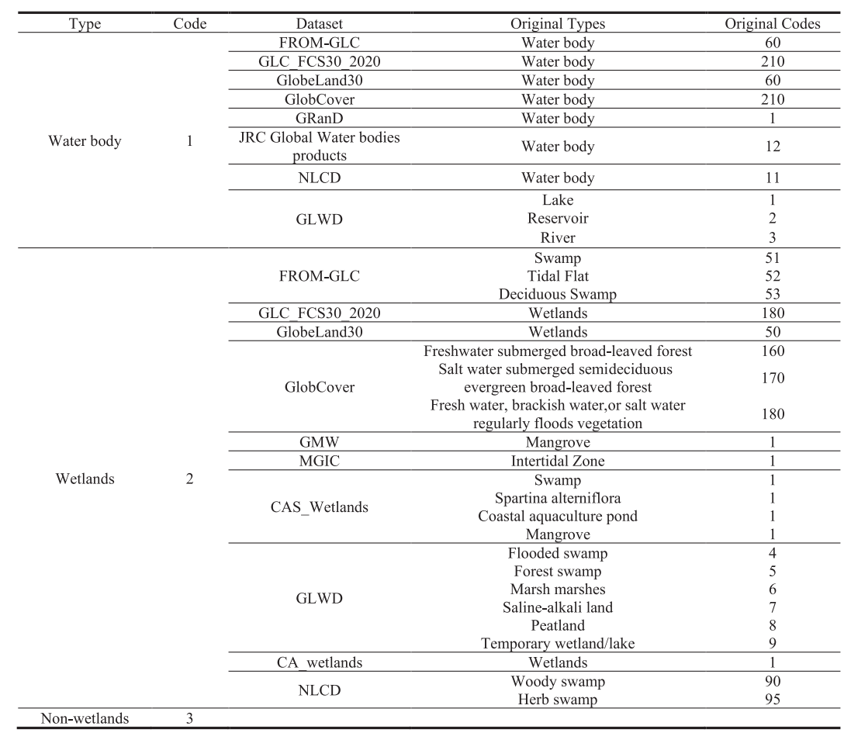
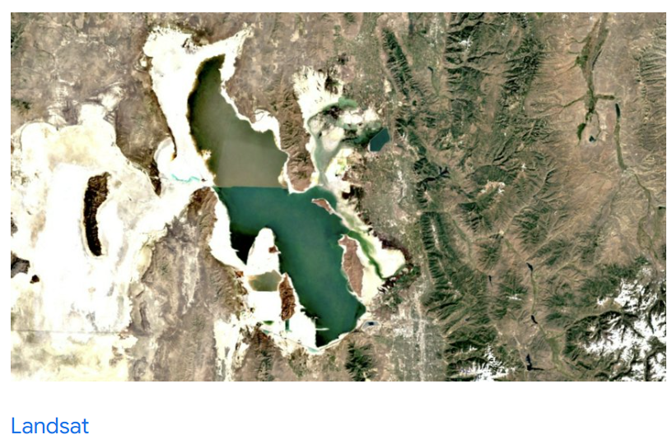
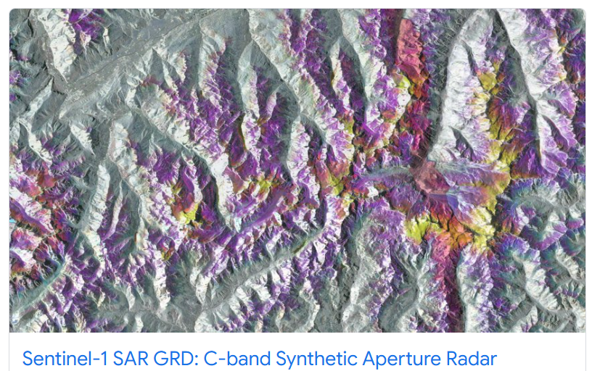
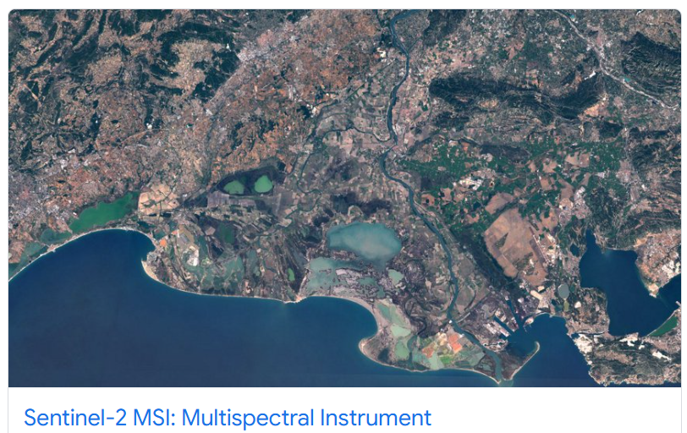
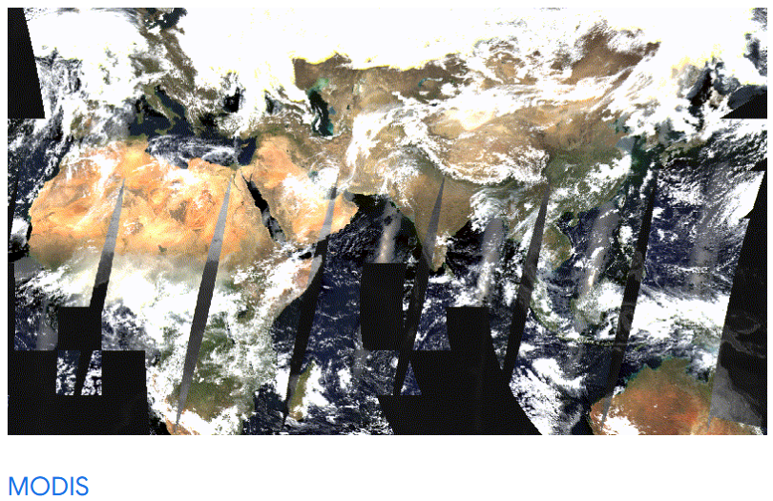
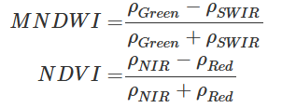
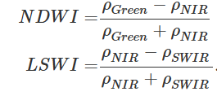
Global Wetland Samples
Dataset Type Mapping Table
Minimum Maximum Mean Median
Notes:
Then the types were reconfirmed based on 13 global and regional wetland-related datasets. This was not enough. I also extracted the spectra, indices, and statistics of these samples from four sensors in 2020, involving millions of images.
Finally, I selected samples within one standard deviation of different types and confirmed them the third times.

Slide 9
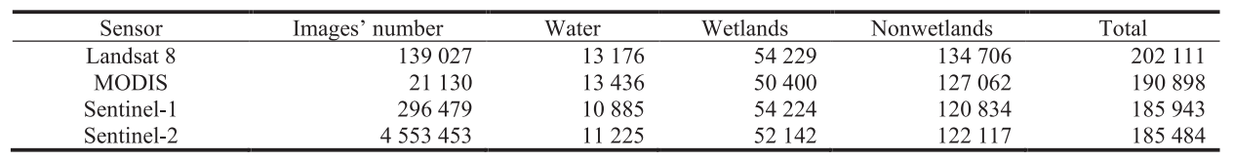
Global Wetland Samples
a.
b.
Sample distribution obtained from four sensors
(a). Landsat.
(b) MODIS.
(c). Sentinel-2.
(d) Sentinel-1.
c.
d.
Notes:
Here are the sample counts for different sensor choices and their distribution.

Slide 10
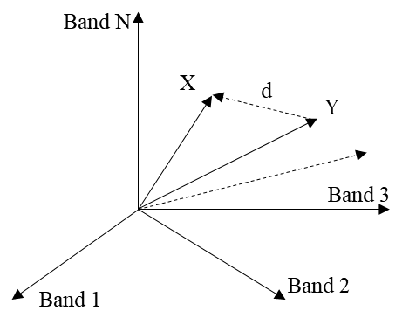
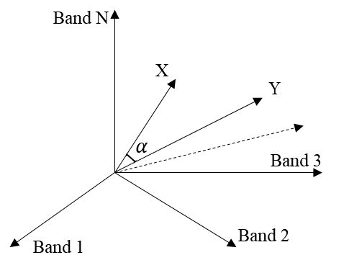
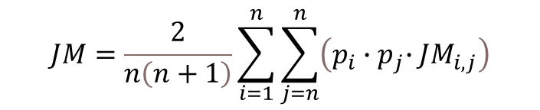

Analysis of Wetland Classification Features
Spectral Distance
Spectral Angle Distance
Random Forest Variable
Importance Ranking
Jeffries–Matusita Distance
$$JM=\frac{2}{n\left(n+1\right)}\sum_{i=1}^{n}{\sum_{j=n}^{n}{\left(p_{i}{∙p}_{j}∙{JM}_{i,j}\right)}}$$
$$VI\left(M_{A}\right)=\frac{1}{N}\sum_{t=1}^{N}{\left(B_{n_{t}}^{M_{A}}−B_{O_{t}}^{M_{A}}\right)}$$
Notes:
Based on these samples, I further explored how different types of spectral performance differed, and selected four methods to calculate their similarity.

Slide 11
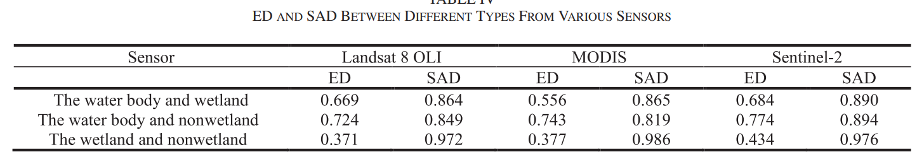
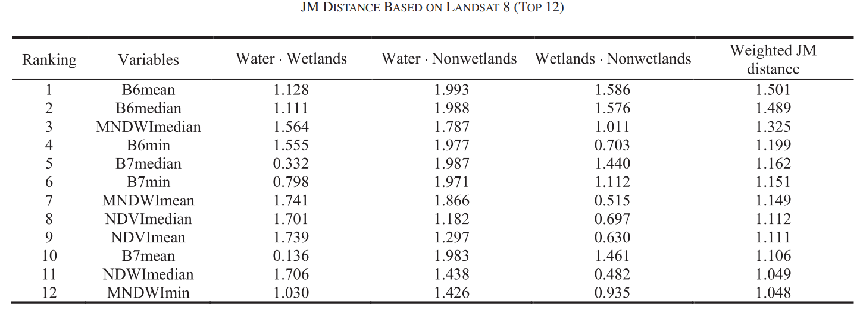
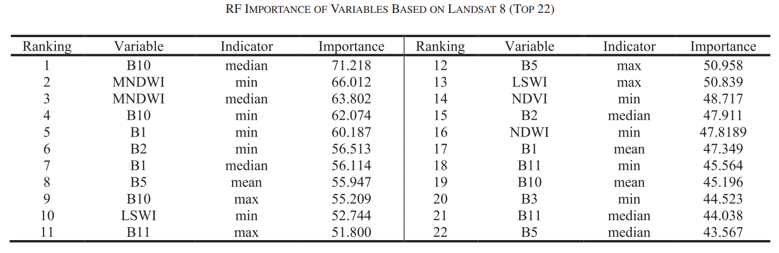
Analysis of Wetland Classification Features
Notes:
The results showed that wetlands and non-wetlands were the most difficult to distinguish on all three sensors, while non-wetlands and water bodies were the easiest.
B6, MNDWI, and NDVI have the largest JM distance.
I tested it again with random forest and the results showed that B10 and MNDWI were most helpful.

Slide 12
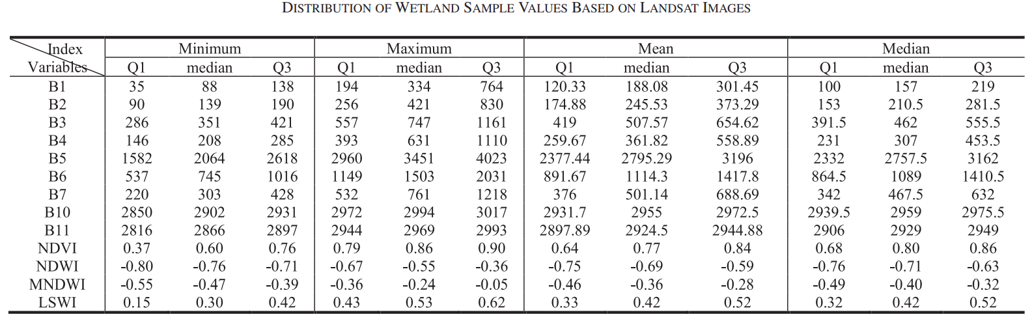
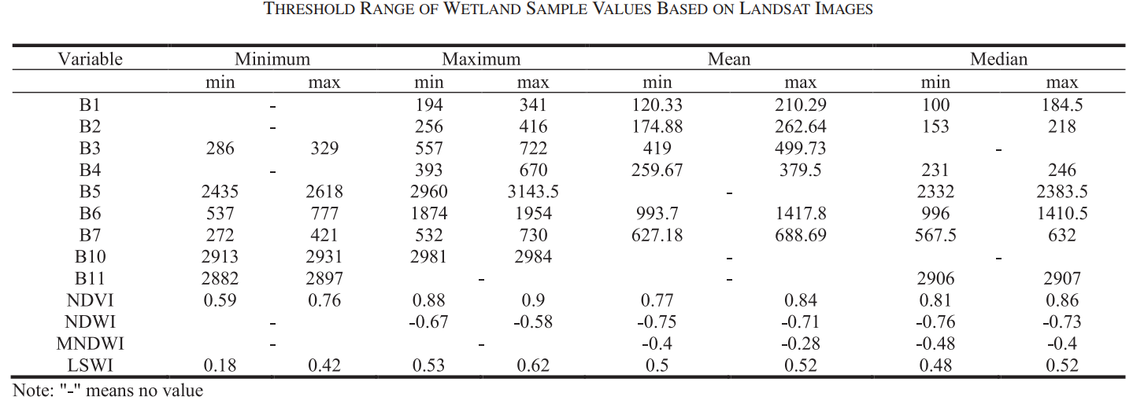
Analysis of Wetland Classification Features
Notes:
Finally, taking Landsat as an example, I give a range. If you want to use this indicator, what its value should be, and what is the best value to completely separate the three.

Slide 13
Analysis of Wetland Classification Features
The shortwave infrared band and land surface water index can distinguish nonwetlands from other land cover types well.
The modified normalized difference water index, normalized difference vegetation index, normalized difference water index, and thermal infrared bands could help distinguish water bodies and wetlands.
C bands in Sentinel 1 perform well in identifying water bodies, but the ability to distinguish wetlands is limited.
Notes:
Here is a summary of the information provided by each sensor. If you want to distinguish non-wet areas, you'd better use the shortwave band and LSWI indicators. If you want to distinguish water bodies from wet areas, you'd better use MNDWI, NDVI, NDWI and thermal infrared bands. The C band can distinguish water bodies very well, but its ability to distinguish wetlands is very limited.

Slide 14
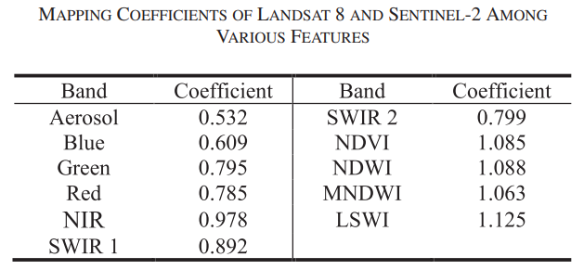
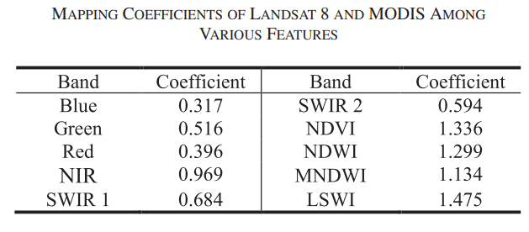

Multi-satellite Collaboration
$$c= \frac{L_{i}}{S_{j}}$$
where $L_{i}$ is the median value of the sample in band $i$ of Landsat 8, and $S_{j}$is the median value of the sample in band $j$ of Sentinel-2 corresponding to band $i$.
Notes:
The values ​​of the same location in different sensor images are different, so can we use them directly? The answer is that it is best to convert them, and here is the conversion factor.

Slide 15
Conclusion
I proposed a method for automatically producing global wetland samples based on 13 global and regional wetland-related datasets and millions of images from Landsat 8, MODIS, Sentinel-1, and Sentinel-2.
I analyzed the classification capabilities of wetland features in the above four sensors and obtained a multisensor, full-spectral-band, multi-index wetland classification feature dataset at a global scale.
The mapping coefficients of the corresponding spectral bands and indexes between Sentinel-2, MODIS data, and Landsat were obtained to help realize the collaborative use of multisensor image data.

Slide 16
Conclusion
Paper
Yan, X., & Niu, Z. (2024). Classification Feature Optimization for Global Wetlands Mapping. IEEE Journal of Selected Topics in Applied Earth Observations and Remote Sensing, 17, 8058–8072. https://doi.org/10.1109/JSTARS.2024.3382580
Dataset
Yan, X., Niu, Z. (2023) Global Wetland Samples (Based on Sentinel-1/2, Landsat, MODIS images)[DS/OL]. Science Data Bank. https://doi.org/10.57760/sciencedb.07573

Slide 17
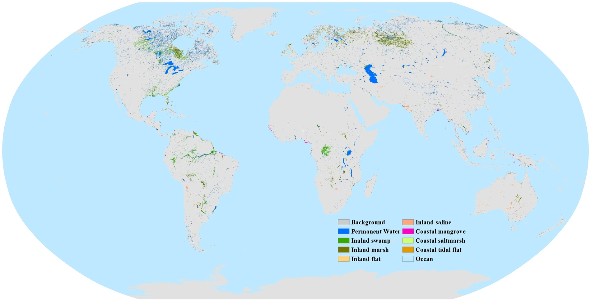
Thank you for listening!
xin.yan@uga.edu
Spatial distribution of eight global wetland subcategories in 2022.
Zhang, X., Liu, L., Zhao, T. et al. Global annual wetland dataset at 30 m with a fine classification system from 2000 to 2022. Sci Data 11, 310 (2024). https://doi.org/10.1038/s41597-024-03143-0

