Slide 1


Super-Resolution Synthesis of Full-Band FMCW Radar for Snow Thickness Measurement: Paving the Way for Spaceborne Implementation
Dr. Sara Neshani
April 24, 2025

Slide 2



The Remote Sensing Center was initiated in 2017.

Slide 3
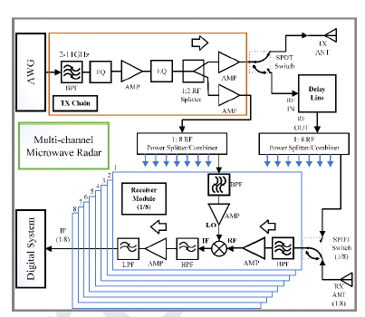
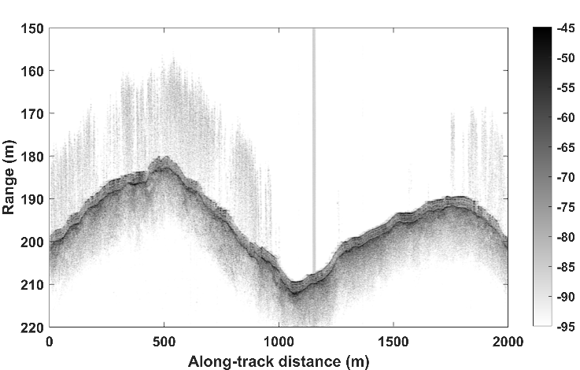
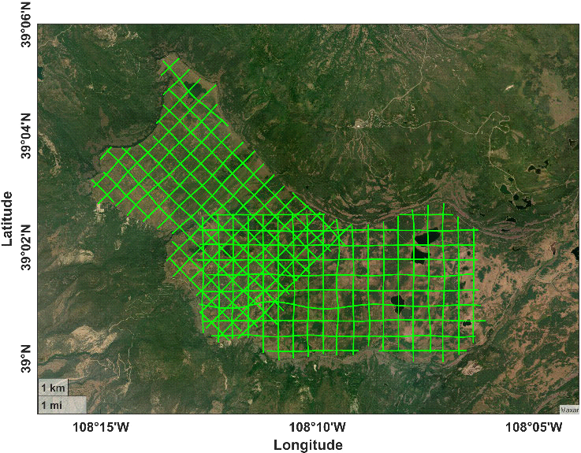
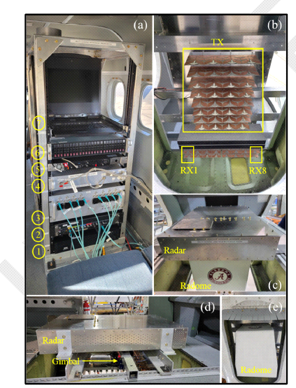
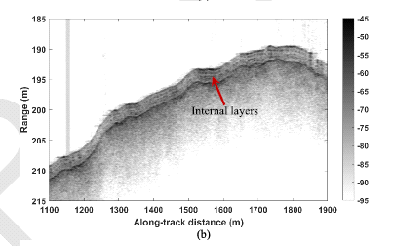
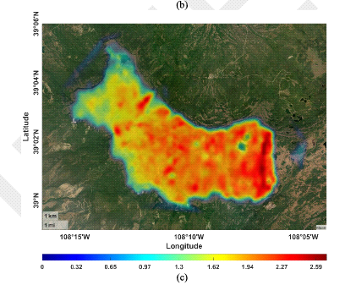
Snow Thickness
Figure 3: Block diagram of the radar (left top), radar
system and antenna array (bottom left), radar
echograms in the middle that clearly show air
-
snow
and snow
-
land interfaces and internal layers in snow
(middle), flight lines over which data are collected (top
right) and snow thickness map(bottom right)

Slide 4
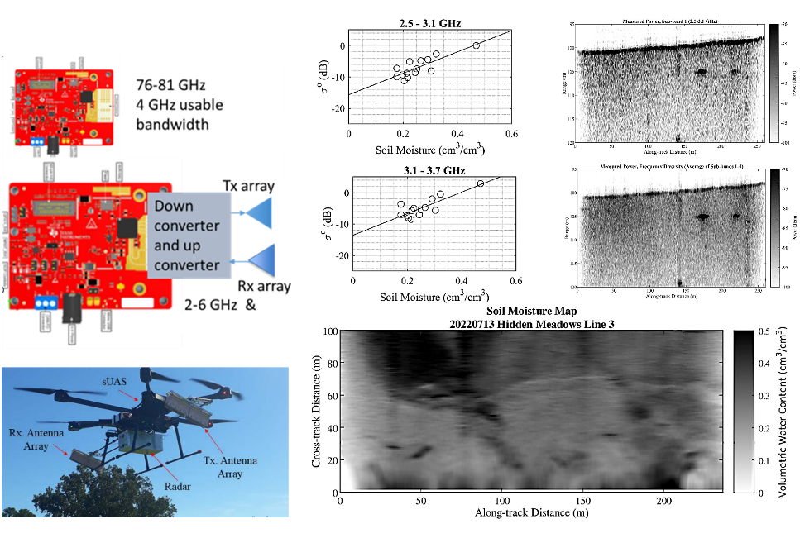
Soil Moisture

Slide 5
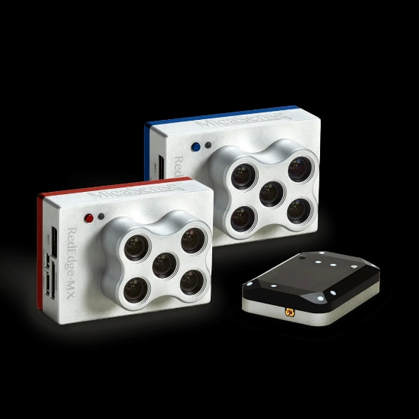
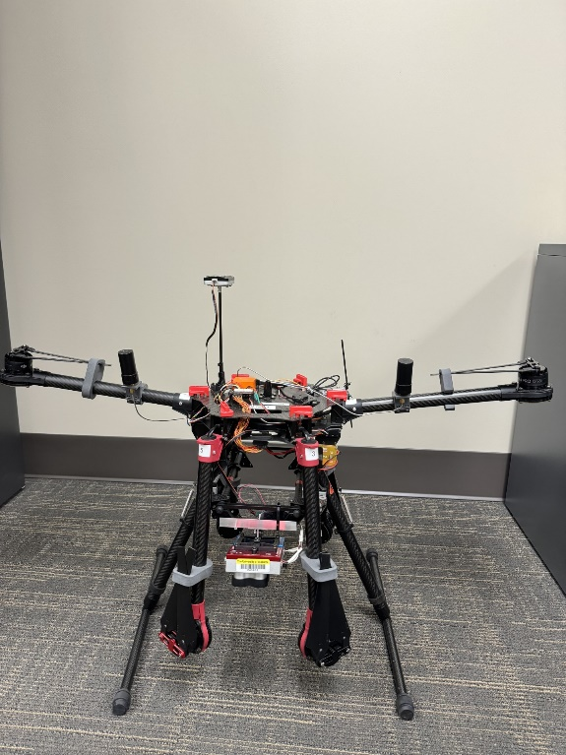
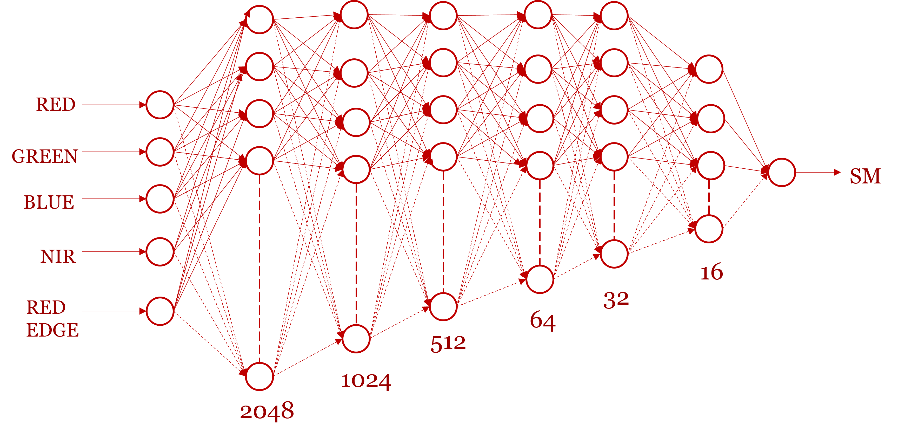
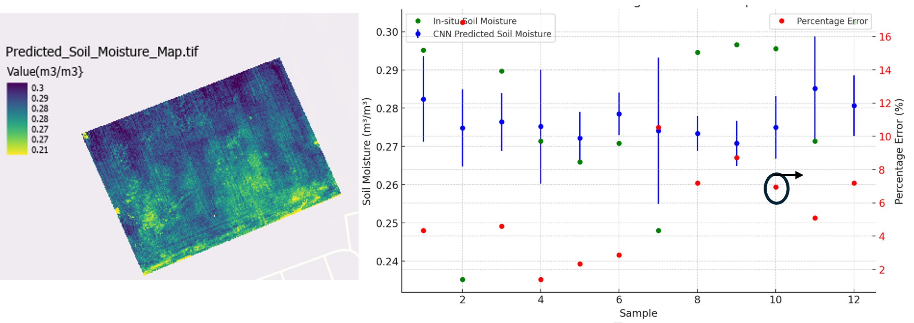
Soil Moisture

Slide 6

Fine Resolution Snow Radars, Super-Resolution Algorithms, Potentials
Why Snow Measurements Matter?
Snow in Polar Research
  Controls sea ice thickness estimation by affecting freeboard.
  Acts as a thermal insulator, modulating sea ice growth and melt.
  Limits light penetration, impacting Arctic marine ecosystems.
  Snow Water Equivalent (SWE) is vital for interpreting satellite altimetry data and understanding polar mass balance.
Snow and Agriculture
  Determines planting schedules via runoff predictions.
  Impacts soil moisture and irrigation planning.
  SWE helps forecast water supply for crops, especially in snow-fed regions.
Snow and Water Resource Management
  Crucial for: Spring runoff prediction, Reservoir management, Drought and flood risk modeling.
  Essential for hydroelectric power planning and urban water systems.

Slide 7


Fine Resolution Snow Radars, Super-Resolution Algorithms, Potentials
Snow Thickness Estimation — Errors and the Need for Correction
  Ignoring snow depth – Underestimates sea ice thickness (snow compresses ice freeboard)
  Misidentifying snow surface as ice surface – Overestimates ice thickness due to false radar/lidar surface return
  Neglecting snow density variations – Inaccurate SWE, distorts water budget estimates
  Missing internal snow layers, limits scientific insights
  Uncorrected satellite radar altimetry, leads to high error margins (up to 70%) in sea ice volume models
  Relying only on snow depth, not SWE – Poor water resource planning (reservoirs, irrigation, flood control)
  Insufficient resolution – Cannot resolve shallow layers or detect recent snowfalls
  Gaps between observations – Misses the dynamics of critical events like early snowmelt or mid-season snowstorms
  Ignoring terrain and vegetation effects – Reduces snow detection reliability
Zygmuntowska M, et. al (2014) Uncertainties in Arctic sea ice thickness and volume: new estimates and implications for trends. The Cryosphere, 8(2):705–720.

Slide 8
Fine Resolution Snow Radars, Super-Resolution Algorithms, Potentials
Improving Snow Thickness Estimation
Satellite and Airborne Snow Measurement:
  - Provide wide spatial coverage and continuous monitoring.
  - Require corrections to improve the accuracy of snow depth and internal layering.
Need for High-Resolution Measurement Methods:
  - Essential for accurate retrieval of snow-air/snow-ice interfaces and SWE.
Ultrawideband (UWB) FMCW Radars:
  - Enable fine-resolution snow thickness measurement over land and sea ice.
  - Operate over a wide frequency range (e.g., 2–18 GHz).
  - Resolution Dependency on Bandwidth: ΔR = c / (2B).
  - Larger bandwidth means finer resolution (e.g., 8 GHz → ~1.875 cm).

Slide 9
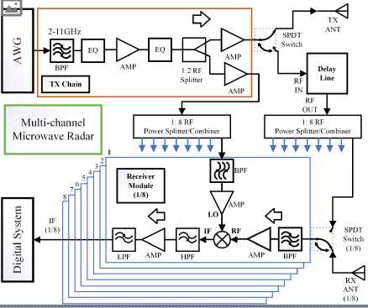


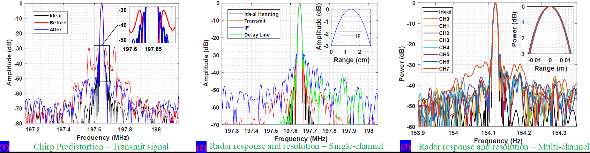
Fine Resolution Snow Radars, Super-Resolution Algorithms, Potentials
Development and optimization of airborne FMCW radars for high-resolution snow depth measurements
Shriniwas Kolpuke
S. Kolpuke et al., "Airborne Multichannel UWB FMCW Radar for Snow Depth Measurements," in IEEE Transactions on Geoscience and Remote Sensing, vol. 62, pp. 1-18, 2024

Slide 10
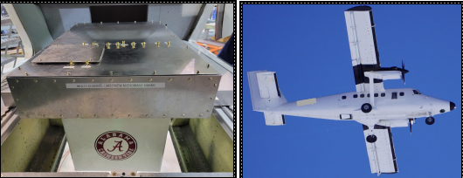
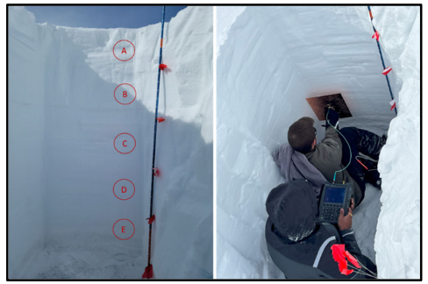
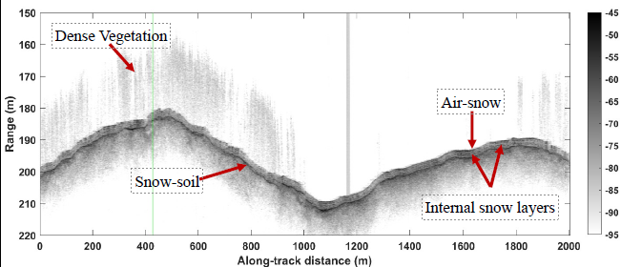
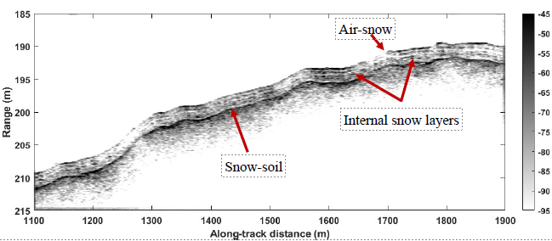
Fine Resolution Snow Radars, Super-Resolution Algorithms, Potentials
•Radar penetrates dense vegetation 20-25 m tall and maps the bottom snow-soil interface.
•The bottom interface is clearly visible in the entire snow line.
•The radar also mapped internal snow layers.
S. Kolpuke et al., "Airborne Multichannel UWB FMCW Radar for Snow Depth Measurements," in IEEE Transactions on Geoscience and Remote Sensing, vol. 62, pp. 1-18, 2024

Slide 11
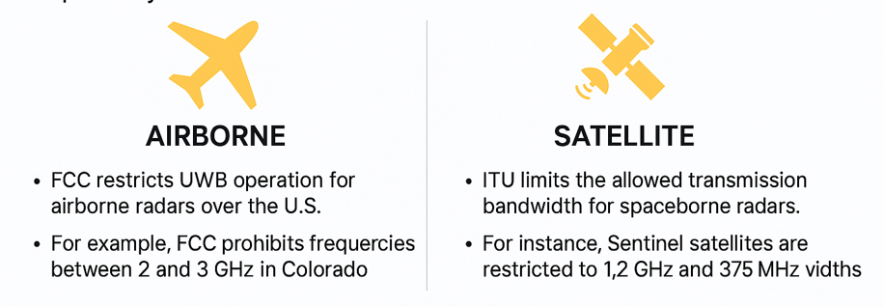
Fine Resolution Snow Radars, Super-Resolution Algorithms, Potentials
Challenges in UWB Snow Radar Measurements
At frequencies below 6 GHz, returns from snow-covered sea ice and land are dominated by quasi-specular reflections.
UWB radars operating over 1–6 GHz provide excellent resolution but face serious regulatory challenges.
Regulatory Challenges:
  - FCC (Federal Communications Commission) restricts airborne radar transmission over many bands in the U.S.
  - ITU (International Telecommunication Union) limits spaceborne transmission bandwidth globally.
  - Operates in S-band (NISAR) and C-band (Sentinel-1).
  - Allowed bandwidths are limited (~75–80 MHz per band).
  - Full UWB performance (1.2–5.5 GHz) not feasible directly from space.
  - FCC restricts several bands, creating gaps between subbands in 2–6 GHz range.
  - Example narrow subbands: 2.3–2.4 GHz, 3.3–3.4 GHz, 4.3–4.4 GHz, 5.3–5.4 GHz.

Slide 12
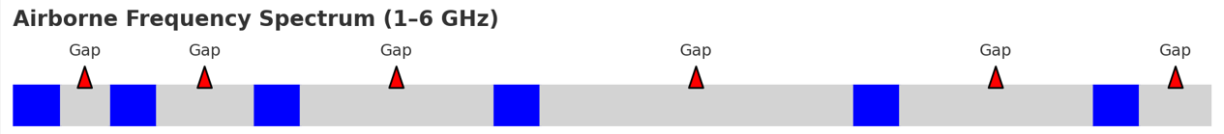
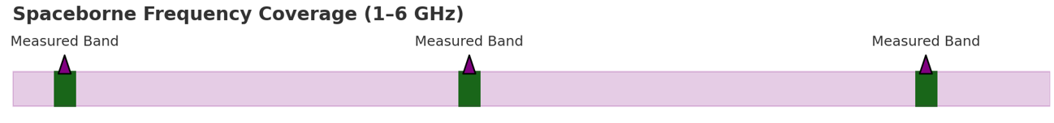
Fine Resolution Snow Radars, Super-Resolution Algorithms, Potentials
Solutions for Accurate Snow Thickness Estimation
Full-Bandwidth Synthesis from Narrow Subbands:
  - Combines sparse radar measurements into a continuous frequency response.
  - Uses gap-filling algorithms and spectral modeling to simulate UWB radar returns.
Multi-Frequency Radar Altimeter Design:
  - Implements a 3-point radar on satellites (e.g., at 1.25, 3.2, and 5.4 GHz).
  - Enables wide frequency coverage using narrow subbands approved by ITU.
Super-Resolution Algorithms:
  - Enhances resolution beyond the physical bandwidth limits.
  - Techniques: Root-MUSIC, linear/nonlinear regression, model-based estimation.
Machine Learning for Band Stitching:
  - ML/DL models predict missing band data and correct phase/magnitude discrepancies.
  - Helps reconstruct echograms with clear snow-air and snow-ice interfaces.
1.25 GHz
3.2 GHz
5.4 GHz

Slide 13
Fine Resolution Snow Radars, Super-Resolution Algorithms, Potentials
Intermediate signal frequency (IF) is directly proportional to the target's range
Resolution is inversely proportional to the transmit signal bandwidth
Achieving centimeter-level accuracy in measuring these variations
requires UWB radars operating across bandwidths spanning several gigahertz.

Slide 14
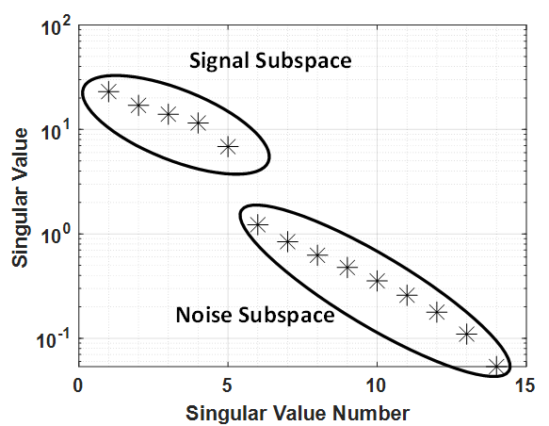
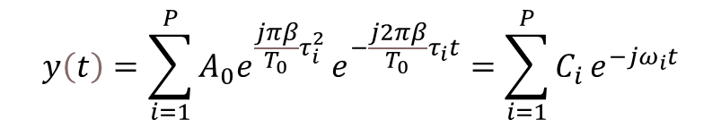
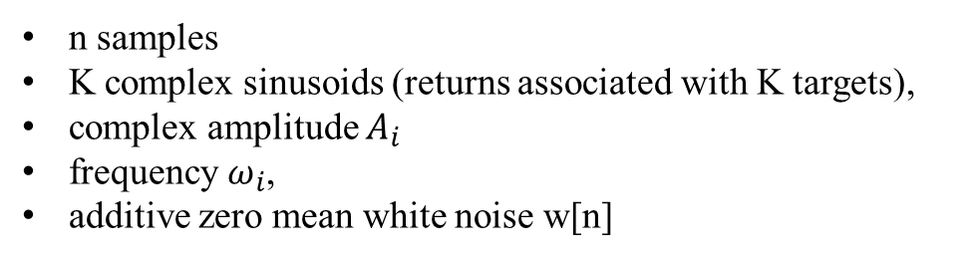
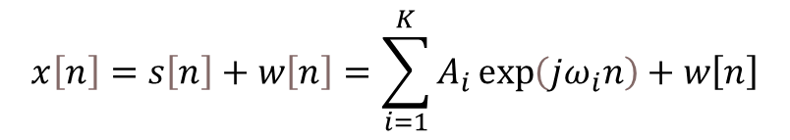
Fine Resolution Snow Radars, Super-Resolution Algorithms, Potentials
FM, IF signal
$$x\left[n\right]=s\left[n\right]+w\left[n\right]=\sum_{i=1}^{K}{A_{i}\exp\left(jω_{i}n\right)+w\left[n\right]}$$
n samples
K complex sinusoids (returns associated with K targets),
complex amplitude $A_{i}$
frequency $ω_{i}$,
additive zero mean white noise w[n]
Radar Return
$$y\left(t\right)=\sum_{i=1}^{P}{A_{0}e^{\frac{jπβ}{T_{0}}τ_{i}^{2}}}e^{−\frac{j2πβ}{T_{0}}τ_{i}t}=\sum_{i=1}^{P}{C_{i}}e^{−jω_{i}t}$$
K. M. Cuomo, J. E. Pion, and J. T. Mayhan, “Ultrawide-band coherent processing,” IEEE Transactions on Antennas and Propagation, vol. 47, no. 6, pp. 1094–1107, Jun. 1999

Slide 15
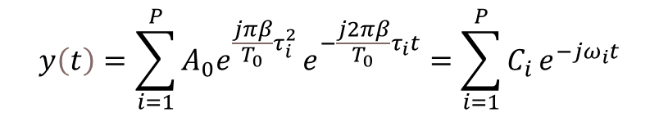
Fine Resolution Snow Radars, Super-Resolution Algorithms, Potentials
Radar Return
$$y\left(t\right)=\sum_{i=1}^{P}{A_{0}e^{\frac{jπβ}{T_{0}}τ_{i}^{2}}}e^{−\frac{j2πβ}{T_{0}}τ_{i}t}=\sum_{i=1}^{P}{C_{i}}e^{−jω_{i}t}$$
“Super-Resolution Algorithm for UWB Snow Depth Measurement from Sparse Narrow Bands,” Sara Neshani, Shriniwas Kolpuke, Prasad Gogineni, IEEE RADAR Conference. 2025.

Slide 16
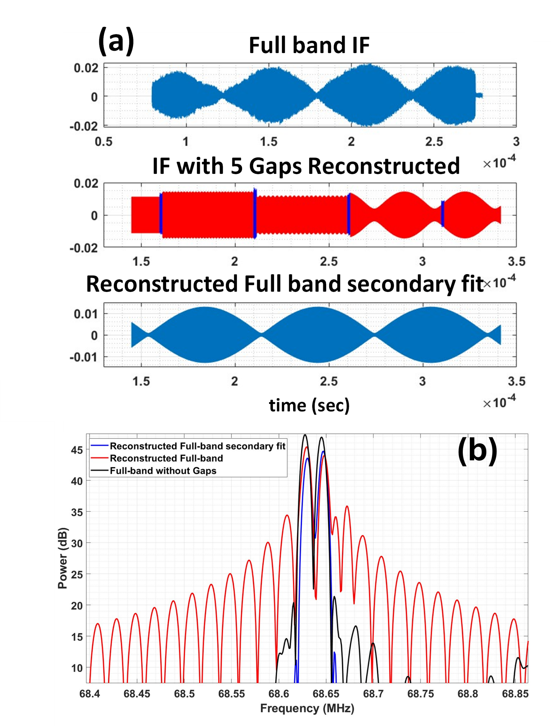
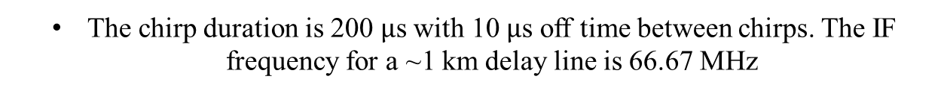
Fine Resolution Snow Radars, Super-Resolution Algorithms, Potentials
2.2-4.2 GHz full band synthesis theoretical verification
2-6 GHz full band synthesis theoretical verification using delay line data for dual target case with four 100 MHz narrow subbands available and 5 gaps.
The chirp duration is 200 $μ$s with 10 $μ$s off time between chirps. The IF frequency for a ~1 km delay line is 66.67 MHz

Slide 17
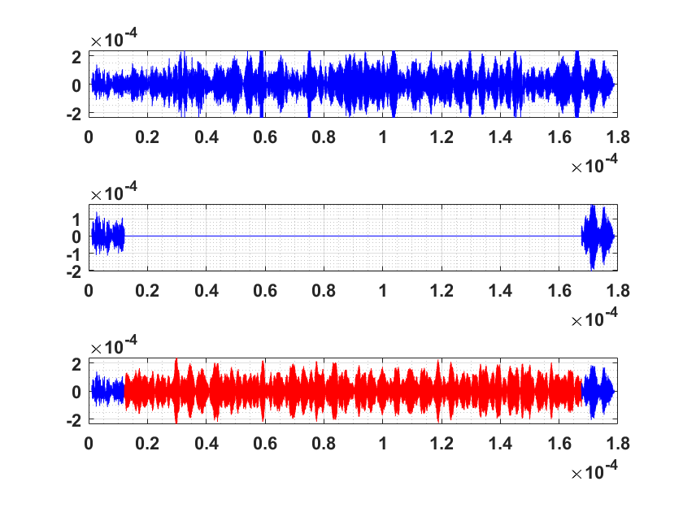
Fine Resolution Snow Radars, Super-Resolution Algorithms, Potentials
2.2-4.2 GHz full band synthesis experimental verification
Full Band (2 GHz)
1.75 GHz Gap
Re(Amplitude)
Reconstructed Full Band with 12 pole
time (sec)
2.2-4.2 GHz full band synthesis experimental verification using snow data with 1.75 GHz gap.

Slide 18
Full Band Reconstruction
Original Full Band (2 GHz)
Full Band including 1.75 GHz Gap
Reconstructed Full Band
& Median Filtering (9-Pole)

Slide 19
Full Band Reconstruction

Slide 20
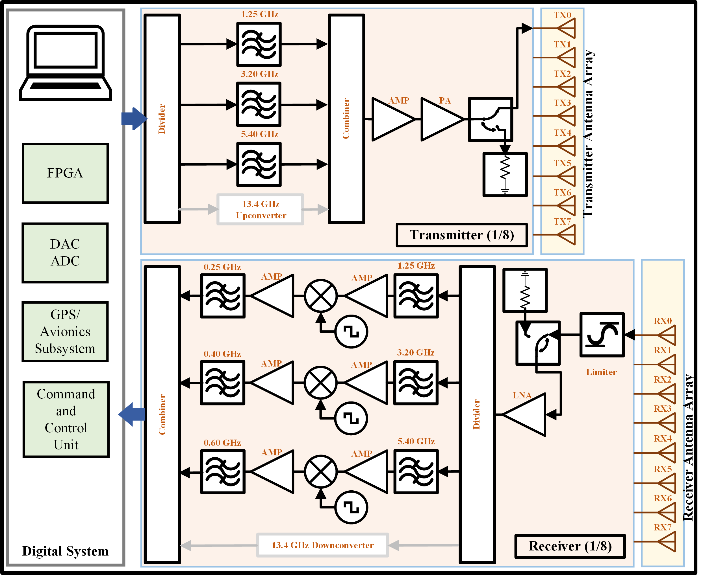
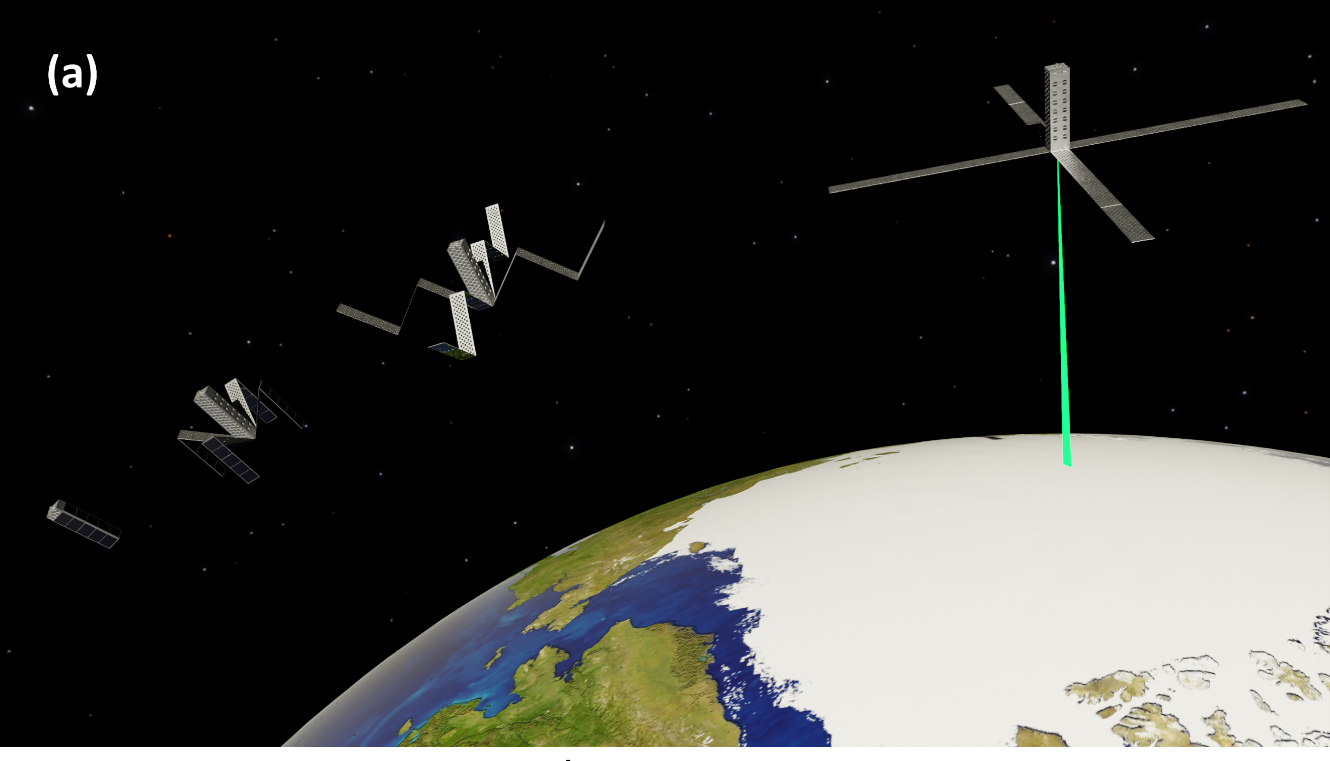
Fine Resolution Snow Radars, Super-Resolution Algorithms, Potentials
Potential and Future Extension
Spaceborne 3 Frequency Radar Altimeter
A CubeSat with two large low-profile foldable array of 3.5 m x 25 cm
Block diagram of the multi-frequency radar altimeter.

Slide 21


Thank You!

Slide 22
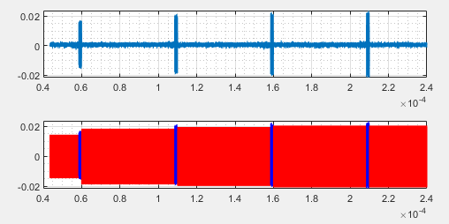
Operating Frequencies:
2.3-2.4 GHz
3.3-3.4 GHz
4.3-4.4 GHz
5.3-5.4 GHz
Gap:
2.0-2.3 GHz
2.4-3.3 GHz
3.4-4.3 GHz
4.4-5.3 GHz
5.4-6.0 GHz
Total Chirp length: 200 us
Padding: 10us
Beat frequency: 66.67 MHz
Window: 1% Tukey
Single target 40 dB attenuation
The reconstructed I channel data vs. time (s)
Dr. Neshani, Remote Sensing Center, UA

