Slide 1
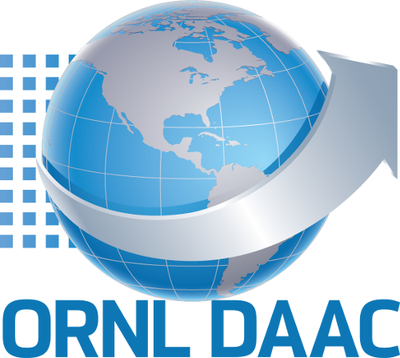
Hyperspectral data from NASA Airborne platforms at the ORNL DAAC
Scott M. Pearson, Michele Thornton, Yaxing Wei, and Rupesh Shrestha
Remote Sensing and Environmental Informatics Group, Environmental Sciences Division, Oak Ridge National Laboratory
April 24, 2025

Slide 2
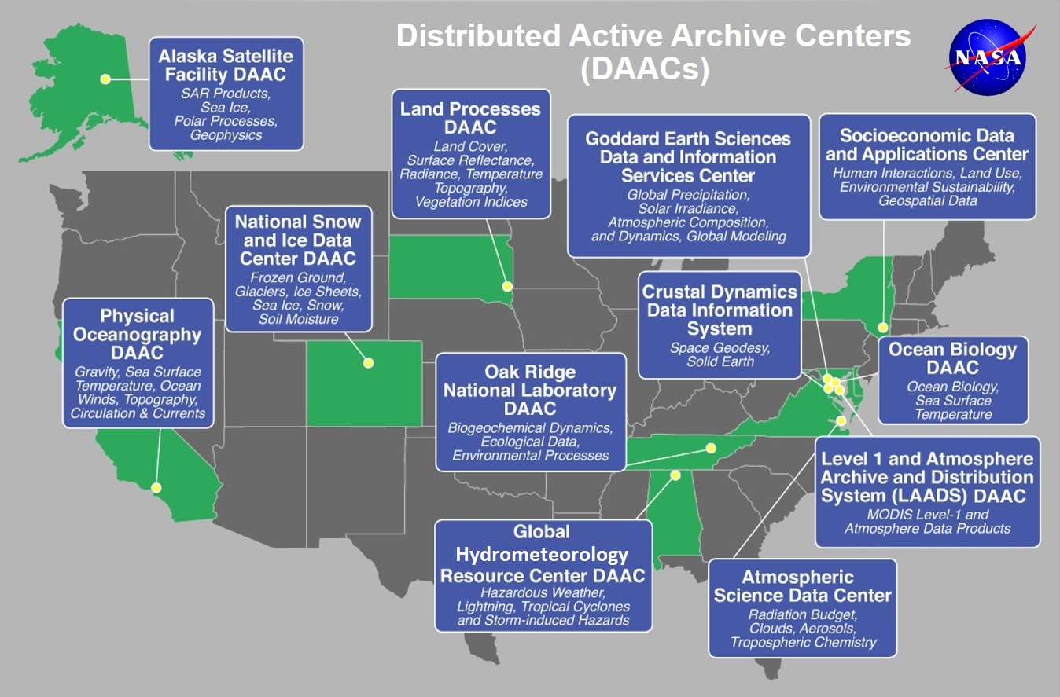
NASA DAACs: Distribute Earth Science data products
Serve scientists and data users
NASA’s Open data initiative
Findable, Accessible, Interoperable, Reusable
Science themes

Slide 3
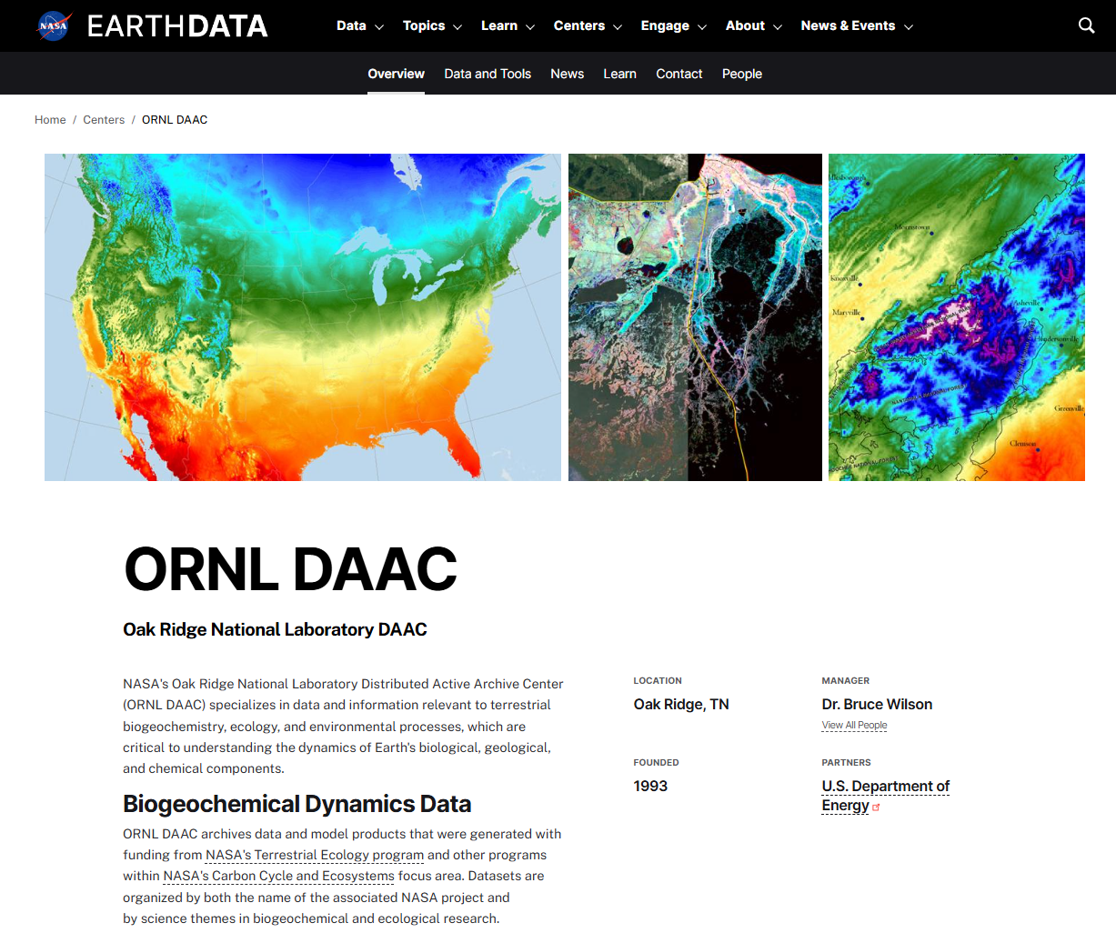
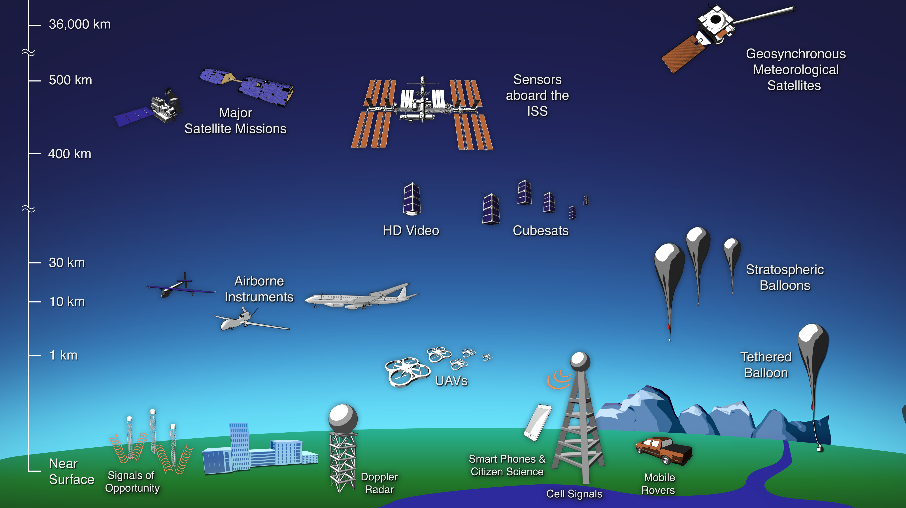
ORNL DAAC
Terrestrial ecology
Field observations
Airborne missions
Orbital products
Model code & results
https://daac.ornl.gov → https://www.earthdata.nasa.gov/centers/ornl-daac

Slide 4

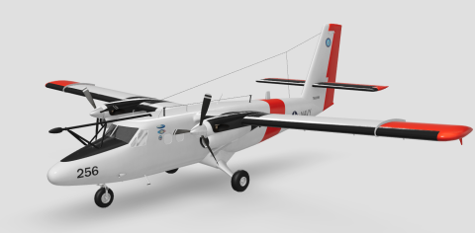
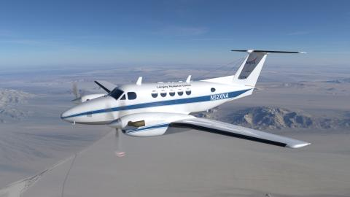
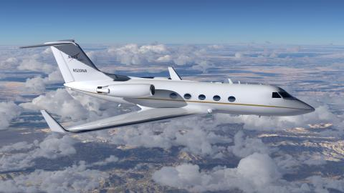
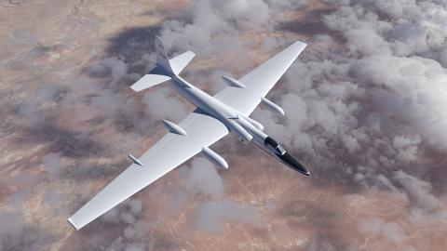
Airborne data support …
Airborne-field investigations, process studies
ABoVE, Delta-X, BioSCape, GEMx
Orbital instruments: development, calibration-validation:
MODIS/ASTER Airborne Simulator (MASTER)
Airborne science research
Western Diversity Time Series, Greenhouse Gas
Airborne Platforms
operate at range of altitudes: 260 to 26,200 m
often deploy multiple instruments
Twin Otter
B200
Gulfstream III
ER-2
https://airbornescience.nasa.gov/aircraft
Notes:
Platform Images source: https://airbornescience.nasa.gov/aircraft

Slide 5
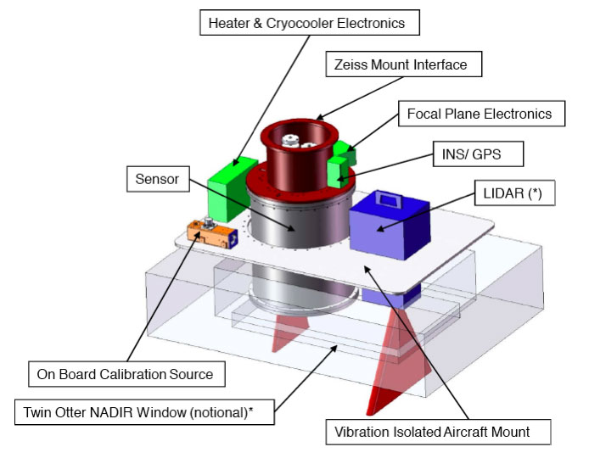
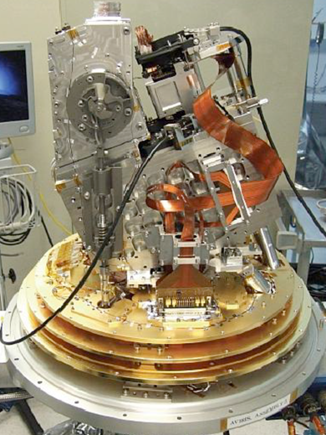
Example spectroscopy instruments
MODIS/ASTER Airborne Simulator (MASTER)
Airborne Visible / Infrared Imaging Spectrometer (AVIRIS)
AVIRIS-Classic, AVIRIS-Next Generation (AVIRIS-NG), AVIRIS-3, …
Hyperspectral Thermal Emission Spectrometer (HyTES)
Portable Remote Imaging Spectrometer (PRISM)
AVIRIS-NG instrument
Radiance: electromagnetic radiation reflected or emitted by an object (brightness for specific wavelength); depends on illumination. Units: μW nm⁻¹ cm⁻² sr⁻¹
Reflectance: ratio (light leaving) / (light striking); depends on the material observed. Units: 0 – 1.0
https://avirisng.jpl.nasa.gov

Slide 6
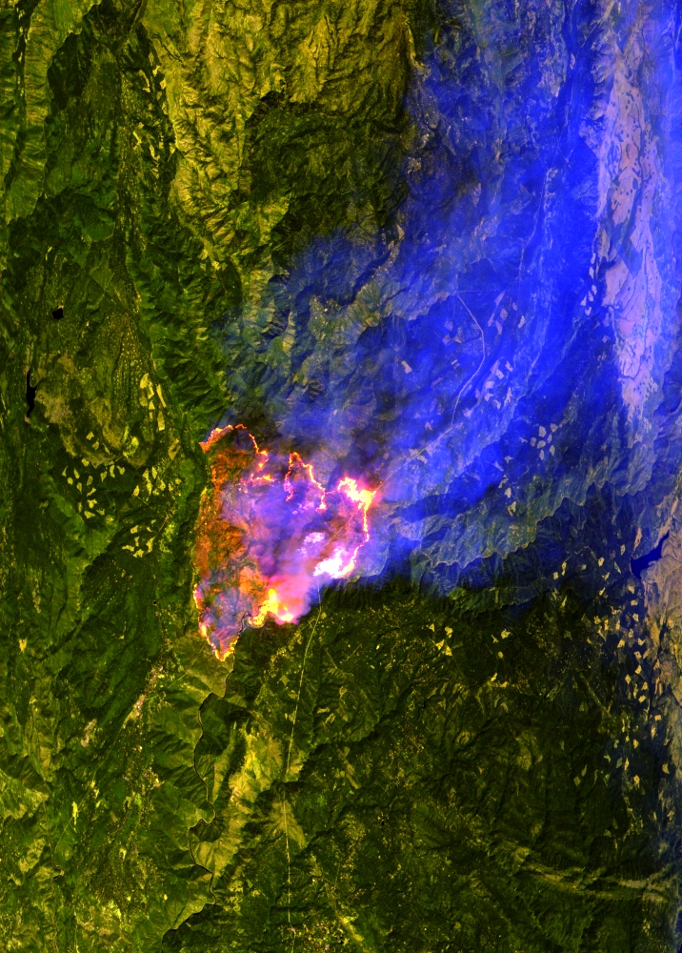
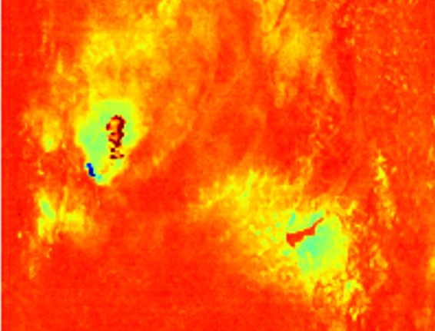
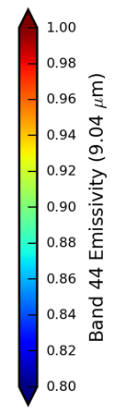
MODIS/ASTER Airborne Simulator (MASTER)
MASTER quicklook (R 4000, G 2200, B 1600 nm)
Spectral range : 460 to 12,879 nm (visible – thermal IR)
Spectral resolution 50 bands, irregular intervals
Whisk-broom scanner; 716 pixels, 2.5 mrad FOV
Spatial resolution depends on distance from sensor to surface (i.e., altitude)
Products:
Atmospheric corrected emissivity
Land surface temperature
Emissivity
The Western Diversity Time Series will observe ecosystems and provide critical information on natural disasters such as volcanoes, wildfires, and drought.
Mosquito Fire, California; 2022-09-08
Notes:
Sources: https://asapdata.arc.nasa.gov/sensors/master/data/deploy_html/wdts_2022_summer.html, MASTERL2_2263000_10_20220908_2004_2018_V02-images.zip (emissivity)
The Western Diversity Time Series (formerly HyspIRI) will observe California’s ecosystems and provide critical information on natural disasters such as volcanoes, wildfires, and drought. It will provide a benchmark on the state of the ecosystems against which future changes can be assessed, as the instruments will be capable of identifying vegetation type and health.

Slide 7
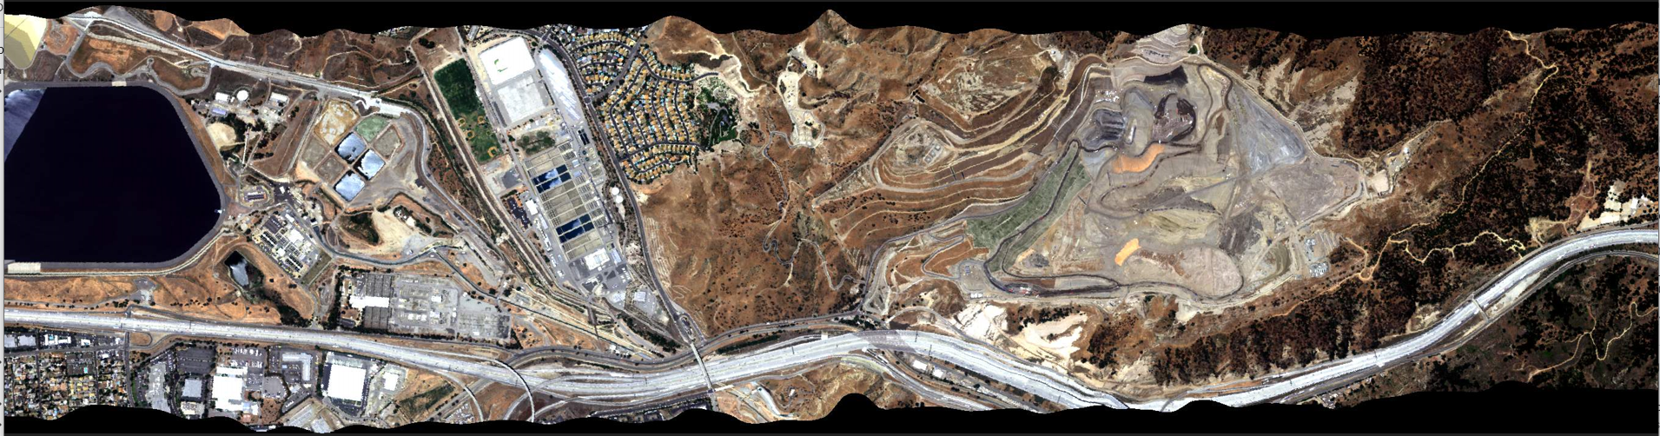
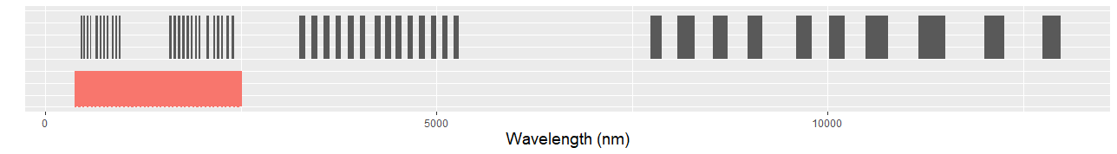
Airborne Visible / Infrared Imaging Spectrometer- Next Generation (AVIRIS-NG)
Spectral range : 380 to 2,510 nm (visible – near IR),
Spectral resolution 425 bands, 5-nm intervals
Pushbroom scanner with 640 cross-track elements, 1.4 mrad FOV (greater spatial resolution)
Applications
plant diversity
ecosystem functions
soil type
geology / minerals
greenhouse gas
cal/val for satellite instr.
MASTER
AVIRIS-NG
Notes:
Image: ang20200708t192518_geo.jpg

Slide 8
Radiance and reflectance data
Calibrated radiance data – Level 1B (L1B):
Radiance units: μW nm⁻¹ cm⁻² sr⁻¹
Georeferenced swath data in HDF or netCDF format
data in instrument coordinates: lines x samples along flight trajectory
pixel size on ground varies f(parallax, terrain)
Corrected surface reflectance – Level 2 (L2):
Scaled reflectance units: 0.0 to 1.0
Orthocorrected in GeoTIFF, ENVI, or netCDF
Terrain corrected with regular pixel size
Atmospheric and BRDF corrections may be applied
Radiance: electromagnetic radiation reflected or emitted by an object (brightness for wavelength); depends on illumination.
Reflectance: ratio (light leaving) / (light striking); depends on the material observed.

Slide 9
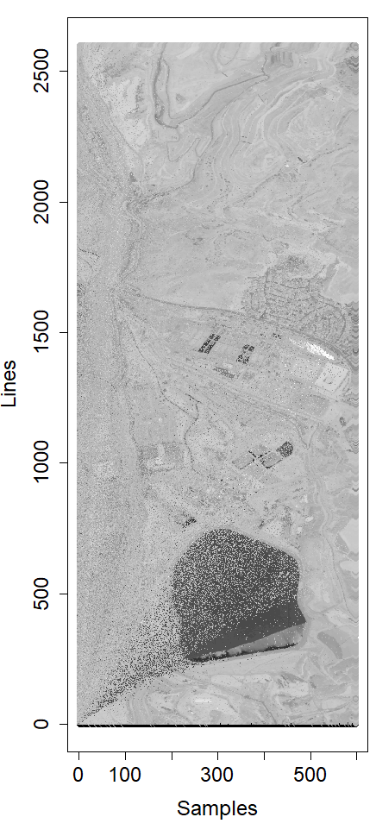
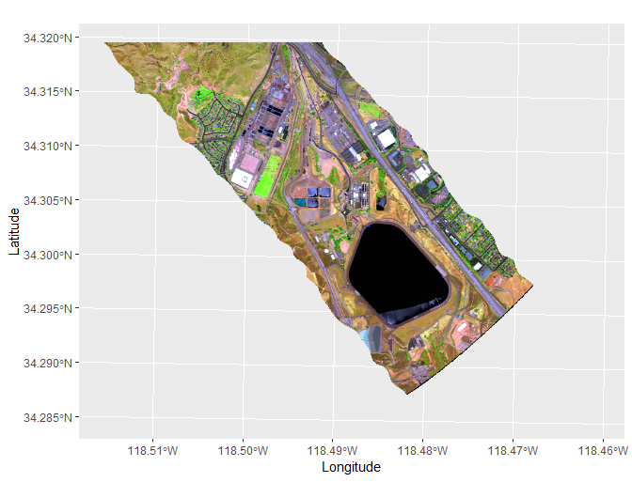
Swath data: georeferencing & rectification
Raw data
Orthocorrected data
flight path
Original data in instrument coordinates: lines x samples
Coordinates assigned to each pixel f(sensor-surface geometry, terrain)
Resampled to regular grid (some pixels are interpolated), GLT
Notes:
AVIRIS-NG: ang20200708t192518. Left image is gray scale of single band (red). Right is RGB image from radiance values.

Slide 10
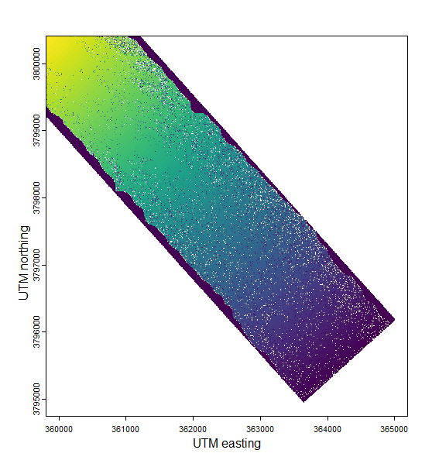
Radiance file structure & formats
Calibrated radiance : μW nm⁻¹ cm⁻² sr⁻¹
Image cube – “instrument” coordinates: lines x samples
Georectified image – matrix with regularly spaced pixels
Geolocation – per pixel: lon/lat or UTM coordinates
Geometric lookup table – relates instrument image cube pixels to rectified pixels; true vs. interpolated pixels
Observation parameters: sensor to surface geometry, solar geometry, surface slope & aspect
Notes:
In graphic, white pixels are interpolated. The color gradient shows “line” from image cube.

Slide 11
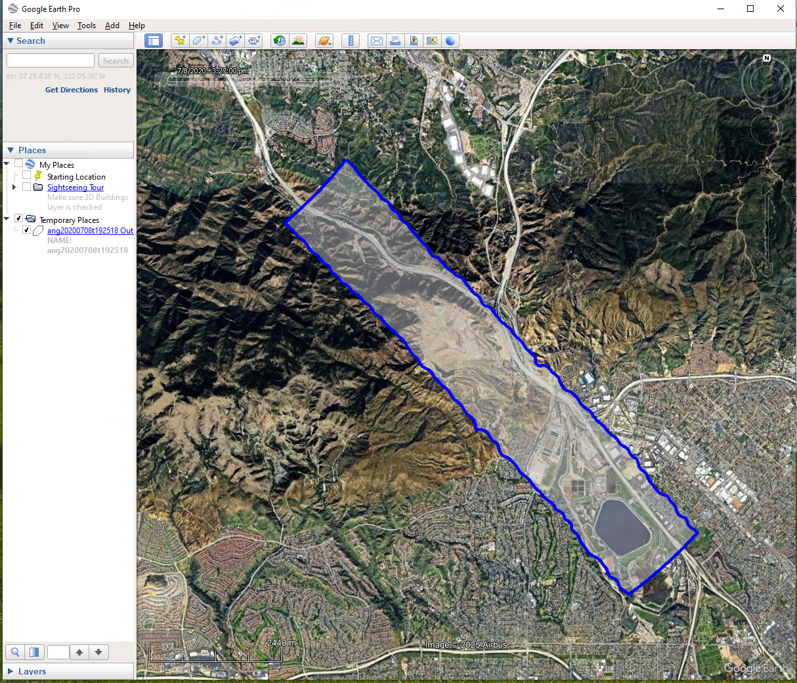
Ancillary files
Spectral calibration: wavelength centers, range, FWHM for each band
Quicklook images : RGB, high resolution or reduced resolution
KMZ for viewing in Google Earth or GIS import
Polygon outline of imagery footprint
Polygon with RGB quicklook overlay
Imagery footprint for
ang20200708t192518

Slide 12
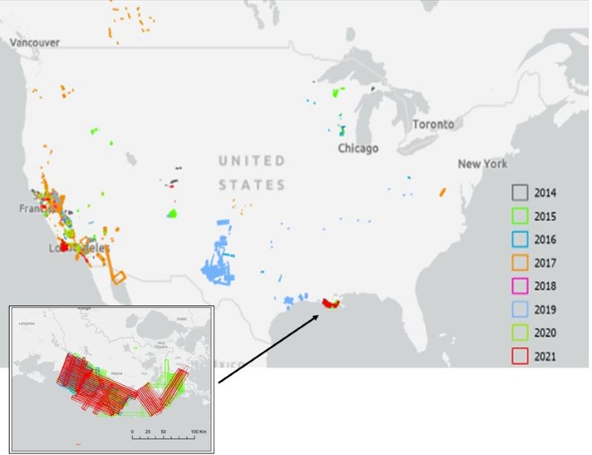
Flight line catalogs for AVIRIS family & MASTER
AVIRIS-Classic / -NG : Flight Line Geospatial and Contextual Data
https://doi.org/10.3334/ORNLDAAC/2140
MASTER: Flight Line Geospatial Polygons and Contextual Data
https://doi.org/10.3334/ORNLDAAC/2151
Indexed by date, location, flight metadata
CSV, Shapefile, KMZ, GeoTIFF formats
Notes:
https://daac.ornl.gov/cgi-bin/dataset_lister.pl?p=47

Slide 13
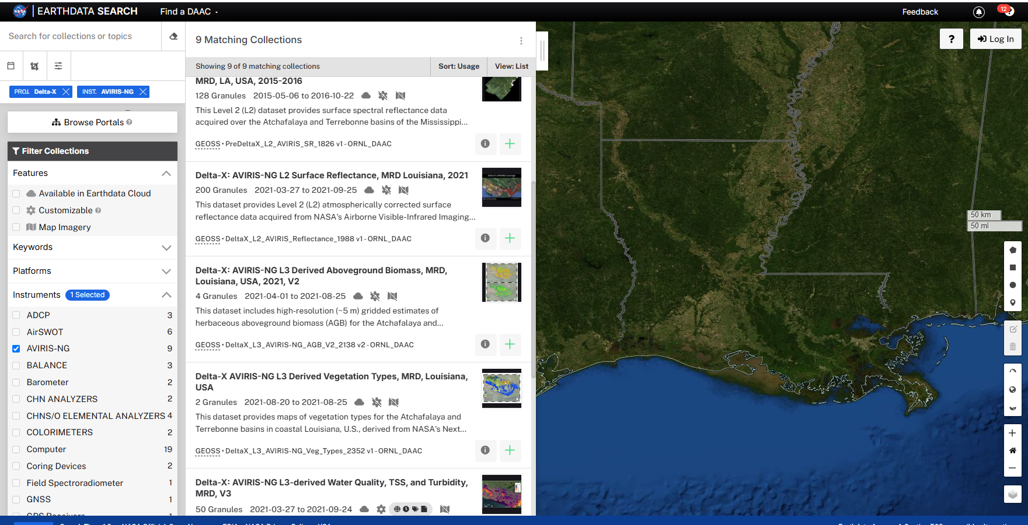
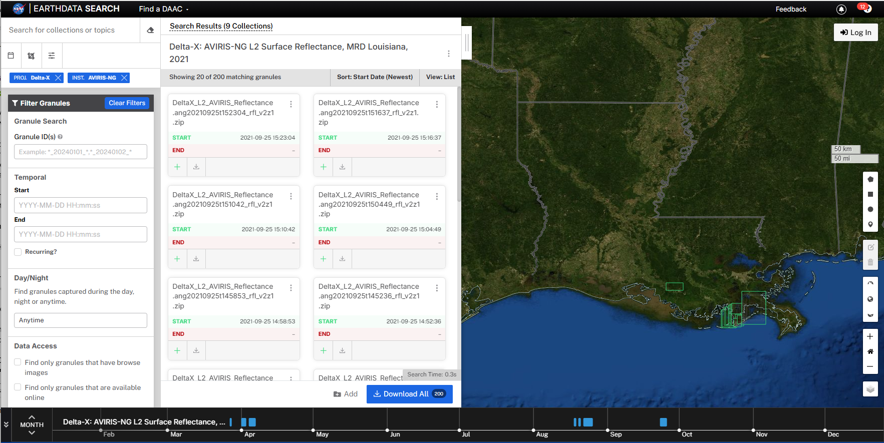
Data discoverability and access
Access through NASA’s Earthdata search (search.earthdata.nasa.gov)
Filter by instrument, project, date/time, spatial bounds
Download and access options; Web-based user interface or API tools
Search example:
AVIRIS-NG products
from
Delta-X project

Slide 14
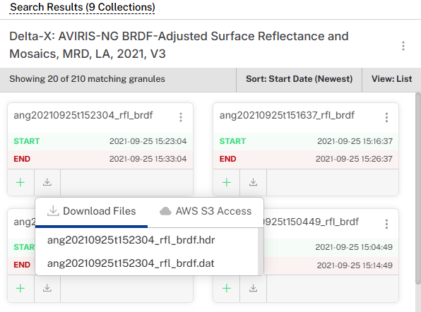
Data access options
Direct download
AWS cloud access
Earthdata login required
https://data.ornldaac.earthdata.nasa.gov/protected/deltax/DeltaX_L2A_AVIRIS-NG_BRDF_V3/data/ang20210925t152304_rfl_brdf.hdr
s3://ornl-cumulus-prod-protected/deltax/DeltaX_L2A_AVIRIS-NG_BRDF_V3/data/ang20210925t152304_rfl_brdf.hdr

Slide 15
Enterprise services
Search and download APIs through NASA’s CMR
See https://nasa-openscapes.github.io/earthdata-cloud-cookbook/, https://www.earthdata.nasa.gov/data/tools/earthaccess
Python, R, and MATLAB programming options
Subsetting and reprojection via OPenDAP and Harmony (https://harmony.earthdata.nasa.gov/)
Combine data from different collections
Select variables, transform data; reproject to preferred CRS
Select output format: NetCDF, GeoTIFF, JPEG2000, JSON, ASCII
Jupyter Notebook demo available.

