Slide 1



USING TERRESTRIAL LASER SCANNING TO EVALUATE THE IMPACTS OF FORESTRY MANAGEMENT PRACTICES ON THE UNDERSTORY COMPLEXITY OF A LONGLEAF PINE SAVANNA IN SOUTHERN MISSISSIPPI
Noah Williamson
University of Southern Mississippi

Slide 2
Background
Longleaf Pine Savannas
Terrestrial Laser Scanning
Understory Complexity Index

Slide 3
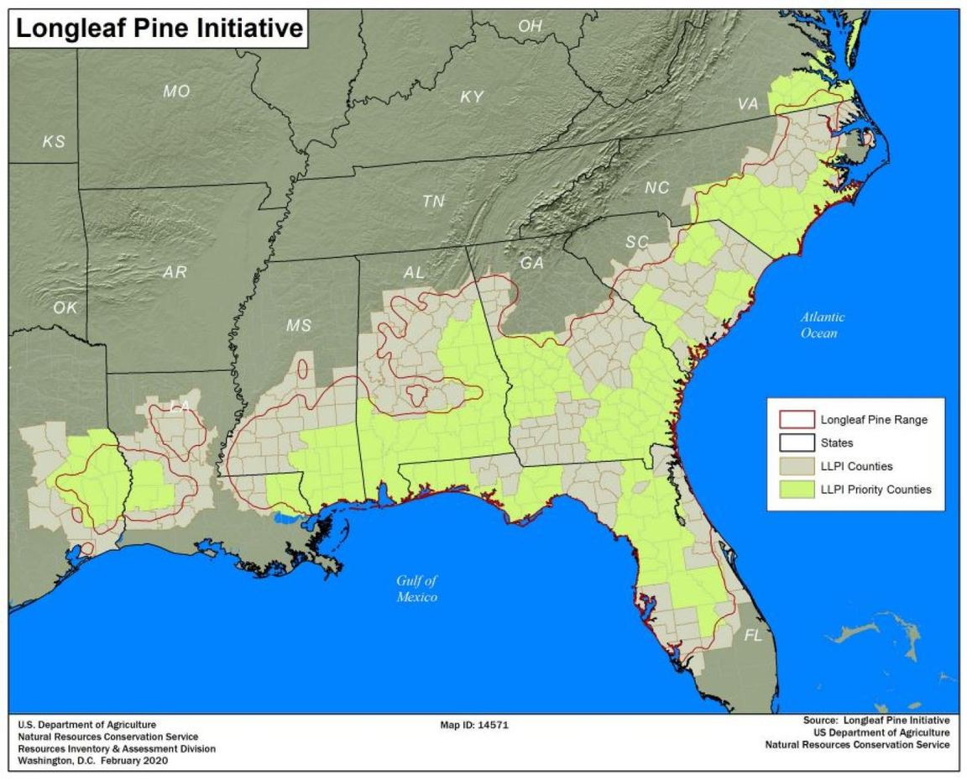
Longleaf Pine Savannas
Characteristics:
  Endemic to the Southeastern United States
  Host to many endemic, endangered, or threatened species
  Reduced to a fraction of its historical range
  Requires regular prescribed burning or similar management practices
Source: USDA Natural Resources Conservation Service

Slide 4
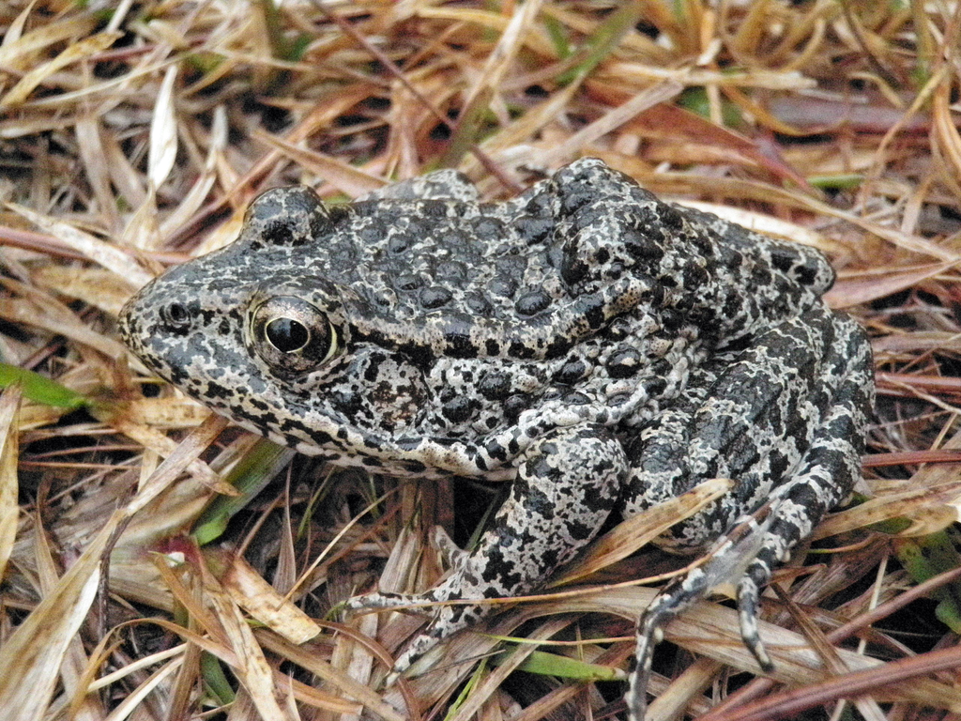
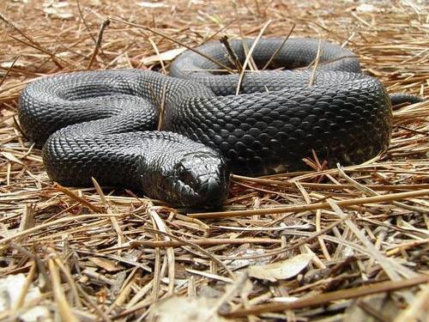
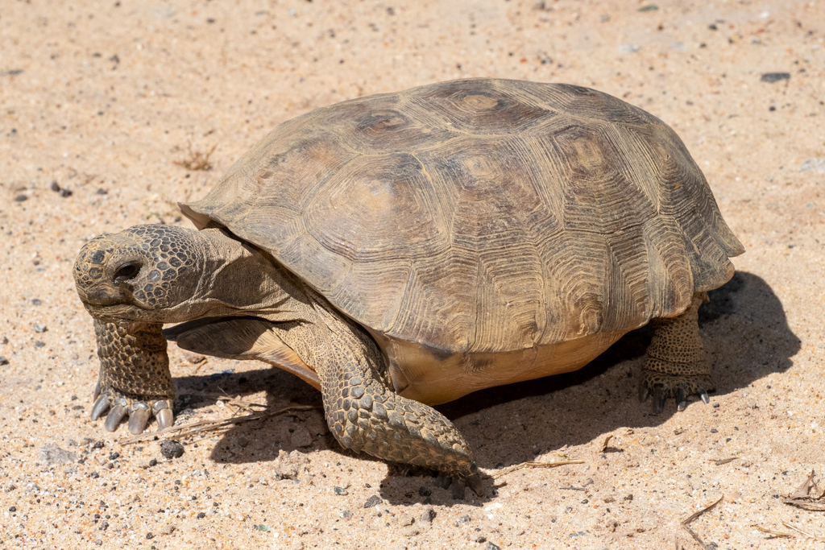
Biological Importance
Endemics
PC: USDA
PC: Ashley Bosarge
PC: Jake Zadik

Slide 5
Terrestrial Laser Scanning
Characteristics:
  Ground-Based Remote Sensing Technique using Light (LiDAR)
  Generates Dense Point Cloud Datasets
  Results are Replicable, Comparable over Time, and Easy to Manipulate
  Useful in the Field of Ecology, Among Others
    Geology, Geography, Archaeology, Architecture, Glaciology, Forensic Sciences
  Relatively Inexpensive to Generate Data

Slide 6
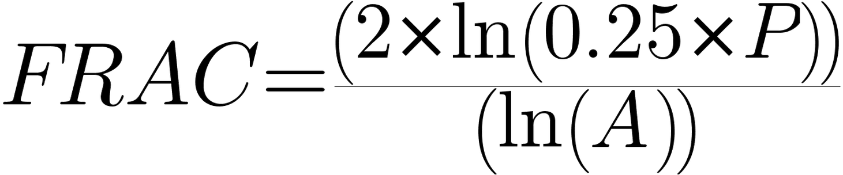
Understory Complexity Index
Characteristics:
  Structural Complexity is an Indicator of Vital Ecosystem Functions
    Separate from Biodiversity, However
  Willim et al. (2019) Found that Ground-Based Point Clouds of a Forest Understory can be Used to Evaluate its Complexity
  The Understory Complexity Index Processing Chain Produces a Comparable Value, the Fractal Dimension Index (FRAC) for that Ecosystem’s Complexity
The Formula for the Fractal Dimension Index, as defined by McGarigal and Marks, is:

Slide 7
Literature Gap
Only ~40 Results on Google Scholar
Not applied to Longleaf Pine Savannas
Typically Expensive
Why?
  Relatively Novel Technique
  Longleaf Pine Savannas are Endemic to the Southeast US
Benefits?
  Quantitative Metric
  Interdisciplinary
  Useful Across Different Ecosystems
  Relatively Affordable and Accessible

Slide 8
Objectives
  Generate quantitative and comparable Understory Complexity Index values for Longleaf Pine Savannas under various management strategies using Terrestrial Laser Scanning technology.​
    Management Strategies: Fire Supression, Prescribed Burning, Herbivore Grazing, and Forestry Mulching
  Refine and promote a low-cost method for forestry analysis via TLS devices that can be applied and compared between different ecosystems.​
  Add to the knowledge base surrounding the Longleaf Pine Savanna ecosystem to assist in future conservation efforts.

Slide 9
Materials / Methods

Slide 10

Procedures
  Using a LIVOX Tele-15 LiDAR Scanner, Scans were taken at 6 different sites, with 4 locations each, and 4 scans at each location, for a total of 96 point cloud datasets
  Scans were taken in the cardinal directions, with at least 50 meters between locations, and with overlap minimized
  Point Clouds were processed in accordance to the UCI Processing Chain in CloudCompare
LIVOX Tele-15 LiDAR Scanner
Cost: $1,499.00
FOV: 14.5° * 16.2°
Point Cloud Density: 2,400,000 pps

Slide 11
Our Setup
Technology | Specifications | Cost
LiDAR | Livox Tele-15 FOV: 14.5° * 16.2° Range Precision: 2cm Angular Precision: <0.03° Point Cloud Density: 2,400,000 pps | $ 1,499.00
Computer | B-Max B-1 Pro Mini-PC RAM: 8GB Storage: 128 GB Weight: 2.2 g Dimensions: 12 x 12 x 2.2 cm | $ 99.00
Monitor | Akntzs 7” Touchscreen Monitor Resolution: 1024 pixels Dimensions: 7 | $ 53.99
Batteries | KBT Rechargeable Lithium Ion Batteries12 V 1200mH System Battery Runtime: 4+ hrs | $ 16.99
Tripod | ZOMEI 74” Camera Tripod Weight: 6.6 lbs | $ 36.79
Software | Cloud CompareOpen Source 3D Point Cloud Analysis Software | $ 0.00
Total Cost |  | $ 1,705.77
Shopping List
  Affordable
  Most Expensive Item
    LiDAR
  Open-Source Software
  Portable

Slide 12
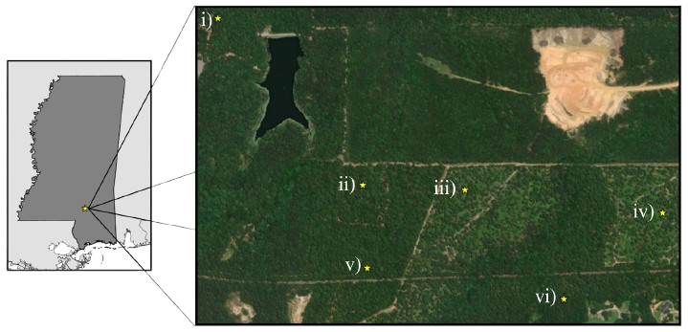
Study Locations
Locations:
i) Forestry Mulching
ii) Herbivore Grazing
iii) Prescribed Burning
iv) Prescribed Burning
v) Fire Suppression
vi) Fire Suppression

Slide 13
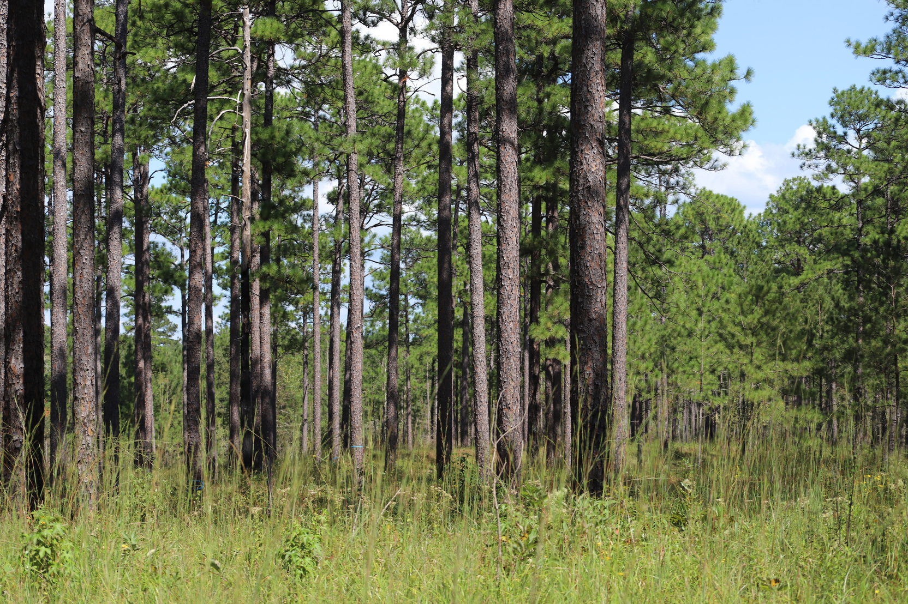
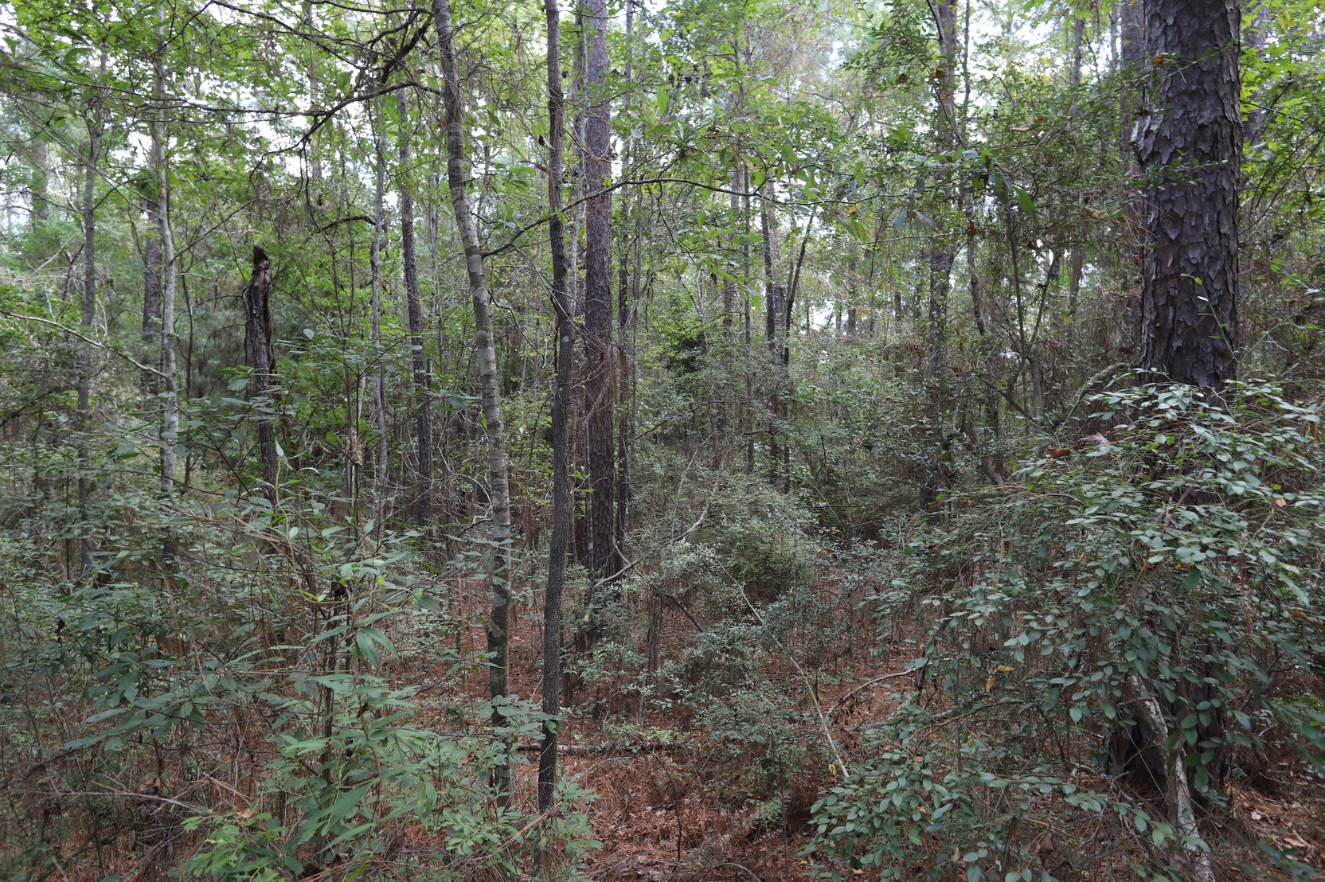
Site Comparison
Annual Prescribed Burns
Fire Suppression

Slide 14
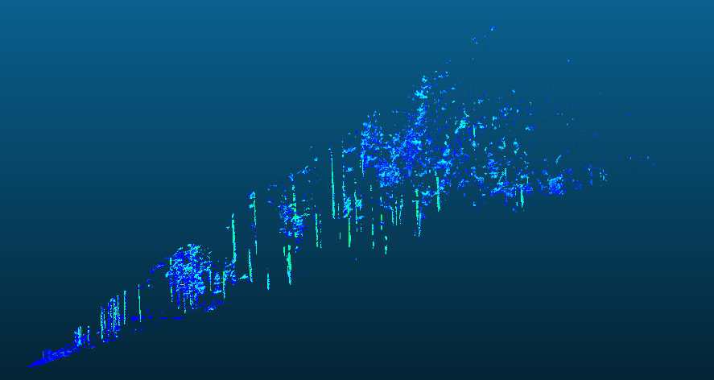
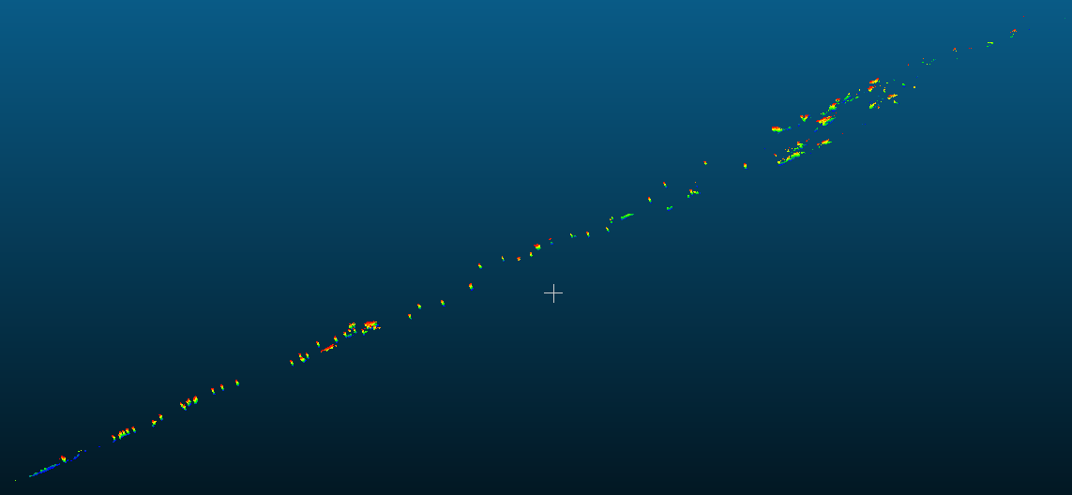
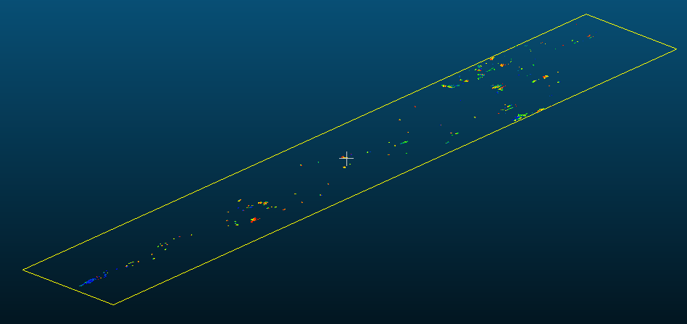

Processing Pathway
Import to CloudCompare

Slide 15
Processing Pathway
Clean and Filter

Slide 16
Processing Pathway
Flatten

Slide 17
Processing Pathway
Reduce Points to First Hits

Slide 18
Processing Pathway
Import Flattened Point Cloud into ArcGIS
Manually Convert Point Cloud to Polygon
Calculate Fractal Dimension Index (FRAC)

Slide 19
Results + Data Analysis

Slide 20


Slide 21
Treatment​ | Median FRAC​ | Standard Error FRAC​
Fire Suppression​ | 3.55​ | 0.27​
Annual Prescribed Burns​ | 2.25​ | 0.22​
Herbivore Grazing​ | 2.6​ | 0.22​
Forestry Mulching​ | 4.04​ | 0.08​
Data
Treatment Comparison | p-value
Fire Suppression - Annual Burns | 1.2 × 10-6 *
Fire Suppression - Mulching | 0.66
Fire Suppression - Grazing | 4.8 × 10-7 *
Grazing - Mulching | 8.9 × 10-6 *
Grazing - Annual Burns | 0.065
Mulching - Annual Burns | 7 × 10-5 *
Left: Statistical Analysis Results from Pairwise Wilcoxon Tests // * = statistically significant
Above: Median and Standard Error FRAC Values for each Treatment

Slide 22
Concluding Remarks
  When Longleaf Pine Savanna ecosystems are managed with regular prescribed burning or herbivore grazing, a low understory complexity is produced. When these ecosystems are mulched or when fire is suppressed, a higher understory complexity is produced.​
  It is possible to use low-cost, open-source technology to produce a widely applicable value for the Understory Complexity of the Longleaf Pine Savanna, showing promise as a useful metric and method for other ecosystems.​
  We were able to assess the complexity of the Longleaf Pine Savanna under these various treatments, adding to our understanding of this ecosystem.
  Further studies could explore how alternative burning regimens, different grazing behaviors, or less-destructive mulching techniques could influence the understory complexity of various ecosystems.

Slide 23
Future Directions
Seasonality: Will the Understory Complexity Index reflect seasonal changes in Structural Complexity?
Climate: Does the Understory Complexity Index reveal changes in structural complexity in forests of different climates?
Intersectionality: How can the Understory Complexity Index be used to gain insight into other fields of ecosystem research?
Value: Is the Understory Complexity Index worth adopting as a metric for evaluating forest health and complexity?

Slide 24

Acknowledgements
I would first and foremost like to extend my thanks to Dr. Kayla Stan for mentoring me throughout this project, providing the technology necessary for data acquisition, and her patience. Thanks to the Drapeau Center for Undergraduate Research and the School of Biological, Earth and Environmental Sciences at the University of Southern Mississippi for providing funding for this project. I am also grateful for the opportunity to present my findings as an undergraduate at ASPRS, and thankful for those who made it possible.

Slide 25
References
  CloudCompare (version 2.13.2). 2024. Open Source Project. Available at: http://www.cloudcompare.org/.
  Livox Tele-15 LiDAR Sensor. Livox Technology Company, Ltd
  McGarigal, K., and Marks, B.J. 1995. FRAGSTATS: spatial pattern analysis program for quantifying landscape structure. Portland, OR: U.S. Department of Agriculture, Forest Service, Pacific Northwest Research Station. p.PNW-GTR-351. https://doi.org/10.2737/PNW-GTR-351.
  U.S. Department of Agriculture, Natural Resources Conservation Service. "Longleaf Pine Initiative." Accessed at : https://www.nrcs.usda.gov/programs-initiatives/longleaf-pine-initiative.
  Willim, K. et al. 2019. Assessing Understory Complexity in Beech-dominated Forests (Fagus sylvatica L.) in Central Europe—From Managed to Primary Forests. Sensors 19 (7): 1684. https://doi.org/10.3390/s19071684.

