Slide 1
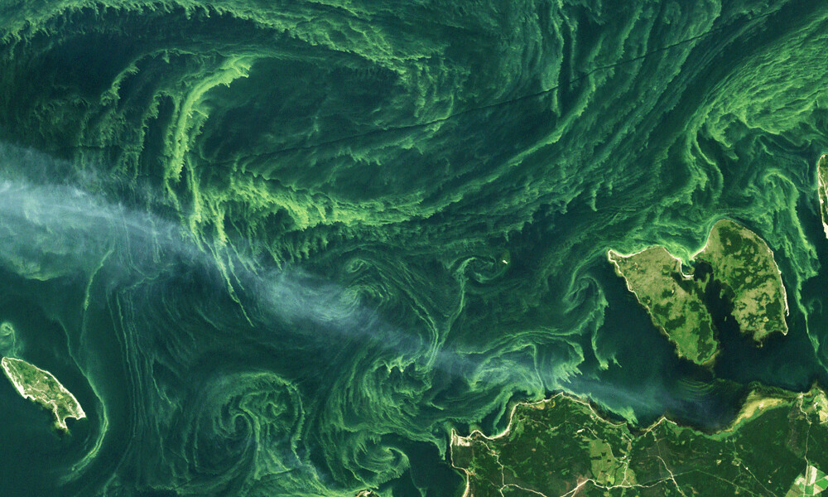




Low-cost Sensor to Strengthen CyanoHAB Monitoring with New Gen Ocean Color Satellites for Underrepresented Regions
Chintan B. Maniyar¹, Abhishek Kumar¹, Keshav Raviprakash^{1,2},
Mark A. Seferian^{2,3}, Isabella R. Fiorentino¹, Deepak R. Mishra¹
¹Center for Geospatial Research, Department of Geography, University of Georgia
²College of Engineering, University of Georgia
³AI institute for Advanced Optimization, Georgia Institute of Technology

Slide 2
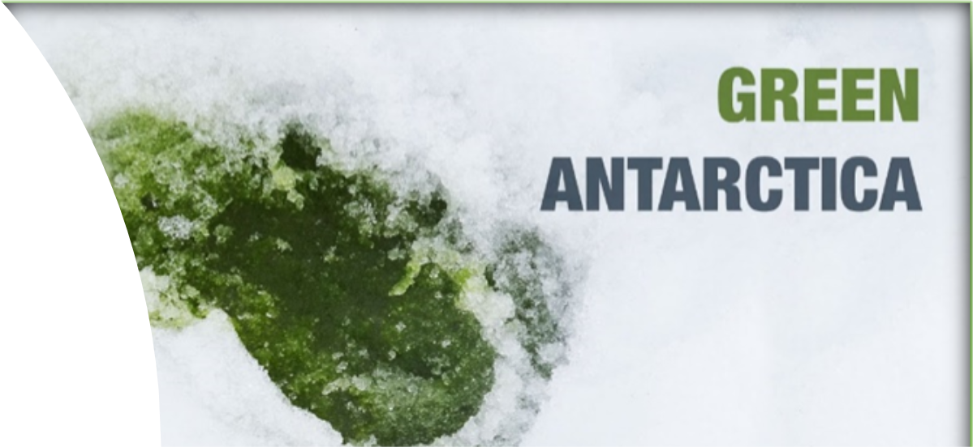
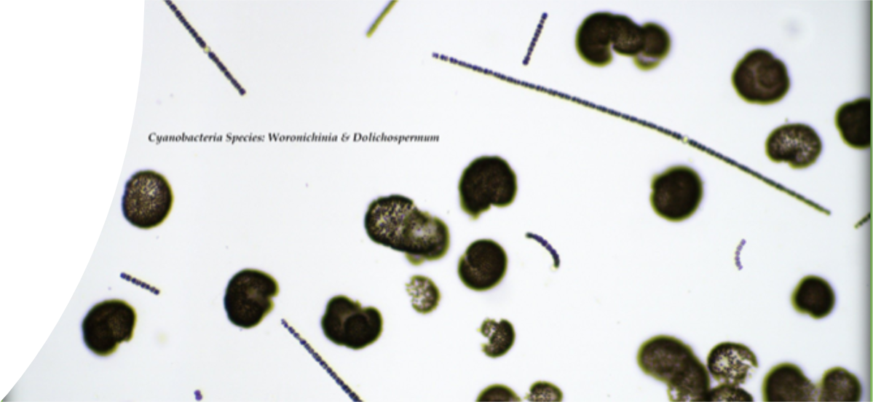
What are CyanoHABs?
Cyanobacterial Harmful Algal Blooms
A distinct group of phytoplankton – over 3 billion years old
Adaptable to a variety of aquatic environments
Need nutrient rich waters and warm temperature to bloom
Toxic – neurotoxins and hepatotoxins
https://www.smithsonianmag.com/smart-news/algae-are-turning-antarcticas-ice-green-180974960/
Credit: Dr. Susan Wilde

Slide 3
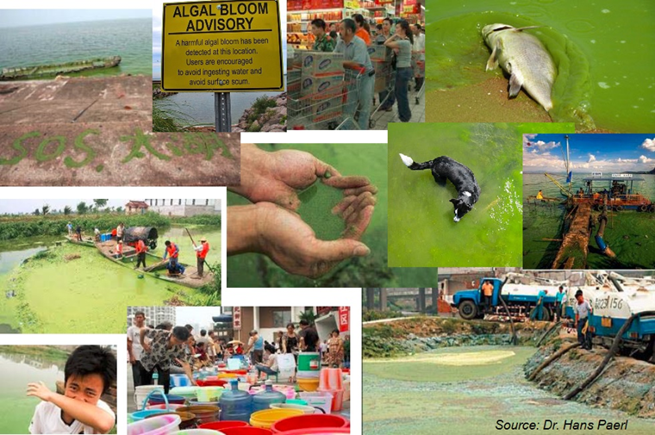
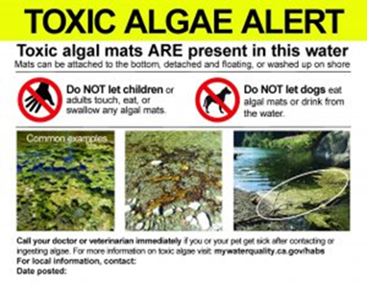
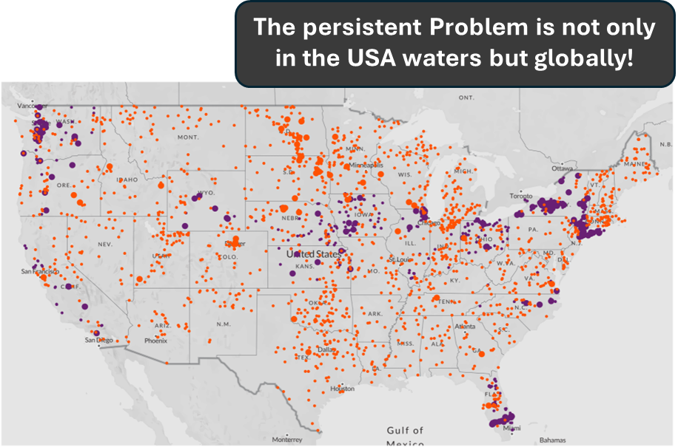
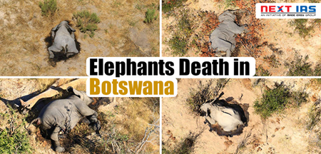
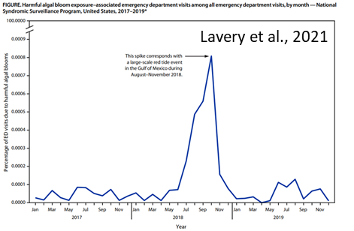
Why should we study CyanoHABs?
Economic loss
Over $5B/year (LG Sonic, 2023)
Public Health Hazards
Over $10B/year (Anderson et al,)
Biodiversity Loss
https://www.ewg.org/interactive-maps/2019_microcystin/map/

Slide 4
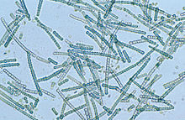
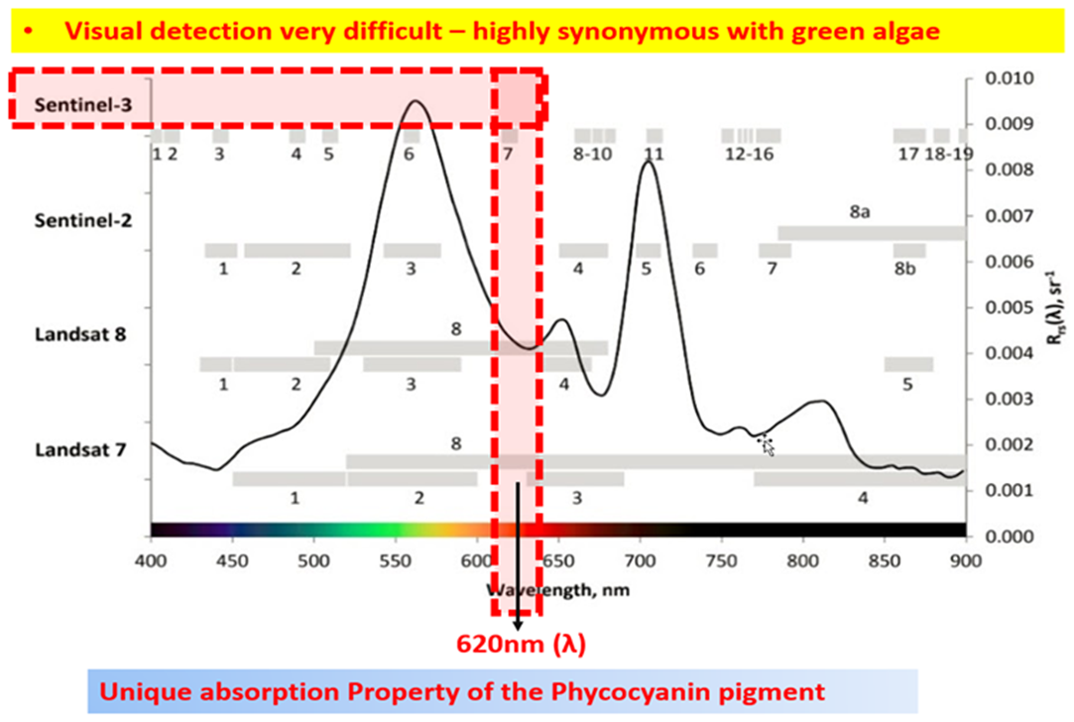
Remote Sensing of CyanoHABs
Visual detection is difficult - highly synonymous with green (non-toxic) algae
Remote sensing of CyanoHABs either with Phycocyanin (PC) or Chlorophyll-a (Chl-a) pigments
PC is unique to CyanoHABs and absorbs light strongly at 620 nm à PC concentration
Chl-a present in all phytoplankton bloom and used frequently as a proxy à Cyanobacteria Cell Density (CCD)

Slide 5
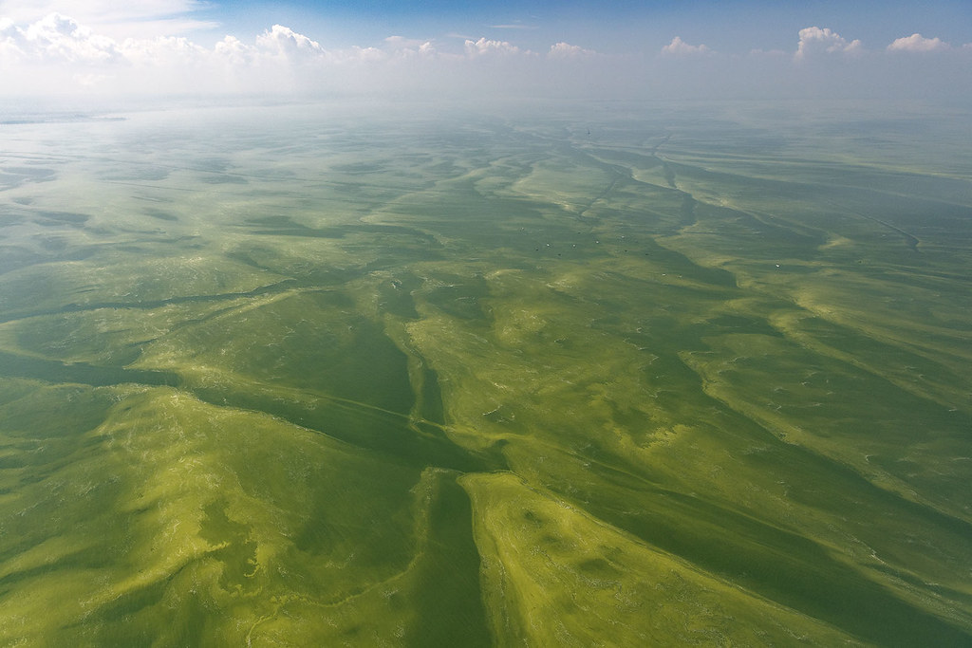
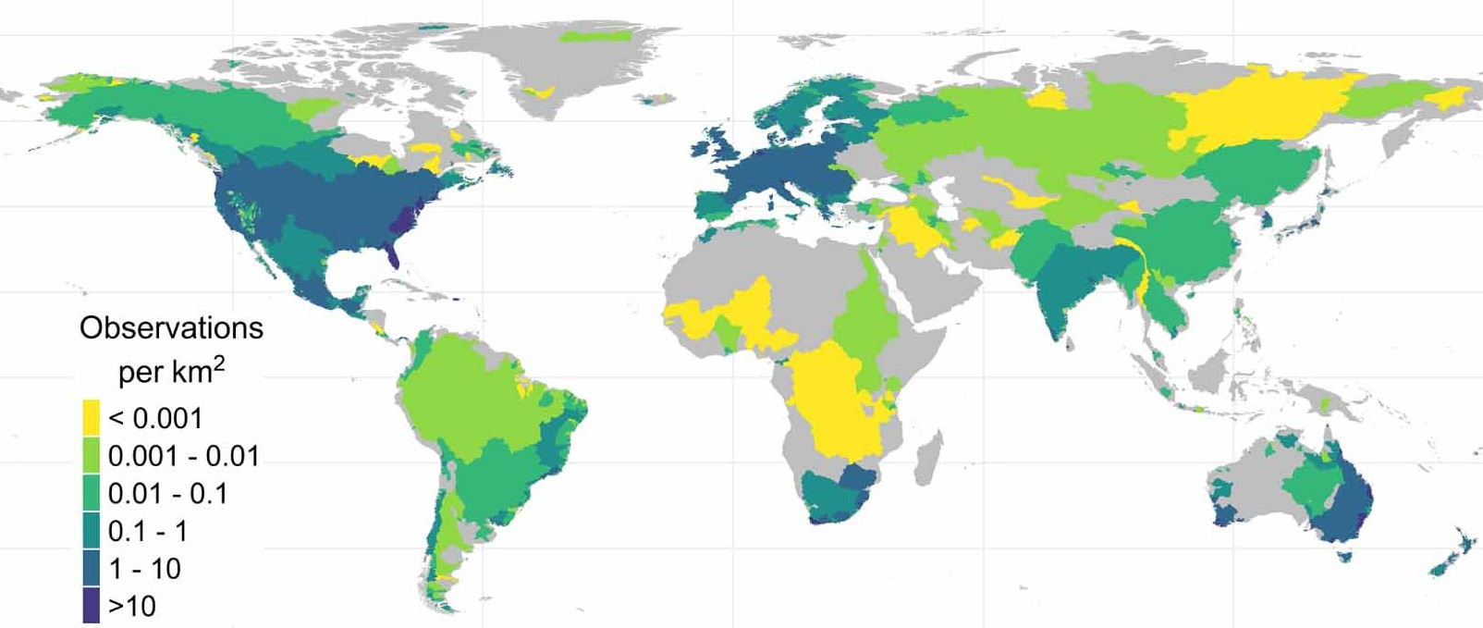



Gaps in Global CyanoHAB Monitoring
Monitoring efforts and accessibility skewed towards Global North
Under sampled or developing regions – significant blind spots
Severe events go unreported
Why?
Lack of affordable resources
Jones et al, 2024: 10.1088/1748-9326/ad6919

Slide 6
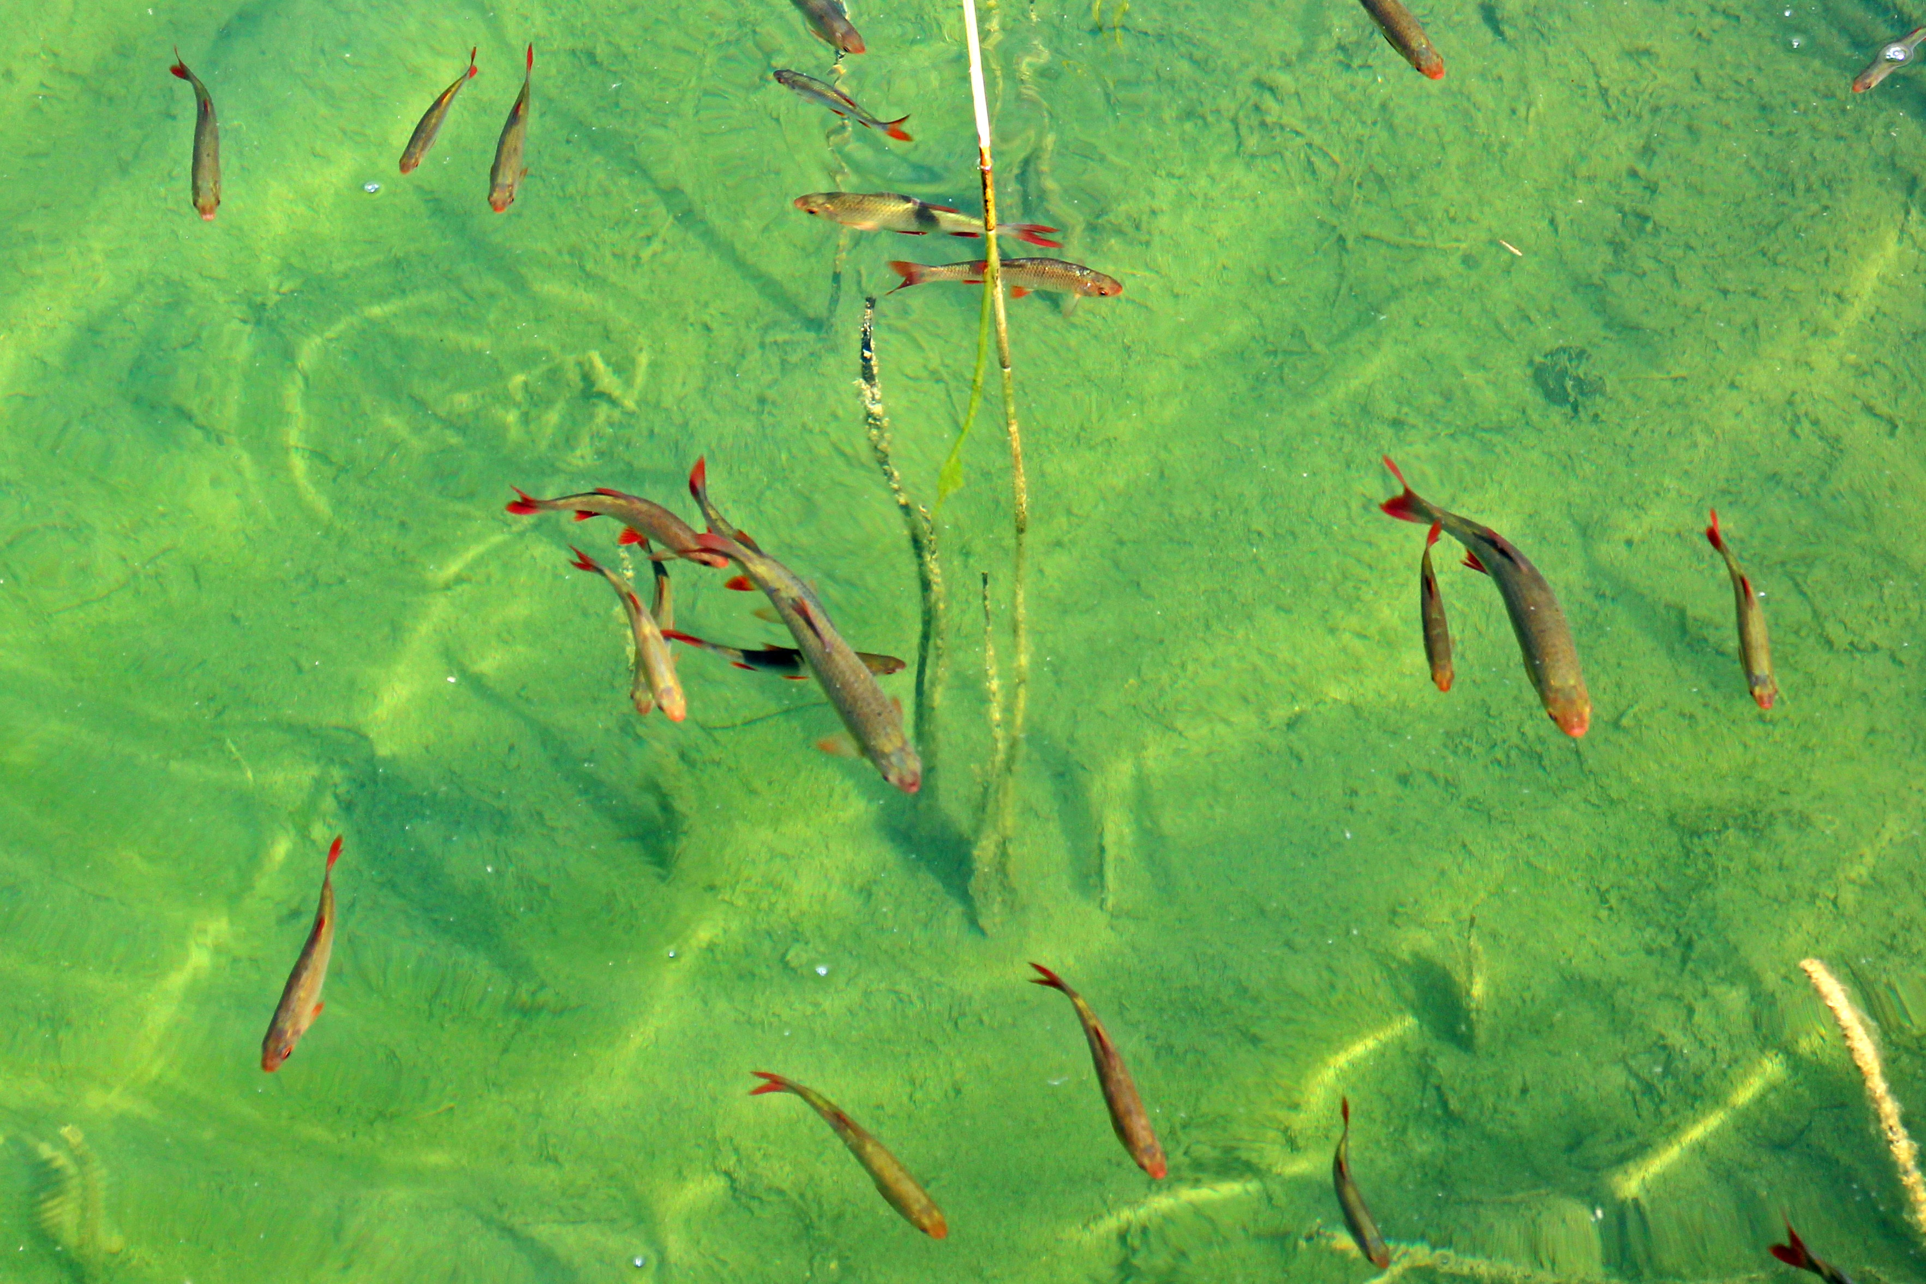

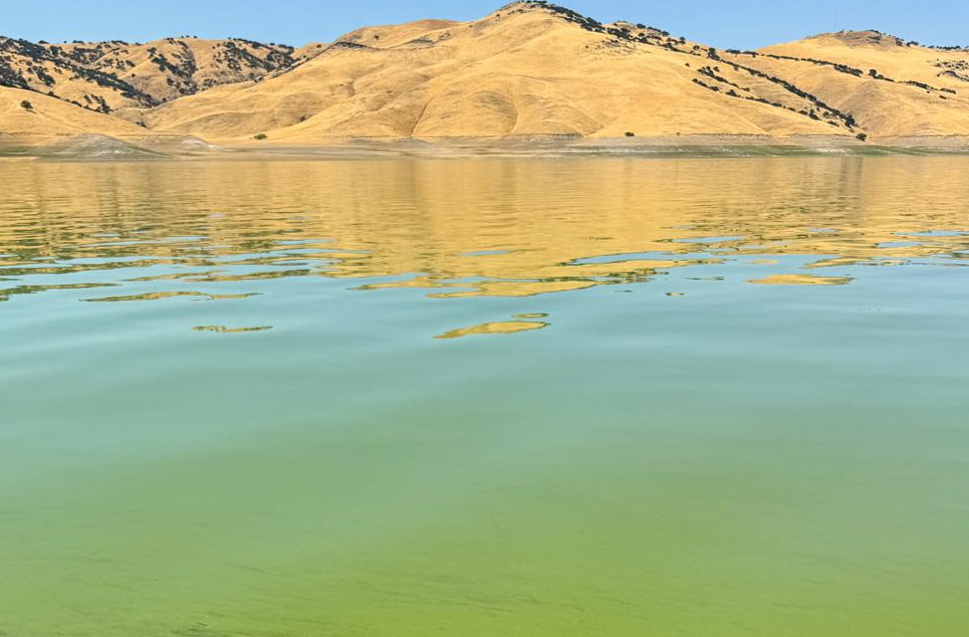
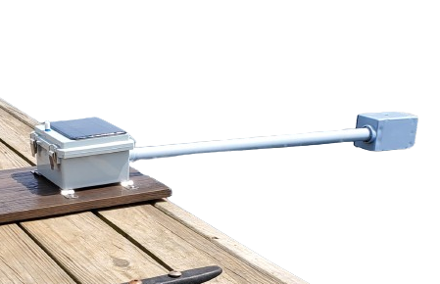
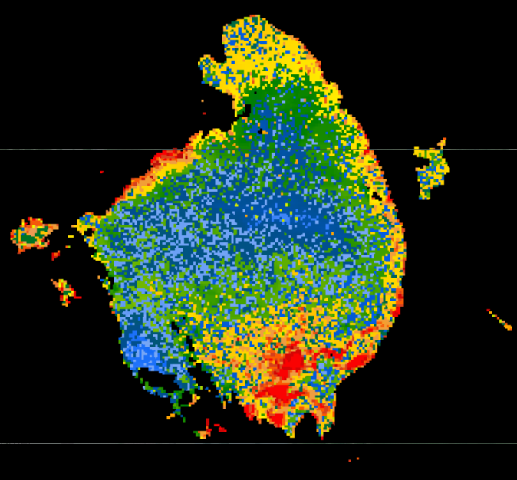
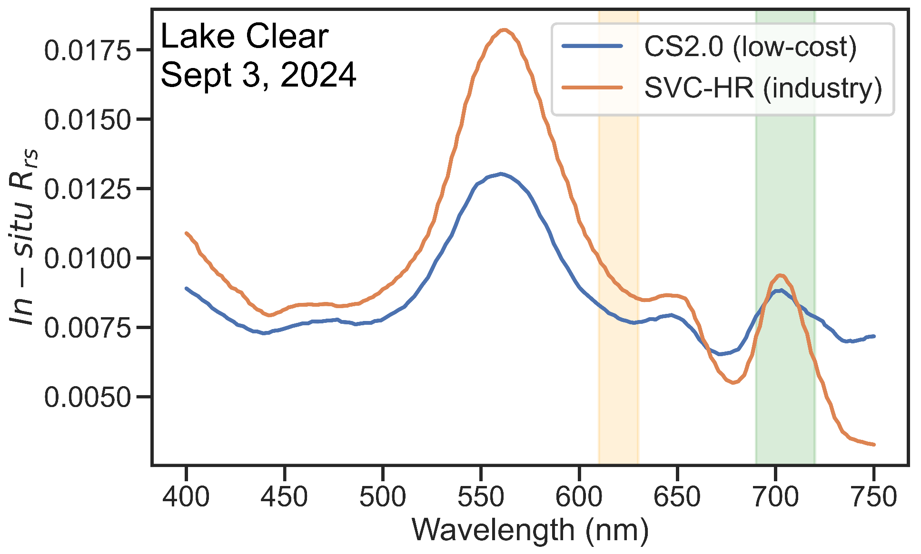
Solution: A Low-cost Hyperspectral CyanoHAB Sensor
Although satellite data is free, in-situ radiometry data is always needed to validate satellite observations and model development
In-situ sampling is costly
  Logistics – boat, buoys etc.
  Sensors – sophisticated/industry-grade in-situ sensors are prohibitively costly (upto $100,000 (SVC inc., 2025))
  Training – special skills to operate sensors
Limits in-situ data collection in resource limited and developing regions
Low-cost
In-situ data
CyanoHAB Satellite Maps:
Sentinel-2/3; PACE; Landsat-8/9
Maniyar et al., 2025 (under review in ACS ES&T Water)

Slide 7
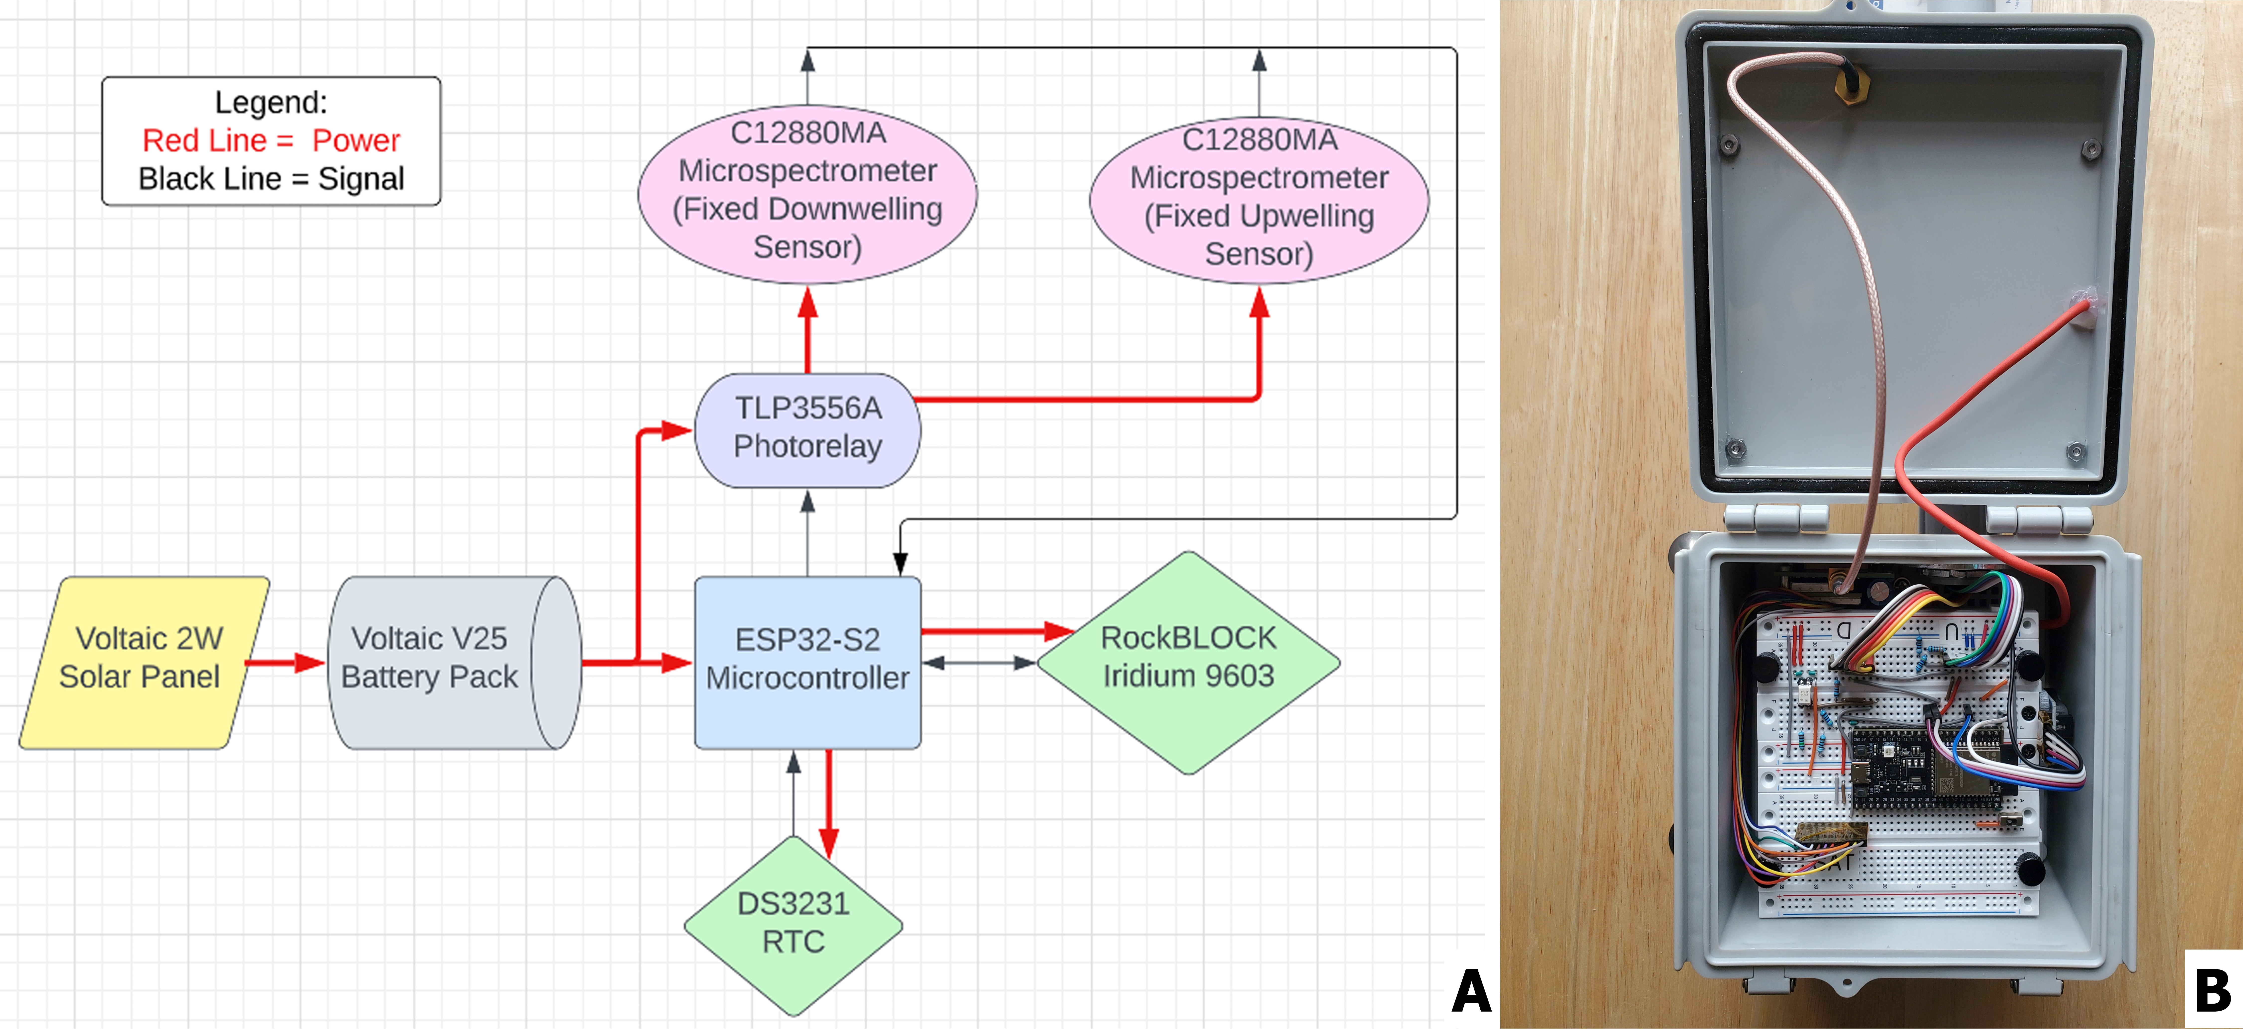
Cyanosense 2.0: Design & Development
Maniyar et al., 2025 (under review in ACS ES&T Water)

Slide 8
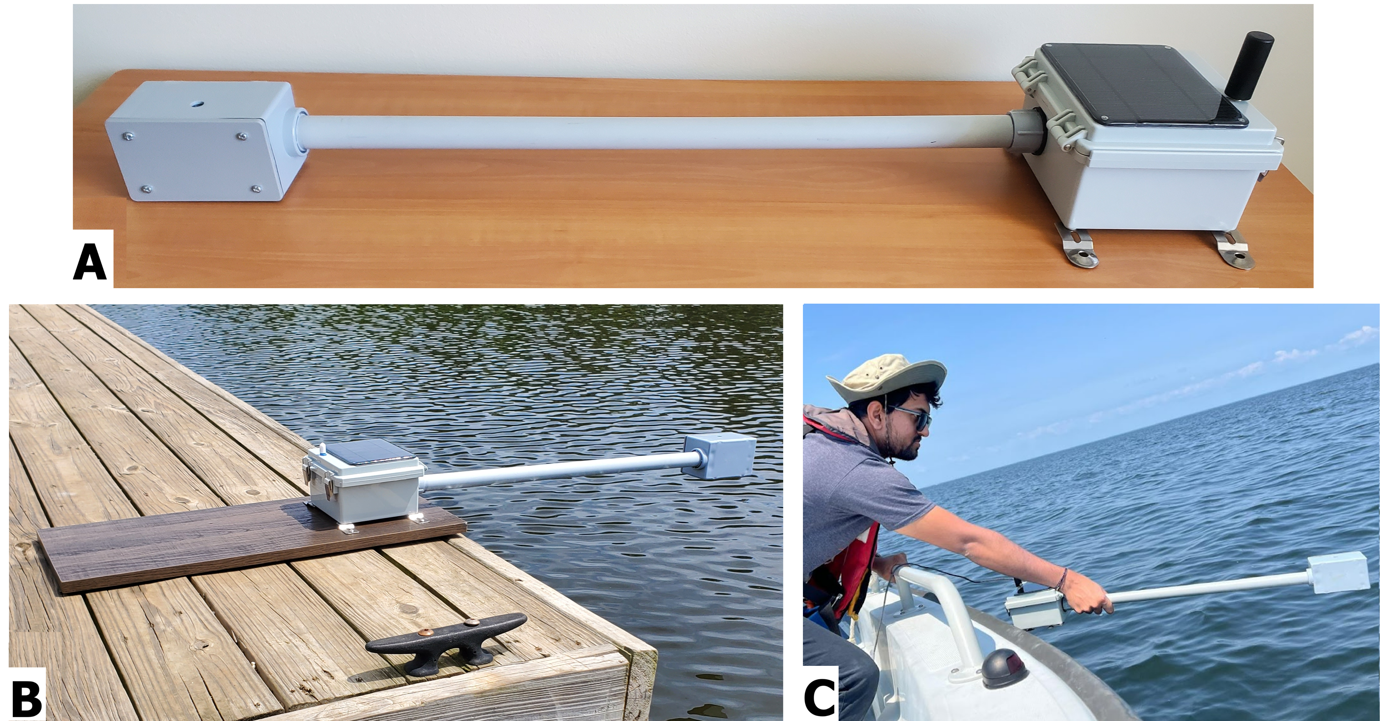
Cyanosense 2.0: Operation
Maniyar et al., 2025 (under review in ACS ES&T Water)

Slide 9
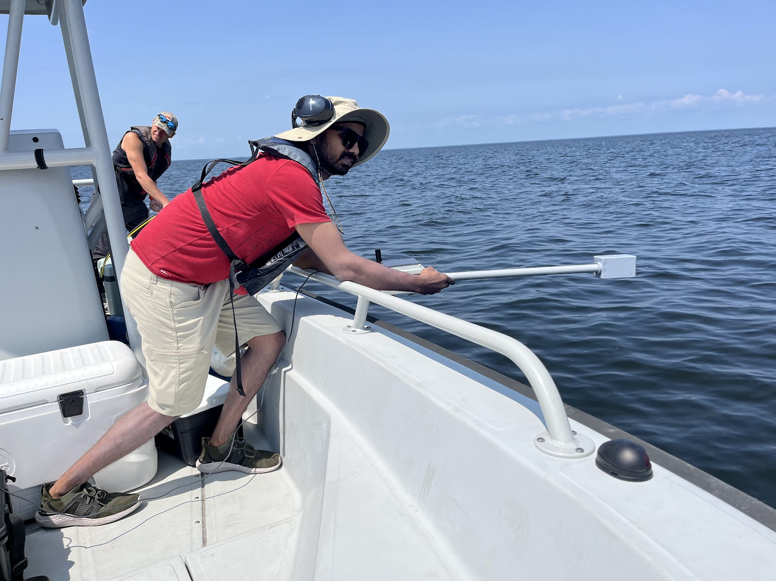
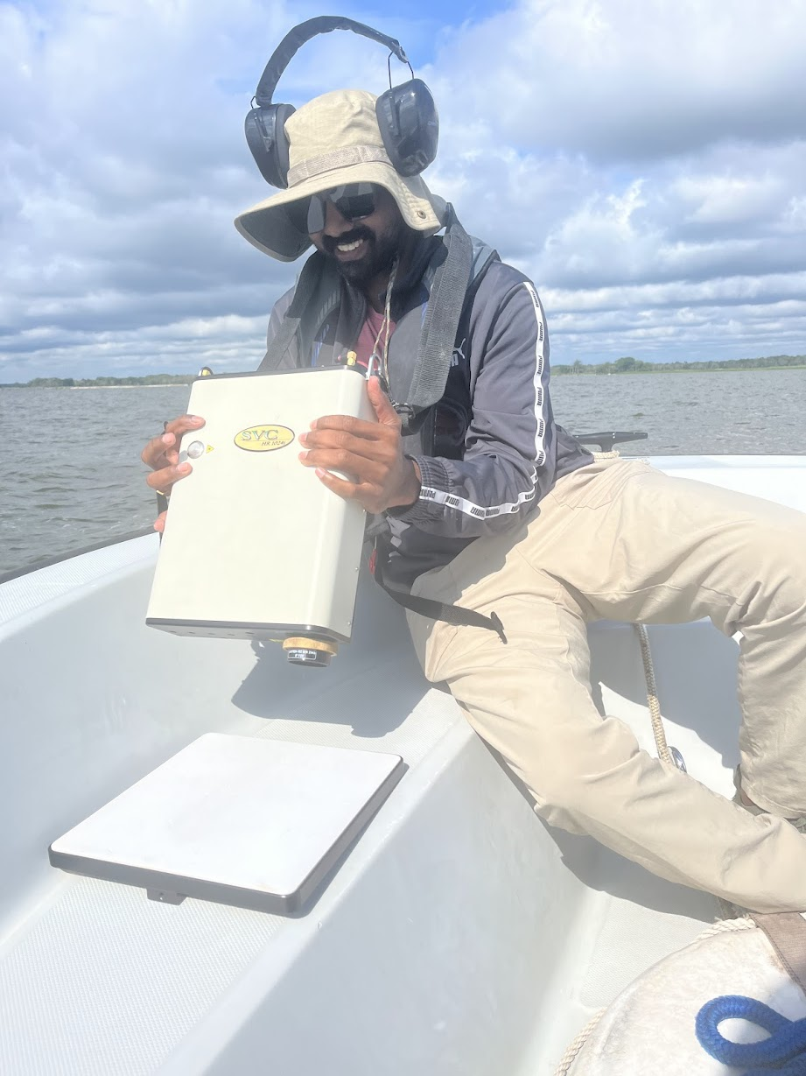
Does it really work? US-wide Testing
Cyanosense2.0
$1,300
(to evaluate)
SVC 1024-HRi
$70,000
(as reference)
We visited 6 CyanoHAB prone lakes across the US in Summer 2024 to test Cyanosense 2.0!
Maniyar et al., 2025 (under review in ACS ES&T Water)

Slide 10
Radiometric Evaluation (in-situ)
Radiometric sensitivity in the CyanoHAB active region: 550 nm – 750 nm
Maniyar et al., 2025 (under review in ACS ES&T Water)

Slide 11
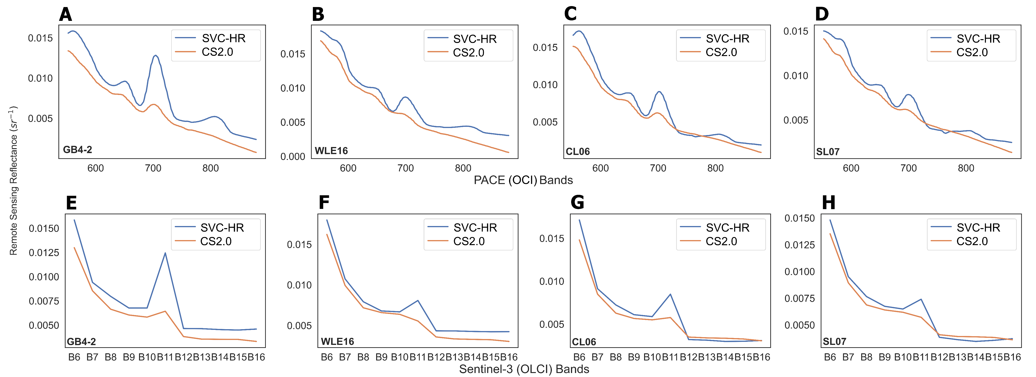
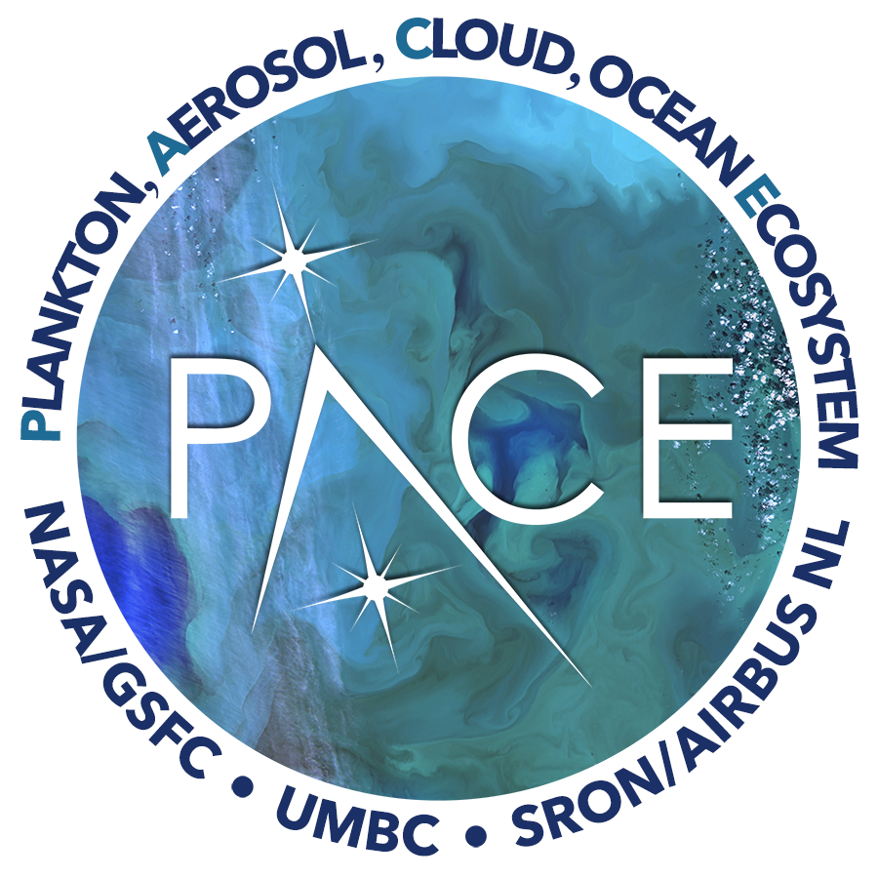
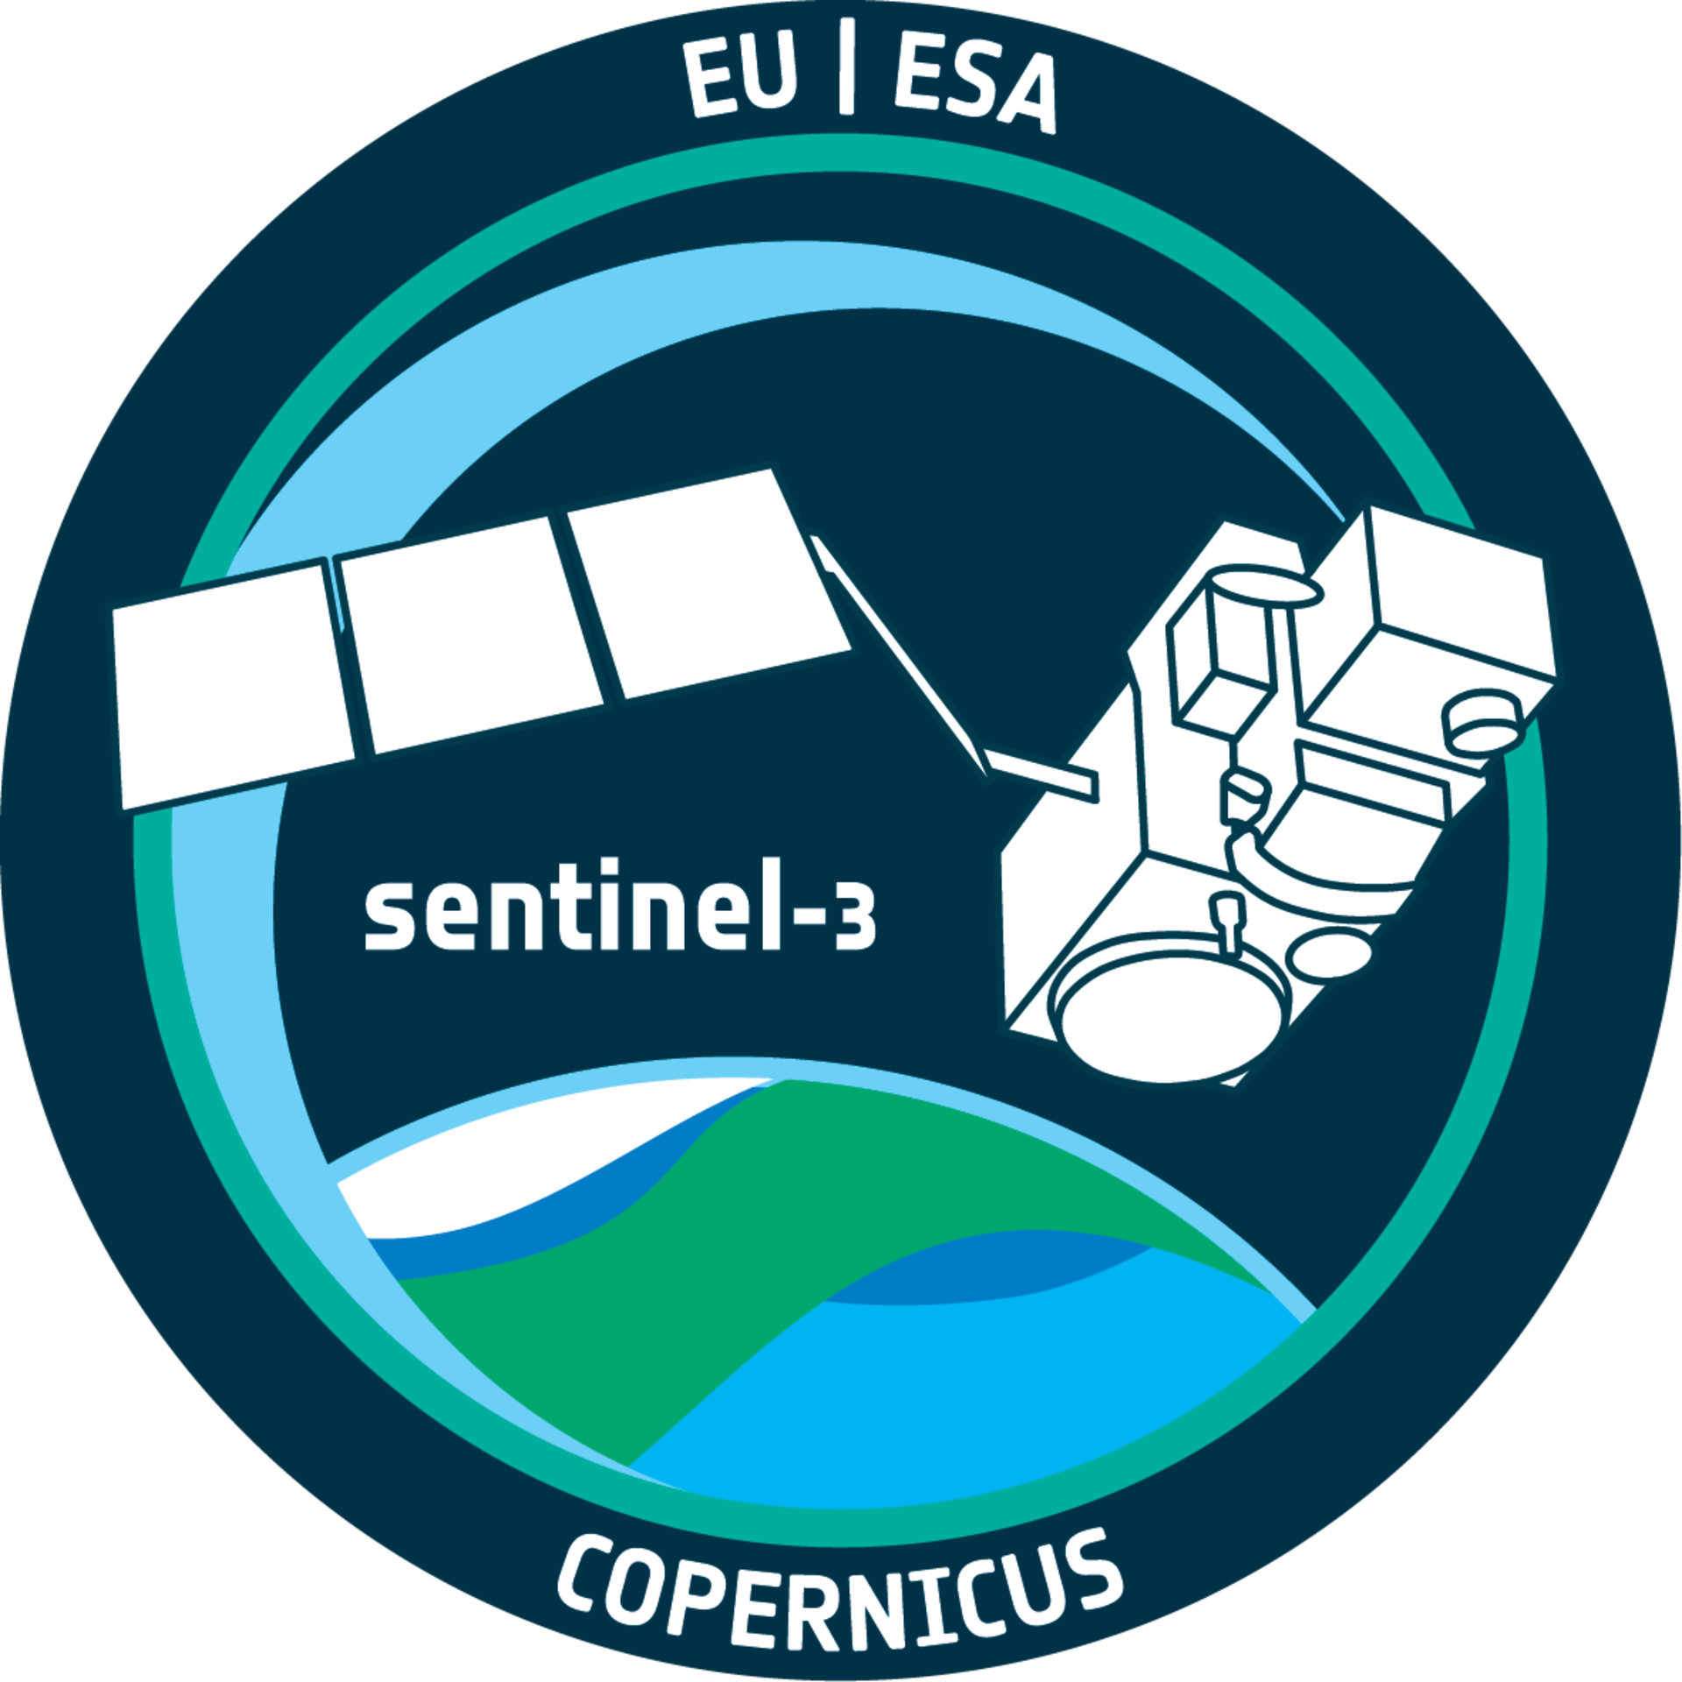
Cyanosense 2.0: Satellite Validation
Sentinel-3 (OLCI) PACE (OCI)
Maniyar et al., 2025 (under review in ACS ES&T Water)

Slide 12
Supporting Satellite-based CyanoHAB Monitoring
NDCI PC3 CI PCI
Sentinel-3 (OLCI) PACE (OCI)
Maniyar et al., 2025 (under review in ACS ES&T Water)

Slide 13
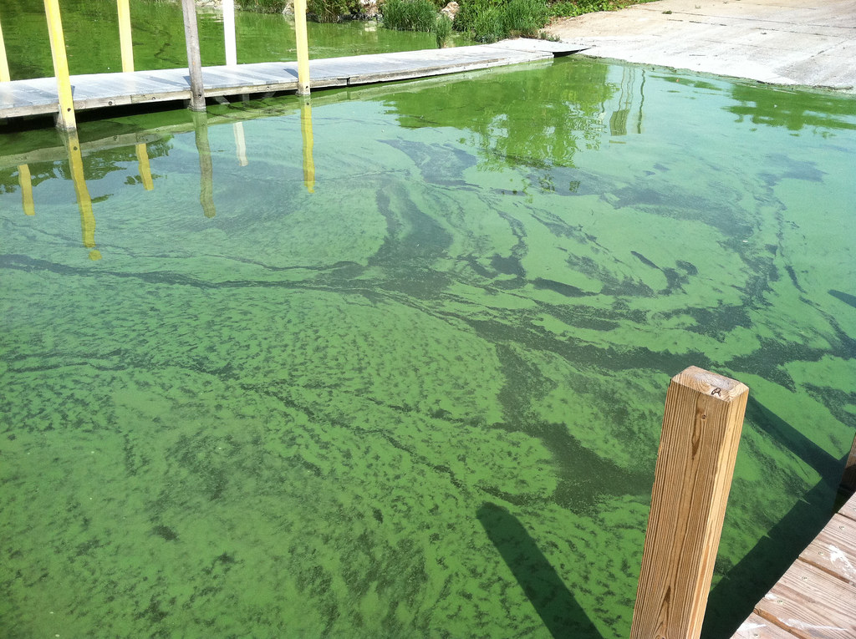
How does Cyanosense 2.0 benefit us?
Fits easily into existing monitoring frameworks
  EPA CyAN, USGS, GEOHAB, NLA etc.
Promotes citizen science
Easily affordable by developing and underrepresented regions
  Bridges monitoring gaps at a global level
  Long-term ground data collection
  Satellite validation
Suitable for other water quality parameters as well
Limitations
  Radiometric sensitivity in NIR region

Slide 14
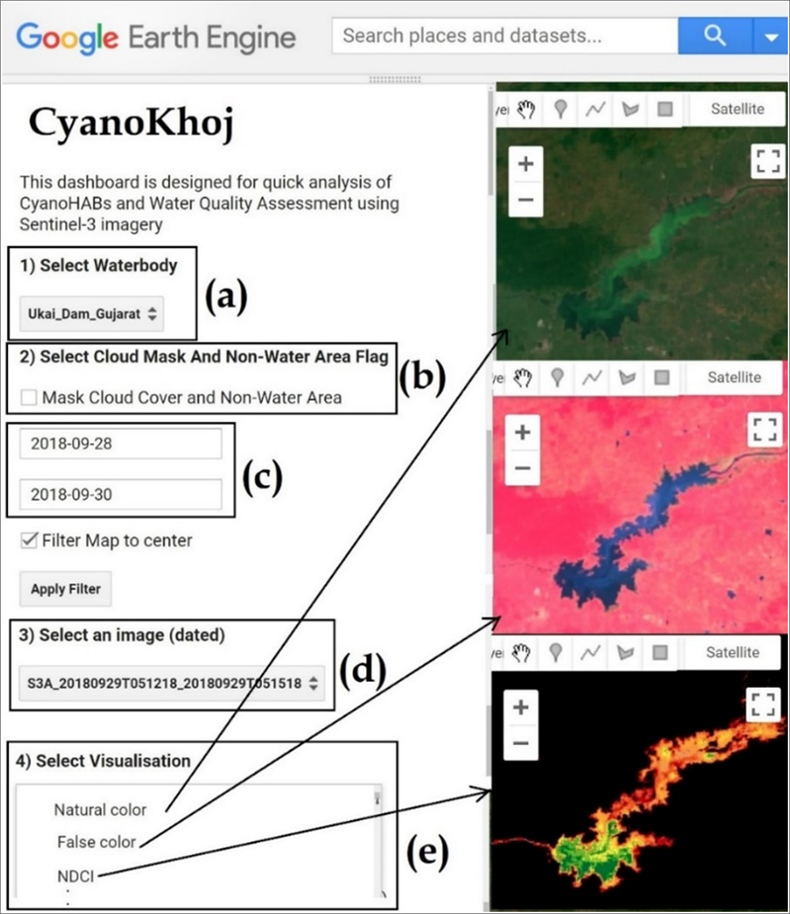
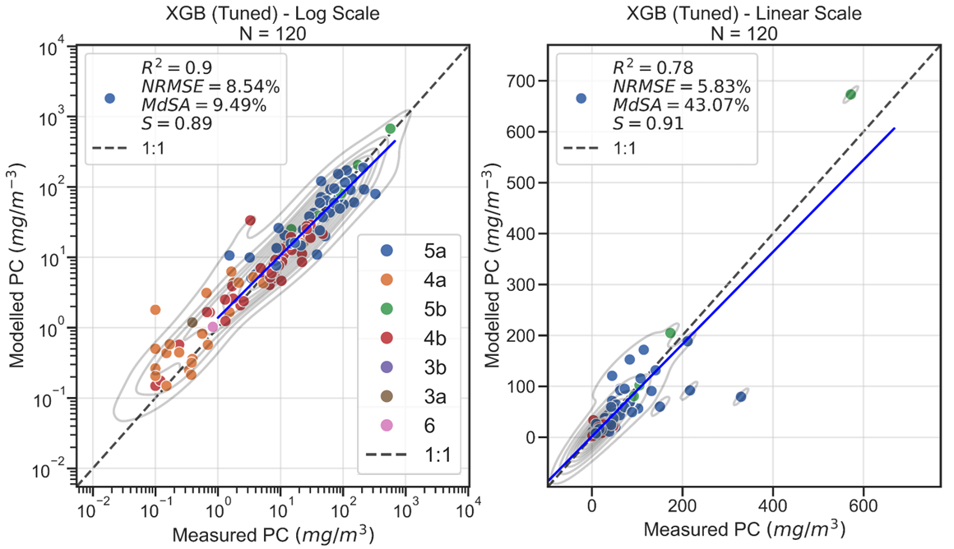
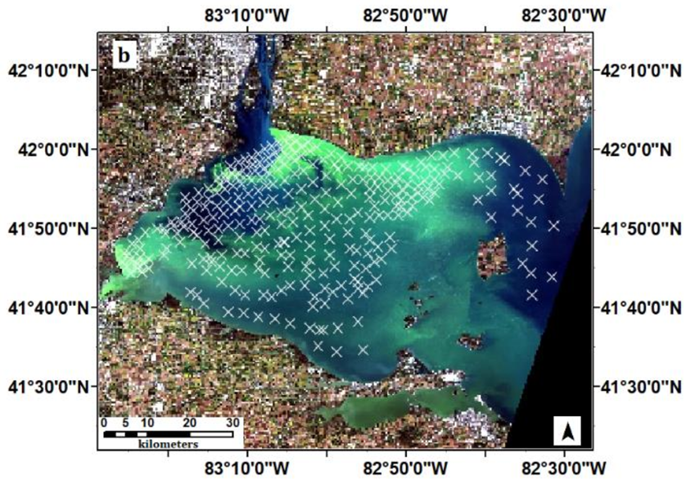
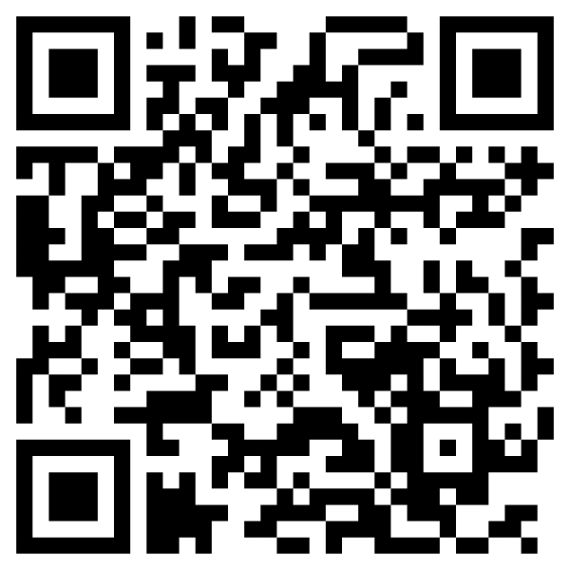
Overarching Borader Impact/
Bigger Picture
In-situ
data
Satellite Data
(PACE, Sentinel-2/3, Landsat-8/9)
Early Warning Model:
Geo-AI,
QR-NN,
Mixture of Experts
Global CyanoHAB Dashboard (opensource)
Access it here:

Slide 15
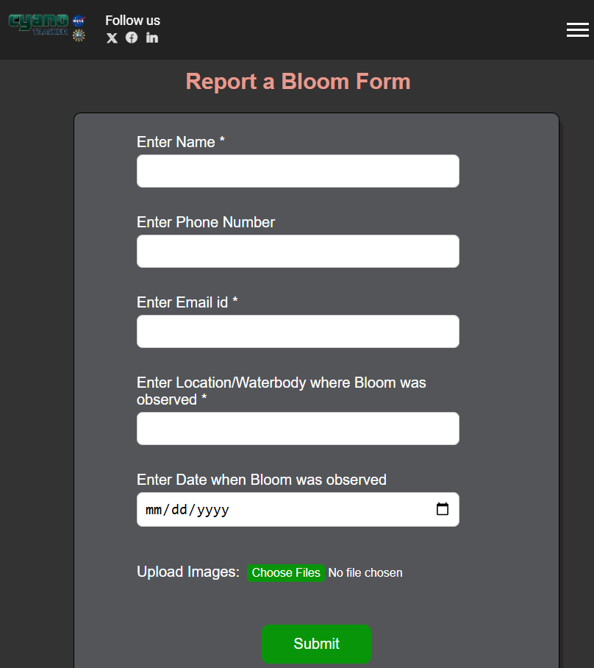
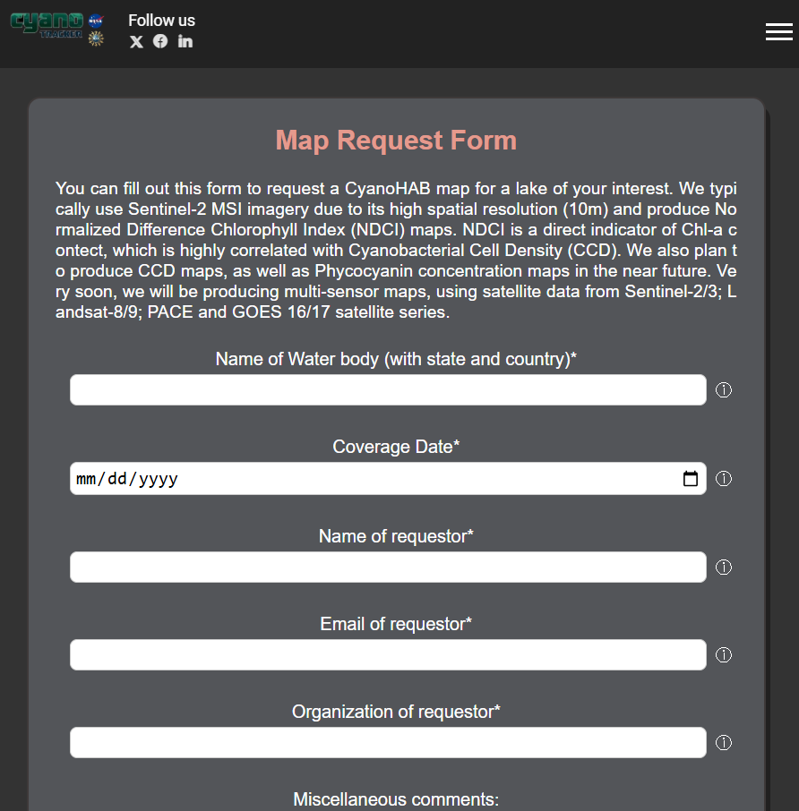
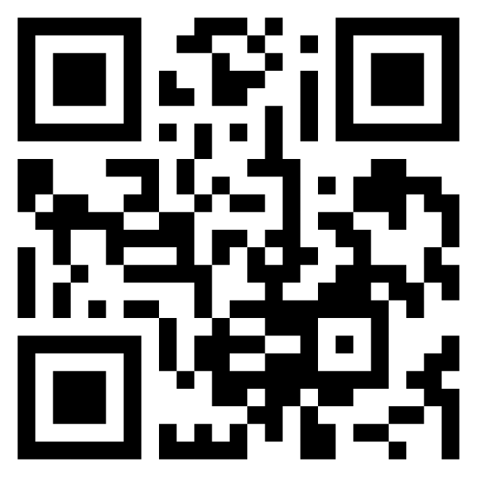
CyanoTRACKER Project Website
(app coming soon!)
Report a bloom/HAB!
Request a HAB-Map!
Access our website here!
See an algal bloom anywhere near you? Report it on our website and we will relay it on to the authorities!
You can also request a satellite-based CyanoHAB map of any location if you flag an ongoing bloom!

Slide 16
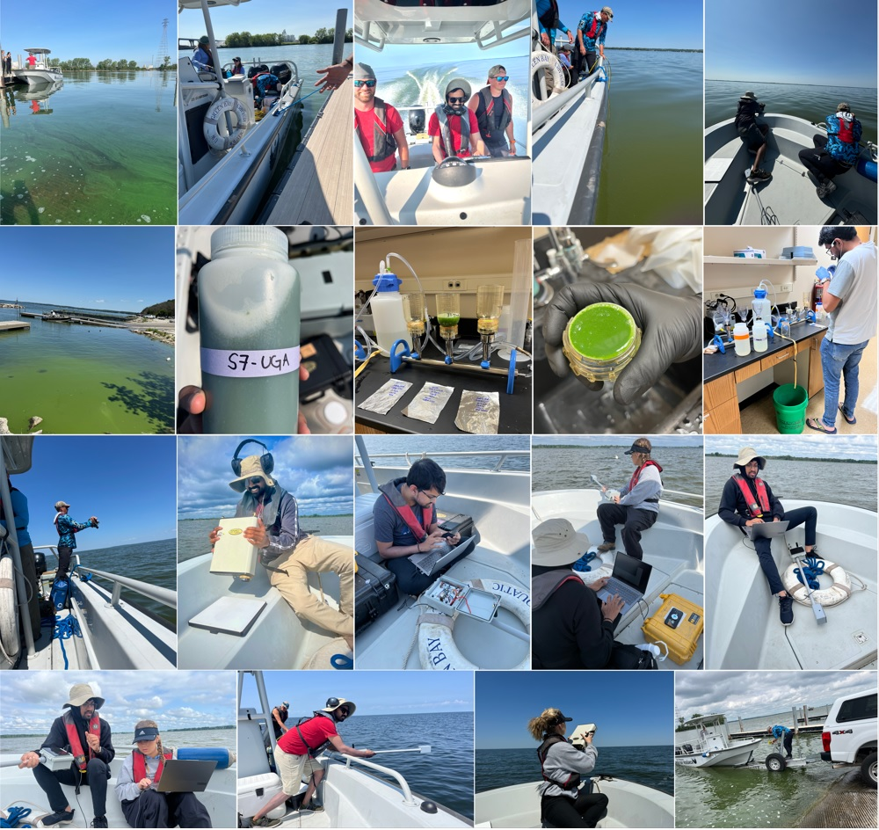
Acknowledgements
ASPRS and ORNL
Field campaign
  Cleveland State University, University of Wisconsin-Milwaukee,
  Florida Atlantic University, Utah State University,
  Department of Environmental Quality
Funding Agencies
  NASA FINESST: #80NSSC24K0068
  NASA ESROGSS: #80NSSC23K125
Logistical Support and Contribution
  Jonathan Crowell, Aladdin Al-Khatib, Maggie Kurdle, Ranganadh Srivillibhutturu, Nancee Uniyal, Rajneesh Sharma

Slide 17
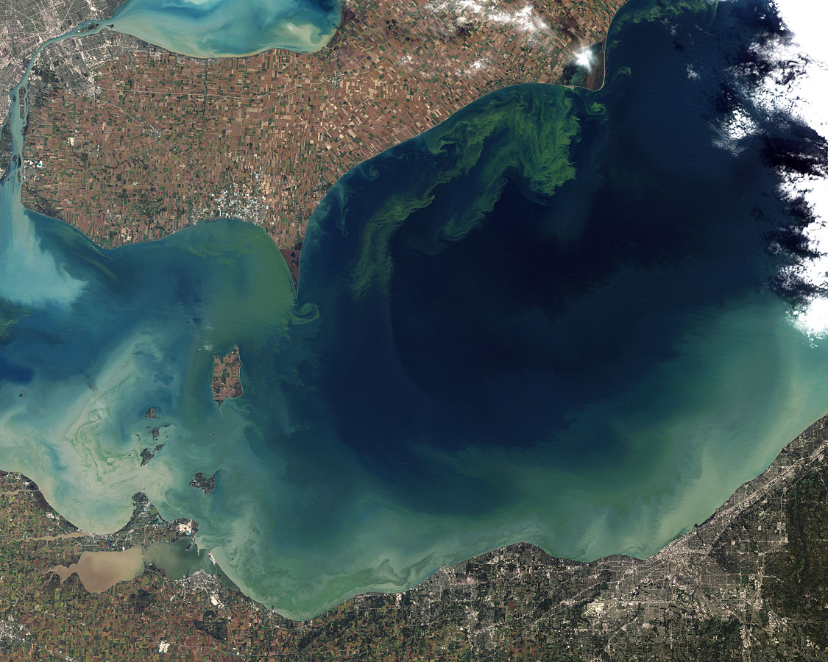
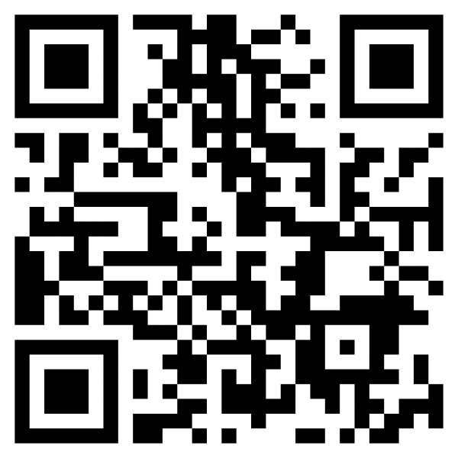
Thank you for your attention!
Any comments/ questions/ suggestions are welcome!
chintanmaniyar@uga.edu
LinkedIn

