Slide 1

Evaluating NASA Ames Stereo Pipeline for Automated Processing of High-Resolution Historical Remotely Sensed Datasets: Case Studies from 1970 Corona KH-4B and 1969 Flight HB-PF Stereo Imagery
Gilberto Maldonado
Graduate Student, Civil Engineering, Conc. In Geomatics
California State University, Fresno
Dr. Yushin Ahn
Associate Professor, Ph.D., C.P.
Department of Civil and Geomatics Engineering
California State University, Fresno
gilbertom@mail.fresnostate.edu
Jordan Brown
Ph.D. Candidate, Anthropology
University of California, Berkeley
Huchiun, Lisjan Ohlone Territory
yahn@mail.fresnostate.edu
jordanbrown@berkeley.edu

Slide 2
Table of Contents
Section 1
Section 2
Section 3
Section 4
Section 5
Introduction:
Motivation for this Research.
Importance of Historical Imagery.
My Reseach Questions.
Brief Overview of Project Status.
Related Research:
Prior Studies.
Limitations of Traditional Approaches.
Relevance of NASA ASP in Filling the Gap.
Example of ASP in Terrestrial DEM Generation.
Methodology:
What is ASP?
Why was ASP Selected?
High-Level Overview of Workflow.
Current Issues.
Initial Results:
Early DEM Outputs
Corona KH-4B
Flight HB-PF
Visuals
Next Steps:
Challenges
In-Progress Refinements
Broader Goals.

Slide 3
Section I: Introduction

Slide 4

Motivation
The Earth’s surface is continuously changing due to natural and anthropogenetic processes .
High-resolution historical imagery offers a unique opportunity to analyze long-term landscape evolution.
However, much of this data—like the KH-4B and HB-PF imagery—remains underutilized due to technical processing challenges.
My goal is to explore modern, open-source photogrammetric methods to unlock the value of this archival data.

Slide 5
Datasets Used: Corona KH-4B (1970)
Corona KH-4B DS1111-2126DA024, curtesy from the U.S. Geological Survey
Corona KH-4B DS1111-2126DF018, curtesy from the U.S. Geological Survey

Slide 6
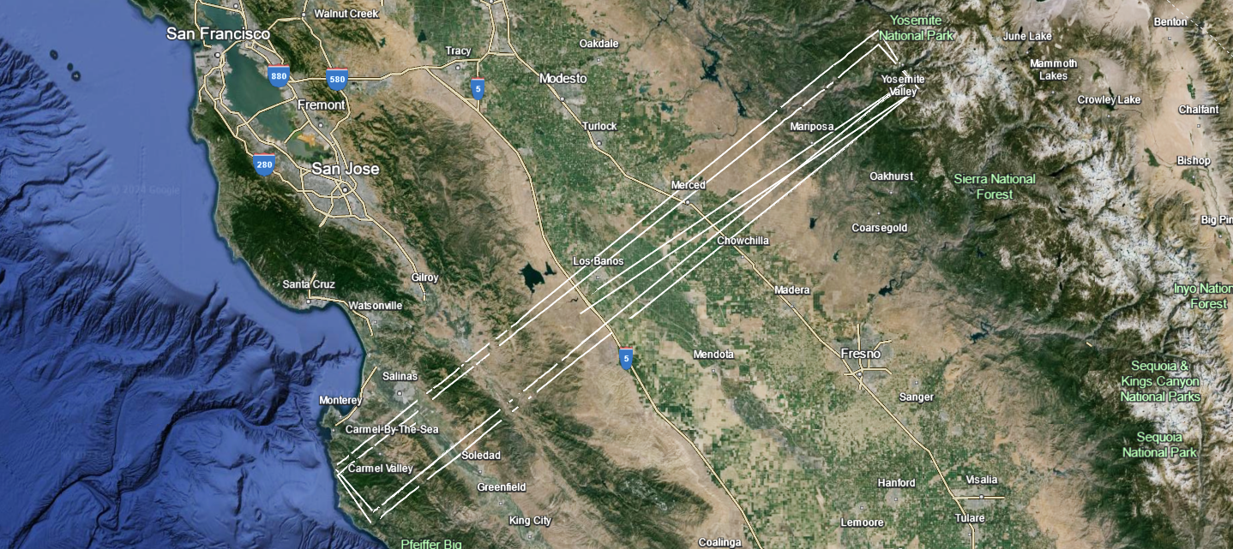
Area of Interest of Corona KH-4B Stereo Dataset

Slide 7
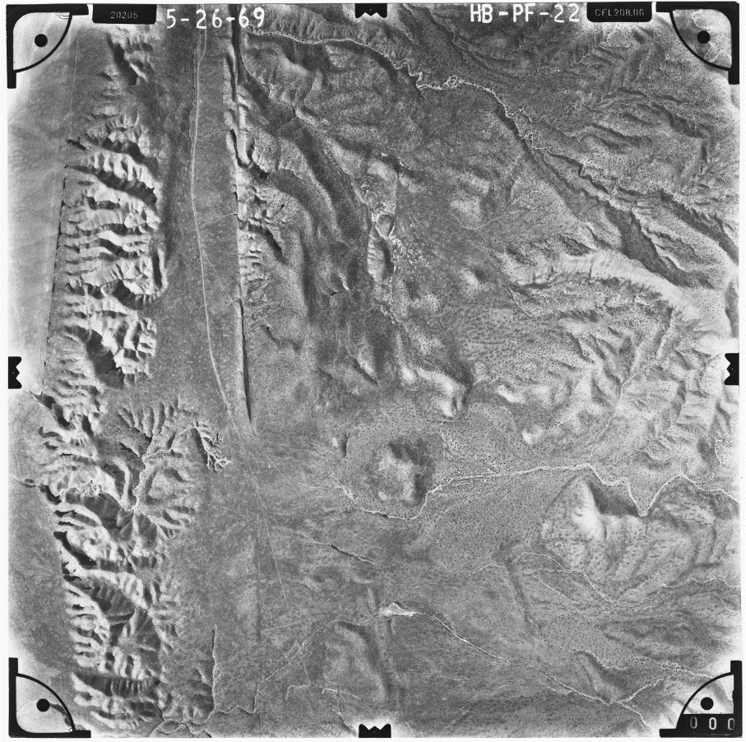
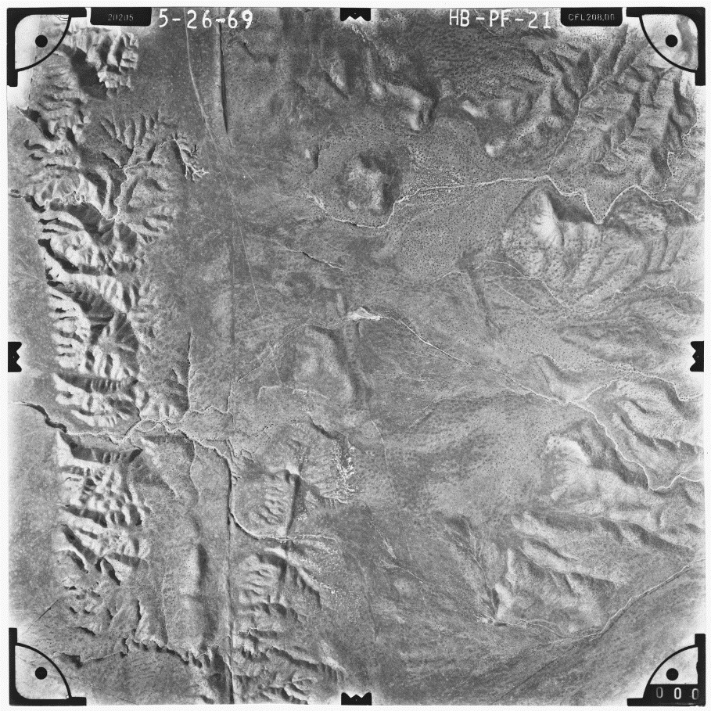
Dataset Used: Flight HB-PF (1969)
Frame #22 of Flight HB-PF, Curtesy from Frame Finder
Frame #21 of Flight HB-PF, Curtesy from Frame Finder

Slide 8
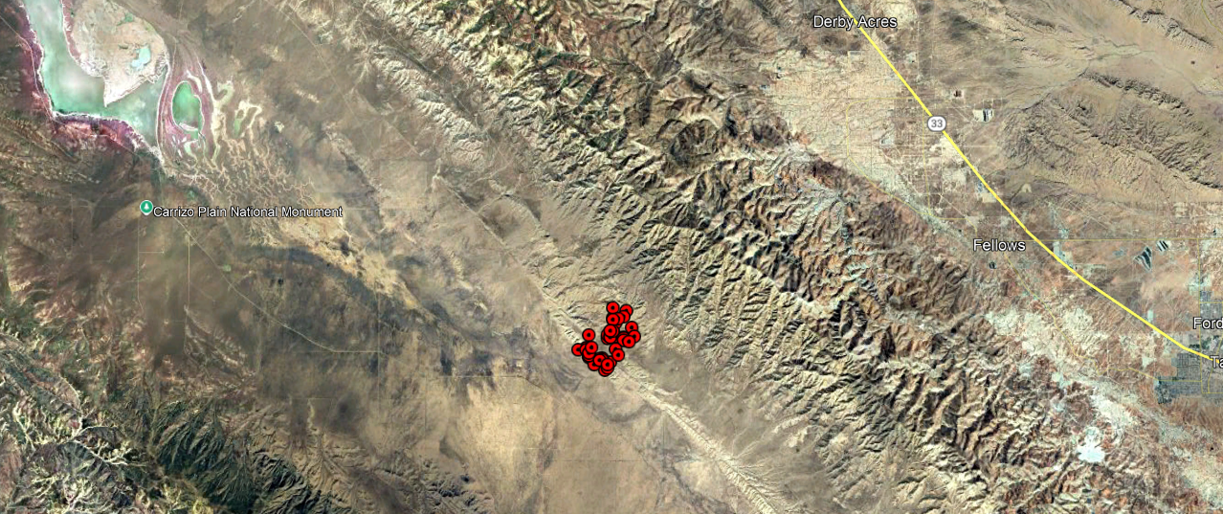
Area of Interest of Flight HB-PF Photography Dataset

Slide 9
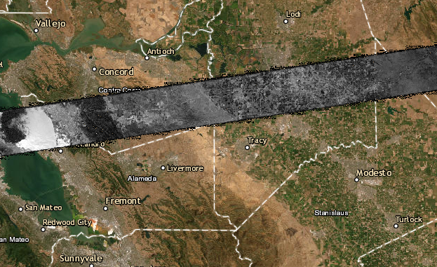
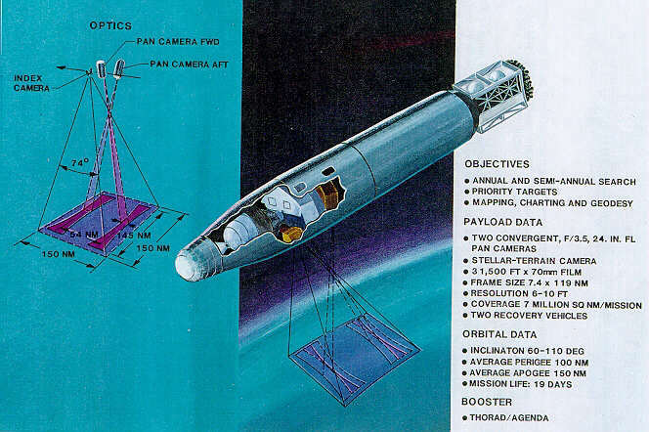
Importance of Historical Imagery
Declassified Corona KH-4B and aerial surveys capture prior terrain prior to urbanization, agriculture expansion, and seismic alteration.
These datasets fill the temporal gap between early topographic maps and modern satellite missions like Landsat and Sentinel.
They are crucial for environmental reconstruction, archeological exploration, and cultural heritage preservation.

Slide 10
Project Goal
Can the NASA Ames Stereo Pipeline (ASP) be used to effectively to generate DEMs historical imagery with incomplete metadata?
What is the achievable accuracy using panoramic imagery in ASP?
How can this processing pipeline be optimized for broader use in geoarchaeology and historical terrain reconstruction?

Slide 11
Status of Project
This is an ongoing research project with promising early results.
DEMs have been generated from KH-4B and HB-PF imagery using ASP’s stereo and point cloud tools.
Bundle adjustment and GCP-based camera model refinement workflows are still being evaluated.
Next steps involve accuracy assessment, mosaicking, and integration with modern reference datasets.

Slide 12
Section II: Related Research

Slide 13
Prior Studies Using Historical Datasets
Casana and Cothren (2008) demonstrated the value of Corona KH-4B stereo imagery for archeological landscape analysis using manual and semi-automated methods.
Menze and Ur (2012) applied stereo image processing to KH-4B to map long-term settlement patterns across Mesopotamia (Region in Iraq)
More recent efforts by Orengo et al. (2020) and Luo et al. (2019) highlight machine learning and remote sensing integration with historical datasets.

Slide 14
Challenges with Historical Imagery
Manual photogrammetry is time-intensive and often requires expert input.
Commercial software (e.g., ERDAS, Agisoft) often lacks flexibility for archival panoramic sensors and open automation.
Poor documented metadata in historical imagery makes bundle adjustment and orientation correction difficult without ground truth.

Slide 15
Examples of ASP in Terrestrial DEM Generation
Shean et al. (2016) used ASP to automatically generate 1,001 high-resolution DEMs from WorldView stereo pairs across polar regions.
ASP has been used to process millions of images from NASA’s Operation IceBridge project, aligning DEMs with narrow-strip LiDAR data.
In both examples, ASP demonstrated performance comparable to commercial tool with greater resilience to difficult conditions.

Slide 16
Section III: Methodology and Software

Slide 17
Overview of ASP: Capabilities and Sensor Support
The NASA Ames Stereo Pipeline (ASP) is an open-source suite of geospatial tools designed to generate Digital Elevation Models (DEMs) and orthoimages from stereo imagery.
Originally developed for planetary science missions, ASP supports Earth observation, historical imagery, and aerial photogrammetry.
ASP is built for flexibility: it accepts modern commercial satellite data, historical film scans, aerial imagery, and even planetary datasets.
Outputs include: point clouds, DEMs, textured 3D models, orthoimages, and refined camera models.

Slide 18
Why Was ASP Selected?
ASP is one of the few open-source tools capable of handling archival datasets with minimal metadata (e.g., KH-4B panoramic scans).
It supports bundle adjustments, structure-from-motion and map-projection, making it ideal for historical workflows.
Highly customizable and well-documented.
Strong community support and proven track-record.

Slide 19
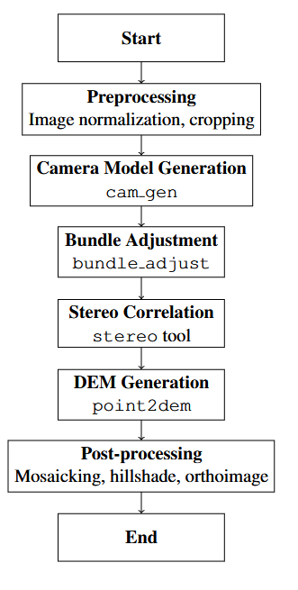
Project Workflow

Slide 20
Current Issues
Incomplete Metadata: Many frames lack precise orientation or camera calibration parameters.
Panoramic Distortion: KH-4B imagery radial and tangential distortion not well modeled by basic pinhole or optical bar approximations.
Bundle Adjustment Challenge: GCPs are insufficient to anchor all image pairs; solution convergence varies.
DEM Artifacts: Gaps and striping in textureless terrain; requires tuning of stereo correlation settings.

Slide 21
Section IV: Initial Results

Slide 22

DEM Generation from Map-Projected Corona KH-4B

Slide 23
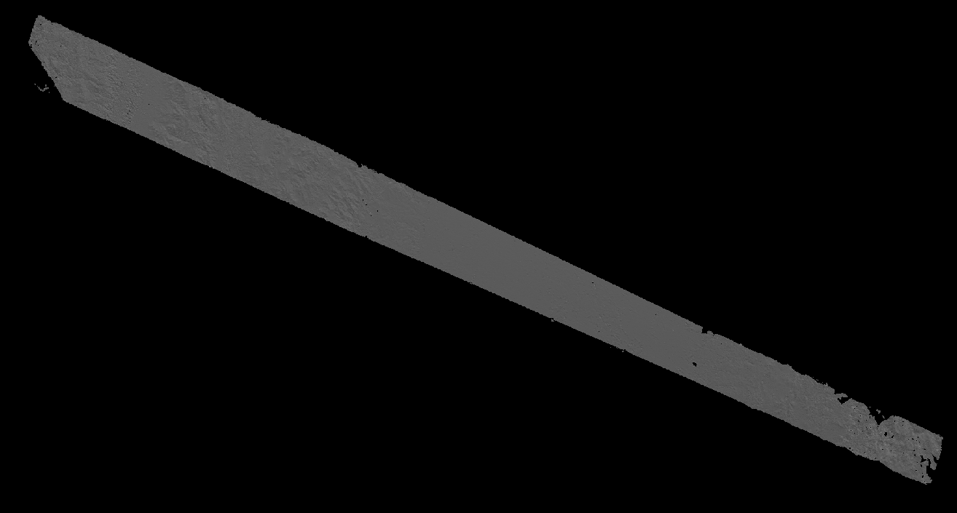
Hillshade Generation from Map-Projected Corona KH-4B

Slide 24
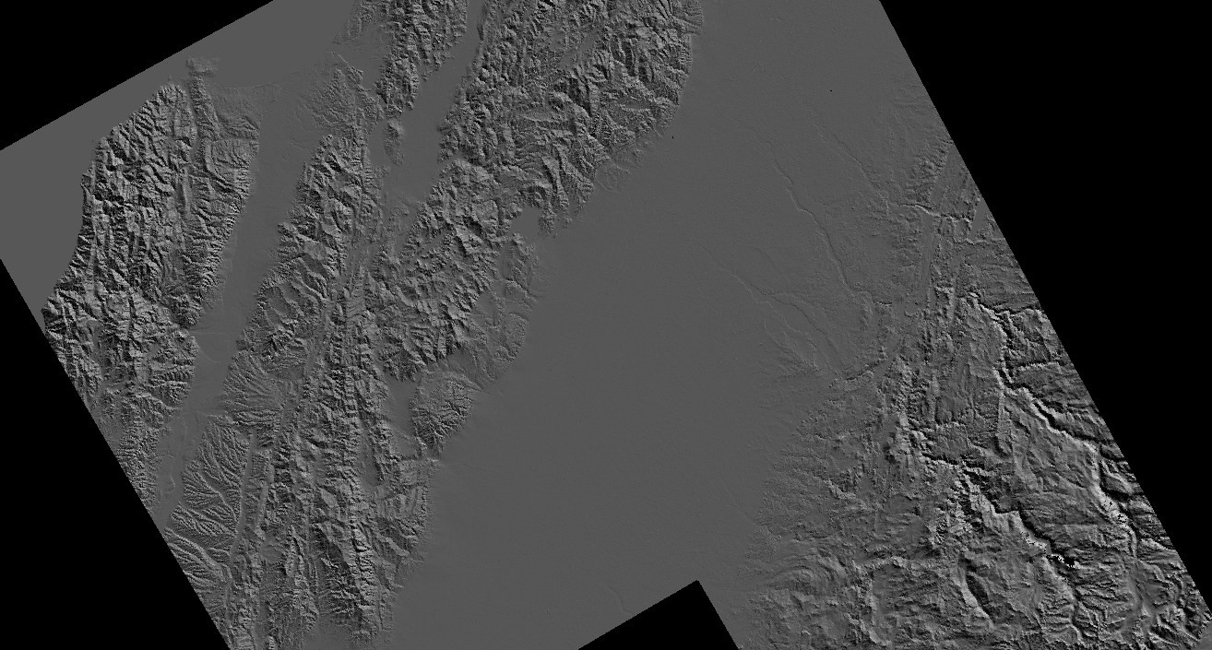
Reference Hillshade, Curtesy of Earth Explorer

Slide 25
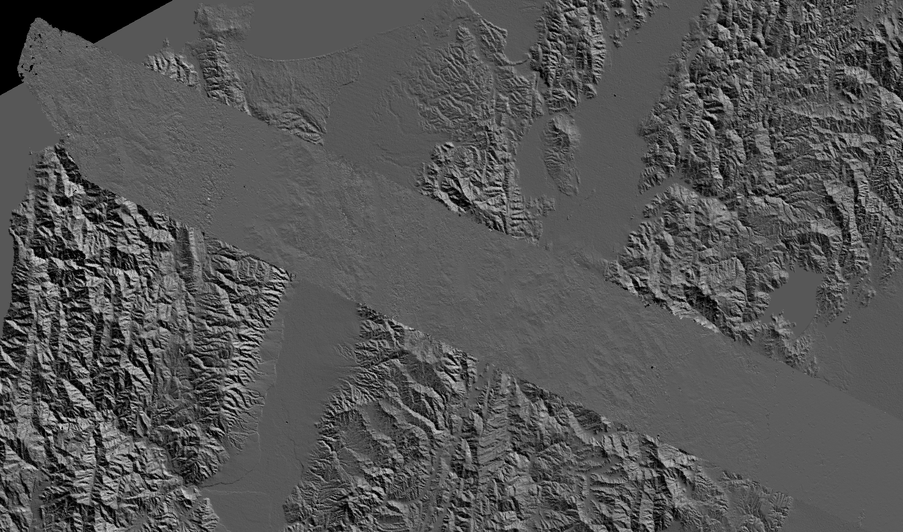
Overlay of Hillshade (ASP) on Reference Hillshade (EE)
Visual Observation:
Misalignment
Lack of topographic features
Noise (holes)
Missing elevation data from corners

Slide 26
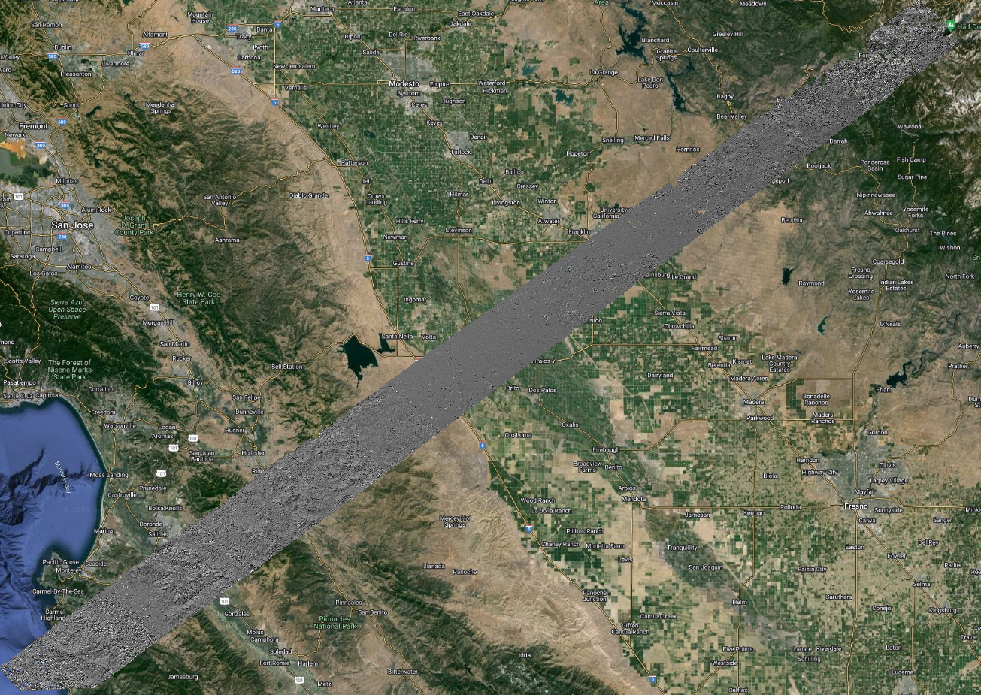
Hillshade Overlay
Visual Observation:
Misalignment
Lack of topographic features
Noise (holes)
Missing elevation data from corners

Slide 27
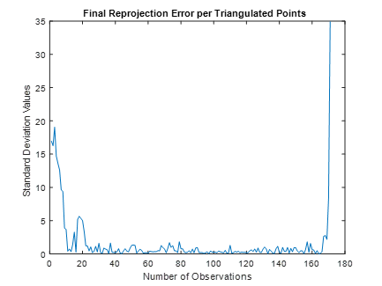
Results – Key Observations
Final pixel reprojection error (~170 points) are greater than 1 pixel.
Indicating there are discrepancies between the camera model and the map-projected images.
ASP is attempting to produce a DEM with these triangulated points
Misalignment between reference DEM and QGIS base map
Further experimentation is necessary to determine whether this method consistently underperforms.
Standard deviation is above 3000 (m)

Slide 28
Results
DEM Generation from Map-Projected Corona KH-4B
DEM Generation from Corona KH-4B supplemented with RSGCPs
DEM Generation from Map-Projected Corona KH-4B

Slide 29
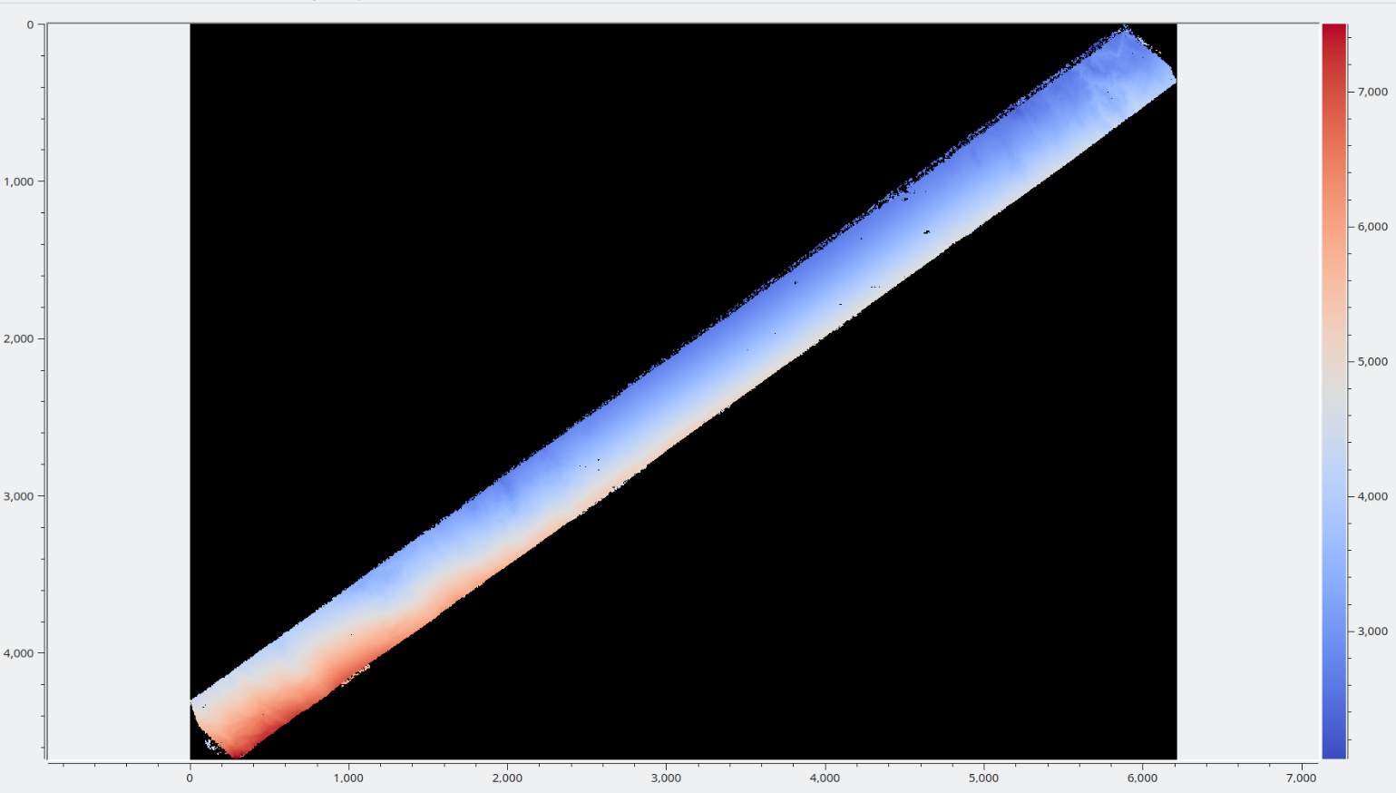
DEM Derived from Unaltered Corona KH-4B Stereo Images with RSGCPs

Slide 30
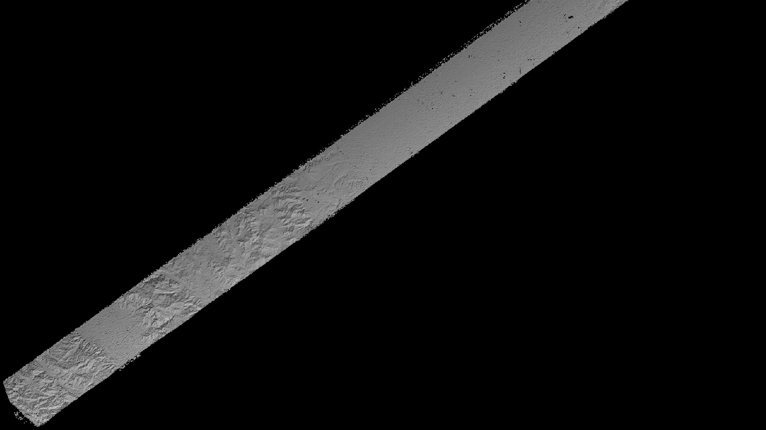
Hillshade Derived from Unaltered Corona KH-4B Stereo Images with RSGCPs

Slide 31
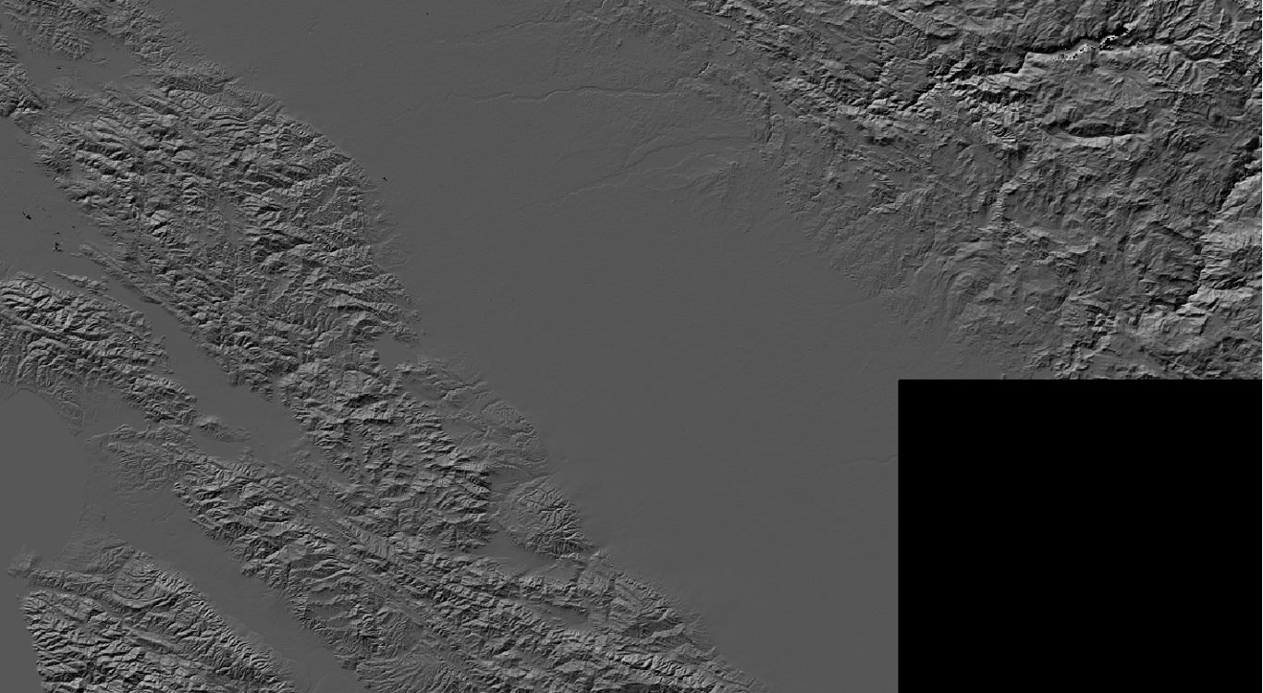
Reference Hillshade, Curtesy of Earth Explorer

Slide 32
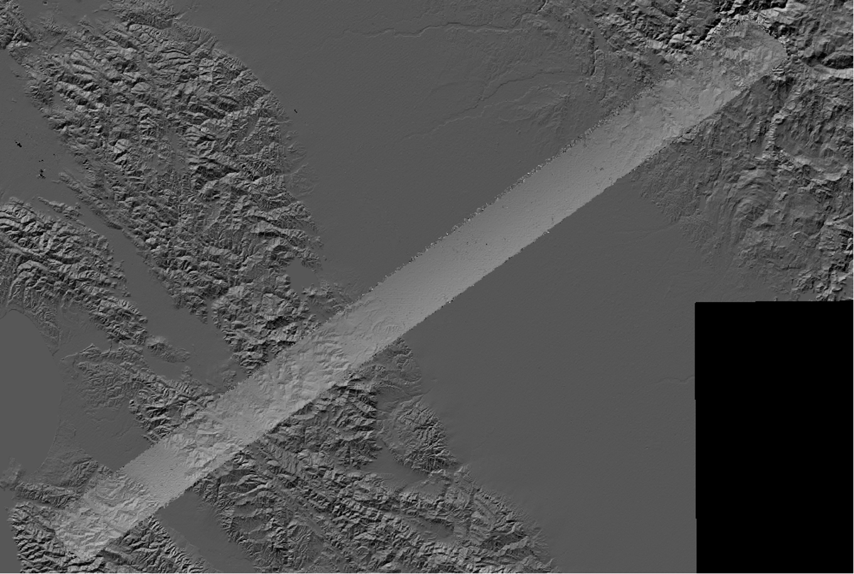
Overlay of Hillshade (ASP) on Reference Hillshade (EE)
Visual Observation:
Improved alignment
More topographic features
Less noise
Full DEM (no missing corners)

Slide 33
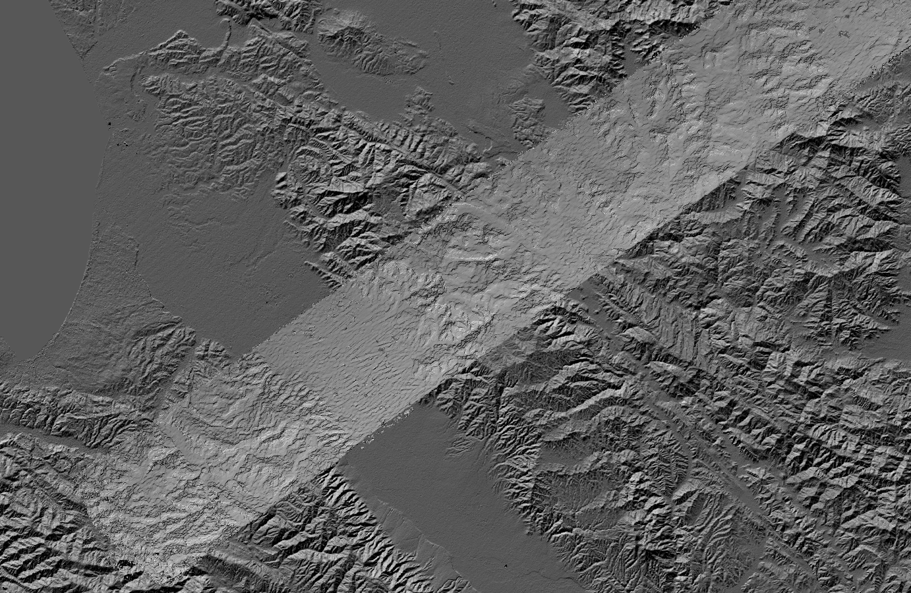
Overlay of Hillshade (ASP) on Reference Hillshade (EE)
Visual Observation:
Detailed hillshade
Reduction in offset
Further studies need to be conducted

Slide 34

Results – Key Observations
Final pixel reprojection error (3 points) are lower than 1 pixel.
ASP is attempting to produce a DEM with these triangulated points
Improved alignment between reference DEM and QGIS base map
Further experimentation is necessary to determine whether this method can produce satisfactory results.
Standard deviation is about ~1000 (m)

Slide 35
Results
DEM Generation from Map-Projected Corona KH-4B
DEM Generation from Corona KH-4B supplemented with RSGCPs
DEM Generation from Flight HB-PF

Slide 36
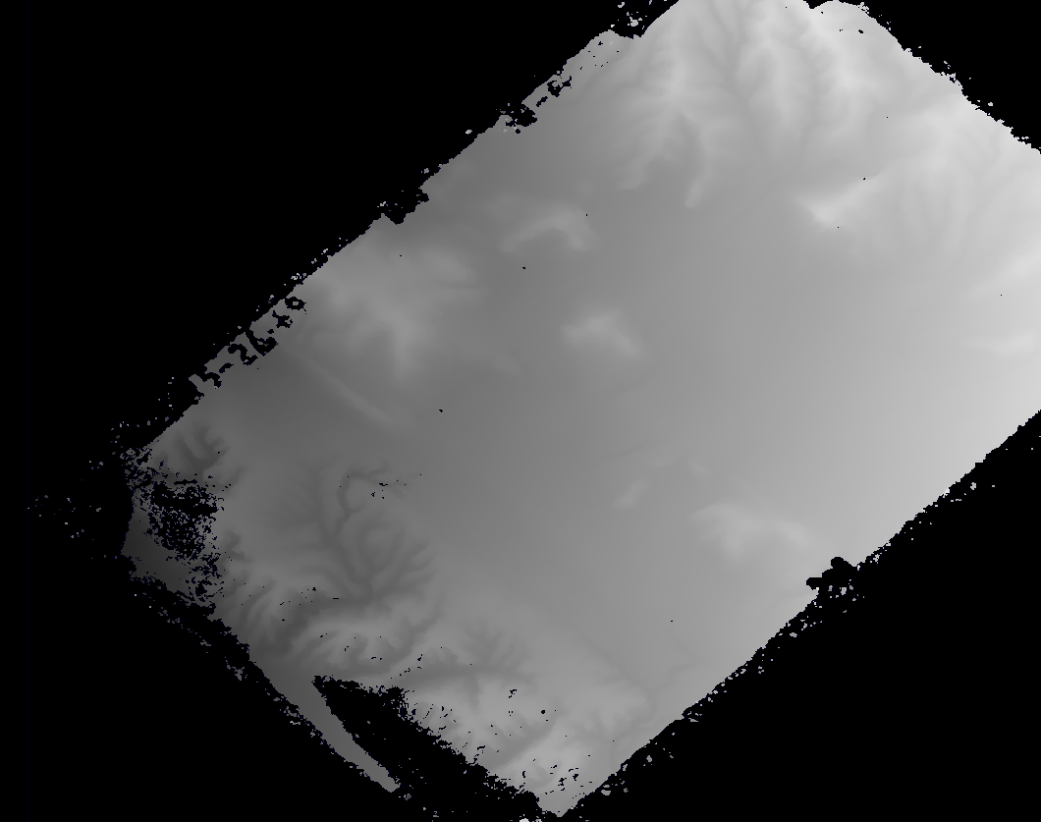
DEM Generation from Flight HB-PF Stereo Images

Slide 37
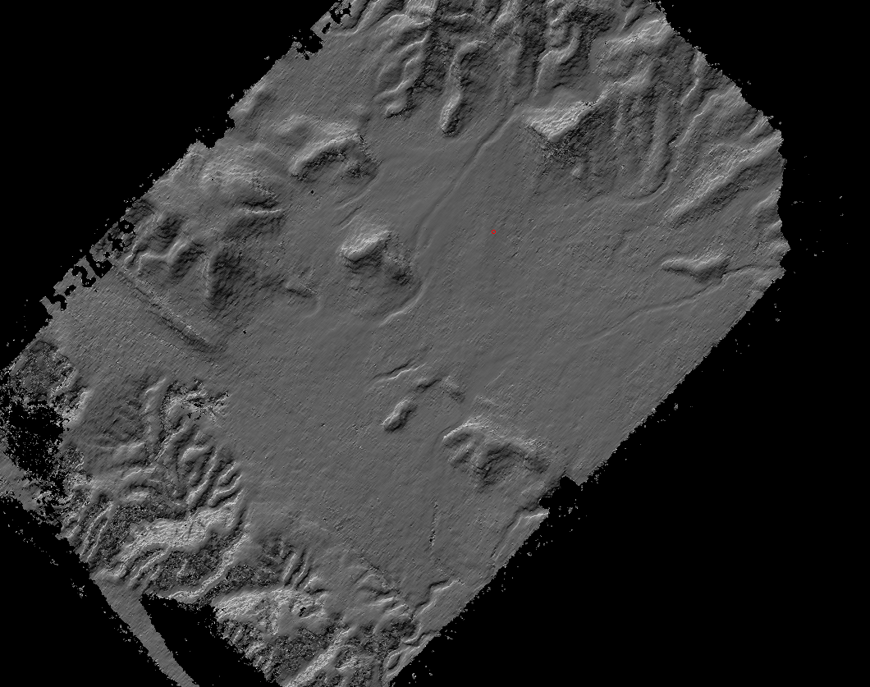
Hillshade Generation from Flight HB-PF Stereo Images

Slide 38
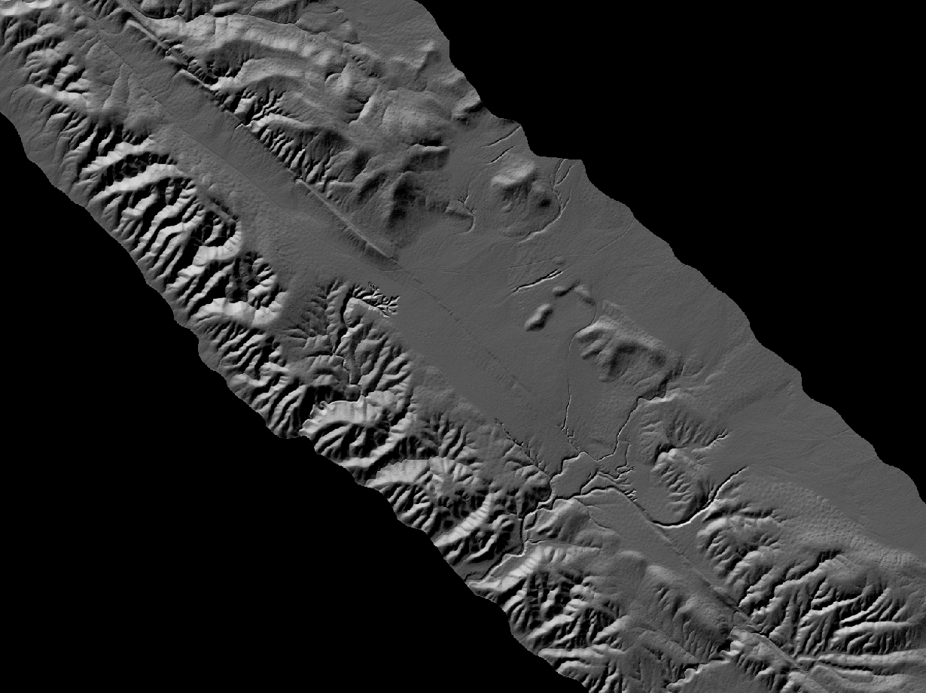
Reference Hillshade, Curtesy of OpenTopography

Slide 39
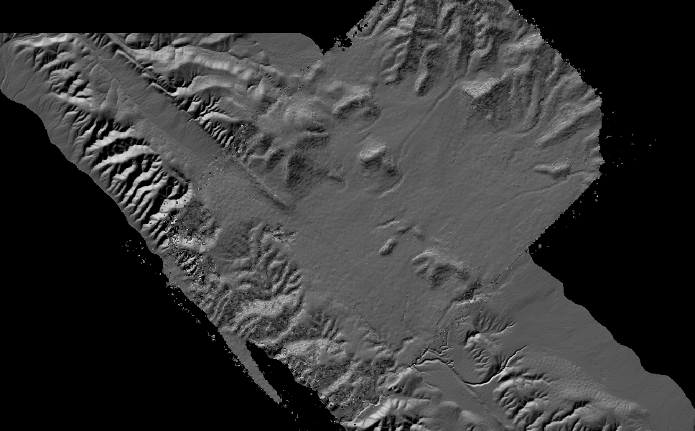
Hillshade Overlay on Reference-Hillshade

Slide 40
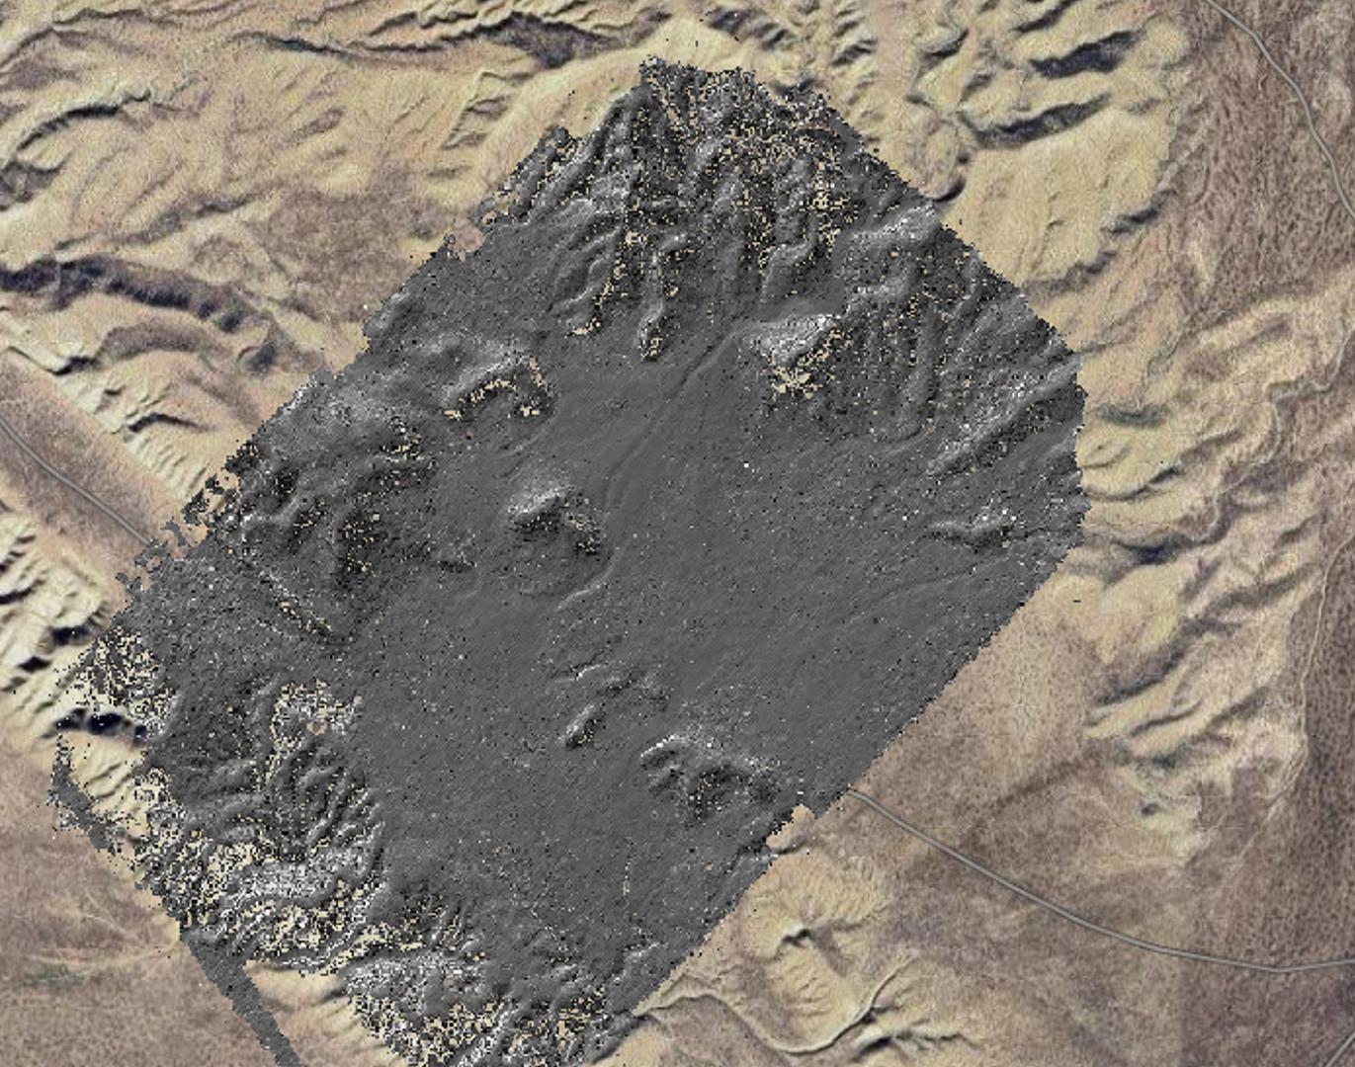
Results – Key Observations
Final pixel reprojection error (~900 points) are below 1 pixel.
Improved alignment between generated DEM and reference DEM
Further experimentation is necessary to determine whether this method can consistently produce promising results.
Standard deviation is about ~27 (m)

Slide 41
Results Overview
Dataset | Methodology | Results
Corona KH-4B | Map-projected stereo images | Generated DEM with a standard deviation of ~3km/3000m
Corona KH-4B | Unaltered stereo images, supplemented with ~5m – 10m RSGCPs | Generated DEM with a standard deviation of ~1km/1000m
Flight HB-PF | Unaltered stereo images, supplemented with ~5m – 10m RSGCPs | Generated DEM with a standard deviation of ~27m

Slide 42
Section V: Discussion, Limitations, and Next Steps

Slide 43
Challenges
Incomplete metadata from historical Corona KH-4B and HB-PF imagery continues to affect orientation accuracy during bundle adj.
GCPs are limited and unevenly distributed across the study area, reducing confidence in georeferencing and vertical accuracy.
Stereo matching artifacts, including striping and voids, are observed in low-texture terrain.
DEM stitching across multiple frames is still a manual and time-consuming task.

Slide 44
In-Progress Refinements
Testing improved interest point matching strategies to better initialize bundle adjustment.
Incorporating more GCPs from orthophotos and modern DEMs.
Evaluating stereo settings, such as SGM parameters and filtering thresholds, to improve surface continuity in the output DEMs.

Slide 45
Broader Goal
Enable scalable processing of regional historical terrain datasets for multi-temporal analysis.
Support applications in geoarchaeology, landscape change detection, and pre-modern topographic reconstruction.
Provide a reproducible, open-source ASP-based workflow that can be adopted by other researchers working with legacy imagery.
Contribute to the growing open science movement within the photogrammetry and remote sensing communities.

Slide 46
Q&A
Thank You for Your Time and Attention.

