Slide 1
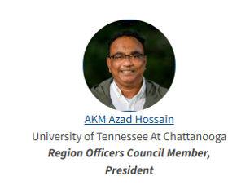
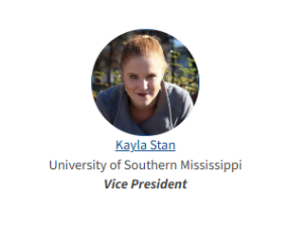

ASPRS Mid-South Region Conference 2025
Oakridge National Laboratory, April 24-25, 2025
Welcome!

Slide 2
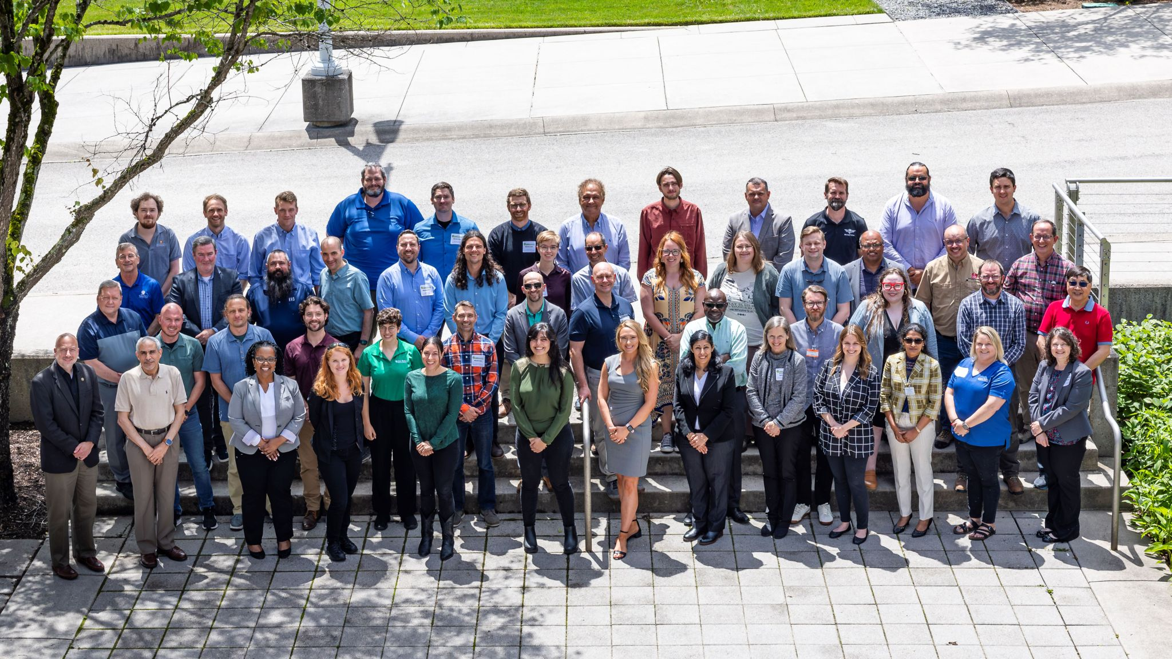

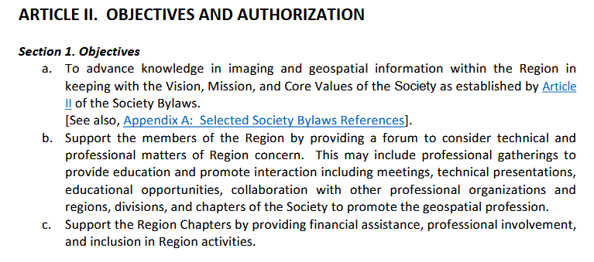
Organizing the annual regional meeting is one of the most important objectives of our society!
2024 ASPRS Mid-South Regional Conference, Oak Ridge National Laboratory, 9-10 May 2024

Slide 3
We are very happy to have this meeting organized and thank you all for your support and participation!
We couldn’t do it without the support of ORNL, ASPRS Main Office, our sponsors NV5, Impulse Radar, OSK, and Spectral Evolution.
We would also like to give special thanks to the conference organizing committee lead by
Dr. David Hughes!

Slide 4
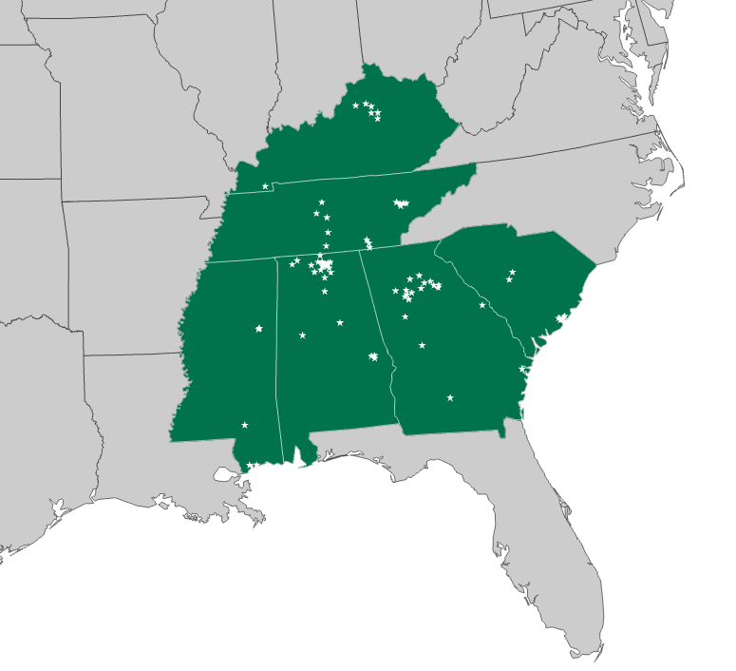
By the Numbers
6 States
8 Student Chapters
151 members in the community

Slide 5
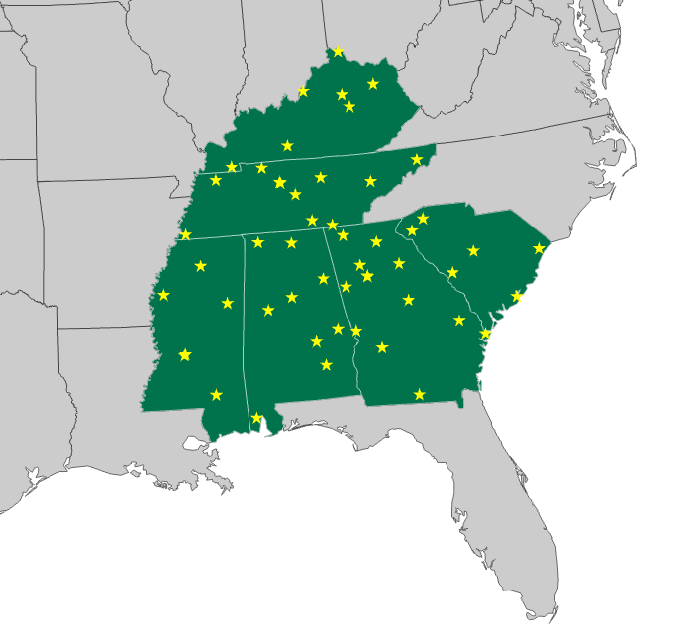
In 2023…
52 4-Y Inst.
773 Bachelors
81 Doctoral

Slide 6

This Year @ ASPRS
143 Total Participants
16 institutions with submitted talks
Representation from all states in the region

Slide 7
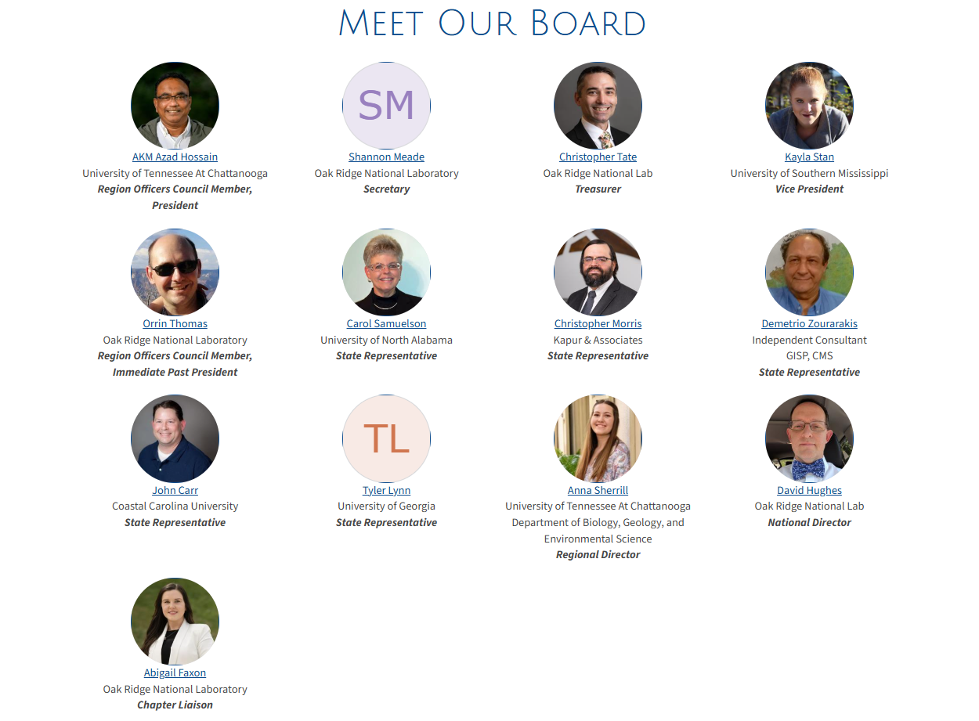

Slide 8
Join the Community Today

