Slide 1

Landscape or Founder Effect? High-Resolution Land Cover and Phenological Analysis of Anthrax Outbreak Landscapes in the Texas Anthrax Triangle Leveraging Cloud-Based High-Performance Computing
Dryver Finch, Hannah V. Herrero, Caroline Petersen, Bryn Nurczyk, Morgan A. Walker, Diansy Zincke, Ted Hadfield, Jane Southworth, Michael H. Norris, Jason K. Blackburn

Slide 2
Agenda
Background/Problem
Methods
Results
Discussion
Conclusions/Future work

Slide 3
Background

Slide 4
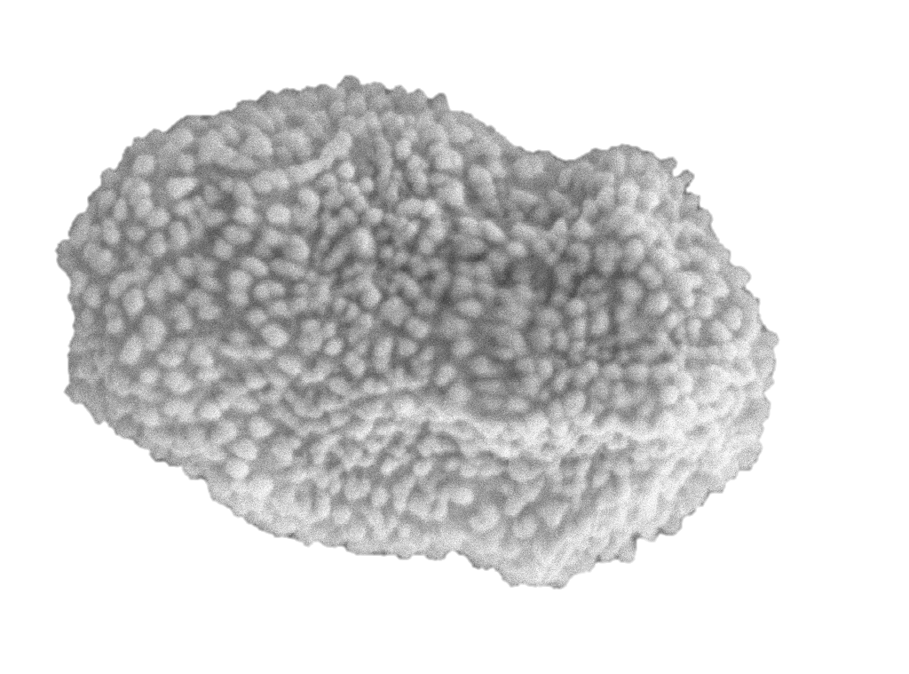
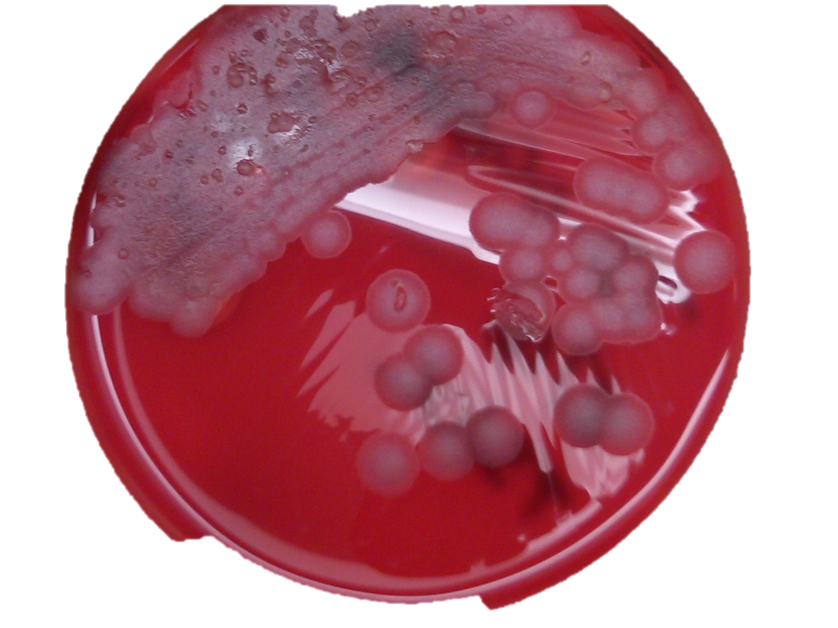
Bacillus anthracis
Spore forming pathogen that can survive for long periods in the environment under certain conditions (something we can model to predict the geographic distribution)
Spores are essentially metabolically inactive; evolution happens during replication (something we can track with genetic markers to study evolution)
Anthrax is caused when vegetative cells release proteins that are toxic into the bloodstream (something we can track; antibodies)
Replication leads to pathogen evolution (genetic changes); we can track these during outbreaks, between outbreaks, and across spatio-temporal scales

Slide 5
Modeling environmental pathogen transmission
Blackburn et al. (2019)

Slide 6
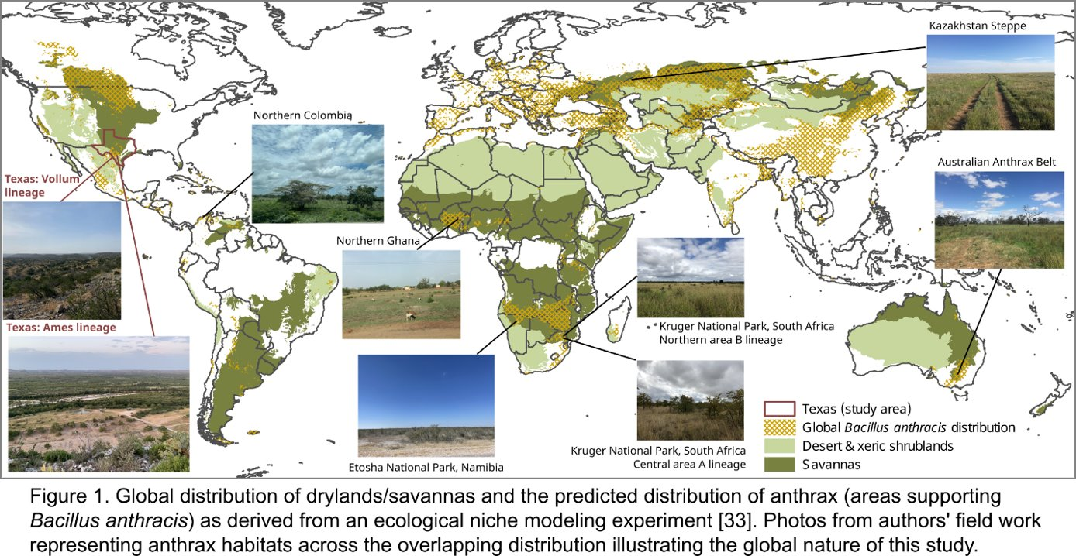

Slide 7
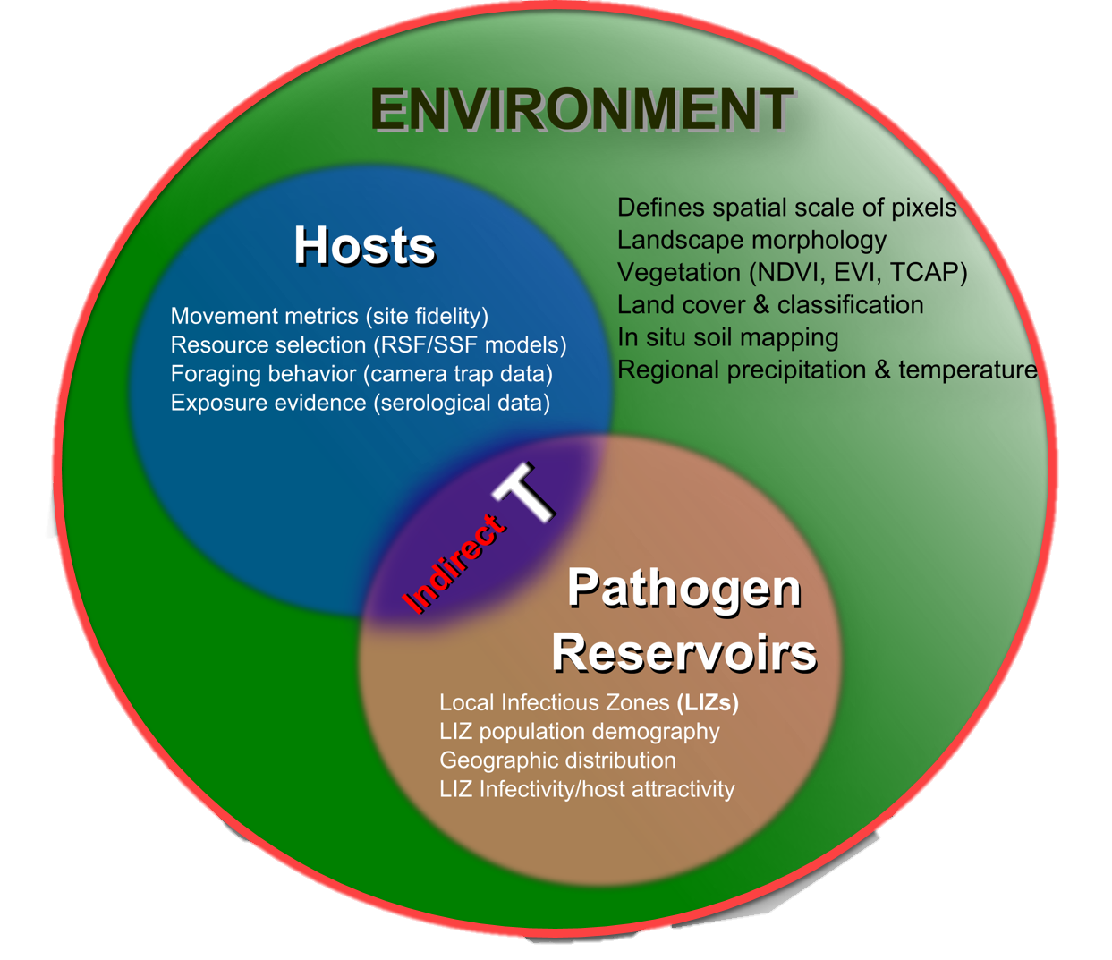
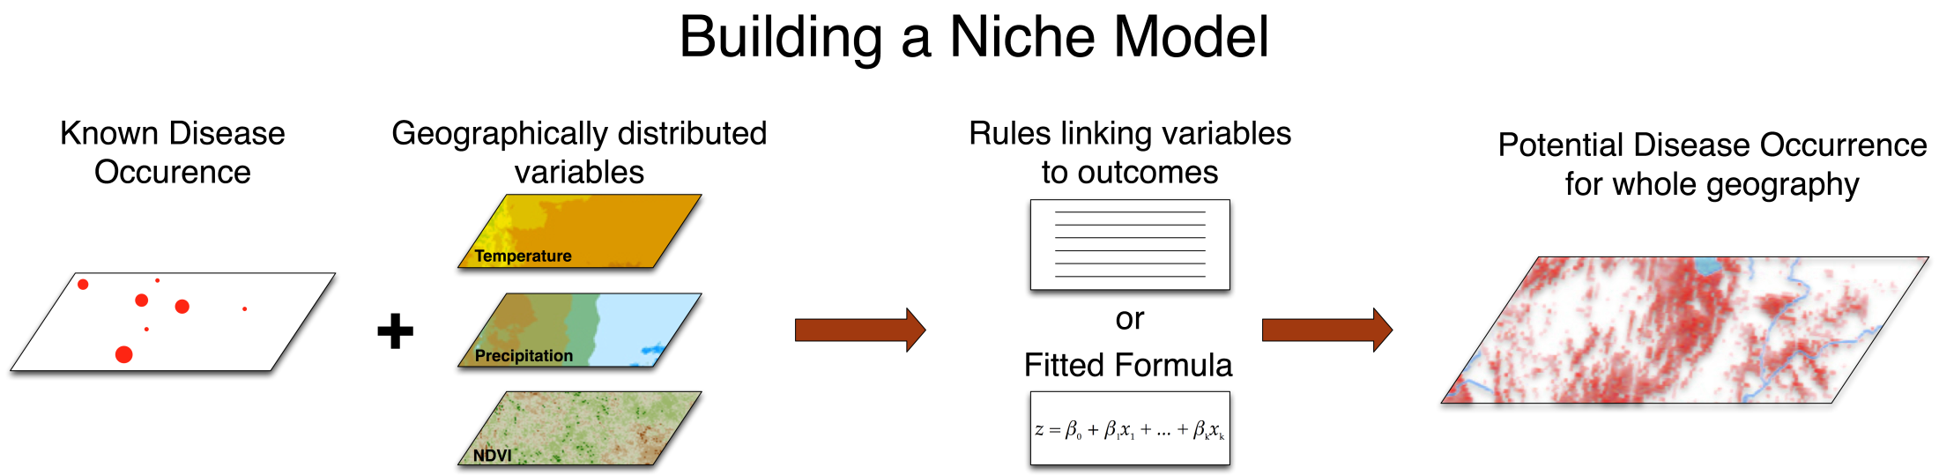
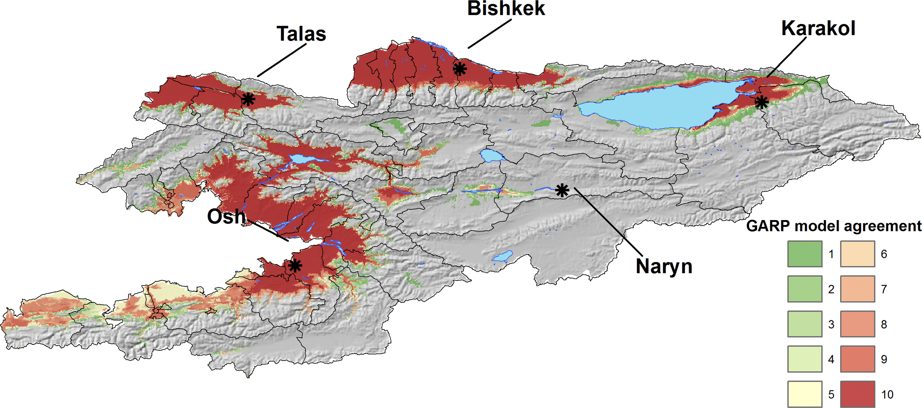
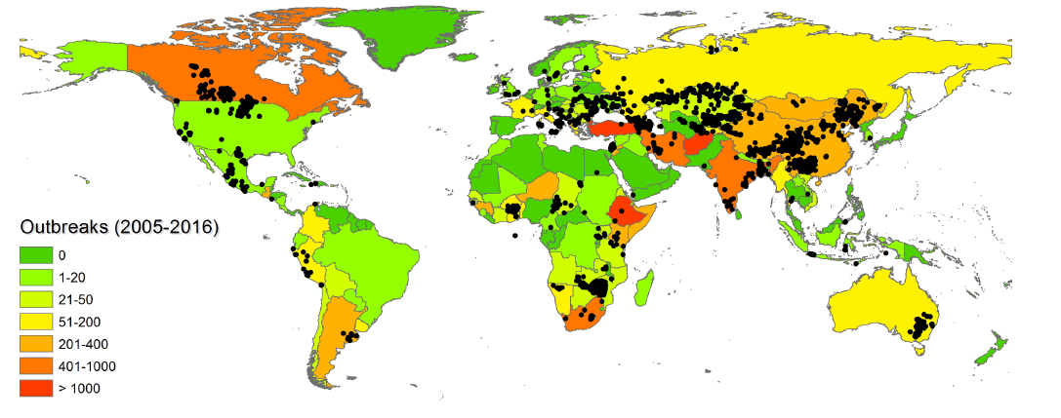
Mapping pathogens
Alexander et al. (2012), Blackburn et al. (2007), Blackburn et al. (2017), Kracalik et al. (2017), Yang et al. (In Review A, B)

Slide 8
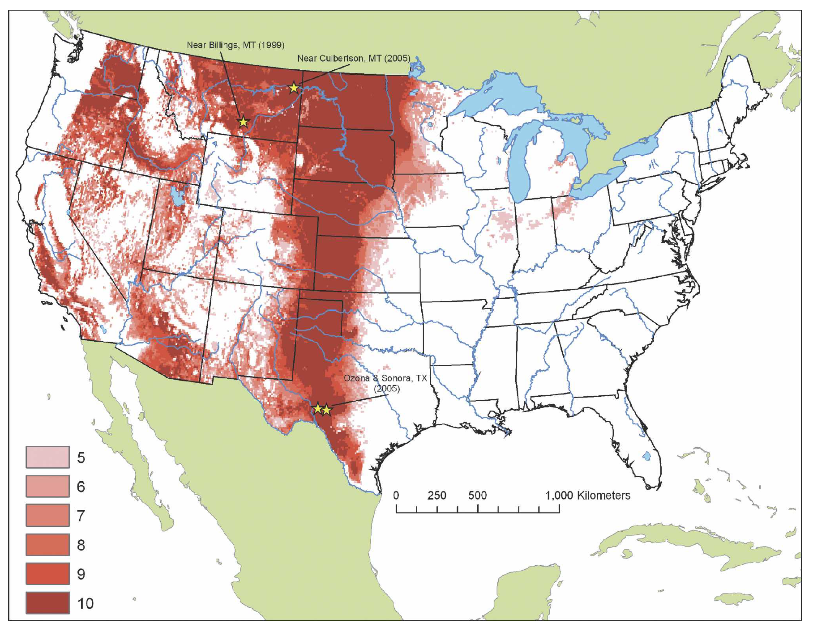
Mapping pathogens considering bioinformatics
Blackburn et al. (2007), Mullins et al. (2011), Yang et al. (2020A, 2020B)

Slide 9
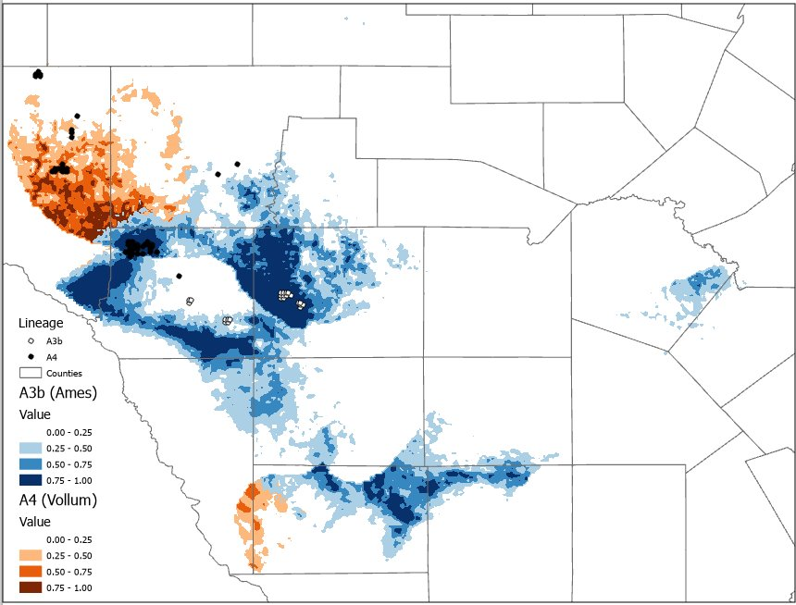
Texas Anthrax Triangle (TAT)

Slide 10
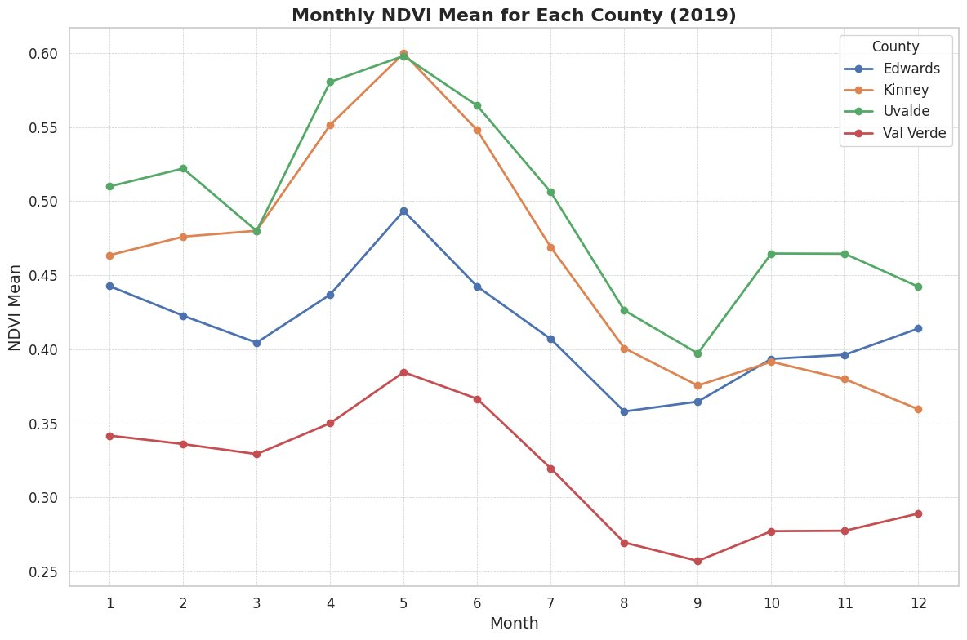
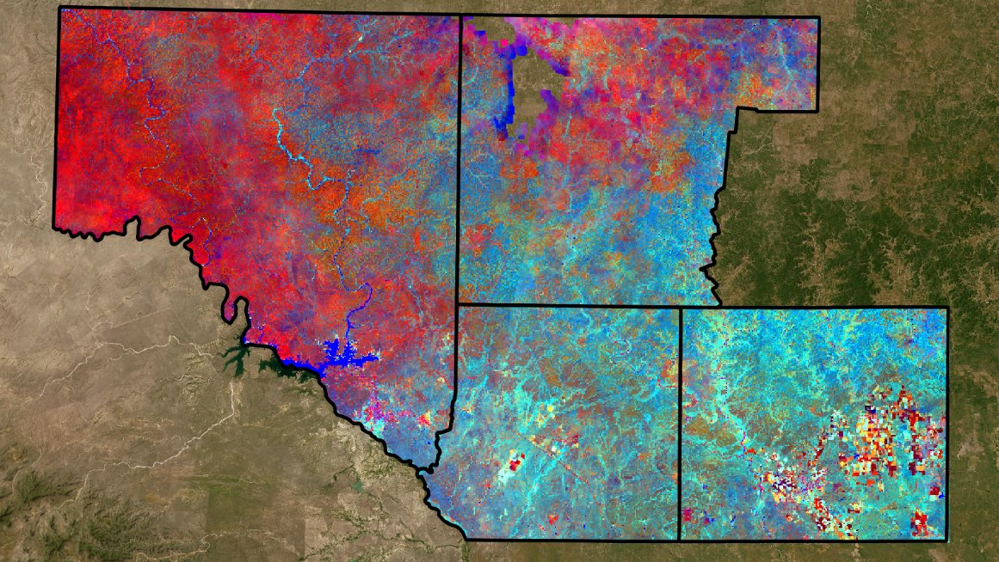

Slide 11
Data & Methods

Slide 12



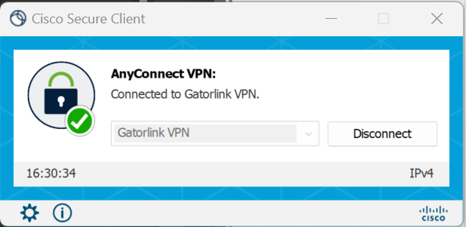



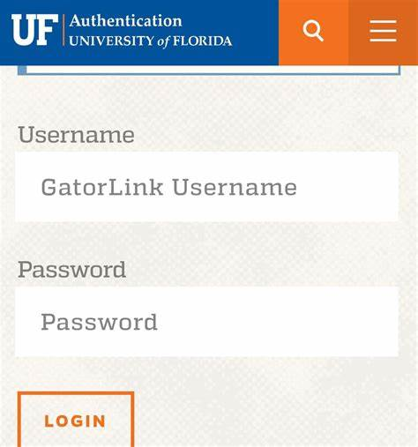








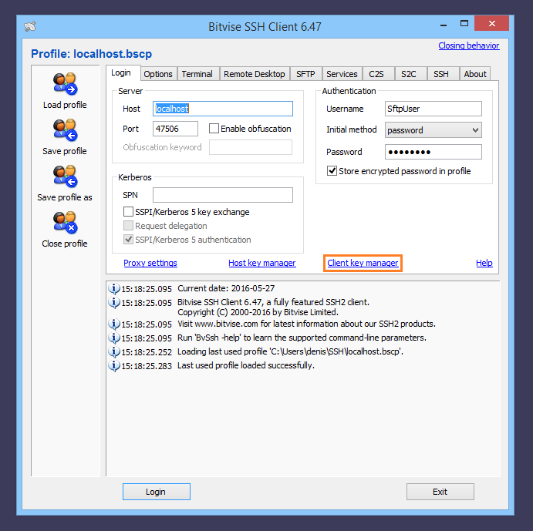


University of Tennessee with
EPI access/UF Gatorlink
Planet to GEE w/API
For analysis and processing
UF Firewall
UF EPI Desktop Machines
EPI Long-term storage
Planet Server w/SEER Lab Managed logins controlled by Planet License to UF SEER Lab
Download to EPI
Move to HiPerGator as needed
UF Staff with EPI
access/UF Gatorlink
HiPerGator for analysis, as needed
Data back to EPI for long-term storage

Slide 13
Planet Imagery
Landsat
(30-meter)
Sentinel-2
(10-meter)
Planet
(3-meter)

Slide 14
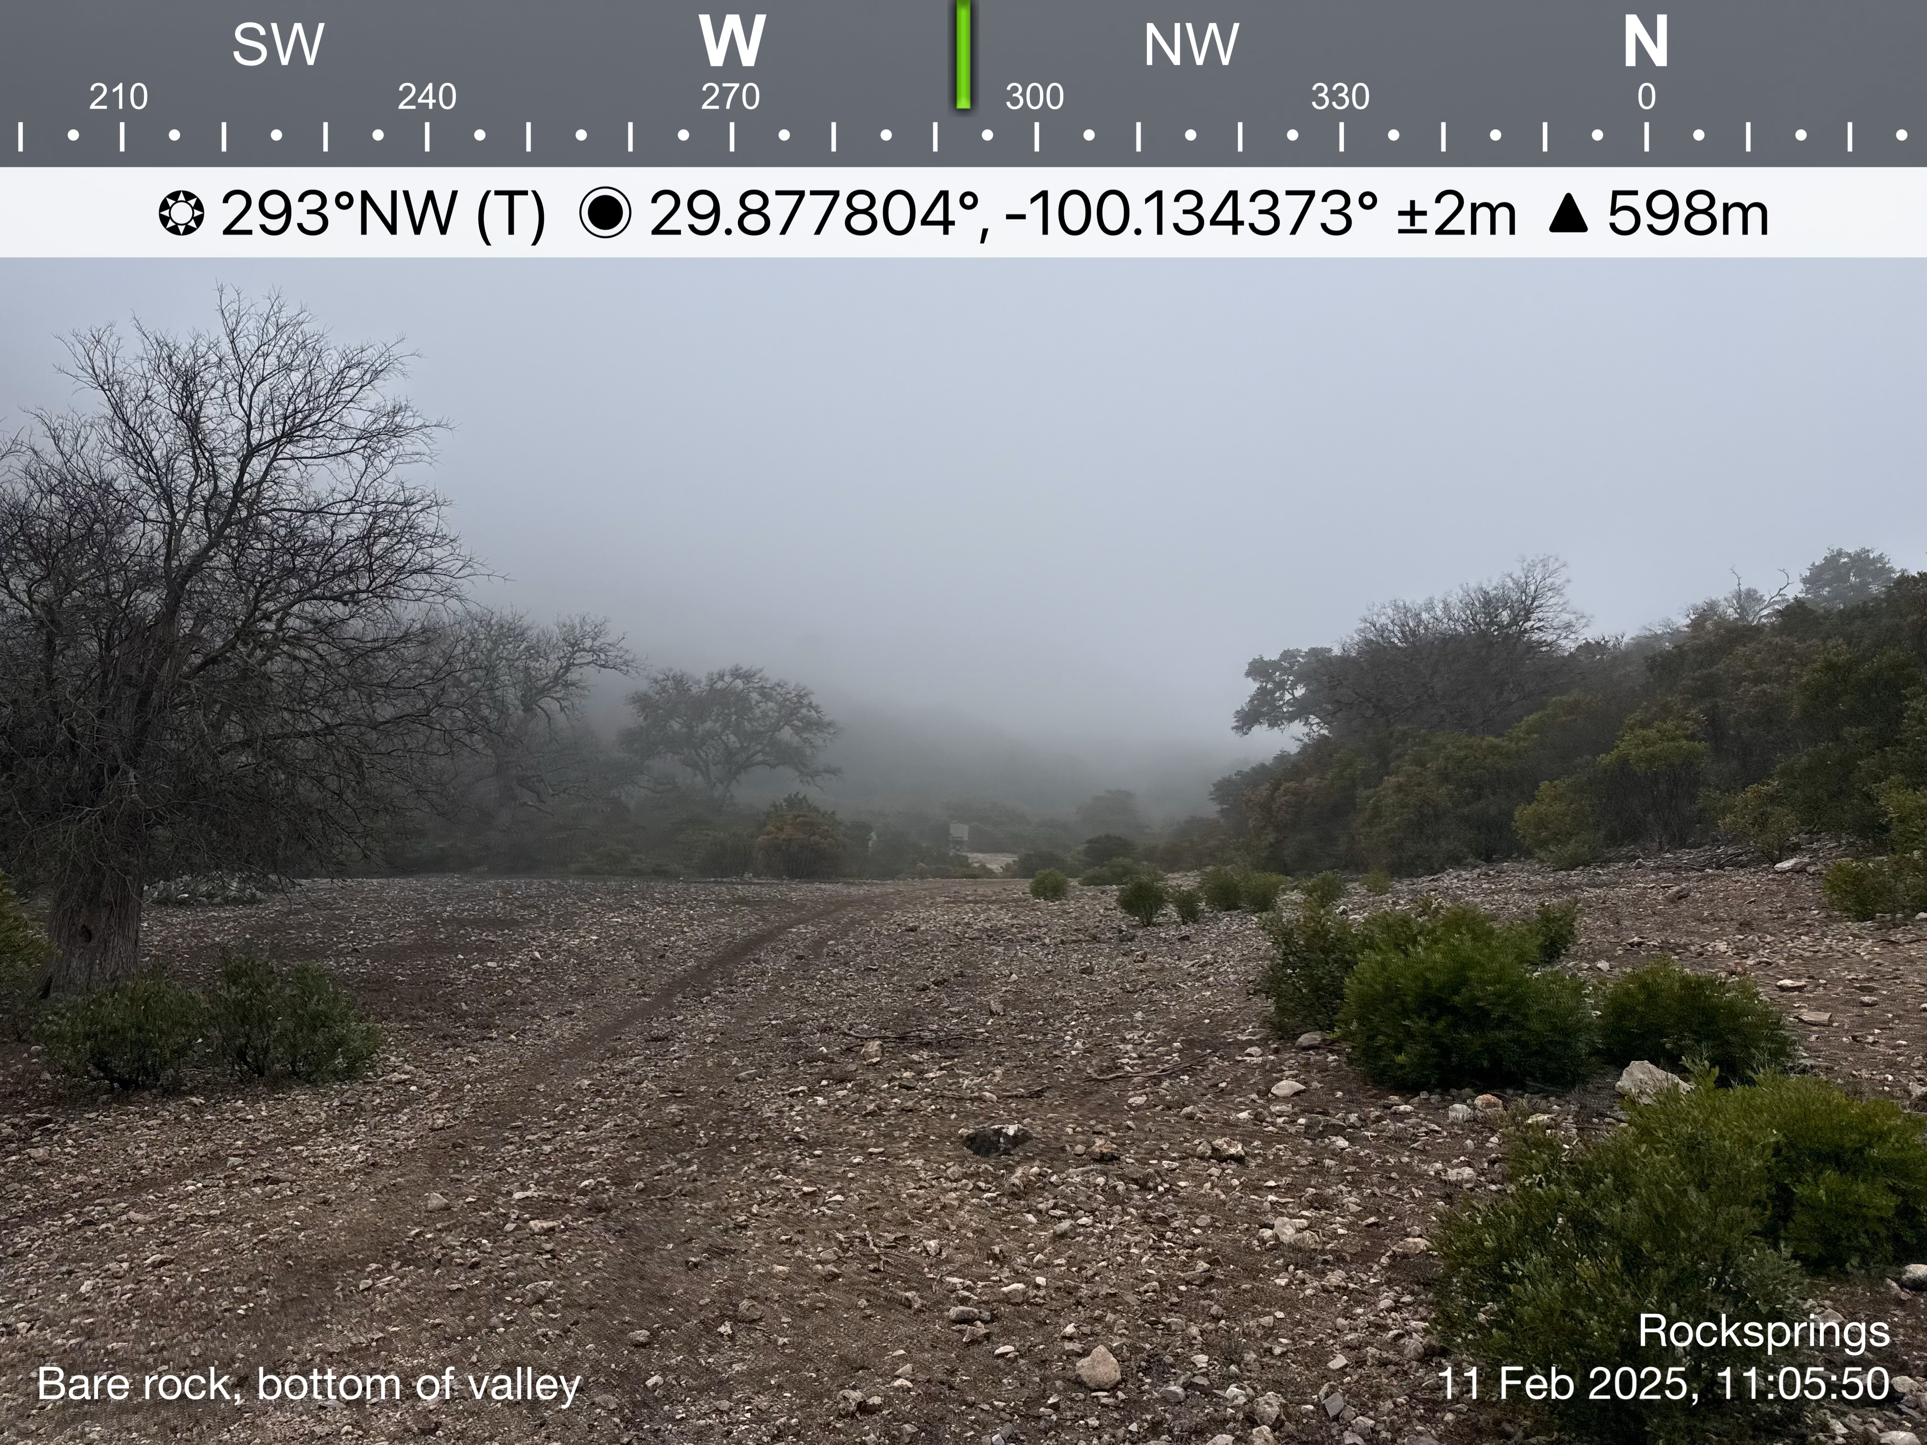
Training Points and Carcass Data
Training points were collected by Drs. Blackburn and Herrero in February 2025
405 photos with general landcover descriptions, lat/long, rotation
Developed an algorithm to sort descriptions into 5 discrete classes
Bare Soil/Grass
Low-Density Bush
Med-Density Bush
High-Density Bush
Trees/Forest
Carcass points with location, outbreak year and lineage

Slide 15
Random Forest Classification
Semi-Automatic Classification Plugin in QGIS
Allows start-to-finish data configuration, processing, analysis, and post-processing
August 2019 Composite Image
3-meter buffers around training points
Extract reflectance values and learn patterns
Applies learning to new pixels
Congedo, Luca, (2021). Semi-Automatic Classification Plugin: A Python tool for the download and processing of remote sensing images in QGIS. Journal of Open Source Software, 6(64), 3172, https://doi.org/10.21105/joss.03172

Slide 16
Results

Slide 17
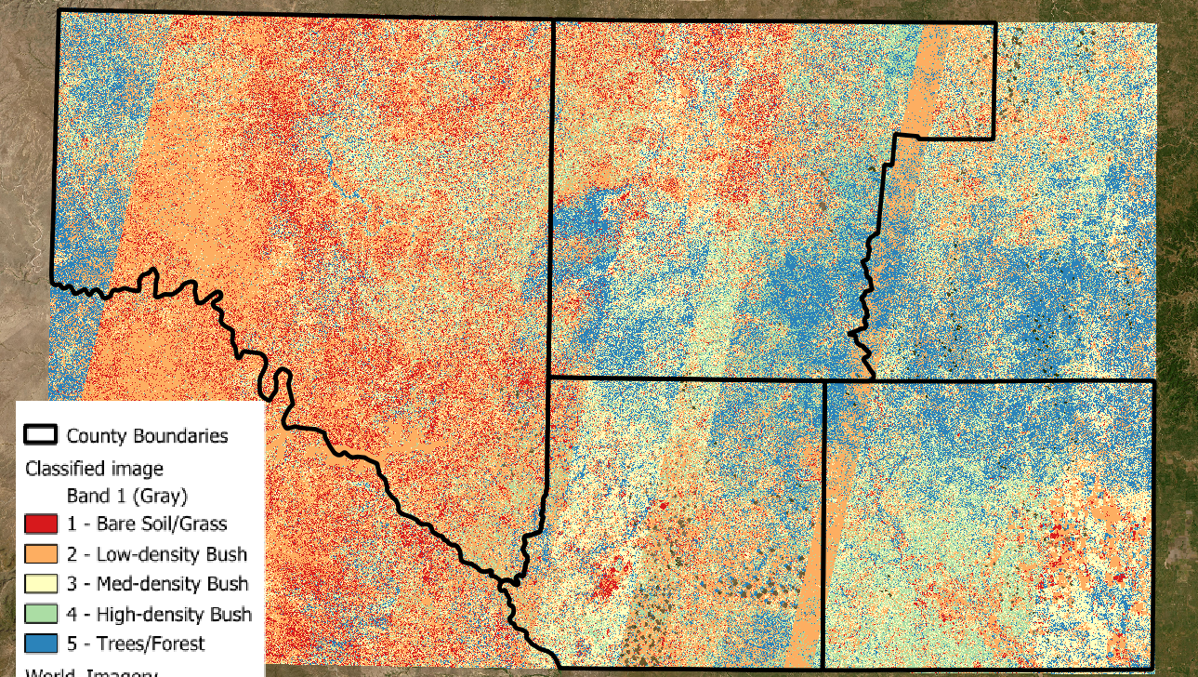

Slide 19
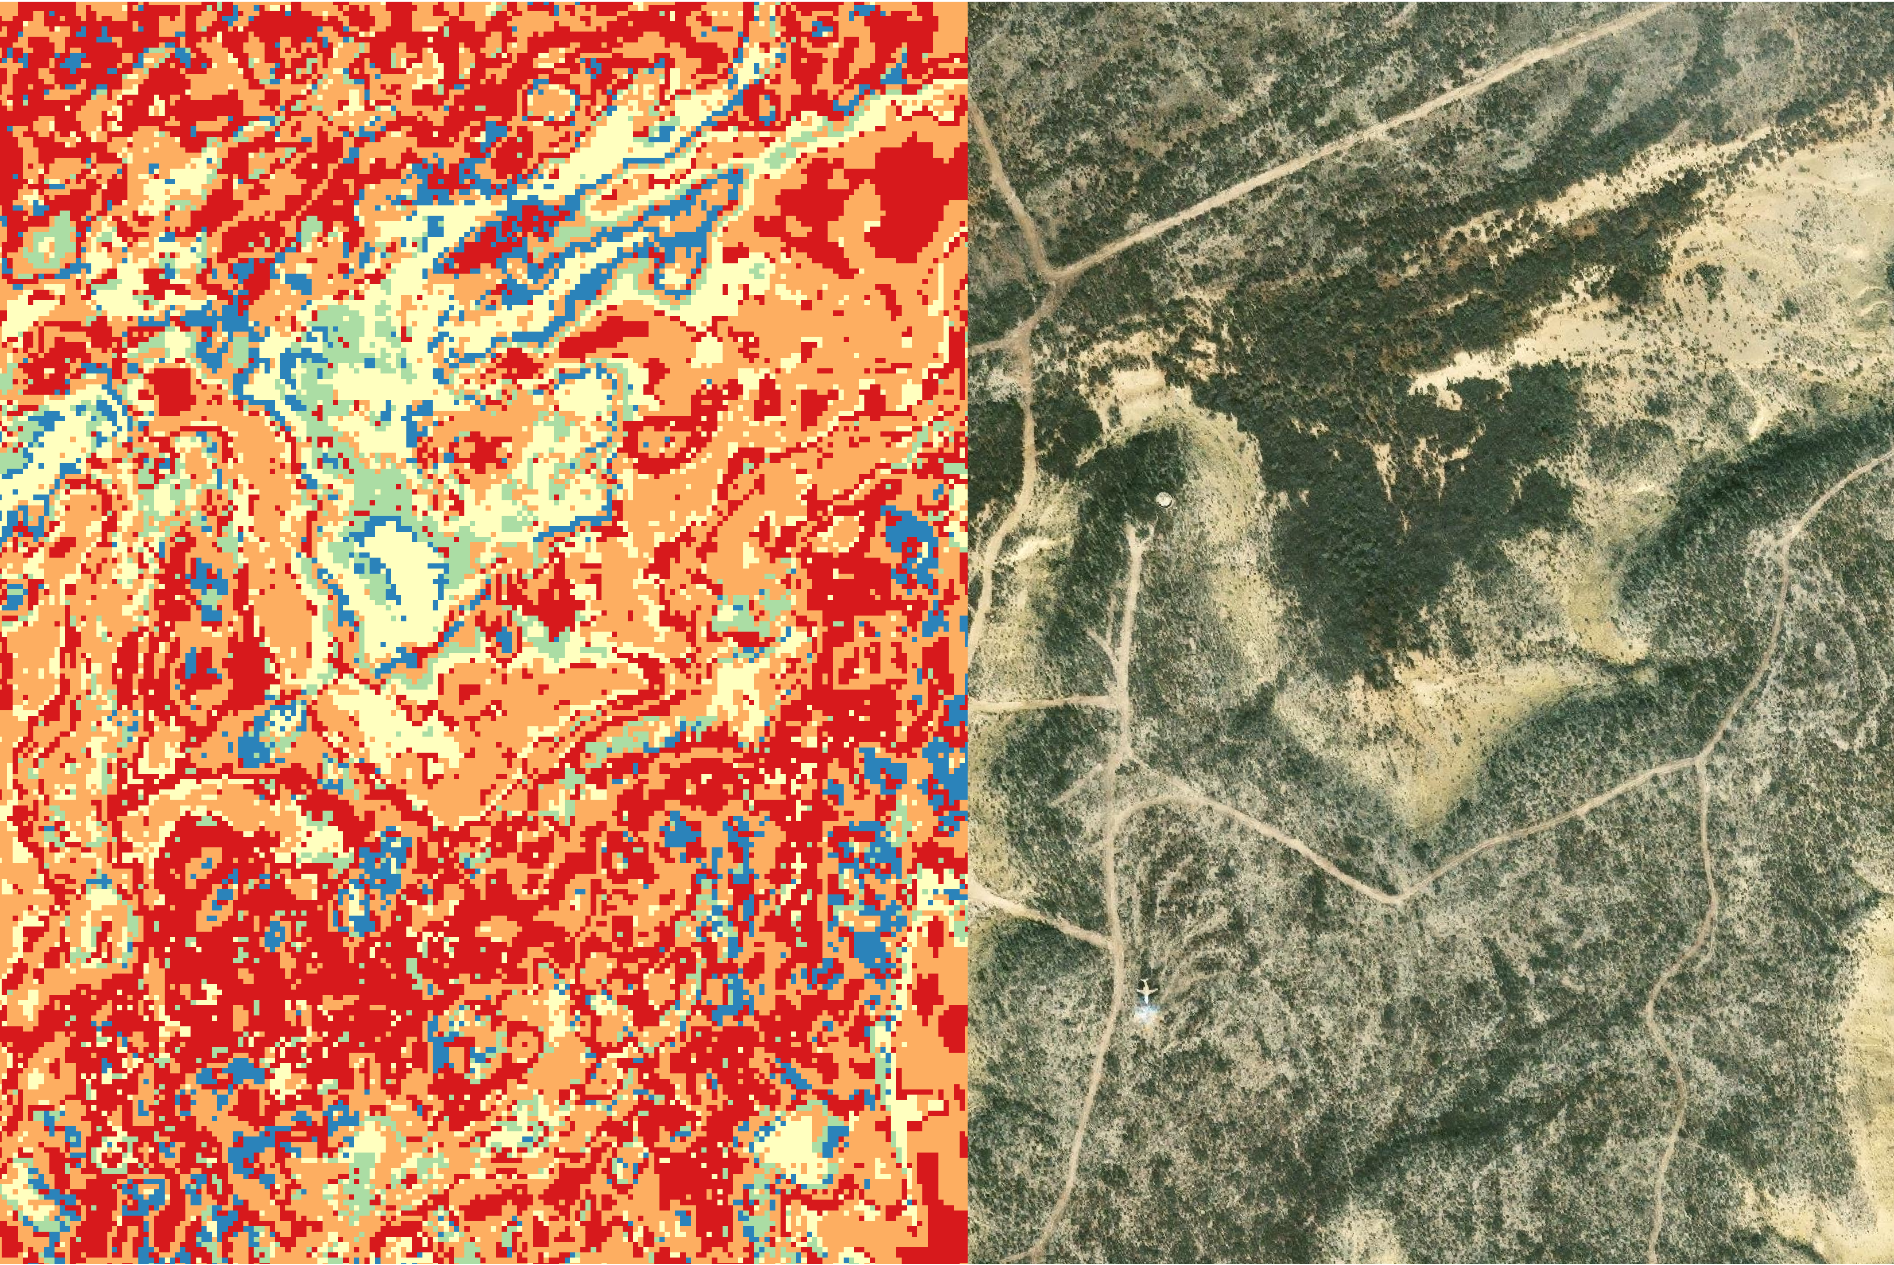
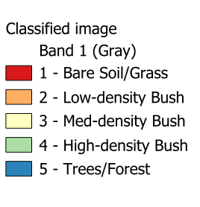

Slide 20
Discussion

Slide 21
Bare Soil/Grass | 13
Low-Density Bush | 59
Med-Density Bush | 50
High-Density Bush | 29
Trees/Forest | 32
Carcass Points by Landcover Type
59.56% of the carcasses were found in Low or Medium Density Bush

Slide 22
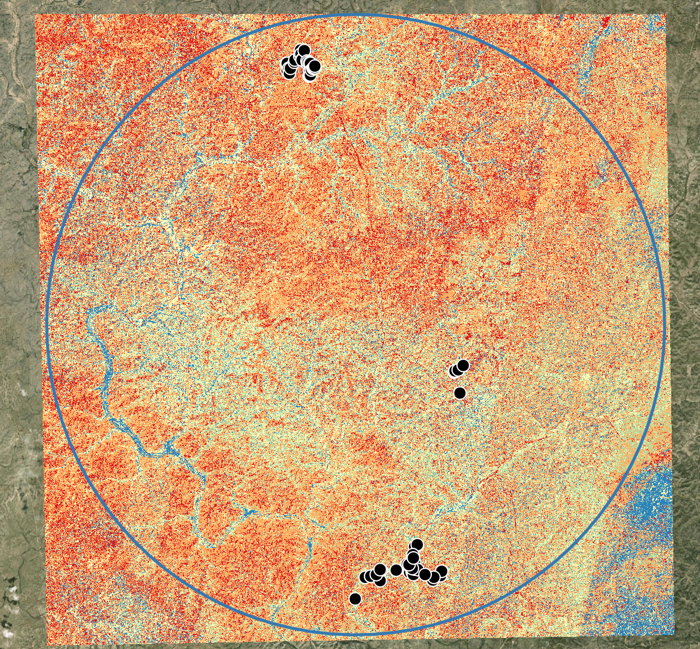
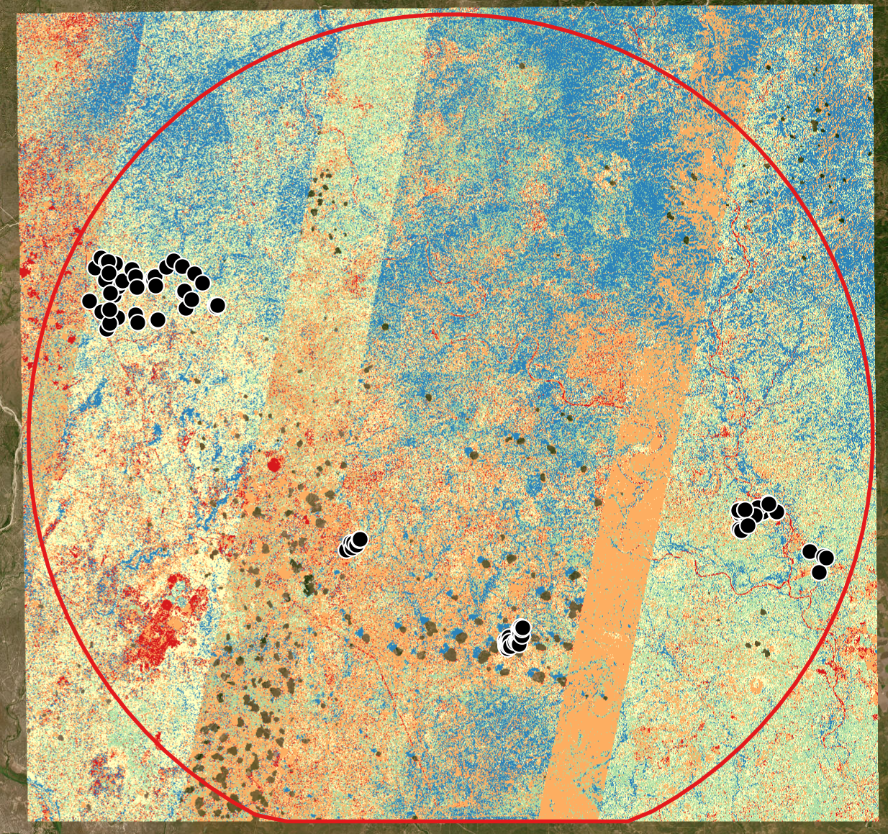
Vollum
Ames

Slide 23
Cover Type | Ames | Percent | Area % | Vollum | Percent | Area %
Bare Soil/Grass | 4 | 6.25% | 3.85% | 9 | 7.56% | 17.03%
Low-Density | 28 | 43.75% | 31.13% | 31 | 26.05% | 40.61%
Med-Density | 8 | 12.50% | 23.11% | 42 | 35.29% | 23.31%
High-Density | 14 | 21.88% | 19.88% | 15 | 12.61% | 12.21%
Trees/Forest | 10 | 15.63% | 22.04% | 22 | 18.49% | 6.84%

Slide 24
Conclusion/Future Work

Slide 25
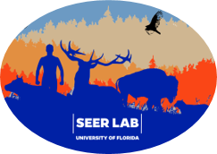

Thank you! Dryver Finch University of Tennessee Knoxville DRYZFINC@VOLS.UTK.EDU

