Slide 1
Automatic Image Matching: A Remote Sensing Comparison
April 24-25, 2025|Oak Ridge, TN
Christopher Tate, PhD
Orrin Thomas, PhD, Stan Seiferth, Sean Pharris, Kjell Ryerson
Oak Ridge National Laboratory

Slide 2
The scope
Needs for ability to automatically feature match in challenging images, precisely aligned imagery over remote sites for various applications, not everything is over urban areas or has manmade features
Most adjustment research pertaining to Maxar multiview imagery relies on sparse feature matching (typically SIFT)
Most of that research/literature focuses on the winnowing stage of the process to remove bad matches, which is a separate (though very important) research topic on its own, but a decent set of matches must be produced before this step can even occur

Slide 3
The Scope
Benchmark Dataset
Algorithm Implementations
Evaluation of Algorithms
Such a dataset doesn’t yet exist
No one is going to make such a dataset with actual ground truth feature correspondences
To be used in conjunction with SMaUG (Thomas et al., 2025)
We intend to publish this as a tool for the community
Code repository containing any algorithms added to investigation
Easy to add new/additional algorithms
Can be run on any other image sets with appropriate sensor model metadata
We also intend to publish this as a tool for the community
Determine best algorithms for global image matching operations
Determine best algorithms for domain specific applications
Compare new and state of the art algorithms with older algorithms in a consistent and quantitive way

Slide 4
World Biome Stats – 14 Distinct Biomes (7 forest (41.5%*) and 7 non-forest (58. 5%*) biomes)
Deserts & Xeric Shrublands
Tropical & Subtropical Grasslands, Savannas, & Shrublands
Flooded Grasslands & Savannas
Temperate Grasslands, Savannas, & Shrublands
Boreal Forests/Taiga
Temporal Broadleaf & Mixed Forests
Mangroves
Tropical & Subtropical Dry Broadleaf Forests
Temperate Conifer Forests
Tropical & Subtropical Moist Broadleaf Forests
Montane Grasslands & Shrublands
Tropical & Subtropical Coniferous Forests
Tundra
Mediterranean Forests, Woodlands, & Scrub
Independent Region that is not a biome
Rock and Ice
(Dinerstein, et al., 2017)
* Percentage of Earth’s terrestrial area

Slide 5
World Biome Sampling
~70 distinct sites/locales to target for imagery collections
We want to identify and add in sites over different types of human settlements as well.
Plan to use Maxar imagery: WV01, WV02, WV03, GE01 at full resolution
Plan to collect imagery over a range of dates from these sites: ranging from 2008 to current
Starting with image pairs with a large temporal difference
WV: WorldView
GE: GeoEye

Slide 6
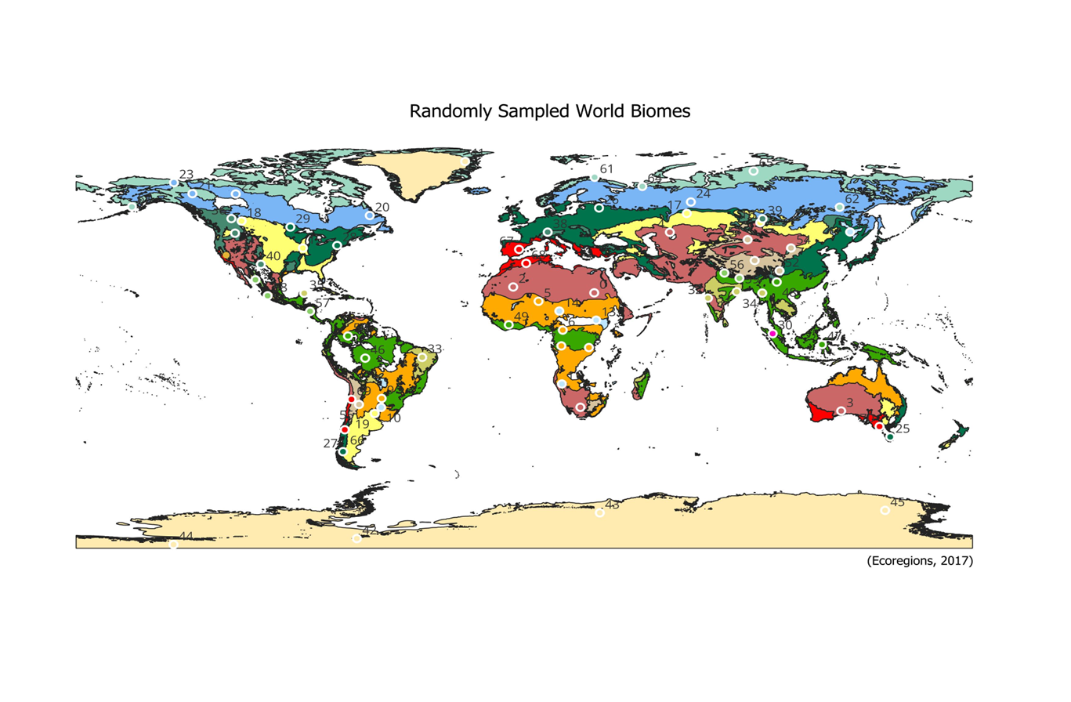
Sites
(Dinerstein, et al., 2017)

Slide 7
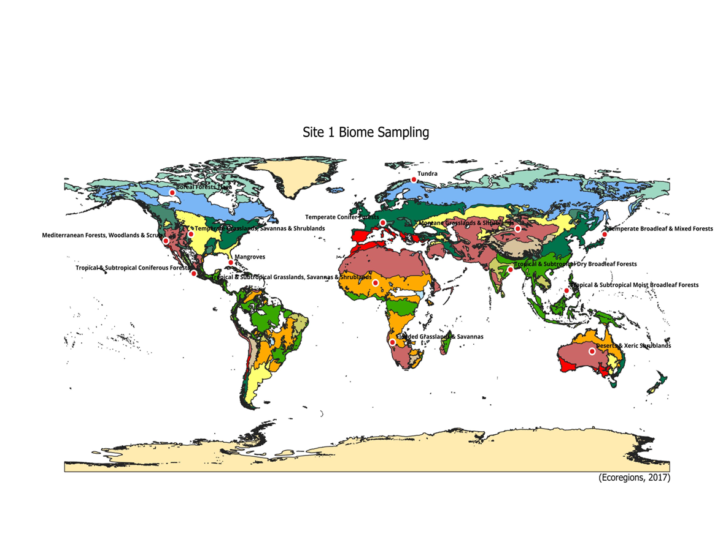
Sites (at present)
(Dinerstein, et al., 2017)

Slide 8
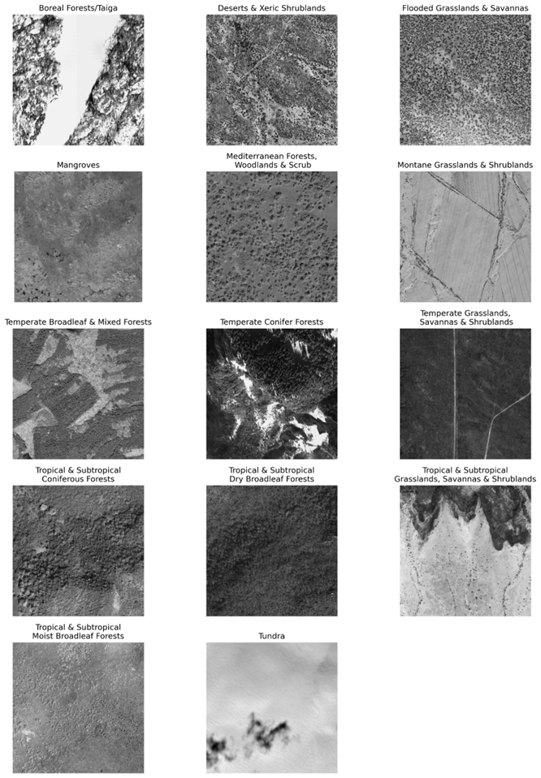
Site 1 Biomes
(©2024 Maxar )

Slide 9
Algorithms (a mix of useful pillars and state of the art)
Sparse Matching:
Traditional:
SIFT (Lowe, 1999)
ORB (Rublee et al., 2011)
SURF (Bay et al., 2006)
Deep-learning:
D2-Net (Dusmanu et al., 2019)
SuperGlue (Sarlin et al., 2020)
R2D2 (Revaud et al., 2019)
ALSFeat (Luo et al., 2020)
Dense Matching
Dense Kernelized Feature Matching (DKM) (Edstedt et al., 2023)

Slide 10
Data Processing within Pipeline
Full resolution GSD: Earliest reference image is chipped to 1000x1000 subset, but no down sampling.
Sensor Models: RPC sensor models are written out with offsets for the chips
Subsequent images are chipped and rectified to the same area of the reference image through homography application to correct rotation and scale differences between the images
Radiometric normalization of images through histogram matching per Tu et al. (2013)
Any necessary preprocessing, typically conversion to 8-bit, stretching, etc.

Slide 11
Experimental Design
Each algorithm will run on the same large set of images that we have produced.
Algorithms should be broadly optimized for good performance, though not at the level of individual locales or datasets.
This will allow for comparisons of results and breakdowns of results
Across biomes
Across settlement types
Across dates
Across sensors

Slide 12
Quality Metric: Satellite Matching Utility Grade (SMaUG)
Typically, feature matching algorithm evaluations are:
Performed on non-remote-sensing image sets
Performed on data with ground truth, allowing for calculation of corresponding metrics
Remote sensing data with ground truth is not widely available, and comparison to ‘truth’ is impractical for large-scale training.
SMaUG measures the utility of matches as uncertainty in pixels (smaller is better)
Quantifies the quality, quantity, and distribution of matches
Maximum uncertainty of the transformed corners
In units of pixels (easy interprebility!)
Smaller is better
For our application: Maxar CE90 is 5 meters (~10 pixels) (Maxar , 2021)so anything that produces a QM score > 10 pixels is not successful and is rejected as a failure
(Thomas et al., 2025)

Slide 13
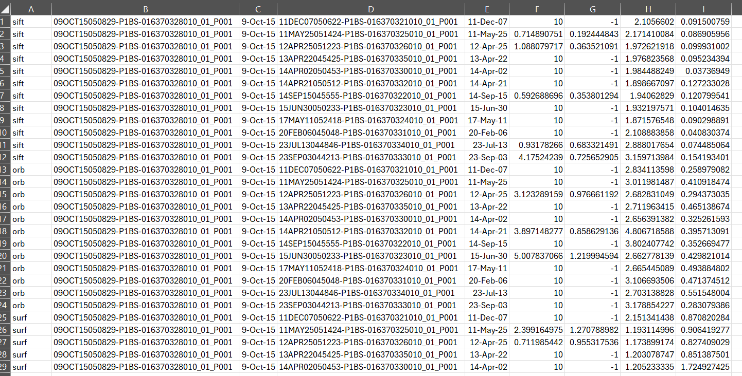
Outputs

Slide 14
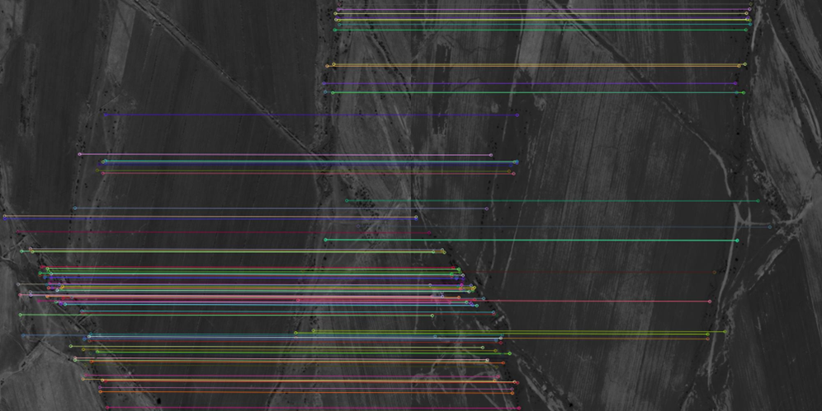
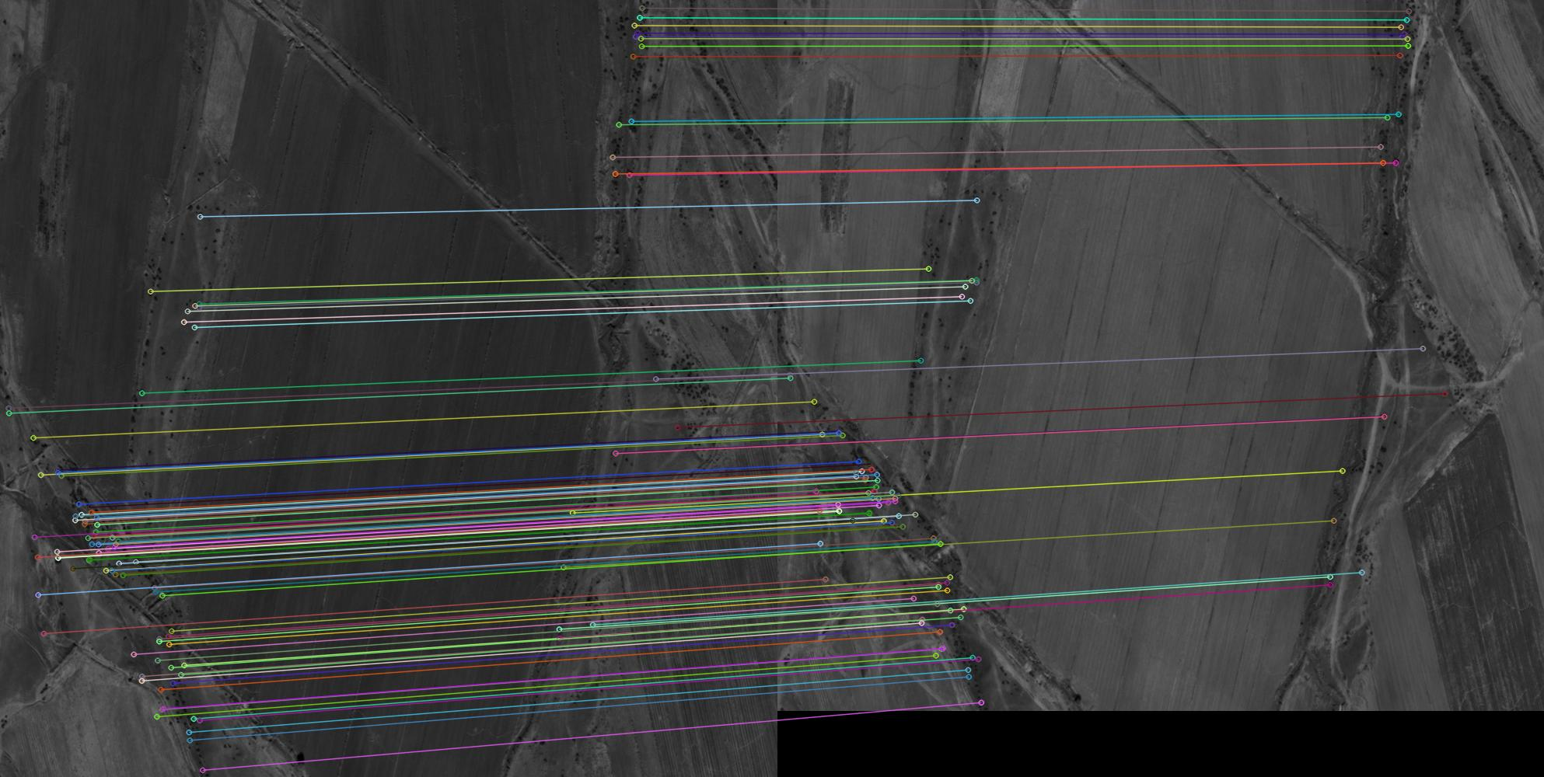
Outputs
Warped image space
(©2024 Maxar )
Original image space

Slide 15
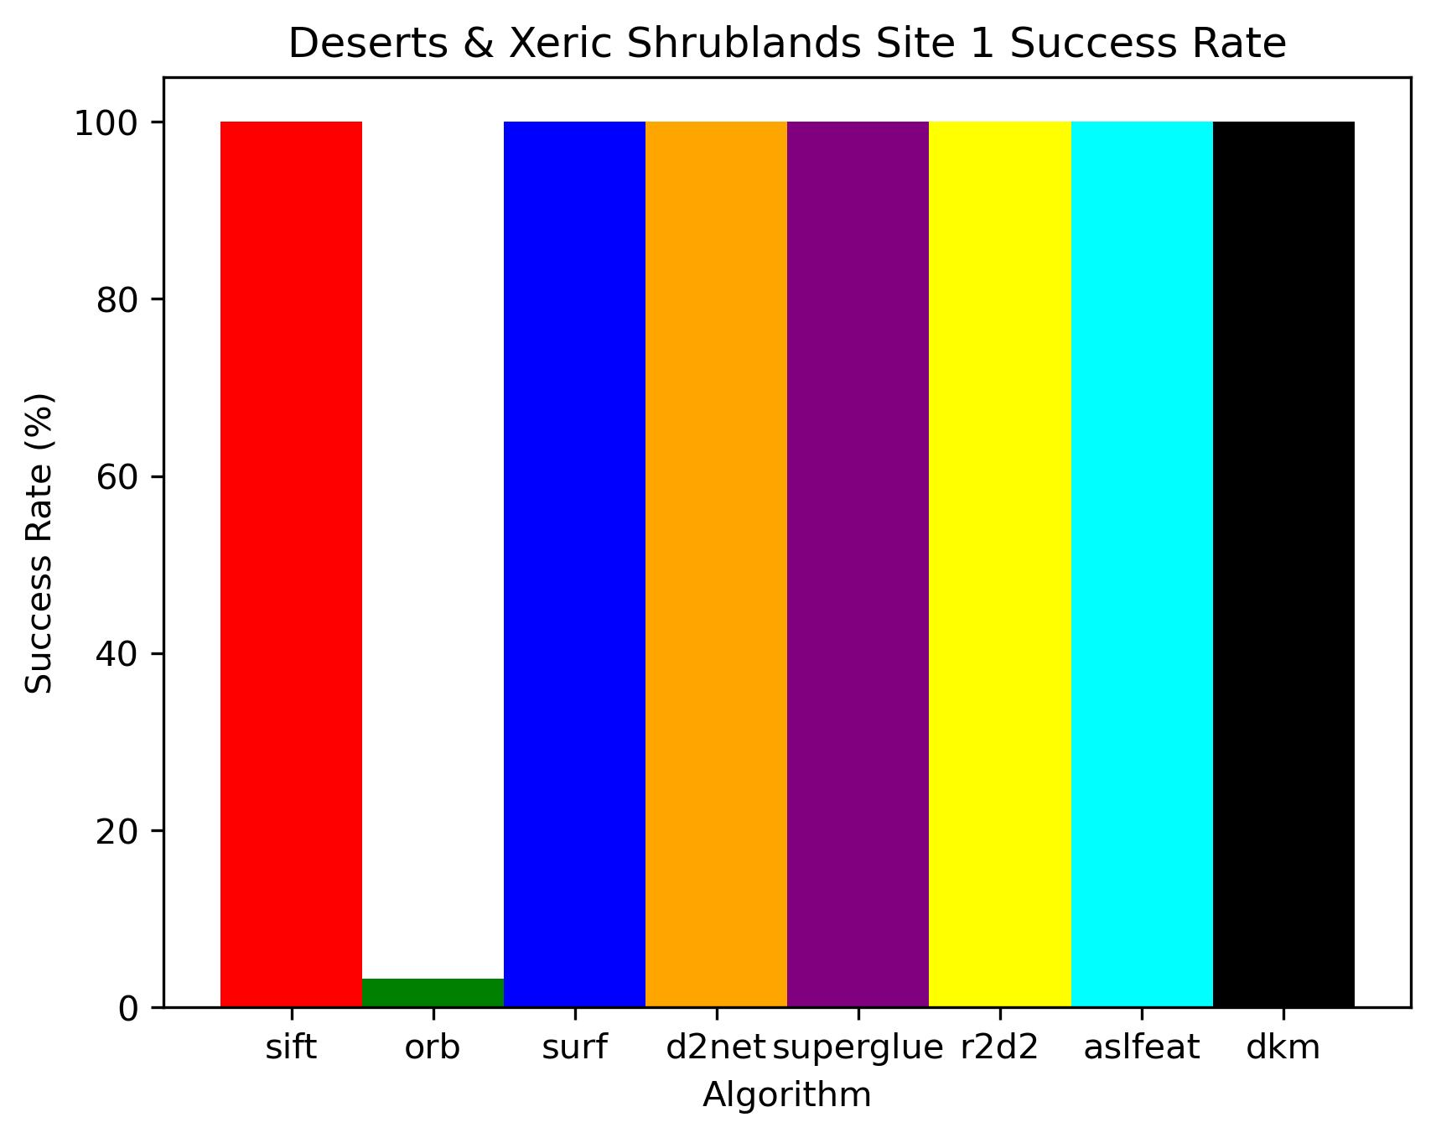
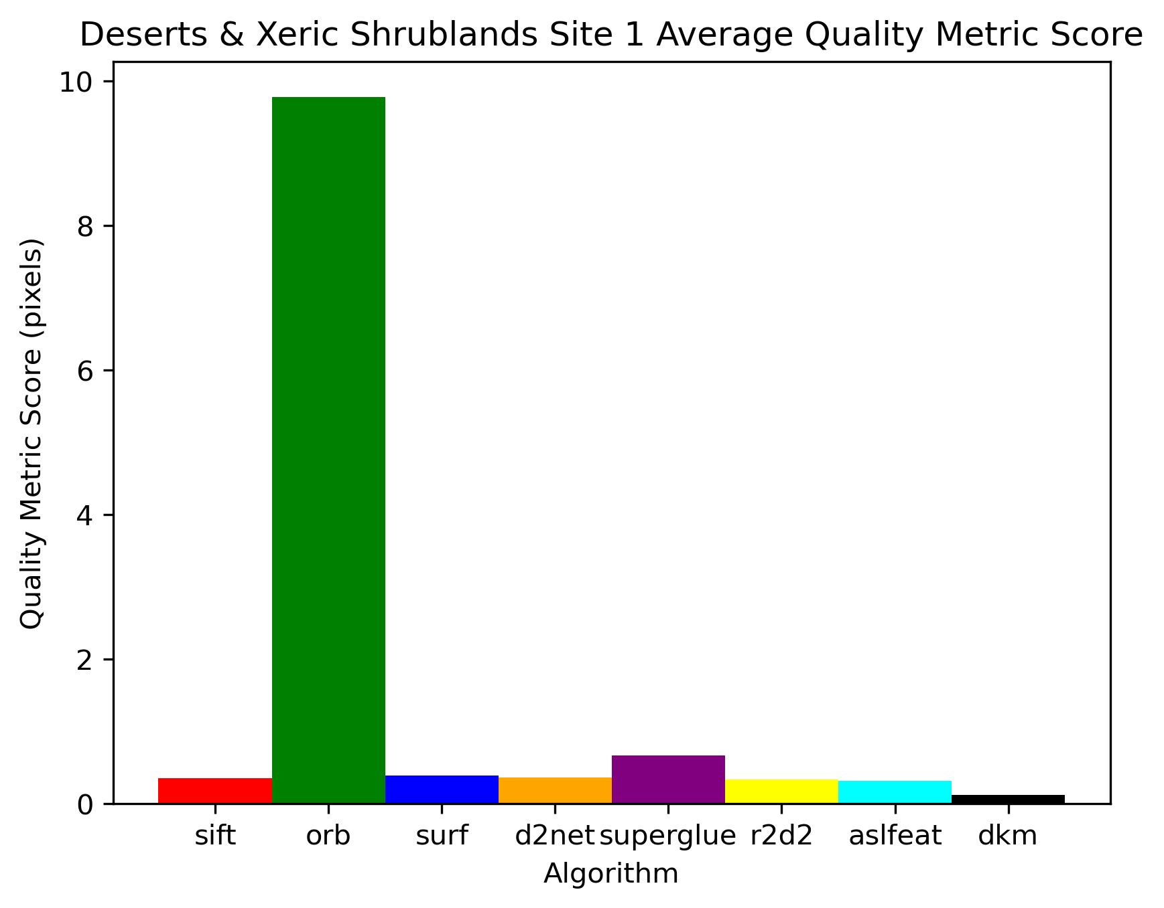
Biome: Deserts & Xeric Shrublands Results

Slide 16
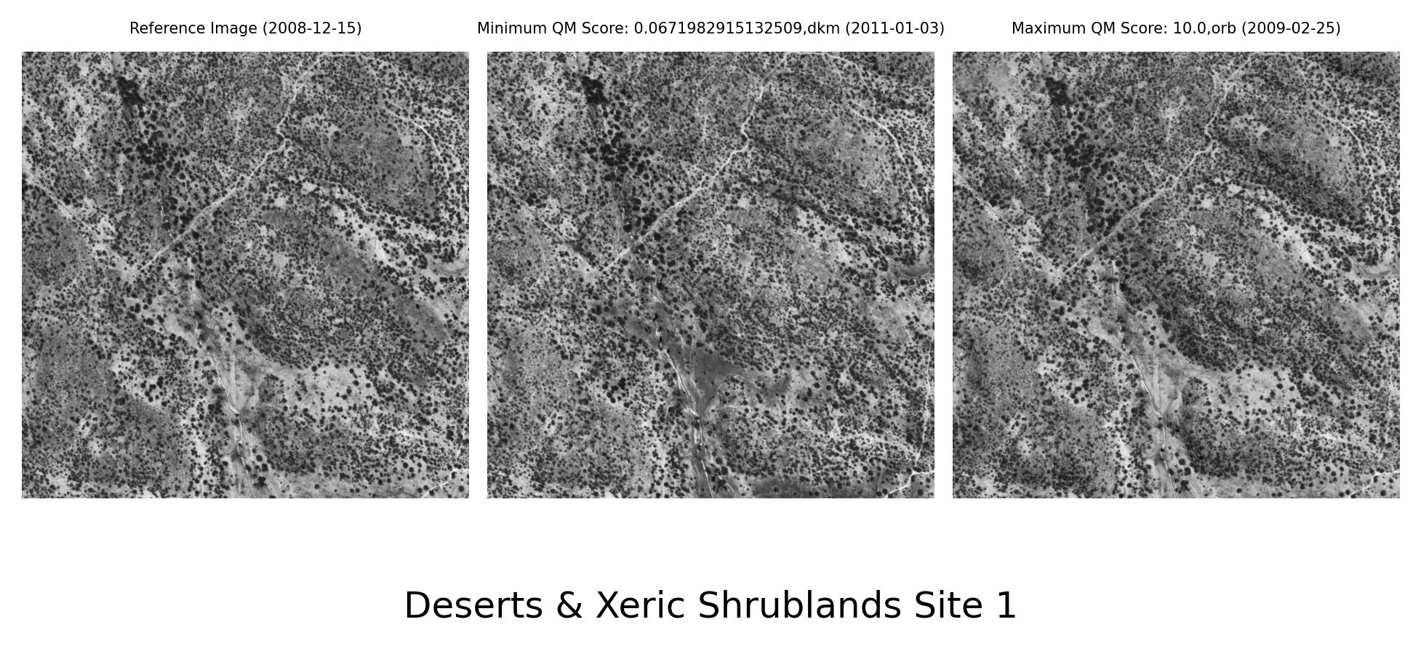
Biome: Deserts & Xeric Shrublands Results
(©2024 Maxar )

Slide 17
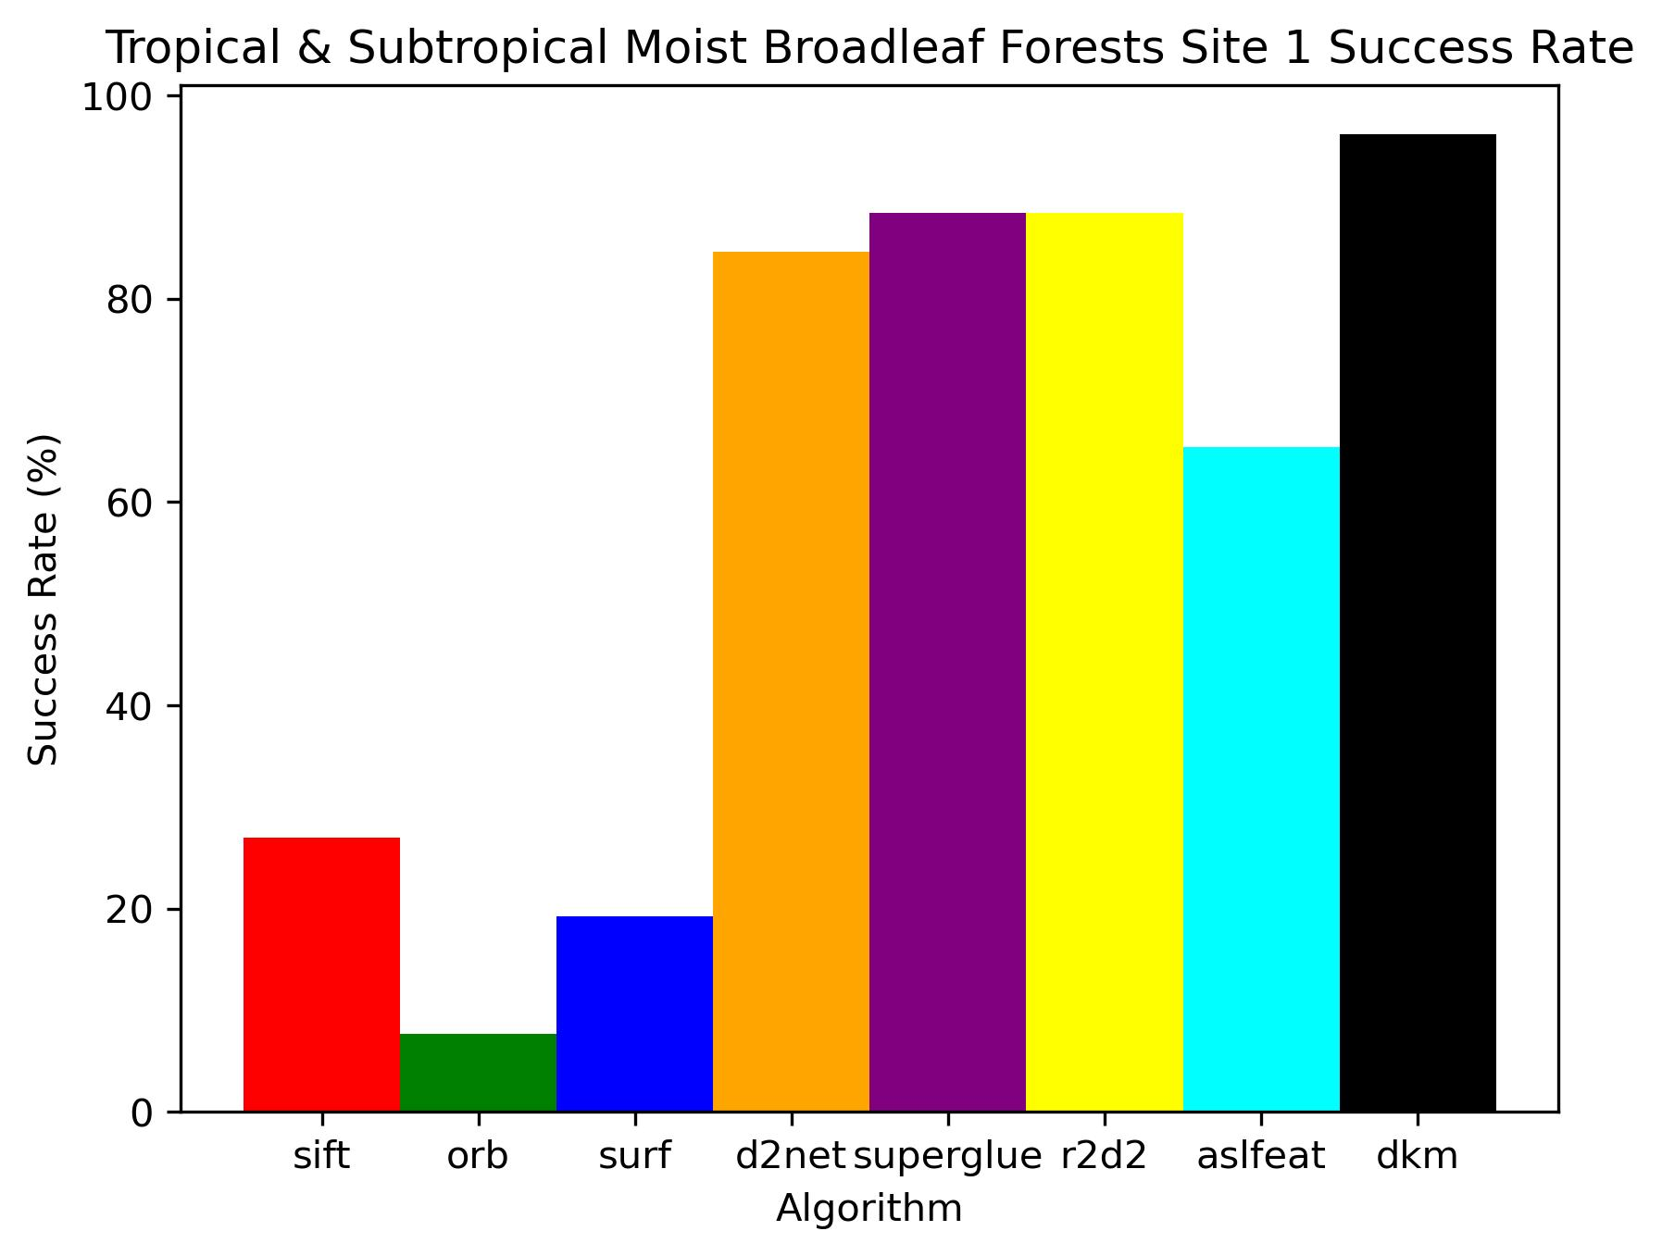
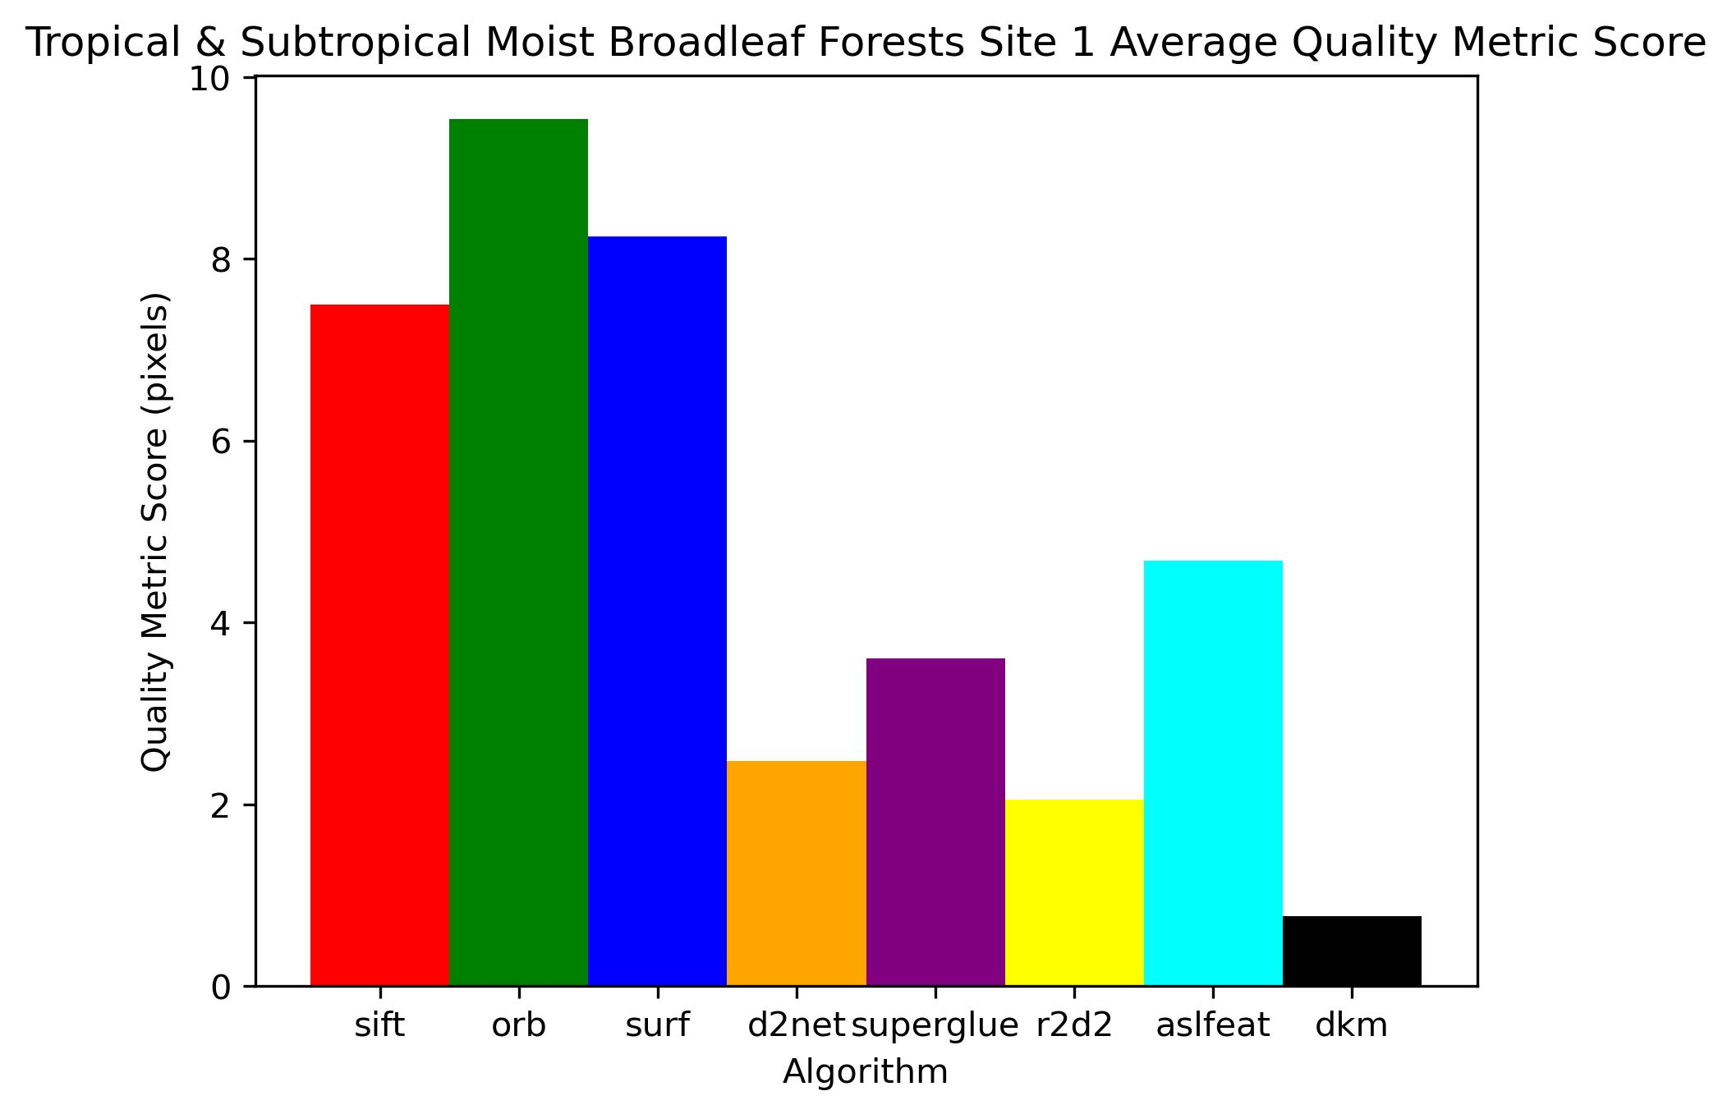
Biome: Tropical & Subtropical Moist Broadleaf Forests Results

Slide 18
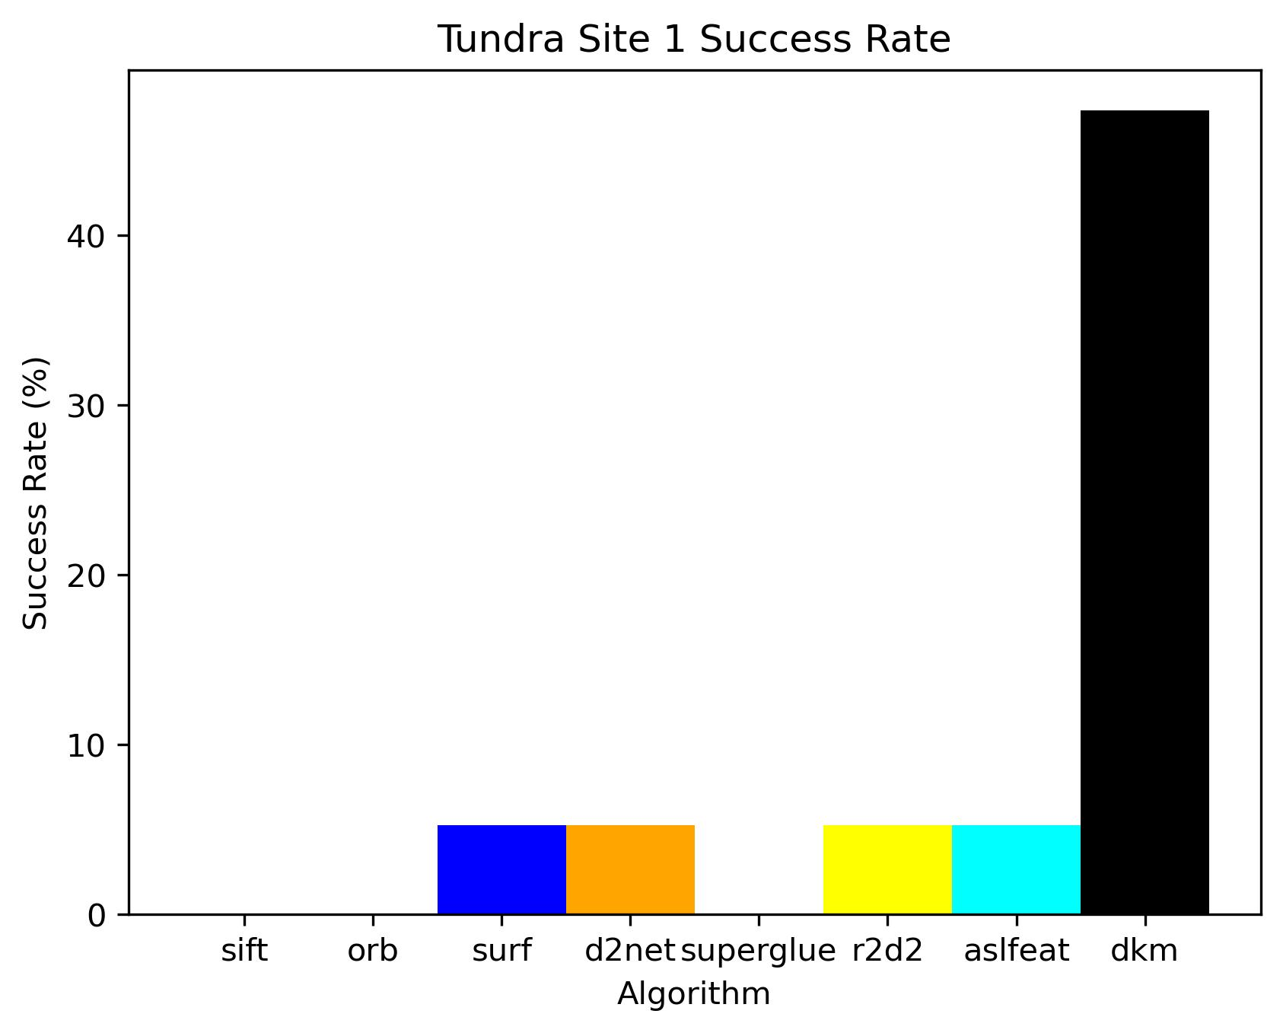
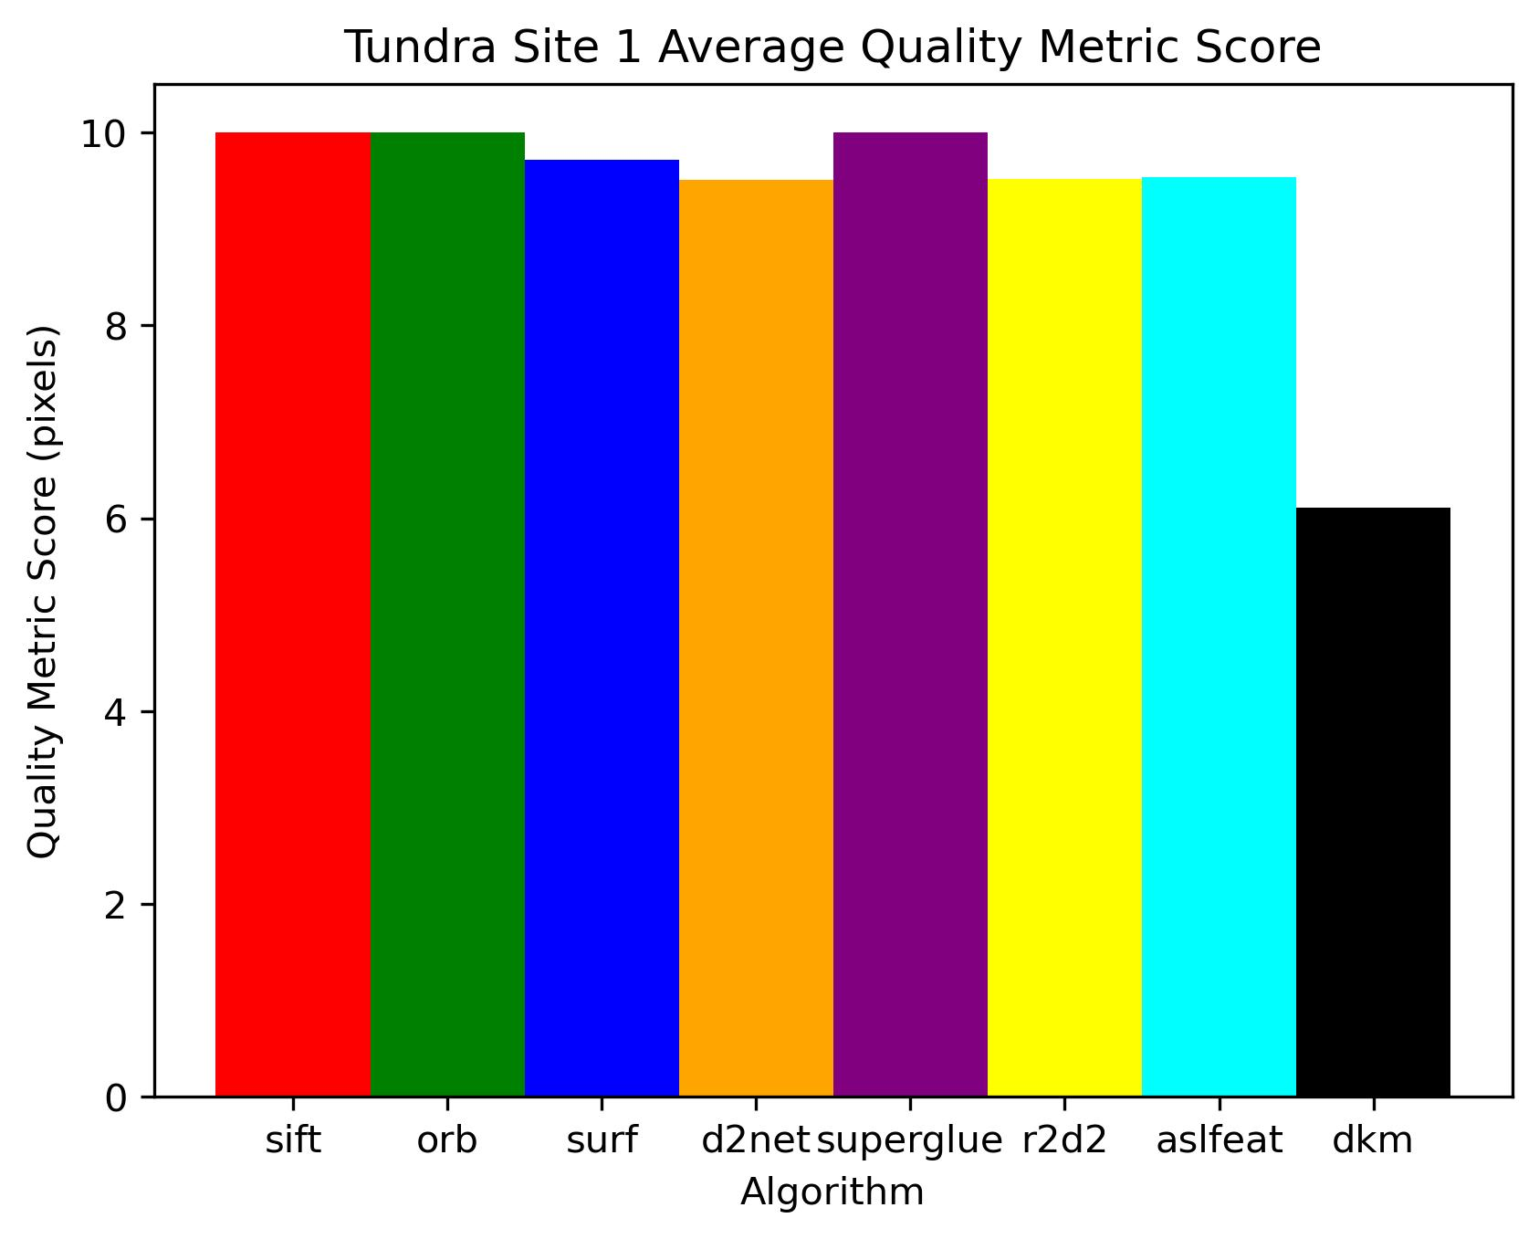
Biome: Tundra Results

Slide 19
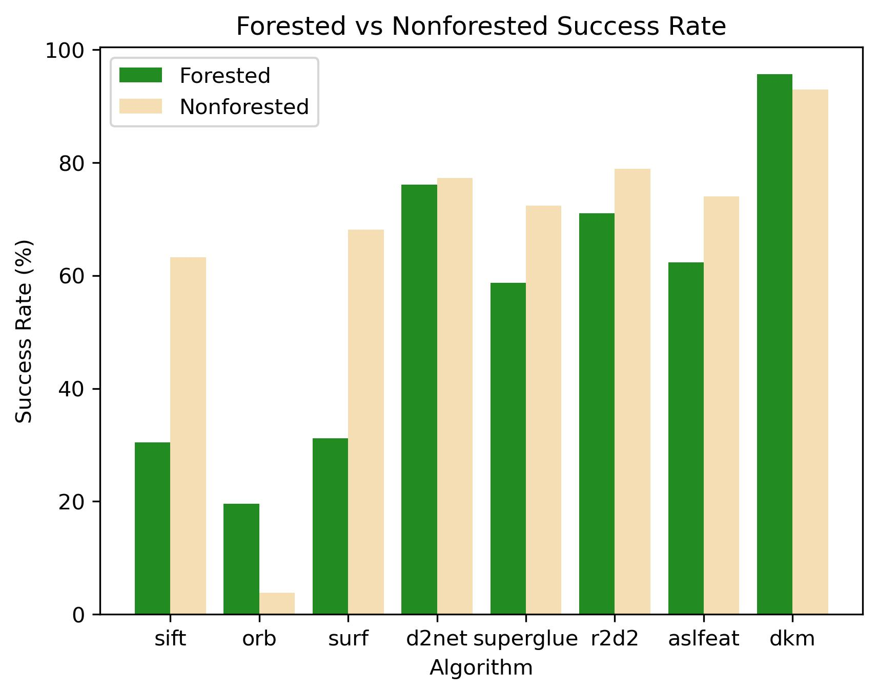
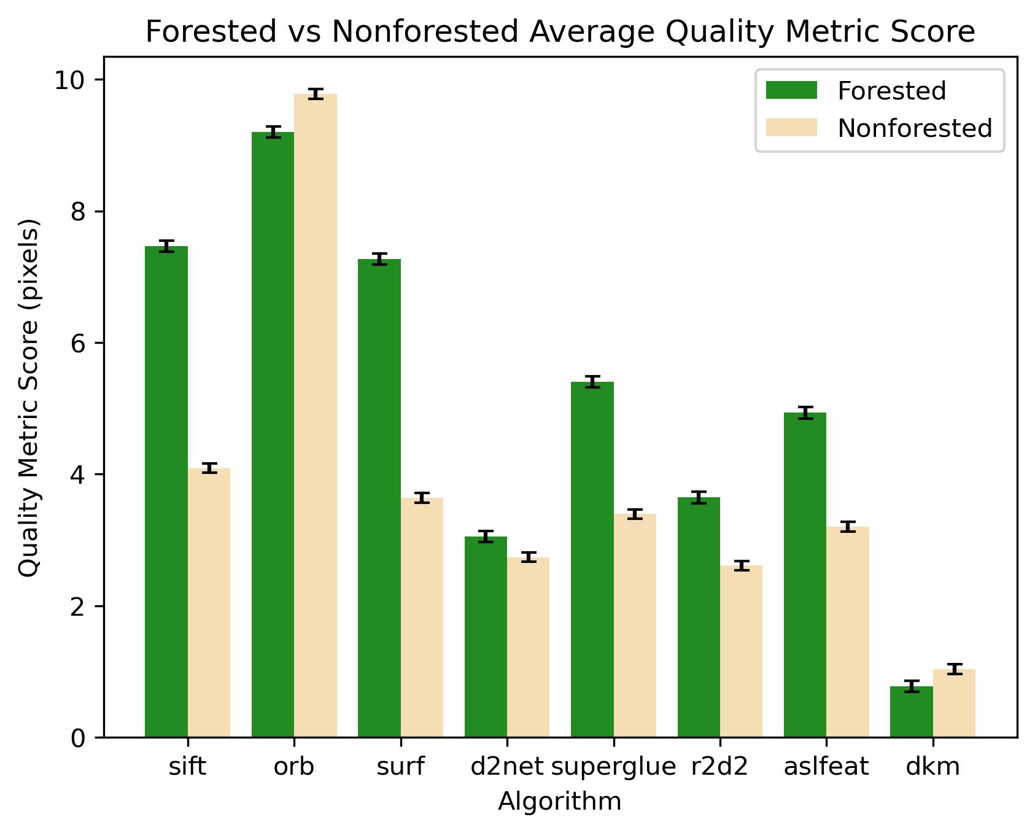
Forested vs Nonforested Biomes

Slide 20
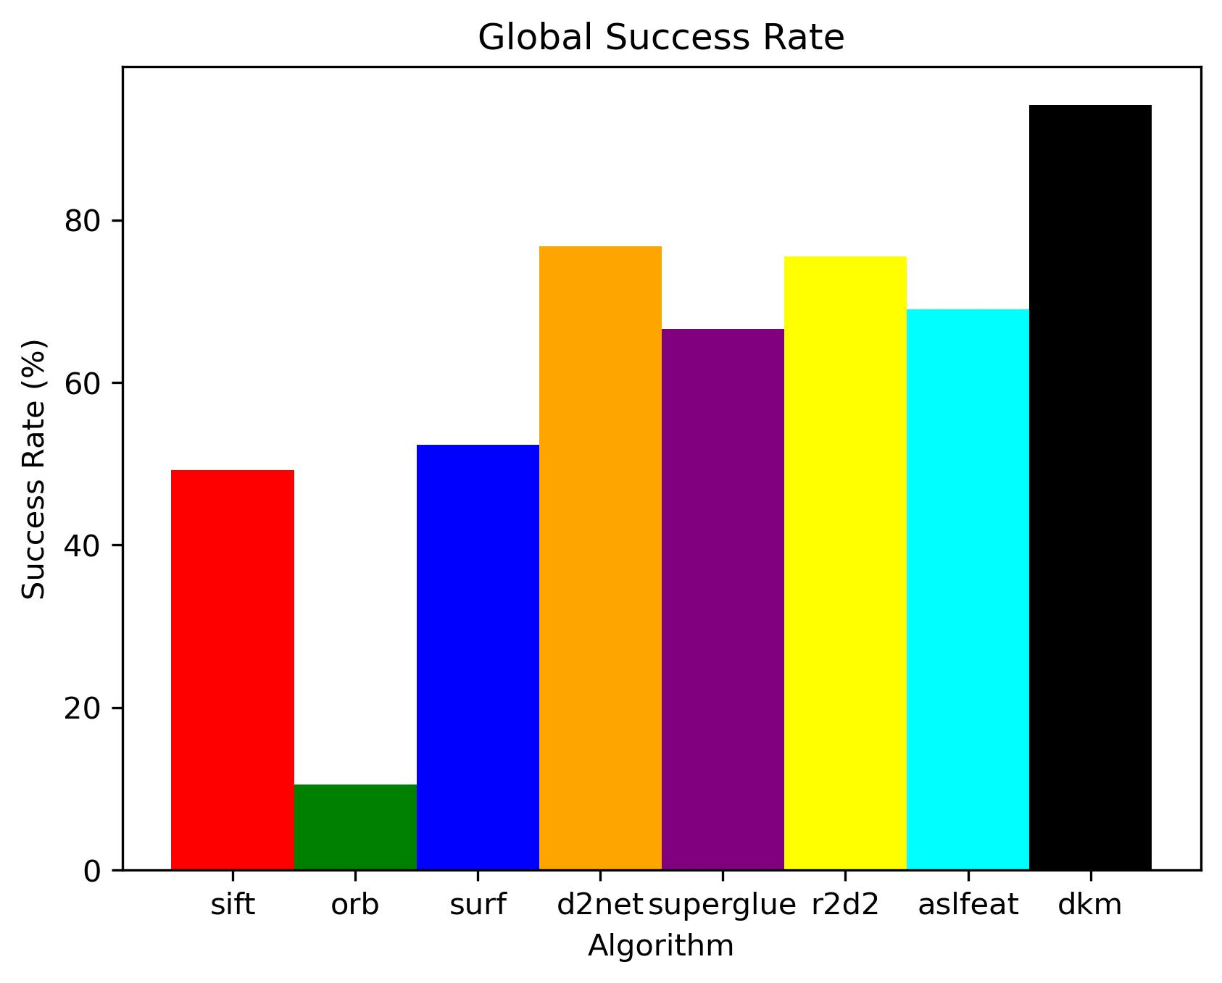
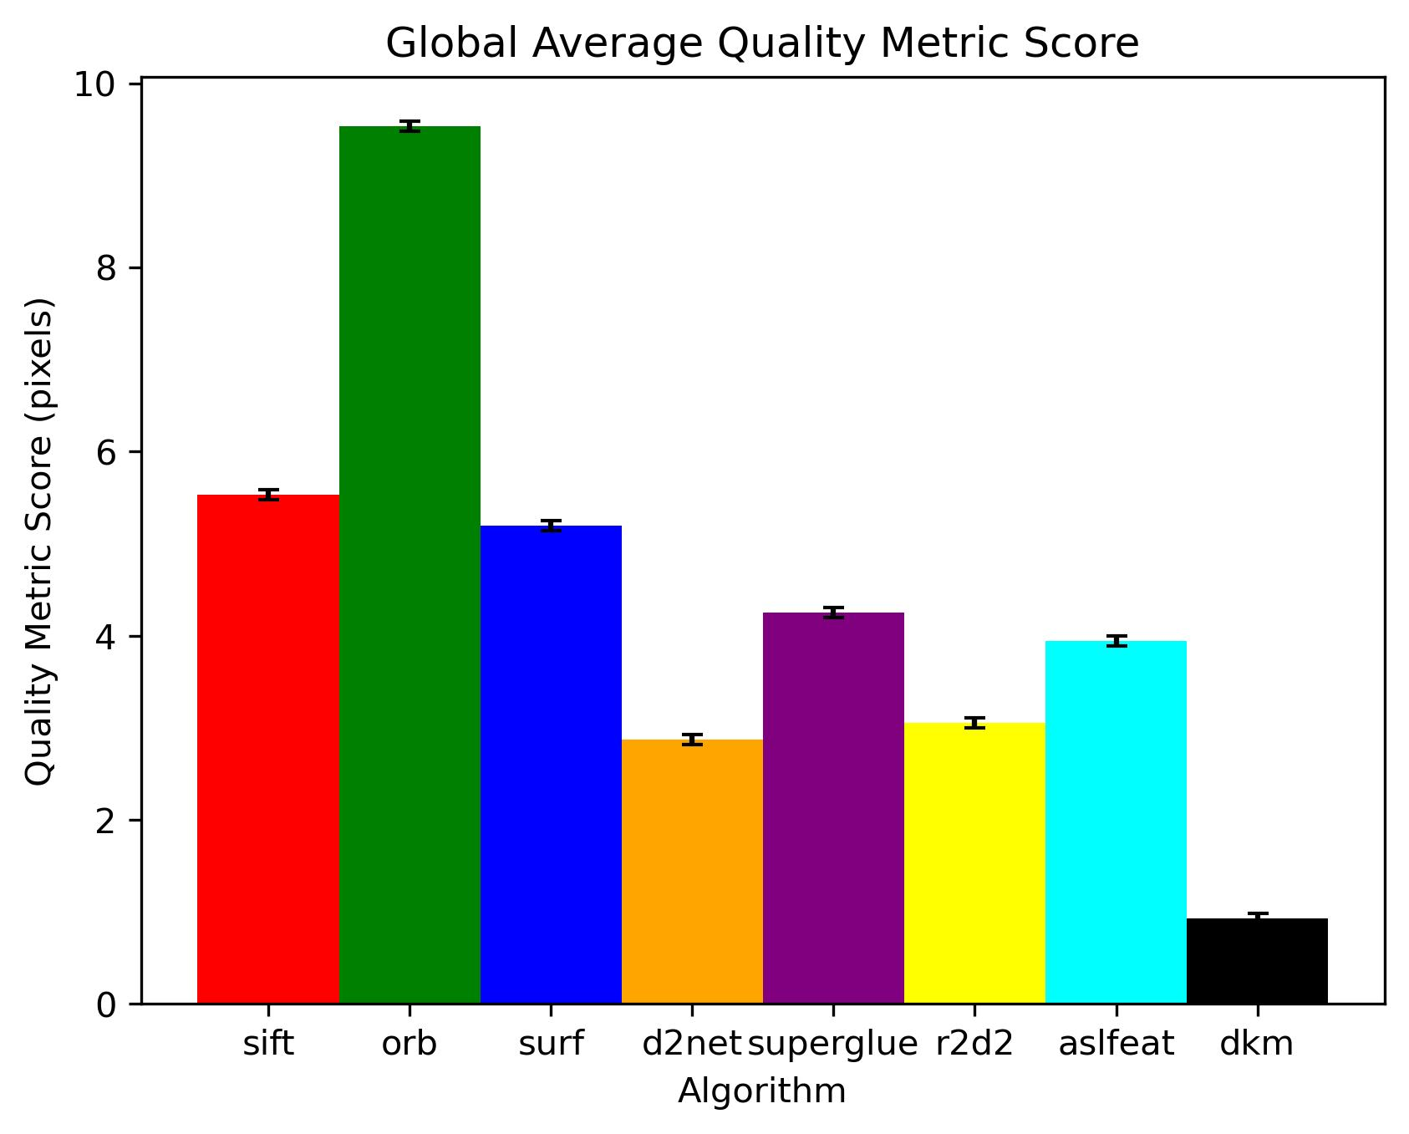
Global Results

Slide 21
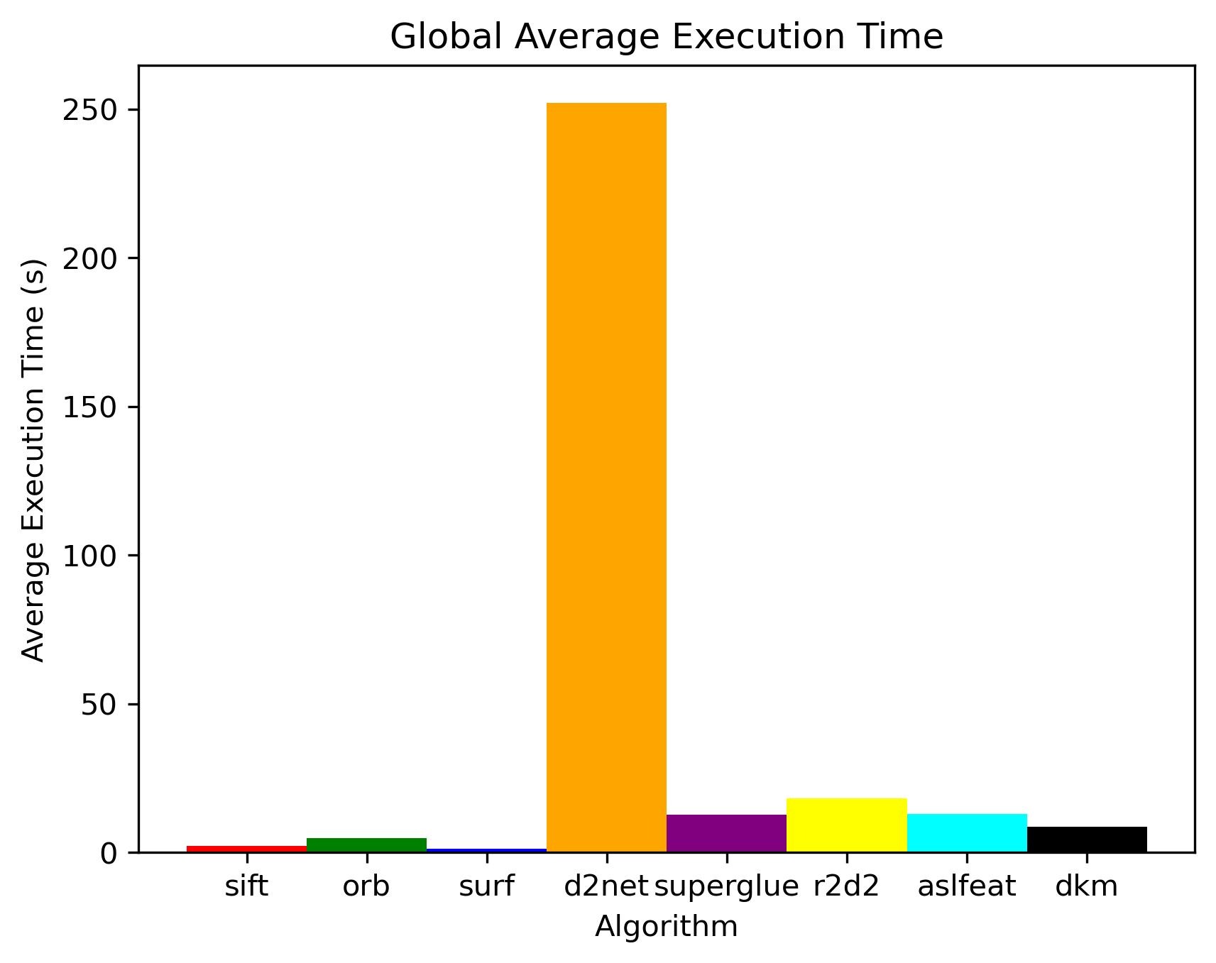
Average Execution Time of Algorithms

Slide 22
Current Status & Future Work
Conclusions:
DKM appears most successful in SMaUG scores and success rates across biomes.
However, it has the ability to hallucinate matches – most of the time these are rejected by the quality metric as they should be
D2Net performs effectively, however, is very slow relative to other algorithms
R2D2 strikes a good balance between timing and effectiveness
Even though most literature is still using SIFT and the traditional algorithms are the fastest, recent machine learning algorithms are outperforming it and the other traditional matchers in terms of quality of matches
Future:
Continue constructing the global dataset for biomes and additional locale types
Agriculture, Urban/human settlements
Continue algorithm characterization on challenging image sets
Newer algorithms to be implemented:
RoMa, LightGlue, Ml-AspanFormer, LoFTR, BRIEF, BRISK
ML retraining/transfer learning in the satellite image domain?

Slide 23
References
Eric Dinerstein, et al. , An Ecoregion-Based Approach to Protecting Half the Terrestrial Realm, BioScience, Volume 67, Issue 6, June 2017, Pages 534–545, https://doi.org/10.1093/biosci/bix014
L. Tu and C. Dong, "Histogram equalization and image feature matching," 2013 6th International Congress on Image and Signal Processing (CISP), Hangzhou, China, 2013, pp. 443-447, doi: 10.1109/CISP.2013.6744035.
D. G. Lowe, "Object recognition from local scale-invariant features," Proceedings of the Seventh IEEE International Conference on Computer Vision, Kerkyra, Greece, 1999, pp. 1150-1157 vol.2, doi: 10.1109/ICCV.1999.790410.
Bay, H., Tuytelaars, T., & Van Gool, L. (2006). Surf: Speeded up robust features. In Computer Vision–ECCV 2006: 9th European Conference on Computer Vision, Graz, Austria, May 7-13, 2006. Proceedings, Part I 9 (pp. 404-417). Springer Berlin Heidelberg.
Edstedt, J., Athanasiadis, I., Wadenbäck, M., & Felsberg, M. (2023). DKM: Dense kernelized feature matching for geometry estimation. In Proceedings of the IEEE/CVF Conference on Computer Vision and Pattern Recognition (pp. 17765-17775).
Sarlin, P. E., DeTone, D., Malisiewicz, T., & Rabinovich, A. (2020). Superglue: Learning feature matching with graph neural networks. In Proceedings of the IEEE/CVF conference on computer vision and pattern recognition (pp. 4938-4947).
Dusmanu, M., Rocco, I., Pajdla, T., Pollefeys, M., Sivic, J., Torii, A., & Sattler, T. (2019). D2-net: A trainable cnn for joint description and detection of local features. In Proceedings of the ieee/cvf conference on computer vision and pattern recognition (pp. 8092-8101).
Revaud, J., De Souza, C., Humenberger, M., & Weinzaepfel, P. (2019). R2d2: Reliable and repeatable detector and descriptor. Advances in neural information processing systems, 32.
Luo, Z., Zhou, L., Bai, X., Chen, H., Zhang, J., Yao, Y., ... & Quan, L. (2020). Aslfeat: Learning local features of accurate shape and localization. In Proceedings of the IEEE/CVF conference on computer vision and pattern recognition (pp. 6589-6598).
Rublee, E., Rabaud, V., Konolige, K., & Bradski, G. (2011, November). ORB: An efficient alternative to SIFT or SURF. In 2011 International conference on computer vision (pp. 2564-2571). Ieee.
Thomas, Orrin, et al., (2025). Grading Automatic Image Matches. ASPRS Mid-South Conference 2025, Oak Ridge, TN, USA.
Maxar, Accuracy of WorldView Products, (2021), Maxar Technologies.

Slide 24
Extras

Slide 25
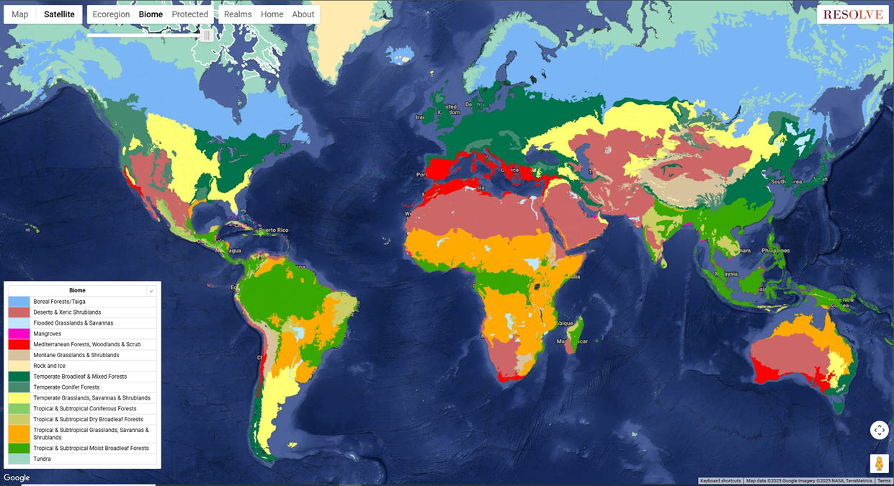
World Biomes
(Dinerstein et al., 2017)

Slide 26
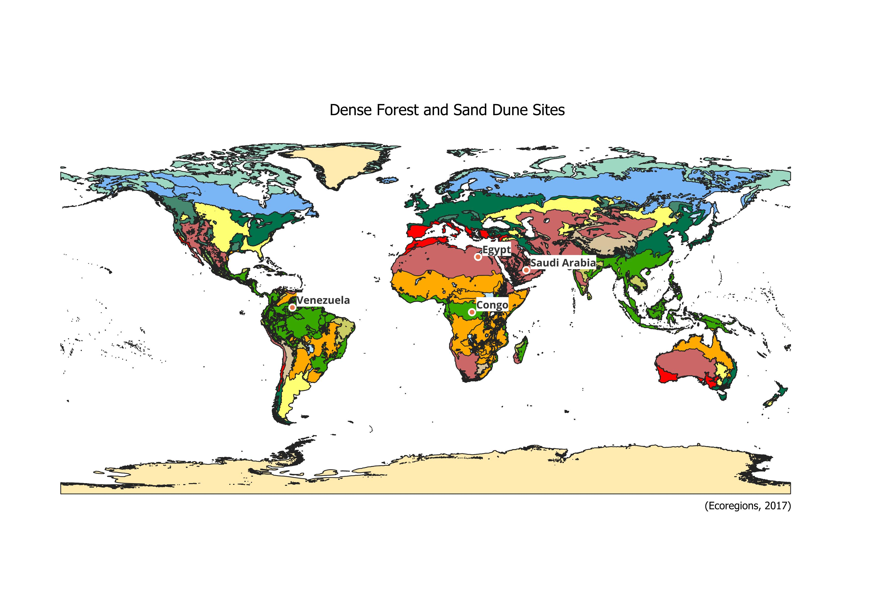
Sites
Notes:
This slide may not be needed…

Slide 27
The scope
We want to define a set of automatic tie point algorithms for global processing of satellite images. We aim to test matching algorithms on a variety of imagery contents.
The tests should:
Sample the biomes of Earth’s surface
Extend through time as much as possible
Include urban/human settlements types
Have quantifiable performance metrics in the absence of truth data

