Slide 1


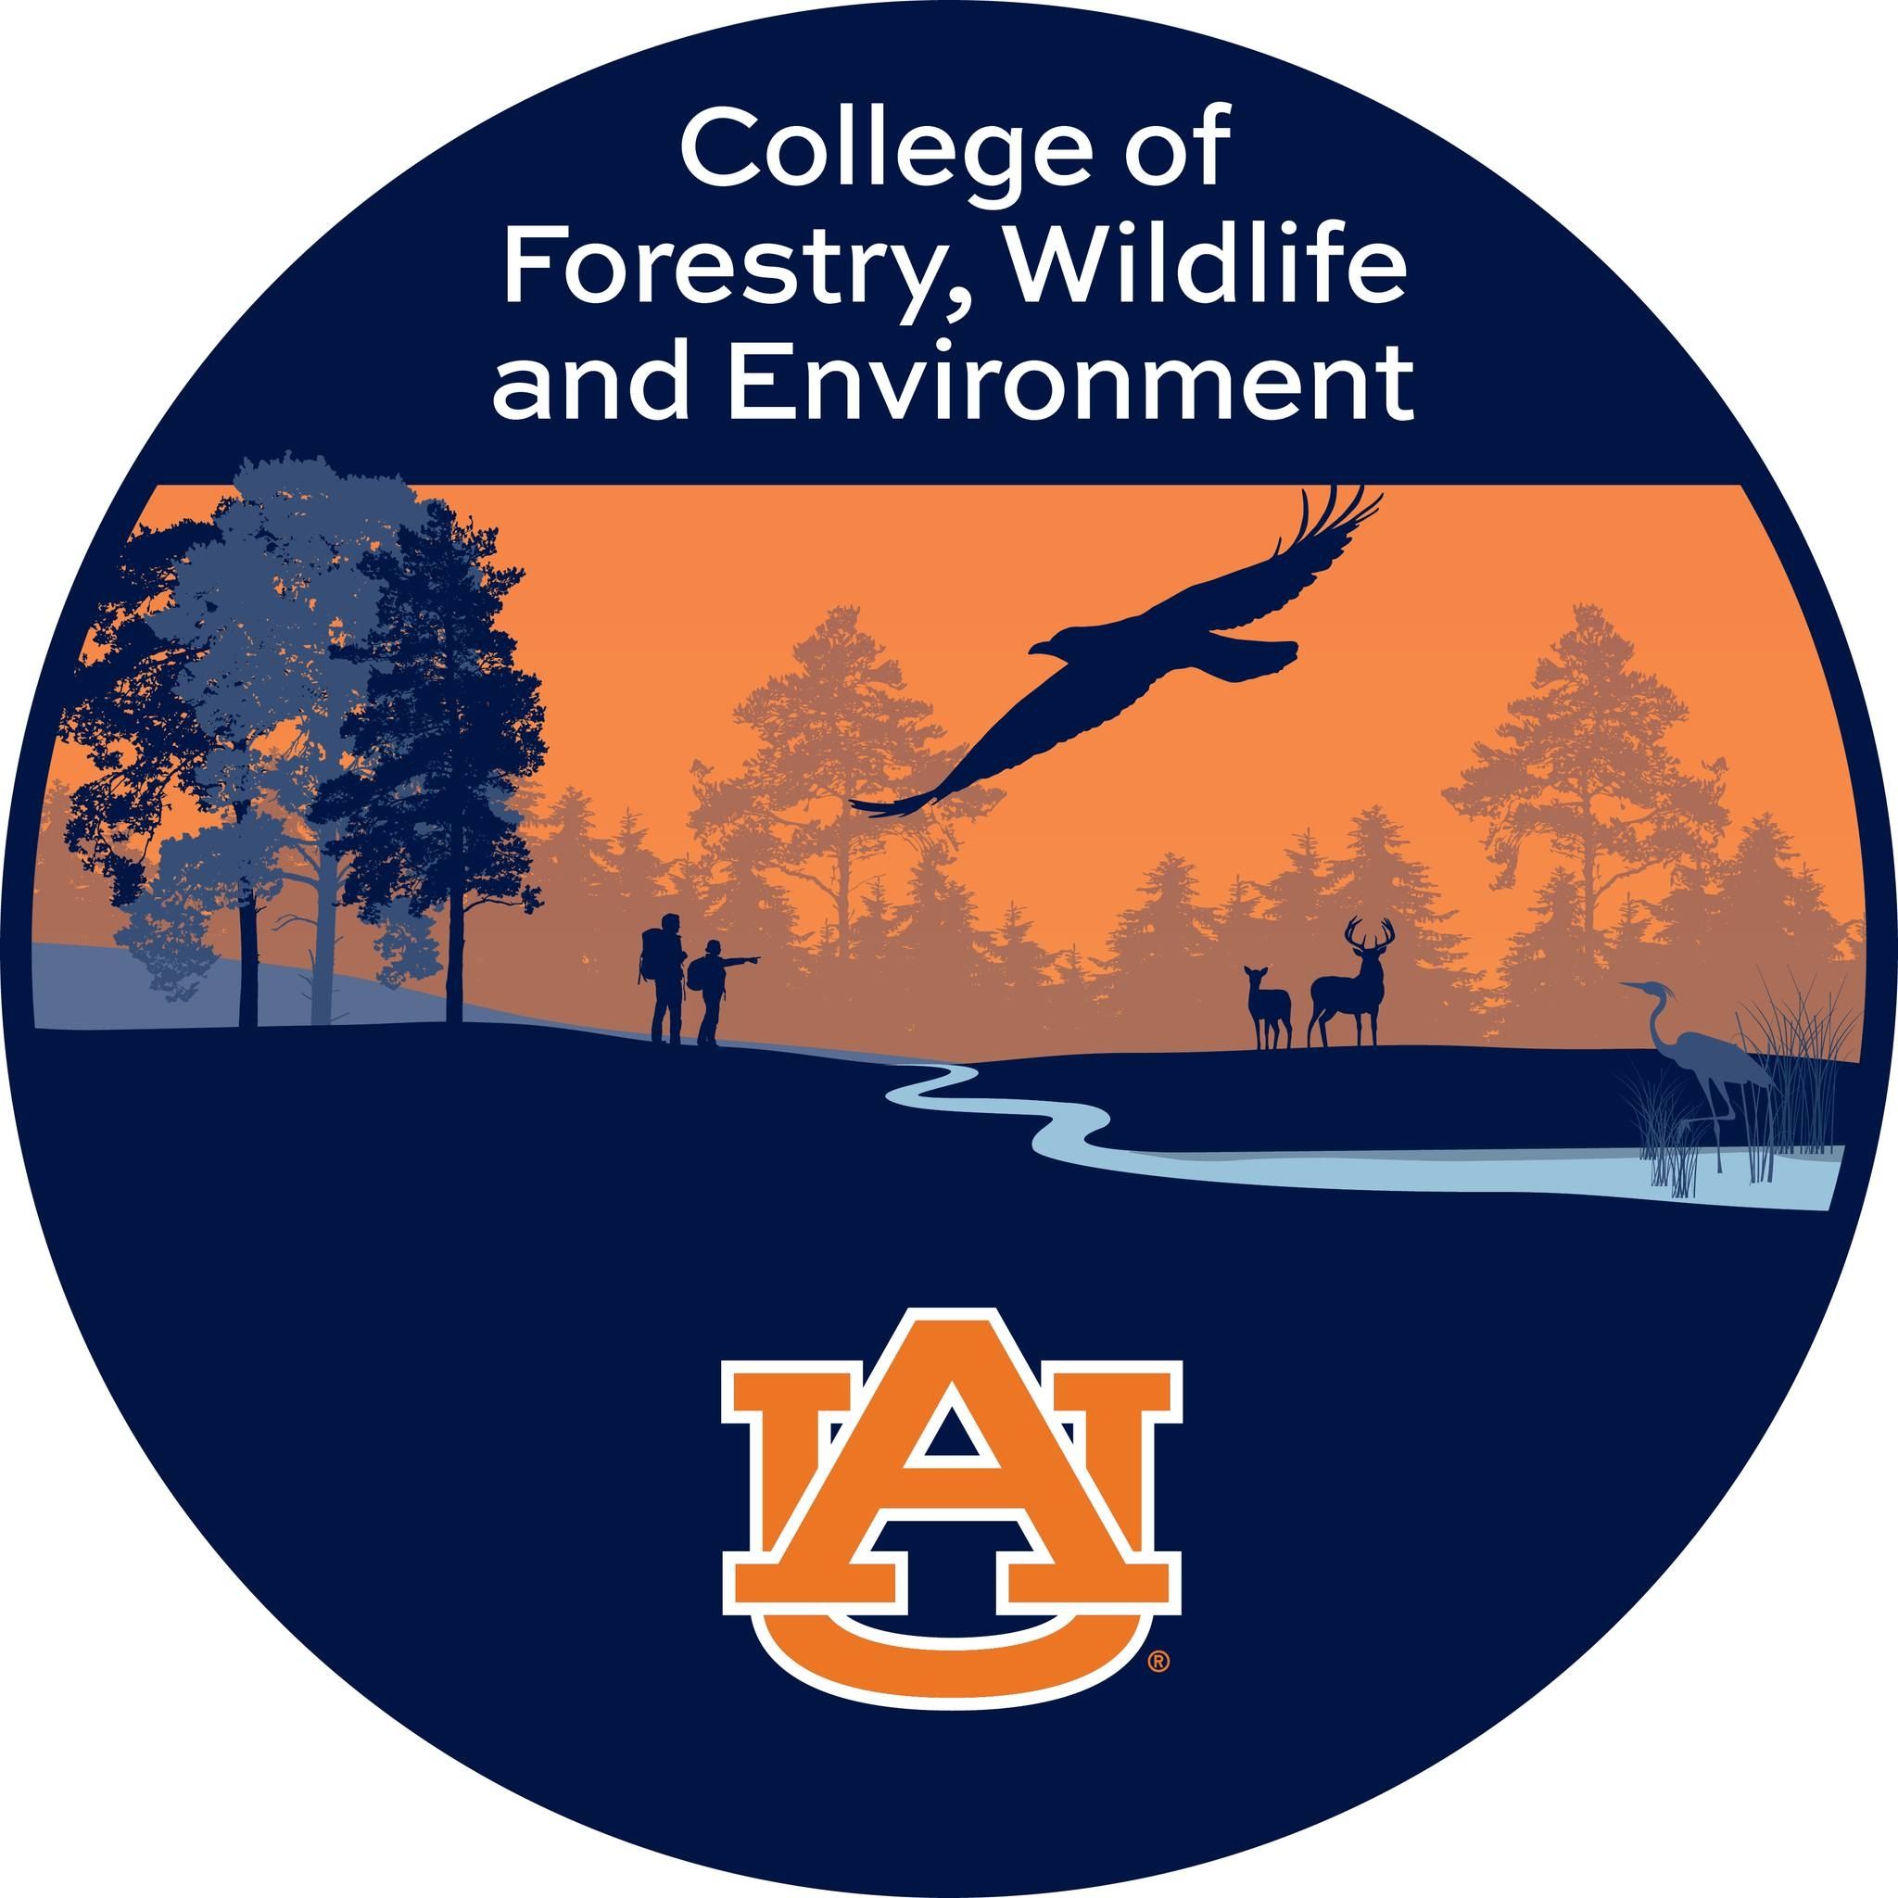
A bibliometric analysis of remote sensing applications for Brown Spot Needle Blight detection
ASPRS Mid-South Region Conference 2025
Date: 04/25/2025
Doctoral Advisor
Dr Lana L. Narine, Associate Professor
Geospatial Analytics Lab,
College of Forestry, Wildlife and Environment,
Auburn University
Presented by
Swati Singh, PhD Candidate
Geospatial Analytics Lab
College of Forestry, Wildlife and Environment
Auburn University
1

Slide 2
Introduction
What is Brown Spot Needle Blight?
Brown Spot Needle Blight (BSNB) poses a significant threat to loblolly pine (Pinus taeda) forests in the southeastern United States, with outbreaks reported in 36 of Alabama’s 67 counties (Alabama Forest Commission, 2022).
The disease continues to spread, necessitating quarantine measures and early detection strategies for effective management.
Surveys are essential for pathogen detection and support phytosanitary and forest management efforts (Hartmann et al., 2022). However, traditional survey methods, while effective, are spatially limited and subject to assessor variability (Cao et al., 2022).
Remote Sensing (RS) offers a complementary approach to field-based methods, enabling broader and more consistent monitoring than ground-based assessments.
RS techniques have been applied to detect and map Dothistroma Needle Blight (DNB) and Pine Wilt Disease (PWD), but research on RS-based BSNB detection remains limited.
Bibliometric analysis helps assess the existing literature, identifying trends, methodological approaches, and gaps in BSNB monitoring. This study evaluates how RS has been utilized for BSNB detection and highlights areas for further investigation.
2

Slide 3
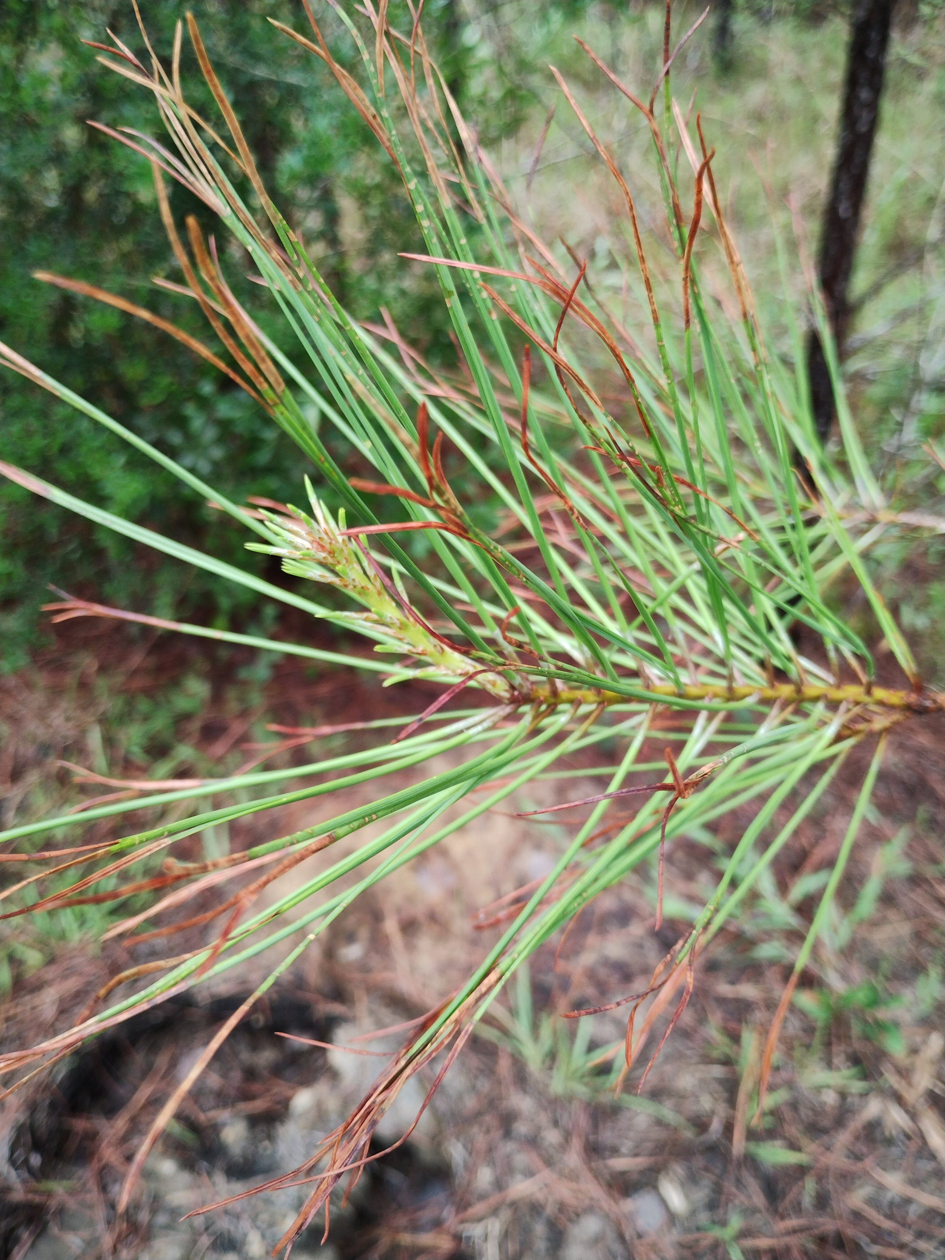
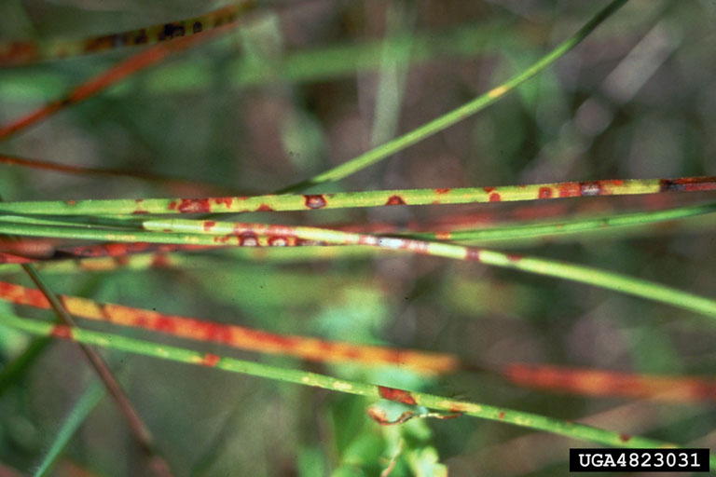
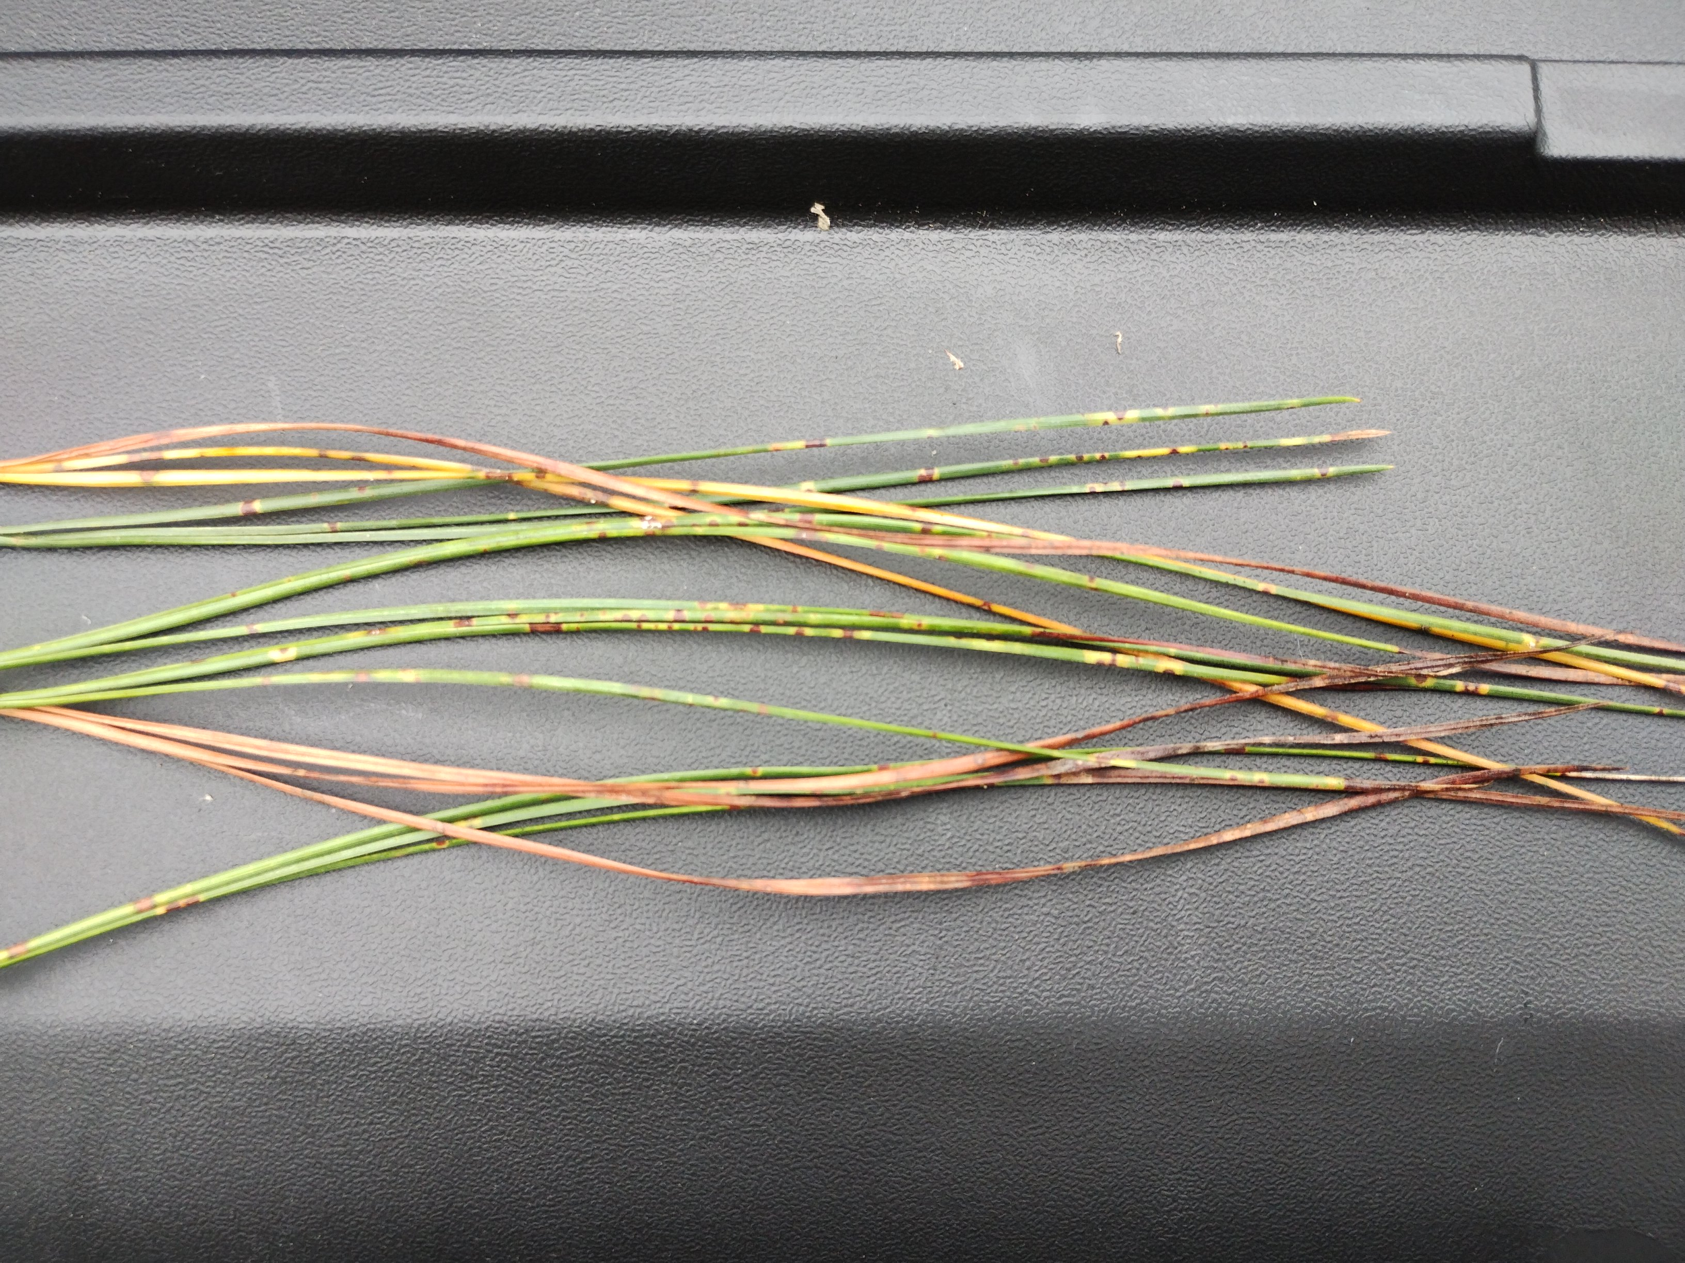
BSNB Symptomology
How does it look?
BSNB symptoms initially manifests as chlorotic flecks on needles, which later develop into resin-soaked necrotic lesions. As the infection advances, needles turn brown and are prematurely shed, leading to defoliation.
Disease symptoms characterized by irregular, frequent brown spots and bands caused by BSNB.
a
b
Figure 1. Symptoms of Brown Spot Needle Blight (Lecanosticta acicola) on loblolly pine (Pinus taeda). (a) Close-up of infected needles showing chlorotic flecks, necrotic lesions, and browning.(b) Field observation of a symptomatic tree displaying needle discoloration, lesion formation, and defoliation.
3

Slide 4
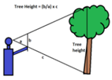
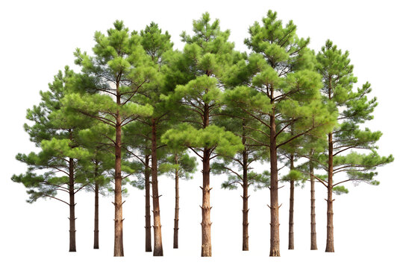
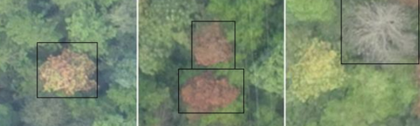
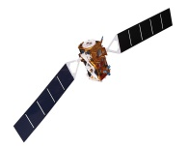

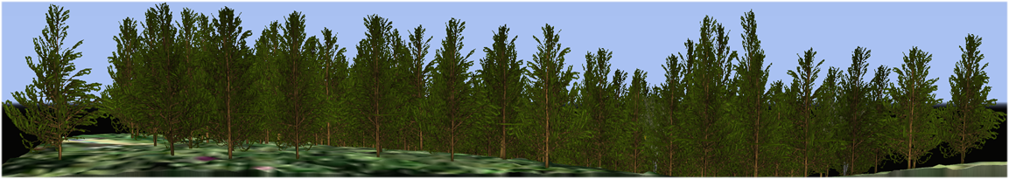
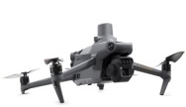
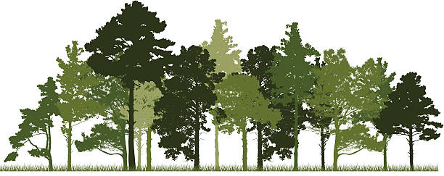
Problem Statement
Why Remote Sensing?
Traditional Methods
(Ground-based assessments)
Challenges
(Labor-intensive, time-consuming, small scale)
Remote Sensing
(Multi-source data)
Goal
(Enhanced monitoring, early intervention)
Spaceborne
Incident light sensors
Airborne
Crown-condition classification
(U.S. Forest Service, 1990)
Not provide comprehensive coverage
(Schnebele et al. 2015)
Unmanned Aerial Vehicle (UAV)
BSNB Distribution Map
Ambient Light
Multisource Remote Sensing
(Lausch et al. 2018; Zhang et al. 2019; Han et al. 2022)
4

Slide 5
Study Objective and Research Questions
Lecanosticta acicola presents economic and ecological challenges, highlighting the need for early detection and monitoring strategies. This study examines the potential of remote sensing for identifying and tracking BSNB symptoms.
Key research questions:
(i) To what extent can remote sensing be applied for BSNB detection and monitoring?
(ii) What are the advantages and limitations of RS in other pine needle disease studies, and how can these inform BSNB research?
5

Slide 6
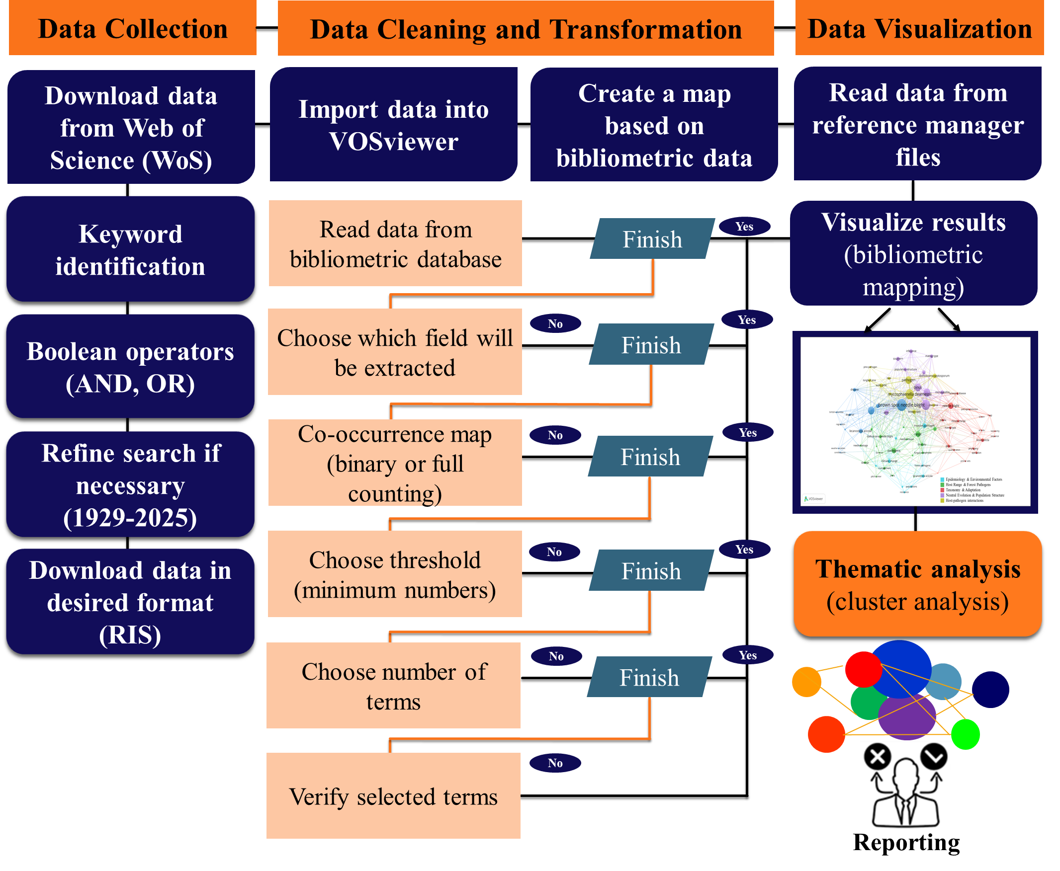
Methodology
Figure 3. Methodology Flowchart.
6

Slide 7
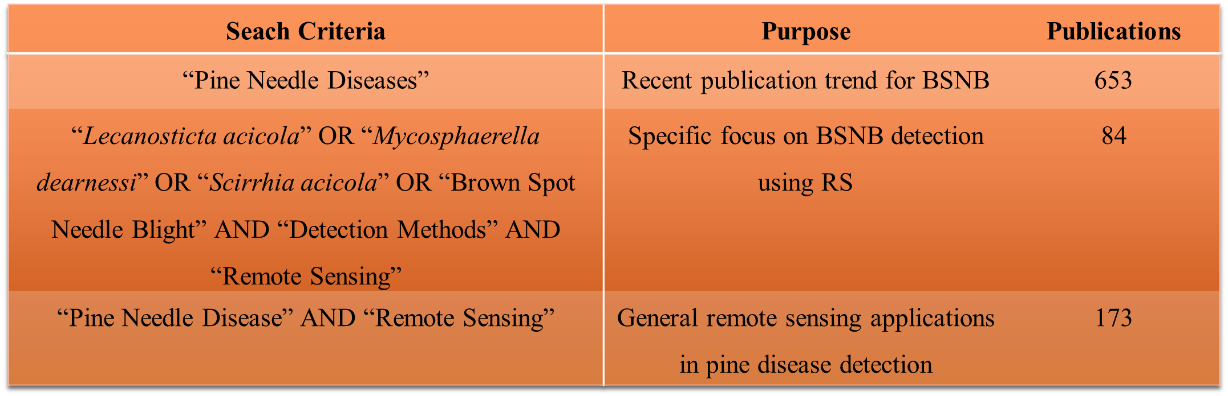
Methodology
Table 1. Search criteria and publication results.
7

Slide 8
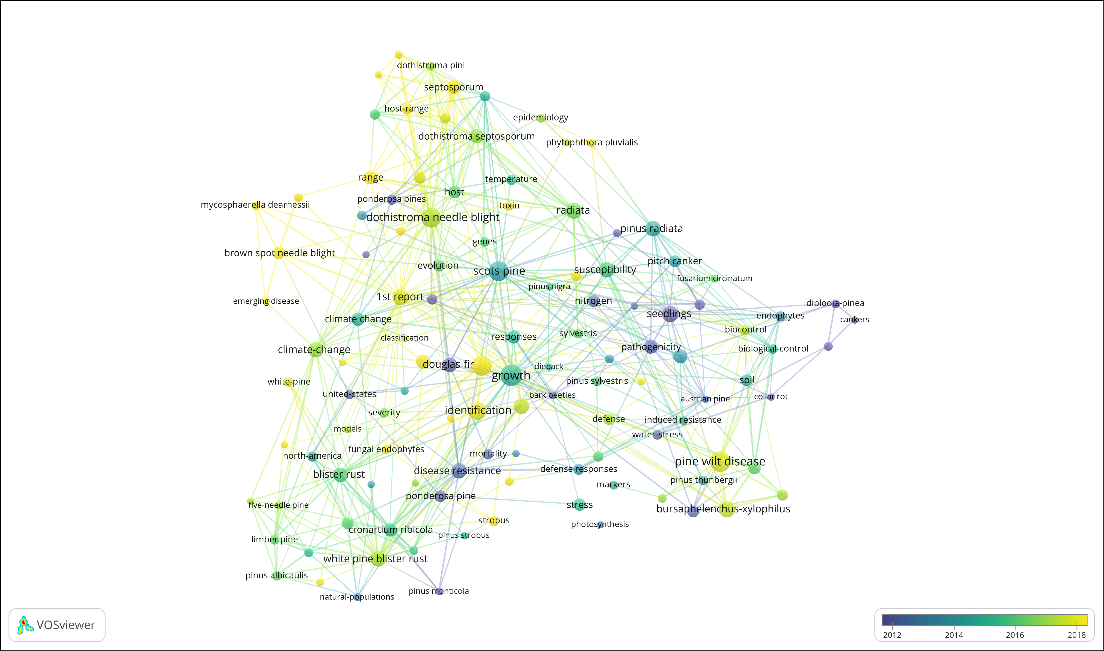
Results
Figure 3. Bibliometric network visualization of needle disease research trends.
8

Slide 9
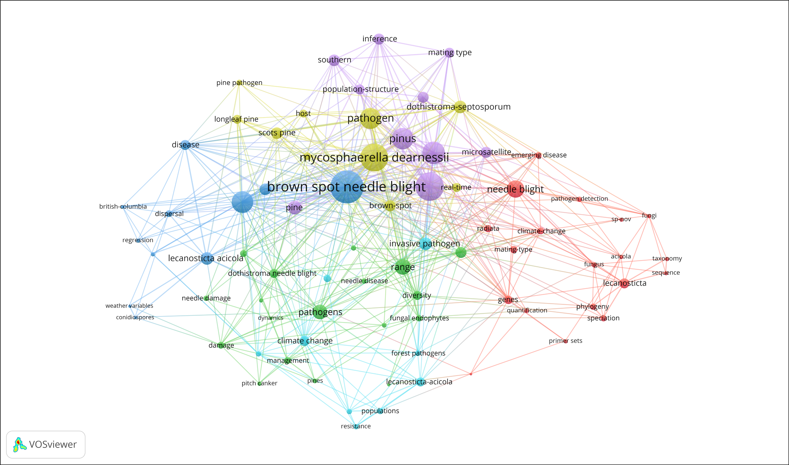
Results
Epidemiology & Environmental Factors
Host Range & Forest Pathogens
Taxonomy & Adaptation
Neutral Evolution & Population Structure
Host-pathogen interactions
Figure 4. Co-occurrence Network of BSNB Research.
9

Slide 10
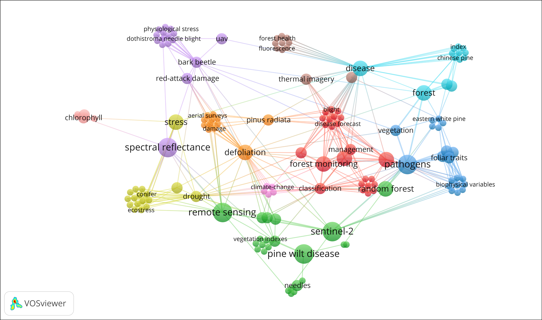
Results
Figure 5. Remote sensing applications in the study of pine needle diseases.
10

Slide 11
Conclusions
Bibliometric analysis shows limited research on RS applications for BSNB detection, despite its established use in Dothistroma Needle Blight and Pine Wilt Disease studies.
RS-based approaches for DNB detection have demonstrated effective utilization of spectral data, while PWD monitoring has integrated machine learning techniques for improved classification accuracy.
Although geospatial analysis has been applied to BSNB in climate studies, its integration with RS for direct disease detection and monitoring remains unexplored.
Combining RS-based classification and machine learning methods could enhance early detection and tracking of BSNB, providing a more comprehensive approach to disease management.
This study highlights the need for future research to optimize RS-based methodologies, refine predictive models, and integrate multi-source data to improve BSNB monitoring and risk assessment.
11

Slide 12
Selected References
Cao, Y., Feng, W., Quan, Y., Bao, W., Dauphin, G., Ren, A., ... & Xing, M. (2022). Forest disaster detection method based on ensemble spatial–spectral genetic algorithm. IEEE Journal of Selected Topics in Applied Earth Observations and Remote Sensing, 15, 7375-7390.
Han, Z., Hu, W., Peng, S., Lin, H., Zhang, J., Zhou, J., ... & Dian, Y. (2022). Detection of standing dead trees after pine wilt disease outbreak with airborne remote sensing imagery by multi-scale spatial attention deep learning and Gaussian kernel approach. Remote Sensing, 14(13), 3075.
Hartmann, H., Bastos, A., Das, A. J., Esquivel-Muelbert, A., Hammond, W. M., Martínez-Vilalta, J., ... & Allen, C. D. (2022). Climate change risks to global forest health: emergence of unexpected events of elevated tree mortality worldwide. Annual Review of Plant Biology, 73(1), 673-702.
Lausch, A., Borg, E., Bumberger, J., Dietrich, P., Heurich, M., Huth, A., ... & Schaepman, M. E. (2018). Understanding forest health with remote sensing, part III: requirements for a scalable multi-source forest health monitoring network based on data science approaches. Remote sensing, 10(7), 1120.
Schnebele, E., Tanyu, B. F., Cervone, G., & Waters, N. J. E. T. R. R. (2015). Review of remote sensing methodologies for pavement management and assessment. European Transport Research Review, 7, 1-19.
Van Der Nest, A., Wingfield, M. J., Janoušek, J., & Barnes, I. (2019). Lecanosticta acicola: A growing threat to expanding global pine forests and plantations. Molecular Plant Pathology, 20(10), 1327-1364.
Zhang, C., & Kovacs, J. M. (2012). The application of small unmanned aerial systems for precision agriculture: a review. Precision agriculture, 13, 693-712.
12

Slide 13
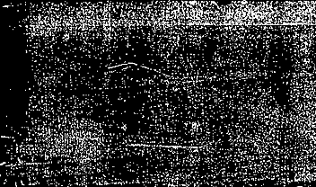

Acknowledgements
This research is supported by the U.S. Forest Service, whose contributions we gratefully acknowledge.
Thank you
Question & Suggestions??
13

