Slide 1

Remote Sensing of Chlorophyll-a in Rivers: A Comprehensive Literature Review
Anna Sherrill, Nicklaus Kuntzman, Maia Shields, Connor Firat, and Azad Hossain
Department of Biology, Geology, and Environmental Science | UTC Geological and Environmental Remote Sensing Laboratory
University of Tennessee at Chattanooga
2025 ASPRS Mid-South Conference
April 24th 2025
In-Person at ORNL

Slide 2
About the Project
Developing Models to Study Water Quality in the Tennessee River Using Remote Sensing
The comprehensive literature review that is the focus of this presentation is a part of a currently on-going project. The project is being carried out by a team of researchers at the University of Tennessee at Chattanooga Geological and Environmental Remote Sensing Laboratory (GERS Lab) as part of the NASA ROSES Research Initiation Award Program.
The goal of the research is to develop models to estimate and quantify water quality parameters such as turbidity and chlorophyll in the Tennessee River, along the city of Chattanooga. Since there are currently no existing models for chlorophyll estimation for the Tennessee River, a comprehensive literature review was carried out. This creates a basis for modelling and ensures that an understanding of remotely sensing chlorophyll in complex waters such as rivers is gained.

Slide 3
Contents
Remote Sensing of Chlorophyll-a in Rivers: A Comprehensive Literature Review
The literature review consists of a collection of 90+ sources relating to the remote sensing of water quality, remote sensing of chlorophyll, history of remotely sensing WQP’s, and future applications. The presentation is organized as follows:
Review of the Remote Sensing of Water Quality Parameters (WQP’s)
Review of Chlorophyll-a and its implications
Review of the complexities of remotely sensing chlorophyll-a in inland waters
Discussion of existing chlorophyll-a estimation models for inland waters
Future applications and conclusion
Acknowledgements

Slide 4
Remote Sensing of Water Quality Parameters
Remote Sensing of Chlorophyll-a in Rivers: A Comprehensive Literature Review
The remote sensing of water quality parameters has become increasingly important as anthropogenic activities such as pollution, overexploitation, and destruction have severely threatened the existence of clean and safe water systems.
The use of remote sensing as a means for water quality research can be dated back to 1974, when Robert C. Wrigley and Alexander J. Horne [1] utilized multispectral photography to highlight infrared activity and algal concentrations. Utilizing remote sensing techniques, the researchers were able to create an “aerial photographic technique” for surface blooms.
The use of remote sensing techniques to quantify WQP’s has only increased overtime as it offers an accessible, accurate, and affordable solution to the ever-growing concerns of water quality.
1. Wrigley, R.C. and A.J. Horne, Remote sensing and lake eutrophication. Nature (London), 1974. 250(5463): p. 213-214.

Slide 5
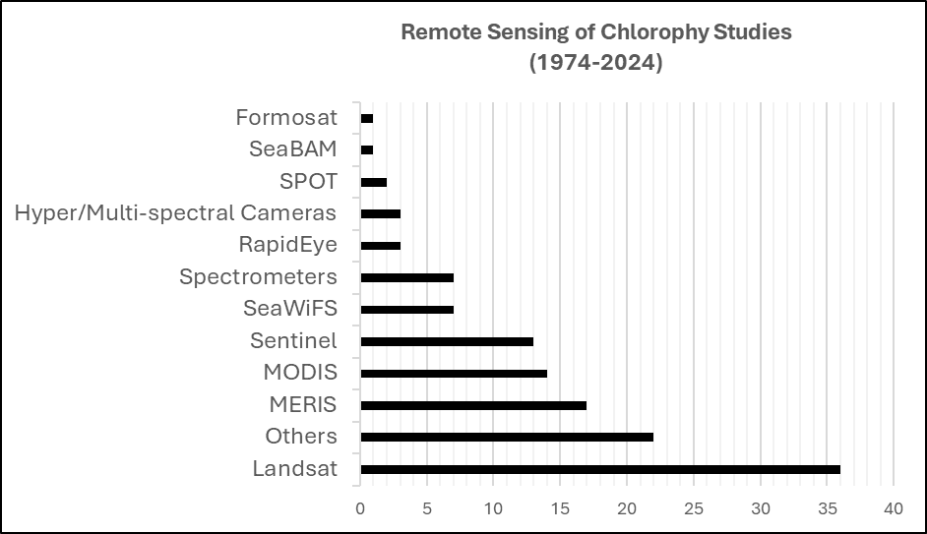
Remote Sensing of Water Quality Parameters
Remote Sensing of Chlorophyll-a in Rivers: A Comprehensive Literature Review
Water quality studies utilizing remote sensing have been done using a wide range of satellites and data points. The project that this literature review is a part of is focusing on NASA’s Landsat 8/9 satellites, however, the literature review included a range of different satellites to ensure that there was a variety of models being studied. Satellites/data sources that were in the reviewed literatures included Landsat, MERIS, MODIS, Sentinel-2, SeaWiFS, RapidEye, and more [2-8]
2. Hellweger, F.L., et al., Use of satellite imagery for water quality studies in New York Harbor. Estuarine, coastal and shelf science, 2004. 61(3): p. 437-448.
3. Mishra, S., R.P. Stumpf, and A. Meredith, Evaluation of RapidEye data for mapping algal blooms in inland waters. International Journal of Remote Sensing, 2019. 40(7): p. 2811-2829.
4. Wang, F., et al., Applications of Landsat‐5 TM imagery in assessing and mapping water quality in Reelfoot Lake, Tennessee. International Journal of Remote Sensing, 2006. 27(23): p. 5269-5283.
5. Ouma, Y.O., K. Noor, and K. Herbert, Modelling Reservoir Chlorophyll-a, TSS, and Turbidity Using Sentinel-2A MSI and Landsat-8 OLI Satellite Sensors with Empirical Multivariate Regression. Journal of Sensors, 2020. 2020: p. 1-21.
6. Del Castillo, C.E. and R.L. Miller, On the use of ocean color remote sensing to measure the transport of dissolved organic carbon by the Mississippi River Plume. Remote Sensing of Environment, 2008. 112(3): p. 836-844.
7. Härmä, P., et al., Detection of water quality using simulated satellite data and semi-empirical algorithms in Finland. The Science of the total environment, 2001. 268(1): p. 107-121.
8. Lee, Z., et al., Determination of primary spectral bands for remote sensing of aquatic environments. Sensors (Basel, Switzerland), 2007. 7(12): p. 3428-3441.

Slide 6
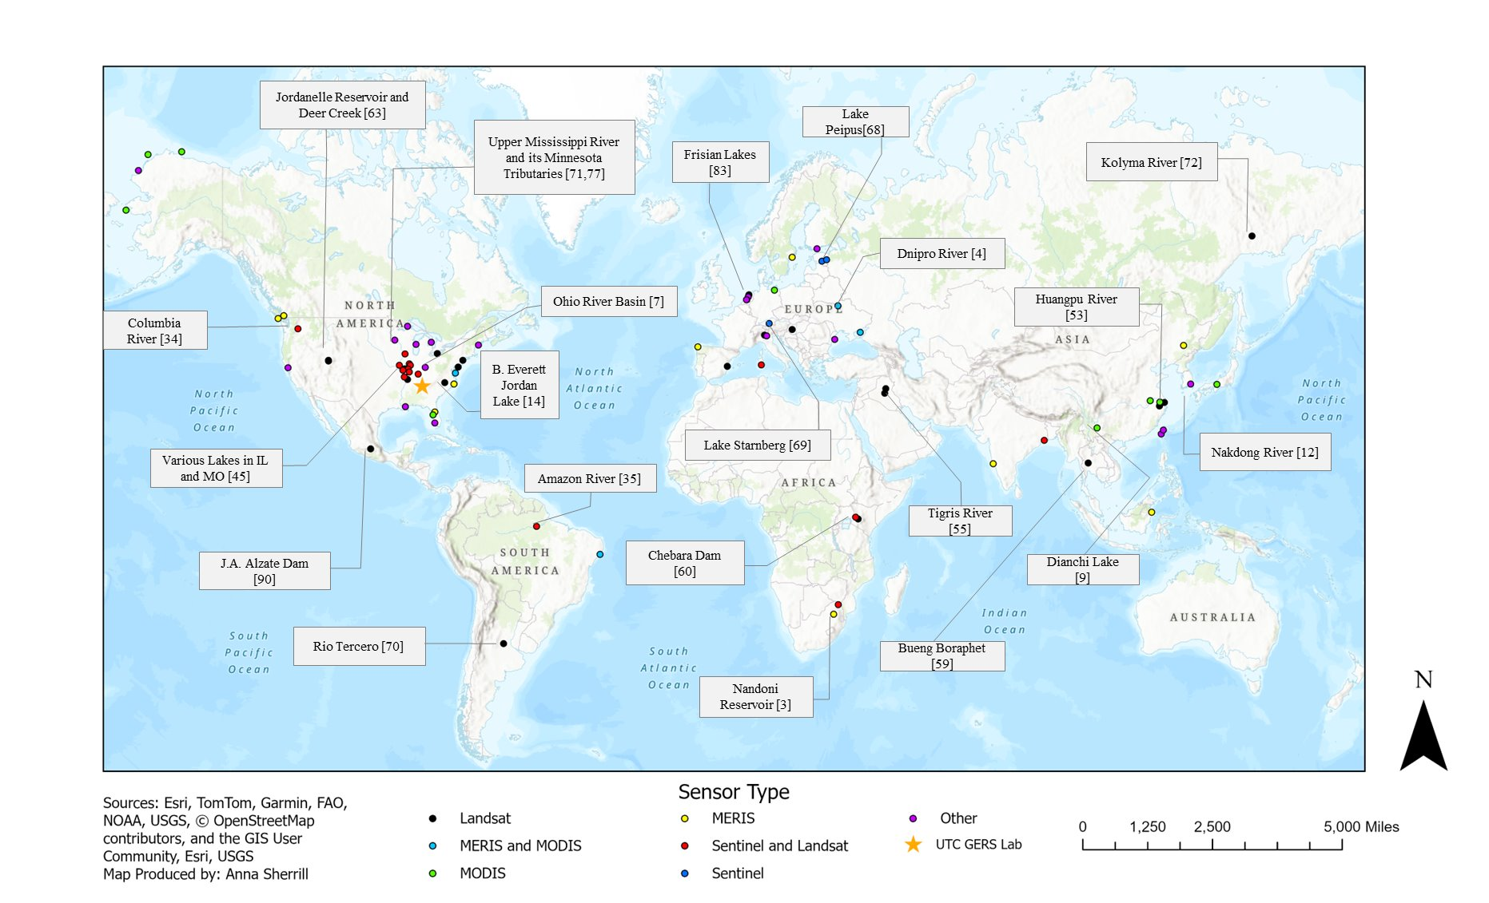
Remote Sensing of Water Quality Parameters
Remote Sensing of Chlorophyll-a in Rivers: A Comprehensive Literature Review
Global Distribution of Reviewed Literature:

Slide 7
Remote Sensing of Water Quality Parameters
Remote Sensing of Chlorophyll-a in Rivers: A Comprehensive Literature Review
Each data source has strengths and weaknesses, which is why it is important to understand the capabilities of each respective source. Satellites are popularly used due to their various spatial capabilities, sensors, and resolutions that can be catered to researchers needs. Satellite imagery can allow for monitoring in a variety of study sites such as remote areas and can offer historical data as well [9] .
In order to ensure accurate water quality estimation models, researchers emphasize the importance of season specific models, real-time in-situ measurements, and statistical analysis such as regressions. These are important due to the optically complex nature of bodies of water such as rivers. It is also important that variables such as atmospheric correction, band width, sensor capabilities, site characteristics, and characteristics of the variable being measured/estimated are considered to prevent inaccuracies [8][10-17].
WQP’s that are commonly measured using remote sensing include: CDOM, TSS, SDT, Turbidity, and Chlorophyll-a.
8. Lee, Z., et al., Determination of primary spectral bands for remote sensing of aquatic environments. Sensors (Basel, Switzerland), 2007. 7(12): p. 3428-3441.
9. Ogashawara, I. and M.J. Moreno-Madrinan, Improving Inland Water Quality Monitoring through Remote Sensing Techniques. ISPRS international journal of geo-information, 2014. 3(4): p. 1234-1255.
10. Sagan, V., et al., Monitoring inland water quality using remote sensing; potential and limitations of spectral indices, bio-optical simulations, machine learning, and cloud computing. Earth-science reviews, 2020. 205: p. 103187.
11. Ambarwulan, W., et al., Estimating specific inherent optical properties of tropical coastal waters using bio-optical model inversion and in situ measurements: case of the Berau estuary, East Kalimantan, Indonesia. Hydrobiologia, 2011. 658(1): p. 197-211.
12. Chu, H.-J., S.-J. Kong, and C.-H. Chang, Spatio-temporal water quality mapping from satellite images using geographically and temporally weighted regression. ITC journal, 2018. 65: p. 1-11.
13. Hansen, C.H., et al., Reservoir water quality monitoring using remote sensing with seasonal models: case study of five central-Utah reservoirs. Lake and Reservoir Management, 2015. 31(3): p. 225-240.
14. Menken, K.D., P.L. Brezonik, and M.E. Bauer, Influence of Chlorophyll and Colored Dissolved Organic Matter (CDOM) on Lake Reflectance Spectra: Implications for Measuring Lake Properties by Remote Sensing. Lake and Reservoir Management, 2006. 22(3): p. 179-190.
15. Hu, C., K.L. Carder, and F.E. Muller-Karger, Atmospheric Correction of SeaWiFS Imagery over Turbid Coastal Waters: A Practical Method. Remote sensing of environment, 2000. 74(2): p. 195-206.
16. Mouw, C.B., et al., Aquatic color radiometry remote sensing of coastal and inland waters: Challenges and recommendations for future satellite missions. Remote sensing of environment, 2015. 160: p. 15-30.
17. Pahlevan, N., et al., Sentinel-2/Landsat-8 product consistency and implications for monitoring aquatic systems. Remote sensing of environment, 2019. 220: p. 19-29.

Slide 8
Review of Chlorophyll-a
Remote Sensing of Chlorophyll-a in Rivers: A Comprehensive Literature Review
It is important to understand why the remote sensing of chlorophyll-a is important, as well as the implications that chlorophyll-a has on our aquatic ecosystems [18-21].
Chlorophyll-a is a necessary compound in the productivity of plants and algae
Chlorophyll-a is unique in its blue-green appearance.
Large concentrations of toxic cyanobacteria (blue-green algae) can pose human health hazards such as liver damage, liver cancer, or even neurotoxicity.
Most species of algae are not harmful and are vital to aquatic ecosystems, however, algal blooms can wreak havoc on ecosystems by depleting organisms of sunlight.
Anthropogenically induced eutrophication of freshwaters can have harmful effects on ecosystems, human health, and our economy.
Eutrophication can negatively impact recreational water usage, real estate, increased spending on t + e species recovery, and drinking water.
Increased concentrations of Chlorophyll-a can be an early indicator of potentially harmful algal blooms and eutrophication.
18. Agrawal, A. and K. Gopal, Toxic Cyanobacteria in Water and Their Public Health Consequences. 2012, Springer India: India. p. 135-147.
19. Dodds, W.K., et al., Eutrophication of U.S. Freshwaters: Analysis of Potential Economic Damages. Environmental science & technology, 2009. 43(1): p. 12-19.
20. Smith, V.H., Eutrophication of freshwater and coastal marine ecosystems - A global problem. Environmental science and pollution research international, 2003. 10(2): p. 126-139.
21. Ingrid Chorus, I.R.F.H., HEALTH RISKS CAUSED BY FRESHWATER CYANOBACTERIA IN RECREATIONAL WATERS. Journal of Toxicology and Environmental Health, Part B, 2000. 3(4): p. 323-347.

Slide 9
Remote Sensing of Chlorophyll - Inland Waters
Remote Sensing of Chlorophyll-a in Rivers: A Comprehensive Literature Review
The estimation and quantification of chlorophyll-a for inland waters using remote sensing is increasingly more complex than that of oceans [22, 23]. There are many studies utilizing existing models for chlorophyll estimation in oceans. Remote sensing of chlorophyll-a in inland waters such as rivers can be difficult due to several factors such as:
Smaller spatial scales (Often less than 100km)
High levels of biodiversity
Increased sensitivity to anthropogenic activity
High production levels
Elevated turbidity
Ever-changing chemical processes
As inland bodies of waters such as rivers become threatened, researchers have begun to contribute more towards the remote sensing of chlorophyll-a and other WQP’s in rivers [24-28].
22. Hestir, E.L., et al., Measuring freshwater aquatic ecosystems: The need for a hyperspectral global mapping satellite mission. Remote sensing of environment, 2015. 167: p. 181-195.
23. Kuhn, C., et al., Performance of Landsat-8 and Sentinel-2 surface reflectance products for river remote sensing retrievals of chlorophyll-a and turbidity. Remote Sensing of Environment, 2019. 224(224): p. 104-118.
24. Mpakairi, K.S., et al., Chlorophyll-a unveiled: unlocking reservoir insights through remote sensing in a subtropical reservoir. Environmental Monitoring and Assessment, 2024. 196(4).
25. Choe, E., J.-W. Lee, and S.-U. Cheon, Monitoring and modelling of chlorophyll-a concentrations in rivers using a high-resolution satellite image: a case study in the Nakdong river, Korea. International Journal of Remote Sensing, 2015. 36(6): p. 1645-1660.
26. Tsukamoto, H., et al., An Assessment of Chlorophyll a Concentration using Satellite Remote Sensing in Lake Biwa. Journal of The Remote Sensing Society of Japan, 2019. 39(2): p. 103-111.
27. Brezonik, P., K.D. Menken, and M. Bauer, Landsat-based Remote Sensing of Lake Water Quality Characteristics, Including Chlorophyll and Colored Dissolved Organic Matter (CDOM). Lake and Reservoir Management, 2005. 21(4): p. 373-382.
28. Lins, R.C., et al., Assessment of Chlorophyll-a Remote Sensing Algorithms in a Productive Tropical Estuarine-Lagoon System. Remote sensing (Basel, Switzerland), 2017. 9(6): p. 516.

Slide 10
Remote Sensing of Chlorophyll - Inland Waters
Remote Sensing of Chlorophyll-a in Rivers: A Comprehensive Literature Review
Due to the optical properties of chlorophyll-a, and rivers, reflectance ratios must be narrowed down to ensure that the most accurate values are acquired for the prediction model. A review of the selected literature revealed the following:
Reflectance ratios gathered from the 380-800nm range produced the most accurate derivation of major water properties such as phytoplankton biomass, CDOM, suspended sediments, and bottom properties [8].
Reflectance ratios ranging from 704nm to 672nm establish strong relationships to chlorophyll-a in shallow and eutrophic freshwater, as well as deep water lakes [29].
Reflectance ratios at 700nm-670nm were found to be a strong predictor of chlorophyll-a in a wide range of water bodies including those that are high in turbidity and CDOM [14].
Models developed utilizing the band ratios discussed above have proven to be successful across various satellites and data sources such as MERIS, MODIS, Landsat, and Sentinel [7,30].
7. Härmä, P., et al., Detection of water quality using simulated satellite data and semi-empirical algorithms in Finland. The Science of the total environment, 2001. 268(1): p. 107-121.
8. Lee, Z., et al., Determination of primary spectral bands for remote sensing of aquatic environments. Sensors (Basel, Switzerland), 2007. 7(12): p. 3428-3441.
14. Menken, K.D., P.L. Brezonik, and M.E. Bauer, Influence of Chlorophyll and Colored Dissolved Organic Matter (CDOM) on Lake Reflectance Spectra: Implications for Measuring Lake Properties by Remote Sensing. Lake and Reservoir Management, 2006. 22(3): p. 179-190.
29. Gons, H.J., Optical Teledetection of Chlorophyll a in Turbid Inland Waters. Environmental science & technology, 1999. 33(7): p. 1127-1132.
30. Gower, J., et al., Detection of intense plankton blooms using the 709 nm band of the MERIS imaging spectrometer. International Journal of Remote Sensing, 2005. 26(9): p. 2005-2012.

Slide 11
Existing Chl-a Estimation Models – Inland Waters
Remote Sensing of Chlorophyll-a in Rivers: A Comprehensive Literature Review
Although inland bodies of water are highly variable, existing chlorophyll-a estimation models can be looked at and analyzed to strengthen the model that is being developed. In the reviewed literature, there were several different existing models that resulted in the successful estimation/quantification of chlorophyll-a in freshwater, inland waters such as rivers, lakes, and reservoirs. Some of the models that were highlighted include:
Two-band models utilizing the NIR-Red ratio as well as ratios of 753:665, 708:665, and 720:670. Each of these models yielded successful results with relatively low RMSE values across different satellites [31-35]
Three-band models using Landsat’s bands 1,3, and 5 showed strong correlations, as well as three-band models utilizing the ratios of 665:708:753 and 675:695:730 [31,34,37].
Existing three-band models such as OC3M for MODIS have been shown to underestimate concentrations of chlorophyll-a, but correction for specific study sties can make these models more accurate [26].
Single band models such as those using Landsat’s TM band 3 have shown to have some accurate results [38].
26. Tsukamoto, H., et al., An Assessment of Chlorophyll a Concentration using Satellite Remote Sensing in Lake Biwa. Journal of The Remote Sensing Society of Japan, 2019. 39(2): p. 103-111.
31. Gilerson, A.A., et al., Algorithms for remote estimation of chlorophyll-a in coastal and inland waters using red and near infrared bands. Optics express, 2010. 18(23): p. 24109-24125.
32. Rundquist, D.C., et al., Remote measurement of algal chlorophyll in surface waters: the case for the first derivative of reflectance near 690 nm. Photogrammetric Engineering and Remote Sensing, 1996. 62(2): p. 195-200.
33. Chu, H.-J. and Y.-C. He, Remote sensing water quality inversion using sparse representation: Chlorophyll-a retrieval from Sentinel-2 MSI data. Remote sensing applications, 2023. 31: p. 101006.
34. Gitelson, A.A., J.F. Schalles, and C.M. Hladik, Remote chlorophyll- a retrieval in turbid, productive estuaries: Chesapeake Bay case study. Remote sensing of environment, 2007. 109(4): p. 464-472.
35. Tebbs, E.J., J.J. Remedios, and D.M. Harper, Remote sensing of chlorophyll-a as a measure of cyanobacterial biomass in Lake Bogoria, a hypertrophic, saline–alkaline, flamingo lake, using Landsat ETM. Remote sensing of environment, 2013. 135: p. 92-106.
36. Giardino, C., et al., Detecting chlorophyll, Secchi disk depth and surface temperature in a sub-alpine lake using Landsat imagery. The Science of the total environment, 2001. 268(1): p. 19-29.
37. Tyler, A.N., et al., Remote sensing of the water quality of shallow lakes: A mixture modelling approach to quantifying phytoplankton in water characterized by high‐suspended sediment. International Journal of Remote Sensing, 2006. 27(8): p. 1521-1537.
38. Keith, D., et al., Monitoring algal blooms in drinking water reservoirs using the Landsat-8 Operational Land Imager. International Journal of Remote Sensing, 2018. 39(9): p. 2818-2846.

Slide 12
Future Applications and Conclusions
Remote Sensing of Chlorophyll-a in Rivers: A Comprehensive Literature Review
The comprehensive review of literature revolving around the remote sensing of chlorophyll-a in freshwater inland bodies of water can help guide the creation of new estimation models in these complex waters. The review helps establish a background on remote sensing, the remote sensing of WQP’s, and the remote sensing of Chlorophyll-a.
The application of remote sensing to quantify chlorophyll-a in freshwater rivers can help provide important functions such as:
Early detection of eutrophication and harmful algal blooms
Help assess the overall health of the aquatic ecosystem
Help classify the trophic condition of the river
Track algal growth and productivity
Aid in the monitoring of overall water quality

Slide 13
Sources Cited in this Presentation
Remote Sensing of Chlorophyll-a in Rivers: A Comprehensive Literature Review
Wrigley, R.C. and A.J. Horne, Remote sensing and lake eutrophication. Nature (London), 1974. 250(5463): p. 213-214.
Hellweger, F.L., et al., Use of satellite imagery for water quality studies in New York Harbor. Estuarine, coastal and shelf science, 2004. 61(3): p. 437-448.
Mishra, S., R.P. Stumpf, and A. Meredith, Evaluation of RapidEye data for mapping algal blooms in inland waters. International Journal of Remote Sensing, 2019. 40(7): p. 2811-2829.
Wang, F., et al., Applications of Landsat‐5 TM imagery in assessing and mapping water quality in Reelfoot Lake, Tennessee. International Journal of Remote Sensing, 2006. 27(23): p. 5269-5283.
Ouma, Y.O., K. Noor, and K. Herbert, Modelling Reservoir Chlorophyll-a, TSS, and Turbidity Using Sentinel-2A MSI and Landsat-8 OLI Satellite Sensors with Empirical Multivariate Regression. Journal of Sensors, 2020. 2020: p. 1-21
Del Castillo, C.E. and R.L. Miller, On the use of ocean color remote sensing to measure the transport of dissolved organic carbon by the Mississippi River Plume. Remote Sensing of Environment, 2008. 112(3): p. 836-844.
Härmä, P., et al., Detection of water quality using simulated satellite data and semi-empirical algorithms in Finland. The Science of the total environment, 2001. 268(1): p. 107-121.
Lee, Z., et al., Determination of primary spectral bands for remote sensing of aquatic environments. Sensors (Basel, Switzerland), 2007. 7(12): p. 3428-3441.
Ogashawara, I. and M.J. Moreno-Madrinan, Improving Inland Water Quality Monitoring through Remote Sensing Techniques. ISPRS international journal of geo-information, 2014. 3(4): p. 1234-1255.
Sagan, V., et al., Monitoring inland water quality using remote sensing; potential and limitations of spectral indices, bio-optical simulations, machine learning, and cloud computing. Earth-science reviews, 2020. 205: p. 103187.
Ambarwulan, W., et al., Estimating specific inherent optical properties of tropical coastal waters using bio-optical model inversion and in situ measurements: case of the Berau estuary, East Kalimantan, Indonesia. Hydrobiologia, 2011. 658(1): p. 197-211.
Chu, H.-J., S.-J. Kong, and C.-H. Chang, Spatio-temporal water quality mapping from satellite images using geographically and temporally weighted regression. ITC journal, 2018. 65: p. 1-11.
Hansen, C.H., et al., Reservoir water quality monitoring using remote sensing with seasonal models: case study of five central-Utah reservoirs. Lake and Reservoir Management, 2015. 31(3): p. 225-240.
Menken, K.D., P.L. Brezonik, and M.E. Bauer, Influence of Chlorophyll and Colored Dissolved Organic Matter (CDOM) on Lake Reflectance Spectra: Implications for Measuring Lake Properties by Remote Sensing. Lake and Reservoir Management, 2006. 22(3): p. 179-190.
Hu, C., K.L. Carder, and F.E. Muller-Karger, Atmospheric Correction of SeaWiFS Imagery over Turbid Coastal Waters: A Practical Method. Remote sensing of environment, 2000. 74(2): p. 195-206.
Mouw, C.B., et al., Aquatic color radiometry remote sensing of coastal and inland waters: Challenges and recommendations for future satellite missions. Remote sensing of environment, 2015. 160: p. 15-30.
Pahlevan, N., et al., Sentinel-2/Landsat-8 product consistency and implications for monitoring aquatic systems. Remote sensing of environment, 2019. 220: p. 19-29.
Agrawal, A. and K. Gopal, Toxic Cyanobacteria in Water and Their Public Health Consequences. 2012, Springer India: India. p. 135-147.
19. Dodds, W.K., et al., Eutrophication of U.S. Freshwaters: Analysis of Potential Economic Damages. Environmental science & technology, 2009. 43(1): p. 12-19.

Slide 14
Sources Cited in this Presentation
Remote Sensing of Chlorophyll-a in Rivers: A Comprehensive Literature Review
20. Smith, V.H., Eutrophication of freshwater and coastal marine ecosystems - A global problem. Environmental science and pollution research international, 2003. 10(2): p. 126-139.
21. Ingrid Chorus, I.R.F.H., HEALTH RISKS CAUSED BY FRESHWATER CYANOBACTERIA IN RECREATIONAL WATERS. Journal of Toxicology and Environmental Health, Part B, 2000. 3(4): p. 323-347.
Hestir, E.L., et al., Measuring freshwater aquatic ecosystems: The need for a hyperspectral global mapping satellite mission. Remote sensing of environment, 2015. 167: p. 181-195.
Kuhn, C., et al., Performance of Landsat-8 and Sentinel-2 surface reflectance products for river remote sensing retrievals of chlorophyll-a and turbidity. Remote Sensing of Environment, 2019. 224(224): p. 104-118.
Mpakairi, K.S., et al., Chlorophyll-a unveiled: unlocking reservoir insights through remote sensing in a subtropical reservoir. Environmental Monitoring and Assessment, 2024. 196(4).
Choe, E., J.-W. Lee, and S.-U. Cheon, Monitoring and modelling of chlorophyll-a concentrations in rivers using a high-resolution satellite image: a case study in the Nakdong river, Korea. International Journal of Remote Sensing, 2015. 36(6): p. 1645-1660.
Tsukamoto, H., et al., An Assessment of Chlorophyll a Concentration using Satellite Remote Sensing in Lake Biwa. Journal of The Remote Sensing Society of Japan, 2019. 39(2): p. 103-111.
Brezonik, P., K.D. Menken, and M. Bauer, Landsat-based Remote Sensing of Lake Water Quality Characteristics, Including Chlorophyll and Colored Dissolved Organic Matter (CDOM). Lake and Reservoir Management, 2005. 21(4): p. 373-382.
Lins, R.C., et al., Assessment of Chlorophyll-a Remote Sensing Algorithms in a Productive Tropical Estuarine-Lagoon System. Remote sensing (Basel, Switzerland), 2017. 9(6): p. 516.
Gons, H.J., Optical Teledetection of Chlorophyll a in Turbid Inland Waters. Environmental science & technology, 1999. 33(7): p. 1127-1132.
Gower, J., et al., Detection of intense plankton blooms using the 709 nm band of the MERIS imaging spectrometer. International Journal of Remote Sensing, 2005. 26(9): p. 2005-2012.
Gilerson, A.A., et al., Algorithms for remote estimation of chlorophyll-a in coastal and inland waters using red and near infrared bands. Optics express, 2010. 18(23): p. 24109-24125.
Rundquist, D.C., et al., Remote measurement of algal chlorophyll in surface waters: the case for the first derivative of reflectance near 690 nm. Photogrammetric Engineering and Remote Sensing, 1996. 62(2): p. 195-200.
Chu, H.-J. and Y.-C. He, Remote sensing water quality inversion using sparse representation: Chlorophyll-a retrieval from Sentinel-2 MSI data. Remote sensing applications, 2023. 31: p. 101006.
Gitelson, A.A., J.F. Schalles, and C.M. Hladik, Remote chlorophyll- a retrieval in turbid, productive estuaries: Chesapeake Bay case study. Remote sensing of environment, 2007. 109(4): p. 464-472.
Tebbs, E.J., J.J. Remedios, and D.M. Harper, Remote sensing of chlorophyll-a as a measure of cyanobacterial biomass in Lake Bogoria, a hypertrophic, saline–alkaline, flamingo lake, using Landsat ETM. Remote sensing of environment, 2013. 135: p. 92-106.
Giardino, C., et al., Detecting chlorophyll, Secchi disk depth and surface temperature in a sub-alpine lake using Landsat imagery. The Science of the total environment, 2001. 268(1): p. 19-29.
Tyler, A.N., et al., Remote sensing of the water quality of shallow lakes: A mixture modelling approach to quantifying phytoplankton in water characterized by high‐suspended sediment. International Journal of Remote Sensing, 2006. 27(8): p. 1521-1537.
Keith, D., et al., Monitoring algal blooms in drinking water reservoirs using the Landsat-8 Operational Land Imager. International Journal of Remote Sensing, 2018. 39(9): p. 2818-2846.

Slide 15
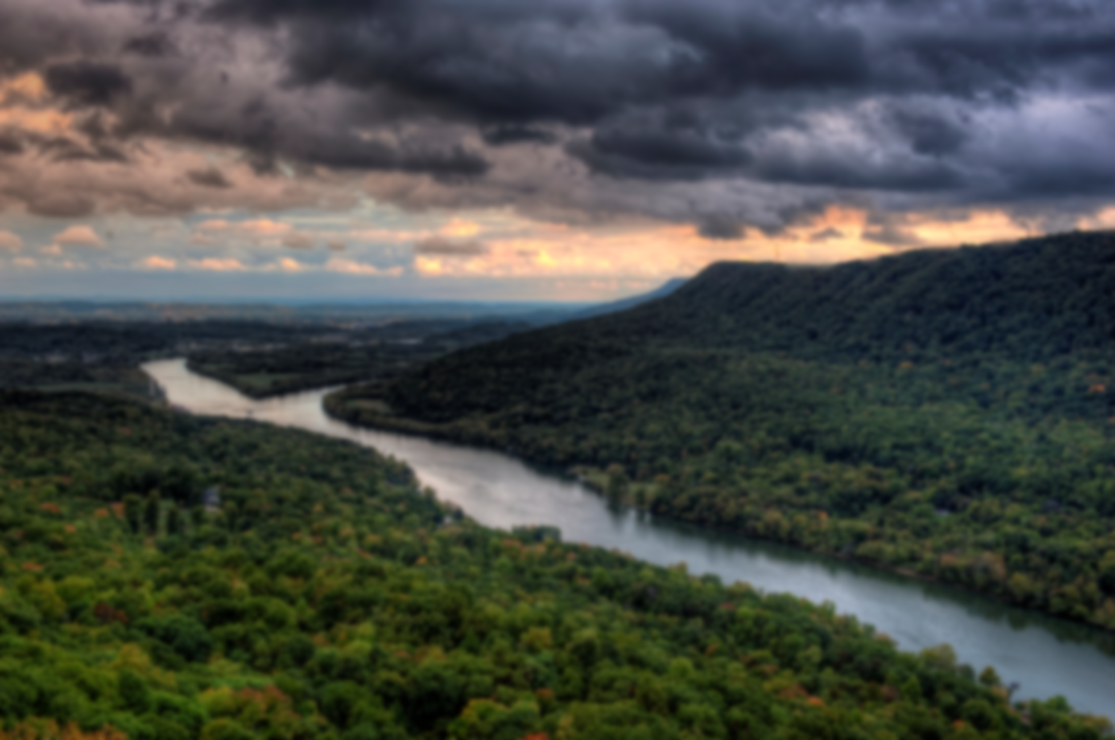
This research is based upon work supported by NASA ROSES RIA grant under the award No.80NSSC24K0784.
I would like to thank the University of Tennessee at Chattanooga GERS Lab, Dr. Azad Hossain for being the advisor for this project, and my fellow research team.
Thank you to the ASPRS Mid-South Region and ORNL for hosting the Mid-South Region Conference.
Thank you!
Acknowledgements

