Slide 1
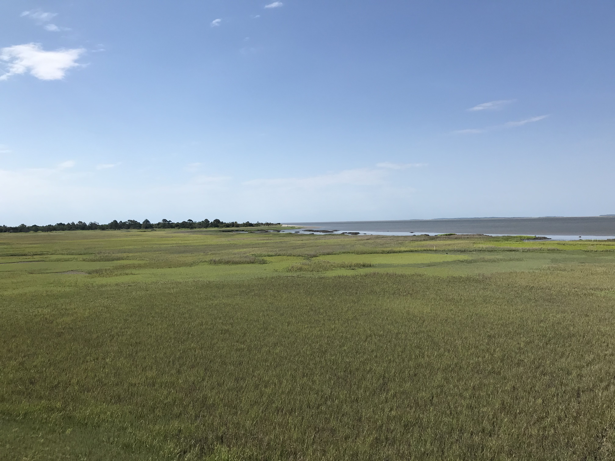



Using UAVs to Evaluate the Impact of Wrack Disturbance on Plant Recovery
Tyler Lynn^{1,4}, John Schalles^{2,4}, Merryl Alber^{3,4}, Deepak Mishra^{1,4}
¹Department of Geography, University of Georgia
²Department of Biology, Creighton University
³Department of Marine Sciences, University of Georgia
⁴Georgia Coastal Ecosystems LTER

Slide 2
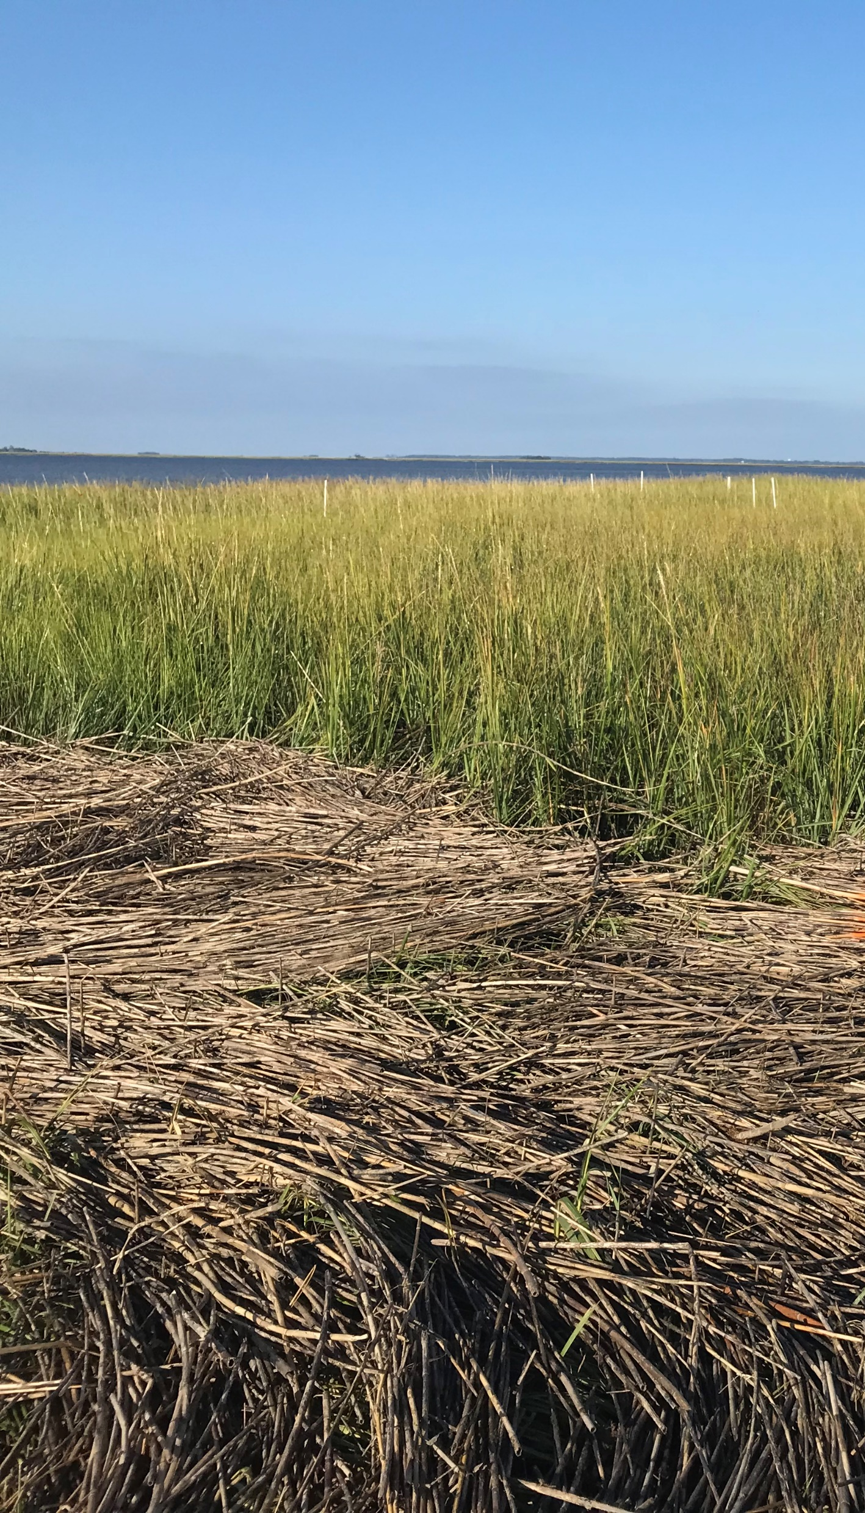
Background
Wrack: dead, floating plant material
Environmental factors influence where wrack is distributed and how long
Wrack historically observed via field observations or aerial photography
UAVs provide opportunity to track wrack distribution
Notes:
Positive: transportation of biomass;
Negative: smothers underlying vegetation;
Can change community composition and longer residence times may elicit significant response

Slide 3
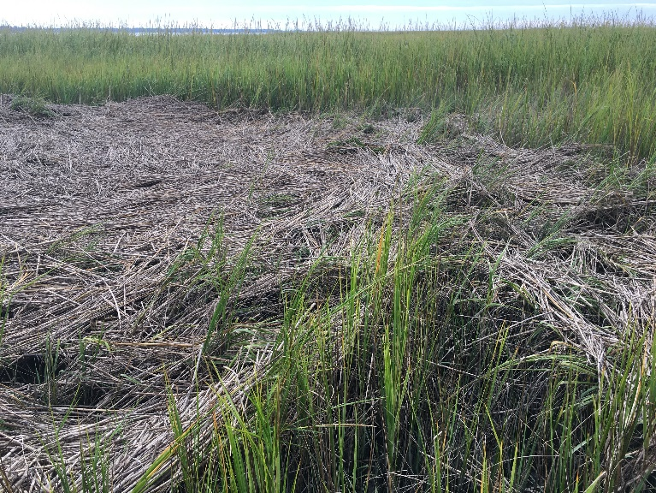
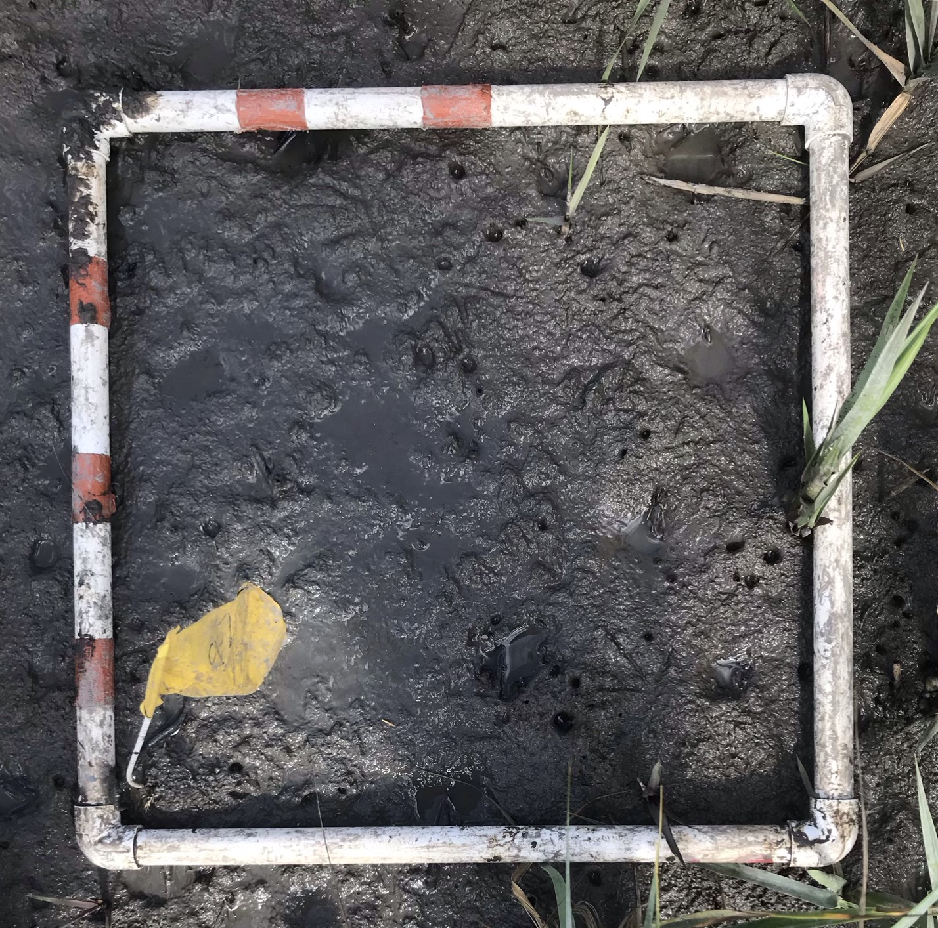
Evaluating Wrack
What are the spatial and temporal patterns of wrack distribution?
How do wrack characteristics affect plant recovery?
Frequency
Intensity, Size
Duration
Persistence
Recovery
State change
Cumulative Disturbance-scape

Slide 4
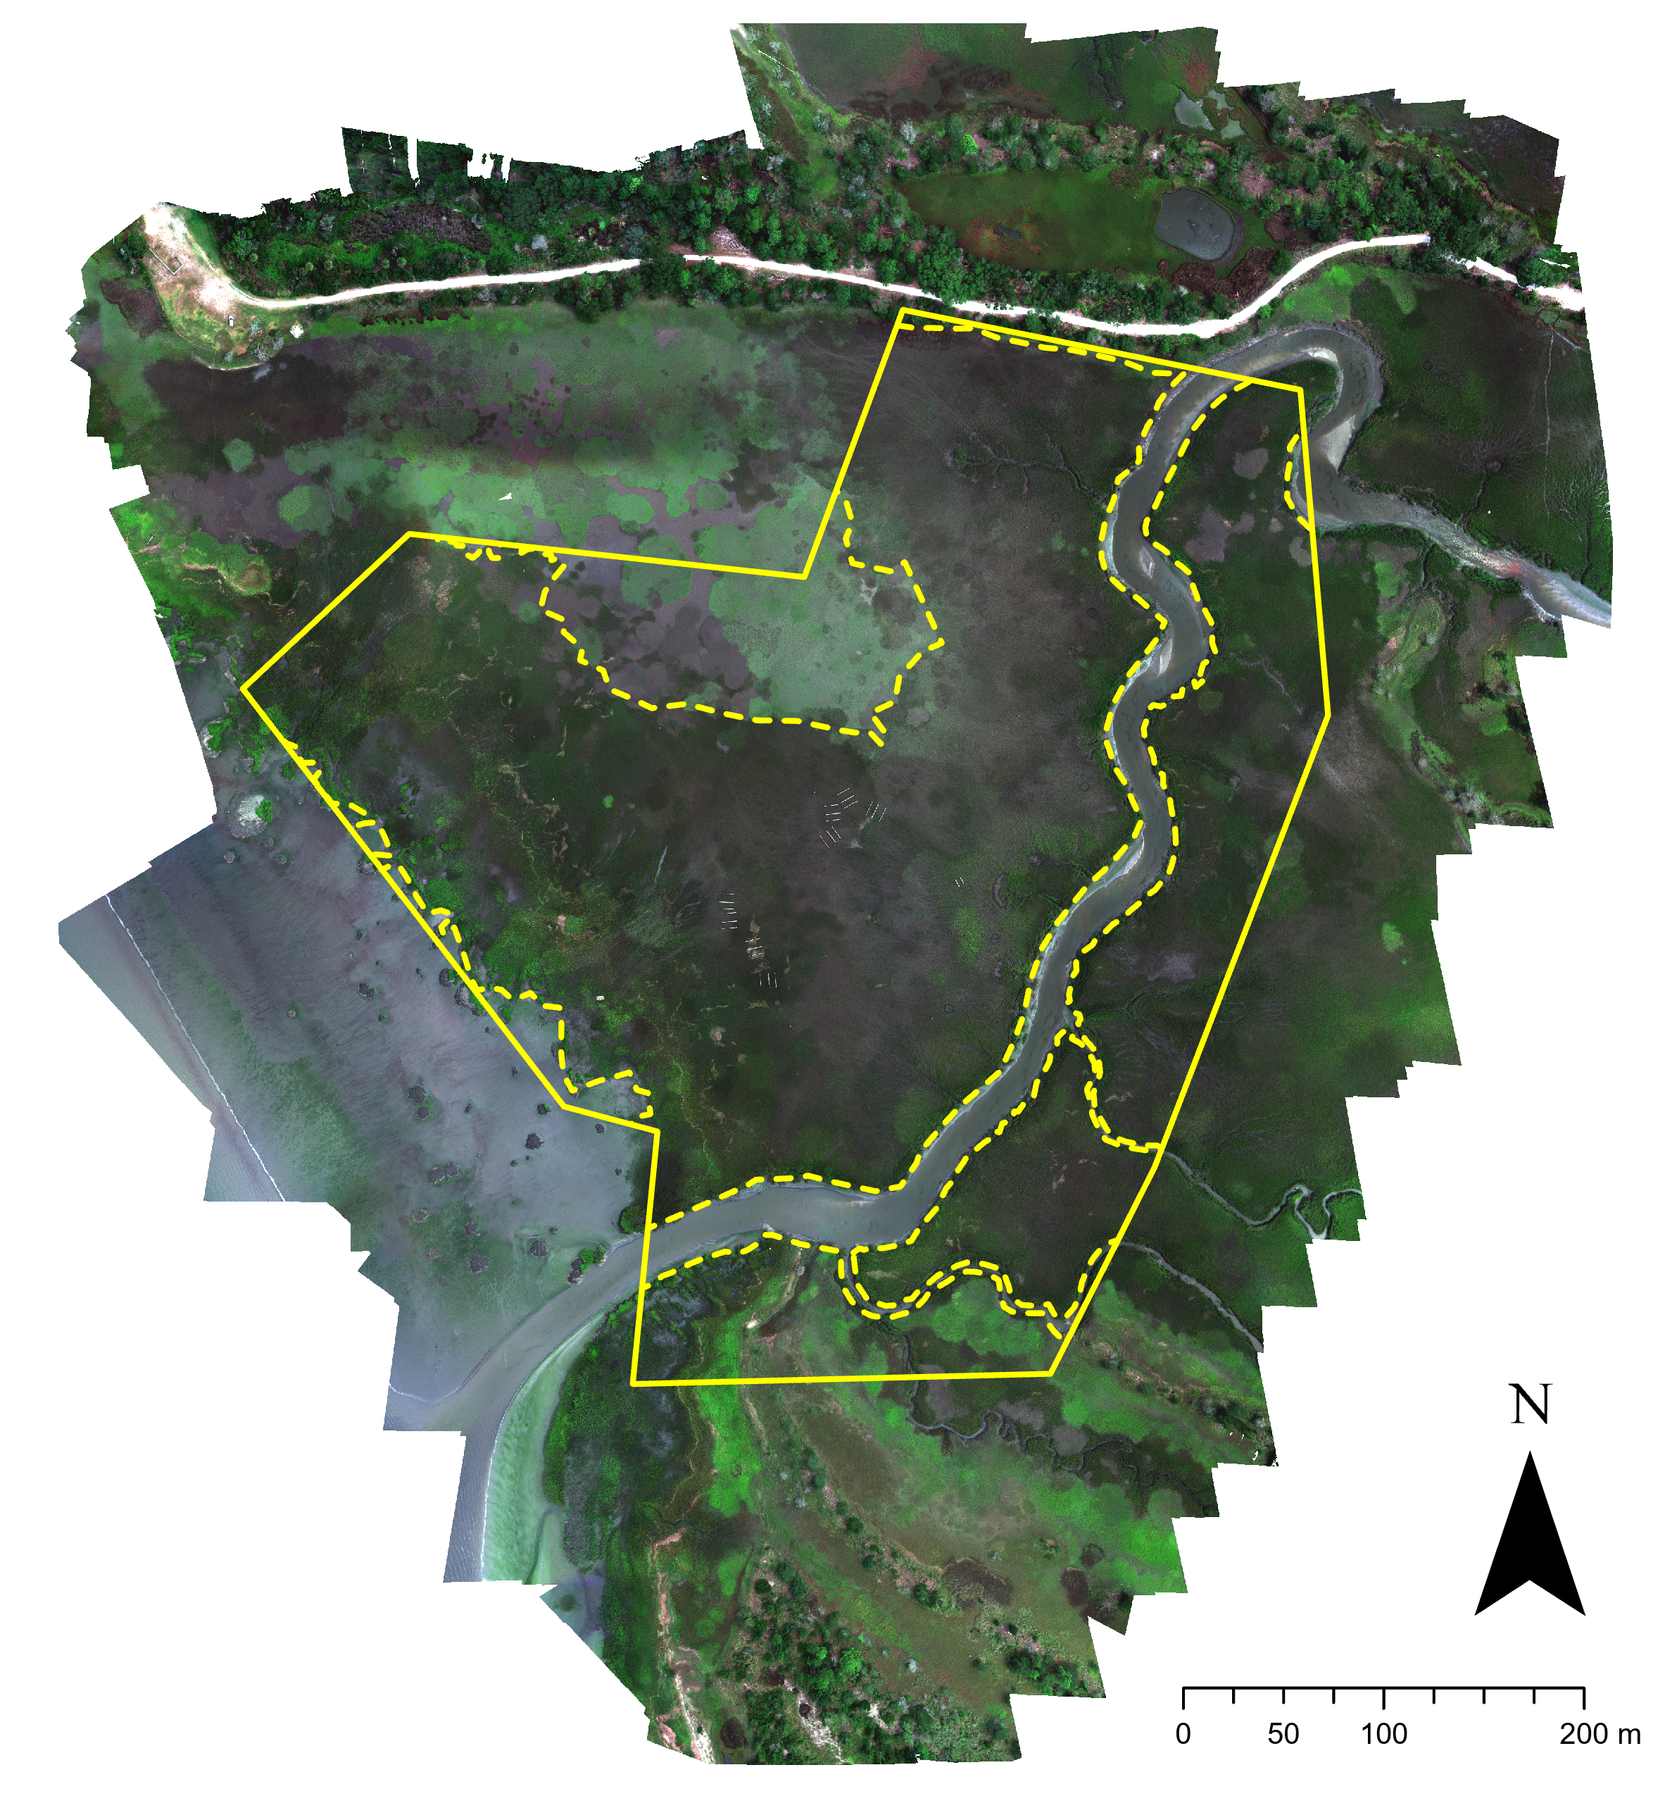
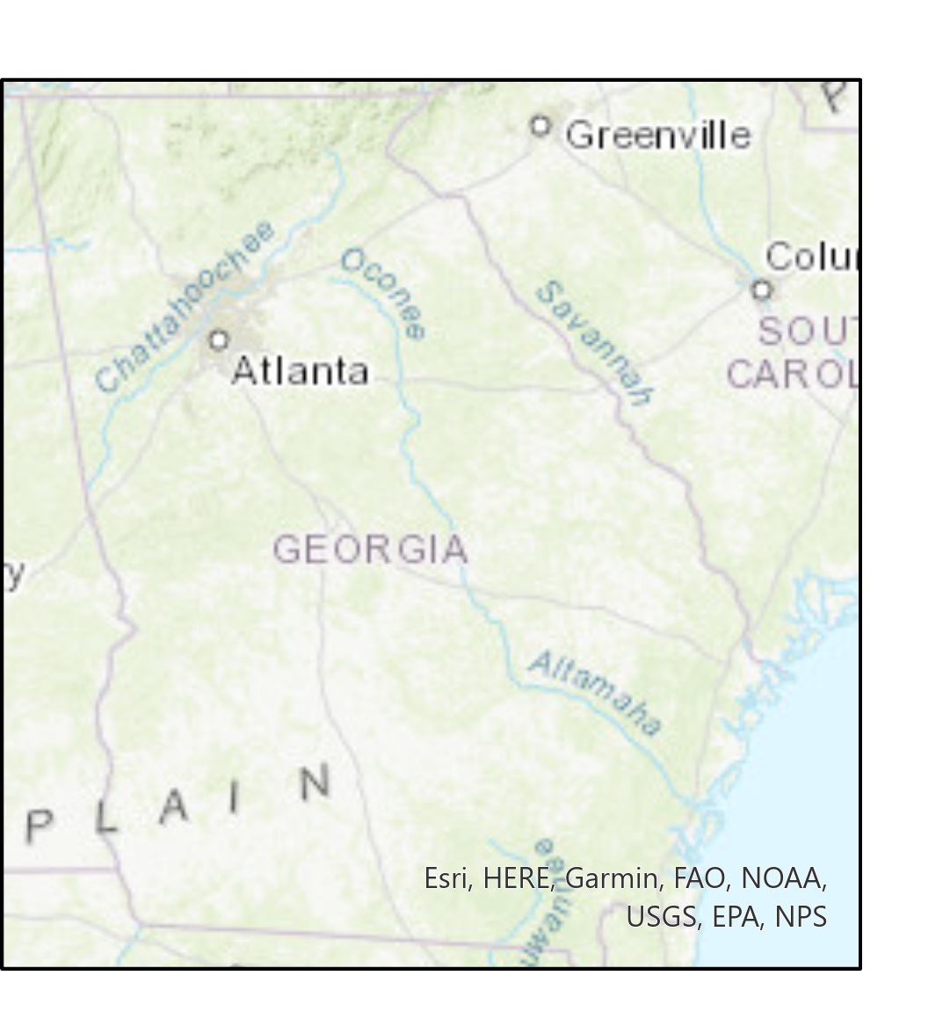
Study Site
Sapelo Island, GA
Dean Creek Marsh:
Area of ~18 ha
Dominated by Spartina alterniflora
Elevation ranges from 0 – 2 m

Slide 5

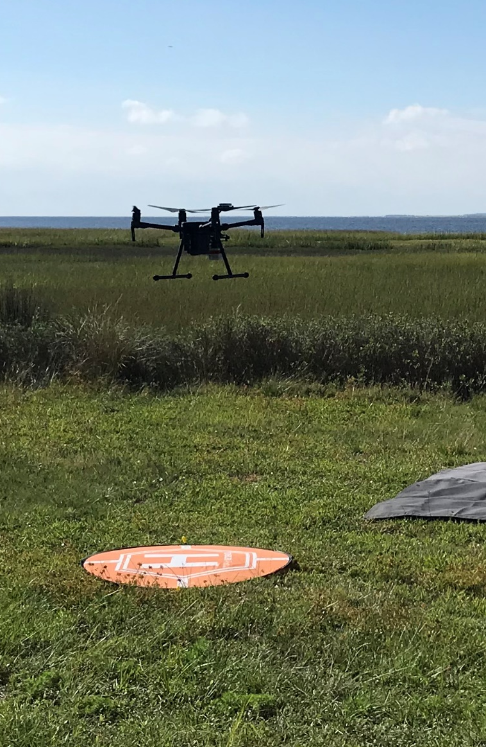


Data Acquisition
DJI Matrice with Micasense Altum
6 Bands: Blue, Green, Red, Red-Edge, NIR, & Thermal-Infrared
5 cm x 5 cm pixels
Images acquired monthly
54 images (ongoing)
8 in 2020
12 in 2021
12 in 2022
12 in 2023
10 in 2024

Slide 6
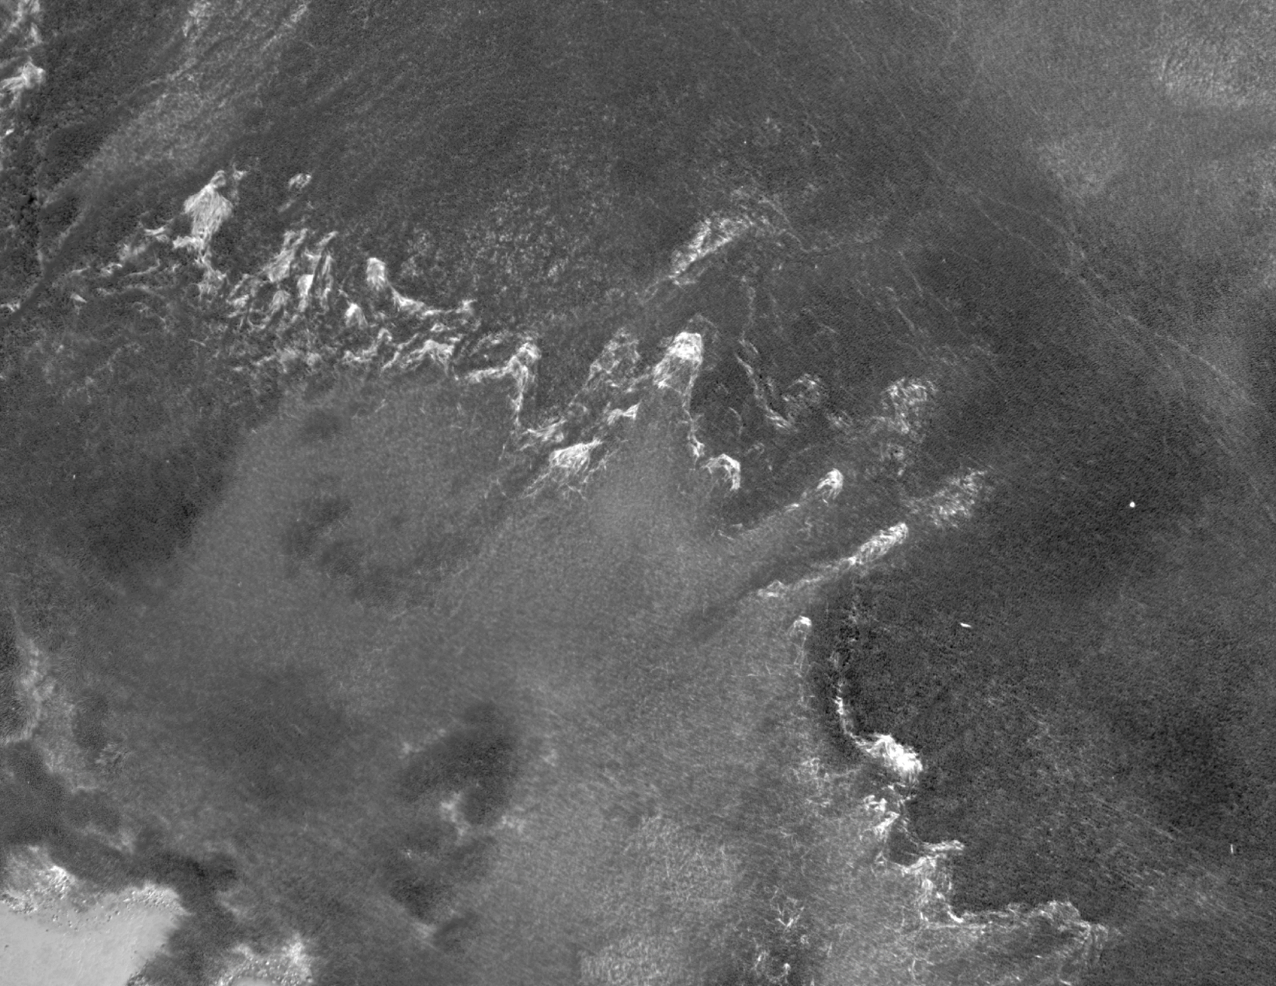
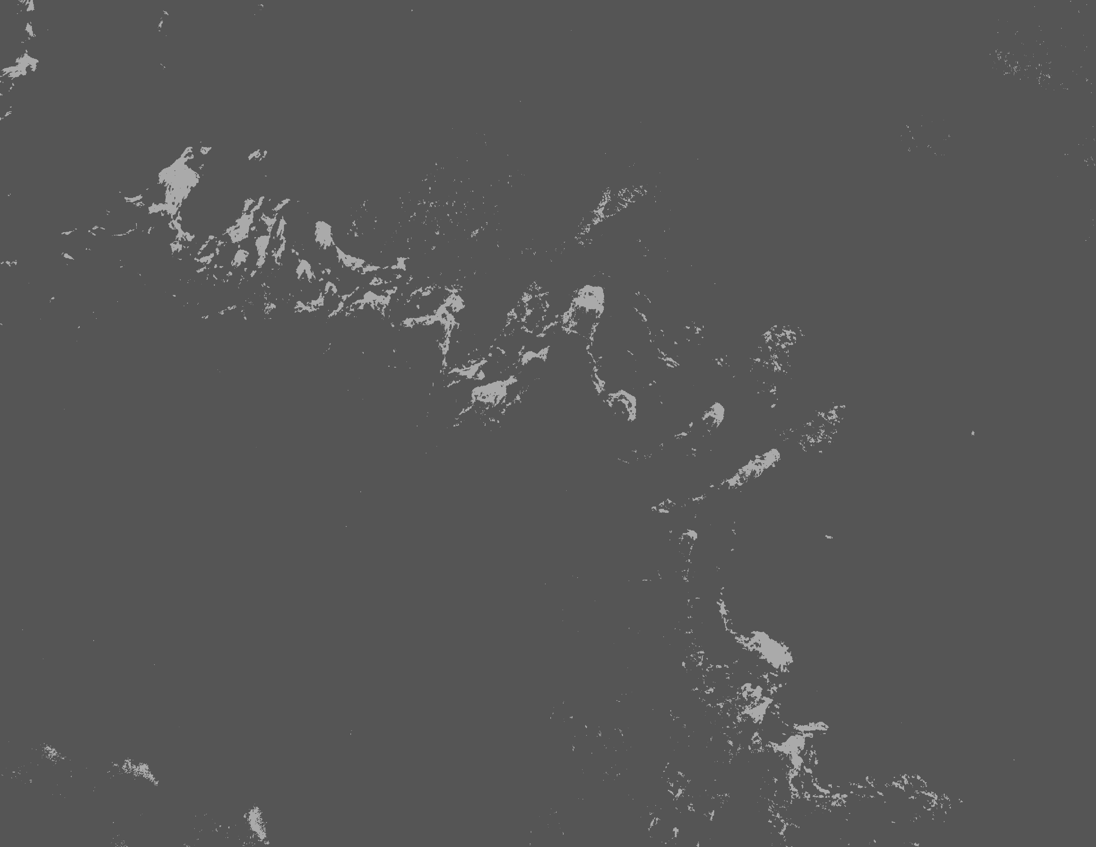
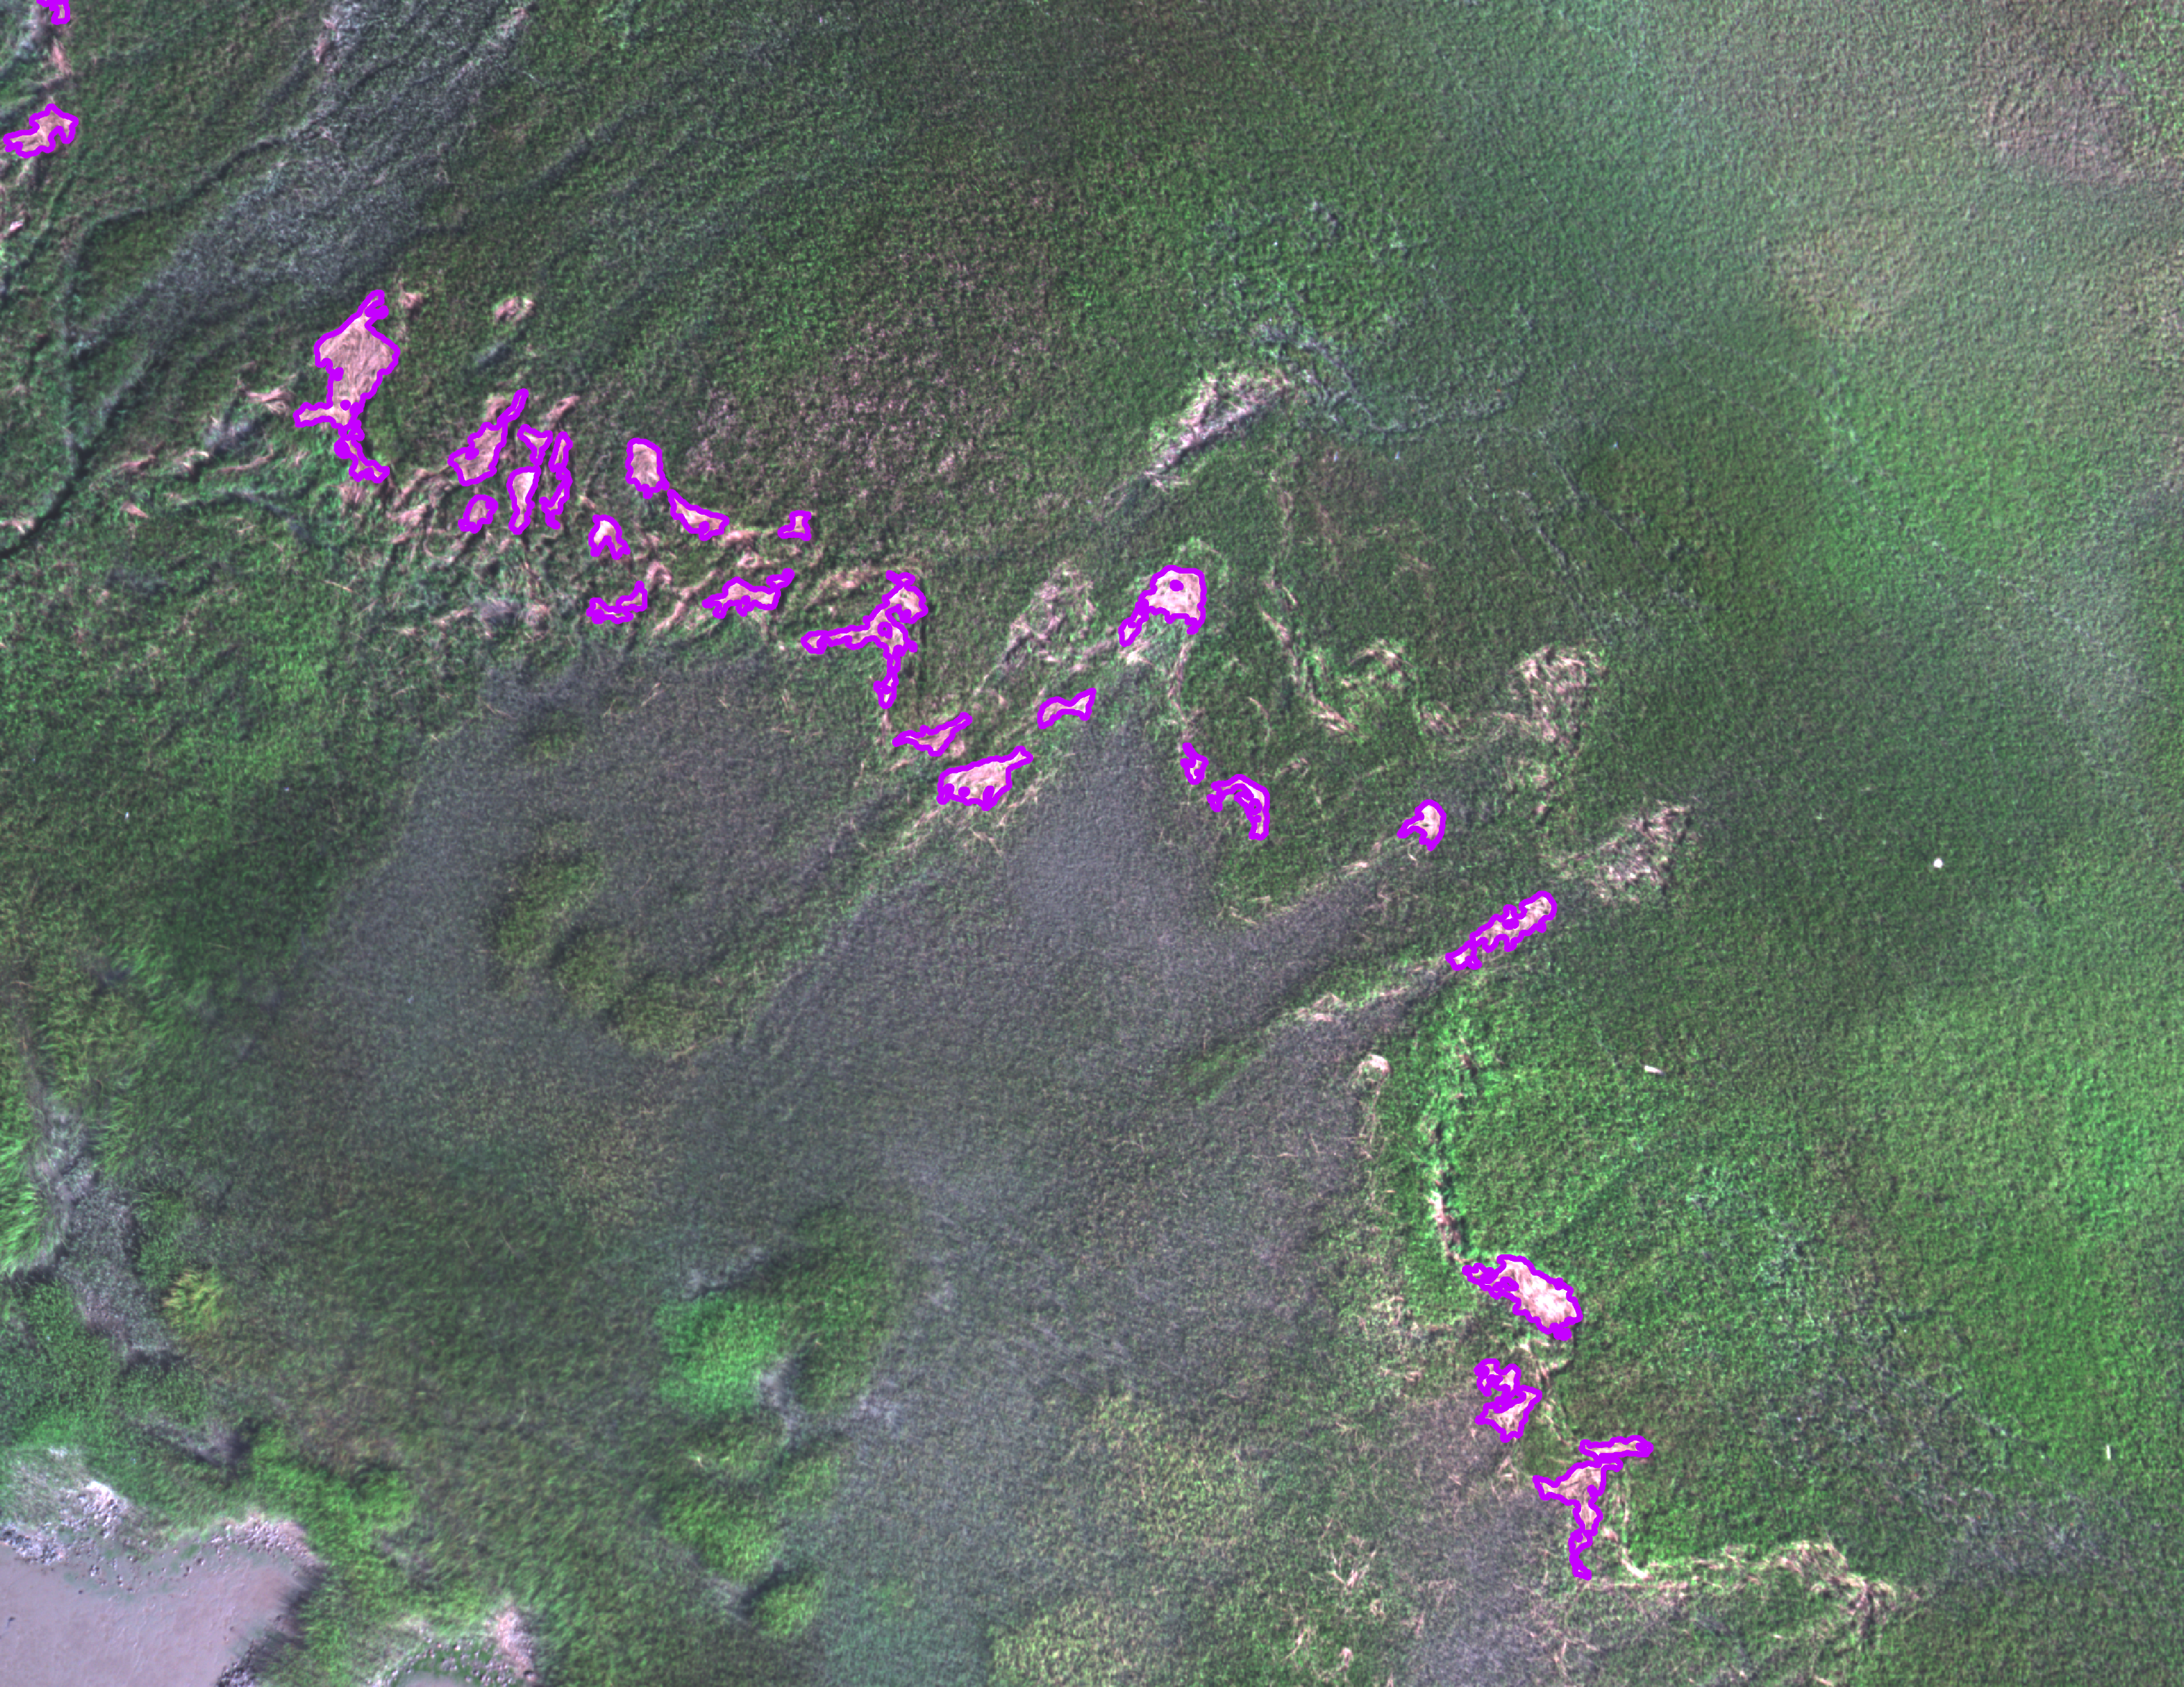
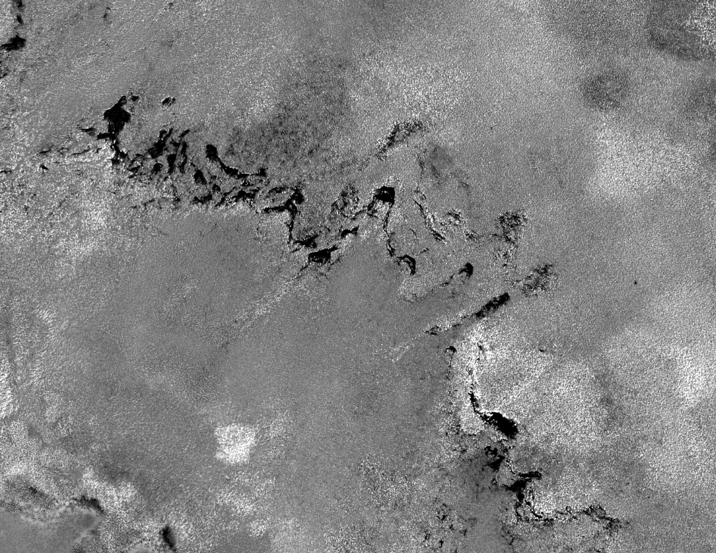
Wrack Identification
PCA Component 2
Binary Wrack Map
Identified Wrack Polygons
PCA Component 4
Lynn et al. 2023
Notes:
Exclude wrack patches less than 1 m2;
Look at month to month patterns

Slide 7
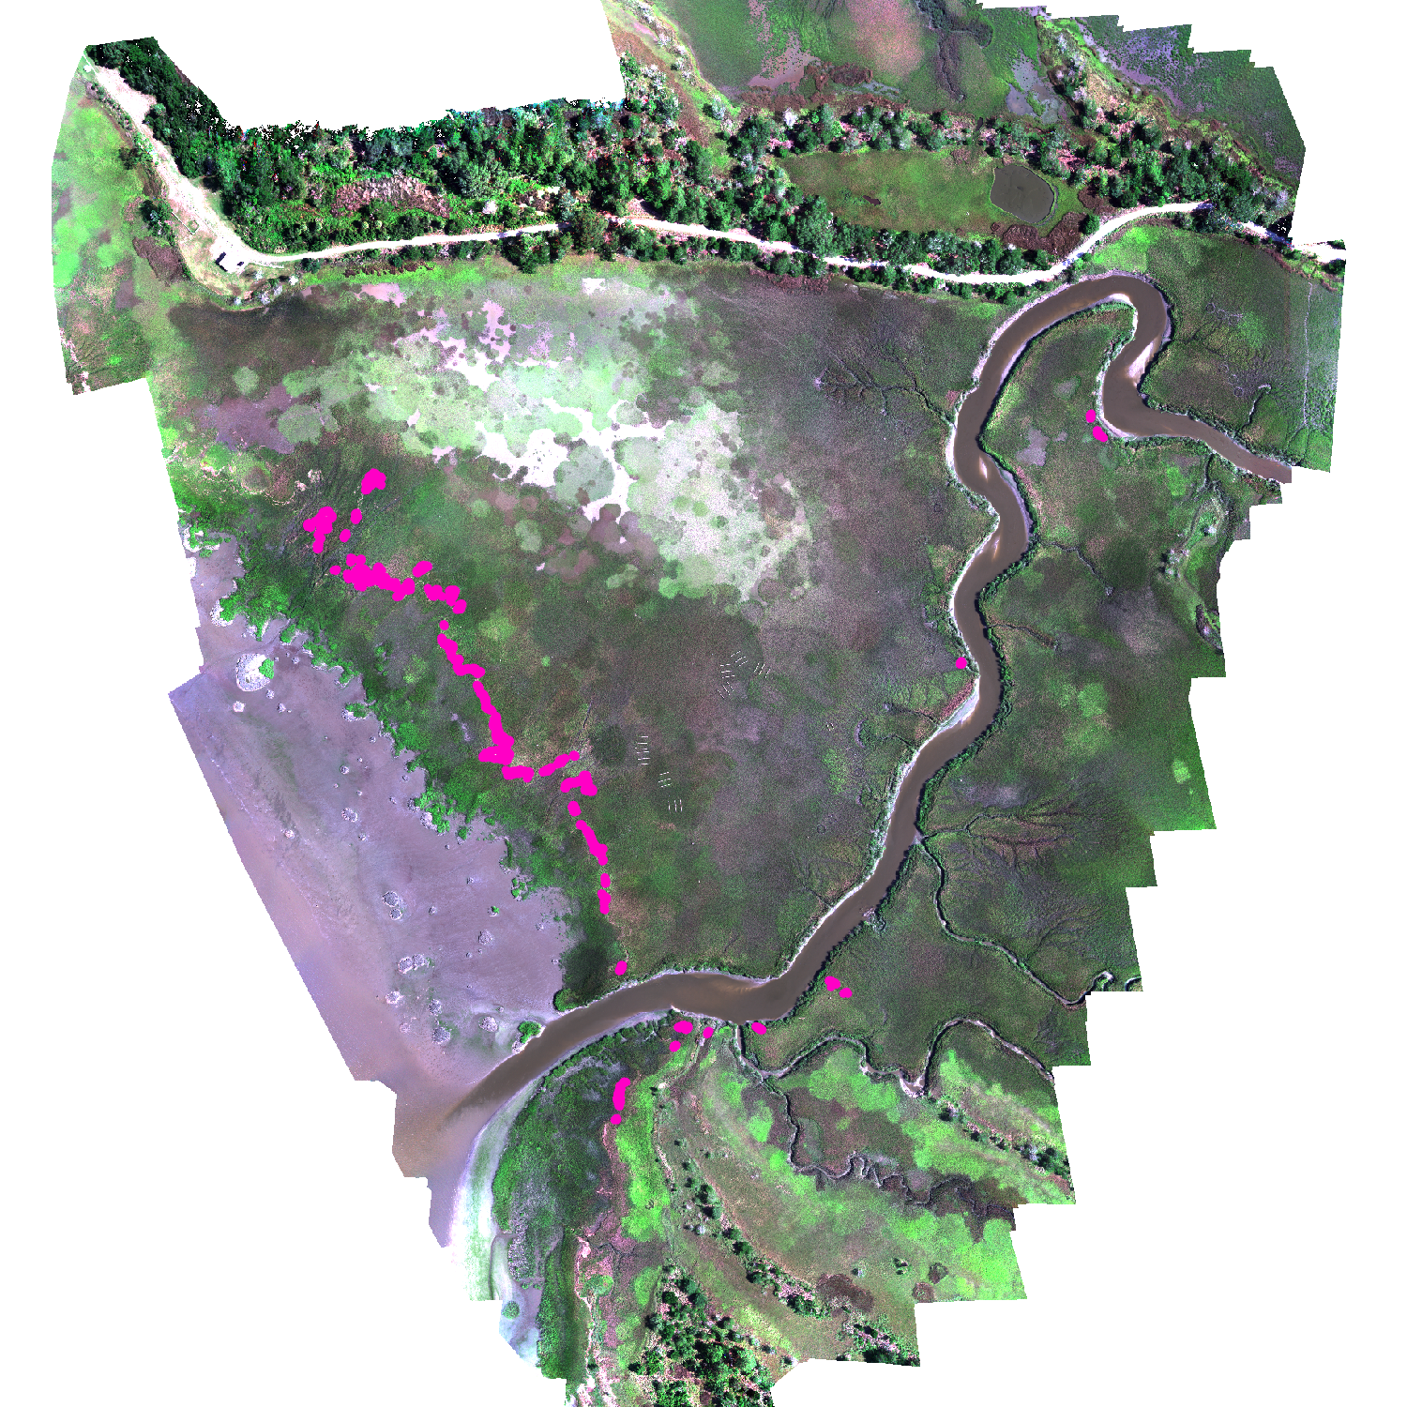
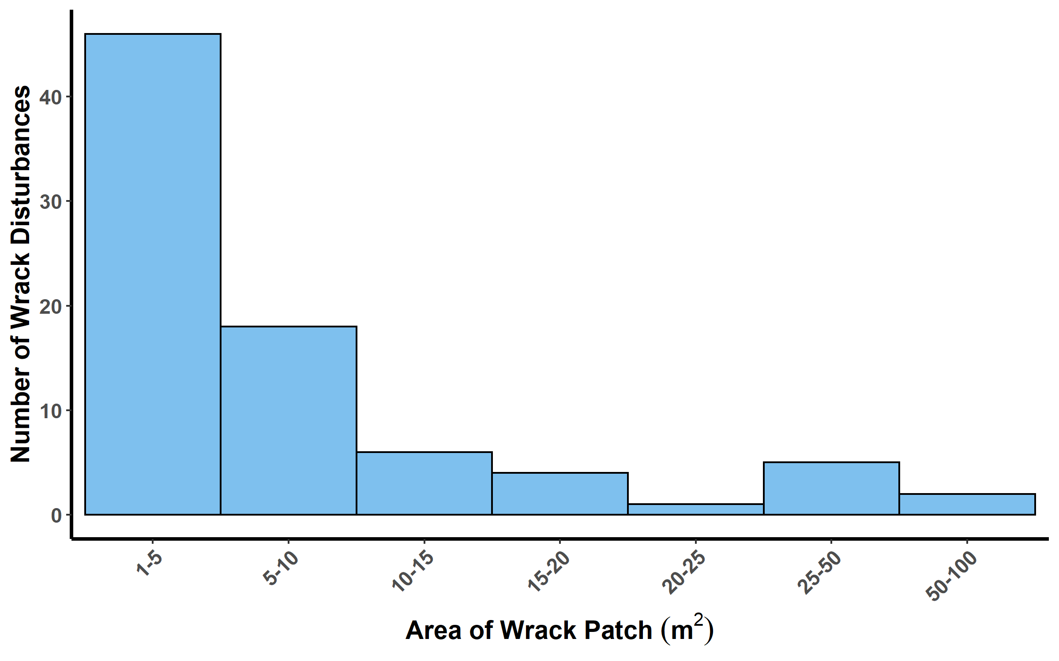
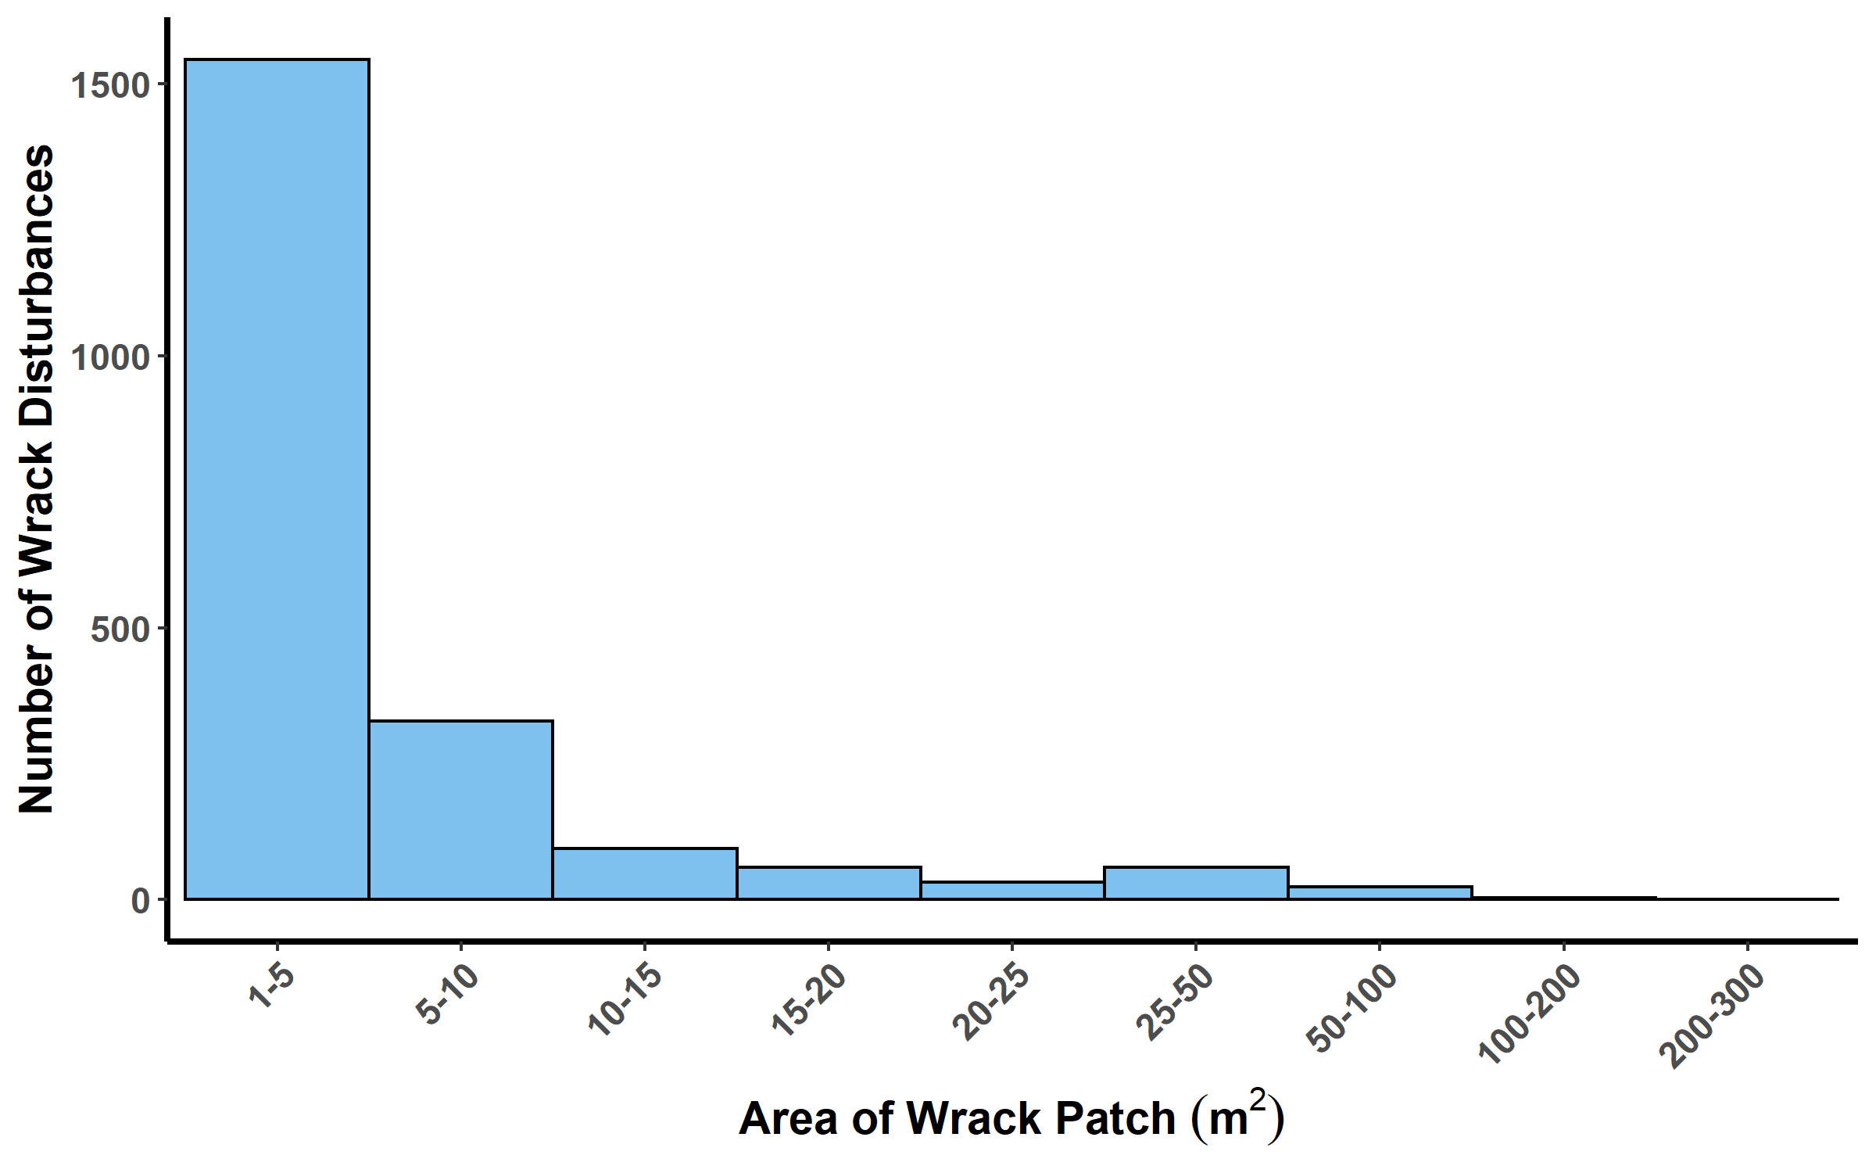
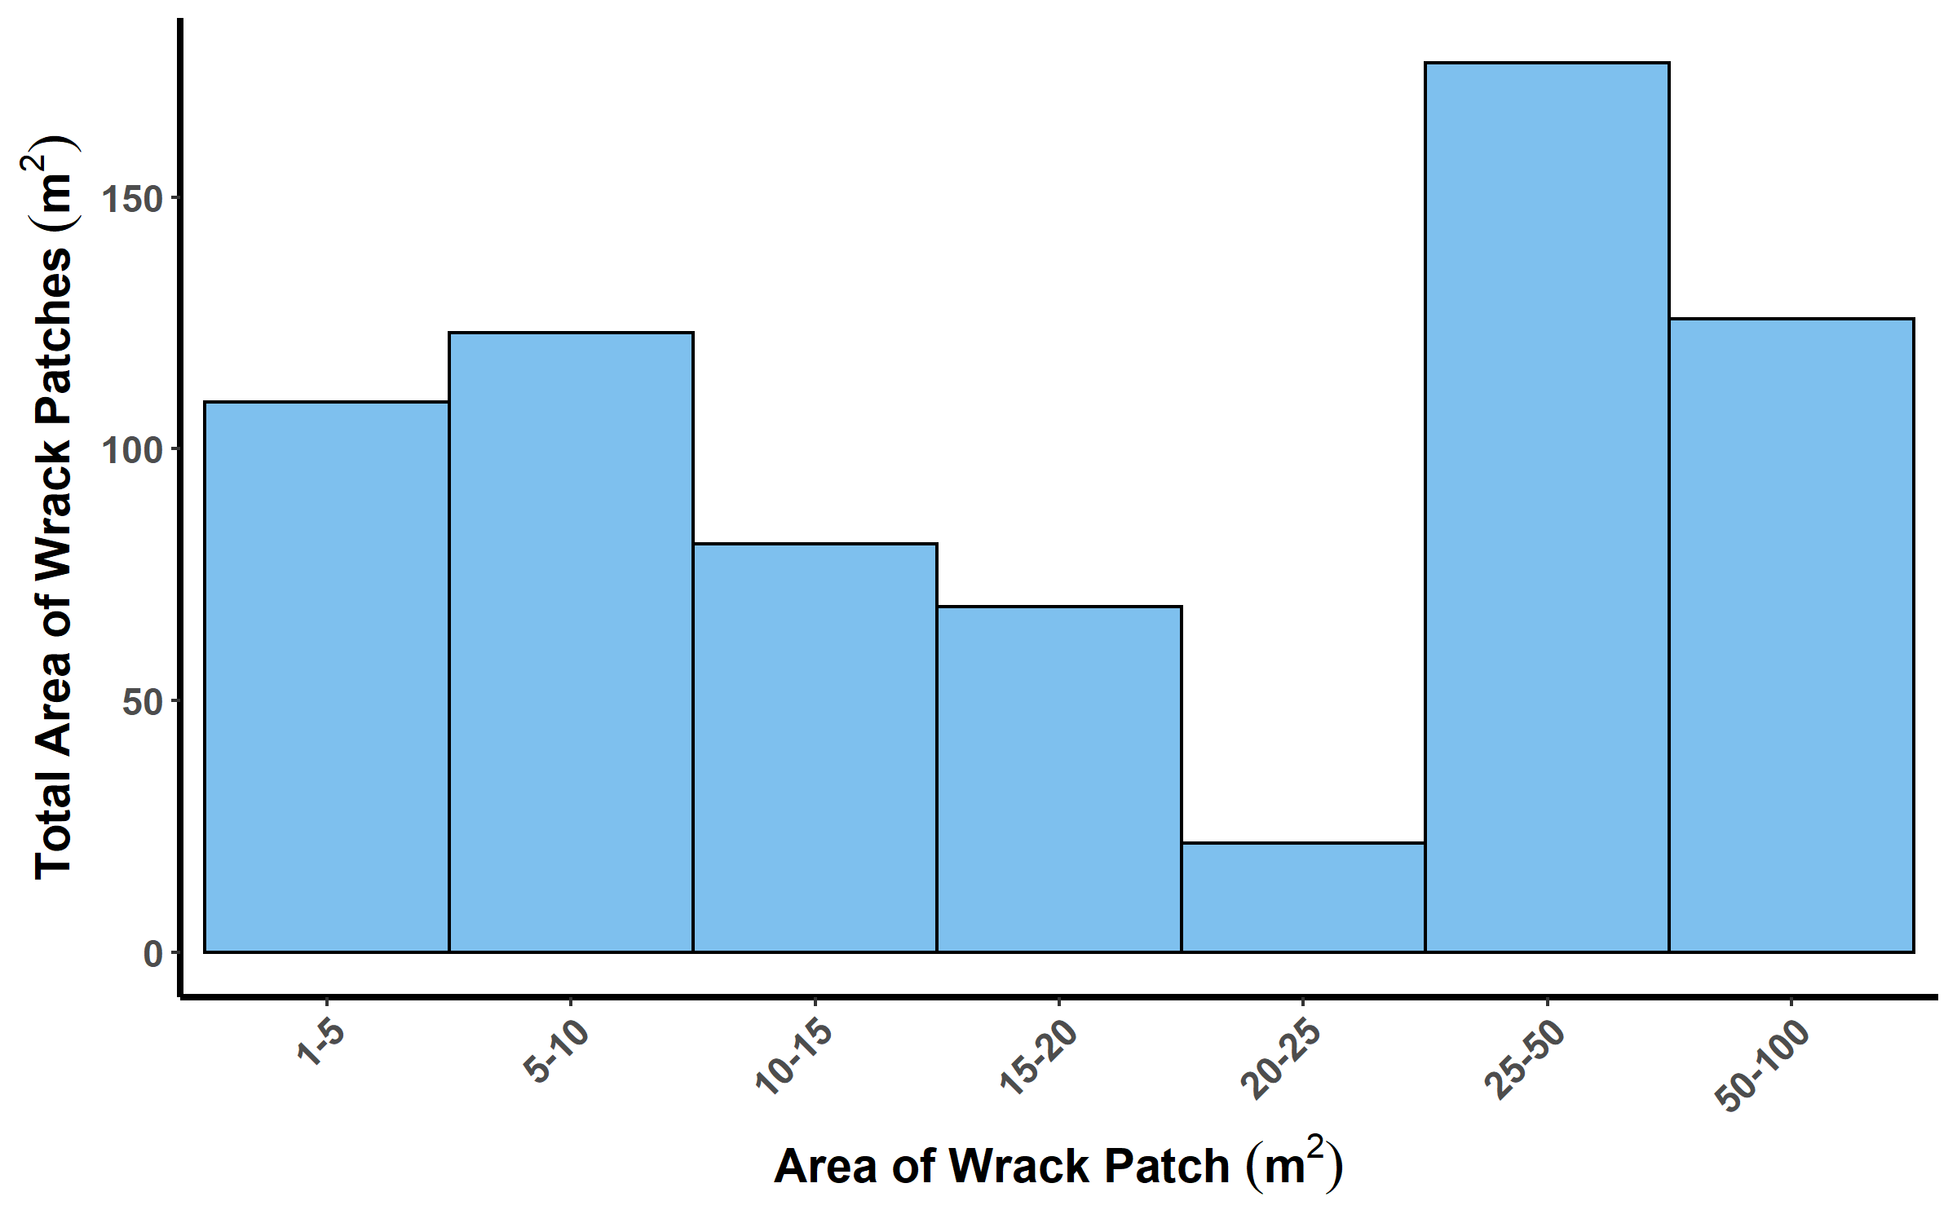
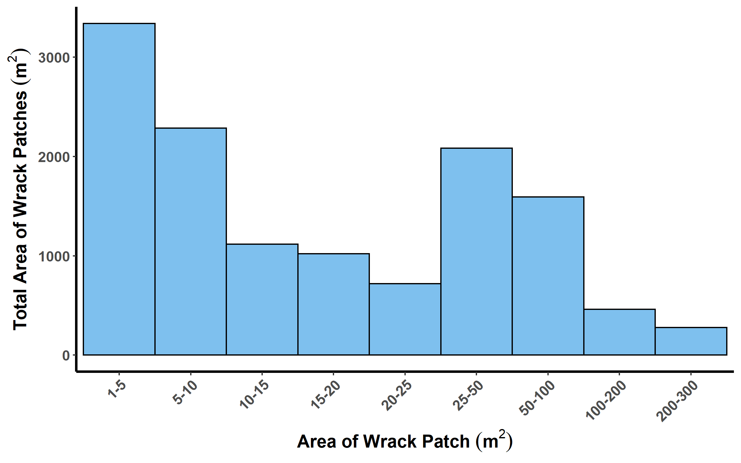
Using the Classified Imagery
August 2021
2020 - 2021
Lynn et al. 2023

Slide 8
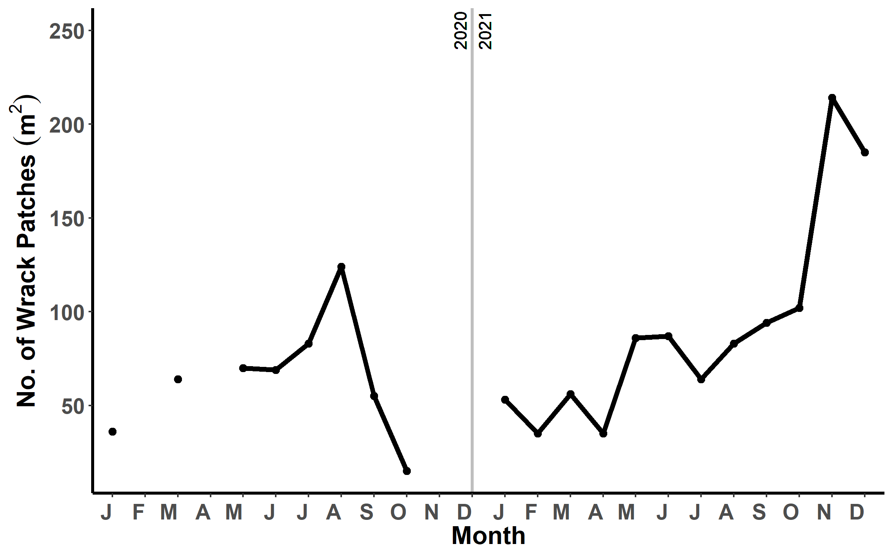
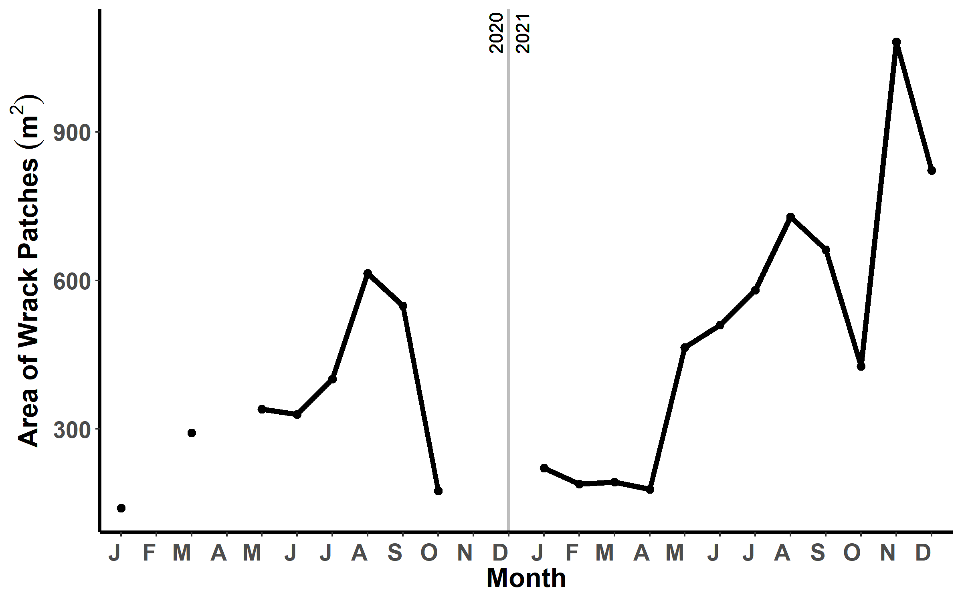
Size-Frequency Distributions
Lynn et al. 2023

Slide 9
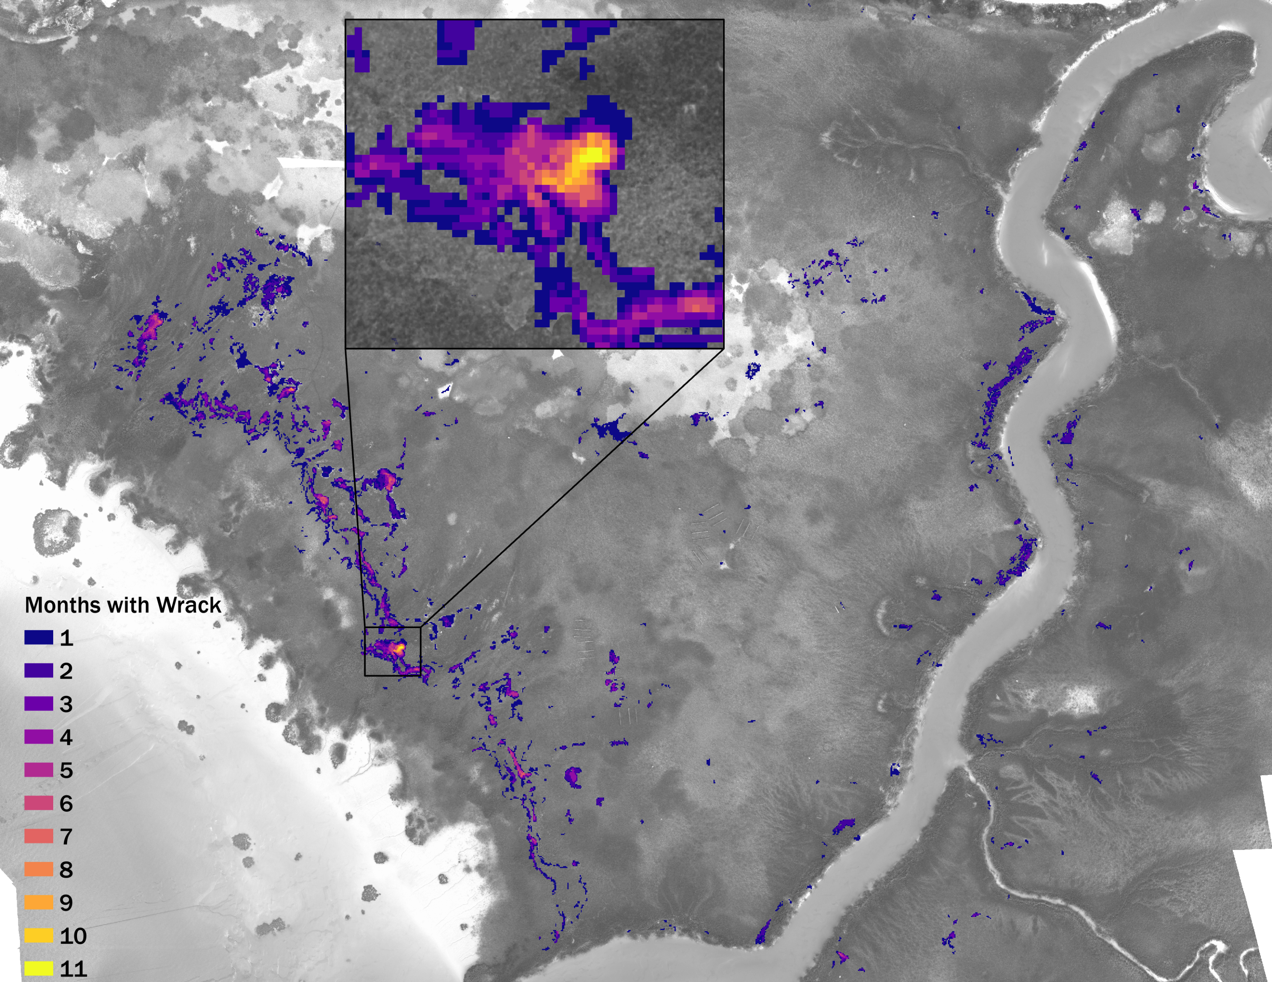
# of Months | # of Pixels
1 | 1190000
2 | 513100
3 | 151700
4 | 93000
5 | 44500
6 | 20000
7 | 6100
8 | 1800
9 | 1800
10 | 700
11 | 500
Lynn et al. 2024

Slide 10
Evaluating Wrack
What are the spatial and temporal patterns of wrack distribution?
How do wrack characteristics affect plant recovery?
Frequency
Intensity, Size
Duration
Persistence
Recovery
State change
Cumulative Disturbance-scape

Slide 11
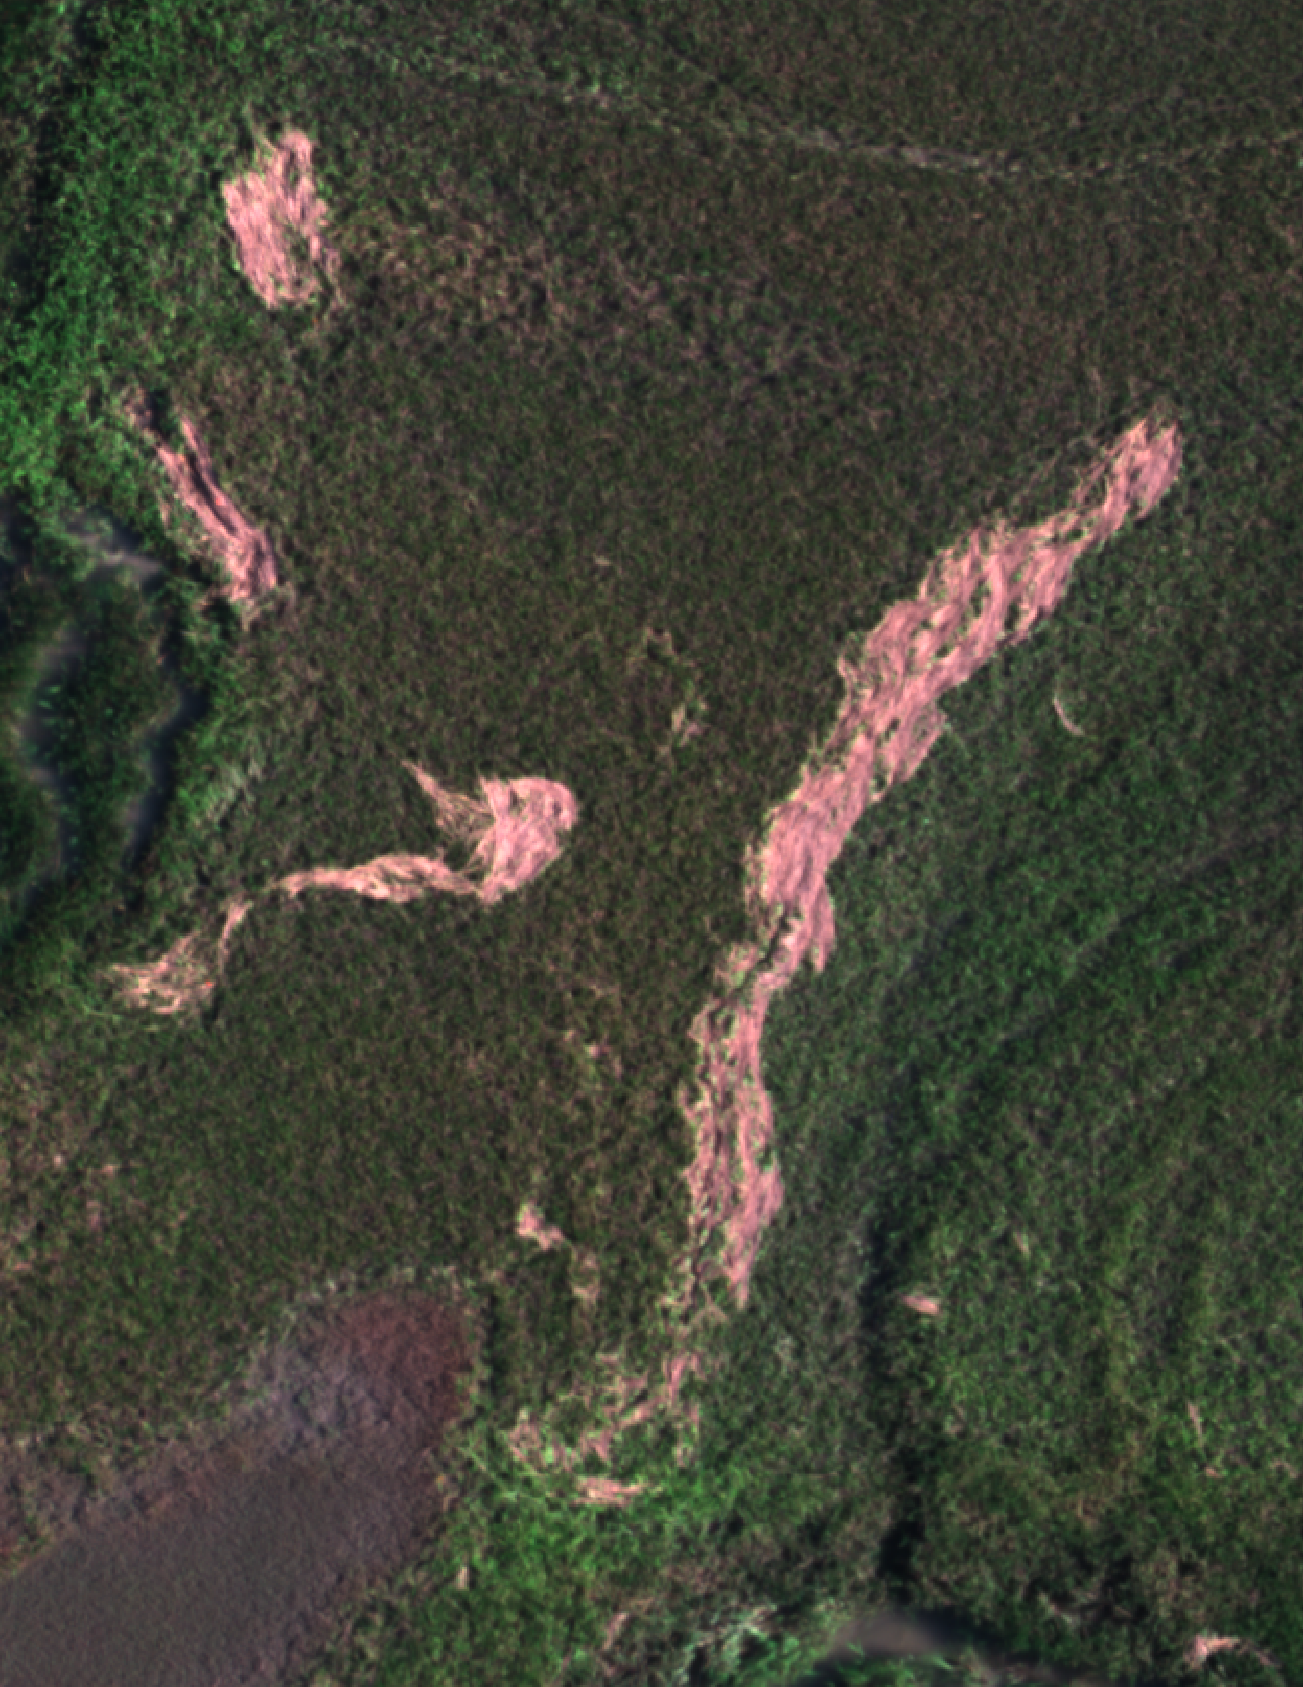
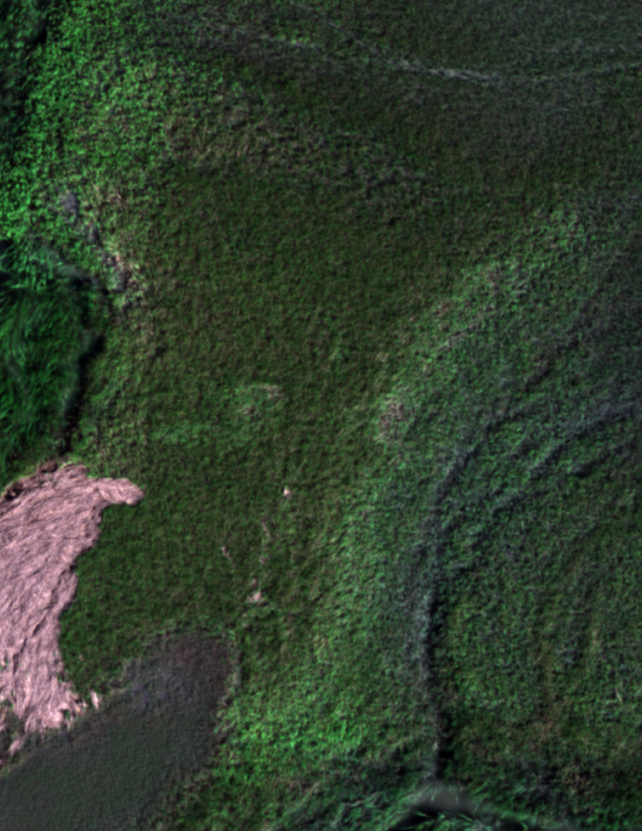
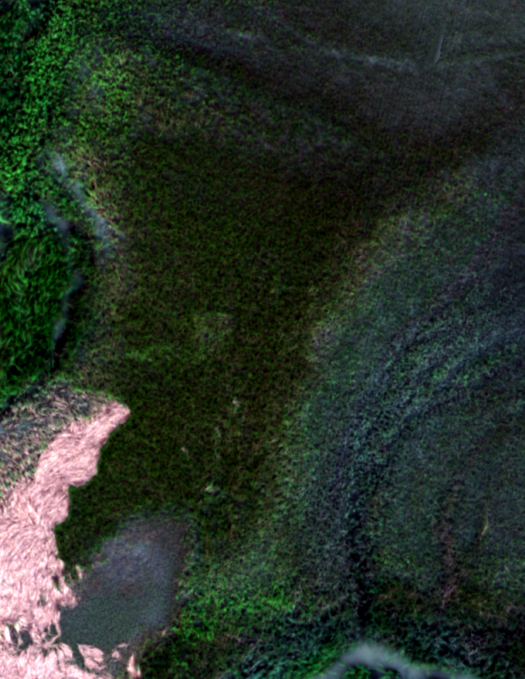
Analyzing the Impact of Wrack Disturbances on Plant Recovery
1 month after wrack
3 months after wrack

Slide 12
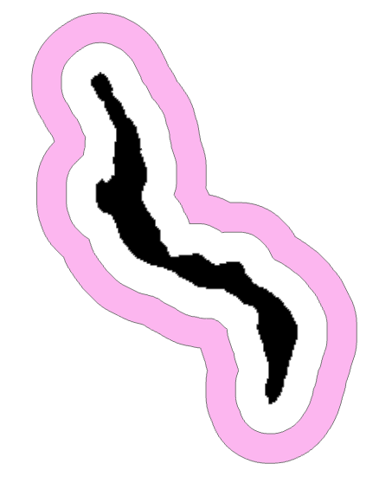
How can we evaluate plant recovery?
Estimate expected plant productivity using Normalized Difference Vegetation Index (NDVI)
NDVI = (NIR – Red)/(NIR + Red)
Compare those estimates to the observed values in disturbed areas
Controls for wrack patches can be challenging to select
Areas of similar elevation, orientation, etc. as wrack disturbed areas can be difficult to identify
We used a 1 m control buffer around wrack patches to model expected NDVI using kriging
Black polygon = wrack area
Pink polygon = kriging data

Slide 13
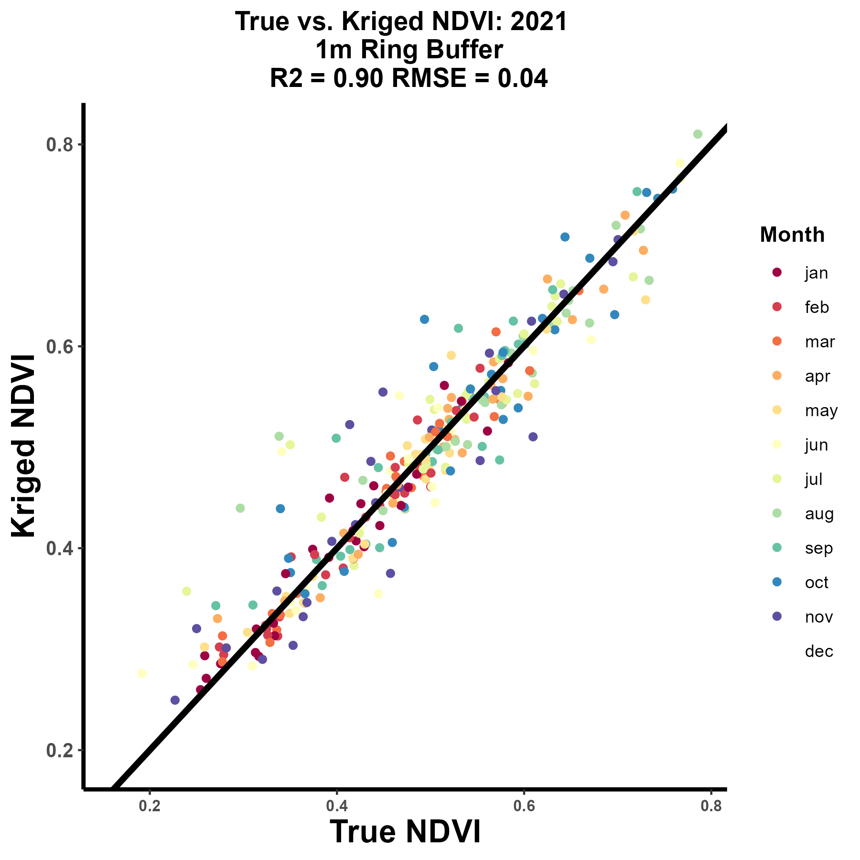
Kriging Results
25 pseudo-wrack patches and controls
Used controls to predict NDVI of pseudo-wrack patches using kriging
No differences in prediction accuracy by season

Slide 14
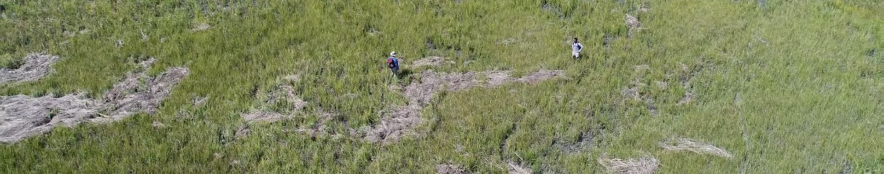
Methods
Compared kriged NDVI values to observed NDVI values in areas previously disturbed by wrack
Considered disturbed areas recovered when observed NDVI was +/- 5% of kriged NDVI
Selected all patches that arrived in 2021 and evaluated wrack characteristics to see how they impacted plant recovery

Slide 15
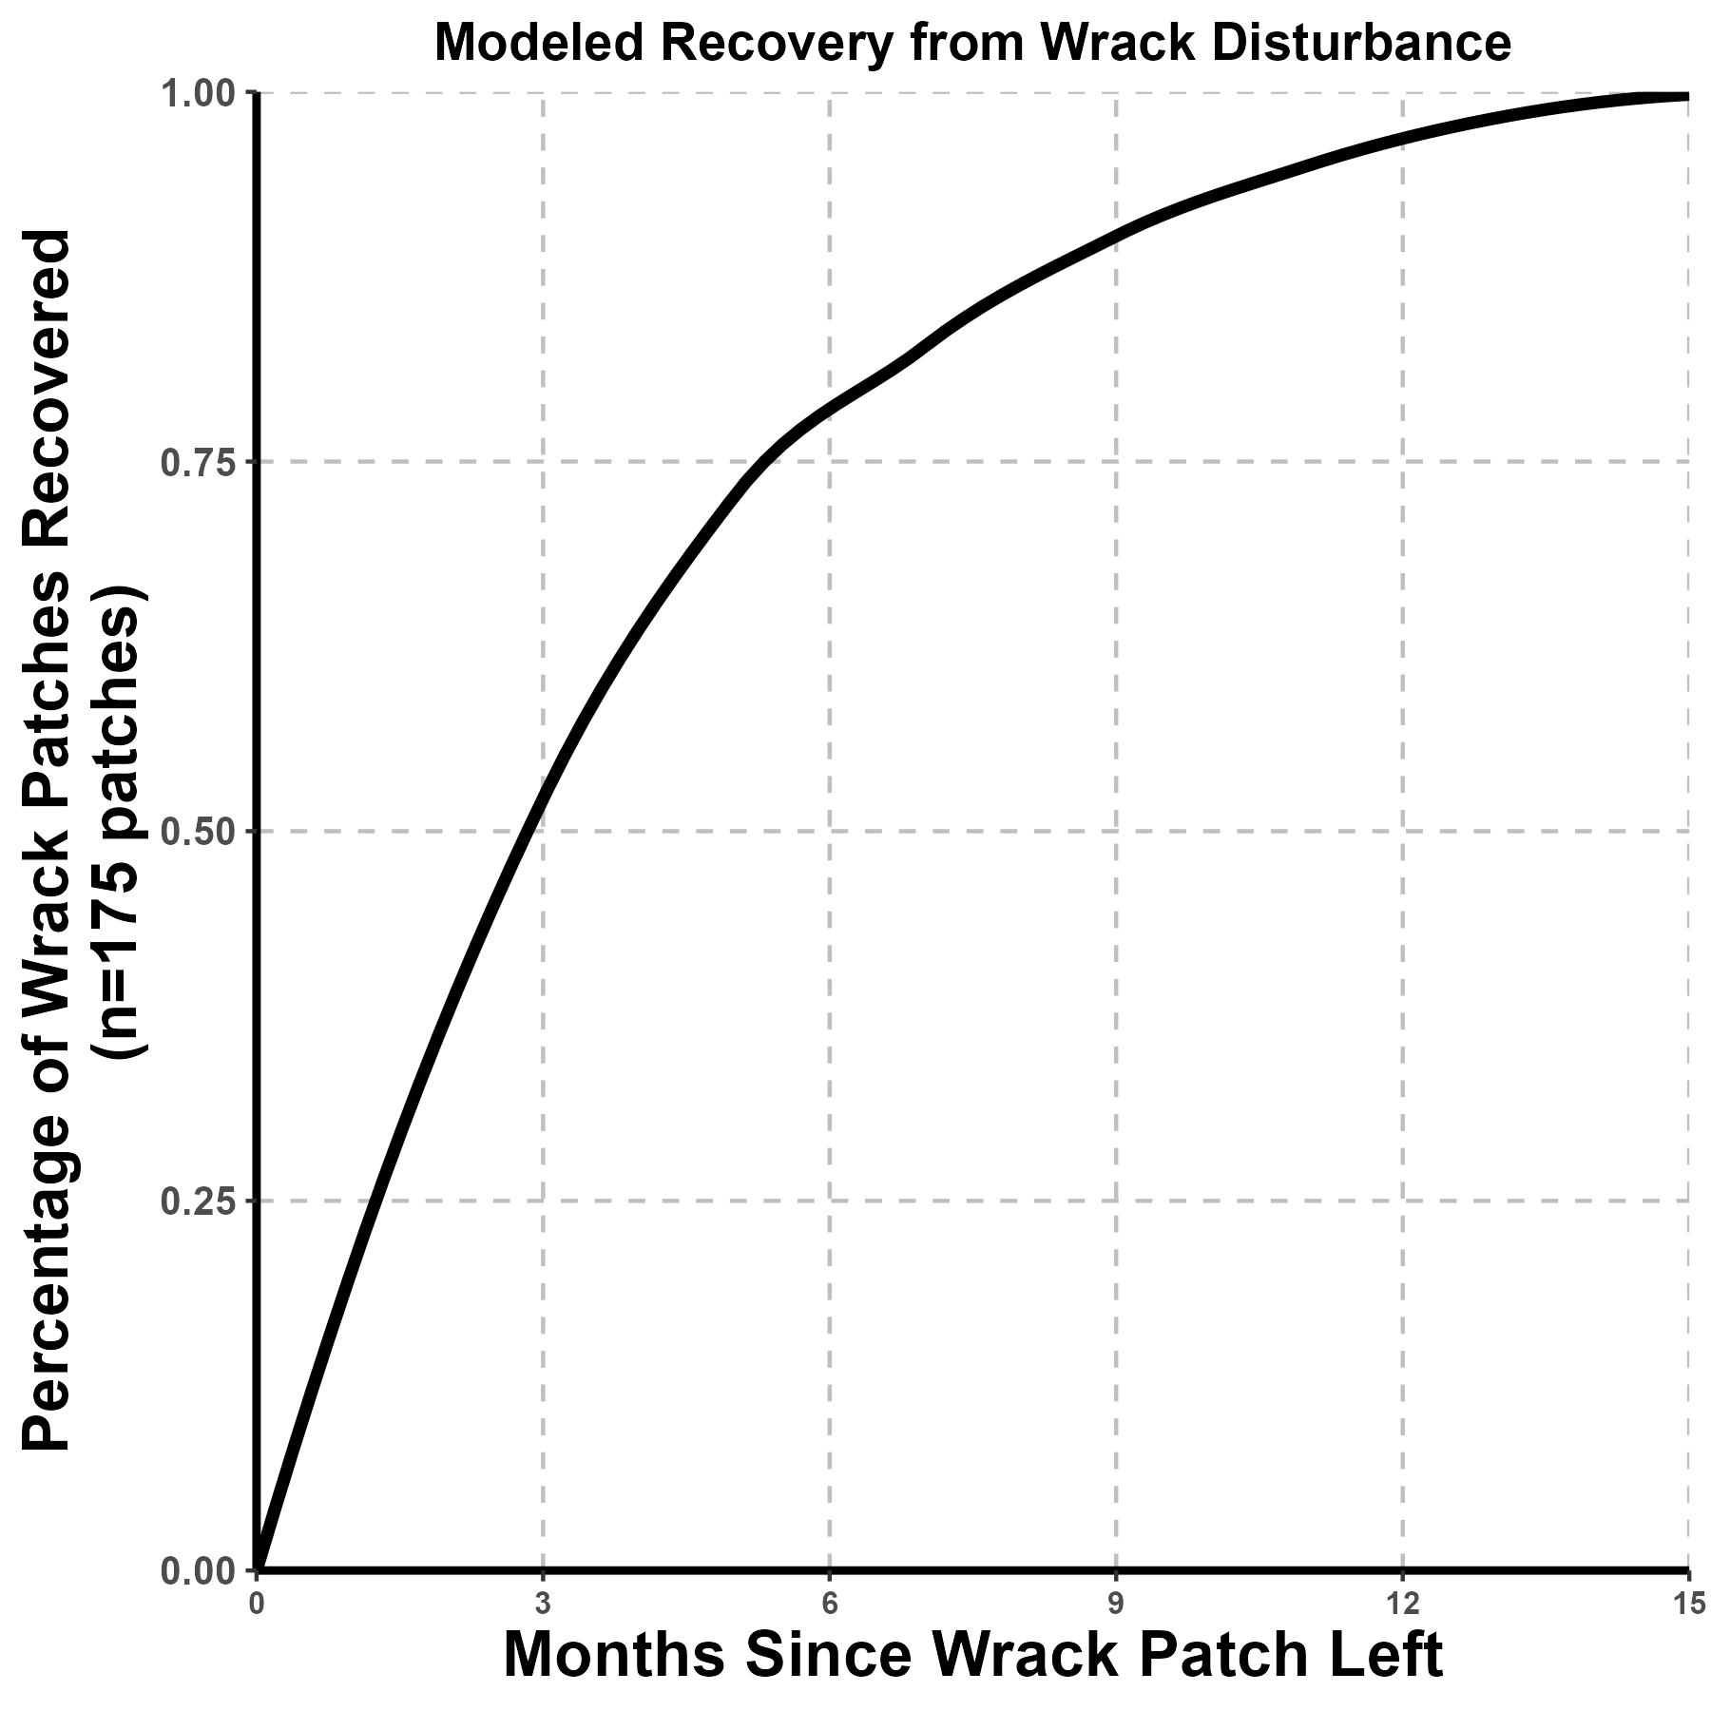
Survivability Model for Recovery Analysis
75% of all wrack patches were considered recovered 6 months after wrack disturbance
>90% of wrack patches recovered by 1 year

Slide 16
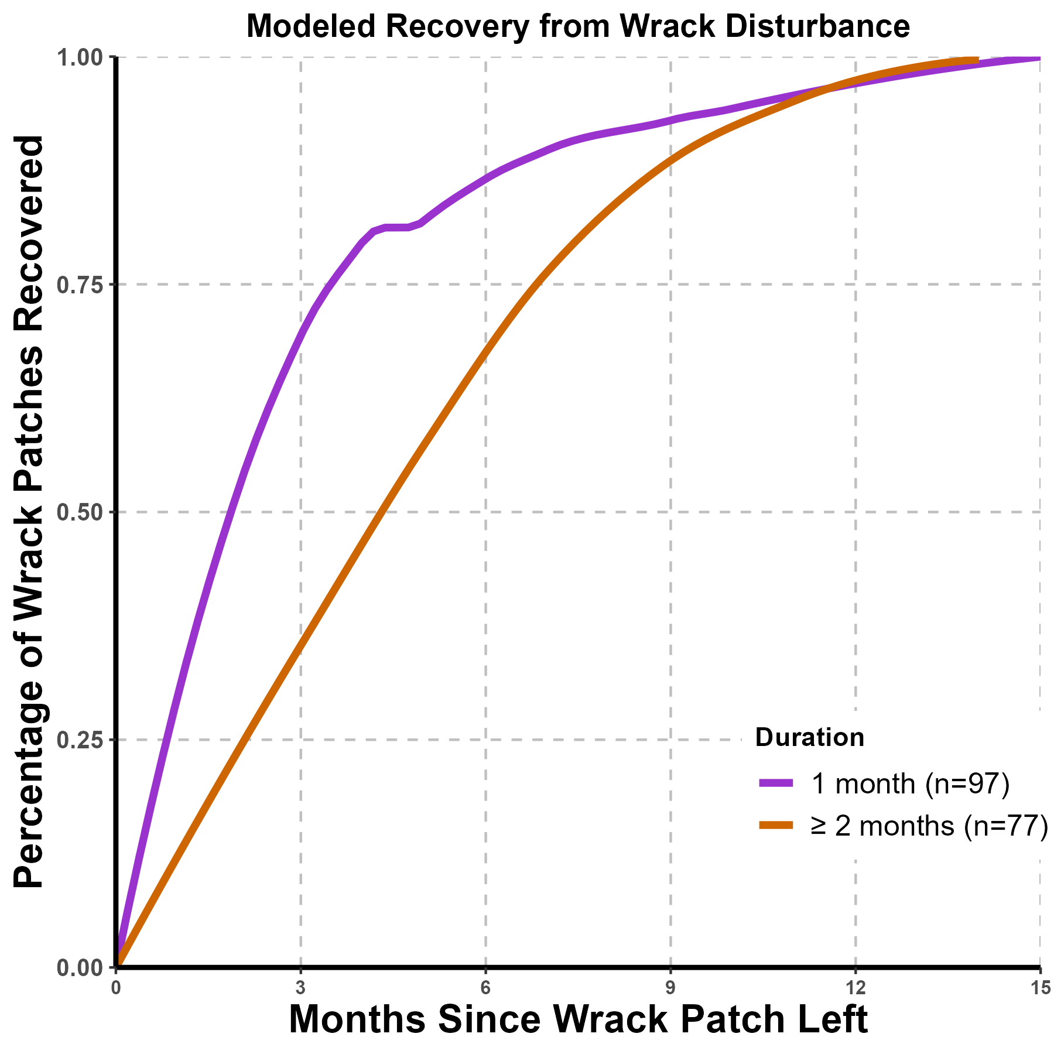
Survivability Model for Recovery Analysis
~75% of wrack patches with 1 month duration recovered by ~3 months
Wrack patches with 1 month duration recovered ~2-3 months faster than patches there for ≥ 2 months

Slide 17
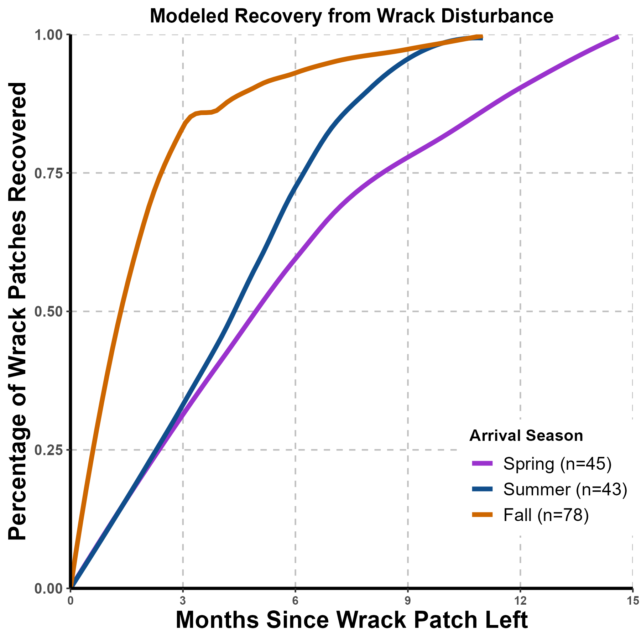
Survivability Model for Recovery Analysis
Wrack patches arriving in the fall recover fastest
Wrack patches arriving in the summer recover slightly faster than spring

Slide 18
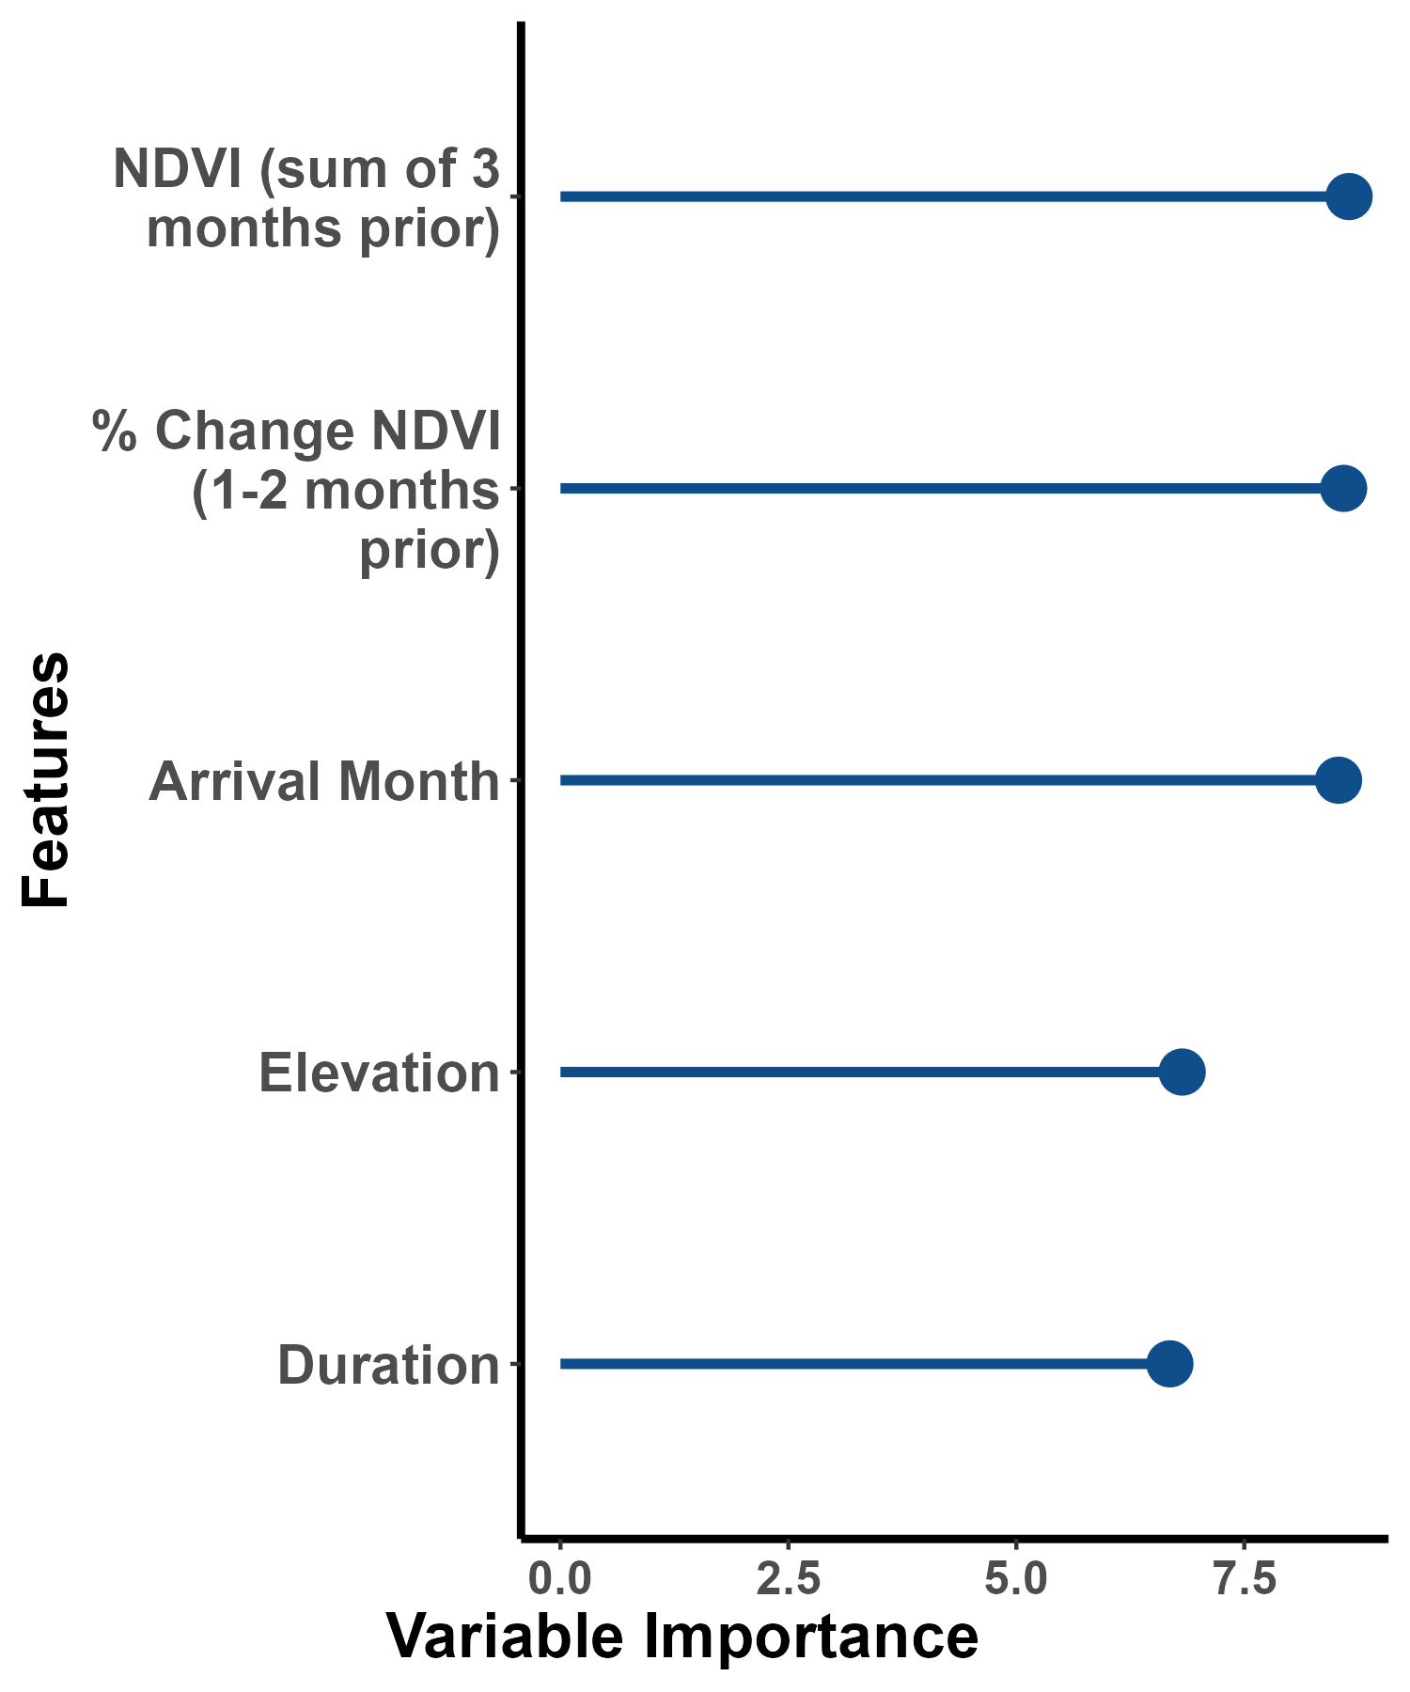
Random Forest Analysis
R² = 40 %
Vegetation phenology prior to wrack arrival and the month of wrack arrival were most important variables
Elevation and duration of wrack patch also important for determining recovery

Slide 19
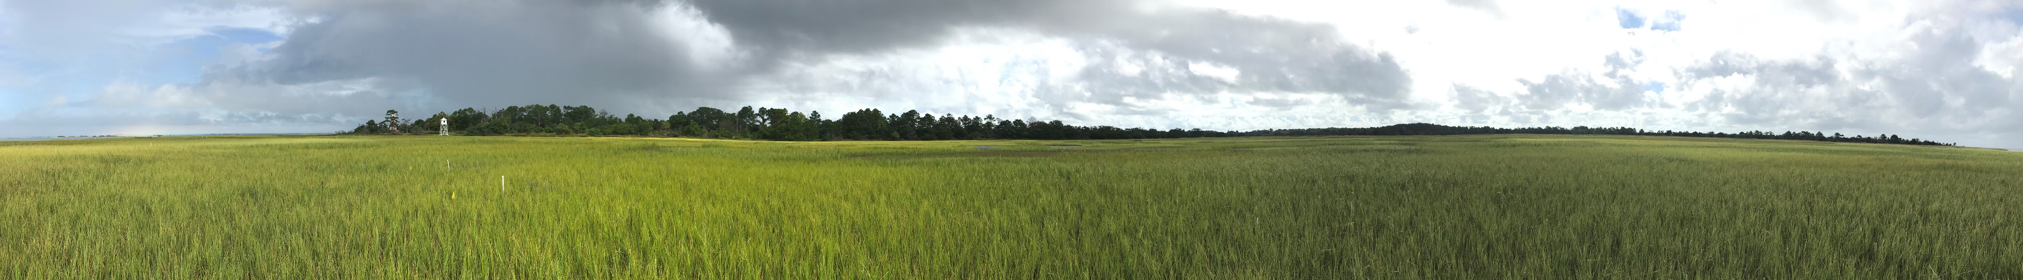
Conclusions
Kriging estimates of NDVI can be used to evaluate recovery of disturbed wrack patches and had 90% accuracy in predicting NDVI in test data
75% of wrack patches were recovered within 6 months and > 90% recovered by 1 year
Patches in place for 1 month recovered ~3 months faster than patches in place for ≥ 2 months
Patches that arrived in the fall recovered fastest
Vegetation phenology and wrack arrival month were most important variables in determining recovery length of disturbed areas

Slide 20
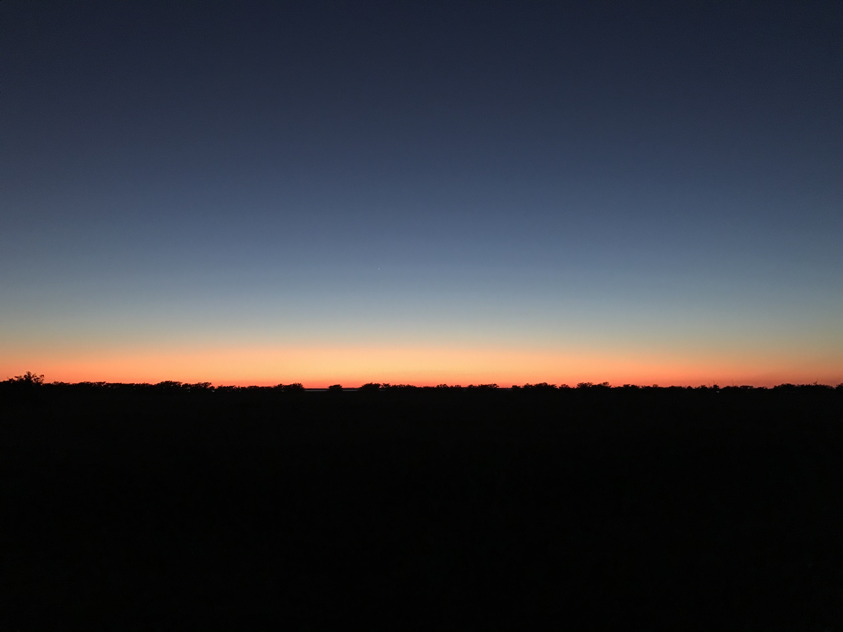
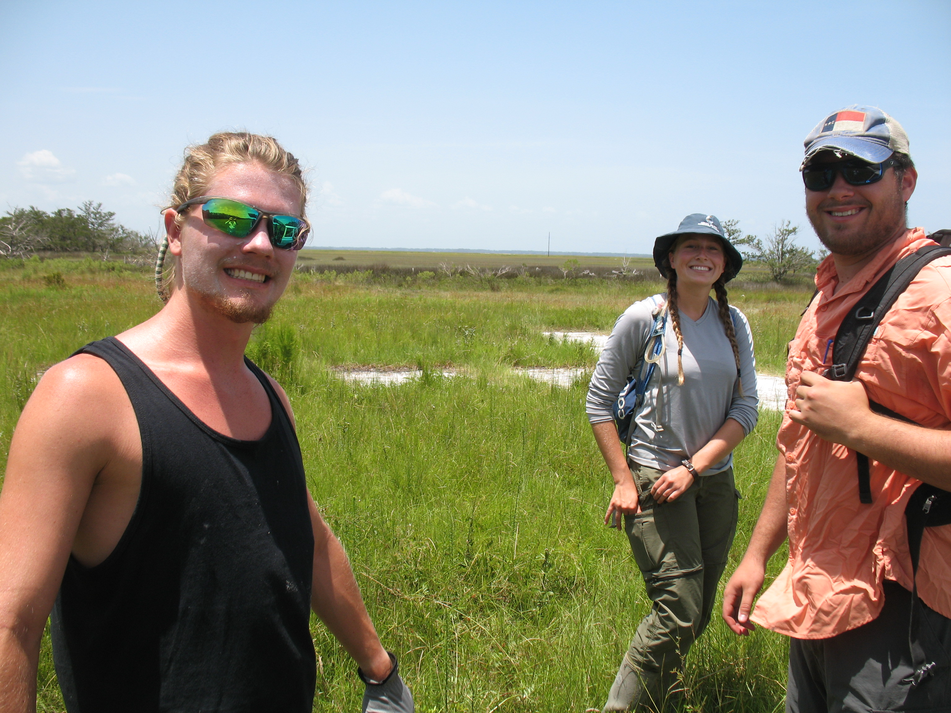
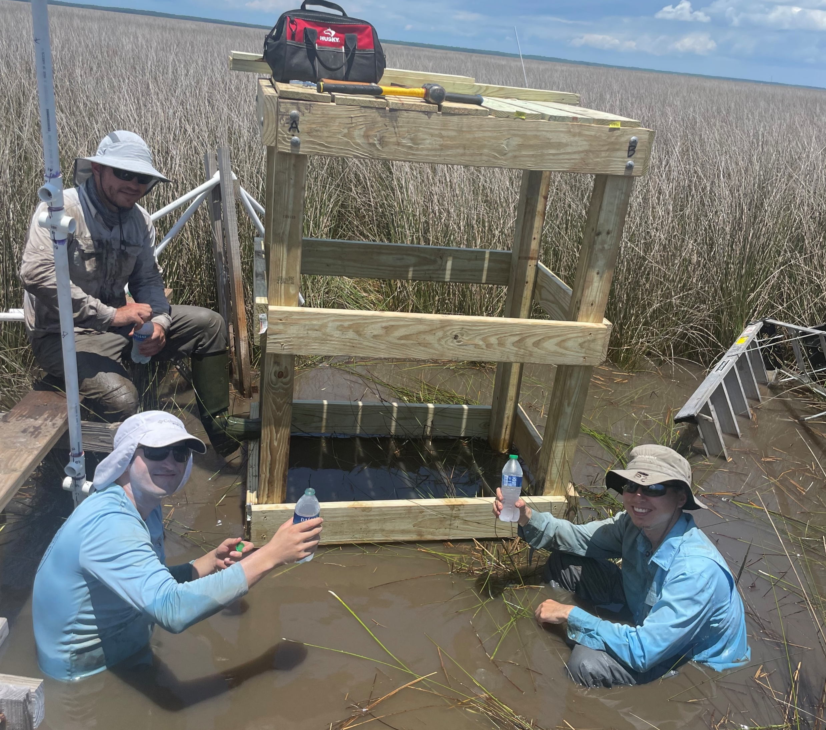

Acknowledgements
Schalles Lab
Harrison Curin
Tommy Pudil
Mitch Torkelson
GCE-LTER Disturbance Committee
GCE-LTER Remote Sensing Committee
GCE-LTER Field techs
Labmates

Slide 21
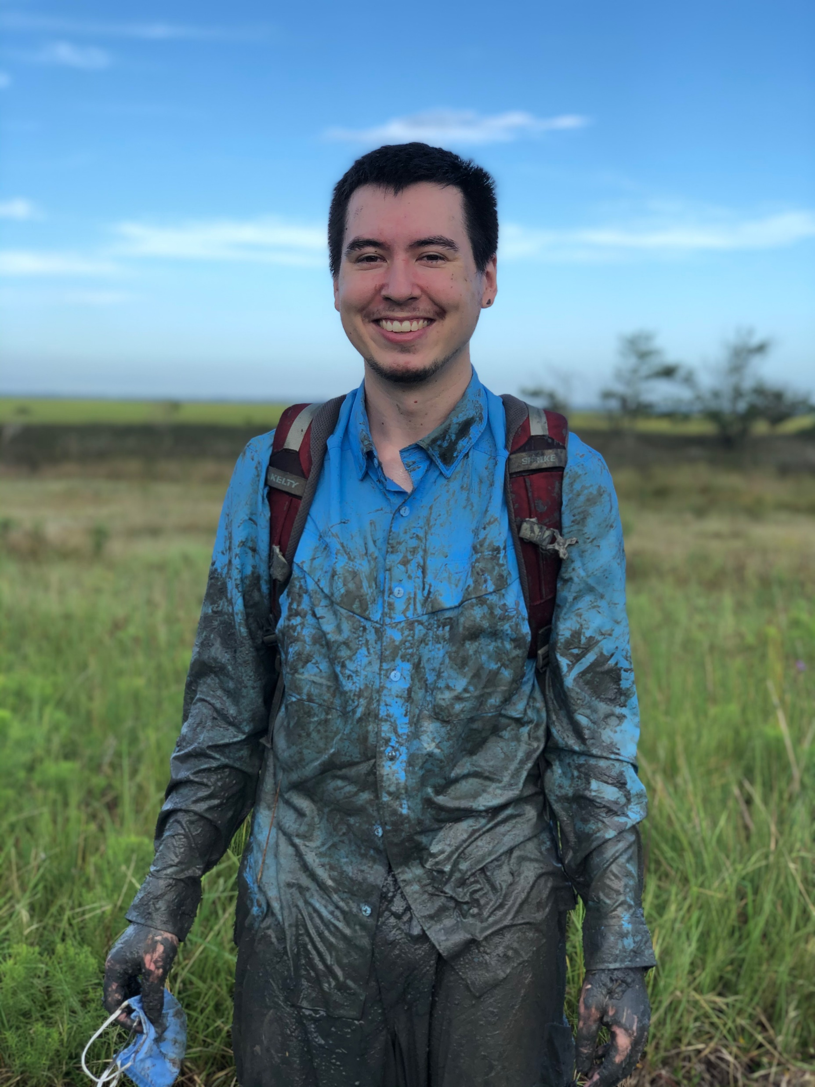
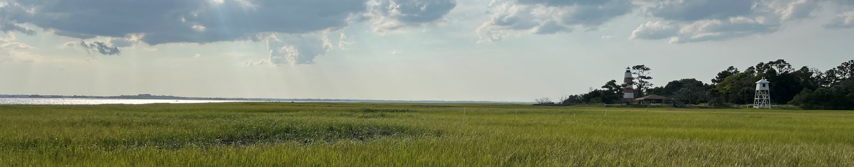
Contact
Tyler Lynn
University of Georgia
Department of Geography
tyler.lynn@uga.edu

