Slide 1


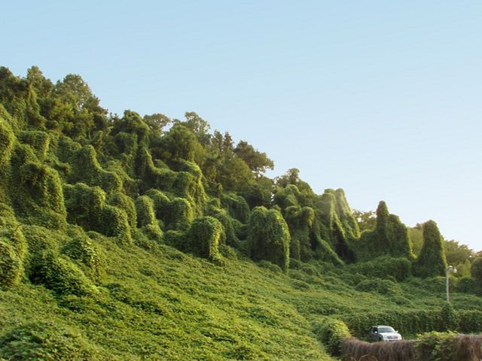



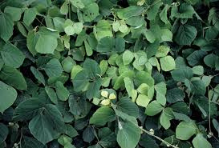
MODELING HABITAT SUITABILITY FOR KUDZU IN HAMILTON COUNTY, TN - A NOVEL CITIZEN SCIENCE STUDY USING GIS
Sydney Fuhrig, AKM Azad Hossain
April 24, 2025
Source: Google Images

Slide 2



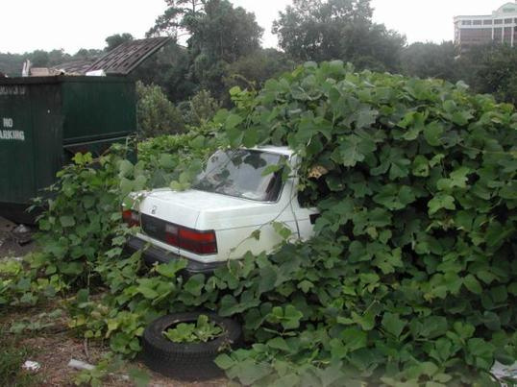

Problem Statement
Kudzu exists in many locations throughout Hamilton County and the Southeastern US.
It’s been termed “the vine that ate the South.”
Knowing the location of kudzu plants and prime habitat for the vine is crucial to management efforts.
Using GIS to predict kudzu locations with existing publicly available data would be a cost-effective tool to help direct resources toward managing kudzu populations.
Source: Google Images

Slide 3
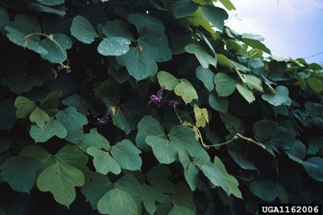
Literature Review
Kudzu can grow on any soil type and is only strongly affected by insufficient moisture and harsh winters (Qiu et al., 2013)
Most studies modeling kudzu habitat only use rainfall and temperature data (Qiu et al., 2013)
There is existing work using GIS for suitability models of native plant species, less for invasives (Bakirman & Gumusay, 2020)
A few habitat suitability and predictive models for kudzu exist (Shen et al., 2021; Kovach-Hammons & Marshall 2023)
Citizen science has been used to map kudzu with positive results (Hawthorne et al., 2015)
Source: Google Images

Slide 4
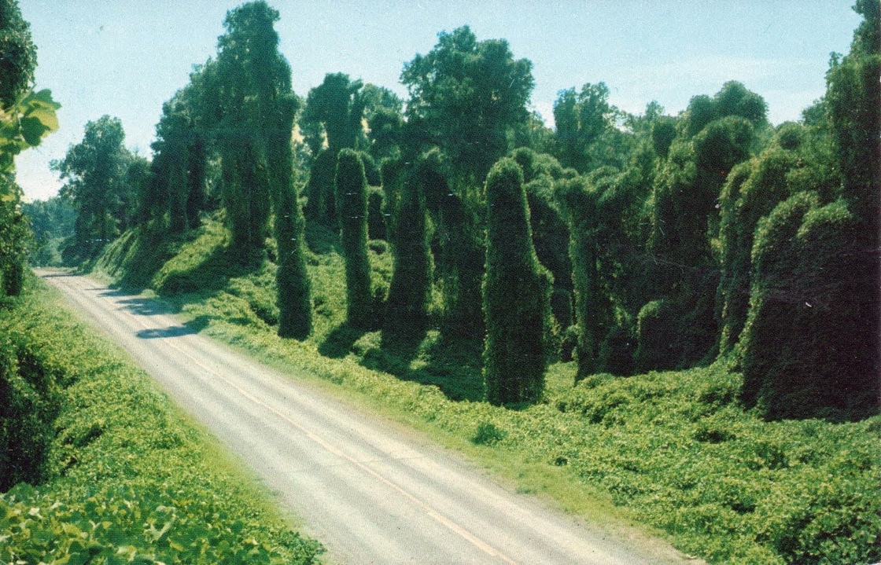
Goal & Objectives
Understanding Kudzu’s range and growth is crucial to land use planning and invasive species management efforts
No habitat suitability models using citizen science location data exist
GOAL: Determine suitability kudzu habitat in Hamilton County to predict areas where it’s likely to thrive
Source: Google Images

Slide 5
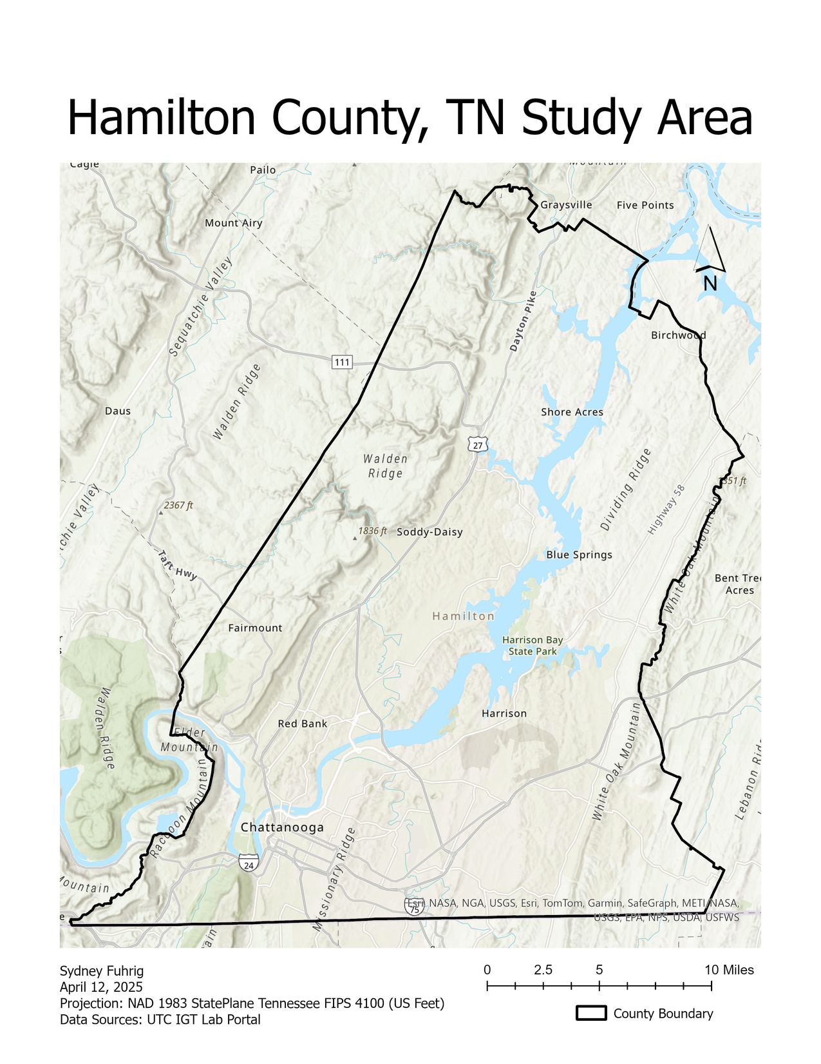
Main Tasks
1. Determine habitat criteria for kudzu
2. Apply this to Hamilton County to create the desired predicted areas model
3. Determine if the model predictions of suitable habitat align with known kudzu locations in Hamilton County

Slide 6

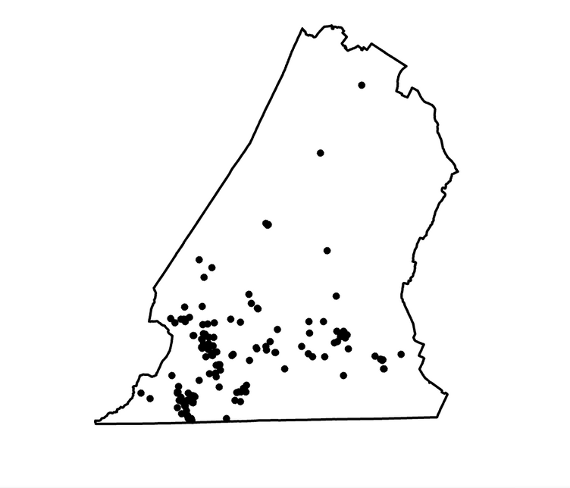
Data
DOWNLOADED:
Kudzu Observations (200 points) - iNaturalist
Hamilton County Boundary - UTC IGT Lab
Landsat 9 - USGS (April 2025)
NLCD - USGS (2023)
Slope - USGS (Course Lab 4)
Soil Type - USGS Soil Survey
DERIVED:
NDVI
Water Body Surfaces
Ranked Model Input Layers
iNaturalist Observations

Slide 7
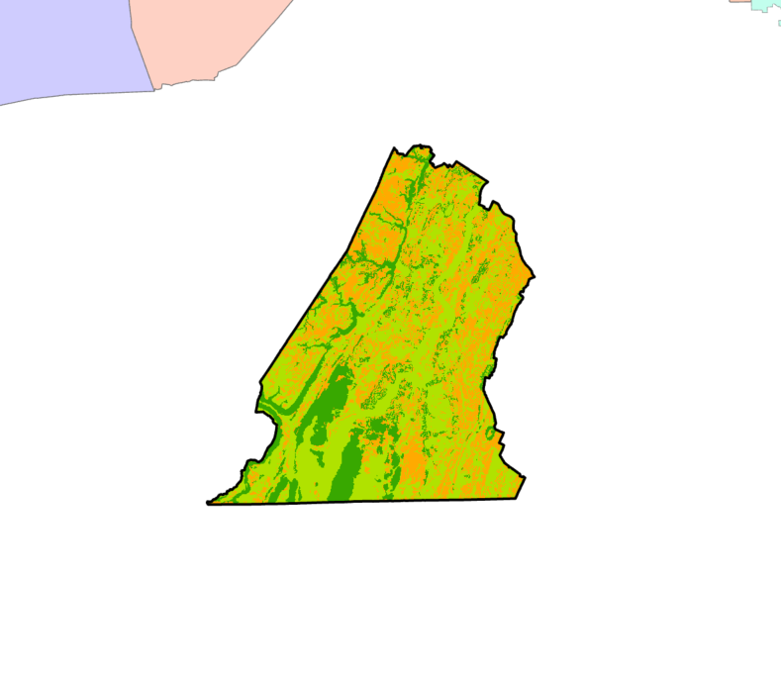
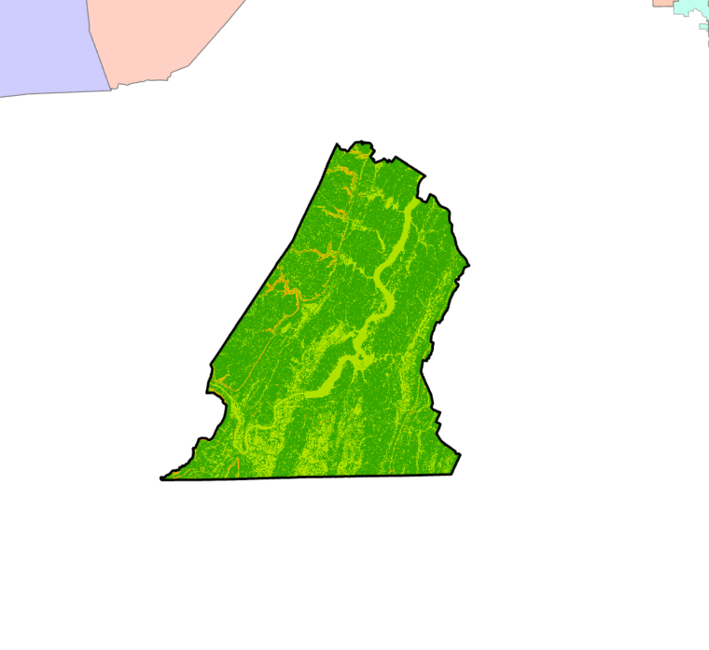
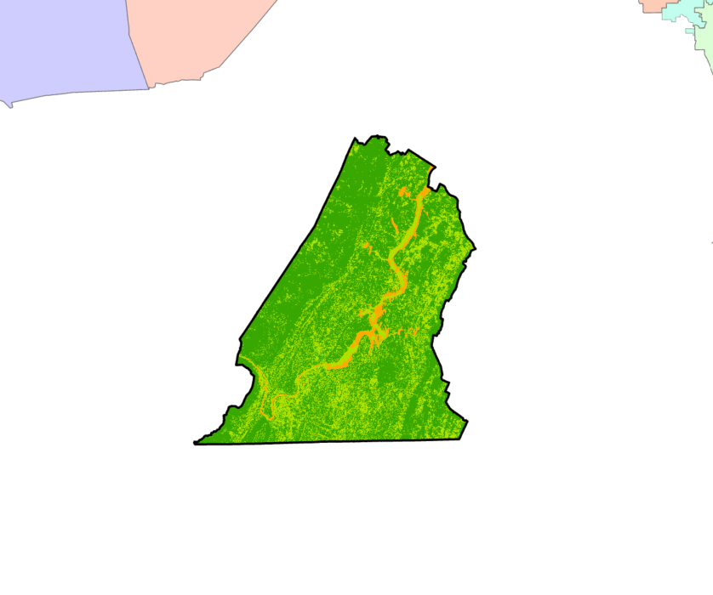
Ranked Model Components
1 = LOW SUITABILITY | 2 = MEDIUM SUITABILITY | 3 = HIGH SUITABILITY
Soil Type
Slope
NDVI
1 = Soils without Kudzu Observations
2 = 30 Soils with Kudzu Present
3 = BuF, FwD, FuE
1 = Slope > 28.36
2 = Slope 0 - 1.63 OR 19.45 - 28.36
3 = Slope 1.63 - 19.45
1 = NDVI ≤ 0 OR > 0.5
2 = NDVI 0 - 0.15 OR 0.27 - 0.5
3 = NDVI 0.15 - 0.25

Slide 8
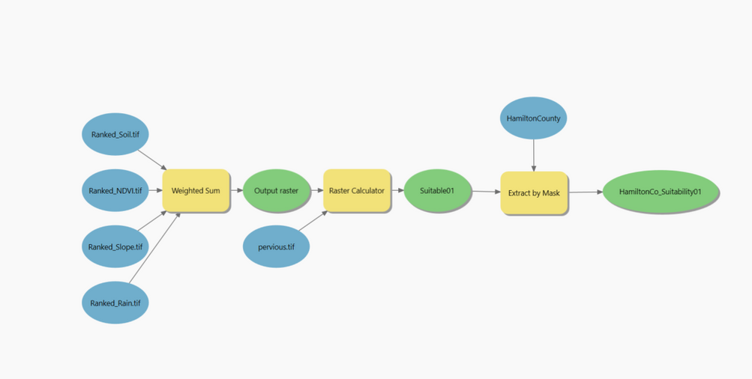
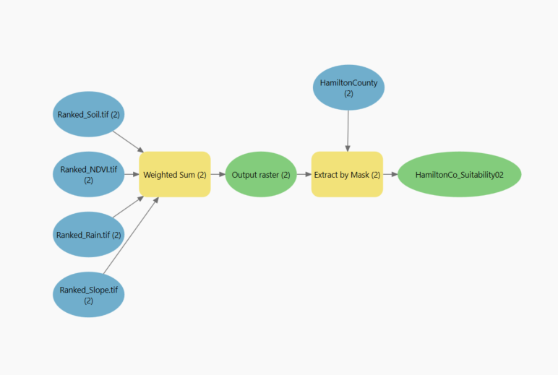
Model Iterations
Model 1: Unweighted with ranked slope, soil, NDVI, rainfall (pervious surfaces condition)
Model 2: Removed pervious surfaces condition
Model 3: Ranked rainfall weight of 2 (with pervious surfaces condition)
Model 4: Ranked Soil weight of 2 (with pervious surfaces condition)
Model 5: Ranked NDVI weight of 2 (with pervious surfaces condition)
Model 6: Unweighted, removed rainfall (with pervious surfaces condition)
Model 7: Unweighted, removed rainfall and pervious condition
Model 8: Unweighted, reranked NDVI (1-3 instead of previous 0-3)
Model 9: Unweighted, added step to remove water bodies

Slide 9
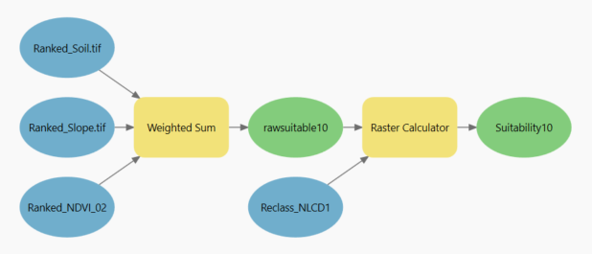
The Final Model
Ranked Slope
Ranked Soil
Weighted Sum
Raw Suitability Layer
Raster Calculator
Final Suitability Layer
Ranked NDVI
Water Bodies
ArcGIS Pro 3.3.0

Slide 10
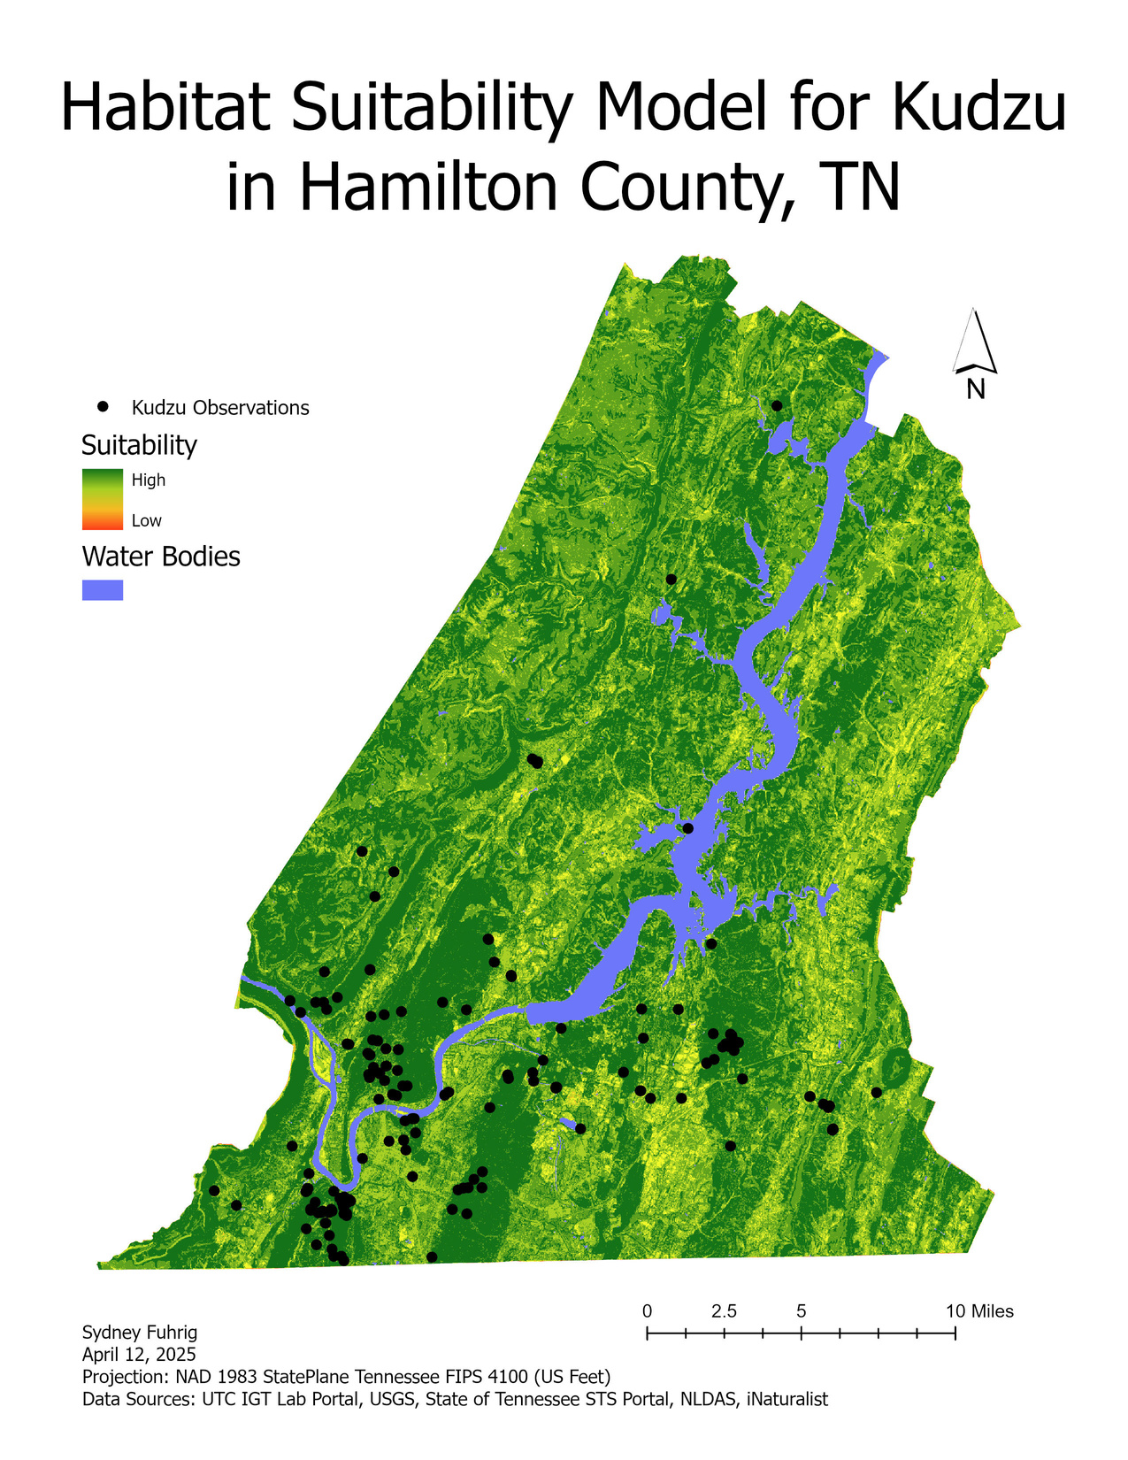
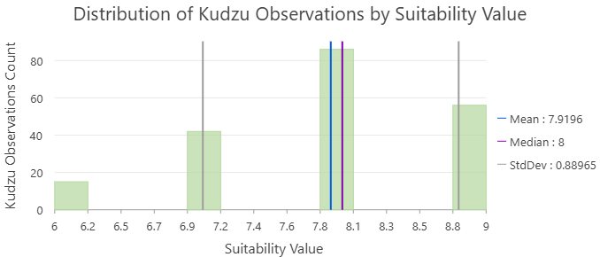
Model Results

Slide 11

Conclusion
Mapping invasive species habitat is crucial
This model proves that citizen science data has utility in habitat suitability models
NEXT STEPS:
Collect primary kudzu observation data
Evaluate accuracy of iNaturalist data
Evaluate conditions over time
Add temperature and precipitation data to model
Conduct formal accuracy assessment with field data
Source: Google Images

Slide 12
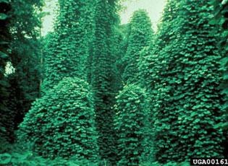
THANK YOU!
Questions?
Sydney Fuhrig, AKM Azad Hossain
University of Tennessee at Chattanooga
gkf432@mocs.utc.edu

Slide 13
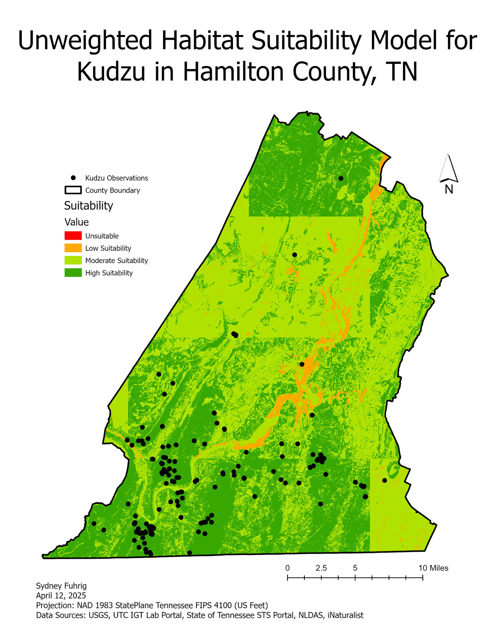
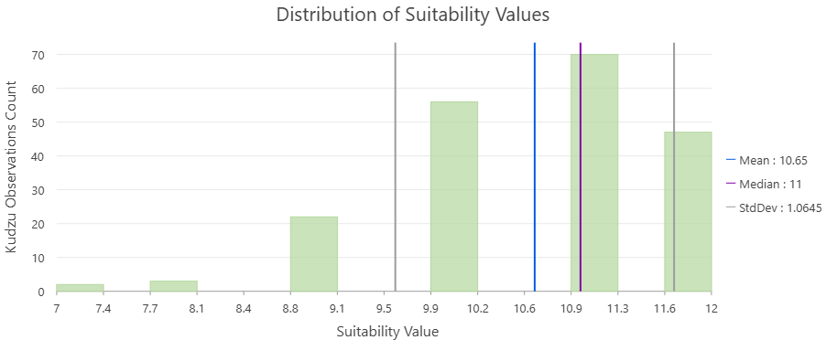
Model Results

Slide 14
References
Aurambout, J.-P. ., & Endress, A. G. (2018). A model to simulate the spread and management cost of kudzu (Pueraria montana var. lobata) at landscape scale. Ecological Informatics, 43, 146–156. https://doi.org/10.1016/j.ecoinf.2017.12.004
Bakirman, T., & Gumusay, M. U. (2020). A novel GIS-MCDA-based spatial habitat suitability model for Posidonia oceanica in the Mediterranean. Environmental Monitoring and Assessment, 192(4). https://doi.org/10.1007/s10661-020-8198-1
Hawthorne, T. L., Elmore, V., Strong, A., Bennett-Martin, P., Finnie, J., Parkman, J., Harris, T., Singh, J., Edwards, L., & Reed, J. (2015). Mapping non-native invasive species and accessibility in an urban forest: A case study of participatory mapping and citizen science in Atlanta, Georgia. Applied Geography, 56, 187–198. https://doi.org/10.1016/j.apgeog.2014.10.005
Kovach-Hammons, A. M., & Marshall, J. M. (2023). Predictive Modeling of Kudzu (Pueraria montana) Habitat in the Great Lakes Basin of the United States. Plants, 12(1), 216. https://doi.org/10.3390/plants12010216
‌Kudzu. (n.d.). Www.tn.gov. https://www.tn.gov/protecttnforests/invasive-plants/kudzu.html
Qiu, F., Chastain, B., Zhou, Y., Zhang, C., & Sridharan, H. (2013). Modeling land suitability/capability using fuzzy evaluation. GeoJournal, 79(2), 167–182. https://doi.org/10.1007/s10708-013-9503-0
Rai, P. K., & Singh, J. S. (2020). Invasive alien plant species: Their impact on environment, ecosystem services and human health. Ecological Indicators, 111(0), 106020. https://doi.org/10.1016/j.ecolind.2019.106020
Shahrtash, M., Tucker, A. E., Weaver, M. A., & Brown, S. P. (2023). Control strategies for the invasive plant kudzu (Pueraria montana) only minimally impacts soil activity, chemistry, and bacterial and fungal communities. Pedobiologia, 101, 150897. https://doi.org/10.1016/j.pedobi.2023.150897
‌Shen, M., Tang, M., Jiao, W., & Li, Y. (2024). Kudzu invasion and its influential factors in the southeastern United States. International Journal of Applied Earth Observation and Geoinformation, 130(103872), 103872–103872. https://doi.org/10.1016/j.jag.2024.103872
‌Shen, M., Tang, M., & Li, Y. (2021). Phenology and Spectral Unmixing-Based Invasive Kudzu Mapping: A Case Study in Knox County, Tennessee. Remote Sensing, 13(22), 4551. https://doi.org/10.3390/rs13224551
Waldner, L. S. (2008). The kudzu connection: Exploring the link between land use and invasive species. Land Use Policy, 25(3), 399–409. https://doi.org/10.1016/j.landusepol.2007.09.006
‌
Wang, C.-J., & Wan, J.-Z. (2021). Functional trait perspective on suitable habitat distribution of invasive plant species at a global scale. Perspectives in Ecology and Conservation. https://doi.org/10.1016/j.pecon.2021.07.002

