Slide 1
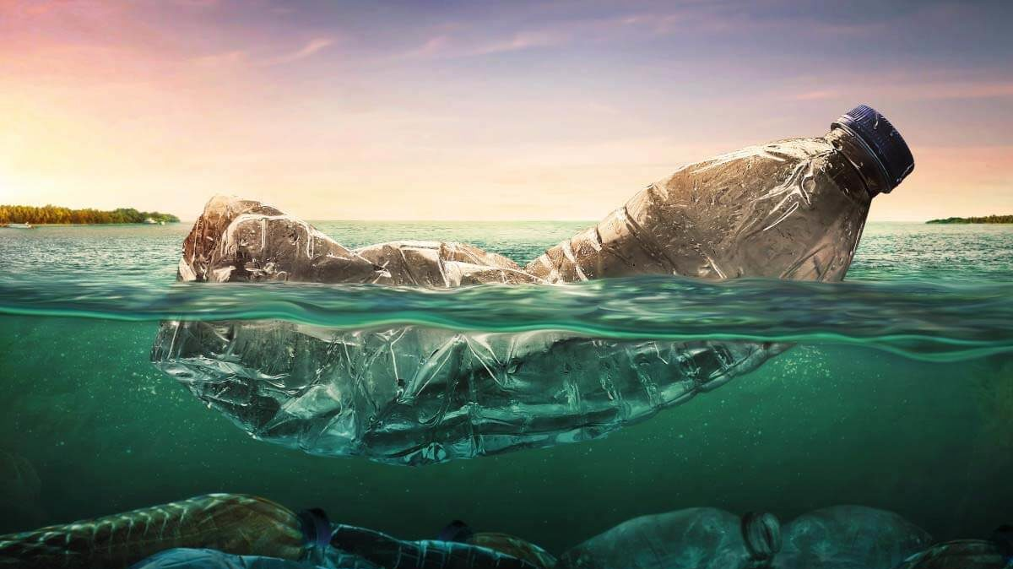
Microplastic Analysis in TN Environments Using Standard Reflectance Spectroscopy
Presented by: Jake Carr and Michael Mckinney

Slide 2
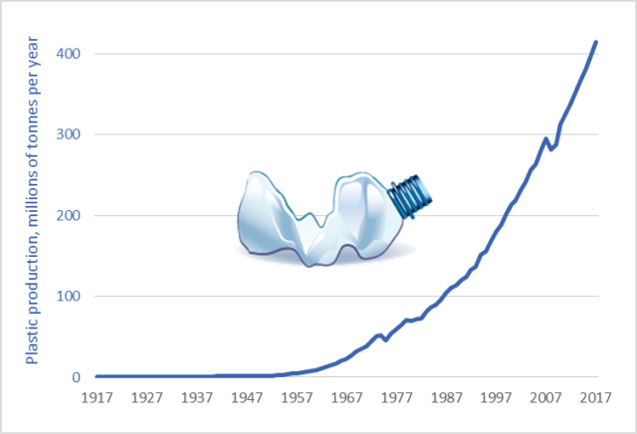

Plastic Production per year
10 million tons dumped in oceans
50% made are single use products
9 percent average recycling rate
More plastic in oceans than fish by 2050

Slide 3
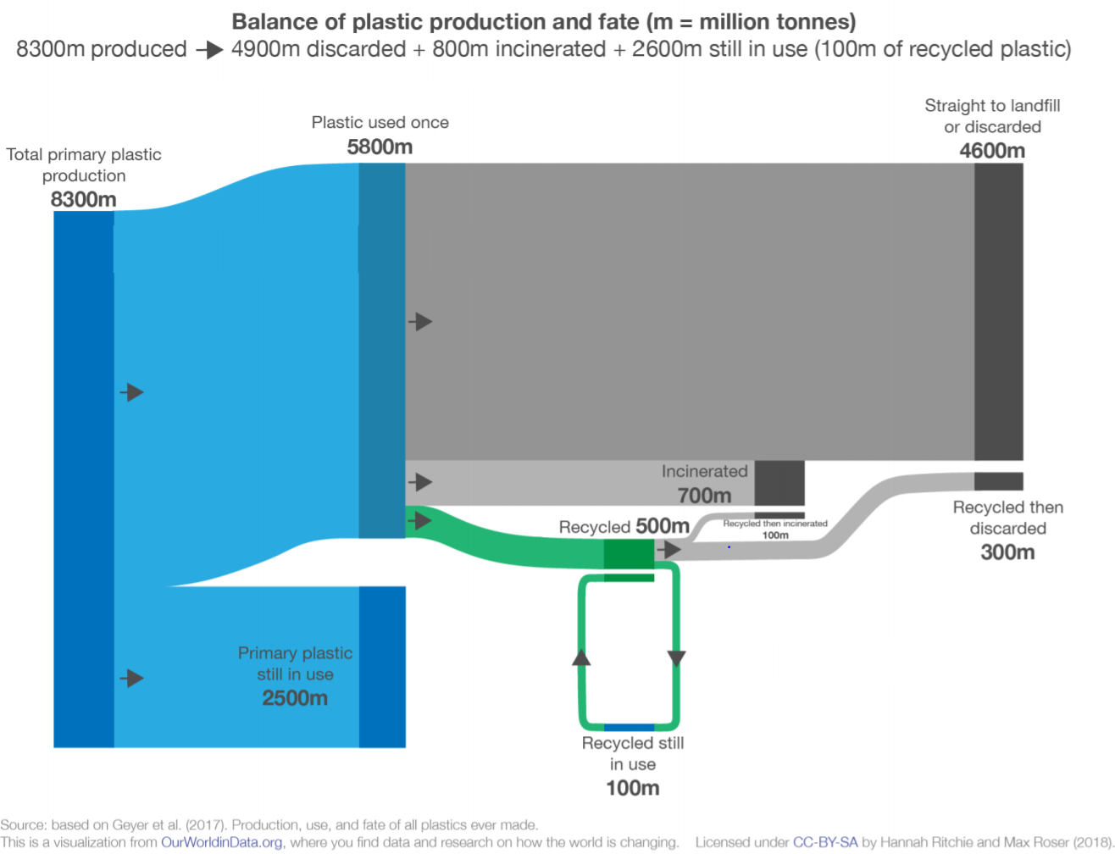
55% into the environment
8% incinerated
4% recycled then discarded
1% recycled still in use
30% primary still in use
Geyer et al., 2017
Notes:
Recycling has failed. For plastics, it’s not 10% recovery. It’s more like 1% recovery. We’ve incinerated 8 times more than we’ve recycled.
It’s not a circular economy. It’s more like a loop-the-loop.

Slide 4
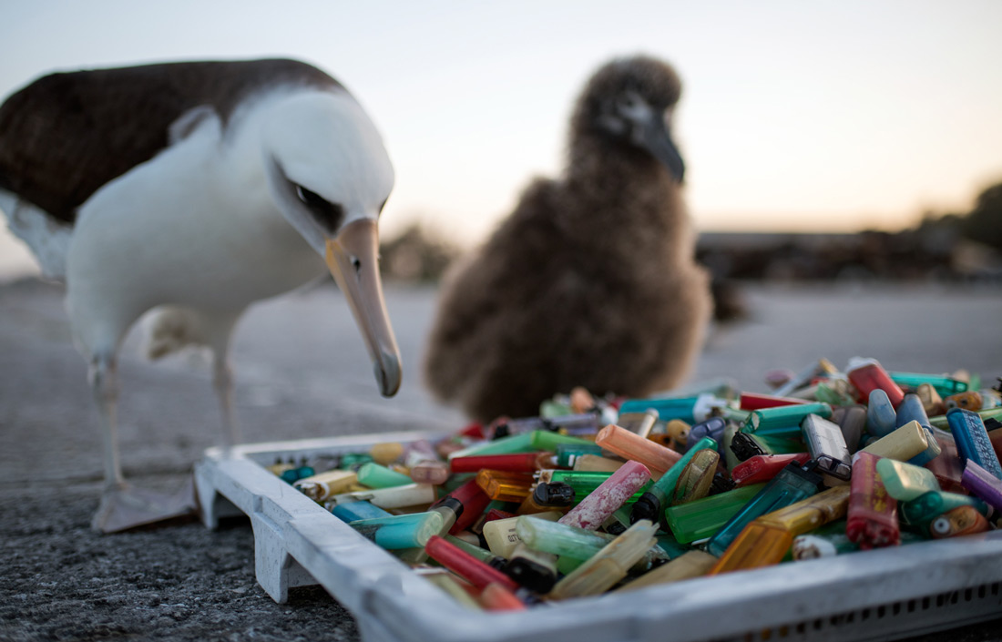
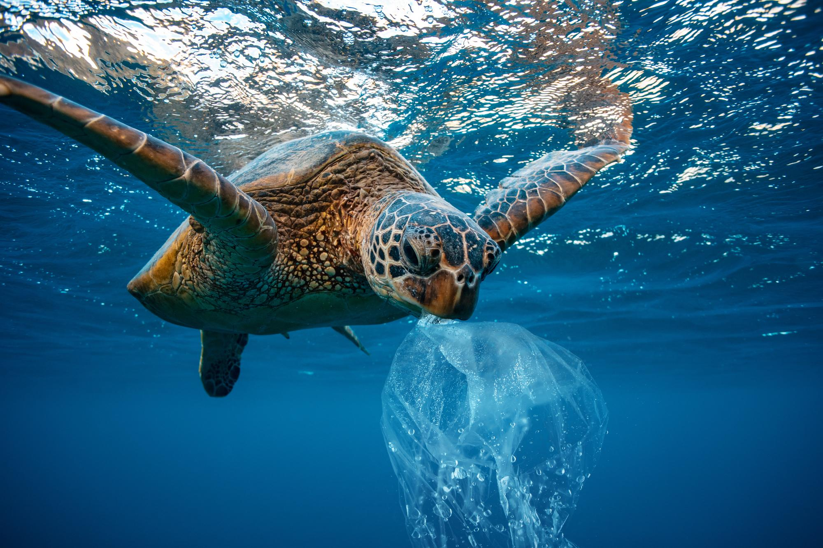
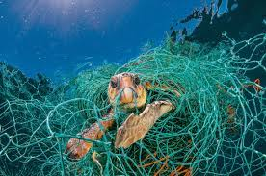
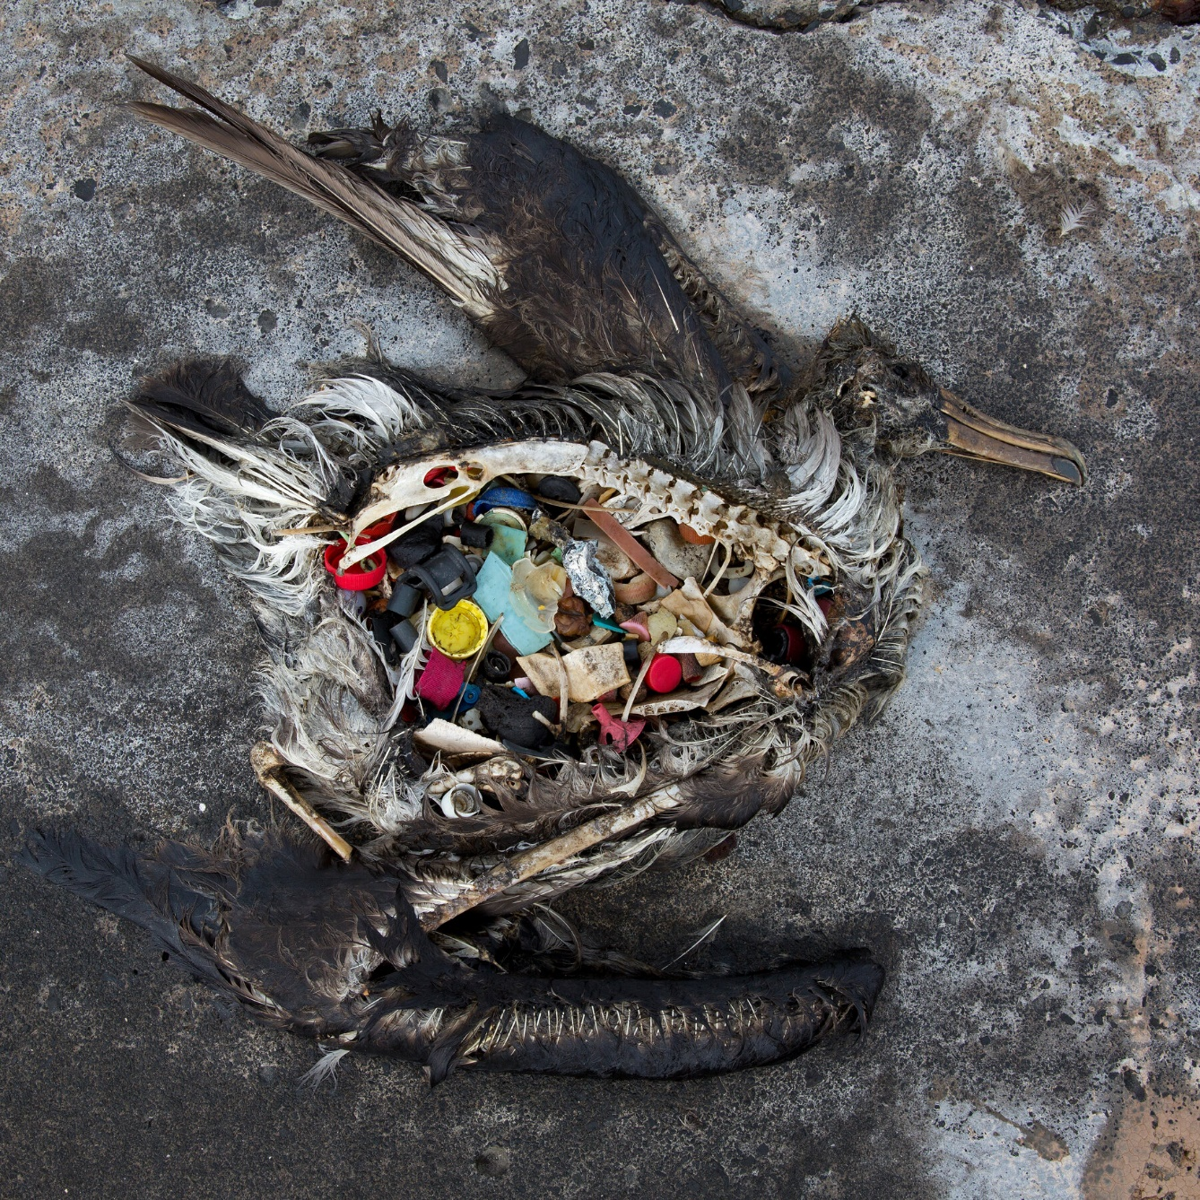

Slide 5
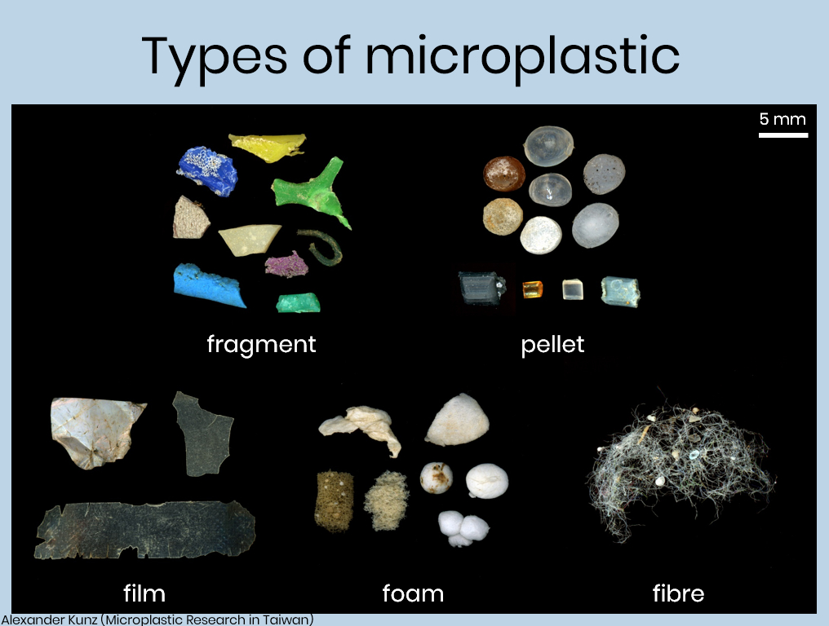
What are they?
Solid polymer state
<5mm
Insolubility in water
High Resistance to biodegradation
Natural vs non natural

Slide 6
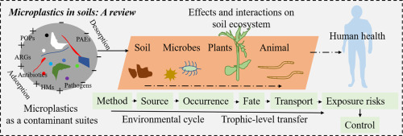
Food chain transportation

Slide 7


Impacts of microplastics on humans and ecosystems
Martin Pletz, Ingested microplastics: Do humans eat one credit card per week? Journal of Hazardous Materials Letters, Volume 3, 2022

Slide 8
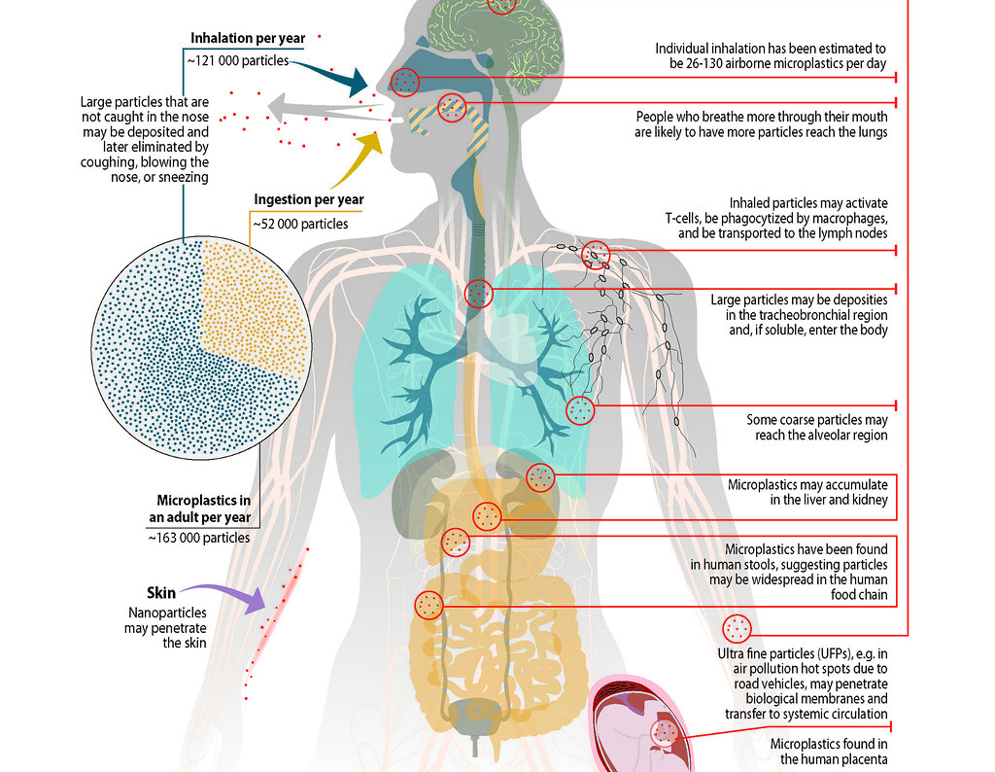
Source: United Nations Environment Programme, 2021

Slide 9

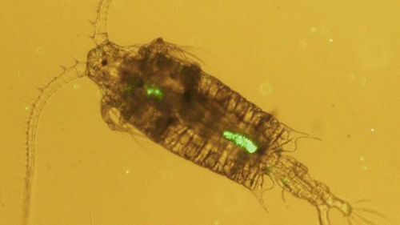


IMPACTS OF MICROPLASTICS | Overview
Changing properties of beaches
Ingestion by animals
Vectors for harmful pathogens
Magnet for toxins
Notes:
Some studies suggest that the presence of microplastics in sand can alter the permeability (how easily water passes through) and temperature of the sand, which could have impacts on sea turtles which have temperature-dependent sex-determination e.g. Carson et al.(2011)
Microplastics can also act as vectors for harmful pathogens and invasive species which latch on and use the plastic as a floating raft. The smaller the plastic item, the larger the surface-area-to-volume ratio, allowing more microorganisms to attach to one piece of plastic. These floating rafts can then transport pathogens and invasive species to new geographic areas.
The properties of plastic make them so they act as magnets for toxins present in the marine environment, notably Persistent Organic Pollutants (POPs). These are pollutants present in run-off from agricultural fields, for example, which have difficultly breaking down in the marine environment. Studies have found that these pollutants can be present on and in microplastics at a concentration of 1 million times the background concentration in surrounding seawater.
This is also a problem when microplastics are ingested, as these toxins are carried into the bodies…. (see next slide)

Slide 10

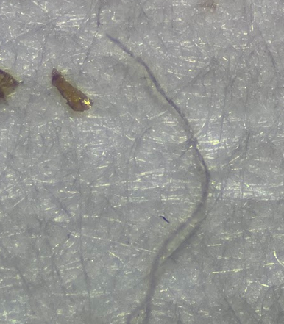
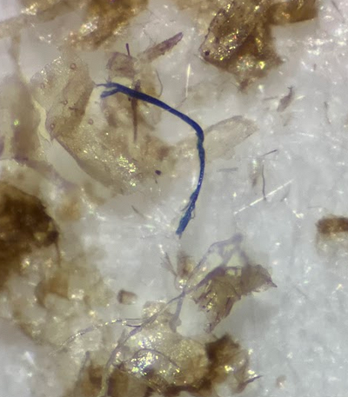
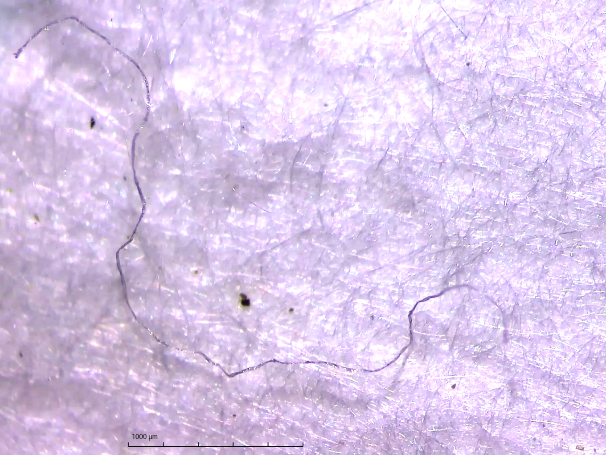
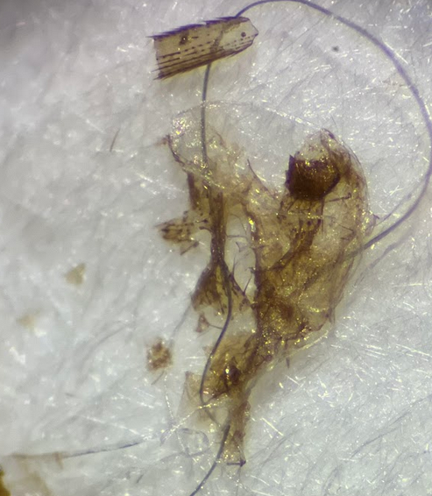
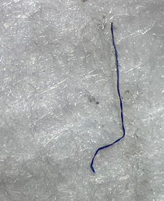
Fibers –
GI TRACTS

Slide 11
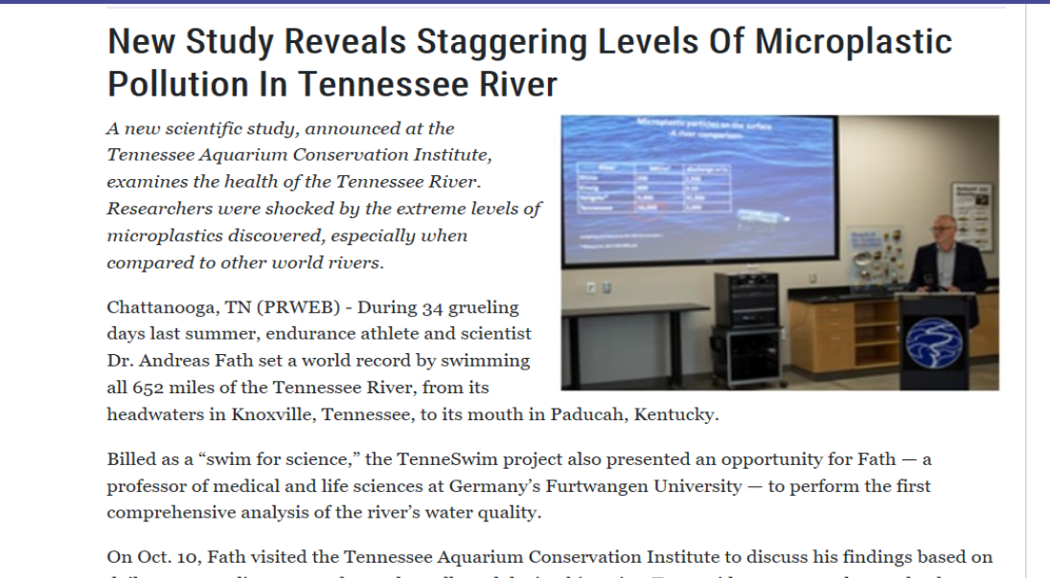
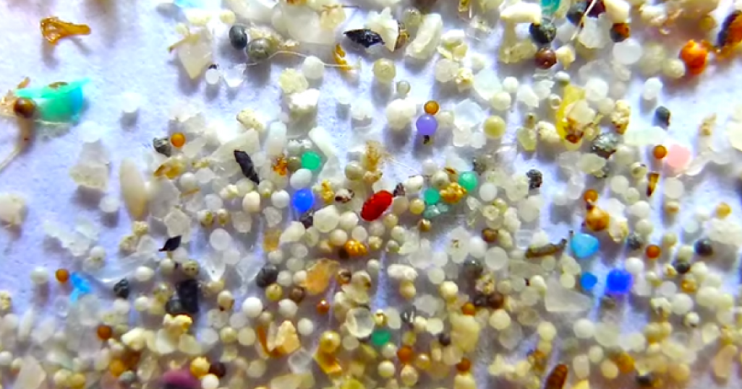

Slide 12
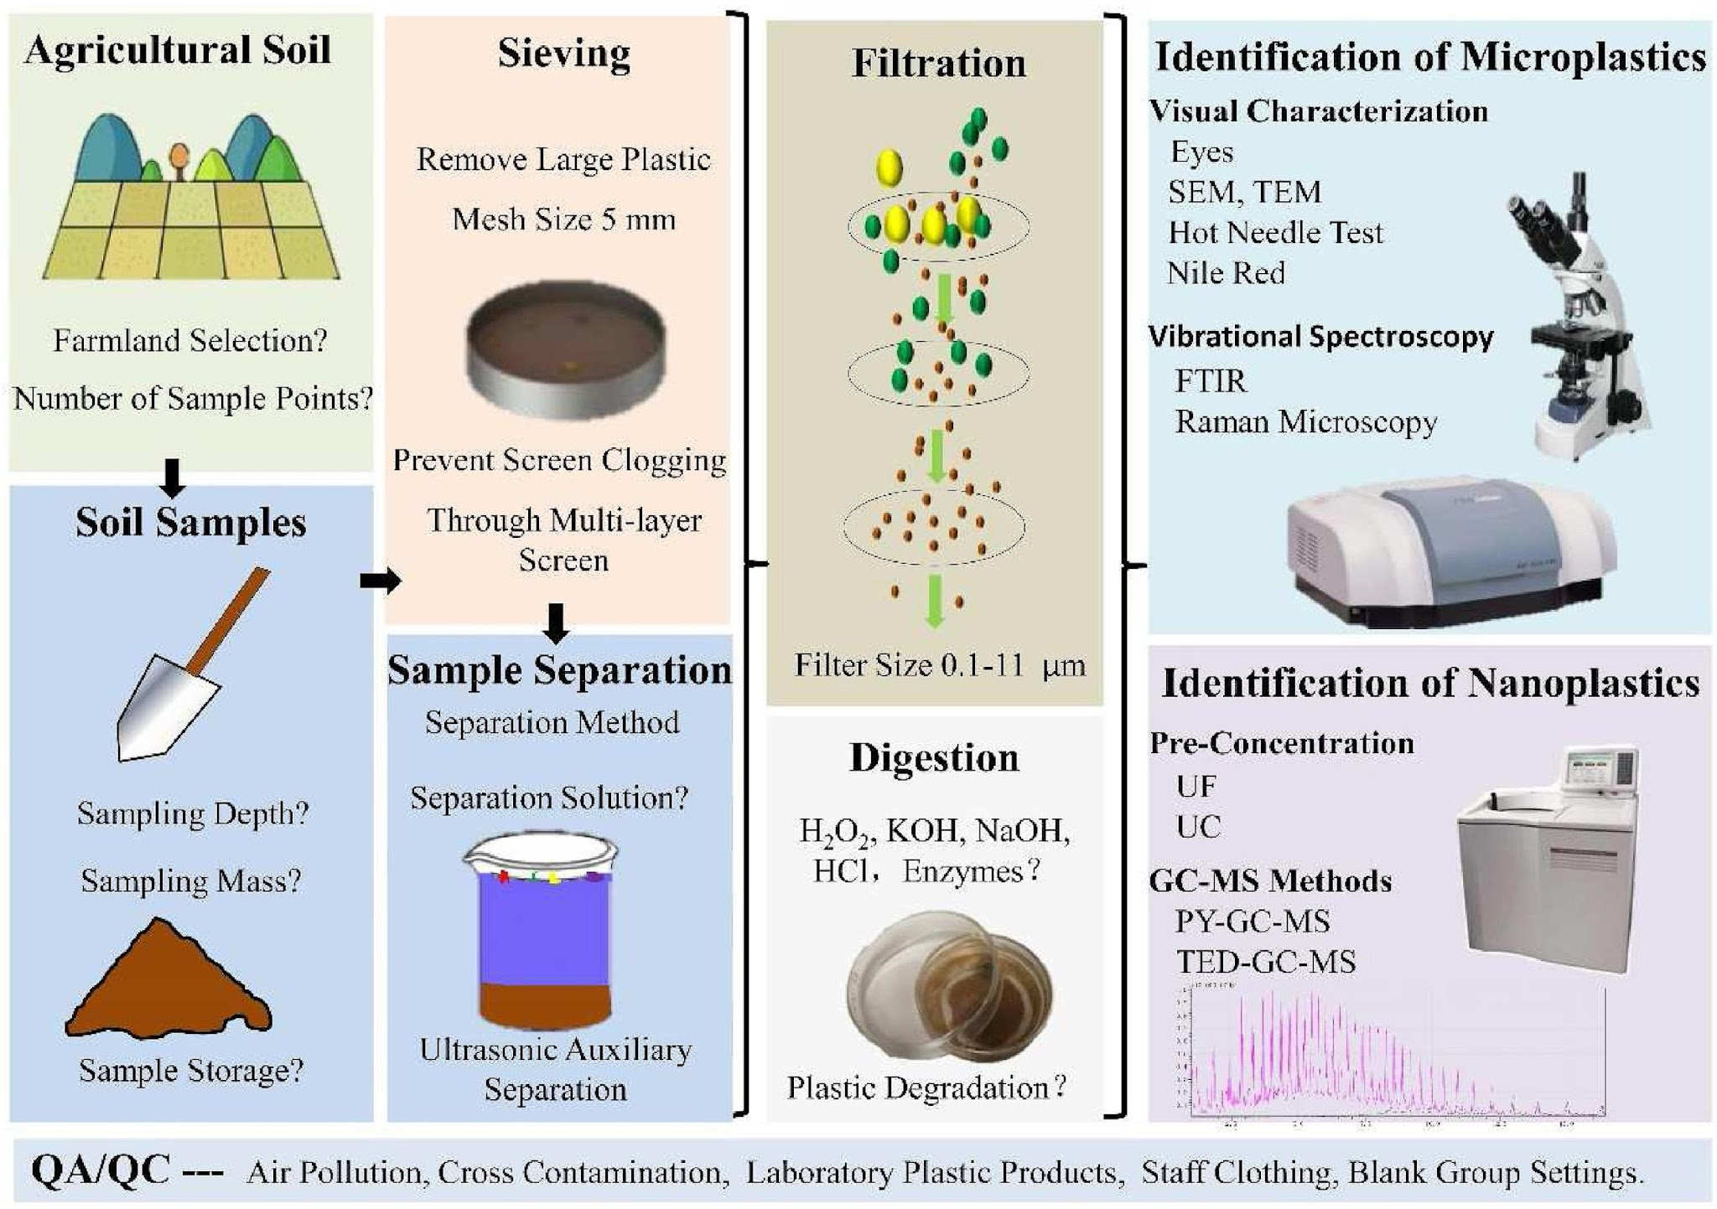
The Current Method For Processing environmental microplastic
Junhao et al. J. enviro mgmt. 2021

Slide 13

The Modified Method For Processing environmental microplastic
Junhao et al. J. enviro mgmt. 2021

Slide 14

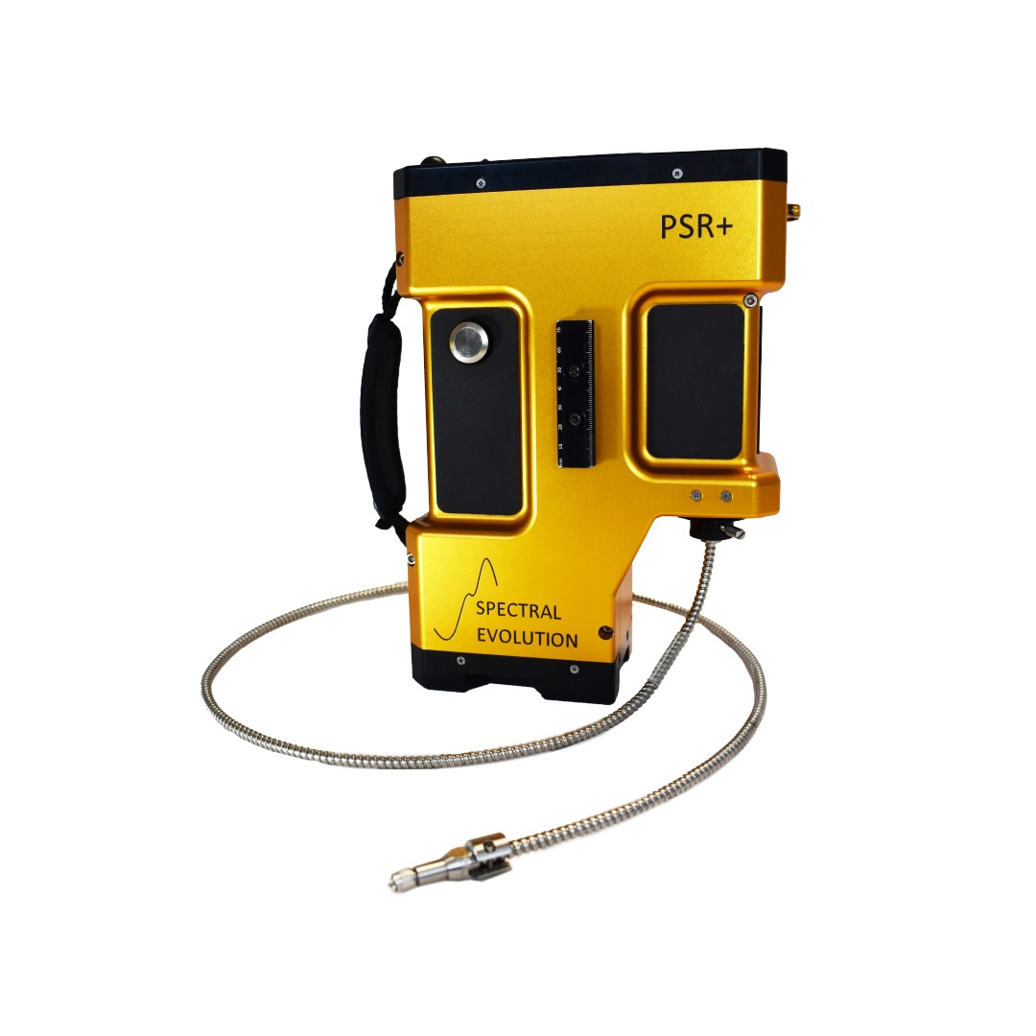
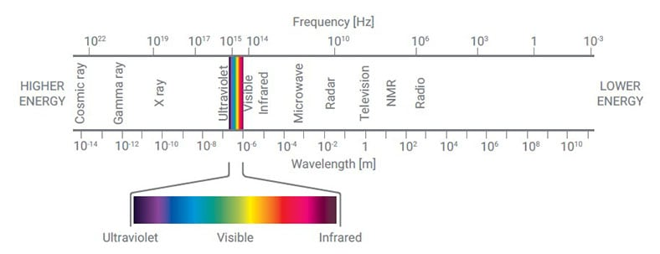
Quantifications
TN Red Clay Soil +
  PP (Polypropylene)
  PVC (Polyvinyl Chloride)
  LDPE (Low Density Polyethylene )
  PS (Polystyrene)
10 known concentrations per plastic polymer: from 1% to 10%, with 1% increment.
Each sample has a total mass of 15 grams.

Slide 15
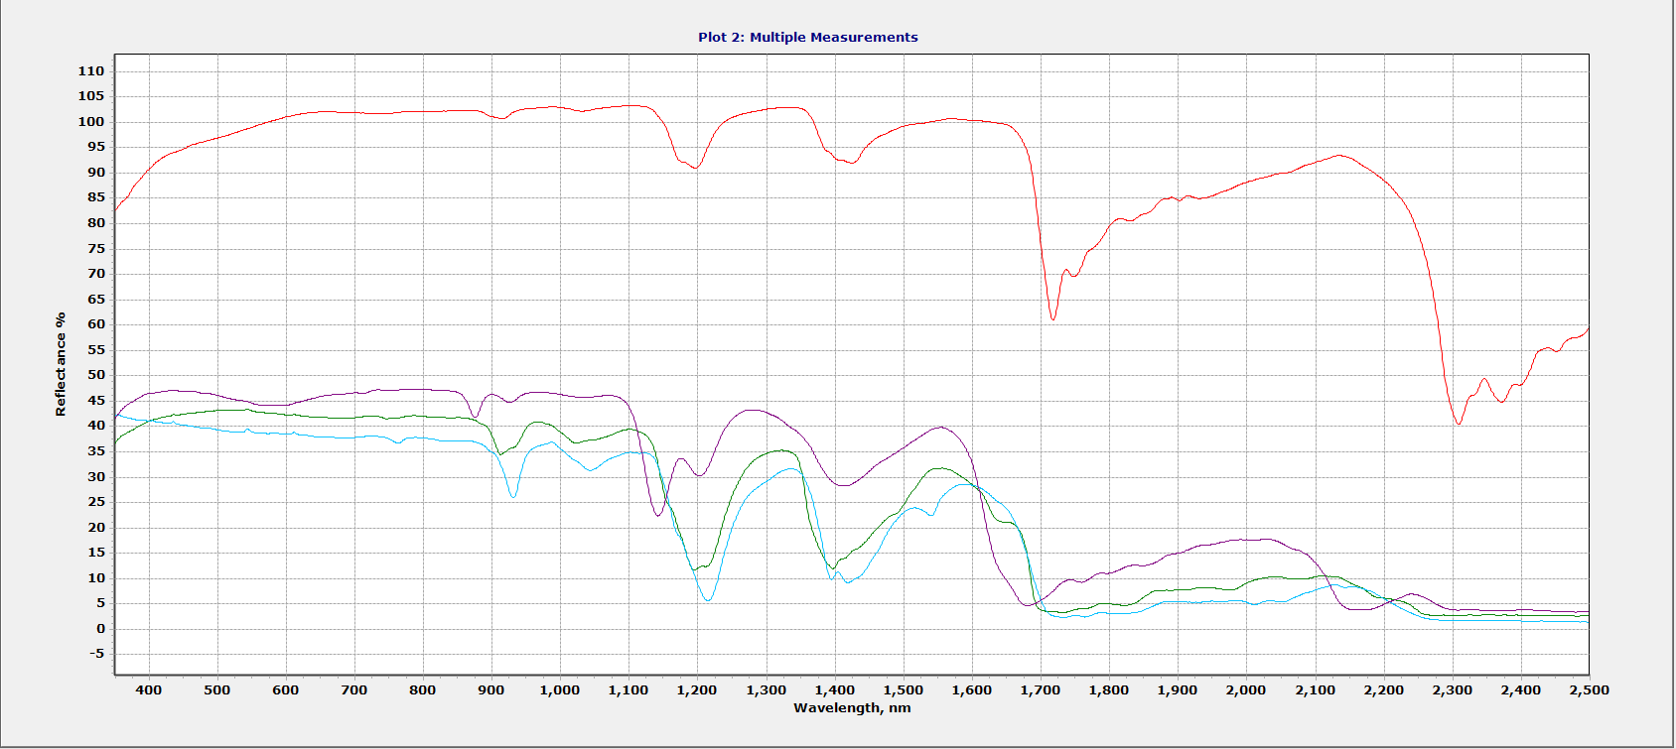
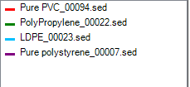
UV-Vis-NIR Spectroscopy
Spectroscopy allows for the identification of a material or compound through their unique reflectance.
In this case spectroscopy allows for us to look at the individual structure of the polymers.

Slide 16
UV-Vis-NIR Spectroscopy
Polymer Structures are categorized in two ways:
Semi Crystaline- More reflectance Amorphous- Less reflectance
The different structures plays a role in the polymer's unique reflectance.

Slide 17
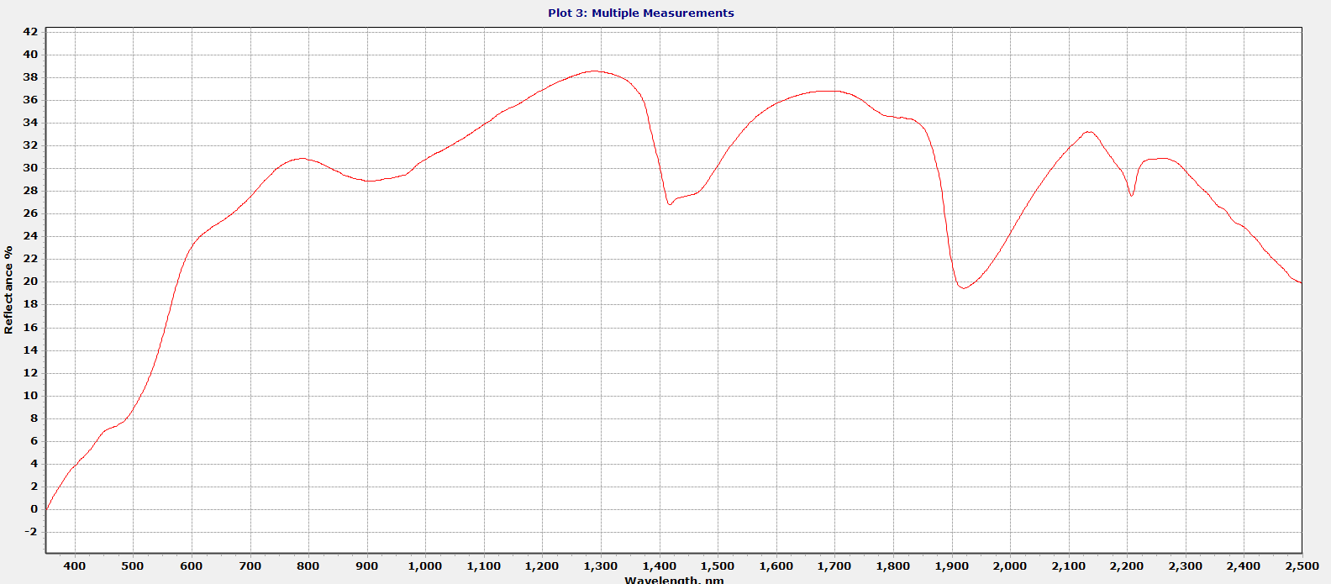
Tn Red Clay Soil Measurements

Slide 18
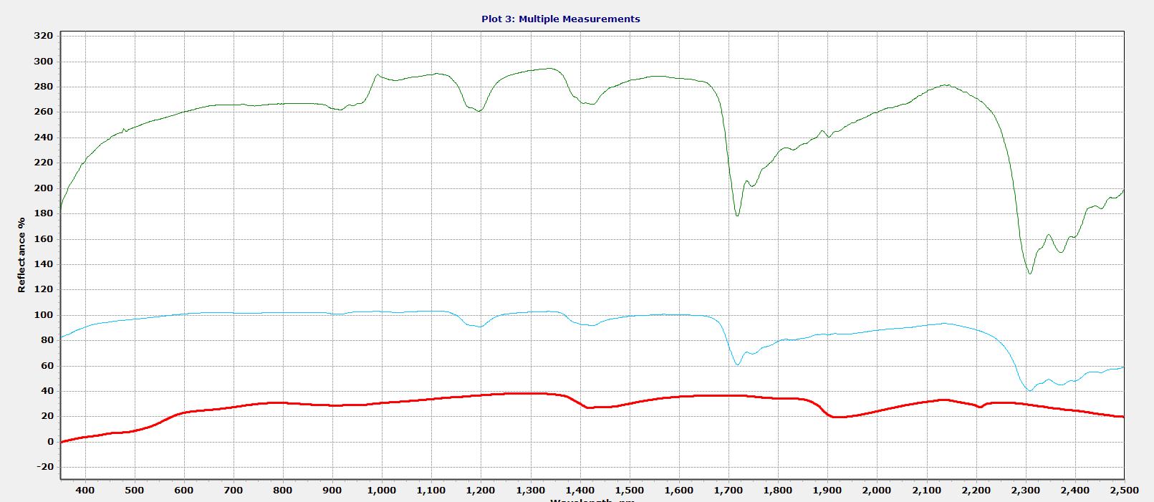

TN Soil and PVC Mixture

Slide 19
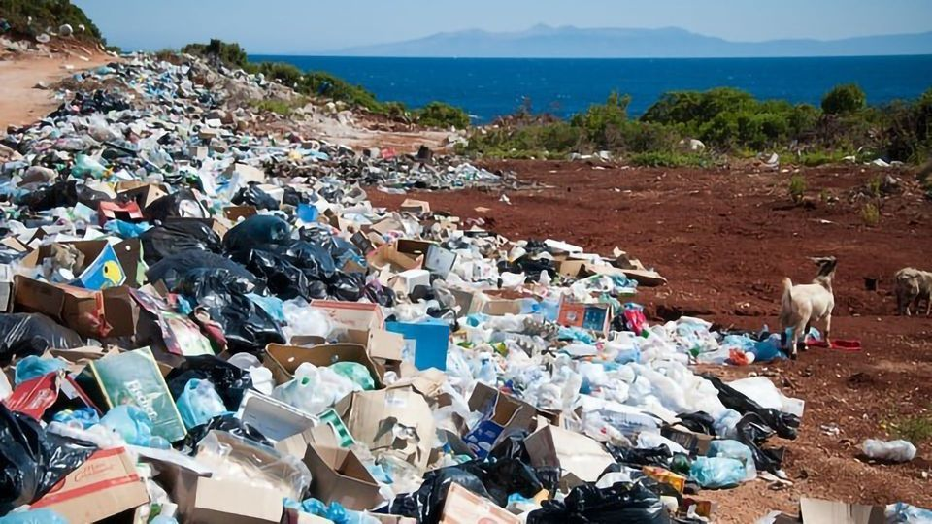
Sample Prep
Identify + quantify 4 types of MPs within soil
  PP (Polypropylene)
  PVC (Polyvinyl Chloride)
  LDPE (Low Density Polyethylene )
  PS (Polystyrene)
The PSR+ allows us to quickly identify the microplastic polymer within soil in a 1%-10% concentration range.
Particle size: 250-840 microns
Step 1
Soil Milled to 250-840 Microns
Step 2
Plastic Polymer Milled to 250-840 Microns
Step 3
Soil and Plastics Mixed together
Step 4
Mixture Grounded with Mortar and Pestle
Step 5
Mixture analyzed with contact probe

Slide 20
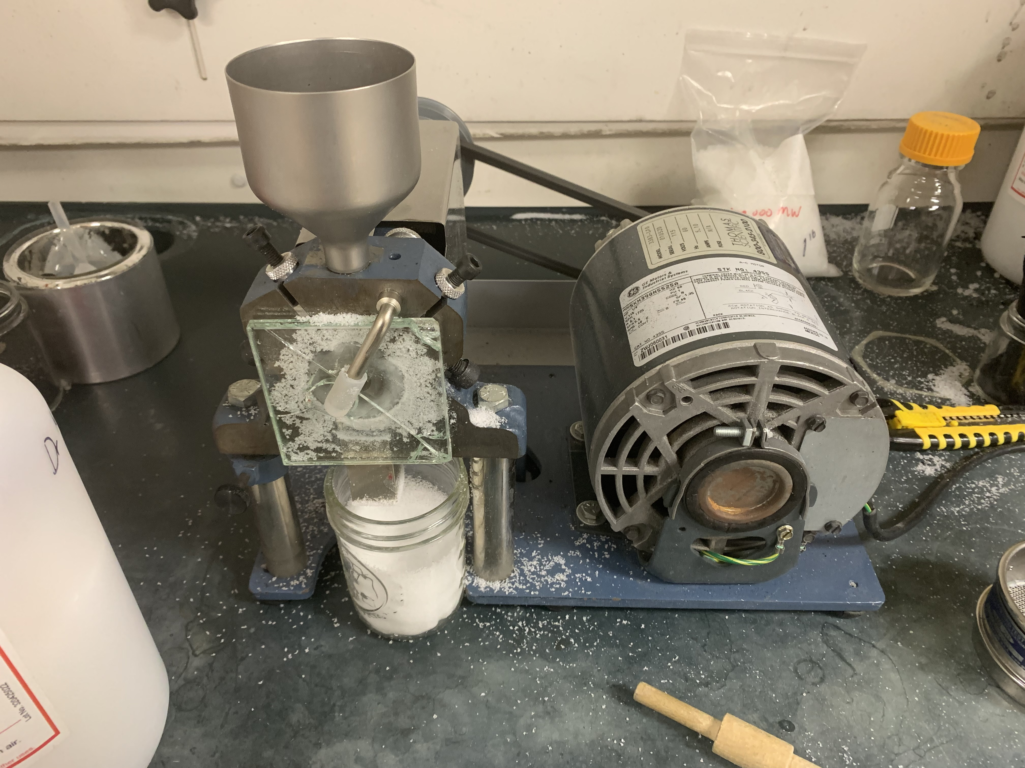
Milling Plastics
The Mill allows for the destruction of plastic standards to generate microplastics.
The image to the right shows a funnel in which plastic beads are slowly dropped into the mill, in which the beads are crushed.
The sieve at the exit of the mill stops larger microplastic particles from entering the glass conatiner.

Slide 21
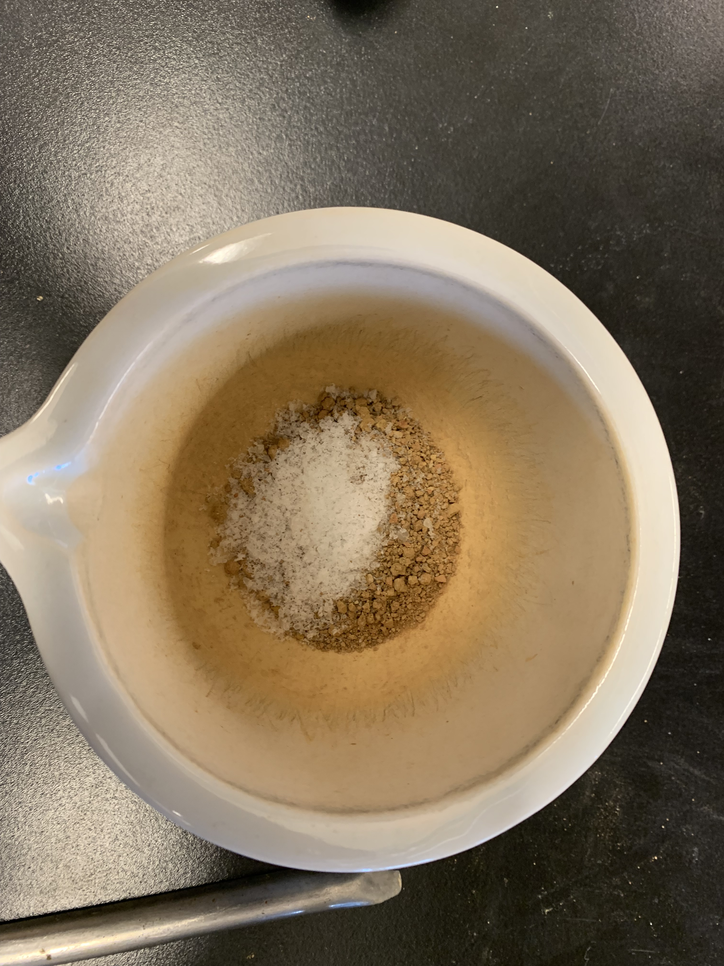
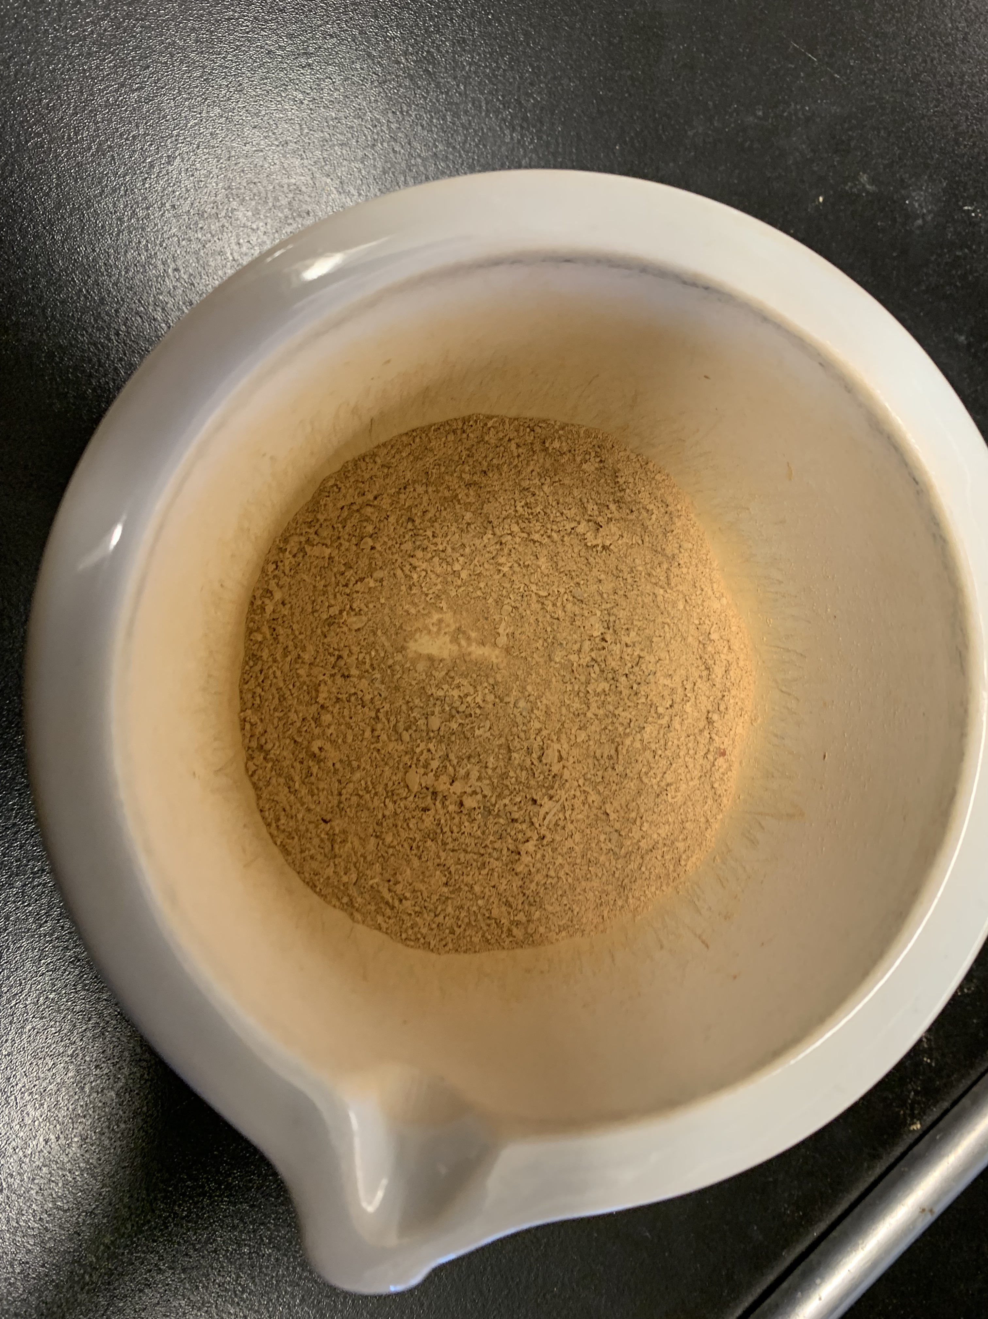
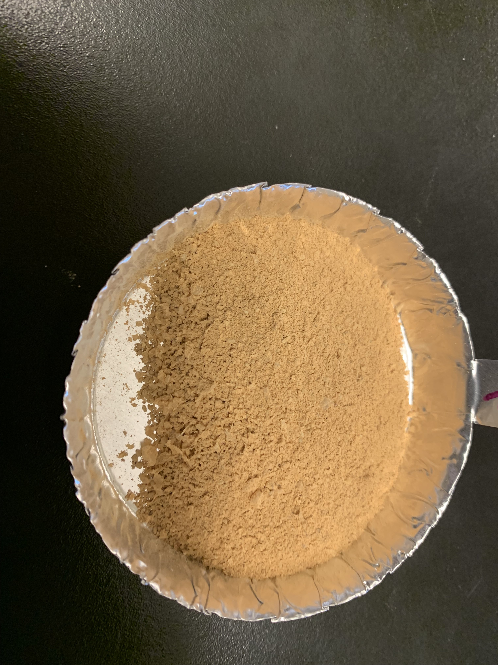
Mortar and Pestle
Step 1: Mix soil and microplastics
Step 2: Grind the mixture for 5 minutes
Step 3: Transfer to Aluminum pan for measurement.

Slide 22
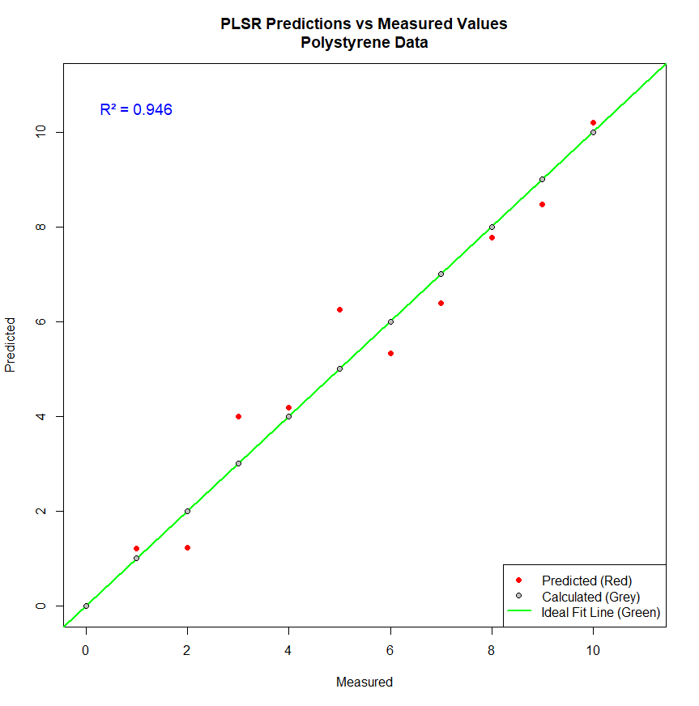
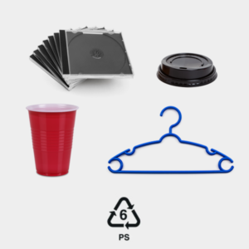
PS (Polystyrene)
Polystyrene can be either amorphous or semi-crystalline.
R^2=.946
In this study the polystyrene is amorphous. Which could be indicative of our high R squared value.

Slide 23
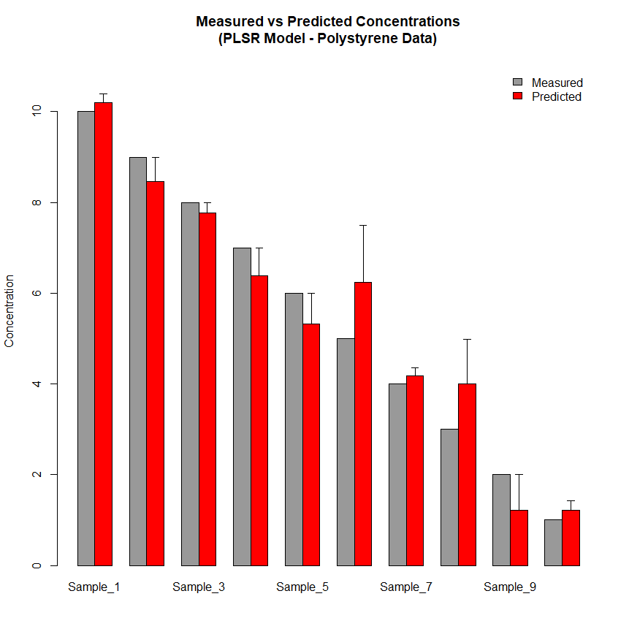
Polystyrene

Slide 24
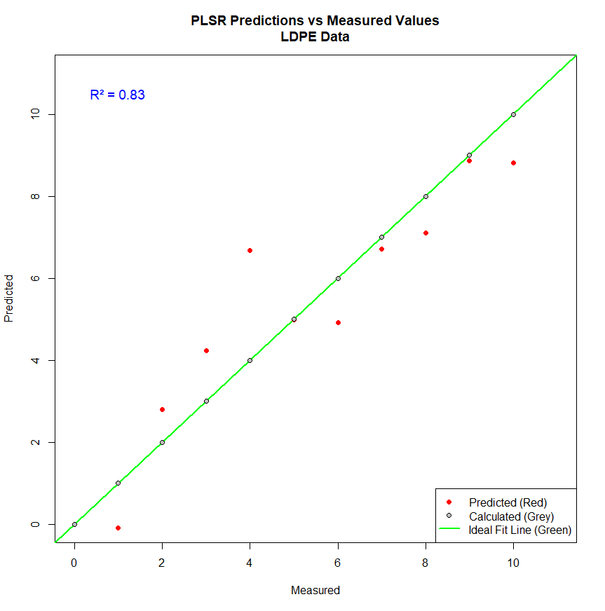
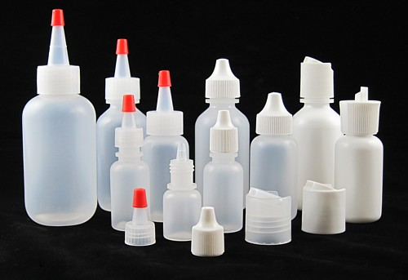
LDPE (Low Density Polyethylene)
LDPE is a semi-crystalline polymer.
R^2=.83
The results of this model was below expectations with the new methodology but the R^2 value is very similar to ones found in the literature.

Slide 25
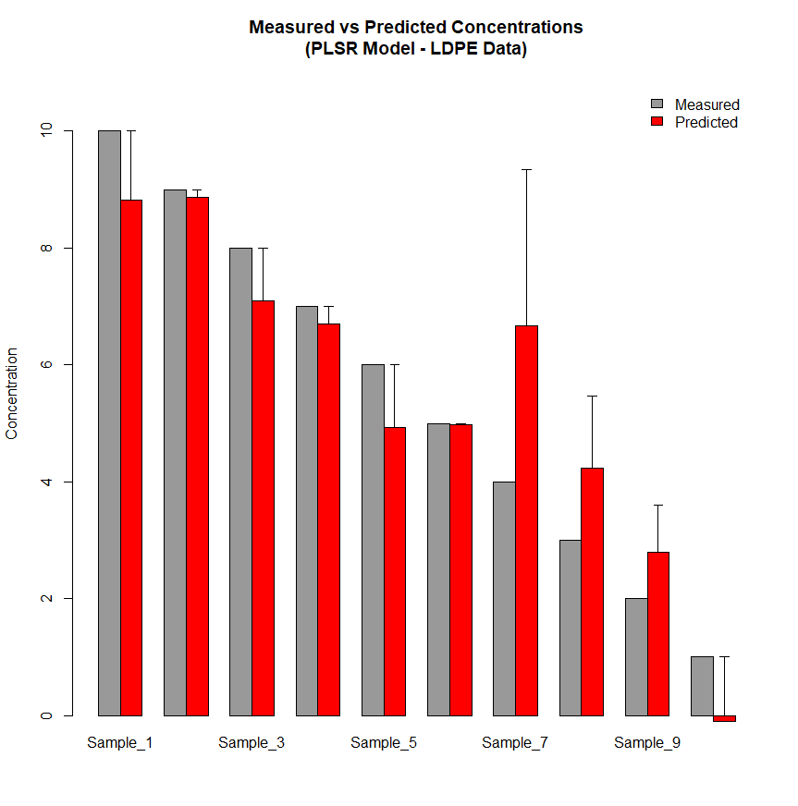
Low Density Polyethylene

Slide 26
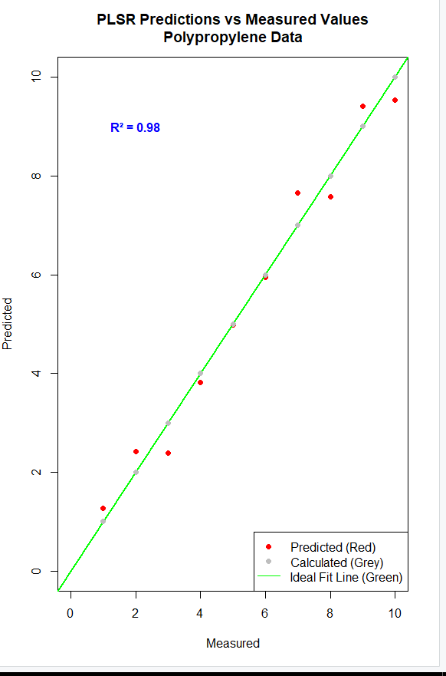
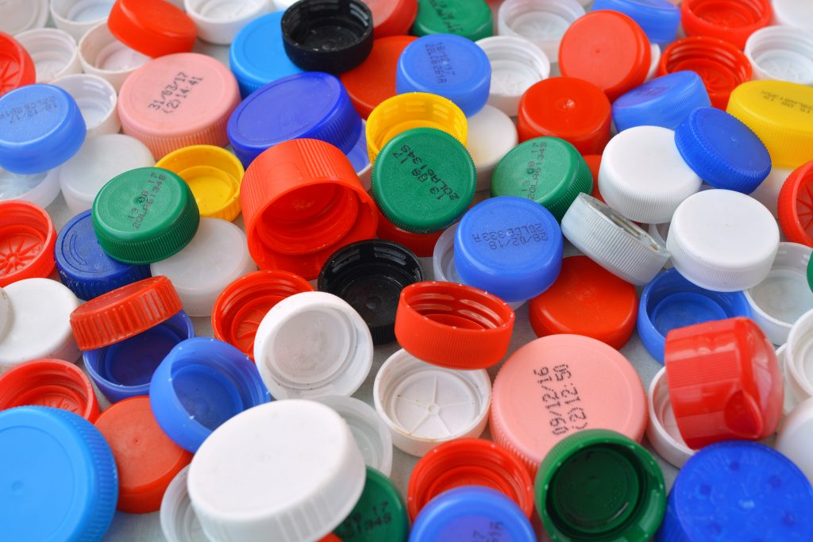
Polypropylene (PP)
Polypropylene is a semi-crystalline polymer.
R^2= .98
The results of this model exceeded expectations and exceeded majority of the R^2 values that were observed in the literature.

Slide 27
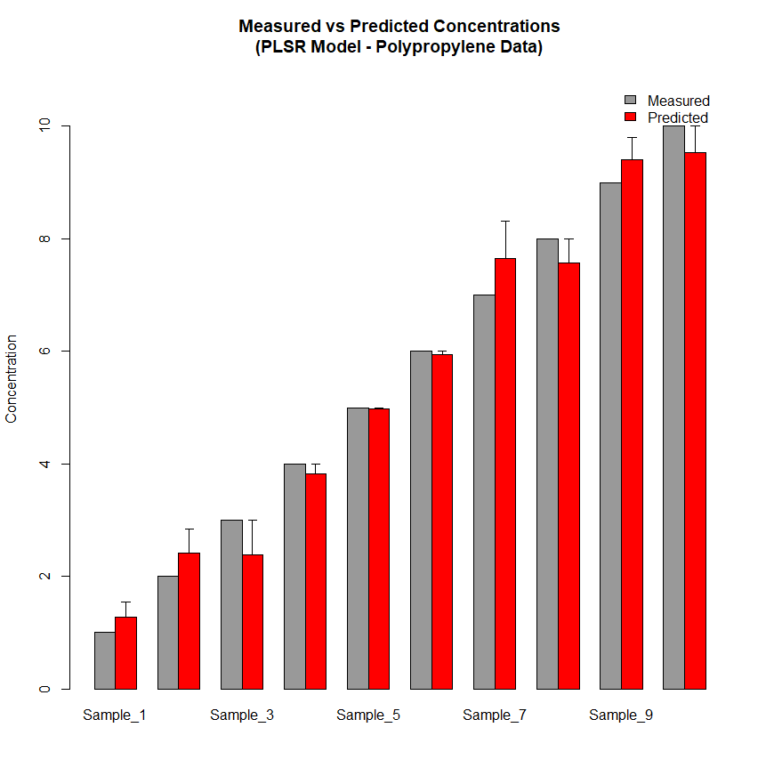
Polypropylene

Slide 28
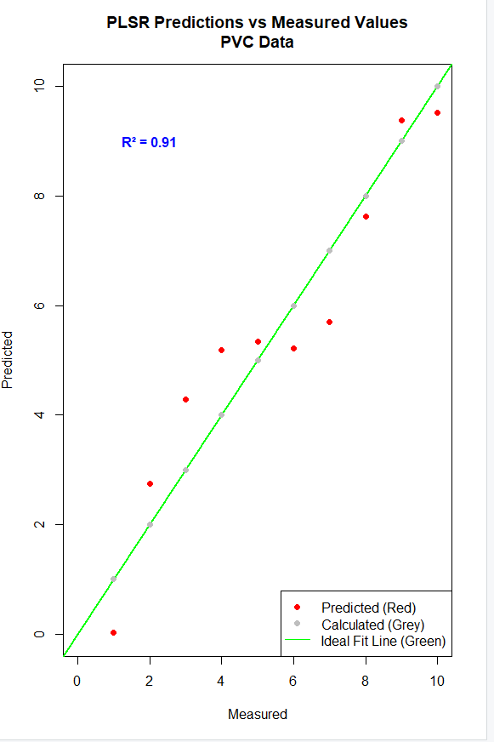
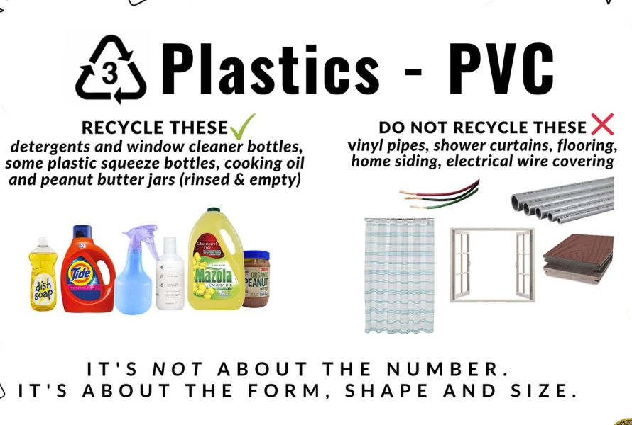
PVC (Polyvinyl Chloride)
PVC is an amorphous thermoplastic.
R^2= 0.91
The results of the model is on par with the models found in literature.

Slide 29
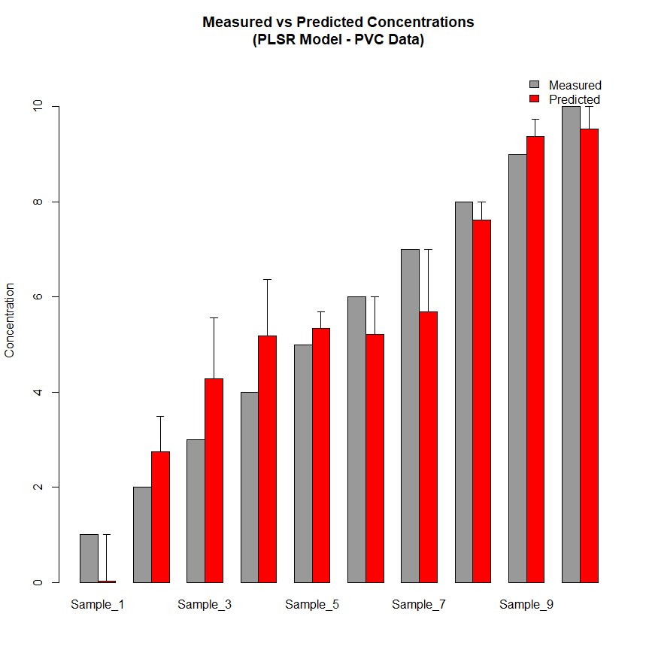
Polyvinyl Chlorine

Slide 30
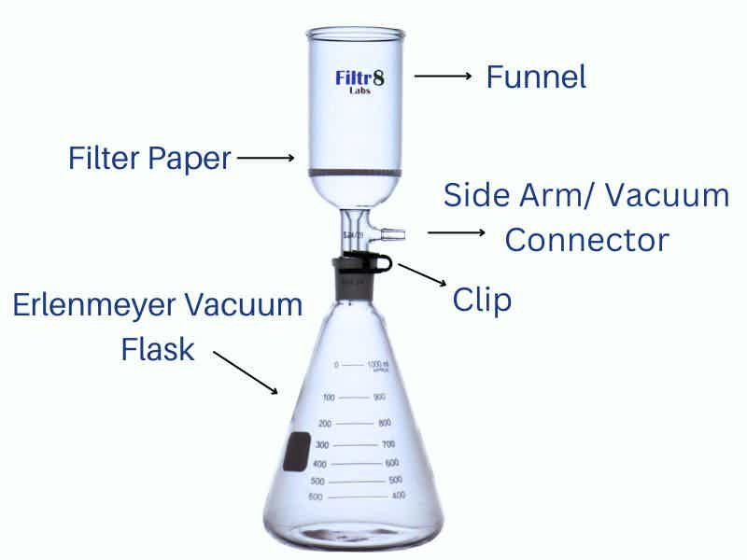
Enviromental Samples
Identify + quantify 5 types of MPs within environmental mediums
  PP (Polypropylene)
  PVC (Polyvinyl Chloride)
  LDPE (Low Density Polyethylene )
  PS (Polystyrene)
  Nylon 12
The PSR+ allows us to quickly identify the microplastic polymers in environmental samples by conducting scans of the filter paper.
Freshwater
9 liters of water collected from 3 different Ponds
Groundwater
13 liters of water sampled from one aquifer at 300 ft depth
Dry Atmospheric Deposition
3 liters collected from rinsing galvanized steel buckets
Precipitation
Roughly three liters of water collected from Hurricane Helene
Soil
A density separation was conducted resulting in the formation of 3 liters of sample

Slide 31
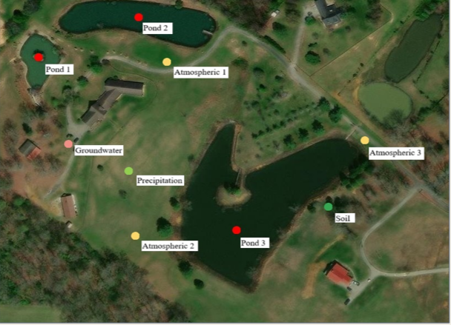
Sample Site

Slide 32
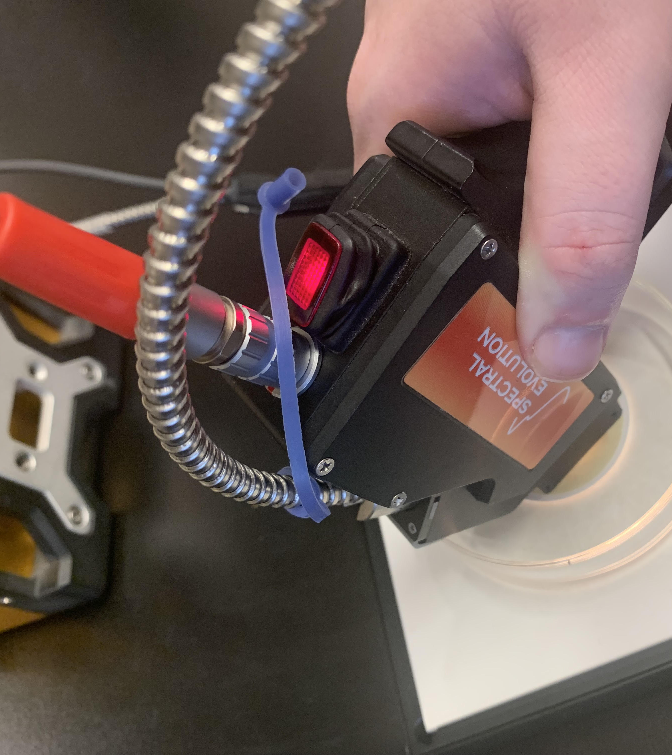
Enviromental Sample Prep
All samples were measured through a contact prop measurement on a Glass fiber filter paper:
  Water was vacuum filtered
  Soil a density separation via sodium Iodine was done to isolate plastic material
  Atmospheric samples were collected by rinsing the collection device and vacuum filtered afterward.

Slide 33
Enviromental Microplastic Types
Environment | Fibers | Fragments | Films | Foams | Microbeads | Pellets | Total
Dry Atmospheric Deposition | 328 | 10 | 9 | 0 | 0 | 0 | 347
Hurricane Helene | 309 | 26 | 4 | 0 | 0 | 0 | 339
Groundwater | 302 | 38 | 19 | 4 | 8 | 8 | 379
Surface Water | 407 | 68 | 33 | 11 | 11 | 16 | 546
Soil | 122 | 31 | 14 | 6 | 8 | 7 | 188

Slide 34
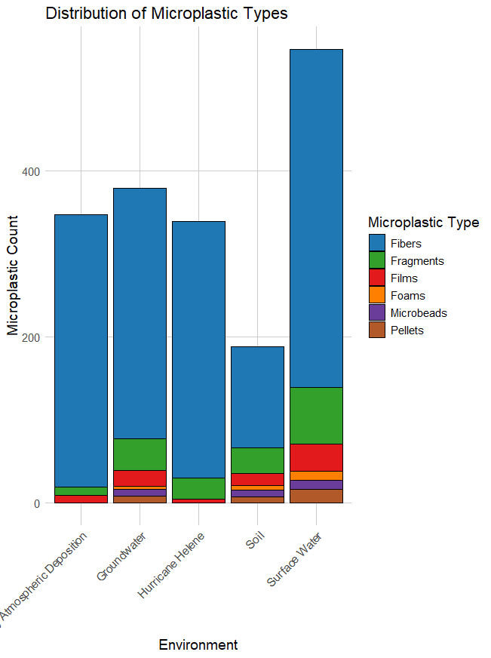

Slide 35
Enviromental Microplastic Colors
Env | Purple | Black | Blue | Brown | Gray | Green | Orange | Pink | Red | Yellow
Dry Atmospheric Deposition | 172 | 51 | 52 | 10 | 26 | 15 | 3 | 5 | 12 | 1
Hurricane Helene | 42 | 170 | 69 | 6 | 30 | 9 | 2 | 3 | 7 | 1
Groundwater | 18 | 35 | 127 | 6 | 158 | 21 | 3 | 3 | 7 | 1
Surface Water | 164 | 32 | 19 | 4 | 20 | 200 | 101 | 2 | 4 | 0
Soil | 20 | 36 | 20 | 55 | 35 | 6 | 10 | 2 | 4 | 0

Slide 36
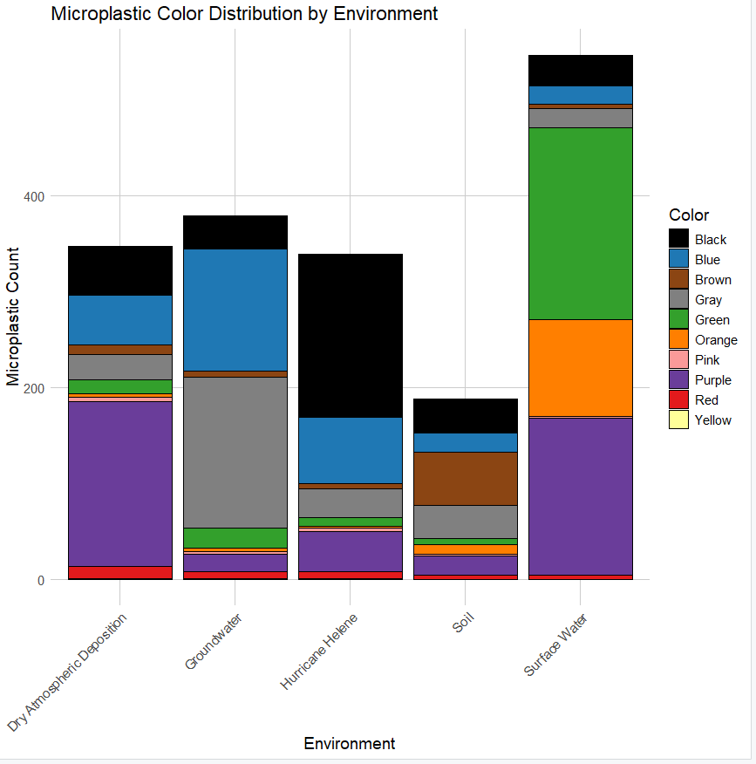

Slide 37
Spectrographic Enviromental Results
Environment | Samples | Scans | Plastic Signatures
Freshwater | 270 | 1350 | 17
Groundwater | 137 | 685 | 2
Dry Atmospheric Deposition | 60 | 300 | 5
Hurricane Helene Precipitation | 37 | 185 | 8
Soil | 30 | 150 | 20

Slide 38
Enviromental Plastic Identification
Surface Water
  PVC-2
  Nylon- 14
  LDPE-2
Groundwater
  1 PVC
  1LDPE
Soil
  PVC-6
  PP-4
  PS-4
  LDPE-6
Dry Atmospheric Deposition
  Nylon-4
  LDPE-1
Precipitation
  Nylon/LDPE-3
  LDPE-5
ENV. | PVC | Nylon | LDPE | PP | PS | Ny/LDPE
Surface Water | 2 | 16 | 2 | 0 | 0 | 0
Groundwater | 1 | 0 | 1 | 0 | 0 | 0
Soil | 6 | 0 | 6 | 4 | 4 | 0
Dry Atmospheric Deposition | 0 | 4 | 1 | 0 | 0 | 0
Precipitation | 0 | 3 | 5 | 0 | 0 | 3

Slide 39
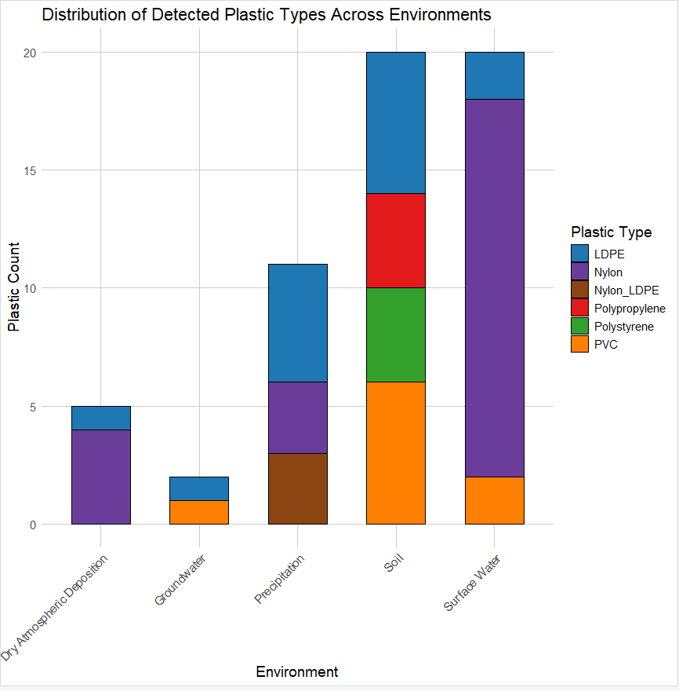
Enviromental Plastic Identification

Slide 40
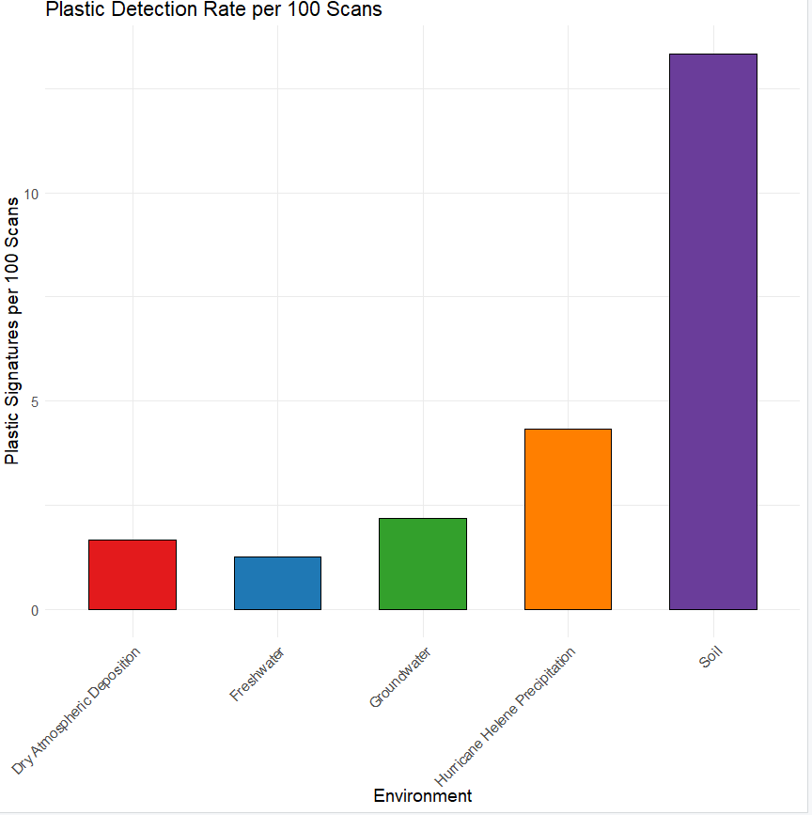
Plastic Detection Rate

Slide 41
Conclusions
Using standard reflectance Spectroscopy UV-VIS-NIR measurements of plastic polymers were able to be identified in artificially polluted soils.
A PSLR model was generated and was able to identify all polymers in the case study.
Using this model polymer pollution can be identified and quantified in a laboratory setting or in the field.
The results from the environmental samplings indicates a potential of contact probe analysis for microplastic identification

Slide 42

Questions?

