Slide 1



An evaluation of machine learning and Bayesian-based frameworks for forest aboveground biomass mapping and uncertainty quantification using airborne lidar and PlanetScope imagery
Presenter: Nisham Thapa
PhD student
College of Forestry, Wildlife, and Environment
Auburn University

Slide 2
Outline
Introduction
Why should we care?
Goal and Objectives
Methods
Results
Discussion
Conclusions

Slide 3
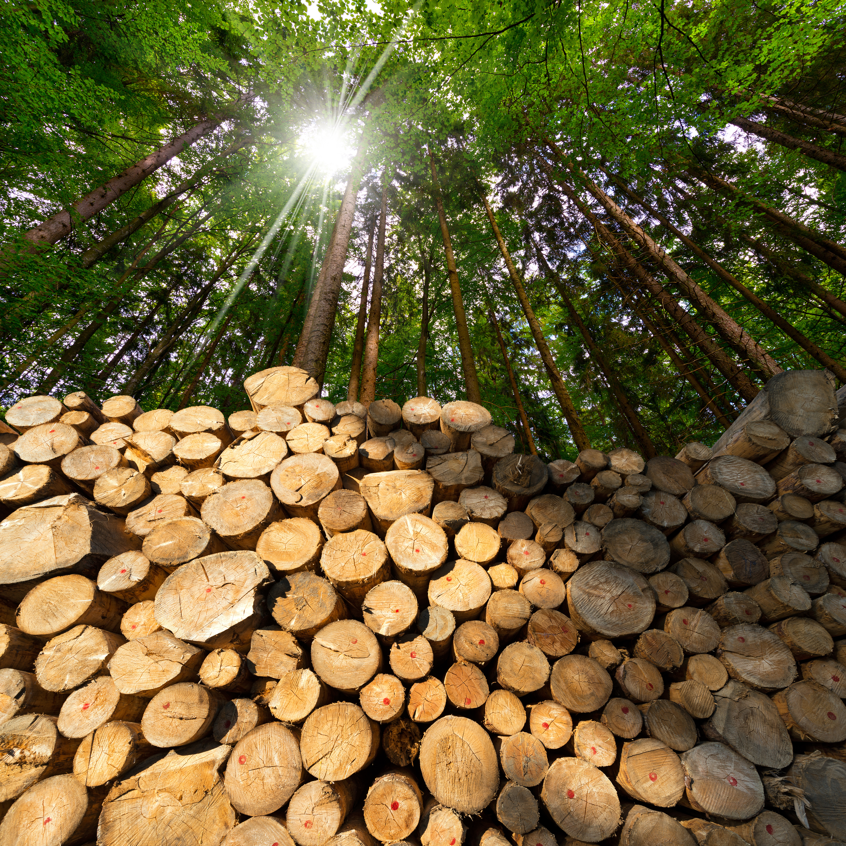
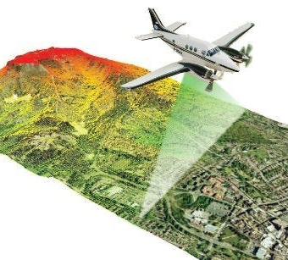
Introduction
Around 68% of the southern United States (US) is forested, making it one of the largest carbon sinks in the US and contributing up to $76 billion annually.
Forest Above Ground Biomass Density (AGBD):
Density of dry weight of living trees above ground.
Predictor of forest carbon. Crucial for understanding carbon dynamics and carbon monitoring.
Remote Sensing data:
Airborne lidar: Laser scanning system that measures the vertical structure of forest.
Planetscope imagery: High-resolution (3m), multispectral (8 bands) satellite imagery.
Source: Adobe Stock

Slide 4
Why should we care?
Estimating AGBD in the diverse mixed forests of the southern US using remote sensing is challenging due to variations in spectral and structural attributes driven by high species diversity.
To overcome these challenges and obtain comprehensive AGBD estimates, developing accurate site-specific frameworks using airborne lidar and PlanetScope imagery is essential for mixed temperate forests in the southern US.

Slide 5
Goal and Objectives
The goal of the study is to develop a robust methodological framework for improving AGBD estimation in mixed temperate forests of the southern US.
The four specific objectives are to:
Investigate and compare Random Forest (RF) with Bayesian-based Gaussian Process Regression (GPR) for estimating AGBD.
Evaluate 5 variable selection methods for estimating AGBD in study sites from five ecoregions in the southern US.
Compare whether ecoregion-specific modeling approaches can enhance AGBD estimation accuracy compared to generalized models.
Develop site-specific maps of AGBD and AGBD uncertainties based on the optimal framework for five ecoregions in the southern US.

Slide 6
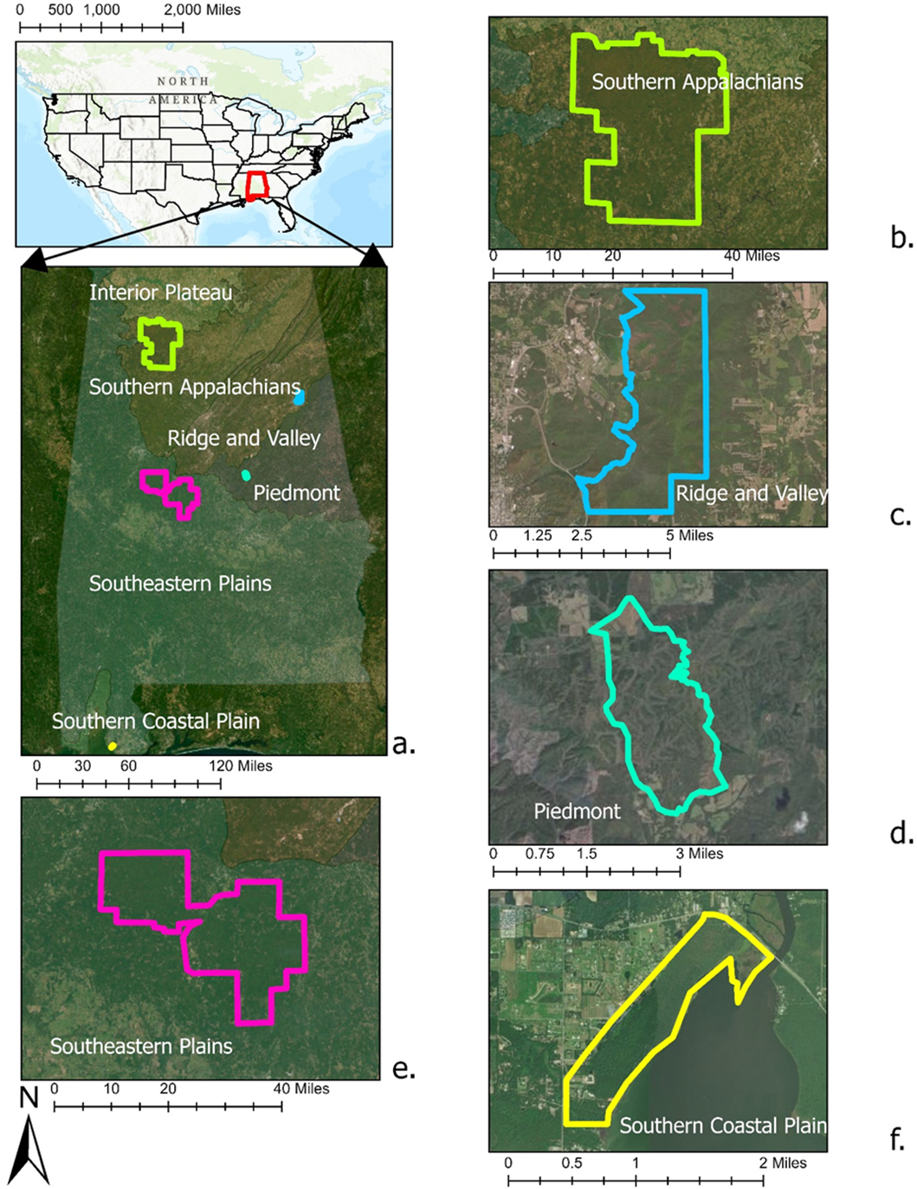
Methods
5 study sites: Area ranges from 13.5 to 733 km².
4 data sources: PlanetScope imagery, airborne lidar, ancillary, and field data.
2 modeling methods: RF and Bayesian-based GPR.
5 variable selection methods: (1) all predictors, (2) top 5 most important variables obtained from RF, (3) top 10 important variables obtained from RF, (4) Least Absolute Shrinkage and Selection Operator (lasso), and (5) Recursive Feature Elimination (RFE).
2 modeling approaches: Generalized and ecoregion level.
Ecoregion-specific AGBD maps (20 m) with uncertainty estimates: Based on the optimal framework.

Slide 7
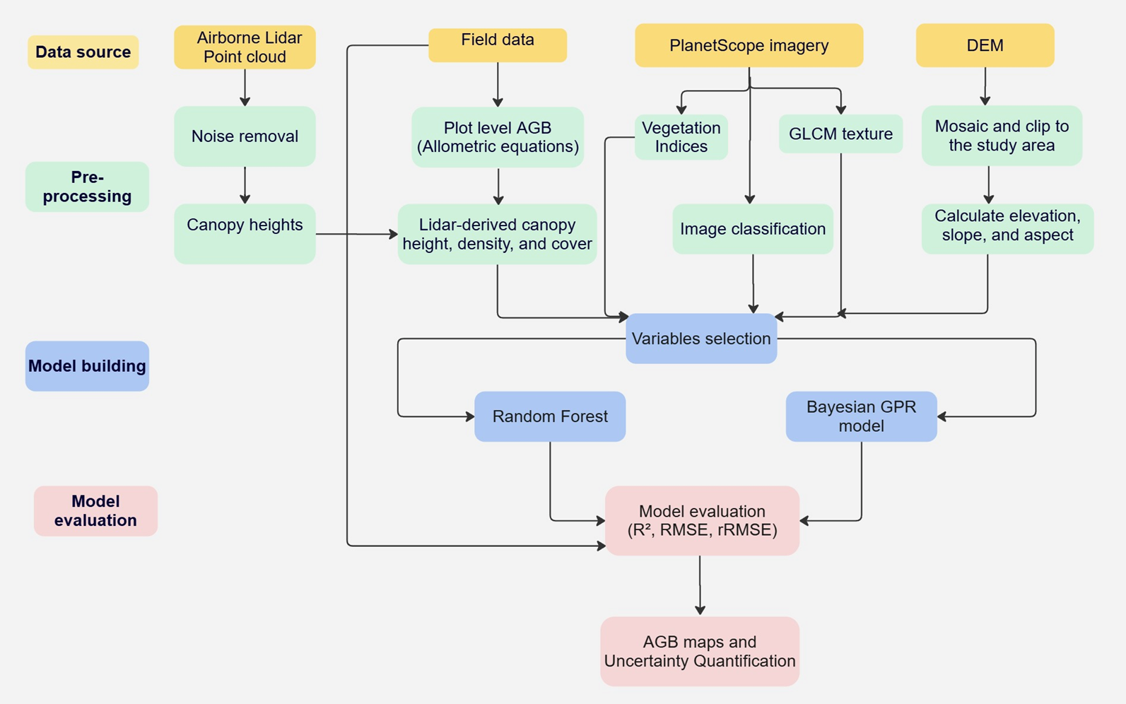
Methods

Slide 8
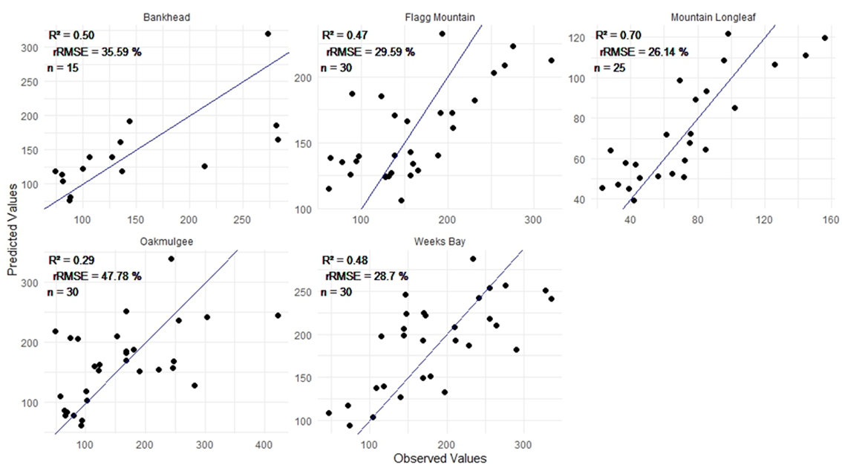
Results

Slide 9
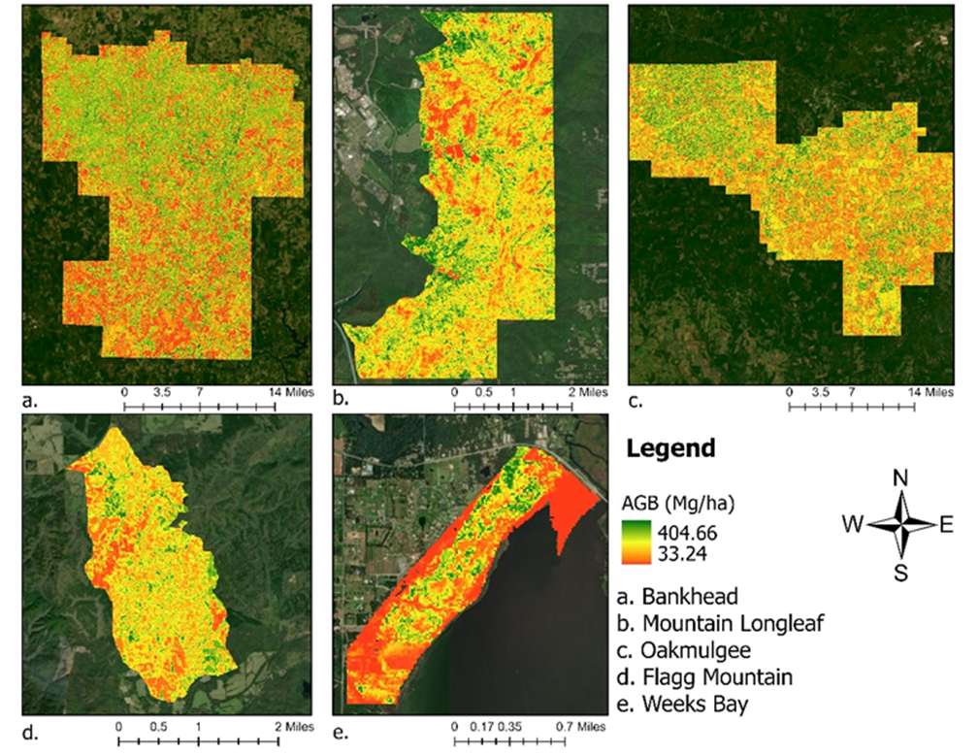
Results

Slide 10
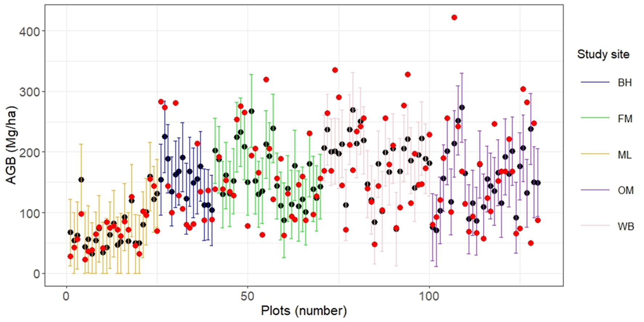
Results

Slide 11
Discussion
RF is demonstrated to have a strong predictive capability for ecological data. Despite the challenges posed by large spatial extent and mixed forest conditions, the Bayesian approach outperformed RF in Bankhead and Oakmulgee study sites.
Regardless of the modeling algorithms used, optimal results were achieved when variable selection methods were applied rather than using all variables in a model. Overall, the RF-based variable selection method outperformed lasso and RFE.
The highest model performance in the Mountain Longleaf site (R² = 0.70), presented with uncertainty estimates, reflects strong agreement with ground data supporting that model accuracy is better in forest conditions with less AGBD variability (33.24 Mg/ha – 137.07 Mg/ha).

Slide 12
Conclusion
We conclude that the Bayesian method is better suited for study sites with smaller sample sizes and larger areas under mixed forest conditions.
We recommend developing ecoregion-specific AGBD models with regionally selected predictors instead of a generalized model for optimal accuracy.
The mapped outputs are anticipated to serve as a valuable source of information for validating spaceborne products, facilitating AGBD monitoring, and understanding AGBD dynamics over time and space.

Slide 13
THANK YOU !
ANY QUESTIONS ??

