Slide 1
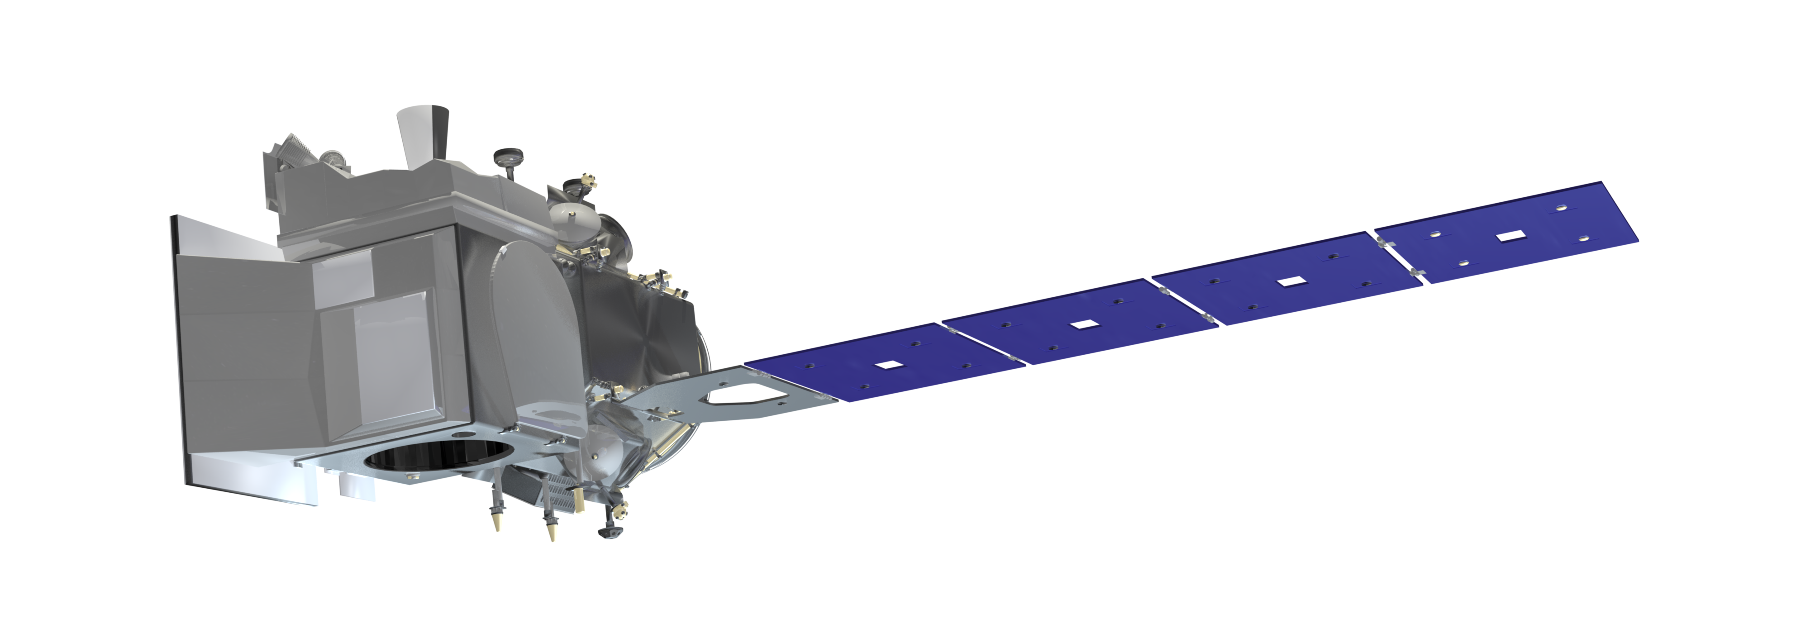
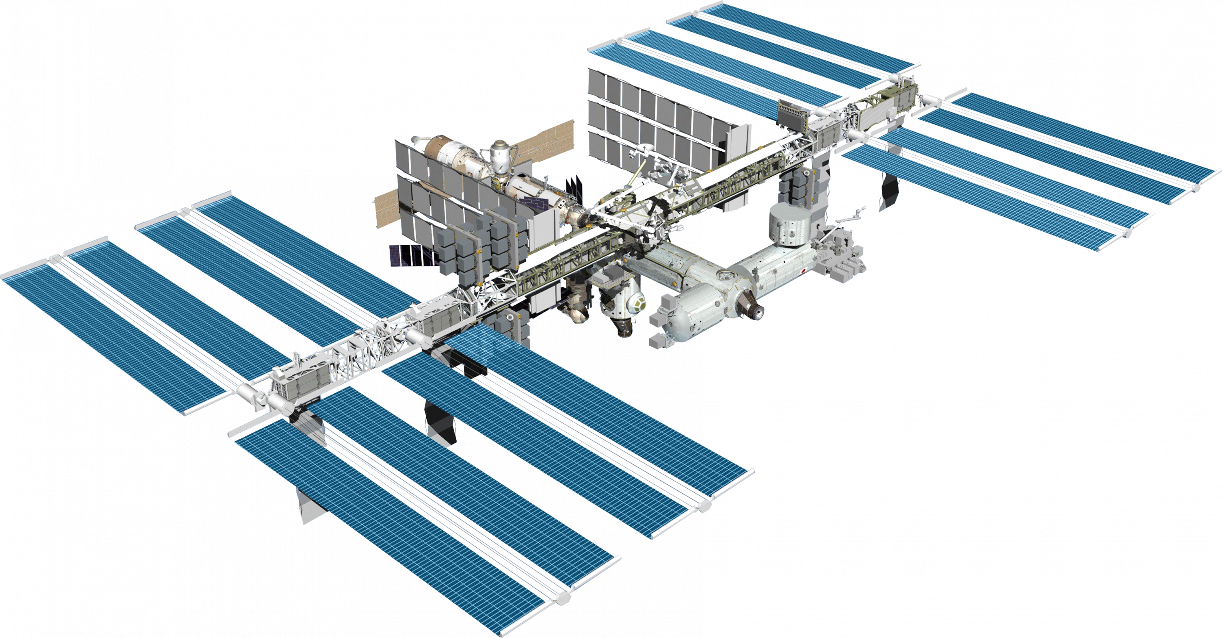
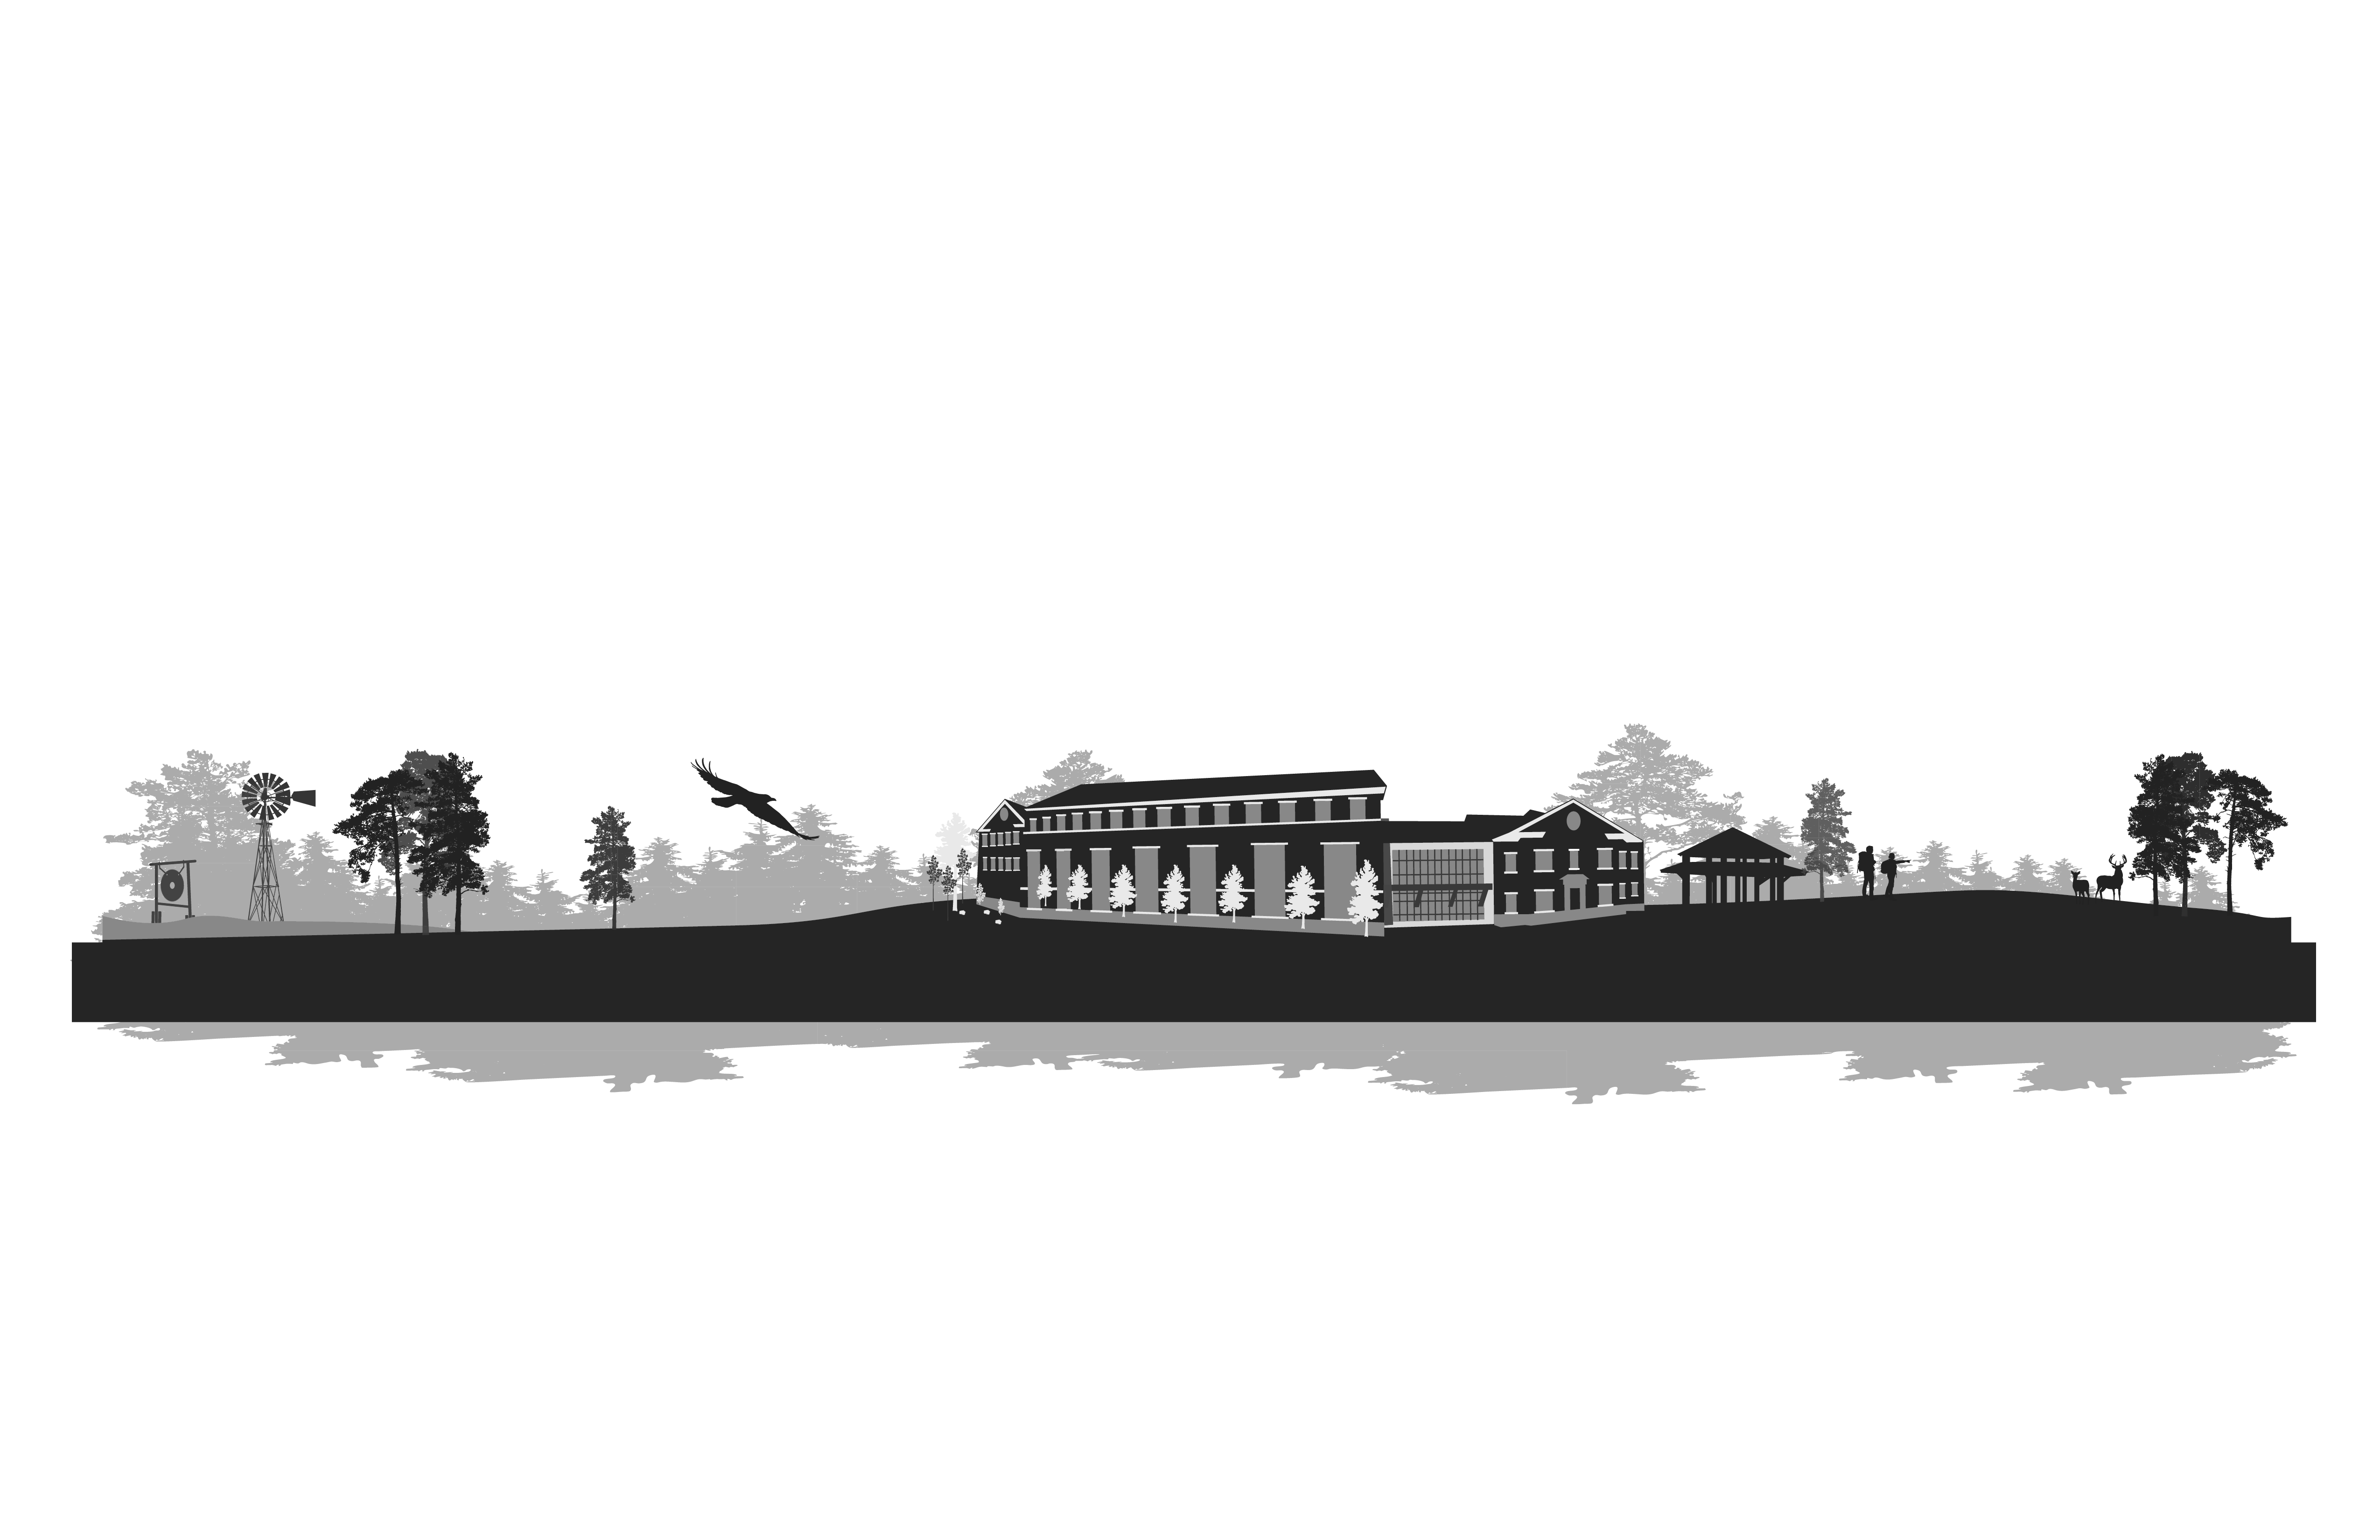
Assessing the Synergistic Potential of GEDI and ICESat-2 for Forest Aboveground Biomass Estimation
Presenter: Janaki Sandamali
Co-authors: Lana L. Narine, Nisham Thapa and Adam Maggard
Geospatial Analytics Lab
College of Forestry Wildlife and Environment
Auburn University

Slide 2
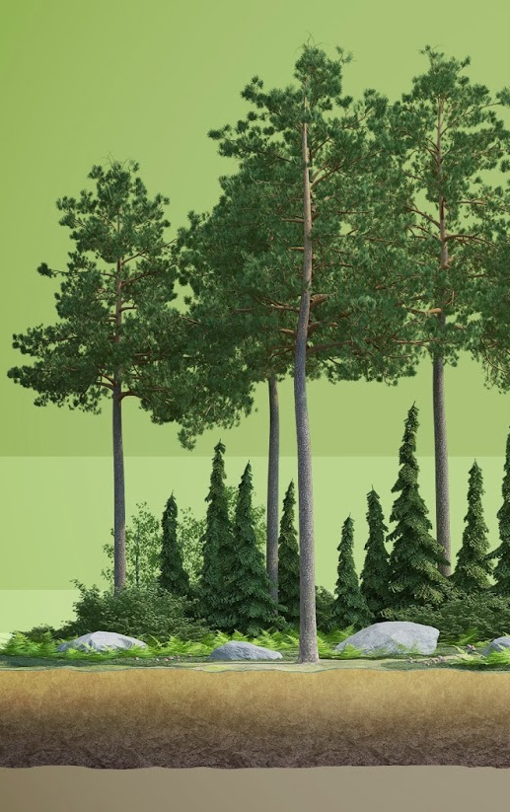
Forest Aboveground Biomass
Forest Aboveground Biomass (AGB) plays a crucial role in understanding the global carbon cycle and mitigating climate change.
AGB encompasses all wood and plant live biomass above the ground, including tree trunks, branches, bark, seeds, and leaves.
Accurate estimation of forest AGB is essential for understanding the carbon cycle and mitigating climate change.

Slide 3
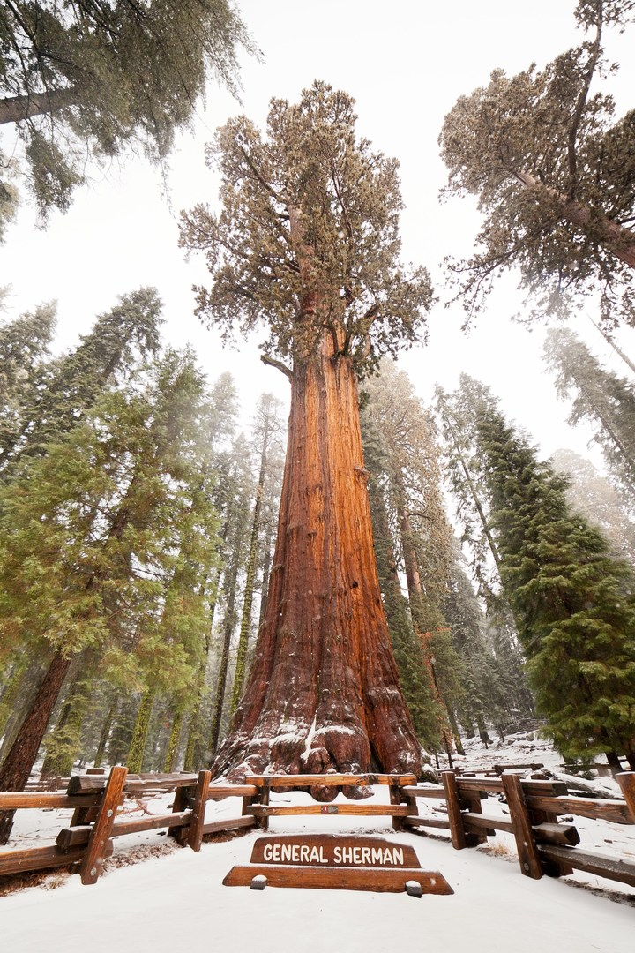
Measuring Forest Aboveground Biomass
If I asked you to measure the weight of the General Sherman tree in Sequoia National Park, California?
Figure 1. The General Sherman tree in Sequoia National Park, California.
Notes:
The General Sherman tree in Sequoia National Park, California, is the largest living tree on Earth by volume.

Slide 4
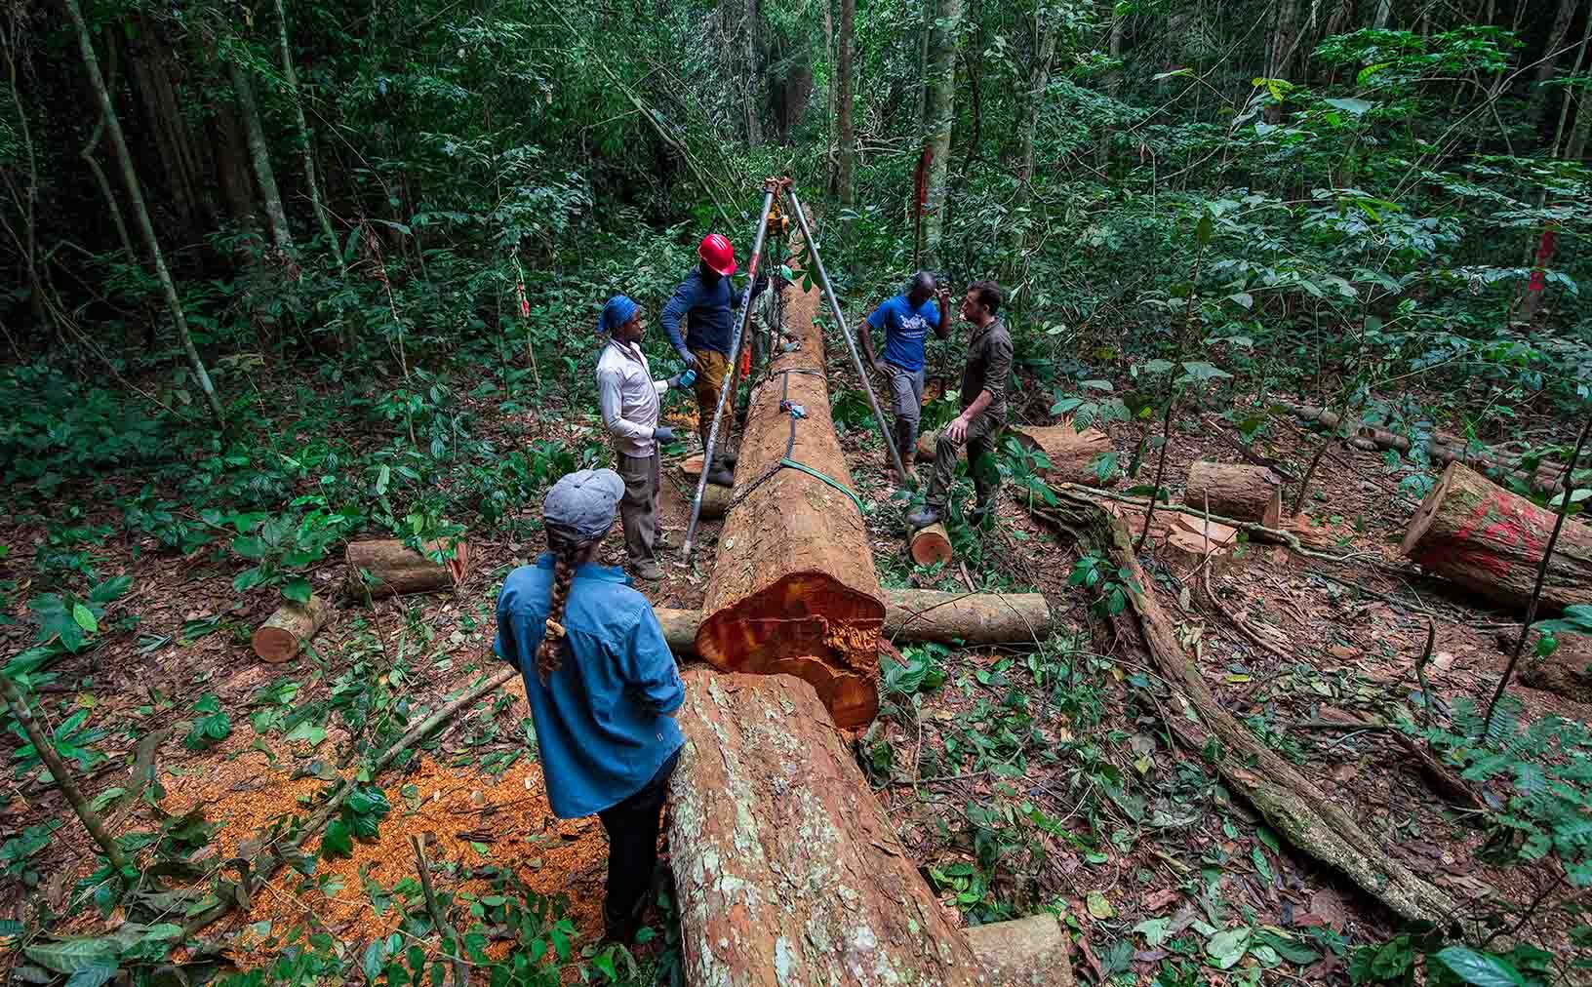
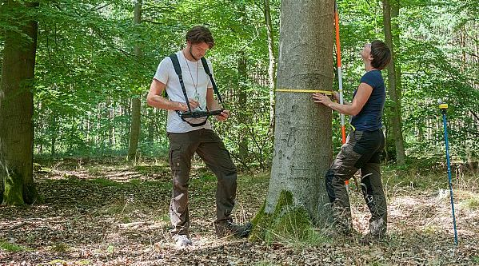
Measuring Forest Aboveground Biomass
Figure 2. Methods of Field Data Collection
Source: https://www.thuenen.de/en/thuenen-topics/forests/the-german-national-forest-inventory/carbon-inventory-2017-an-interim-review-1

Slide 5
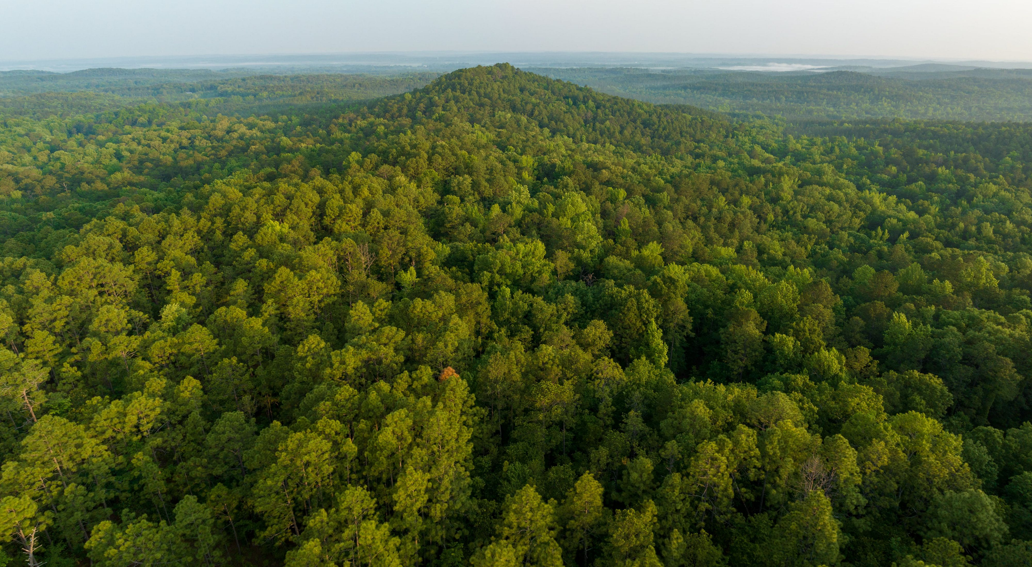




But if I asked you to measure the weight of all trees in Alabama?
Number of people?
Cost?
Time?
Accessibility to every tree?

Slide 6
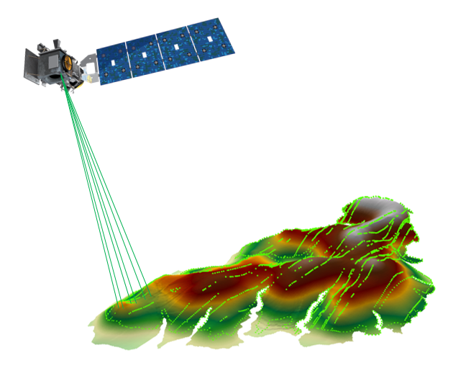
Remote Sensing
Spaceborne light detection and ranging (lidar) missions provide three-dimensional forest structural information with global or near-global coverage.
These systems enable efficient, repeatable, and cost-effective AGB estimation.
Studies have utilized Machine learning and deep learning techniques for AGB estimation with spaceborne lidar.
  Random Forest (RF)
  Extreme Gradient Boosting (XGBoost)
  Convolution Neural Network (CNN)
Notes:
Spaceborne light detection and ranging (lidar) missions provide three-dimensional forest structural information with global or near-global coverage.
These systems enable efficient, repeatable, and cost-effective biomass monitoring, offering a transformative opportunity to enhance the accuracy and scalability of AGB estimation.
Studies have utilized Machine learning and deep learning techniques for AGB estimation with spaceborne lidar
Random Forest (RF)
Extreme Gradient Boosting (XGBoost)
Convolution Neural Network (CNN)

Slide 7
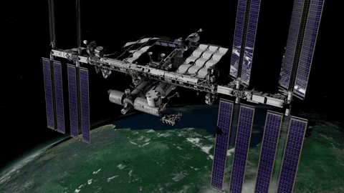

Global Ecosystem Dynamics Investigation (GEDI)

Slide 8
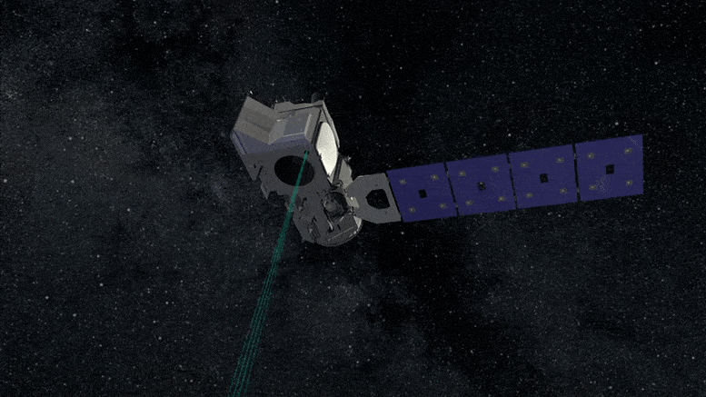

Ice, Cloud, and land Elevation Satellite-2 (ICESat-2)

Slide 9
Research Limitations and Opportunities
GEDI and the ICESat-2 spaceborne lidar missions provide valuable data for deriving AGB information.
Despite the potential of each, the synergistic use of both datasets remains underexplored.

Slide 10


Goal and Objectives
Goal:
Assess the synergistic use of GEDI and the ICESat-2 to estimate forest AGB density (AGBD).
Objectives:
Evaluate machine learning and deep learning approaches for AGBD estimation using GEDI and ICESat-2 data.
Develop a statewide AGBD map using a combined canopy height (CH) map along with other earth observation data in high-performance computing (HPC).

Slide 11
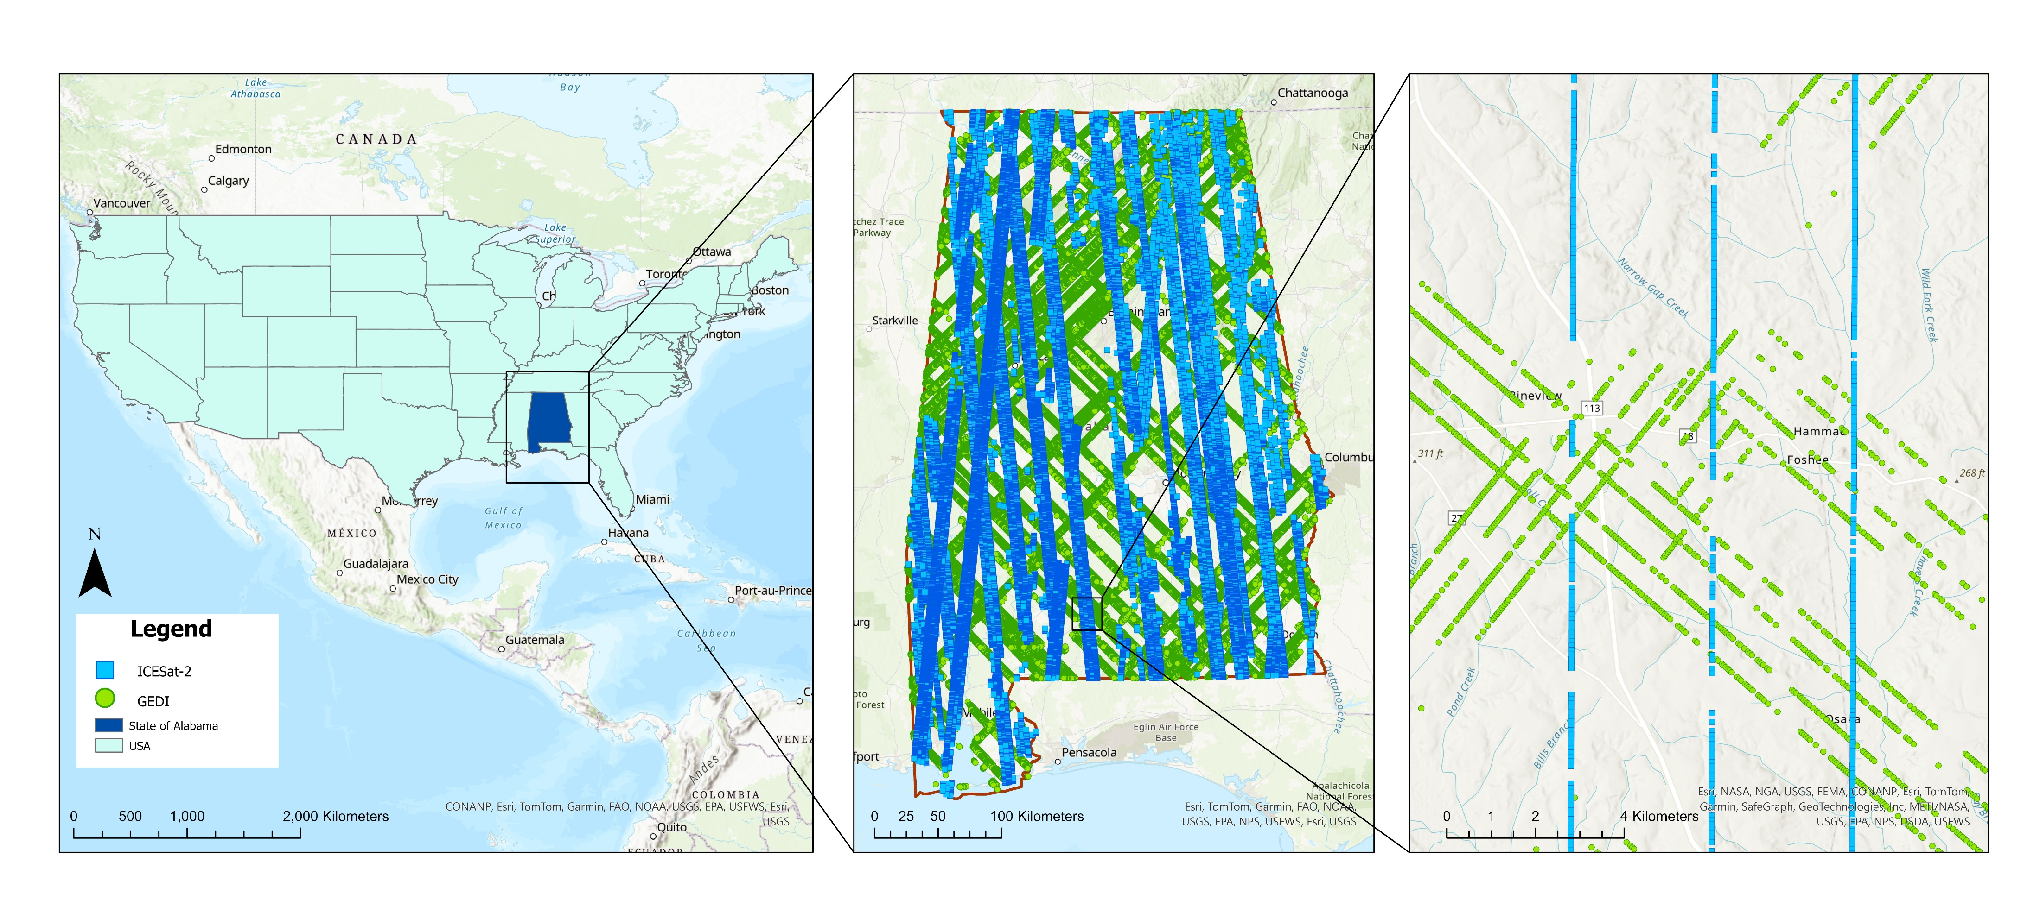
Study area
(a) (b) (c)
Figure 3. (a) The study area -State of Alabama, (b)&(c) Distribution of GEDI level 2A (L2A) and ICESat-2 ATL08 products.
Notes:
Forests of the Southern United States (US) account for 29% of the nation’s aboveground carbon stocks, with Alabama’s 23 million acres of timberlands playing a critical ecological and economic role.

Slide 12
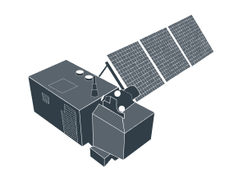
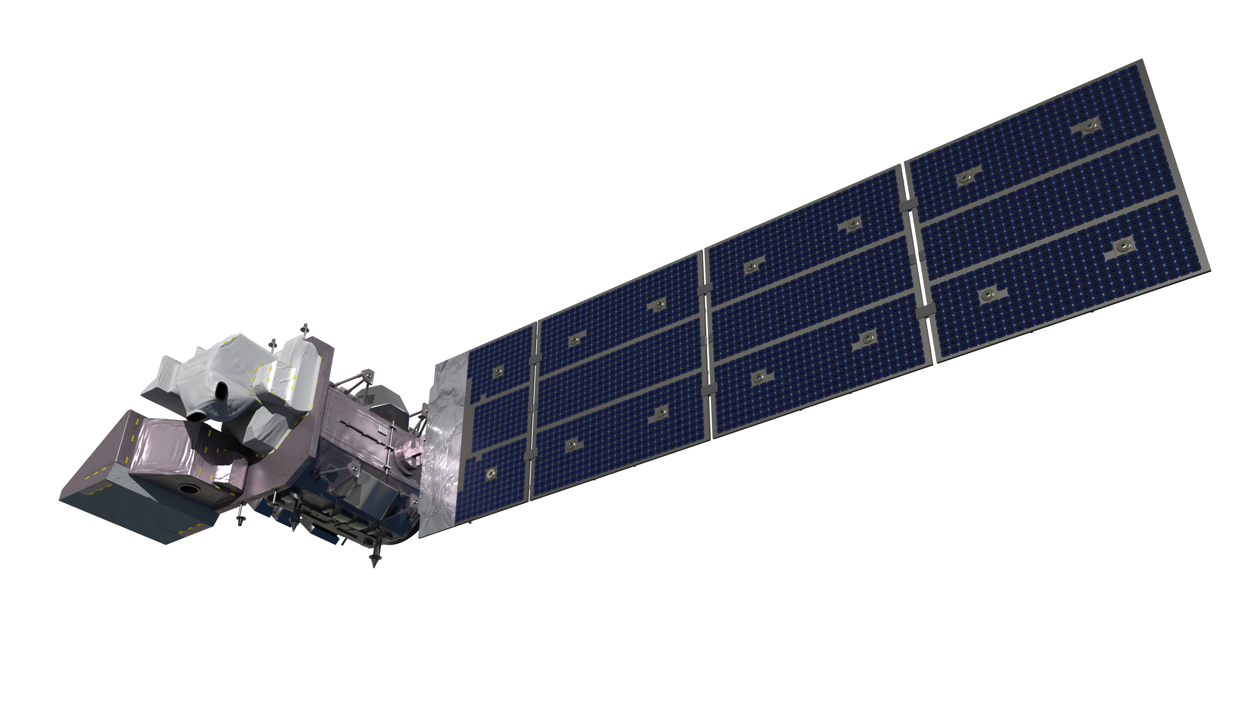
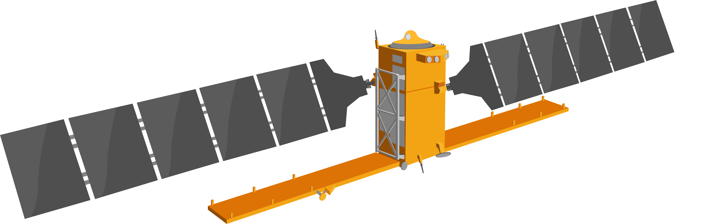

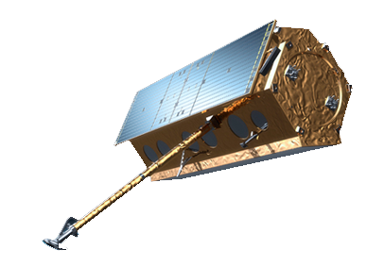
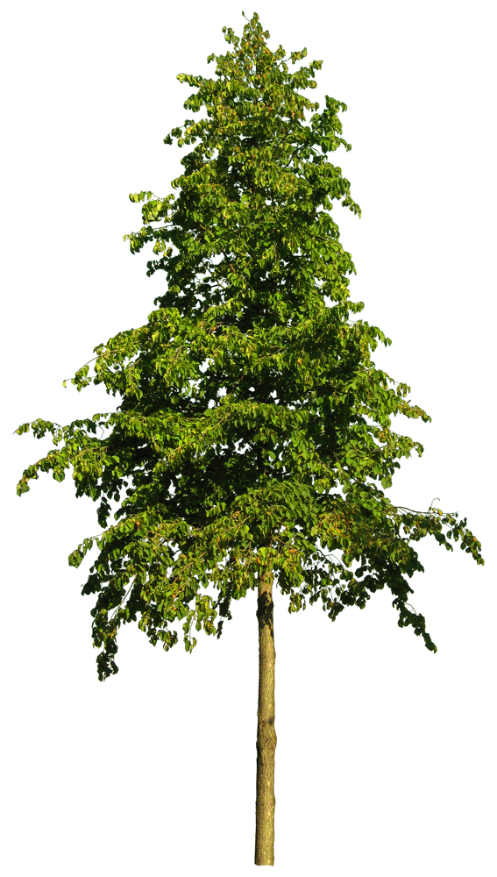
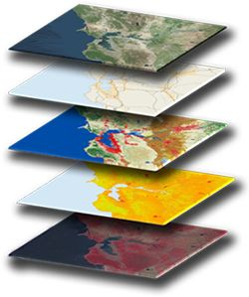
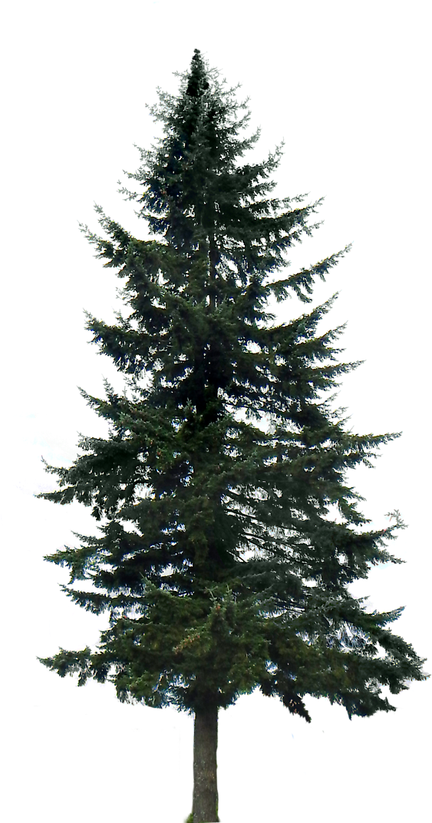
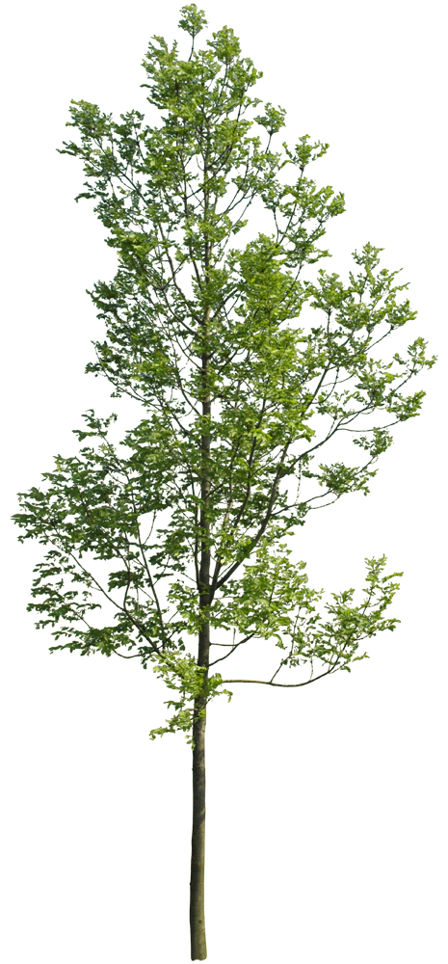

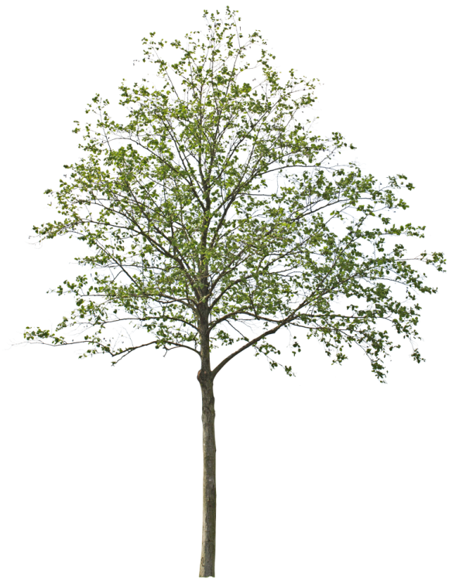
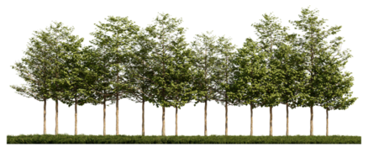
Data
Landsat 9
Sentinel-2
Sentinel-1
TanDEM-X
Earth Observation Satellite Data
Climate and ancillary data
Airborne lidar
Field Data
Notes:
The Global Ecosystem Dynamics Investigation (GEDI) and the Ice, Cloud, and land Elevation Satellite-2 (ICESat-2) light detection and ranging (lidar) missions each provide discrete, along-track measurements of vegetation structure, including CH

Slide 13
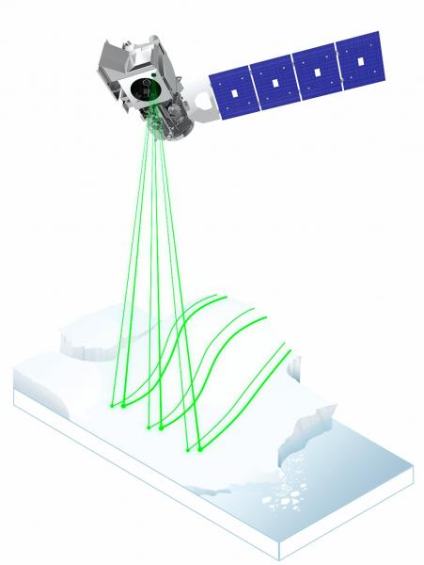
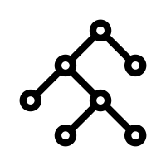
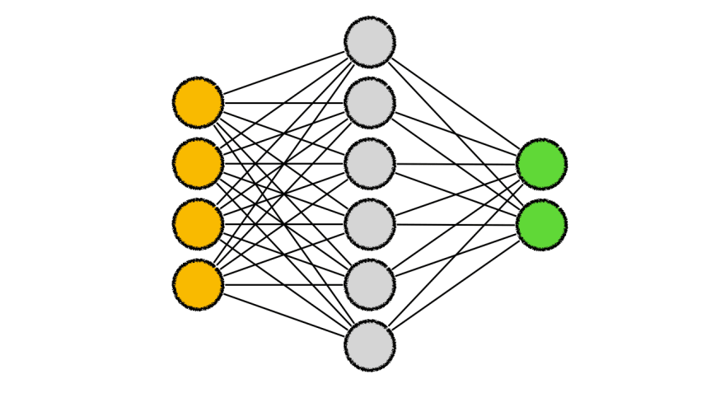
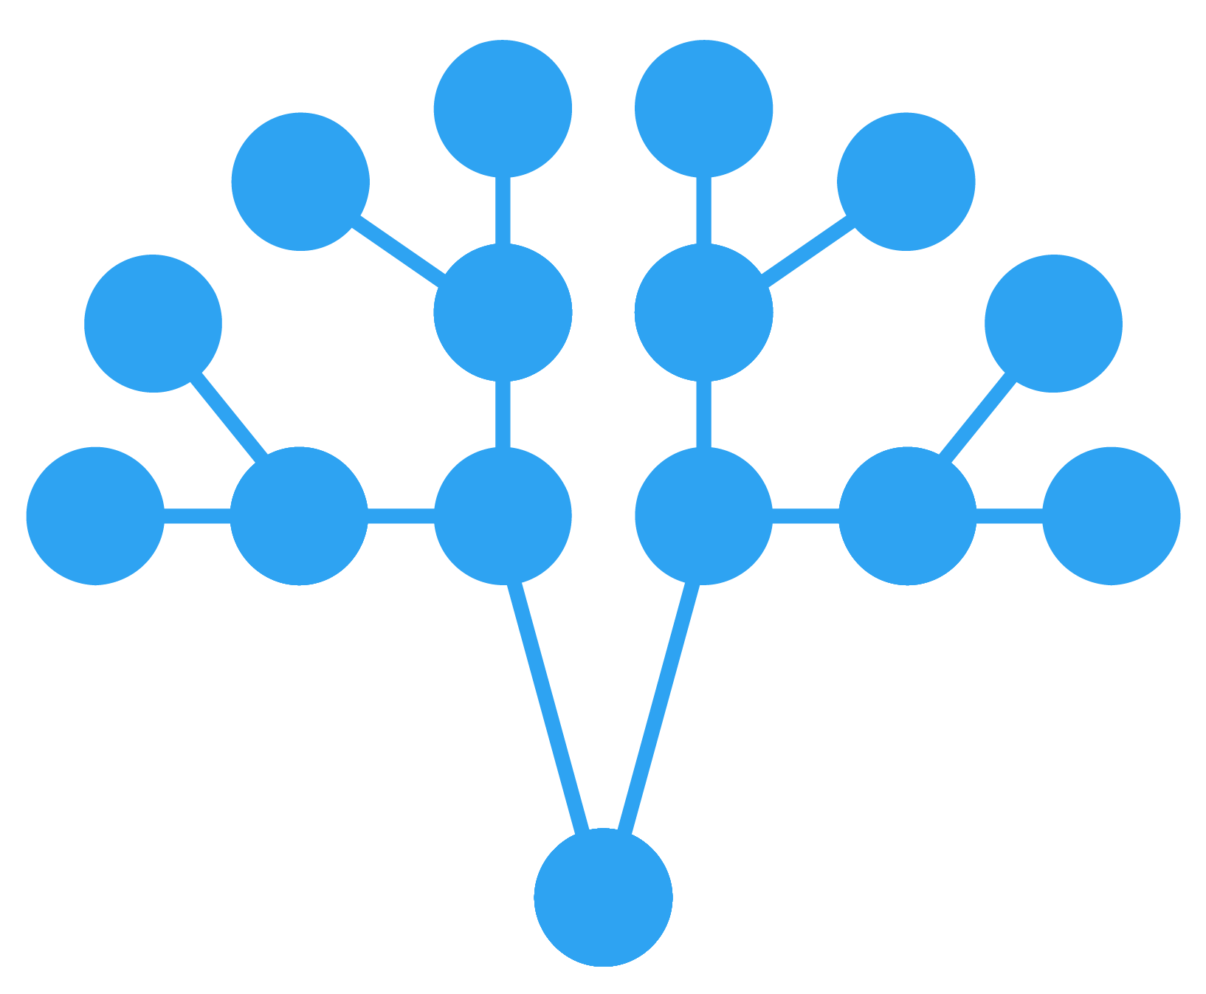
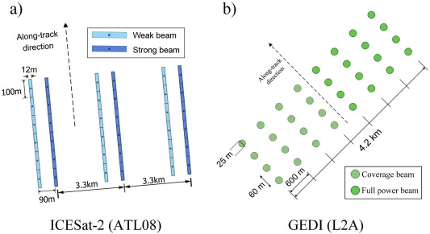

Methodological workflow
Landsat 9
Sentinel-2
Sentinel-1
TanDEM-X
Climate and ancillary data
Airborne lidar
Field Data
CH and AGB Modeling
ICESat-2
GEDI
Training and testing
Validation
Random Forest
Convolutional Neural Network
Extreme Gradient Boosting
Canopy height
Canopy height Mapping
AGB Mapping
Hyperparameter tuning
Five-Fold Cross Validation
Variable selection (SHAP (SHapley Additive exPlanations)
Schematic of the ground tracks of (a) ICESat-2 ATL08 and (b) GEDI L2A products
Selection of best model
High-Performance Computing
Figure 4. The workflow adopted in experimental analysis.
Contacts

Slide 14
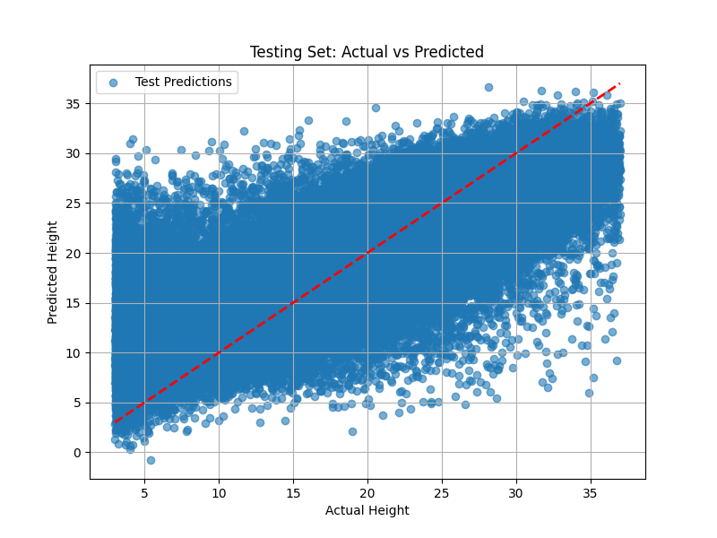
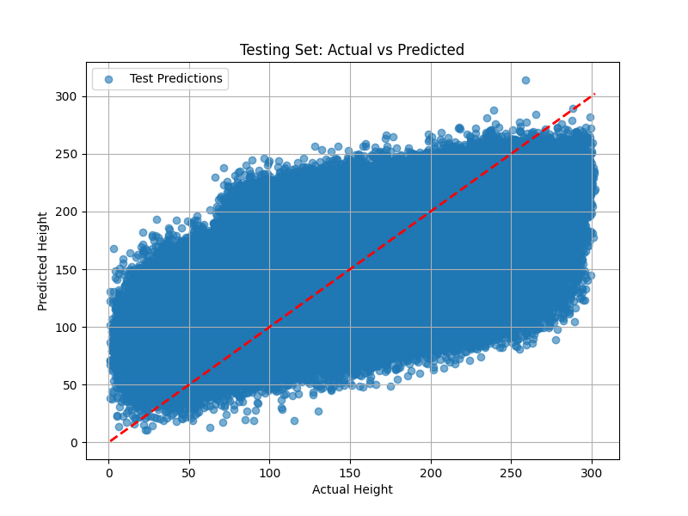
Table 1. Preliminary model results for different modeling algorithms.
Forest Metrics | RF |  | CNN |  | XGBoost
 | R² | RMSE | R² | RMSE | R² | RMSE
CH | 0.58 | 4.82 m | 0.52 | 5.03 m | 0.64 | 4.12 m
AGBD | 0.49 | 43.67Mg/ha | 0.48 | 44.21Mg/ha | 0.53 | 41.12 Mg/ha
Forest CH
Forest AGB
Results
Predicted AGBD
Predicted CH
R²: 0.64
RMSE: 4.12 m
R² : 0.53
RMSE: 41.12 Mg/ha
Training CH
Actual AGBD
Actual CH
Training AGB
Figure 5: Comparison between actual versus predicted CH with test data.
Figure 6. Comparison between actual versus predicted AGBD with test data.

Slide 15
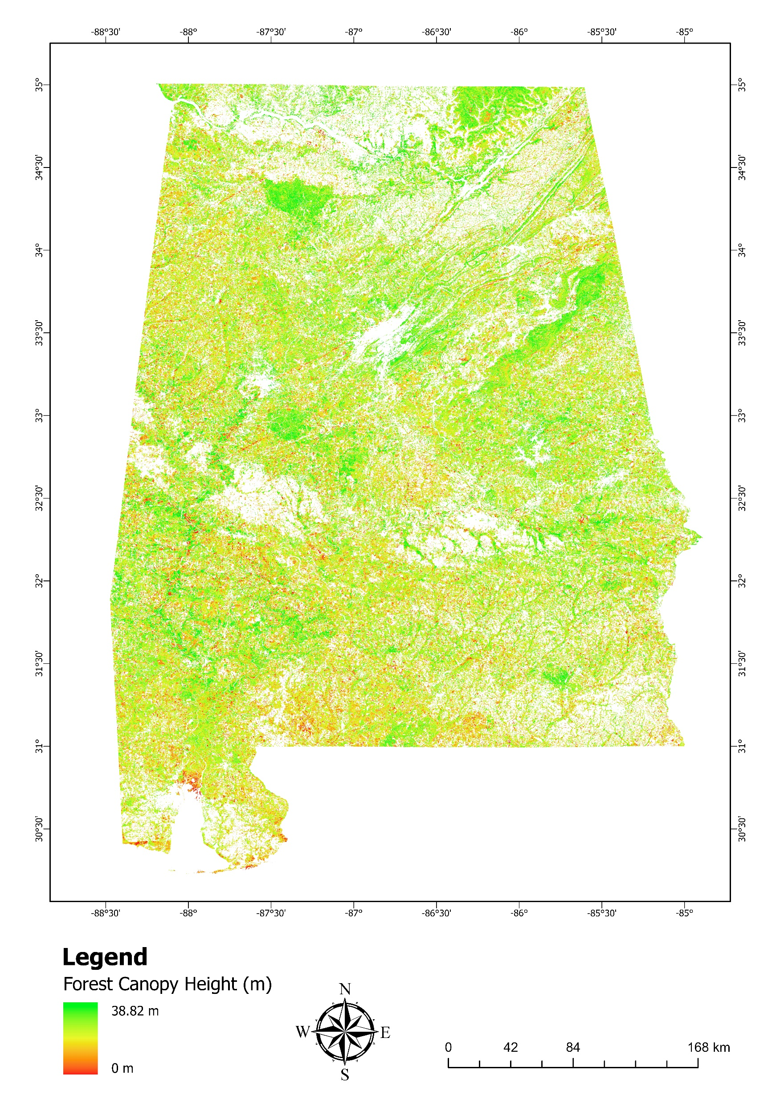
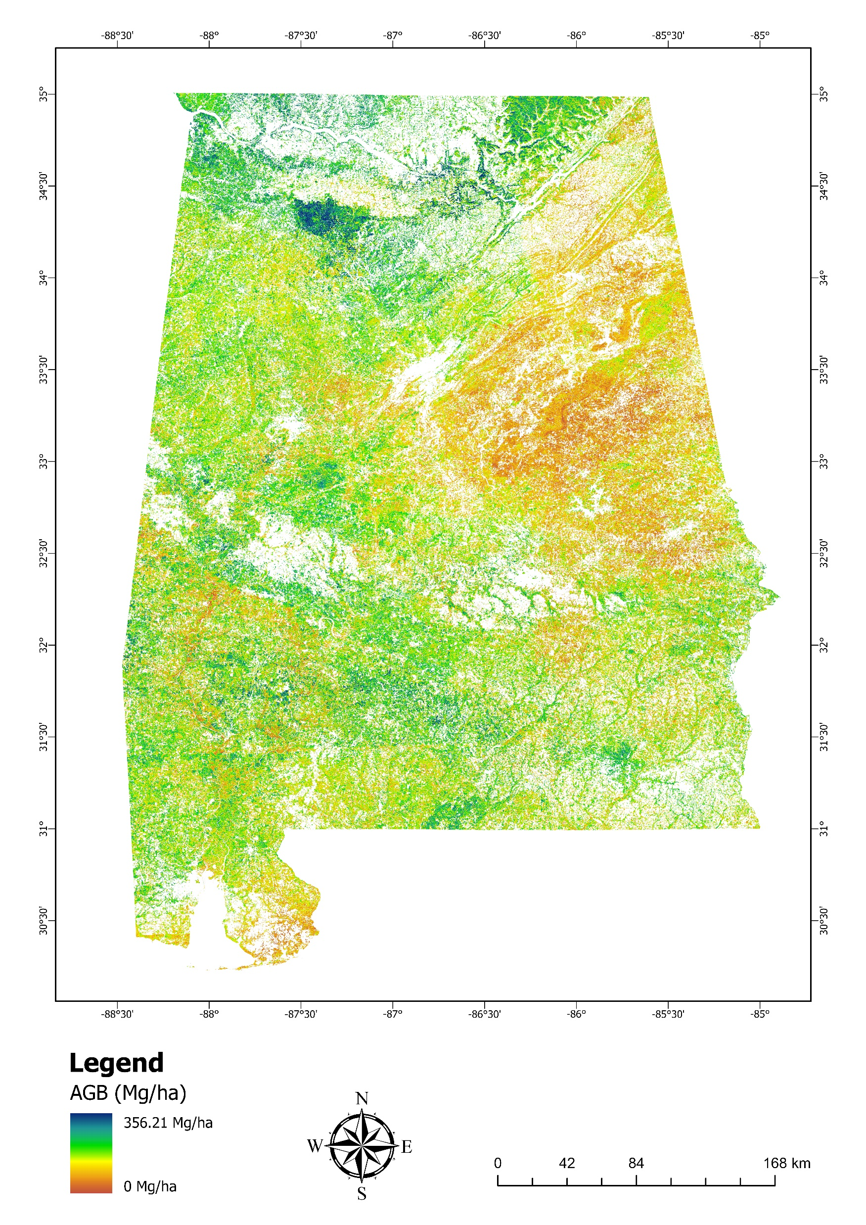
Results
Figure 7: Forest CH map for the state of Alabama
Figure 8. Forest AGBD estimate map for the state of Alabama.

Slide 16
Discussion and Conclusions
Superior Model Performance
Integrated Remote Sensing Approach
HPC
Future Potential of Spaceborne lidar Fusion
XGBoost demonstrated the highest predictive accuracy for AGB, outperforming both RF and CNN.
The proposed methodological framework showcases the effectiveness of integrating multiple open-access remote sensing datasets, including optical, radar, and lidar, for accurate AGB estimation across large geographic extents.
The HPC-based processing framework enabled efficient handling of large-volume spatial data.
The study underscores the synergistic use of GEDI and ICESat-2 data for forest structure and biomass mapping efforts.

Slide 17
References
Dubayah, R., Armston, J., Healey, S. P., Bruening, J. M., Patterson, P. L., Kellner, J. R., Duncanson, L., Saarela, S., Ståhl, G., Yang, Z. Q., Tang, H., Blair, J. B., Fatoyinbo, L., Goetz, S., Hancock, S., Hansen, M., Hofton, M., Hurtt, G. & Luthcke, S. (2022) GEDI launches a new era of biomass inference from space. ENVIRONMENTAL RESEARCH LETTERS, 17(9).
Ellwood, M. D. & Foster, W. A. (2004) Doubling the estimate of invertebrate biomass in a rainforest canopy(1476-4687 (Electronic)).
Lowman, M. (2021) Life in the treetops—An overview of forest canopy science and its future directions. PLANTS, PEOPLE, PLANET, 3(1), 16-21.
Malambo, L. & Popescu, S. (2024) Mapping vegetation canopy height across the contiguous United States using ICESat-2 and ancillary datasets. Remote Sensing of Environment, 309, 114226.
Milenković, M., Reiche, J., Armston, J., Neuenschwander, A., De Keersmaecker, W., Herold, M. & Verbesselt, J. (2022) Assessing Amazon rainforest regrowth with GEDI and ICESat-2 data. Science of Remote Sensing, 5, 100051.
Narine, L. L., Popescu, S. C. & Malambo, L. (2020) Using ICESat-2 to estimate and map forest aboveground biomass: A first example. Remote Sensing, 12(11).
Sandamali, J. & and Narine, L. L. (2025) A data-driven, cloud-based approach for forest aboveground biomass mapping using GEDI and other earth observation data: an ecoregion-specific Investigation across the state of Alabama, USA. Geocarto International, 40(1), 2465446.
Zhu, X., Nie, S., Zhu, Y., Chen, Y., Yang, B. & Li, W. (2023) Evaluation and Comparison of ICESat-2 and GEDI Data for Terrain and Canopy Height Retrievals in Short-Stature Vegetation. Remote Sensing, 15(20), 4969.

Slide 18
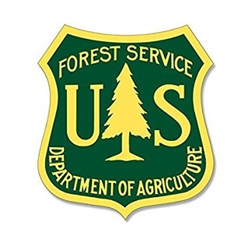
Thank You
Acknowledgement
This Research is supported by the USDA Forest Service (Grant # 22-JV-11330180-064).
Janaki Sandamali
jsk0043@auburn.edu

